Slide 1
Are Switchbacks the Magnetohydrodynamic Equivalent of Smoke Rings?
Peter Wyper
Durham University
Collaborators:
Lorenzo Matteini, Etienne Pariat, Jade Touresse, Jonathon Squire
ESPM
10th Sept. 2024

Slide 2
Switchbacks
Raouafi et al. 24
Typical properties
Alfvénic → in-phase 𝛿v and 𝛿B, e.g. Kasper et al. 19, Bale et al. 19.
Spherically polarized → |B|≈const. implies B is deflected not reduced, e.g. Wooley et al. 20.
Patchy occurrence in data, e.g. Shi et al. 22.
Occurrence increases beyond the Alfvén point (still some below it though!).

Slide 3
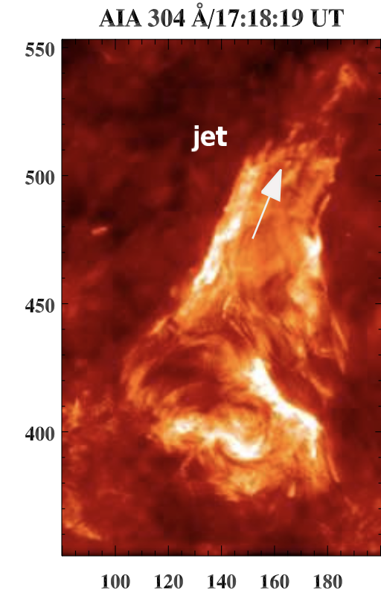
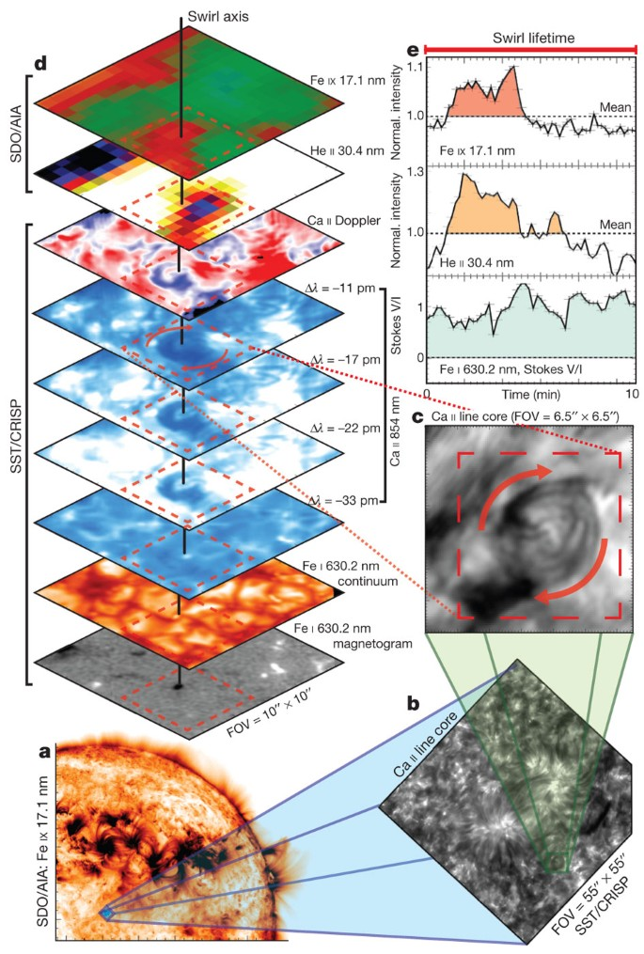
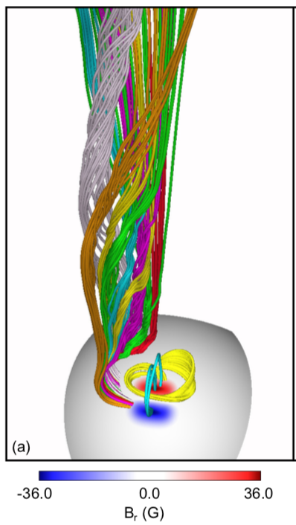
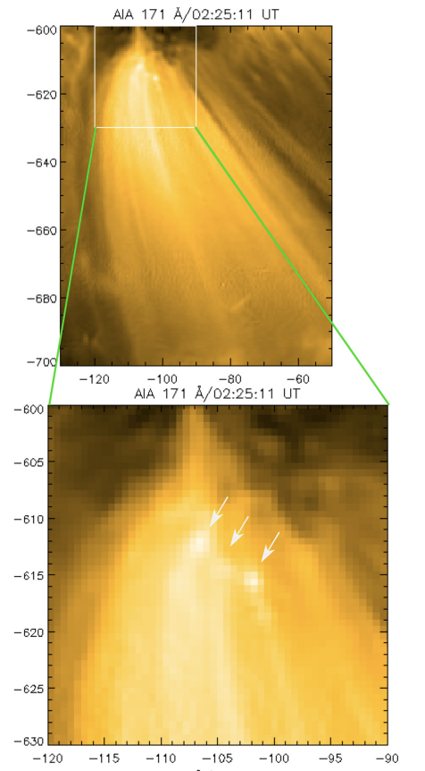
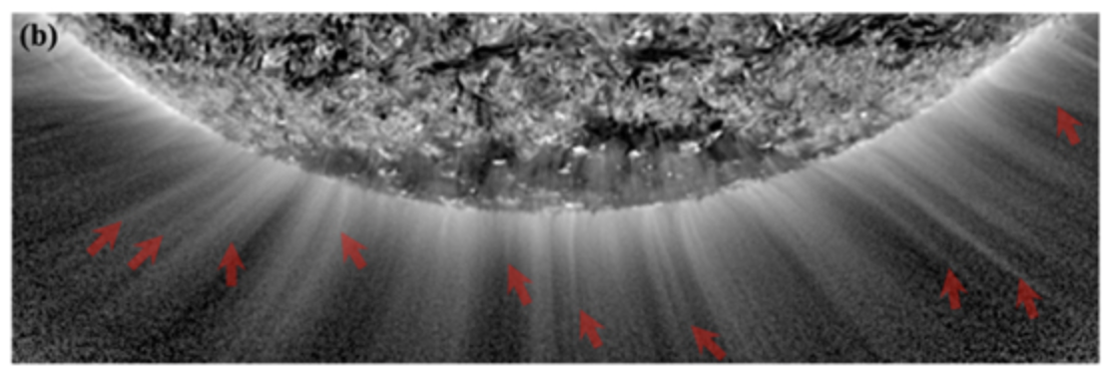
Sources of Torsional Alfvénic Waves
Coronal jets
Swirls
Bursty interchange reconnection
Kumar et al. 18
Wyper et al. 18
Jetlets, Spicules etc
Wyper et al. 22
Wedemeyer-Böhm et al. 12,13, Magyar et al. 21
Raouafi et al. 23, Kumar et al. 23
All launch pulses of Torsional Alfvén waves.

Slide 4
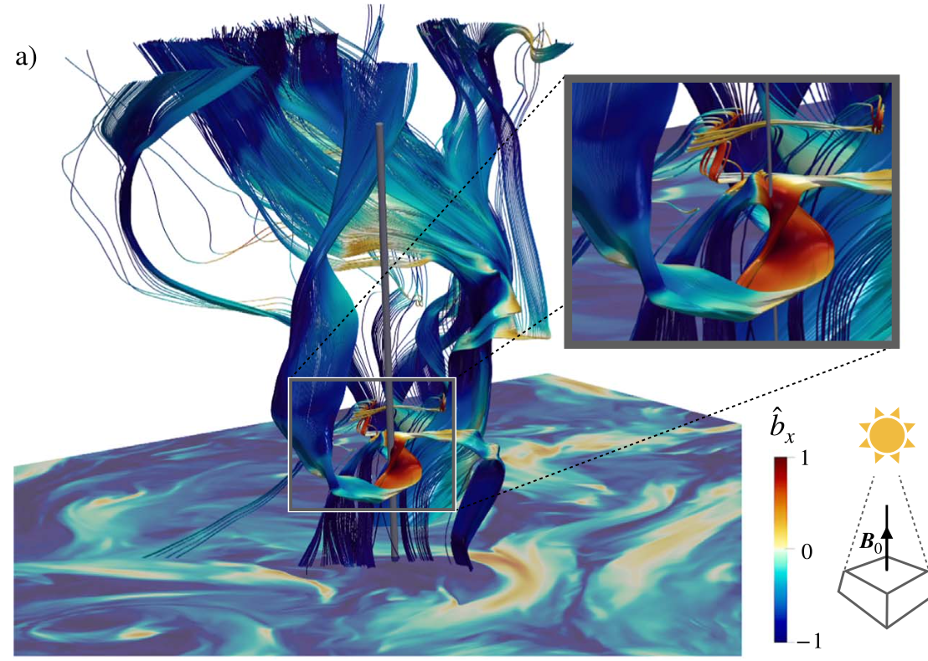
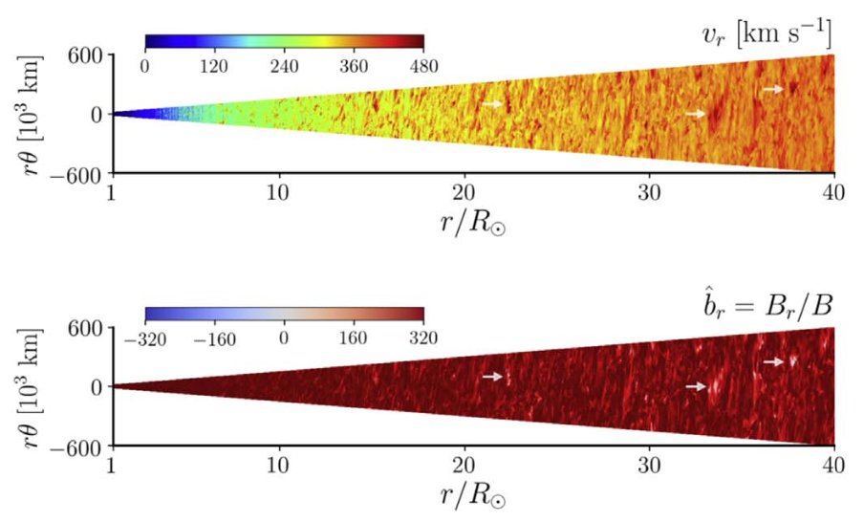
Alfvén wave propagation
Expanding box – parameterized expansion
Full volume – radial open field
Squire et al. 20, Mallet et al. 21, Matteini et al. 24
Shoda et al. 20, see also Roberts et al. 17
Alfvén waves:
Shown that ${|δB|}/{|B_{0}|}$ grows in an expanding wind (Squire et al. 20).
Super-radial expansion → accelerates ${|δB|}/{|B_{0}|}$ growth.
Spherical polarization (${|B_{0}+δB|}/{|B_{0}|}≈$ const.) naturally develops (Mallet et al. 21, Matteini et al. 24).
SP Alfvénic perturbations are steady state MHD solutions (in a moving reference frame, e.g. Barnes & Holweg 74). Can be any amplitude so includes $B_{r}$ reversals.

Slide 5
Wave evolution
-400
-200
0
200
400
Iso-surface: Br = 0
Super-radial expansion; R ≲ 10 Rs.
Low β, sub-Alfvénic → high β, super-Alfvénic.
Rotational surface flow launches a Torsional Alfvén wave pulse.
Duration: 20 mins. Width: 60 Mm. (Large coronal jet values). $V_{drive}≈{0.5V}_{A}$ on surface (300 km/s).
Evolves a ring-shaped volume where $B_{r}<0$.
Similar behaviour with different driving times & speeds.

Slide 6
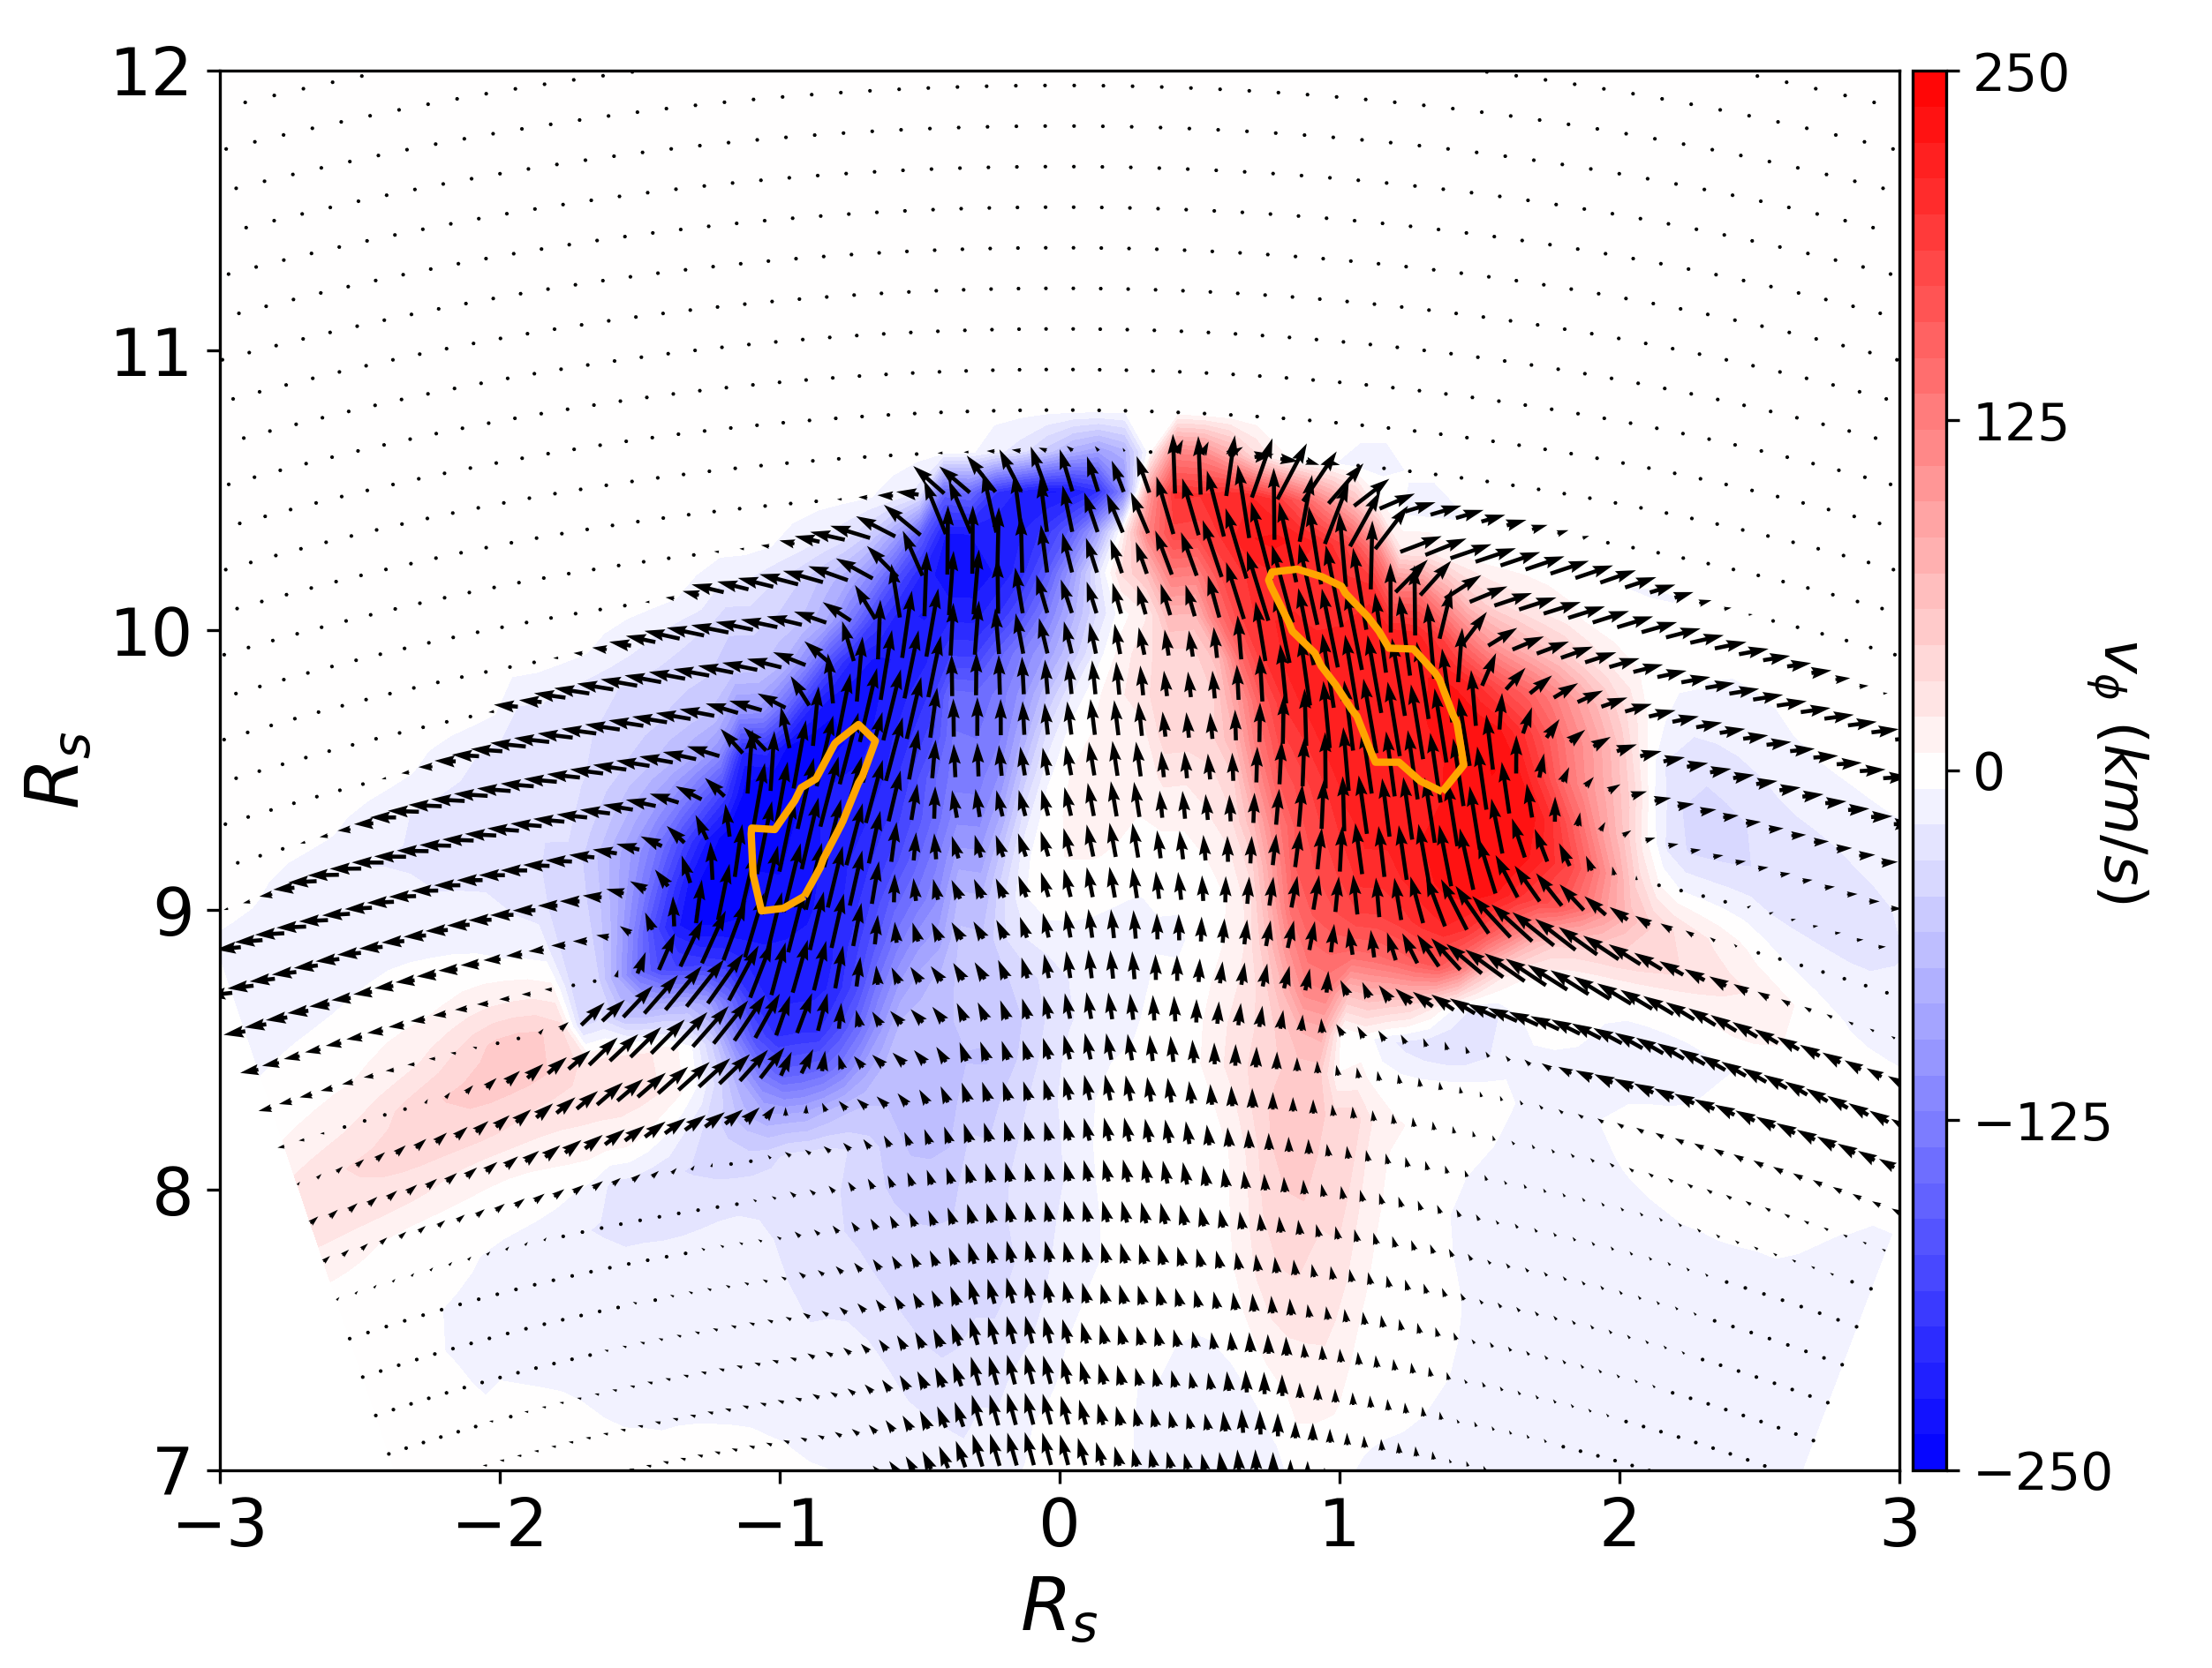
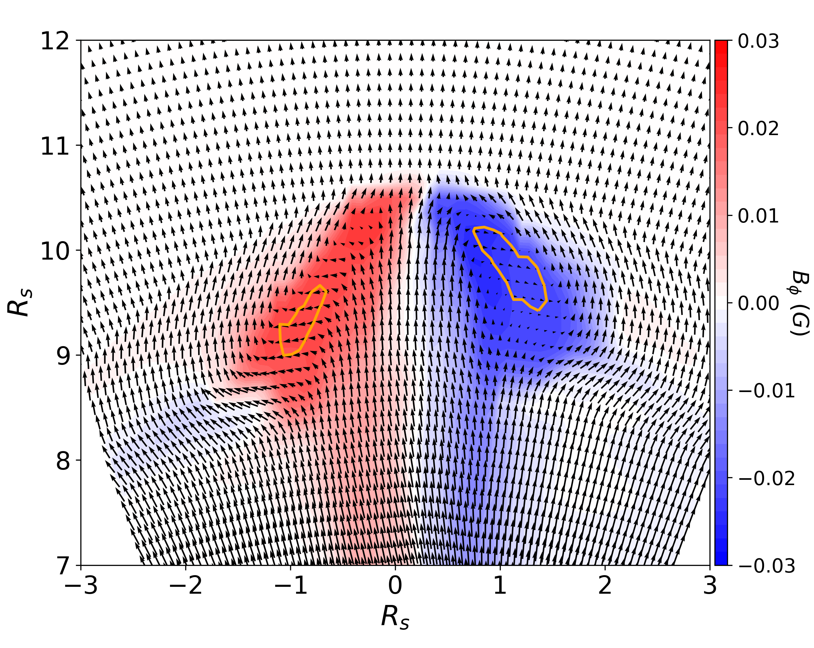
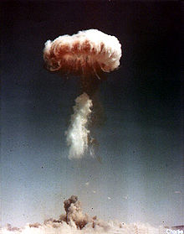
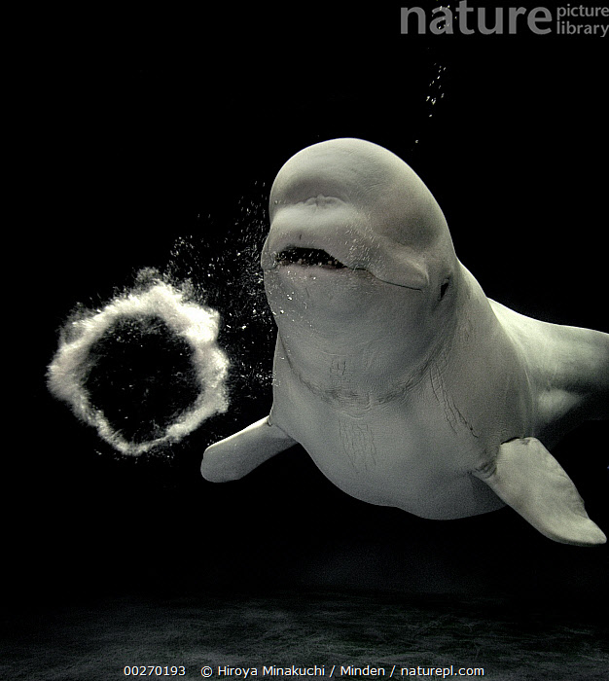
SB structure
Moving frame of reference:
$v − v_{sw}(t=0)$
Velocity
Magnetic field
Fluid vortex rings: Smoke rings, bubble rings.
Structure = similar to a rotating vortex ring (broader disc-like shape than fluid rings).
SB inversions in the upflow.
SB radially elongated despite overall structure “pancaking”.

Slide 7
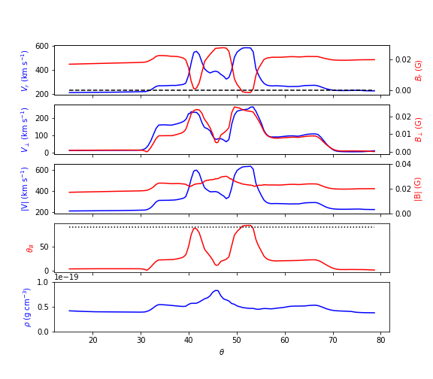
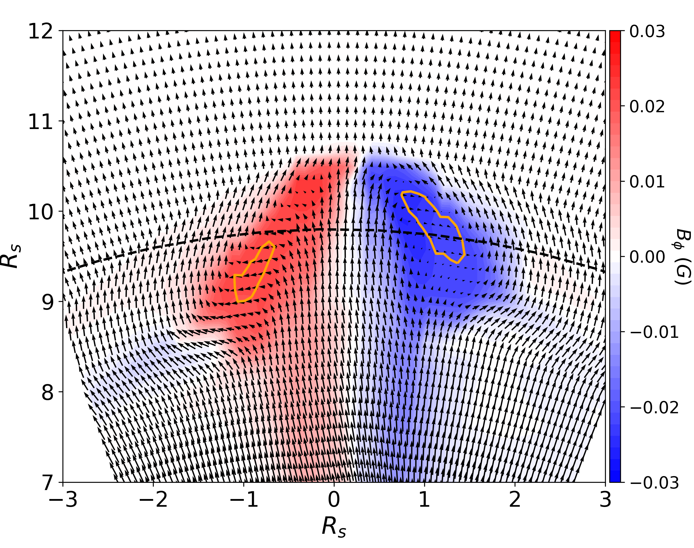
SB structure
Magnetic field
Line sample (fixed time)
Alfvénic spherically polarized deflections.
Route to axi-symmetric SBs (e.g. Shi et al. 24).

Slide 8
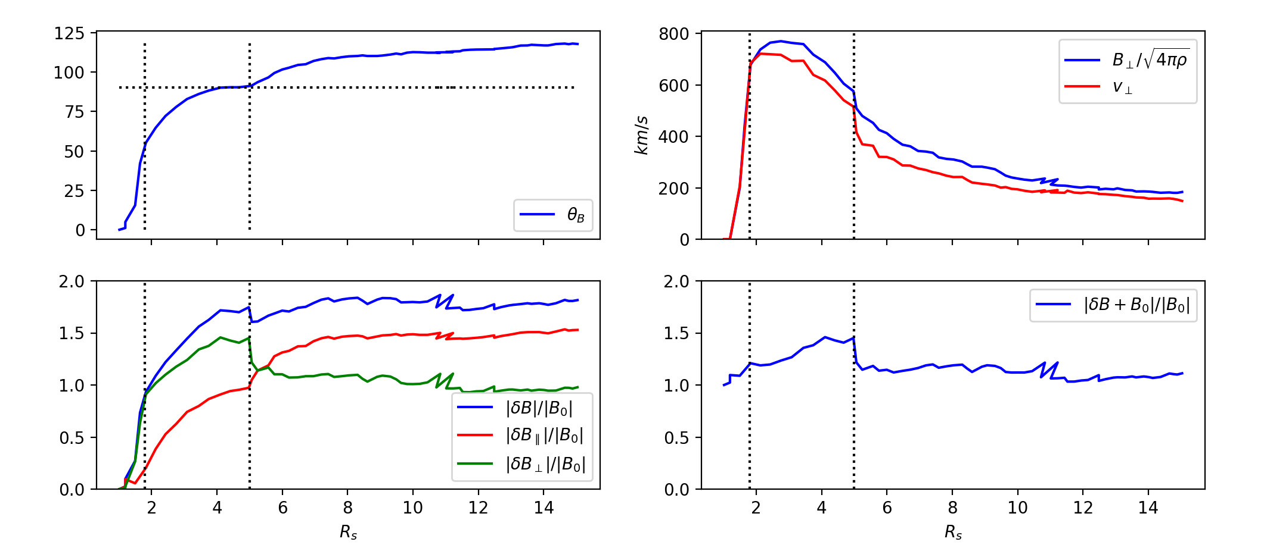
Switchback formation
Deflection angle from
$B_{0}=B(t=0)$.
Tracking the switchback through the volume
(1) Each time identify position ($R_{SB}$) of maximum deflection ($θ_{B}$).
(2) Plot local values of quantities vs $R_{SB}$.
(3) Position does not follow the same fluid parcel and moves around the SB volume. But gives an idea of typical values at different radii.

Slide 9
Switchback formation
1
2
3
Deflection angle from
$B_{0}=B(t=0)$.
3 main phases of evolution
Growing amplitude Alfvén wave in expanding wind. $|δ$B|/|$B_{0}$| grows.
Spherical polarization develops. Drives a reduction in $B_{r}$, increasing $\left|δB_{∥}\right|$ until deflection reaches 90 degrees.
Plateau – maximum deflection position moves away from the axis of rotation. SB reversal forms and grows.
Evolution similar to Alfvén wave growth/SB formation in expanding box simulations (Squire et al. 20, Matteini et al. 24).

Slide 10
Asymmetric propagation
Similar evolution → but a tilt develops!
Field line curvature? Alfvén speed gradients? TBD.
Asymmetric SB region.
Leads to a preferential deflection near the HCS (ask me after!).

Slide 11
Summary
Torsional Alfvén waves
Plentiful sources in the solar corona (swirls, jets/jetlets, IR plasmoids).
Naturally develop a vortex ring-like disc structure as they propagate into the solar wind.
Radially extended SB reversals form in the upflows of the ring (local in-situ spikes in Vr).
These simulations are large, but the concept should apply to smaller scales.
Evolution consistent with Alfvén wave growth in expanding wind scenario (e.g. Squire et al. 20, Mallet et al. 21).
Mechanism operates below and above Alfvén point → but SBs form at least a few solar radii out.
Tests so far require around ¾ of a turn within the pulse (well within observed ranges).
Provides a plausible link between interchange reconnection in its various forms (and swirls) and SBs in-situ.

Slide 12
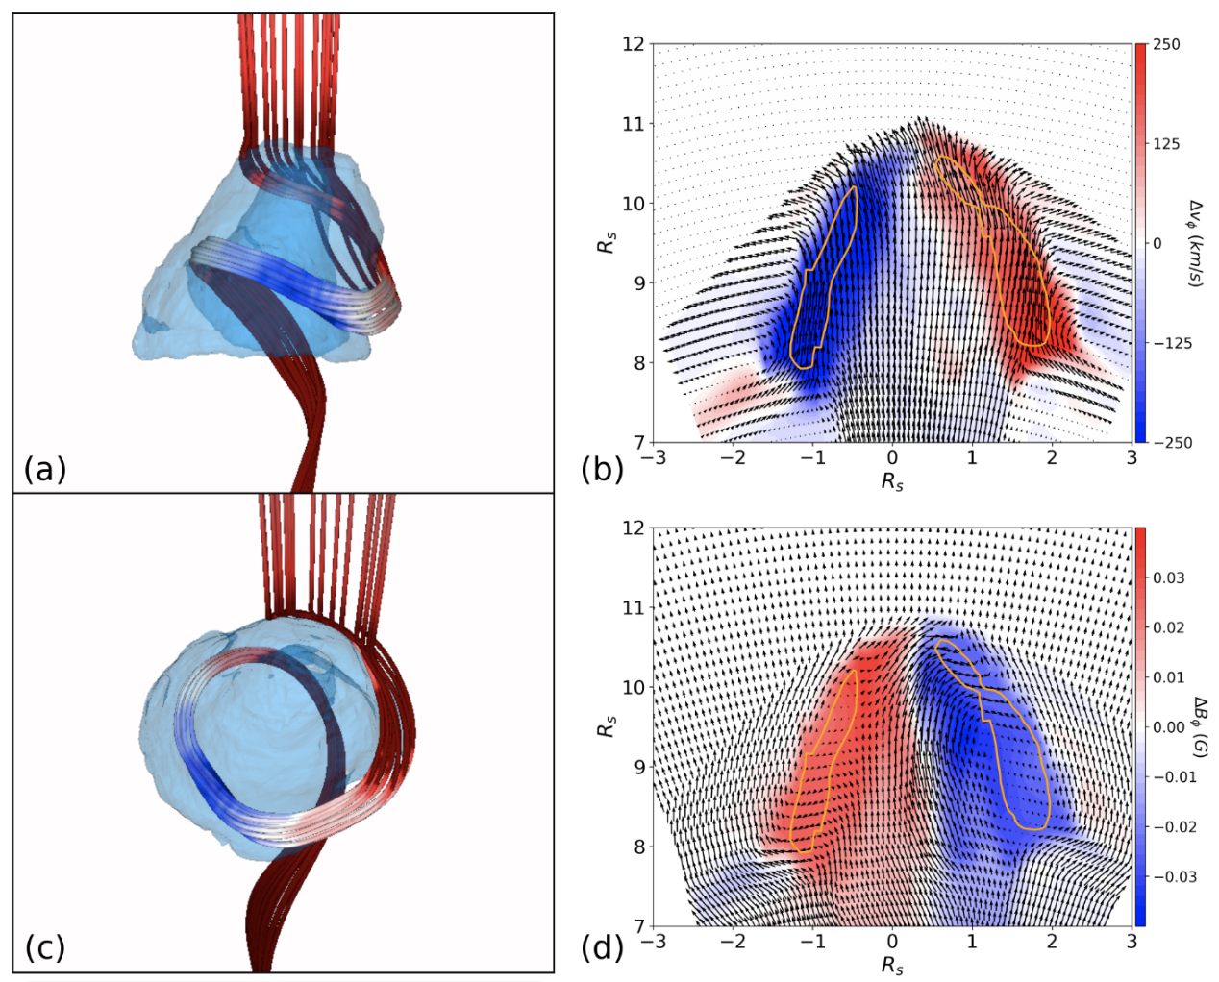
Larger amplitude

Slide 13
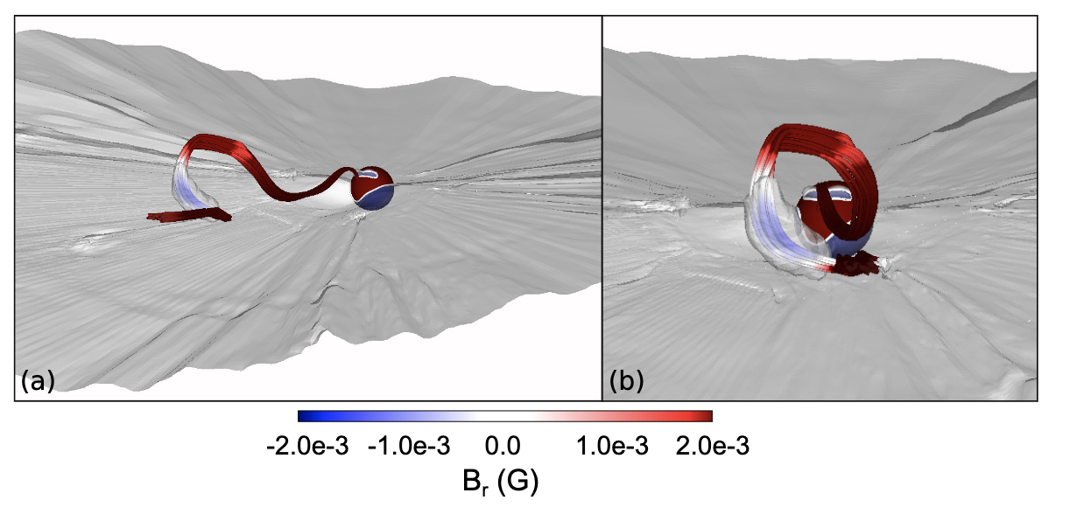
Deflection

Slide 14
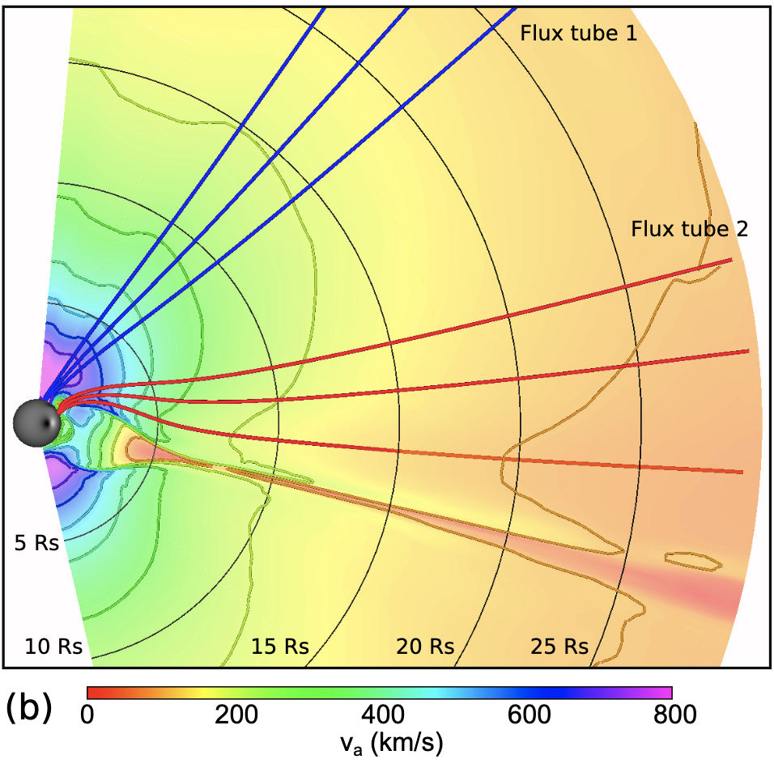
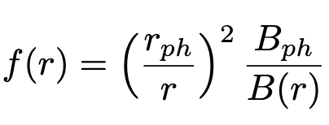
Initial condition
Expansion factor:
Super-radial expansion; R ≲ 10 Rs
Low β, sub-Alfvénic → high β, super-Alfvénic
Flux tube 2 similar.
Full-Sun dynamic equilibrium (Wyper et al. 21) – isothermal wind + PFSS

Slide 15
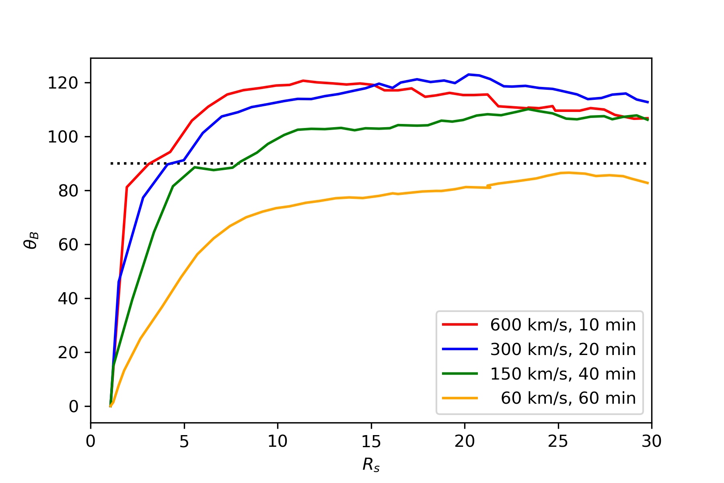
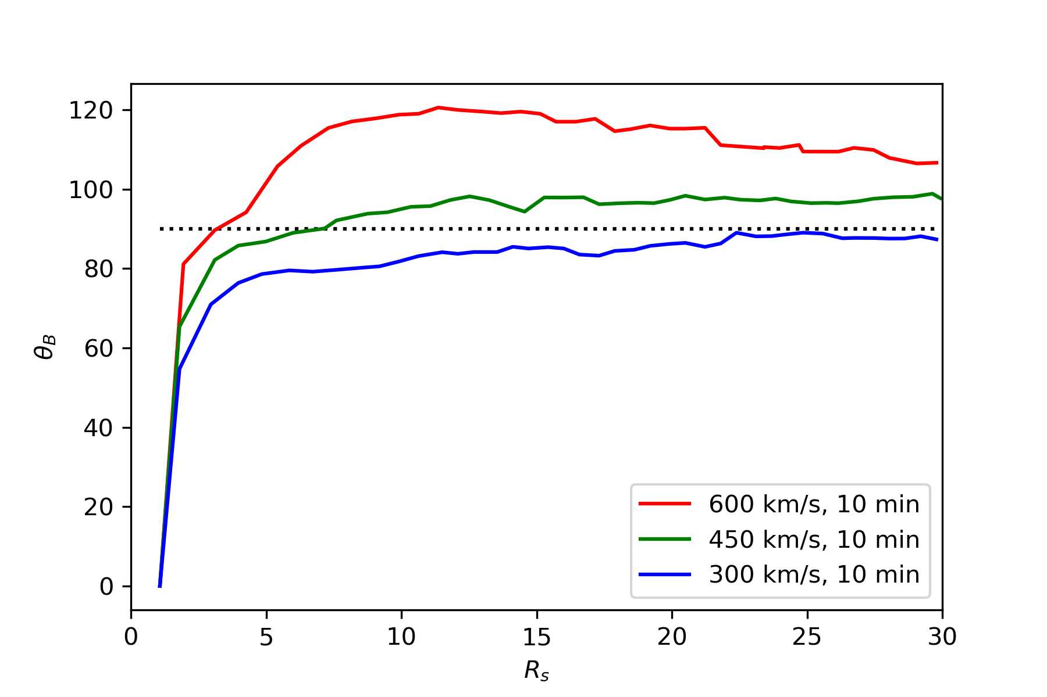
Robustness?
Same twist injected overall
(longer, slower driving)
Less twist injected overall
(same driving time, varied speed)
Blue curve: previous case.
~1 max turns in each simulation.
Max deflection relatively insensitive to injection speed or timescale.
Slower injection = SB formation further out. Takes longer for twist to “squash up” and form the disk.
Alfvén point ≈ 11 Rs.
Less overall twist directly reduces maximal deflection (lower initial amplitude).
One turn, ¾ turn, ½ turn.
Minimum for Br reversal (for this flux tube) $≈3/4$ of a turn.
Jets/plasmoids → over 2 turns sometimes observed.

