Slide 1
Vortex Flows in the Solar Atmosphere: Detection and Heating Mechanisms in 3D MHD Numerical Simulations
Matías Koll Pistarini^{1,2}, Elena Khomenko^{1,2}, Tobías Felipe^{1,2}
¹ Instituto de Astrofísica de Canarias, 38205 La Laguna, Tenerife, Spain
² Departamento de Astrofísica, Universidad de La Laguna, 38205, La Laguna, Tenerife, Spain
ESPM-17 - September 2024

Slide 2
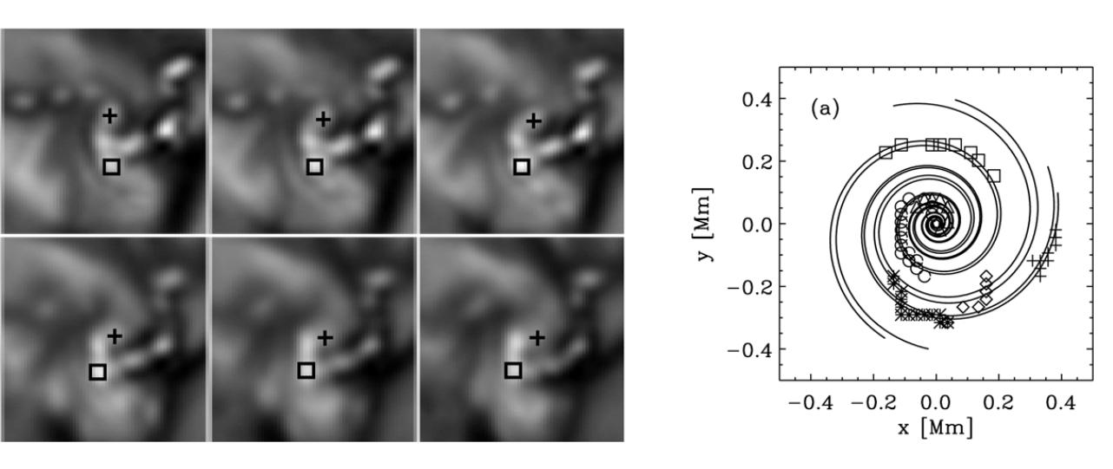
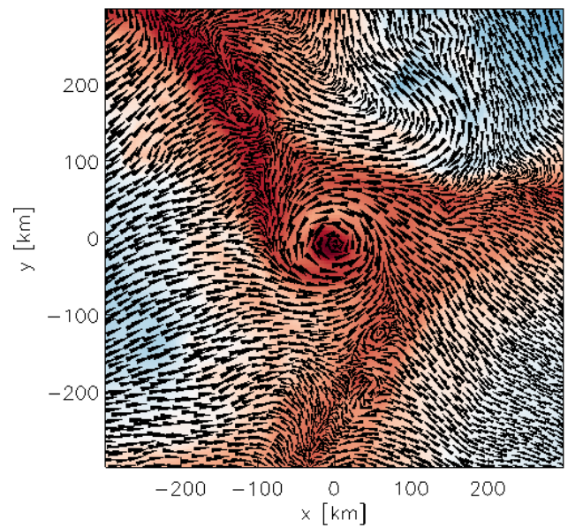
What is a vortex?
A vortex is the collective motion associated with the azimuthal component of a vector field (e.g. true velocity or magnetic field) about a common centre or axis and that it is persistent in time (Tziotziou et al. 2023).
Observations
Simulations
Moll et al. 2011
Bonet et al. 2008

Slide 3
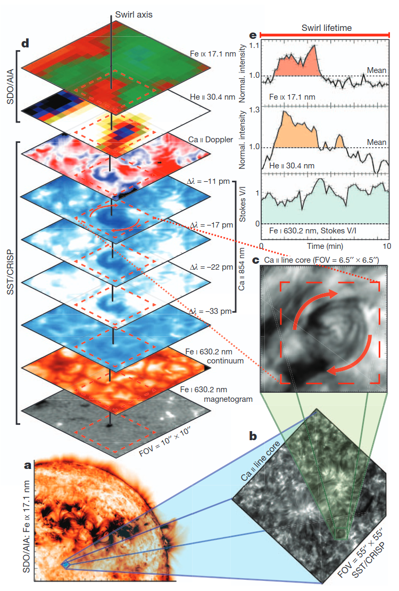
Vortices in observations and simulations
Vortices can connect and transport energy into several layers of the solar atmosphere.
All of the previous studies of vortices in simulations are done using different numerical codes, magnetic field configurations and spatial resolutions.
Wedemeyer-Böhm et al. 2012

Slide 4
Objectives
Understand the energy transport and dissipation mechanisms in vortex flows under different magnetic field configurations and spatial resolutions.

Slide 5
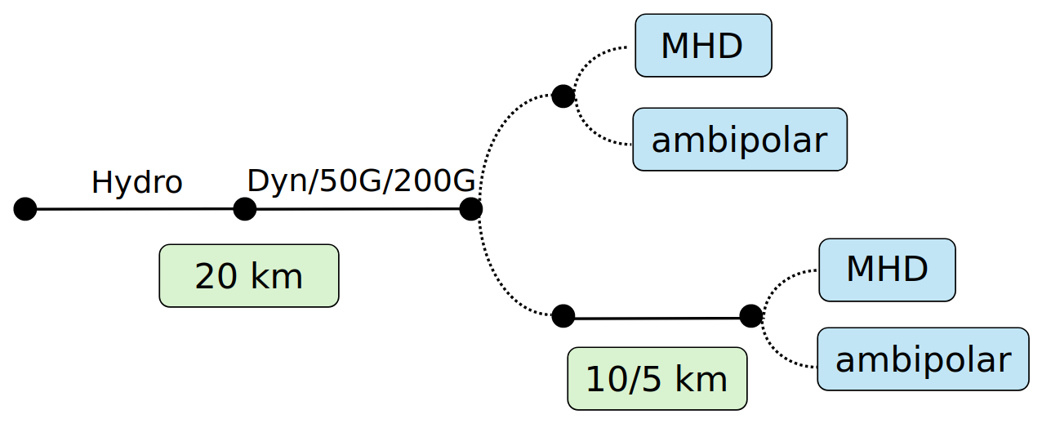
MANCHA numerical simulations
- Set of simulations used:
(Modestov et al. 2024)
SSD 〈B_{z}〉= 0 G
20 x 20 x 14 km³
10 x 10 x 7 km³
5 x 5 x 3.5 km³
〈B_{z}〉= 50 G
20 x 20 x 14 km³
10 x 10 x 7 km³
〈B_{z}〉= 200 G
20 x 20 x 14 km³
SSD stands for small-scale dynamo
1.4 Mm
Z=0
0.95 Mm
5.6 Mm
5.6 Mm

Slide 6
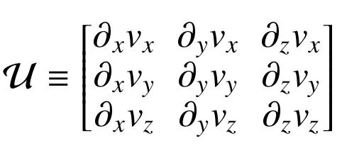
SWIRL code
SWirl Identification by Rotation centers Localization (SWIRL) - Canivete Cuissa & Steiner (2022)
- Mathematical criteria based on the velocity gradient tensor.
- Clustering algorithm that automatically detect vortices.
+
Search clusters based on the mathematical criteria applied
Rortex
𝜔 ≡ vorticity
u_{r}≡ real eigenvector of
λ ≡ complex eigenvalue of
Previous filtering of the simulations using a FFT to remove p-modes
Input:
2D velocity field
Output:
List with identified vortices

Slide 7
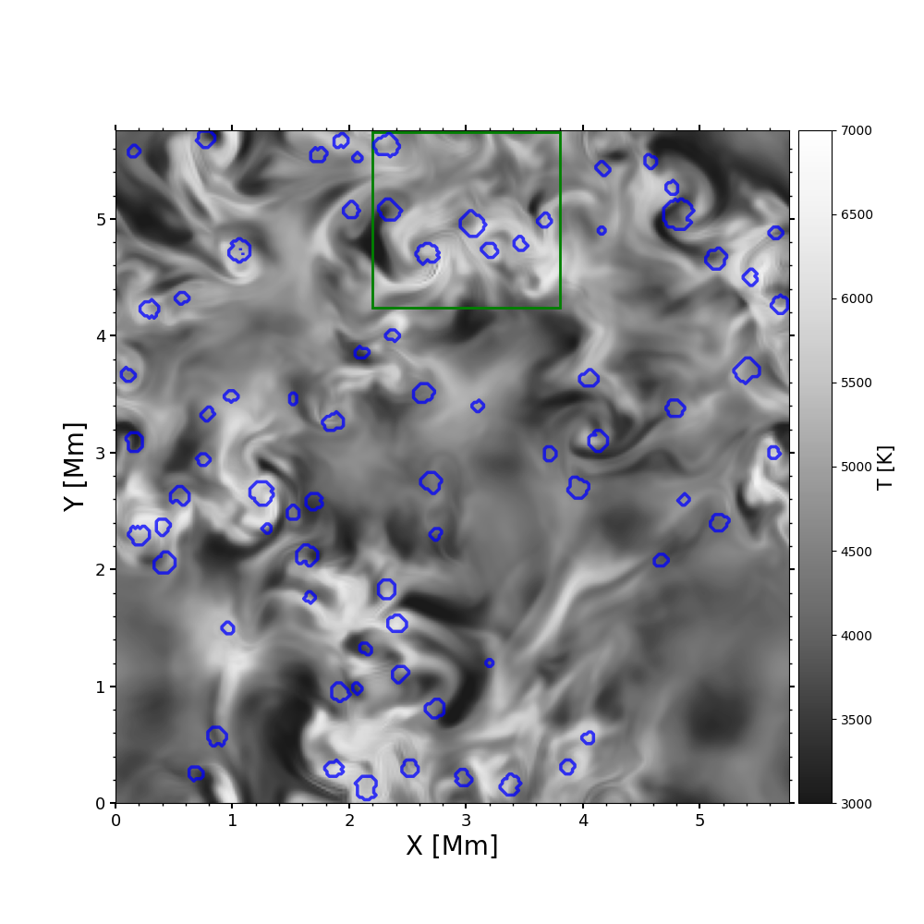
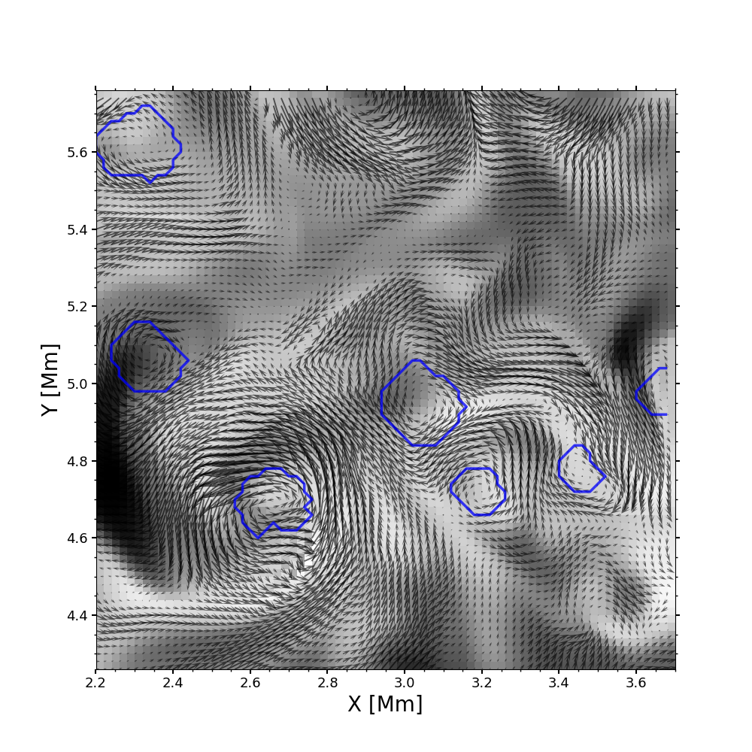
SWIRL code: examples
Model Bz 50 G, Z = 0.59 Mm, Time = 350 s

Slide 8
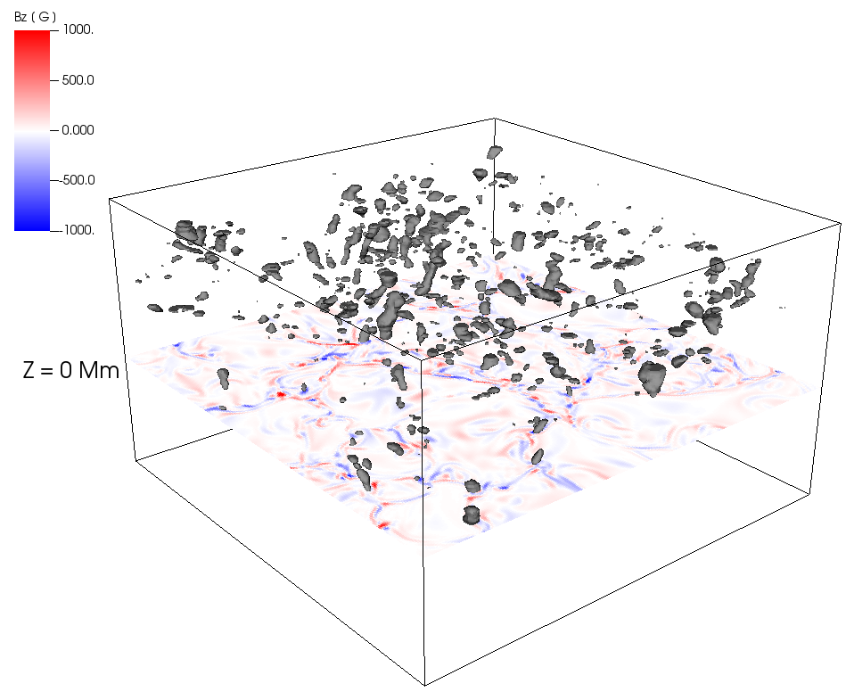
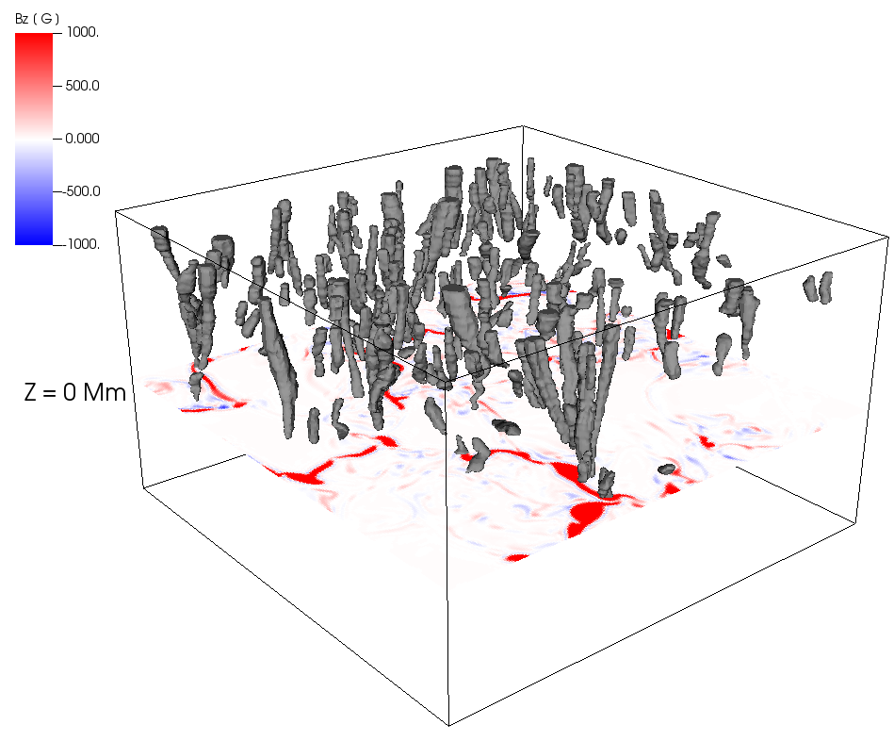
3D Vortices
Dynamo
Bz 50 G

Slide 9
Results
Statistical analysis
Number and size of vortices.
Mean temperature and Heating mechanisms
- Viscosity
- Magnetic
- Ambipolar

Slide 10
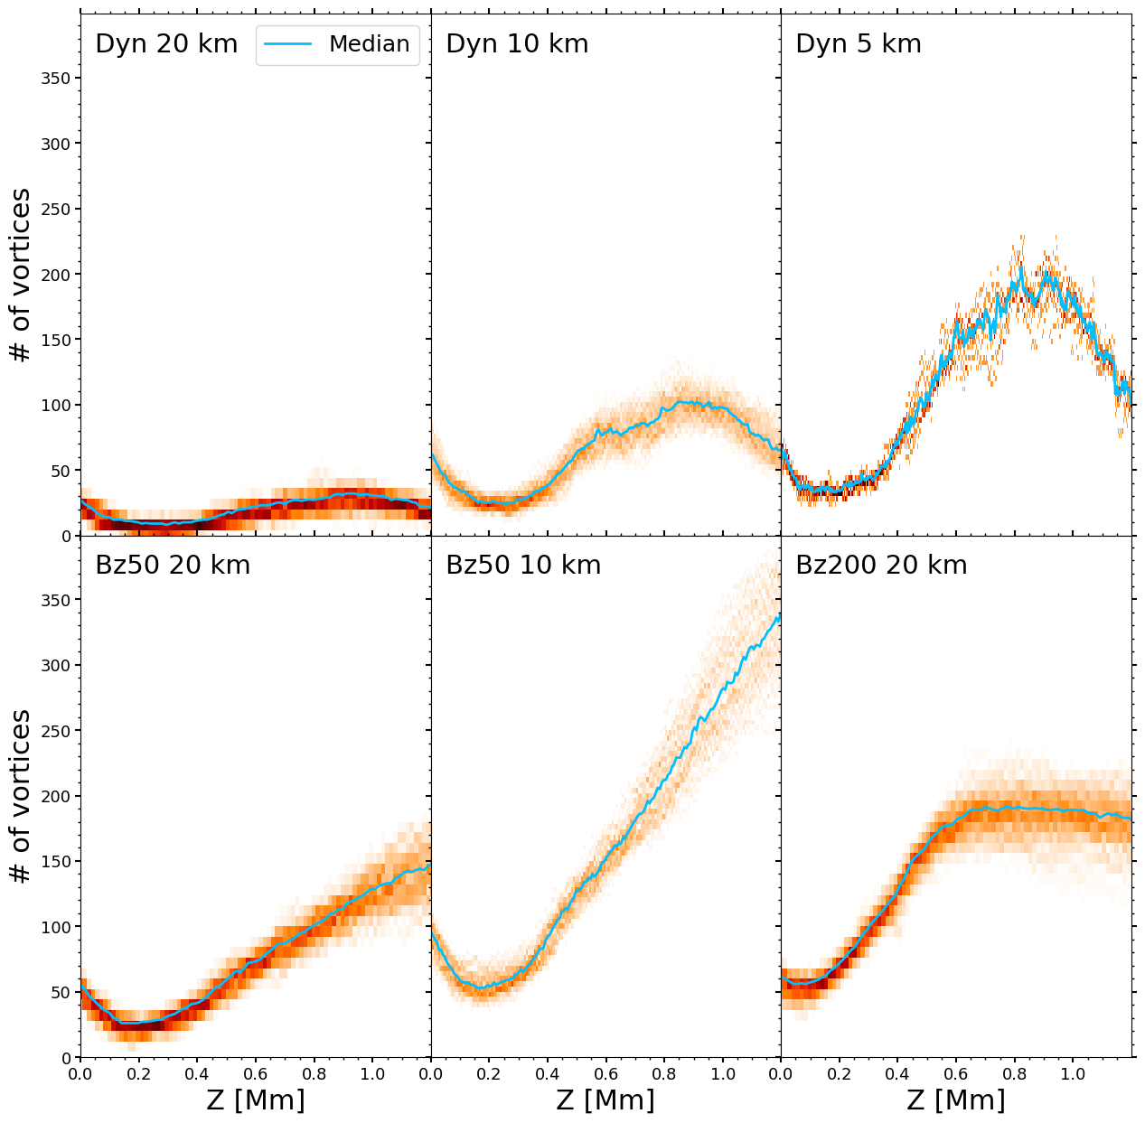
Results: Number of vortices
Spatial resolution is the major source of the increase in the number of detections.
Magnetic field tends to increase the number of vortices detected with height.
But higher magnetic field seem to suppress the number of detections Bz 200 G model

Slide 11
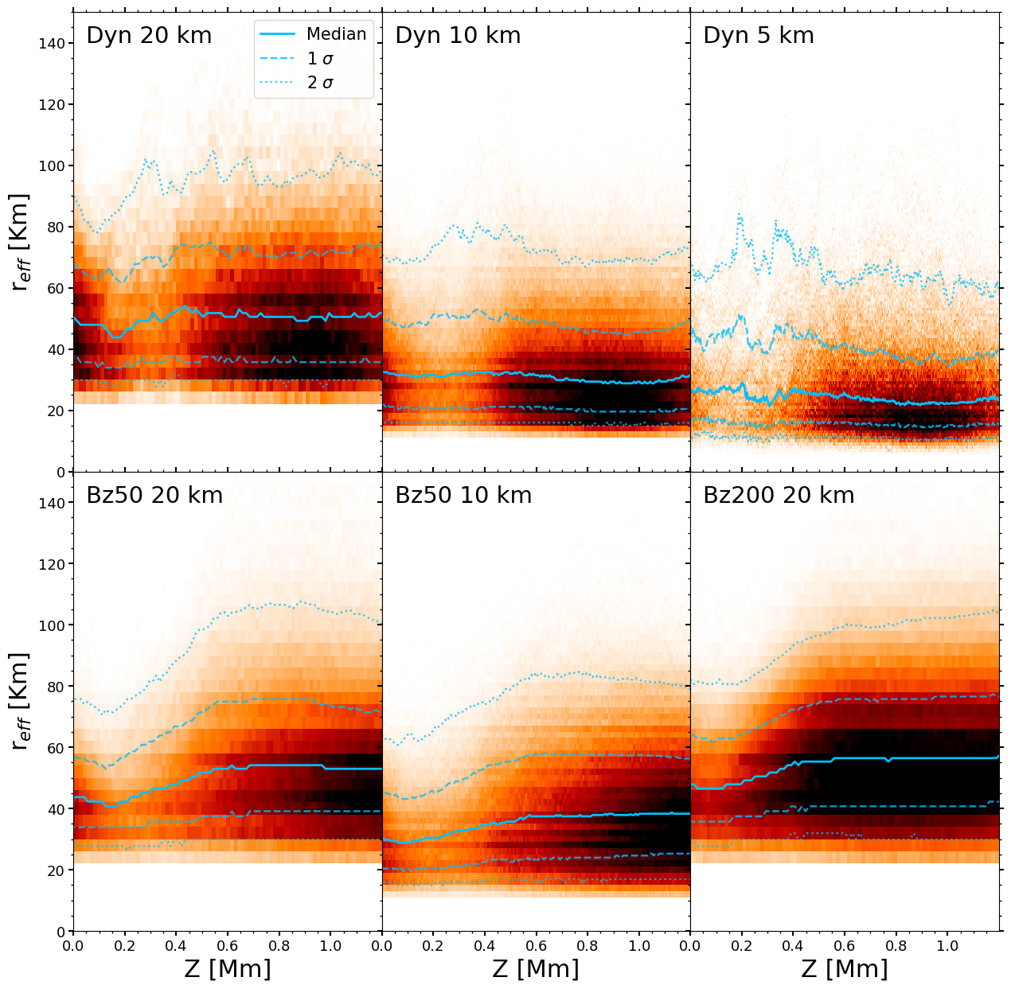
Results: Effective radius
Detected vortices cover a wide range of sizes between ~20-100 Km in radius (similar results are found in Yadav et al. 2021 and Canivete Cuissa et al. 2023).
Increasing spatial resolution tends to reduce vortex sizes.
At 5 Km simulation seems to reach a limit in vortex size.
Magnetic field structures the size of vortices with height.

Slide 12
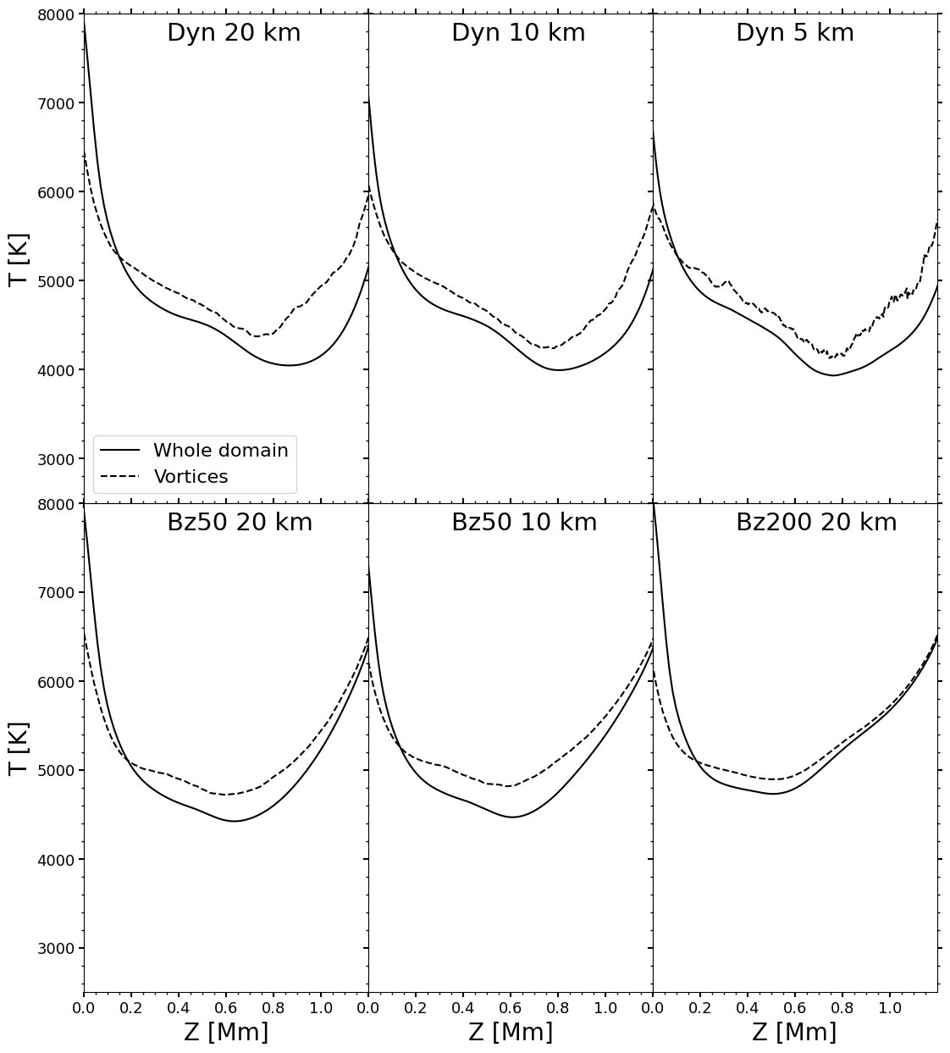
Results: Temperature
Vortices always have higher temperature profiles than the mean atmosphere.
No significant changes in temperature profile due to spatial resolution.

Slide 13
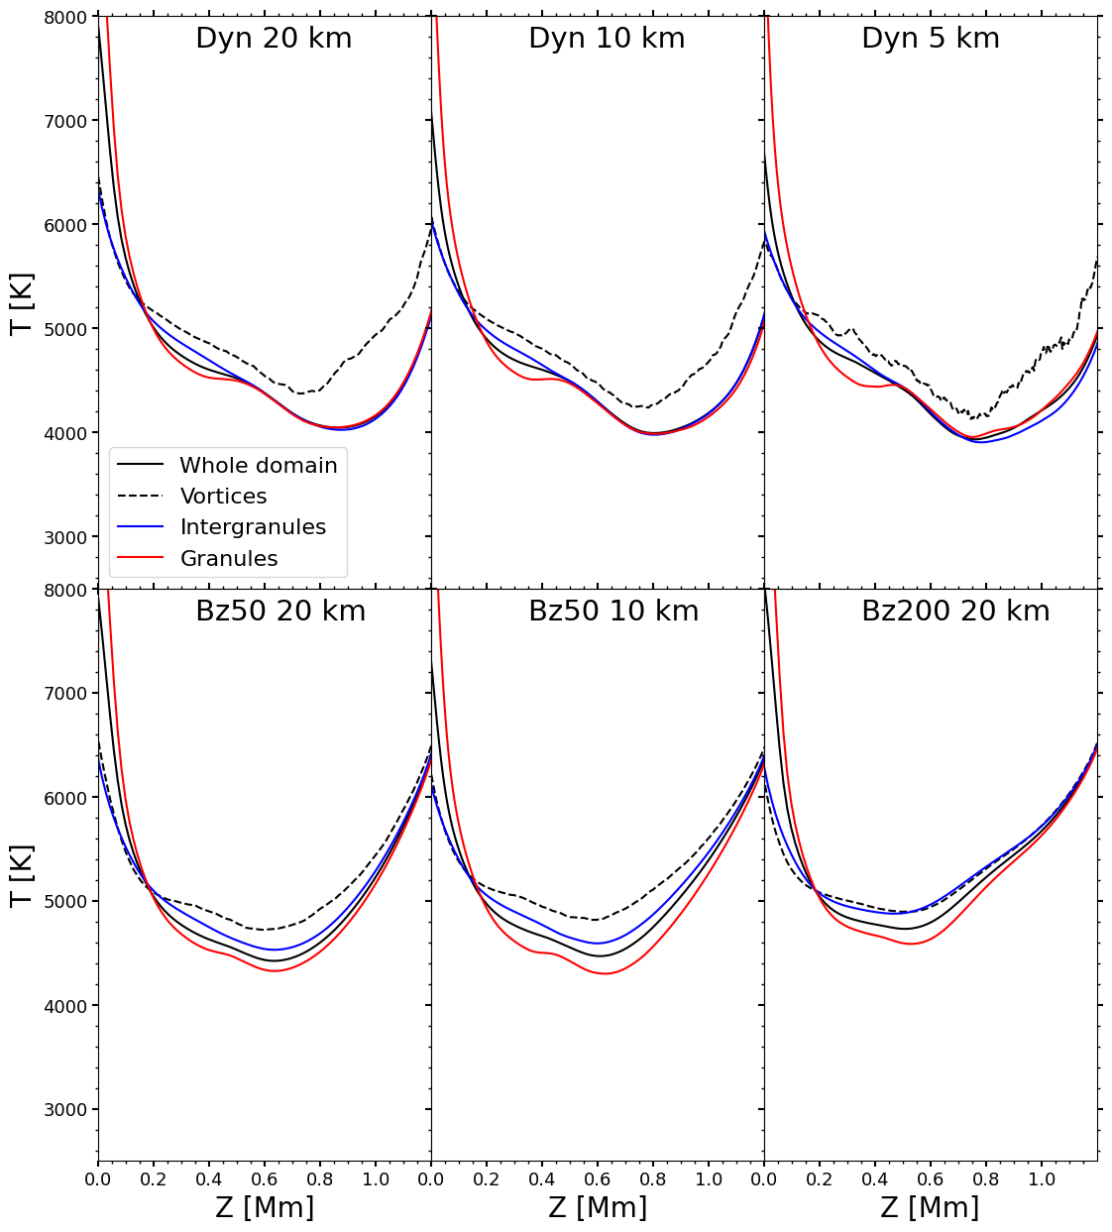
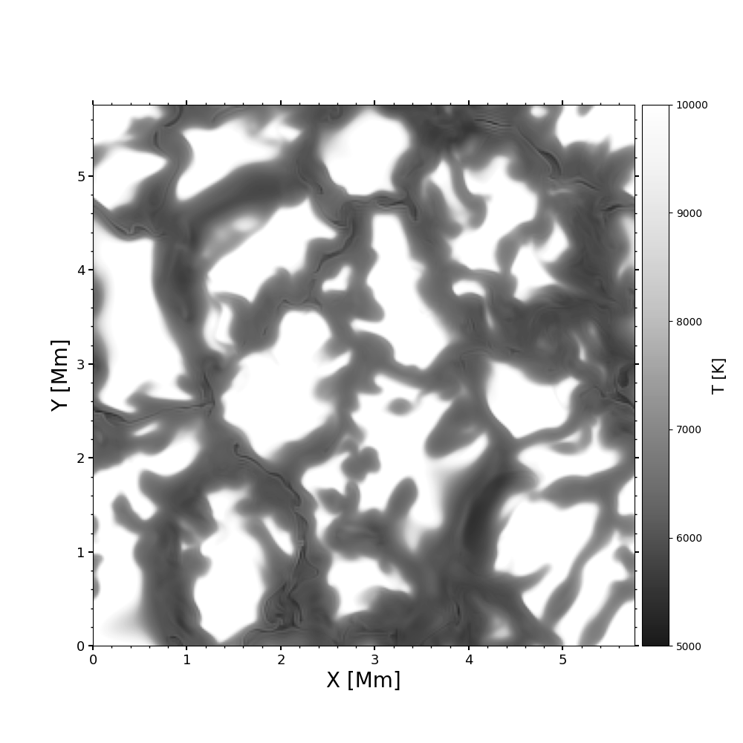
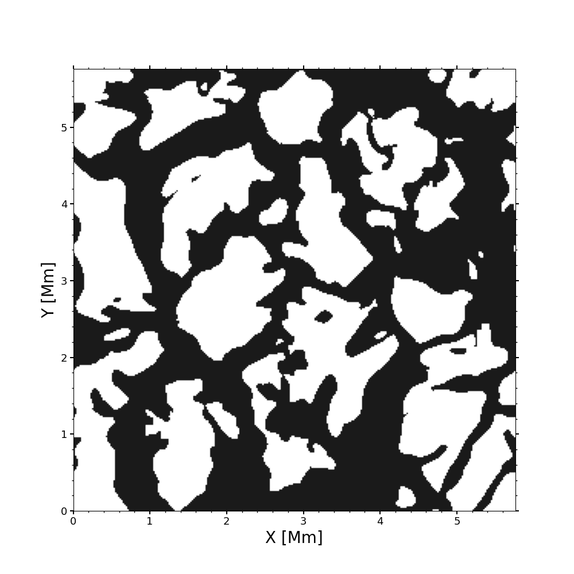
Results: Temperature
Vortices always have higher temperature profiles than the mean atmosphere.
No significant changes in temperature profile due to spatial resolution.
Granules/Intergranules mask at Z=0 Mm
Reversed granulation

Slide 14
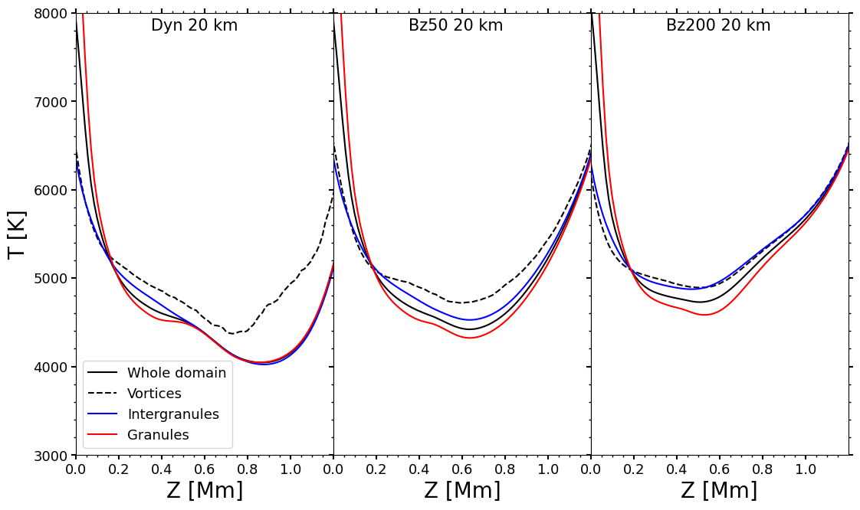
Results: Temperature
Magnetic field tends to reduce the temperature difference between vortices and the average atmosphere, especially in the upper layers.

Slide 15
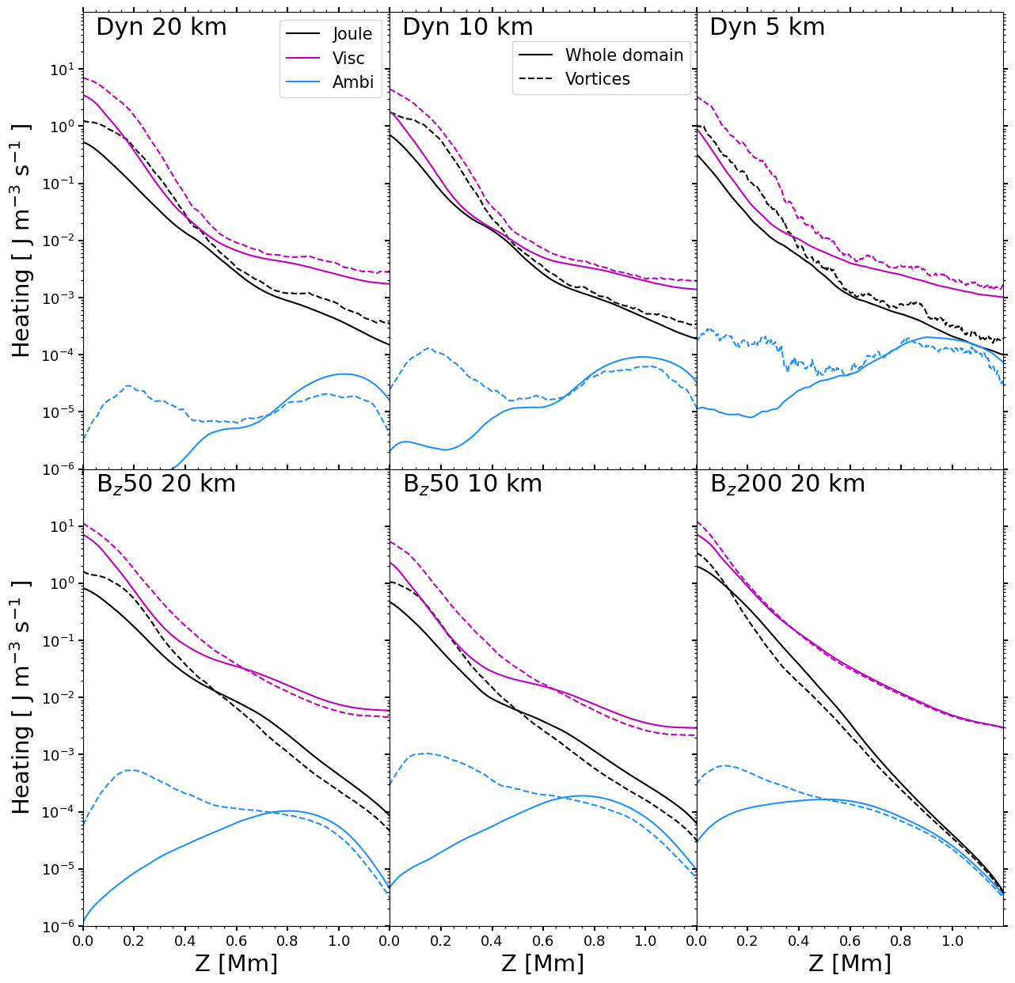
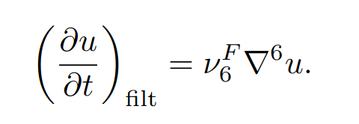
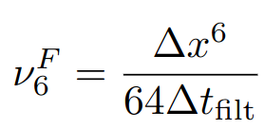
Results: Heating mechanisms
Heating mechanisms:
Numerical terms: Viscous and Joule
Physical terms: Ambipolar diffusion
Dissipation terms caused by filtering in Mancha:
;
Heating rates analyzed in the energy equation:
Numeric
Physical
≡ viscous stress tensor

Slide 16
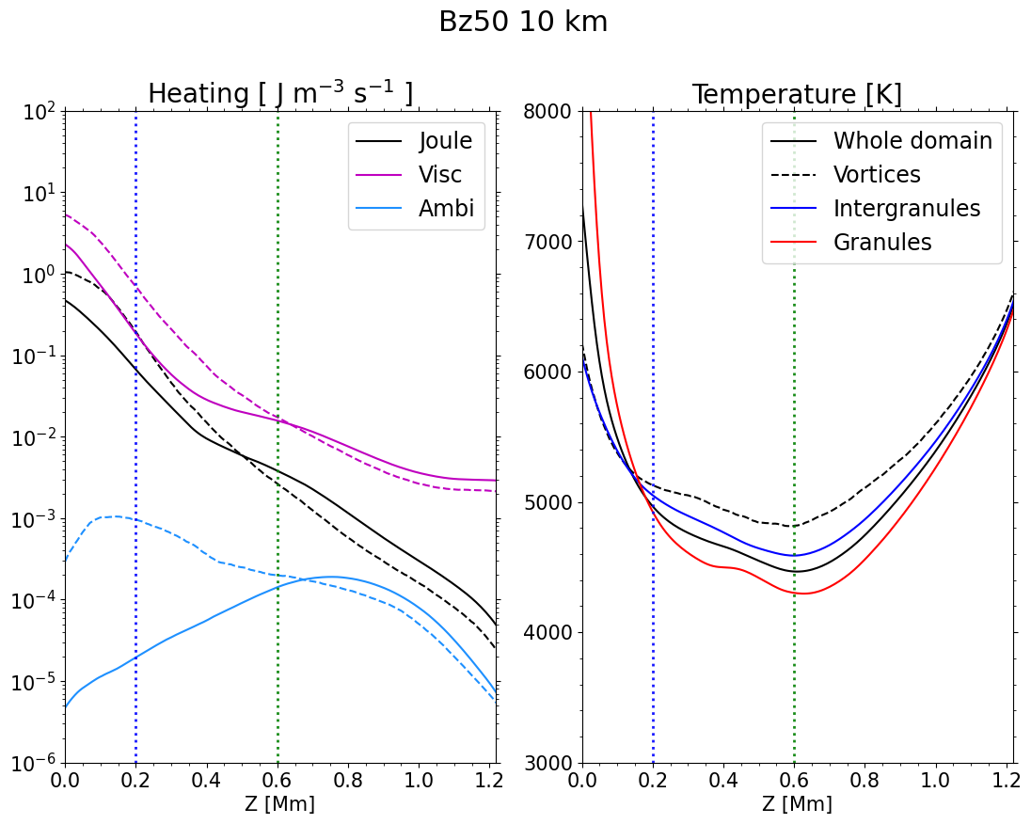
Results: Heating mechanisms
Vortices tend to have higher heating rate than the mean atmosphere at lower layers (up to ~0.6 Mm).
Temperature in vortices starts to increase above the temperature of integranules from 0.2 Mm.
Vortices have similar heating rate than the mean atmosphere at higher layers (from ~0.6 Mm).
Temperature in vortices is above the mean temperature by hundreds of Kelvin.
Are they dissipating energy at lower layers and transporting the heated plasma into higher layers?

Slide 17
Conclusions
SWIRL code allows to perform a reliable detection of vortices in numerical simulations.
Number and size of vortices highly depend on the magnetic field configuration and the spatial resolution.
Confirm that vortices have higher temperatures than the surrounding media.
Heating rates are higher in vortices than in the mean atmosphere just in lower layers.
Viscous heating is the dominant mechanism in all the models.
We speculate that vortices dissipate energy in the lower layers, transporting the heated plasma into higher layers in order to explain the observed increase in temperature.
Project PID2021-127487NB-I00 funded by
We thankfully acknowledge the technical expertise and assistance provided by the Spanish Supercomputing Network (Red Española de Supercomputación), as well as the computer resources used: LaPalma Supercomputer, located at the Instituto de Astrofísica de Canarias, and MareNostrum based in Barcelona/Spain.
The simulations analyzed in this work required about 15 millions of CPU/hours

Slide 18
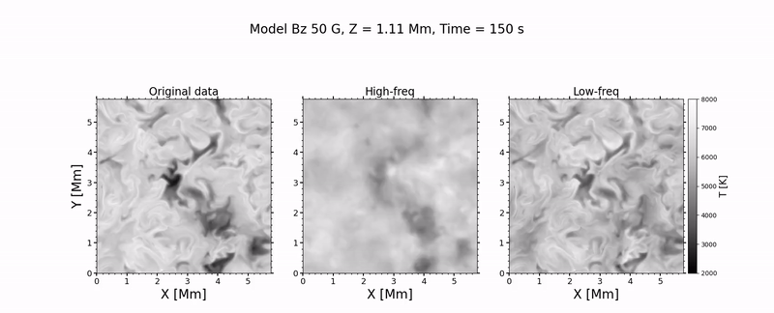
Appendix: FFT filtering
- Remove fast oscillations well-defined structures are maintained.
- Allow to compare structures in simulations one to one
Benefits of applying this filter to the simulations

Slide 19
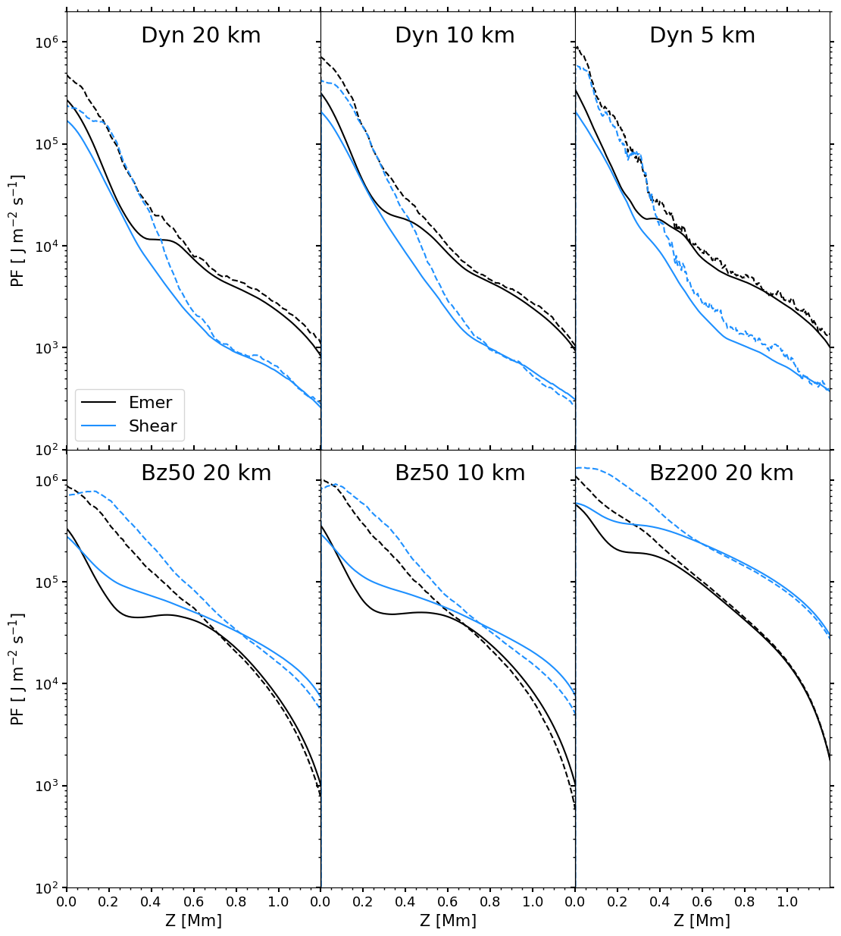
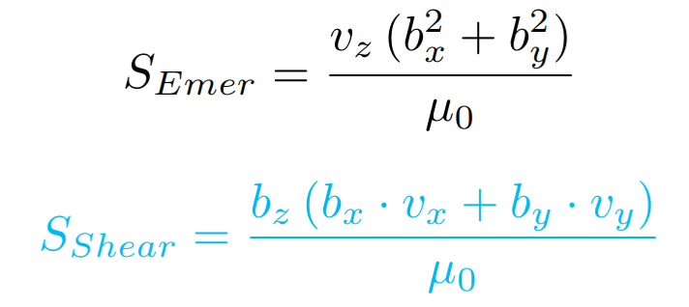
Appendix: Poynting Flux
Vertical components of Poynting Flux:
Emerging term:
Shear term:

Slide 20
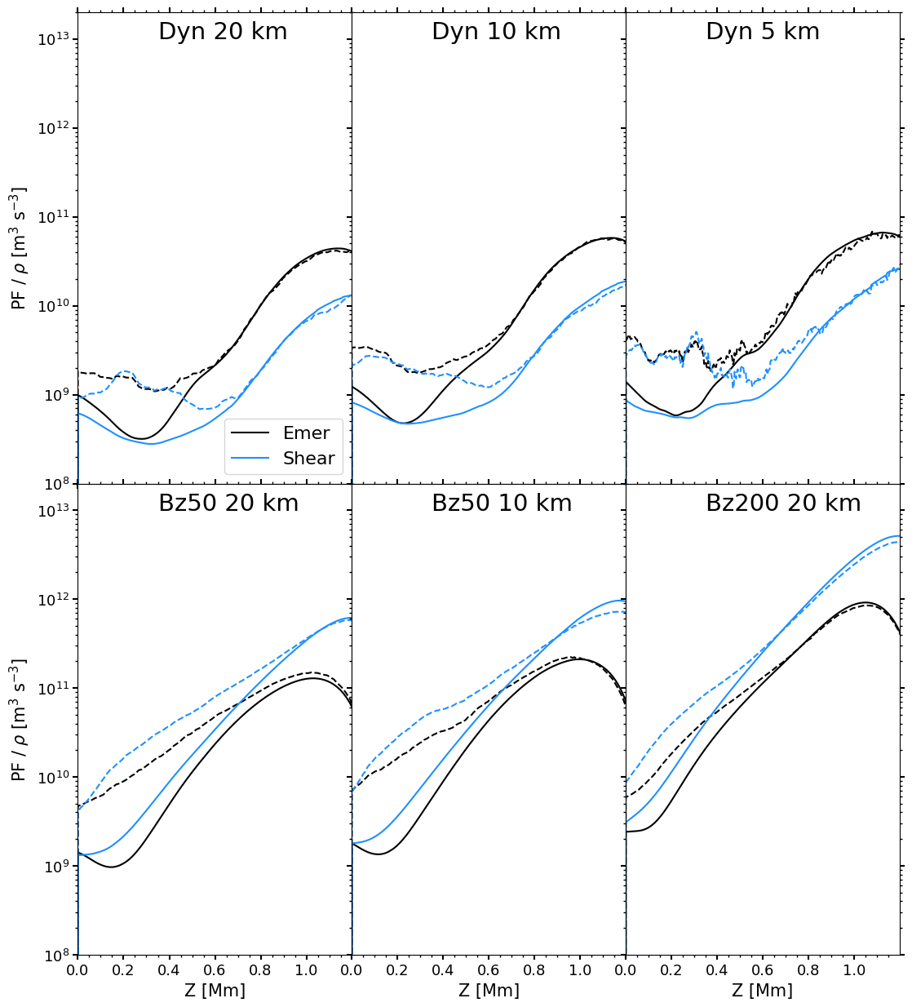
Appendix: Poynting Flux
Vertical components of Poynting Flux:
Emerging term:
Shear term:

