Slide 1
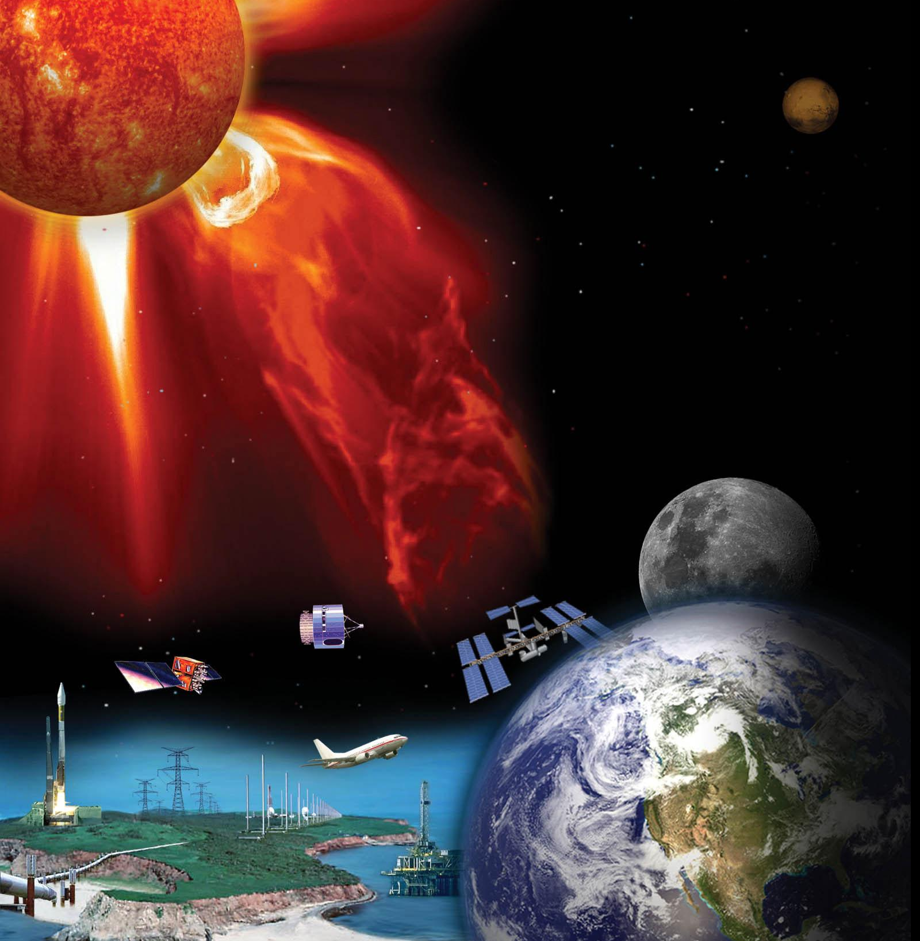
Predicting Geo-Effectiveness Two Days Prior to CME Impact with EUHFORIA
Outline
Introduction and motivation
(Semi-)Empirical models of geomagnetic indices – Master’s thesis of Mr. Senne Doumen
MHD model of geomagnetic indices – Maharana+2024a
Insights from CME modelling – Maharana+2022,2024b
Conclusions and outlook
Anwesha Maharana
On behalf of Stefaan Poedts, Senne Doumen
Collaborators: P. Wintoft (Lund university), M. Tahtouh (ONERA, Toulouse)
Credit: NASA
17th ESPM, Turin, 13/09/2024
Notes:
I should thank my supervisor Stefaan Poedts for giving me this opportunity of replacing him for the talk as he had leave the conference earlier. And I am sure he’d have thanked the organisers for letting him present our work here. So, thanks to the organiser. :)
I am Anwesha, from KU Leuven, Belgium. Finished my PhD 2 weeks back but still on a PhD contract this month. So, I don’t exactly know how to introduce myself. It’s tricky but lemme get to the trickier business.
– talk about predicting geo-effectiveness – thanks to Michaela for setting the scene for space weather.
– based on (1) the Master’s thesis work of Senne Doumen, (2) Coupling of EUHFORIA and OpenGGCM, (3) insights from flux rope modelling
<number>

Slide 2
Coronal & heliospheric modelling for space weather forecasts
PARADISE (particle transport)
solar corona
EUHFORIA/ Icarus
“Coronal” model
“Heliospheric” model
0.1 AU
2.1 AU or 5 AU
2
Centre for mathematical Plasma Astrophysics
2
Credit: Dr. Michaela Brchnelova
Notes:
Thanks to Michaela for setting the stage. Now you know all about the space weather modelling chains. To this chain, I am going to add the next component in this talk

Slide 3
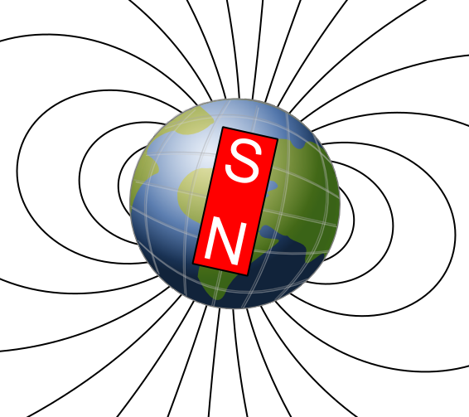
Coronal & heliospheric & magnetospheric modelling for space weather forecasts
PARADISE (particle transport)
solar corona
EUHFORIA/ Icarus
Geomagnetic indices – Dst, Kp, AE
“Coronal” model
“Heliospheric” model
“Magnetospheric” model
0.1 AU
3
Centre for mathematical Plasma Astrophysics
3
Credit: Dr. Michaela Brchnelova
Notes:
The magnetospheric models.
We use the output of EUHFORIA to drive the magnetospheric models

Slide 4
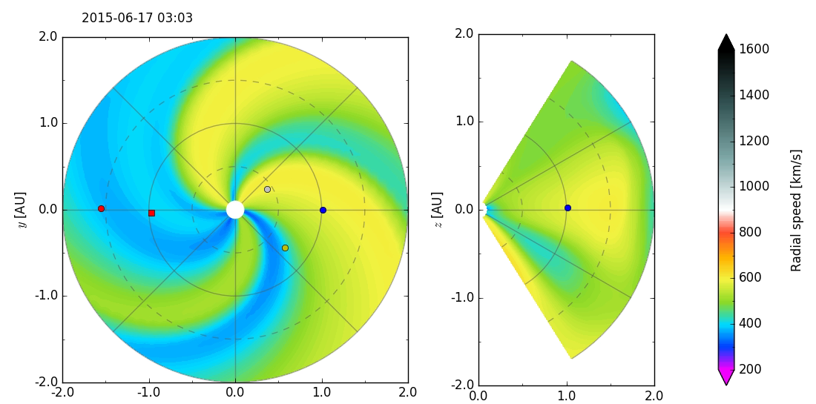
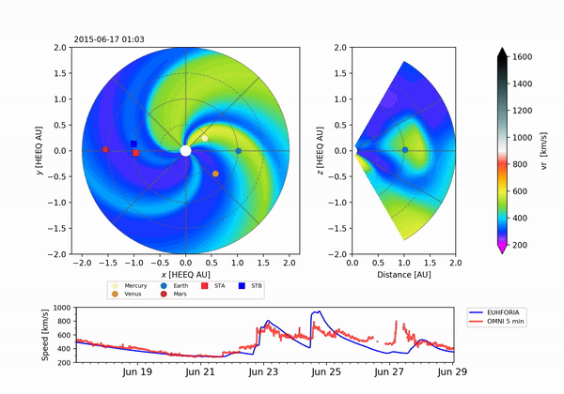
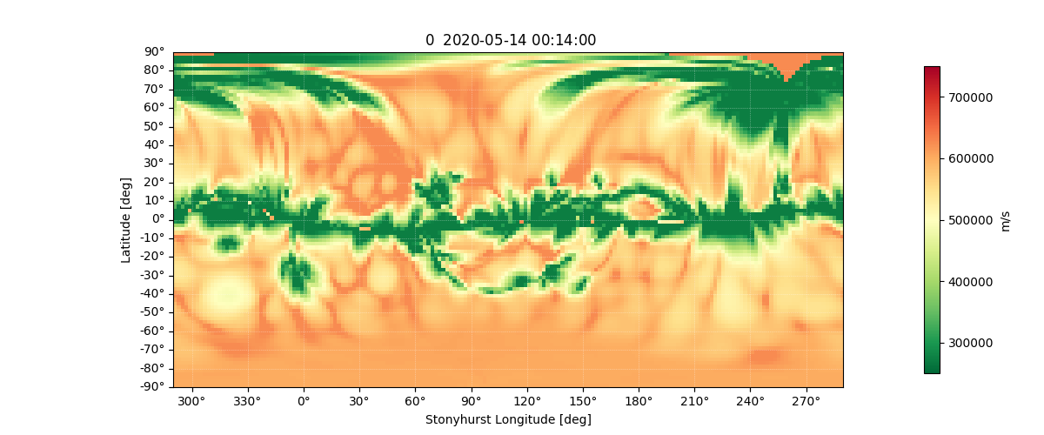
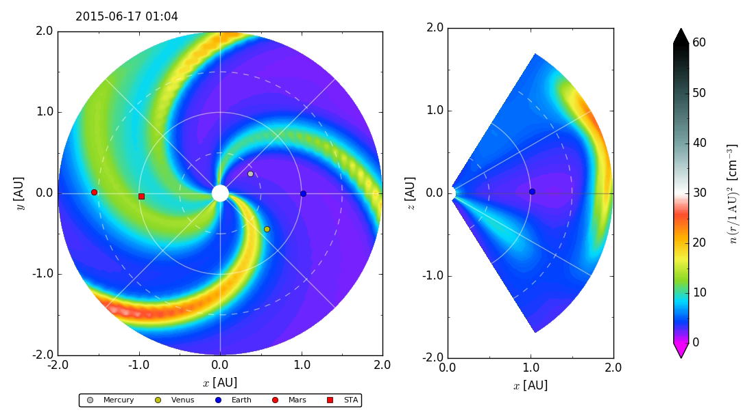
EUHFORIA ‘European heliospheric forecasting information asset’
Corona: Semi-Empirical WSA model
Heliosphere: 3D time dependent ideal MHD model
Synoptic Magnetogram (1 R_{sun})
Evolves MHD parameters v, n, B, T
(0.1 - 2.0 AU)
PFSS model
(1 - 2.6 R_{sun})
v_{r}
v_{r}
SCS model
(2.3 R_{sun} - 0.1 AU)
n
MHD parameters (0.1 AU) using empirical relations
Pomoell & Poedts, 2018
Solar wind relaxation
CME insertion @0.1 AU
Forecasting
4
Centre for mathematical Plasma Astrophysics
Notes:
I will majorly focus on this chain with WSA coronal model, EUHFORIA heliosphere. EUHFORIA is a physics-based heliospheric wind and CME evolution tool.
It consists of two parts:
with a semi-empirical coronal domain which provides solar wind plasma parameters at the inner boundary 0.1 AU using a data-driven approach.
Using the synoptic magnetometer data and assuming current free field, in the lower corona, magnetic field lines are radially extrapolated using the Potential Source Surface (PFSS) model up to 2.6 solar radii.
In the upper coronal domain, Schatten Current Sheet (SCS) model is employed to extrapolate the field up to 0.1 AU.
Other plasma parameters are computed using empirical relations using a modified Wang-Sheeley-Arge approach.
These parameters are used as boundary conditions to drive the 3D time dependent MHD model of inner heliosphere up to 2 AU.
First, we obtain a steady state solution for the solar wind, to mimic the conditions before the CME was released.
The figures on the right show equatorial and meridional slice of radial velocity and scaled number density of a steady state solar wind solution.
Then CMEs are inserted into the domain as time dependent boundary conditions and self-consistently evolved by MHD equations.
A finite volume numerical scheme and constrained transport approach is applied to advance the magnetic field components in a divergence-free way.
Finally, the plasma parameters are also evolved using a cell-average finite volume method and forecasting is done at Earth or any point in the 3D domain.
<number>

Slide 5
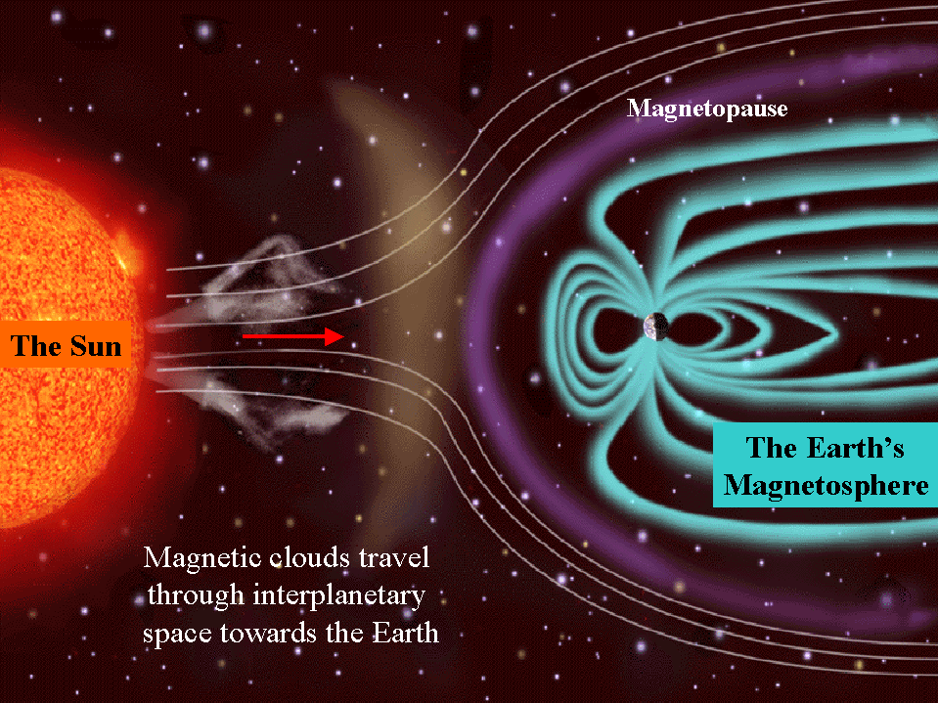
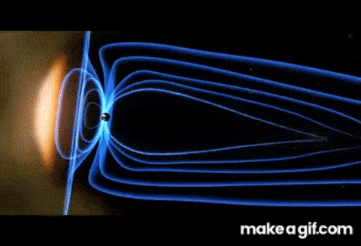
CMEs and Space Weather
B_{z}
Fig. A CME observed in visible light [Temmer & Bothmer, 2023]
CMEs propagate through the heliosphere to reach Earth.
4
Note: Illustration not-to-scale
Source: SOHO/LASCO
Notes:
… the CMEs propagates through the interplanetary medium to reach Earth and impacts its magnetosphere. When the magnetic field is oriented southward, i.e., the Bz is negative, the CME causes intense space weather disturbances. Space weather is defined as the solar activity driven conditions in the interplanetary and near-Earth space. Describe the gif.
We need to quantify the effect of this disturbance. This is done using geomagnetic indices that you might have heard about.

Slide 6
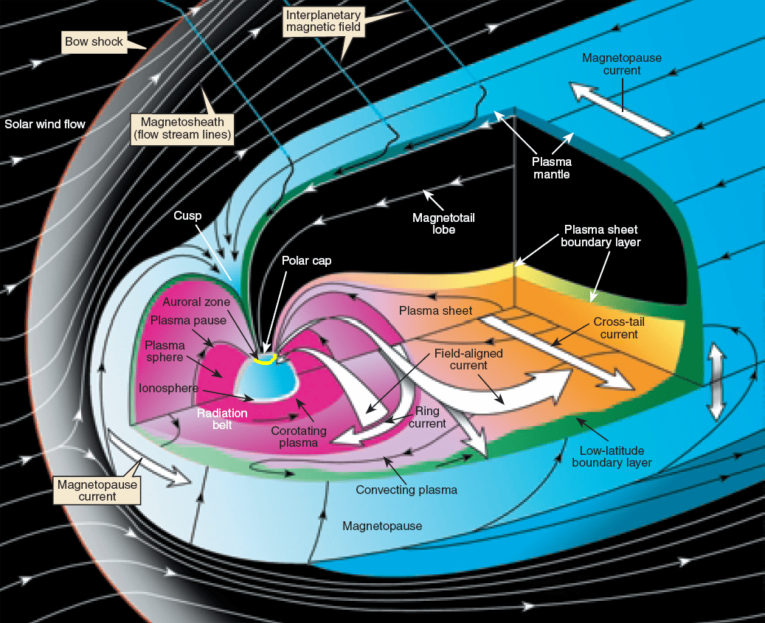
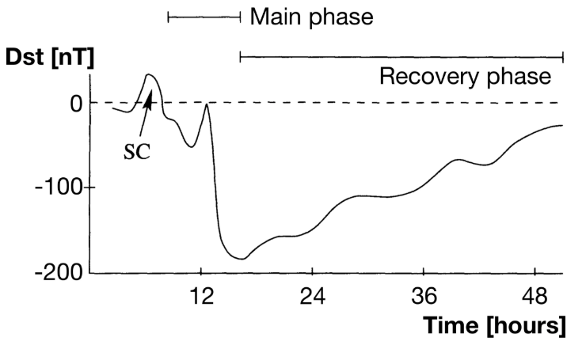
Quantifying geo-effectiveness of CME impact
Disturbance storm time (Dst) index The strength of the ring current,
Ring current
severe storm
Adapted from Kallenrode 2004
6
Adapted from Pollock+2003
Centre for mathematical Plasma Astrophysics
Notes:
The most popular one is the Dst index. I realised this is diverse audience, so let me give you quick glimpse at what exactly we are computing.
When the plasma flows towards towards the equator, the electrons and ions drift in opposite directions, giving rise to the ring current – equatorial current. This current induces a magnetic field opposite to the Earth’s magnetic field, hence weakening it. This is measured by the Dst index. The negative the Dst index, the severe the geomagnetic storm is.
<number>

Slide 7
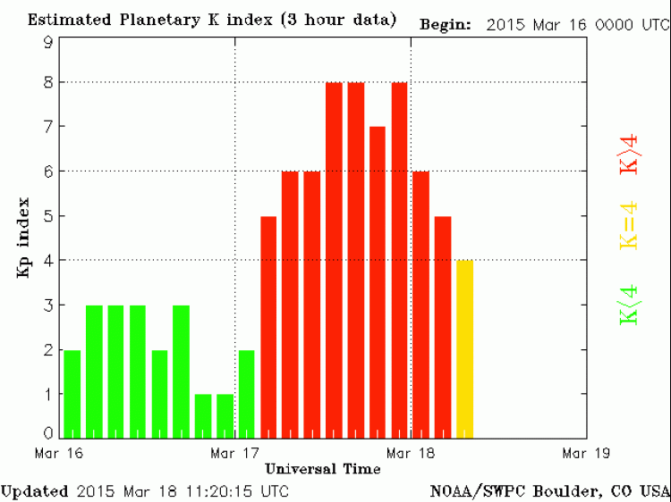
Quantifying geo-effectiveness of CME impact
Kp-index
The contribution of ring current and the auroral electrojets to quantify geomagnetic activity.
Auroral electrojets
Severe
Moderate
Quiet
Ring current
6
Adapted from Pollock+2003
Centre for mathematical Plasma Astrophysics
Notes:
Kp index is another metric to quantify the geomagnetic impact and takes into account the contribution from both the equatorial ring current and the auroral electrojets closer to the poles. Kp is an integer value and when it goes above 4, it means the storm is severe.
<number>

Slide 8
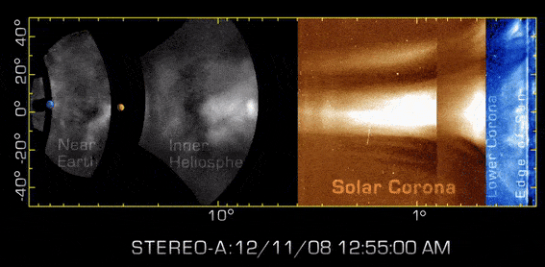
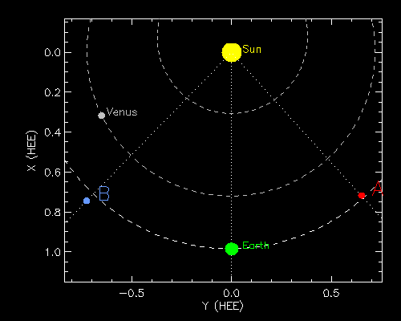
Rationale
CME
STEREO-B
STEREO-A
SC
Source: NASA
Predicting geomagnetic indices
Nowcasting using real-time solar wind data obtained at L1 ~1 hour in advance
vs
Forecasting using EUHFORIA simulated inputs ~1–2 days in advance
Realistic flux-rope CME models
Internal magnetic field topology
Operational forecasting
<number>
Centre for mathematical Plasma-Astrophysics
Notes:
Coming back to the CMEs. We have established that we need to track the CMEs and forecast their arrival. But how do we track them?
When the CME starts propagating away from the Sun into the interplanetary medium, we call it an interplanetary CME or ICME. We have remote observations of the CME evolving as it travels from Sun to Earth. Again, these observations do not tell us about the internal magnetic field structure of the CMEs.
We need the CME to pass through a SC (in situ) so that we can measure its magnetic field properties. So, how does a CME look like in situ?

Slide 9
Types of geomagnetic impact prediction models
(Semi-)Empirical models
3D Physics-based models
Analytical formula executed in seconds-minutes →Faster predictions
e.g., Empirical relations
Kp model: Newell+2008
Dst model: O’Brien and McPherron 2000
Neural network models
Feed-forward NN (Kp): Wintoft+2017
Recurrent NN: SWING (ONERA, France)
NARMAX model: SNGI (University of Sheffield, UK)
3D output obtained using MHD model of magnetosphere can be used to drive GIC models.
Facilitate predicting Auroral Electrojet indices predictions (A-indices) during storms and substorms
e.g., OpenGGCM
<number>
Centre for mathematical Plasma Astrophysics
Notes:
Two types – empirical and physics-based
Analytical – very easy to run – seconds to minutes time of execution
In this work, we have considered mainly three kinds of models

Slide 10
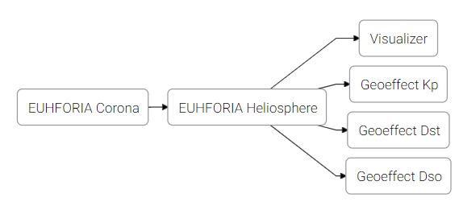
Methodology: EUHFORIA in the ESA VSWMC
Newell et al. (2008)
O’Brien & McPherron (2000)
Ayala-Solares et al. (2016)
Alternative models:
IRF-Kp model (Wintoft et al. 2017)
SWING model (Dst + Kp, ONERA)
<number>
Centre for mathematical Plasma Astrophysics
Notes:
Senne used the geo-effect models available in the VSWMC which are available. Anyone can access these models for free and also approach us/Stefaan if they want their models to be added to this amazing framework.
<number>

Slide 11
Methodology: EUHFORIA with magnetised spheromak CME
1 CME
3 CMEs
Event 2012, Scolini+2019
Event 2017, Scolini+2020
Note: A single forecasting resolution simulation takes max ~2–3 hours on 144 nodes of KU Leuven supercluster. *Subject to changes depending on the complexity of the event.
B_{z}
B_{z}
<number>
Centre for mathematical Plasma Astrophysics
Credit: Senne Doumen
Notes:
<number>

Slide 12
Results with (semi-)empirical models
Notes:
<number>

Slide 13
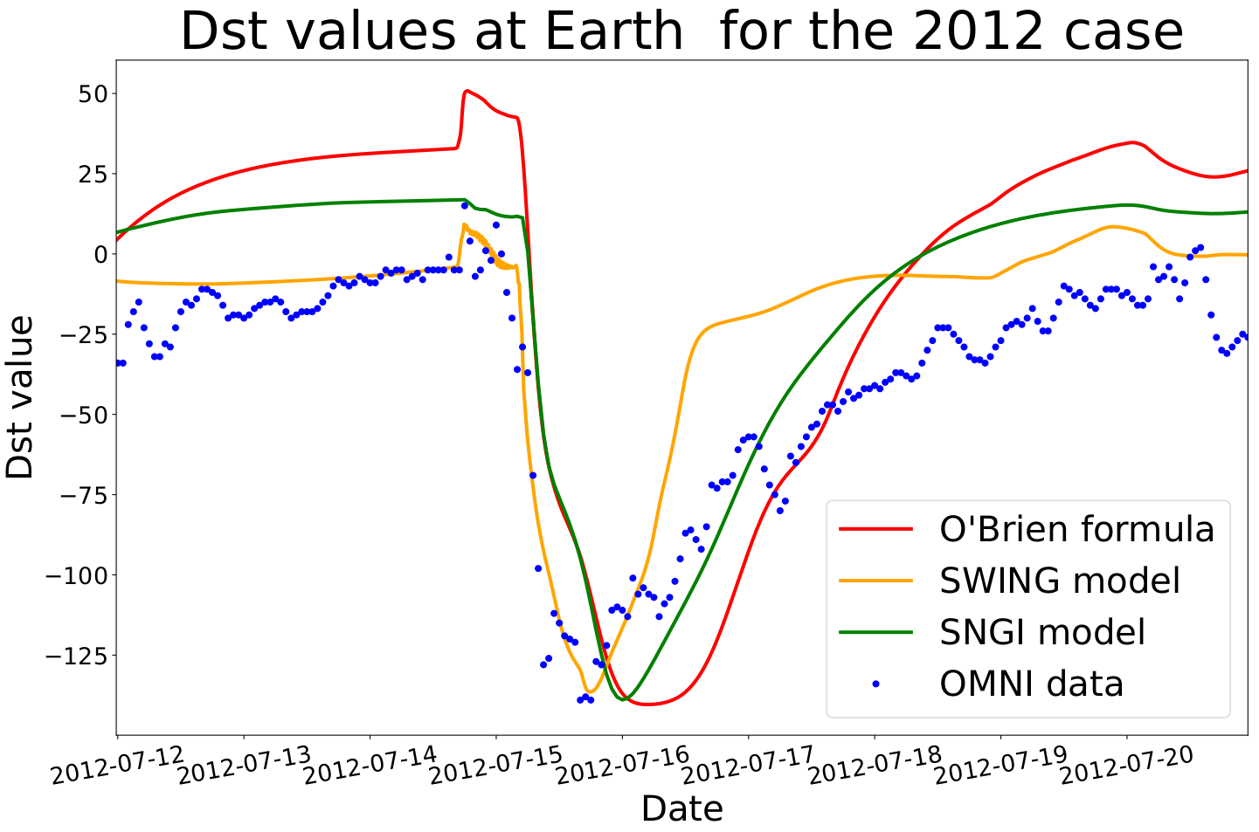
Dst models
<number>
Centre for mathematical Plasma Astrophysics
Credit: Senne Doumen
Notes:
We did not see much effort/effect by keeping virtual satellites around (?)

Slide 14
Dst models
Dst prediction models leaderboard
SWING: Recurrent NN
SNGI: NARMAX
O’Brien: Empirical
<number>
<number>
Centre for mathematical Plasma Astrophysics
Credit: Senne Doumen
Notes:
Computed metrics to evaluate the performance of all these models

Slide 15
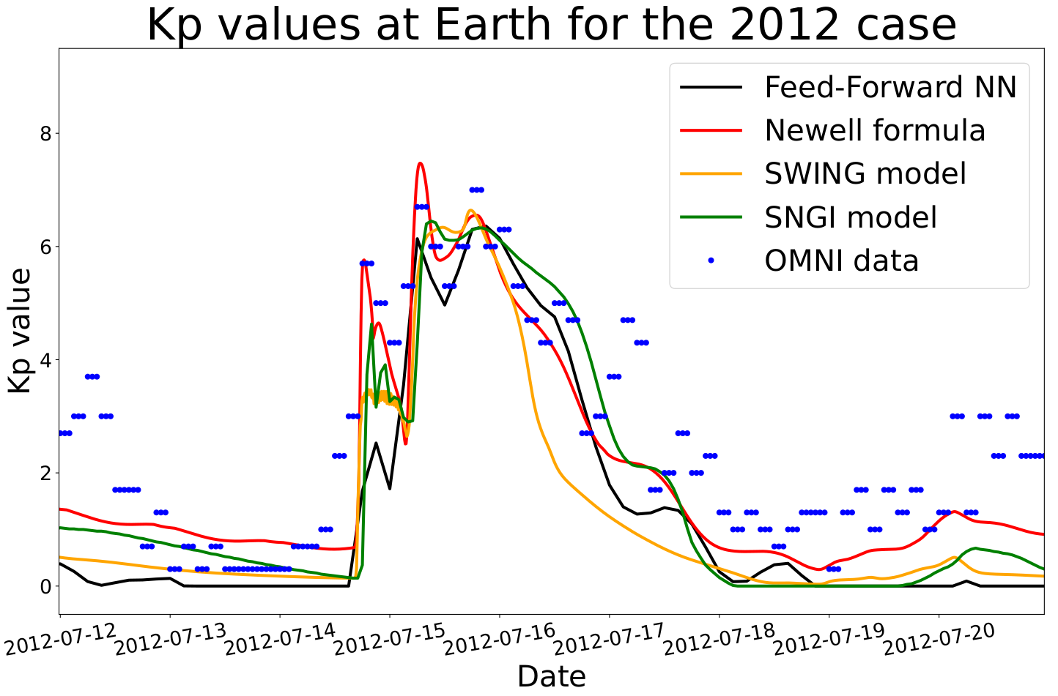
Kp models
<number>
Centre for mathematical Plasma Astrophysics
Credit: Senne Doumen

Slide 16
Kp models
Kp prediction leaderboard
Newell (emp.) & SNGI (NARMAX)
SWING: Recurrent NN
Feed-forward NN
Takeaways!
Neural network performing as good as/better than empirical models. Could be case-dependent (?) Need more validation to conclude!!!
<number>
Centre for mathematical Plasma Astrophysics
Credit: Senne Doumen

Slide 17
Results with MHD model
Notes:
<number>

Slide 18
Types of geomagnetic impact prediction models
(Semi-)Empirical models
3D Physics-based models
Analytical formula executed in seconds-minutes →Faster predictions
e.g., Empirical relations
Kp model: Newell+2008
Dst model: O’Brien and McPherron 2000
Neural network models
Feed-forward NN (Kp): Wintoft+2017
Recurrent NN: SWING (ONERA, France)
NARMAX model: SNGI (University of Sheffield, UK)
3D output obtained using MHD model of magnetosphere-ionosphere-thermosphere (MIT) can be used to drive GIC models.
Facilitate predicting Auroral Electrojet indices predictions (A-indices) during storms and substorms
e.g., OpenGGCM →simulations take ~2–6 hours
<number>
Centre for mathematical Plasma Astrophysics
Notes:
3D models have better bandwidth to drive the models down the chain like the GIC models – for power grid operators to take mitigation measures.

Slide 19
Quantifying geo-effectiveness of CME impact
Auroral electrojets
Auroral indices A proxy of the response of the ionosphere to the substorms which are quite stochastic and have high temporal variability. AL, AU, AE = AU - AL
<number>
Adapted from Pollock+2003
Centre for mathematical Plasma Astrophysics
Notes:
There are another variety of geomagnetic disturbances, called the substorms which are highly stochastic magnetic field fluctuations in the Earth’s magnetic field. These happen even in the absence of a strong CME driving.

Slide 20
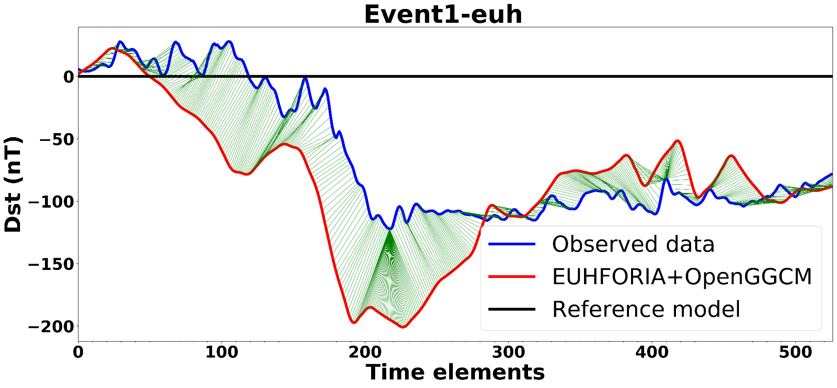
Validation of coupling
Event 2012: Scolini+2019
Magnetospheric response: Dst index → Prediction with EUHFORIA input comparable with those using L1 measurements.
TAKEAWAY! All predictions are sensitive to the B_{z} input
→emphasis on improving EUHFORIA predictions. Numerics of the complex MIT models need improvement.
Outlook
Explore other MHD magnetosphere models and benchmark their performance with EUHFORIA simulation - Add smart noise to input!
Assess the capabilities of using MHD magnetosphere models as compared to empirical models
EUHFORIA+OpenGGCM
Observations+OpenGGCM
(reference)
Ionospheric response: Auroral indices (AU, AL, AE) →order of magnitude comparable.
Lessons learned: Stefaan had to push me quite a lot to publish this work. It took me a while to make peace with the state of these results. So, I got delayed in listening to him. But, I finally did. :)
<number>
Maharana+2024a
Centre for mathematical Plasma-Astrophysics
Notes:
One example of the validation using the event from September 2017. Here are the results for Dst and A-indices.
The observations are in red. OpenGGCM predictions using EUHFORIA in blue, and using in situ observations in black.
We find a good agreement of the Dst predictions with observations. However, it is tricky to explain the fine structures, difficult to explain.
Given the small scale variations in the profiles of geomagnetic indices in addition to the time delays, it is not convenient to assess the model performance with error evaluators like Root Mean Square error or other correlation coefficients. Hence we employ an advanced time series comparing algorithm called Dynamic Time Warping method (DTW) that optimally aligns two time-dependent sequences. The algorithm identifies the similar patterns and the time derangement between them.
AE index is a response to small scale perturbations in the ionosphere.
It is difficult to map the AE peaks modelled by OpenGGCM directly with the observations due to this high variability. But the magnitudes can be reproduced in the simulations

Slide 21
Have we solved the problem?
Notes:
If the geomagnetic index computation takes time in the order of minutes to hours, then we should be able to forecast the impact a couple of hours after the eruption
Constraining CME initial parameters
Improving EUHFORIA predictions with
advanced but fast FR models
<number>

Slide 22
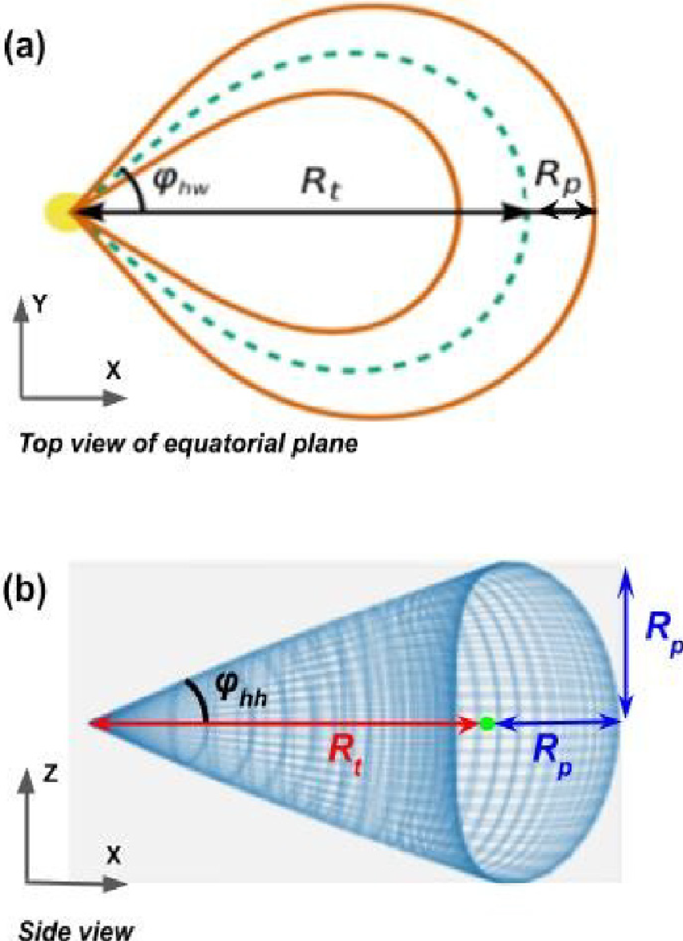
Steps in generating EUHFORIA predictions
For more information: my freshly baked thesis &
Poster 27D
For operational space weather forecasting:
Accurate geometry and magnetic field predictions
As fast as in real-time for ensemble modelling
Step 1: Constraining CME parameters based on observations
Step 2: Choice of CME models in EUHFORIA
FRi3D model Isavnin+2016, Maharana+2022
High level of uncertainties (time-consuming)
Horseshoe model Linan+2024, Maharana+2024b
<number>
Centre for mathematical Plasma Astrophysics

Slide 23
Horseshoe
FRi3D
spheromak
FR CME models and empirical geo-effect models
v
Comparison of Dst compute using O’brien and McPheron 2000 (post-event analysis)
Horseshoe model fast (~spheromak) and accurate (~FRi3D).
B_{x}
B_{y}
B_{z}
Dst
<number>
Maharana et al. (2024b)
Centre for mathematical Plasma Astrophysics

Slide 24
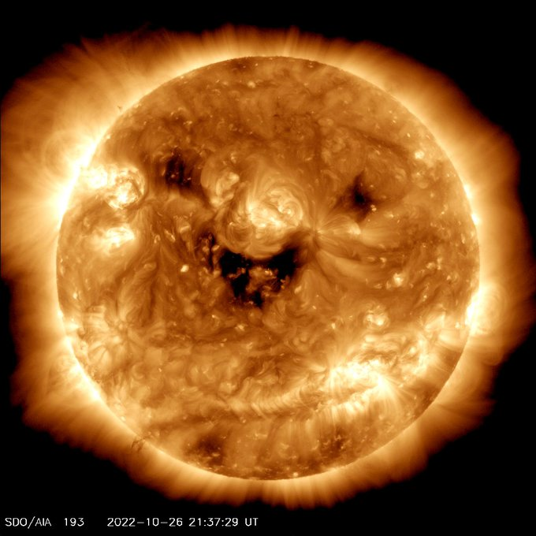
Conclusion and Outlook
We presented the current state-of-the-art in predicting geomagnetic indices 1-2 days ahead of time using synthetic EUHFORIA predictions with magnetised CMEs.
(Semi-)Empirical models are promising for fast geo-effectiveness predictions.
3D magnetosphere-ionosphere-thermosphere models for complex phenomena like substorms and for driving the GIC models.
Further statistical validation studies are needed to assess the performance and reliability of geo-effect indices predictions based on synthetic L1 data.
Improved CME models like FRi3D and Horseshoe models will be employed for accuracy.
Need a platoon of forecaster…
Bottleneck ⇒ Accuracy of CME and solar wind predictions at Earth
Bottleneck ⇒ Constraining initial parameters of the CME Potential solution ⇒ Ensemble modelling
Source: iStock
<number>
Centre for mathematical Plasma Astrophysics

Slide 25
Credit: NASA Goddard
Thank you!
stefaan.poedts@kuleuven.be anwesha.maharana@kuleuven.be
Acknowledgements: EU H2020 project EUHFORIA 2.0 (Project 870405) + ESA project ITT AO/1-10125/19/NL/HK (Heliospheric Modelling Techniques). Funded also by the European Union. Views and opinions expressed are however those of the author(s) only and do not necessarily reflect those of the European Union or [name of the granting authority]. Neither the European Union nor the granting authority can be held responsible for them. This project (Open SESAME) has received funding under the Horizon Europe programme (ERC-AdG agreement No 101141362).
Other references: EUHFORIA web page
<number>
Centre for mathematical Plasma Astrophysics

Slide 26
Extras

Slide 27
Outlook
(Semi-)Empirical models are promising for fast geo-effectiveness predictions Bottleneck ⇒ Accuracy of CME and solar wind predictions at Earth.
Even if we make fast running CME models Bottleneck ⇒ Constraining initial parameters of the CME Potential solution ⇒ Ensemble modelling
Not just one forecaster…
<number>
Source: iStock

Slide 28
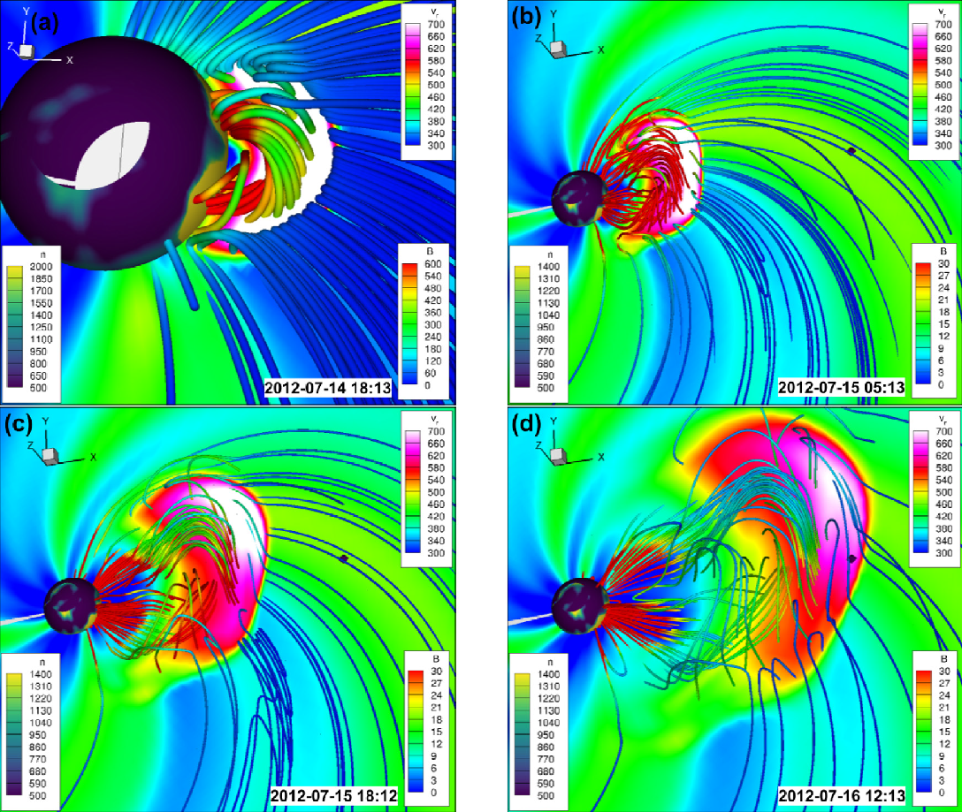
FR CME models in EUHFORIA I
FRi3D model
3D visualization of the EUHFORIA simulation results of the CME that erupted on 12 July 2012 using the FRi3D model, evolving in the heliospheric domain of EUHFORIA.
For more information: my freshly baked thesis
&
Poster 27D
For operational space weather forecasting:
Accurate geometry and magnetic field predictions
As fast as in real-time for ensemble modelling
Flexible deformable flux rope structure
Modified Lundquist type topology
FRi3D flux rope geometry.
<number>
Maharana et al. (2022): FRi3D model
Centre for mathematical Plasma Astrophysics
<number>

Slide 29
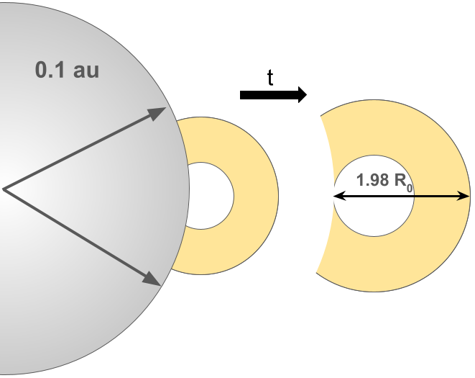
FR CME models in EUHFORIA II
Horseshoe model
For more information: my freshly baked thesis &
Poster 27D
3/4th Torus model
Analytical, almost force-free modified Miller-Turner topology
<number>
Maharana et al. (2024b): Horseshoe model
Centre for mathematical Plasma Astrophysics

Slide 30
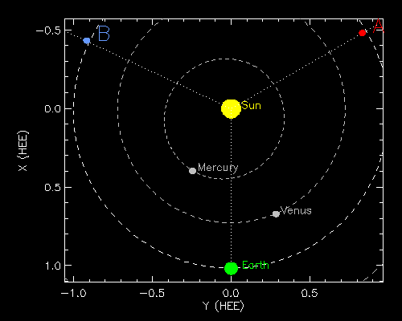
Validation event - 12 July 2012
Geometrical parameters
STEREO-B
STEREO-A
Insertion time
Latitude
Longitude
Half-width
Half-height
Toroidal height
CME parameters are constrained independently from remote observations.
Geometrical parameters obtained using the FRi3D 3D reconstruction tool using multi-viewpoint observations.
Poloidal height
STEREO B
STEREO A
Speed
STEREO B
STEREO A
CME shell
<number>
Centre for mathematical Plasma-Astrophysics
Notes:
For geometrical parameters, we perform a 3D geometrical reconstruction using the multi-viewpoint observations from Stereo A and Stereo B. We have used the FRi3D model reconstruction tool. We obtain these morphological parameters.

Slide 31
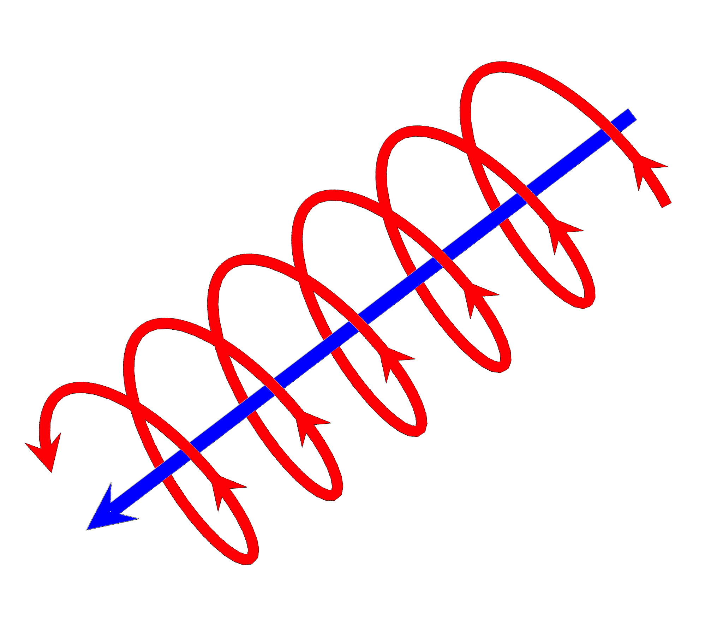
Validation event - 12 July 2012
Magnetic field parameters
Chirality
EUV/X-ray sigmoid
[Demoulin & Pariat 2009, Palmerio+2017]
Chirality Forward S-shaped sigmoid implies right-handed FR
Side view
PIL
Polarity
Tilt
Polarity inversion line (PIL)
[Palmerio+2017, Scolini+2019]
Tilt: 45°
Axial magnetic field: South-Eastward
Sigmoid
[Longcope & Beveridge, 2007]
PIL
<number>
Centre for mathematical Plasma-Astrophysics
Notes:
To constrain our CME magnetic field parameters, we use the solar proxies of the CME eruptions.
We use EUV and magnetogram observations to relate to the standard flare model. Here a forward S-shaped sigmoid means right-handed chirality.
The polarity and the geometric axial orientation of the FR are obtained using the magnetogram observations. So, for this event, the flux rope front is interpreted as the schematic shown here.
—------------------------------------------------------------------------------------------------
Btw,
Extreme UV radiation spans the 10 to 30 nm wavelength range. The 94 angstorm filter is 9.4 nm.
Visible range is 400 (v) to 700 (r) nm.

Slide 32
Rationale
Predicting geomagnetic indices
OpenGGCM (an MHD model of magnetosphere-ionosphere-thermosphere) is driven by solar wind data at L1 from
in-situ observations: Wind (Reference for comparison)
MHD simulations: EUHFORIA (with magnetised CME models)
Nowcasting using real-time solar wind data obtained at L1 ~1 hour in advance
Forecasting using EUHFORIA simulated inputs ~1–2 days in advance
Realistic flux-rope CME models in EUHFORIA →predict the CME and wind parameters at L1/Earth 1–2 days before their actual arrival.
Synthetic L1 data can be used as input for magnetosphere models and (semi-)empirical and neural network (NN) models for prediction of geo-effect indices (Dst, Kp, AE, etc.).
<number>
Centre for mathematical Plasma-Astrophysics
Notes:
The major point that I want to highlight here is the advantage of forecasting over nowcasting. Instead of using the realtime L1 observations that is obtained within 1 hour in advance before the storm impacts at Earth, we can use the EUHFORIA modelled data to compute the geomagnetic indices well in advance up to 1-2 days.
Although empirical models for geomagnetic indices are available, MHD models of magnetosphere provide more physical insights and have better bandwidths to drive the models down in the chain, like the GIC models.
Understanding CME structures and, in particular, the evolution of their internal magnetic field structure is key to predictions of geo-effectiveness.
Realistic flux-rope CME models in EUHFORIA (Pomoell & Poedts, 2018) can predict the CME and wind parameters at L1 two to three days before their actual arrival.
Synthetic L1 data can be used as input for magnetosphere models and semi- empirical and NN models for prediction of geo-effect indices (Dst, Kp, AE, etc.).
Thus, the Dst, Kp, AE indices can be predicted several days in advance.
Validation events

Slide 33
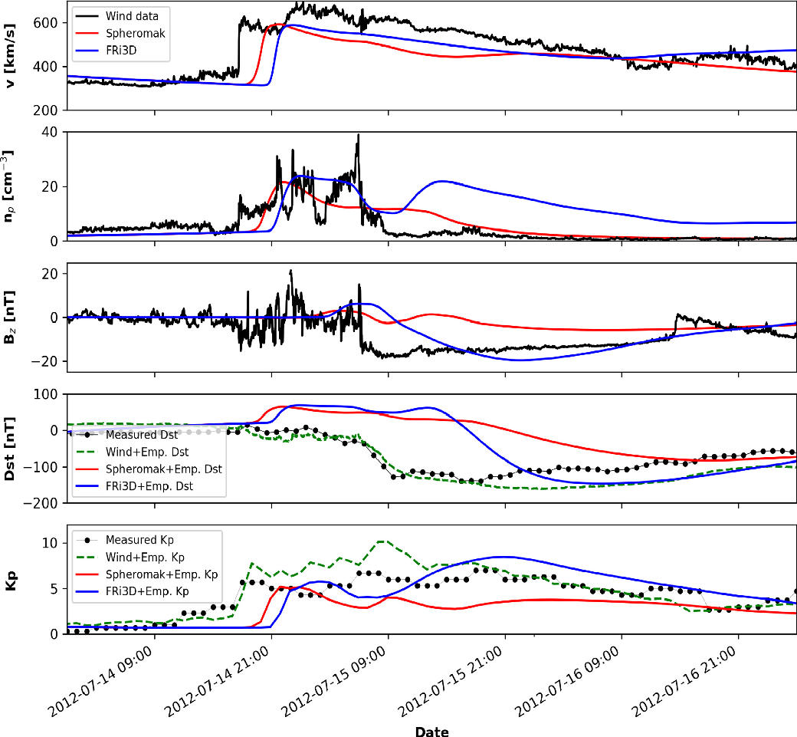
Geo-effectiveness
Using a spheromak and FRi3D CME.
Comparison of the geoeffectiveness predictions employing the empirical Dst formalism of O’Brien and McPherron (2000a,b) and the empirical Kp-index formalism of Newell et al. (2007, 2008) with observations. The empirical Dst (panel 4) and Kp index (panel 5) computed using the measured Wind data (green dashed line), and EUHFORIA simulated solar wind data using the spheromak (in red solid line) and FRi3D (in blue solid line) are compared with their measured values. The solar wind parameters (v; n_{p}; B_{z}) at Earth are additionally plotted to show their correlation with the geomagnetic indices. For example, B_{z} and n_{p} strongly influence Dst and Kp index respectively.
_{p}
<number>
Maharana et al. (2022): FRi3D model
Centre for mathematical Plasma Astrophysics
<number>

Slide 34
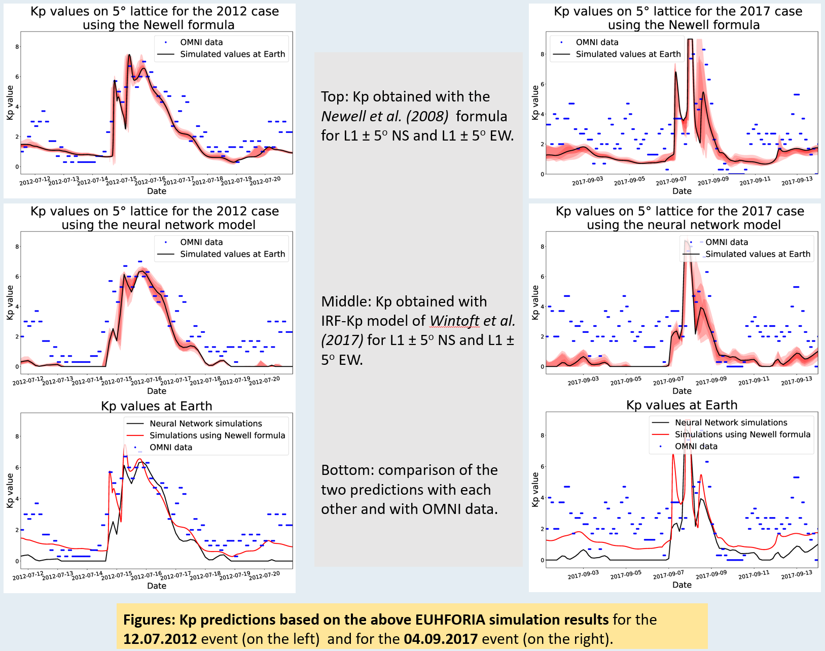
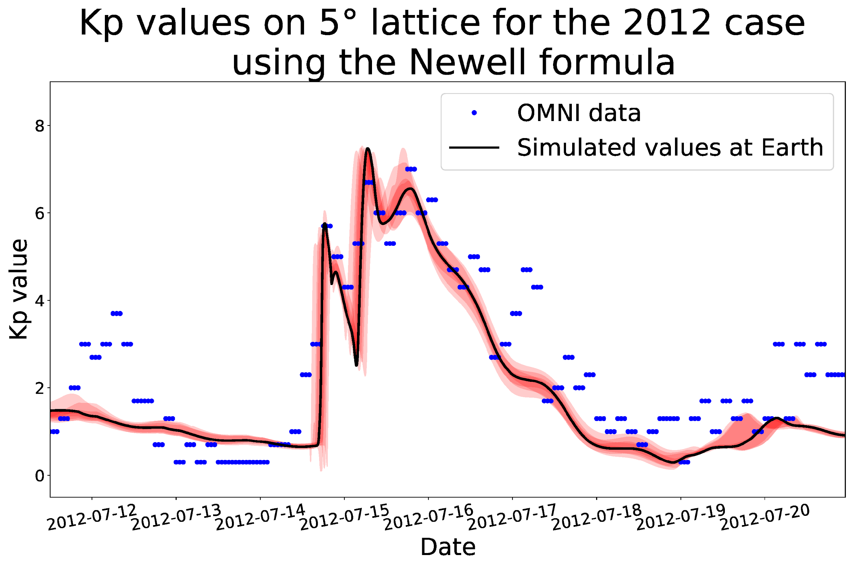
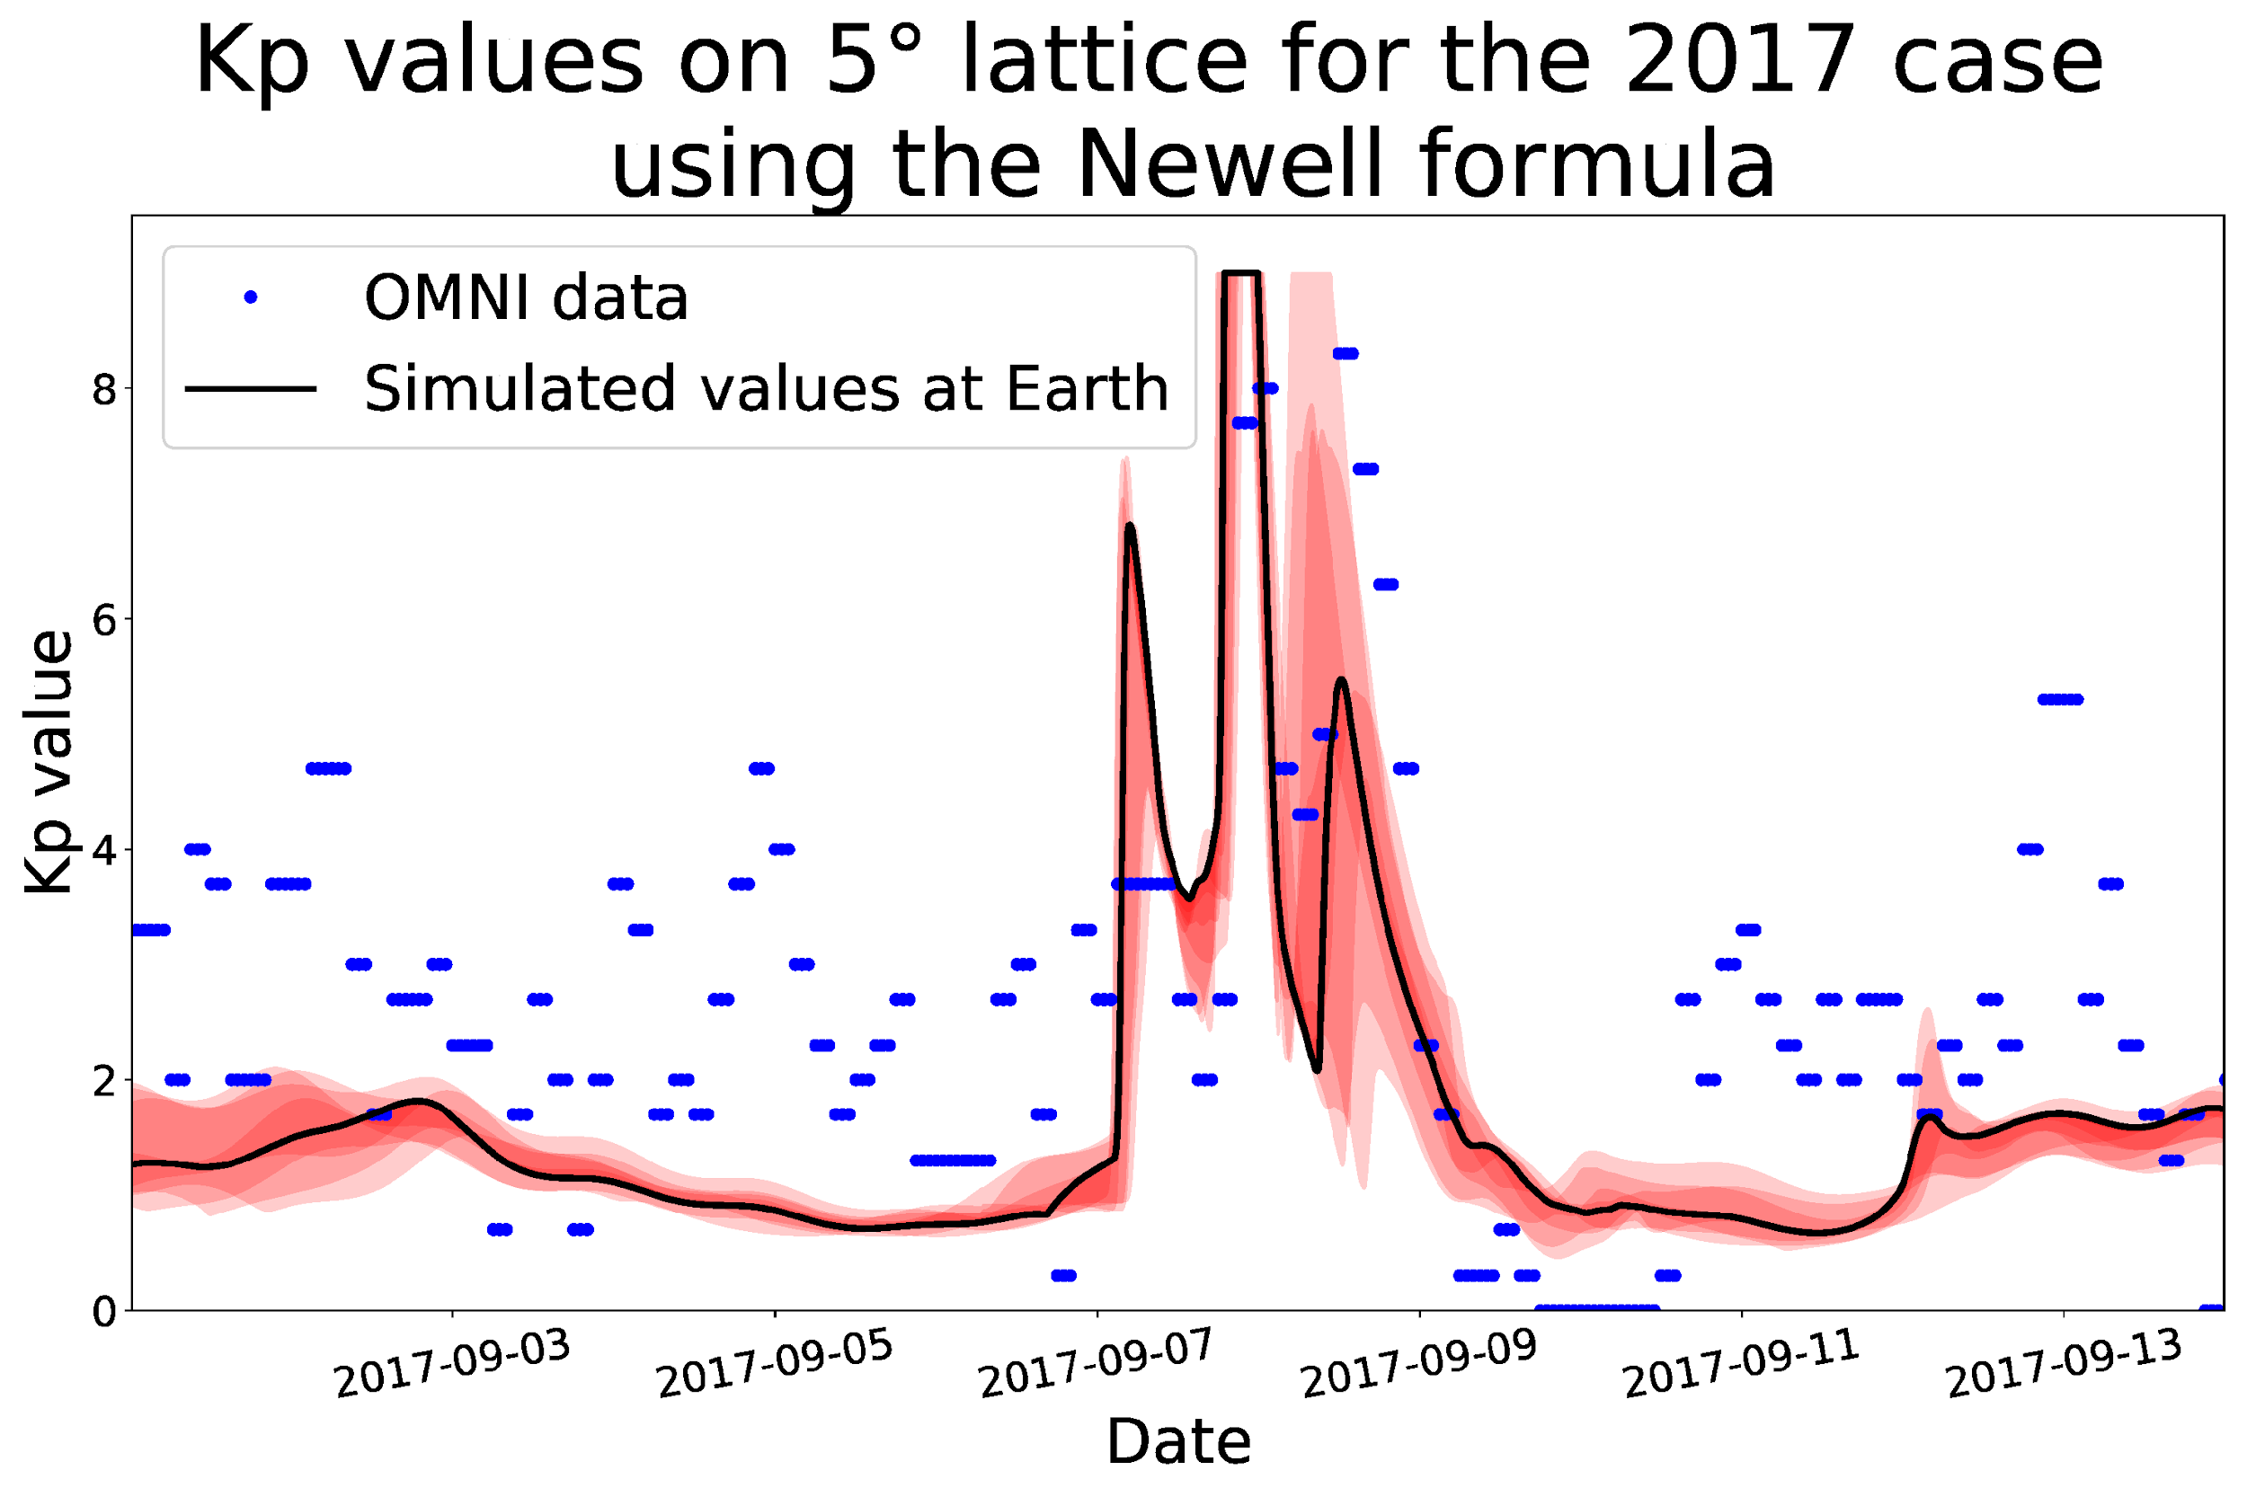
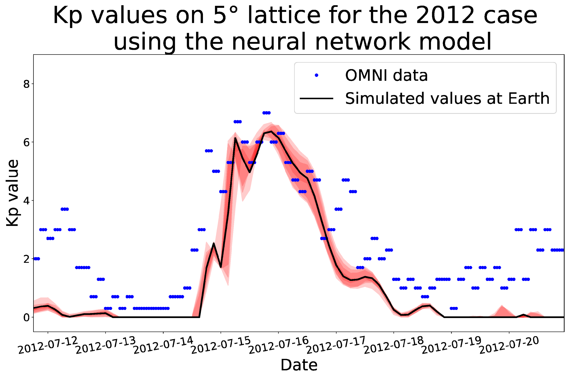
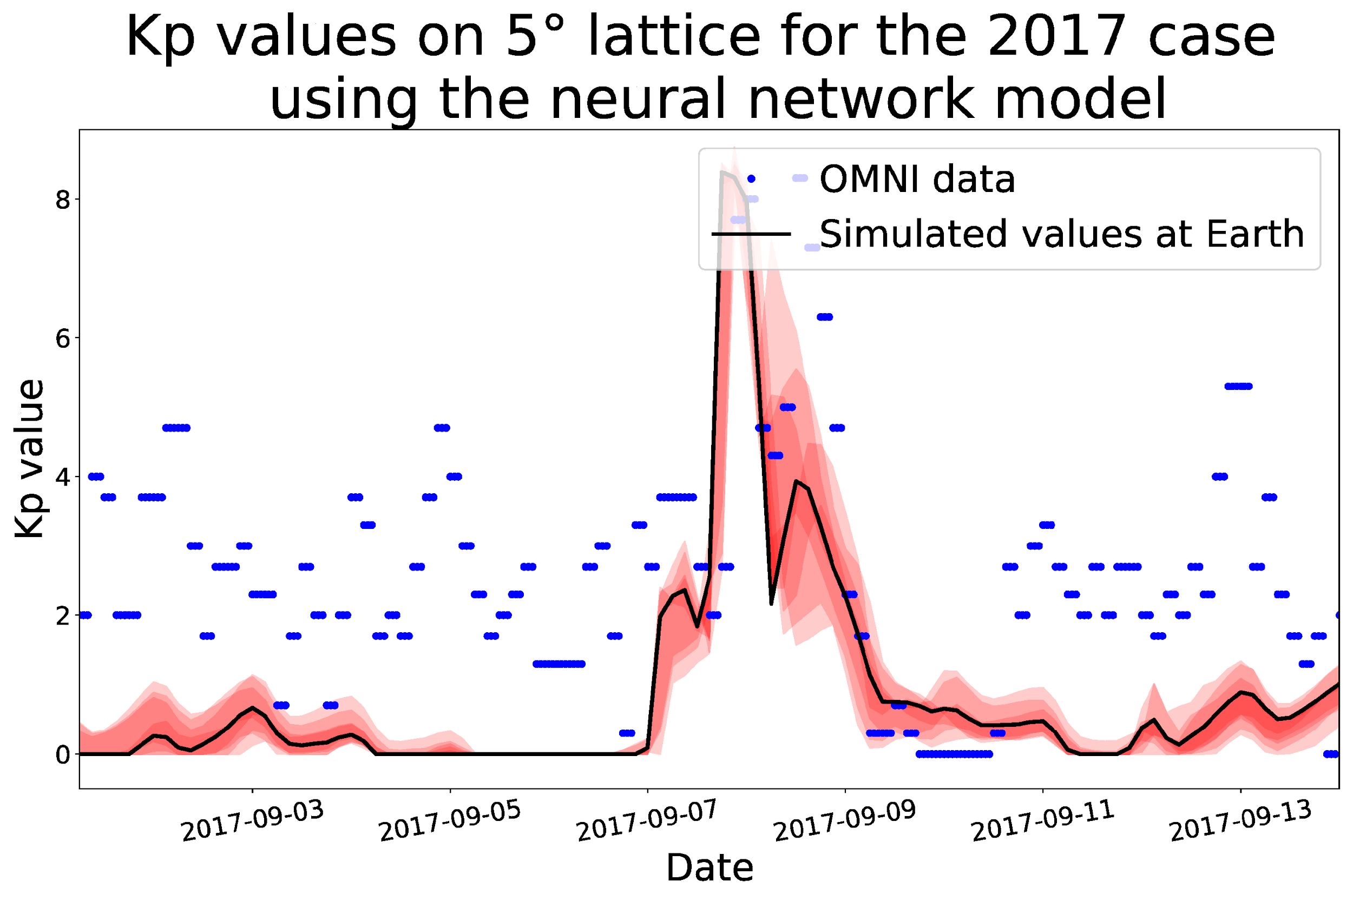
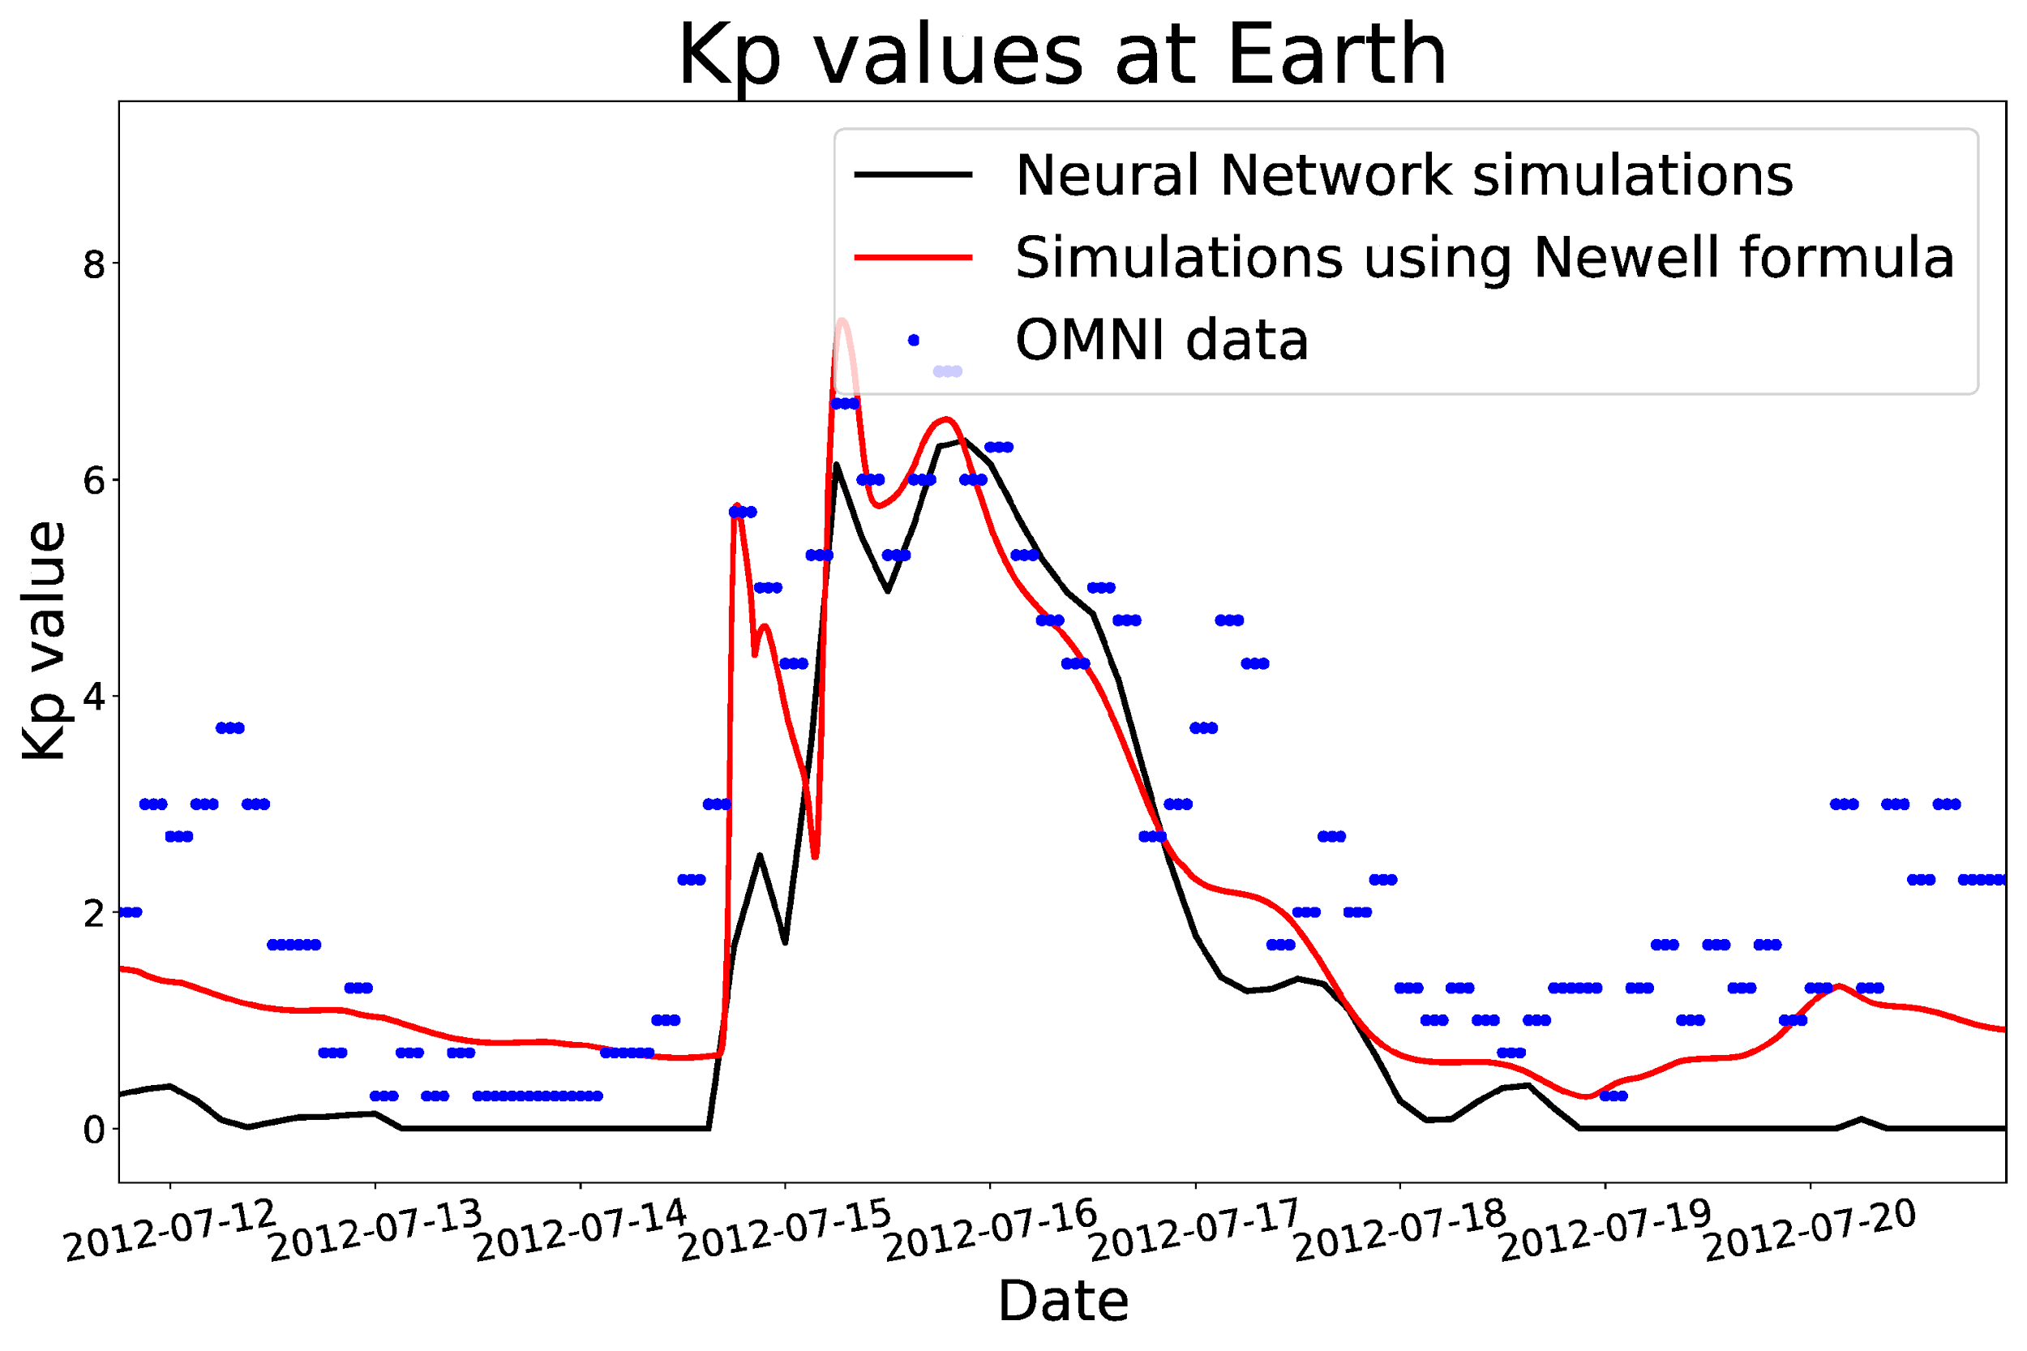
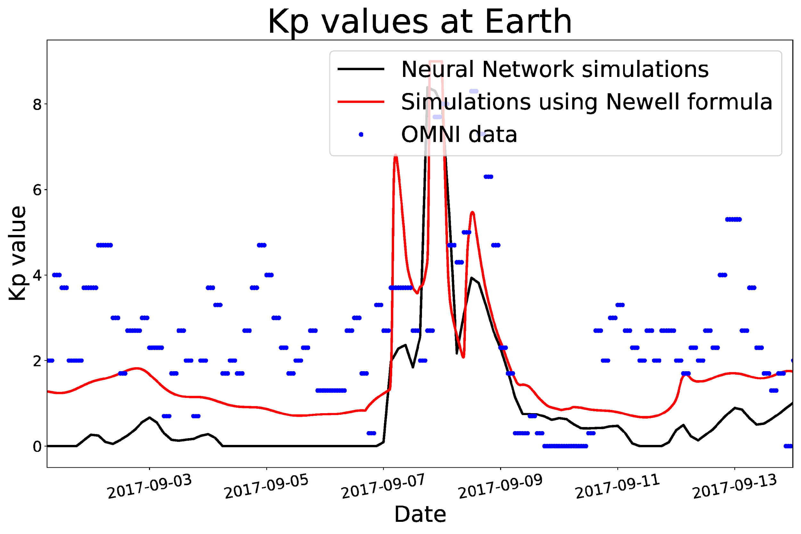
Kp predictions
<number>
Centre for mathematical Plasma Astrophysics
Top: Kp obtained with the Newell et al. (2008) formula for L1 ± 5º NS and L1 ± 5º EW.
Middle: Kp obtained with IRF-Kp model of Wintoft et al. (2017) for L1 ± 5º NS and L1 ± 5º EW.
Bottom: comparison of the two predictions with each other and with OMNI data.
Figures: Kp predictions based on the above EUHFORIA simulation results for the 12.07.2012 event (on the left) and for the 04.09.2017 event (on the right).
Notes:
<number>

Slide 35
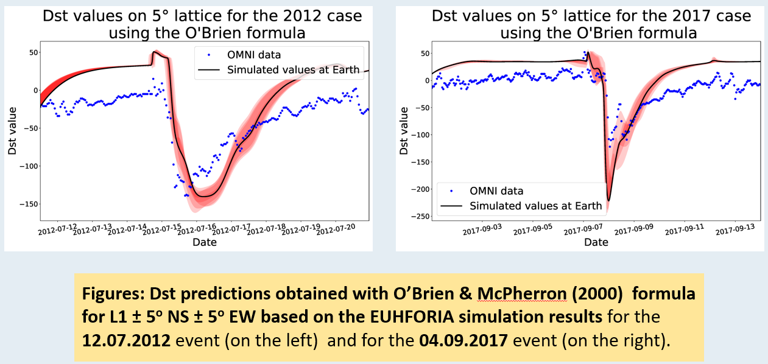
Dst predictions
<number>
Centre for mathematical Plasma Astrophysics
Top: Kp obtained with the Newell et al. (2008) formula for L1 ± 5º NS and L1 ± 5º EW.
Middle: Kp obtained with IRF-Kp model of Wintoft et al. (2017) for L1 ± 5º NS and L1 ± 5º EW.
Bottom: comparison of the two predictions with each other and with OMNI data.
Figures: Kp predictions based on the above EUHFORIA simulation results for the 12.07.2012 event (on the left) and for the 04.09.2017 event (on the right).
Notes:
<number>

Slide 36
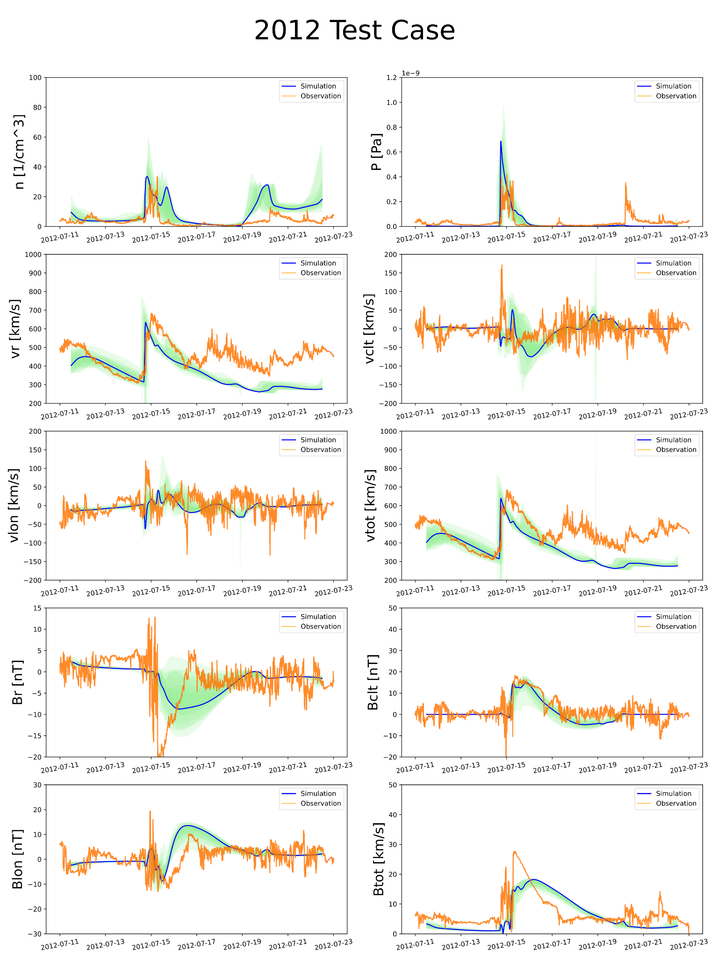
EUHFORIA with spheromak CME
<number>
Centre for mathematical Plasma Astrophysics
Notes:
<number>

Slide 37
Auroral Electrojet (AE, AL, AO, AU) indices
AE index is a proxy of the response of the ionosphere to the substorms which are quite stochastic and have high temporal variability. It is derived from geomagnetic variations in the horizontal component observed at selected (10-13) observatories along the auroral zone in the northern hemisphere.
AU and AL indices are, respectively, defined by the largest and the smallest (normalized) values selected from all the stations. The symbols, AU and AL, derive from the fact that these values form the upper and lower envelopes of the superposed plots of all the data from these stations as functions of UT.
The difference, AU - AL, defines the AE index, and the mean value of the AU and AL, i.e. (AU+AL)/2, defines the AO index.
The term "AE indices" is usually used to represent these four indices (AU, AL, AE and AO).
<number>
Maharana et al. (2024)
Centre for mathematical Plasma Astrophysics
Notes:
To normalize the data a base value for each station is first calculated for each month by averaging all the data from the station on the five international quietest days. This base value is subtracted from each value of one-minute data obtained at the station during that month.
The AU and AL indices are intended to express the strongest current intensity of the eastward and westward auroral electrojets, respectively. The AE index represents the overall activity of the electrojets, and the AO index provides a measure of the equivalent zonal current.
<number>

