Slide 1





Parametrization of SHARP Vector Magnetic Field Using Disentangled Representation Learning
Ekaterina Dineva¹, Giovanni Lapenta†, George Miloshevich¹, and Jasmina Magdalenić Zhukov¹
¹ KU Leuven, Centre for mathematical Plasma-Astrophysics

Slide 2
Motivation
The idea: Machine Learning (ML) forecasting framework, which combines human-made parameters and ML features.
Variational Autoencoders for feature extraction
  Study the potential of ML features for active region parametrization.
  How does it connect to dynamical changes associated with emergence (and redistribution) of surface magnetic flux?
  Use this information to identify features in the VAE-based dataset, which can indicate changes in the active regions' evolution and potentially eruptions.
Goal: Compare/combining empirical (human-made) parameters and ML features for active region classification and flare forecasting.

Slide 3
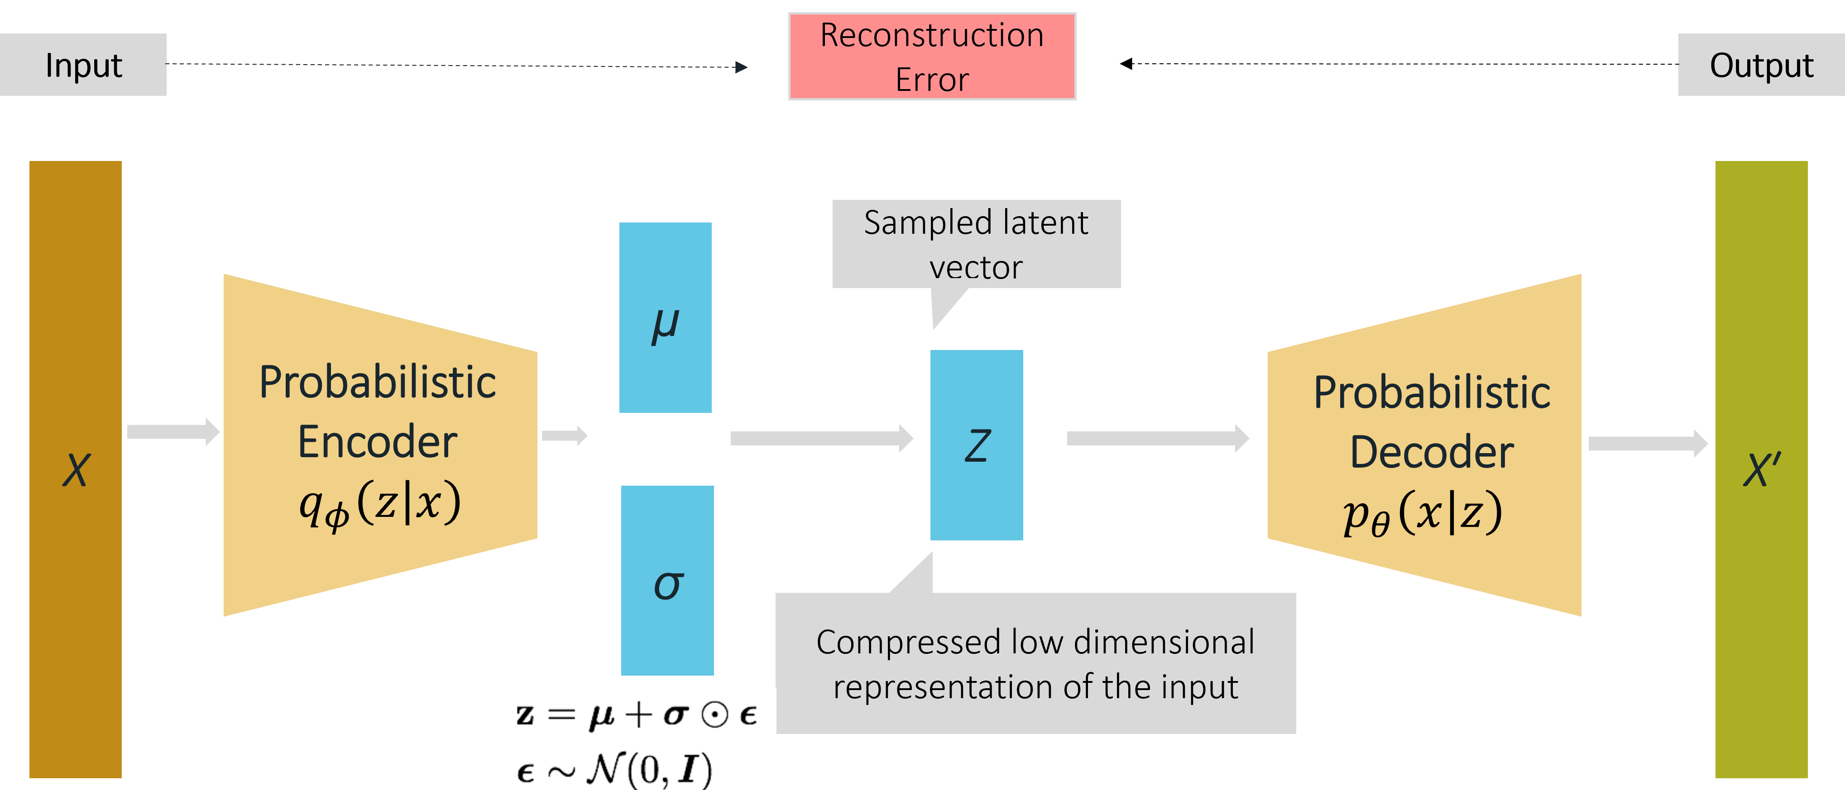
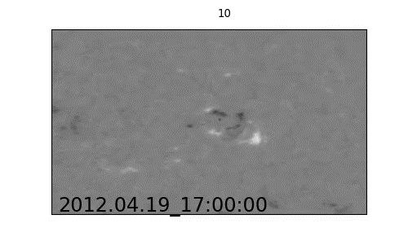
Variational Autoencoder
Reconstruction Loss + Latent Loss
VAE latent space aims to generalize the information contained in the input
VAE can be used to generate new information
Why VAE:
  Dimensionality reduction while keeping fundamental information about structure
  Latent space: ML features for active region parametrization
  Anomaly detection and pattern recognition

Slide 4
Variational Autoencoder
Reconstruction Loss + Latent Loss
VAE latent space aims to generalize the information contained in the input
VAE can be used to generate new information
Why VAE:
  Dimensionality reduction while keeping fundamental information about structure
  Latent space: ML features for active region parametrization
  Anomaly detection and pattern recognition
Disentangled representation: a single latent variable is sensitive to a specific data generative factor
β-VAE: an implementation of the VAE framework that employs an adjustable hyperparameter β
β > 1 results in more disentangled latent representation
Reconstruction Loss
Latent Loss

Slide 5
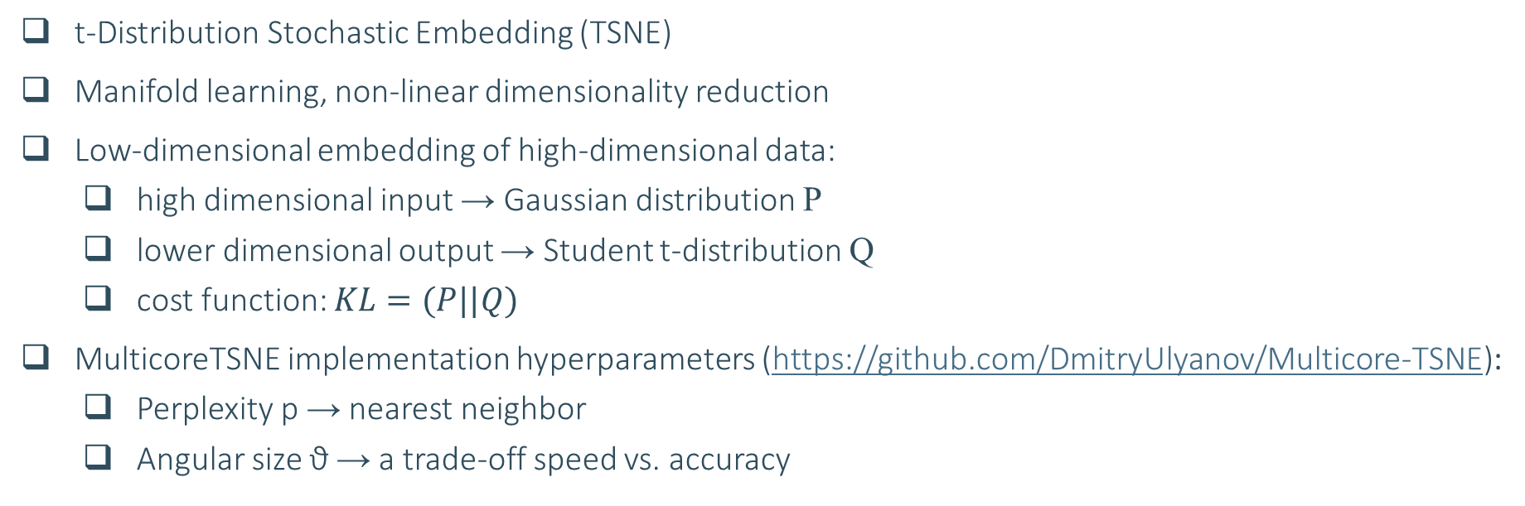
Machine Learning Algorithms TSNE
t-Distribution Stochastic Embedding (TSNE)
Manifold learning, non-linear dimensionality reduction
Low-dimensional embedding of high-dimensional data:
  high dimensional input → Gaussian distribution P
  lower dimensional output → Student t-distribution Q
  cost function: $KL=(P||Q)$
MulticoreTSNE implementation hyperparameters (https://github.com/DmitryUlyanov/Multicore-TSNE):
    Perplexity p → nearest neighbor
    Angular size ϑ → a trade-off speed vs. accuracy

Slide 6
Empirical Parameters
Based on SDO Helioseismic and Magnetic Imager (HMI) LOS magnetograms and intensity full-disk images.
Cadence: 12 minutes
HMI Active Region Patch (HARP): automatic detection based on strong filed concentration
May contain multiple NOAA active regions
SHARP datasets:
  Segments: magnetic flux, intensity, Doppler
  16+ empirical parameters
Two types of datasets:
  Near-real-time (NRT) SHARP data ≈ 3h
  Definitive SHARP data ≈ 5 weeks (is what we are using)
Bobra et al., 2014, Solar Phys 289

Slide 7
Results: How does disentanglement manifests?
VAE latent variables
Classification
SHARP VMF map

Slide 8
Data Preparation and Reconstruction
Dataset:
  44 HARPs and 54 NOAA active regions
  Total images: 49 900+
  Solar Cycle 24: 2010 – 2019 year
Segment: CEA VMF B_{r} maps
Cut-off at +/- 2000 G
Converted to gray-scale images
Images are normalized (0,1) before passing to the NN
Excluded images: solar-limb observations (corrupted images)
Resized: 128 x 256 pix
Dataset split: 50/50
Final dataset: 8-dimensional latent vector per image

Slide 9
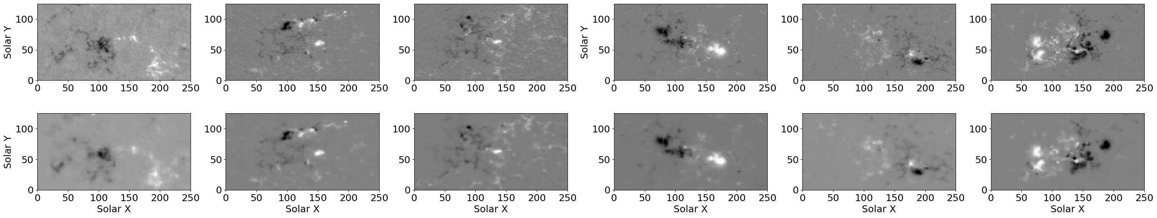
Data Preparation and Reconstruction
Dataset:
  44 HARPs and 54 NOAA active regions
  Total images: 49 900+
  Solar Cycle 24: 2010 – 2019 year
Segment: CEA VMF B_{r} maps
Cut-off at +/- 2000 G
Converted to gray-scale images
Images are normalized (0,1) before passing to the NN
Excluded images: solar-limb observations (corrupted images)
Resized: 128 x 256 pix
Dataset split: 50/50
Final dataset: 8-dimensional latent vector per image

Slide 10
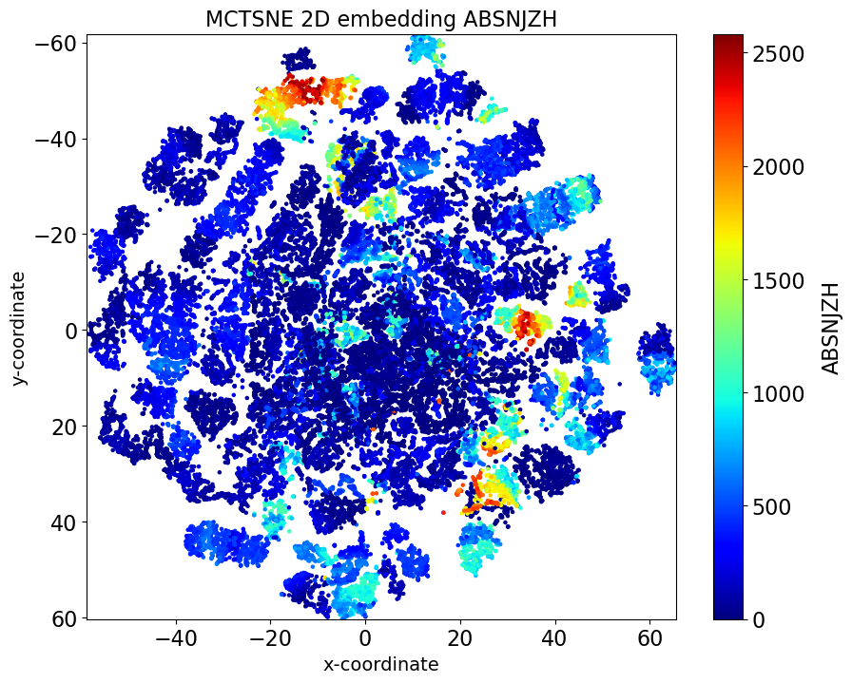
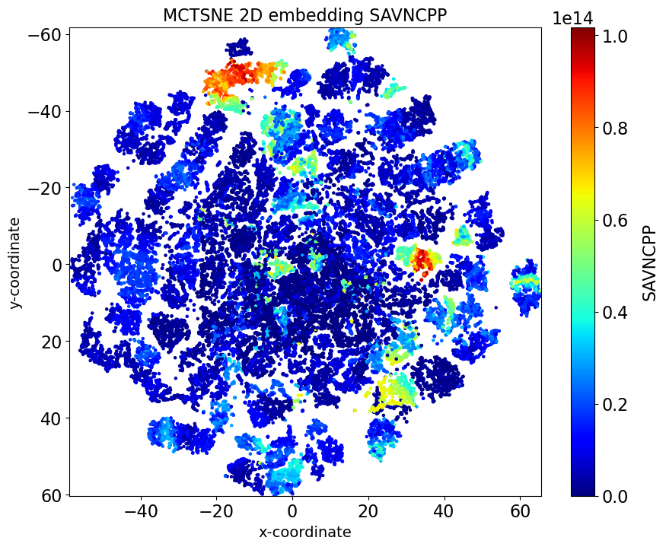
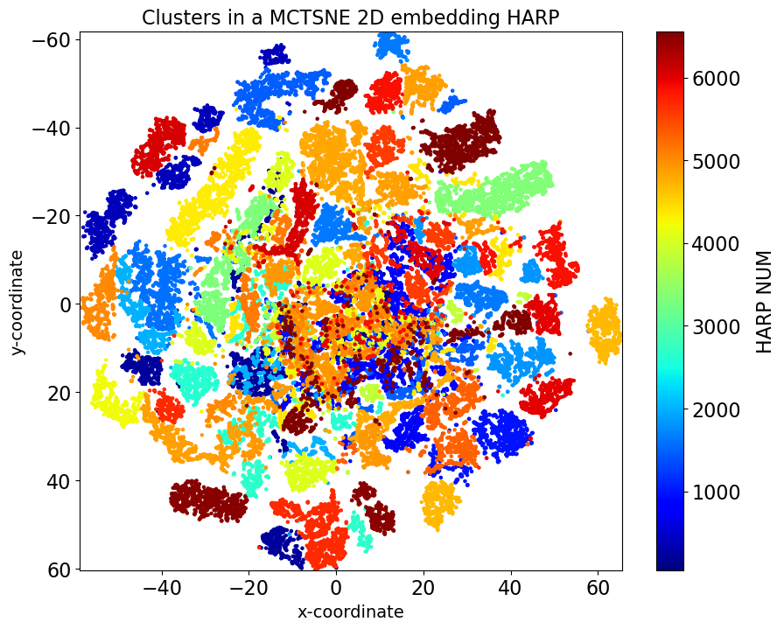
MulticoreTSNE: Exploring the VAE Features
ABSNJZH → Absolute value of the net current helicity [G²/m]
SAVNCPP → Sum of the absolute value of the net currents per polarity [A]
HARP number

Slide 11
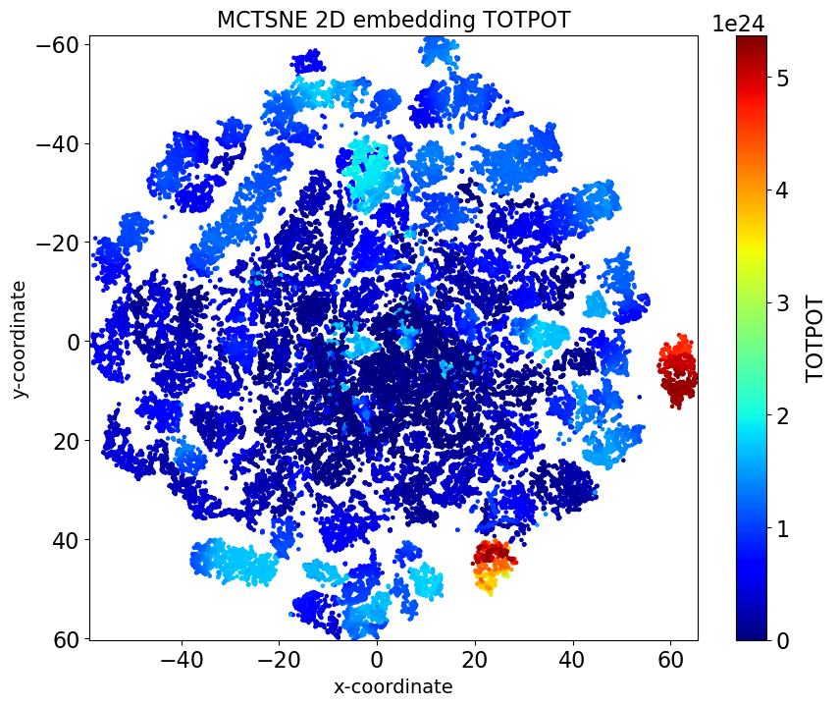
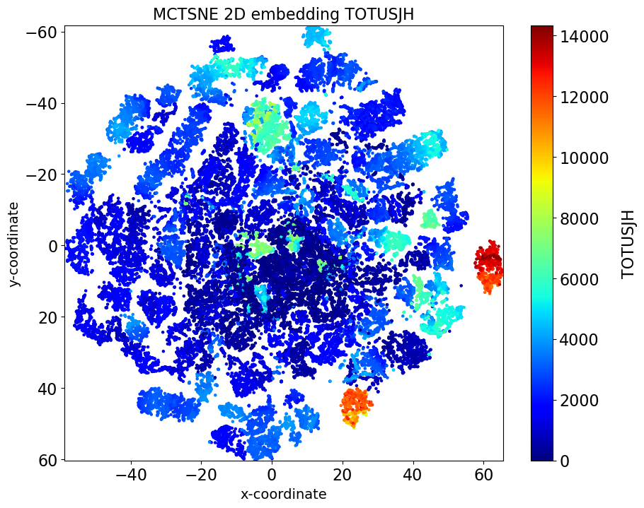
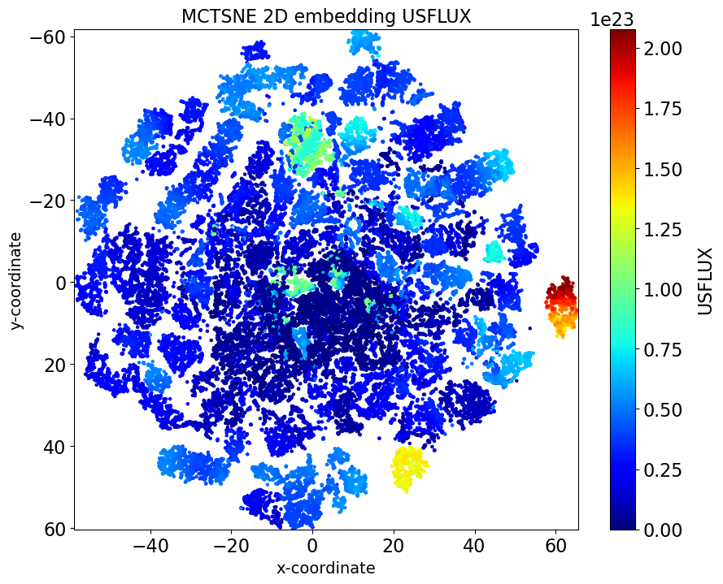
MulticoreTSNE: Exploring the VAE Features
TOTPOT → Total photospheric magnetic energy density [ergs/cm³]
TOTUSJH → Total unsigned current helicity [G²/m]
USFLUX → Total unsigned flux [Mx]

Slide 12
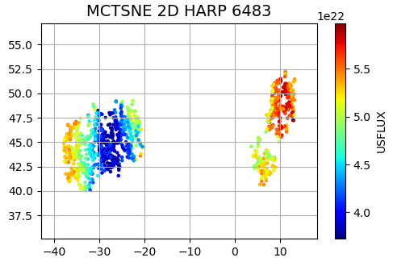
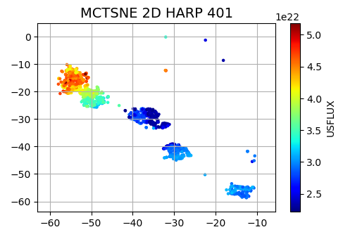
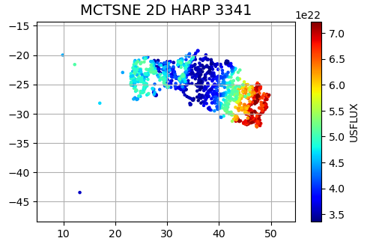
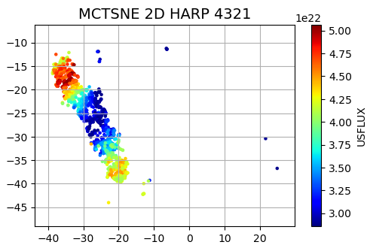
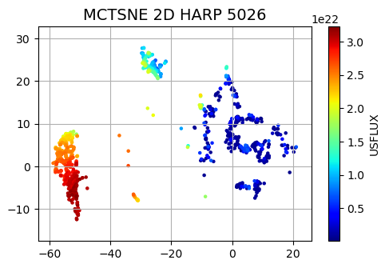
MulticoreTSNE: Exploring the VAE Features
Where are the individual HARP active regions in the TSNE embedding?
Color-coded according to total unsigned flux (USFLUX)

Slide 13
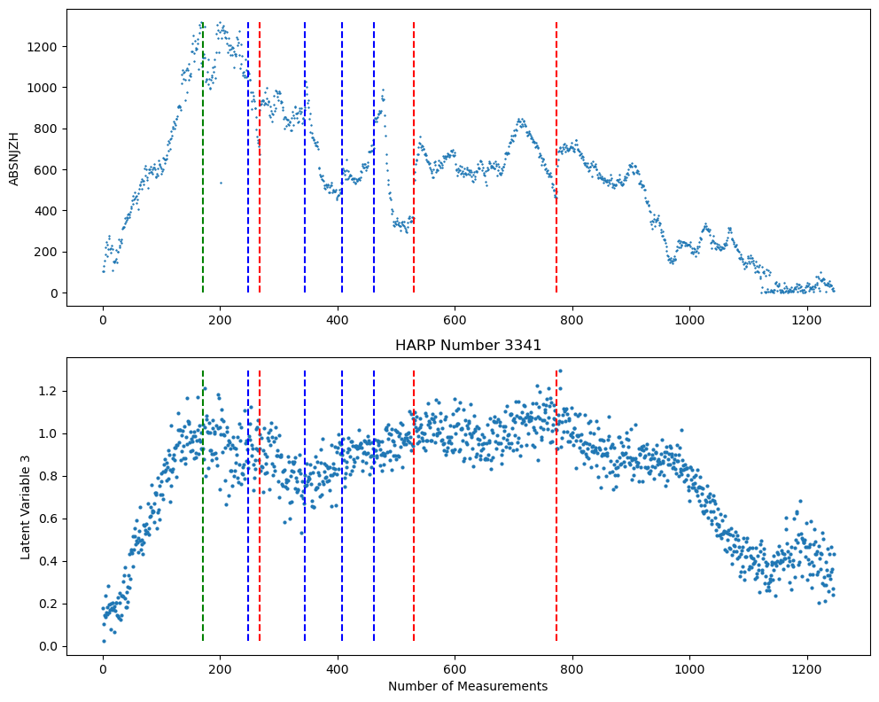
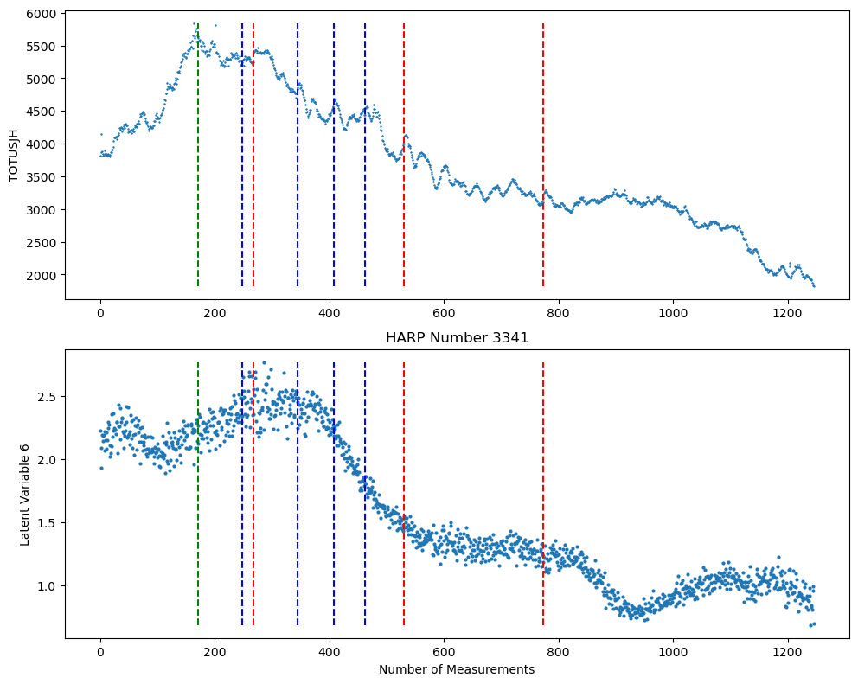
Exploring the VAE Features: HARP 3341 aka NOAA 11890
ABSNJZH → Absolute value of the net current helicity [G²/m]
TOTUSJH → Total unsigned current helicity [G²/m]

Slide 14
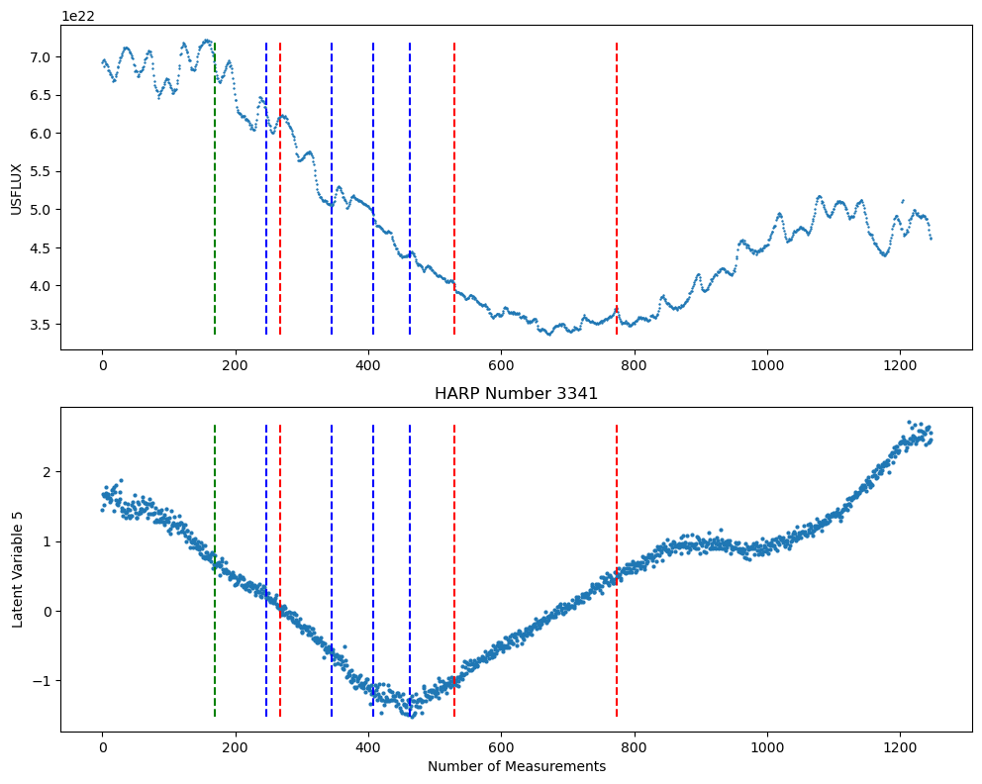
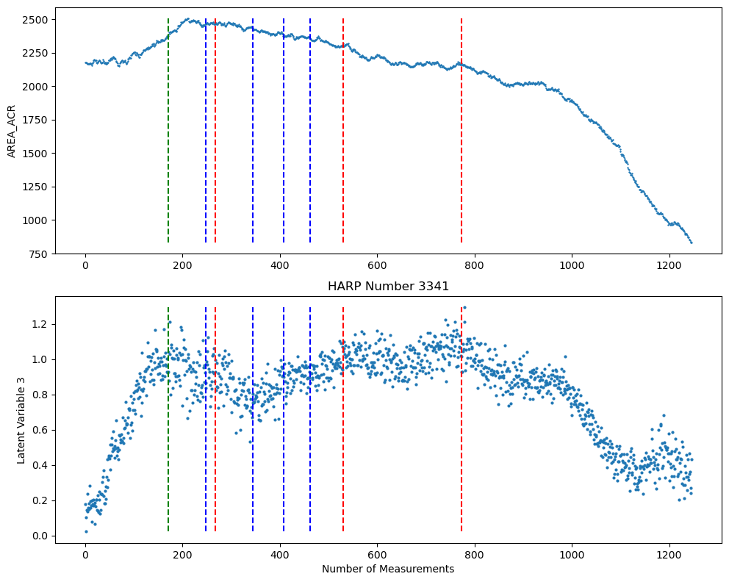
Exploring the VAE Features : HARP 3341 aka NOAA 11890
USFLUX → Total unsigned flux [Mx]
AREA_ACR → Area of strong field pixels in the active region

Slide 15
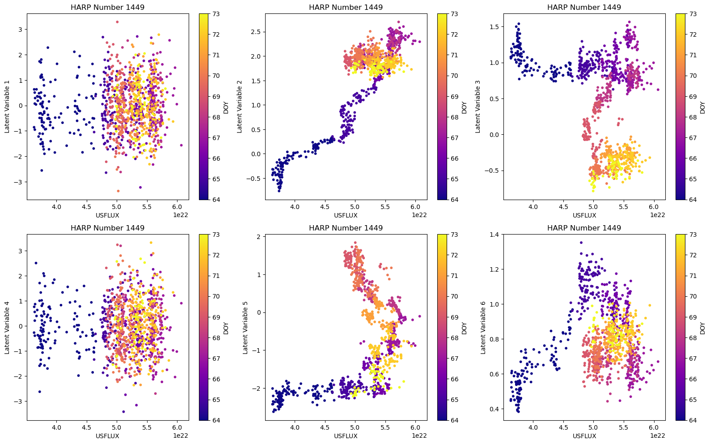
ML Features vs. SHARP Parameters
HARP 3341 aka NOAA 11890
Total unsigned flux (USFLUX) – magnetic complexity indicator
Not all latent variables carry “relatable” information
Although some linearity exists, the relation between physical parameters and ML-features appear more complicated
Pro: have a potential to bring additional information to forecasting schemes involving human-made and ML features

Slide 16
Takeaway and Future work
Successful parametrization of SHARP B_{r} maps using VAE ML features, which describe the morphological evolution of the HARP active regions.
Some of the ML features show similar evolution to the SHARP parameters.
The non-linear relation between empirical and ML-based parameters has a potential to facilitate a joined analysis and space weather forecasting schemes.
Future work
  Statistical exploration of the ML features with respect to the AR evolutionary stages
  Supervised forecasting models with VAE as part of AI system
  Add more information to the parametrization (AARP AIA 1600 Å dataset: Dissauer et al. 2022)

Slide 17
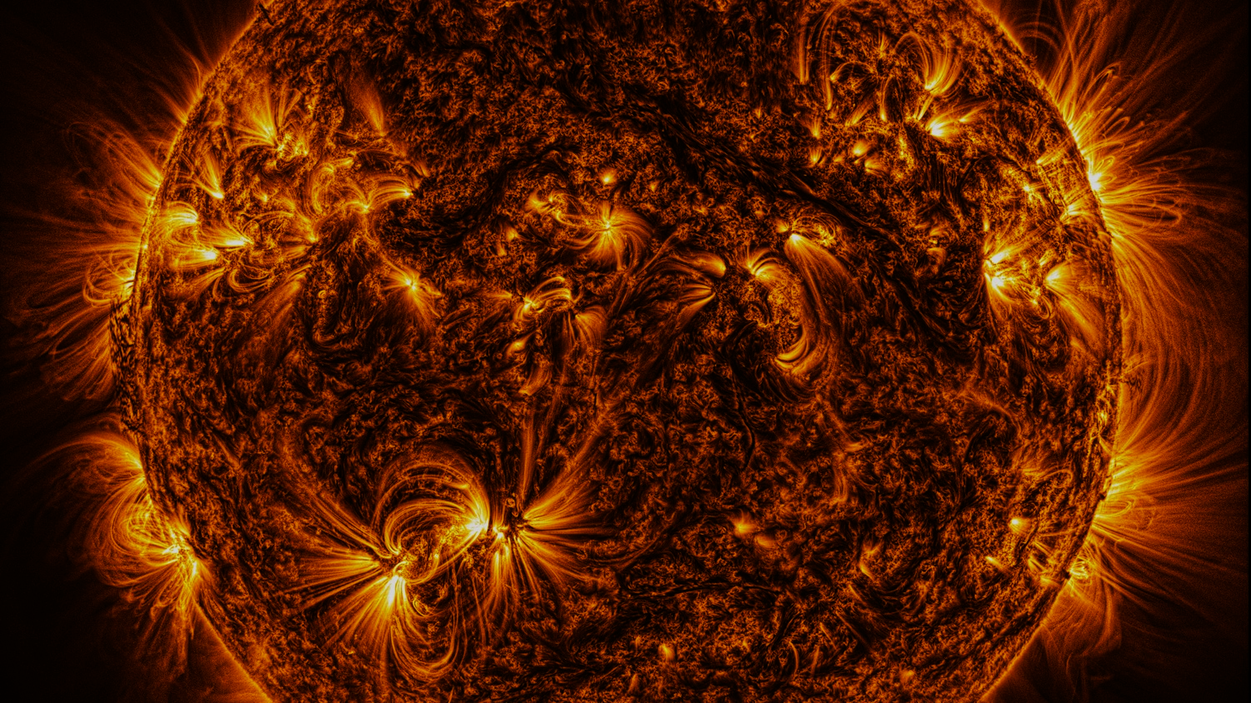
Thank you for your attention!
© NASA/SDO/A. Diercke

