Slide 1
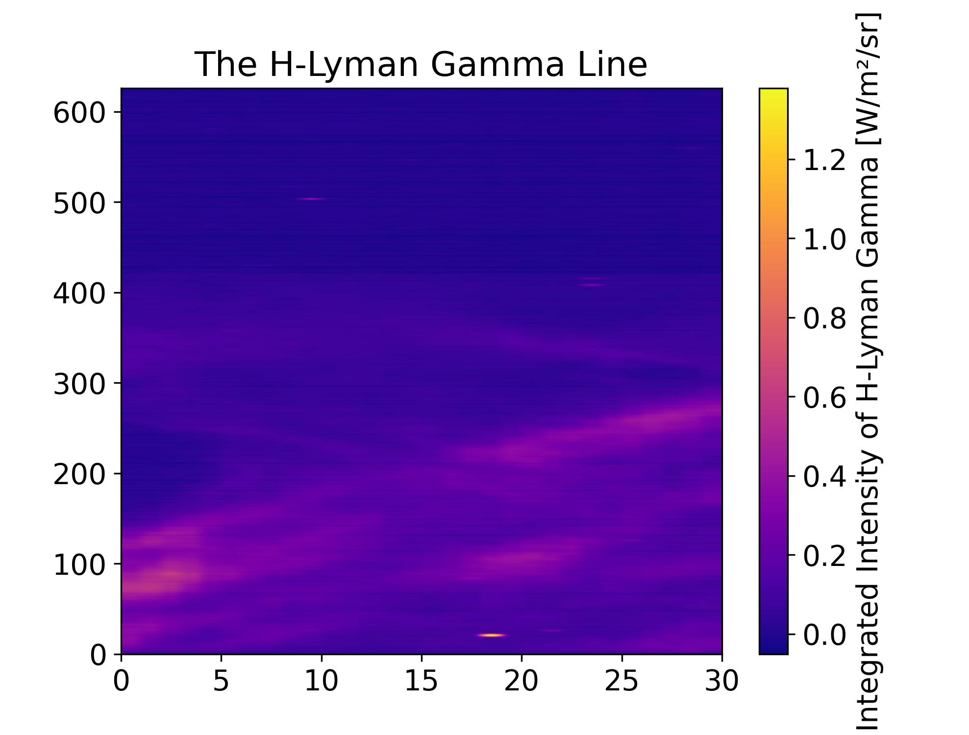
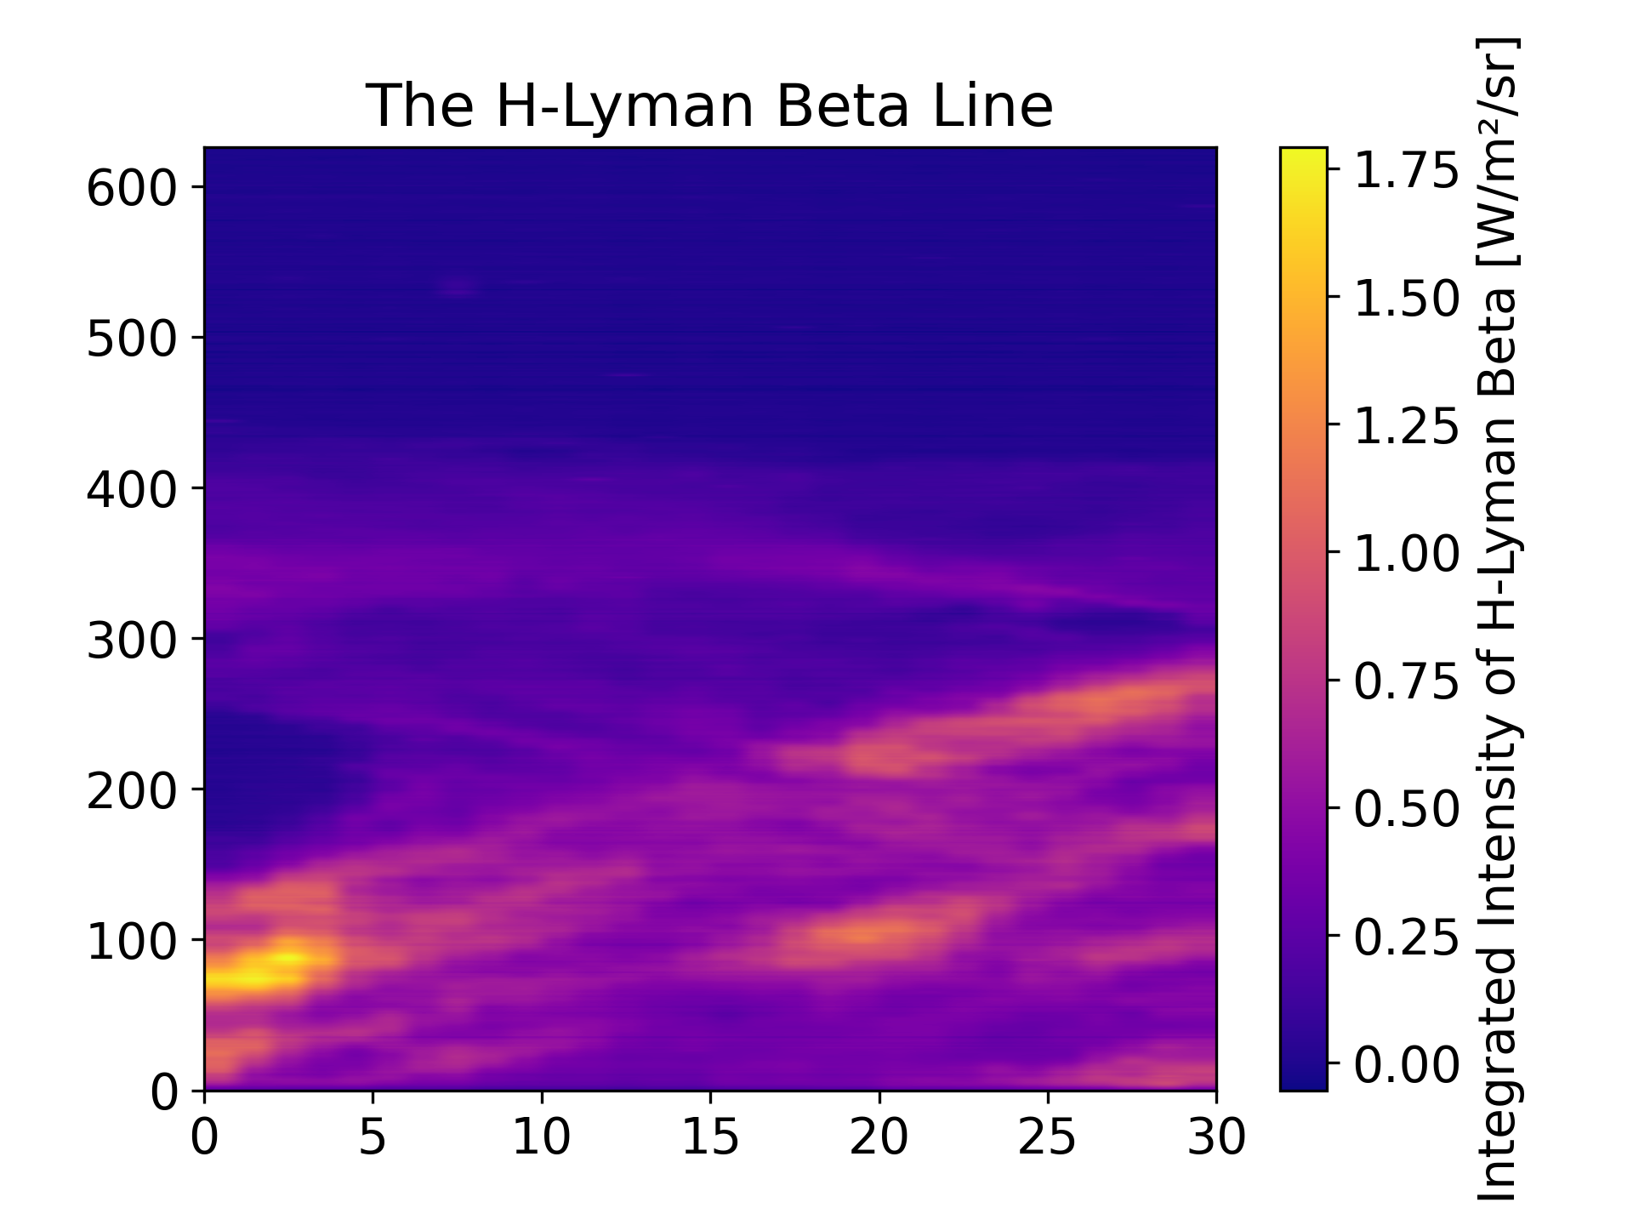
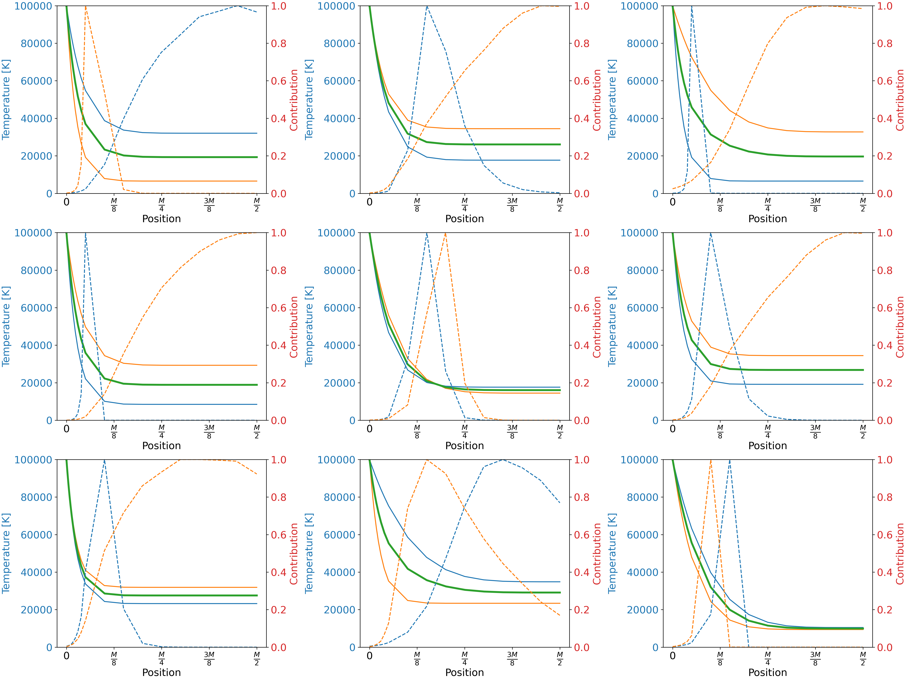
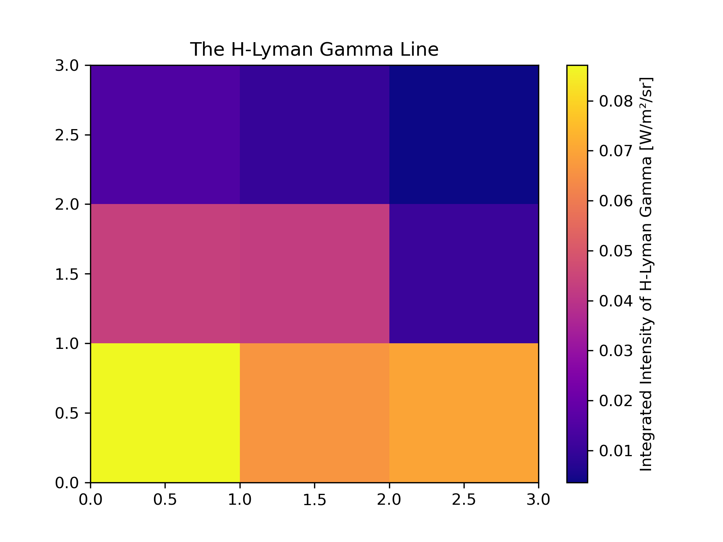
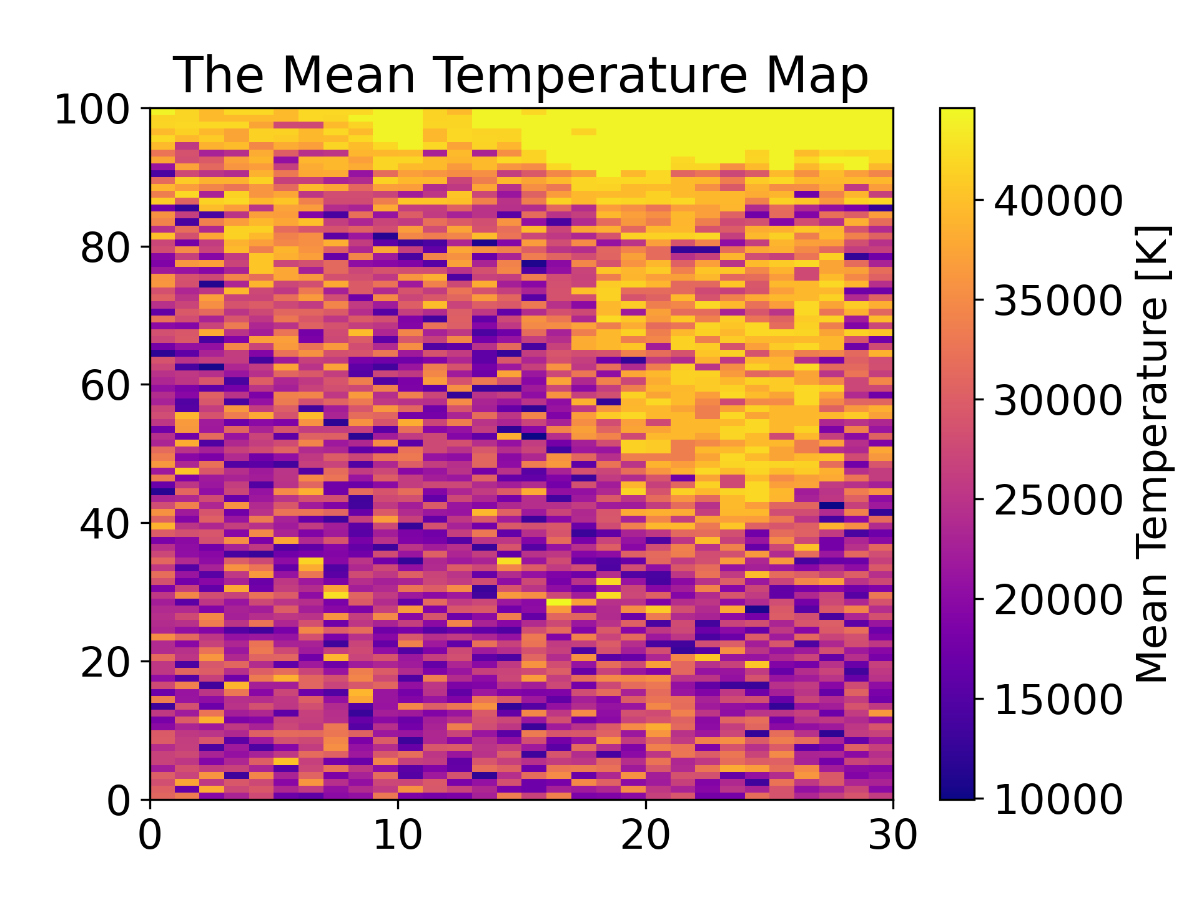
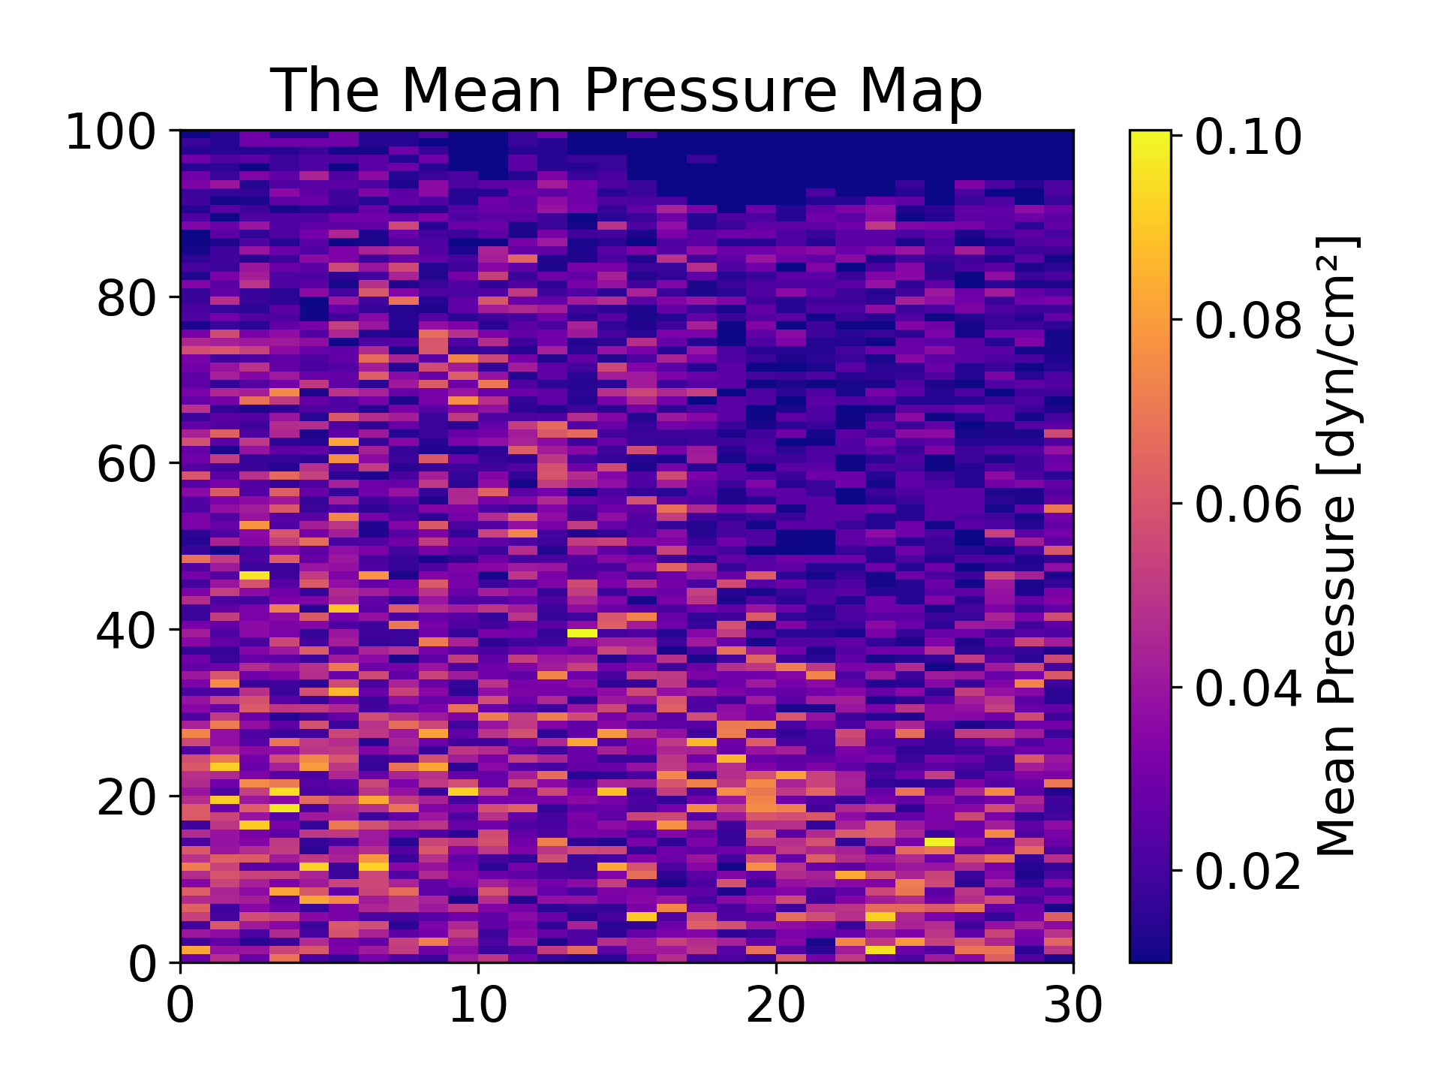
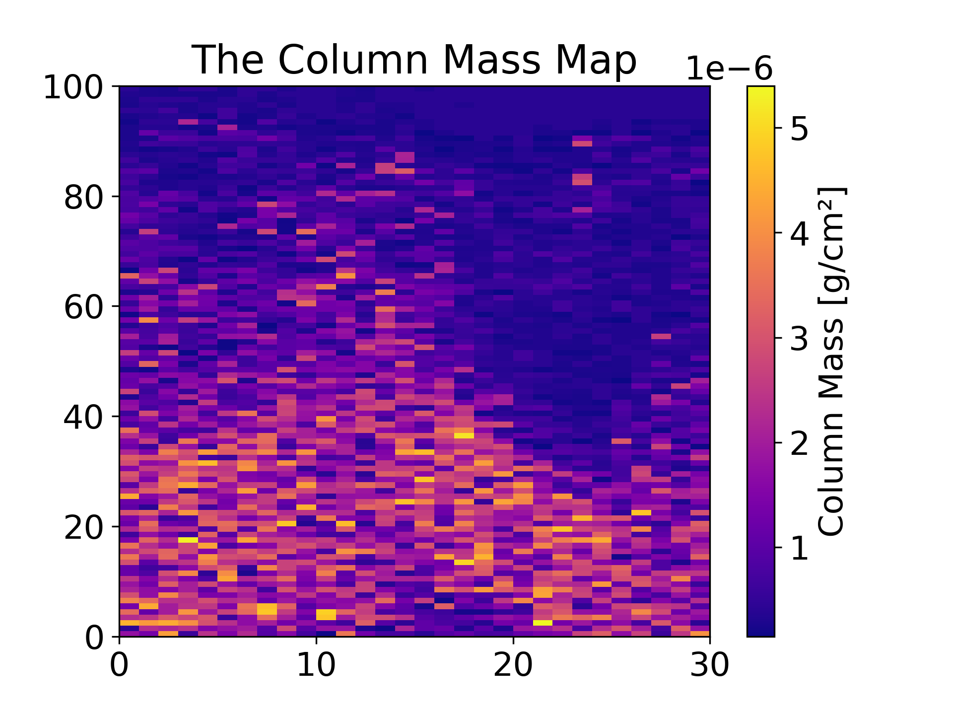
Parameters’ Maps Generated by H Ly-$β$ and H Ly-$γ$ Lines from SPICE Data and Non-LTE Modeling
Yong Zhang⁽¹⁾, Nicolas Labrosse⁽¹⁾, Susanna Parenti⁽²⁾, Therese Kucera⁽³⁾
(1) University of Glasgow; (2) Université Paris Saclay; (3) NASA Goddard Space Flight Center
Introduction
Objective: generating parameters’ maps (pixel level) by SPICE data (DOI:10.48326/idoc.medoc.spice.4.0) acquired from a first dedicated observation of off-limb solar prominence by SPICE on 7~8 UT, April 15th, 2023 (Fig. 1).
Fig. 1: Limb prominence observed by SPICE on 15 April 2023. The red rectangle indicates the prominence pixels analyzed in this work.
To interpret the data, we use 1D prominence slab model [1, 2, 3]. Free parameters include central & surface temperature, central & surface pressure, $γ$ (indicating the steepness of the temperature profile), column mass, microturbulent velocity, altitude, and radial velocity of the moving prominence.
Method
As a first approach, we divide the intensity map of Ly-$β$ and Ly-$γ$ into 9 regions inside the prominence. For each region, the intensity is the mean of that region (Fig. 2).
Fig. 3: Temperature profiles for the 9 pixels shown in Fig. 2. Contribution functions for Ly-$β$ and Ly-$γ$ are also shown.
Result
By the method mentioned above, we find the best model for all pixels. By information from those models, we generate parameters’ maps for three parameters that are most related to the intensity of Ly-$β$ and Ly-$γ$lines: Temperature, pressure, and column mass (Fig. 4).
Fig. 2: Intensity map in prominence region initially divided in 9 pixels to develop our method.
We generate 1000 random models based on our estimate of parameters’ ranges.
Our procedure to obtain the best model which has the closest intensity with both Ly-$β$ and Ly-$γ$ lines is:
1. For each pixel, we find model A and model B. Model A is the model that has the closest H Ly-$β$ intensity with observation among the 1000 random models. Model B is the model that has the closest H Ly-$γ$ intensity with observation among the 1000 random models;
$2$. The new temperature (pressure) profiles are obtained by taking a linear combination of $T_{A}$ and $T_{B}$ ($p_{A}$ and $p_{B}$), where the coefficient is determined by how the contribution function of Ly-$β$ and Ly-$γ$ lines vary inside the prominence slab;
3. In practice, we find that taking the average of $T_{A}$ and $T_{B}$ ($p_{A}$ and $p_{B}$) works well for most positions to give a good agreement between computed and observed intensity simultaneously for both Ly-$β$ and Ly-$γ$ lines;
4. We ensure a monotonic variation for the new temperature (pressure) profiles inside the prominence slab.
Figure 3 shows the results.
Fig. 4: Parameters map in the prominence region shown in Fig. 1 for mean temperature, mean pressure, and column mass.
Conclusion
This is a new method to identify parameters of solar prominence in pixel level by SPICE data, which could be applied easily to future SPICE prominence observations. This approach can be extended by using a larger number of models and comparing models and data for other lines.
References
[1] Labrosse, N., Gouttebroze, P., & Vial, J. C. (2007). A&A 463(3): 1171-1179.
[2] Labrosse, N. et al. (2008). Ann. Geophys. 26: 2961-2965.
[3] Labrosse, N., & McGlinchey, K. (2012). A&A 537.

