Slide 1


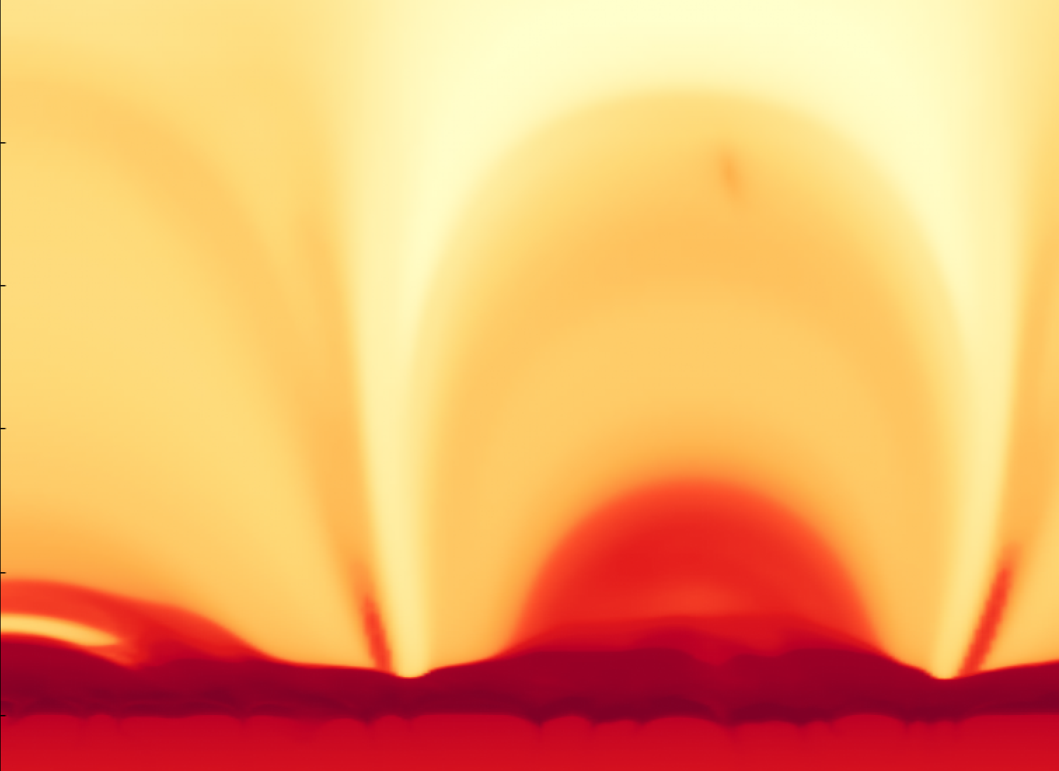


Implementation of thermal conduction energy transfer models in the Bifrost code
George Cherry,
Mikolaj Szydlarski, Boris Gudiksen
georgche@uio.no
georgche@astro.uio.no
Notes:
Slide 1: (30 seconds)
Hello, it’s lovely to be here talking today. My name is George Cherry, I am a PhD student at the Rosseland Centre for Solar physics in Oslo, and I work with our simulations code Bifrost. Today I want to talk about our thermal conductivity in the upper solar atmosphere and what is important to consider when choosing how to calculate this term in different simulations

Slide 2


Thermal conductivity
$$\frac{∂e}{∂t}=…−∇_{∥}⋅q$$
$$q=−κ_{0}T^{5/2} ∇_{∥}T$$
Notes:
Slide 2: (30 sec) Thermal conductivity is an important heat transfer mechanismfor the chromosphere and corona, and is embodied as an additional term in the energy equation, through the divergence of the heat flux.
Bifrost assumes Spitzer conductivity, which takes the heat flux parallel to the magnetic field, and therefore the conduction term acts as a non-linear diffusion equation, dependent on the temperature.

Slide 3
Methods
Notes:
Slide 3: (10 seconds) Bifrost has 3 methods of solving Thermal conductivity.

Slide 4



Numerical methods
The explicit method
$$\frac{∂e\left[i,n\right]}{∂t}=\frac{e\left[i,n\right]−e\left[i,n−1\right]}{Δt}$$
$$∇q\left[i,n\right]=\frac{q\left[i,n\right]−q\left[i−1,n\right]}{Δx}$$
$$C∝Δx^{2}$$
Notes:
Slide 4: (30 seconds) The first is an explicit Euler method. This is a computationally fast calculation with a good degree of accuracy, but the second-order derivatives, mean the courant condition will scale with the square of the spatial step. So there is a strict limit on the time-step.

Slide 5

Numerical methods
The implicit method
Calculate explicit heat flux
$$\frac{e^{∗}−e[n] }{Δt}=∇_{∥}⋅q[n]$$
Notes:
Slide 5-8: (30 seconds) The second method is an implicit solver, which is unconditionally stable and so a much larger range in time-steps available. First the explicit heat flux is used to approximate the new energy term.

Slide 6

Numerical methods
The implicit method
Calculate explicit heat flux
Approximate energy
$$\frac{e\left[n+1\right]−e^{∗}}{Δt}=∇_{∥}⋅q[n]$$
Notes:
This acts an intermediate time-step, e star, and is used as the source term for the implicit calculation.

Slide 7

Numerical methods
The implicit method
Calculate explicit heat flux
Approximate energy
Implicit scheme (Crank-Nicholson)
$$\frac{e\left[n+1\right]−e^{∗}}{Δt}=θ∇_{∥}⋅q\left[n+1\right]+\left(1−θ\right)∇_{∥}⋅q[n]$$
Notes:
Then a Crank-Nicholson scheme relaxes the approximation to a converged solution. Here theta is a weighting between the explicit and implicit parts of the method.

Slide 8

Numerical methods
The implicit method
Calculate explicit heat flux
Approximate energy
Implicit scheme (Crank-Nicholson)
Multi-grid inversion
$$\frac{e\left[n+1\right]−e^{∗}}{Δt}=θ∇_{∥}⋅q\left[n+1\right]+\left(1−θ\right)∇_{∥}⋅q[n]$$
Notes:
To accelerate the convergence, a multi-grid solver is also implemented.

Slide 9
Numerical methods
The implicit method
Multi-grid inversion of non-linear problem $u=L^{−1}f$
Grid size N³
Grid size (0.5 N)³
Grid size (0.25 N)³
Grid size (0.125 N)³
Notes:
Slide 9: (45 seconds) The multi-grid takes the original approximation, and performs corrections on a series of coarser grids before making its way back to the original resolution.
Each individual level and the full cycle can be repeated, until the solution is appropriately converged.
At the coarsest grid size, the calculations happen on only one core and this can become computationally expensive with complex parallelization.
(3 minutes 30)

Slide 10



Numerical methods
The wave method
$$\frac{∂q}{∂t}=\frac{1}{τ}\left.\left(−\frac{q^{∗}}{f_{sat}}−q\right.\right)$$
$$f_{sat}=1+\frac{\left|q^{∗}\right|}{1.5ρC_{s}^{3}}$$
$$τ={\left.\left( f_{CFL}\frac{Δx_{min}}{Δt}−\left|v\right|\right.\right)}^{−2}\frac{f_{sat}κ_{0}T^{\frac{7}{2}}}{e}$$
Rempel 2016
Notes:
Slide 10 (1 minute):
The final method is a hyperbolic approximation, following the equations set out in Rempel 2016. It is an explicit method that converges to the spitzer equation in time. Due to the wave-like nature of the solutions, it is more robust to instability and has a similar time-step range as the implicit method.
Tau sets the rate of convergence, which scales with the time-step squared. The Courant condition now scales with 1/dt, so although lower dt means a shorter convergence time, it also leads to instability.
The saturation factor fsat included here *point* lengthens the convergence time, but increases the stability of the method for larger time-steps.

Slide 11
Testing
Notes:
Slide 11: (2 seconds)

Slide 12


The self-similar test
Analytical 1st order approximation by Furuseth et al. (2024)
(See poster 187 topic 5)
Density: ${10}^{−15}$ g cm⁻²
Magnetic field: 0.316 $\hat{x}$ G
Velocities: u = 0 m s⁻¹
Background temp: ${10}^{4}$ K
Notes:
Slide 12: (45 seconds) In order to test the robustness of these methods, we analyse the thermal diffusion of an initial Gaussian temperature profile in coronal conditions, with background temperature 10^4 Kelvin.
This can be compared to a self-similar approximation for the long-term diffusion of a point source with the same total quantity. The 1st order analytical solution deviates from the physical solution at the feet, so we focus on the solutions around the peak. If you are interested in the equations, I am presenting this in the poster sessions.
Tot: 5 mins 15

Slide 13
Results
Notes:
Slide 13: (2 seconds)

Slide 14

Accuracy
Relative error $=\frac{T_{n}−T_{a}}{T_{a}}$
Notes:
Slide 14: (10 seconds) Here we see the relative error for the first three seconds of the simulation. We tested each methods with both constant and adaptive time-stepping.

Slide 15
Accuracy
Notes:
Slide 15: (10 seconds) The explicit method converges quickly towards the solution, with most of the work being done in the 1st second.

Slide 16
Accuracy
Constant dt
Adaptive dt
Fig 2: The average relative error around the peak (T > 10⁵ K) for various set ups.
Notes:
Slide 16: (10 seconds) The unsaturated wave method for constant dt behaves almost identically to the explicit method. This is not replicated in the variable dt case, where it struggles with much greater deviance from the solution.

Slide 17
Accuracy
Constant dt
Adaptive dt
Notes:
Slide 17: (15 seconds) The wave method performs similarly for both constant and adaptive time-stepping. There are high frequency waves in the adaptive method, but it is robust enough to handle them. Both the wave method..
Tot: 6 minutes (?)

Slide 18
Accuracy
Implicit
Explicit
Notes:
Slide 18: (10 seconds) ...and the implicit method lag behind the analytical solution initially.

Slide 19
Accuracy
Notes:
Slide 19: (10 seconds) If we compare the performances of these methods, the implicit method seems to perform better here…

Slide 20
Accuracy
Notes:
Slide 20: (20 seconds) … but in the long run this error continues to builds up, whilst the wave method converges to the analytical solution.
This is a buildup of approximation errors within the multigrid solver and the choice of iterations for each level. However, we can see that the buildup is only small so only becomes significant in longer-running simulations.
7 minutes (pause)

Slide 21
Time-stepping
Notes:
Slide 21 (30 seconds):
In the first three seconds of the adaptive time-step runs, both the implicit and wave methods have reached time steps up to an order higher than the explicit method.
We can see that the wave method is much more sensitive in the control of dt because it must control the initial waviness of the solution, before increasing the time-step. Within Bifrost we can use localized diffusivity (known as hyperdiffusion) to aid this control.

Slide 22

Time-stepping
$$\frac{1}{τ}∝\frac{1}{Δt^{2}}$$
Notes:
Slide 22 (15 seconds ): Hyperdiffusion also allows us to reach lower starting timesteps, which should help the method to converge faster due to tau's dependence on dt.
Tot: 7 min 45

Slide 23
Time-stepping
Notes:
Slide 23 (20 seconds): Without hyper-diffusion we can only start the simulation at a time-step of at least 10^-4 seconds. The method is more unstable for smaller dt and tries to recover stability by keeping the time-step lower, which creates the two dips seen in the time-step evolution.

Slide 24
Time-stepping
Notes:
Slide 24 (10 seconds): In the hyper-diffusive case, the second dip in timestep is completely avoided and the relative error also decreases quicker in the long-term, showing faster convergence.
Tot: 8 minutes 15

Slide 25
Time-stepping
Notes:
Slide 25 (10 seconds): The run starting with the lowest time-step, 10^-5 seconds, gives the best results both in terms of relative error, and time-stepping.

Slide 26
Performance
Notes:
Slide 26 (5 seconds):
We looked at the performance for each method at two points in time.

Slide 27
Performance
t = 1.6 seconds
Notes:
Slide 27 (30 seconds): At 1.6 seconds, the wave time-step finally overtakes the implicit time-step. We can see that, the implicit simulations, in pink, have run for less iterations, but are still almost twice as computationally expensive as the wave runs in blue and yellow.

Slide 28
Performance
t = 3.0 seconds
Notes:
Slide 28 (1 minute): Later on at 3 seconds, the wave method still wins computationally, as expected, but now we start to see the sensitivity of the method to different set-ups.
In yellow we have the wave method with hyperdiffusion applied. The run starting the timestep at 10^-4 seconds runs faster and has less iterations than the same run without hyperdiffusion in blue. This is because the method reaches longer time-steps in a shorter period of time.
But if we look at the run starting the timestep at with 10^-5 seconds, it produces so many iterations to begin with that it counteracts the speed at which the method reaches higher time-steps so it becomes computationally slower.
There is also some play-off between computation speed, and accuracy.

Slide 29
Performance
t = 3.0 seconds
Notes:
Slide 29 (30 seconds):
Let’s focus on two wave runs. In blue is the wave run starting at timestep 0.5 milliseconds and in yellow starting at timestep 0.1 milliseconds, We can see that the blue run is computationally faster than the yellow run, so is superior for speed.
But in terms of relative error at this time…

Slide 30
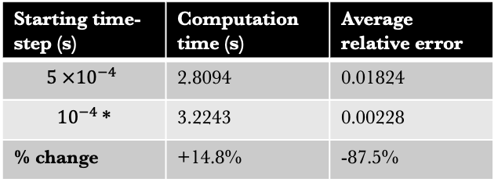
Performance
At 3.0 simulated seconds:
Starting time-step (s) | Computation time (s) | Average relative error
$5 ×{10}^{−4}$ | 2.8094 | 0.01824
${10}^{−4}$* | 3.2243 | 0.00228
% change | +14.8% | -87.5%
Notes:
Slide 30 (15 seconds): … the yellow run is by far superior. We can calculate that, for a nearly 15 % increase in computation time, we gain an 87.5% reduction in the average relative error. So the optimal set up may change dependent on the priorities of the simulation.

Slide 31

Conclusions
Pure thermal testing to find extreme limits of the methods
Notes:
Slide 31 (1 minute 30):
We used this pure thermal test to find the extreme limits of each method, and to understand how the behaviour of each one might influence a more complex simulation.
The inclusion of more physics is likely to create natural stabilisers for these methods, such that conditions for stability become less strict.

Slide 32
Conclusions
Pure thermal testing to find extreme limits of the methods
Optimise the wave method with initial dt
Notes:
The wave method is by far superior for longer simulations. We have shown it can be optimised for either accuracy or efficiency.

Slide 33
Conclusions
Pure thermal testing to find extreme limits of the methods
Optimise the wave method with initial dt
Wave method superior except for…
  Small dt
  Short simulations and dependent quantities
Notes:
There are two disadvantages to this method:
Firstly that the code becomes unstable for smaller time-steps, which can be useful when starting or restarting a simulation.
Secondly that the accuracy of the wave method can be poor for a significant period of time initially, which can have knock-on effects to other processes in the simulation.

Slide 34
Conclusions
Pure thermal testing to find extreme limits of the methods
Optimise the wave method with initial dt
Wave method superior except for…
  Small dt
  Short simulations and dependent quantities
… instead use explicit (1) or implicit (2)
Notes:
The explicit method makes a good alternative for the first problem, and the implicit method can be used for the second, but currently there is no way to switch between different methods in one simulation.
With more complexity, the computation time from the implicit multigrid is also likely to be much higher, because of the need for more iterations within each level.

Slide 35
Conclusions
Pure thermal testing to find extreme limits of the methods
Optimise the wave method with initial dt
Wave method superior except for…
  Small dt
  Short simulations and dependent quantities
… instead use explicit (1) or implicit (2)
Room for development of new method
Notes:
This leaves opportunity for a new method as a better alternative for short and complex simulations.

Slide 36
Any Questions?
George Cherry,
Mikolaj Szydlarski, Boris Gudiksen
georgche@uio.no
georgche@astro.uio.no

