Slide 1
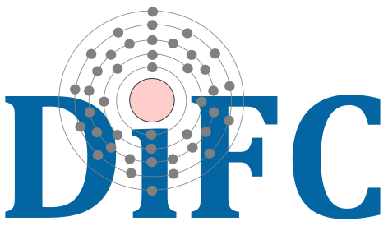
MHD Modelling of nanojets in coronal loops
09/09/2024
ESPM-17
Paolo Pagano & Gabriele Cozzo
Università degli Studi di Palermo
C. Argiroffi, F. Reale, A. Petralia, P. Testa, P. Antolin, J. Martinez-Sykora, B. De Pontieu
Notes:
Slide1: hello everyone! Thanks for attending this online seminar. I hope that this new format will work out, but I also hope that we can drop it as soon as possible.
Today I wold like to introduce you a research that we have carried out with Patrick and strangely a group of people all from Palermo. The topic of this research is to explain some jet-like features observed in a coronal rain complex and whether these can be he dynamic counter part of nanoflare heating events. In this presentation, of course, I will mostly focus on the modelling of these events, after a short introduction about observations and in the following part I will address specifically the asymmetric properties of the jets and how can they be explained.

Slide 2
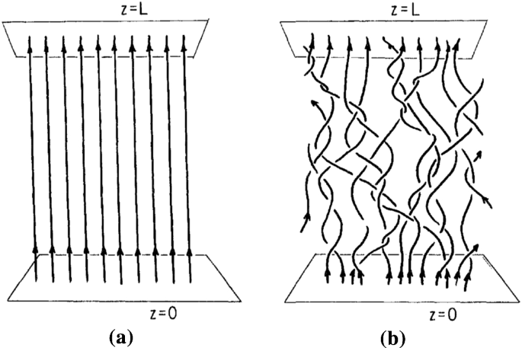
Nanoflares
Impulsive
$${10}^{24}erg$$
5-10 MK
Small and short
Notes:
Slide 4: However, today we focus on a different scenario. Nanoflares. These are considered burst reconnection events that on very short time scale heat the corona up to several MK. As they are considered events, it is natural to think of them as a succession of nanoflares with different energies. However, without many chances to observe them, it’s not likely we can further investigate on their nature directly from the observation of the heating.
Therefore, today we focus on a possible dynamic counterpart of nano flares that are the jets that can stem from the loop strand because of the magnetic reconnection.

Slide 3
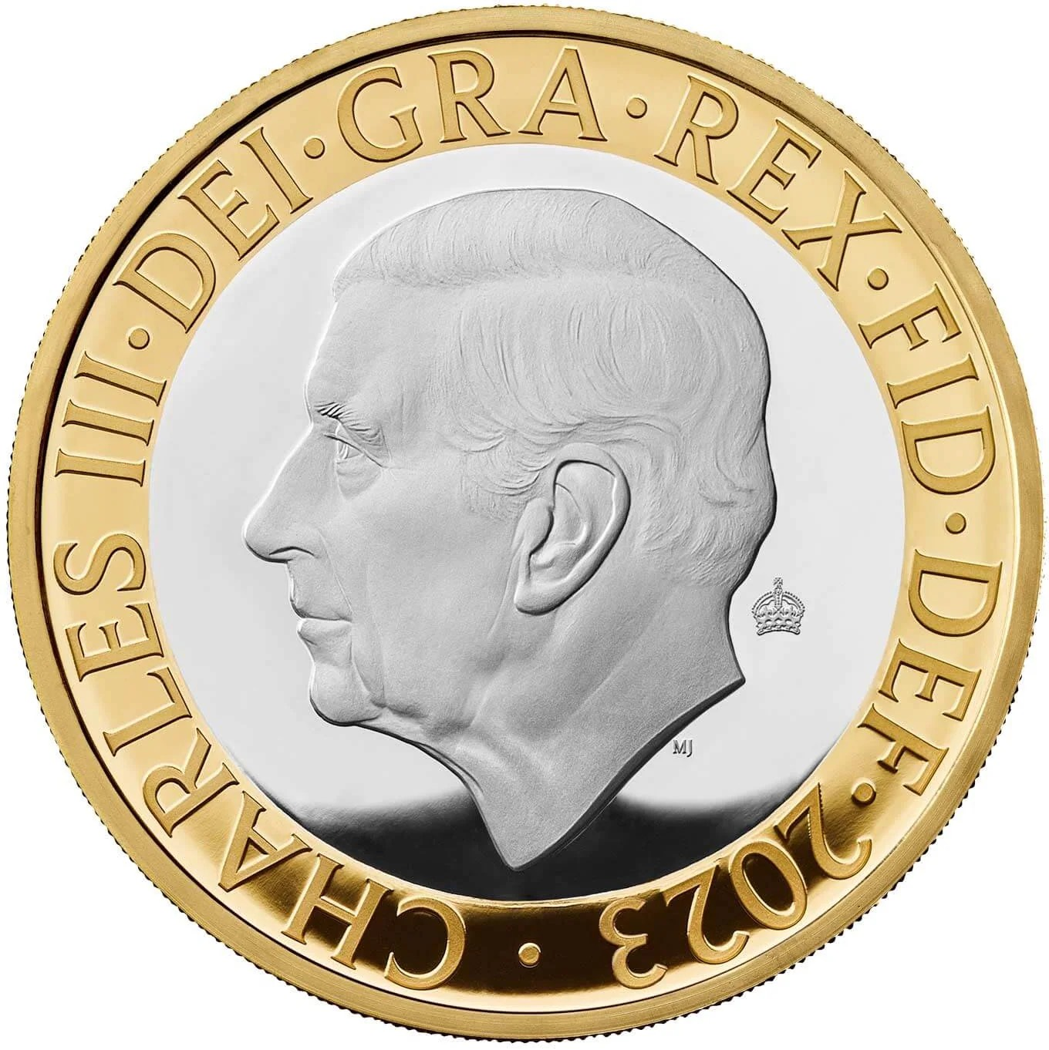
Nanojets
Short $∼10s$
$$v∼100Km/s$$
Transverse
1000 Km
Notes:
Slide 4: However, today we focus on a different scenario. Nanoflares. These are considered burst reconnection events that on very short time scale heat the corona up to several MK. As they are considered events, it is natural to think of them as a succession of nanoflares with different energies. However, without many chances to observe them, it’s not likely we can further investigate on their nature directly from the observation of the heating.
Therefore, today we focus on a possible dynamic counterpart of nano flares that are the jets that can stem from the loop strand because of the magnetic reconnection.

Slide 4
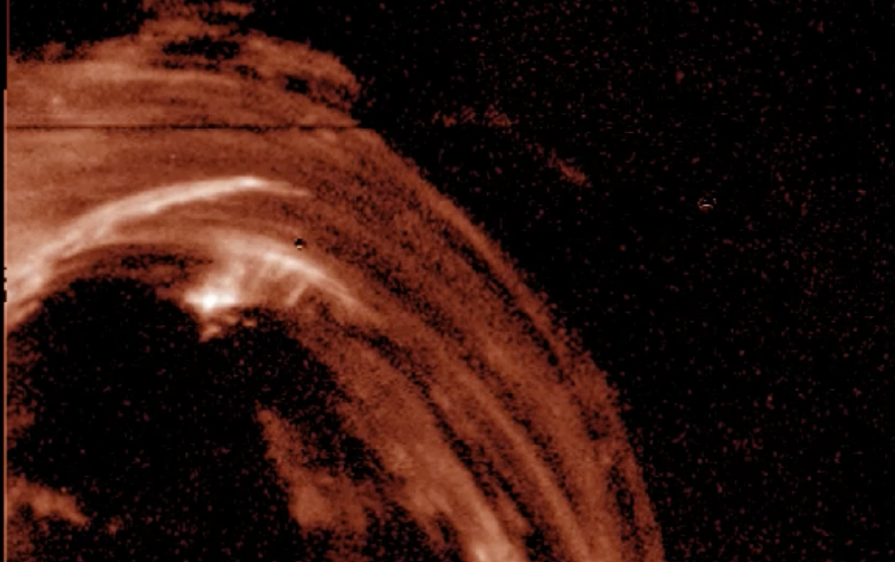
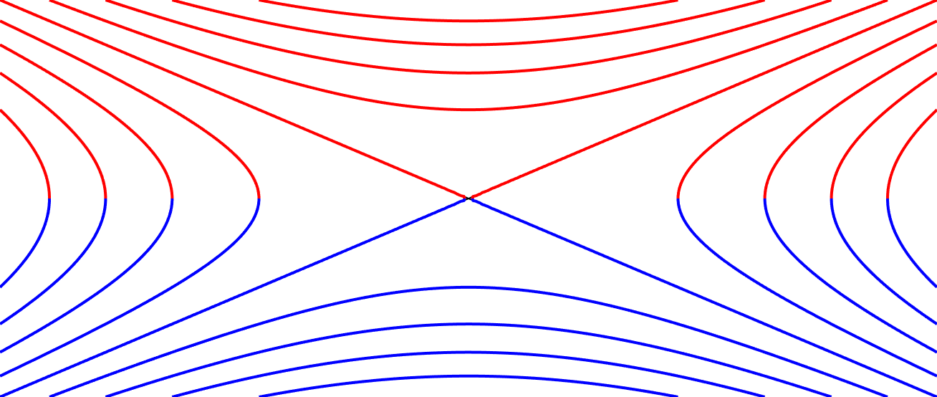
Antolin et al., 2021
Nanojets are magnetic reconnection in the solar corona
transient
3D
burst
steady
component
2D
stable
guide

Slide 5
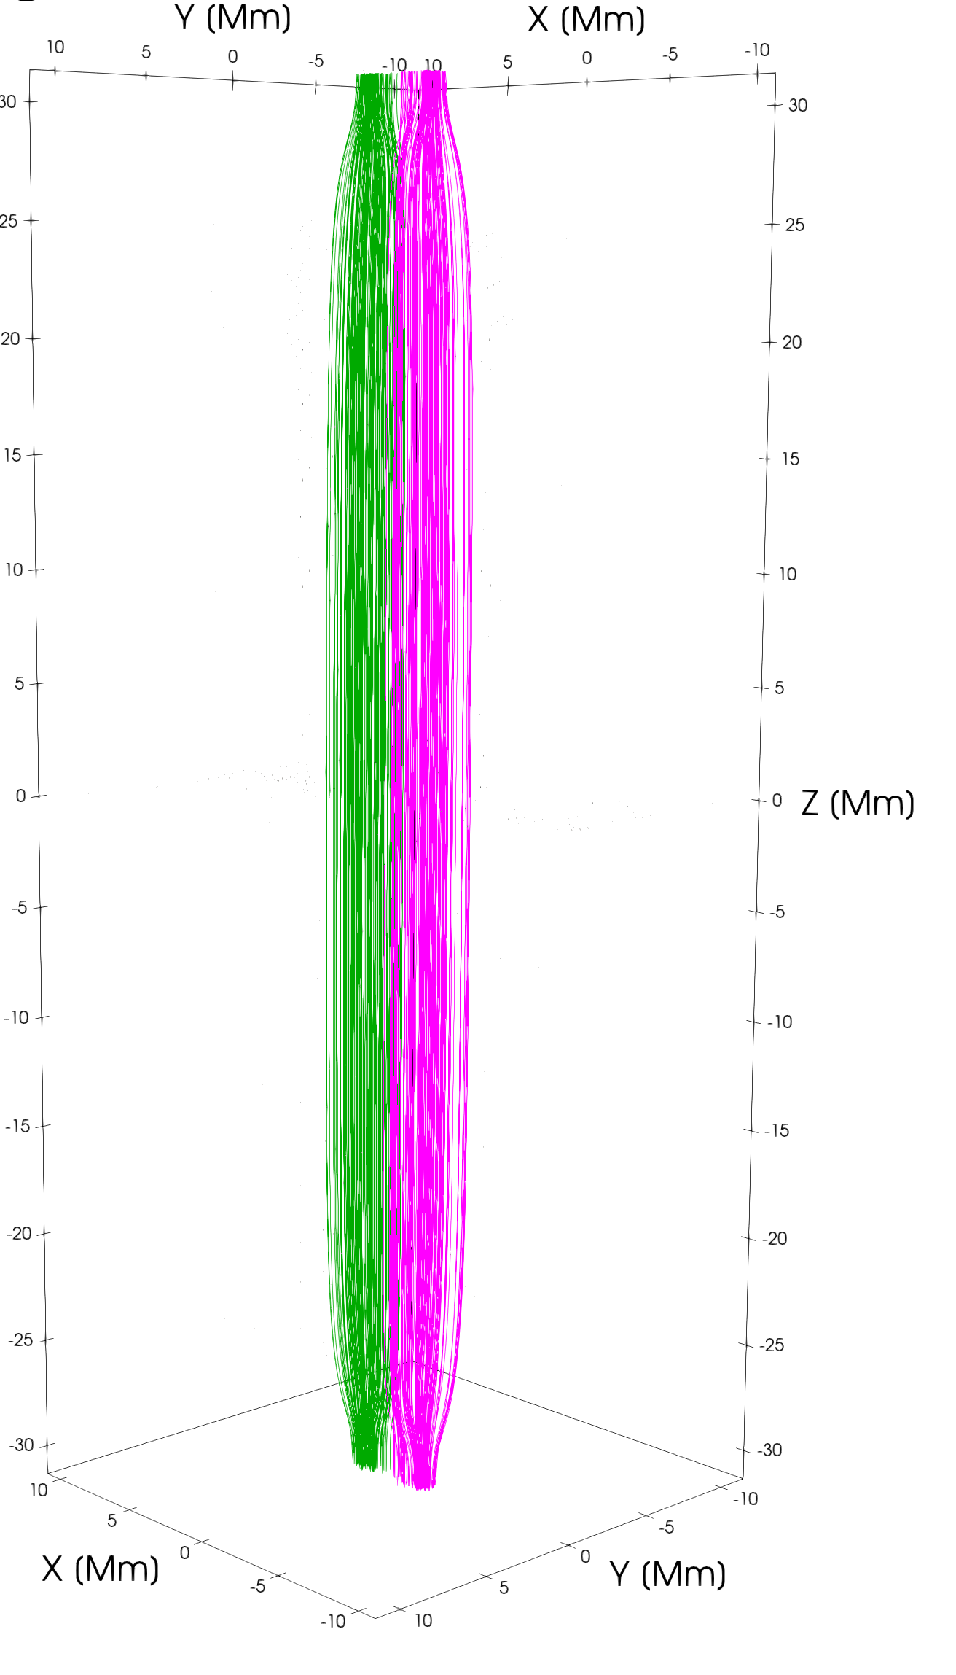
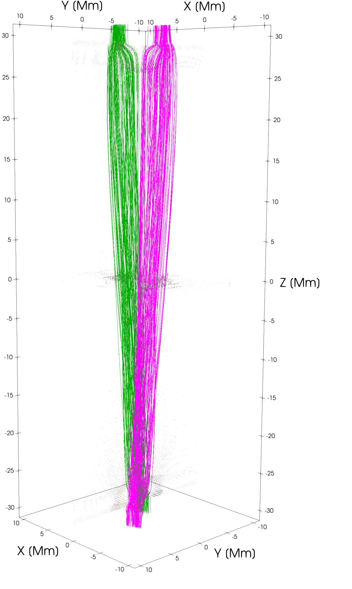
Numerical model
Reconnection and jets
Chromosphere
Driver
Magnetic Reconnection
Chromosphere
Driver

Slide 6
3D MHD Model
PLUTO (University of Turin)
90K CPU hours @CINECA Galileo 100 2021 1.1 PFlops
$$\frac{∂ρ}{∂t}+\overset{⃗}{∇}⋅(ρ\overset{⃗}{v})=0$$
$$\frac{∂ρ\overset{⃗}{v}}{∂t}+∇⋅(ρ\overset{⃗}{v}\overset{⃗}{v}−\overset{⃗}{B}\overset{⃗}{B}+∇p)=ρ\overset{⃗}{g}$$
$$\frac{\overset{⃗}{∂B}}{∂t}−∇⋅(\overset{⃗}{v}\overset{⃗}{B}−\overset{⃗}{B}\overset{⃗}{v})=−∇×(η⋅\overset{⃗}{J})$$
$$\frac{∂E}{∂t}+∇⋅\left((E+p)\overset{⃗}{v}−\overset{⃗}{B}(\overset{⃗}{v}⋅\overset{⃗}{B})\right)=ρ\overset{⃗}{v}⋅\overset{⃗}{g}−n_{e}n_{H}Λ(T)+H−∇⋅{\overset{⃗}{F}}_{c}−∇⋅\left[(η⋅\overset{⃗}{J})×\overset{⃗}{B}\right]$$
$$E=\frac{p}{ρ(γ−1)}+\frac{1}{2}v^{2}+\frac{B^{2}}{8πρ}$$
$$J_{0}=250Gs^{−1}$$
$$\left(|\overset{⃗}{j}|≥J_{0}\right)$$
$$η_{0}={10}^{14}cm^{−2}s^{−1}$$
$$\{$$
$$η_{0}$$
$$η=$$
$$κ(T)Λ(T)=constant$$
$$0$$
$$\left(|\overset{⃗}{j}|<J_{0}\right)$$
$$H=Λ(T)(t=0)$$

Slide 7
Reconnection and jets
Reconnected field lines

Slide 8
What causes the reconnection?

Slide 9
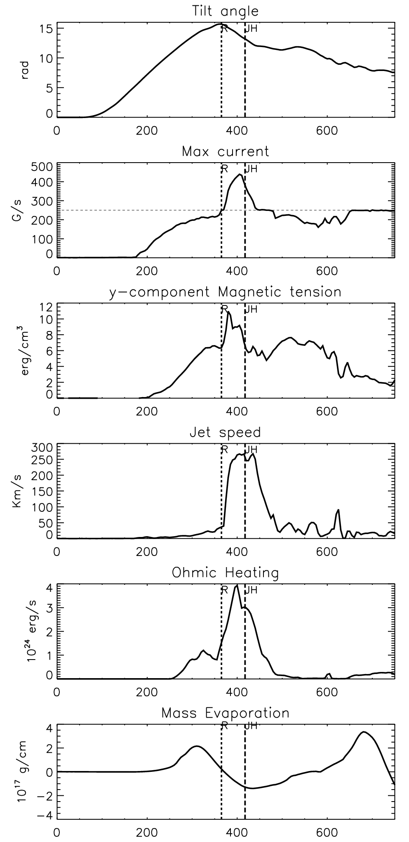
Numerical model

Slide 10
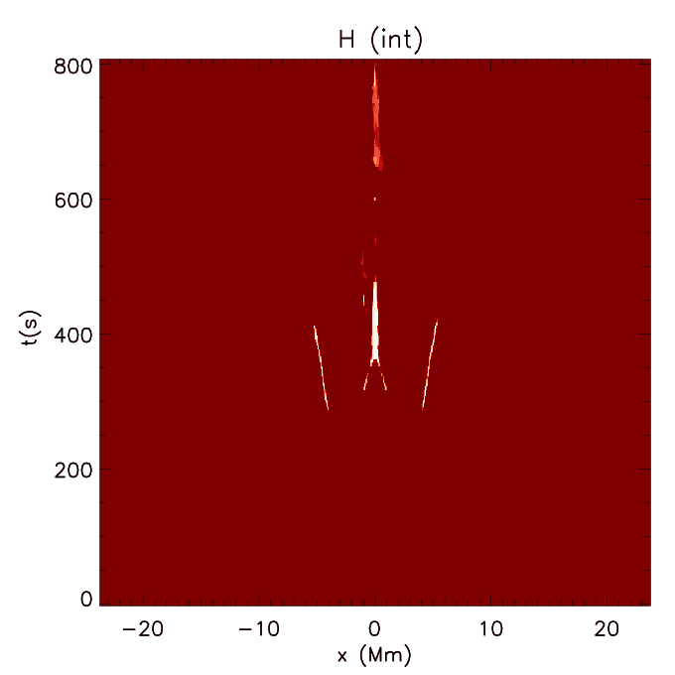
Heating
Heating from reconnection
$$∫_{t}∫_{V}HdVdt=7.5×{10}^{26}erg$$
Coronal heating

Slide 11
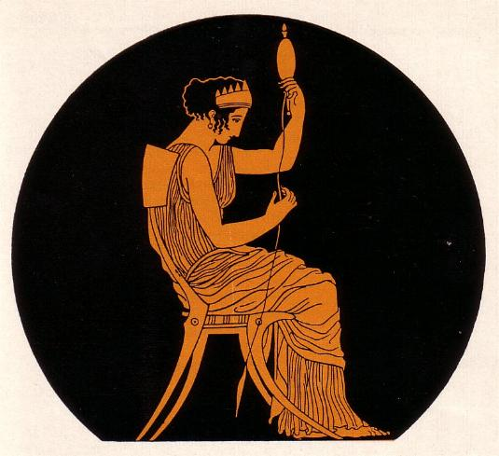
Effect of J0
J0 governs the frequency of reconnection (in this model)
J0=100
J0=250
J0=500

Slide 12
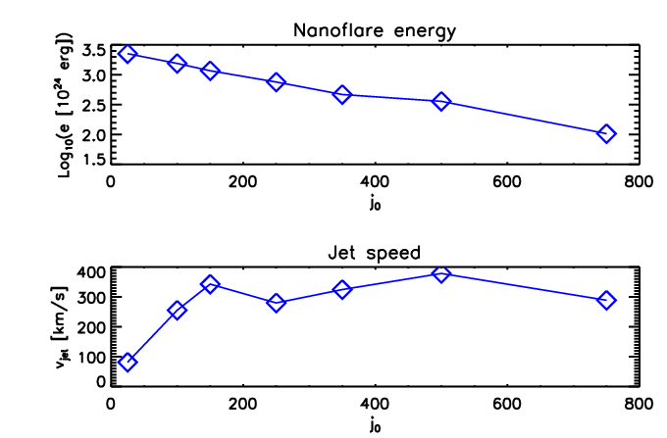
J0=[25,100,150,250,350,500,750]
No heating
E >> 10²⁴ erg
large flux tubes
energetic events
- small heating more efficient
Jet saturates
Two different regimes for heating release and jet
No jet

Slide 13
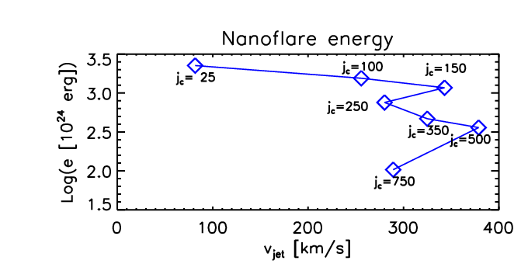
Currently very difficult to correlate jet speed with heating and viceversa
Speed independent of heating
Heating independent of speed

Slide 14
Another way: MHD avalanches
Unstable loop v.s. nearby stable loop
Kink Instability as source of large scale energy release: initial helical perturbation fragments in a turbulent way. Can trigger an MHD avalanche.
Transient, 3D, bursty, component reconnection
Horizontal cut:
current density / velocity / heating

Slide 15
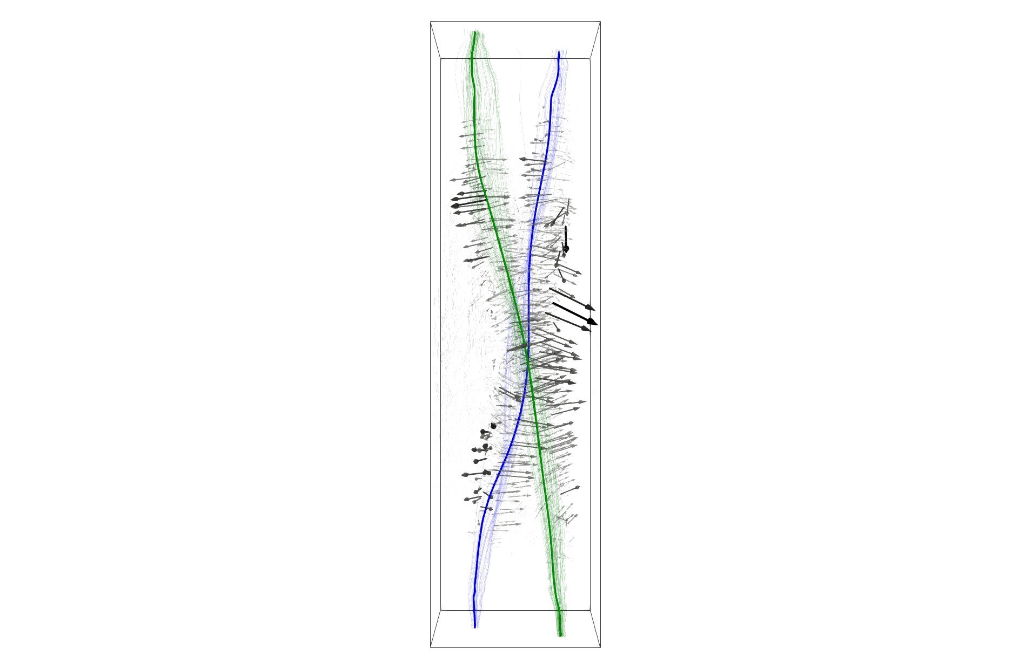
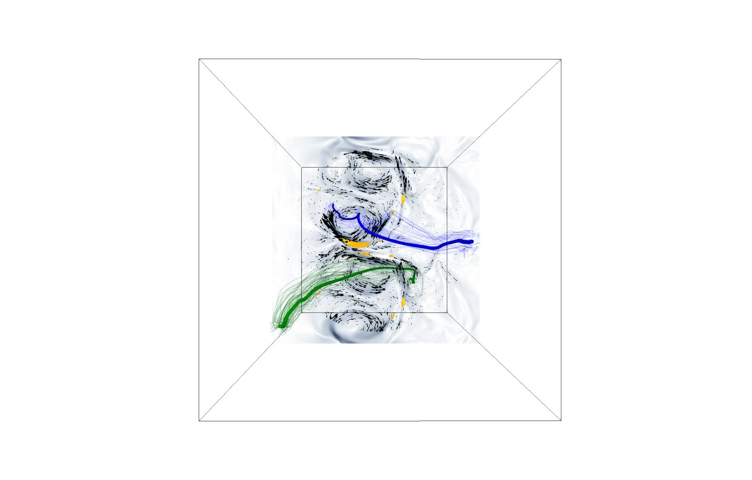
At least one
(~first of the avalanche)

Slide 16
Or many more… down the avalanche
$$∼15min^{−1}$$
We find a total of 512 nanojets in ~2100 s

Slide 17
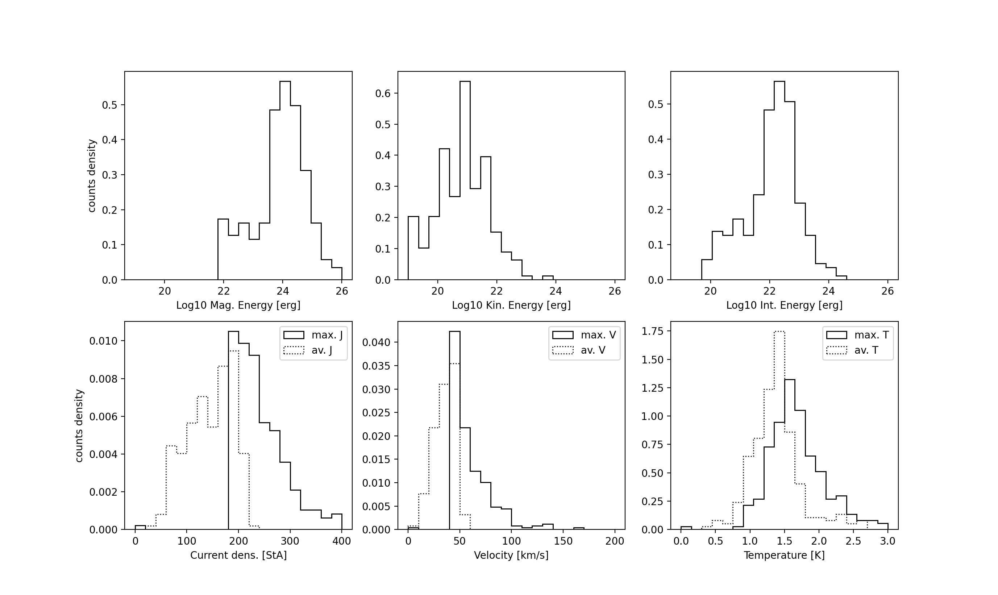
$$E_{M}=1.1×{10}^{27}$$
$$E_{K}=1.2×{10}^{24}$$
$$E_{int}=1.7×{10}^{25}$$
$$≪$$

Slide 18
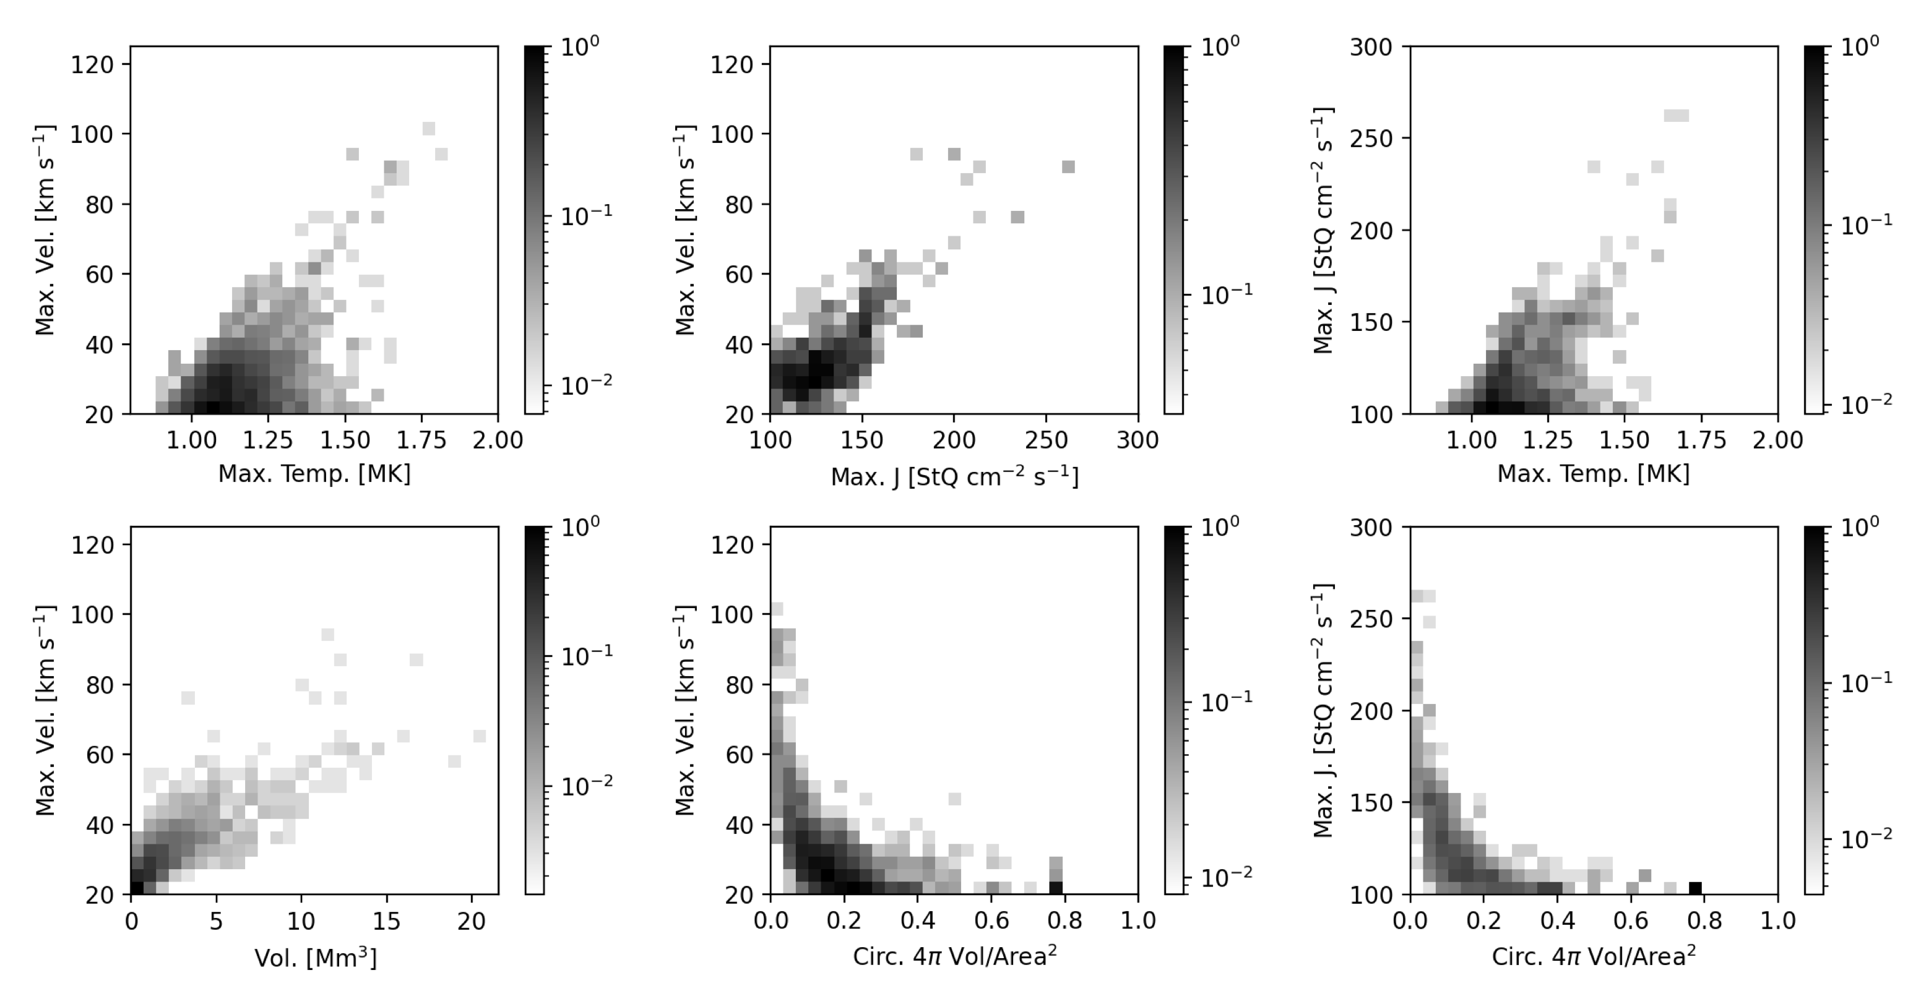
again, troubles when looking for proxies of the energy

Slide 19
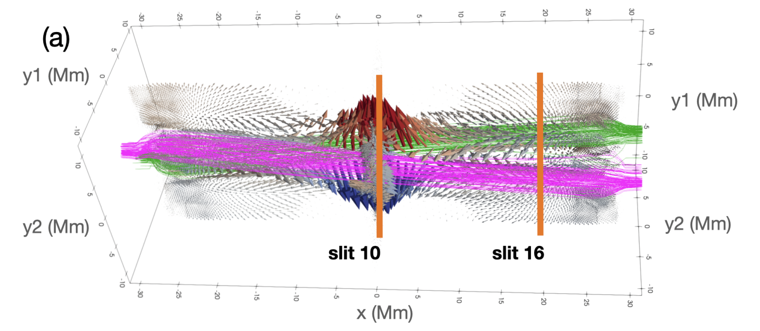
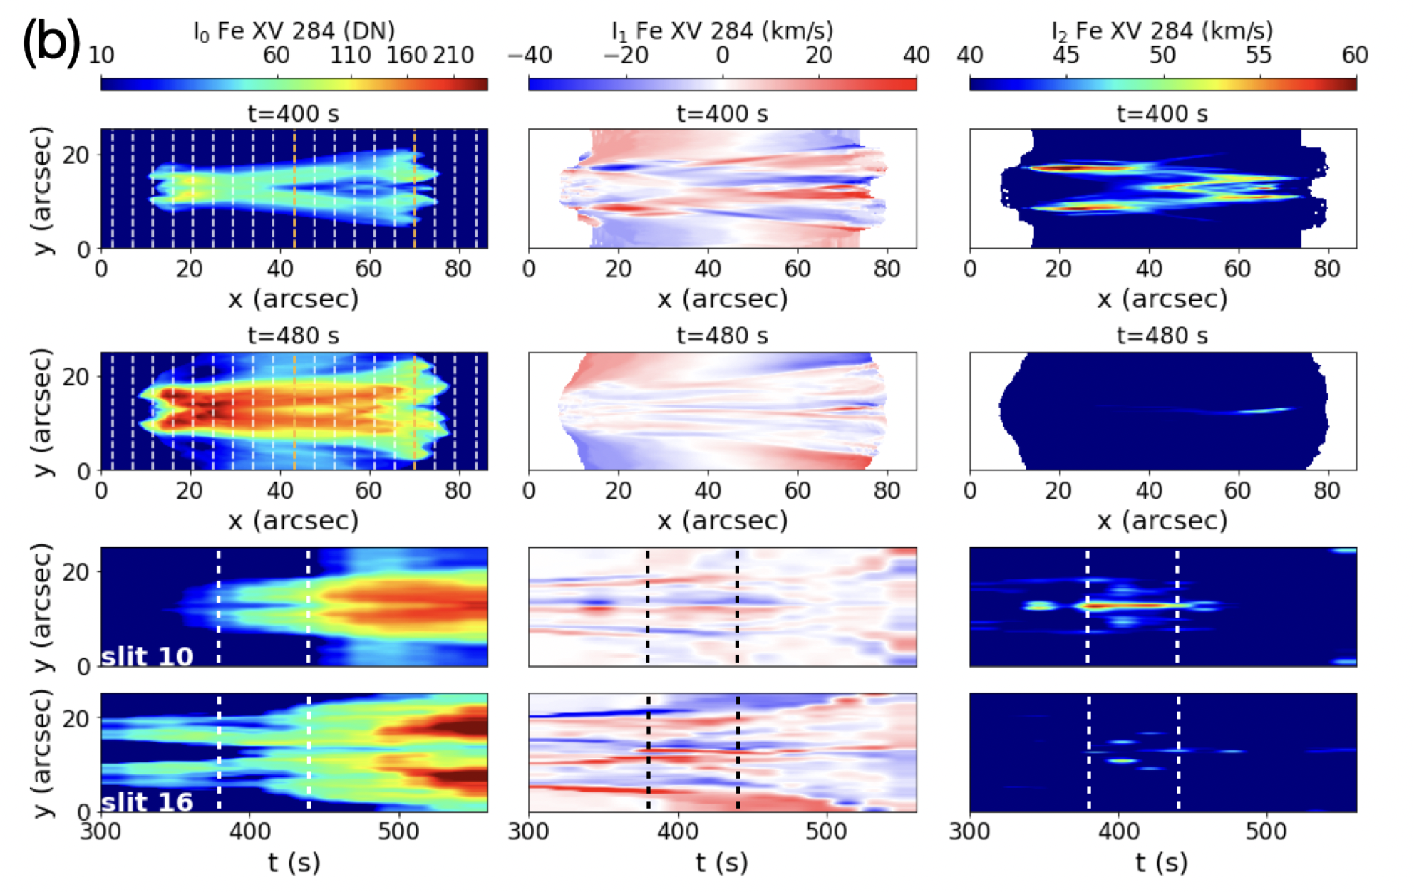
MUSE observables
Line intensity
Doppler shift
Line width
jet
braiding
Signature of nanojet/nanoflare
Fe XV 284 Muse passband
De Pontieu et al. 2022

Slide 20
Conclusions
Nanojets remain one of our main leads to see coronal heating in action.
We need to better understand how nanojets are a proxy for heating.
Magnetic reconnection in the corona is transient and can be (is!) triggered by magnetic forces. Also heating is transient.
Magnetic reconnection is interlinked with MHD waves

