Slide 1
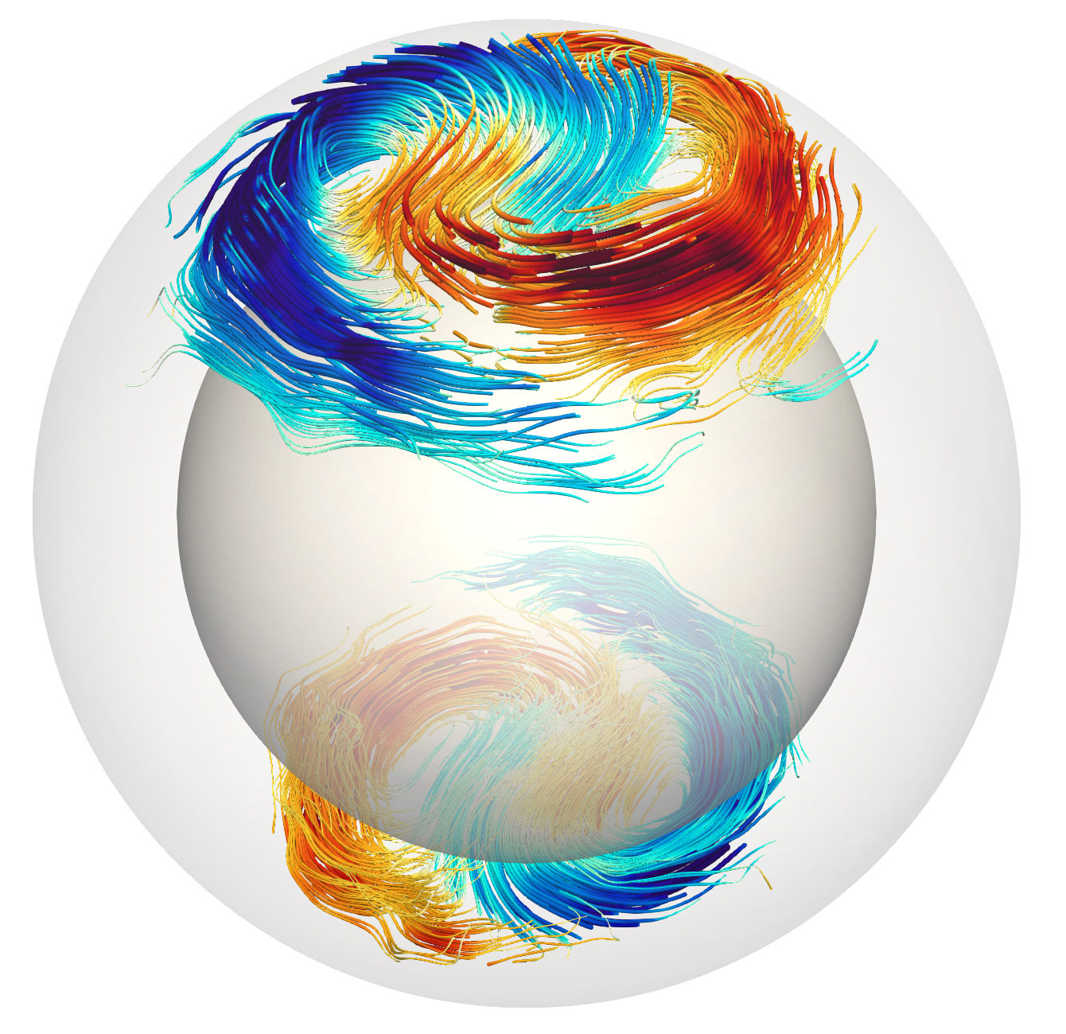
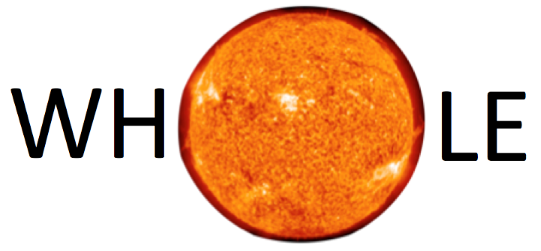
The Sun’s differential rotation is controlled by baroclinically-unstable high-latitude inertial modes
Yuto Bekki
bekki@mps.mpg.de
Max Planck Institute for Solar System Research (MPS), Göttingen, Germany
Collaborators : R. Cameron, L. Gizon
Bekki et al., Science Adv., 10 eadk5643 (2024)
https://doi.org/10.1126/sciadv.adk5643
17th European Solar Physics Meeting (ESPM-17), Turin, Italy, 9 Sept. 2024

Slide 2
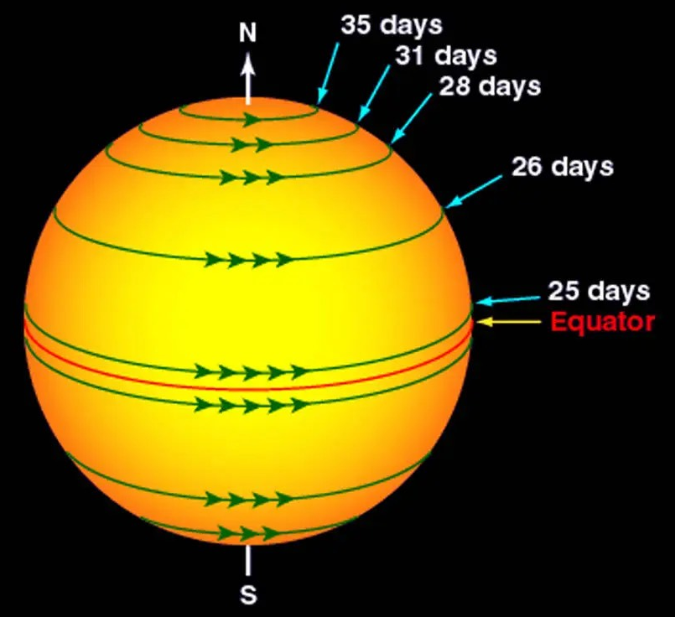
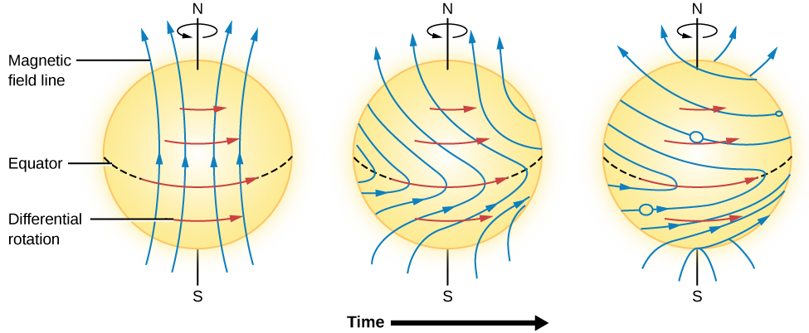
The Sun’s differential rotation
The Sun’s outer 30% is called convection zone
The Sun’s convection zone is known to rotate differentially, i.e., the equator rotates faster ($P≈$24 days) whereas the poles rotate slower ($P≈$35 days)
This differential rotation is believed to play a crucial role in sustaining the Sun’s magnetic activity via $Ω$-effect
$©$NASA
$©$Douglas College Astronomy

Slide 3
Thermal wind balance: Role of the latitudinal entropy gradient
Internal angular velocity profile (differential rotation) of the Sun is precisely measured by global helioseismology [e.g., Schou et al. 1998]
The solar differential rotation does not follow the Taylor-Proudman’s theorem which predicts constant rotation rates on cylinder
To break the Taylor-Proudman’s constraint, latitudinal entropy difference is believed to exist in the Sun’s convection zone
Differential rotation
(observed)
Thermal wind balance approx.
Entropy perturb.
(estimated)
Deviation from TP theorem
Latitudinal entropy gradient
The estimate latitudinal entropy difference corresponds to a latitudinal temperature difference of 𝛥_{𝜃}𝑇 ($=$𝑇_{pole}$−$𝑇_{eq} ) $≈$ 5-10 K [e.g., Miesch 2005], which is small and very difficult to measure [e.g., Kuhn et al. 1997, Rast et al. 2008]

Slide 4
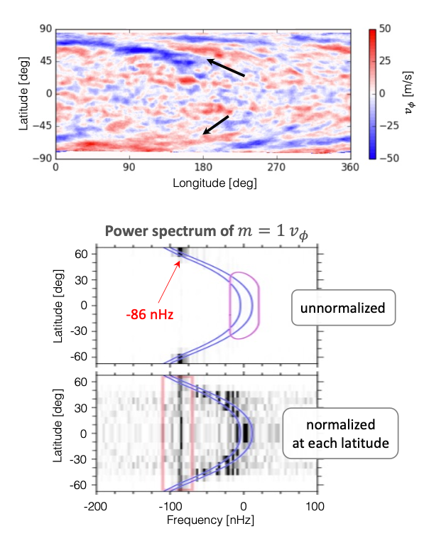
Polar spiral flows High-latitude inertial modes
Near the polar region of the Sun, spiraling flow patterns are observed [Hathaway et al. 2013, Bogart et al. 2015]
Largely consist $m=1$ component and have the velocity amplitude of $20−30m/s$ at the surface
Often (mis)interpreted as the giant convection cells from the deep interior that transport the angular momentum equatorward [Hathaway et al. 2013, Hathaway & Upton 2021]
$v_{φ}$ (SG tracking map)
[Hathaway et al. 2013]
Power spectrum of $m=1$ $v_{φ}$
Recently, Gizon et al. (2021) instead showed that these polar flows are characterized by single frequency at all latitudes (once the spectrum is normalized)
Indicating that they are global-scale modes of inertial oscillation (where the restoring force is the Coriolis force)
We call them “high-latitude inertial modes”
[Gizon et al. 2021]

Slide 5
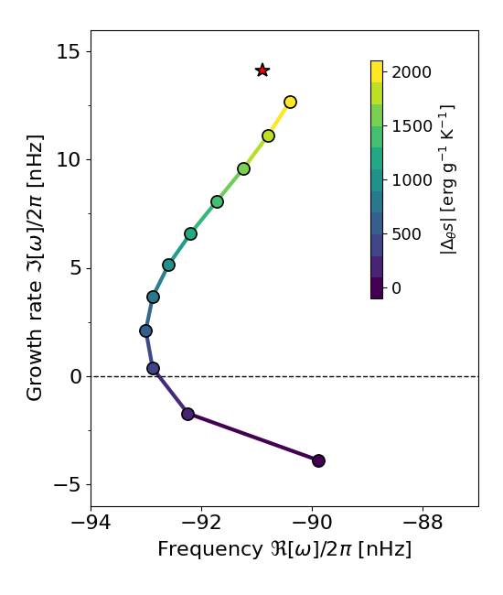
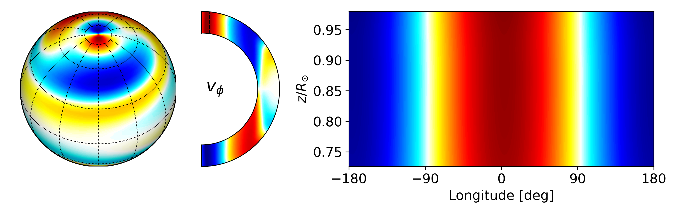
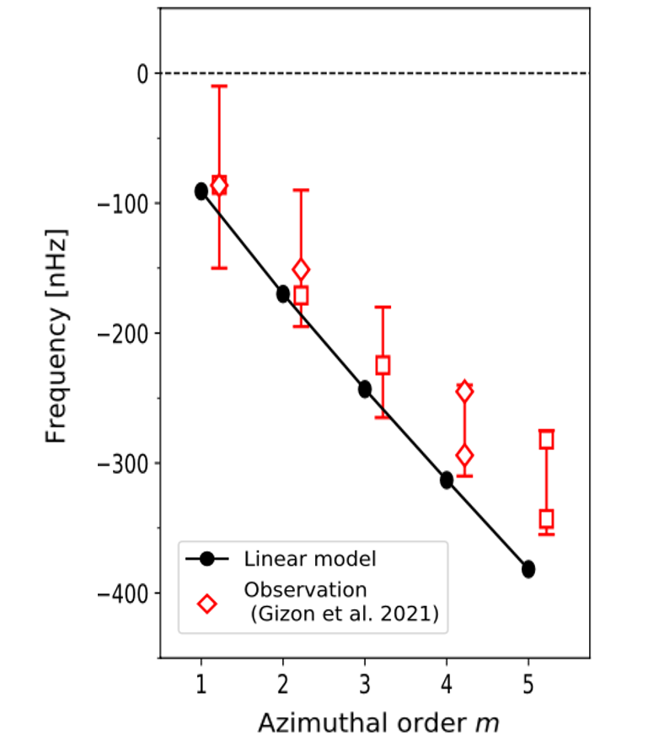
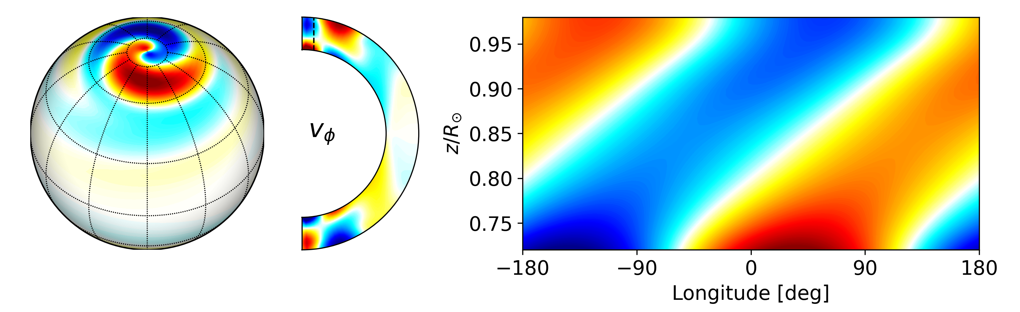
High-latitude inertial modes are baroclinically unstable
Bekki et al. (2022a) carried out a linear eigenmode analysis to show that the high-latitude modes become linearly unstable when a latitudinal entropy gradient $∂s/∂θ$ exists, i.e., baroclinically unstable
The observed spiral pattern can be obtained only when a large $|∂s/∂θ|$ is included
The dispersion relation of the baroclinically-unstable modes agree well with the observations
Linear eigenfrequency ($m=1$)
Case without $∂s/∂θ$ (non-baroclinic)
Dispersion relation
unstable
$$Δ_{θ}T=8K$$
$$Δ_{θ}T=6K$$
$$Δ_{θ}T=4K$$
Case with $∂s/∂θ$ (baroclinic)
$$Δ_{θ}T=2K$$
stable
$$Δ_{θ}T=0K$$

Slide 6
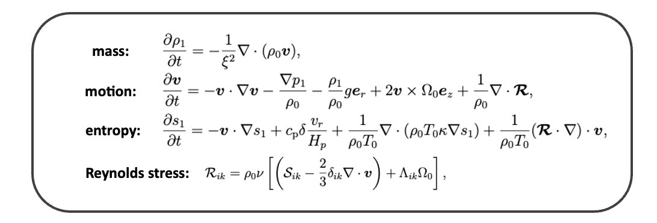
3D mean-field simulations of solar large-scale flows
To study the amplitudes of the high-latitude inertial modes, we carry out a set of mean-field simulations of the solar large-scale flows in a 3D spherical shell [Bekki & Cameron 2023, Bekki et al. 2024]
Small-scale convection is NOT solved but parametrized and modelled (e.g., Λ-effect, turbulent diffusion)
Differential rotation and meridional circulation are driven by prescribed $Λ$–effect (following Rempel 2005’s 2D model)
Base of the convection zone is assumed to be weakly subadiabatic ($δ<0$) by which the latitudinal entropy gradient is generated via the interaction with the meridional circulation [Rempel 2005]
We vary the subadiabaticity at the base $δ_{0}(<0)$ as a free parameter which controls the baroclinicity

Slide 7
Nonlinear evolution of baroclinically-unstable modes
Non-axisymmetric
velocity $v_{φ}^{′}$
Differential rotation
$$\overline{Ω}/2π$$
Entropy perturbation
$${\overline{s}}_{1}$$

Slide 8
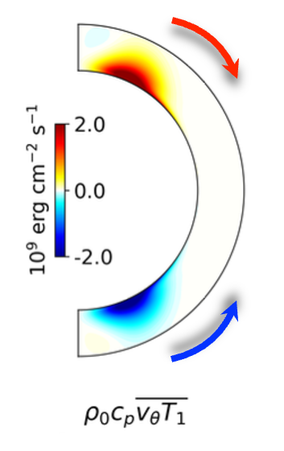
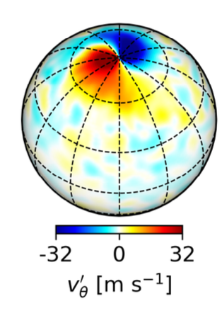
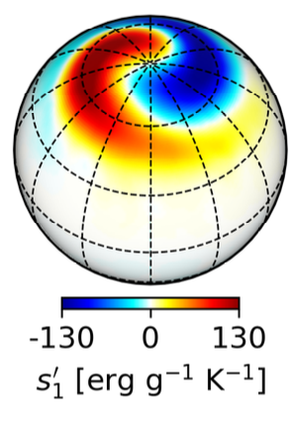
Nonlinear saturation: Equatorward heat transport by modes
We find that both amplitudes of baroclinic modes and $∆_{θ}T$ initially increase with increasing baroclinicity
However, when the mode amplitudes exceed a threshold value, they start to give a significant negative feedback, i.e., $∆_{θ}T$ decreases as baroclinic forcing increases and mode amplitudes increase
This is because of the equatorward heat transport by baroclinic modes, which reduces $∆_{θ}T$ (nonlinear saturation)
The observed mode amplitudes imply $∆_{θ}T≈7$K in the middle convection zone (observational evidence of the thermal wind balance)
Latitudinal enthalpy flux
more baroclinic

Slide 9
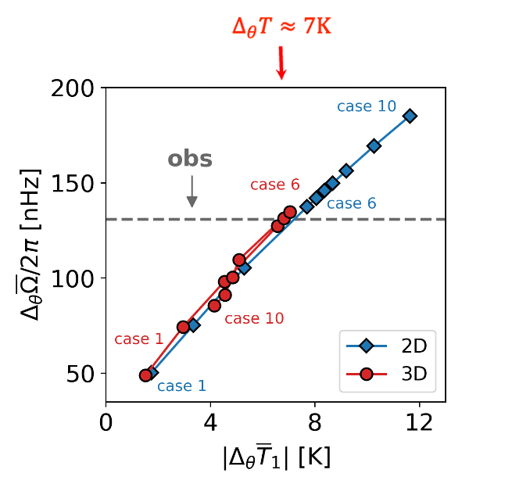
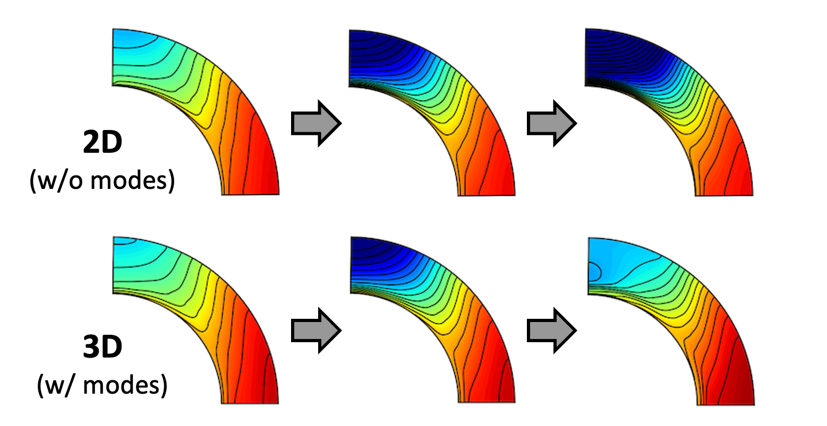
Significant impact on differential rotation amplitudes
In 2D axisymmetric model (where the baroclinic modes are excluded), latitudinal differential rotation amplitudes $∆_{θ}Ω$ can be increased by changing the model parameters
In realistic 3D model (where the non-axisymmetric modes play a role), $∆_{θ}Ω$ is limited by baroclinically unstable modes
The solar observation implies that the Sun’s differential rotation likely reaches its possible maximum value
more baroclinic

Slide 10
Role of baroclinicity on angular momentum balance
Angular momentum eq.
Temporal evolution of angular momentum fluxes
equator-ward AMT
Meridional circulation
poleward
AMT
Reynolds stress (modes)
Λ-effect (prescribed)
Viscous diffusion
Reduction of $Δ_{θ}Ω$ is dominantly caused by the poleward angular momentum flux by meridional flow $F_{θ}^{MC}$
This is caused by the change in the baroclinic torque Equatorward heat transport by modes
More poleward AMT by MC
Meridional vorticity eq.
$$\frac{∂{\overline{ζ}}_{φ}}{∂t}=2r\sin{θ}Ω_{0}\frac{∂Ω_{1}}{∂z}−\frac{g}{rc_{p}}\frac{∂{\overline{s}}_{1}}{∂θ}+[…]$$
Baroclinic torque
Meridional circulation
$$\frac{∂{\overline{ζ}}_{φ}}{∂t}<0$$

Slide 11
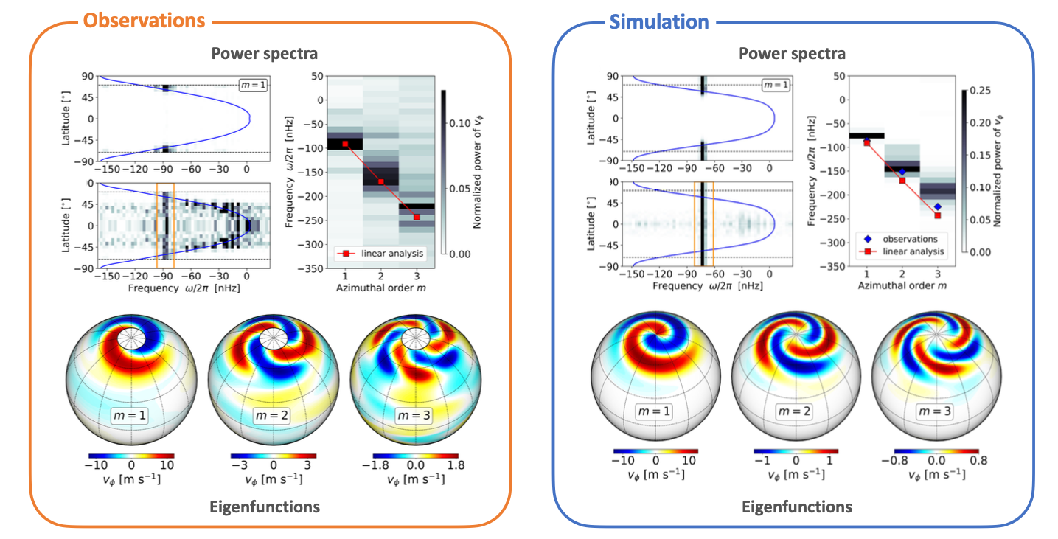
Various observed properties of high-latitude inertial modes explained
Our 3D mean-field model with $∆_{θ}T≈7$K nicely reproduces many observed properties of the high-latitude inertial modes

Slide 12
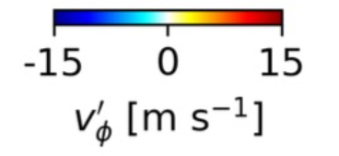
Summary
Observation (SG tracking)
Differential rotation of the Sun
The non-Taylor-Proudman differential rotation is believed to be sustained by thermal wind balance
A small latitudinal temperature difference 𝛥_{𝜃}𝑇 ($=$𝑇_{pole}$−$𝑇_{eq} ) is expected to exist in the Sun but difficult to measure
High-latitude inertial modes (polar spiral flows)
[Courtesy:
D. Hathaway]
The high-latitude inertial modes have the largest velocity amplitudes [Gizon et al. 2021]
They are baroclinically unstable even in the presence of such a small 𝛥_{𝜃}𝑇 [Bekki et al. 2022]
Mean-field sim.
Nonlinear saturation of high-latitude modes [Bekki et al. 2024]
The high-latitude modes saturate by transporting heat equatorward and reducing 𝛥_{𝜃}𝑇 in CZ
They control the latitudinal differential rotation by regulating the baroclinicity
The observed amplitudes of baroclinic modes can be used to infer 𝛥_{𝜃}𝑇 ≈ 7 K
Our study implies that the Sun’s differential rotation is close to its maximum possible value

