Slide 1
Simulation of Particle Acceleration and Transport
in 3D Turbulent Reconnection Regions
Zining Ren¹
Contributors：Xin Cheng¹ , Yulei Wang¹, and Xiaocan Li²
1, Nanjing University, China; 2, Dartmouth College, USA
Notes:
Good afternoon everyone! Grad to have this chance to introduce our work.
This work is mainly done by Zining Ren. He is now a graduated student of our group.
Because of the visa problem, he cannot be here. So I help him to give this talk.
I’m Yulei Wang from Nanjing University of China.

Slide 2
Outline
Motivation
MHD model and method
Results
Conclusions
Notes:
There are four part of this talk.

Slide 3
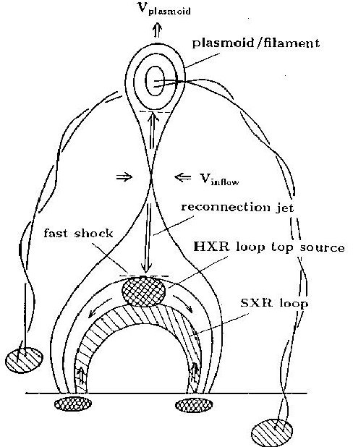
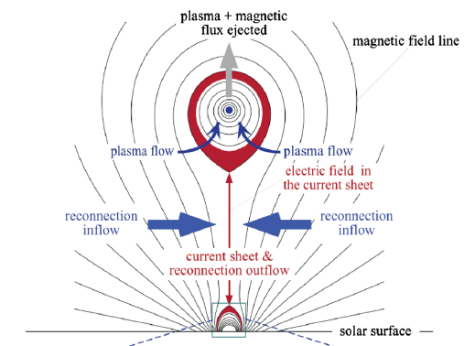
Motivation
- The current sheet (CS) and flare loops
Solar flare
Standard Flare Model
Lin-Forbes Model
helioviewer.org
Shibata, 1995
Lin & Forbes, 2000
Notes:
Solar flares and CMEs are the most energetic events in the solar system.
According to standard flare model, the main mechanism driving the eruption is believed to be magnetic reconnection taking place in the current sheet.
Massive magnetic energies are rapidly released to heat plasmas and accelerate charged particles.

Slide 4
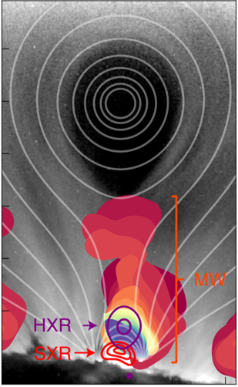
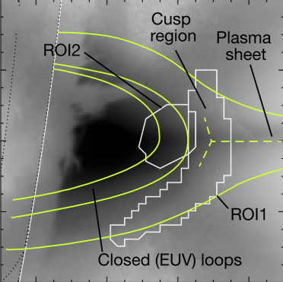
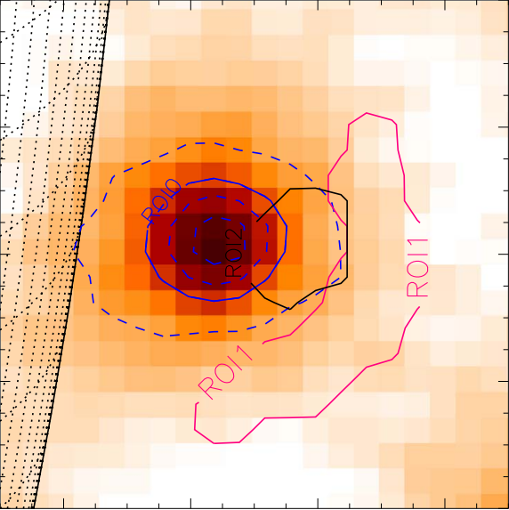
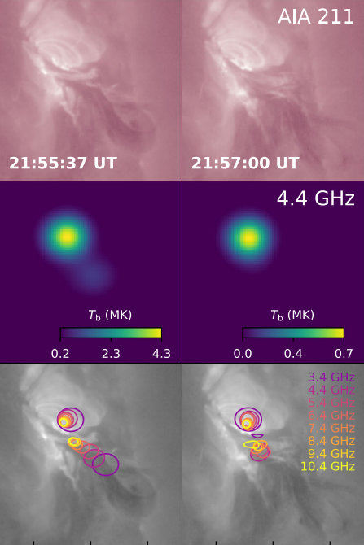
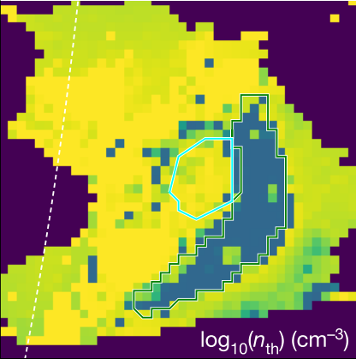
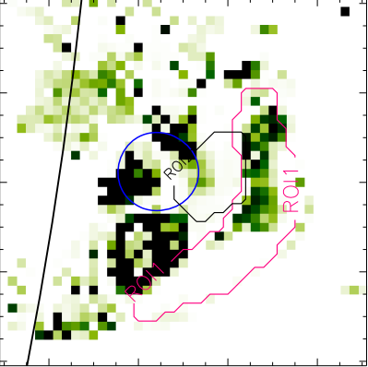
Motivation
- Observations of energetic electrons
Chen + 2015, 2020
Fleishman + 2022
Kontar + 2023
Kou + 2022
Termination shock
acceleration
EOVSA
Microwave band
RHESSI
HXR
Acceleration in CS and loop top
Notes:
Accelerated electrons can produce HXR and Microwave emissions as frequently observed at the top of the flare loops.
The spectrum of those electrons has been found to usually take a power law.
Besides the loop top, the microwave emissions have also been observed in the CS above the loop top.
However, how these high-energy electrons are accelerated during flares is still unclear.

Slide 5
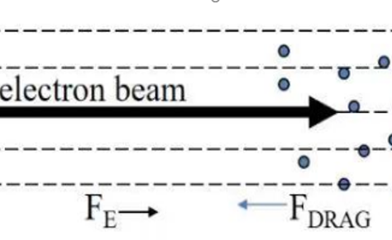
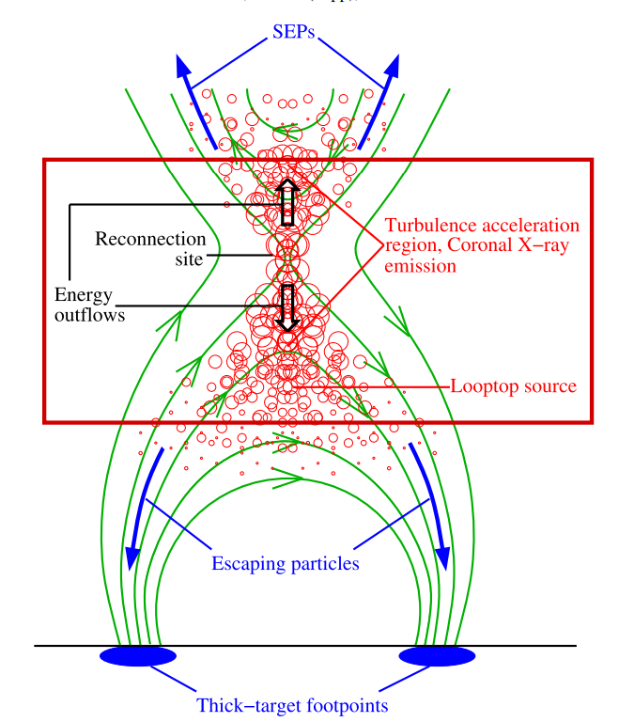
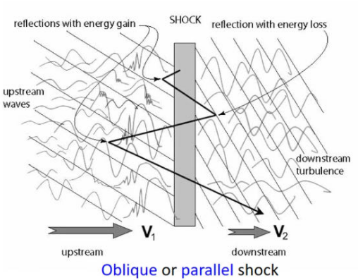
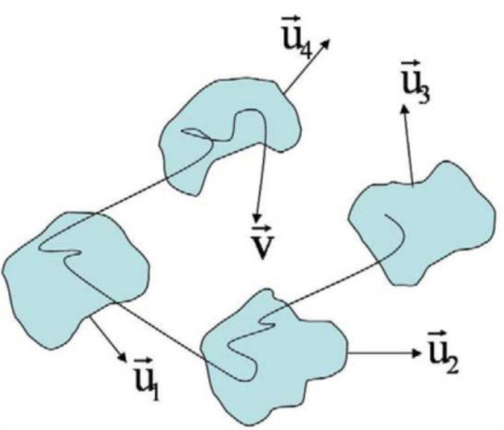
Motivation
- Main particle acceleration mechanisms
Acceleration mechanism in flare CS and loop top?
Direct acceleration of reconnection electric field
First-order Fermi acceleration (Diffusive shock acceleration)
Second-order Fermi acceleration (Stochastic acceleration)
Petrosian + 2016
Notes:
Theoretically, there are three mainstream acceleration mechanisms, including the xxx, the xxx, and the xxx.
In flare CS and Loop top, the physical condition is very complex and all of them processes might happen but have different importance.

Slide 6
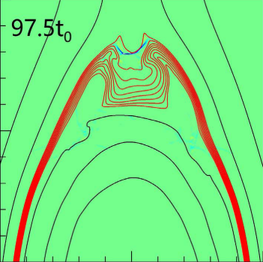
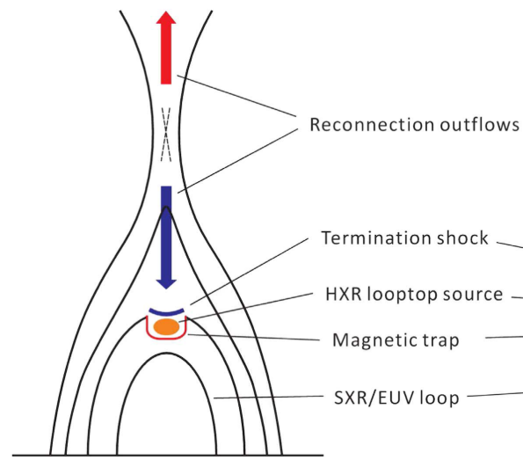
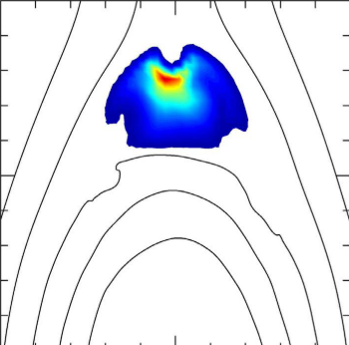
Motivation
- Termination shock acceleration at flare loop top
Tsuneta + 1998, Aurass + 2002, Mann + 2006, Chen 2015, Shen + 2018, …
2D model
3D reality?
50-100 keV
Credit: Sijie Yu
Kong + 2019, 2020, 2022
Particles are trapped in the loop-top magnetic bottle;
Repeatedly accelerated by termination shock.
Finite length and nonuniform on the third direction;
Long and stable termination shock?
Effects of turbulence?
Notes:
Previous studies have showed that at flare loop top, the TS is the key to accelerate electrons.
Based on 2D MHD simulations, Kong et al have done a lot of analyses and proposed that particles can be well trapped in the magnetic bottle at the down stream side of the TS where particles are repeatedly accelerated by TS.
However, on the one hand, the TS has not been confirmed by observations; on the other hand, as shown by this movie, a real flare is a 3D process, the CS and loop top might be highly turbulent. How does the turbulence influence the TS and acceleration is less discussed.

Slide 7
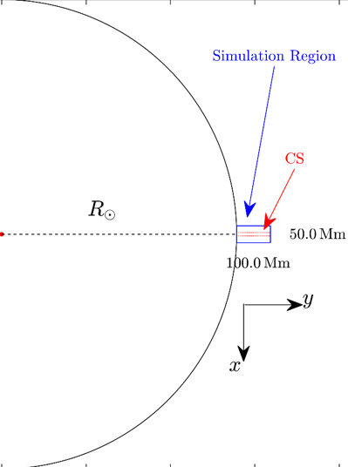
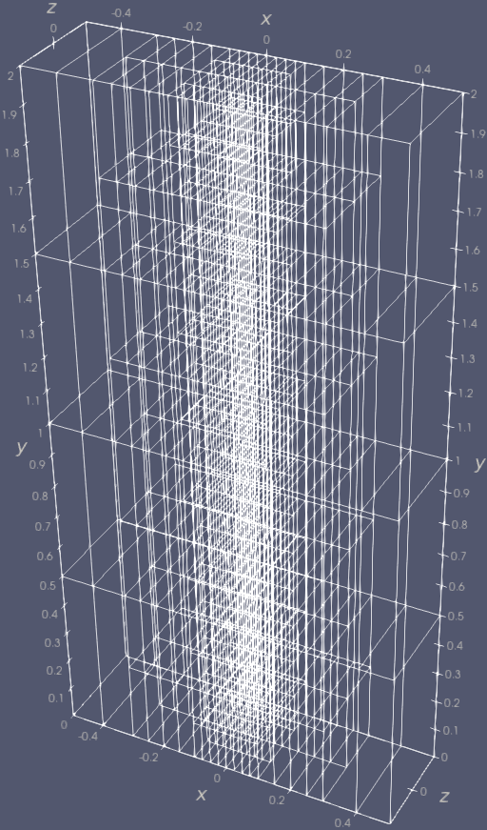
MHD model and method
26km
100Mm
MHD Eq. with coronal effects
Solved by Athena++
Simulation time: 8.2 (15.7 min)
Total grids: ${10}^{9}$
Core-hour: >4M
Data-size per moment: 60GB
Lundquist number: $S=2×{10}^{5}$
z-direction
current
y-direction
velocity
Density
Temperature
Wang et al. 2023, ApJL
Notes:
Recently, we conducted a 3D high-resolution MHD simulation, which includes necessary coronal effects.
To get accurate results, we use a uniform high-resolution mesh in the CS and loop top.

Slide 8
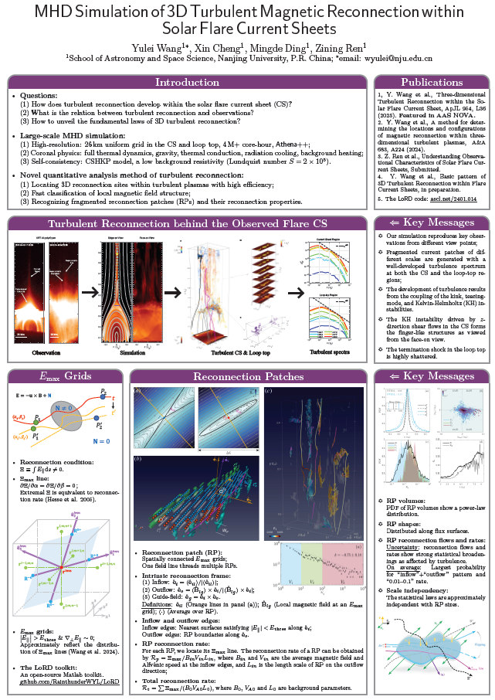
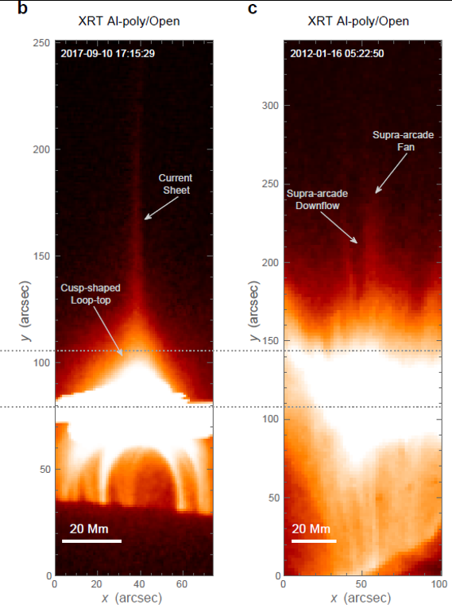
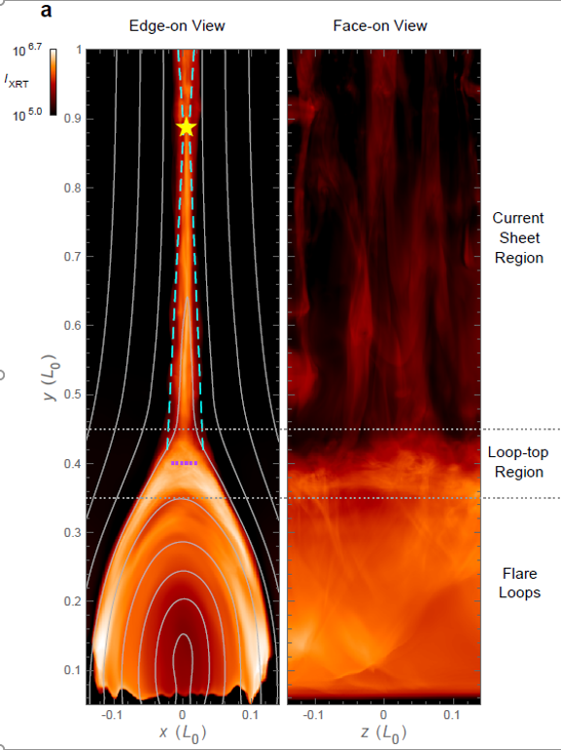
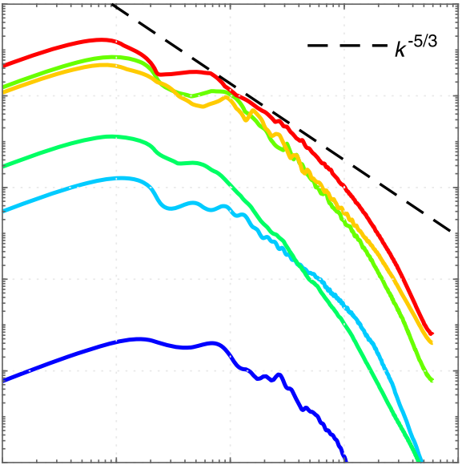
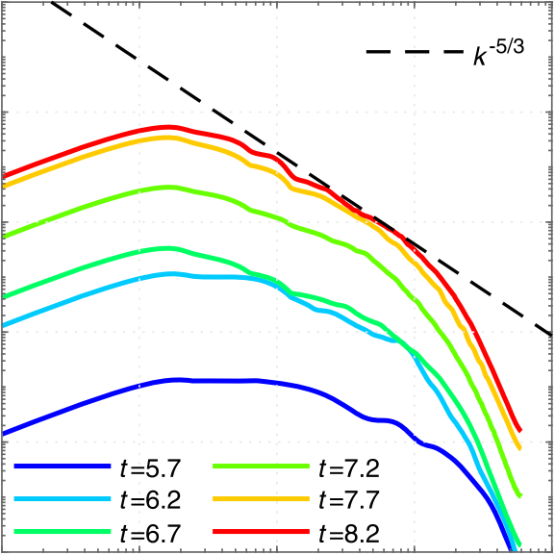
MHD model and method
Turbulent magnetic energy spectrum
Observations
Synthesized XRT images
Fragmented CSs
CS
Topic 2
10B: #198
Loop top
The simulation reproduces key observations on different view points:
Edge-on view: Petscheck-type close to standard model;
Face-on view: Finger-like bright-dark structures.
Fragmented reconnection region with turbulent spectrum:
Chaotic CS and loop top
Inertial region spanning more than one magnitude of $k$
Wang et al. 2023, ApJL
Notes:
The systhesized images of our simulation data capture the key observations of flare systems from different view points.
Both the CS and the loop top region reach well developed turbulent states as verified by the power-law inertial region of turbulent magnetic energy spectra.
Because of the limited time, I cannot tell all the details. If you are interested in this work, please come to my poster today and tomorrow.

Slide 9
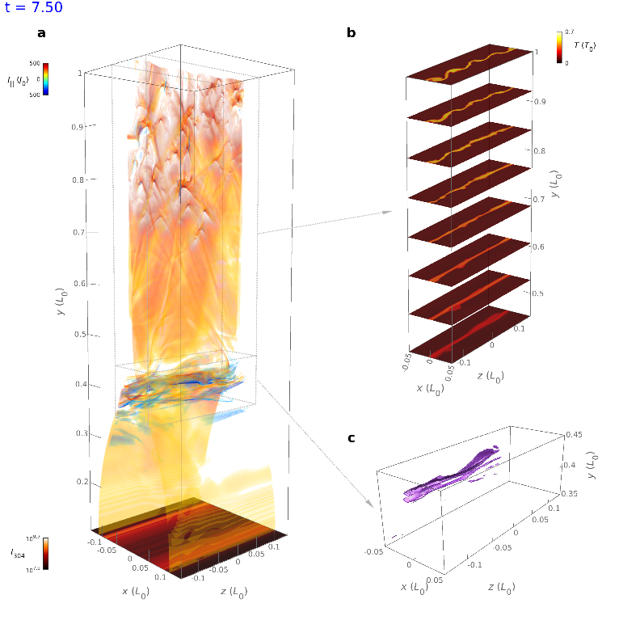
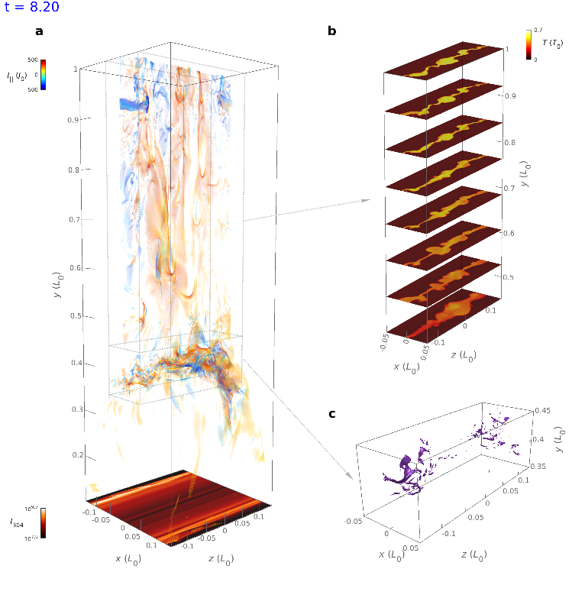
MHD model and method
- Evolutions of turbulence and termination shocks within CS and loop top
Temperature slices
$t=7.5$: close to 2D pattern
$t=8.2$: 3D pattern with strong turbulence
Our target: to study particle acceleration in turbulent reconnection!
Can electrons still be efficiently accelerated?
What is the difference for acceleration at the CS and loop top?
Can termination shocks accelerate electrons if being fragmented?
Parallel
current
Termination shock
The current sheet consisting of multi-scale patches due to turbulence.
fragmented termination shock
Notes:
But here, I want to emphasize that, at different stages of the reconnection, the patterns of TS changes significantly.
To be specific, at t=7.5, the TS forms and extend a long distance on the direction of guide field. At this moment , it’s similar with 2D model.
But later, as the development of LT turbulence, the TS becomes highly fragmented in space, which is quite different from 2D models.
So these features of turbulent reconnection inspire us to (click) analyze xxx;
The main questions we try to solve are: xxx.

Slide 10
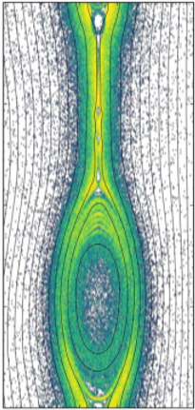
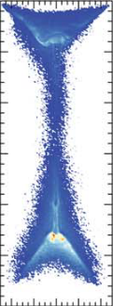
MHD model and method
- Parker transport equation (PTE)
Approximations:
Isotropic momentum distribution;
Strong turbulence.
$$\frac{∂f}{∂t}+\left(V+V_{d}\right)⋅∇f−\frac{1}{3}∇⋅V\frac{∂f}{∂\ln{p}}=∇⋅\left(κ∇f\right)+Q$$
Advection & drift
Momentum increase due to compression
Diffusion
Source term
- Solve PTE by the stochastic differential equation (SDE) method
$$dX=\left(∇⋅κ+V\right)ds+\sum_{α}{P_{α}}dW_{α}\left(s\right) ,$$
$$dp=−\frac{p}{3}\left(∇⋅V\right)ds .$$
The Global Particle Acceleration and Transport (GPAT) Model:
Developed by Xiaocan Li
github.com/xiaocanli/stochastic-parker
Li + 2018, 2019, 2023, Kong 2019, 2020, 2022, Yu 2022, …
Notes:
Here we use the PTE method to study these questions.
The PTE is a Forkker-Plank type equation which can be effectively solved by the SDE.
The evolution of SDEs is controlled by the background velocity and magnetic fields of MHD simulation.
The code we use is developed by XC Li. This is the github link. It has been used in many publications.

Slide 11
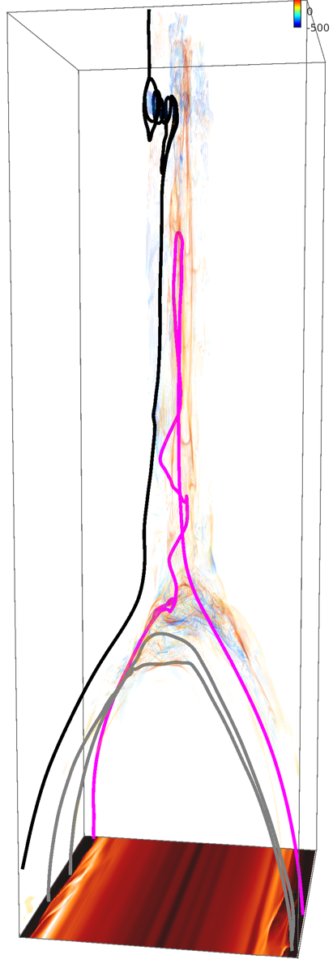
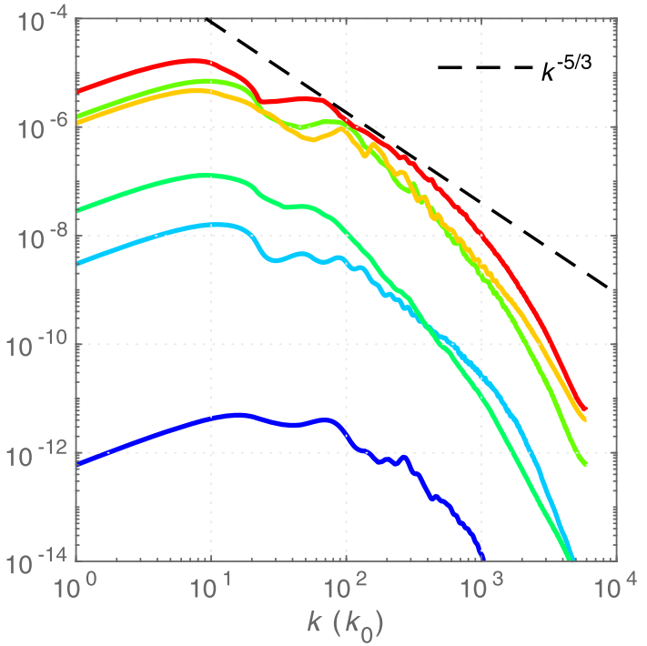
MHD model and method
- Key configurations
Particle injection:
Injection region
Around the principal reconnection point of ${\left\langle B\right\rangle }_{z}$;
$x∈\left(−0.01,0.01\right),y∈\left(0.65,1.0\right),z∈(−0.15,0.15)$
Initial energy
5 keV;
Single energy for simplification.
Injection rate
Constant rate.
Particle Boundaries
Periodic on guide-field direction;
Open on other directions
Diffusion coefficient:
Turbulence correlation length:
$1/L_{c}\sim 100$ (start scale of inertial region)
$σ^{2}=\left\langle δB^{2}\right\rangle /B_{0}^{2}\sim 1$: strong turbulence
$κ_{∥}=1.62ν^{4/3}L_{c}^{2/3}Ω_{0}^{−1/3}/σ^{2}$
$κ_{⊥}=0.01κ_{∥}$
CS
$$L_{c}$$
Notes:
This slide shows our key configurations.
We inject particles in this region. Their initial energy is set to single energy for simplifying discussion.
They are injected with a constant rate. The boundaries on the guide-field direction are periodic for particle. And the rest are open particle boundaries.
For the diffusion coefficient, the key parameters include the turbulence correlation length and the strength of turbulence.
The perp kappa is set to be 1% of para kappa similar to previous works.

Slide 12
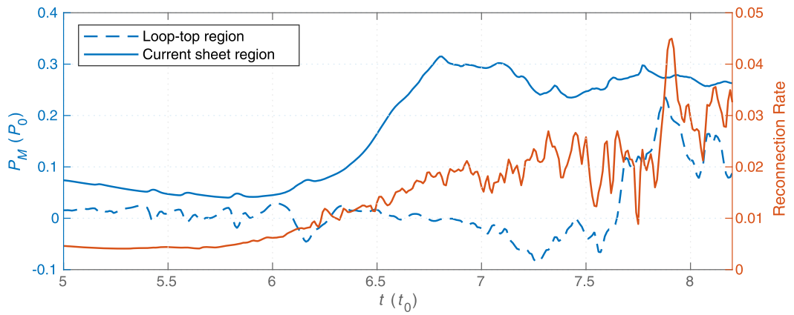
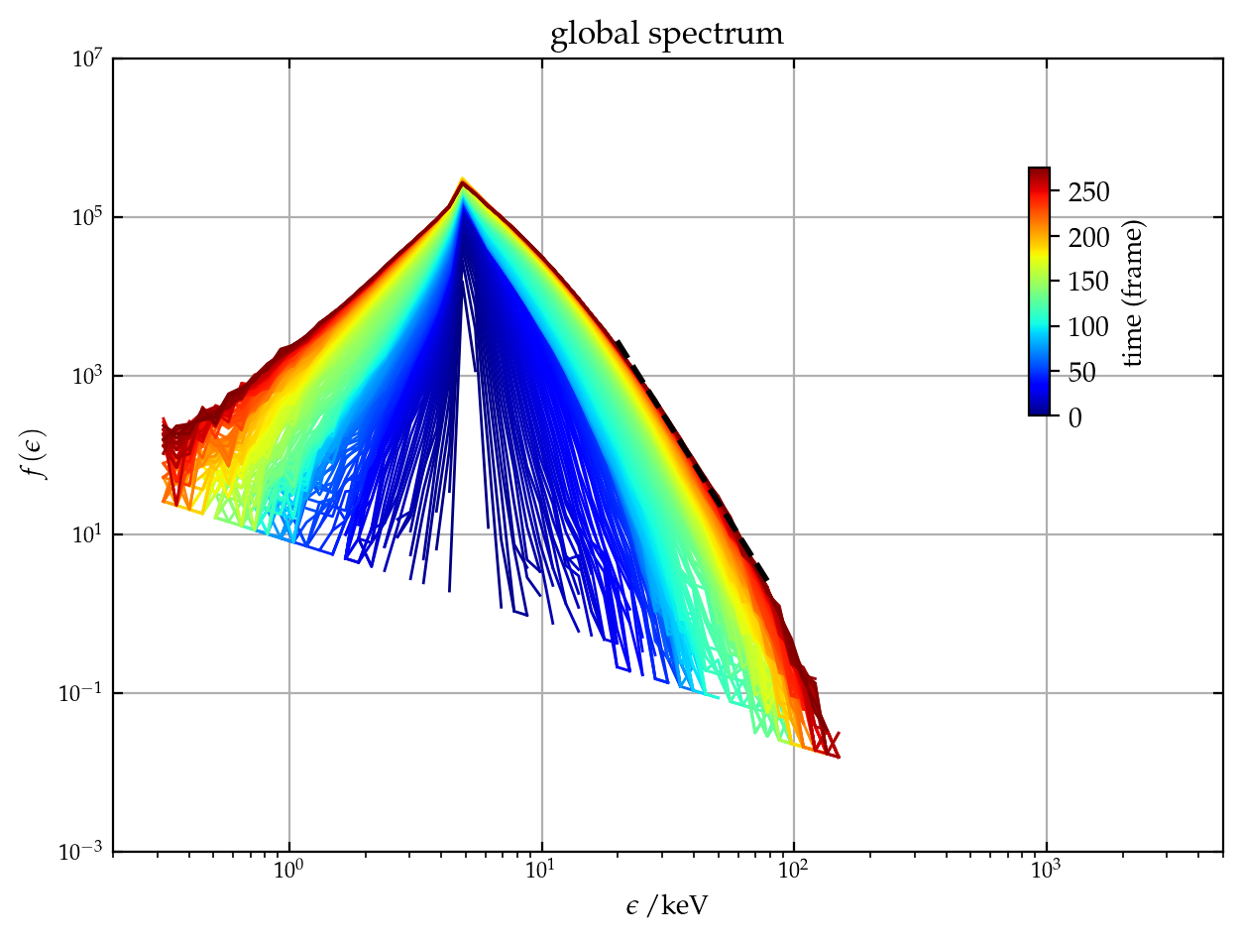
Results: Global Evolution
Spectrum in global region
Start injection
Energetic electrons first appear in the CS and are further accelerated at loop top;
Some can be accelerated to $>100$ keV;
A spectrum with a power-law region.
2-5 keV
5-16 keV
16-48 keV
48-140 keV
140-369 keV
Notes:
In this case, we start to inject at the rising phase of the fast reconnection. the MHD background also evolves with time.
The result shows that xxx.
So next we set several simple tests to figure out the detailed acceleration effects.

Slide 13
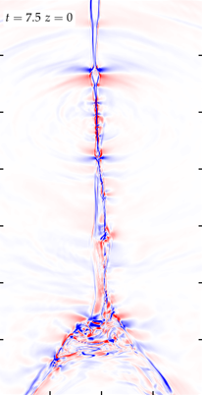
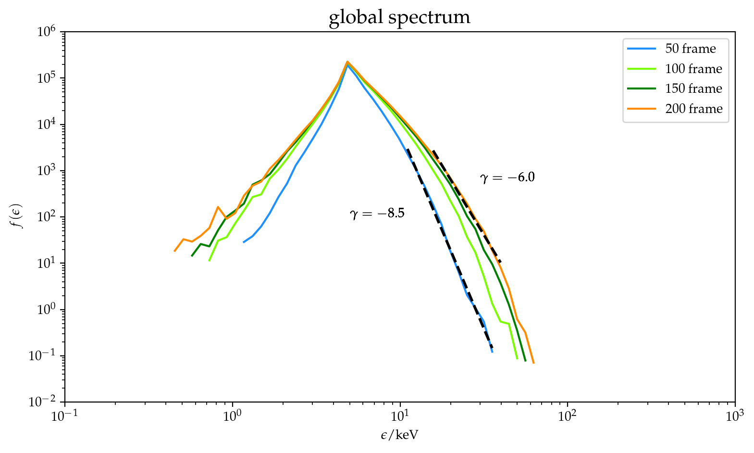
Results: Acceleration in Current Sheet
- Configuration
Fixed MHD background at $t=7.5$;
Remove the loop top region.
- Key message
At $t=7.5$, tearing-mode instability has shattered the CS into pieces. Many local reconnection flows form various small-scale shocks (with large $−∇⋅v$), which can accelerate electrons.
$$∇⋅v$$
2-5 keV
5-16 keV
16-48 keV
48-140 keV
140-369 keV
Notes:
In this case, we study the acceleration in only the current sheet.
We let the MHD field be fixed at the moment t=7.5. We also remove the loop top region to get rid of the effects of TS. We let the system evolve for 2 Alvfenic time.
It is shown that the particle can still be accelerated to form a power-law spectrum. This is because in the CS, there are many small-scale shocks.

Slide 14
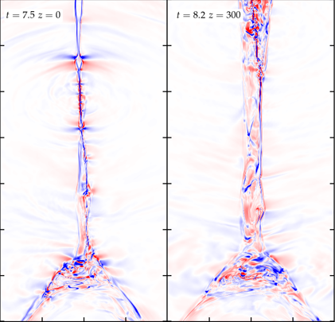
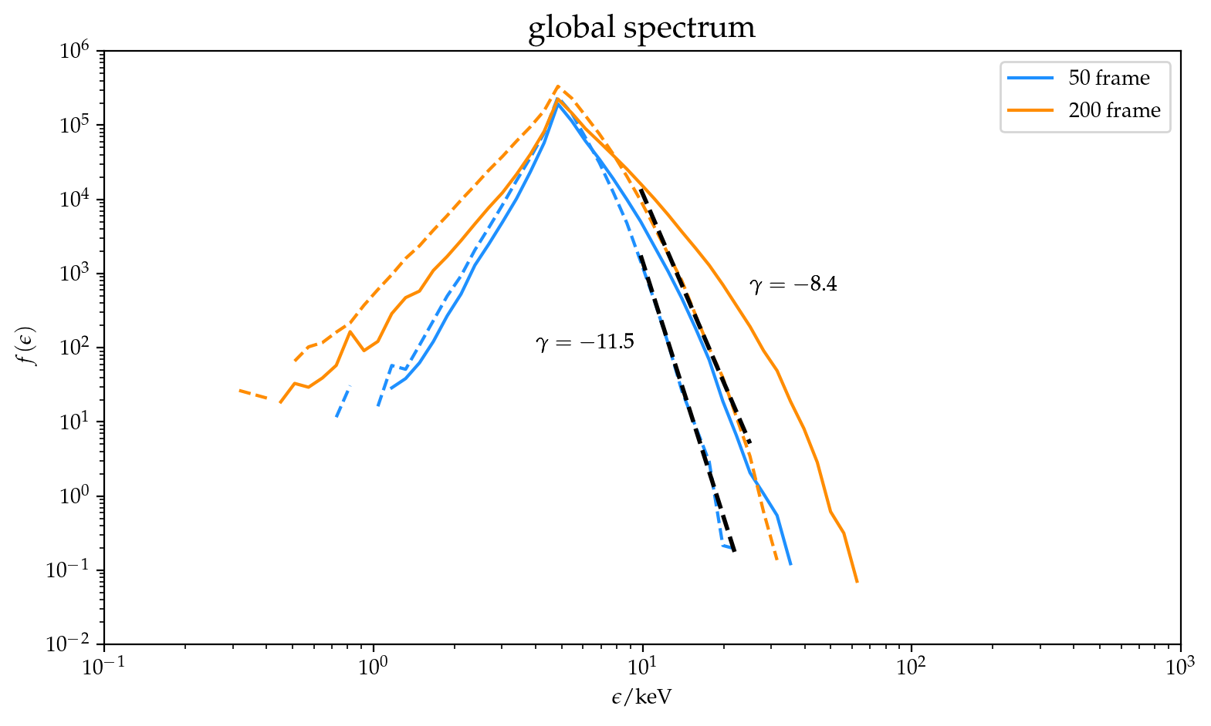
Results: Acceleration in Current Sheet
At $t=8.2$
Turbulence in CS is well developed;
Electrons can also be accelerated but with a softer power-law index compared with $t=7.5$.
Reason:
Guide field gets weak and the magnetic field becomes vertical, causing a fast loss of particles at upper and down open boundaries.
$$∇⋅v$$
$$t=7.5$$
$$t=8.2$$
Notes:
To compare, we run a similar case using the MHD data at t=8.2. At this moment, the turbulence in CS is well developed.
It’s shown that the particle can still be accelerated, but is not that good compared with t=7.5.
The reason is that at the 8.2 Guide field gets weak and the magnetic field becomes vertical, causing a fast loss of particles at upper and down open boundaries.

Slide 15
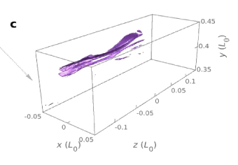
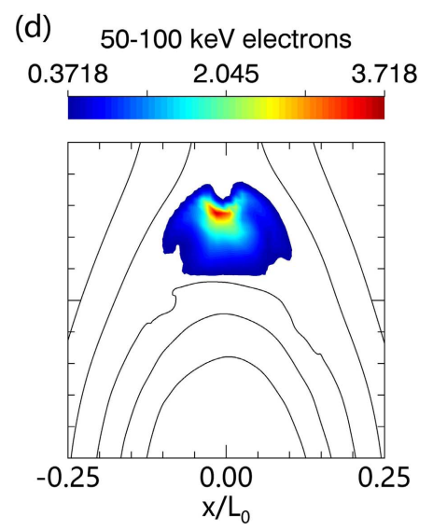
Results: Acceleration of Loop-top Shocks
- Configuration
Fixed MHD background at $t=7.5$;
Include the loop top region.
- Key message
The addition of a stable loop top TS significantly improves the acceleration;
Similar with 2D models.
The termination shock extends a large distance and relatively stable in time.
Similar with 2D models.
2-5 keV
5-16 keV
16-48 keV
48-140 keV
140-369 keV
Kong et al. 2019
Notes:
In the last test, we add the loop top region and the other settings are the same.
This slide shows the result at t=7.5; as shown by this figure, the xxxxxx .
It’s shown that the particles are effectively accelerated at the loop top, which is consistent with 2D results.

Slide 16
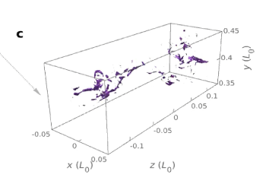
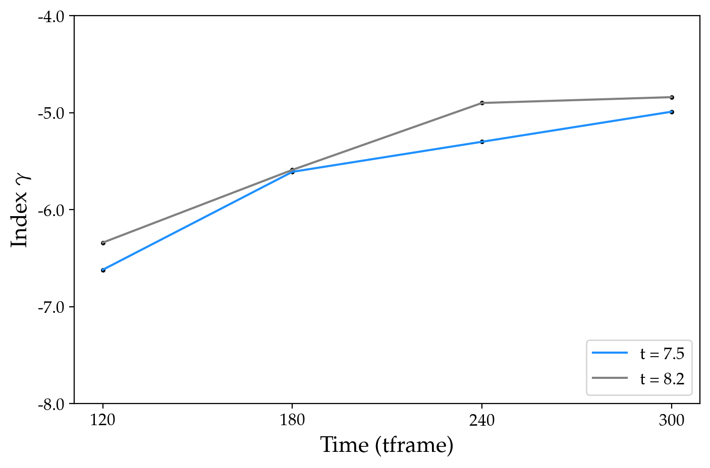
Results: Acceleration of Termination Shocks
- At $t=8.2$
Loop-top termination shock breaks into small pieces;
Highly turbulent loop top.
- Key message
The power-law index is similar as $t=7.5$;
Electrons are still be well accelerated at the loop top even without a termination shock.
Highly shattered termination shock
Notes:
Here we use the moment at 8.2 when the TS gets highly fragmented.
The results show that :xxxxx

Slide 17
Conclusions
With time-evolved flare MHD model of 3D turbulent reconnection, we show that electrons can be accelerated to > 100 KeV and power-law spectrum;
For a flare with stable 3D TS, the acceleration is highly efficient, consistent with what found by previous 2D models;
Besides at TS, electron acceleration also works at the turbulent CS, although slightly efficient, well explaining the CS MW emissions;
The loop-top TS may be not necessary because the electrons can be accelerated to the same outcome even though it is totally fragmented.
Questions and Comments!
Notes:
To conclude,

