Slide 1







26 November 2023 – Università di Catania – Dip di Fisica
SKA Regional Centres (SRC):
the development plan
Andrea Possenti

Slide 2
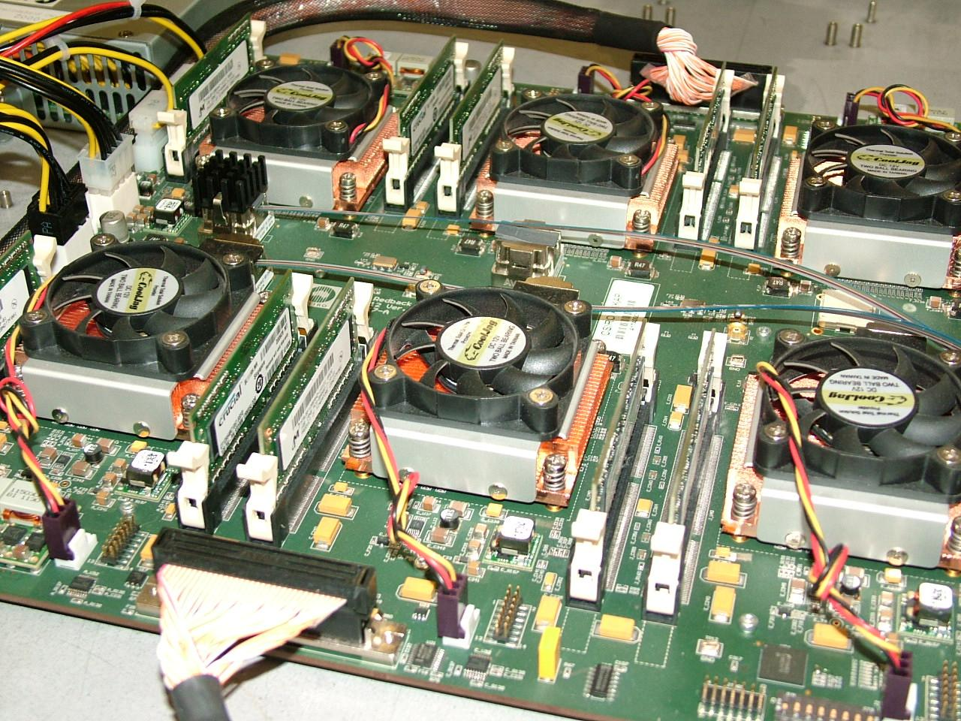



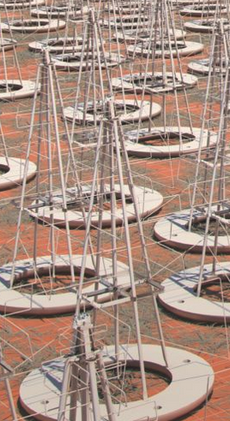
The SKAO data flow
CSP: Central Signal Processor
5 Tb/s
data buffer of 2 weeks
SDP: Science Data Processor
SRC: SKA Regional Centre network
e.g. FPGAs in the ASKAP correlator
SRC
5 + 9 Tb/s
data buffer of 2 minutes
SRC
e.g. SDP prototype, Cambridge
SRC
SKA portal
SRC
SRC
600 PB/yr
data persistence
Distributed facilities
USERS
Adapted from Philippa Hartley (SKAO)

Slide 3
The aim of the Ska Regional Centres (SRCs) and the birth of the SRC-SC
July 2016: the SKA Board deliberated:
“The SKA Observatory will coordinate a network of SKA Regional Centres that will provide the data access, data analysis, data archive and user support interfaces with the user community”
November 2018: the SKA Board deliberated:
“The mission of the SRC Steering Committee (SRC-SC) is to define and create a long-term operational partnership between the SKA Observatory and an ensemble of independently-resourced SKA Regional Centres.”

Slide 4
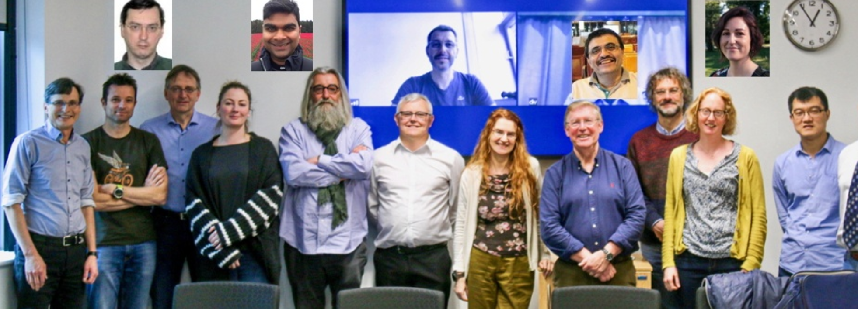
The SRC-Steering Committee (SRCSC)
Karen Lee-Waddell
Severin Gaudet
An Tao
Jean-Pierre Vilotte
Hans-Rainer Kloeckner
Yogesh Wadadekar
Andrea Possenti
Akahori Takuya
Hyunwoo Kang
Michiel van Haarlem
Tiago Peres
Fernando Camilo
Lourdes Verdes-Montenegro
John Conway
Emma Tolley
Rob Beswick
Antonio Chrysostomou
Rosie Bolton (secretary)
Australia
Canada
China
France
Germany
India
Italy
Japan (observer)
Korea (observer)
The Netherlands
Portugal
South Africa
Spain
Sweden
Switzerland
United Kingdom
SKA Organisation

Slide 5
The statute of the Ska Regional Centres (SRCs)
November 2018: the SKA Board also deliberated:
“The SRC-SC will be superseded in due course by the operational partnership that is formed as a result of its work”
SRC-SC and SKAO have been drafting an agreement during these weeks about the new government, rules and roadmap for the core activities of the SRC network
January-February 2024: the Council will review and hopefully finally endorse the plan

Slide 6

The responsibilities of the SKA Observatory and of the Ska Regional Centres (SRCs)
The SKA Observatory and the SRCs will be jointly responsible for:
a) maximizing the quality of SKA data delivered to users;
b) the production of Advanced Data Products;
c) storing, archiving and curation of the primary SKA output data and of the Advanced Data Products;
d) ensuring that the approved science program can be accommodated within available resources;
e) ensuring the availability of a platform of distributed services across computational and data infrastructures to support the user community to deliver SKA science, under the FAIR principles.

Slide 7
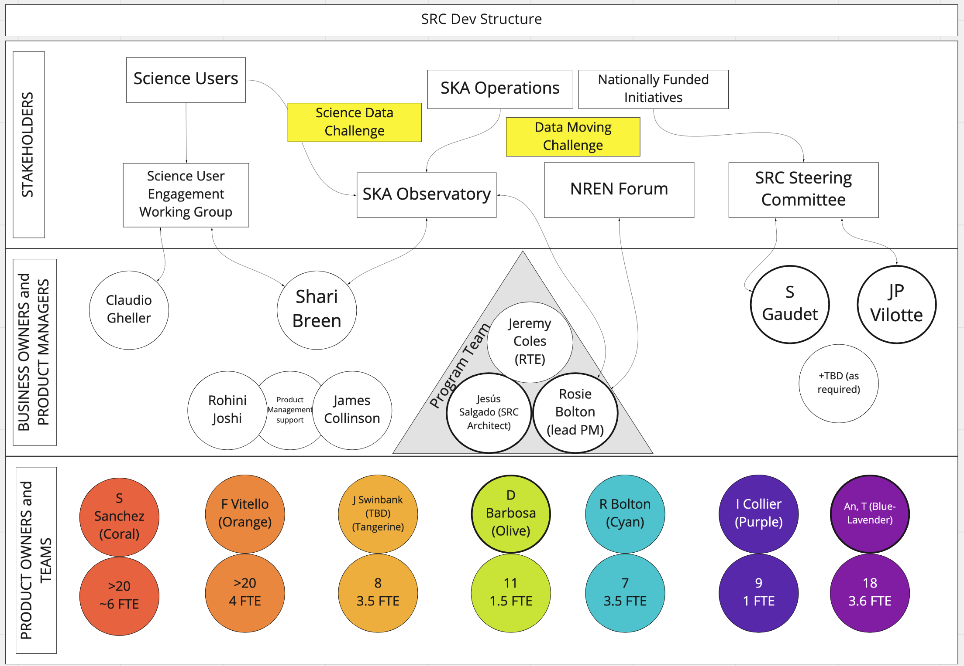
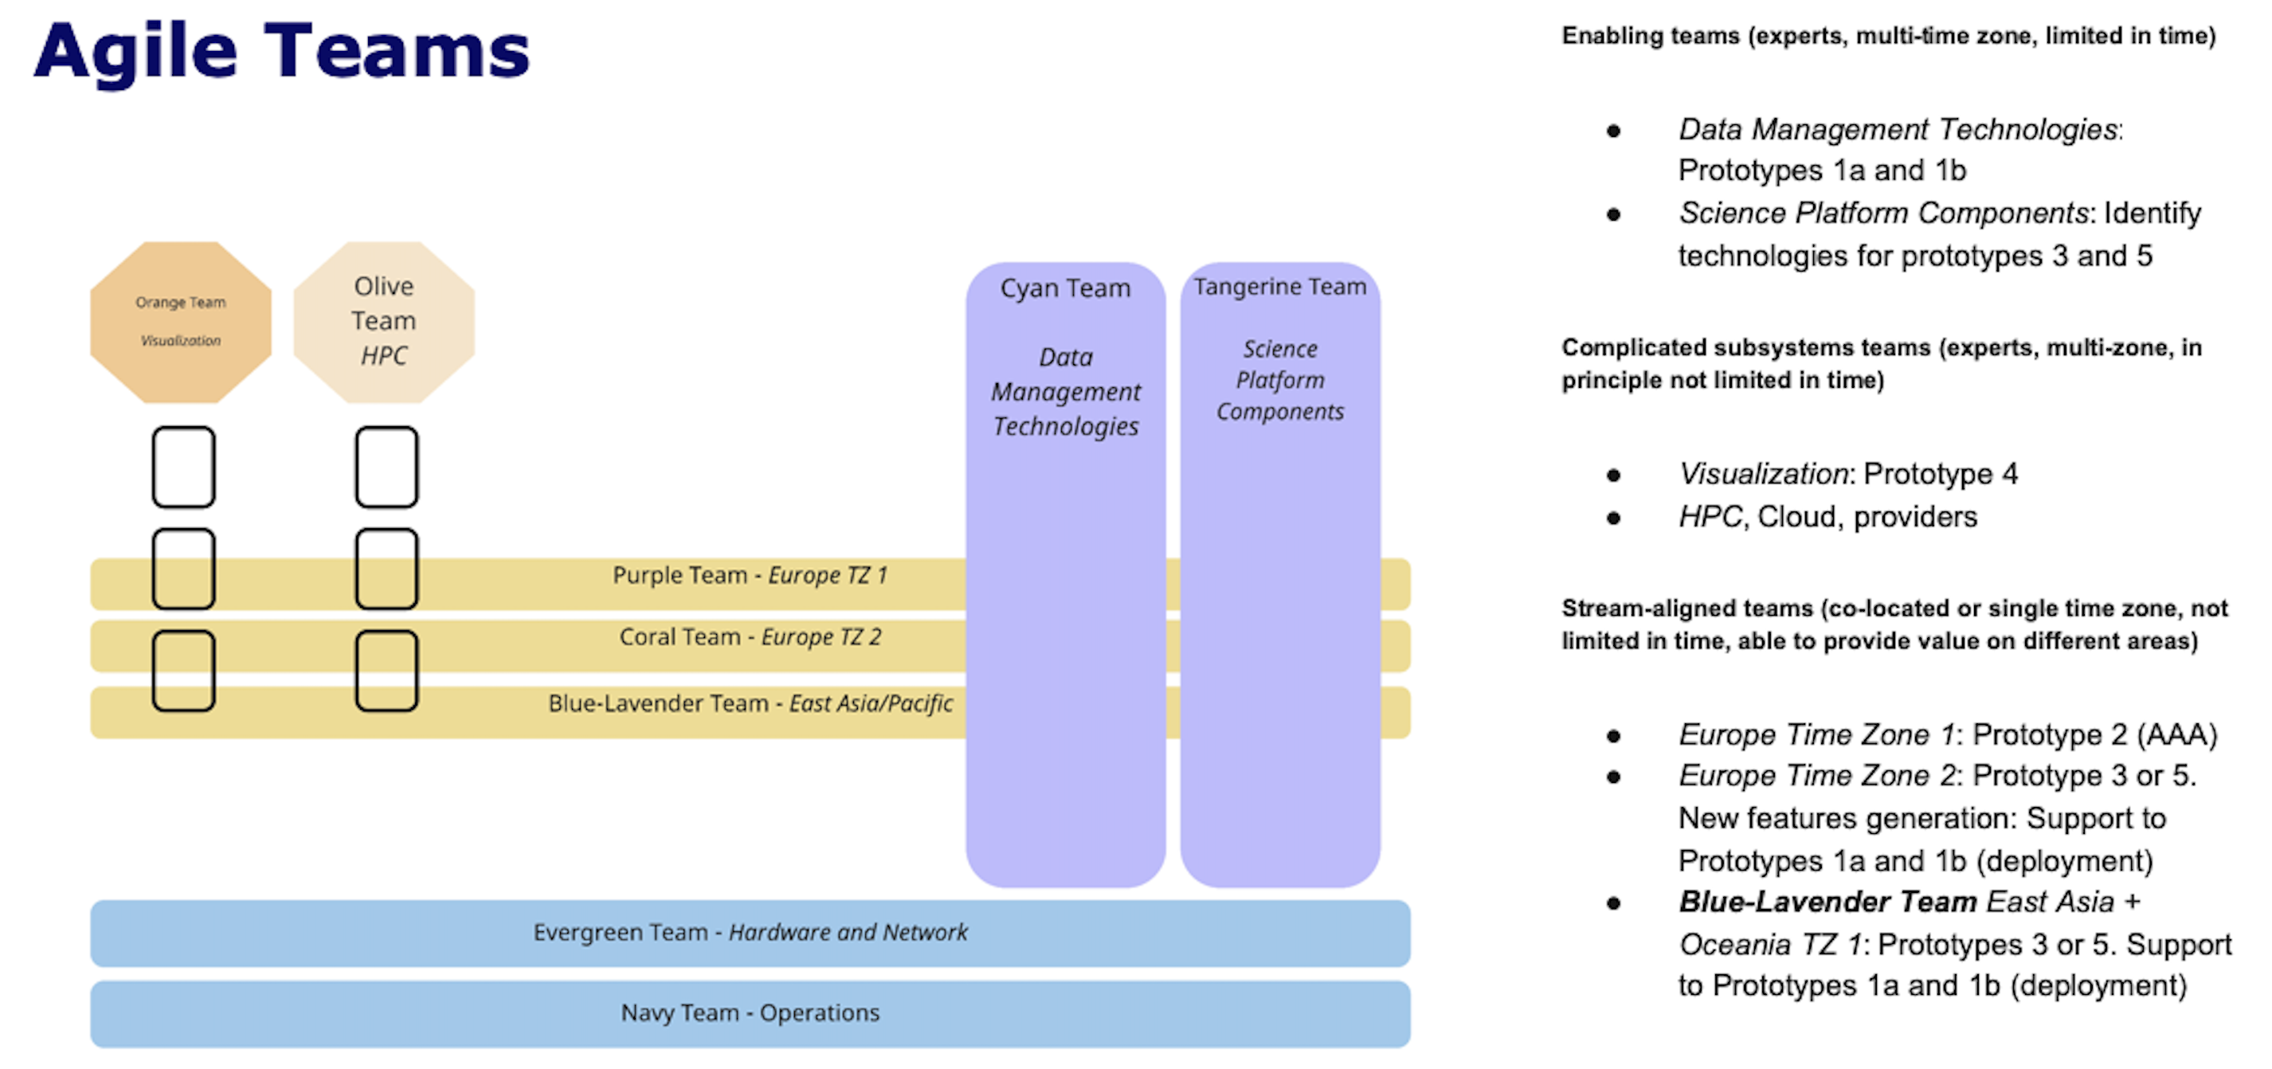
The working structure: the Agile Teams

Slide 8
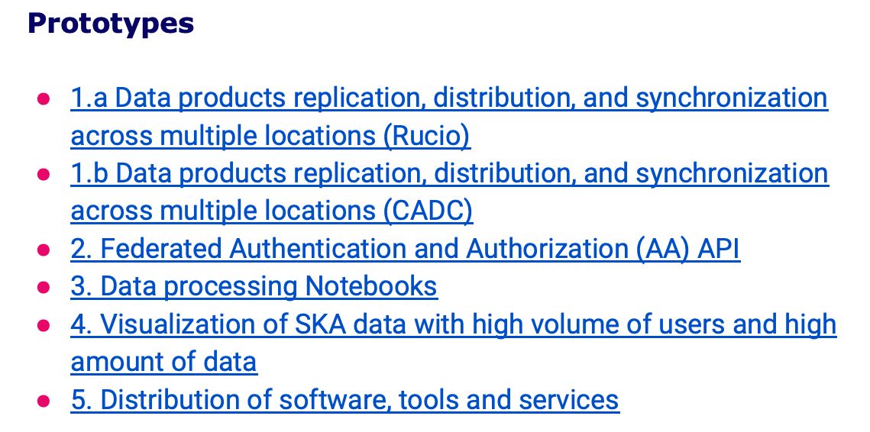
The ongoing work: The prototypes

Slide 9
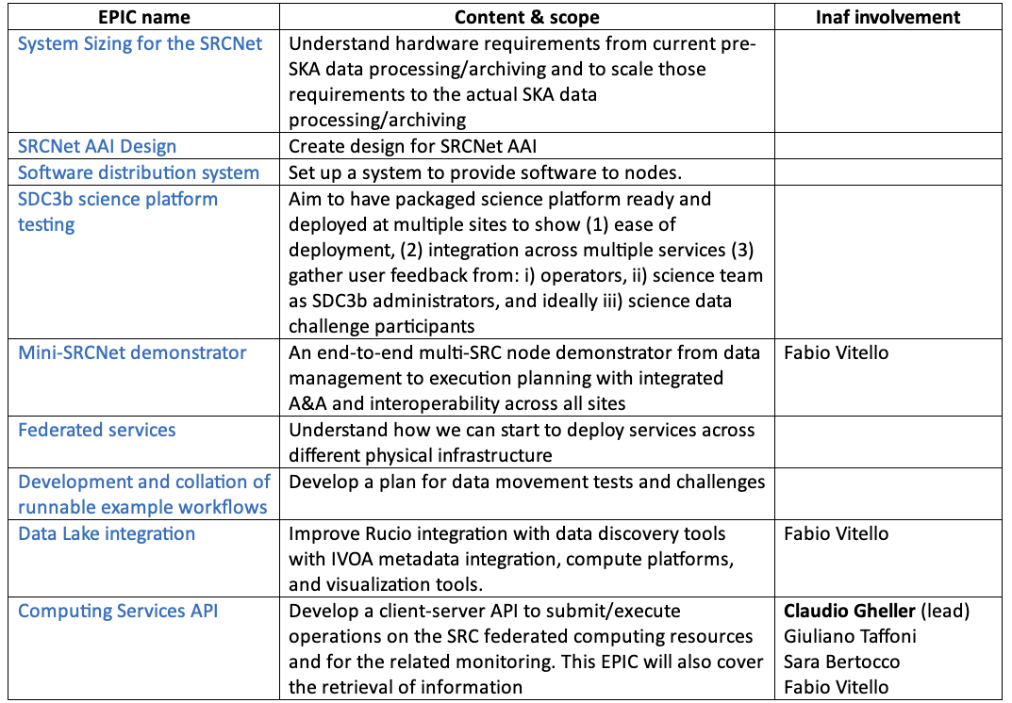
The Epics

Slide 10
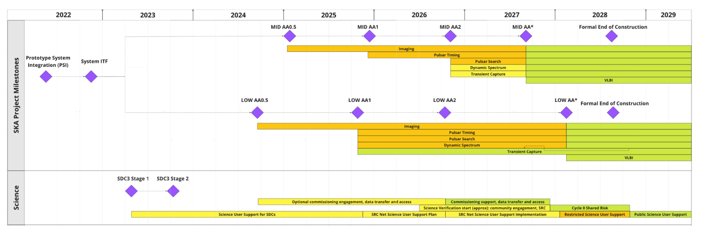
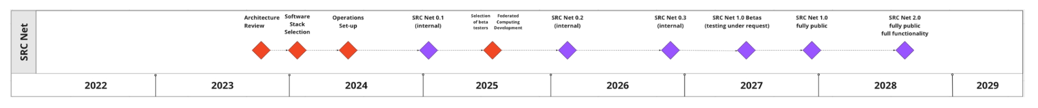
The Roadmap of the SRCnet
Preliminary Plan
SRCnet v2.0 at end of construction
SRCnet available to support AA2
SRCnet v1.0 to support Cycle 0

Slide 11
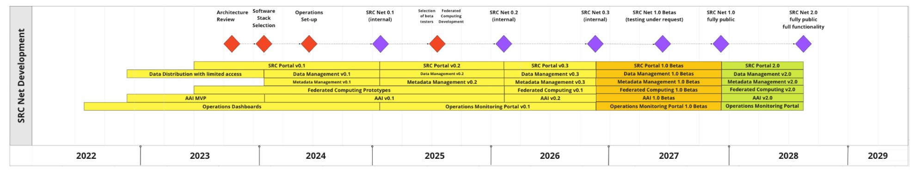
The Roadmap of the SRCnet
Preliminary Plan
SRCnet v 2.0 at end of construction
SRCnet available to support AA2
SRCnet v 1.0 to support cycle 0

Slide 12
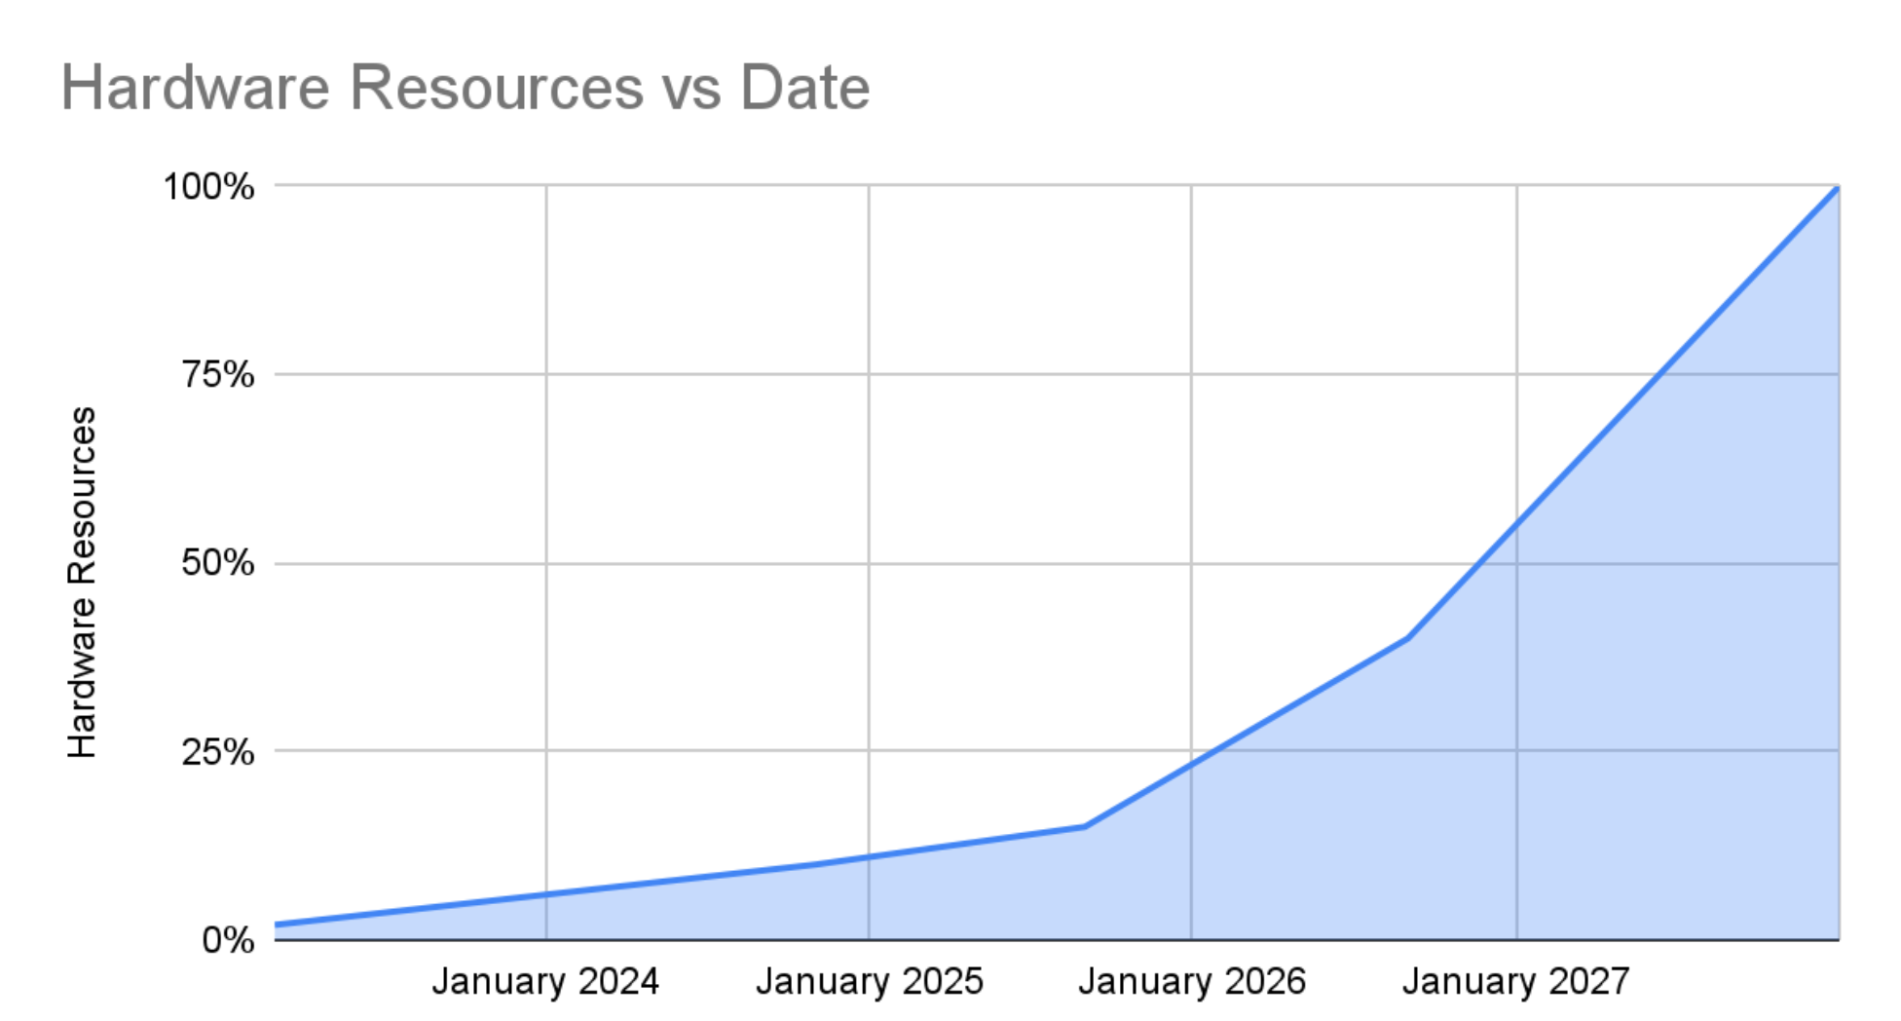
Hardware resources growth
Preliminary Plan

Slide 13
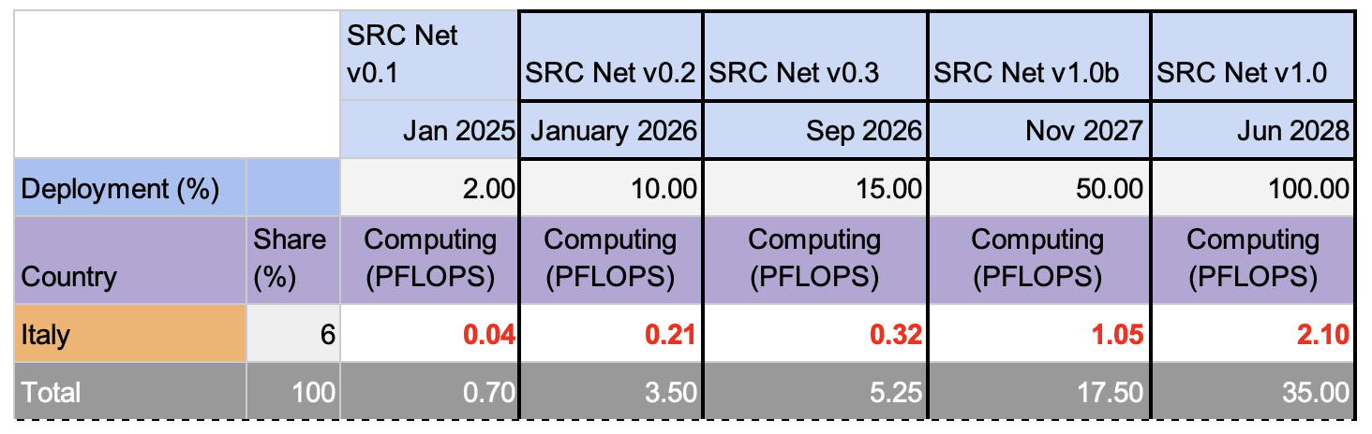
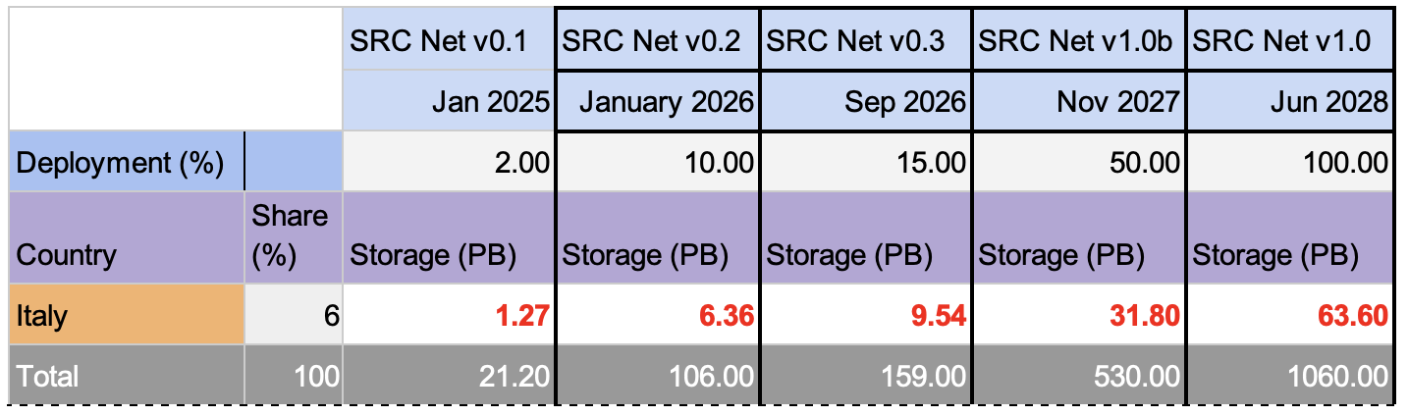
Some early estimates
Preliminary Plan

Slide 14
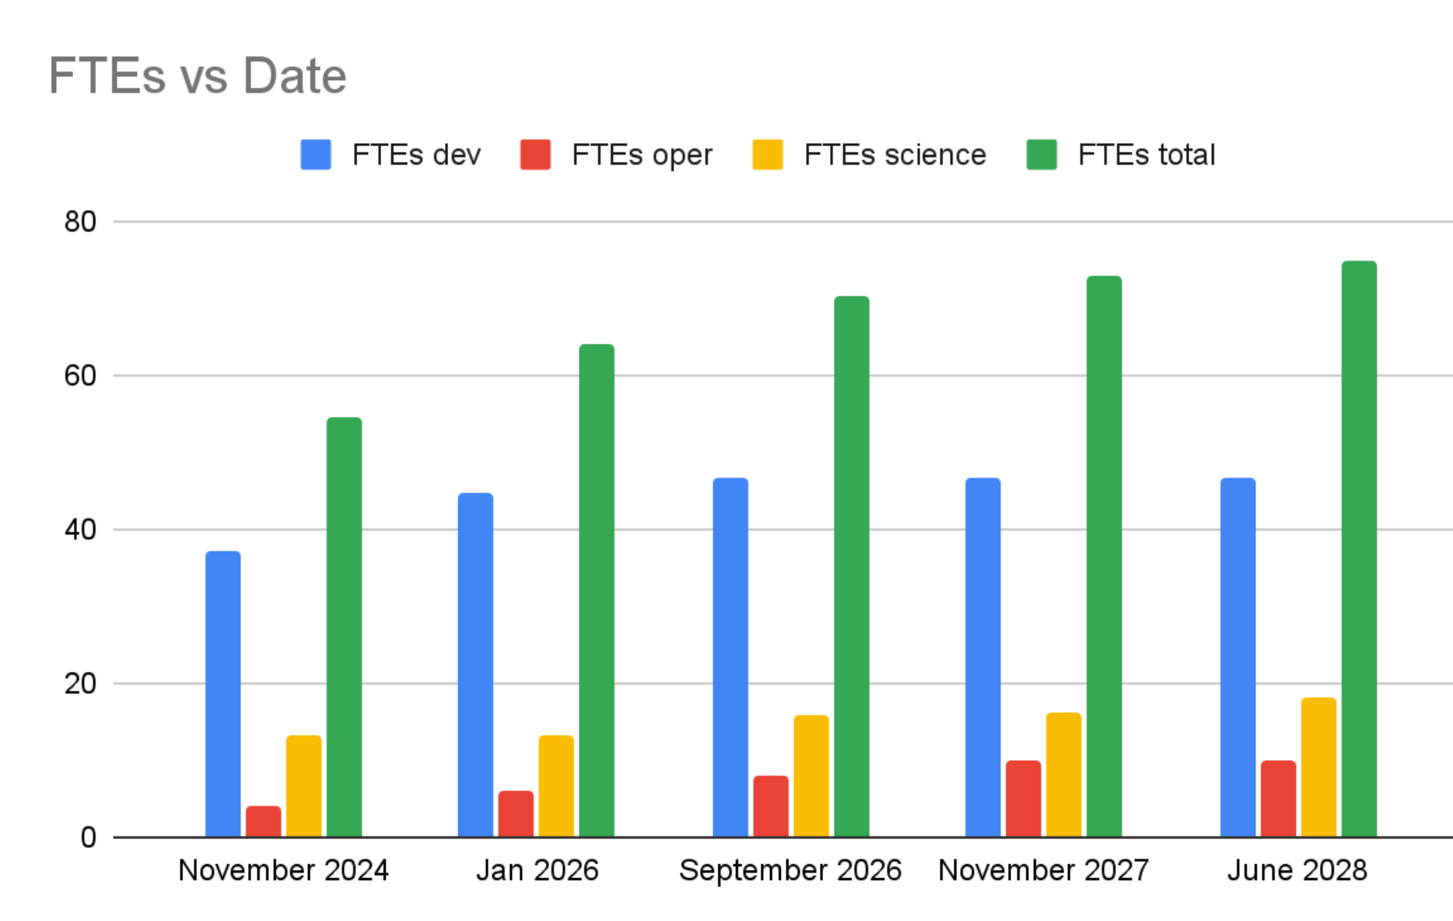
Human resources growth
Preliminary Plan

Slide 15

Italian expected outcome of the SRC network foundation
1. The identification of a kernel of “modi operandi” in the interactions among the various actors to secure an efficient, persistante, and always developable science-needs driven system
2. The establishment of a SRC network with a significant node located in Italy
3. The recognition of the local investments in both hardware and human expertise, and its conversion into incentives as soon as possible

Slide 16
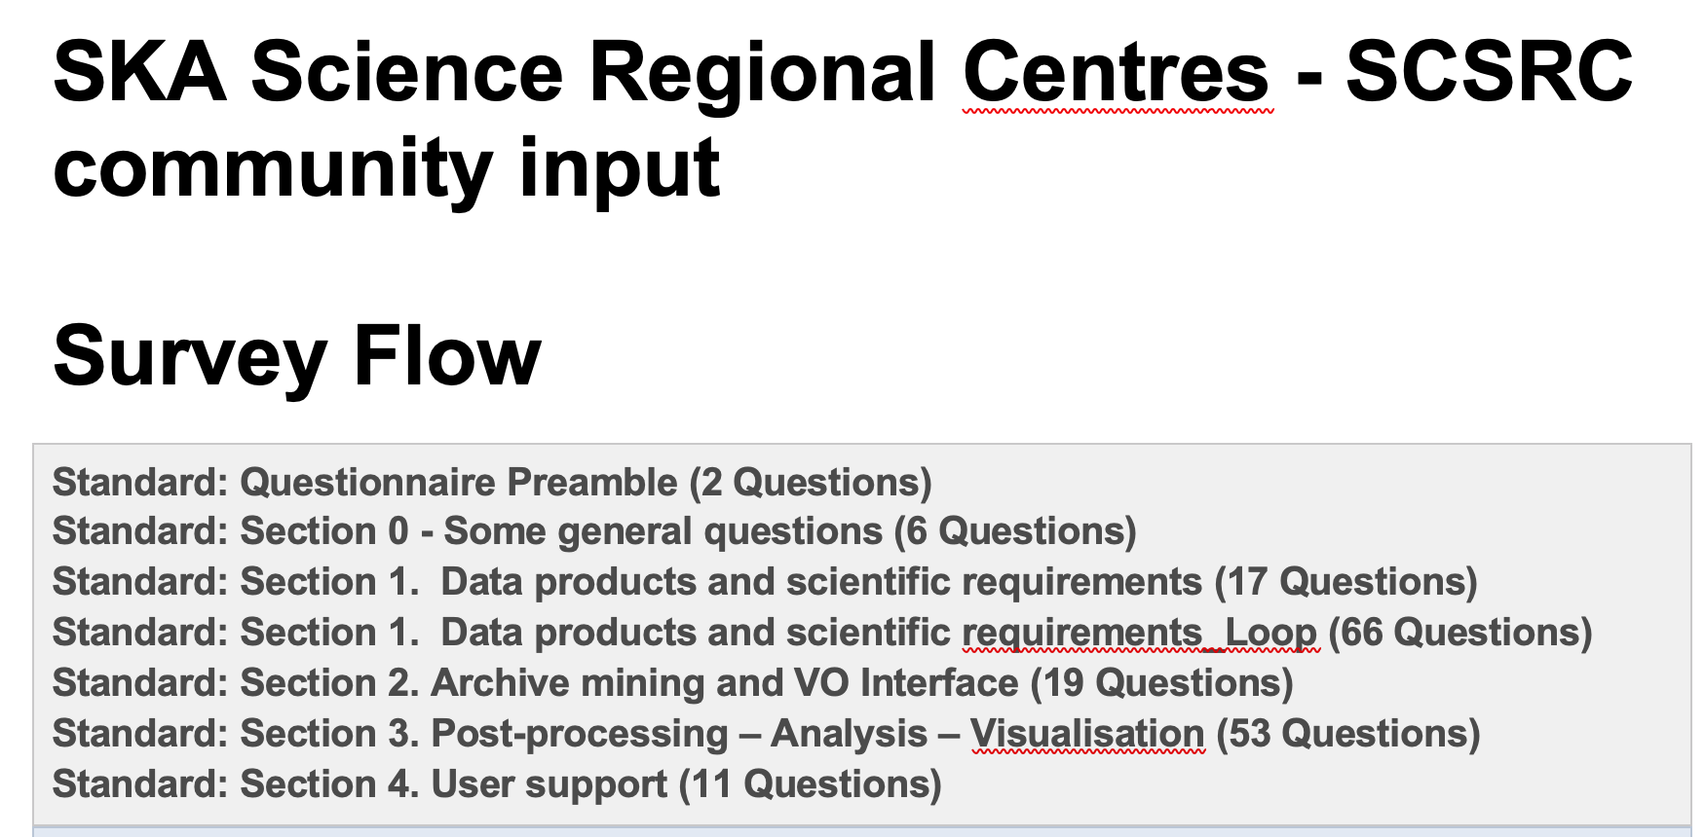
The Italian contribution to the global effort
science
≈ 100 Italian astro-scientists are members of the SKA Science Working Groups!
Develop requests and imagine solutions to the USE CASES for the SRC network
+
Staying at the frontline in ADAPTING to the new way for doing data reduction and computation in the SKA era
+
Exploit experience in precursors & pathfinders to provide suggestions and solutions
The Questionnaire for the SWGs: 174 questions!

Slide 17
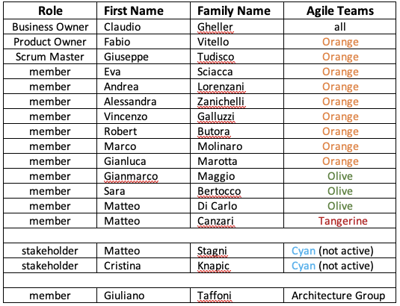
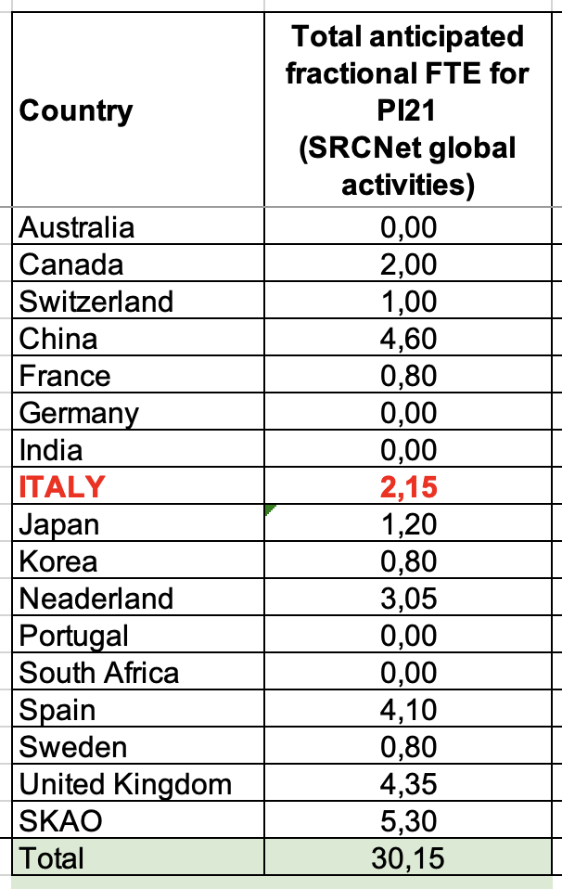
The Italian contribution to the global effort
expertise

Slide 18
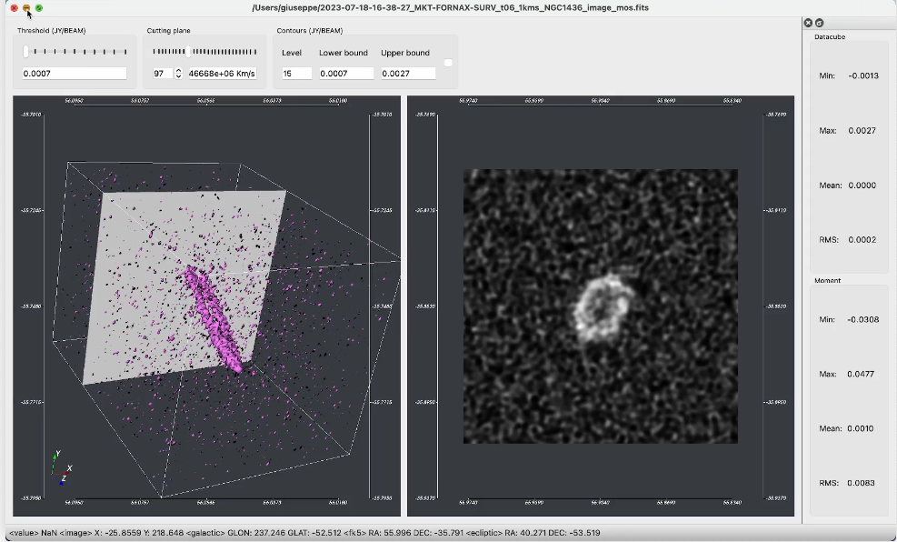
The work of the Orange Team
Started with working on Prototype 4: Visualization in PI15 (June 2022)
Contributing to the definition of visualization use cases for SRCNet
Visualization Tools review (dependencies, interfaces, workshop)
Collection of data products and data formats from precursors and pathfinders
Adapting Visualization Tools to address use cases and work with SRC architecture and its data lake
Development, testing and deployment of SODA (Server-side Operations for Data Access) into SRCNet, integrated with Rucio Data Lake and Discovery services
Review of Solutions and Technologies for the Computing Services API
Testing and deployment of visualization tools and data access services into SRC nodes
Courtesy Tudisco & Vitello

Slide 19
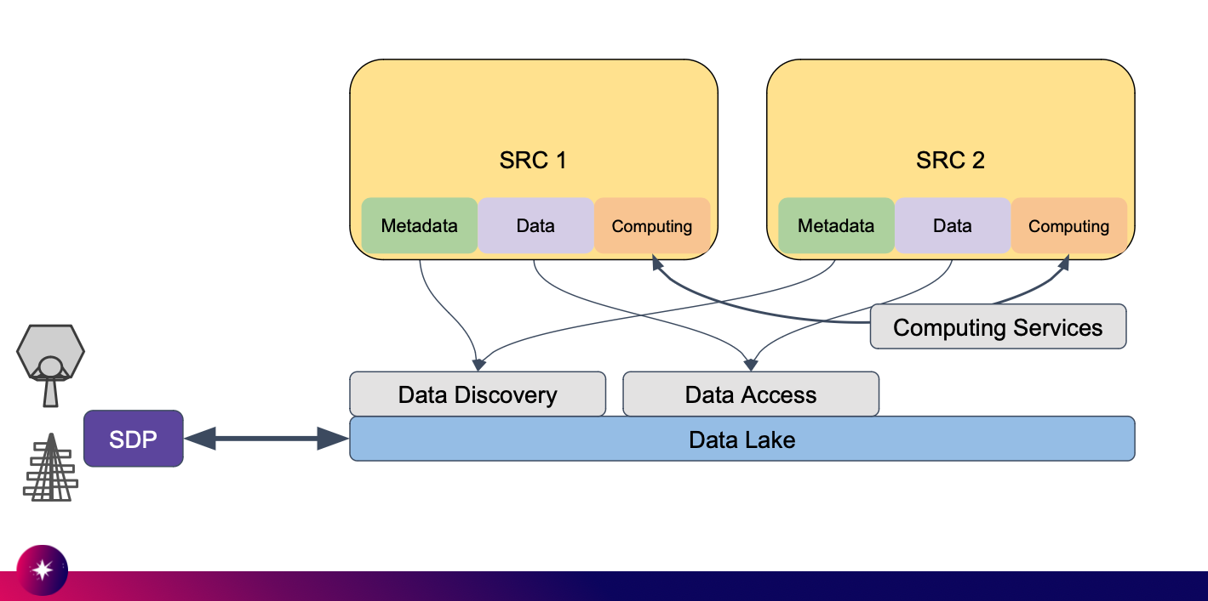
The work of the Orange Team
the next steps
Contributions on the following SRCNet Epics
Mini SRCNet Demonstrator
  Benchmark and Optimization of SODA performances
Data Lake Integration
  Adapt SODA to work with storage manager service (SRM)
  Collection and classification of heterogeneous datasets from precursors and pathfinders for testing services and tools
Computing API
Adapt SODA so that it can process requests through the Computing API (Application Programming Interface)
Adapt VisIVO to invoke cutout and visualize data through the Computing API (Application Programming Interface)
image credits:Jesús Salgado - SKA Regional Centre Architect
Courtesy Tudisco & Vitello

Slide 20
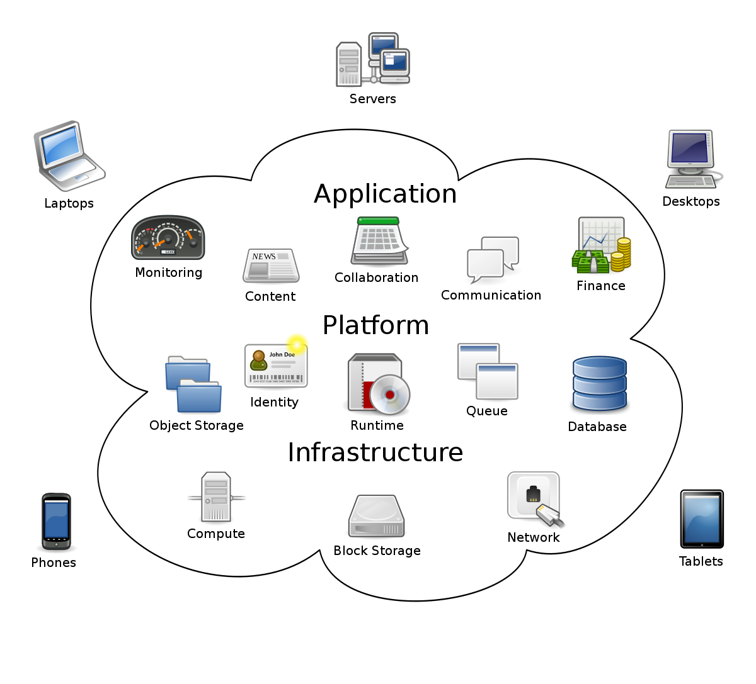

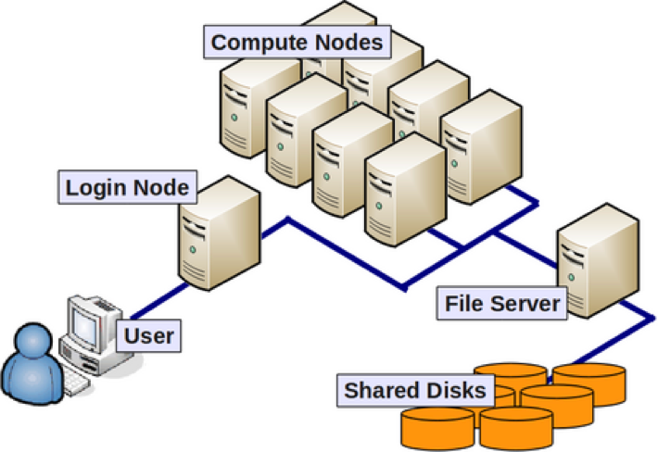

The work of the Olive Team
Contributions on Computing API (Application Programming Interface)
Discussion
Use cases
Requirements
Authentication and Authorization
Solutions
  ExecutionPlanner ?
  Dirac ?
  Others ?
Computing
API
SKA User
Cloud
compute
Local compute
Clusters
HPC/HTC compute
Courtesy Bertocco & Maggio
Notes:
Commento: stiamo partecipando al lavoro di definizione di use cases, requisiti e soluzioni per realizzare delle API che mettano l'utente SKA in grado di utilizzare diverse infrastrutture di computing (cloud, cluster HPC ed HTC, piccole risorse per il calcolo locale) in maniera trasparente. In particolare partecipiamo ad un gruppo di lavoro che discute il caso dei cluster per HPC che hanno delle peculiarità nelle policy di accesso di cui bisogna tenere conto in fase di progettazione e sviluppo.

Slide 21
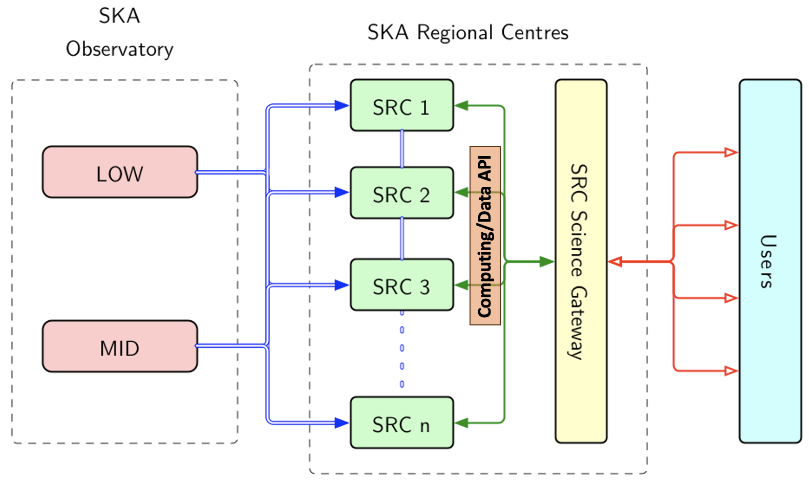
The Epic about Computer Service API (Application Programming Interface)
Aim: design & implement an Application Programming Interface (API) to
Discover computing services, answering the question "what computing services are available and suitable to run my task?”
Access computing services, answering the question "how can I run my task on the selected computing service (and when)?”
THE FOCUS IS NOT ON THE TECHNOLOGY, BUT TO PROVIDE AN ABSTRACTION ABOVE TECHNOLOGY
Courtesy Gheller
Notes:
What is an Epic?
In agile development, an epic represents a series of user stories that share a broader strategic objective. When several epics themselves share a common goal, they are grouped together under a still-broader business objective, called a theme.
Another important distinction is that a user story can be completed within the timeframe of an agile sprint. An epic will typically require development work covering several sprints.

Slide 22
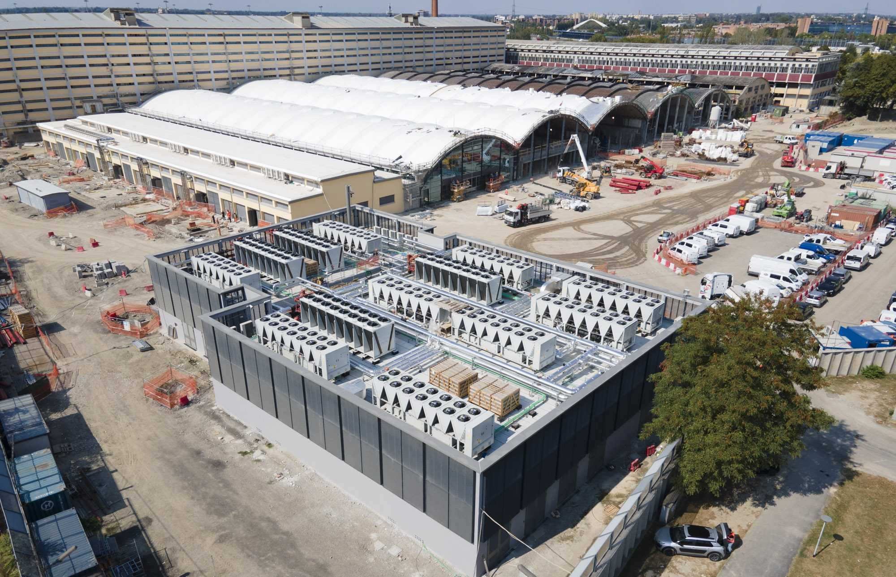
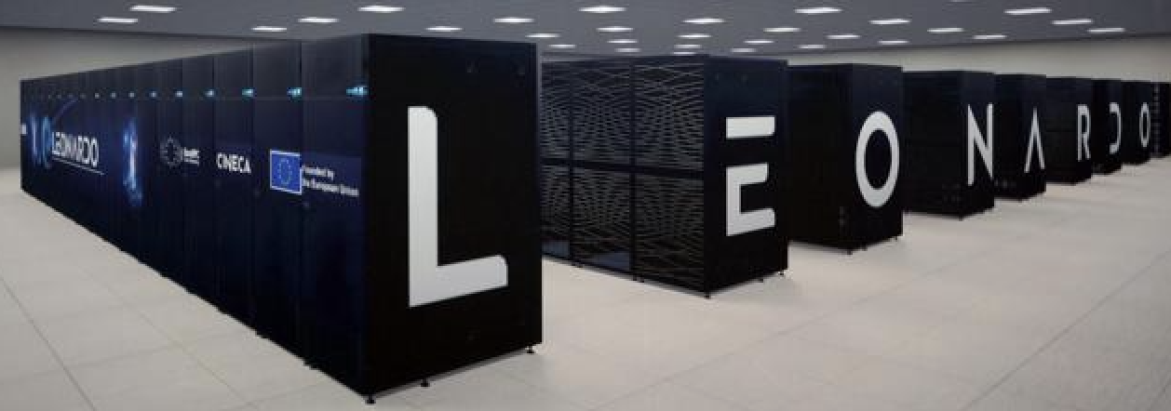
The Italian contribution to the global effort
hardware: initial assets
Acquisition of ≈1.5 PetaFlop/s (with a combination CPU and GPU) and ≈11 PBy (combined between fast disks for computing and tapes for long-term preservation) Tier-3 computing system, to be installed inside of one of the CINECA areas at the Bologna Technopole
The Technopole already hosts the European weather centre ECMWF, the Leonardo super-computer and will host the United Nations University on Climate Change
Use of a Tier-2 sizing system integrated into a Tier-1 sizing system and becoming the kernel of the Italian node of the SKA Regional Center. Investment of the CN-PNRR for the needs of INAF and CNR owned by CINECA, with guaranteed (non-exclusive) use for INAF. Expected for INAF: about 4 PetaFlop/s (Data Centric Nodes and Booster Nodes) and ≈2 PBy high speed storage

Slide 23
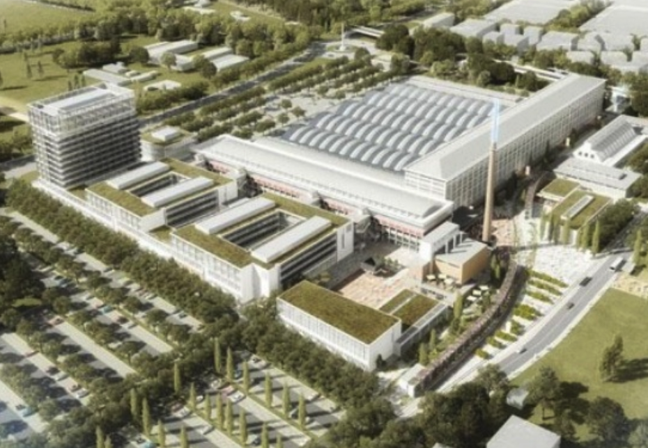
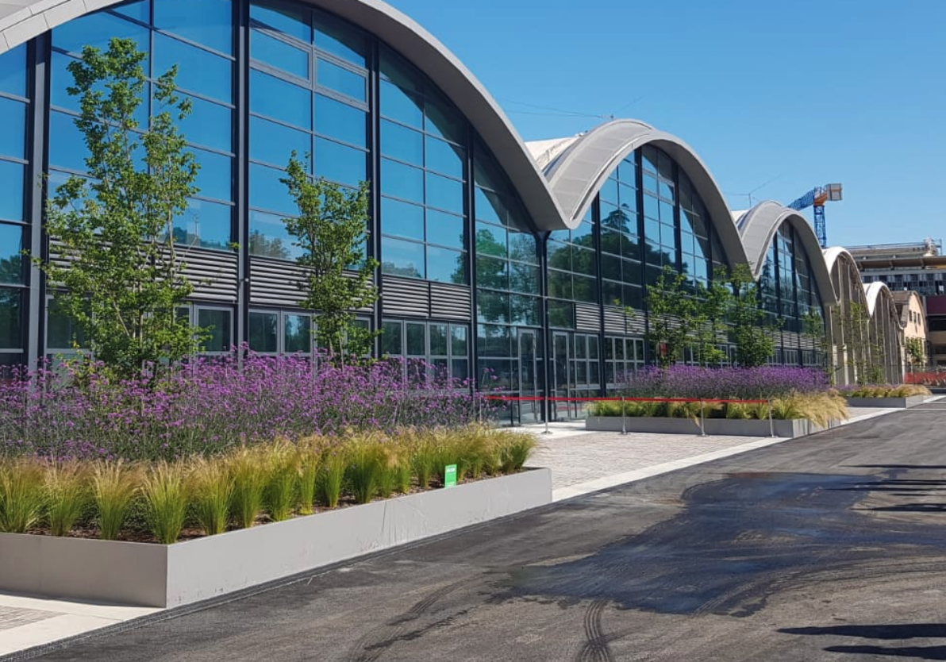
The development of the INAF node
hardware on the longer term (beyond 2024)
1st Step in the Global effort: We will begin with a Tier-3/Tier-2 protoSRC by the end of the 2024 (v 0.1 of the SRCnet node)
2nd Step in the Global effort: … and progressively attain, by mid 2028, a Tier-2/Tier-1.5 size system (v 1.0 of the SRCnet node) with capability of ≈ 2 Pflops and ≈ 60 PBy of storage (30 PBy on-line and 30 PBy near on-line), connected at 100 GB/s with the other nodes
3rd Step in the Global effort: … and finally, by 2030, a Tier-1 size infrastructure with capability of ≈ 3+ Pflops and ≈ 150 PBy/yr of storage (45 Pby on-line and 105 Pby/yr near on-line), connected at 100 GB/s with the other nodes (v 2.0 of the SRCnet node)
Technopolo - Bologna
National effort: growing in parallel an infrastructure with capability of ≈ 5+Pflops and ≈ 1o PBy/yr of storage connected at 100 GB/s with the other nodes for the national needs related to precursors/pathfinders and to exploitSKA data and SKA archives

Slide 24
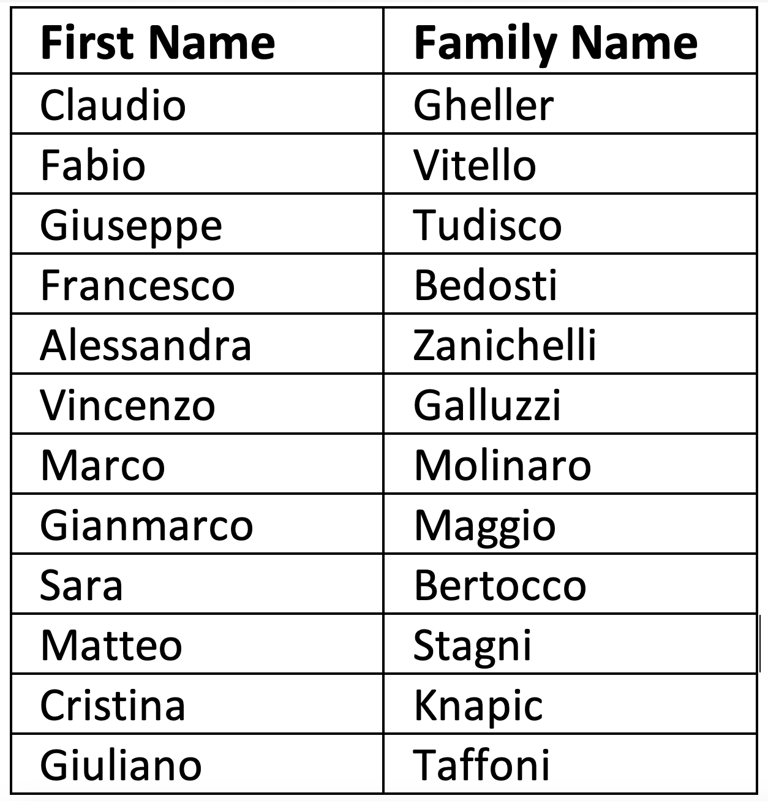
Roadmap of the INAF node: the national effort

Slide 25
Roadmap of the INAF node: the national effort
SRC.IT prototypization
Objective: create a first prototype of Italian SKA Regional Center
integrated in SRCnet v 0.1
On-going tasks:
Set-up of a data-lake based on object storage solutions (S3+CEPH)
  Deploy RUCIO on the top of the distributed repository
  Connect to the RUCIO based SRC data infrastructure
  Experiment VLKB solution for metadata management
Deployment of computing services for on site data-local analysis and visualization
  Access through the Computing API
  Analysis af SKA supported AAI approaches
  Remote visualization
Courtesy Gheller

Slide 26
Global and national effort for the INAF node
the need of personnel
to match the Italian percentage involvement in the SKAO construction, at least 6 FTE must be devoted to the SRC network at regime
to run a significant Italian node of the SRC network, about 10 FTE are needed at regime
now
2024
2025
2026
2027
2028
2029
2030
2.2 FTE
4 FTE
6 FTE
7 FTE
8 FTE
9 FTE
10 FTE
10 FTE
The role of this team will mainly be
(a) understanding of the operations of the data acquisition systems,
(b) operating, jointly with SKAO, the network that will oversee the data analysis/curation/archiving,
(c) developing of scientific software, with the fundamental aid of the national and international scientific community
(d) interacting with and help the users in the preparation and management of the observing programs

Slide 27
Thank you !
Thank you !

