Slide 1

Interoperable Data Lake (IDL)
Carolina Berucci
Spoke 3 Technical Workshop, Trieste October 9 / 11, 2023
ICSC Italian Research Center on High-Performance Computing, Big Data and Quantum Computing
Missione 4 • Istruzione e Ricerca
Notes:
Cover

Slide 2





Summary
Data Space & High-Level Technical Concepts
Interoperable Data Lake - General Objectives
Activities & Work Packages structures of the project
        INFN - DataLake & BlockChain system
      INAF - Data Models and metadata definition
      Leonardo - Database technology
      Thales Alenia Space - Architecture and Algorithms for SSA Processing
Project management structure
Deliverables and milestones
Centro Nazionale di Ricerca in High-Performance Computing, Big Data and Quantum Computing
Missione 4 • Istruzione e Ricerca

Slide 3
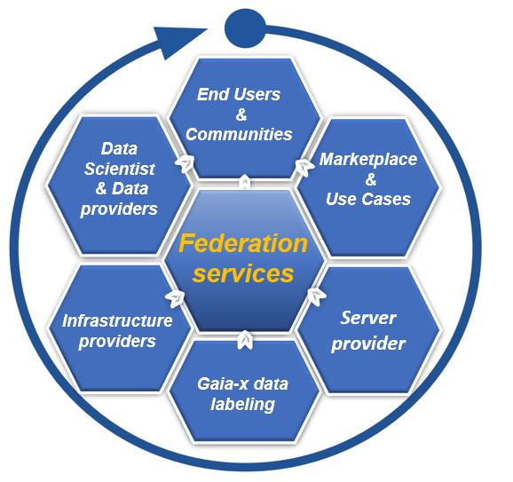
Space Data Space
Our objective is to facilitates access to space data, to foster innovation and to help attract new potential partnership
The Space industry is characterized by the sharing economy, there is a more open, wider market participant outreach that includes academic, commercial and governmental players.
Our solution is a data exchange platform, builds on existing infrastructures (CN HPC), where data acquirers and data providers meet to source, distribute, exchange data securely, in compliance with Gaia-x regulations
The initiative combines platforms and different ecosystems that all follow a common set of rules and policies and deploy a common marketplace to enable a Federated Data Ecosystem
Centro Nazionale di Ricerca in High-Performance Computing, Big Data and Quantum Computing
Missione 4 • Istruzione e Ricerca

Slide 4


Embedding space ecosystem into data value chain
Data sources
Standardized data
Optimized data
Sharing models
Data use
Input sensor and data layer
Aggregation and normalization of data within local, interoperable repositories
Sharing prerequisites through harmonized access management
Depending on the legal basis and use case
Data, insights, software and algorithms as a service
Space satellite sensor
Providers and
Metadata
Security & access management
National Hubs
research institutions
Observatory
Use case
FAIR data
Findability Accessibility
Interoperability Reusability
Data catalogue
Insights
Data
Data Space
data repository
user communities
Harmonized Privacy management
ESA - DIAS
ASI - SSDC
Marketplace
PAAS
SAAS
Centro Nazionale di Ricerca in High-Performance Computing, Big Data and Quantum Computing
Missione 4 • Istruzione e Ricerca

Slide 5
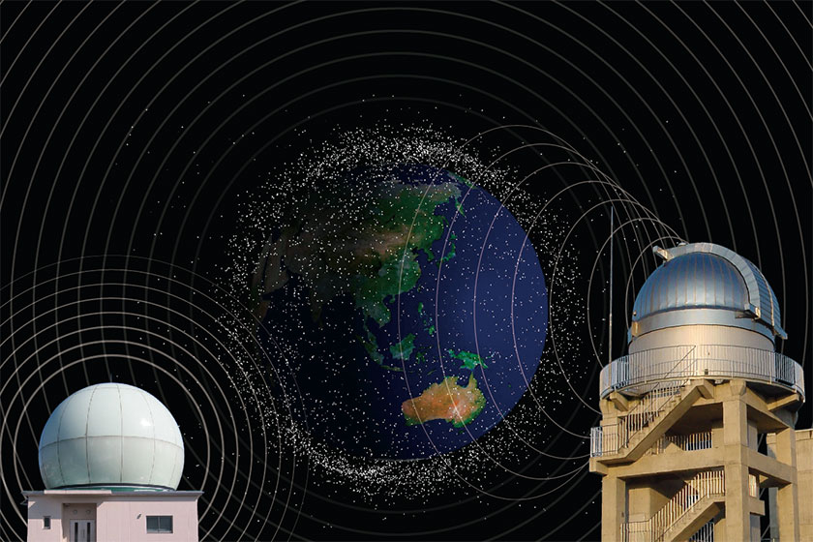
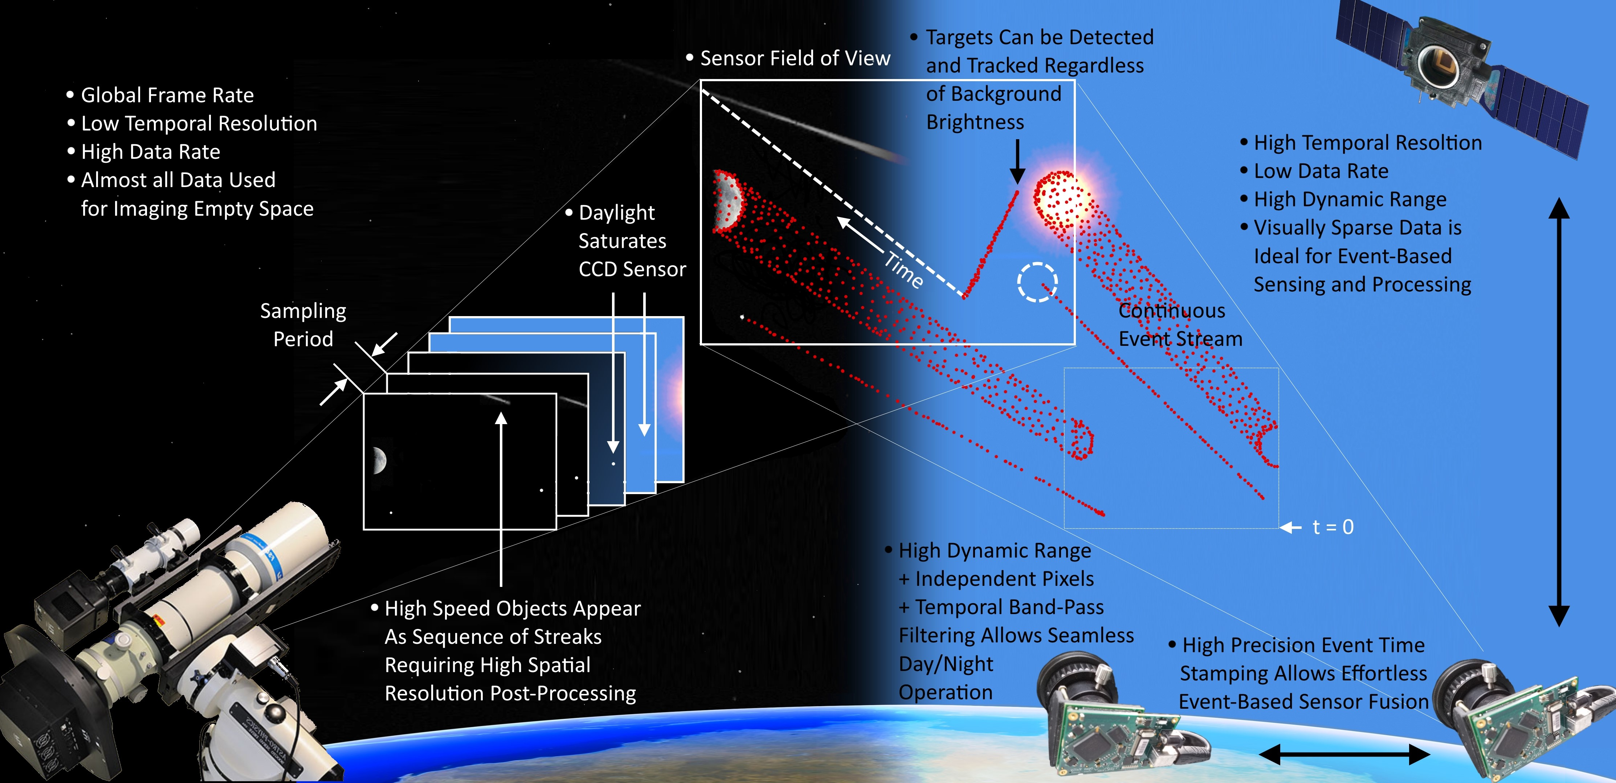
Space Situational Awareness (SSA)
SSA refers to the knowledge of the space environment, including location and function of space objects and space weather phenomena. SSA is generally understood as covering three main areas:
Space Surveillance and Tracking (SST) of man-made objects.
Space WEather (SWE) monitoring and forecast.
Near-Earth Objects (NEO) monitoring (only natural space objects)
Centro Nazionale di Ricerca in High-Performance Computing, Big Data and Quantum Computing
Missione 4 • Istruzione e Ricerca

Slide 6
General Objectives
Design and commissioning of an interoperable, distributed data archive in the perspective on the ICSC HPC, Cloud and Data infrastructure;
Availability (to both scientific and industrial users) of effective interoperable services for the storage and the processing of the data;
Experimentation and Demonstration of the use of blockchain sw stacks for the certification / tracking of valuable datasets;
Updating existing debris databases with new space–based observations and observations from space;
Creation of a public data archive of state-of-the-art astrophysical simulations;
Experimentation of technological solutions capable to support science in large astronomy observatories like LOFAR and the SKA.
Centro Nazionale di Ricerca in High-Performance Computing, Big Data and Quantum Computing
Missione 4 • Istruzione e Ricerca

Slide 7
Activities & Work Packages structures of the project
Centro Nazionale di Ricerca in High-Performance Computing, Big Data and Quantum Computing
Missione 4 • Istruzione e Ricerca

Slide 8
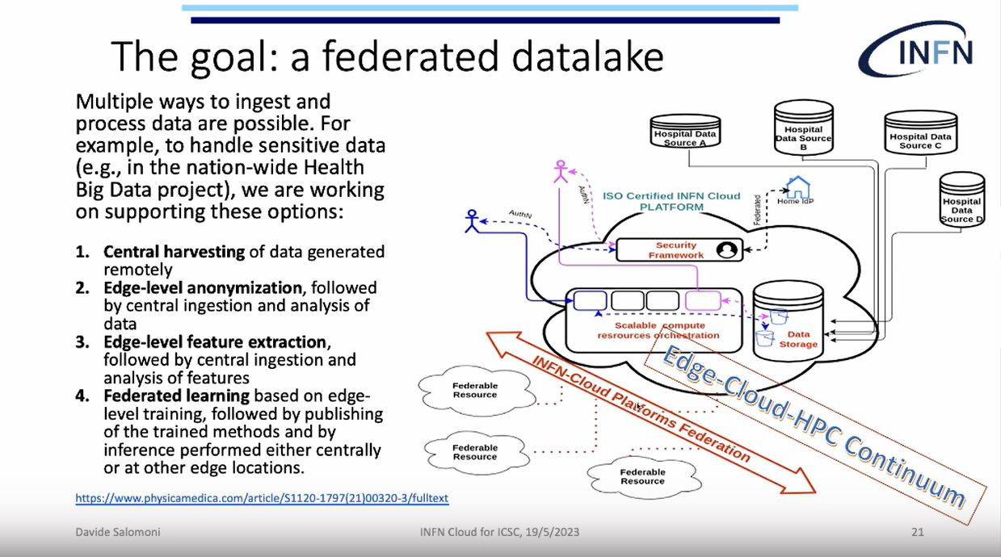
INFN – WP1: DataLake &
  WP3,4: BlockChain system
DataLake
BlockChain system for the data lake
Integration with Spoke 2 Research Program
INFN proposes to test solutions for managing data in a geographically distributed environment to exploit the Data lake. All the services will be deployed in the form of containers managed via container orchestrators.
The prototype will show the feasibility to deploy PaaS services for the actual processing of the data ingested into the Data lake.
Deployment of a blockchain network to execute fundamental CRUD (Create, Read, Update, Delete) operations, catering to the requirements of the project. This blockchain network will be accessible through a REST API with an HTTPS backend, facilitating seamless communication between the blockchain and databases.
Centro Nazionale di Ricerca in High-Performance Computing, Big Data and Quantum Computing
Missione 4 • Istruzione e Ricerca

Slide 9

INAF – WP2: Data Models and metadata definition
Integration with Spoke 3 Research Program
Data Models and metadata definition
Spoke 3 - WP4 - Big Data Management, Storage and Archiving
Objective 2. Big data processing and visualization, via adopting innovative approaches for the analysis of large and complex data volumes and for their exploration.
Objective 3. High Performance storage, Big Data management, and archiving applying the Open Science principles and implementing them in the Big Data Archives.
ACO-S will promote the FAIRness of the research outputs and services across research communities involved in the project
Study and implementation of an IVOA/FAIR compliant data model for the correct description and handling of the data sets.
The data model will include all relevant information about data, software for data reduction, analysis, data policy, and all the information for data filtering for retrieval.
Centro Nazionale di Ricerca in High-Performance Computing, Big Data and Quantum Computing
Missione 4 • Istruzione e Ricerca

Slide 10
Leonardo - Cloud-native distributed database
WP2: Data Models and metadata definition, data archiving
Objective. Support the integration and query of data coming from different sources, complemented with simulated data, with a performance that enables novel application with real-time requirements in SSA use case, to achieve maximum effectiveness and efficiency in data provisioning and exploitation
Requirement analysis: Gather information necessary for the definition, implementation, testing and verification of the database technology to be integrated on top of the data-lake. Analysis and definition of the required data processing activities: preprocess, cleaning, normalize, rescale data, with a focus on data models and metadata definition.
Database deployment in ICSC infrastructure, validation and testing
Implementation of the data ingestion service, to collect data efficiently from the instrument/sensor network. Integrate the components of the prototype system with their applications and data platform and deploy them on the Consortium infrastructure.
Centro Nazionale di Ricerca in High-Performance Computing, Big Data and Quantum Computing
Missione 4 • Istruzione e Ricerca

Slide 11
Thales Alenia Space
WP5: Architecture and Algorithms for SSA Processing
Simulation of state of art algorithms for processing of space based sensors data for SSA and evaluation of the computational load. The simulator will provide:
Information to support architectural trade offs in terms of optimal split between on board and on ground processing
A reference to evaluate complex scenarios with multiple sensors processing
Topics
Investigate existing and upcoming sensors typologies and technologies for space based ssa applications, identify measurable space objects characteristics they can detect and the data typologies they generate
Selection of a representative subset of sensors and identification of the state of art algorithms for data processing
Design and implementation of a mock up (simulator) which is capable to generate a synthetic data set for the selected sensors, implement the algorithms of the processing chain and evaluate the computational load
Centro Nazionale di Ricerca in High-Performance Computing, Big Data and Quantum Computing
Missione 4 • Istruzione e Ricerca

Slide 12
WP1: DataLake
Leader: Daniele Spiga (INFN)
Project management structure
WP2: Data Models and metadata definition
Leader: Cristina Knapic (INAF)
GDL1
Project PI
PI: Carolina Berucci (Leonardo) Co-PI: Cristina Knapic (INAF) Technical Manager: Daniele Spiga (INFN)
WP3: BlockChain system for the data lake
Leader: Francesco Visconti (INAF)
Management Board
Composed by one representative for each industrial partner, one representative for each Spoke the Technical Manager and the WP Leaders. Coordination, verification and planning of the project activities. Fixed meetings: every month.
WP4: Blockchain deployment on the ICSC Datalake
Leader: Alessandro Costantini (INFN)
GDL2
WP5: Architecture and algorithms for data processing
Leader: Gaetano Pastore (TASI)
ICSC Italian Research Center on High-Performance Computing, Big Data and Quantum Computing
Missione 4 • Istruzione e Ricerca
Notes:
Template e guide lines

Slide 13
Deliverables and milestones
WP | Del. code | Definition | Del. date
1 | TN1 | Report the deployment solution used to implement the Data Managementnd results of the functional tests | M12
1 | TN2 | Report the deployment solution used to implement the Data Management and results of the functional tests | M24
2 | TN1 | Dataset identified and data model vs1 | M12
2 | TN2 | Technical report of the database | M18
2 | TN3 | Final report on database and data model vs1.1 | M24
2 | TN1 | Functional, Analysis, document | M6
2 | TN2 | Workflow definitions for data object tracking, and implementation in the licensed software | M18
3 | TN1 | Functional, Analysis, document | M6
3 | TN2 | Workflow definitions for data object tracking, and implementation in the licensed software | M18
4 | TN1 | Report the deployment solutions on the Datalake, with initial evaluation of results | M12
4 | TN2 | Technology tracking report on the blockchain solutions maturity | M24
5 | TN1 | sensors technologies and data typologies report | M8
5 | TN2.1 | Algorithms and simulator design and verification report | M18
5 | TN2.2 | Update - Algorithms and simulator design and verification report v.2 | M24
Centro Nazionale di Ricerca in High-Performance Computing, Big Data and Quantum Computing
Missione 4 • Istruzione e Ricerca

Slide 14
Thank you for your attention!
Centro Nazionale di Ricerca in High-Performance Computing, Big Data and Quantum Computing
Missione 4 • Istruzione e Ricerca

