Slide 1
A new Importer software for data and metadata storage
G. Coran
Spoke 3 Technical Workshop, Trieste October 9 / 11, 2023
ICSC Italian Research Center on High-Performance Computing, Big Data and Quantum Computing
Missione 4 • Istruzione e Ricerca
Notes:
Cover

Slide 2
Scientific Rationale
OAIS standards application to store observative and simulated data with the independent archiving of data and metadata retrieved from headers or related files
Metadata storage in a relational database following data models which will also work for custom formats and for non relational databases
Data file storage now available for standard observative formats, which will also work for custom ones, to meet the observative and simulated data demands
Target to save and distribute data via various infrastructures and cloud services
ICSC Italian Research Center on High-Performance Computing, Big Data and Quantum Computing
Missione 4 • Istruzione e Ricerca
Notes:
Template e guide lines

Slide 3
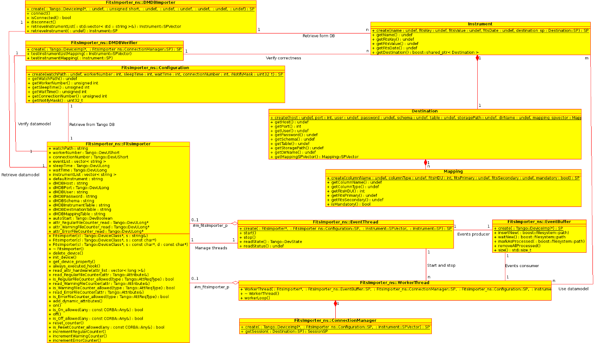
Technical Objectives, Methodologies and Solutions
OAIS principles application with the usage of a development and configuration dedicated software
Fast software able to work with millions of files with a limited configuration requirement, which applies a sturdy mapping for each data collection
Availability to store various types of file formats in various kind of databases for metadata and different archives for related data files
ICSC Italian Research Center on High-Performance Computing, Big Data and Quantum Computing
Missione 4 • Istruzione e Ricerca
Notes:
Template e guide lines

Slide 4
Timescale, Milestones and KPIs
Working independently on the software since August
Successful installation and test obtained in Sept. 15th
Fast and efficient software, tested on large quantities of files, with more to come in Q4 2023
Upgrade of current file formats availability and related libraries to store metadata in a relational database to come in Q2 2024
Upgrade of databases and archives storage types to come in Q4 2024
ICSC Italian Research Center on High-Performance Computing, Big Data and Quantum Computing
Missione 4 • Istruzione e Ricerca
Notes:
Template e guide lines

Slide 5
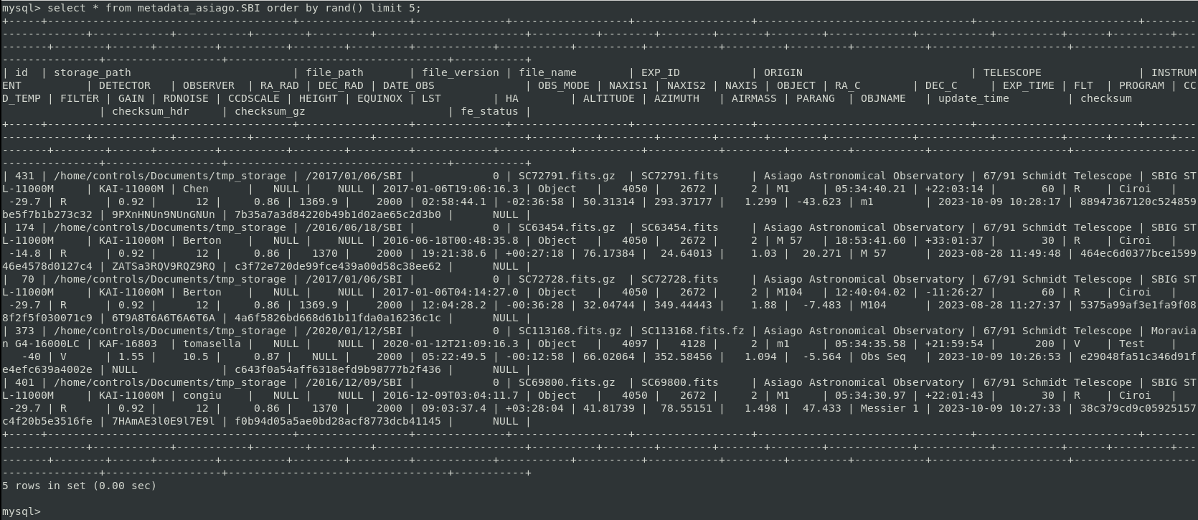
Accomplished Work, Results
Perfect results in data and metadata storage for a 700 files test group
MySQL metadata storage following the given configuration
File stored correctly in a local archive
Very fast execution
ICSC Italian Research Center on High-Performance Computing, Big Data and Quantum Computing
Missione 4 • Istruzione e Ricerca
Notes:
Template e guide lines

Slide 6
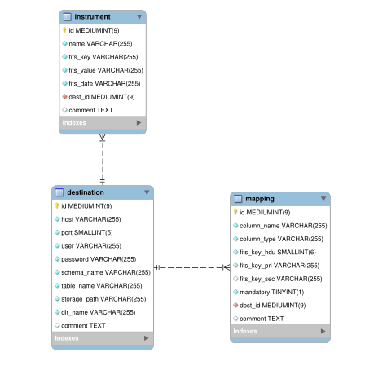
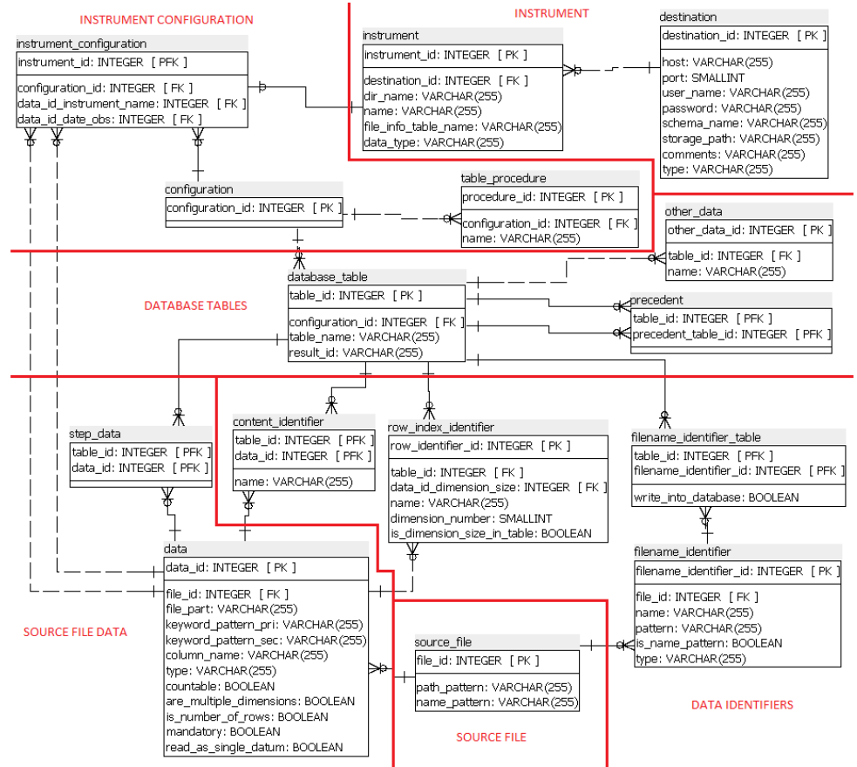
Next Steps and Expected Results (by next checkpoint: April 2024)
Further software application to different data models (FITS, MBFITS)
FITS
MBFITS
ICSC Italian Research Center on High-Performance Computing, Big Data and Quantum Computing
Missione 4 • Istruzione e Ricerca
Notes:
Template e guide lines

Slide 7
Next Steps and Expected Results (by next checkpoint: April 2024)
New data format integration for software usage (HDF5, VTK, etc.) and update of the corresponding data models
Compatibility update for new infrastructures in various supported languages (C++, Python, Java)
First databases and storage archives upgrade to meet the scientific and industrial demands (RDB/No-SQL, RUCIO, mountpoint, cloud)
IMPORTER
Databases (RDB/No-SQL)
Rucio Mountpoint Cloud
FITS, HDF5, VTK, and more (with related libraries)
FITSIMPORTER
Relational Database
Mountpoint
FITS (cfitsio, CCfits)
ICSC Italian Research Center on High-Performance Computing, Big Data and Quantum Computing
Missione 4 • Istruzione e Ricerca
Notes:
Template e guide lines

