Slide 1
Wide-field observations with LOFAR VLBI data
Claudio Gheller, Emanuele de Rubeis, Gianfranco Brunetti, Marco Bondi
IRA-INAF, University of Bologna
Spoke 3 Technical Workshop, Trieste October 9 / 11, 2023
ICSC Italian Research Center on High-Performance Computing, Big Data and Quantum Computing
Missione 4 • Istruzione e Ricerca
Notes:
Cover

Slide 2
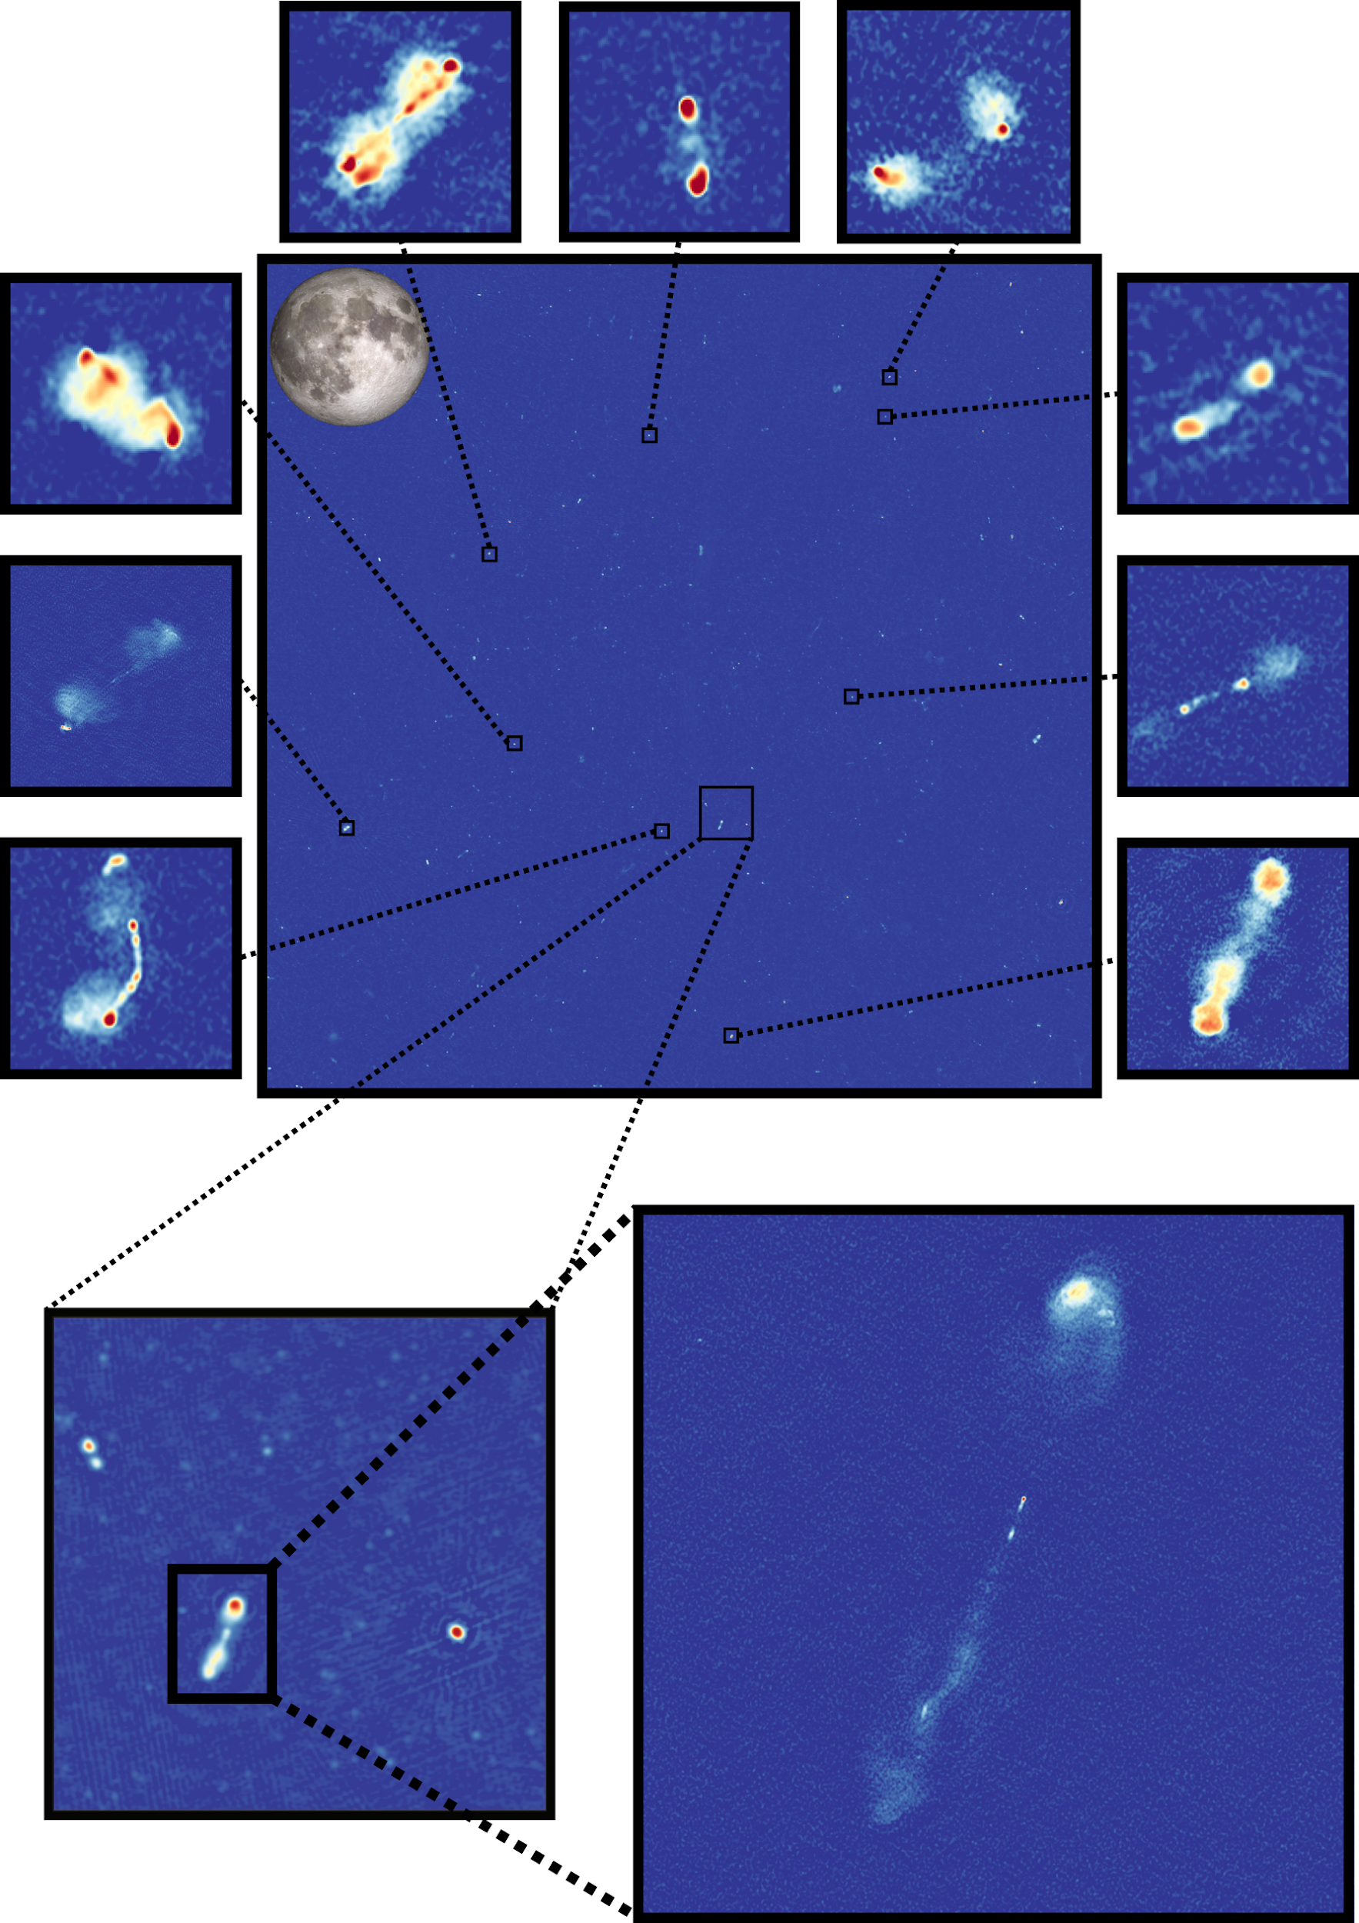
The General Problem
Current and upcoming radio-interferometers are expected to produce volumes of data of increasing size that need to be processed in order to generate the corresponding sky brightness distributions through imaging.
This represents an outstanding computational challenge, especially when large fields of view and/or high resolution observations are processed.
Imaging represents one of the most computational demanding steps of the processing pipeline, both in terms of memory request and in terms of computing time
For example, to make this 83,900x83,500 pixels image it takes ~250,000 CPU hours
Overall the full pipeline can take weeks!
Shimwell et al. (2022)
ICSC Italian Research Center on High-Performance Computing, Big Data and Quantum Computing
Missione 4 • Istruzione e Ricerca
Notes:
Template e guide lines

Slide 3
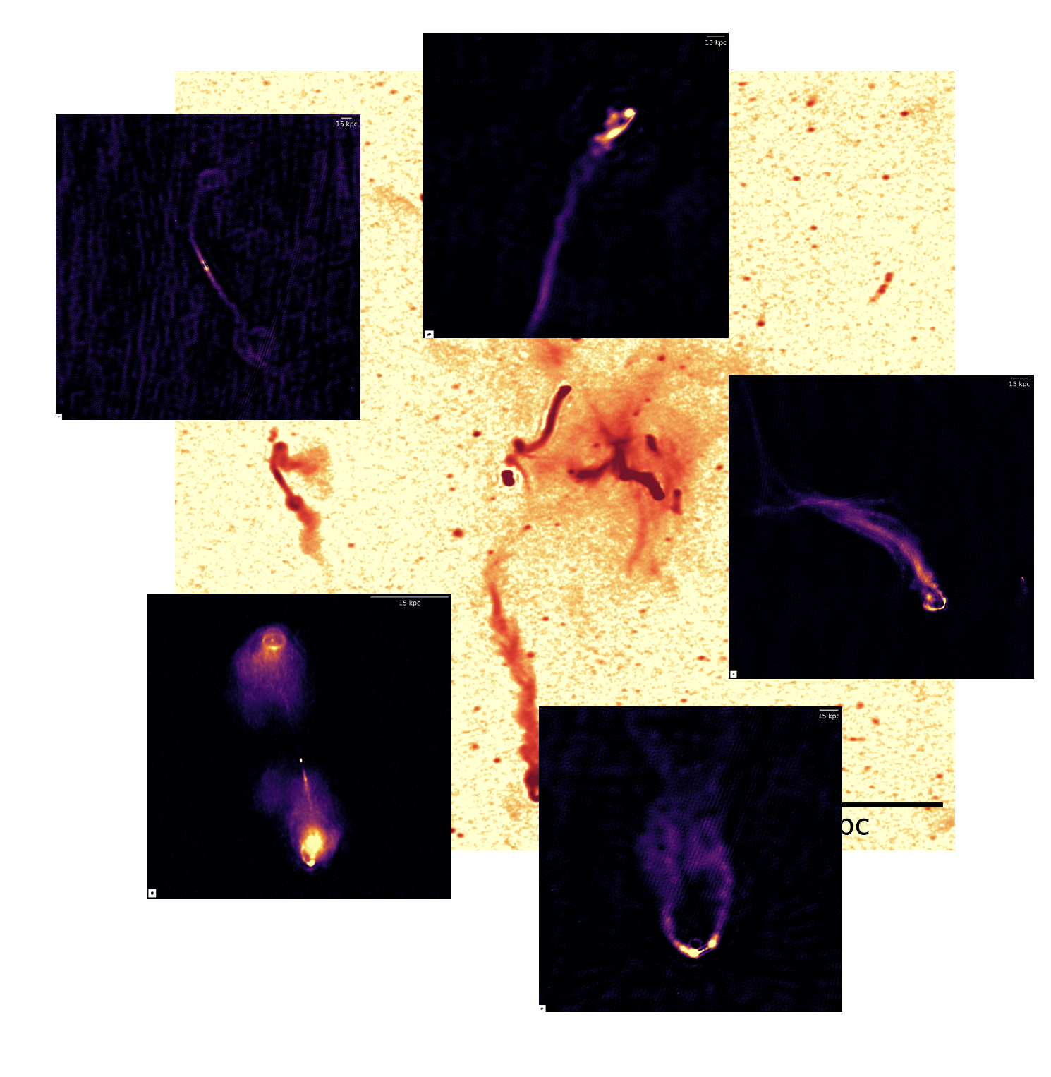
Our Target: Full resolution wide-field LOFAR-VLBI of Abell 2255
Abell 2255 is a merging galaxy cluster that exhibits a complex morphological radio structure on multiple scales.
Currently, we are observing its radio galaxies with LOFAR-VLBI at sub-arcsecond resolution. This gives an unprecedented view of such structures, but it can take several days to obtain deep images of each of the target that is shown on the left.
Our aim is to observe of all the radio galaxies of the cluster field at the highest resolution, to study the physics of the intracluster medium, as well as the nature of the filamentary structures that it presents.
ICSC Italian Research Center on High-Performance Computing, Big Data and Quantum Computing
Missione 4 • Istruzione e Ricerca
Notes:
Template e guide lines

Slide 4
The case for a Key Science Project
The goal of our KSP is to run a complex radio-astronomy workflow to reduce the computational time and obtain a full-resolution, wide-field map of Abell 2255 using 80 hours of LOFAR-VLBI observations.
80 hours of observations
6.6 deg², 0.30”x 0.38”
83,950 x 83,500 pixels
With current tools, running on a single CPU, this would take months of computation
ICSC Italian Research Center on High-Performance Computing, Big Data and Quantum Computing
Missione 4 • Istruzione e Ricerca
Notes:
Template e guide lines

Slide 5
The Workflow
Measurement Set
MPI + OpenMP+ CUDA +
StreamFlow
Workflow based parallelization
(StreamFlow - CWL)
OpenMP +
StreamFlow
ICSC Italian Research Center on High-Performance Computing, Big Data and Quantum Computing
Missione 4 • Istruzione e Ricerca
Notes:
Template e guide lines

Slide 6
Some numbers
Size of the (raw data, end-products): (4 TB per night, 20 TB per night)
Image size: 83,950 x 83,500 pixels → 56 GB
Mesh size: 83,950 x 83,500 x 128 → 14 TB → 150-200 Nodes
Pipline Stage | Shimwell et al. (2022) Node hours (Wall Clock) one night | Our Estimate Node hours (wall clock) per night
Overall | 15625 | TBD
Calibration | 3750 (150) | 3750 (37.5)
Imaging | 11875 (475) | 2000 per iteration (20)
ICSC Italian Research Center on High-Performance Computing, Big Data and Quantum Computing
Missione 4 • Istruzione e Ricerca
Notes:
Template e guide lines

