Slide 1
Symmetric solutions for the N-body problem: a computational approach
V.L. Barutello, M. Bergomi, D. Berti, G.M. Canneori, I. De Blasi, D. Ferrario, M. Introna, D. Polimeni, S. Terracini, P. Vertechi
Spoke 3 Technical Workshop, Trieste October 9 / 11, 2023
ICSC Italian Research Center on High-Performance Computing, Big Data and Quantum Computing
Missione 4 • Istruzione e Ricerca
Notes:
Cover

Slide 2
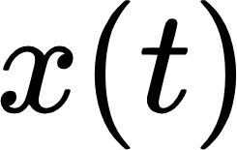
Scientific Rationale
The N-body problem is one of the most important problems in Celestial Mechanics, and consists in trying to predict the motion of N distinct particles under the action of the mutual gravitational interaction.
Poincaré conjecture: the periodic solutions of the problem are dense in the space of all possible bounded solutions.
The chaoticity of the N-body problem is an ambitious conjecture, and the presence of (more and more complex) periodic solutions, which visit the many different regions of the phase space, goes in that direction.
= class of all the possible periodic paths in the configuration space (functions from to a subset of )
The solutions are found as critical points of the Lagrangian action
To find periodic trajectories with particular symmetries, one can rely on the G-equivariance property: given a finite group G, a class of paths in the configuration space is said to be G-equivariant if for any and every
one has .
In practice, the action of an element g on a path is represented by a rotation/reflection and a permutation of the bodies in the coordinates and a reflection/rotation in time.
ICSC Italian Research Center on High-Performance Computing, Big Data and Quantum Computing
Missione 4 • Istruzione e Ricerca
Notes:
Template e guide lines

Slide 3
Technical Objectives, Methodologies and Solutions
Making use of the G-equivariance principle, search for highly complex periodic orbits:
start by creating a database of “simple” symmetric solutions, using the SymOrb program. SymOrb is a program (originally written in FORTRAN, Python and GAP in the 2000s) that, given a finite group G to fix the symmetry, returns a G-equivariant solution for the N-body problem obtained as a minimal critical point for the Lagrangian action. The orbit is obtained by starting from a random initial guess and by choosing a minimisation algorithm among different ones;
the database can be enriched by computing numerically, for each solution, stability indicators like the Floquet exponents (to estimate the rate of separation of close orbits) or the Morse index (work in progress);
the orbits in the database can be classified in terms of their similarity, to group together the ones with the same shape and stability properties (to be done);
starting from the above database, one can use optimization algorithms to produce new orbits, for example, as combinations of the ones already found (to be done).
ICSC Italian Research Center on High-Performance Computing, Big Data and Quantum Computing
Missione 4 • Istruzione e Ricerca
Notes:
Template e guide lines

Slide 4
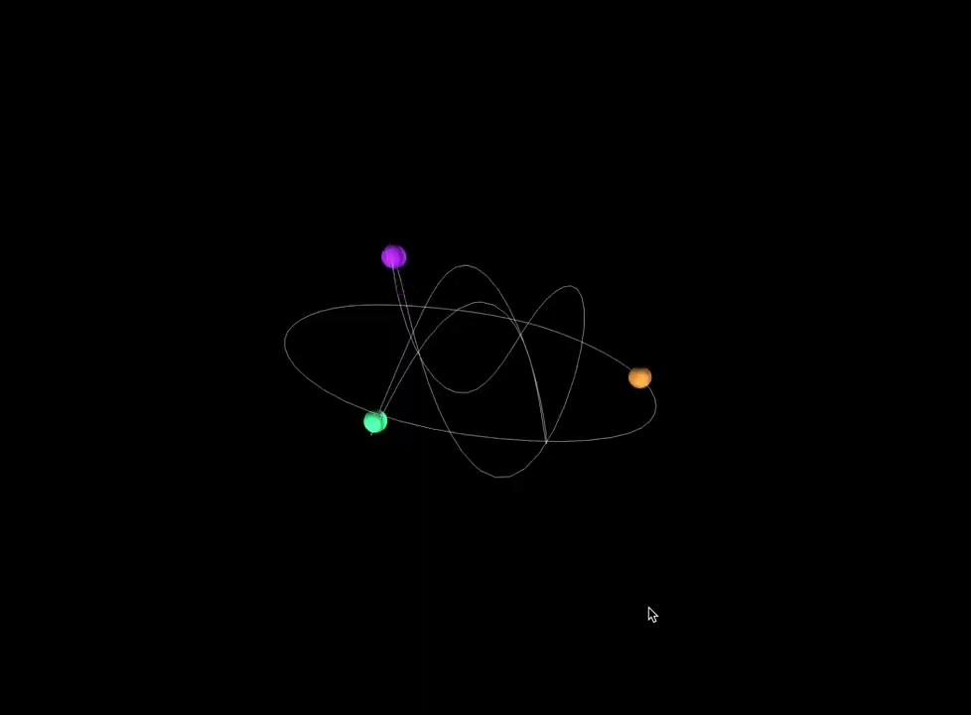
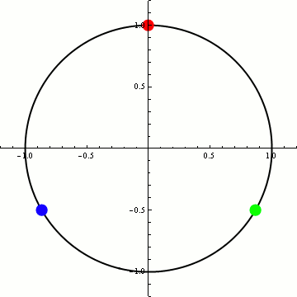
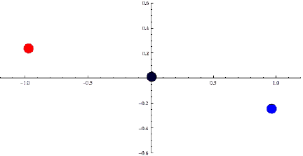
Technical Objectives, Methodologies and Solutions
Example of database for 3 bodies in and
In such case, there are 12 different symmetries groups. For every of them, one can impose any arbitrary initial guess and any minimization method to generate, with SymOrb, a different symmetric periodic solution.
In this way, a catalogue of over 1000 numerically computed solutions has been created: for every solution one can compute the stability indicators.
Circular choreography: invariant under the action of a cyclic group
Figure-eight: invariant under the action of a dihedral group
ICSC Italian Research Center on High-Performance Computing, Big Data and Quantum Computing
Missione 4 • Istruzione e Ricerca
Notes:
Template e guide lines

Slide 5
Timescale, Milestones and KPIs
Translation of the SymOrb routine in Torch (by the end of 2023);
use of SymOrb to construct a big database of periodic solutions of increasing complexity, and refining by classifying the orbits. Note that the detection of complex periodic solutions, from a theoretical point of view, could be particularly hard (January-May 2024);
construction of visualization tools to display the solutions found (by mid-2024);
machine learning procedure (from mid-2024 on):
use part of the data to train a parametric machine to find new symmetric solutions;
creation of new orbits.
ICSC Italian Research Center on High-Performance Computing, Big Data and Quantum Computing
Missione 4 • Istruzione e Ricerca
Notes:
Template e guide lines

Slide 6
Timescale, Milestones and KPIs
Key Performance Indicators
Publication of papers resuming the results at every stage of the project, by focusing both on the theoretical settings and the numerical outcomes
Participation to seminars and conference to disseminate the results and discuss the methodologies with the scientific community
Publication of the algorithms and the databases on a free-access repository on GitHub
Formation: PhD courses
Creation of multimedia contents to facilitate the visualization of the output
Participation to non-technical public dissemination events
ICSC Italian Research Center on High-Performance Computing, Big Data and Quantum Computing
Missione 4 • Istruzione e Ricerca
Notes:
Template e guide lines

Slide 7
Accomplished Work, Results
SymOrb routine: originally written in Fortran, Python and GAP, it has been refined and an optimised interface has been added.
Theoretical framework: starting from the existing literature on the G-equivariant orbith of the N-body problem (Ferrario - Terracini, 2004), a detailed documentation on the theoretical framework has been written, and it has been the subject of a PhD course held in Spring 2023.
Stability indicators: the routines for the numerical computations of an orbit’s Morse index and Floquet exponents have been created (from scratch).
Database: an extended database, containing over 1000 different solutions, have been produced for 3 bodies in 2 and 3 dimensions.
ICSC Italian Research Center on High-Performance Computing, Big Data and Quantum Computing
Missione 4 • Istruzione e Ricerca
Notes:
Template e guide lines

Slide 8
Next Steps and Expected Results (by next checkpoint: April 2024)
Database: the database can be further enriched by considering a greater number of bodies in 2 or 3 dimensions, which could correspond to taking more and more complex symmetry groups.
Classification: the wide database can be refined by grouping together the orbits with similar dynamic properties.
New complex orbits: search for strategies to explore the database and combine different periodic symmetric solutions, to the end of creating new solutions that “shadows” more than one simple trajectory, passing from one to another.
Parametrise the chaos: find solutions that visits many different regions of the phase space. This is the ultimate objective of our analysis, since theoretically the chaotic behaviour is related to the presence of a solution dense in the phase space; such trajectory can be found as a limit of complex periodic solutions.
ICSC Italian Research Center on High-Performance Computing, Big Data and Quantum Computing
Missione 4 • Istruzione e Ricerca
Notes:
Template e guide lines

Slide 9
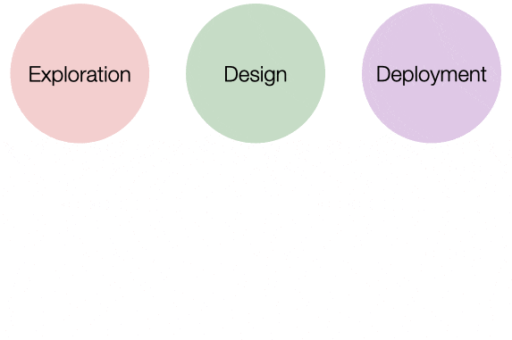
Next Steps and Expected Results (by next checkpoint: April 2024)
Low-code interfaces for data analysis and exploration
We aim to integrate the methods mentioned so far in Dashiboard, a low-code interface developed by Pietro Vertechi and Mattia G. Bergomi as part of the Limen Research Project.
Dashiboard allows to:
swiftly filter data;
create analysis pipelines in a robust and computationally efficient fashion;
visualize results.
ICSC Italian Research Center on High-Performance Computing, Big Data and Quantum Computing
Missione 4 • Istruzione e Ricerca
Notes:
Template e guide lines

Slide 10
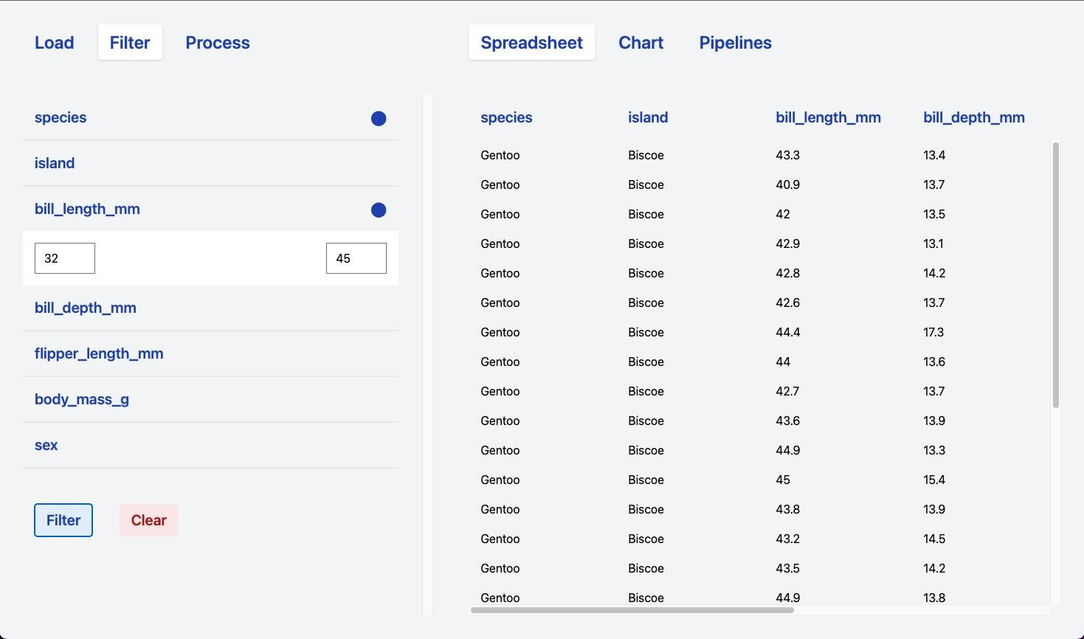
Next Steps and Expected Results (by next checkpoint: April 2024)
Low-code interfaces for data analysis and exploration
We aim to integrate the methods mentioned so far in Dashiboard, a low-code interface developed by Pietro Vertechi and Mattia G. Bergomi as part of the Limen Research Project.
Dashiboard allows to:
swiftly filter data;
create analysis pipelines in a robust and computationally efficient fashion;
visualize results.
ICSC Italian Research Center on High-Performance Computing, Big Data and Quantum Computing
Missione 4 • Istruzione e Ricerca
Notes:
Template e guide lines

Slide 11
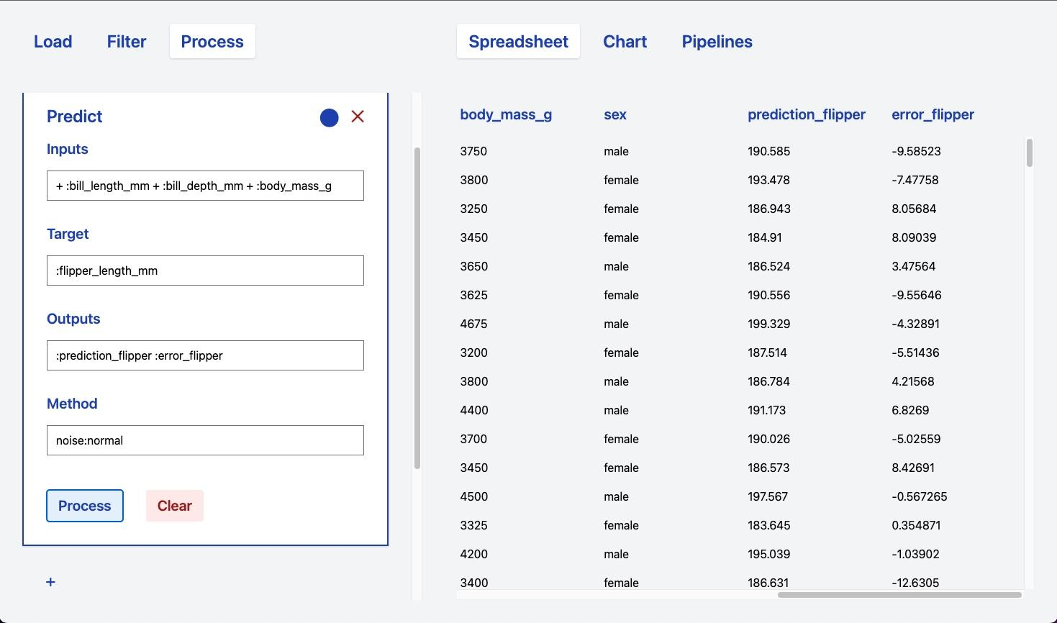
Next Steps and Expected Results (by next checkpoint: April 2024)
Low-code interfaces for data analysis and exploration
We aim to integrate the methods mentioned so far in Dashiboard, a low-code interface developed by Pietro Vertechi and Mattia G. Bergomi as part of the Limen Research Project.
Dashiboard allows to:
swiftly filter data;
create analysis pipelines in a robust and computationally efficient fashion;
visualize results.
ICSC Italian Research Center on High-Performance Computing, Big Data and Quantum Computing
Missione 4 • Istruzione e Ricerca
Notes:
Template e guide lines

Slide 12
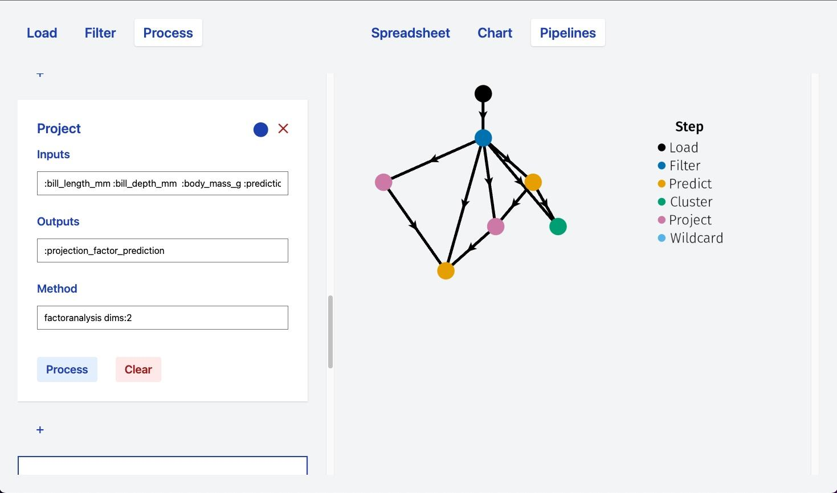
Next Steps and Expected Results (by next checkpoint: April 2024)
Low-code interfaces for data analysis and exploration
We aim to integrate the methods mentioned so far in Dashiboard, a low-code interface developed by Pietro Vertechi and Mattia G. Bergomi as part of the Limen Research Project.
Dashiboard allows to:
swiftly filter data;
create analysis pipelines in a robust and computationally efficient fashion;
visualize results.
ICSC Italian Research Center on High-Performance Computing, Big Data and Quantum Computing
Missione 4 • Istruzione e Ricerca
Notes:
Template e guide lines

Slide 13
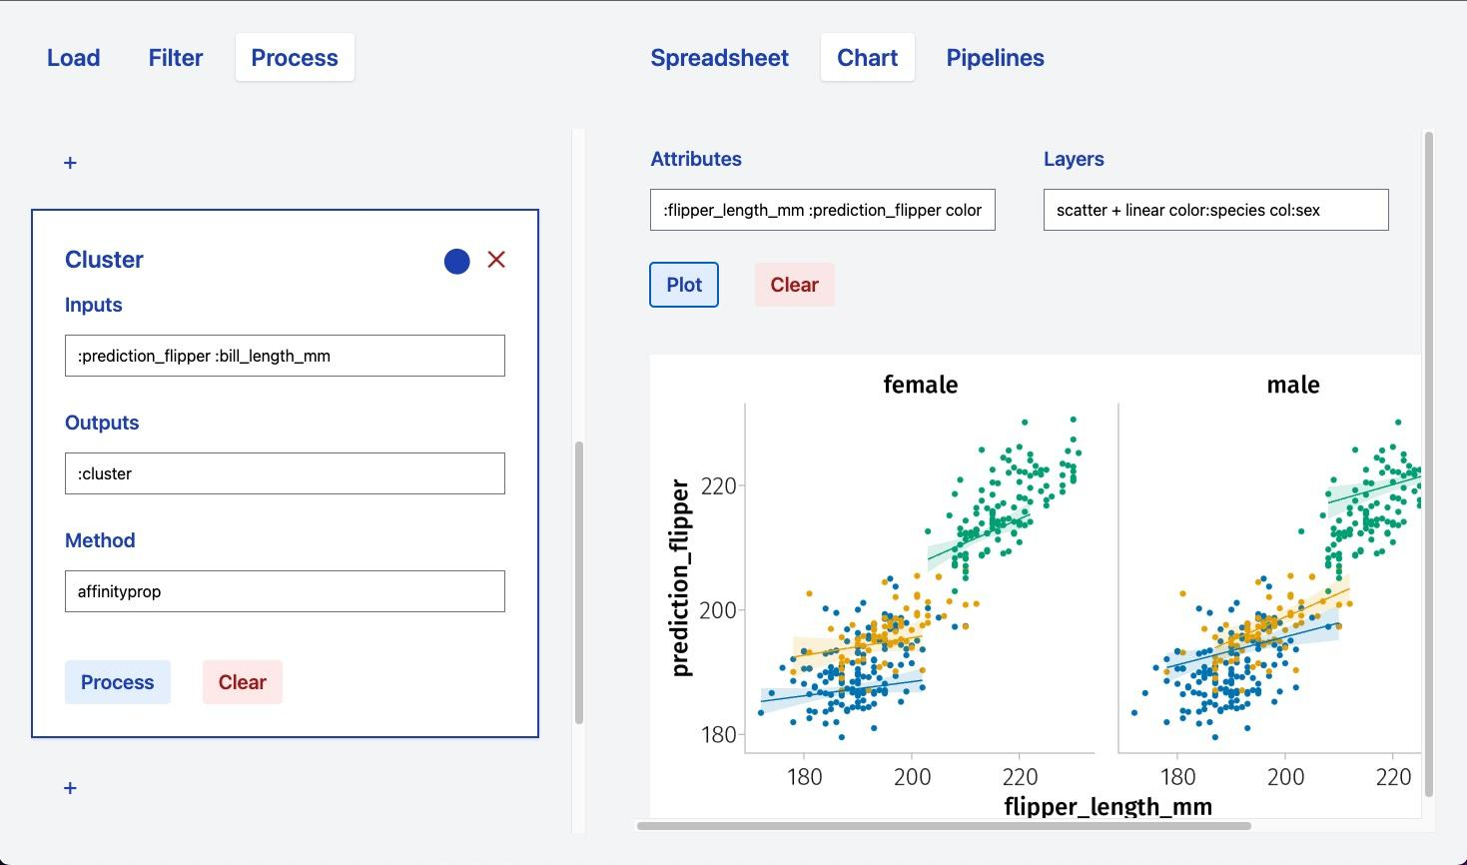
Next Steps and Expected Results (by next checkpoint: April 2024)
Low-code interfaces for data analysis and exploration
We aim to integrate the methods mentioned so far in Dashiboard, a low-code interface developed by Pietro Vertechi and Mattia G. Bergomi as part of the Limen Research Project.
Dashiboard allows to:
swiftly filter data;
create analysis pipelines in a robust and computationally efficient fashion;
visualize results.
ICSC Italian Research Center on High-Performance Computing, Big Data and Quantum Computing
Missione 4 • Istruzione e Ricerca
Notes:
Template e guide lines

