Slide 1
Eulerian and Lagrangian
Algorithms in the
PLUTO code
Alessio Suriano
Spoke 3 Technical Workshop, Trieste October 9 / 11,2023
ICSC Italian Research Center on High-Performance Computing, Big Data and Quantum Computing
Missione 4 • Istruzione e Ricerca
Notes:
Cover

Slide 2
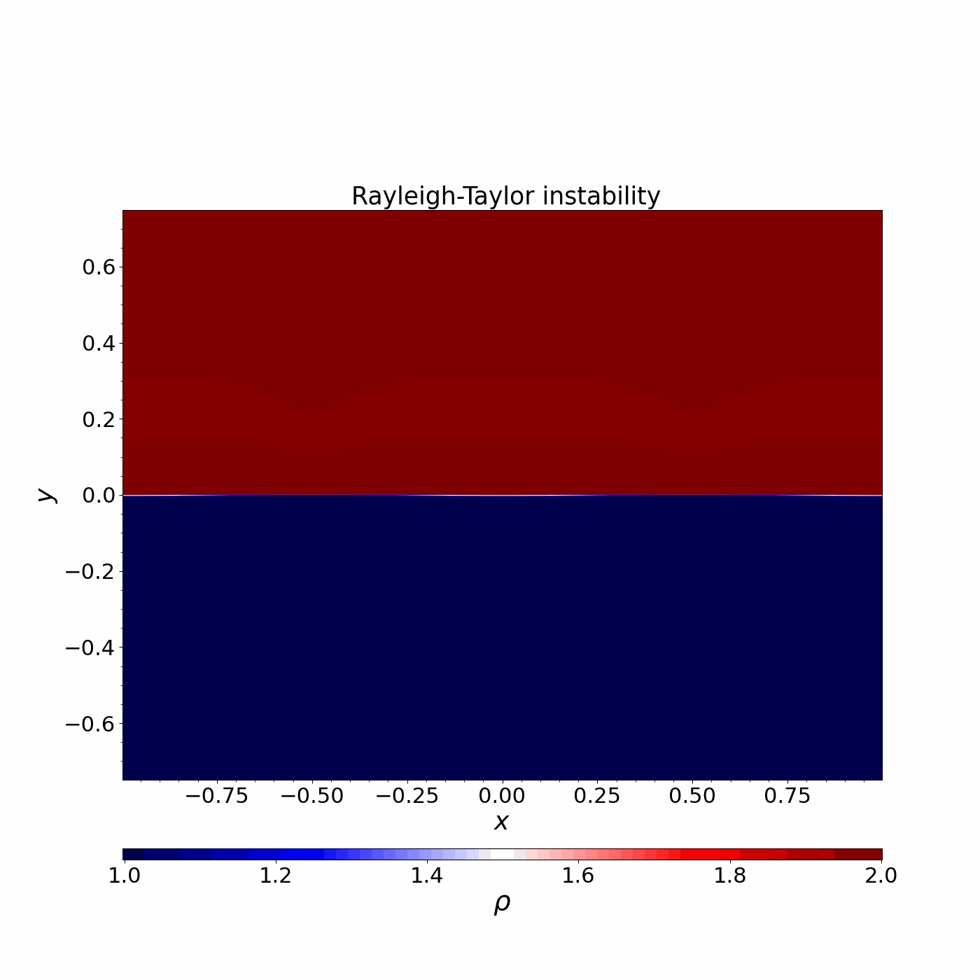
What is PLUTO ?
Finite volume, Godunov-type parallel and modular code
Multi-physics, multi-algorithm framework for solving
gas and plasma dynamics in astrophysics
Target: multidimensional compressible plasma with high
Mach numbers:
Compressible Euler/Navier Stokes;
Newtonian (ideal/resistive) MHD;
(Special) Relativistic MHD;
Heating/cooling processes, chemical network, …
Freely distributed at http://plutocode.ph.unito.it (v. 4.4)
ICSC Italian Research Center on High-Performance Computing, Big Data and Quantum Computing
Missione 4 • Istruzione e Ricerca
Notes:
Template e guide lines

Slide 3
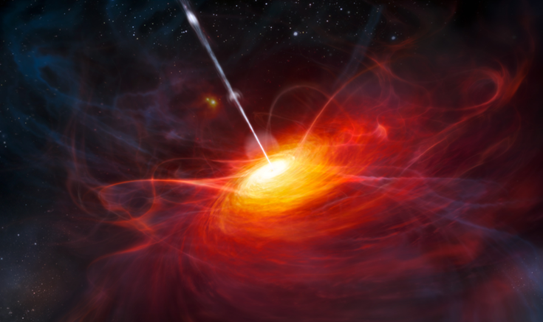
GPU porting of PLUTO
Porting modules of most scientific interest for the group
High Energy Astrophysics
Lagrangian Methods
Synthetic non-thermal spectra
Particle acceleration from DSA and magnetic reconnection
MHD instabilities: Kelvin-Helmholtz, Current Driven
Eulerian Methods
Relativistic Jets from AGN
Power Wind Nebulae
Gamma Ray Bursts
ICSC Italian Research Center on High-Performance Computing, Big Data and Quantum Computing
Missione 4 • Istruzione e Ricerca
Notes:
Template e guide lines

Slide 4
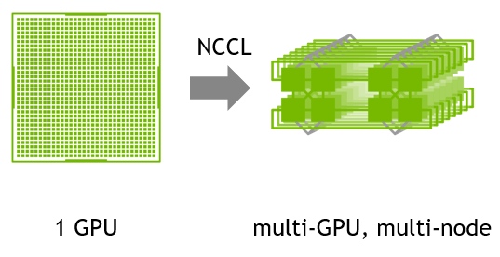
PLUTO-GPU
Full code rewrite to exploit GPU parallelism and increasing performance
Migrating from C to C++
Templates
Classes
Automatic vectorization
Directive-based programming model: OpenACC
MPI and NCCL for inter-GPU and inter-node communication
Versioning w/ GitHub
Portability & Performances
ICSC Italian Research Center on High-Performance Computing, Big Data and Quantum Computing
Missione 4 • Istruzione e Ricerca

Slide 5
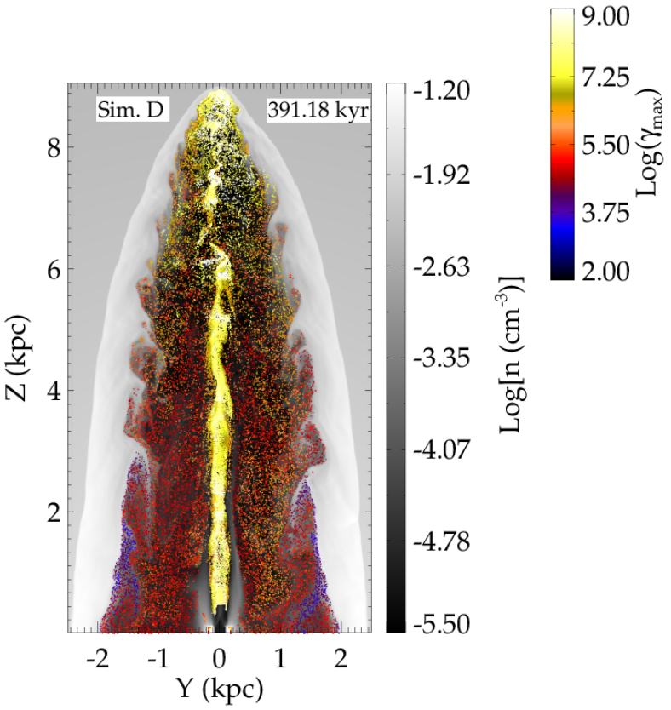
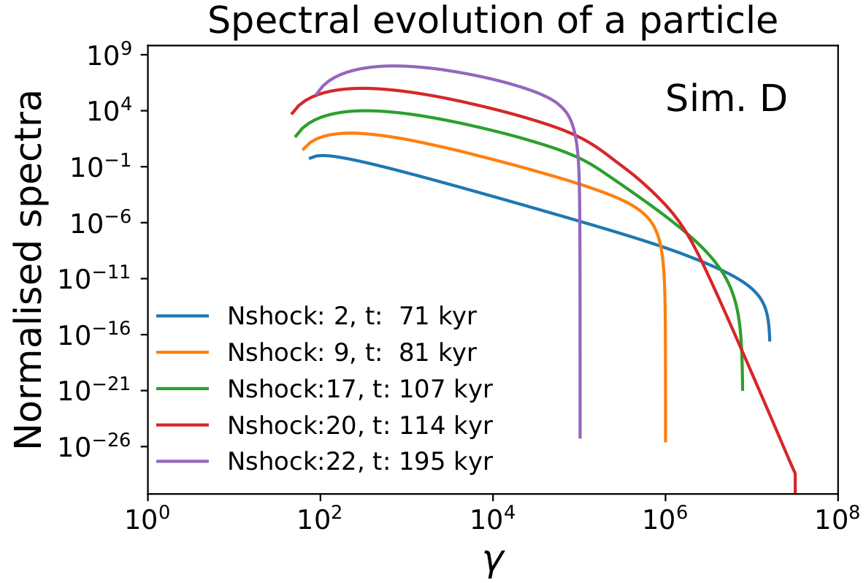
Lagrangian Module - overview
Lagrangian Particles moving in an Eulerian grid
MHD equations
Cosmic ray transport equation
In DSA the spectrum gets hardened
Outside of shocks: adiabatic and synchrotron cooling
̴ 10⁶ particles. Mandatory to exploit GPU parallelism
arXiv:2105.02836v2
ICSC Italian Research Center on High-Performance Computing, Big Data and Quantum Computing
Missione 4 • Istruzione e Ricerca
Notes:
Template e guide lines

Slide 6
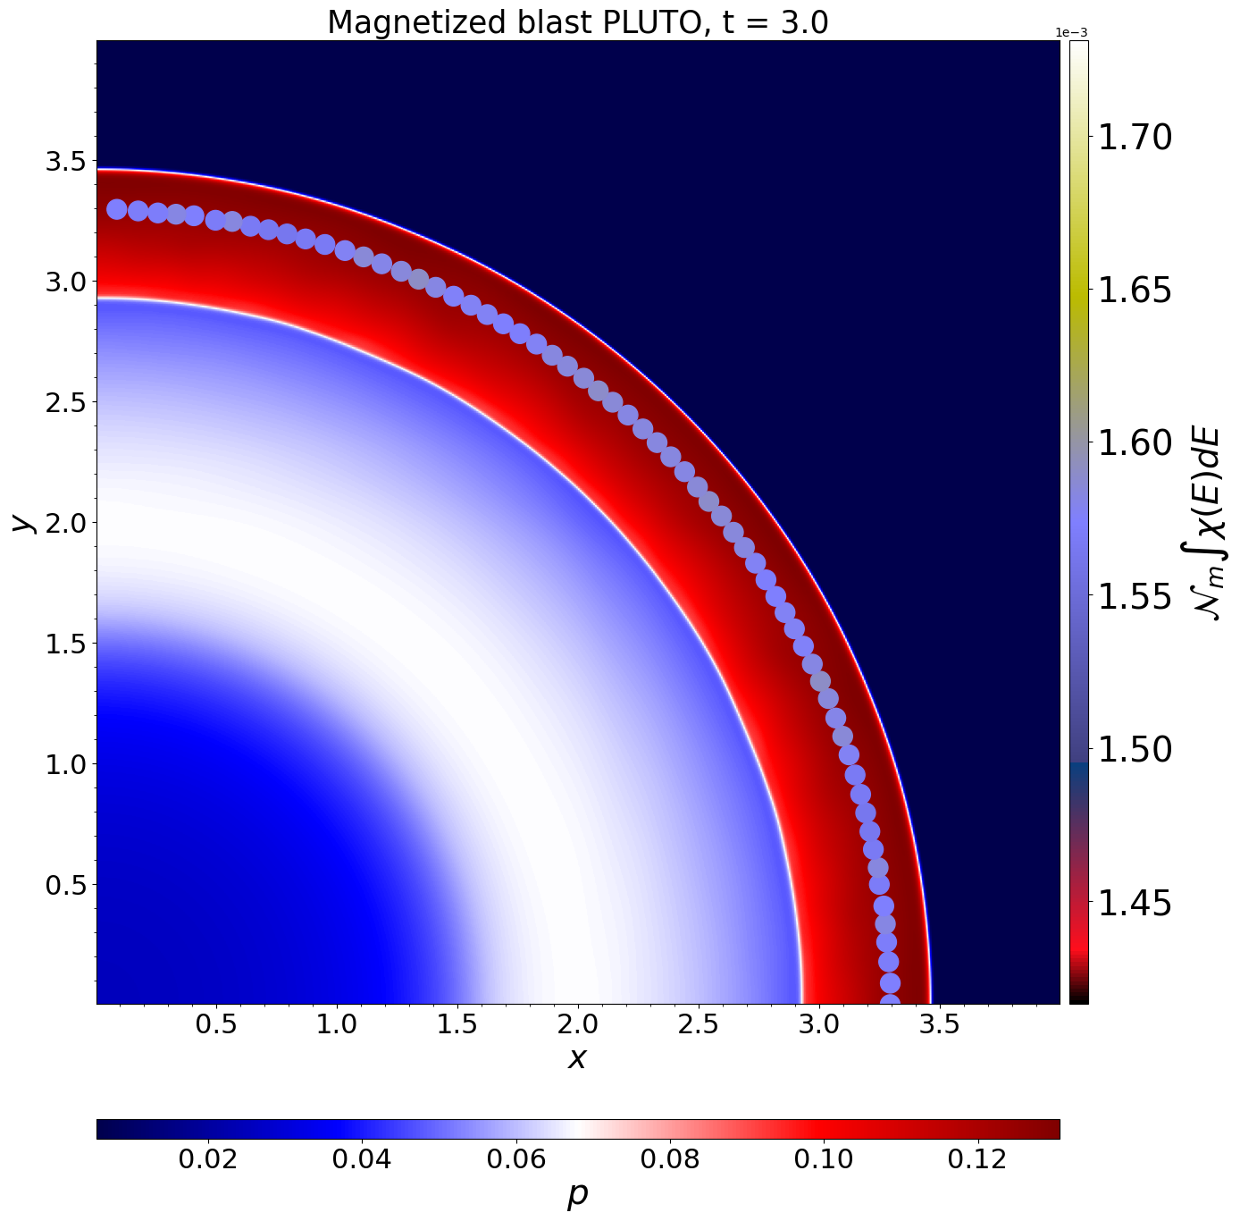
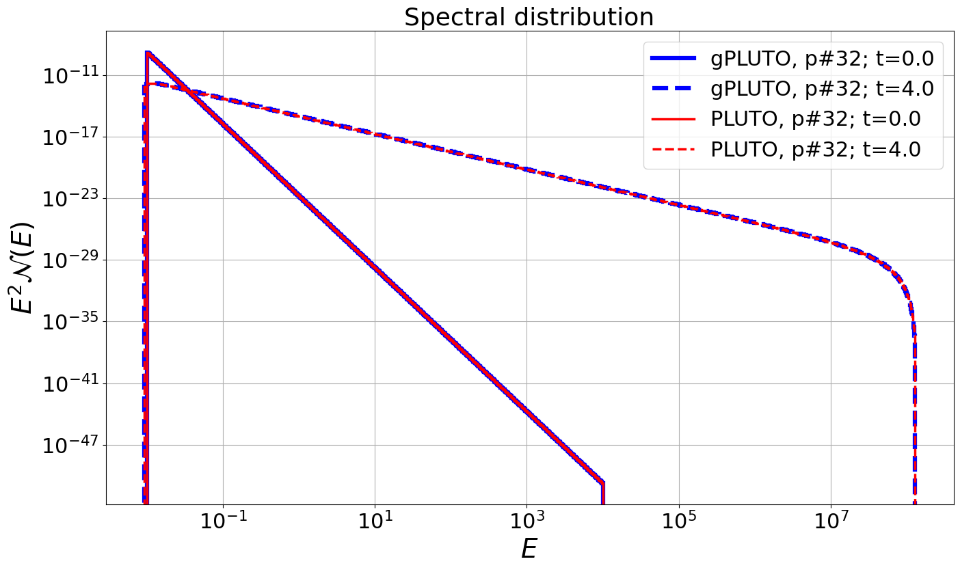
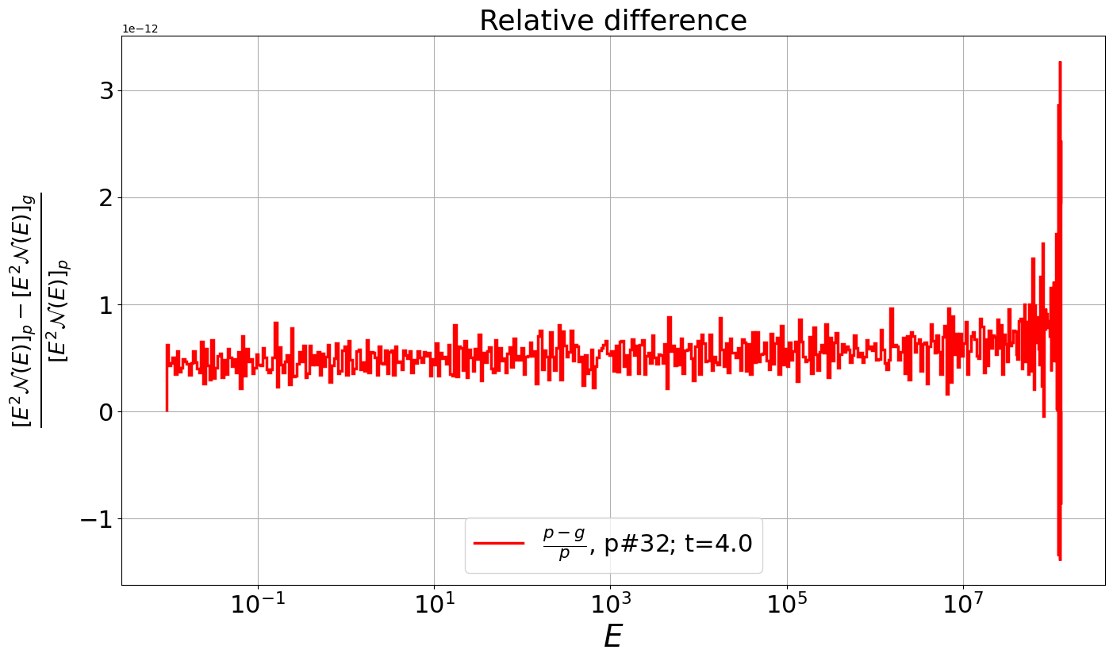
Lagrangian Module - ported and tested
Linked list C++ class
Loop rewriting
Test problems
Relativistic & non-Relativistic planar MHD shocks
Relativistic magnetized Blast
Code review - ongoing
x3E-12

Slide 7
Lagrangian Module - performances
RMHD Blast, 3x10⁵ particles, 64² grid
Dell Vostro w\ 1xNvidia GeForce RTX, Intel Core I7
Next steps
MPI/NVCCL support
Fluid feedback
Jet tests
HPC cluster runs
code | # cores | Execution time [s]
PLUTO | 1 | 188
 | 8 | 41
 | 14 | 35
gPLUTO | 1 | 9
Speedup x20

Slide 8
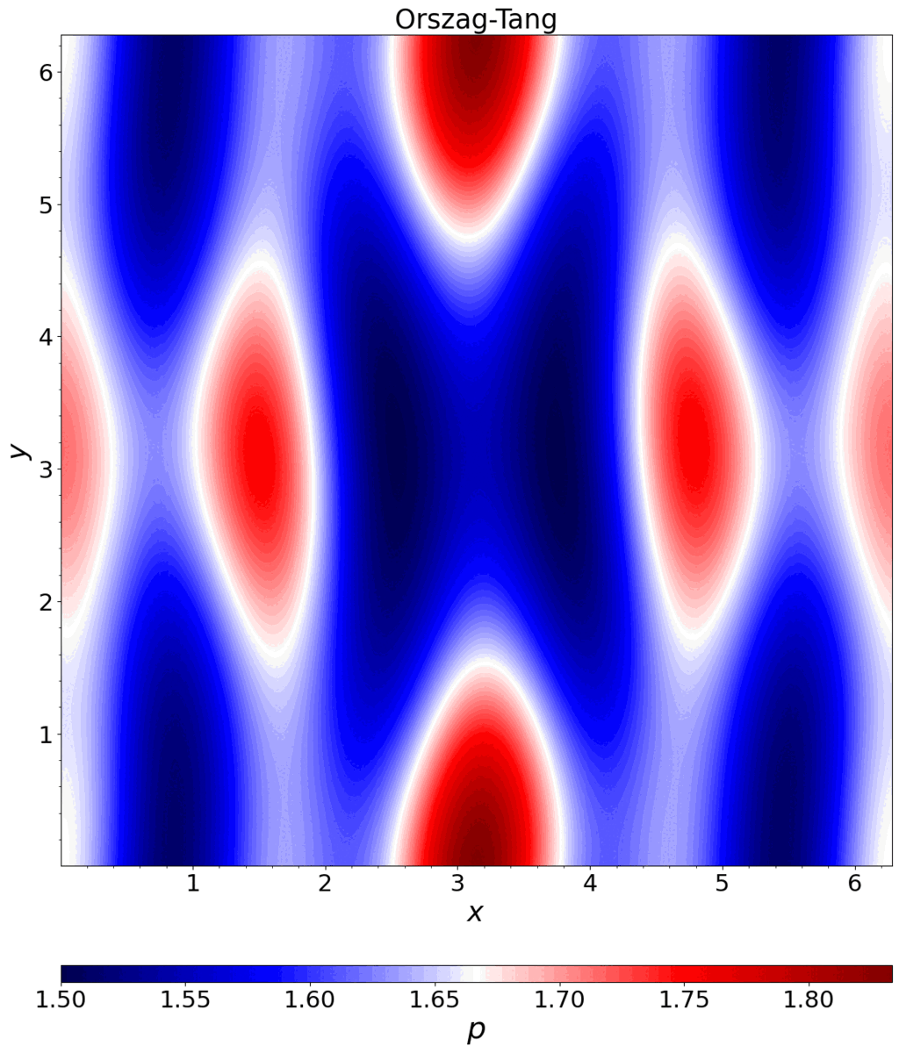
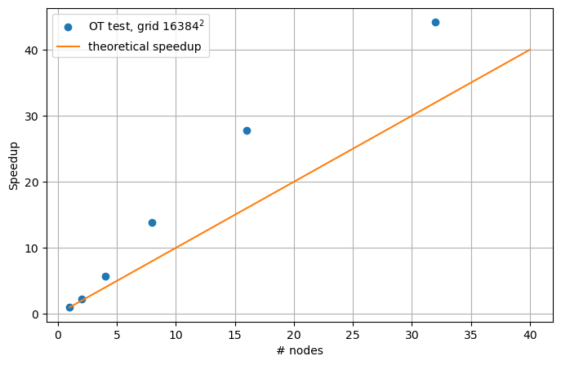
Accomplished Work - PLUTO
2D Orszag-Tang, 16384² grid
Leonardo HPC, 4xNvidia Ampere 100 GPUs/node
ICSC Italian Research Center on High-Performance Computing, Big Data and Quantum Computing
Missione 4 • Istruzione e Ricerca
Notes:
Template e guide lines

Slide 9
Next Steps
Expected Results
20 - 30 speedup
New physical modules and schemes
December 2023
Fully parallel Lagrangian Particles
February 2024
High order methods on GPU (V. Berta)
March 2024
Full performance evaluation on GPU
April 2024
First use cases in 2D and 3D (Jets, DSA, …)
June 2024
General Relativity (M. Bugli)
Fall 2024
First high resolution runs
Documentation completion
Key Performance Indicators
Open source release the GPU code + documentation. ̴ 1 year
Technical report on GPU implementation of grid modules. ̴ 1.5 years
Technical report on GPU implementation of particle modules. ̴ 1.5 years
Publication of articles on Jet simulation ̴ 2 years
ICSC Italian Research Center on High-Performance Computing, Big Data and Quantum Computing
Missione 4 • Istruzione e Ricerca
Notes:
Template e guide lines

Slide 10
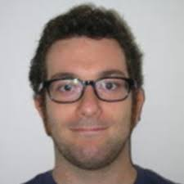
Current Developers
[4th-order schemes]
[Resistive RMHD, Riemann Solvers,
Visualization]
A. Suriano
[Lagrangian Particles]
V. Berta
G. Mattia
M. Rossazza
[EoS, Cooling, Lagr. Particles]
[General relativity,
High-order methods]
B. Vaidya
[GPU porting]
M. Bugli
ICSC Italian Research Center on High-Performance Computing, Big Data and Quantum Computing
Missione 4 • Istruzione e Ricerca

Slide 11
Backup Slides
ICSC Italian Research Center on High-Performance Computing, Big Data and Quantum Computing
Missione 4 • Istruzione e Ricerca

Slide 12
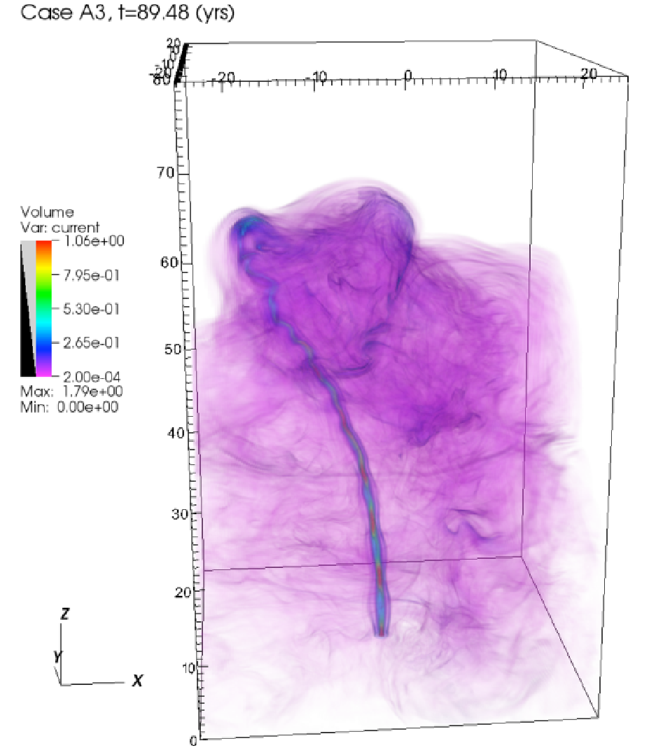
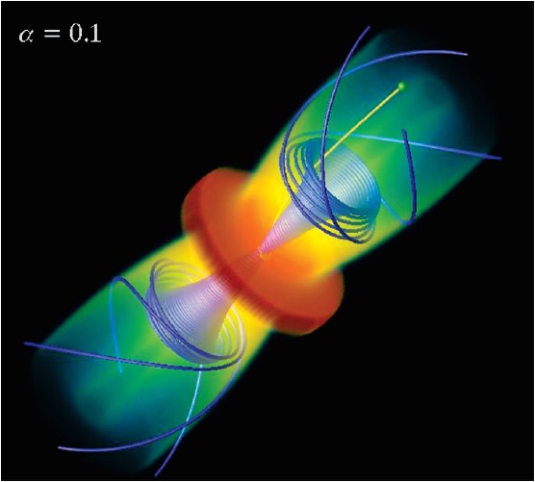
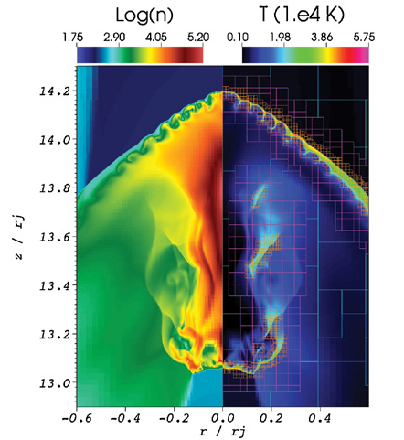
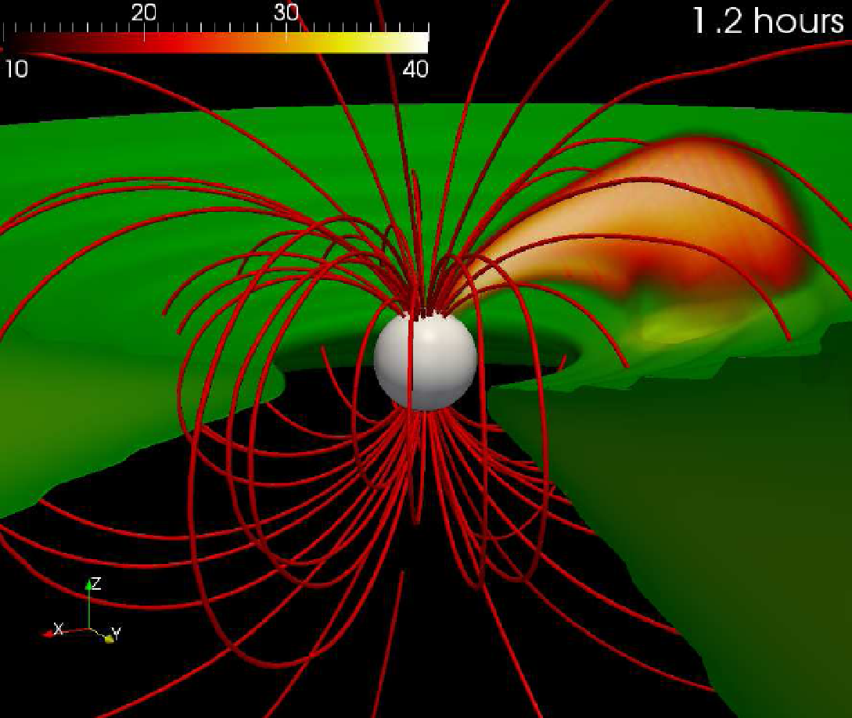
Available Physics Modules
Advection Physics (Hyperbolic PDE)
Hydrodynamics (HD)
Magnetohydrodynamics (MHD)
Relativistic Hydrodynamics (RHD)
Relativistic ideal and nonideal MHD (RMHD)
Thermodynamics
Isothermal
Ideal
Non-constant gamma
Synge Gas (relativistic)
Dissipation Physics (Parabolic PDE)
Viscosity (Navier-Stokes)
Thermal conduction (hydro and MHD)
Hall MHD, Ambipolar diffusion, Magnetic resistivity
Radiation Hydrodynamics (FLD, 2 temp)
Geometry
Cartesian (1D, 2D, 3D)
Cylindrical (1D, 2D, 3D)
Spherical (1D, 2D, 3D)
Source Terms
Gravity / Body forces
Heating / optically thin cooling
Chemical networks
Particle Physics
Lagrangian particles
Cosmic Rays 🡪 MHD-PIC
Dust
ICSC Italian Research Center on High-Performance Computing, Big Data and Quantum Computing
Missione 4 • Istruzione e Ricerca

Slide 13
Available Numerical Algorithms
PLUTO supports 2nd – 4th order finite-volume¹ as well as 5th order finite difference algorithms in multiple spatial dimensions.
Time Stepping
RK2, RK3, RK4
MUSCL-Hancock
Characteristic Tracing
Fully unsplit methods.
Interpolation
Piecewise Linear
Piecewise Parabolic
WENO 3rd – 5th order
Monot. Pres. (MP5)
Primitive or characteristic
fields
Riemann Solvers
Two-shock
AUSM
Roe
HLL / HLLC / HLLD
GFORCE
TVDLF
MUSTA
Parabolic Solver
Explicit
Super-Time-Stepping
Runge-Kutta-Legendre
∇∙B / ∇∙E control
8-wave
Constrained Transport
Hyperbolic Divergence Cleaning
¹Berta V. et al. in prep
ICSC Italian Research Center on High-Performance Computing, Big Data and Quantum Computing
Missione 4 • Istruzione e Ricerca

Slide 14
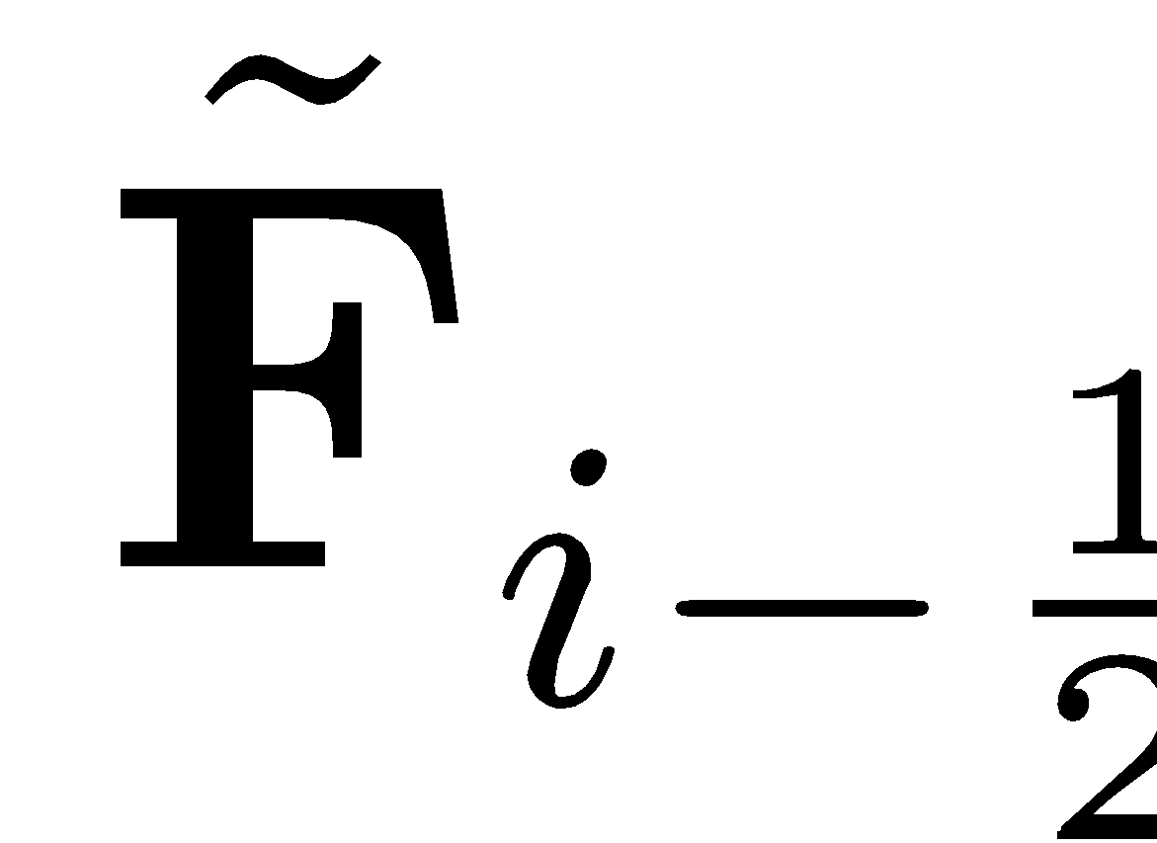
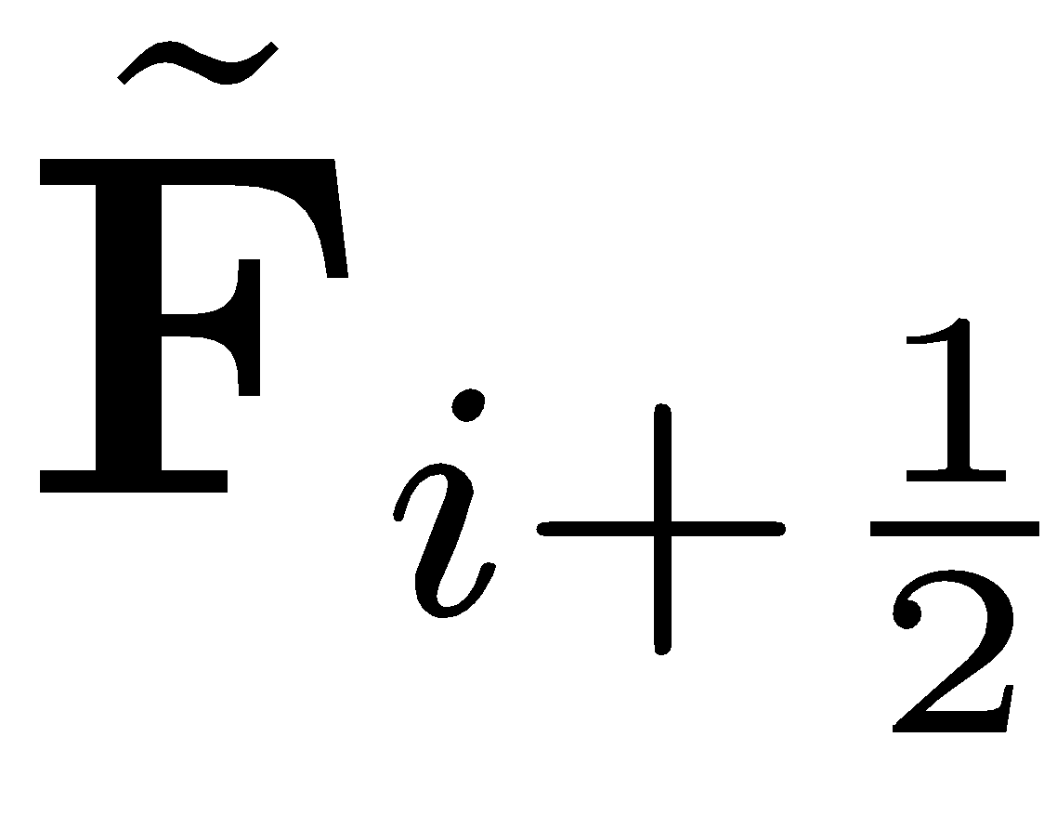
Code Design: Finite Volume, Shock-Capturing
Suited for a system of conservation laws:
F is a tensor, accounting for hyperbolic and parabolic terms:
Grid-based, finite-volume code 🡪
Parabolic (or diffusive) Flux,
🡪 Dissipation physics
Hyperbolic Flux
🡪 wave propagation
ICSC Italian Research Center on High-Performance Computing, Big Data and Quantum Computing
Missione 4 • Istruzione e Ricerca

Slide 15
Hyperbolic Flux Computation 🡪 Riemann Solver
F_{hyp}: Hyerbolic fluxes are computed using a formalism that dates back to the work of Godunov (1961).
The solution considered discontinuous at cell interfaces:
🡪 Requires solving the so-called “Riemann Problem”, i.e., the evolution of an initial discontinuity separating two constant states:
U(x)
U_{L}
U_{R}
X_{i+1/2}
x
ICSC Italian Research Center on High-Performance Computing, Big Data and Quantum Computing
Missione 4 • Istruzione e Ricerca

Slide 16
The Reconstruct-Solve-Update Algorithm
Start from volume-averages
Reconstruct interface values from zone averages using a high-order non-oscillatory polynomial:
Solve Riemann problems between adjacent, discontinuous states.
🡪 Compute interface flux.
3. Update conserved variables with time
stepping algorithm (e.g. RK2):
ICSC Italian Research Center on High-Performance Computing, Big Data and Quantum Computing
Missione 4 • Istruzione e Ricerca

Slide 17
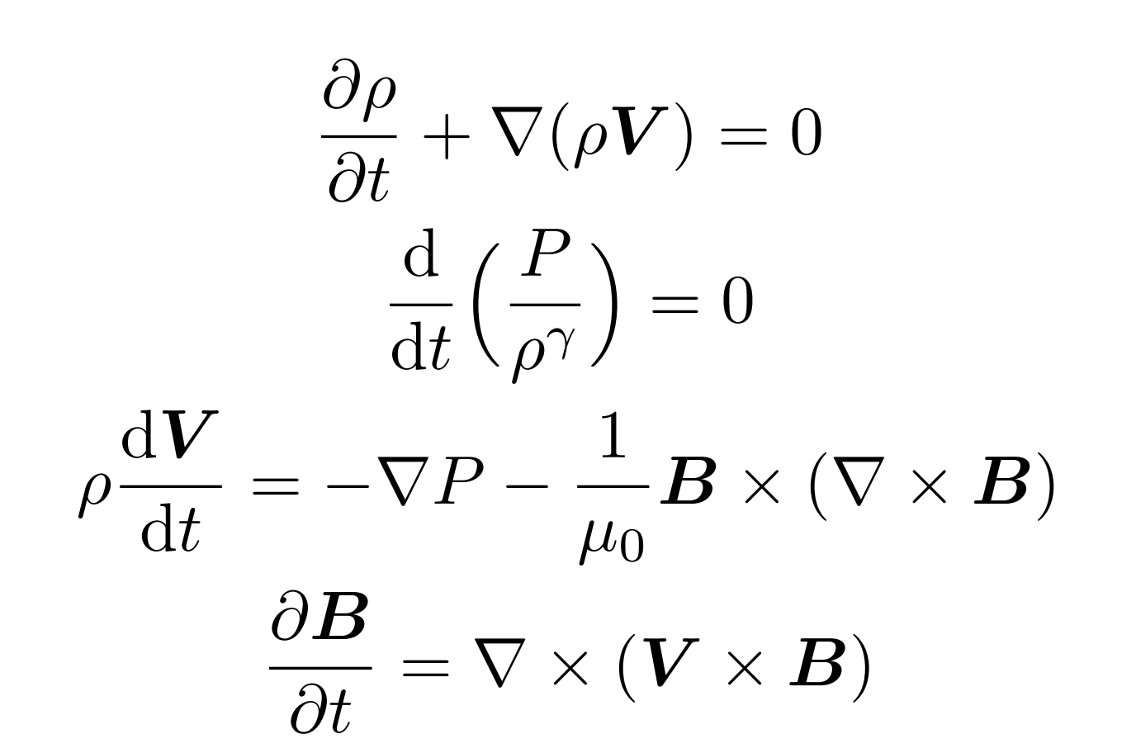
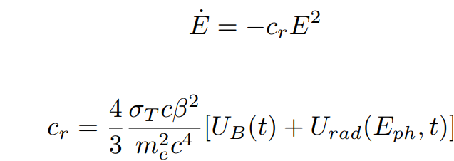
MHD equations
Cosmic Ray Transport
ICSC Italian Research Center on High-Performance Computing, Big Data and Quantum Computing
Missione 4 • Istruzione e Ricerca
Notes:
Template e guide lines

Slide 18
Summary and conclusions
The modular parallel RMHD code PLUTO is being ported on GPU
Core modules have been ported and tested
Good speedup obtained, full evaluation will be conducted
LP module is ported, test and performance evaluation are ongoing
Numerical (NVCCL) and physical (feedback) improvements of the LP module will be addressed
New numerical (HO) and physical (GR) modules will be added in PLUTO
Looking forward to produce adequate documentation and publish the code
Ultimate goal is the production of new scientific results \w HPC clusters simulations
ICSC Italian Research Center on High-Performance Computing, Big Data and Quantum Computing
Missione 4 • Istruzione e Ricerca

