Slide 1
Dynamics of Black Holes in the OpenGADGET3 code
Alice Damiano
Spoke 3 Technical Workshop, Trieste October 9 / 11, 2023
ICSC Italian Research Center on High-Performance Computing, Big Data and Quantum Computing
Missione 4 • Istruzione e Ricerca
Notes:
Cover

Slide 2
Scientific Rationale
Black Holes play a key role in shaping the cosmic environment, releasing huge amount of energy in the surrounding region and quenching the star formation.
The need to introduce them in cosmological simulations faces the issue to trace the orbits of a single “physical meaningful” particle
interacting with macro-particles around that sample an underlying density distribution.
Due to the mass and spatial resolution, the dynamical motion of black holes can be “heated” by scattering with the surrounding particles.
How can we correct for black hole dynamics in simulations ?
What are the effects of a more realistic description of BH dynamics on structure evolution ?
ICSC Italian Research Center on High-Performance Computing, Big Data and Quantum Computing
Missione 4 • Istruzione e Ricerca
Notes:
Template e guide lines

Slide 3
Technical objectives
Methodologies
Cosmological simulations of cosmological boxes and galaxy clusters (zoom-in)
Analysis of the outcome of current code prescriptions to control black hole dynamics and identify a reference “best model”.
Merging together and study the effect of a comprehensive module for black hole dynamics, spinning and kinetic feedback.
Analysis of black hole centering, merger events and co-evolution within the host galaxies
Conduct a simulation test campaign to investigate the coexistence of the
three models, the effect on galaxy evolution at different scales and at different redshift, also varying the simulation resolution
Solution
Black hole dynamics: we have developed a new model for tracing the black hole into the host galaxy. The model relies on a novel numerical implementation of the dynamical friction formula.
We set up different simulations aiming to test the model on different environments at different scales and resolution, thickening the frequency of saving snapshots between 3<z<2 to trace the more active phase of the merger assembly history.
ICSC Italian Research Center on High-Performance Computing, Big Data and Quantum Computing
Missione 4 • Istruzione e Ricerca
Notes:
Template e guide lines

Slide 4
Timescale, Milestones and KPIs
Timescale
Milestones
KPIs
January 2023 - January 2024
Testing and comparing black hole dynamics model implementations. Identification of the dynamics reference model
Dynamical friction model development.
Merging phase tests:
Interplay and effects of the comprehensive module
Simulation campaign
Introduction of the novel implementation into the current version of the code (non-public).
Scientific papers:
DF new model in OpenGadget3
Details of the comprehensive BH module in OpenGADGET3
Final simulation campaign results
Code release
January 2024 - January 2025
Beginning of the “black hole module” merging phase.
January 2025 - January 2026
Set up simulation campaigns including the fully tested black hole physics.
ICSC Italian Research Center on High-Performance Computing, Big Data and Quantum Computing
Missione 4 • Istruzione e Ricerca
Notes:
Template e guide lines

Slide 5
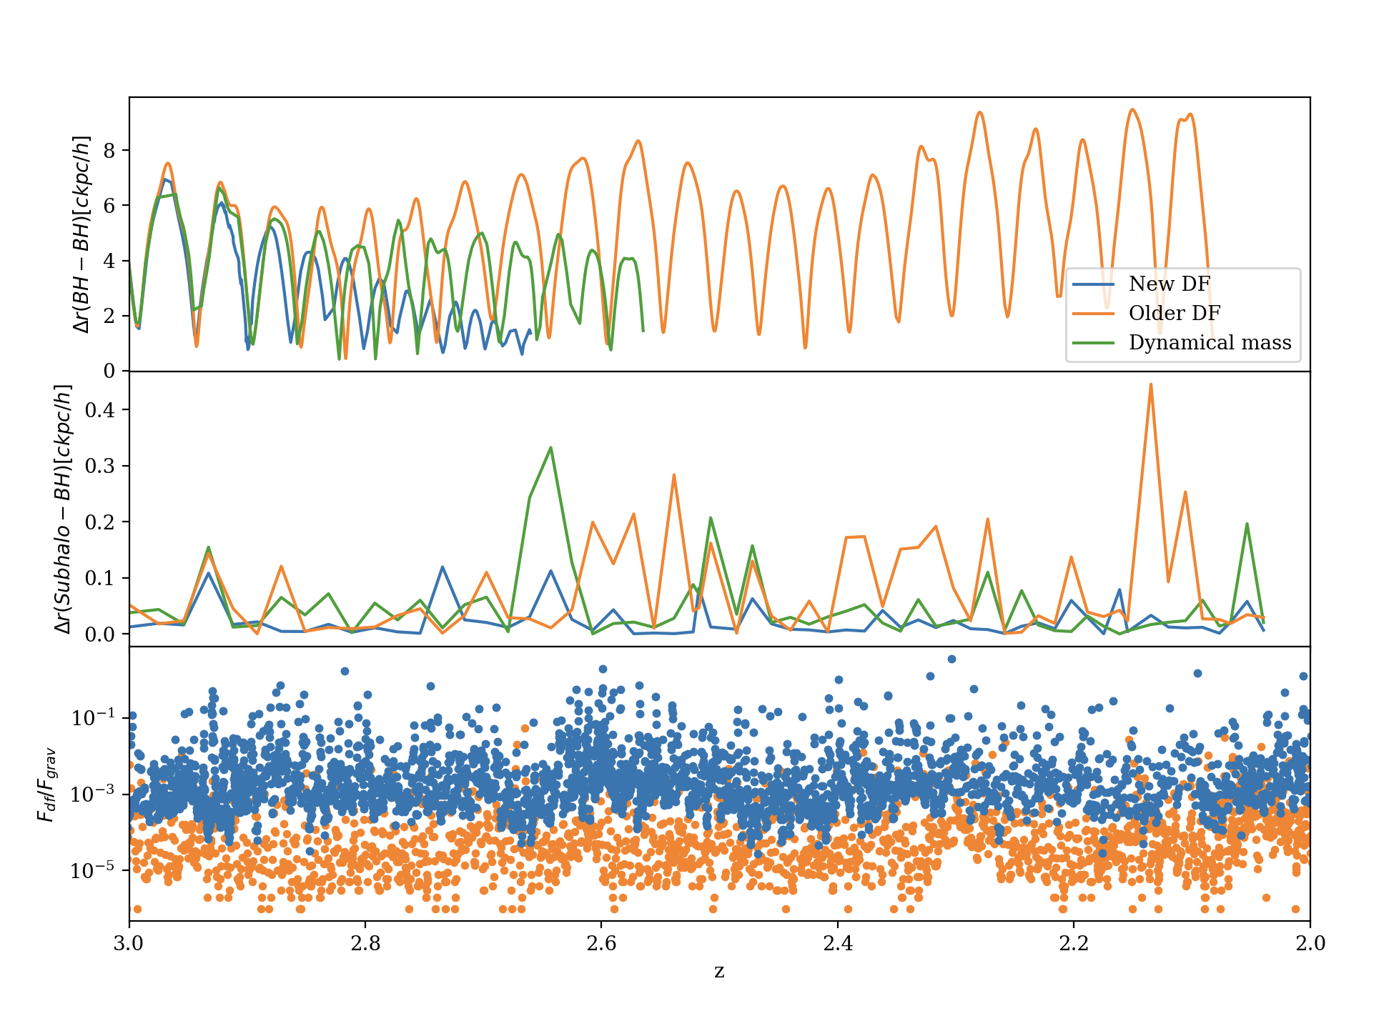
Accomplished Work, Results
Simulations
Results
Performance
The novel dynamical friction prescriptions we introduced is capable to sink the black hole at the center of the galaxy
Overall, it reproduces the orbits of two merging black holes in a more physical way
Different prescriptions of BH dynamics strongly affect the structure evolution, matter content and feedback especially at higher redshift.
Compared to the older version of dynamical friction, the novel implementation does not require SubFind to be executed on the fly, and it simple form deletes all the calculation required for the older version.
Zoom-in clusters
Cl13 ($M={10}^{13}M_{⊙}/h$)
D9 ($M={10}^{15}M_{⊙}/h$)
D9 at lower resolution
Cosmological box (16 $cMpc/h$)
 | Older DF version | New DF
Black hole computations | 1% | 0.5%
Subfind | 10% | -
Post-processing
Black hole details are stored at each redshift.
During the post-processing phase we developed a tool that re-orders each BH data so that their properties can be easily handled.
We set up an imaging tool that uses the SMAC software to process multiple snapshots and creates video of the evolution of a single BH/subhalo during the simulation
ICSC Italian Research Center on High-Performance Computing, Big Data and Quantum Computing
Missione 4 • Istruzione e Ricerca
Notes:
Template e guide lines

Slide 6
Next Steps and Expected Results (by next checkpoint: April 2024)
Paper submission
Latest DF details and comparative studies with other recent works
Setting up simulations as a background for merging together the BH prescriptions
Beginning of the merging phase (February 2024)
ICSC Italian Research Center on High-Performance Computing, Big Data and Quantum Computing
Missione 4 • Istruzione e Ricerca
Notes:
Template e guide lines

