Slide 1
WP1,WP2 Activity Status
S. Della Torre, G. Puglisi, M. Spera, M. Valentini
Spoke 3 Technical Workshop, Trieste October 9 / 11, 2023
ICSC Italian Research Center on High-Performance Computing, Big Data and Quantum Computing
Missione 4 • Istruzione e Ricerca
Notes:
Cover

Slide 2
Outline
brainstorm Peppe e Stef
summary activities (riassuntone della tabella dei codici )
20 linee di progetto
monthly meetings
on Track T1.1 is over, T1.2 in progress
83% success of employment
17% hiring currently on-going
KSP
criticalities
future outlooks

Slide 3
WP1 - HPC codes enabling and optimization
Scope: selects a number of codes that require intensive computational resources to face the next generation of scientific challenges and performs their redesign, reimplementation and optimisation in order to effectively exploit state-of-the-art HPC solutions.
T1.1: Selection, Analysis and testing of codes
T1.2: Software development, refactoring and optimization
T1.3: Integration, Verification and Validation

Slide 4
WP2 - Design of innovative algorithms, methodologies and codes towards exascale and beyond
Scope: This WP identifies innovative algorithms and methodologies upgrading their capability to exploit, and scale on, the exascale and post exascale architectures, reintegrating the resulting improved features in codes, workflows and pipelines. The energy impact will also be specifically considered.
T2.1: Science cases definition, algorithms identification, parallelism level assessment and profiling
T2.2: Algorithms co-design and methodologies to scale-up the capabilities of the algorithms and to find new innovative solutions
T2.3: Design of new architectural solutions aimed at the exploitation of post-exascale infrastructure
T2.4: Algorithms and methodologies integration into new big-data analysis applications

Slide 5
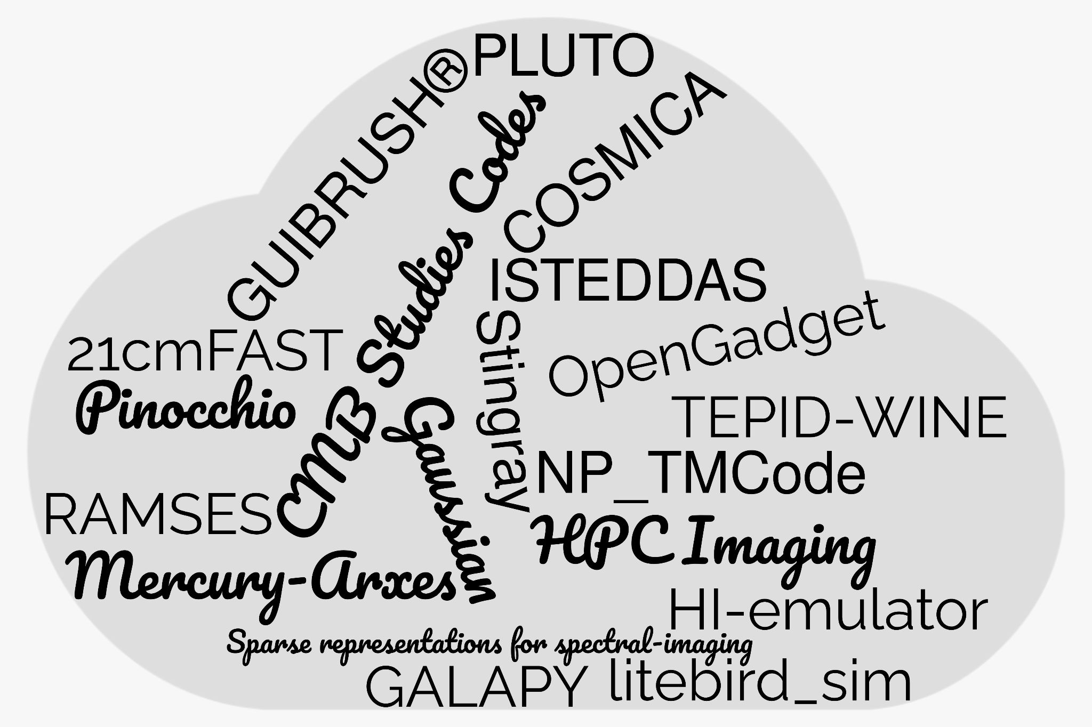
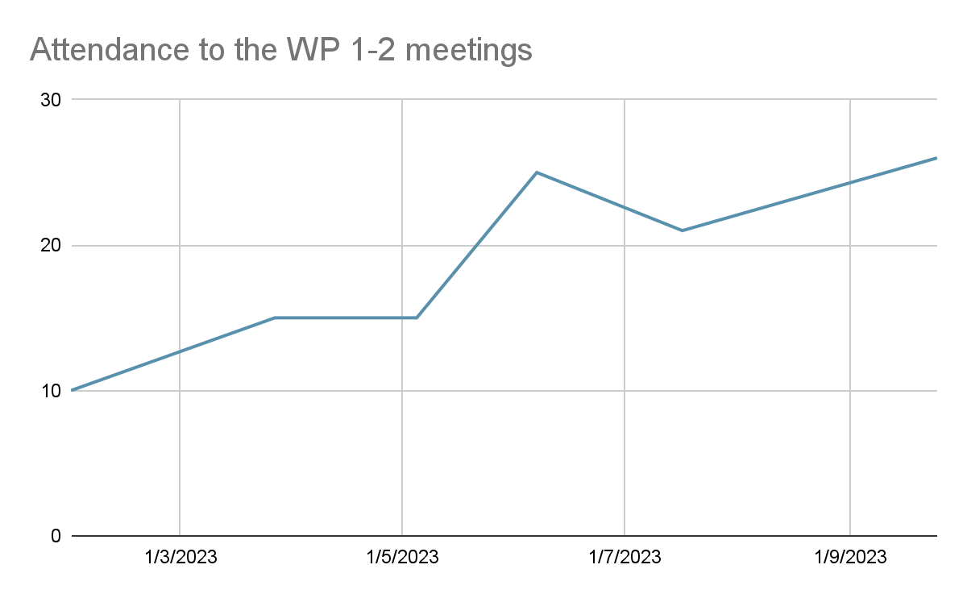
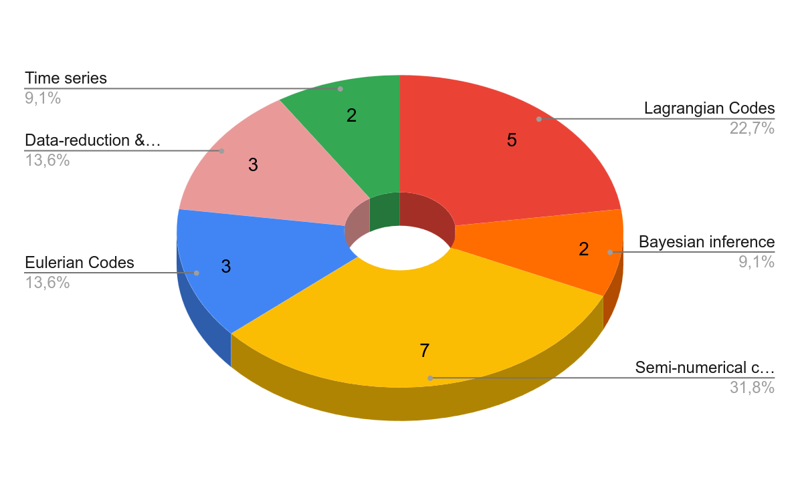
WP1-2 in numbers
21 lines of development
19 Codes
7 WP meetings

Slide 6
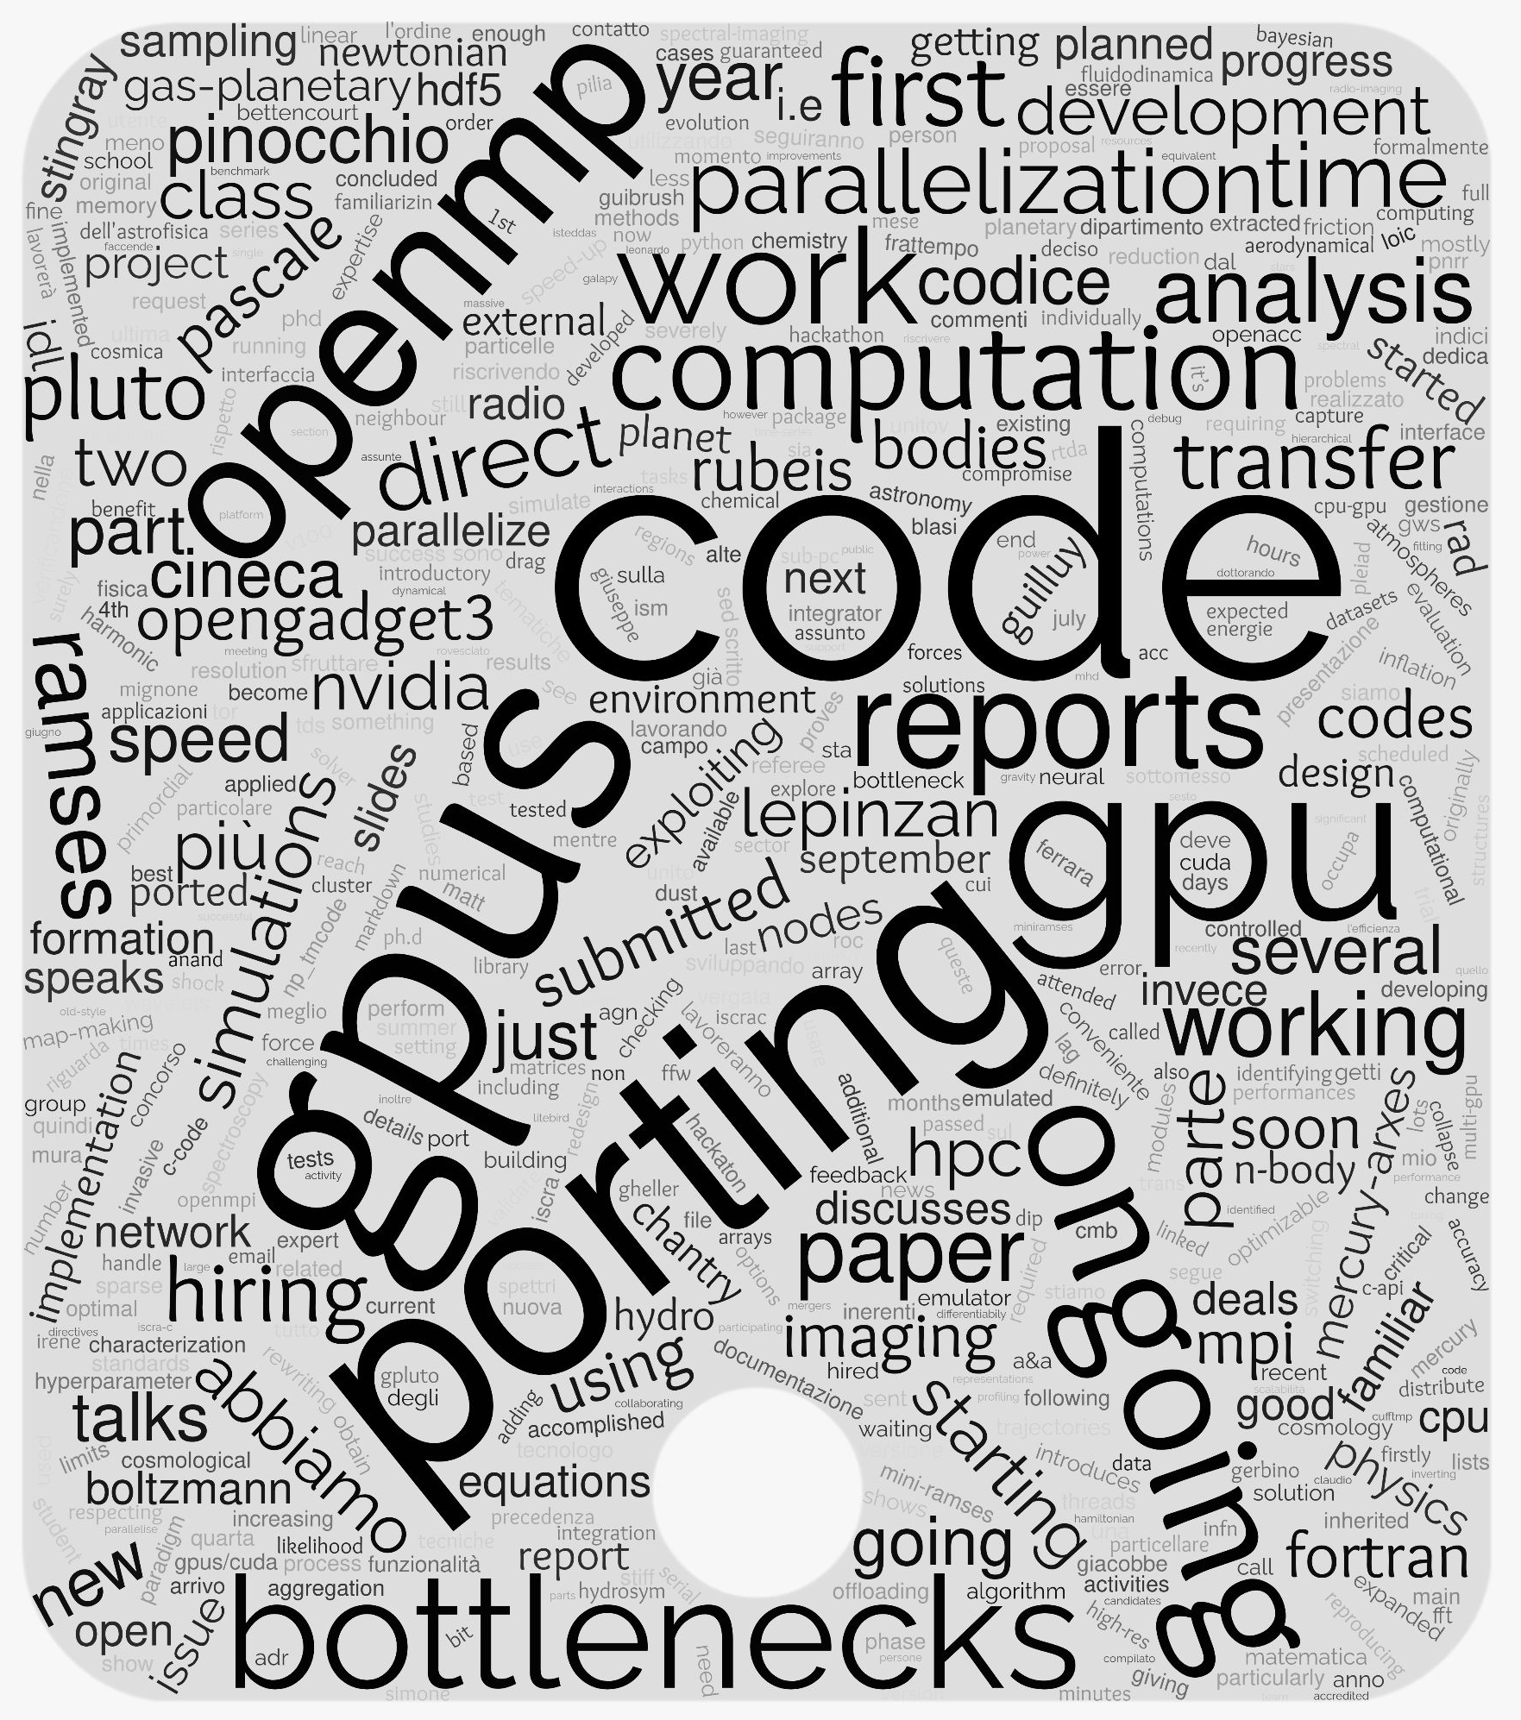
General Status of WP 1-2
The main general achievements was the hiring (almost) completed
Most of the activities concentrated to:
Code performance profiling
Porting on GPU
CUDA
OpenACC
Algorithm
issues
Model implementation Issues
Codes (or part of them) not originally intended to be used on GPU that need to be (partially) rewrote
Inefficient memory scaling
Low computational unit occupancies
Matrix inversion algorithm revisited
low computation-over-transfer ratio
…

Slide 7
General Status of WP 1-2
Mario Spera ISTEDDAS: a new direct N-body code to study compact binary coalescences
Tommaso Ronconi Updates and status of the GalaPy library for modelling the SED of galaxies
Milena Valentini The OpenGADGET3 code
Monaco Massive production of cosmological simulations for Euclid
Marius Lepinzan High Perfomance Cosmology: the PINOCCHIO code
Alice Damiano Dynamics of Supermassive Black Holes in the OpenGADGET code
Alessio Suriano Eulerian and Lagrangian Algorithms in the PLUTO code
Giovanni cavallotto Cosmic rays solar modulation exploiting GPU parallelization
Paolo Campeti GPU Porting of Cosmological Boltzmann solvers
Paolo Campeti Map-Level Emulators of CMB systematics
Andrea Sabatucci Optimization of the analysis pipeline and study of systematics in the LiteBIRD mission.
Emanuele De Rubeis HPC and accelerators exploitation for radio imaging software: a step towards the SKA era
Eleonora Veronica Lai Stingray: Next-Generation Spectral Timing
Giovanni La Mura NP Transition Matrix code for HPC applications of scattering problems
Diego Turrini Mercury-Arxes: High-Performance Planet Formation
Gloria Guilluy Characterization of exoplanetary atmospheres with GUIBRUSH®
Raffaele Pascale RAMSES GPU
Avinash Anand Optimization of datareduction for CMB experiments
Federico De Luca/Simone Ferretti Status and updates of the Sparse representations for spectral imaging algorithm
19 Talks

Slide 8
Critical points
Hardware: we need to access HPC resources to develop and test our codes (actually relying on existing facilities, e.g. local server, local farm,...)
Hardware and Software community: need to improve communication and experience sharing among participants toward the creation of a community environment.

Slide 9
Next Steps and Expected Results (by next checkpoint: April 2024)
Consolidating the results with benchmark test and fine-tunes
validate the most recent changes introduced while improving the code performance and infrastructure
Checking for other parts of the actual codes that may be ported on GPUs
ICSC Italian Research Center on High-Performance Computing, Big Data and Quantum Computing
Missione 4 • Istruzione e Ricerca
Notes:
Template e guide lines

