Slide 1
Spoke 3: Status and Perspectives
Claudio Gheller
Spoke 3 Technical Workshop, Trieste October 9 / 11, 2023
ICSC Italian Research Center on High-Performance Computing, Big Data and Quantum Computing
Missione 4 • Istruzione e Ricerca
Notes:
Cover

Slide 2
Status of the Spoke
First year activity (started September 1, 2022, 3 years project)
Administrative and organizational activities
Set-up of the governance
Budget and financial management
Reporting
Scientific and Technical activities
WPs R&D activities
Collaboration with industries: Innovation Grants
Cascade fundings
ICSC Italian Research Center on High-Performance Computing, Big Data and Quantum Computing
Missione 4 • Istruzione e Ricerca
Notes:
Template e guide lines

Slide 3
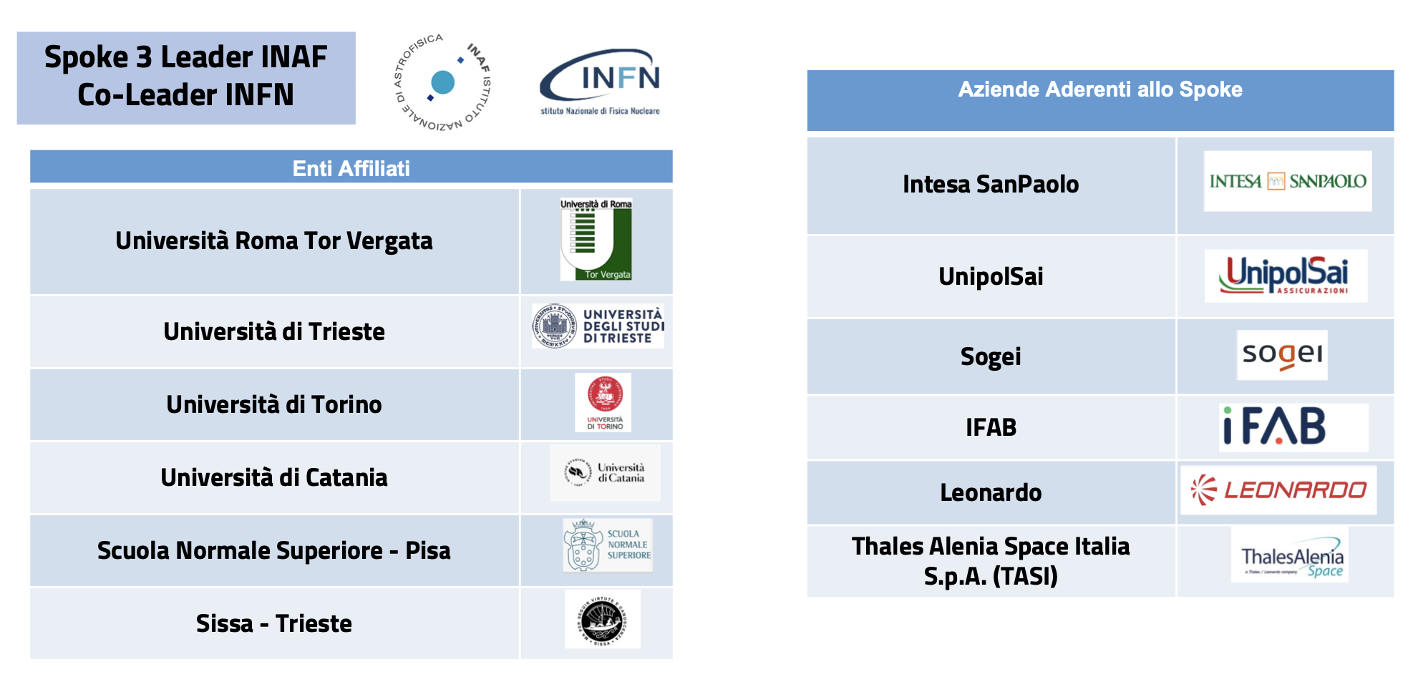
Partnership
ICSC Italian Research Center on High-Performance Computing, Big Data and Quantum Computing
Missione 4 • Istruzione e Ricerca
Notes:
Template e guide lines

Slide 4
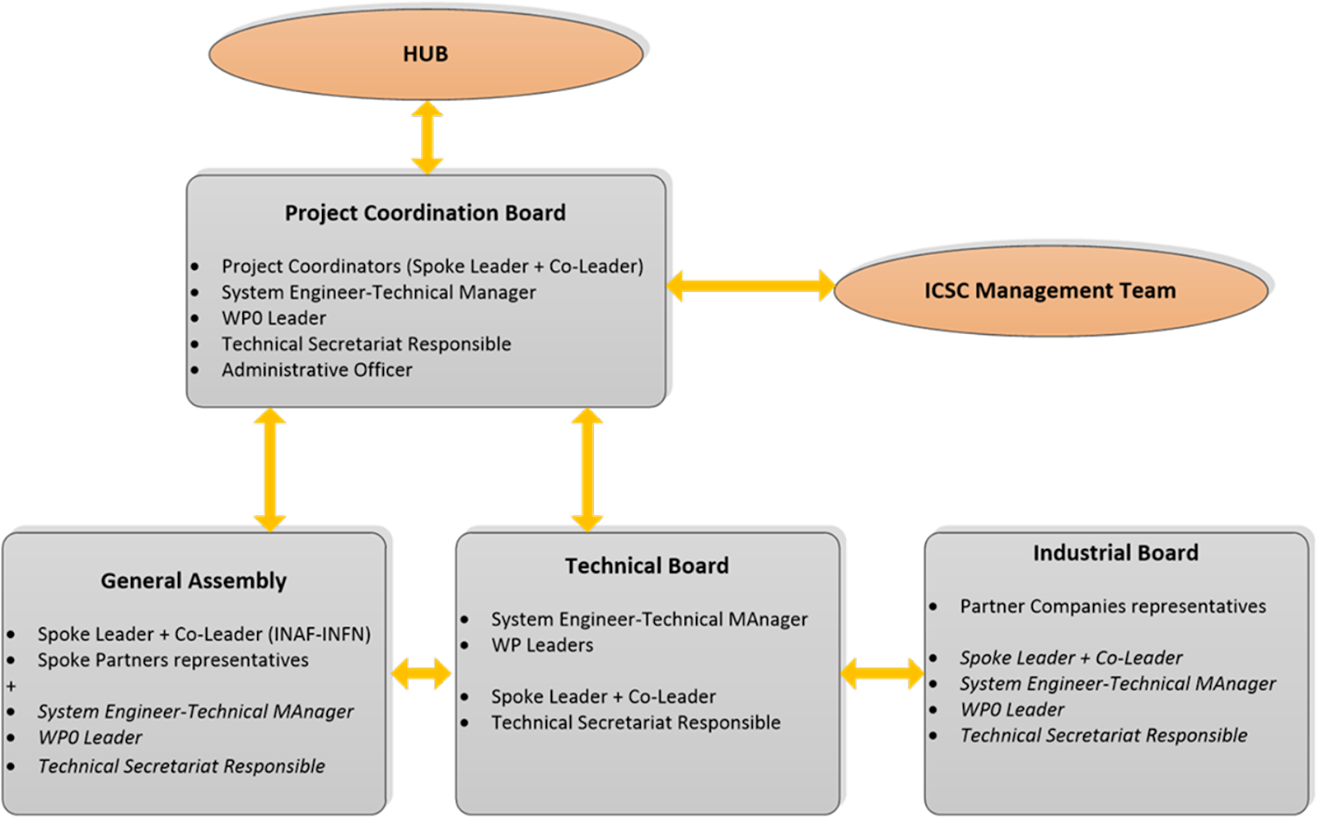
Governance
ICSC Italian Research Center on High-Performance Computing, Big Data and Quantum Computing
Missione 4 • Istruzione e Ricerca
Notes:
Template e guide lines

Slide 5
Budget
ICSC Overall Budget: ~ 320 MEuro
Spoke 3 Total Budget: ~ 12 MEuro
Staff: 3 MEuro
Hirings: 3.5 MEuro
PhD: 1.2 MEuro
Innovation Grant: 1 Meuro
Cascade Fundings: 3.2 Meuro
Hirings
39 researchers hired (research+technical staff + PhD)
ICSC Italian Research Center on High-Performance Computing, Big Data and Quantum Computing
Missione 4 • Istruzione e Ricerca
Notes:
Template e guide lines

Slide 6
Timeline - Milestones
Month 0
Sept. 2022
Month 8
Apr. 2023
Month 12
Aug. 2023
Month 18
Feb. 2024
Month 22
Jun. 2024
Month 26
Oct. 2024
Month 36
Aug. 2025
M4
M6
M7
M8
M9
M10
M5
Month 5
Jan. 2023
Month 24
Aug. 2024
M1
M2
M3
ICSC Italian Research Center on High-Performance Computing, Big Data and Quantum Computing
Missione 4 • Istruzione e Ricerca
Notes:
Template e guide lines

Slide 7
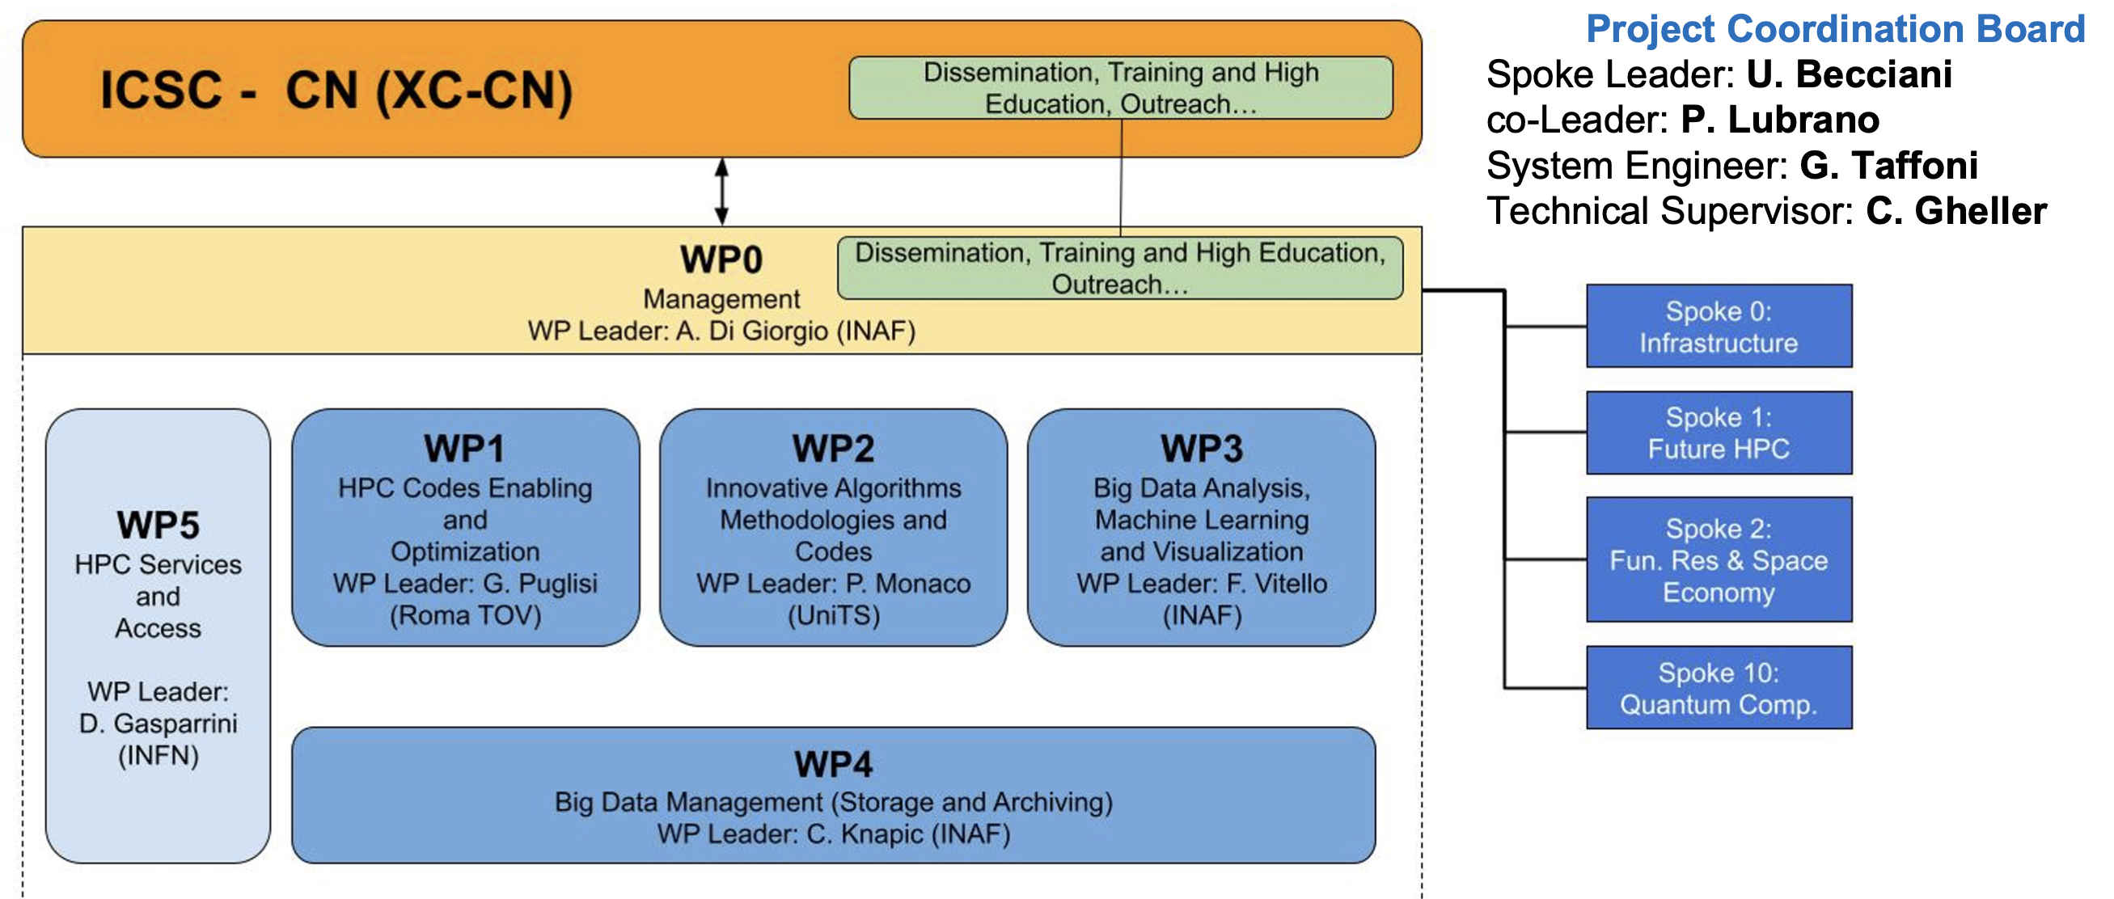
Project layout
ICSC Italian Research Center on High-Performance Computing, Big Data and Quantum Computing
Missione 4 • Istruzione e Ricerca
Notes:
Template e guide lines

Slide 8
Work Packages
Scientific and technical goals identified
Workplan defined
Governance established
Development activities started
Monthly WP meetings
Weekly WP Leaders meetings
6-month All-Hands Meetings (June 2023 Catania, October 2023 Trieste)
ICSC Italian Research Center on High-Performance Computing, Big Data and Quantum Computing
Missione 4 • Istruzione e Ricerca
Notes:
Template e guide lines

Slide 9
Innovation Grants (1)
ICSC Italian Research Center on High-Performance Computing, Big Data and Quantum Computing
Missione 4 • Istruzione e Ricerca
Notes:
Template e guide lines

Slide 10
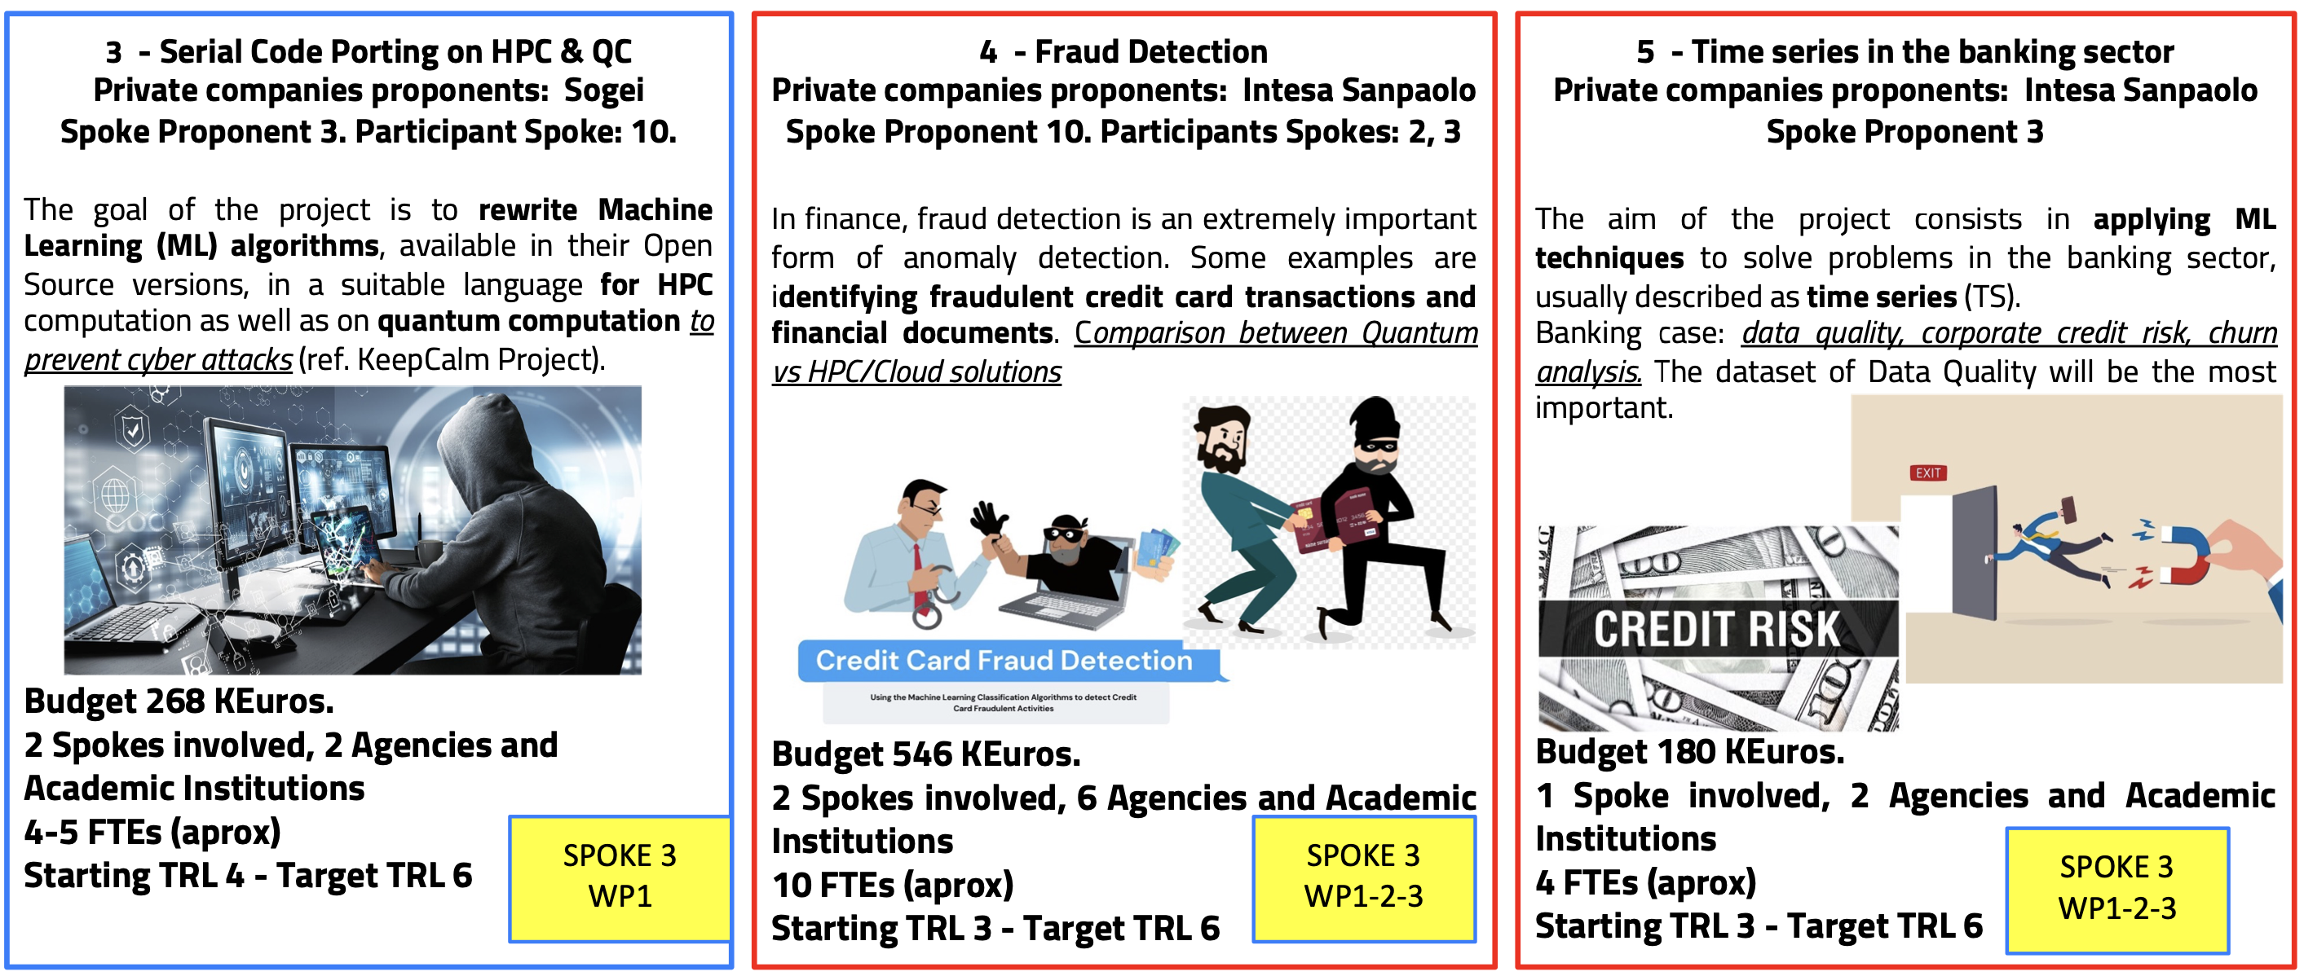
Innovation Grants (2)
ICSC Italian Research Center on High-Performance Computing, Big Data and Quantum Computing
Missione 4 • Istruzione e Ricerca
Notes:
Template e guide lines

Slide 11
Coming Steps
Work Package Activity
Cascade Fundings
Key Science Projects
ICSC Italian Research Center on High-Performance Computing, Big Data and Quantum Computing
Missione 4 • Istruzione e Ricerca
Notes:
Template e guide lines

Slide 12
Work Packages
Scientific and technological activity must be fully developed.
Activity must be clearly reported (at the end of a Milestone) in terms of:
TARGETS
KPIs (Key Performance Indicators): a quantifiable measure of performance over time for a specific objective. Examples:
Publications (journal papers, technical reports, white papers etc.)
Contributions to conferences, workshops etc.
Major software releases (with documentation)
Official meetings
…
ICSC Italian Research Center on High-Performance Computing, Big Data and Quantum Computing
Missione 4 • Istruzione e Ricerca
Notes:
Template e guide lines

Slide 13
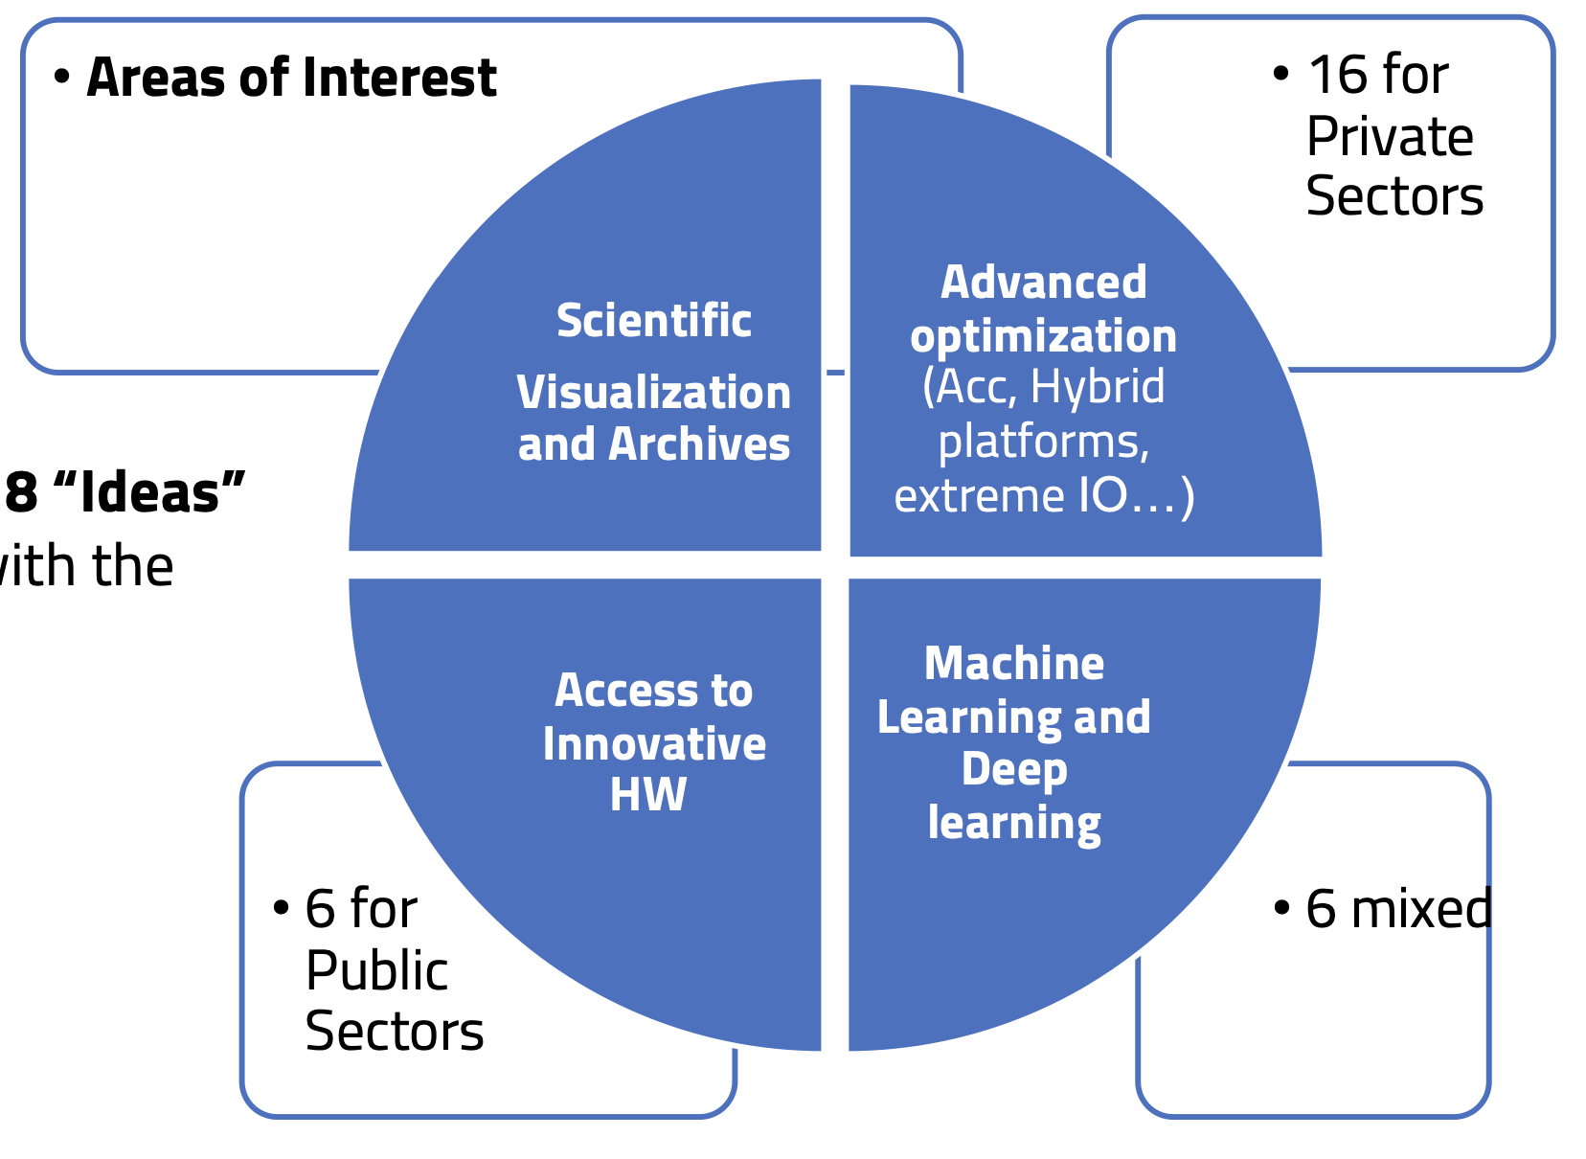
Cascade Fundings
~ 30 Proposals collected and discussed by the Assembly
Summary submitted to the HUB
Requests for about twice the budget
Rules under final processing. Expected by end of October
ICSC Italian Research Center on High-Performance Computing, Big Data and Quantum Computing
Missione 4 • Istruzione e Ricerca
Notes:
Template e guide lines

Slide 14
Key Science Projects
KSPs represent the Spoke 3 flagship applications, main scientific and technological outcomes of the WPs and R&D activities:
8 proposals collected
They will be presented on Wednesday morning
Allocation procedure (both scientific and in terms of computing resources) is being defined
Resources will be allocated according to the ICSC procedure
ICSC Italian Research Center on High-Performance Computing, Big Data and Quantum Computing
Missione 4 • Istruzione e Ricerca
Notes:
Template e guide lines

Slide 15
Thanks to Davide Salomoni
ICSC Italian Research Center on High-Performance Computing, Big Data and Quantum Computing
Missione 4 • Istruzione e Ricerca
Notes:
Template e guide lines

