Slide 1
Investigating the formation and dispersion of star clusters with MOONS and 4MOST
G.G. Sacco

Slide 2
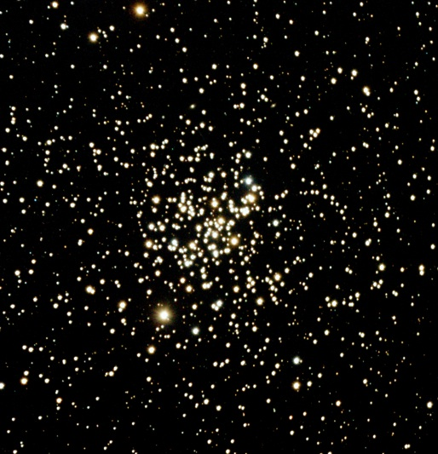
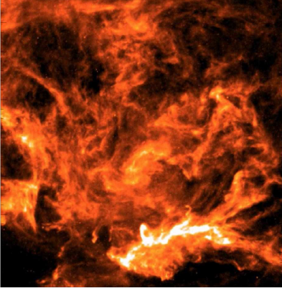
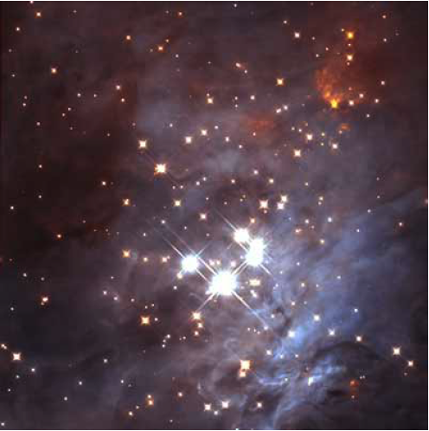
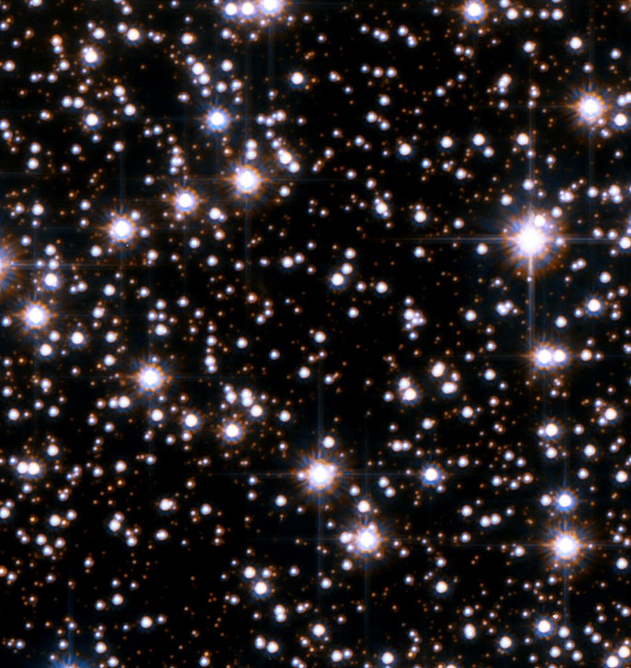
The life of a star cluster
Filaments
Stars and Gas
How do clusters form?
How and why do clusters disperse?
How does the SF environment influence the properties of stars and planetary systems?
Galactic field
André+2014
Muench+ 2008
< 1 Myr
1-10 Myr
Credit: NASA, ESA
>100 Myr
Firenze, 20/11/2023

Slide 3
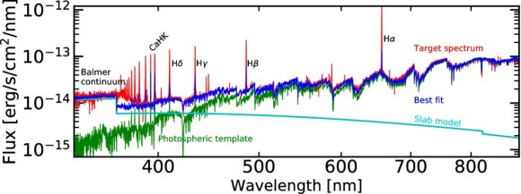
The role of spectroscopy in open cluster studies
Ages and Masses
Kinematics
Outflow and accretion
Chemical abundances
Nebular emission
Manara+2017
Firenze, 20/11/2023

Slide 4
The role of spectroscopy in open cluster studies
N. Wright Talk
Filaments
Stars and Gas
Galactic field
André+2014
Muench+ 2008
< 1 Myr
1-10 Myr
Credit: NASA, ESA
Firenze, 20/11/2023

Slide 5
The MOONS spectrograph at the VLT
Telescope: VLT
FoV: 25 arcmin (diameter)
Fibers: 1001
LR coverage: 0.64-1.8 $μ$m
LR resolution: R_{RI} = 4100, R_{YJ} = 4300, R_{H} = 6600
HR coverage: $λ_{RI}$ = 0.76-0.89 $μ$m, $λ_{YJ}$ = 0.93-1.35 $μ$m, $λ_{H}$ = 1.52-1.64 $μ$m
HR resolution: R_{RI} = 9200, R_{YJ} = 4300, R_{H} = 19700
Currently under integration and assembly. Commissioning in 2025
Cirasuolo et al. 2020
Firenze, 20/11/2023

Slide 6
MOONS survey of young star clusters (S. Randich, K. Biazzo, G. Sacco, B. Nisini)
Five nights Infrared spectroscopic survey of young clusters
Medium resolution spectroscopy of young embedded populations
Capabilities to observe to very low mass stars
Accretion and out flow of very young protostars
Gonzalez et al. 2020
Firenze, 20/11/2023

Slide 7
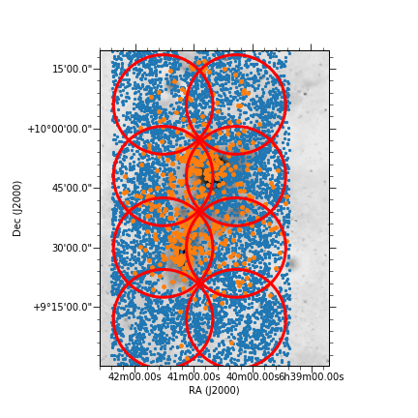
MOONS survey of young star clusters (S. Randich, K. Biazzo, G. Sacco, B. Nisini)
Targets:
About 10 young (age < 3-5 Myr) embedded or partially embedded clusters spanning a large mass range
NGC 2264
Firenze, 20/11/2023

Slide 8
MOONS survey of young star clusters (S. Randich, K. Biazzo, G. Sacco, B. Nisini)
Goals
Cluster kinematics at the earliest stages
Mass accretion and outflow of protostars in different environments
Chemical gradients in very young clusters
Stellar parameters:
Radial Velocities and v sin i
Stellar parameters (Teff, Log g)
Mass accretion rates
Metallicity and abundances
Firenze, 20/11/2023

Slide 9
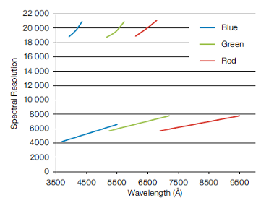
The 4MOST spectrograph at VISTA
Telescope: VISTA (4m at Paranal)
FoV: 4.2 deg²
Low res: R ~6500, fibers =1624, band = 3700-9500 Ang
High resolution: R~ 20000, fibers = 812
High res band: 3926-4355, 5160-5730, 6100-6790 Ang
Starting operations: late 2024
(de Jong et et al. 2019)
Firenze, 20/11/2023

Slide 10
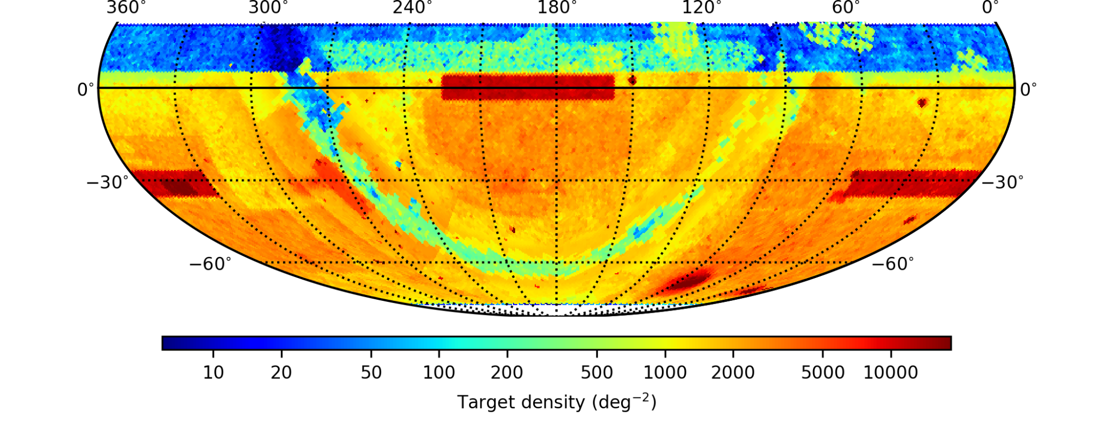
The 4MOST observation strategy
Observation strategy
Only survey defined every 5 years
FoV shared among surveys
70% fiber-time for first 5 years for consortium surveys
30% fiber-time for community surveys
Call for LoI for community survey in 2019
Community survey selected on December 2021 after 2-year long process
Final strategy discussed by ESO OPC in the spring 2024
9 Galactic surveys
9 Extragalactic Surveys
Firenze, 20/11/2023

Slide 11
The 4MOST Survey of Young Stars (4SYS)
PI : G. Sacco
Co-I: +40
Targets: $\sim 100,000$
distance < 500 pc
Age: 1-100 Myr
Area: -70 < DEC < +5 deg
SpT: Later than G7
Mag: 10 < G < 18 mag
Goals
Space and kinematic distributions within 500 pc
Chemical inhomogeneities on scale from a few to 500 pc
Star formation history of the solar neighbourhood
Origin and properties of current and future targets for exoplanet studies
Largest catalog for studying PMS evolution
(Sacco et et al. 2023)
Firenze, 20/11/2023

Slide 12
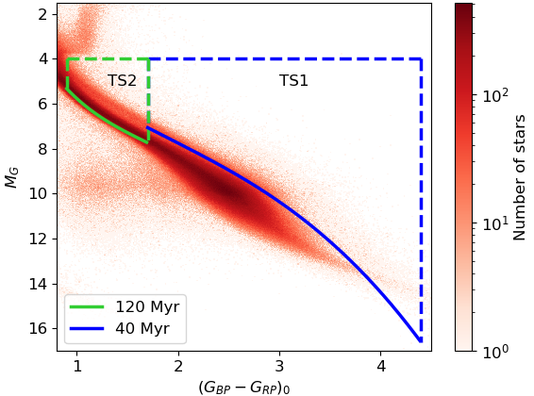
4SYS – Target Selection Strategy
Target Sample 1:
SpT: Later than K7
Age: < 40 Myr
Selection: Gaia CMD
LR and HR
Subsurveys:
TS1_HR (10<G< 15.5)
TS1_LR (15.5<G< 18.)
Stars: $\sim$100,000
Firenze, 20/11/2023

Slide 13
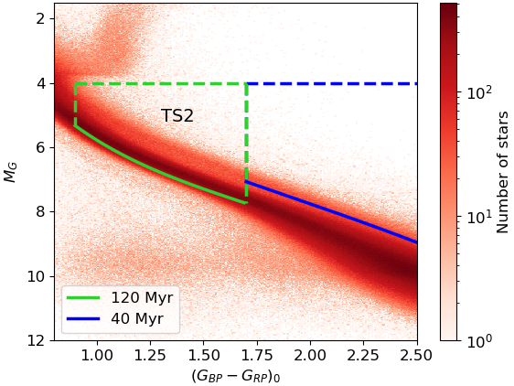
4SYS – Target Selection Strategy
Target Sample 2:
SpT: G7-K7
Age: < 100 Myr
Selection: Gaia CMD+ eRosita X-ray fluxes or TESS rotation periods
HR
Subsurveys: TS2_HR
Stars: ~40,000
Firenze, 20/11/2023

Slide 14
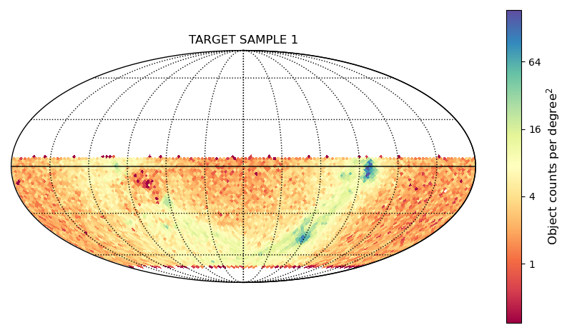
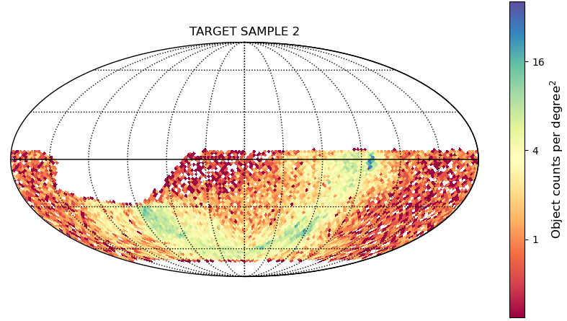
4SYS – Target Selection Strategy
lTarget Sampe 1
Orion
Vela
Target Sample 2
Sco-Cen
Firenze, 20/11/2023

Slide 15
4SYS - Data products
RV and V sini
Stellar parameters (Teff, log(g), [Fe/H])
Chemical abundances
Activity indices (from Ca H &K, Ha, Ca IRT )
Emission line fluxes
Catalogue of bona fide young stars
Mass and ages
Mass accretion rates
Firenze, 20/11/2023

Slide 16
Conclusions
Spectroscopic observations are giving a fundamental contribution in our understanding of the formation of star clusters
We will carry out a survey of young star clusters with the new infrared multi-object spectrograph MOONS at the VLT to study the initial conditions of the star formation process
We will use 4MOST at VISTA to perform a survey of young stars across the whole southern sky to investigate the mechanism leading to cluster dispersion
Firenze, 20/11/2023

