Slide 1




Impacts of spiral arms on the kinematics of the young stars
Mullard Space Science Laboratory
Daisuke Kawata
(Mullard Space Science Laboratory (MSSL), University College London (UCL))
Aisha Almannaei, Natsuki Funakoshi, George Seabroke
(MSSL, UCL)
Testuro Asano, Michiko Fujii, Noriyuki Matsunaga (U. of Tokyo),
Junichi Baba (Kagoshima, NAOJ)
Jason Hunt (Surrey)
This project is a Horizon Europe Marie Skłodowska-Curie Actions Doctoral Network funded under grant agreement no. 101072454.

Slide 2
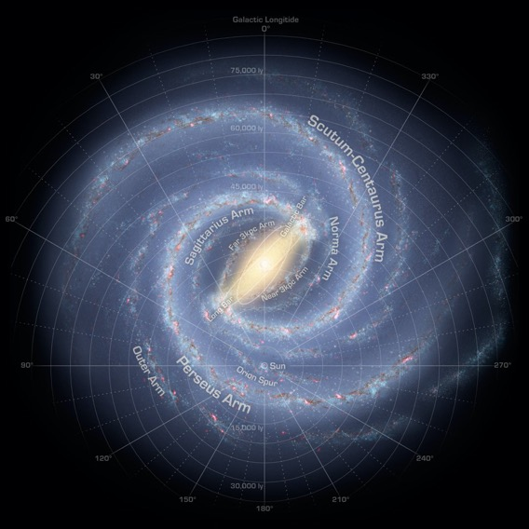
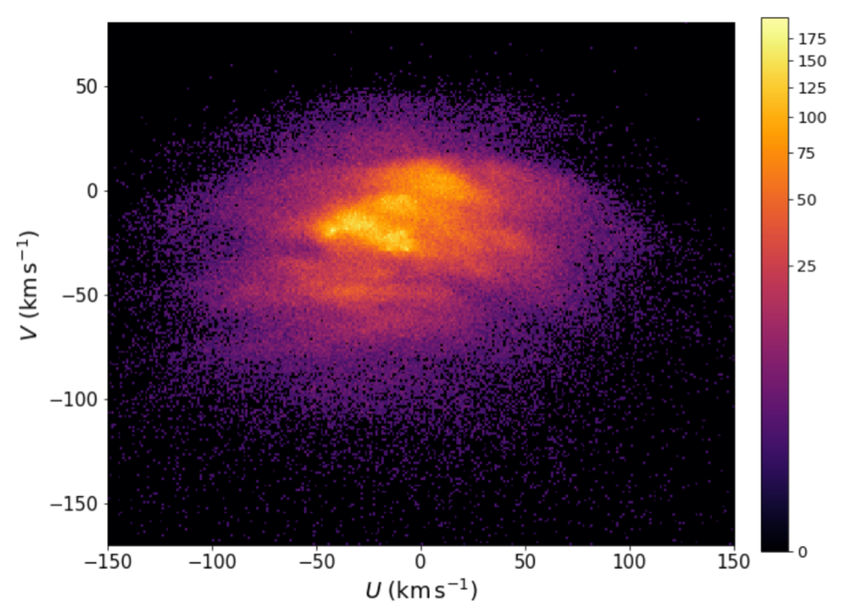
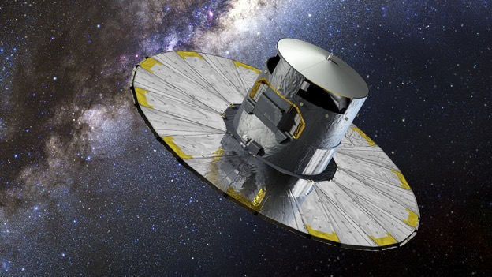
Gaia Revolution!
Stellar velocity distribution in the solar neighbourhood: Many velocity structures!
Gaia DR2 (April 2018)
faster
Rotation
Coma Berenices
Hyades
Sirius
U
Hercules
Sun
Rotation velocity V (km/s)
V
Pleiades
Arcturus
outward
inward
slower
Galactocentric radial velocity U (km/s)
Gaia Collaboration, Katz et al. (2018)

Slide 3
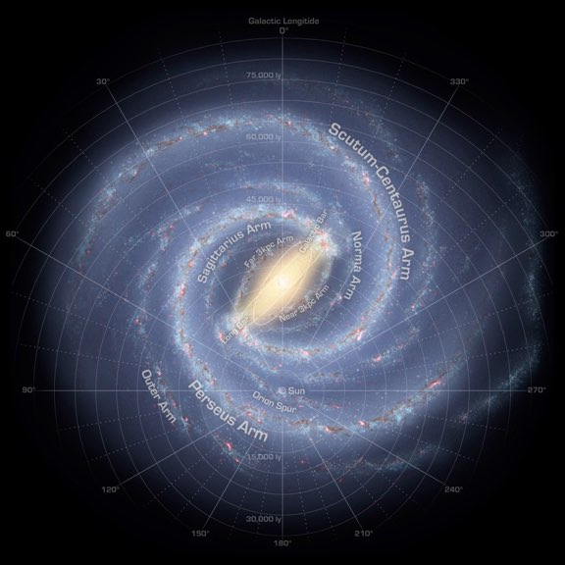
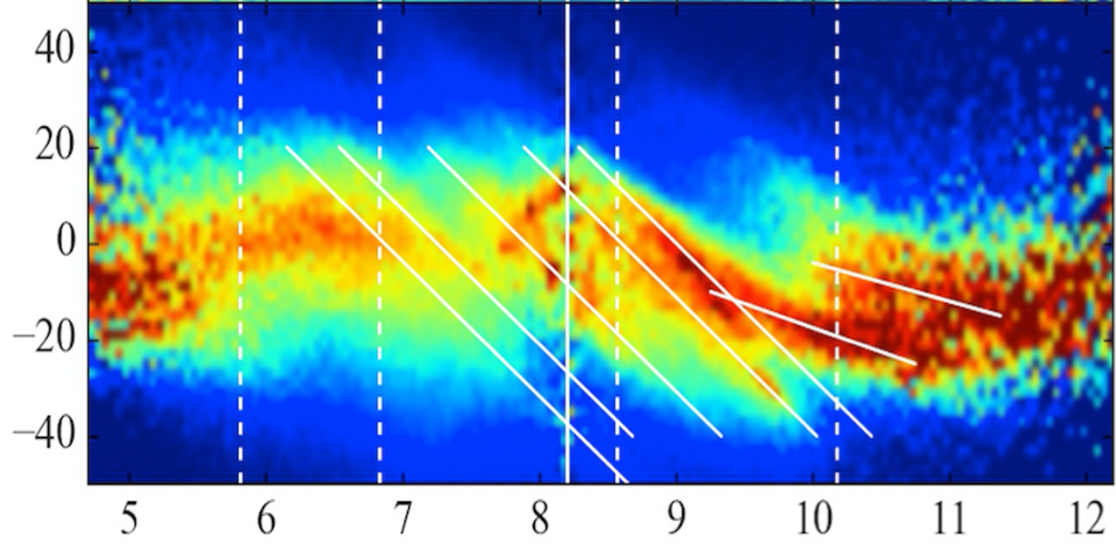
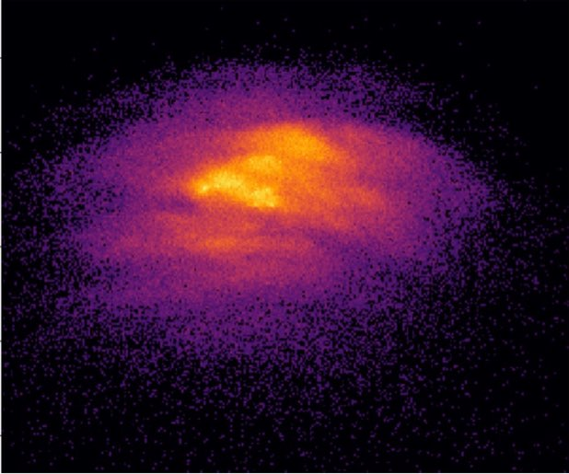
Gaia Revolution: tracing velocity structures in a large range of R: Ridges
(e.g. Antoja et al. 2018; Kawata et al. 2018; Ramos et al. 2018,
Fragkoudi et al. 2019, Khanna et al. 2019, Bernet et al. 2022, Lucchini et al. 2023)
Rotation
What is causing this? Can we learn the nature of Galactic structures?
Sgr dwarf perturbation, Bar, spirals?
Galactoseismology!
Scutum
Sagittarius
Local
Perseus spiral arm
Sun
Hy/Ple
Sirius
R0
Hat
Distance from the centre
Hat
Vrot − VLSR (km/s)
Hyades
Sirius
Vrot
Hercules
Hercules
Pleiades
Rgal (kpc)
Kawata et al. (2018)
outward
Vrad
inward

Slide 4
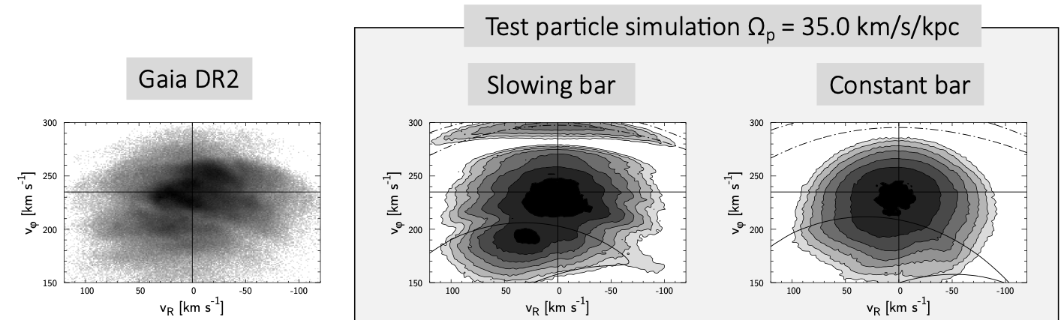
Gaia revolution: Bar pattern speed slower than pre-Gaia belief, and even slowing down?
Hercules stream due to
Outer Lindblad Resonance (OLR) ⇒ Fast bar, ~53 km/s/kpc (Dehnen 1999)
Outer 4:1 Resonance ⇒ Slow bar, ~42 km/s/kpc (Hunt & Bovy 2018)
Co-rotation resonance ⇒ Even slower bar, ~34 km/s/kpc
(Pérez-Villegas et al. 2017; Monari et al. 2019, Lucchini et al. 2023)
300
Vrot (km/s)
150
100
0
−100
Hercules
Vrad (km/s)
Chiba, Friske, Schönrich (2021a,b)
Slow-down bar due to dynamical friction? ⇒ Nature of dark matter, CDM, ULDM, MOND, MOG

Slide 5
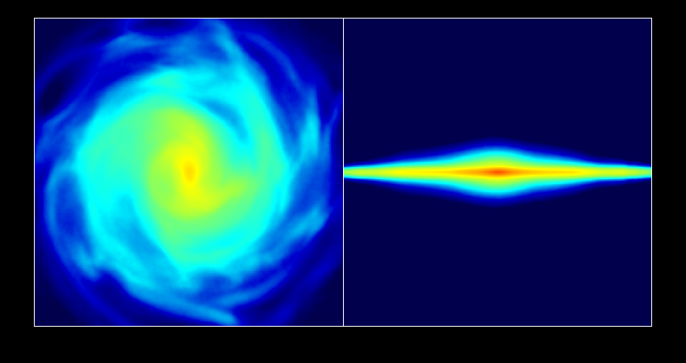
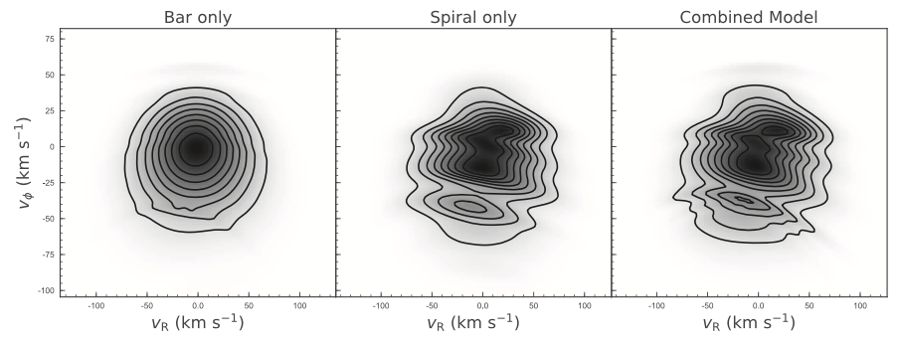

An inconvenient truth...,
transient spirals can cause similar features
(Hunt, Hong, Bovy, Kawata, Grand 2018)
Bar only
Transient spiral only
Combined
75
Gaia DR2
0
V_{rot} (km/s)
−100
100
V_{Rad} (km/s)
−100
100
V_{Rad} (km/s)
−100
100
V_{Rad} (km/s)
−100

Slide 6
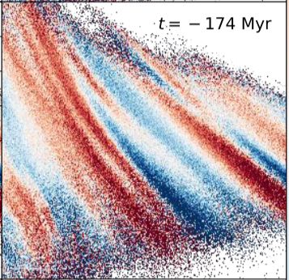
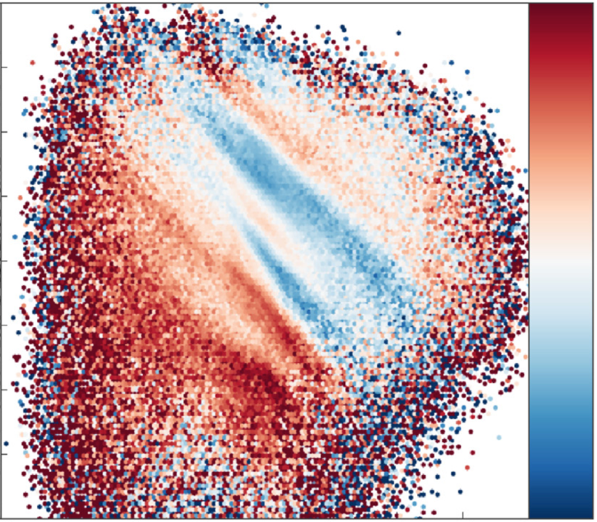
Diagonal ridges in R vs. Vrot and Vrad are also reproduced.
(Hunt, Bub, Bovy, Mackereth, Trick, Kawata 2019)
transient spiral + slow bar
Test particle sim
Gaia data
outward
300
10
Vrot (km/s)
0
Vrad (km/s)
100
−10
6
8
10
5
8
10
inward
Rgal (kpc)
Rgal (kpc)

Slide 7
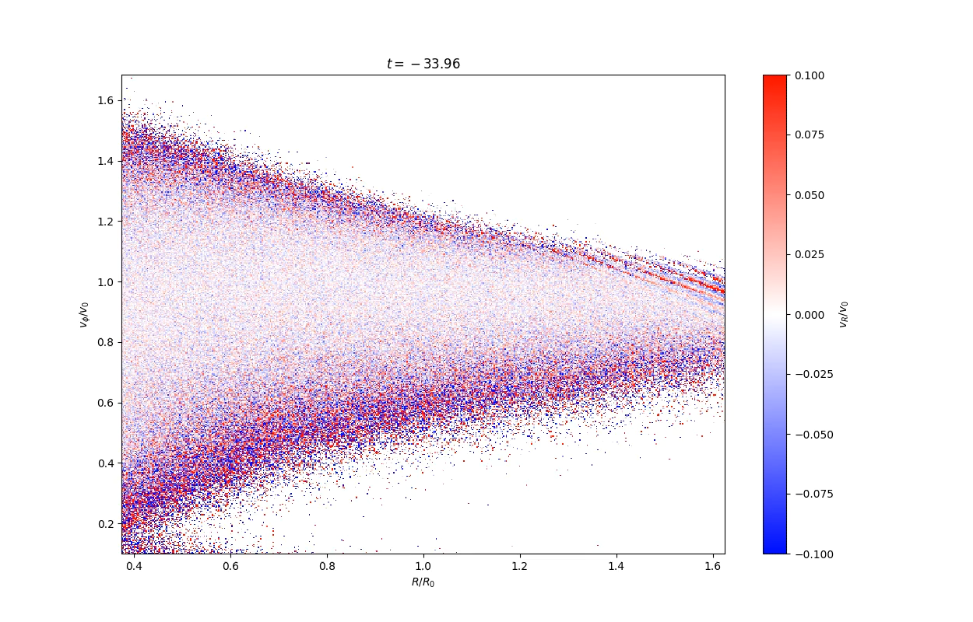
Inconvenient truth No. 2: velocity features due to the transient arms are transient
(e.g. Hunt, …, Kawata et al. 2018, 19; Fujii et al. 2019)
Transient arms can make any velocity feature! (Jason Hunt priv. comm.)
0.1
outward
1.6
1.0
Vrot / Vcirc(R₀)
Vrad/Vcirc(R₀) (km/s)
0
0.2
−0.1
inward
1.0
Rgal / R₀
Test particle simulation with slowly adding bar and then transient arms (Bub & Hunt)

Slide 8
We need to understand the nature of the spiral arm
and their impacts on the stellar kinematics.
Young stars, also open clusters, are likely to be good tracers of the influence of the spiral arms,
because of their colder kinematics.

Slide 9
The rotation curve of the young stars are valuable to trace Vcirc.
Spiral arm impact on the measurement of Vcirc?
Gaia DR3, Drimmel et al. (2023)

Slide 10
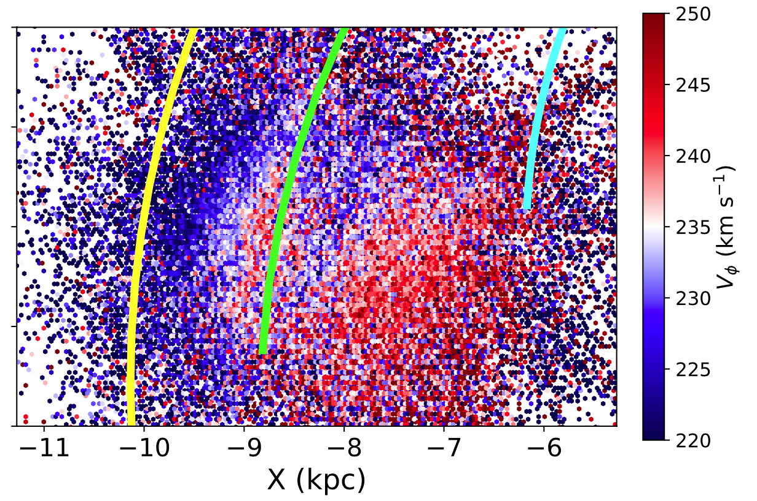
Axisymmetric disk model fitting for
Gaia DR3 OB stars selected by Gaia Collaboration, Drimmel et al. (2023)
(Almannaei, Kawata et al. 2023)
D<2 kpc sample
  Vcirc(R₀) = 233±2 km/s
  V⊙= 13.8 km/s
  V_{R,⊙} = −9.7±0.4 km/s
  R₀ = 8.28±0.04 kpc
  dVcirc/dR = −3.3±0.5 km/s/kpc
Lower Vcirc
Local arm
Sagittarius arm
negative Vcirc gradient
Perseus arm
D<0.5 kpc sample
  Vcirc(R₀) = 238±2 km/s
  V⊙= 12.3 km/s
  V_{R,⊙} = −11.3±0.4 km/s
  R₀ = 8.28±0.03 kpc
  dVcirc/dR = −1.8±1.2 km/s/kpc
Higher Vcirc
Arm positions from Reid et al. (2019)
See Poggio’s talk for alternative choice of the spiral arm locations.
positive Vcirc gradient

Slide 11
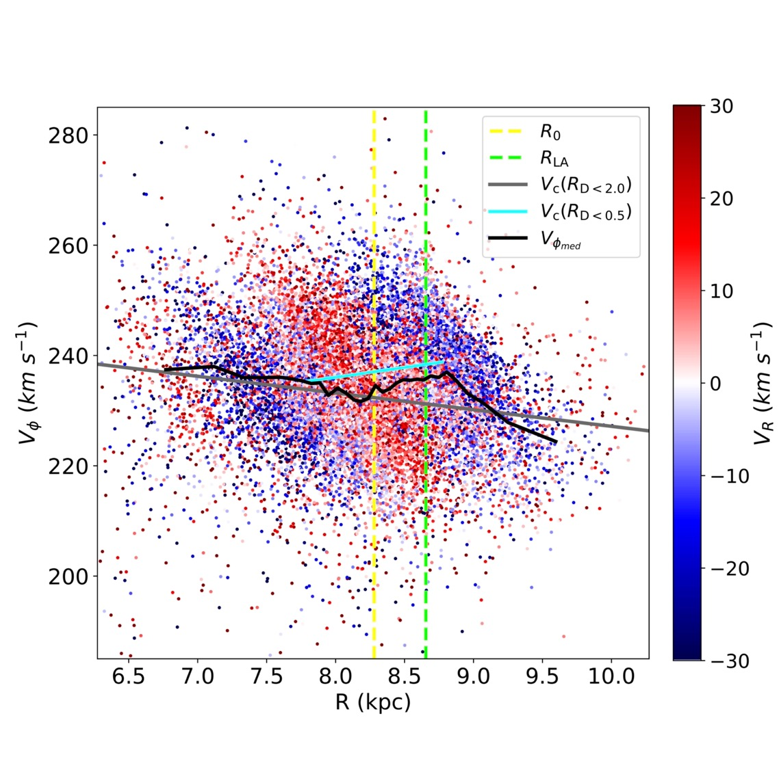
Impact of the Local arm on the rotation velocity of the stars?
Vφ,median radial trend
(see also Bovylev et al. 2021)
negative slope in 6.5<R<10
goes up from R₀ to the Local arm
Influence of the Local arm?
D<0.5 kpc
Vcirc(R)
Vφ,median
D<2 kpc
Vcirc(R)
R₀
Local arm
Almannaei, Kawata et al. (2023)

Slide 12
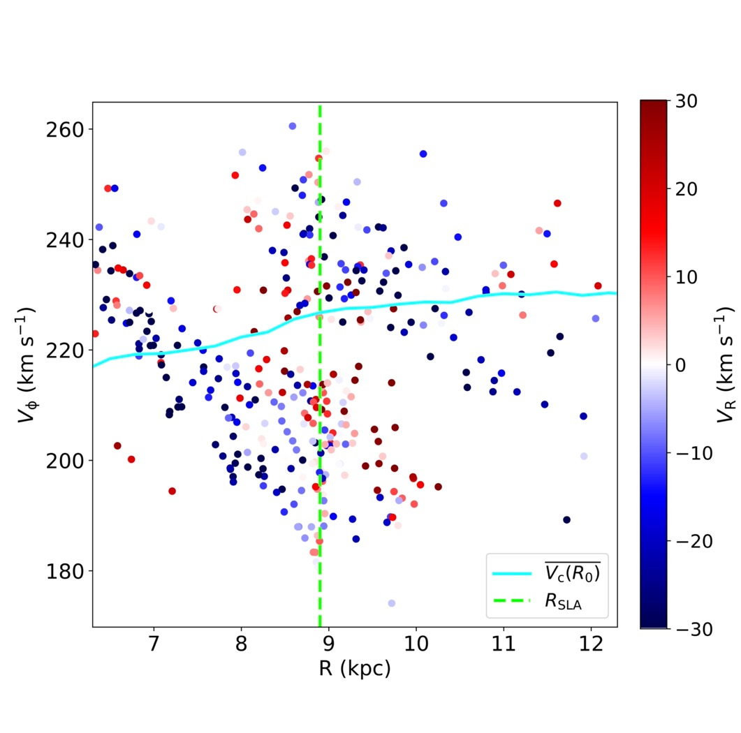
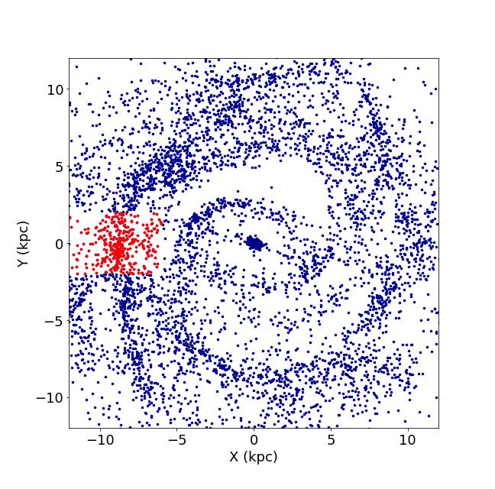
Young stars in N-body simulation around the transient dynamic spiral arm
Lower Vφ inside of the arm, higher Vφ outside of the arm
Spiral arm
Gap of Vφ?
Young (<0.5 Gyr) stars in an isolated disk simulation
with star formation by Junichi Baba.
Almannaei, Kawata et al. (2023)

Slide 13
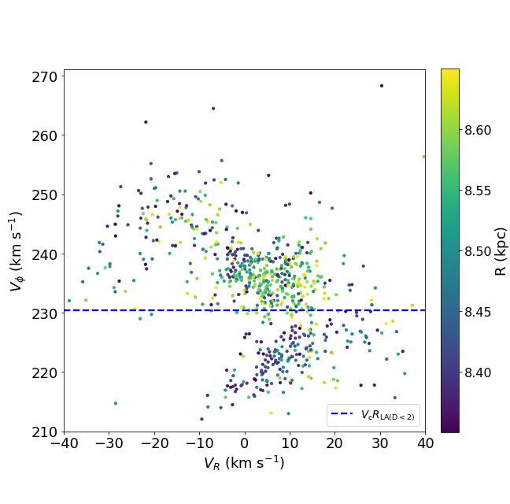
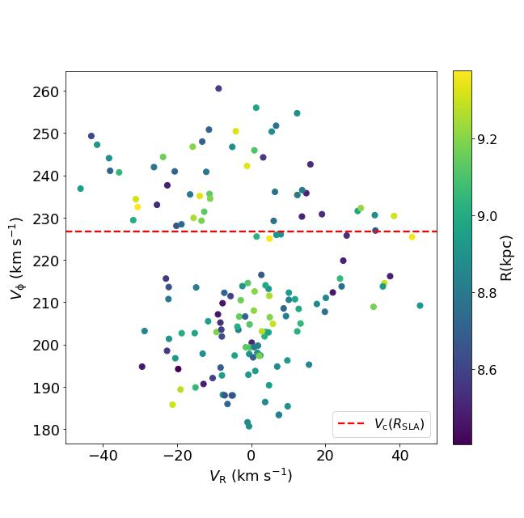
Vφ gap = Coma and Hyades+Pleiades ⇐ Local arm co-rotation resonance? ⇒ Vcirc!
Consistent with the transient and dynamic nature of spiral arm seen in N-body simulations
Gap of Vφ induced by the spiral can be used to indicate co-rotation, i.e. Vcirc!
OB stars around the Local arm
Gaia DR3
Impact of the Local arm is important!
young stars around the spiral arm
N-body simulation
Sirius, bar resonance?
Coma
V_{rot} (km/s)
R (kpc)
Vcirc(R_{arm})
Vcirc(R_{local arm})
D<2 kpc
V_{rot} (km/s)
Hyades + Pleiades
inward
V_{Rad} (km/s)
outward
inward
V_{Rad} (km/s)
outward
inward
V_{Rad} (km/s)
outward

Slide 14
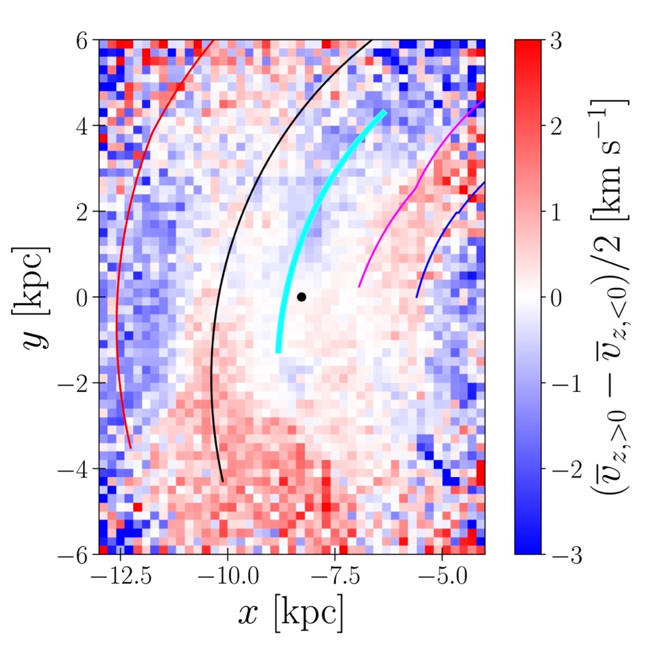
Impact of the spiral arms on the vertical motion, breathing mode.
(Asano, Kawata et al. 2023)
Gaia DR3 all high quality disk data
Galactic disk
edge-on
expand
z
compress
Outer arm
x
expand
Perseus arm
Local arm
Stars around the Local arm shows the vertically compressing motion
compress
Arm positions from Reid et al. (2019)

Slide 15
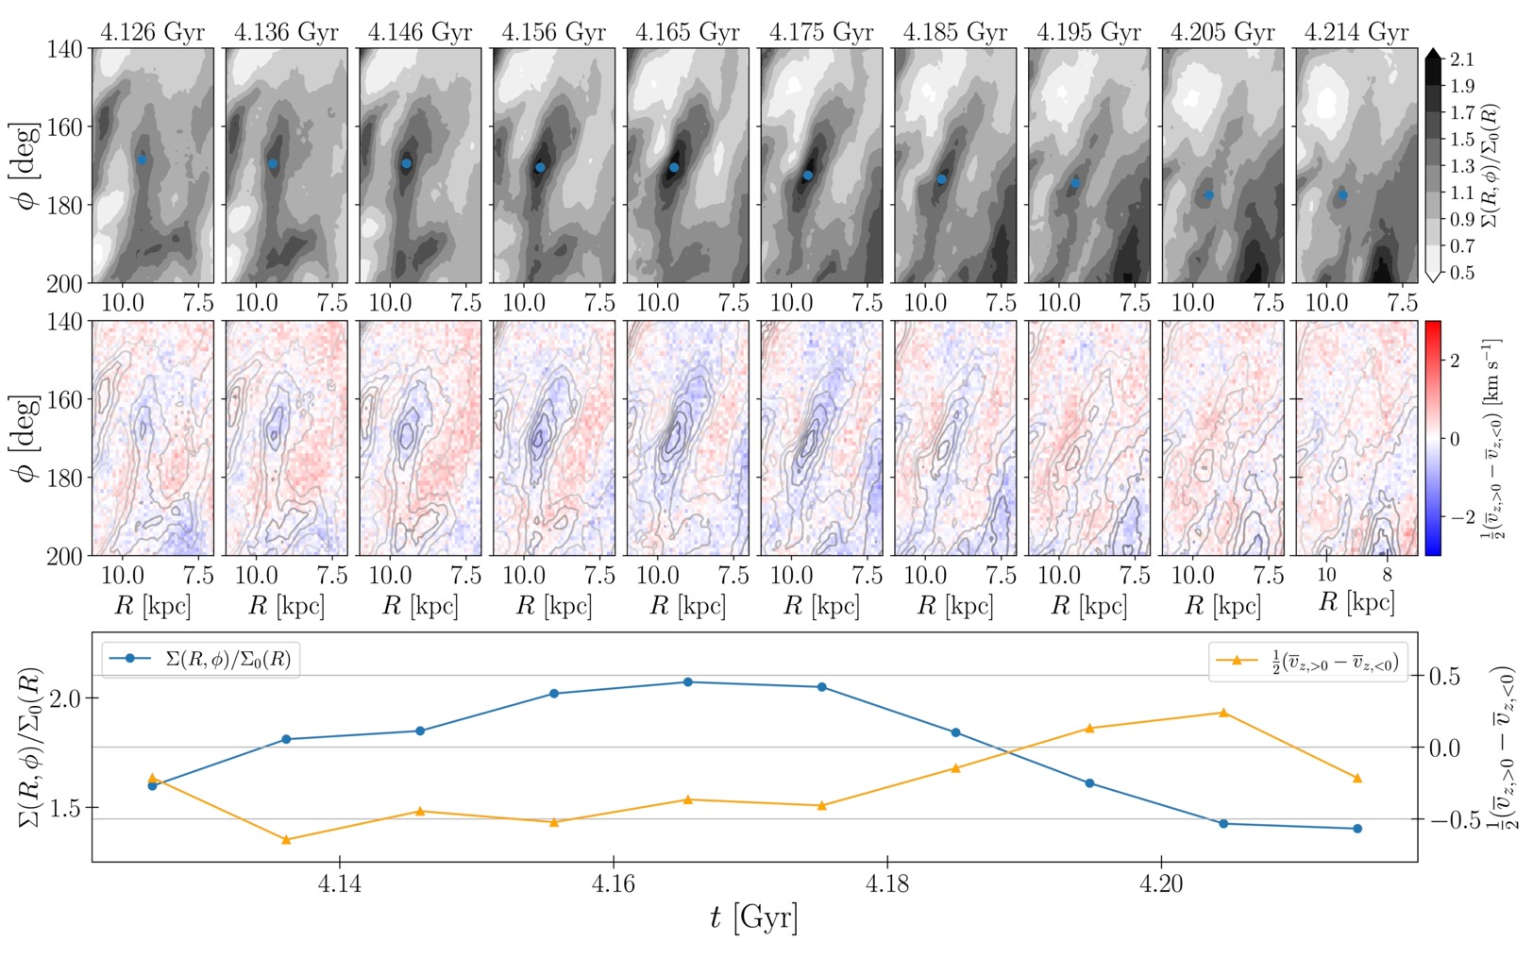
Transient dynamic spiral arms in N-body simulation:
Compressing = Growing arm, Expanding = Disrupting arm
expand
growing
expanding
arm density
compressing
disrupting
Vz(z>0)−Vz(z<0)
compress
Asano, Kawata et al. (2023)

Slide 16
Transient dynamic spiral arms in N-body simulation:
Compressing = Growing arm, Expanding = Disrupting arm
Gaia DR3 all high quality data
expand
Local arm :
compressing vertical motion
= growing?
Tentatively…
  Perseus arm : expanding
  = disrupting
  (see also, Baba, Kawata et al. 2018)
  Outer arm : compressing?
  = growing?
Outer arm
Perseus arm
Local arm
compress

Slide 17
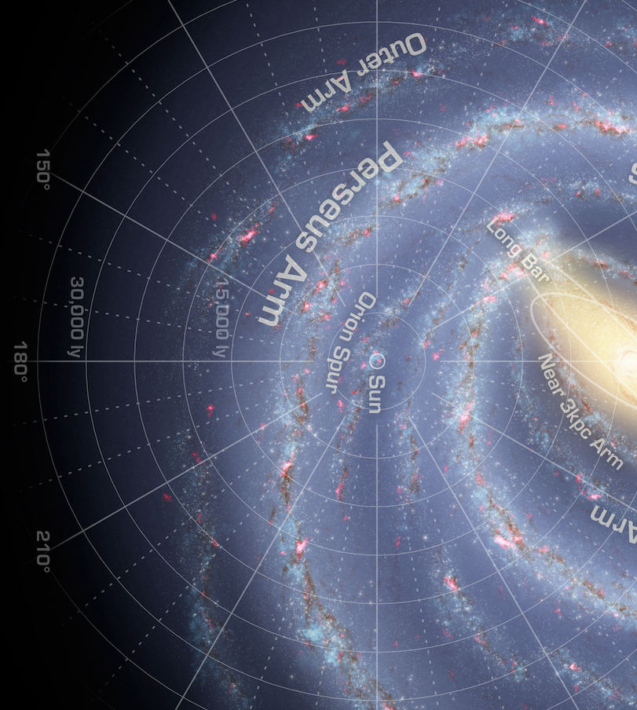
Further clues…
disrupting Perseus arm and growing Outer arm?
Cepheids (age~ a few 100 Myr) kinematics.
(Funakoshi, Matsunaga, Kawata in prep.)
Trailing side
Leading side
Moving along the arm
= growing
Moving perpendicular to
the arm
= disrupting
(Baba, Kawata et al. 18)
inward
outward
inward
outward

Slide 18
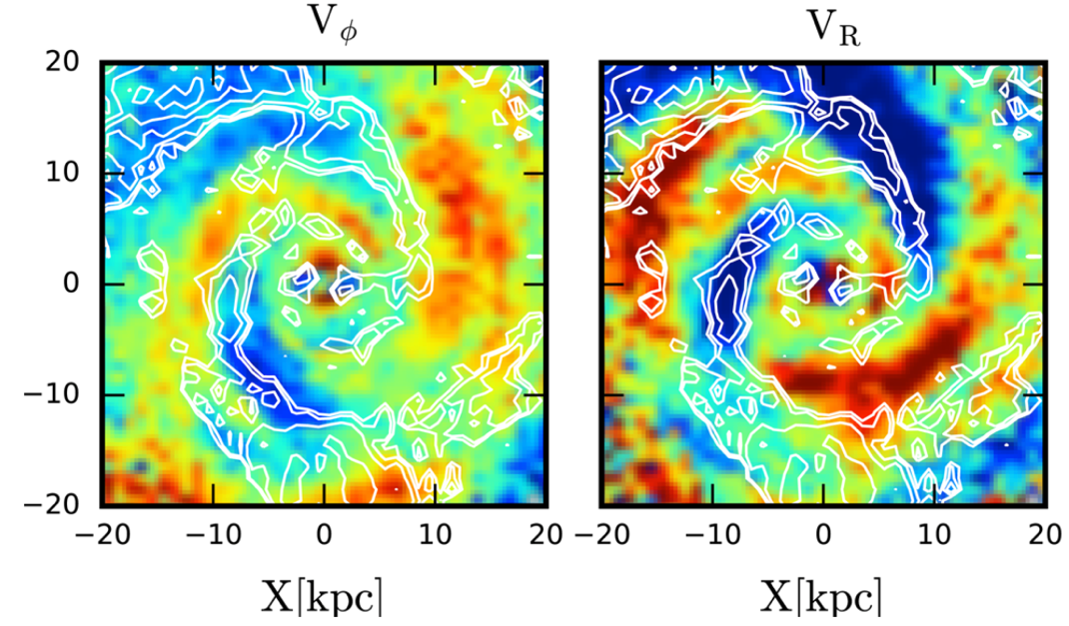
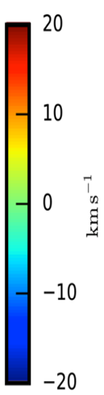
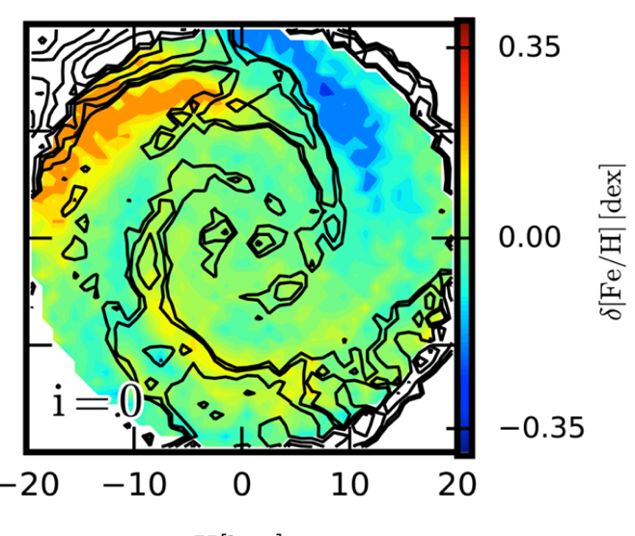
Summary
Spirals in the Milky Way are likely to be transient and dynamic (see also Cantat-Gaudin’s talk)
  Local and Outer arms: growing
  Perseus arm: disrupting
Location and the number of arms are still in debate. (e.g. Poggio’s talk)
Need further studies with
kinematics and metallicity for young populations⇐ Open clusters, young stars?
Prediction for 120 Myr old stars
20
0.35
Δ[Fe/H] (dex)
km/s
−0.35
−20
Grand, Springel, Kawata et al. (2016) Auriga simulation

Slide 19
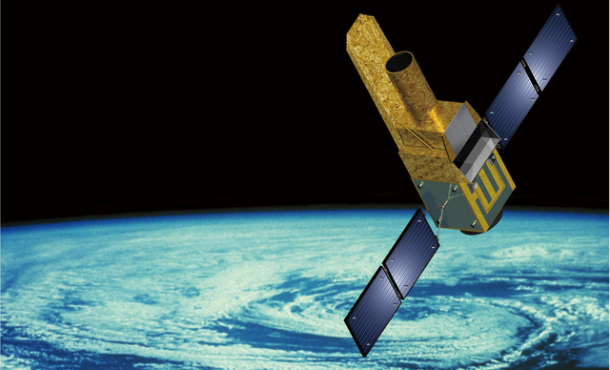
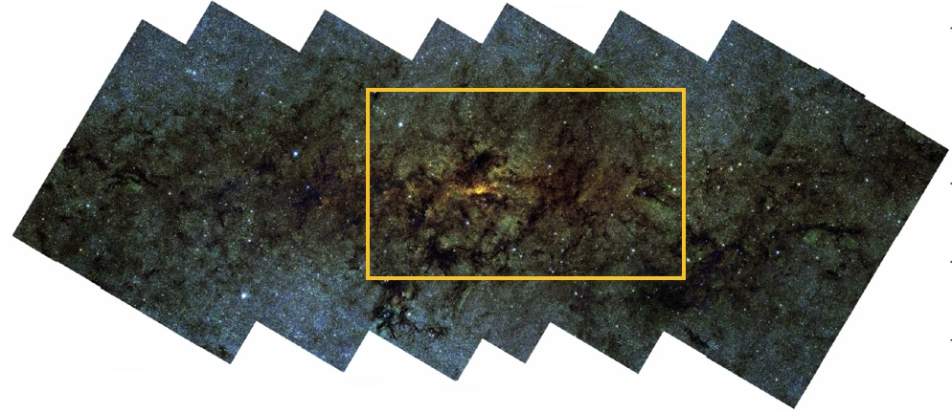


JASMINE (launch 2028 (TBC), selected by ISAS/JAXA)
NIR Galactic centre astrometry and time-series NIR photometry
(PI: Gouda, PS: Kawata, Kawata et al. arXiv:2307.05666)
1.4 deg ~ 200 pc
120’ ~ 280 pc
Galactic centre NIR: Nishiyama et al.
Nishiyama et al.
36 cm diameter, limiting magnitude: Hw(1.1-1.6 μm)=9.5-14.5 mag
3 years mission, ~25 μas (~125 μas/yr) for Hw<12.5 (14.5) mag stars
Inner disk kinematics, star clusters and black holes in the Galactic centre
Hopefully 5-6 new star clusters! (ref. Cantat-Gaudin’s talk)

Slide 20
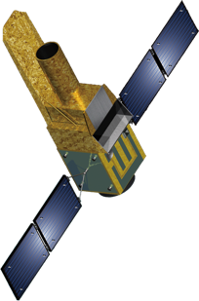
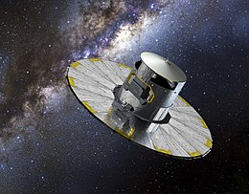
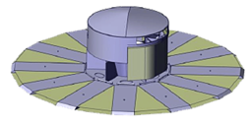
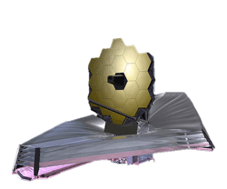
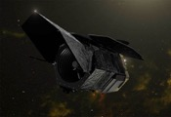
Synergy with the other missions and projects
JASMINE（2028-2031）
▼
２０１０
２０２０
２０３０
２０４０
GaiaNIR: 2045(?)-
Gaia: 2013-25
Gaia Final Full Data Release: >2028(?)
PRIME+SAND 2022-
ULTIMATE-Subaru 2027-
Subaru/PFS: 2023-
SDSS-V Milky Way Mapper: 2020-25
VLT/MOONS: 2023(?)-, WEAVE, 4MOST
JWST: 2021-2031(?)
Roman: 2026-203?

Slide 21
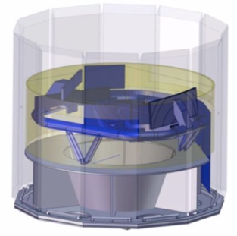
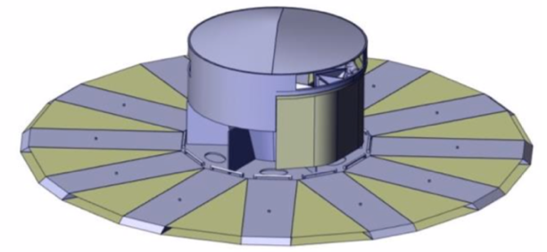
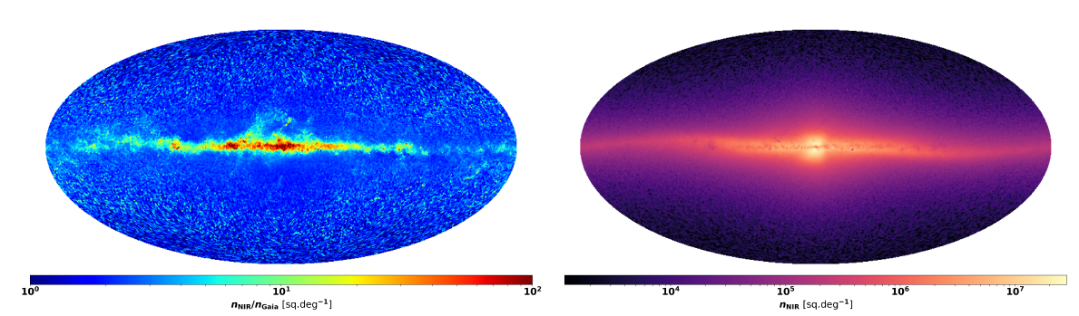
GaiaNIR: All-sky NIR astrometry in 2040s. to study the Galactic disk structures, Galactic seismology, dark matter distribution, massive black holes
PI: David Hobbs (Lund)
NIR (λ=0.8-1.8 μm, GNIR<20 mag)
Gaia-level astrometry (~10 μas)
14 times better proper motion, ~1.8 μas yr⁻¹
Update Gaia Celestial Reference Frame in NIR
ESA Study Report (2017)
GaiaNIR/Gaia
GaiaNIR

Slide 23
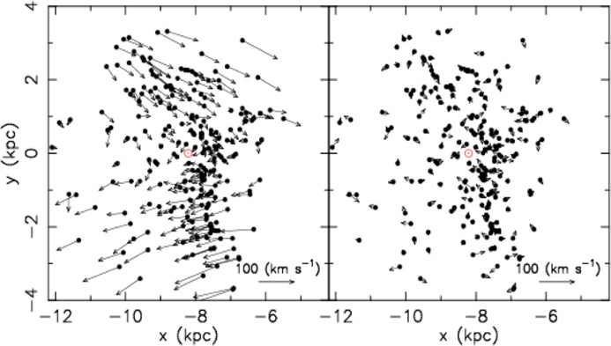
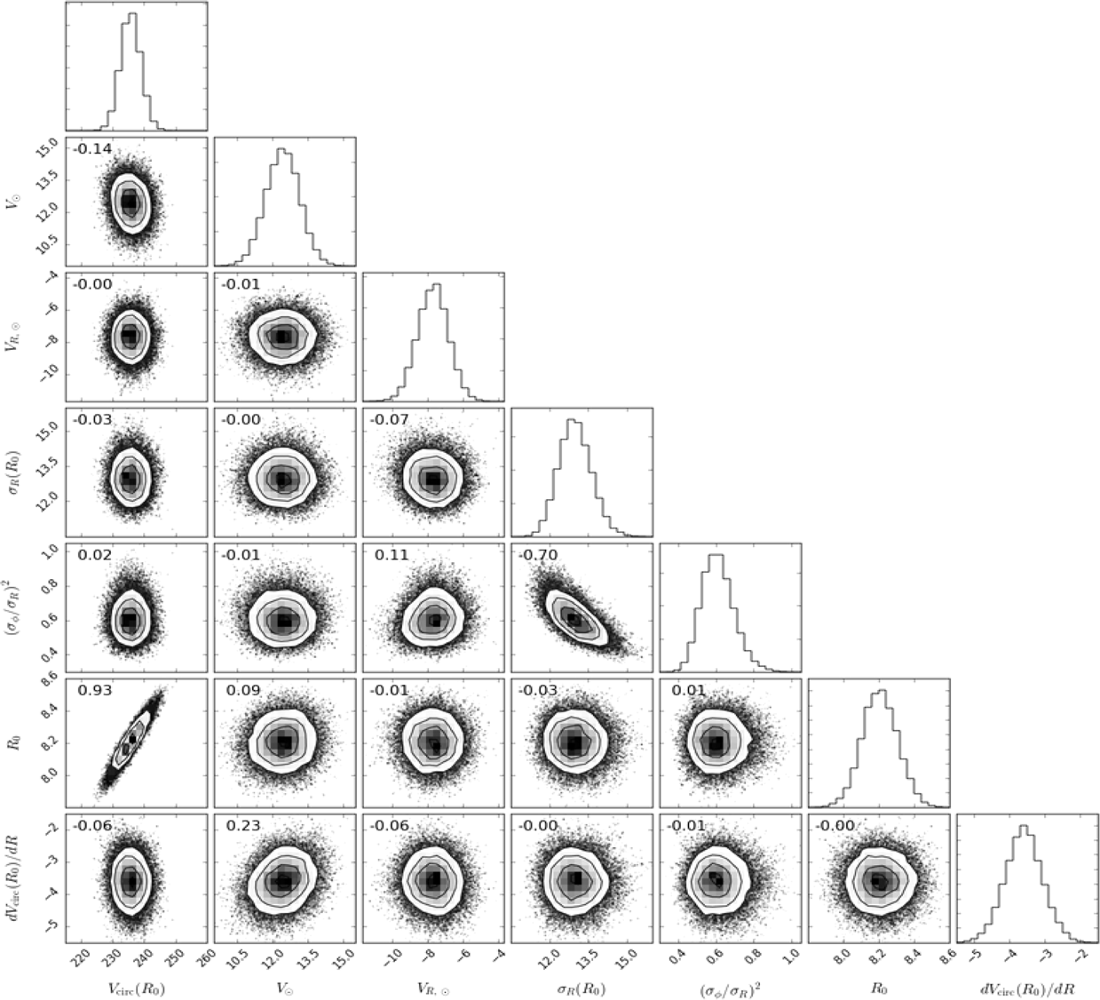
4
Vcirc from Cepheids with Gaia DR2 kinematics
(Kawata et al. 2019,
see also Mróz et al. 2019,
Bobylev et al. 17,21,23)
Y (kpc)
V ⊙
−4
MCMC fitting of axisymmetric disk model.
Vcirc(R₀) = 236±3 km/s
V⊙= 12.4±0.7 km/s
V_{R,⊙} = −7.7±0.9 km/s
R₀ = 8.2±0.1 kpc
dVcirc/dR = −3.6±0.5 km/s/kpc
V _{R,⊙}
−12
X (kpc)
−6
−12
X (kpc)
−6
σ _{R}(R₀)
(σ _{φ} /σ _{R})²
R ₀
dVcirc/dR
Vcirc(R₀)

Slide 24
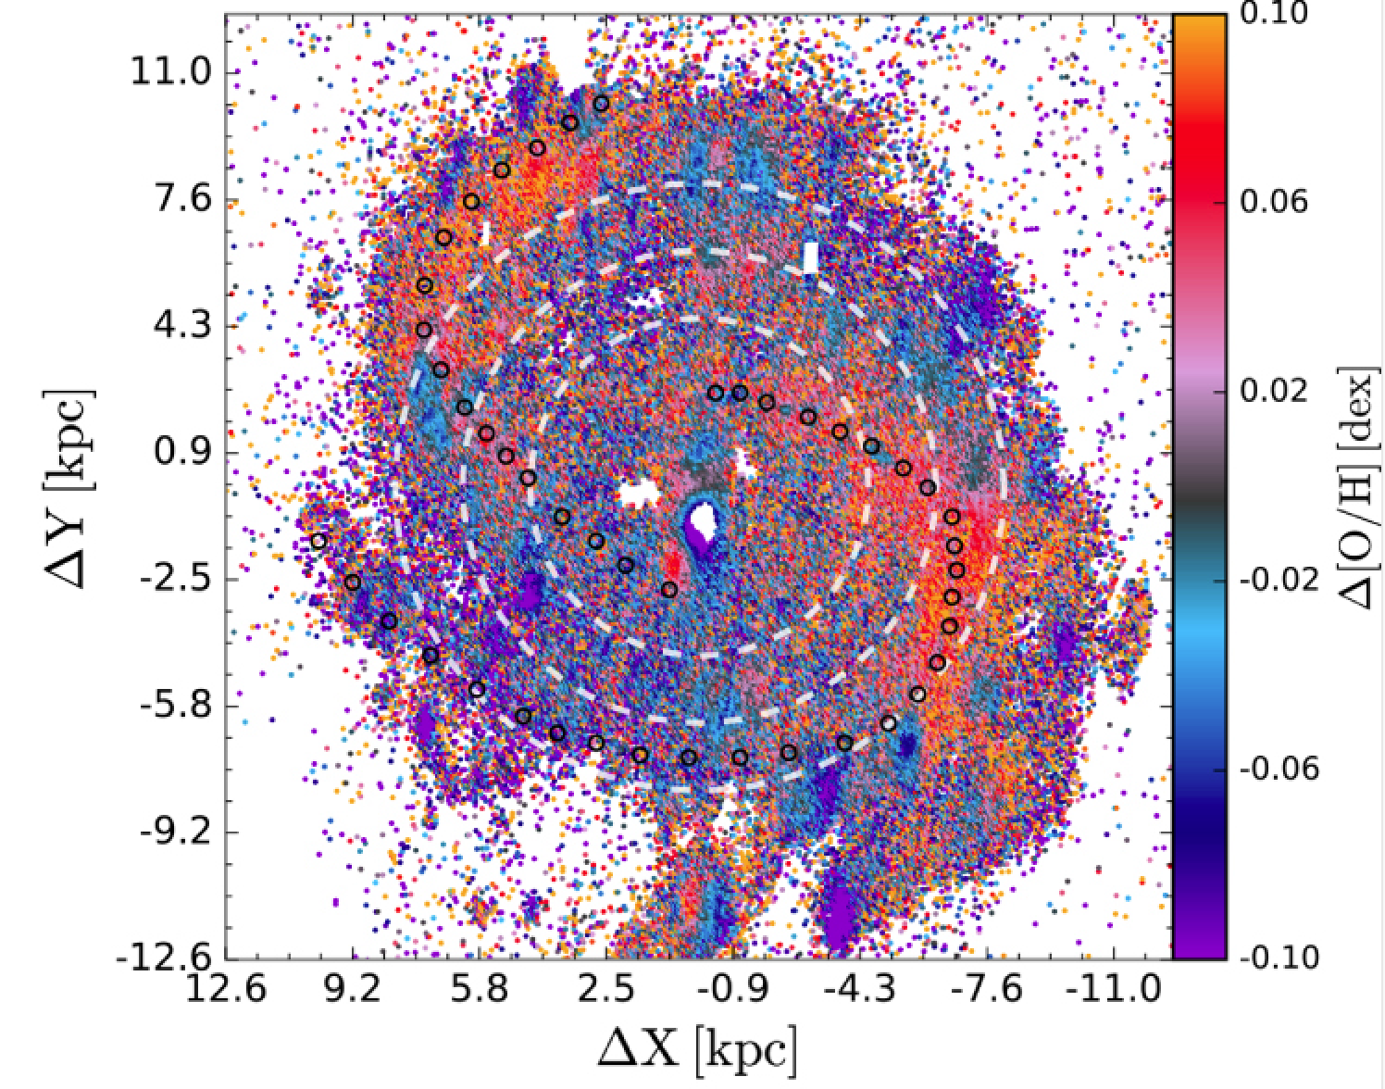
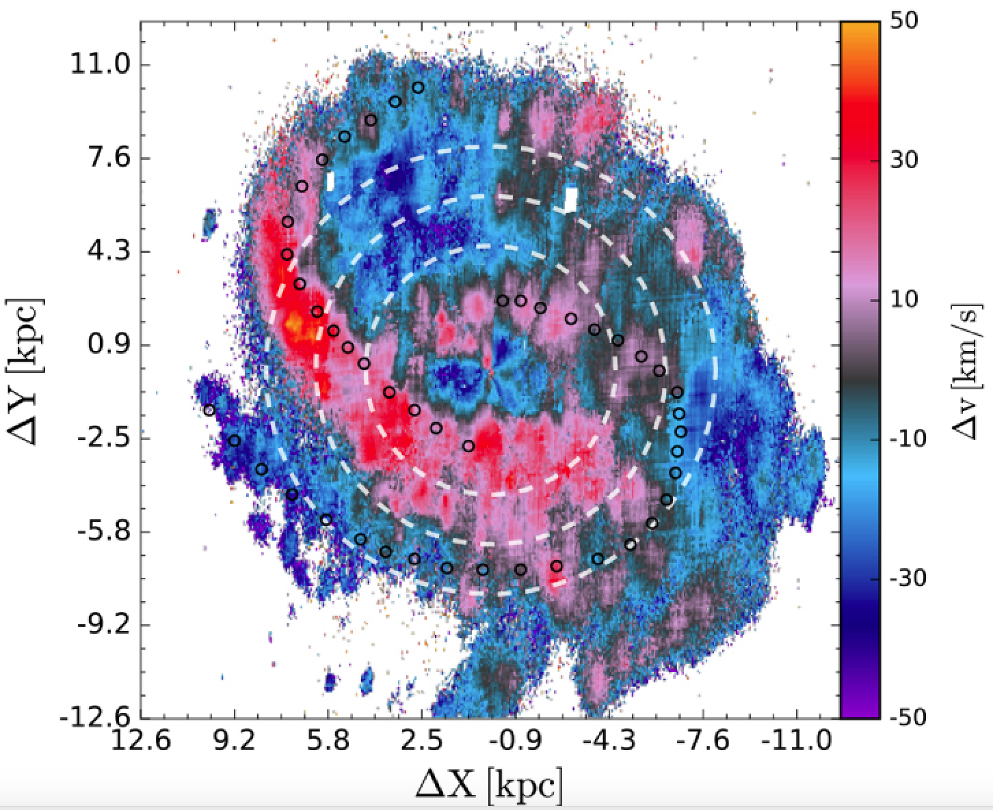
Summary
Comparison with the external galaxies.
NGC6754 MUSE kinematics around the arm
(Sánchez-Menguiano, Sánchez, Kawata et al. 2016)

Slide 25
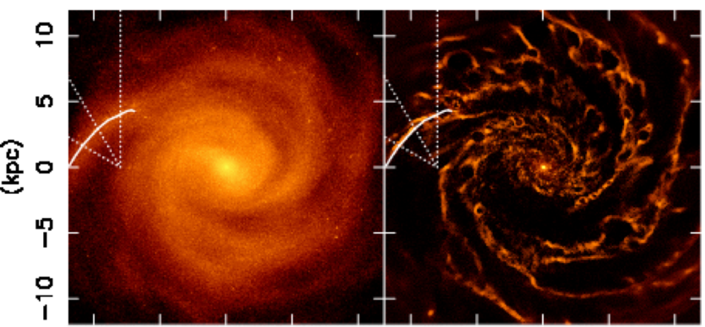
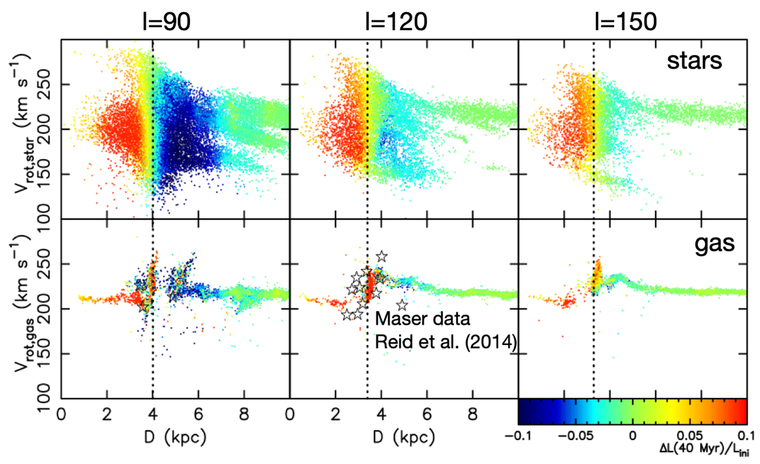
Both gas and stars
Leading side of the arm (outside)
rotating slowly (apo-center phase)
moving outward
losing Lz from the torque of the arm
Trailing side of the arm (inside)
rotating faster (peri-centre phase)
moving inward
gaining Lz from the arm
Kawata et al. (2014)
Grand, Kawata, Cropper (2014)

Slide 26
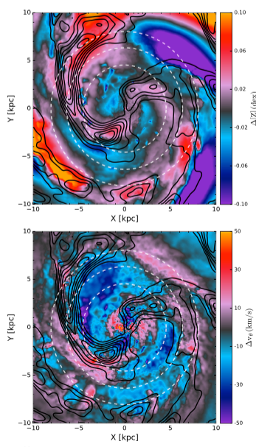
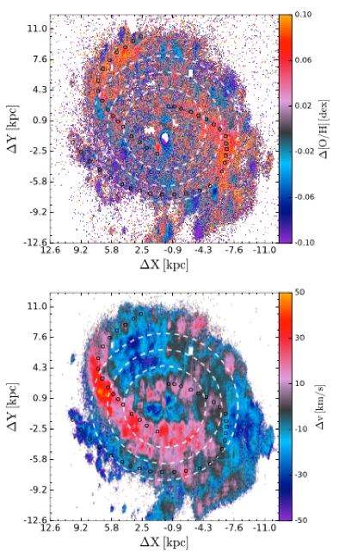
Evidences in the gas radial migration and metallicity distribution
(Sánchez-Menguiano, Sánchez, Kawata et al. 2017)
NGC6754 (MUSE)
simulation
residual Z
see model prediction
Grand, Springel,
Kawata et al. (2016)
Baba et al. (2016)
residual V
Vrot
Vlos
Behind the arm gas move outward and more metal rich and opposite trend at the front!

Slide 27
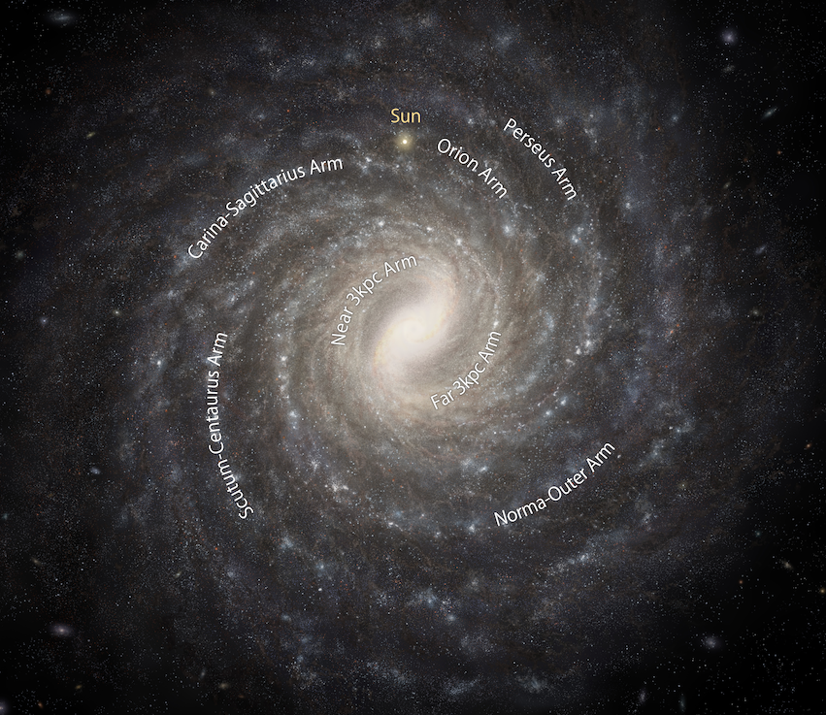
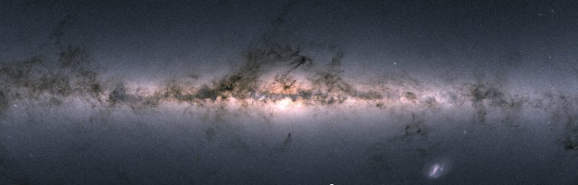
Galactic Centre Survey (Rgc~200 pc)
Near-IR : see through the dust in the disk
Sun
1.4 deg ~ 200 pc
NIR: Nishiyama et al.
NAOJ, Baba et al.
Optical: Gaia

Slide 28
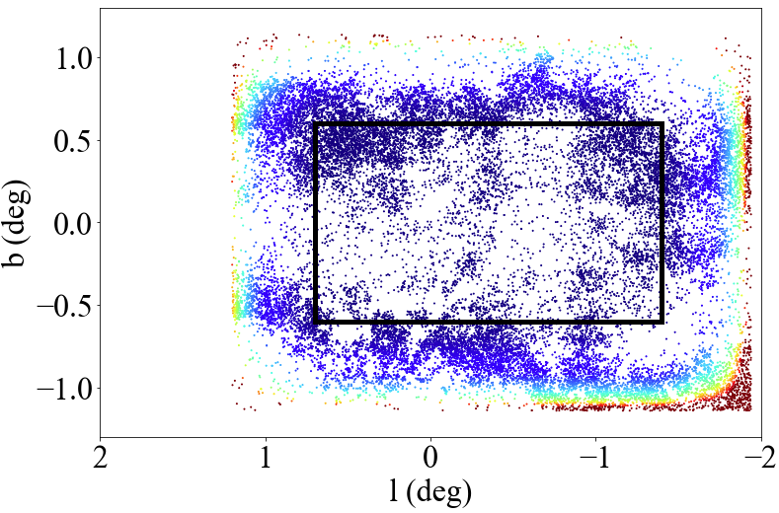
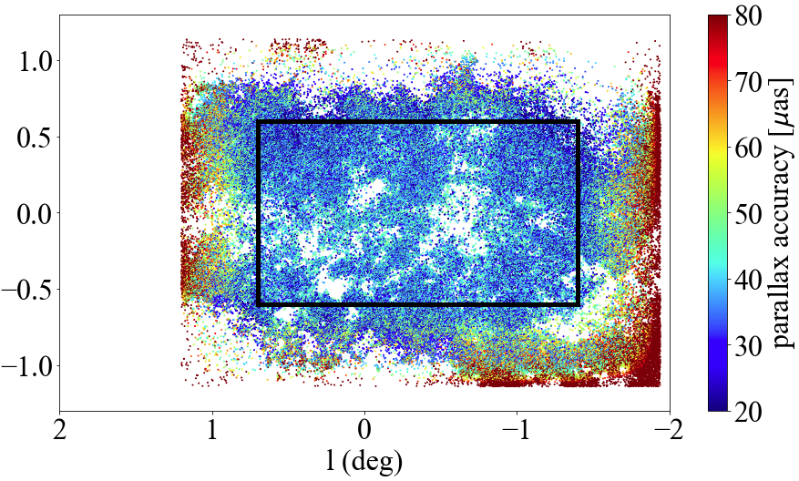
JASMINE Galactic Centre Survey (JGCS) Field and Extra Surrounding Data Field
JGCS: −1.4 < l < 0.7, −0.6 < b < 0.6 (or −0.7 < l < 1.4, −0.6 < b < 0.6)
Precise NIR astrometry, with ~60 K obs. in 3 years (spring and fall only).
12.5s exp. x 18 every ~ 320 min cadence photometry (TBD)
Extra ~0.5 deg surrounding region, less accurate, but the data will be available.
Hw<12.5mag (~25K stars, ~8K in GCS)
~25 μas parallax accuracy
20% distance error at GC
Hw<14.5mag (~170K stars, ~77K in GCS)
< 125 μas/yr proper motion accuracy
<~5 km/s velocity accuracy at GC

