Slide 1
Tidal tails of open clusters
Janez Kos
Faculty of mathematics and physics, University of Ljubljana, Slovenia
https://docs.google.com/presentation/d/1IpXBJ4cS9-JoozGw5lhPLlPWdy7EdjY7c6ZmJdPfUwc/edit?usp=sharing

Slide 2
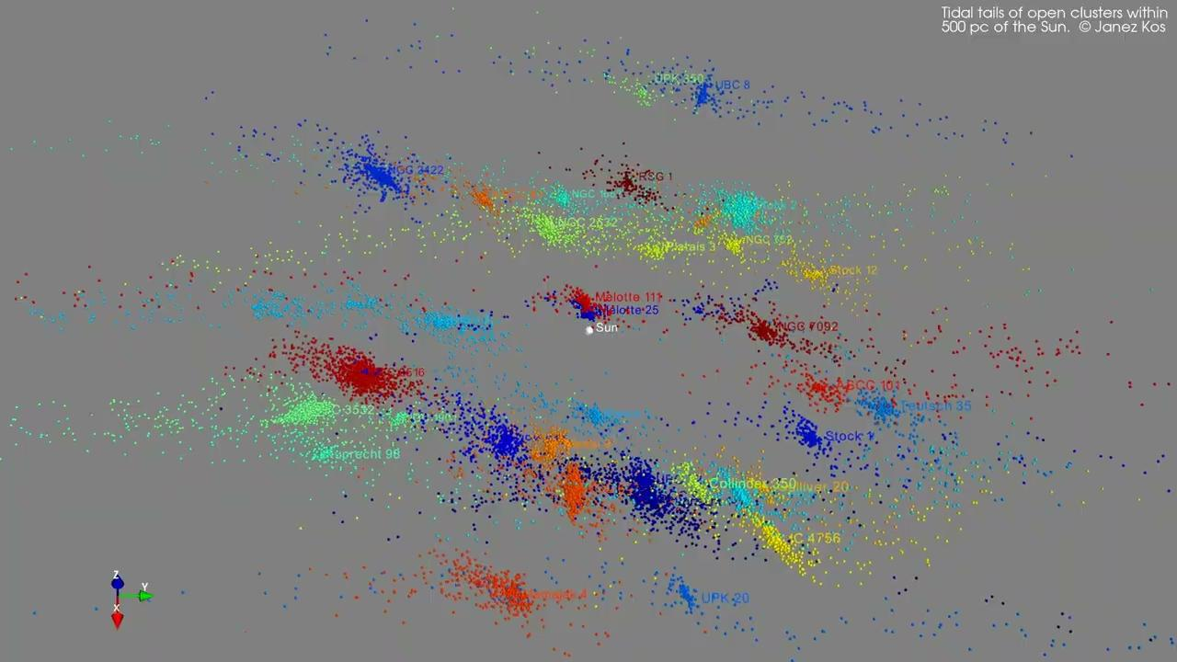

Slide 3
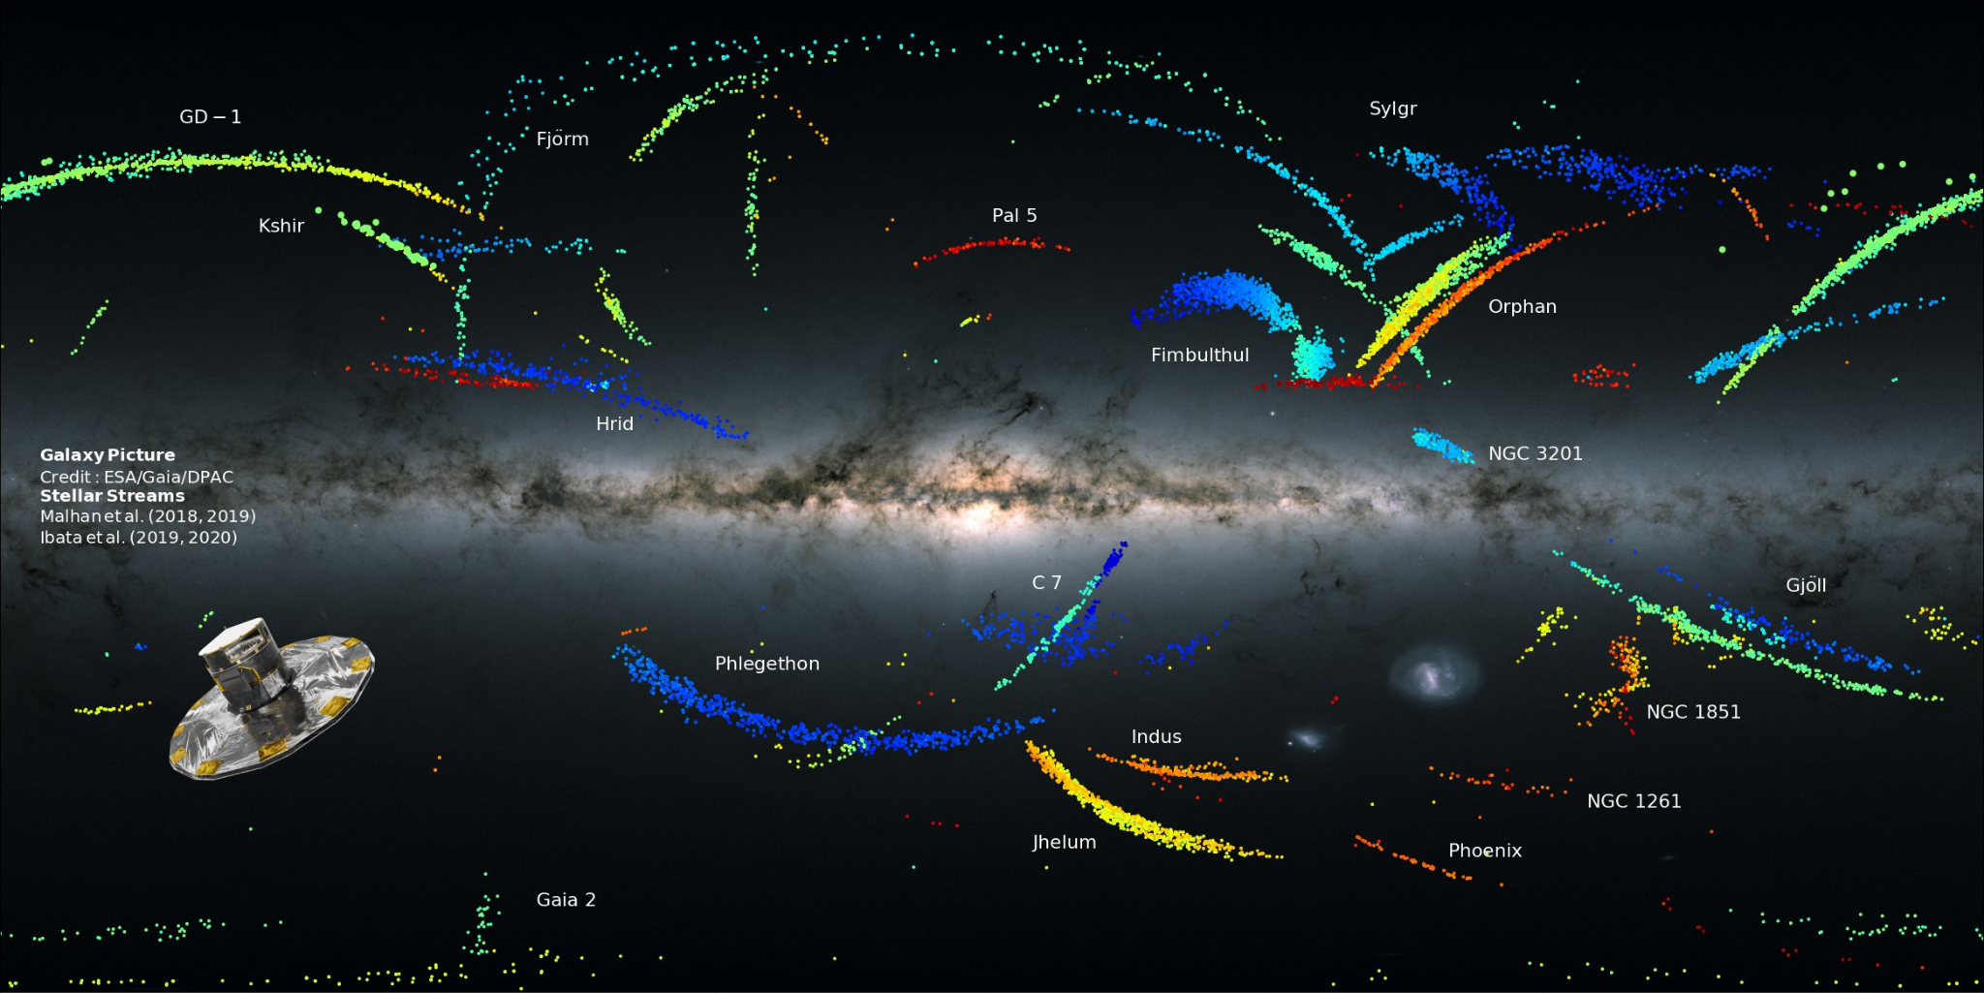
Tidal tails across the Galaxy
Tidal tails of globular clusters and satellite galaxies are being used for studying Galactic gravitational potential, dark matter, testing ΛCDM model, infall, galaxy formation, halo formation, chemical enrichment, mass function …
Similar observations of tidal tails of open clusters open a new channel of information on the inner Galaxy.
We barely started scratching the surface.

Slide 4
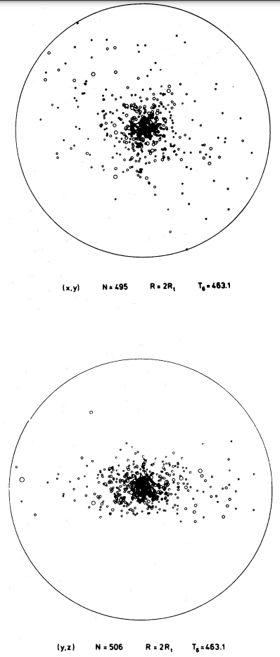
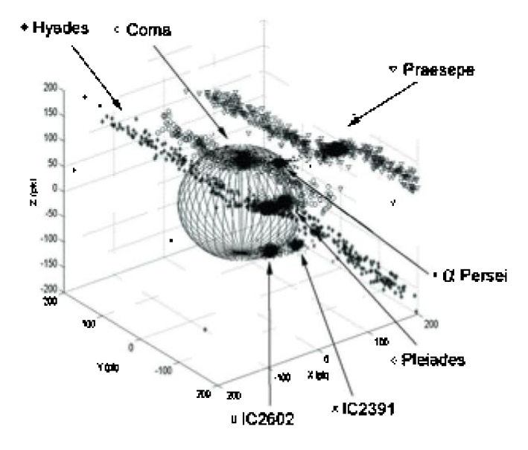
Gaia to the rescue
Theoretically predicted long ago.
Observationally difficult.
1000 x fewer stars in open cluster in a 1000 x denser environment compared to GC in the halo.
Chumak+, 2008
Terlevich, 1987

Slide 5
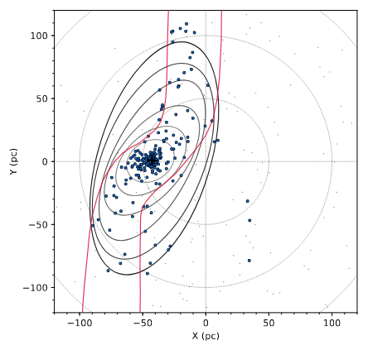
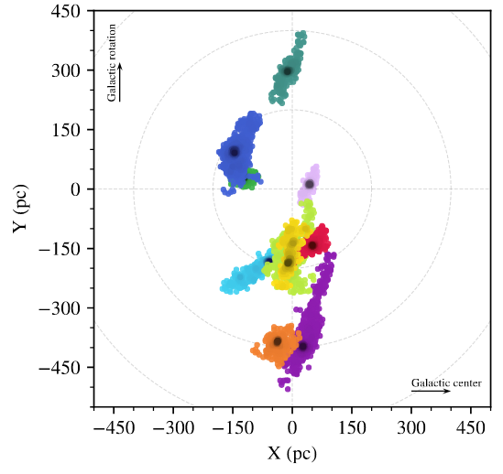
Gaia to the rescue
Theoretically predicted long ago.
Observationally difficult.
1000 x fewer stars in open cluster in a 1000 x denser environment compared to GC in the halo.
Hyades (Meingast & Alves, 2019)
Meingast+, 2021

Slide 6
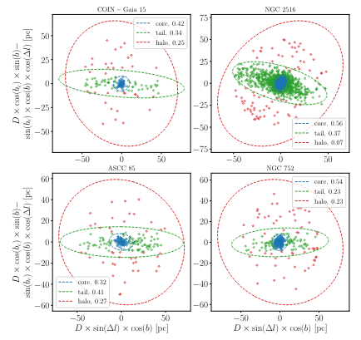
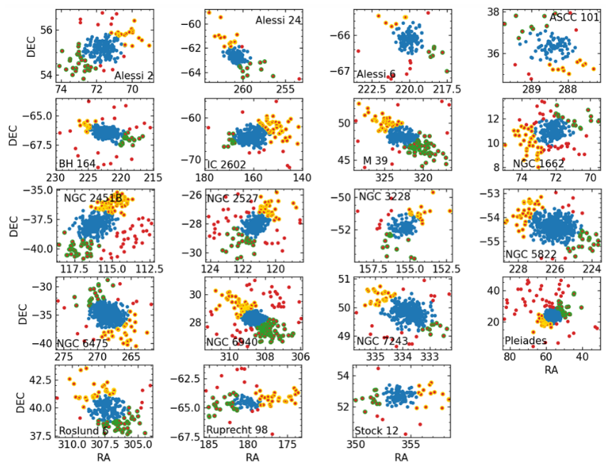
Gaia to the rescue
Theoretically predicted long ago.
Observationally difficult.
1000 x fewer stars in open cluster in a 1000 x denser environment compared to GC in the halo.
Tarricq+, 2022
Bhattacharya+, 2022

Slide 7
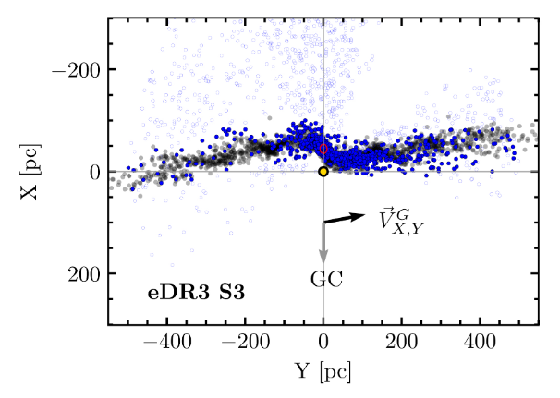
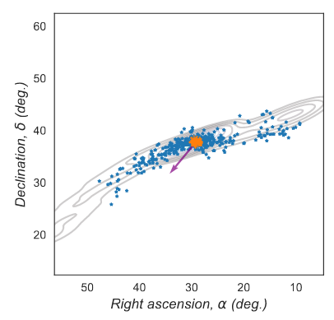
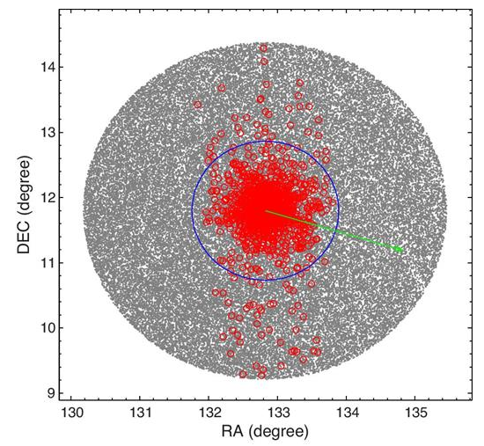
Gaia to the rescue
Theoretically predicted long ago.
Observationally difficult.
1000 x fewer stars in open cluster in a 1000 x denser environment compared to GC in the halo.
Jerabkova+ 2021
Boffin+ 2022
Gao 2020

Slide 8
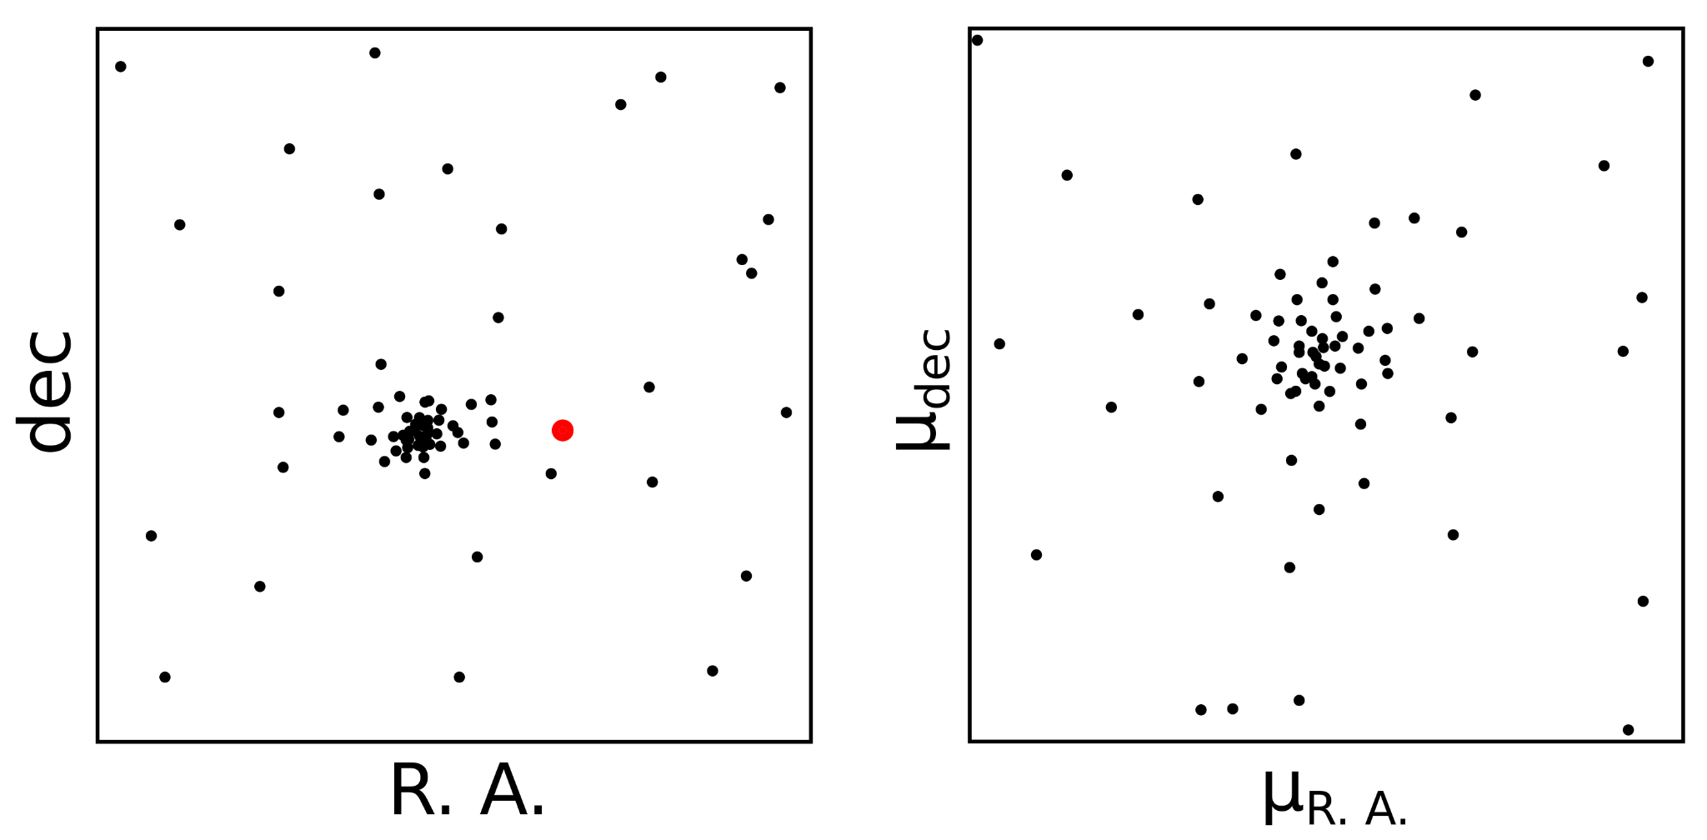
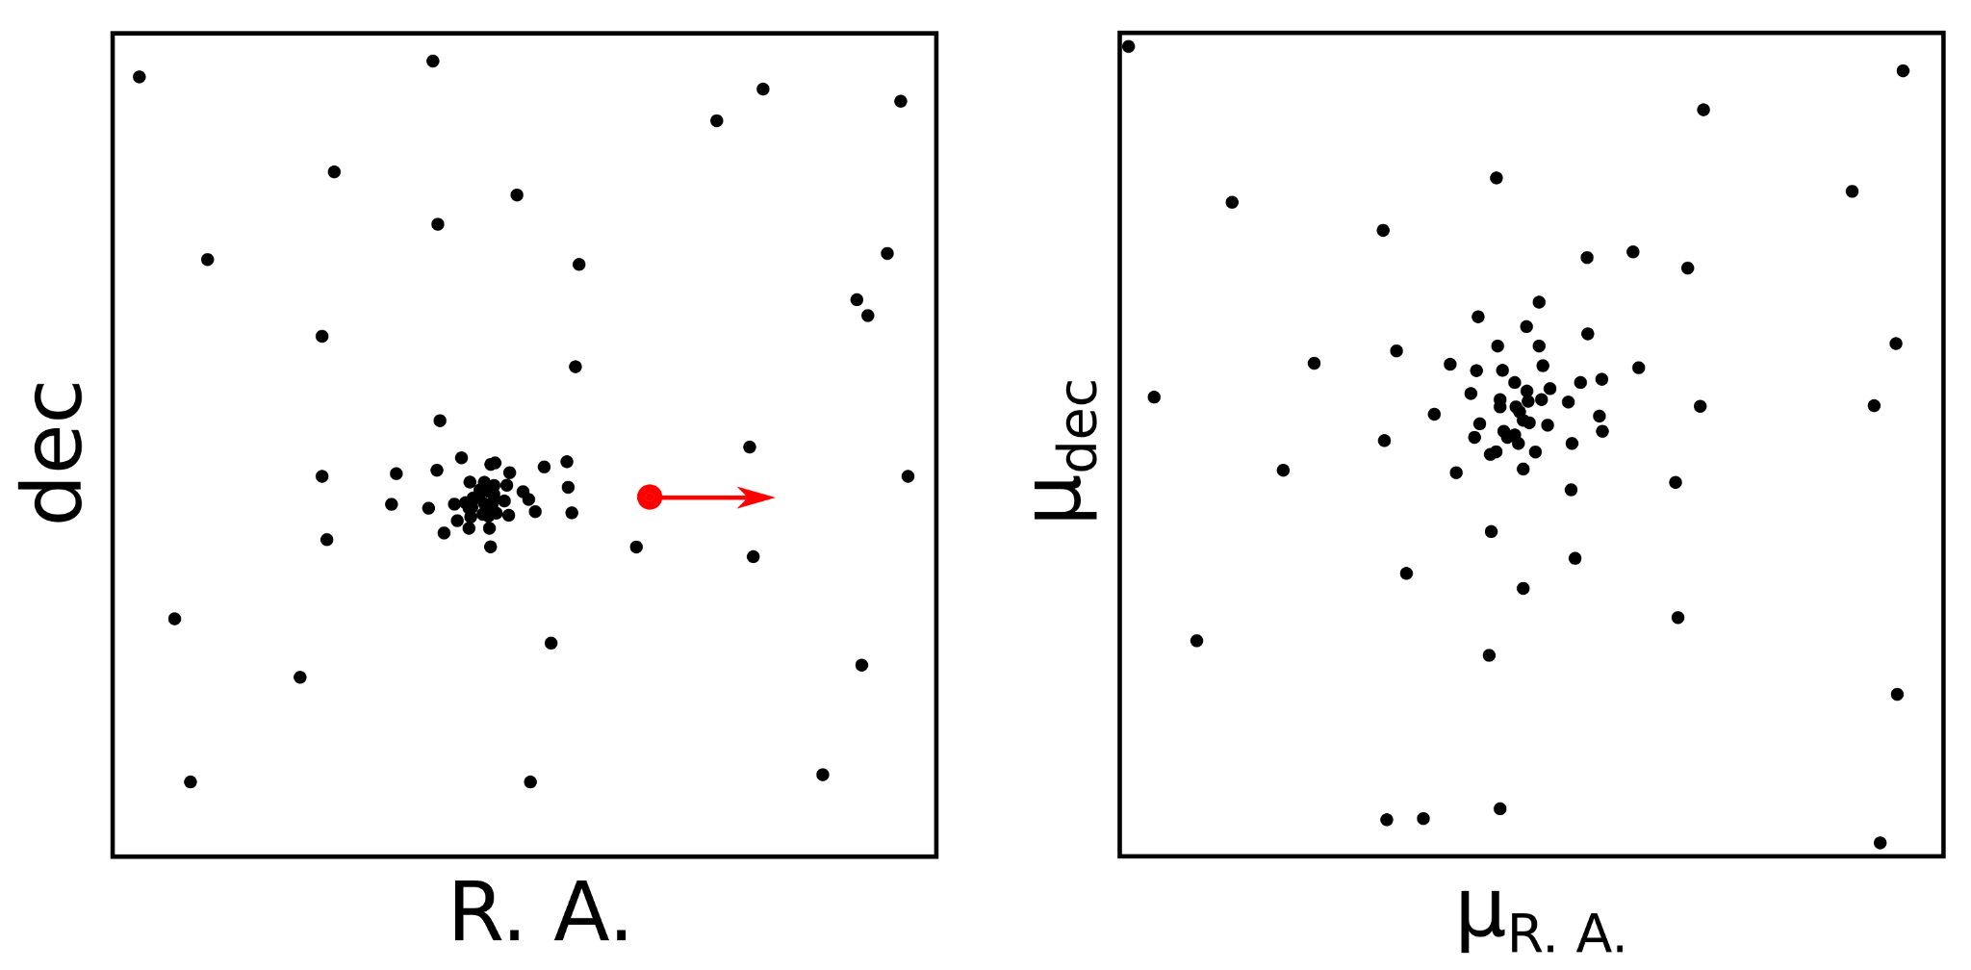
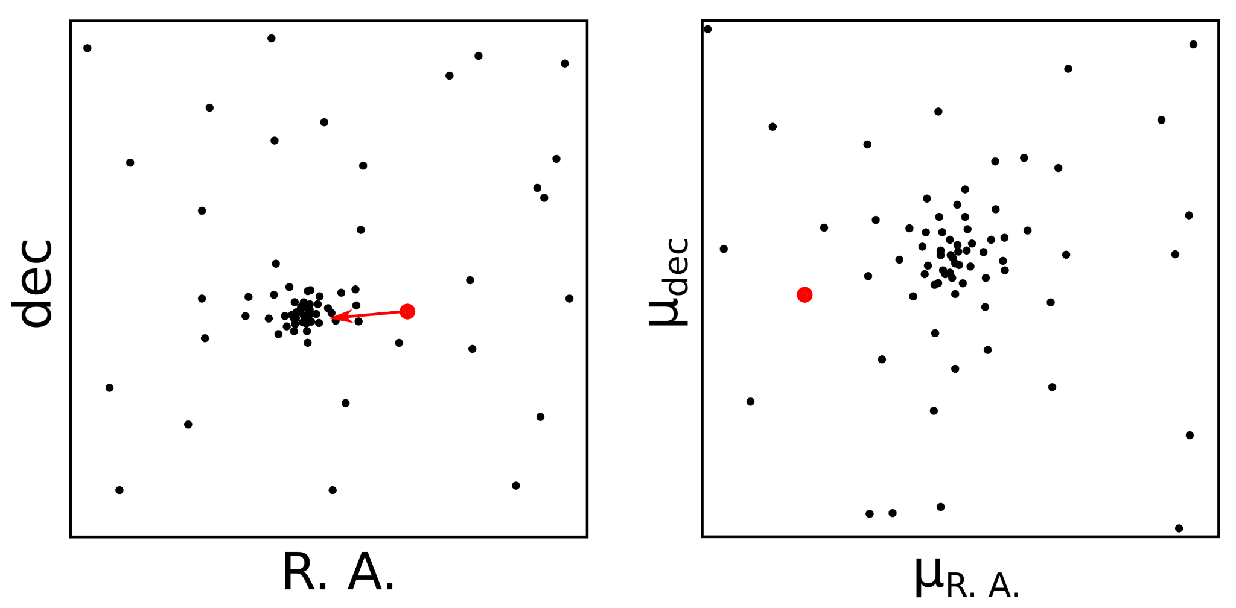
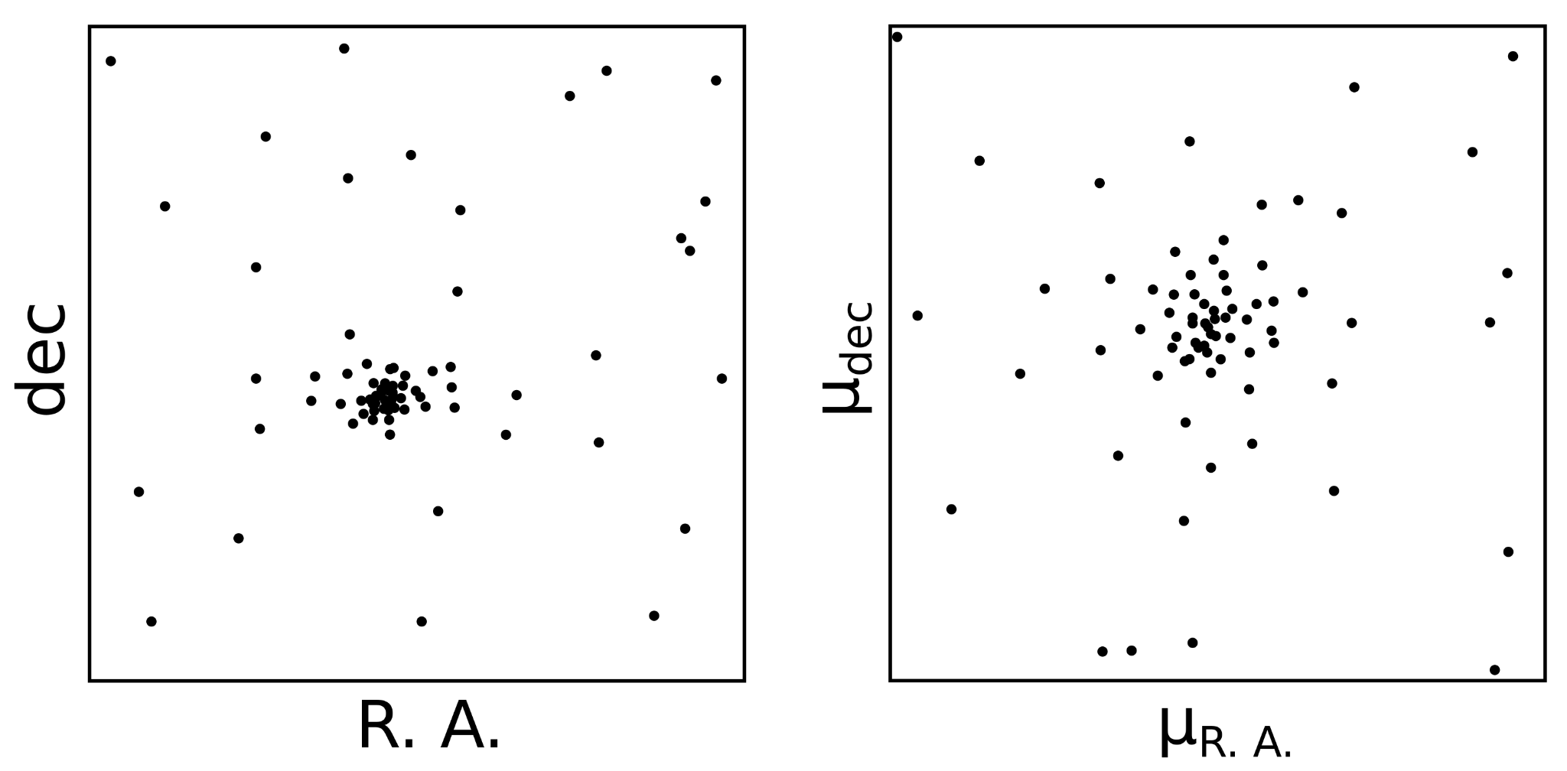
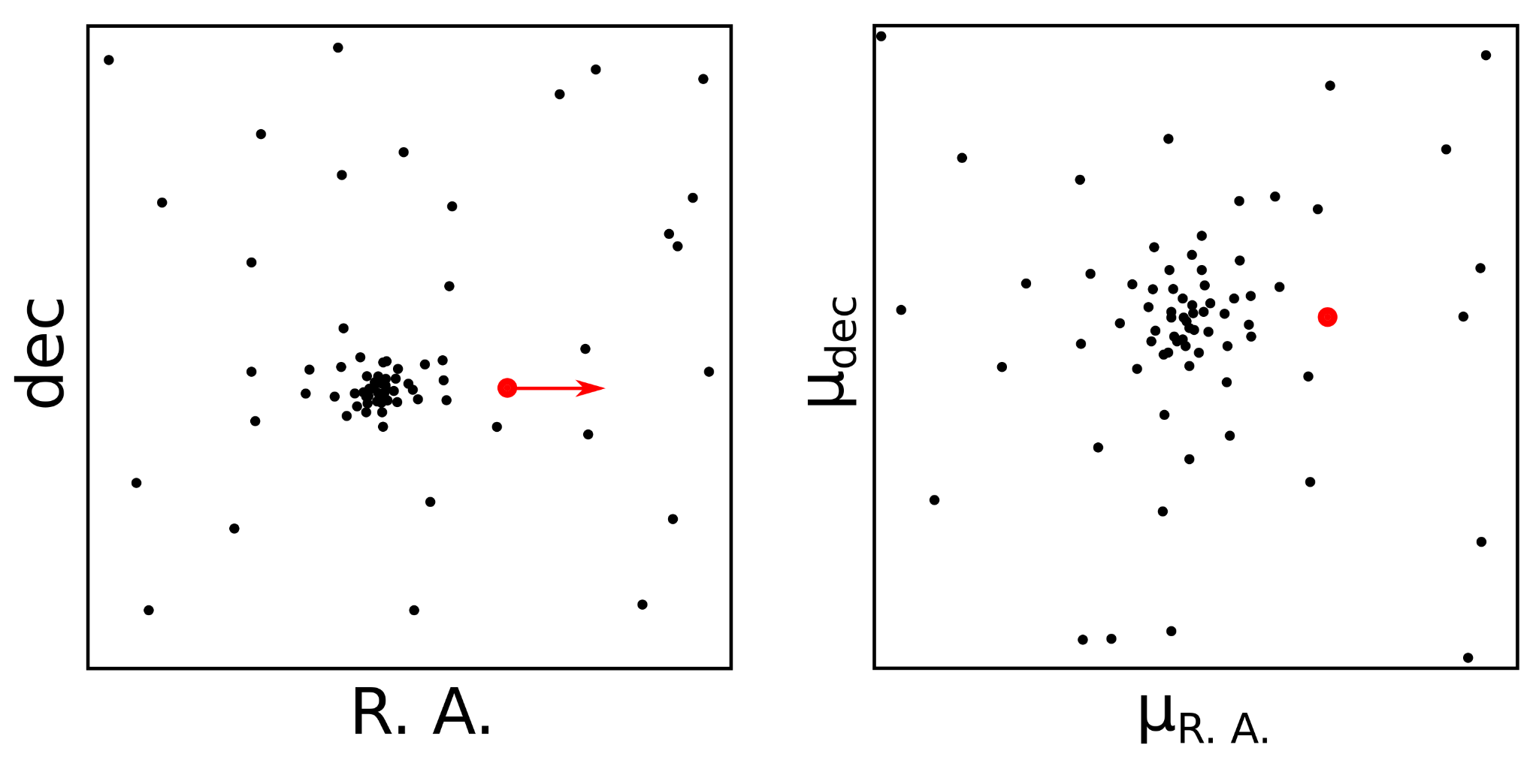
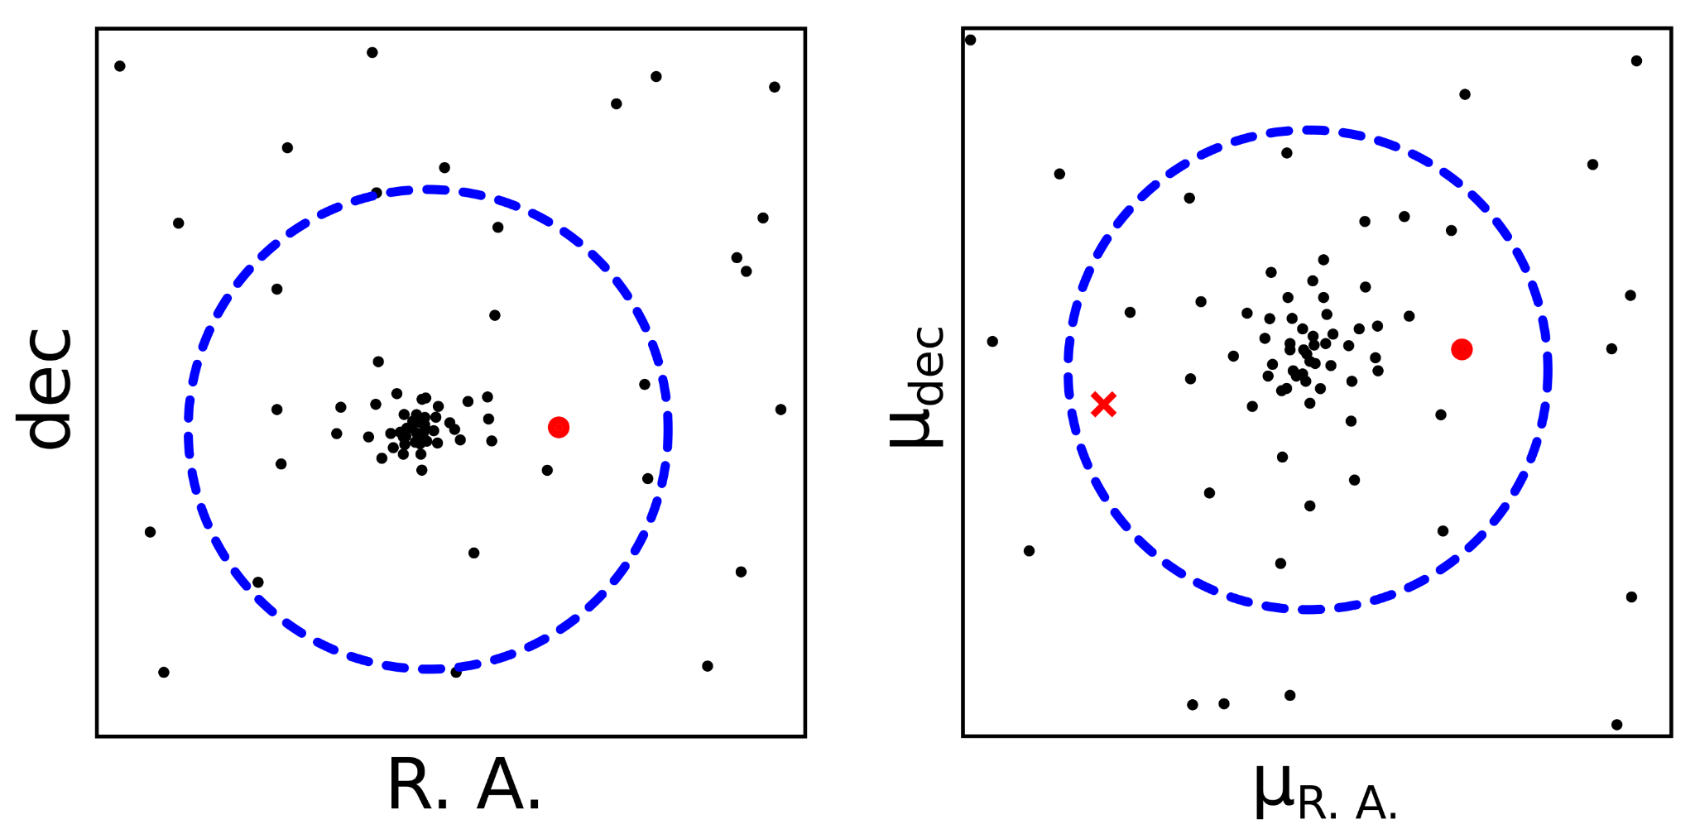
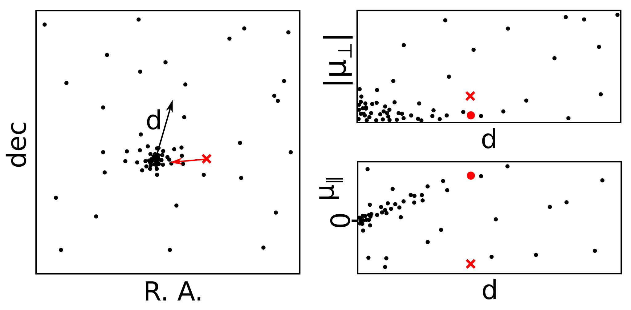
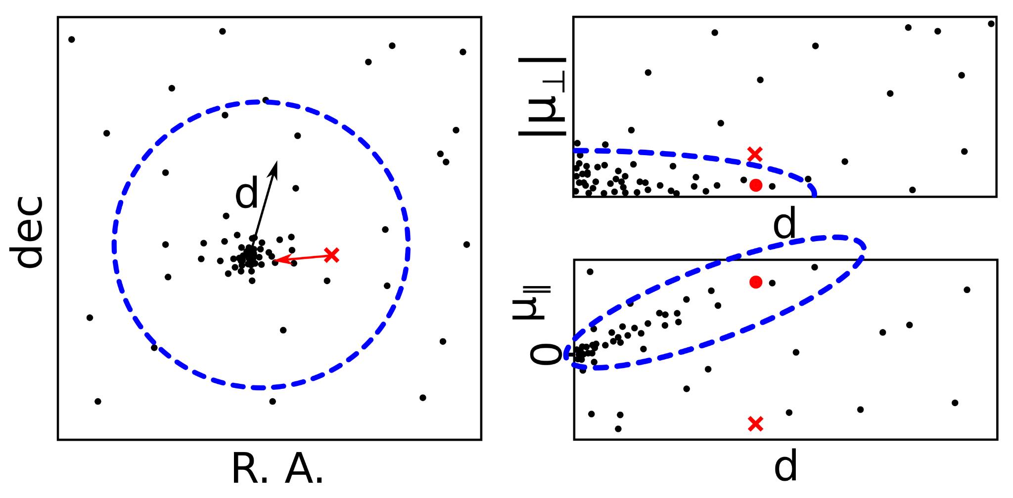
Toward the tidal tails
1. Projected velocity space
A projected velocity space is better than using measured proper motions.
This is the most common way of finding stars far away from the cluster cores (convergent point method and derivatives).

Slide 9
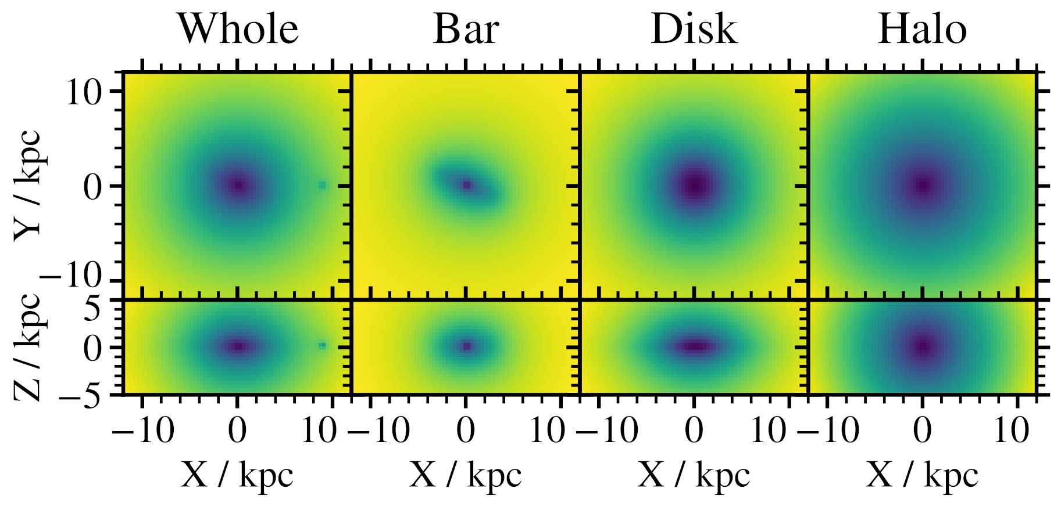
Toward the tidal tails
2. Simulated clusters
A simple simulation that produces realistic tidal tails, suitable for all clusters with no fine tuning:
Gravitational potential of the Galaxy with halo, disk, rotating bar, bulge.
Initialise a cluster at its birth time and position.
Create a Plummer potential with 5000 M⊙.
Populate it with 10⁶ test stars.
Decrease the potential depth to move more stars into tidal tails, add fast stars to simulate a halo.

Slide 10
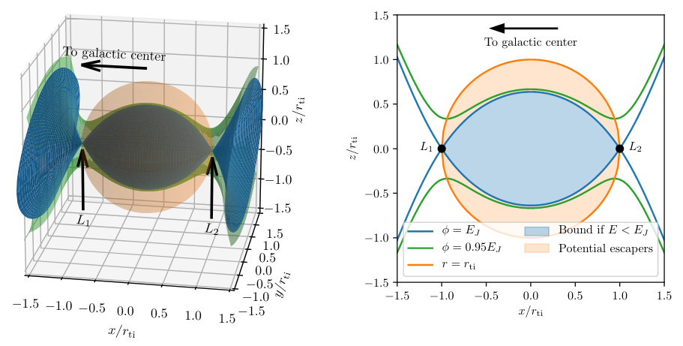
Toward the tidal tails
2. Simulated clusters
A simple simulation that produces realistic tidal tails, suitable for all clusters with no fine tuning:
Gravitational potential of the Galaxy with halo, disk, rotating bar, bulge.
Initialise a cluster at its birth time and position.
Create a Plummer potential with 5000 M⊙.
Populate it with 10⁶ test stars.
Decrease the potential depth to move more stars into tidal tails, add fast stars to simulate a halo.
Stars must flow past the Lagrangian points into the tidal tails

Slide 11
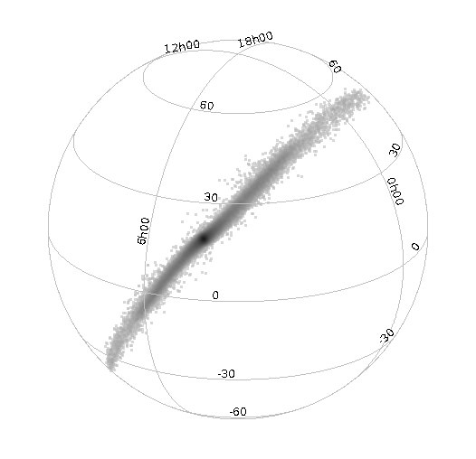
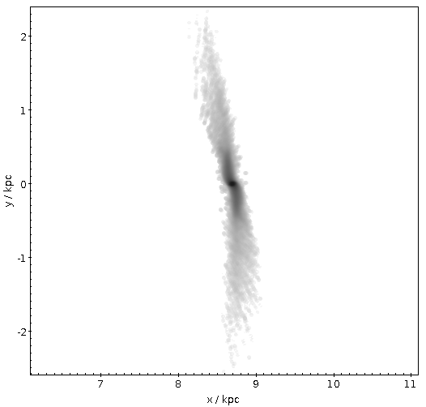
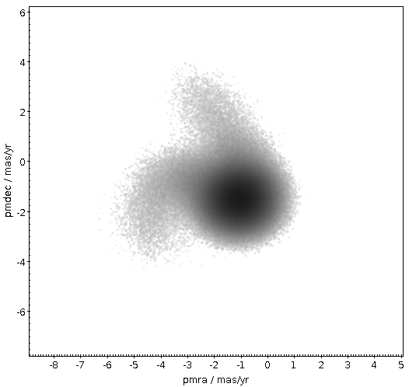
Toward the tidal tails
2. Simulated clusters
A simple simulation that produces realistic tidal tails, suitable for all clusters with no fine tuning:
Gravitational potential of the Galaxy with halo, disk, rotating bar, bulge.
Initialise a cluster at its birth time and position.
Create a Plummer potential with 5000 M⊙.
Populate it with 10⁶ test stars.
Decrease the potential depth to move more stars into tidal tails, add fast stars to simulate a halo.

Slide 12
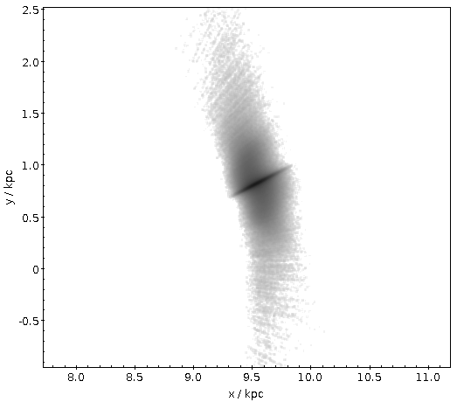
Toward the tidal tails
3. Membership likelihood
Membership likelihood is a probability that a cluster member is found at some position in the parameter space.
Simulations are convolved with observational uncertainties.
5D space (X, Y, Z, v∥, v_{丄}) is binned to parametrise the sampled likelihood.
Likelihood is given by the fraction of stars in the bin.
No need for normalisation.

Slide 13
Toward the tidal tails
4. Membership probability
Membership probability is the probability that a star found at some position in the parameter space is a cluster member.
Bayesian inverse is not possible because we don’t know the number of stars we are looking for.
Calculated by comparing star counts in Gaia with those in a Galaxia simulation (Besançon model of the Galaxy, Padova isochrones and Gaia photometric bandpasses).
Are selection functions the same?
Such membership probabilities are normalised.

Slide 14
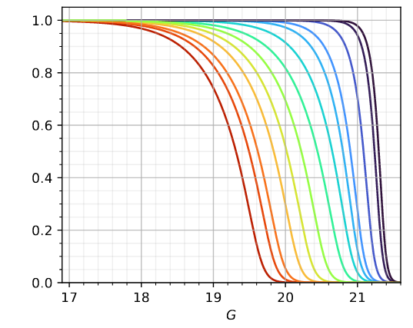
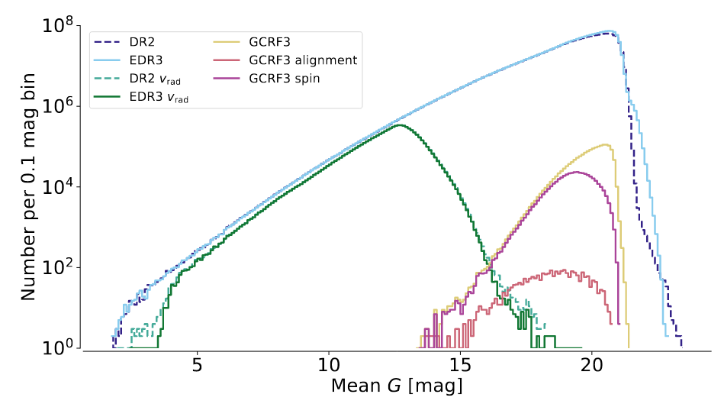
Toward the tidal tails
4. Membership probability
completeness
Membership probability is the probability that a star found at some position in the parameter space is a cluster member.
Bayesian inverse is not possible because we don’t know the number of stars we are looking for.
Calculated by comparing star counts in Gaia with those in a Galaxia simulation (Besançon model of the Galaxy, Padova isochrones and Gaia photometric bandpasses).
Are selection functions the same?
Such membership probabilities are normalised.
Our census limit
Cantat-Gaudin+ 2022
Gaia colab. 2020

Slide 15
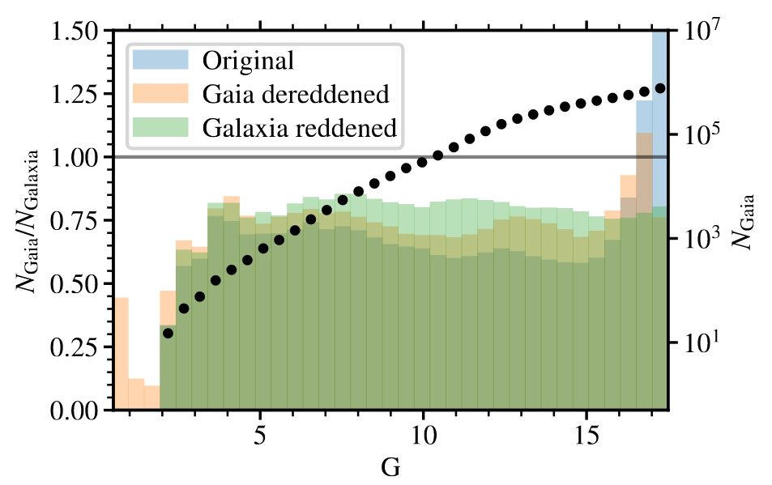
Toward the tidal tails
4. Membership probability
Membership probability is the probability that a star found at some position in the parameter space is a cluster member.
Bayesian inverse is not possible because we don’t know the number of stars we are looking for.
Calculated by comparing star counts in Gaia with those in a Galaxia simulation (Besançon model of the Galaxy, Padova isochrones and Gaia photometric bandpasses).
Are selection functions the same?
Such membership probabilities are normalised.

Slide 16
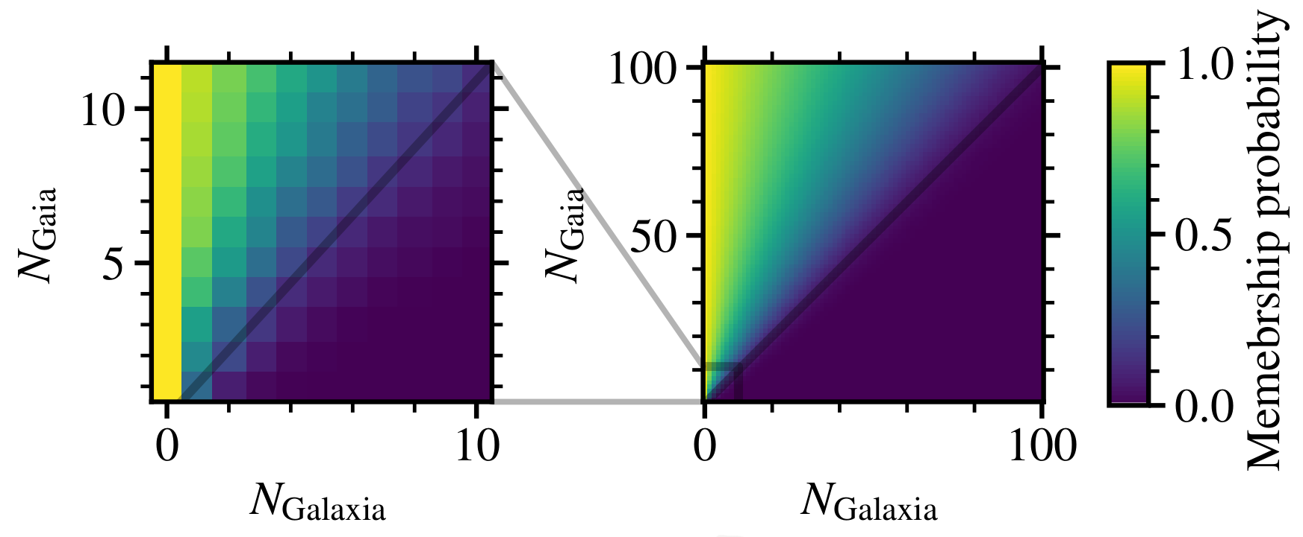
Toward the tidal tails
4. Membership probability
Membership probability is the probability that a star found at some position in the parameter space is a cluster member.
Bayesian inverse is not possible because we don’t know the number of stars we are looking for.
Calculated by comparing star counts in Gaia with those in a Galaxia simulation (Besançon model of the Galaxy, Padova isochrones and Gaia photometric bandpasses).
Are selection functions the same?
Such membership probabilities are normalised.
4 Galaxia stars and 3 Gaia stars give a membership probability of almost 15%

Slide 17
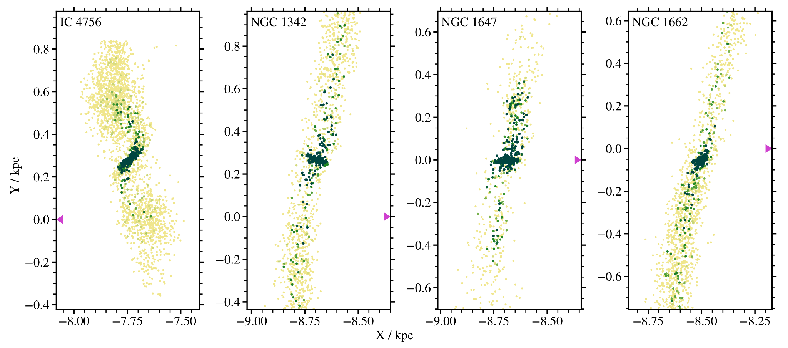
Results

Slide 18
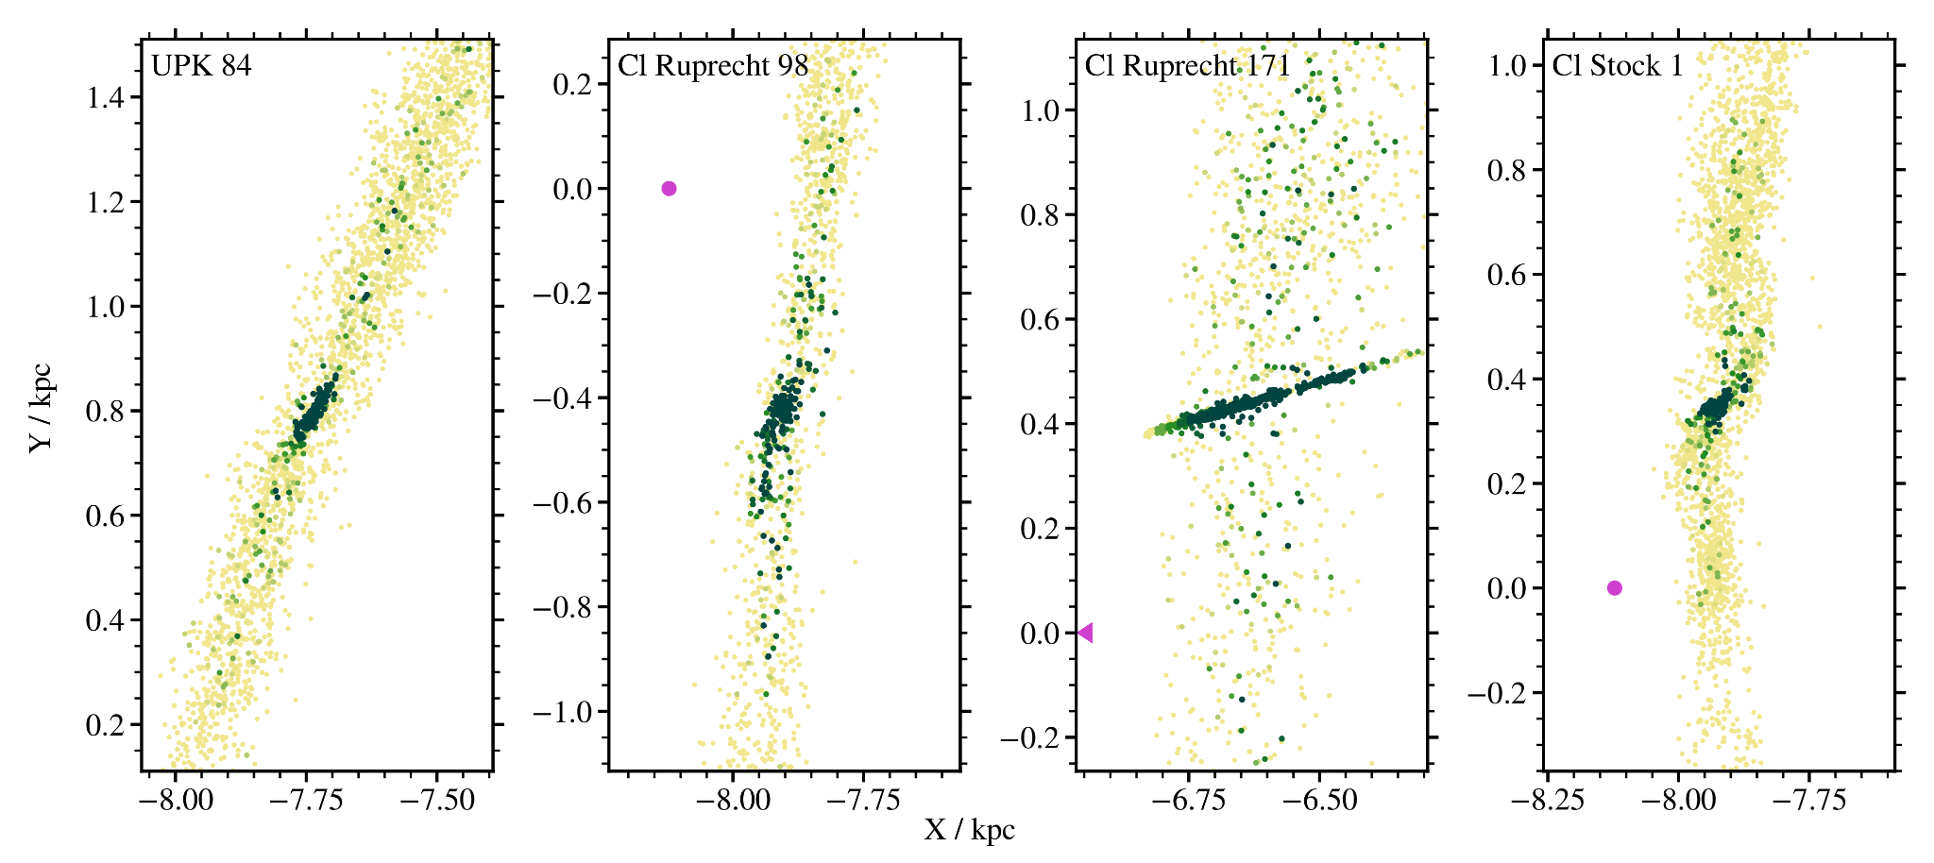
Results

Slide 19
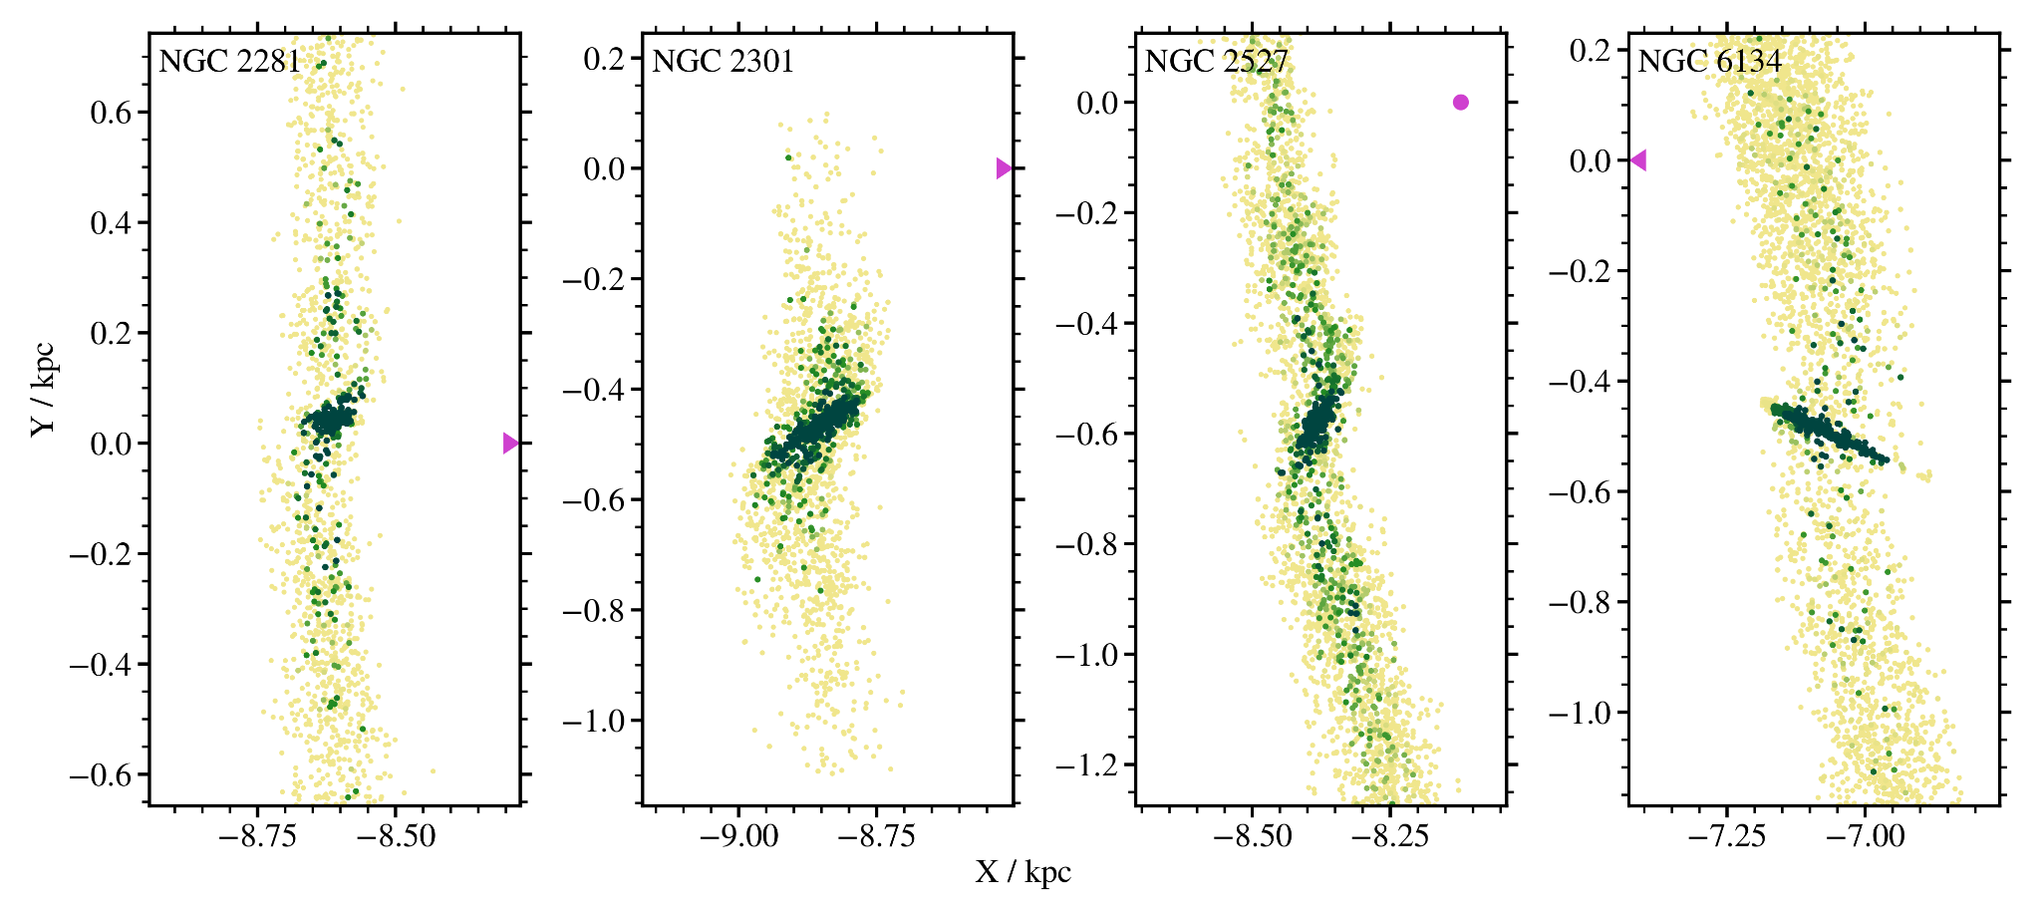
Results

Slide 20
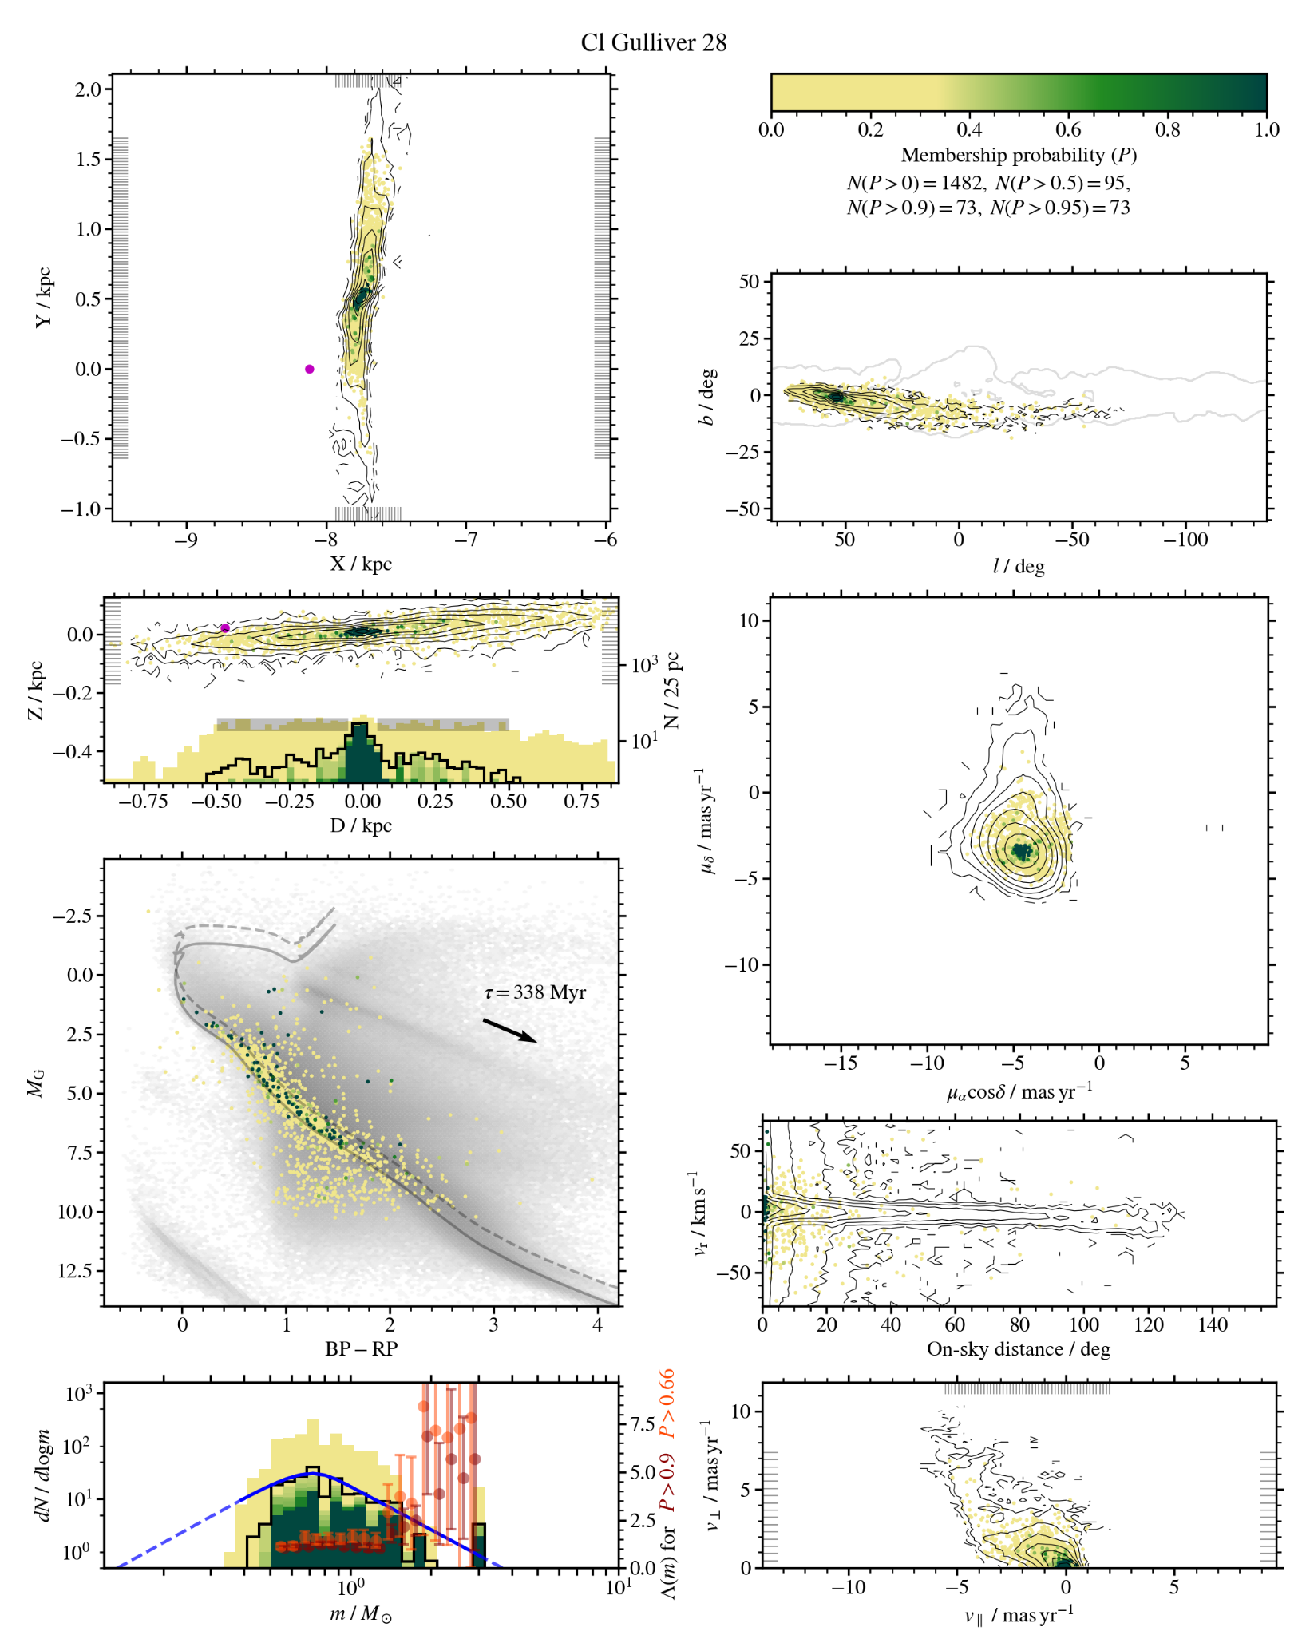
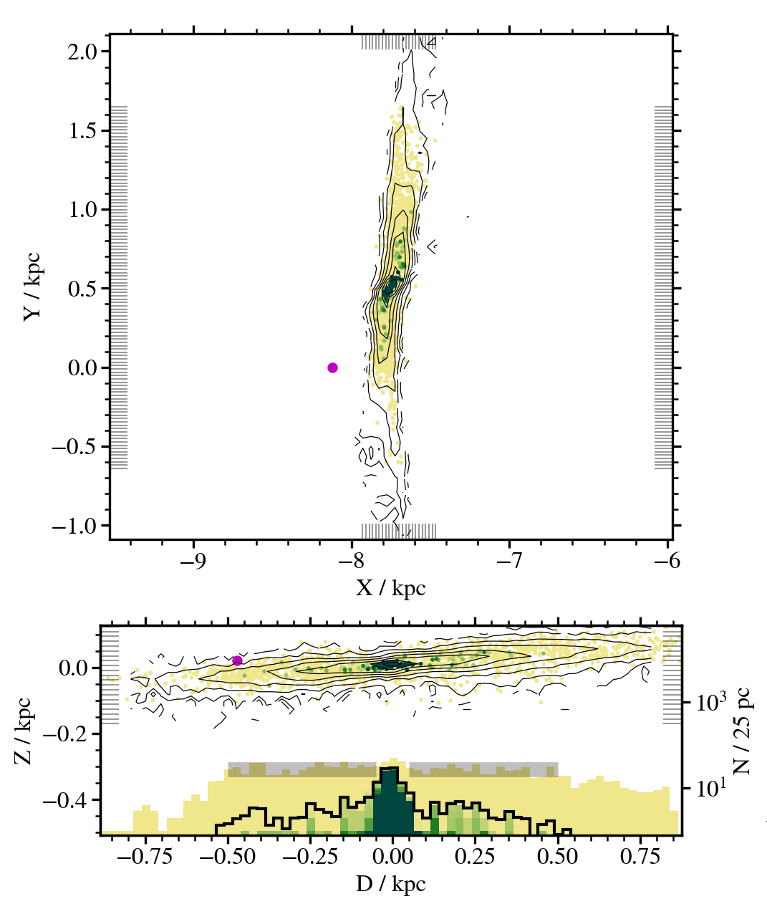
Morphological parameters
Tail lengths
Asymmetry
Cusp index
Mass segregation
Histogram obtained by adding all stars in a bin weighted by membership probability
Stacked histogram color coded by membership probability

Slide 21
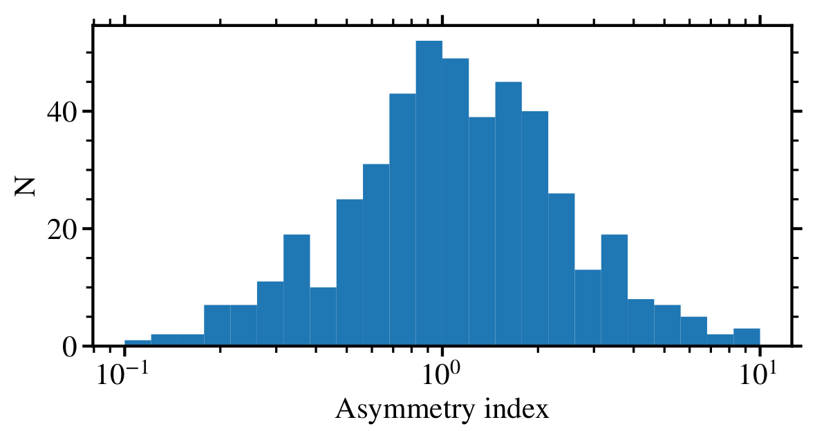
Morphological parameters
Tail lengths
Asymmetry
Cusp index
Mass segregation
More stars in the trailing tail Mores stars in the leading tail
Tidal tails are likely asymmetric.
No preference in the direction of asymmetry.

Slide 22
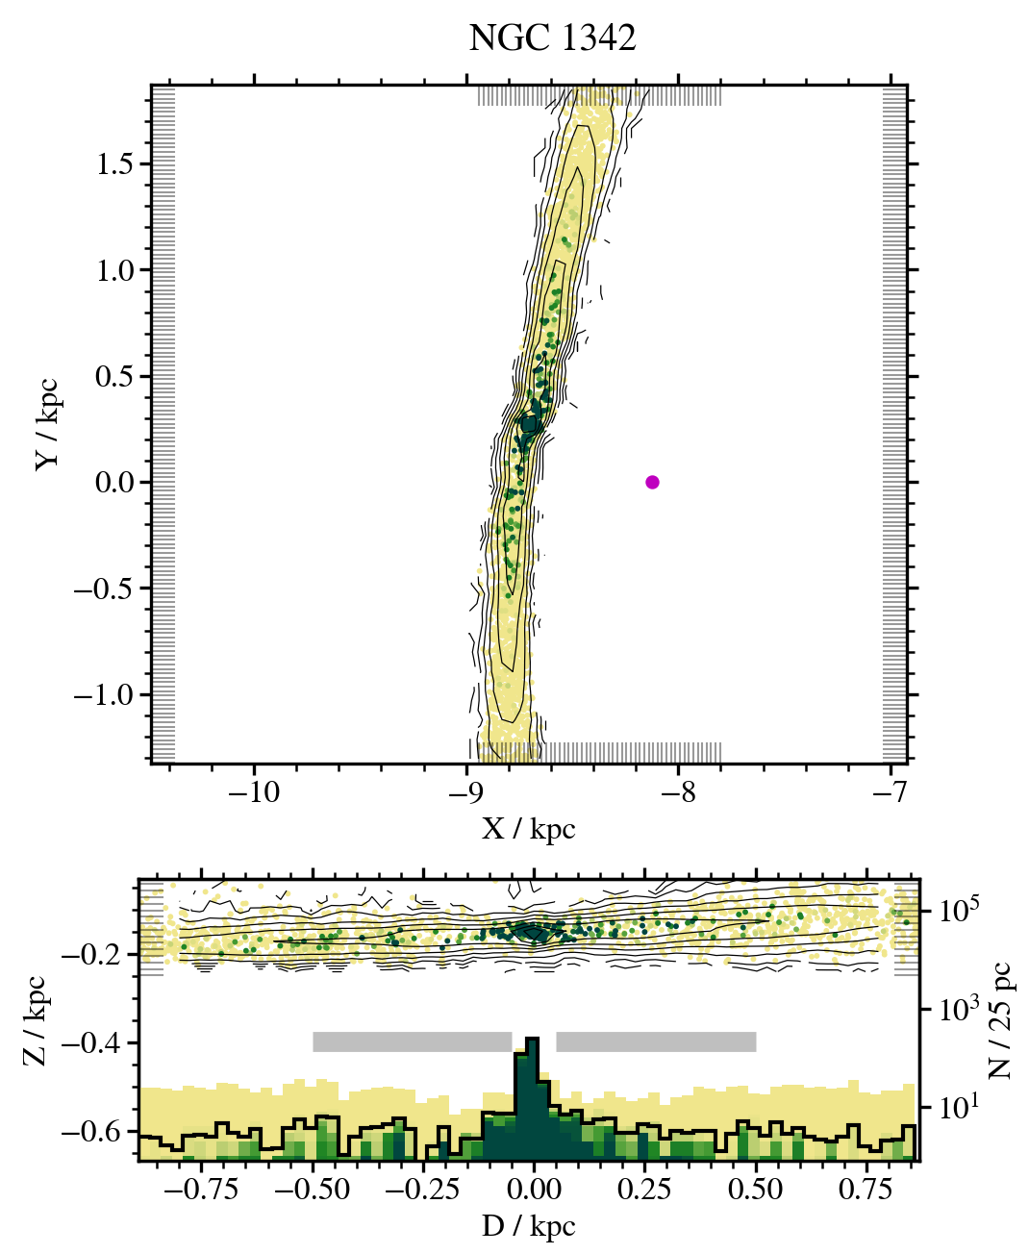
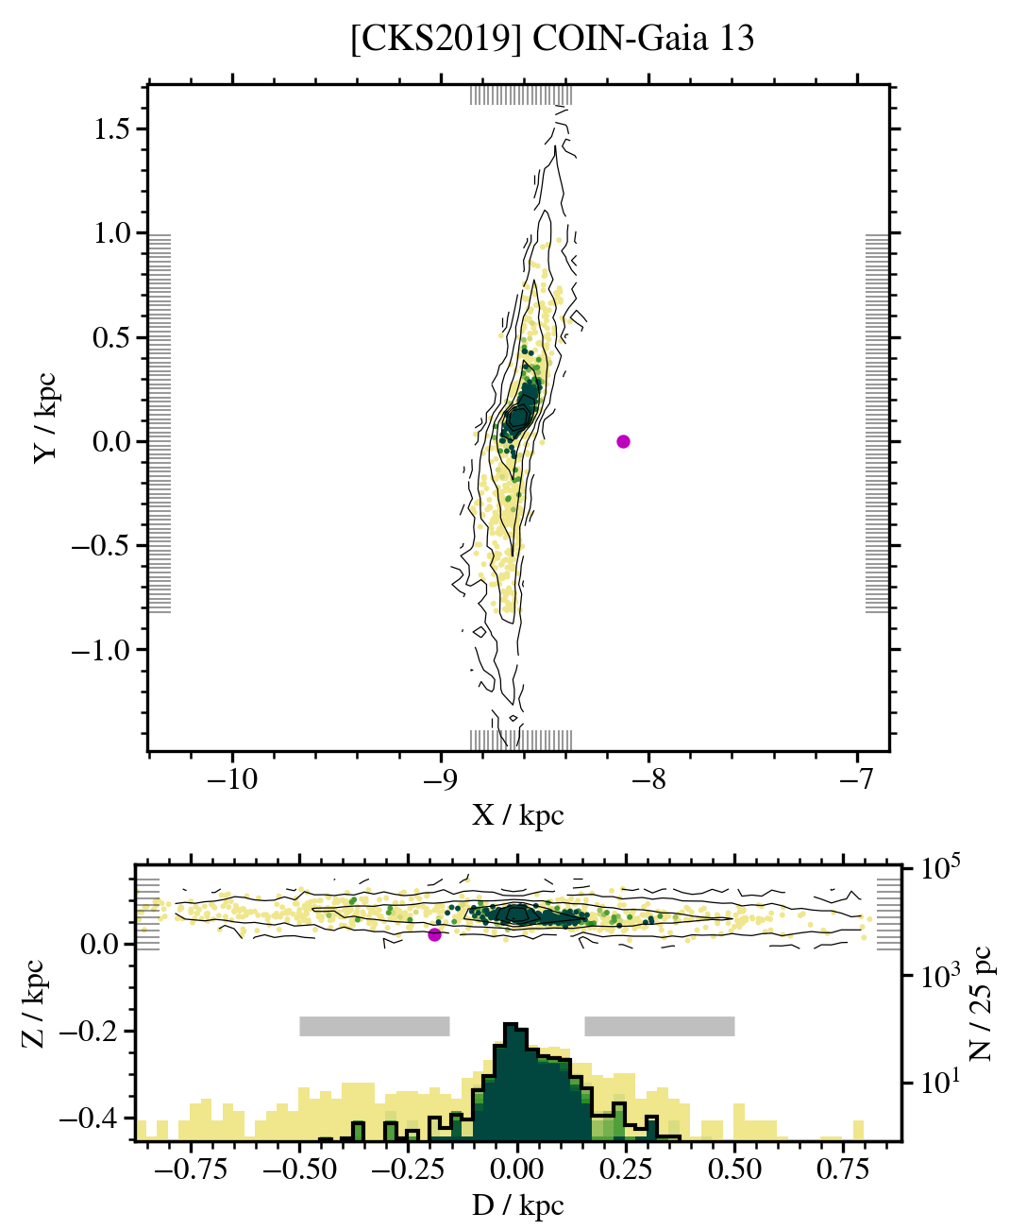
Morphological parameters
Tail lengths
Asymmetry
Cusp index
Mass segregation
Cuspy: tidal tails with pronounced cluster core Gradual decrease in density

Slide 23
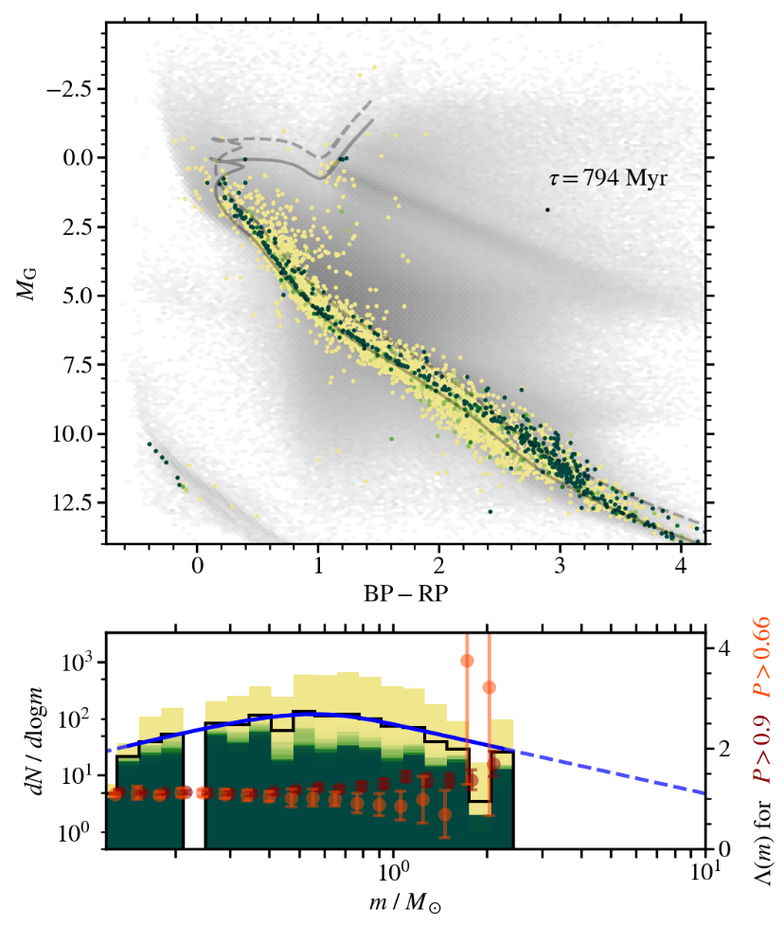
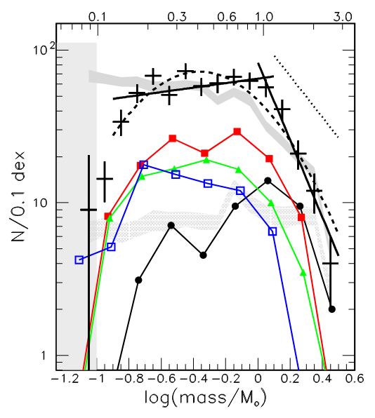
Morphological parameters
Tail lengths
Asymmetry
Cusp index
Mass segregation
Goldman+ 2013
Hyades

Slide 24
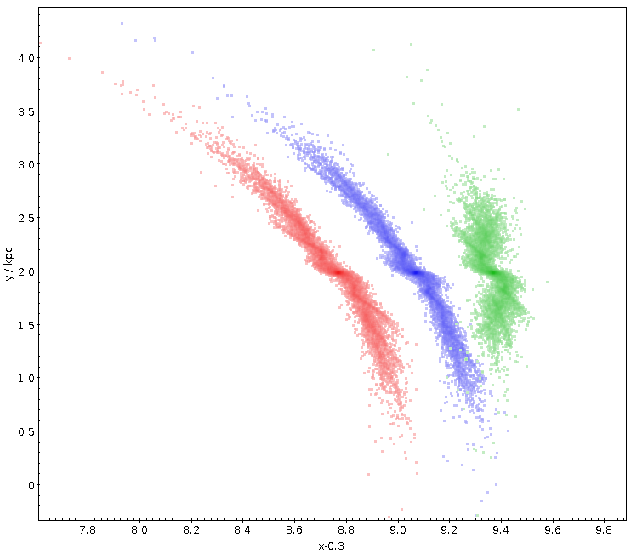
What next
Publish the catalogue (1 000 000+ stars, 475 clusters) – submitted
Age > 100 Myr
Distance < 3 kpc
Size > 45 stars in Cantat-Gaudin (2020)
Known radial velocity
Model testing
Radial velocities
Radial velocity selection function
Verification and weeding out non-members
More accurate synthetic Galaxy, fine structure?
bar rotating 10% slower
bar rotating 10% faster
NGC 7789

Slide 25
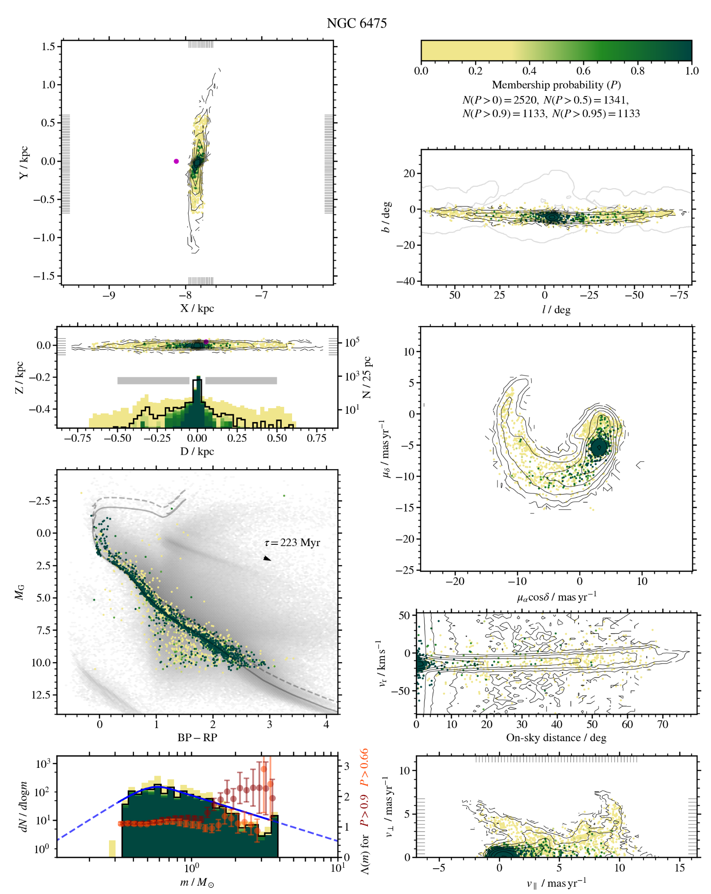
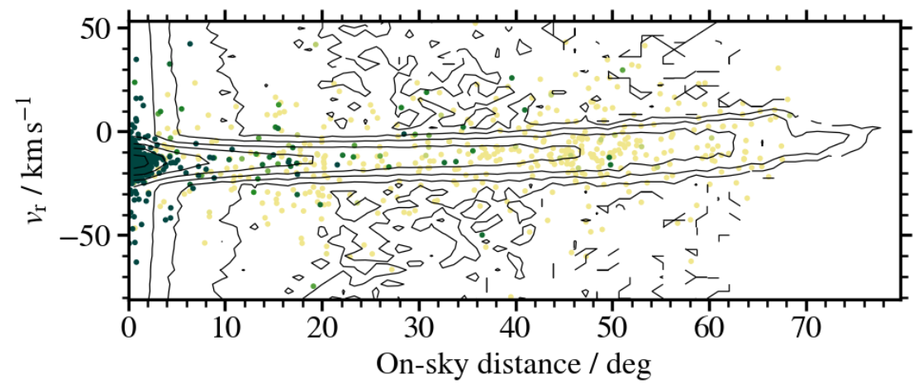
What next
Publish the catalogue (1 000 000+ stars, 475 clusters) – submitted
Age > 100 Myr
Distance < 3 kpc
Size > 45 stars in Cantat-Gaudin (2020)
Known radial velocity
Model testing
Radial velocities
Radial velocity selection function
Verification and weeding out non-members
More accurate synthetic Galaxy, fine structure?

Slide 26
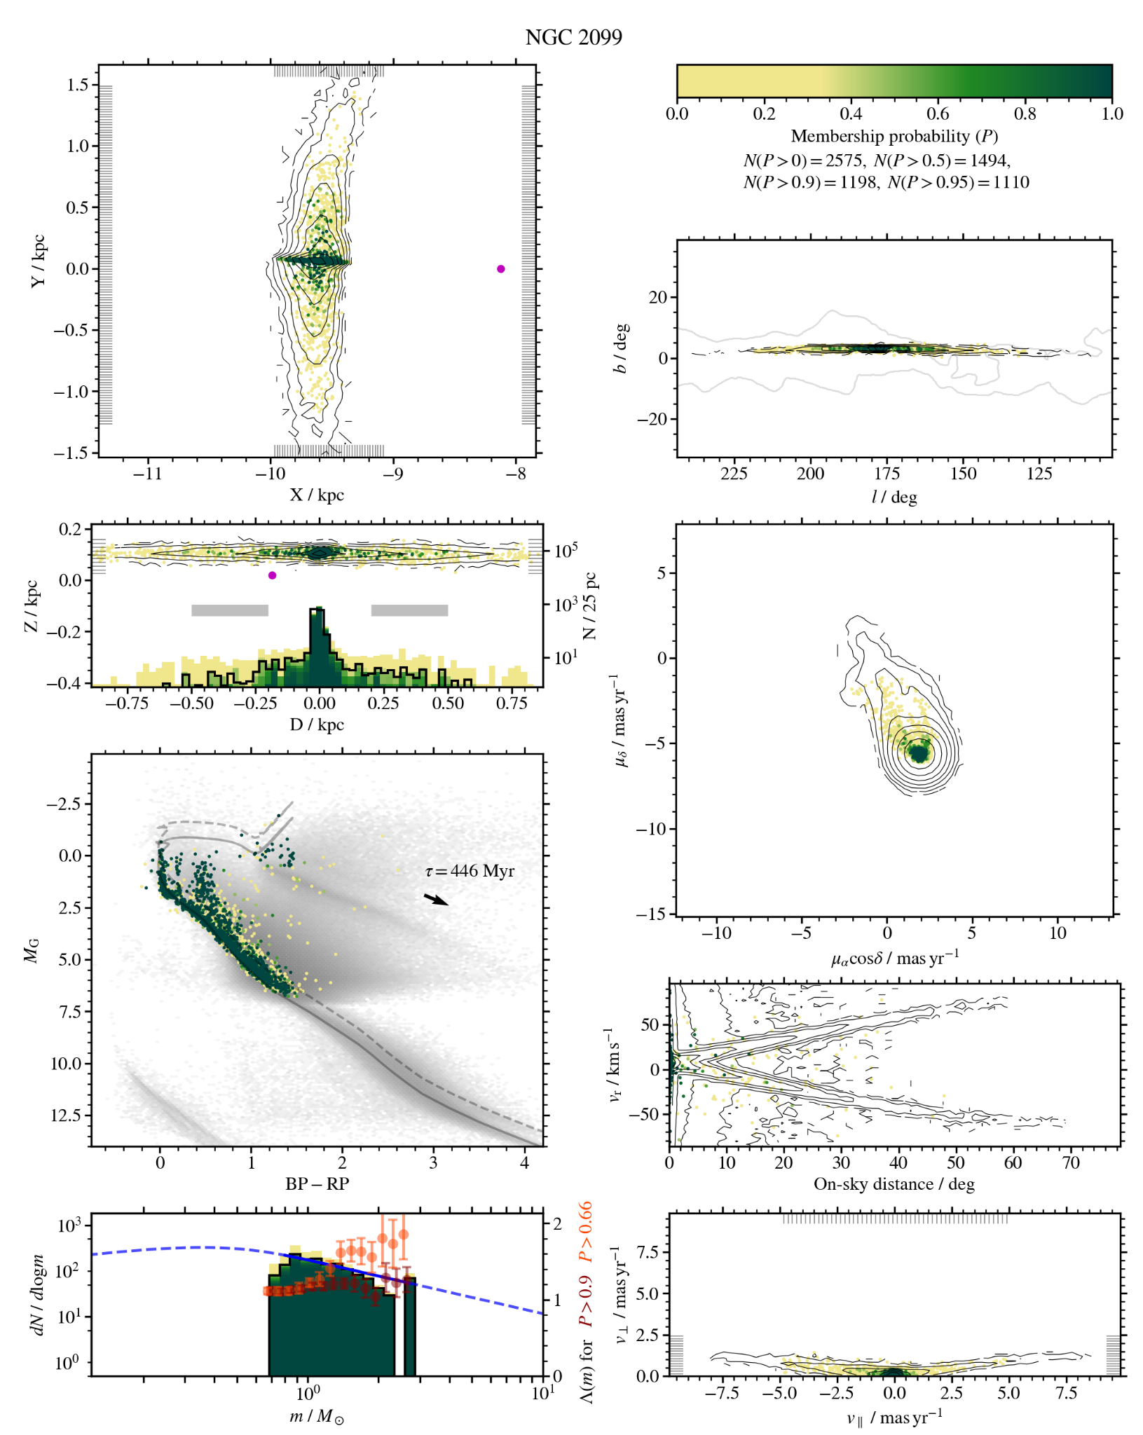
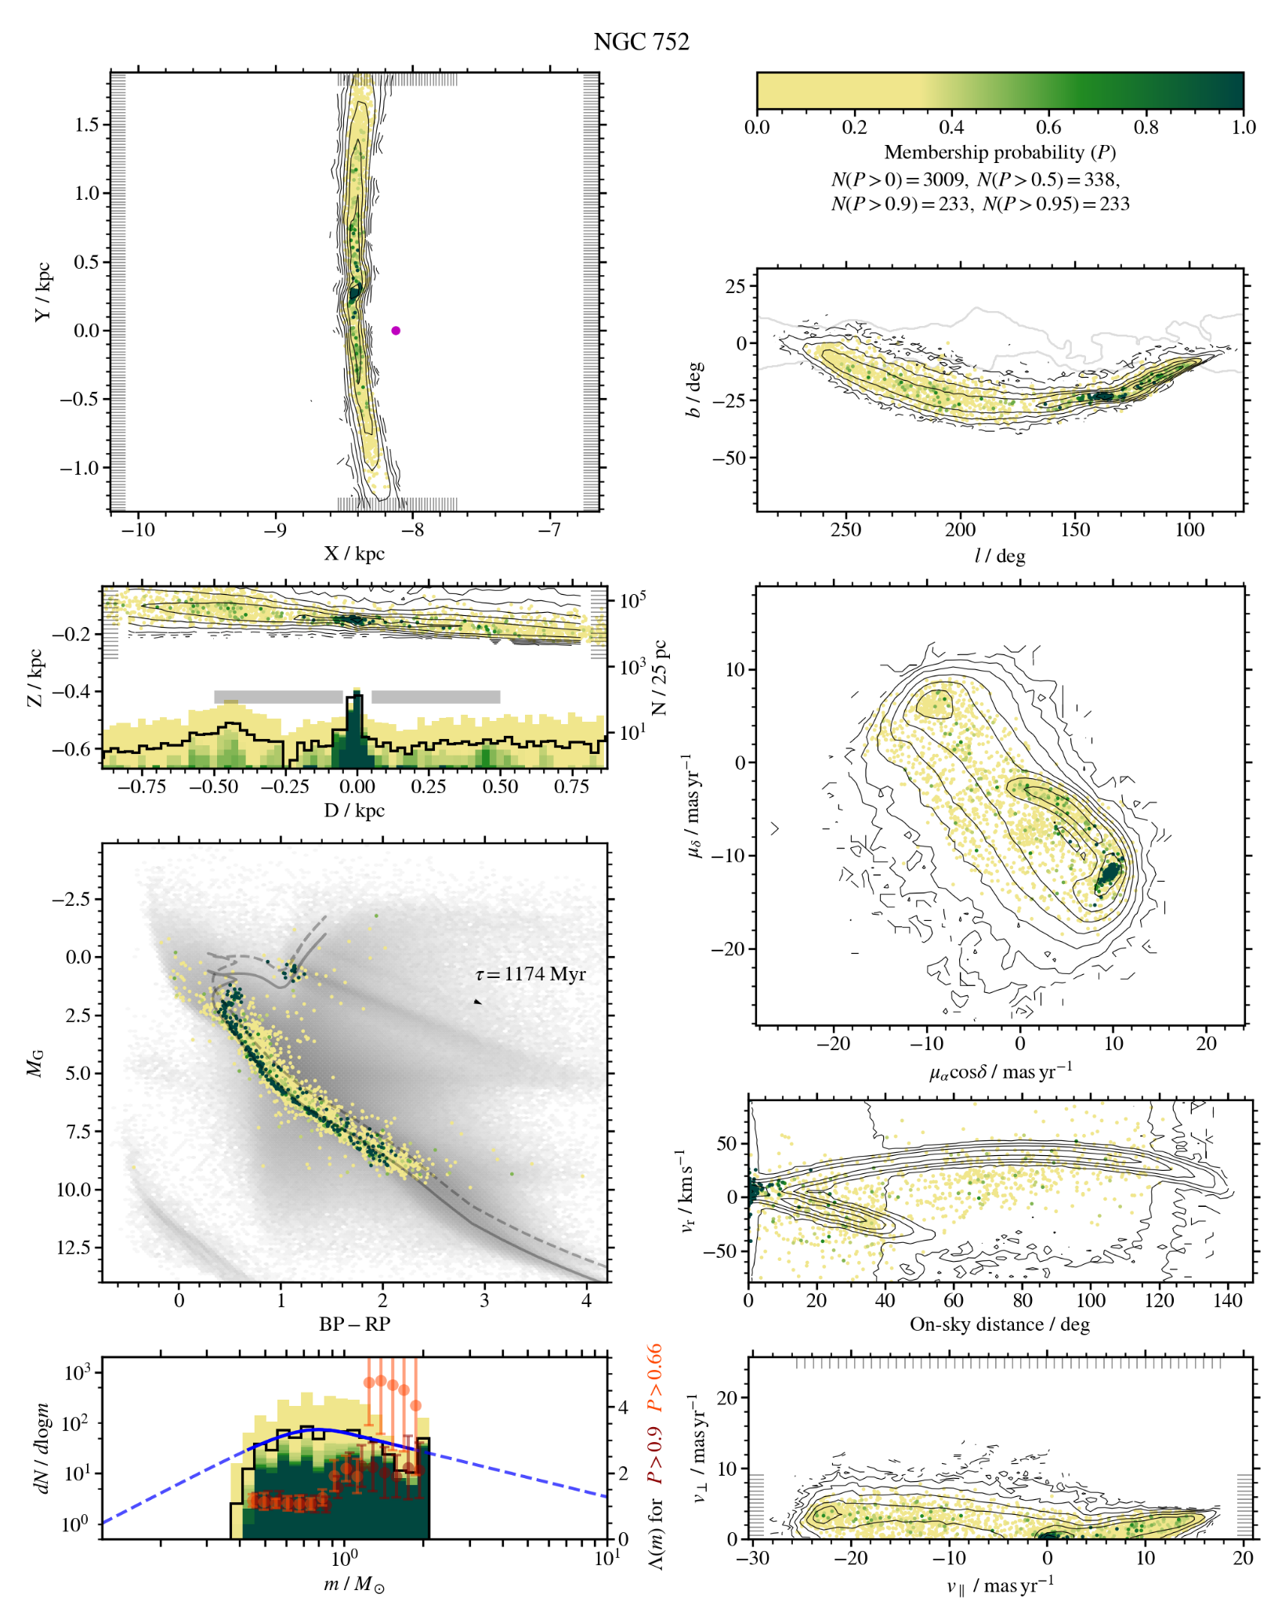

Slide 27
