Slide 1




Open and Young Clusters
in WEAVE & 4MOST
Antonella Vallenari
INAF, Osservatorio di Padova, Italy
From Star Clusters to Field Populations, Firenze, November 20-23, 2023

Slide 2
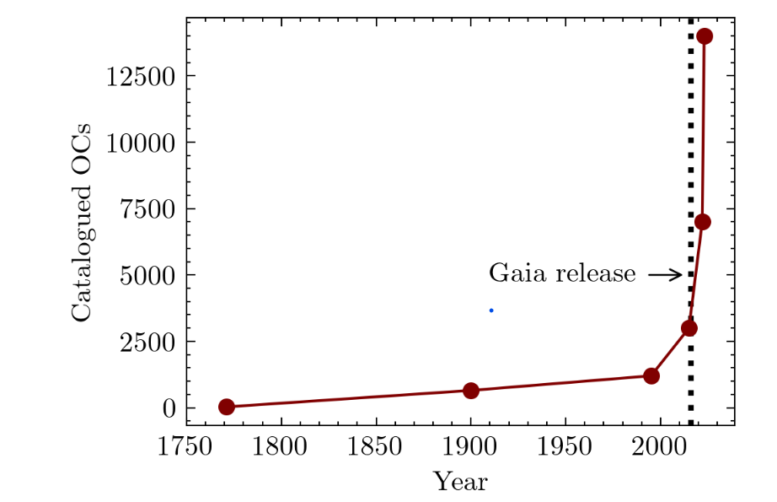
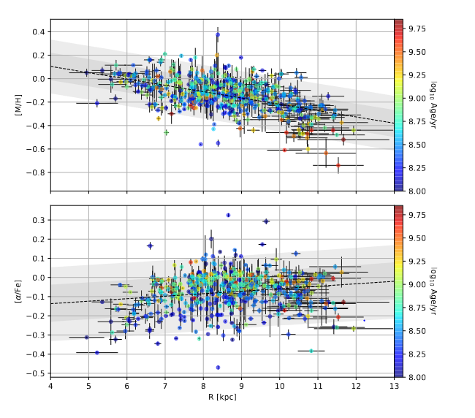
Gaia & open cluster revolution
Perren+2023
  Gaia has changed our view of clusters and open clusters
  Census revision: Cantat+ 2018, 2020 Castro-Ginard et al.(2021); Tarricq et al. (2021), Badawy et al(2022), Hao et al (2022), Kounkel+ (2020)…Hunt&Reffert(2023) with 7000 Ocs, Perren +(2023) with 14,000 OCs
  Membership, parallaxes, proper motions, and radial velocities (Cantat et al 2018, 2020), Soubiran et al 2018, Fu+(2022, 386OC Vrad), Perren+2023
  Age revision: Gaia collab, van Leeuwen+, 2017, 2018, Cantat+2018, Bossini +2018, Cantat-Gaudin+( 2018, 2020); Castro-Ginard et al.(2021); Tarricq et al. (2021), Anders et al (2021),… Perren+(2020), Dias+2021
  Chemical Abundances: GES (Randich+ 2022, Magrini+2023), APOGEE/OCCAM(Myers+2022)
  DR3 data:
    Astrophysical parameters from BP/RP (Andrae+2023) for G<19
    Radial velocities down to G=14 (Katz+2023)
    Chemical abundances (up to 12 elements) for about 1600 stars in 500 OCs (Recio-Blanco+2023): flattening of gradient at young ages
  DR4: not before end of 2025
Fouesneau 2023
M67
Parsec , log(age)=9.4
RecioBlanco+2023
From Star Clusters to Field, Firenze November 20-23, 2023
Notes:
APOGEE OCCAM DR17 has 153 Ocs with 2000 members ; Giraffe R=20,000; UVES R=47000

Slide 3
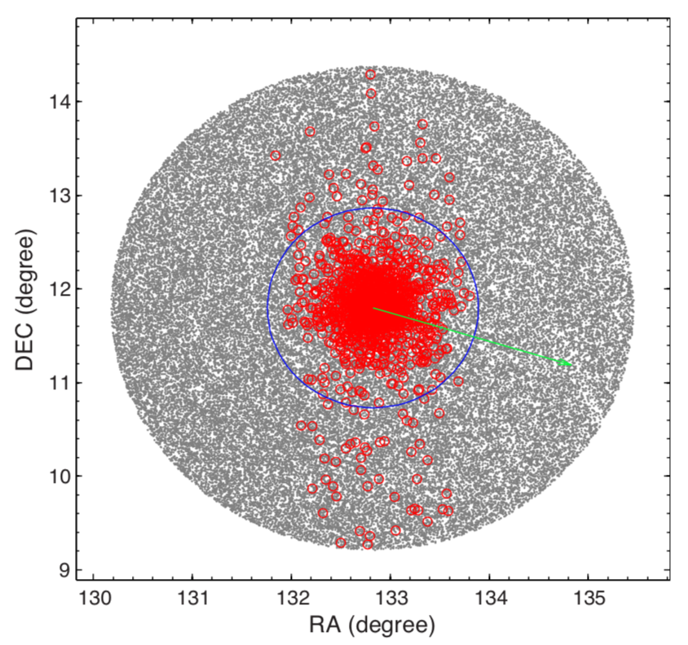
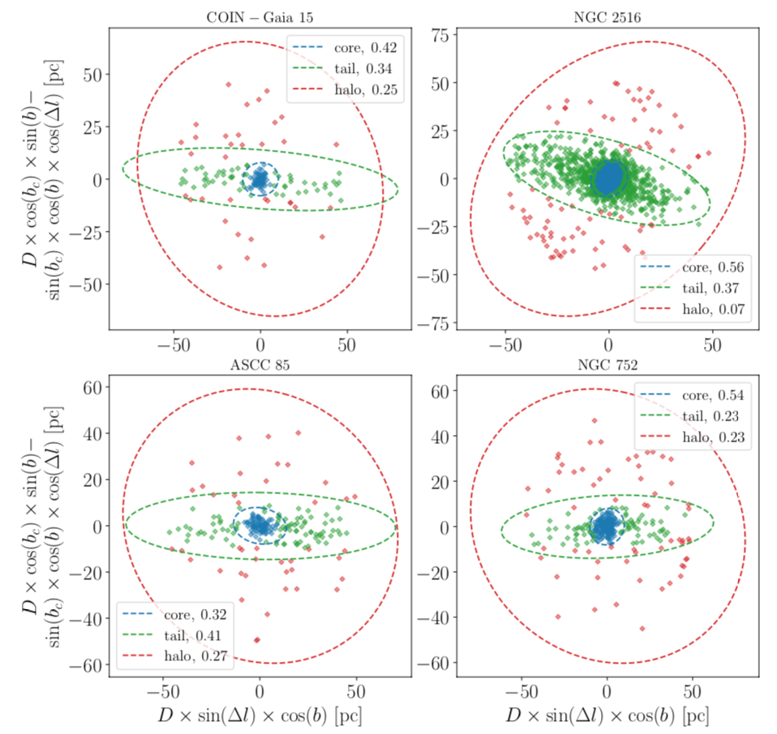
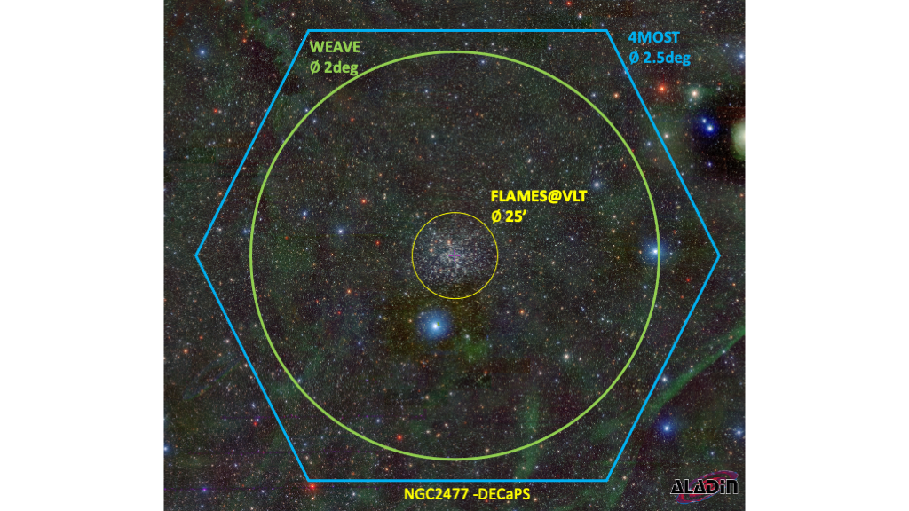
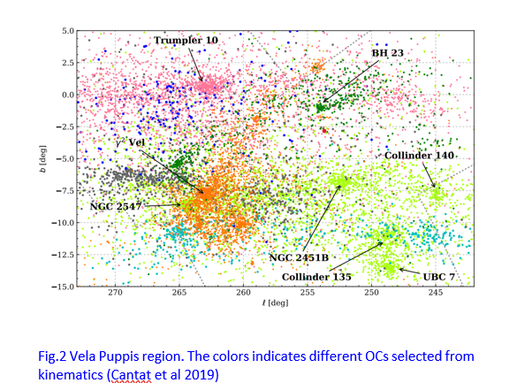
To progress we need spectroscopy on large FoV
M67
Tidal radius
Carrera+ 2019, Gao 2020,
Tarricq+2021, Meingast+2019…
→ WEAVE & 4MOST Cluster surveys
The axes are simply the projection of the
star’s position in the plane of the sky
From Star Clusters to Field

Slide 4
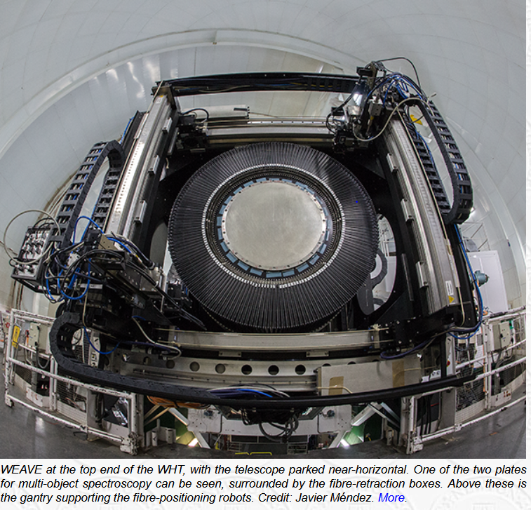
What’s next: WEAVE & 4MOST
  WEAVE (Dalton+2020, Jin+2023)
  4m WHT telescope
  2 deg diameter
  HR(R=20000); LR(R=5000)
  Blue(Green)+Red ;4040A-6850 A
  960 fibers x field (Plate A &B)
  Multiplex per pointing 960
  Cannot observe HR and LR at once
  fibre minimum distance: 60 arcsec
  Fiber size 1.3 arcsec
  miniIFU (790fibres)+LIFU(589 fibre)
  4MOST (de Jong+2019)
  4m VISTA telescope
  2.5deg diameter FOV
  HR=20,000; LR=6500
  Blue,Green, Red
  812 high-res (HR) + 1624 low-res (LR) fibres
  Fibre multiplex per pointing ~2400
  Can observe LR & HR at once
  Fibre minimum distance 15 arcsec
  Fibre size 1.3 arcsec
From Star Clusters to Field, Firenze November 20-23, 2023
Notes:
MiniIFU 20 bundlesx 11 x 12 arcsec^{2 in plate B} ; LIFU: 78 x 90 arcsec^{2 al centro della plate}

Slide 5
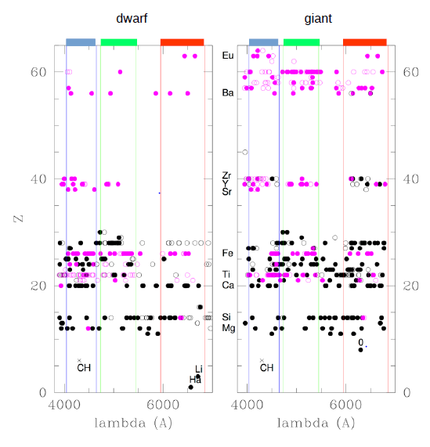
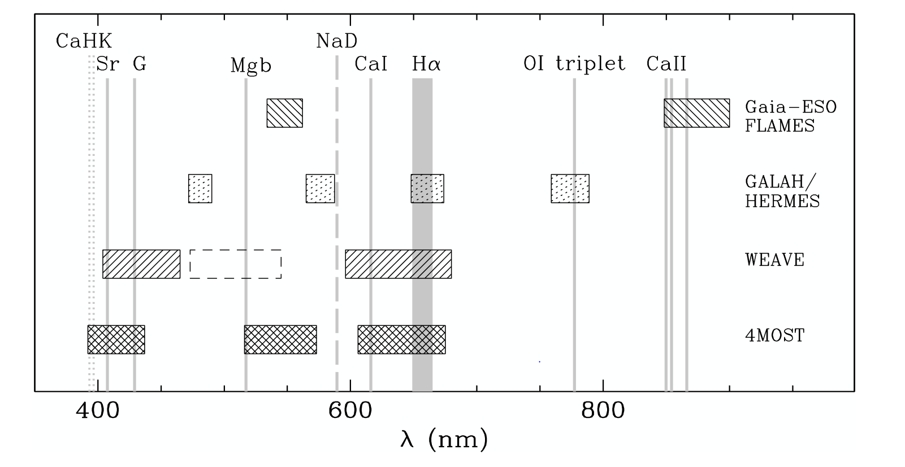


Neutral ; ionised
Feltzing 2020
Nucleosynthetic chanels :
  Lithium → young objects
  iron peak (Fe, Ni, Cr, Co, Zn),
  alpha elements (C, Mg, Si, Ca, [OI]…),
  neutron-capture slow and rapid elements (Zr, Y, Sr, Ba, La, Nd,Eu),
  odd elements (Na, Al, Sc)
WEAVE Science Book (2020)
From Star Clusters to Field, Firenze November 20-23, 2023

Slide 6
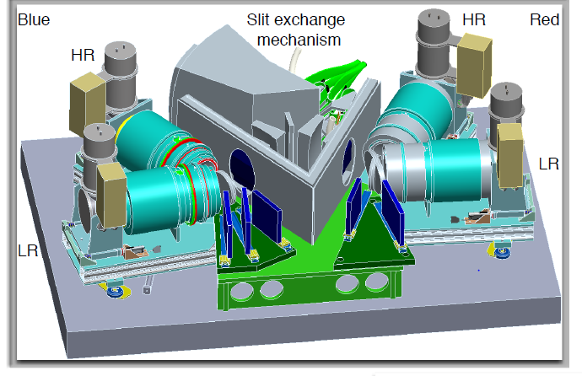






What’s next: WEAVE@WHT
  WEAVE : only HR multifibre in the
  Northern Hemisphere for Surveys
  4m WHT telescope
  2 deg diameter
  HR(R=20000); LR(R=5000)
  Blue(Green)+Red ;4040A-6850 A
  960 fibers x field (Plate A &B)
  Multiplex per pointing 960 (Blue(Green) + Red )
  Cannot observe HR and LR at once
  Interfibre minimum distance: 60 arcsec
  Fiber size 1.3 arcsec
  Pointing time 40 min
  miniIFU (790fibres)+LIFU(589 fibre)

Slide 7
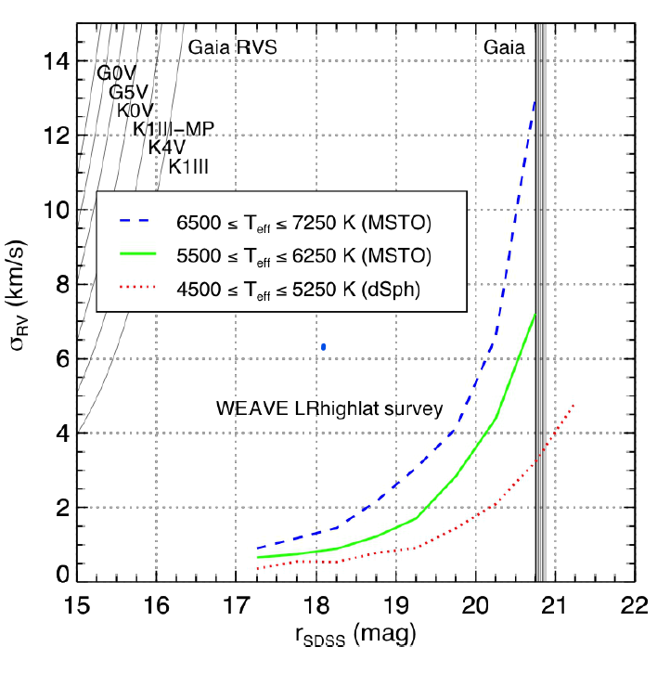
WEAVE& 4MOST Performances
LR: Accurate Vr (2 km/s) (and stellar parameters, incl. Metallicity at 0.2 dex)16<G<20.7
HR: Accurate stellar parameters and detailed chemistry(at 0.05- 0.1 dex) for G>12-16, Vr < 0.05 Km/s
  Teff, log(g), Vrad, Vsini,..Halpha, activity index
Nucleosynthetic chanels :
  Lithium → young objects
  iron peak (Fe, Ni, Cr, Co, Zn),
  alpha elements (C, Mg, Si, Ca, [OI]…),
  neutron-capture slow and rapid elements (Zr, Y, Sr, Ba, La, Nd,Eu),
  odd elements (Na, Al, Sc)
WEAVE, Jin+ 2022

Slide 8
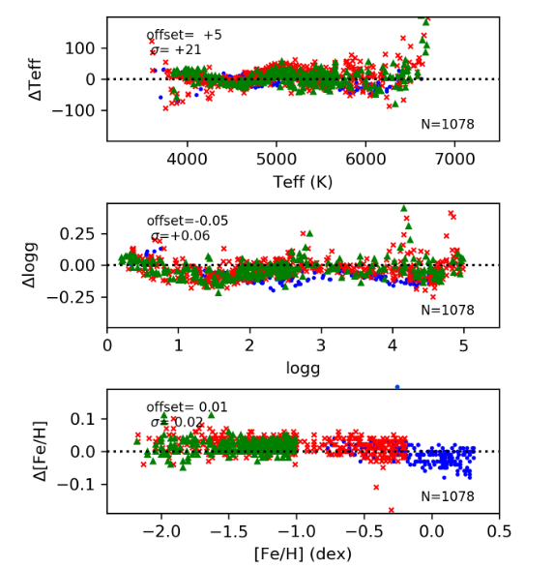
WEAVE& 4MOST Performances
WEAVE, Jin+ 2023
WEAVE, Boeche+2021, S/N=100, HR
Additional pipeline for young stars :Teff, log(g), Vrad, Vsini,..Halpha, activity index (Frasca+)
Cross-survey calibration targets: Ocs, GCs, asteroseismology
From Star Clusters to Field, Firenze November 20-23, 2023
Notes:
LR: Accurate Vr (2 km/s) (and stellar parameters, incl. Metallicity at 0.2 dex)16<G<20.7
HR: Accurate stellar parameters and detailed chemistry(at 0.05- 0.1 dex) for G>12-16, Vr < 0.5 Km/s
Da boeche blue, red green thin thick accreated mock stellar population, S/N
Teff, log(g), Vrad, Vsini,..Halpha, activity index
All nucleosynthetic chanels

Slide 9
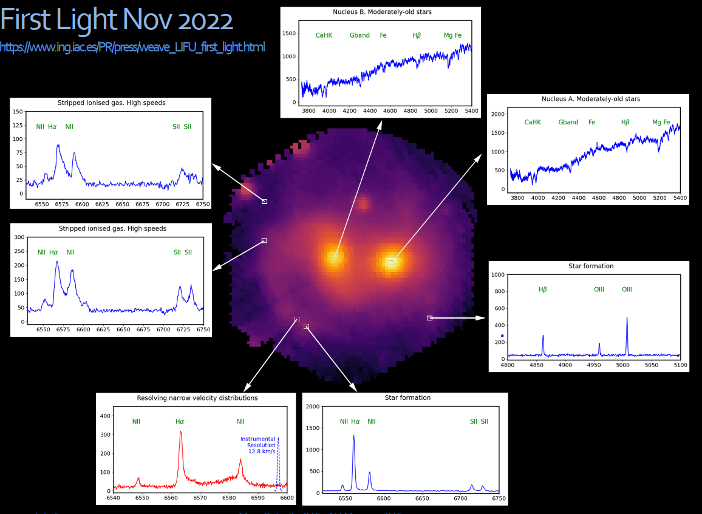
WEAVE& 4MOST Project status
  WEAVE
  LIFU: First light Nov 2022+SV
  Inauguration on Oct 30,2023
  mIFU on going commissioning
  MOS: on going commissioning
    Science Validation: on-going
  WEAVE LIFU First Light
  NGC 7318a/b in Stephan’s Quintet
  (M. Balcells courtesy)
  4MOST
  Test readiness review for hardware: July 2023
  Fibre feed system local acceptance review : May 2023
  Commissioning+ Survey beginning: end 2024
  10 Science programs + 15 Community Surveys
From Star Clusters to Field

Slide 10
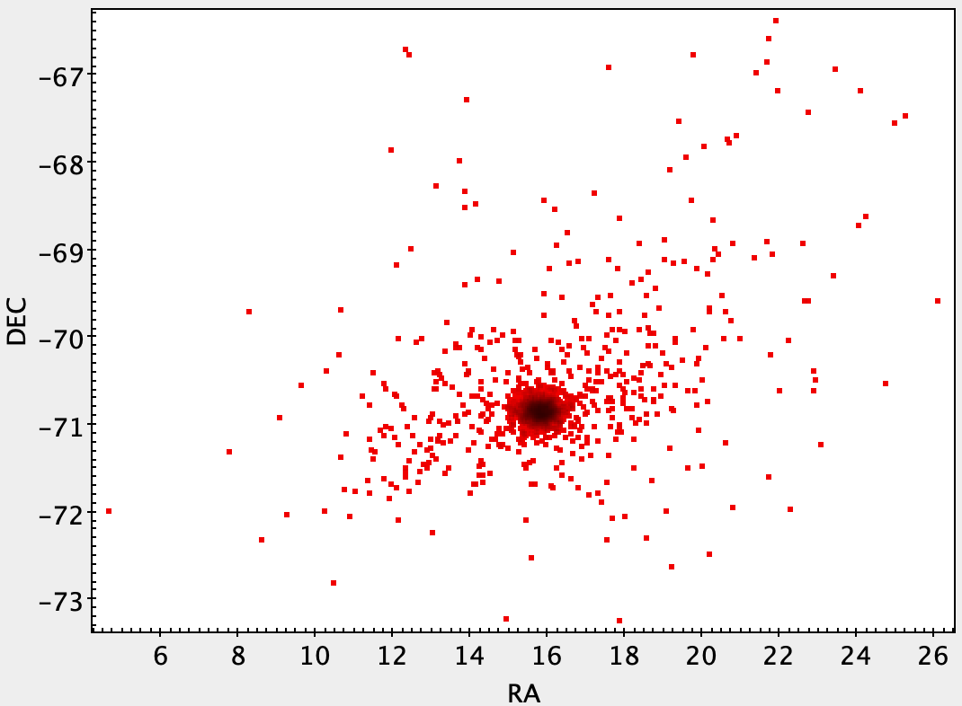
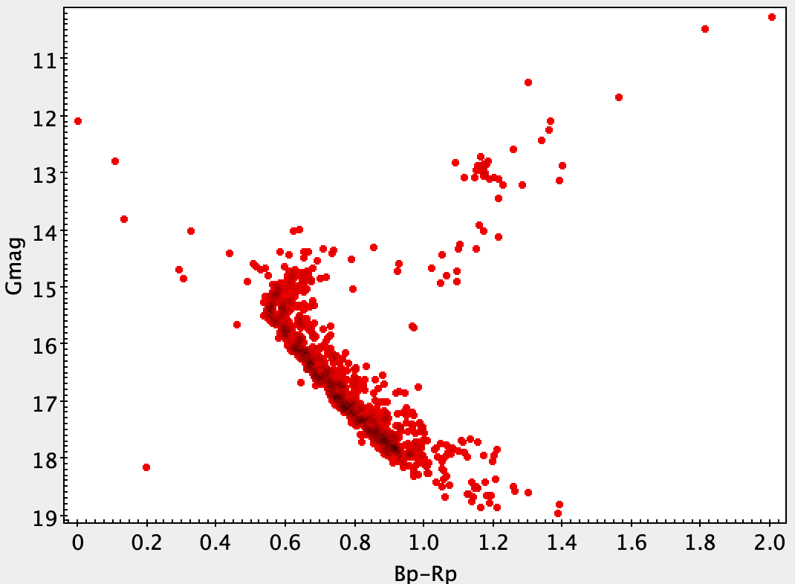
OC Survey goals
  how clusters form, evolve, dissolve, and populate the Milky Way;
  calibrate complex physics that affects stellar evolution→ ages
  formation and evolution of the Galaxy with unparalleled statistics in inner and outer disk
    Red clump stars in Ocs older than 100 Myr: G=16.0 at dist=12 Kpc---→ Rg=20 Kpc
tidal tails & halos evolution of surface abundances
HRS
Courtesy A. Bragaglia
From Star Clusters to Field, Firenze November 20-23, 2023
Notes:
fill metallicity/age distribution: [Fe/H] = −2.5 of GCs to super-solar OCs, a few Myr to 13.5 Gyr
can follow clusters from center to ourskirts, halo, tidal tails (at least in part of them)
2300+ clusters studied both with LR and HR
Inner and outer disk sampling
complement with Gaia-ESO at very center & with Gaia RVS for bright stars

Slide 11
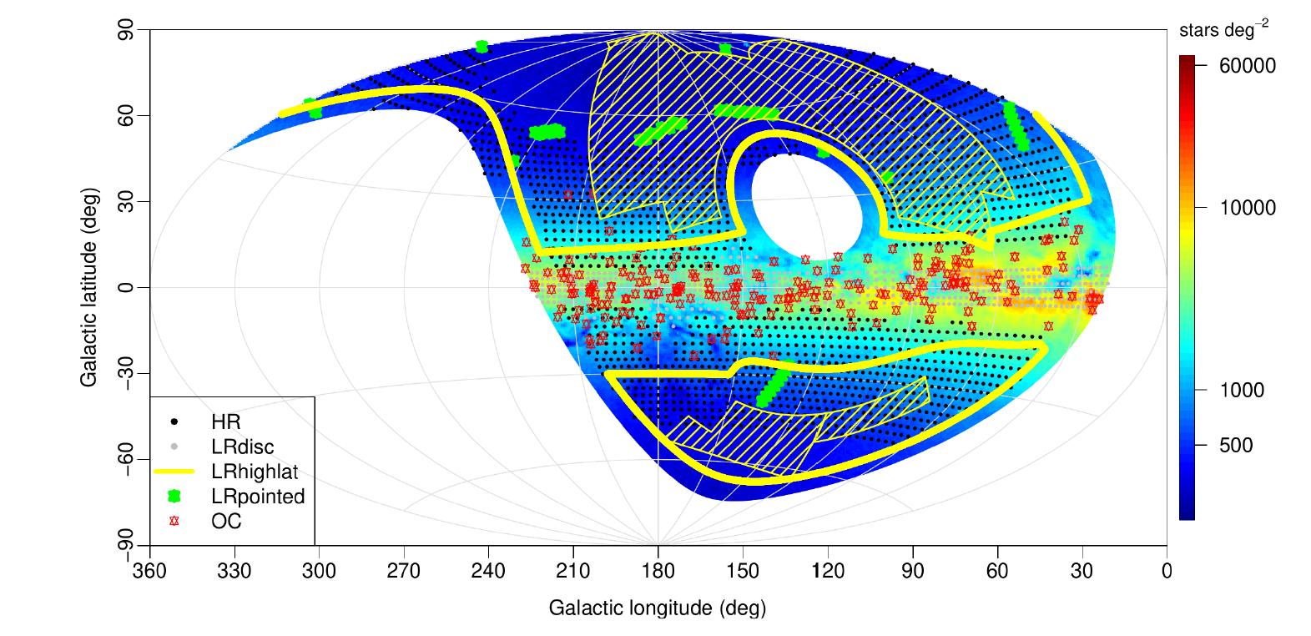
WEAVE OC Survey
  8 Surveys (Galactic + Extragal)
  PI: A.Vallenari, Deputy A. Bragaglia
  About 300 targets, all ages
    OCs as tracers of the Galactic disc and of its chemical evolution:
    4 Rgc annuli, 4 z-slices, 3 [Fe/H] bins and 3 age bins, 2 Ocs per bin→about 300 Ocs
Jin+ 2023
From Star Clusters to Field, Firenze November 20-23, 2023
Notes:
Sampling the outer disk

Slide 12
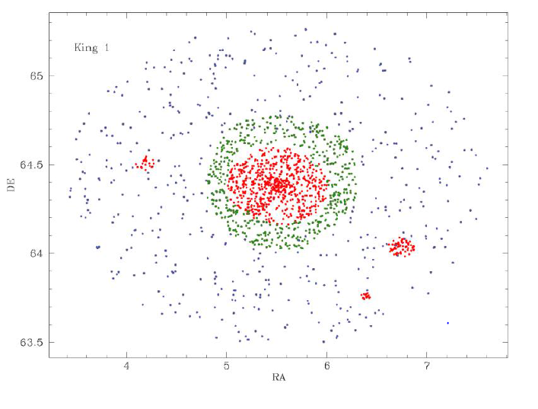
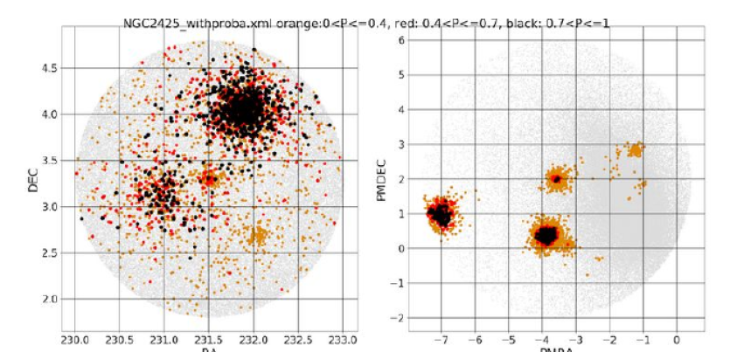
Pointing Strategy for WEAVE
  Each pointing is mastered by only one survey (with some exceptions) → high completeness→ single Ocs, groups,
  Small compact +large diffuse Ocs → synergie with LR disk & HR disk WEAVE surveys
  Target list constantly updated following literature progresses
  All fibres allocated: high probability members (Gaia)+ low prob members→ high completeness → chemical tagging, internal OC kinematics, halos,…
  Repeated observations only on short time scale (a few days):→ little information on binarity
Notes:
High priority to
Ocs where large number of fibres (>500) are allocated on high p members
(apparent) groups of OCs (Several clusters in the same field of view)
Small compact Ocs( 10-100 fibres) are observed in shared pointings in LR disk:70 OCs
Large diffuse OCs (Hyades, Pleiades…) in shared pointings in HR disk: 20 OCs

Slide 13
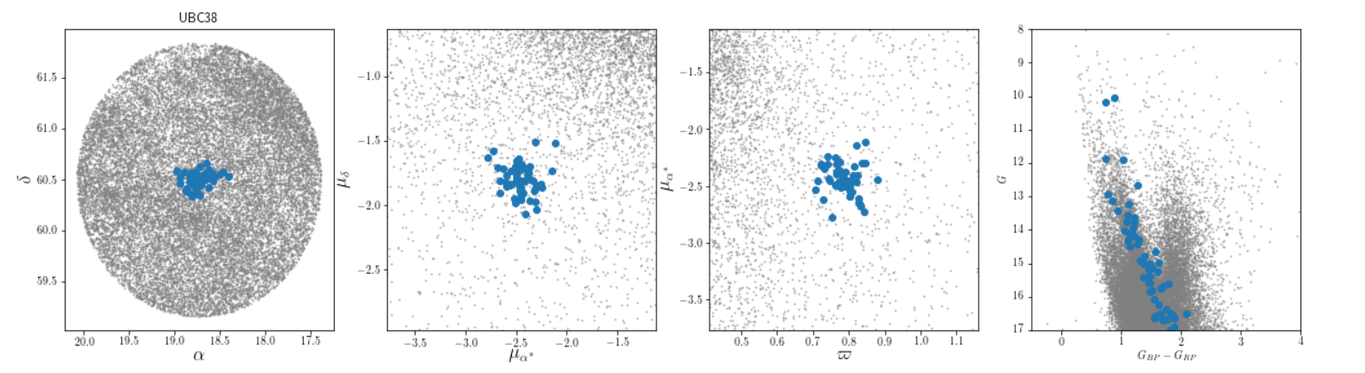
Pointing Strategy for WEAVE
  Each pointing is mastered by only one survey (with some exceptions) → high completeness
  Targets: high probability & low probability members
  Small compact (70 Ocs) +large diffuse Ocs (20 Ocs) → synergie with LR disk & HR disk WEAVE surveys
  Little information on binarity: at best two observations on short time scale (a few days)
Castro-Ginard 2019
From Star Clusters to Field, Firenze November 20-23, 2023
Notes:
High priority to
Ocs where large number of fibres (>500) are allocated on high p members
(apparent) groups of OCs (Several clusters in the same field of view)
Small compact Ocs( 10-100 fibres) are observed in shared pointings in LR disk:70 OCs
Large diffuse OCs (Hyades, Pleiades…) in shared pointings in HR disk: 20 OCs

Slide 14
WEAVE Targets
  Large nearby clusters within 500 pc
  Clusters with halos, coronae, tidal streams (within 2 degrees)
  Apparent groups of clusters
  Large regions with recent star formation
From Star Clusters to Field, Firenze November 20-23, 2023
Notes:
High priority to
Ocs where large number of fibres (>500) are allocated on high p members
(apparent) groups of OCs (Several clusters in the same field of view)
Small compact Ocs( 10-100 fibres) are observed in shared pointings in LR disk:70 OCs
Large diffuse OCs (Hyades, Pleiades…) in shared pointings in HR disk: 20 OCs

Slide 15
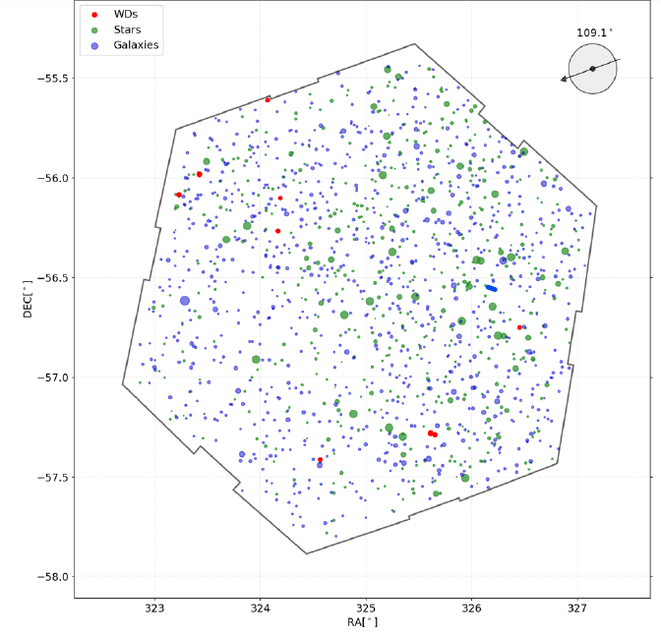
Pointing Strategy for 4MOST
  4MOST: Sharing the focal plane on almost continuous footprint
  Target selection and observational requirements by any survey impacts all other surveys (Guiglion+2019)
  OC survey is a community survey
From Star Clusters to Field, Firenze November 20-23, 2023
Notes:
allow for “smaller" (still ~100k targets!) surveys
Close coordination between different programmes
Target selection and observational requirements by any survey impacts all other surveys

Slide 16
Pointing Strategy for 4MOST
  4MOST: Sharing the focal plane on almost continuous footprint
  Each pointing combines multiple science cases to increase efficiency of the instrument and allow for “smaller" (still ~100k targets!) surveys
  This requires close coordination between different programmes, because changing something in one Survey affects all overlapping Surveys
  Target selection and observational requirements
  by any survey impacts all other surveys
  Community Surveys as Cluster Survey are guest:
  exposure time/ tiles of the Consortium surveys
  Each survey can decide:
    Target selection algorithm
    Spectral success criteria (e.g. s/n)
    Required completeness
    Any repeats and cadence (on a best-efforts) basis)

Slide 17
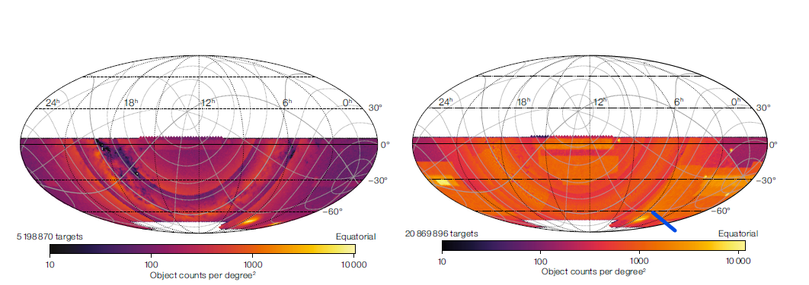
4MOST footprint
HR
LR
  4MOST
  10 Science programs + 15 Community Surveys
  21,000 sq degrees
From Star Clusters to Field, Firenze November 20-23, 2023

Slide 18
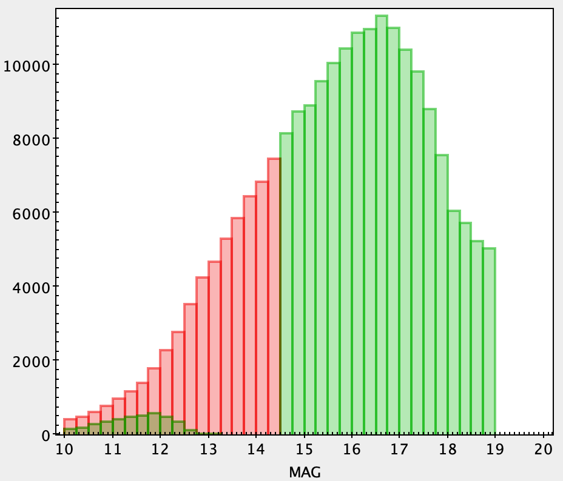
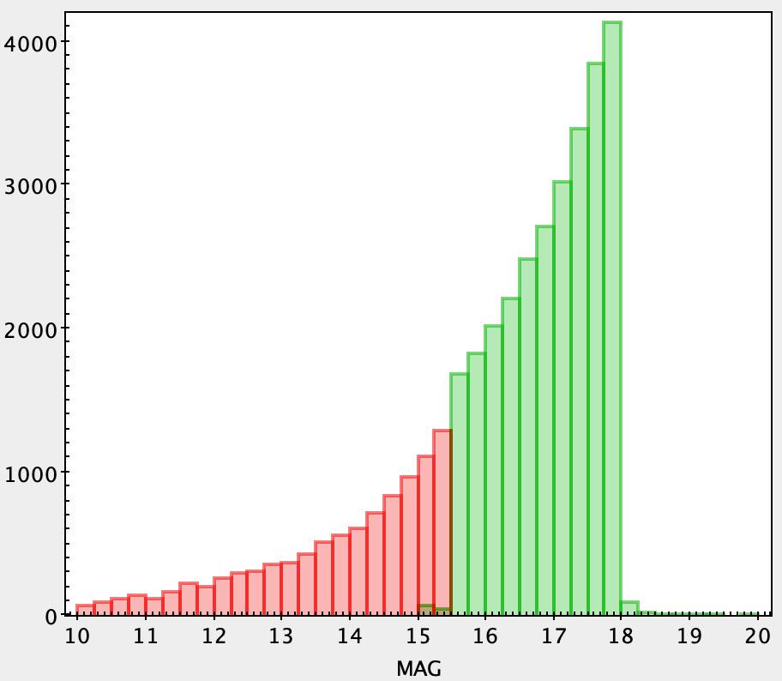
4MOST OC Survey
  OC survey (PI: Lucatello, Vallenari, Bragaglia) on disk footprint
  about 1800 open clusters and 80 SFR (and GCs) (Catalog Nov. 2023)
  >110,000 FGK stars
  Only known bona fide members are selected
  No repeated observations→ no binarity information
Very Young Clusters
HR
LR
Open Clusters
HR
LR
N input Catalog
Input catalogs → successfully observed
70,000 → 40,000 stars in HRS
180,000 → 74,000 stars in LRS
From Star Clusters to Field, Firenze November 20-23, 2023

Slide 19
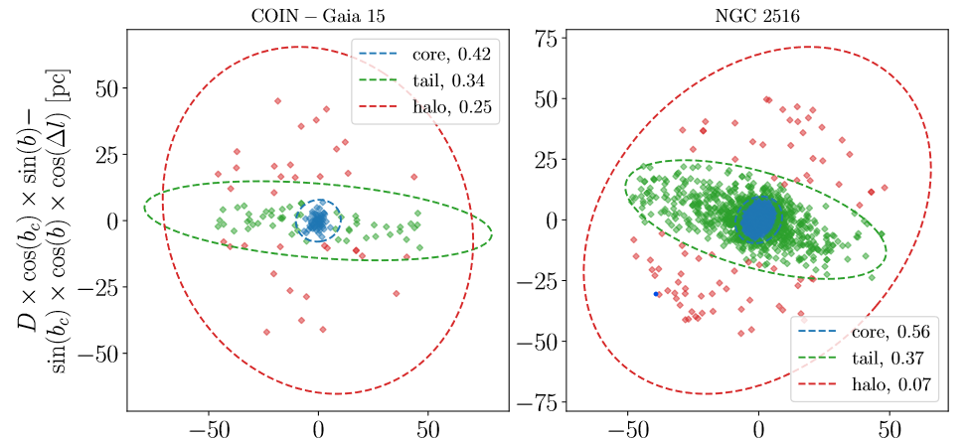
4MOST Input Catalog
  Input Catalog
    Cluster cores from Cantat et al 2020
    extended structures (Theia) from Kounkel &Covey 2019 (70,000 ☆)
    Extended tidal tails from Meingast+(2019,2021) , 10 Ocs
    about 200 Ocs with extended corona, of those 30 Ocs with tidal tails from Tarricq+2022 – Hunt+2023 (2000 ☆ in HR, 30,000 ☆ in LR)
Tarricq+ 2021
The axes are simply the projection of the
star’s position in the plane of the sky
From Star Clusters to Field

Slide 20
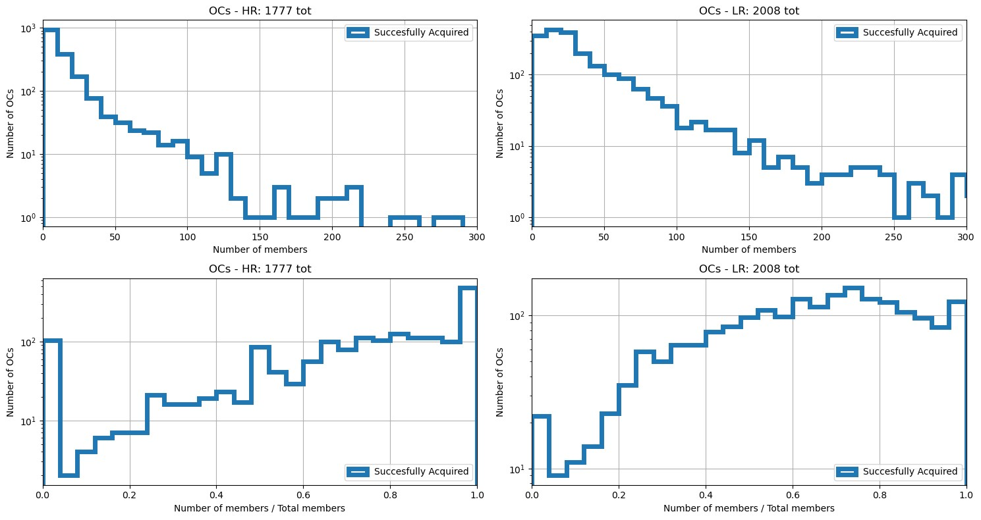
How many stars in how many clusters?
Observed members per OC
HR OCs
LR OCs
Completeness per OC
LR OCs
In HR: 48 Ocs with > 100 stars successfully observed
In LR : 166 Ocs with N > 100 observed stars
Total N stars expected successfully observed:
100,000 stars in OCs
14,000 stars in SFR
From Star Clusters to Field, Firenze November 20-23, 2023

Slide 21
Targets – old OC
NGC 2506 → All: 973 Observed 190 (20%) Not Observed (783, 80%)
HR (35 ☆)
LR (155 ☆)
for this OC, HR will be
extended to G=15.5
to cover MSTO
not observed
(783, 80%)
Note: based on old simulation (iwg2_20230108_zero3.2), not last one with up-to-date catalogue
From Star Clusters to Field, Firenze November 20-23, 2023

Slide 22
Distributed Targets
Can Maj OB1 → All: 682 Observed 417 (61%) Not Observed (265, 39%)
HR (238 ☆, 66%)
LR (179 ☆, 56%)
From Star Clusters to Field, Firenze November 20-23, 2023

Slide 23
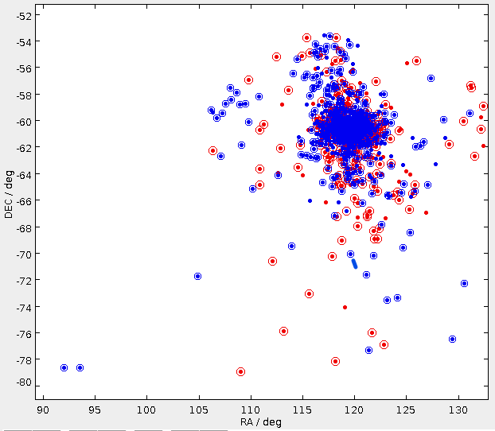
Tidal Tails
NGC 2516 Total 1286 ☆
HR (345 ☆, 63 %)
LR (485 ☆, 61%)
From Star Clusters to Field

Slide 24
Conclusions
  WEAVE OCs
    High completeness on a limited number of clusters:
      Internal kinematics
      Halos
      Tidal tails within 2 degrees
      Chemical tagging (similar selection function)
      Stellar evolution
      Small number of star forming regions
  4MOST OC:
    High number of observed clusters with limited completeness
      Less performant on internal kinematics, halos
      Tidal tails & distributed targets over many degrees in the sky
      Chemical tagging in synergy with the disk survey (different selection function)
      Good coverage of young star forming regions (80 in the South)
  WEAVE+4MOST synergy will change our view of open clusters
    Outer disk sampling (WEAVE)+ inner disk (4MOST)
    > 2000 Ocs/SFRs for the study of disk properties (chemical gradients, age distribution, mixing, spiral structure…)
    High legacy value complementing Gaia-ESO, Gaia, …
From Star Clusters to Field, Firenze November 20-23, 2023

Slide 25
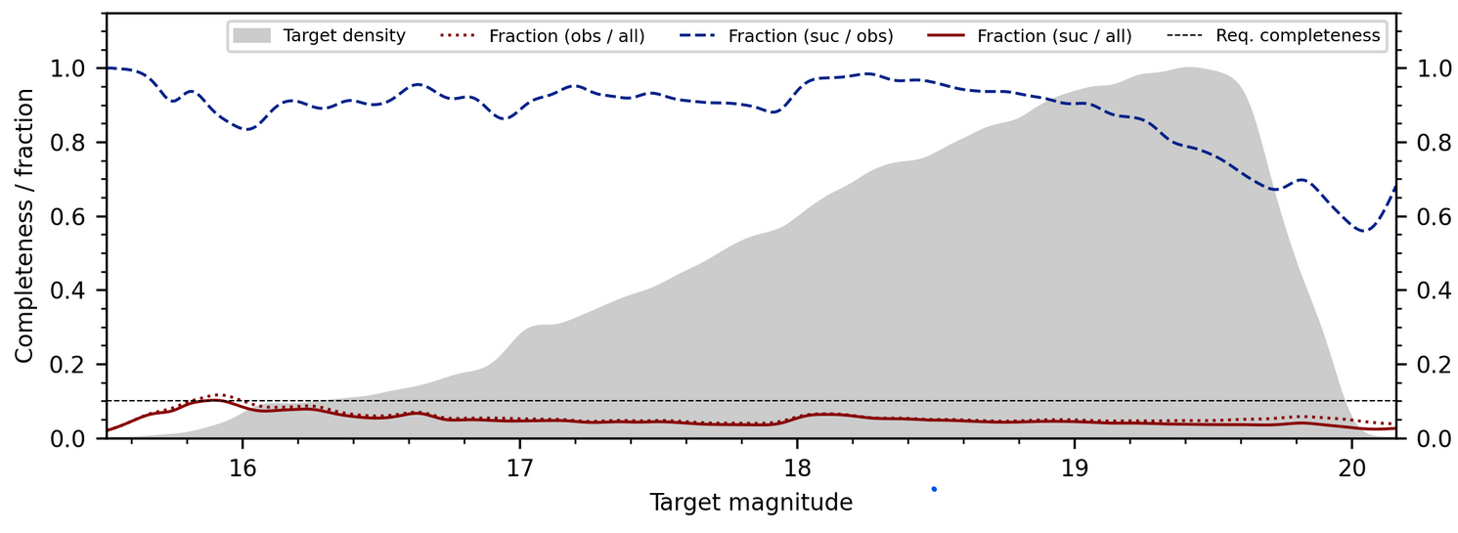
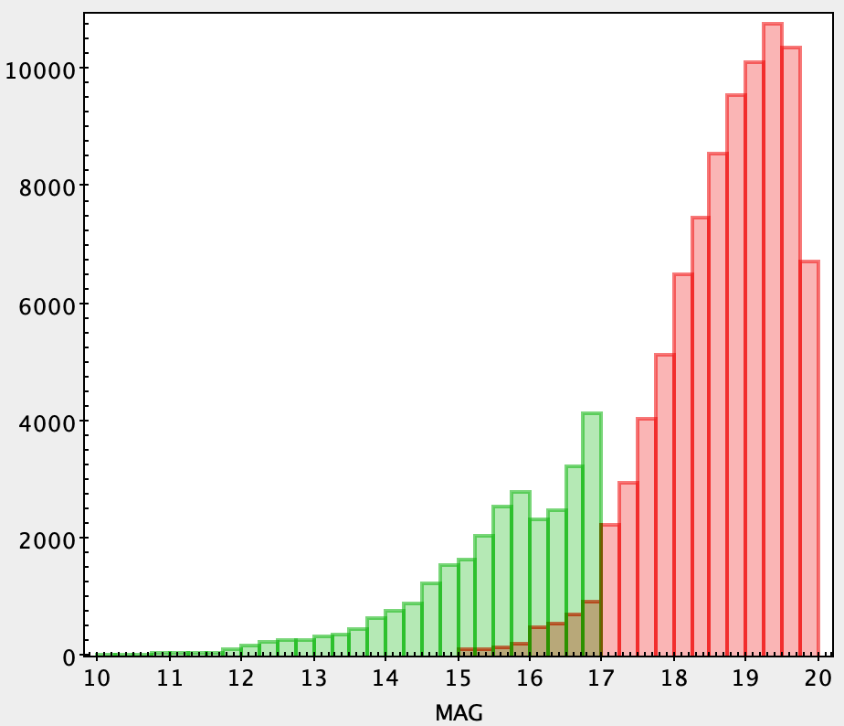
What about Globulars?
  4MOST: GC survey on halo footprint
  40,000 stars in 140 GCs
  Only stars outside the center
  Requested completeness 10%→ output 5%
  A few stars for chemical abundances
WEAVE HR: 16 GCs with 50-100 stars
LR : 27 GCs a few stars
4MOST GCs
HR
LR
4MOST GCs
LR Completeness
N input Catalog
Input catalogs → successfully observed
20,000 → 3,700 stars in HRS
270,000 → 35,000 stars in LRS

Slide 26
Targets - GC
NGC 104/47 Tuc → All: 13145 Observed 3196 (24%) Not Observed (9949, 76%)
not observed
(9949, 76%)
HR (336 ☆)
LR (2860 ☆)
Notes:
The main caveat is that the S7 survey request is too low by about 2Mfh due to an issue with the definition of their RULES. Consequently any quantitative outcomes from this simulation are not reliable. We do however think that there might be some qualitative information which can be gained, especially for surveys which have made significant changes since December.
"

Slide 27
What about Globulars?
  GC survey on halo footprint
  40,000 stars in 140 GCs (frozen Catalog on May 2023)
  Only stars outside the center
  Requested completeness 10%→ output 5%
  A few stars for chemical abundances
GCs
HR
LR
N input Catalog
Input catalogs → successfully observed
12,000 → 3,700 stars in HRS
270,000 → 35,000 stars in LRS

Slide 28
X-survey Calib
GC LR ferguson
Greg traven

Slide 29
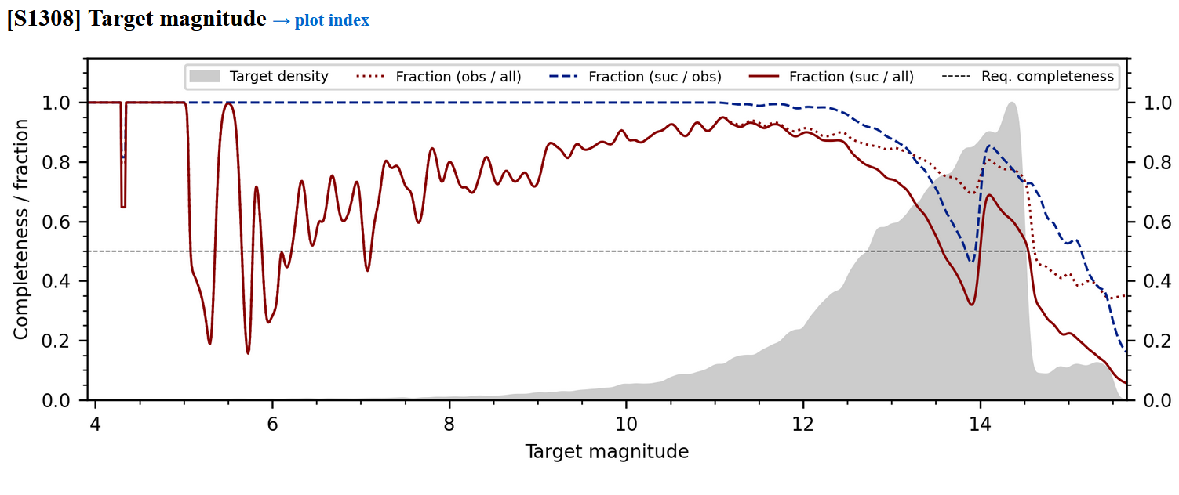
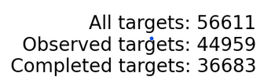
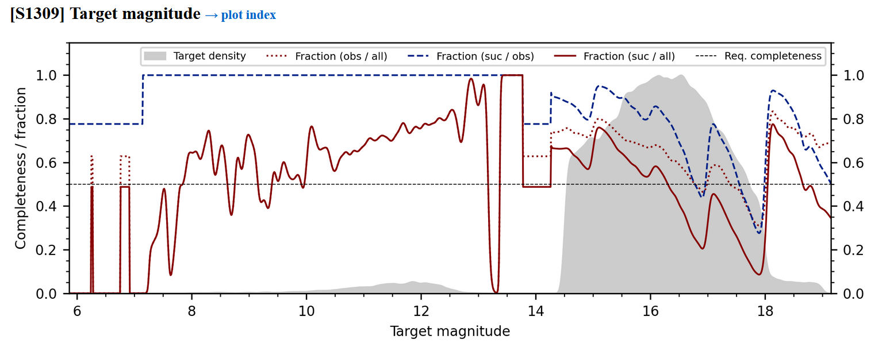
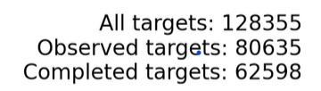
HR-OC
LR-OC

Slide 30
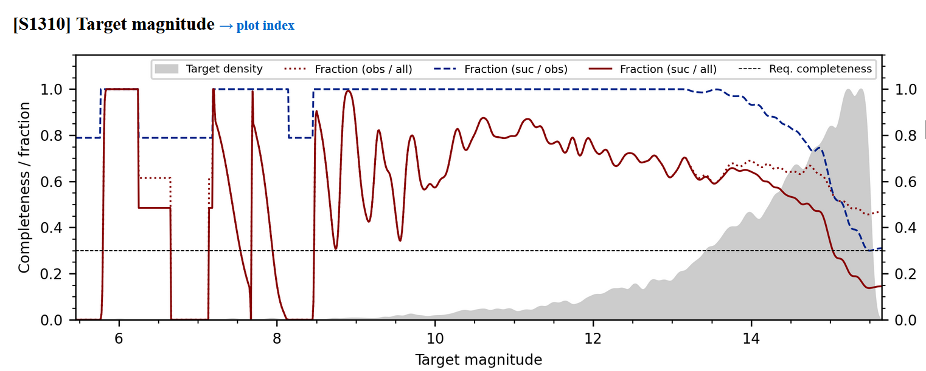

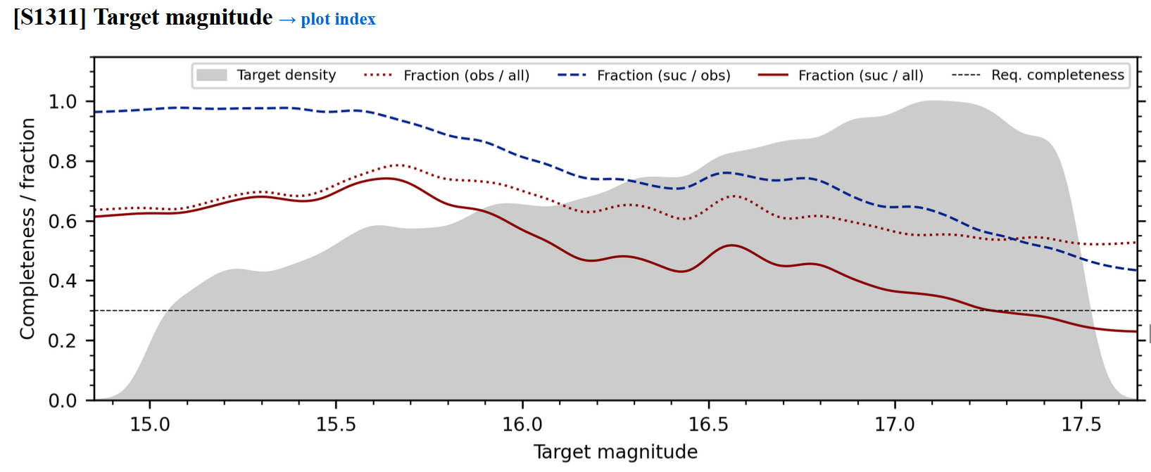

HR-YSO
LR-YSO

Slide 31
