Slide 1
Filamentary Relicts Of Star Formation Discovered By Gaia
Giacomo Beccari
Henri M.J. Boffin
Tereza Jerabkova
ESO
From star clusters to field populations: survived, destroyed and migrated clusters, Nov 20 – 23, 2023, Villa Galileo, Florence

Slide 2
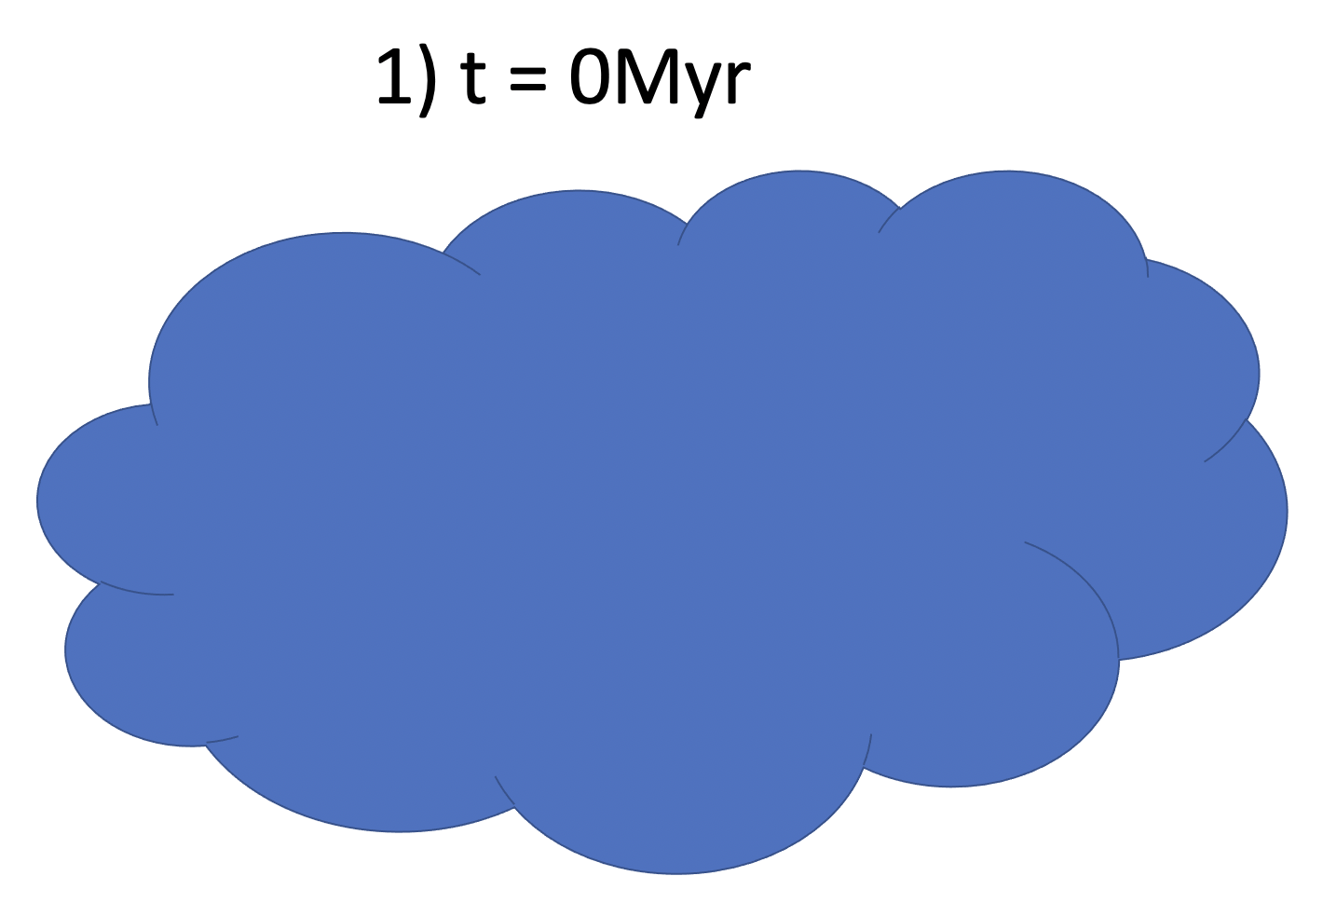
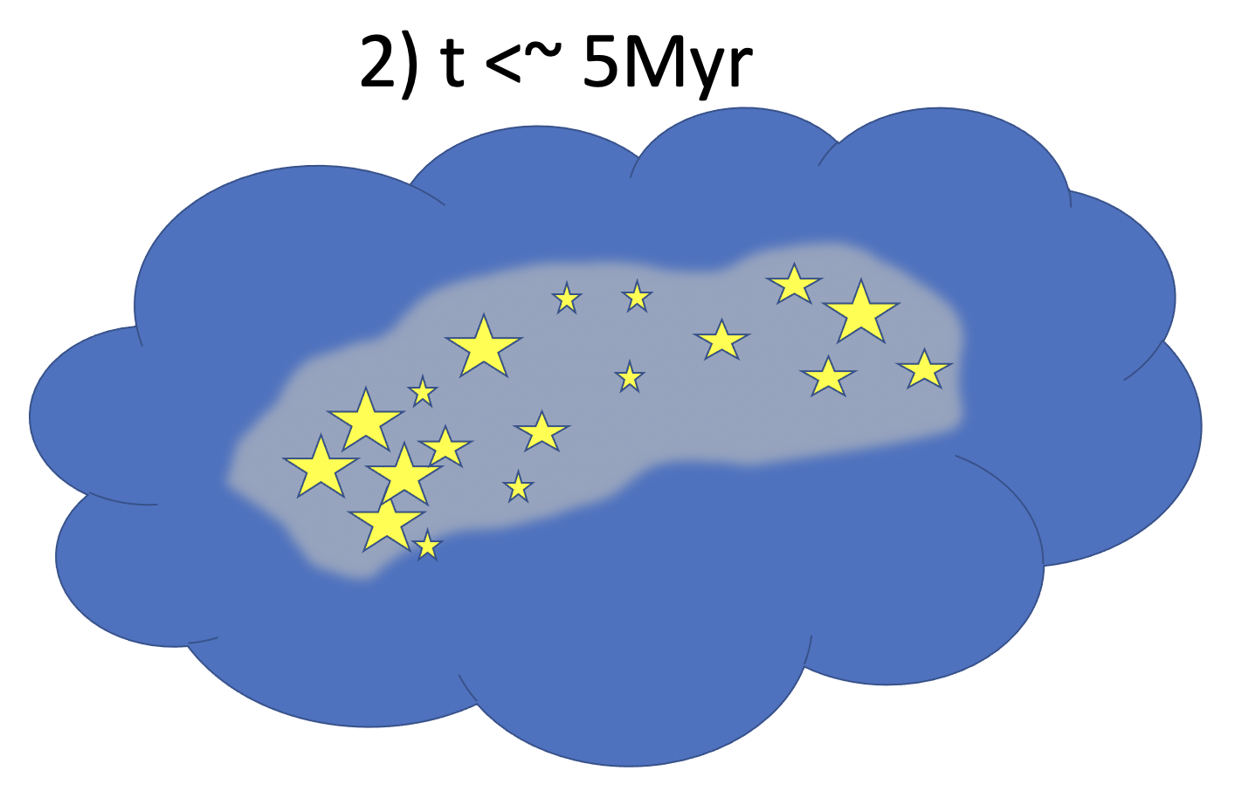
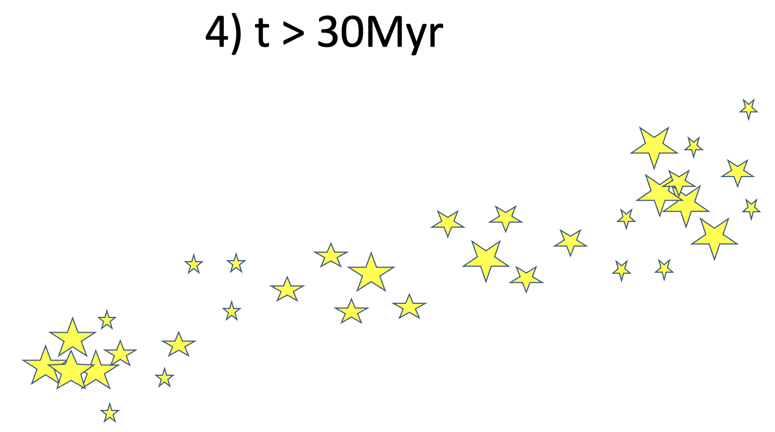
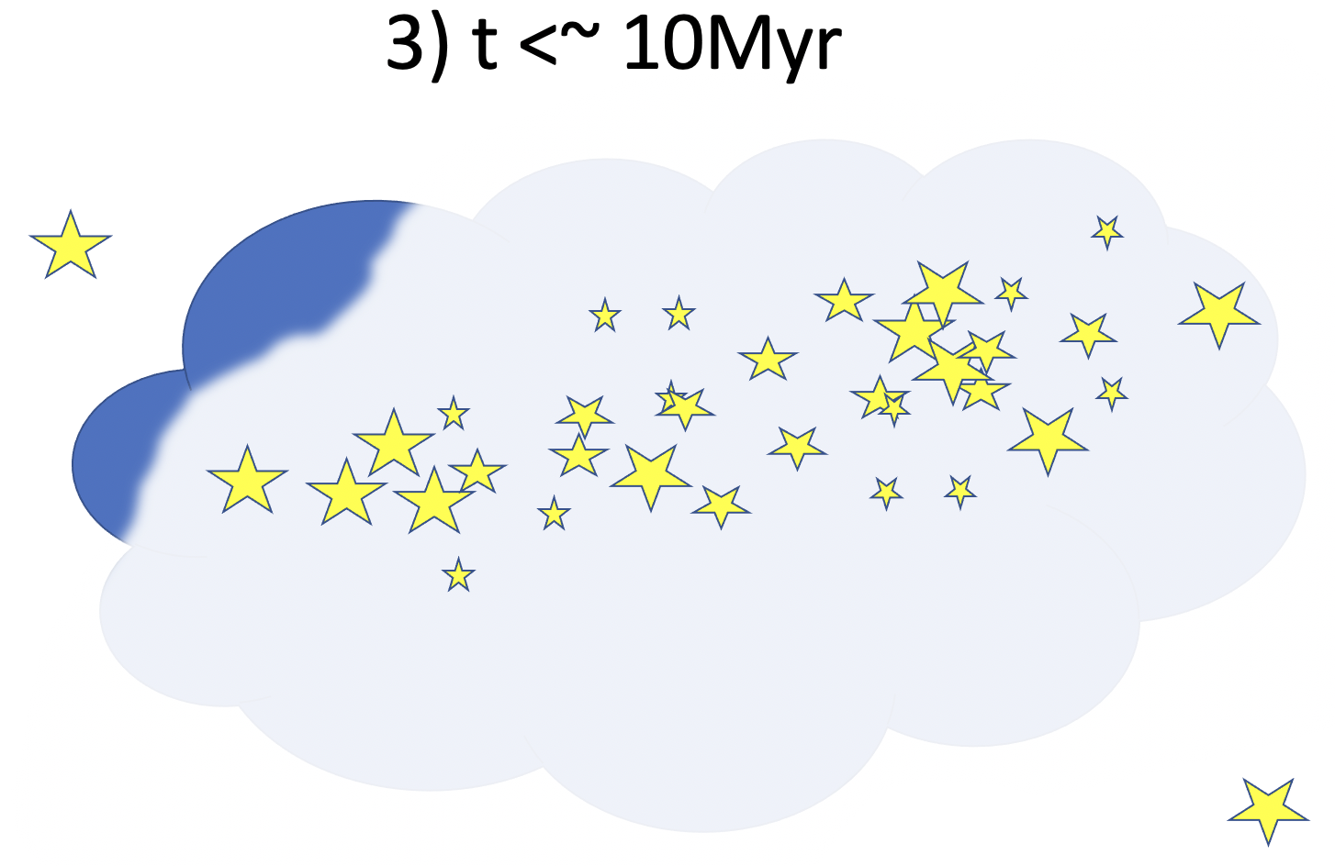
How/Why/When
stars and clusters form?

Slide 3
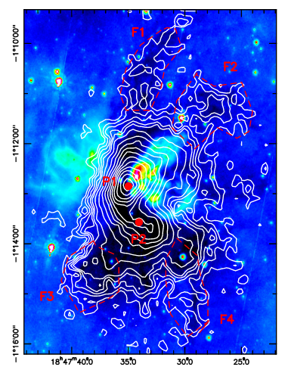
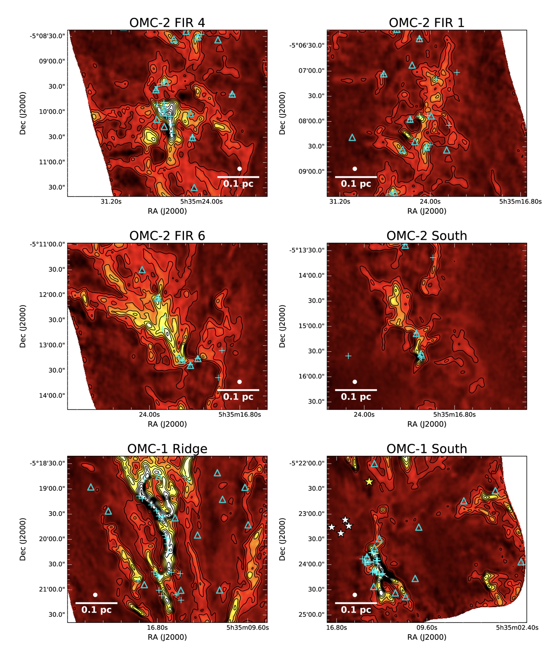
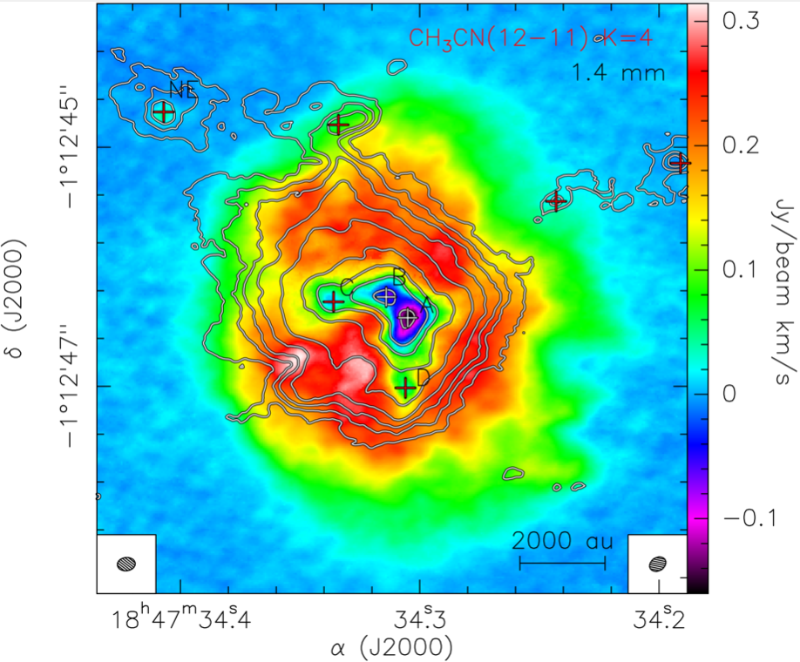
Early stages of star formation
Hacar+2018
G31.41+0.31 (G31) hot molecular core (HMC) is a high-mass protocluster
Beltran+2022

Slide 4
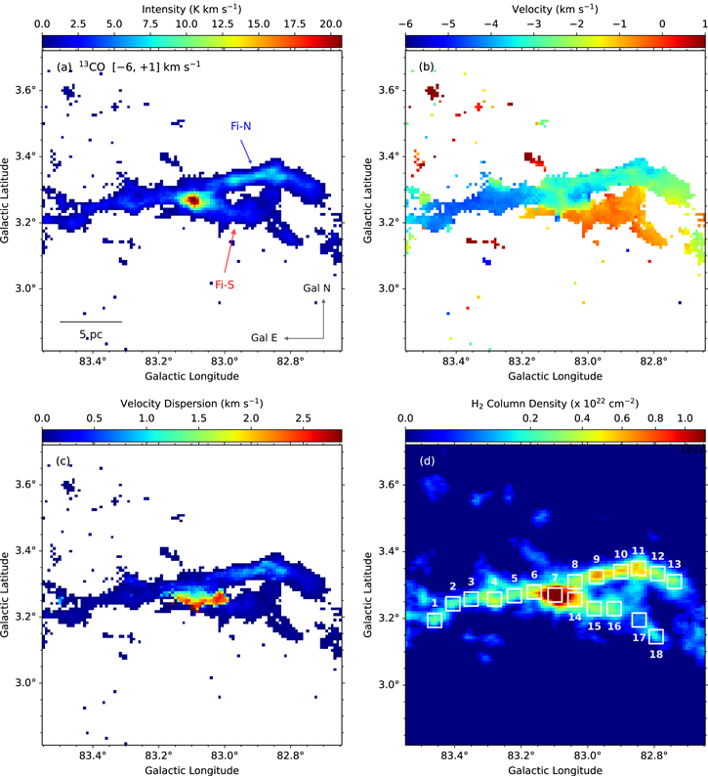
Early stages of star formation
Panja+23

Slide 5
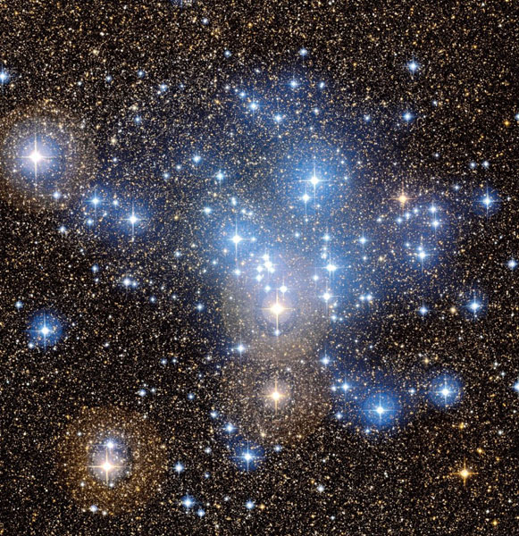
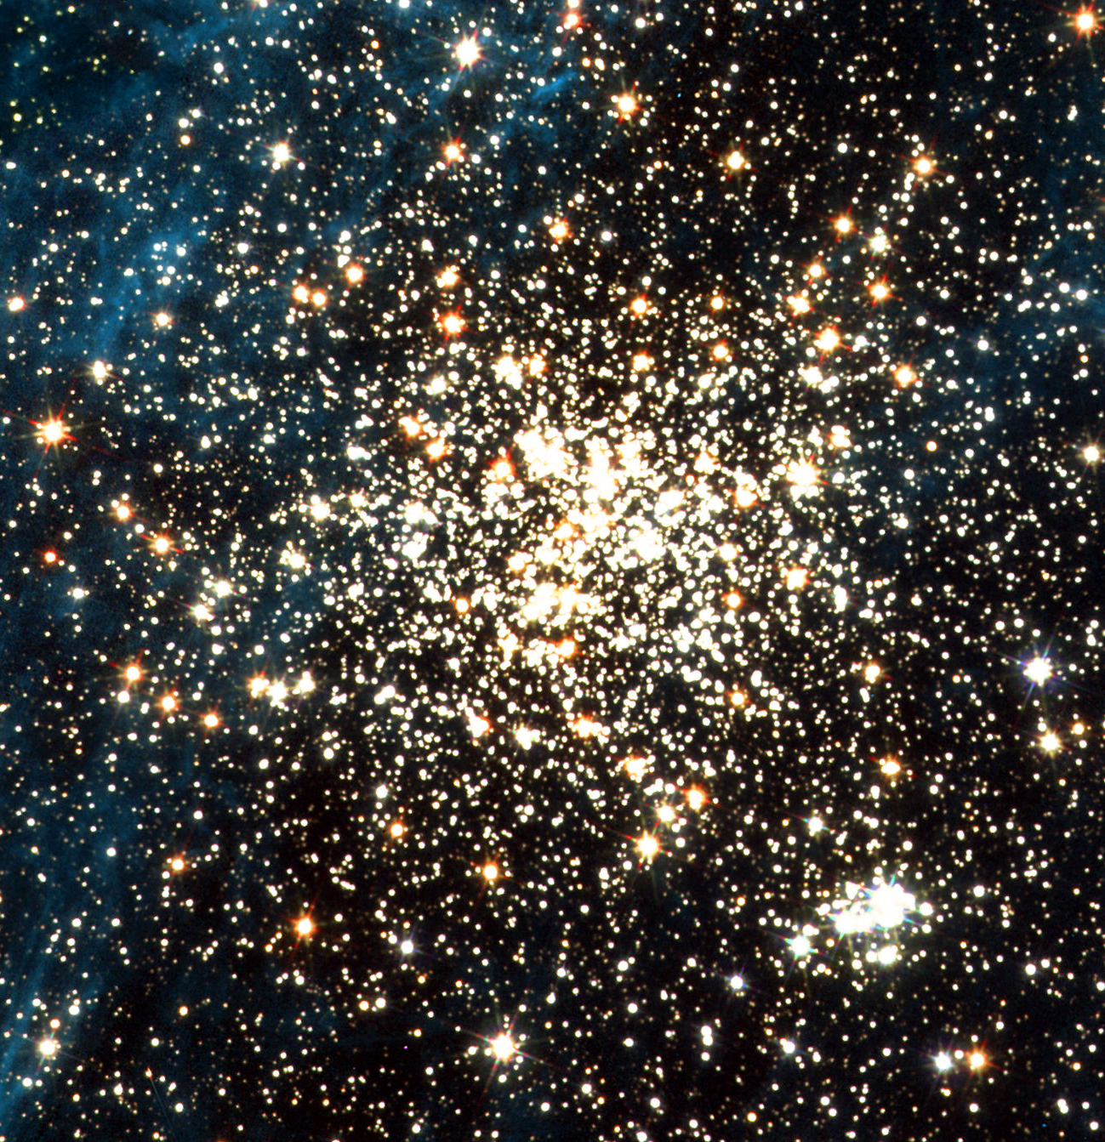
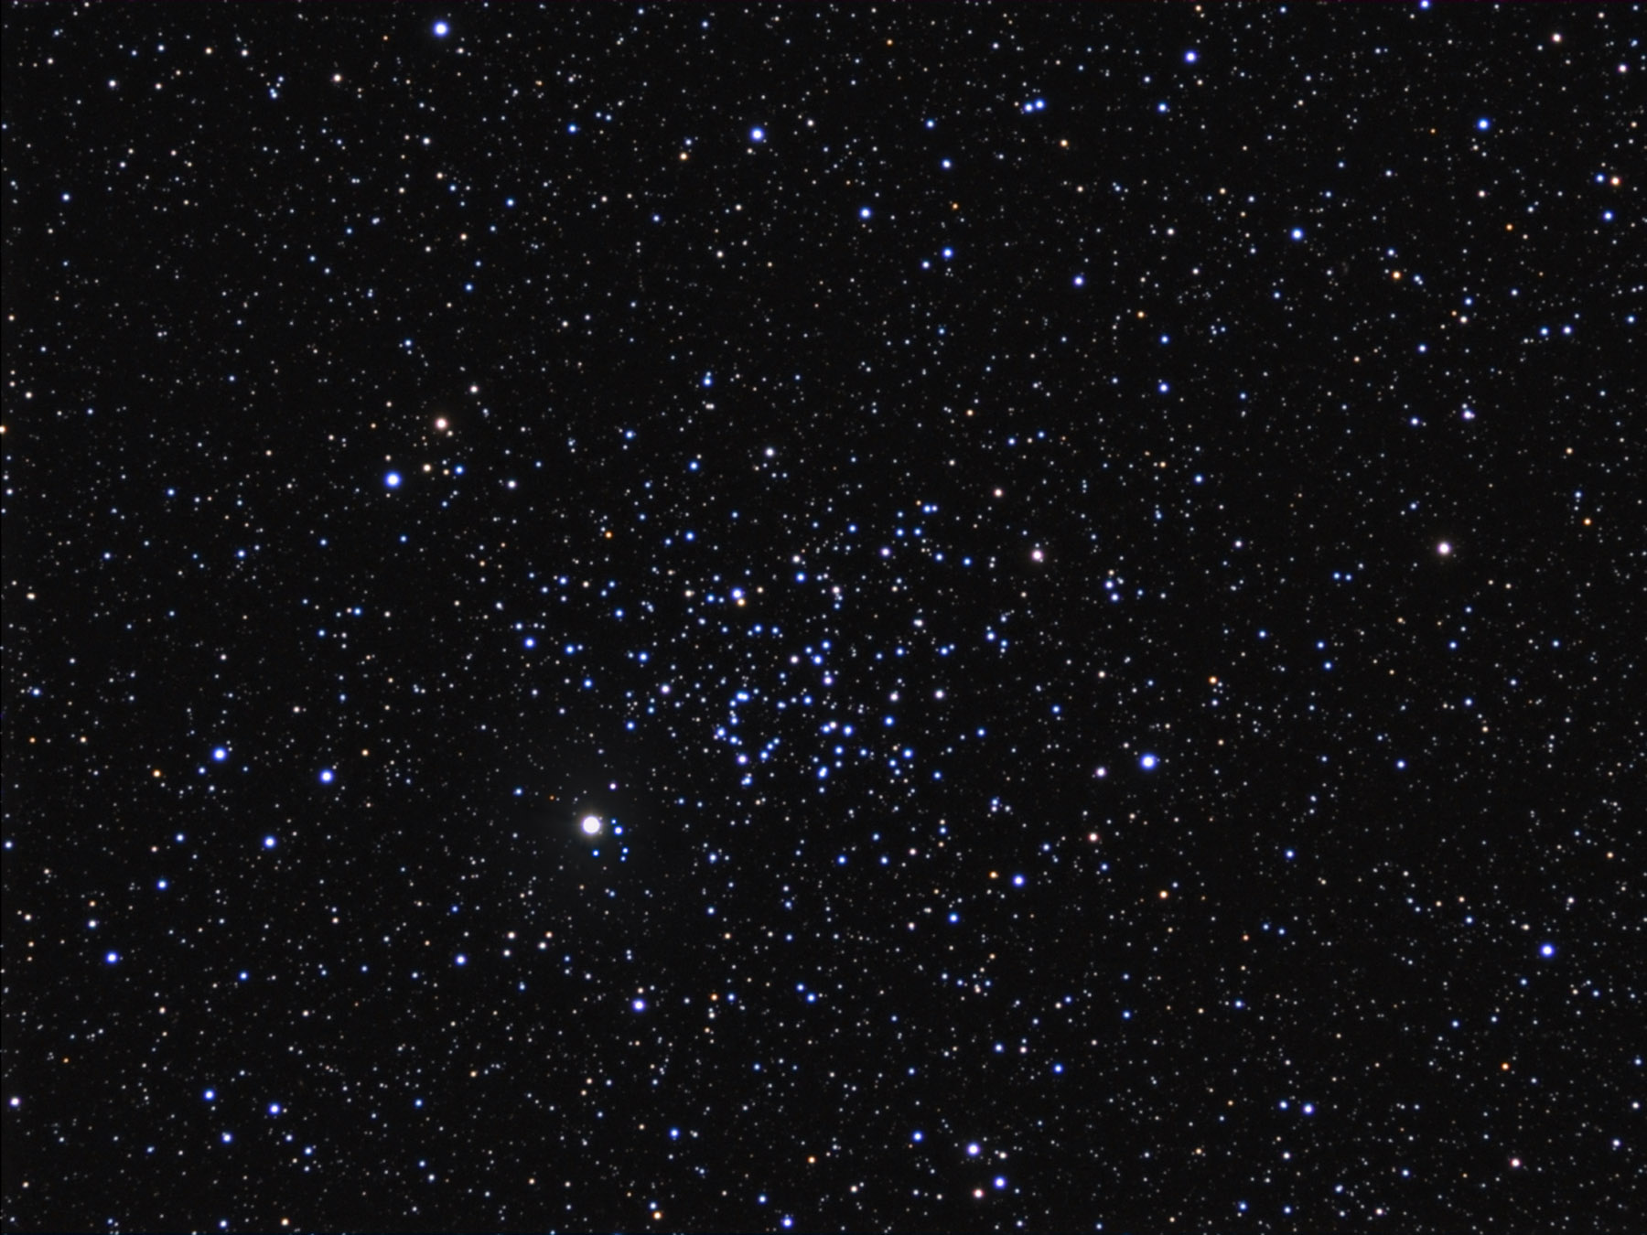
Clusters at >50Myr

Slide 6
Early stages (< 0-10Mrs)
Clusters at >50Myr
???
NGC 2539:property of Jim Thommes

Slide 7
Stellar system at 10 – 50 Myr?
Mostly dust free
Detectable in the optical
Extended over a wide field (>100 pc, i.e. many deg on sky)
Co-eval
Co-distant
Co-moving
Chemically homogeneous

Slide 8


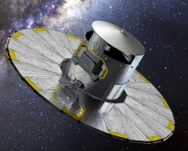






Stellar system at 10 – 50 Myr?
Mostly dust free
Detectable in the optical
Extended over a wide field (>100 pc, i.e. many deg on sky)
Co-eval
Co-distant
Co-moving
Chemically homogeneous

Slide 9
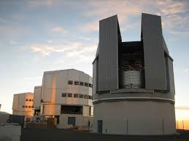
Accretion Discs in H⍺ with OmegaCam ADHOC survey
355hr@VST; PI Beccari: Gamma Vel, UpperSco, Ophiucus, Cha I, Orion, EtaCha, Haffner 18, Lupus...
Filters: u,g,r,i,z,H⍺
H⍺ excess emission as signature of ongoing accretion

Slide 10
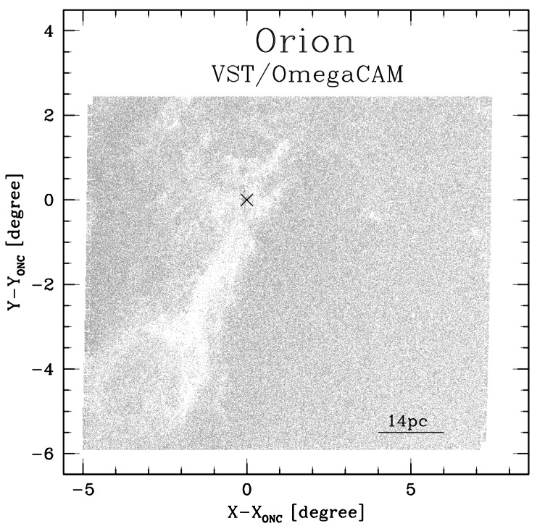
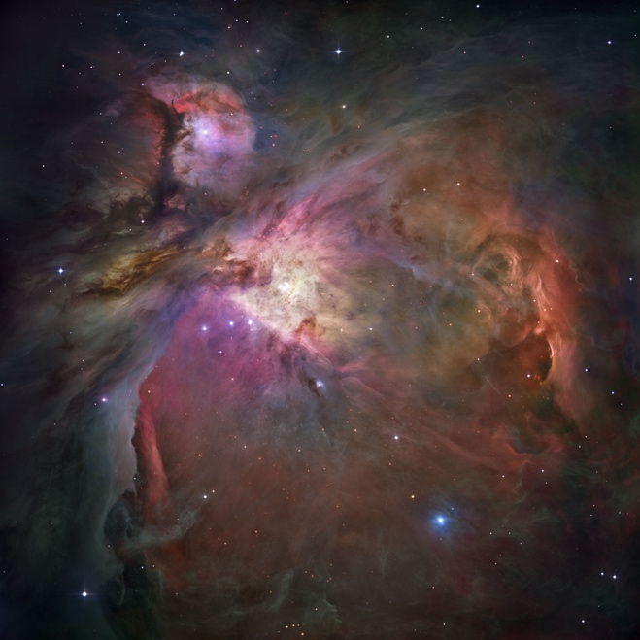
Beccari+ 17

Slide 11
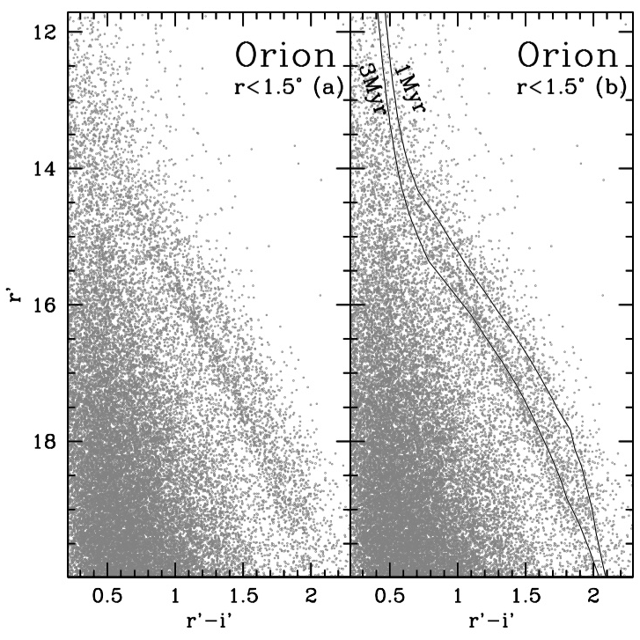
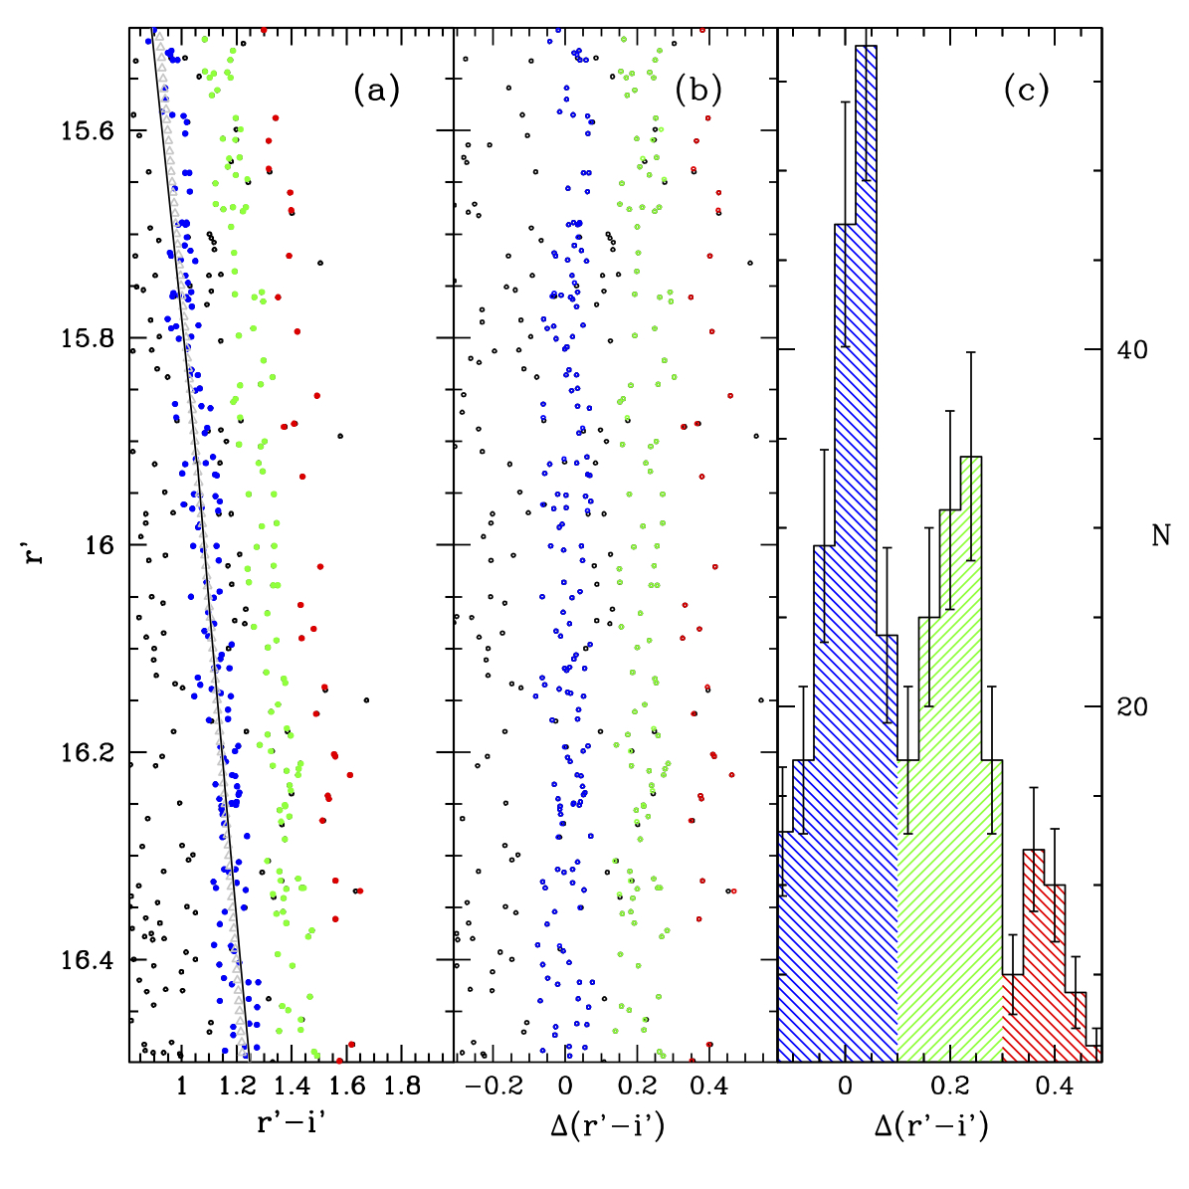
Multiple parallel and discrete Pre-Main Sequences!
Beccari+17

Slide 12
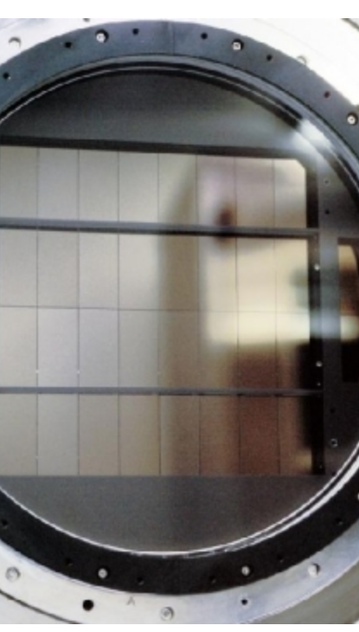

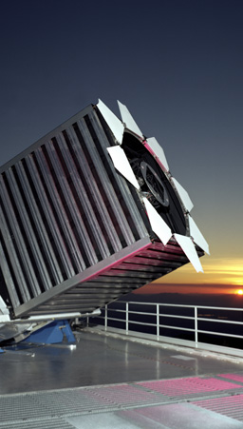
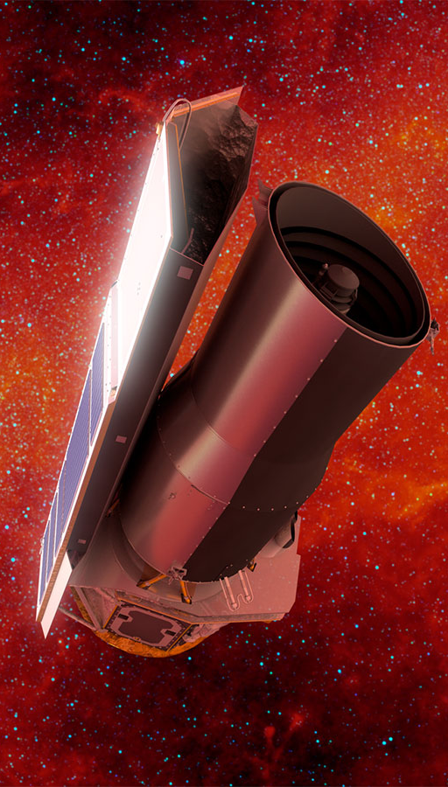
OmegaCAM+GaiaDR3+APOGEEDR17+SPITZER+DaRio16

Slide 13
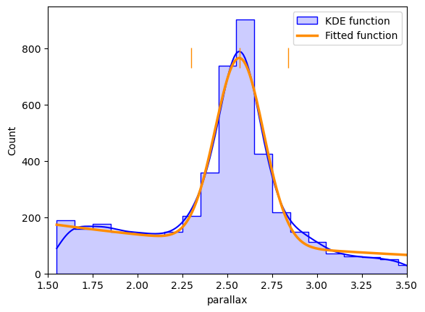
OmegaCAM+GaiaDR3+APOGEEDR17+SPITZER+DaRio16
1) Select by Parallax

Slide 14
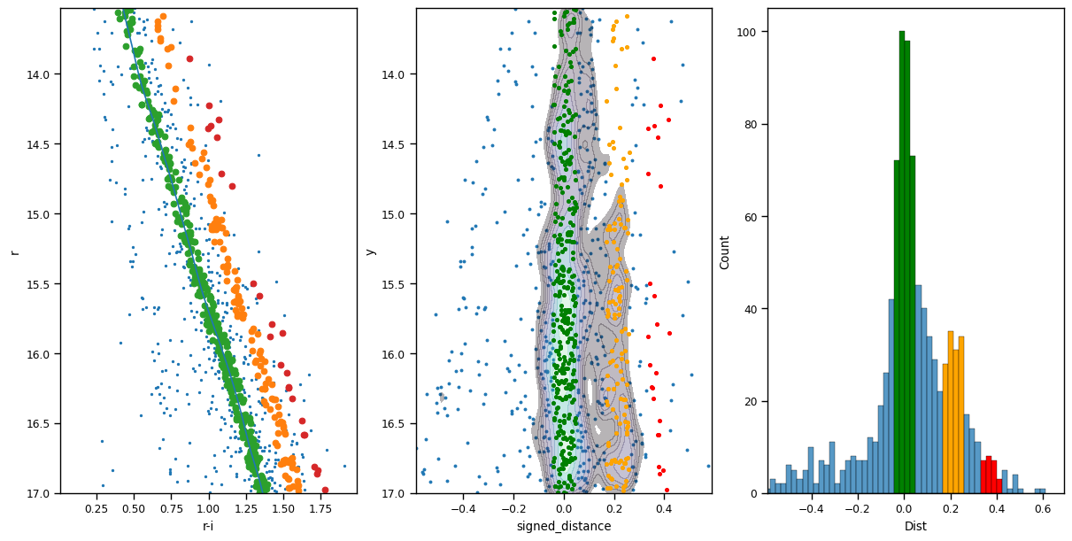
OmegaCAM+GaiaDR3+APOGEEDR17+SPITZER+DaRio16
2) Select on the CMD

Slide 15
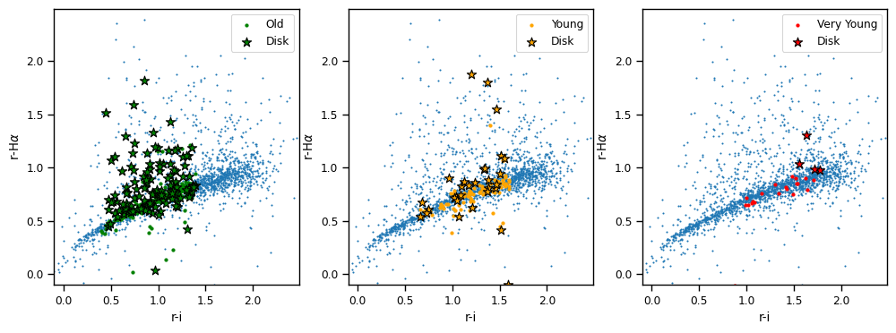
OmegaCAM+GaiaDR3+APOGEEDR17+SPITZER+DaRio16
3) Number of PMS stars with discs according to SPITZER
Fraction of discs:
Old pop (343): 36%
Young pop (128) : 23%
Very Young pop (25) : 16%

Slide 16
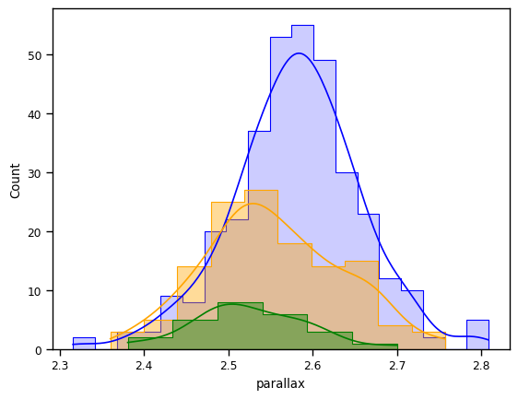
OmegaCAM+GaiaDR3+APOGEEDR17+SPITZER+DaRio16
3) Number of PMS stars with discs according to SPITZER
400 pc
385 pc
OLD
YOUNG
VERY YOUNG
[arcsec]

Slide 17
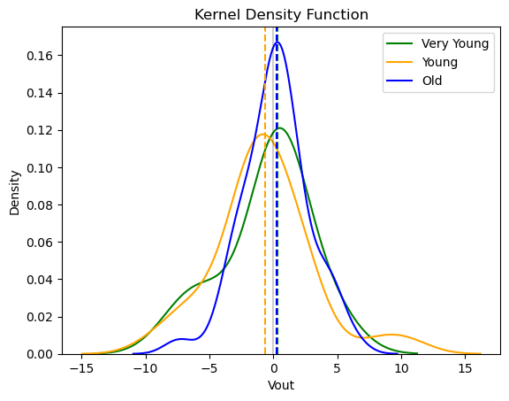
OmegaCAM+GaiaDR3+APOGEEDR17+SPITZER+DaRio16
3) Outward velocity
[km/s]

Slide 18
OmegaCAM+GaiaDR3+APOGEEDR17+SPITZER+DaRio16
3) Outward velocity
OLD pop: N. of stars 90 and Variance=6.6782
YOUNG pop: N. of stars 34 and Variance =14.4630
VERY YOUNG pop: N. of stars 9 and Variance =10.4537
[km/s]

Slide 19
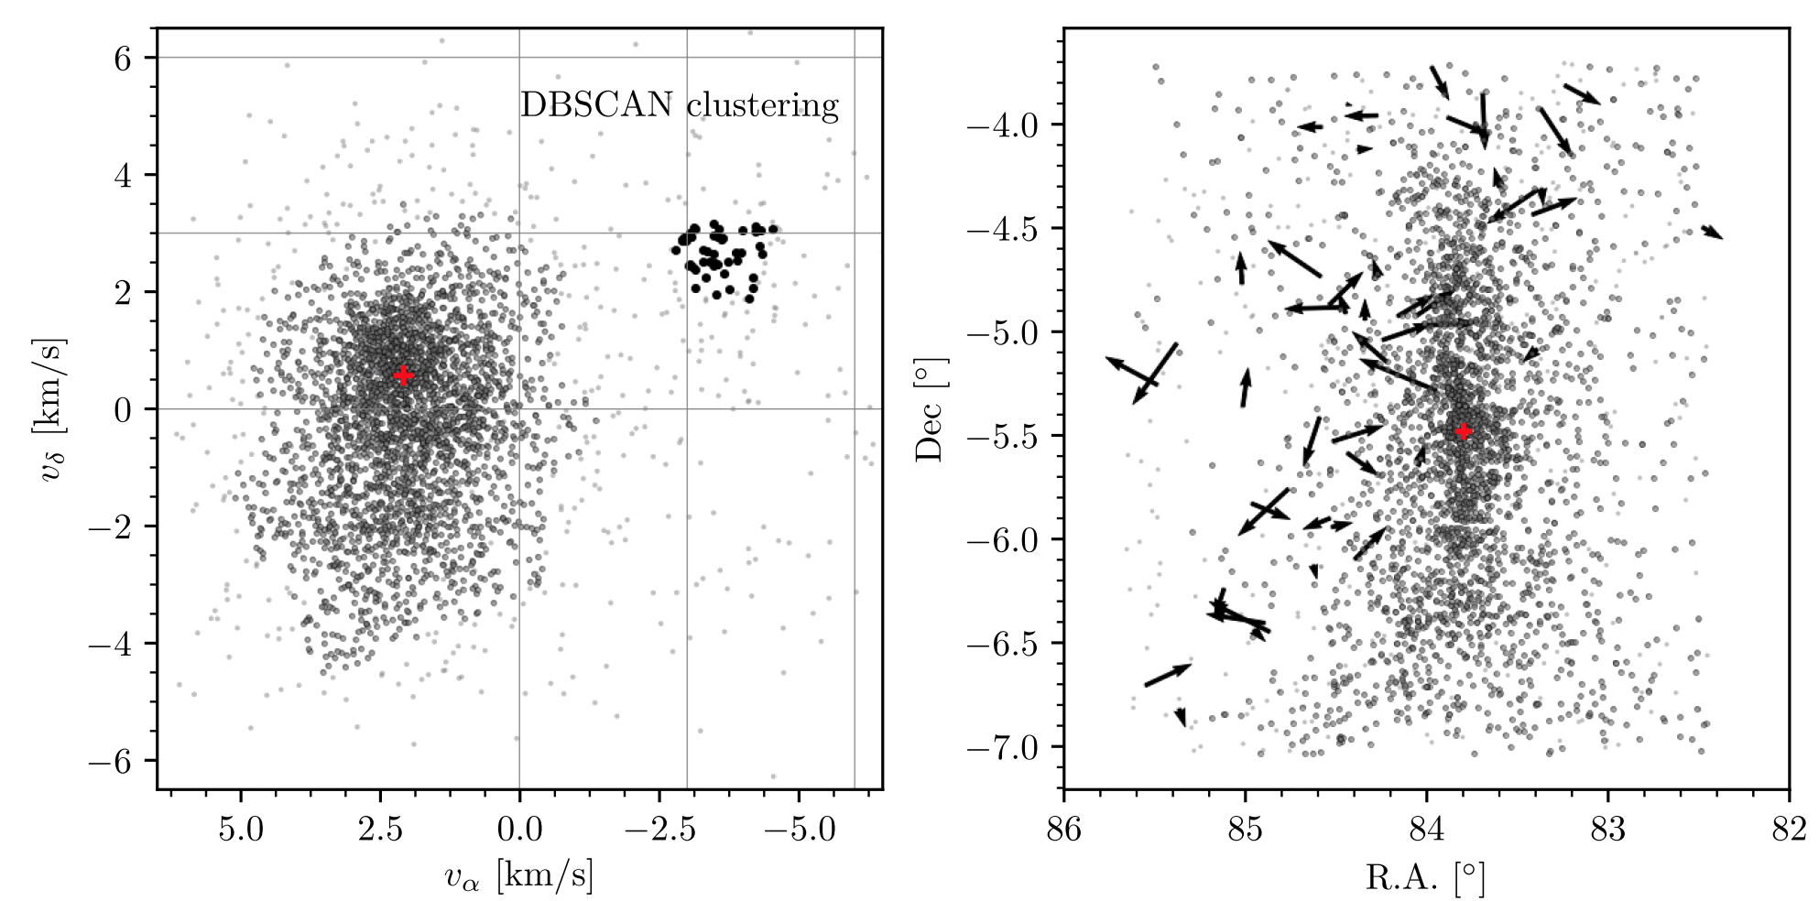
Serendipitous discovery
Jerabkova+19

Slide 20
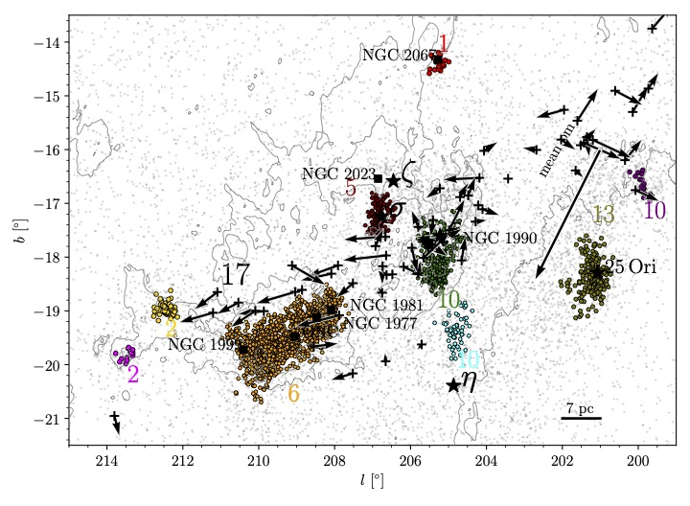
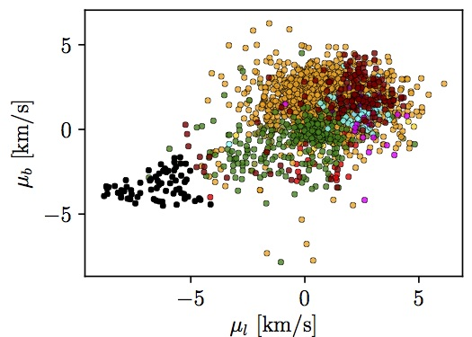
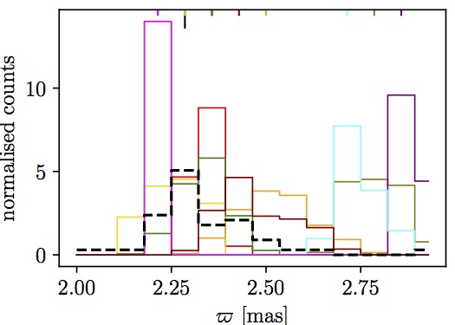
We extended the area to 15 x 15 deg² using Gaia DR2 data
and performed a clustering analysis with DBSCAN
Jerabkova+ 19

Slide 21
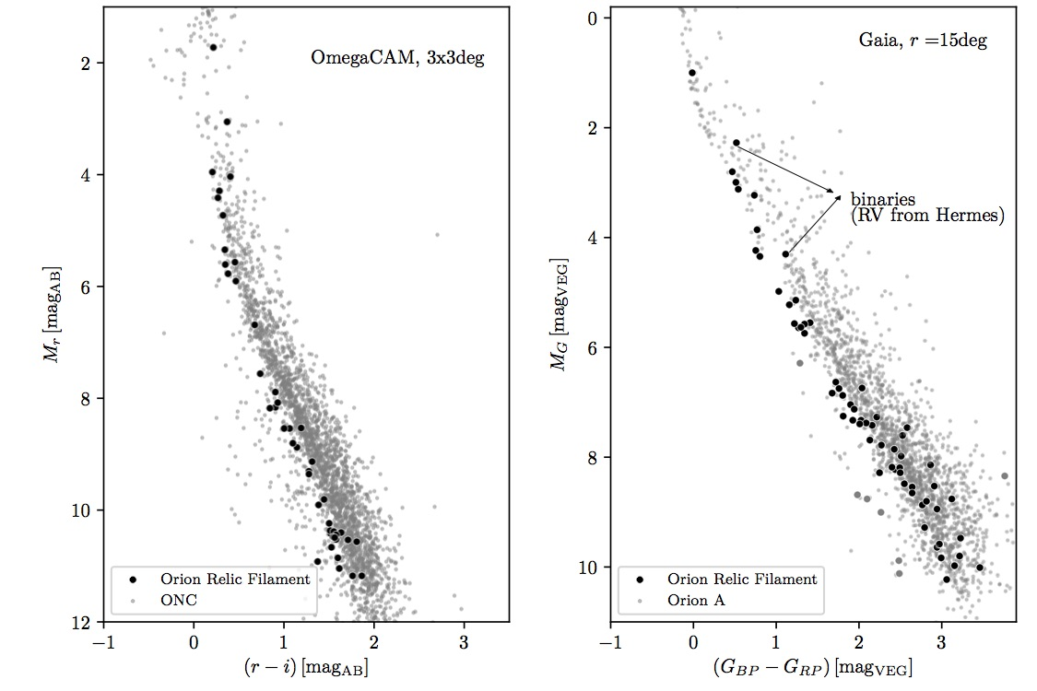
Serendipitous discovery
We discovered a relic filament over a region of ~90 pc
Older than Orion
15-20 Myr old
Jerabkova+19

Slide 22
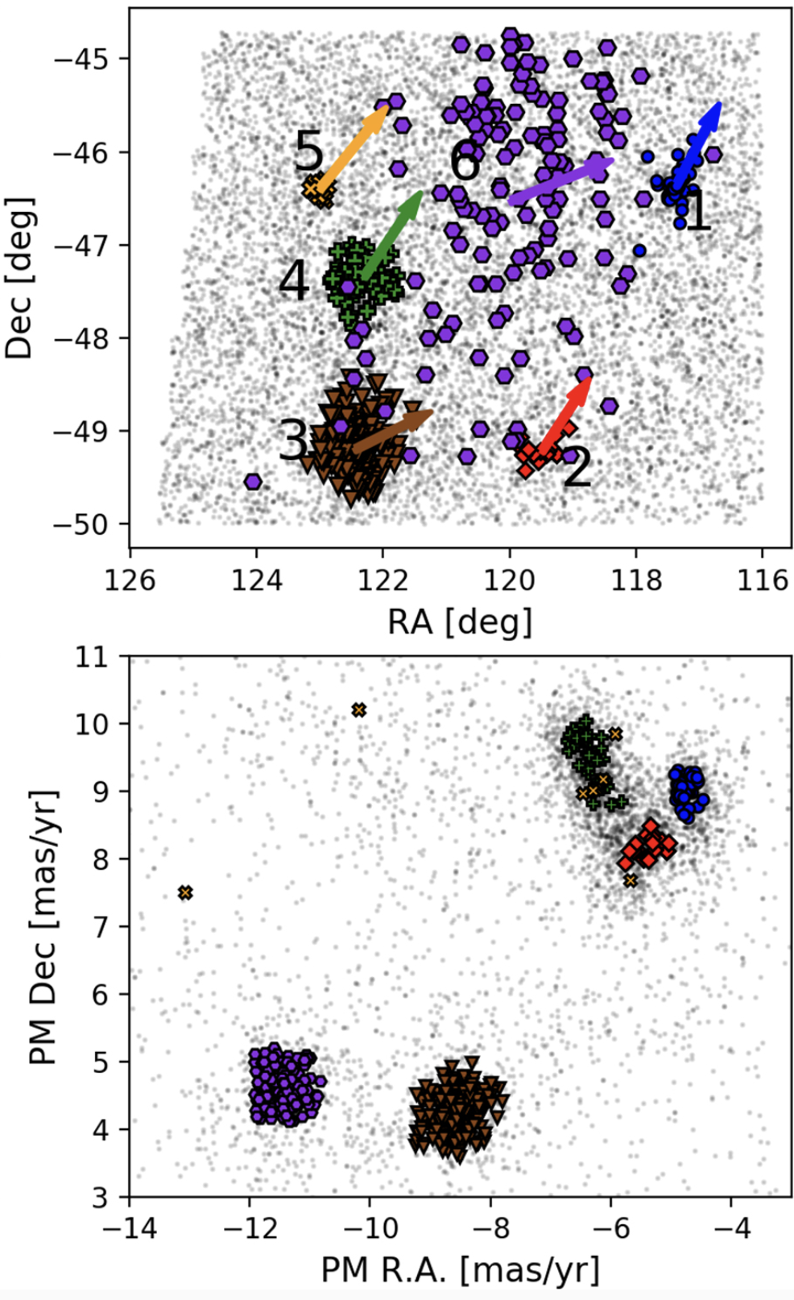
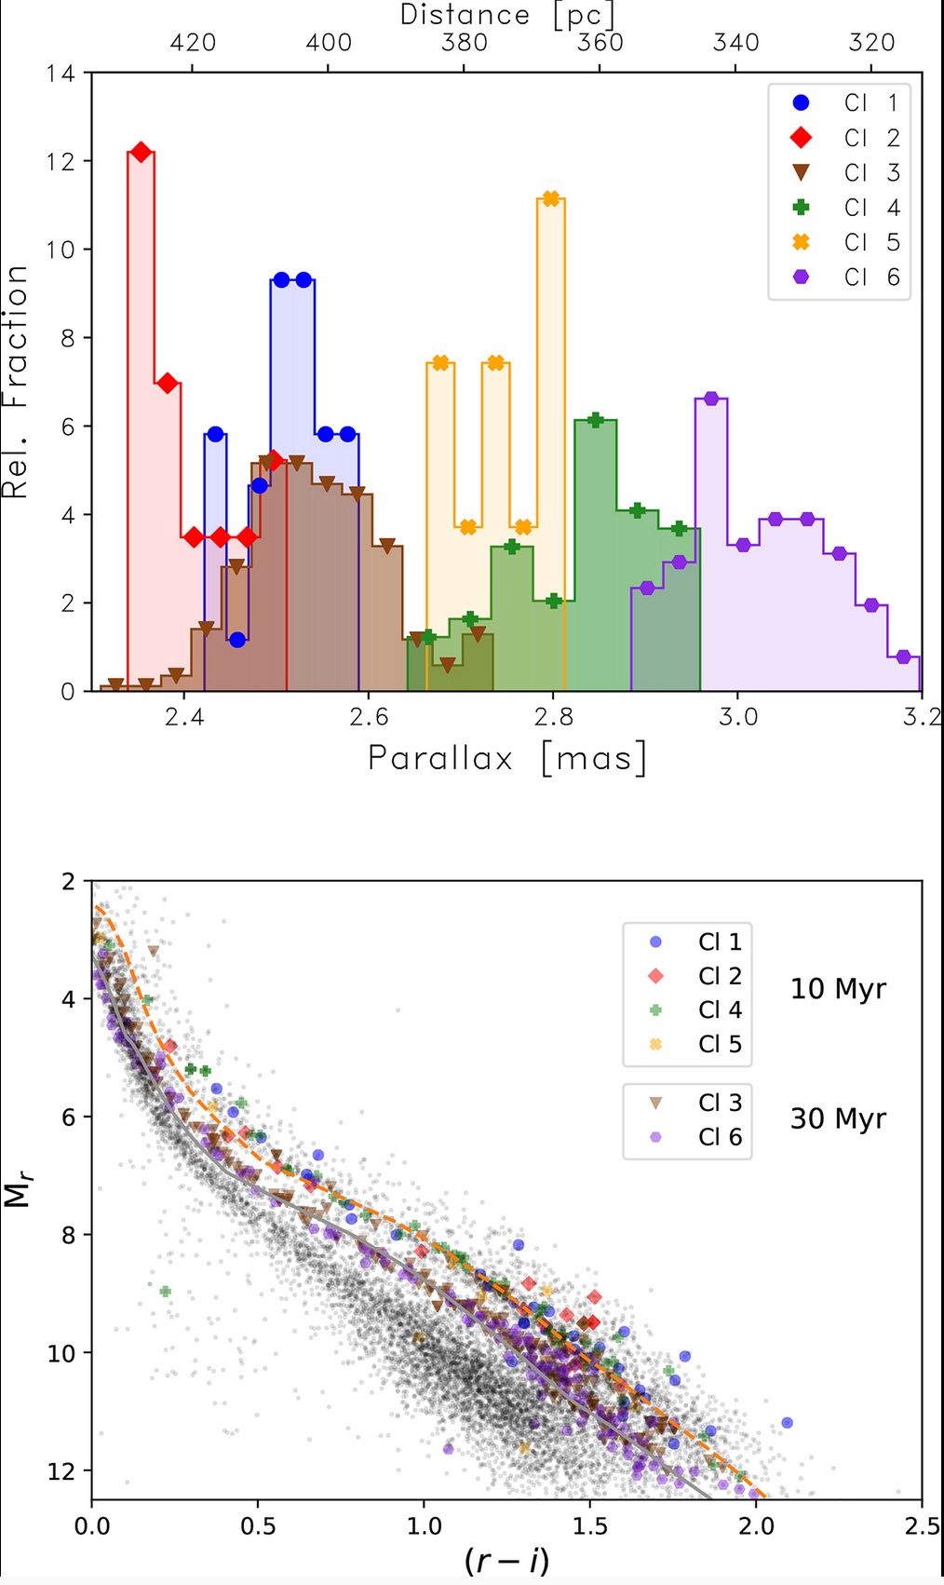
OmegaCam + Gaia: Unveiling Vela OB2
distance
10×5deg region
age
kinematics
Beccari+18

Slide 23
OmegaCam + Gaia: Unveiling Vela OB2

Slide 24
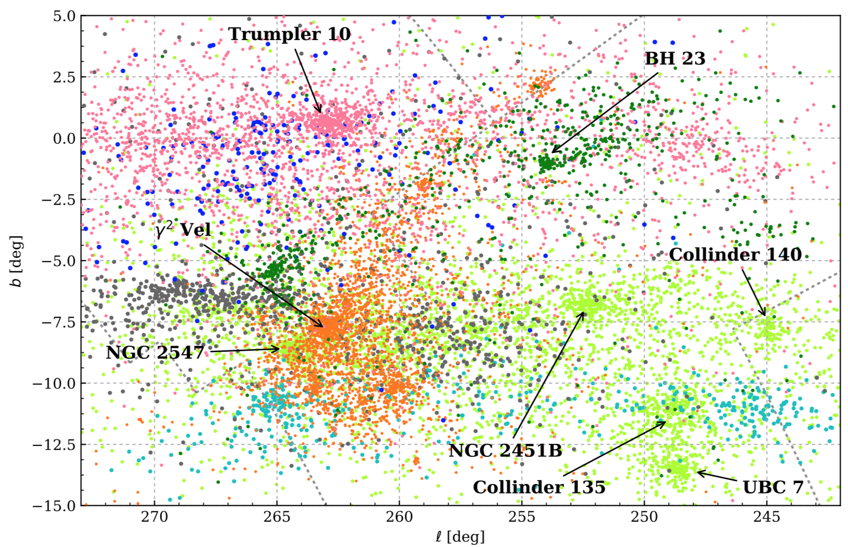
OmegaCam + Gaia: Unveiling Vela OB2
T. Cantat-Gaudin+19

Slide 25
OmegaCam + Gaia: Unveiling Vela OB2
T. Cantat-Gaudin+19
3D structure and kinematics of a
constellation of young clusters

Slide 26
OmegaCam + Gaia: Unveiling Vela OB2

Slide 27
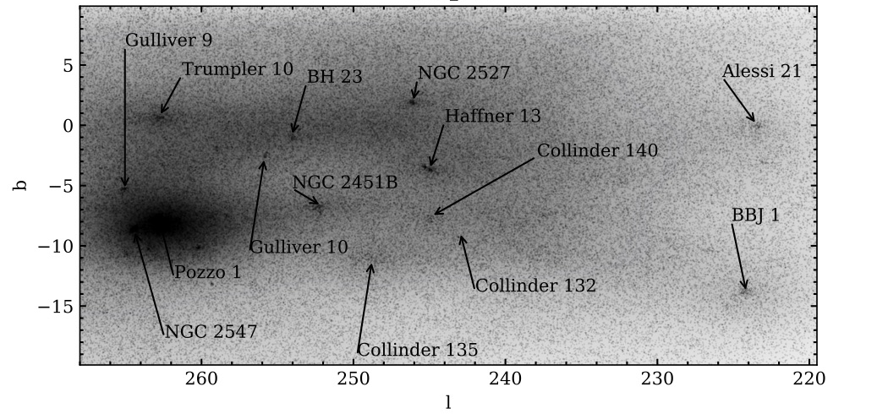
OmegaCam + Gaia: Unveiling Vela OB2
Beccari+20

Slide 28
OmegaCam + Gaia: Unveiling Vela OB2
Beccari+20

Slide 29
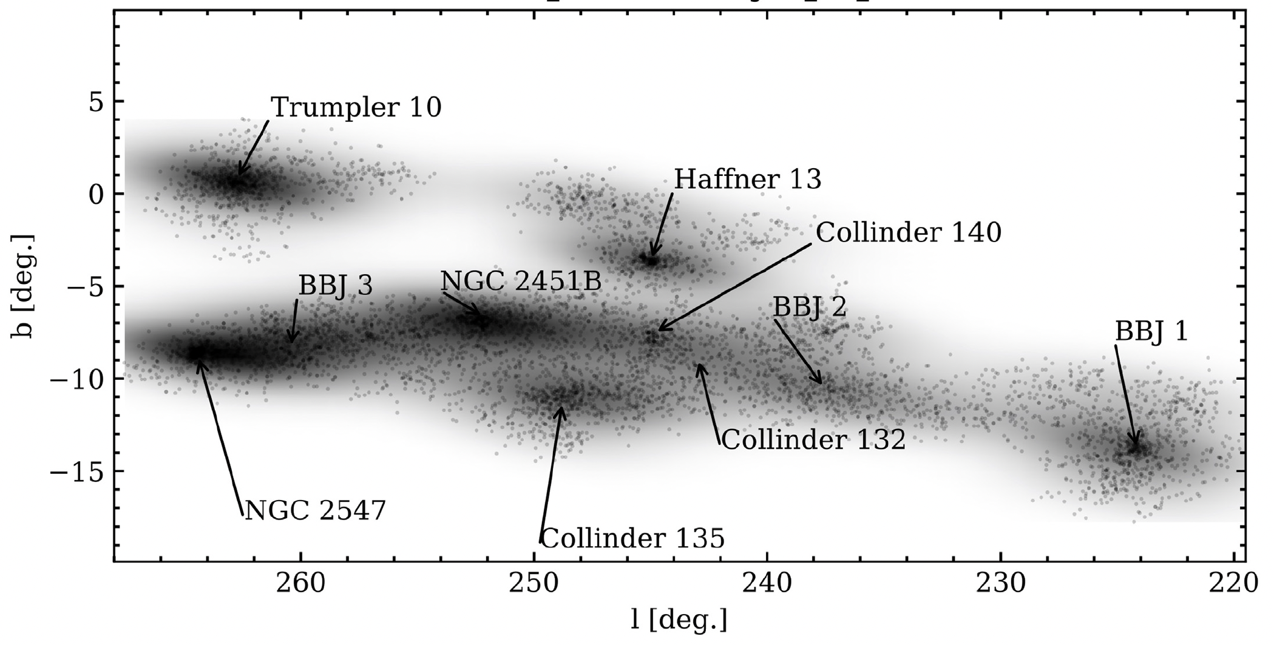
OmegaCam + Gaia: Unveiling Vela OB2
Beccari+20

Slide 30
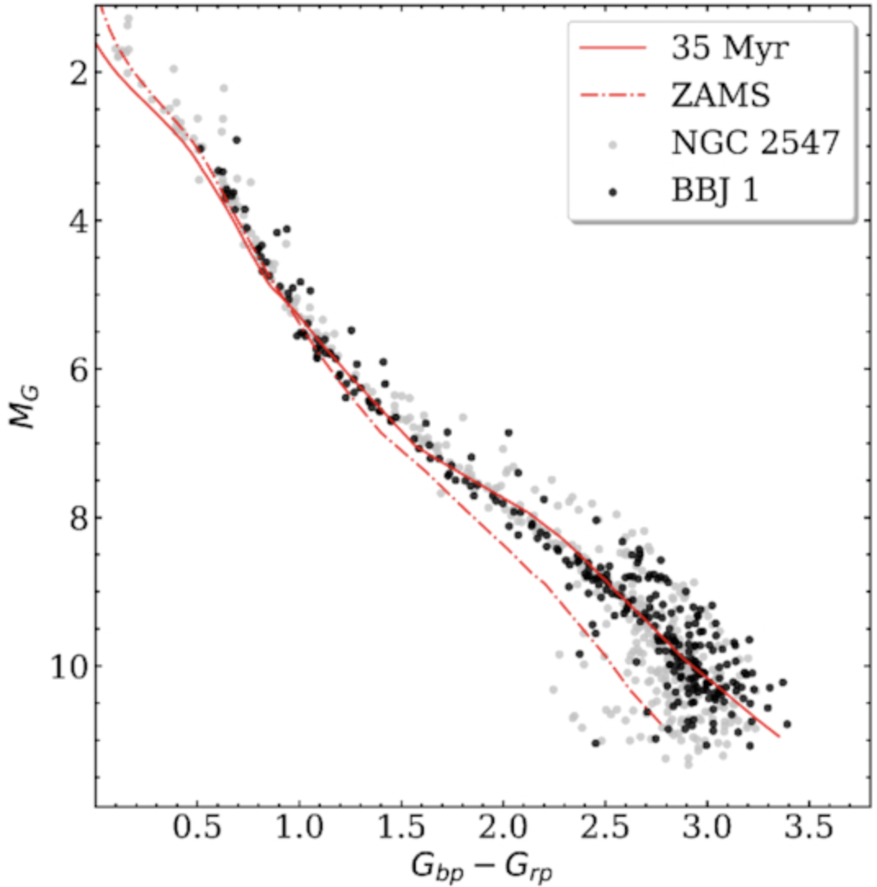
OmegaCam + Gaia: Unveiling Vela OB2
Beccari+20

Slide 31
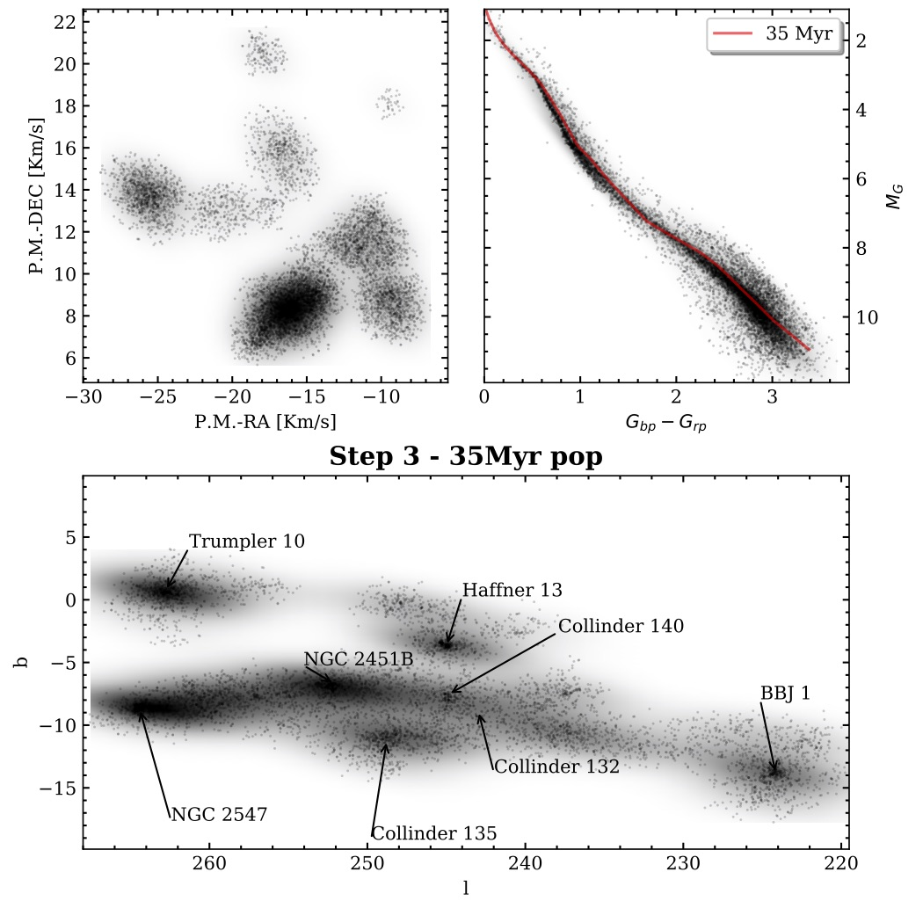
OmegaCam + Gaia: Unveiling Vela OB2
Large structures spanning 260 pc and coeval at 35Myr
Beccari+20

Slide 32
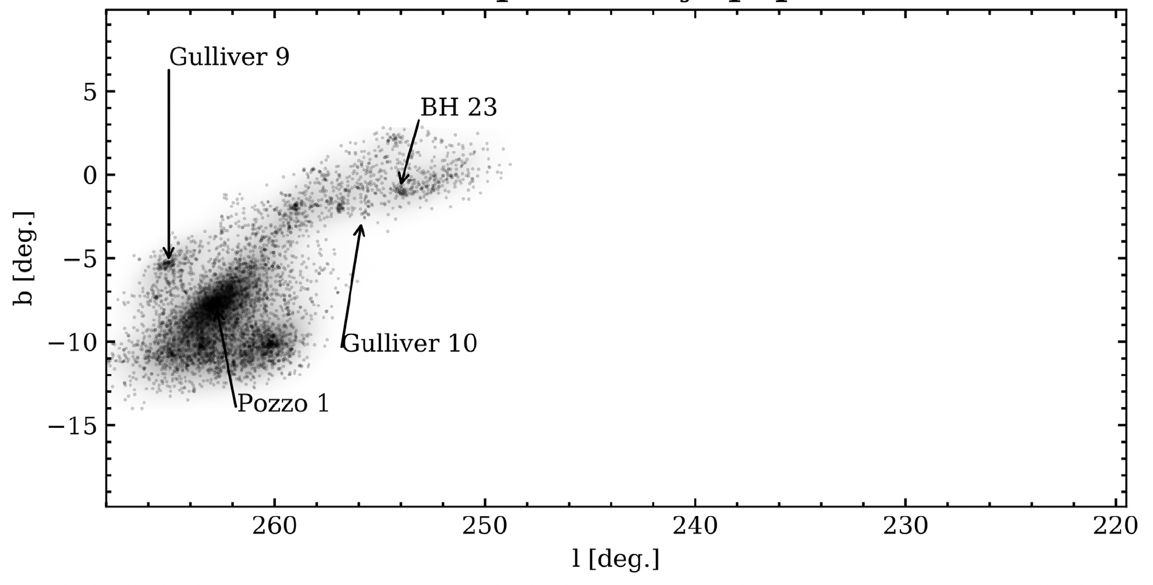
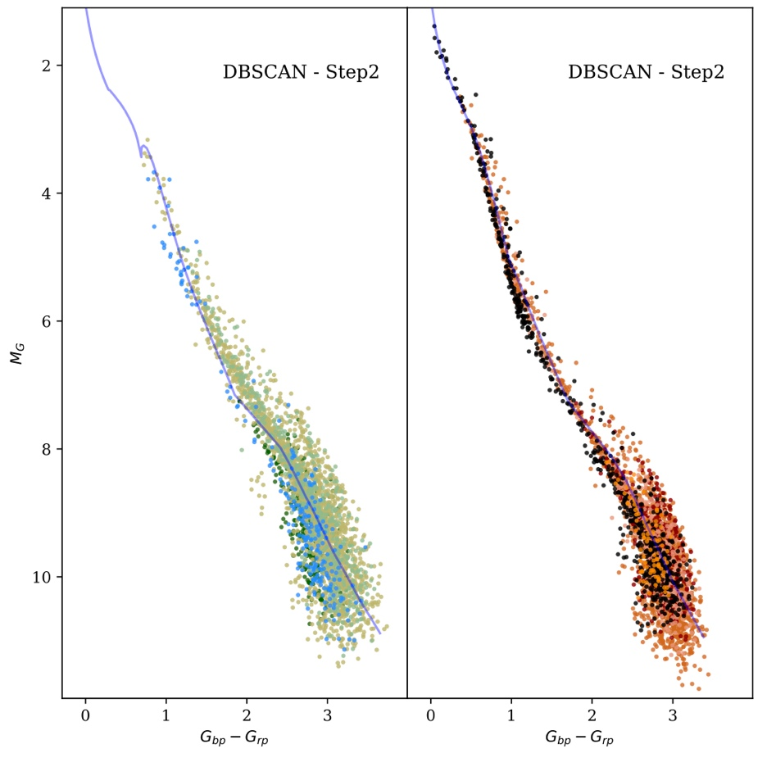
10 Myr old
10 Myr
30 Myr
30 Myr old
Large, co-eval structure spanning 260 pc
260pc
Beccari, Boffin, Jerabkova 20

Slide 33
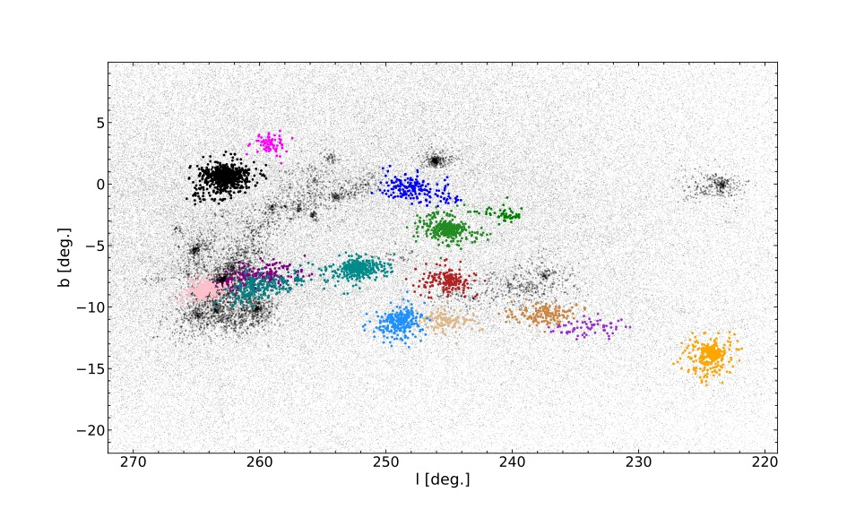
Analysis with Gaia DR3
32 clusters found!
26: 30 Myr old
6: 10 Myr old
Boffin, Beccari, Jerabkova, subm.

Slide 34
Analysis with Gaia DR3
32 clusters found!
26: 30 Myr old
6: 10 Myr old
This allows us to see an ensemble of young stellar clusters just getting out of the original filament in which they were born – on a spectacular large scale
Boffin, Beccari, Jerabkova, subm.

Slide 35
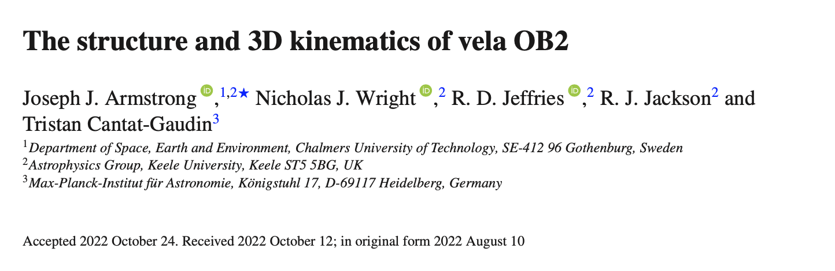
Do you wanna know more?

Slide 36
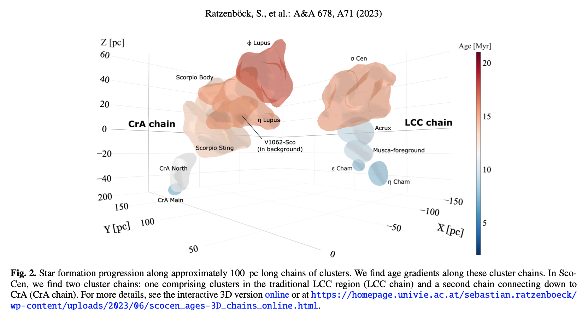
Sco-Cen and Vela…great laboratories!!!
see Josefa’s talk!

Slide 37
Sco-Cen
star formation progression in space and time.
GammaVel
Large, co-eval structure spanning 260 pc

Slide 38
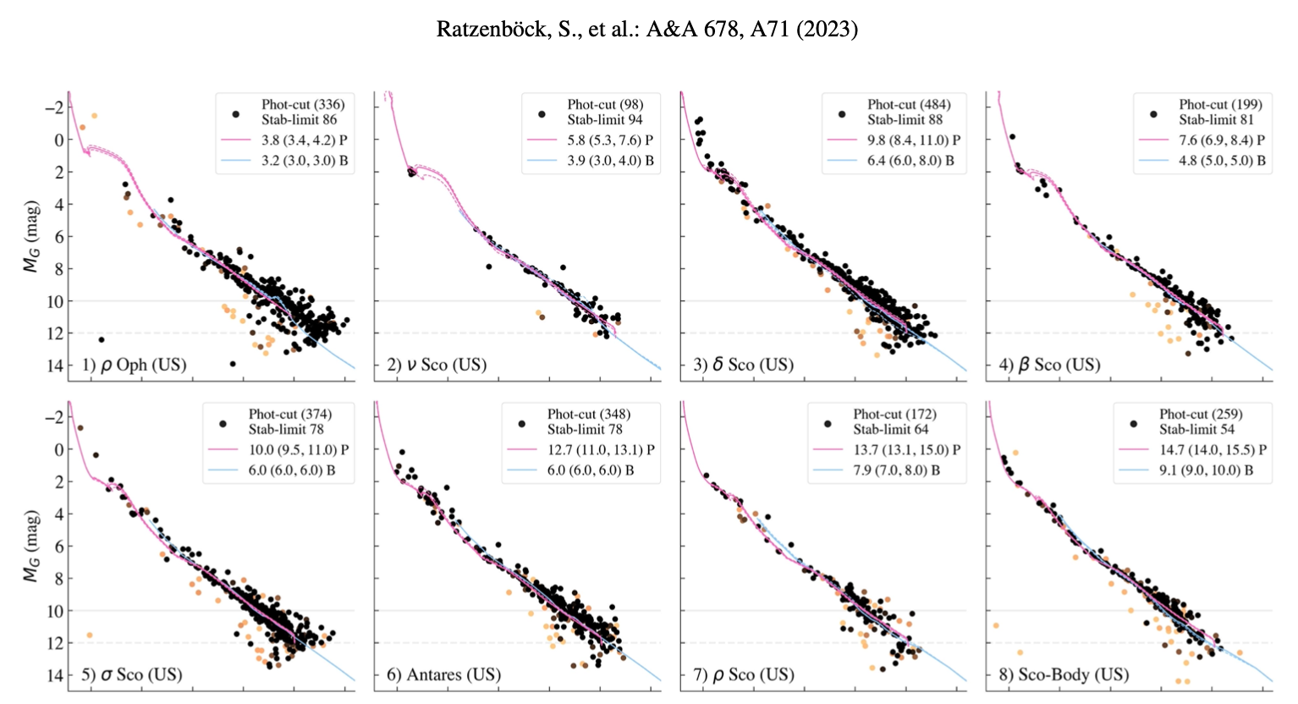

Slide 39
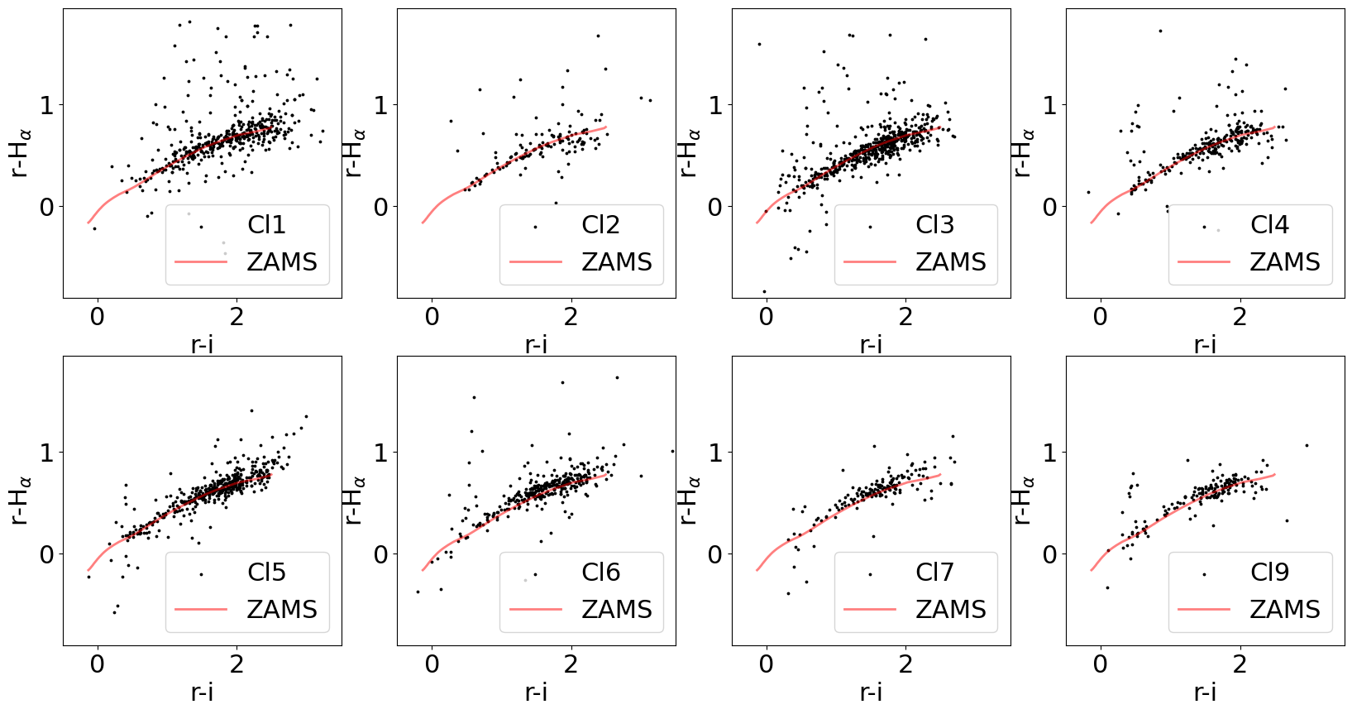

Slide 40


