Slide 1

Sub-clusters and gas and binaries, oh my:
Star Cluster Formation is Messy
Alison Sills
Florence, November 2023

Slide 2
“All stars are formed in clusters”

Slide 3
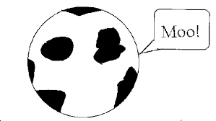
If you want to model a cluster, you need initial conditions
At t=0, the cluster is:
  Isolated
  Spherical
  Monolithic
  Virial equilibrium
  Stars formed instantaneously
  Stars are on the ZAMS
  Stars are single
  Gas-free
𝝁

Slide 4
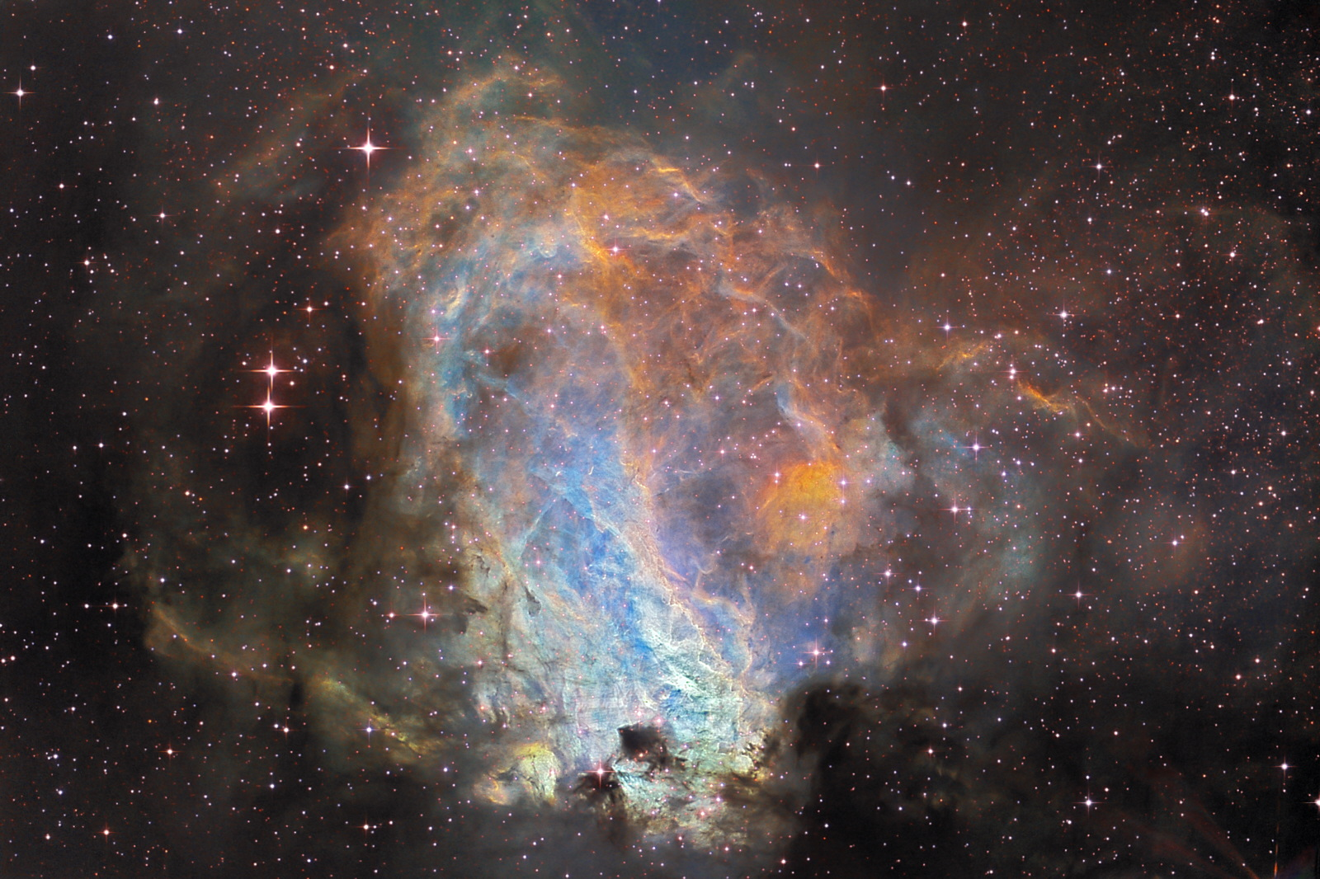
If you want to model a cluster, you need initial conditions
At t=0, the cluster is:
  Isolated
  Spherical
  Monolithic
  Virial equilibrium
  Stars formed instantaneously
  Stars are on the ZAMS (or are point masses)
  Stars are single
  Gas-free
𝝁
Orion – few Myr

Slide 5
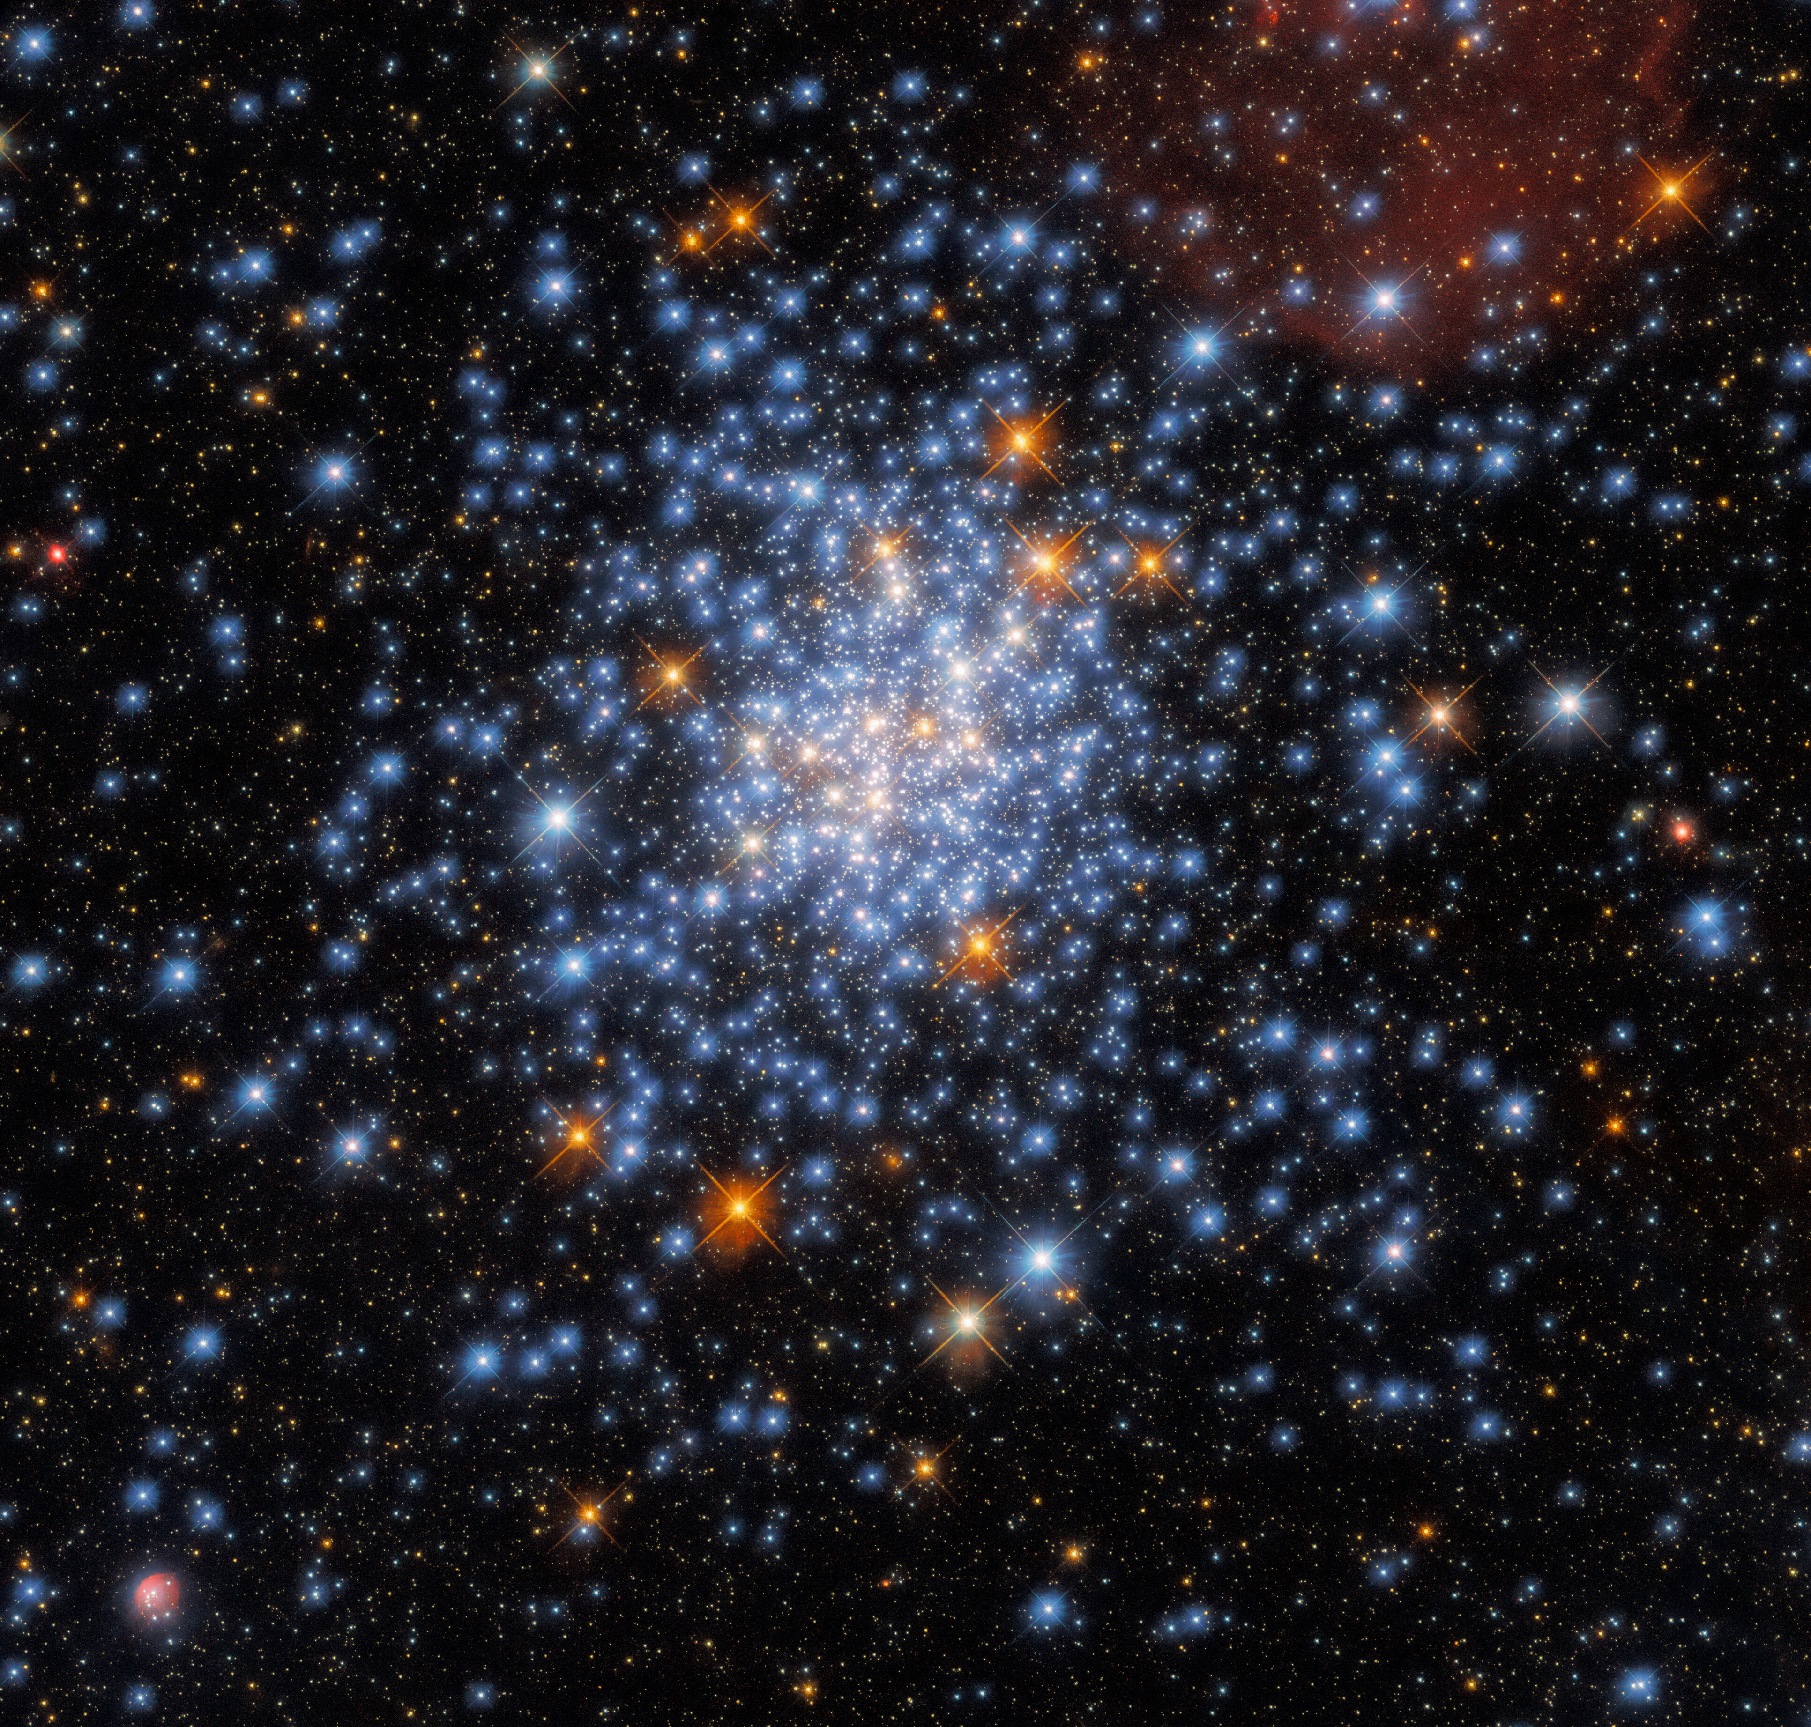
If you want to model a cluster, you need initial conditions
At t=0, the cluster is:
  Isolated
  Spherical
  Monolithic
  Virial equilibrium
  Stars formed instantaneously
  Stars are on the ZAMS
  Stars are single
  Gas-free
𝝁
NGC 330 – 25 Myr

Slide 6
If you want to model a cluster, you need initial conditions
At t=0, the cluster is:
  Isolated
  Spherical
  Monolithic
  Virial equilibrium
  Stars formed instantaneously
  Stars are on the ZAMS
  Stars are single
  Gas-free
𝝁

Slide 7
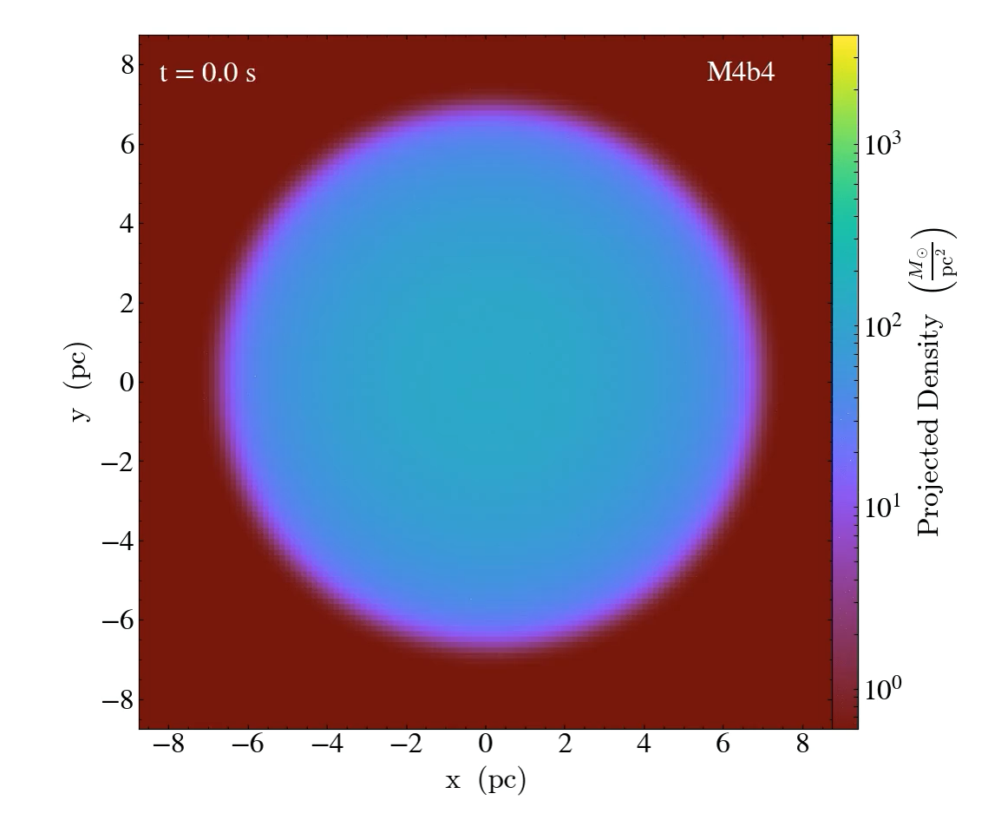
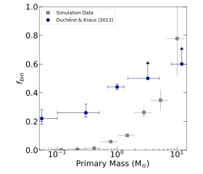
Cluster Formation
TORCH: MHD + stellar dynamics + stellar evolution + feedback in AMUSE (Wall+ 2019, 2020)
Sink particles as star factories
Optimized for binary dynamics; can track dynamical formation of binary systems

Slide 8
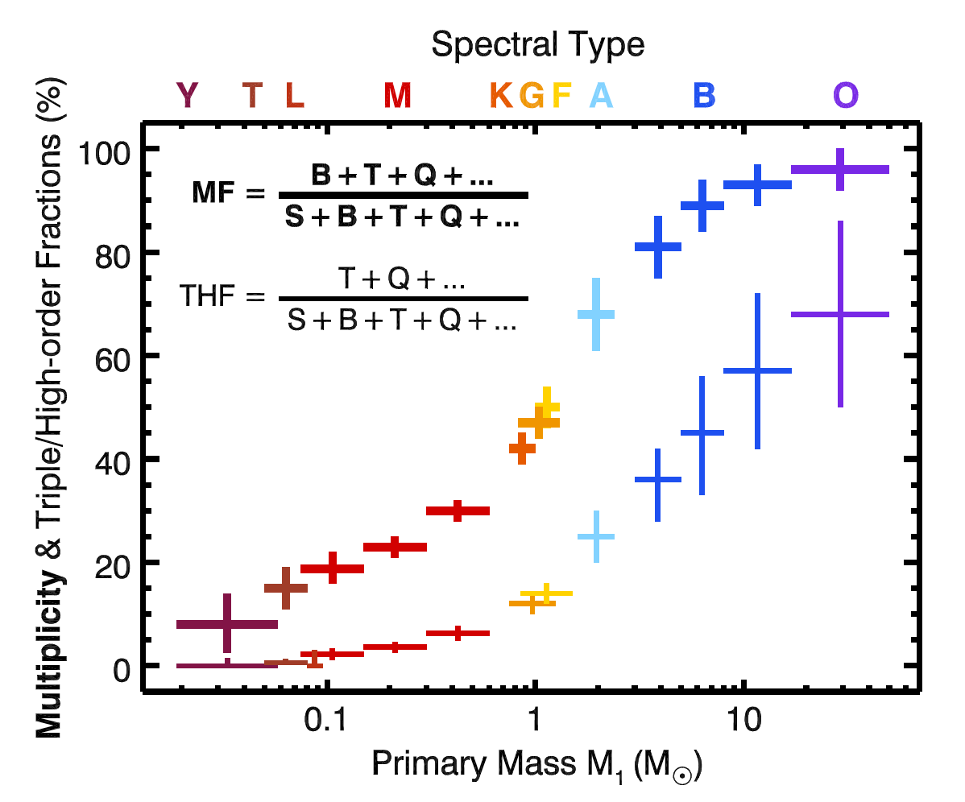

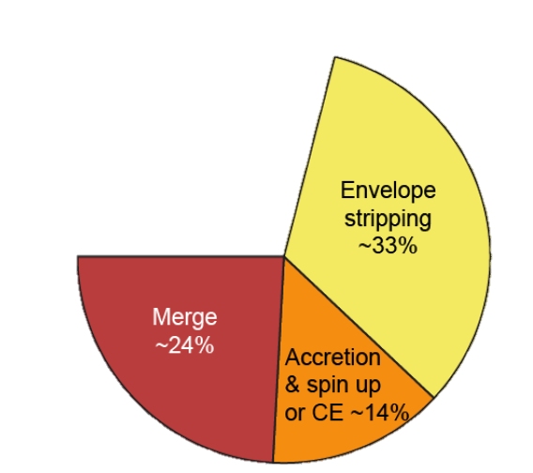
”All stars are formed in binaries”
Offner+ 2022
Sana+ 2012
Most stars are formed in binaries and binary evolution dominates the evolution of massive stars
Notes:
Why should we care? → Clusters

Slide 9
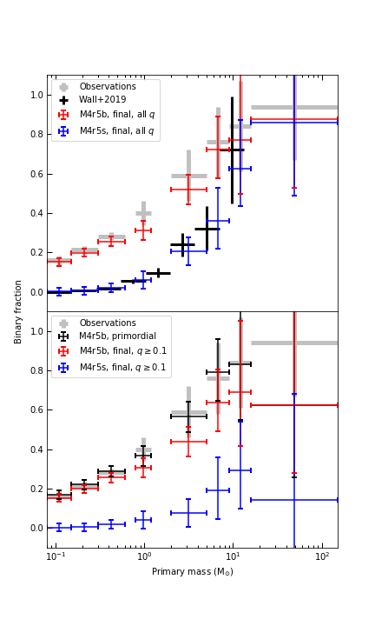
Cluster formation WITH binary formation
Sink particles are given a list of single OR binary stars to form
Binaries are drawn from distributions of f_{bin}, P, q, e as function of M₁
As gas+stellar system evolves:
  dynamical interactions between stars and with gas occur
  more stars/binaries form
All q
q > 0.1
Cournoyer-Cloutier+ 2021

Slide 10
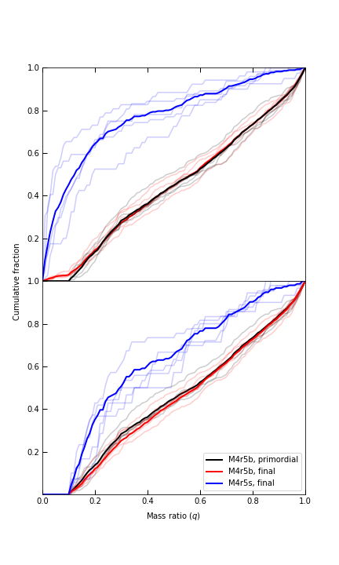
Dynamical Modification of Binary Populations
Without primordial binaries
Binary population is modified in a small but statistically significant way
  Only 2 Myr after star formation began
  In low-mass clusters
  With gas present
Result is a combination of dynamical disruption (of wide systems) and dynamical formation (somewhat massive stars pick up medium-mass companions at medium separations with moderate eccentricity)
All q
With primordial binaries
q > 0.1
Cournoyer-Cloutier+ 2021

Slide 11
If you want to model a cluster, you need initial conditions
At t=0, the cluster is:
  Isolated
  Spherical
  Monolithic
  Virial equilibrium
  Stars formed instantaneously
  Stars are on the ZAMS
  Stars are single
  Gas-free
𝝁

Slide 12
Clusters assembly inside GMCs
Combination of subcluster mergers and continued accretion of gas
Age spreads of ~few Myr and possibly Fe spreads of 0.1 dex are expected
Small subclusters have short dynamical times -- early dynamical evolution is preserved during mergers (e.g. Vesperini+ 2009)
Howard et al 2018

Slide 13
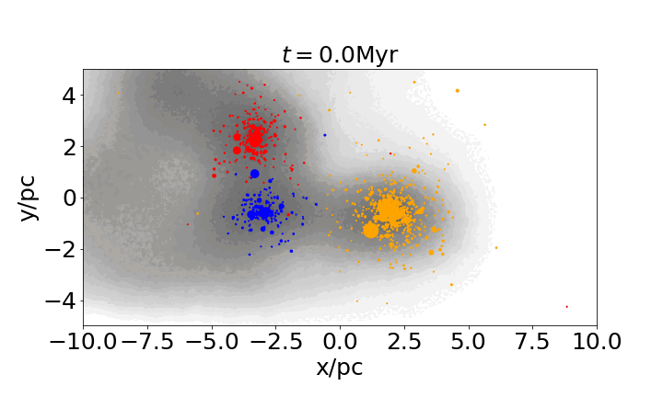
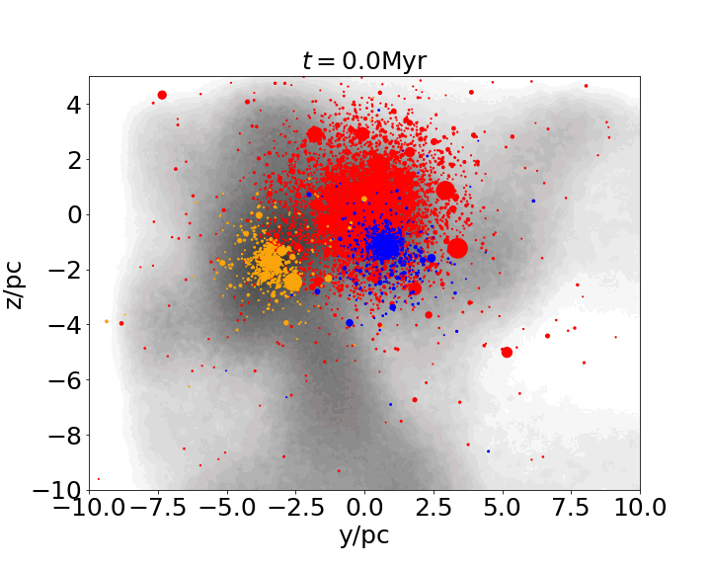
Cluster do not form as monolithic systems
Re-simulating at higher resolution & with full N-body dynamics to probe effects of gas on sub-cluster evolution
Sink particle prescription over-estimates cluster mass
Presence of background gas is critical to dynamics of sub-clusters
Karam & Sills 2021, 2023, in prep

Slide 14
If you want to model a cluster, you need initial conditions
At t=0, the cluster is:
  Isolated Tidal field of galaxy/environment
  Spherical Within 1-10 Myr
  Monolithic Within 1-10 Myr
  Virial equilibrium Within 1-10 Myr
  Stars formed instantaneously 5 Myr age spread
  Stars are on the ZAMS ~30 Myr for the Sun
  Stars are single Nope
  Gas-free ~5 – 10 Myr before cloud is dispersed
𝝁

Slide 15


Take-home messages:
Forming clusters are dynamically active systems
  binary population properties are modified even at very early times.
Clusters do not form as monolithic systems
  sub-cluster mergers are an important part of the cluster assembly process
Clusters take ~10 Myr to reach the t=0 of stellar dynamics models
  Gas is a critically important component during that time
Actual work done by:
Claude Cournoyer-Cloutier
Jeremy Karam

Slide 17
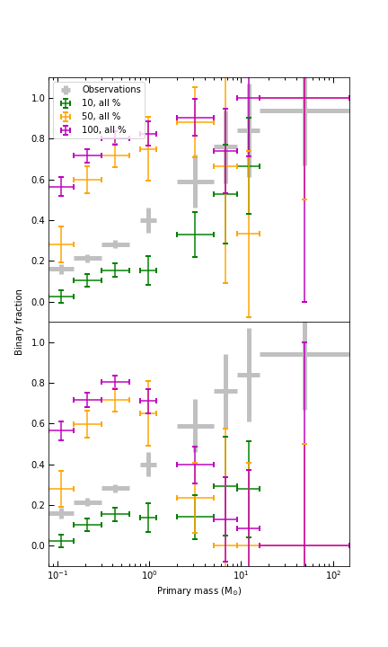
What if we put in some other distribution?
“Dynamicist binaries”:
  Random sampling from the IMF for both primaries & secondaries
  Uniform sampling in log Period
  Thermal eccentricity distribution
  Binary fraction is not mass dependent
All q
q > 0.1
Other distributions can be tested – what’s your favourite?
Flat in q
“eigenevolution” (Kroupa)
What do we expect from binary formation mechanisms?

Slide 18
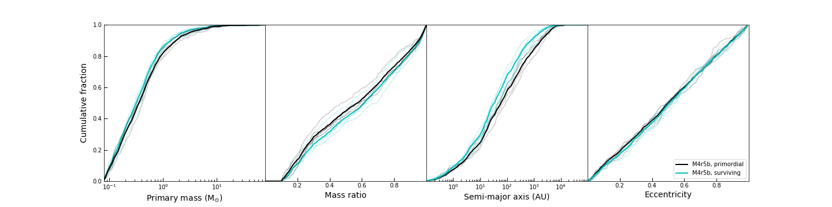
Dynamical Disruption
Black line: initial distribution
Green line: properties of systems that survived to ~2 Myr
Biggest change is semi-major axis: wide systems are destroyed
Cournoyer-Cloutier+ 2021

Slide 19
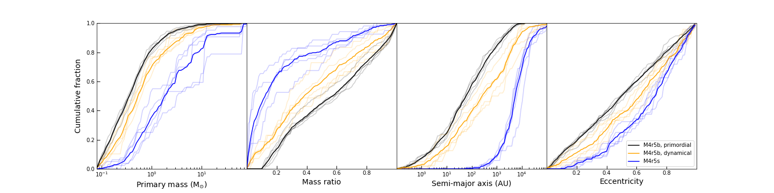
Dynamical Formation
Black: initial distribution
Yellow: formed in simulations with primordial binaries
  Not the same distribution as the initial distribution in any property
Blue: formed in simulations without primordial binaries
  Higher-mass stars pick up low mass companions at large semi-major axes with high eccentricity
Cournoyer-Cloutier+ 2021

Slide 20
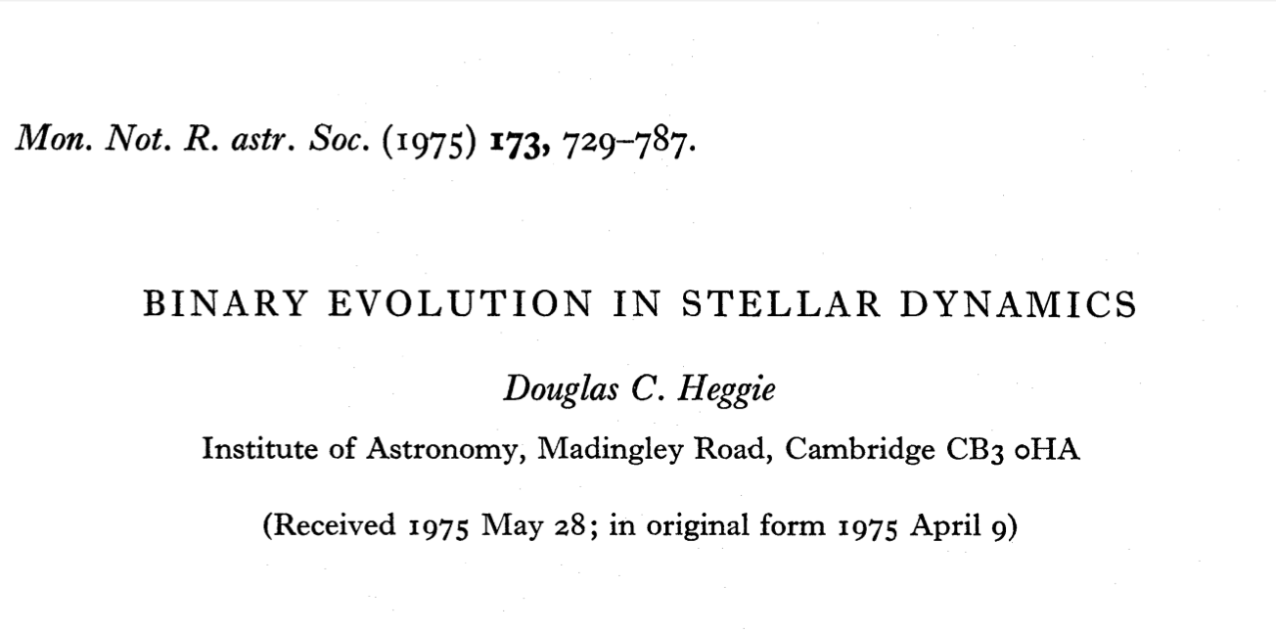
What do dynamical encounters do to individual binary systems?
← note: 58 pages in 1975!
Encounters between a binary and a single star
Heggie’s Law:
Hard binaries (tend to) get harder

Slide 21
What do dynamical encounters do to individual binary systems?
← note: 58 pages in 1975!
Encounters between a binary and a single star
Heggie’s Law:
Hard binaries (tend to) get harder

