Slide 1
Radioastronomy: the path toward Next Generation Computing
CLAUDIO GHELLER¹, ANDREA BOTTEON¹, EMANUELE DE RUBEIS¹, GIULIANO TAFFONI², DAVID GOZ²
INAF – INSTITUTE OF RADIOASTRONOMY BOLOGNA
INAF - ASTRONOMICAL OBSERVATORY OF TRIESTE

Slide 2
THE DATA DELUGE (ALSO IN RADIO ASTRONOMY)
“In the next decade, current and upcoming radio-interferometers, like the Low Frequency, MeerKAT, the Murchison Widefield Array, the Australian Square Kilometre Array Pathfinder, in the perspective of the Square Kilometre Array (SKA MID and LOW), will produce huge volumes of data…” (Gheller at al. 2023)
…………………….
but what are we actually talking about? Is there actually a problem with data size?

Slide 3
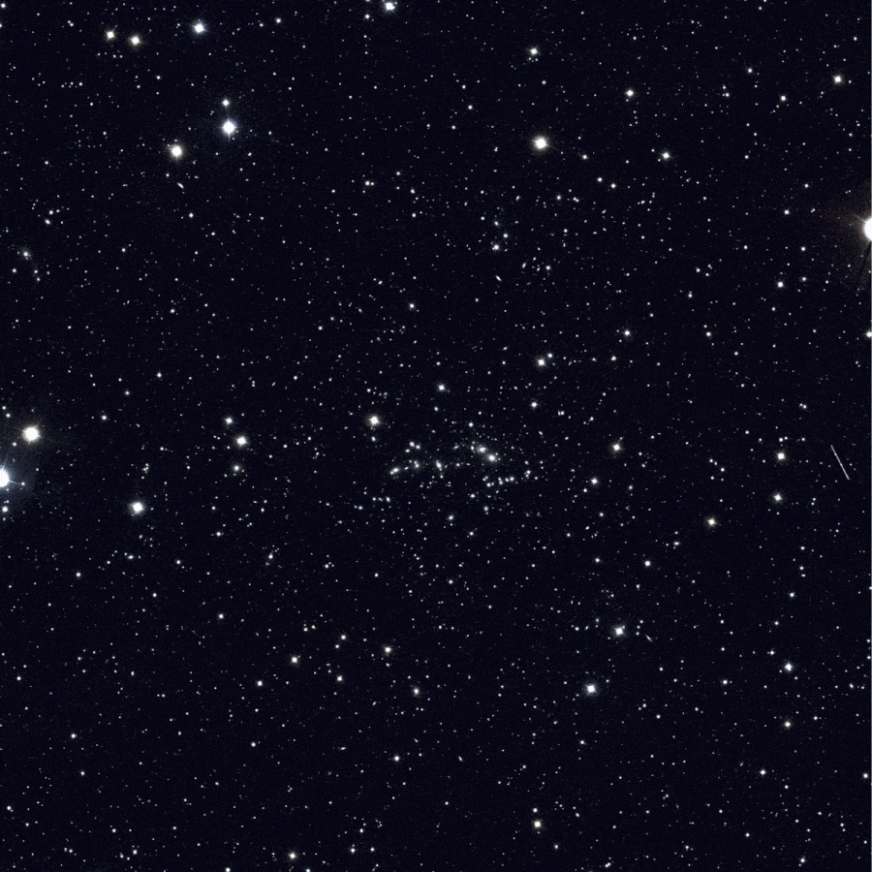
MAKE IT CONCRETE A CASE STUDY: LOFAR HBA DEEP FIELD
Cluster Deep Field made of 42 observations, 8h each, using the High Band Antenna.
Same strategy of LOFAR Two meter Sky Survey – high resolution 120-168 MHz with a time resolution of 1 second and a frequency resolution of 16 channels per 195.3 kHz.
Total amount of 336h of observation of the same target.
Abell 2255 in:
ROSAT, blue
LOFAR HBA 145 MHz, red
LOFAR LBA 49 MHz, purple

Slide 4
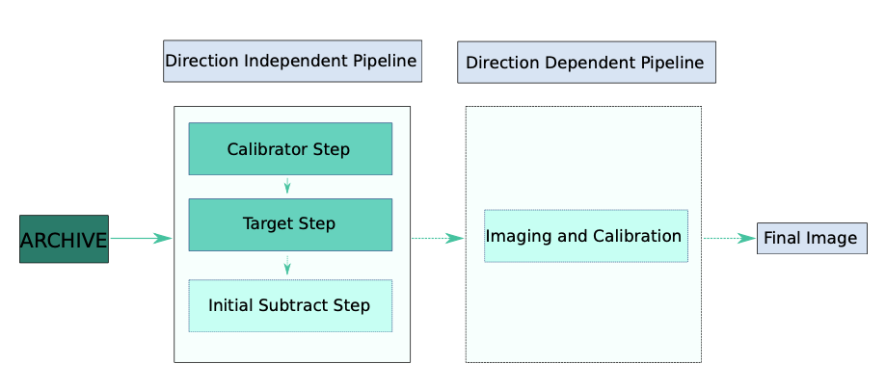
FROM RAW DATA TO SCIENTIFIC PRODUCTS: HOW LONG DOES IT TAKE?
Raw data produced by each night is ~ 5TB for a total of > 200TB of data to store and process.
Download rate at ~ 2-3 days per dataset
Direction Independent Processing per dataset:
Run on calibrator ~ 2/3 h
Run on target image ~ 12/24 h
Direction Dependent Processing per dataset:
Run ~ 8/12 days

Slide 5
SUMMING UP
LOFAR LONG TERM ARCHIVE
Is it reasonable to wait months to process an interferometric observation?
Are computing systems reliable and available long enough to sustain such need?
What will happen when data size will grow to petabyte?
WEEKs/MONTHs
WEEKs
MONTHs
200TB
~2TB
~20TB

Slide 6
NO WAY, WE HAVE TO RUN FASTER!!!
1) The computing challenge. In order to to improve the codes’ performance by:
Designing clever algorithmic solutions
Using optimized libraries
Exploiting multi (multi–core CPUs) and many threads (GPUs) parallelism
Dividing the work among multiple CPUs (distributed parallelism)

Slide 7
IT’S NOT ALL ABOUT CPU TIME & PERFORMANCE…
2) The memory challenge – Huge datasets cannot be loaded in the memory of a single CPU/GPU and cannot be handled by a single processor but by distributed memory systems. Distributed computing, based, e.g., on the adoption of the MPI standard, represents a feasible and effective solution.
3) The data challenge – Increasing data volumes need to be managed, archived, queried, found, accessed efficiently (both raw data, and derived data products)

Slide 8
HOW TO MOVE FORWARD?
All the three challenges have the potential of increasing the time to solution, if not even make the problem impossible to solve
All the three challenges have to be addressed concurrently
This requires:
the adoption of innovative technological solutions, both for hardware and for software
A lot of work and man-power (fourth challenge)
The availability of highly specialized competences (fifth challenge)

Slide 9
1. LET’S KILL THE DOWNLOAD TIME
(Only) one 100% effective solution: do not download data
Move the calculation where the data is.
This is the solution promoted, for instance, by the SKA Regional Centres Network (SRCNet)
But this opens a few technological challenges
Reproducibility of the analysis (software, libraries, environments must be the same);
Distribution of software on different computing platforms
Transparent and easy access of computing resources and data
Interoperability of data centres

Slide 10
LET’S GO PARALLEL
The Data Centres will provide (in principle) HPC resources
The coming decade HPC systems are expected to be:
HYBRID: traditional CPUs + Low Power CPUs + GPUs + Other accelerators (FPGA, ASIC…)
DEPLOYING SPECIALIZED SOFTWARE STACKS, to achieve the maximum level of performance, if needed
SUPPORTING CONTEINERAIZED SOLUTIONS, to achieve the maximum level of portability, if needed
HIGHLY PARALLEL: at all architectural levels
→ PARALLELISM MUST BE EXPLOITED

Slide 11
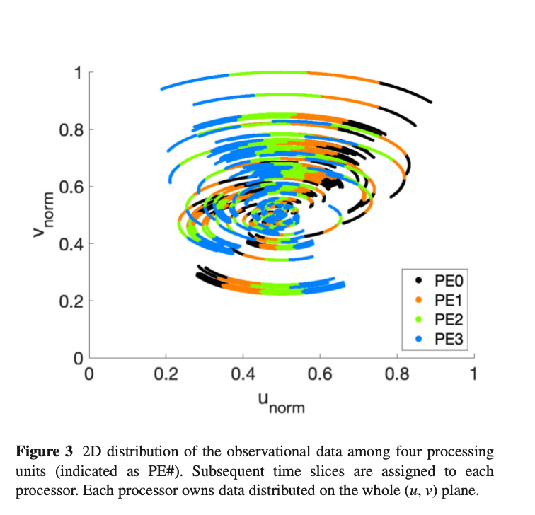
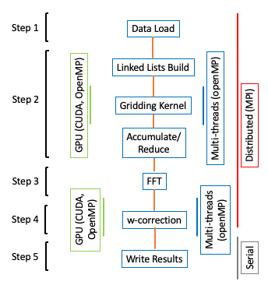
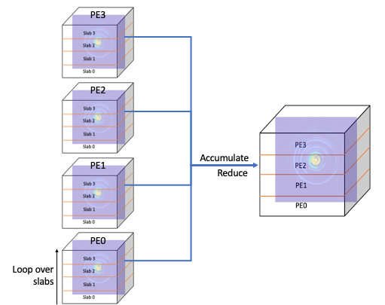
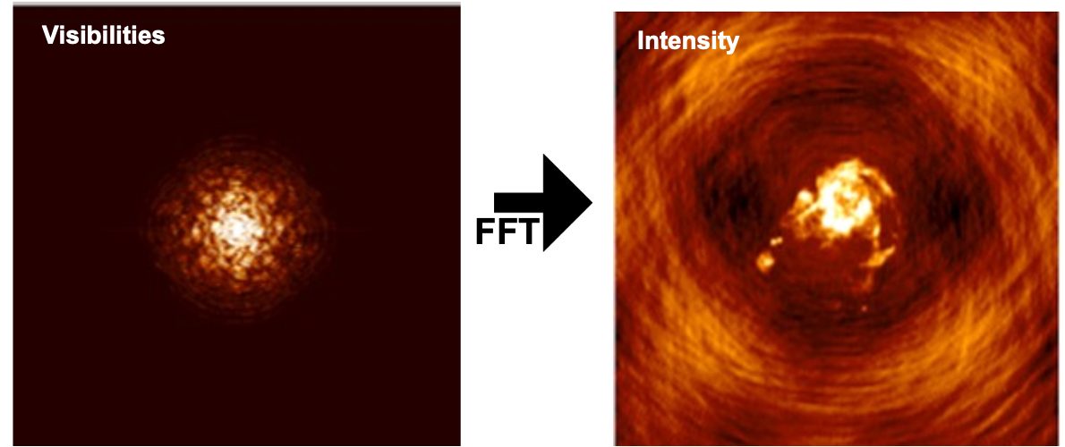
AN EXAMPLE: HIGH PERFORMANCE IMAGING
PE3
PE2
PE1
PE0

Slide 12
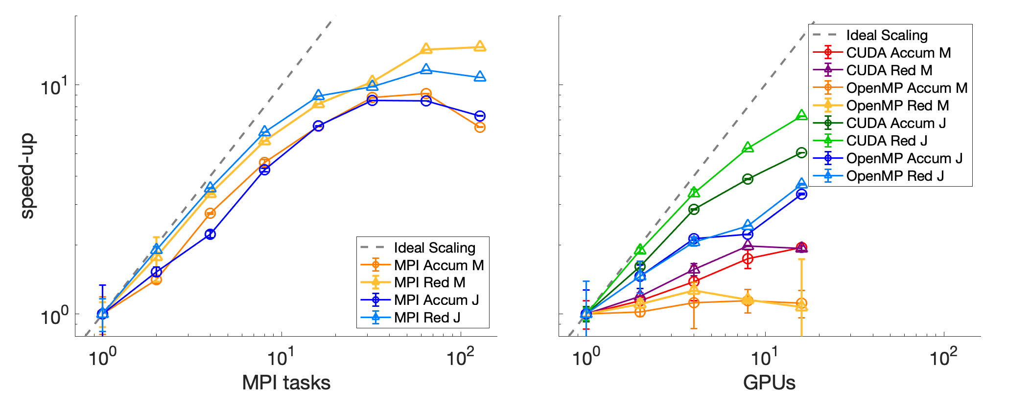
PERFORMANCE GAIN
Single Node, multiple threads
As a result WE COULD PERFORM THE IMAGING OF A ~100 GB dataset on a 32768×32768×64 Mesh (1TB, 2.5 TB total memory request) in about 3000 sec. using 128 GPUs cooperatively.
5-7 days required for a 25500x25500 image with ”traditional” approaches.
NO image tiling or faceting required
Multi nodes, multi GPUs

Slide 13
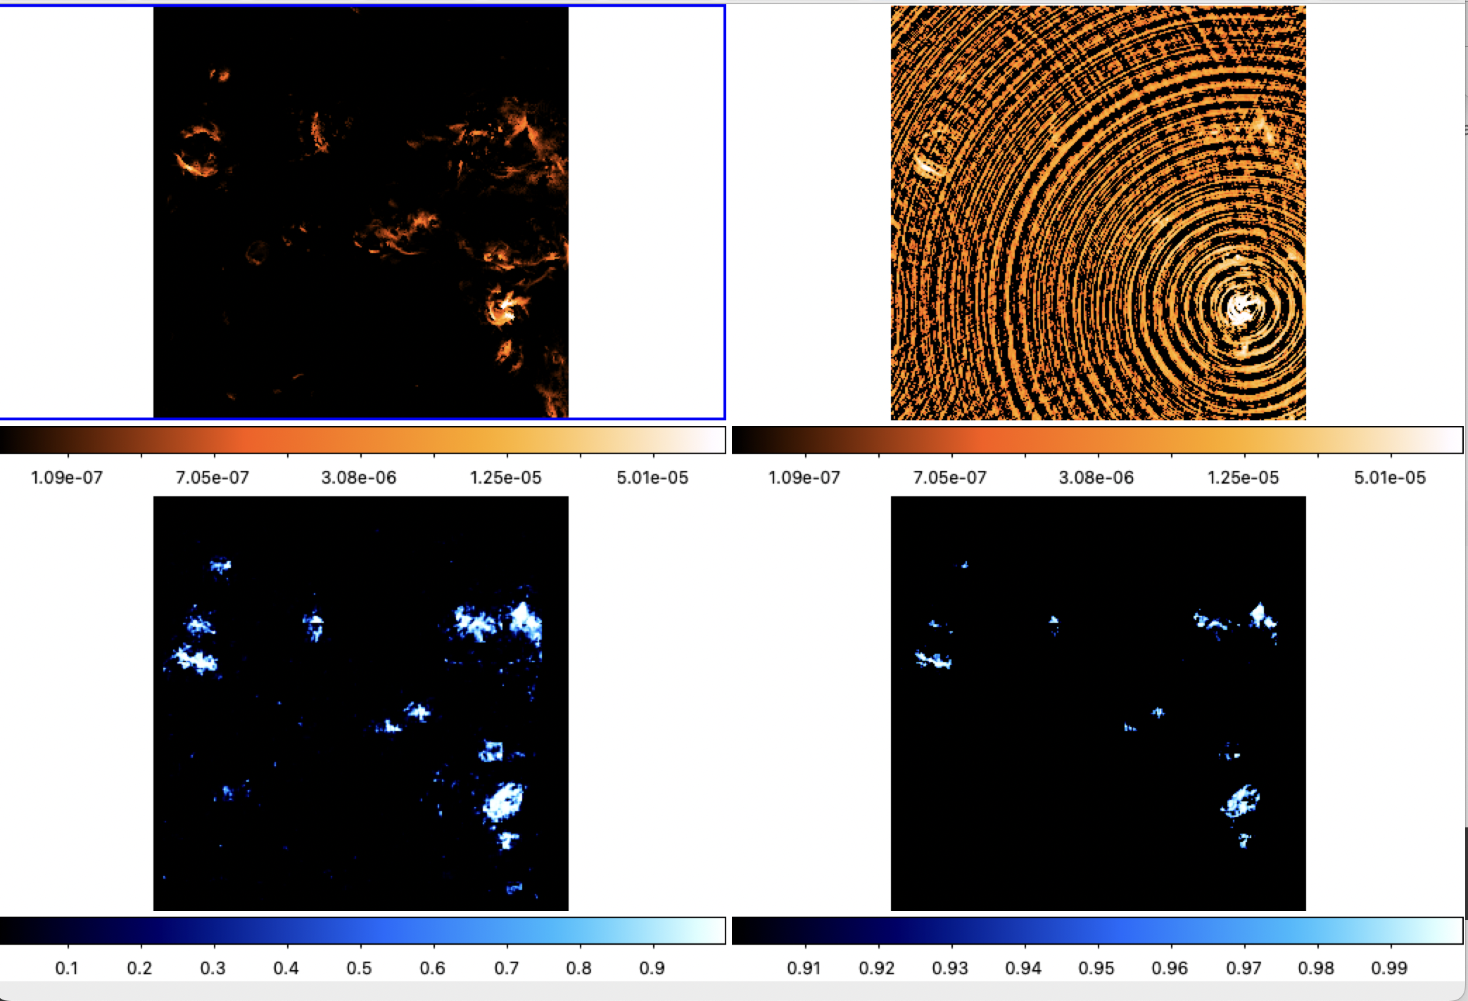
EXPLOITING NOVEL NUMERICAL METHODS
Improve the performance
Automate data analysis
Perform tasks otherwise impossible
SKY MODEL
DIRTY IMAGE
PROB. MAP (0-1)
Fully Convolutional Network
PROB. MAP (>0.9)

Slide 14
CONCLUSIONS
Data analysis in Radio Astronomy is complex in terms o data size and algorithms
Current analysis is done with pipelines based on C/C++ codes and Python that use single node parallelism with no (real) HPC optimization
Moore’s law will not help anymore
NEED TO CHANGE THE APPROACH AND THE PARADIGHM
PARALLEL COMPUTING (at all architectural levels)
EFFECTIVE DATA MANAGEMENT AND ACCESS
INNOVATIVE ALGORITHMIC SOLUTIONS

