Slide 1
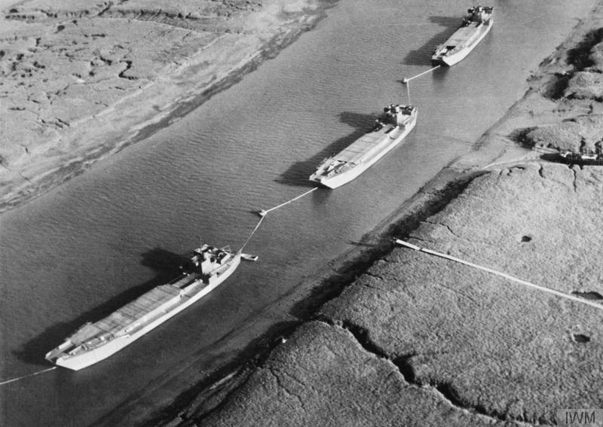

Slide 2
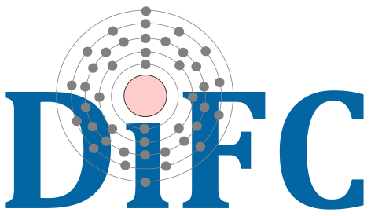
(modelling of)
Nanojets in the Solar Corona
for MUSE
15/06/2023
Paolo Pagano
Università degli Studi di Palermo
INAF USCVIII - Calcolo Critico - Catania
Notes:
Slide1: hello everyone! Thanks for attending this online seminar. I hope that this new format will work out, but I also hope that we can drop it as soon as possible.
Today I wold like to introduce you a research that we have carried out with Patrick and strangely a group of people all from Palermo. The topic of this research is to explain some jet-like features observed in a coronal rain complex and whether these can be he dynamic counter part of nanoflare heating events. In this presentation, of course, I will mostly focus on the modelling of these events, after a short introduction about observations and in the following part I will address specifically the asymmetric properties of the jets and how can they be explained.

Slide 3
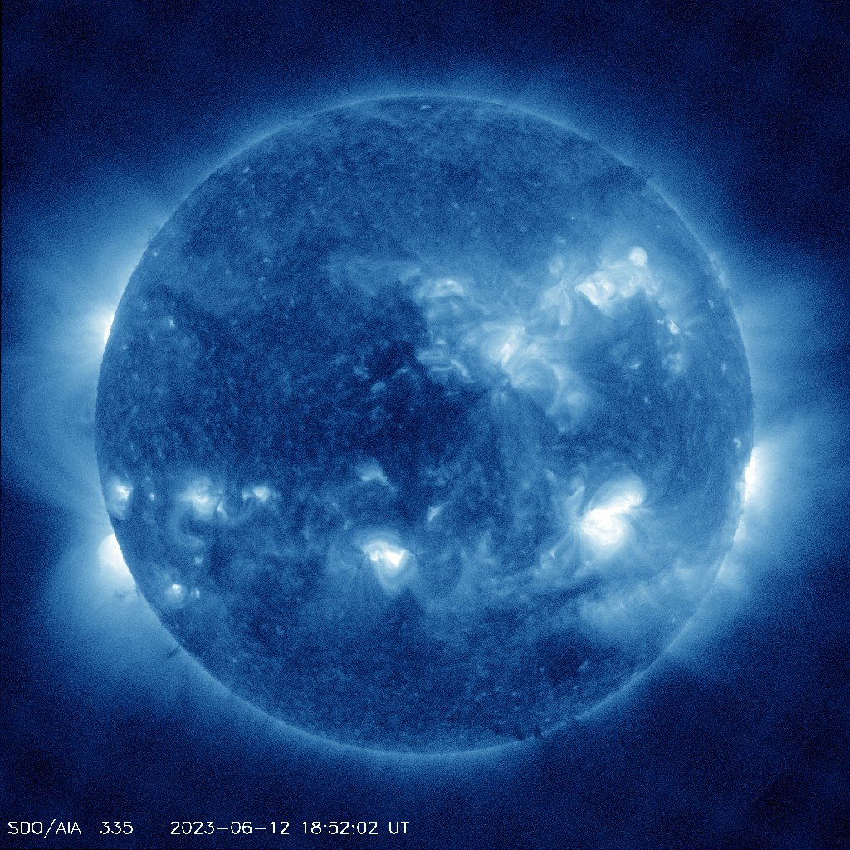
The corona is hot
Fe XVI

Slide 4
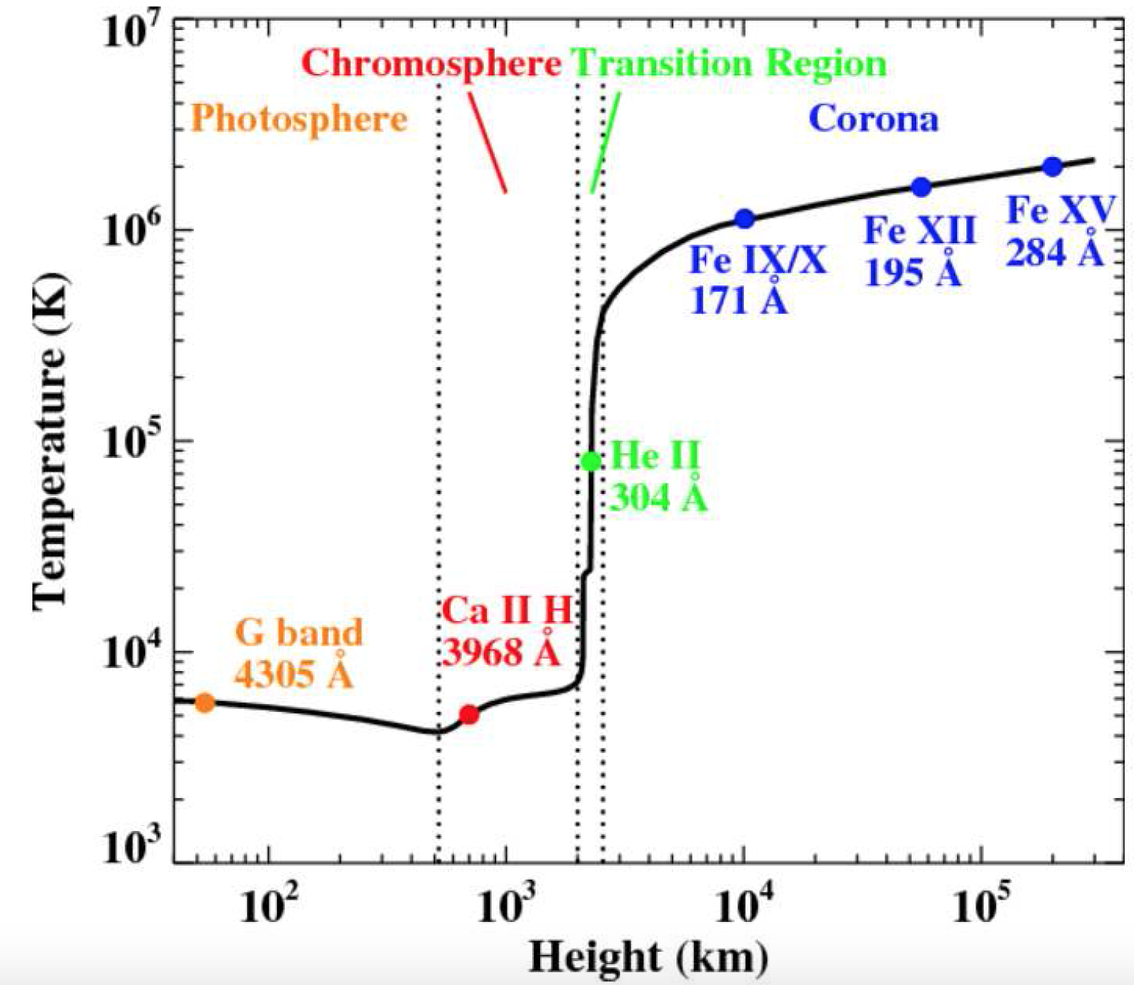
The corona is hot
Fe XVI
$$τ_{C}∼{10}^{3}s$$
Local and persistent mechanism.
$$+{10}^{6}K$$
Quiet Sun
Active Regions
$$3×{10}^{5}\frac{erg}{cm^{2}s}$$
$${10}^{7}\frac{erg}{cm^{2}s}$$

Slide 5
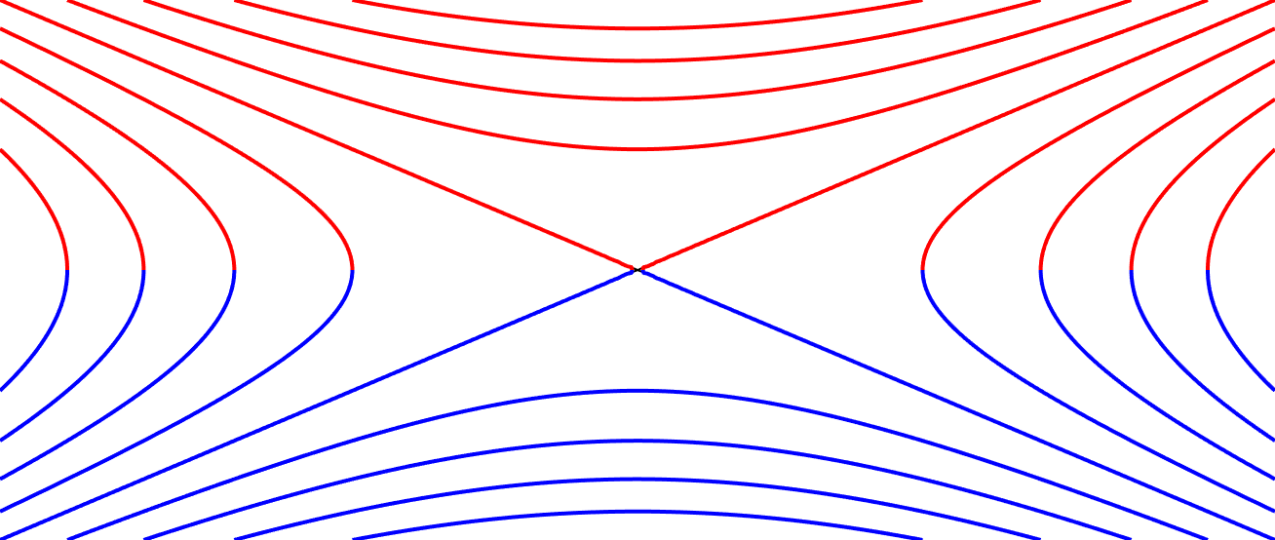
Magnetic reconnection can do it
Plasma flow in
2D
Magnetic flux out
Energy conversion
Plasma flow out
Magnetic flux in
… but in bursts, and in 3D

Slide 6
Coronal loops, where reconnection can happen,
but we can’t see it

Slide 7
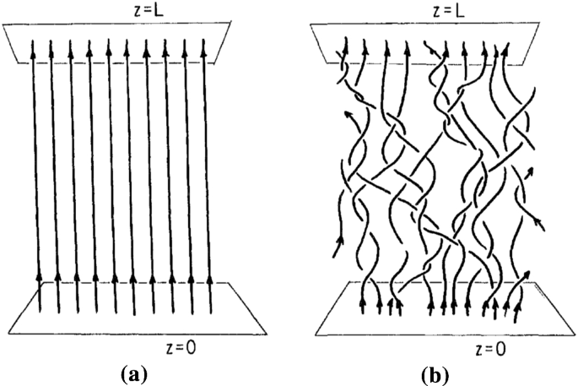
Nanoflares and nanojets
Nanojets
Nanoflares
Intensity bursts
Very short lived (<10 s - 15 s)
V ~ 100-200 km/s
1000-2000 km in length
~500 km in width
Impulsive energy release ~ 10²⁴ erg
Small /short, spatial /temporal scales
Significant localised heating: 5-10 MK
Magnetic reconnection
Notes:
Slide 4: However, today we focus on a different scenario. Nanoflares. These are considered burst reconnection events that on very short time scale heat the corona up to several MK. As they are considered events, it is natural to think of them as a succession of nanoflares with different energies. However, without many chances to observe them, it’s not likely we can further investigate on their nature directly from the observation of the heating.
Therefore, today we focus on a possible dynamic counterpart of nano flares that are the jets that can stem from the loop strand because of the magnetic reconnection.

Slide 9
How are nanojets’ and nanoflares’ properties related?
Can the nanojet mechanism model explain the nanoflare heating scenario?

Slide 10
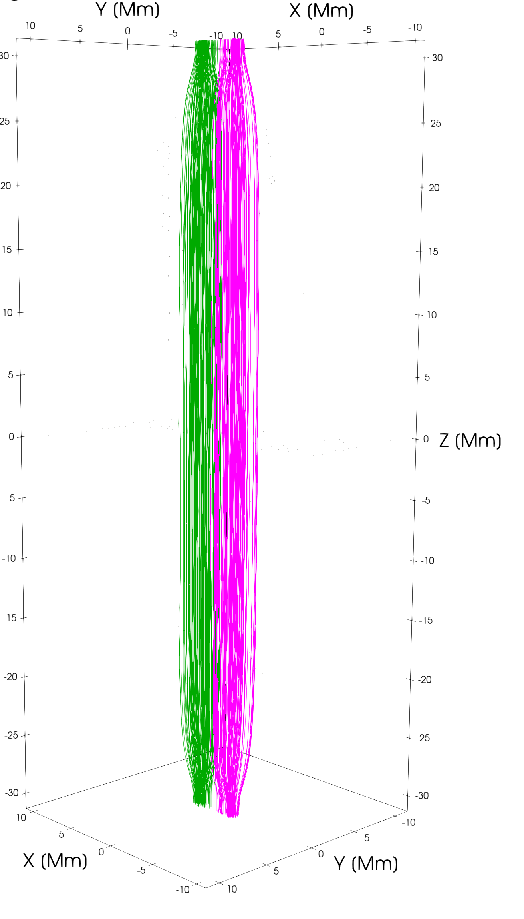
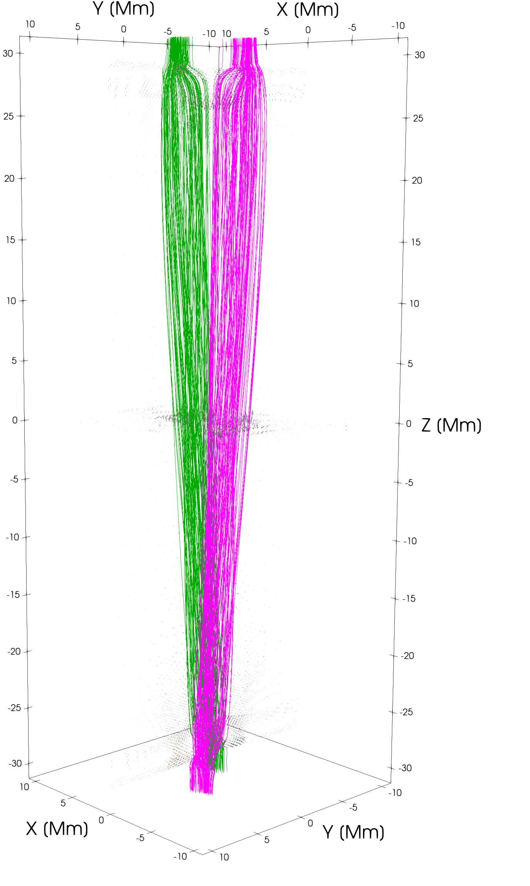
Numerical model
Reconnection and jets
Chromosphere
Driver
Magnetic Reconnection
Chromosphere
Driver

Slide 11
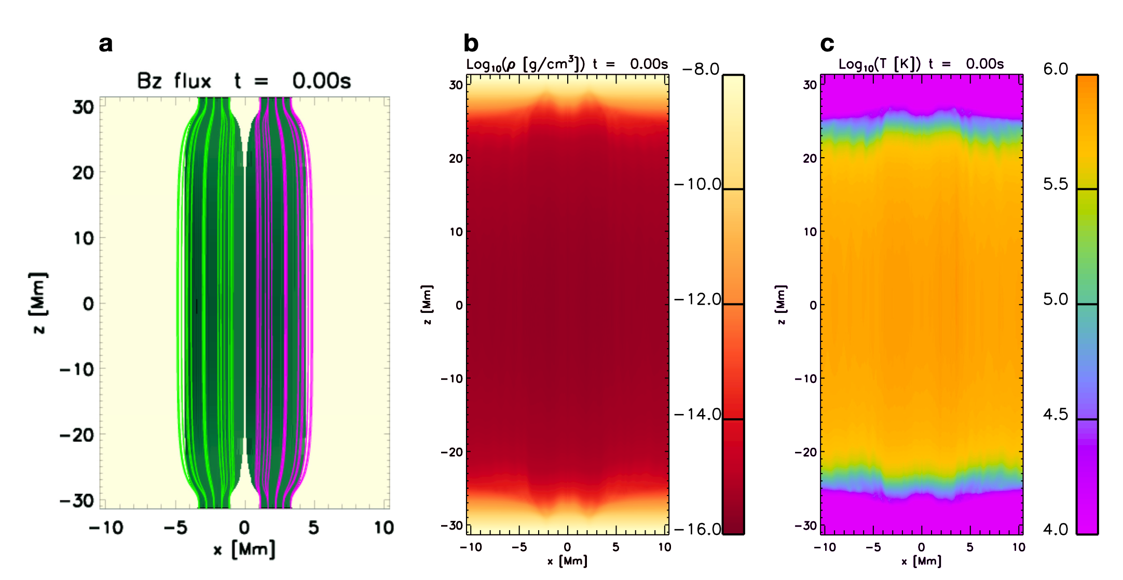
Numerical model
Initial conditions (relaxation)
Hot, dense loops
B0 = 15 G
Bz0 = 300 G

Slide 12
Numerical model
Driver
$$V_{y}=V_{max}sin\frac{t}{τ}2π$$
$$V_{max}=20Km/s$$
$$Δy=2.2Mm$$

Slide 13
3D MHD Model
PLUTO
90K CPU hours @CINECA Galileo 100 2021 1.1 PFlops
constant
$$\{$$
$$η_{0}$$
$$\left(|\overset{⃗}{j}|≥J_{0}\right)$$
H= (t=0)
$$η=$$
$$η_{0}$$
$$\left(|\overset{⃗}{j}|<J_{0}\right)$$

Slide 14
Reconnection and jets
Reconnected field lines

Slide 15
Numerical model
Energy
Kinetic Energy
Temperature

Slide 16
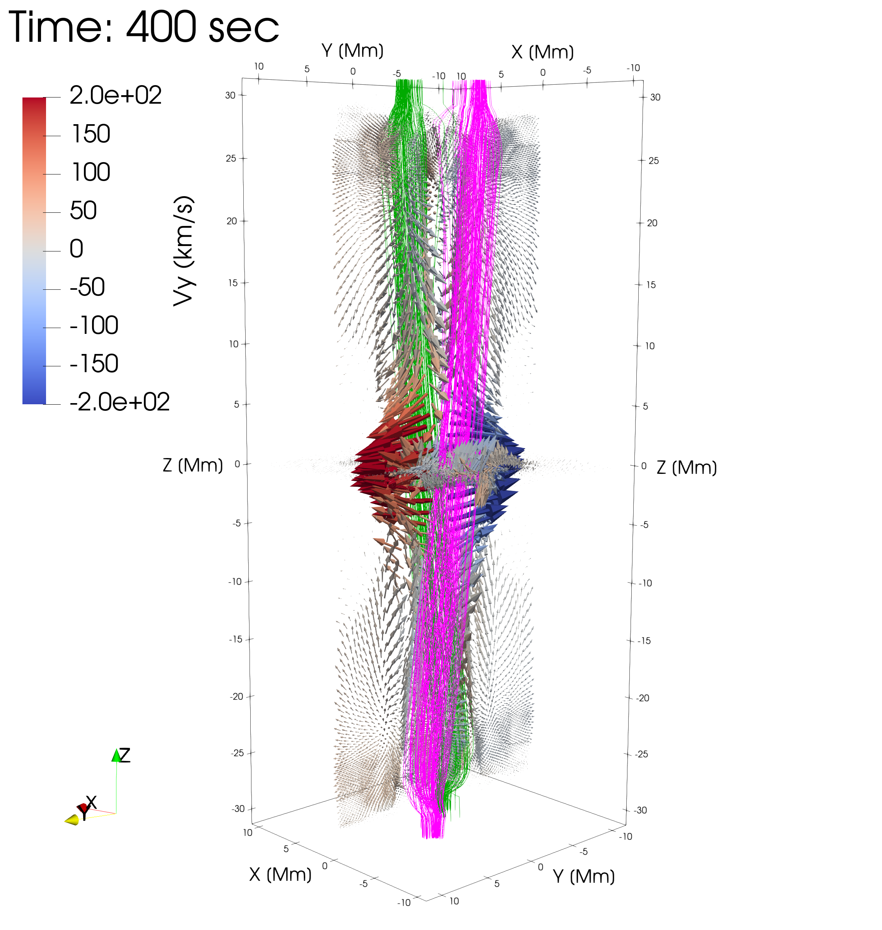
$$−300Km/s<V_{y}<300Km/s$$
Running difference
$$−{10}^{−16}g/cm^{3}>Δρ<{10}^{−16}g/cm^{3}$$
$$∼180Km/s$$
$$ΔE_{M}$$
$$ΔE_{T}$$

Slide 17
What stops the jet?
$$TM_{y}$$
Inward directed magnetic tension
(Stopping the jet)
Outward directed magnetic tension
(Causing the jet)

Slide 18
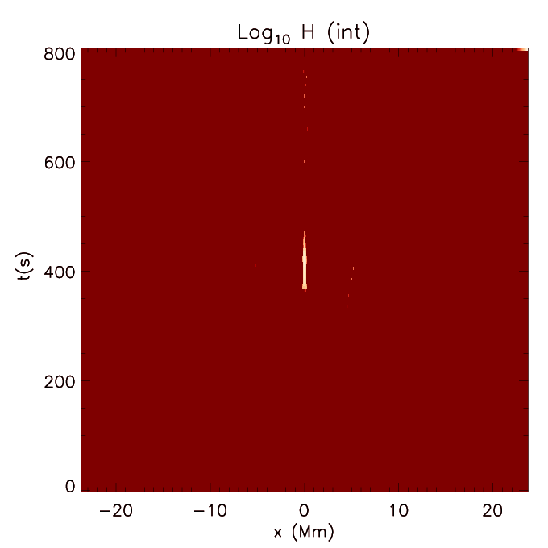
Heating
$$∫_{t}∫_{V}HdVdt=2.2×{10}^{26}erg$$
Heating from nanoflare

Slide 19
What is MUSE?
A rastering spectrograph
Probing the Physics of the Solar Atmosphere with the Multi-slit Solar Explorer (MUSE)
MHD Simulation of Flare Multi-slit Solar Explorer
Breakthroughs:
cadence: 40-100x faster & larger FOV than current/planned spectrographs
spatial resolution: 10x higher than AIA, 25x better than EIS or SOLO/SPICE

Slide 20
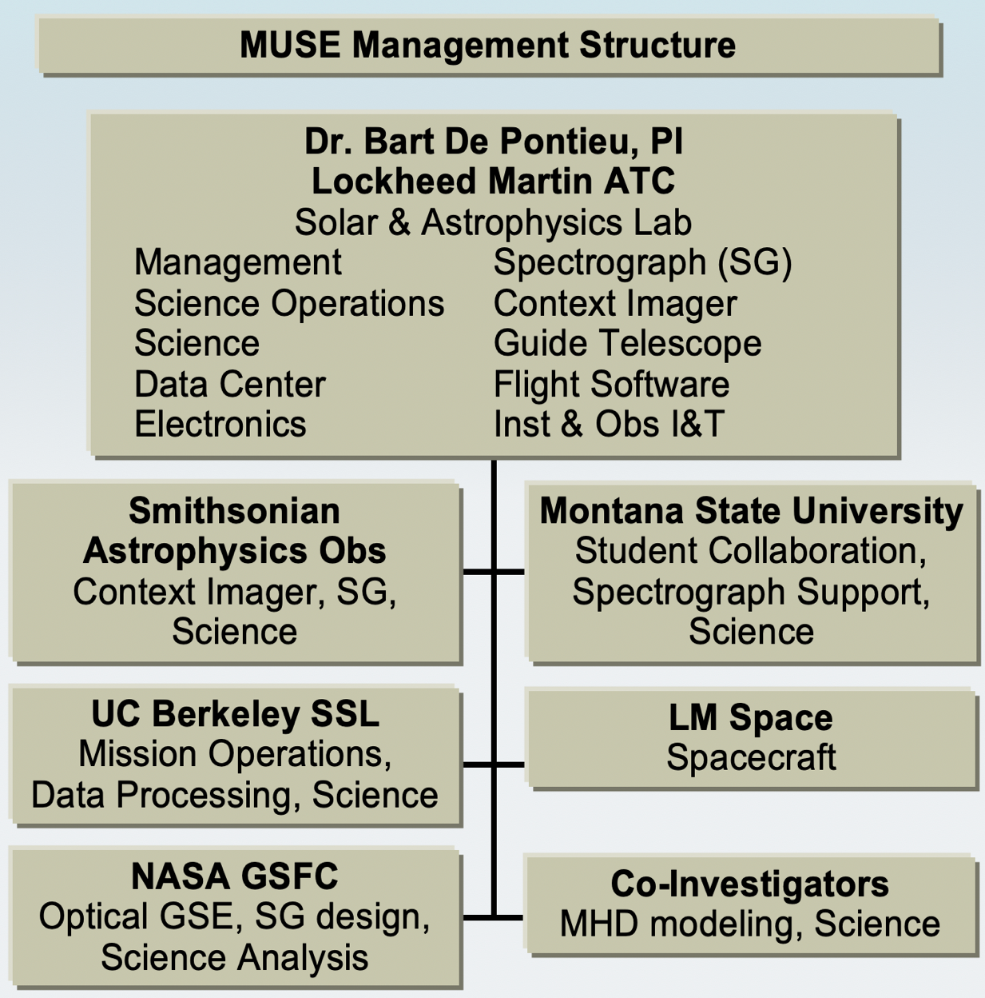
Probing the Physics of the Solar Atmosphere with the Multi-slit Solar Explorer (MUSE)
Institution Teams and Roles
NASA MIDEX 10 Mission
Contributions by:
Norwegian Space Agency (NOSA) for downlinks, data center and science
Italian Space Agency (ASI) for mirrors, thin film filters, coating tests, and science
German Aerospace Center (DLR) for grating, calibration, and science

Slide 21
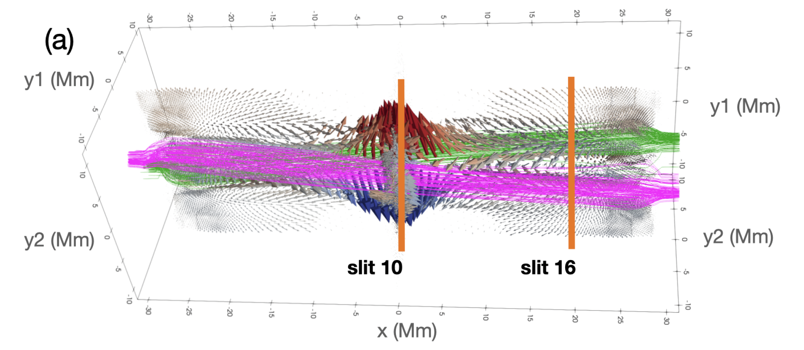
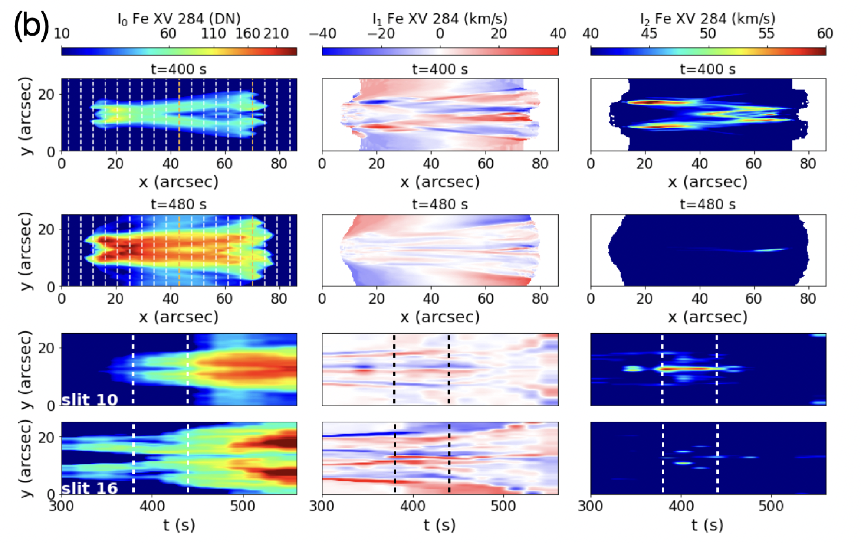
MUSE observables
jet
braiding
Line intensity
Doppler shift
Line width
Signature of nanojet/nanoflare
Fe XV 284 Hottest Muse passband

Slide 22
Conclusions
3D MHD simulations are crucial for understanding coronal heating / nanojets / nanoflares model
The more details we can catch from missions (MUSE) the more advanced our models become
… so that you can see the thing, when you see the thing

