Slide 1
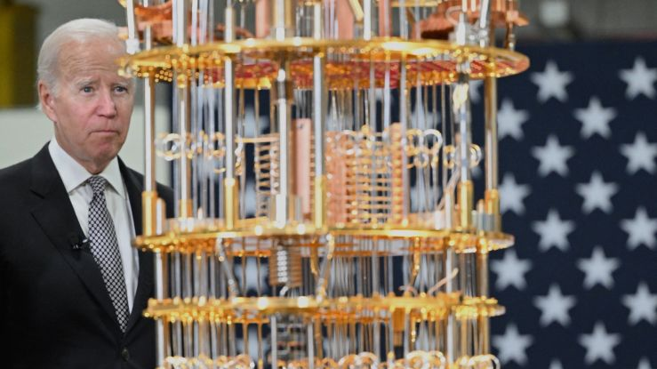
From Vlasov-Poisson to Schrödinger-Poisson
Approaching dark matter simulation with Quantum Computers
Luca Cappelli PhD, (UniTs – INAF - ICSC Spoke 10) luca.cappelli@inaf.it
Supervised by Giuseppe Murante (INAF) &
Stefano Borgani (INAF - UniTs)
From a previous collaboration with Ivano Tavernelli &
Francesco Tacchino (IBM Research Zurich).

Slide 2
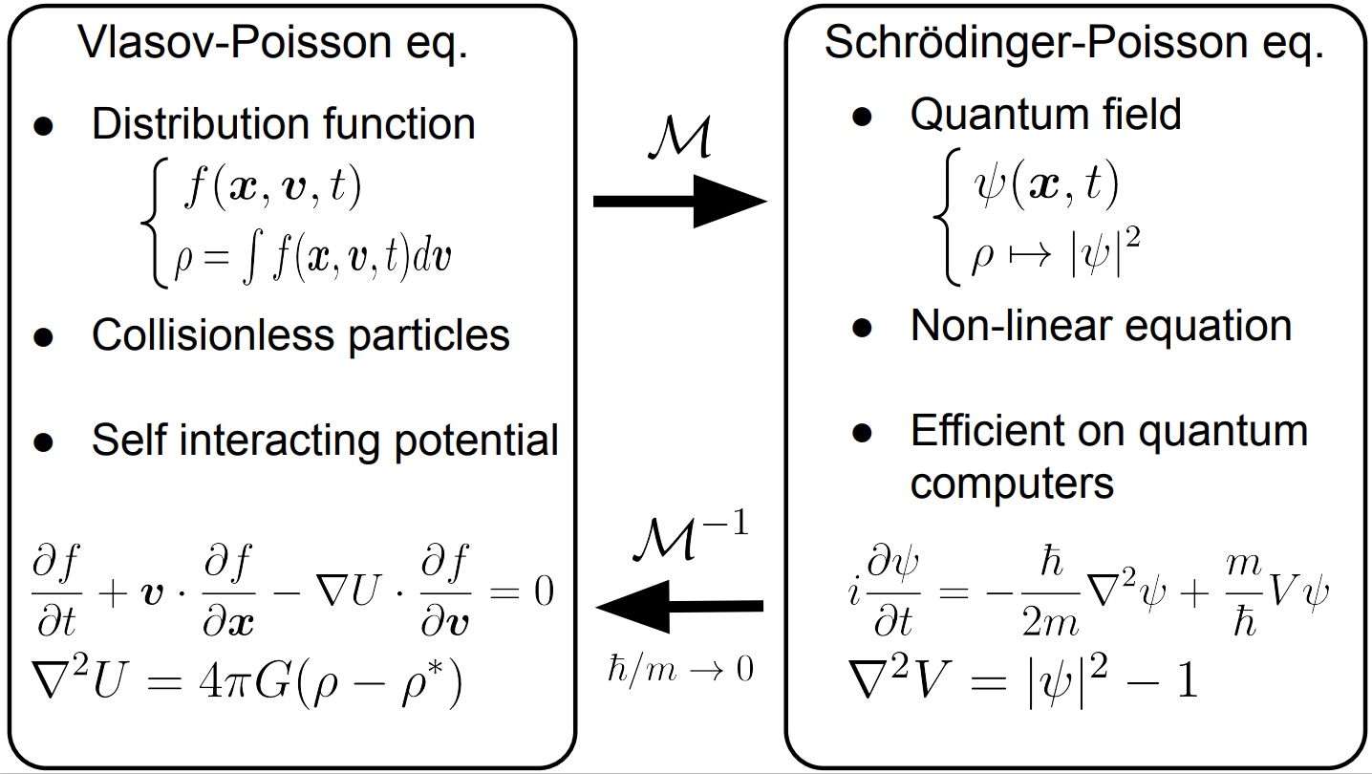
Introducing the problem
Not quantum computer efficient
[1] P.Mocz et al. , Physical Review D 97, 083519 (2018).

Slide 3
«Quantum» problems
Nonlinear dynamics of $Ψ$
vs
linear Quantum Computing
$${i∂}_{t}Ψ=−\frac{λ}{2}∇^{2}Ψ+\frac{1}{λ} V[Ψ] Ψ$$
$$\left\langle ψ | ψ\right\rangle =\sum_{k}{{\left|ψ_{k}\right|}^{2}=1}$$
$$∇^{2}V={\left|Ψ\right|}^{2}−1$$
Self consistent potential

Slide 4
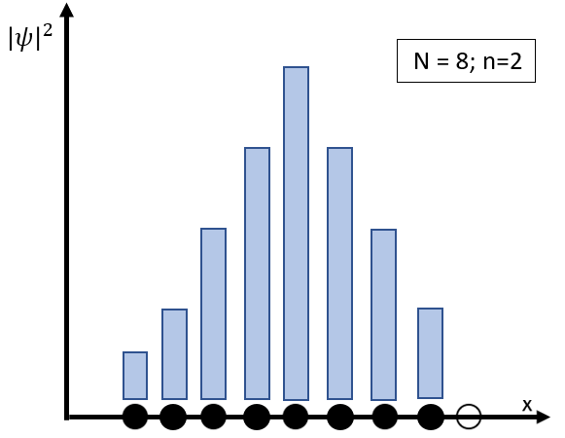
Discretization and encoding
1D: N = 4; L = 4
Generic First quantization encoding
$$\left|ψ \right\rangle =\sum_{j=0}^{N−1}{ψ_{j}|bin\left(j\right)⟩}$$
$$\left|00\right\rangle$$
$$\left|01\right\rangle$$
$$\left|10\right\rangle$$
$$\left|11\right\rangle$$
$$x_{0}$$
$$x_{1}$$
$$x_{2}$$
$$x_{3}$$
x
-2
-1
0
1
2
Logarithmic encoding:
$$n=\log_{2}{N}$$
Classical discretization – Physical wavefunction
;$n=3$
$$Ψ_{k}≃Ψ(x_{k})$$
Generic 2-qubits quantum state
$$\left|ψ\right\rangle =α_{0}\left|00\right\rangle +α_{1}\left|01\right\rangle +α_{2}\left|10\right\rangle +α_{3}|11⟩$$

Slide 5
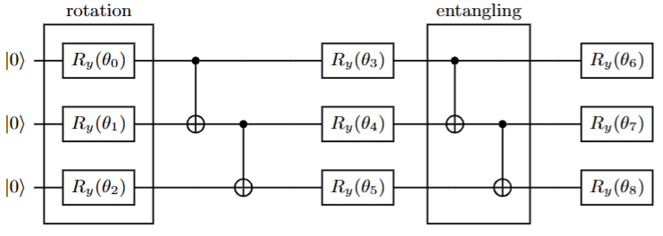
The Variational Approach – uses fewer variables
Trial wavefunction
$$U\left(θ\right)\left|0\right\rangle =|ψ\left(θ\right)⟩$$
Build cost function
$$F(\hat{O_{1}}, …, \hat{O_{L}})$$
i.e, Energy $E=\hat{K}\left(θ\right)+\hat{V}(θ)$
Adjust parameter According to classical minimization method
$$θ_{i}↦θ_{i}+δθ_{i}$$
Quantum
Classical
Classical
Measure Observables
$${\hat{O}}_{j}(|ψ\left(θ\right)⟩)$$

Slide 6
Solving the self-consistency problem-The algorithm
Minimization of
Initial state preparation
$$\left|ψ\left(θ_{0}\right)\right\rangle =U\left(θ_{0}\right)|0⟩$$
Solution of Poisson Eq.
→ $\left|V\left(φ(t)\right)\right\rangle =φ_{V}(t)\tilde{V}(φ(t))$
Quantum Measurement of :
Time evolution
Classically solve
Integrate (Euler method) $θ\left(t+δt\right)=\dot{θ}δt$

Slide 7
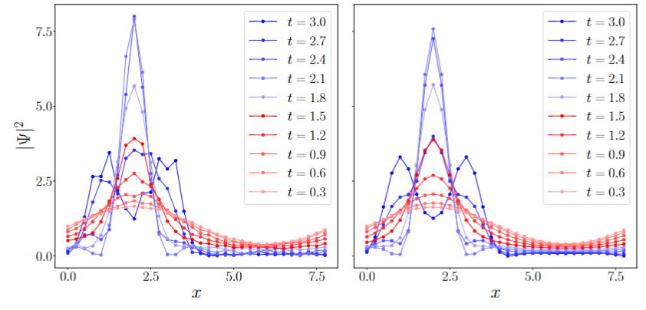
Quantum-VTE
Results

Slide 8
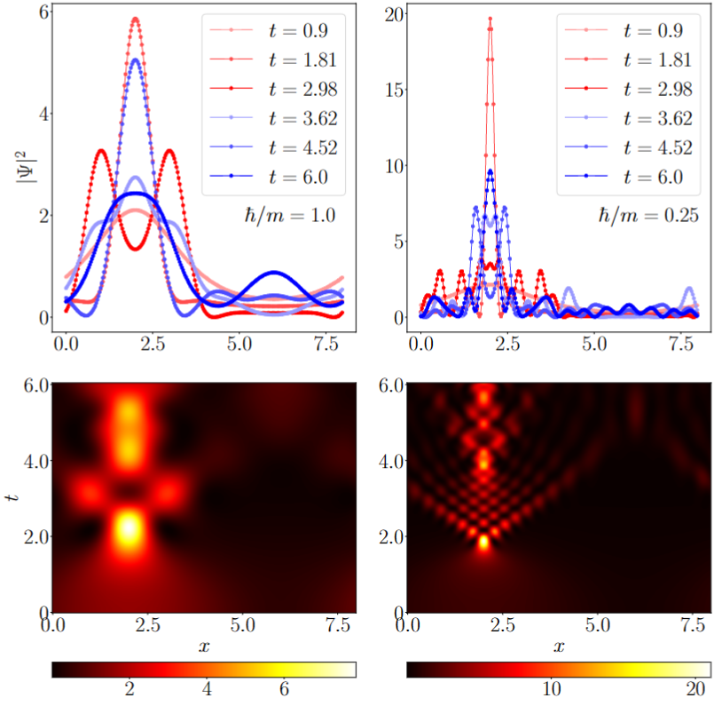
A matter of $λ$ (with classical simulations)
$${i∂}_{t}Ψ=\left(−\frac{λ}{2}∇^{2}+\frac{1}{λ}V\right)Ψ$$
$$∇^{2}V={\left|Ψ\right|}^{2}−1$$
$λ=\frac{ℏ}{m}$ Just Symbolic!!

Slide 9
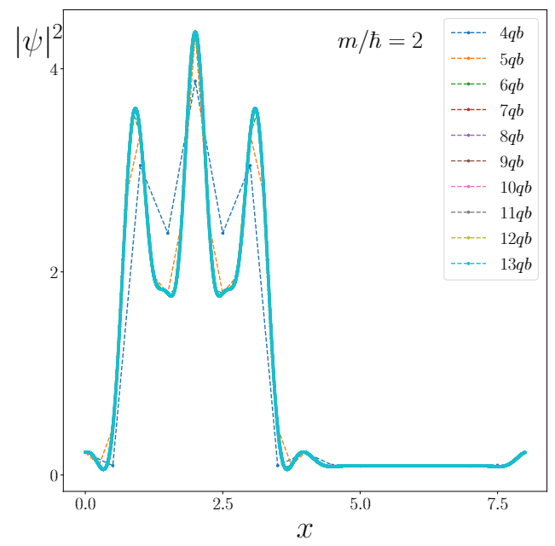
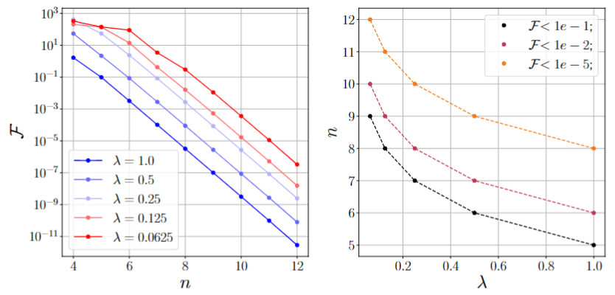
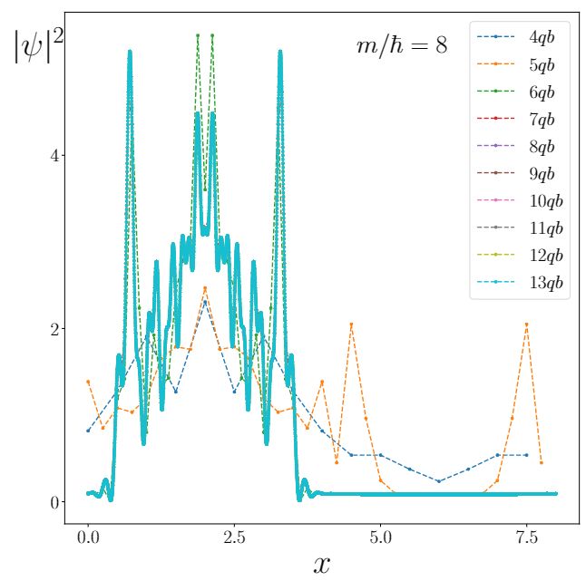
Convergence & resolution
Convergence
$$F={\left|\left|f_{n} −f_{13}\right|\right|}^{2}$$
With: $n$ - number of qubits
$f_{n}$- distribution with resolution $n$
Empirical fit
$$n\left(λ,F\right)=−1.44\log\left(λ\right)+n(F, λ=1)$$

Slide 10
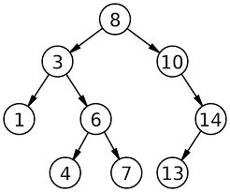
Improvements
Quantum Tree-Search for Tree method
New Algorithms

Slide 11
Thanks for the attention

