Slide 1
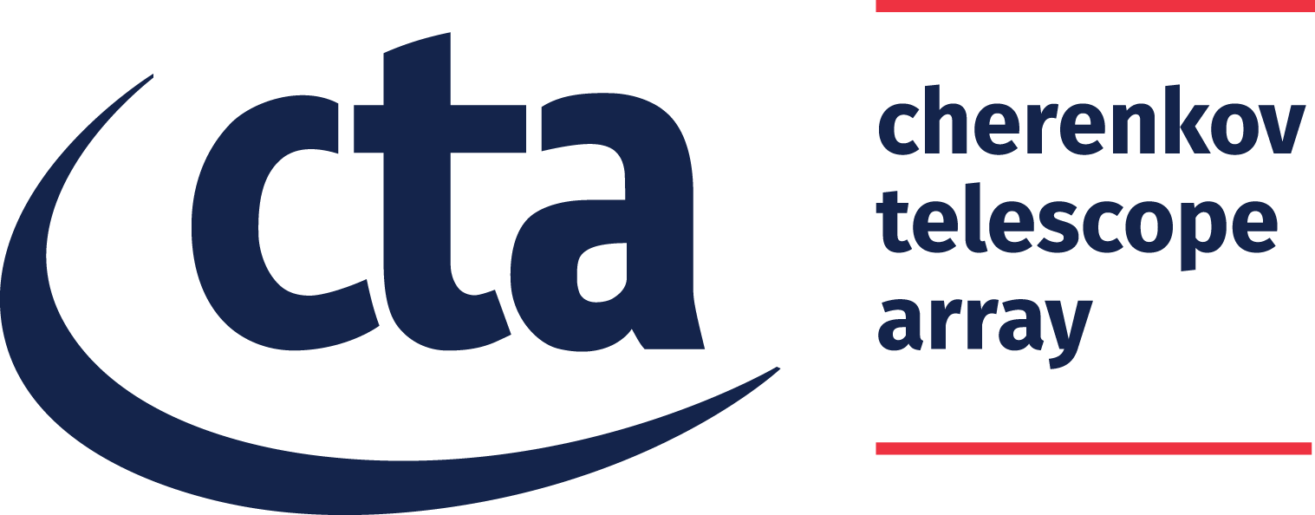


Computational Infrastructure for the Monitoring System of the Cherenkov Telescope Array
INAF USCVIII - Calcolo Critico
15–16 Jun 2023
F. Incardona, A. Costa, K. Munari, P. G. Bruno, S. Germani

Slide 2
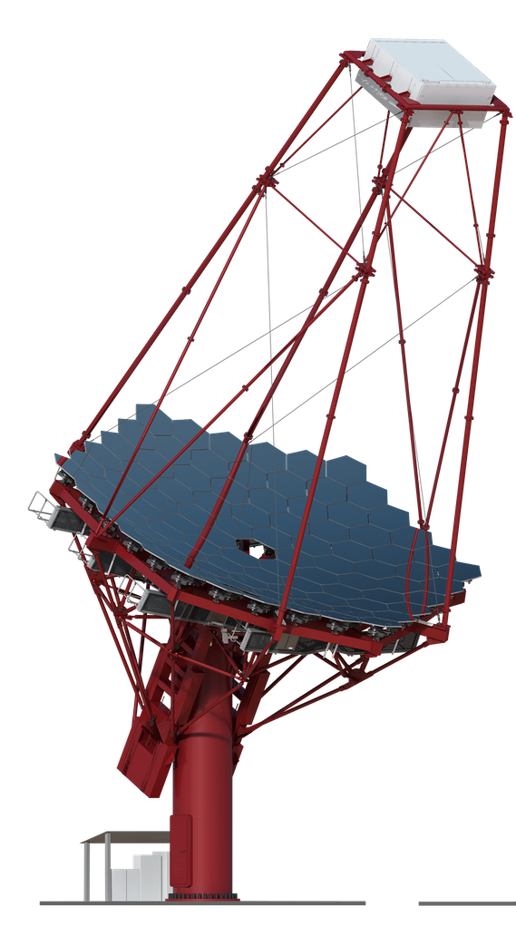
Cherenkov Telescope Array
More than 100 telescopes deployed at the 2 hemispheres of Earth
        Large-Sized Telescope (LST): ~23 m; ~50 tonnes; ~20 sec for repositioning
        Medium-Sized Telescope (MST): ~12 m; “workhorse” of CTA with sensitivity in its core energy range
        Small-Sized Telescope (SST): ~4 m; sensitive to the highest energies
CTA N + CTA S = CTA Observatory (CTAO): the first ground-based gamma-ray proposal-driven observatory open to the worldwide astronomical and particle physics communities
Notes:
The CTA is a telescope facility that will be able to detect very high-energy gamma rays in the range from twenty GeV to three hundreds TeV.
A lot of science can be done thanks to the Cherenkov telescopes, which indeed enable us to investigate phenomena as the origin and the role of the relativistic cosmic particles, the star formation and galaxy evolution, the physics in proximity of neutron stars and black holes, the nature of the dark matter, excetera
CTA will be composed of more than one-hundred telescopes of different sizes deployed at the two Earth’s hemispheres.
The CTA telescopes belong to three classes: Large, Medium, and Small sizes telescopes.
The LST telescopes have a primary mirror of about twenty-three m in diameter, a weight of about fifty tons, and they should fulfill the requirement of about twenty seconds for the repositioning time, which is impressive for such a massive structure
(The MST telescopes are the workhorse of CTA with a mirror of about twelve m, and a sensitivity in the core range of CTA)
(The SST telescopes are the smallest ones and are sensitive to the highest energies)
Different sets of telescopes will be deployed at the two sites, and together they will form the CTA Observatory. It will be the first ground-based gamma-ray observatory open to proposals coming from the worldwide scientific community

Slide 3

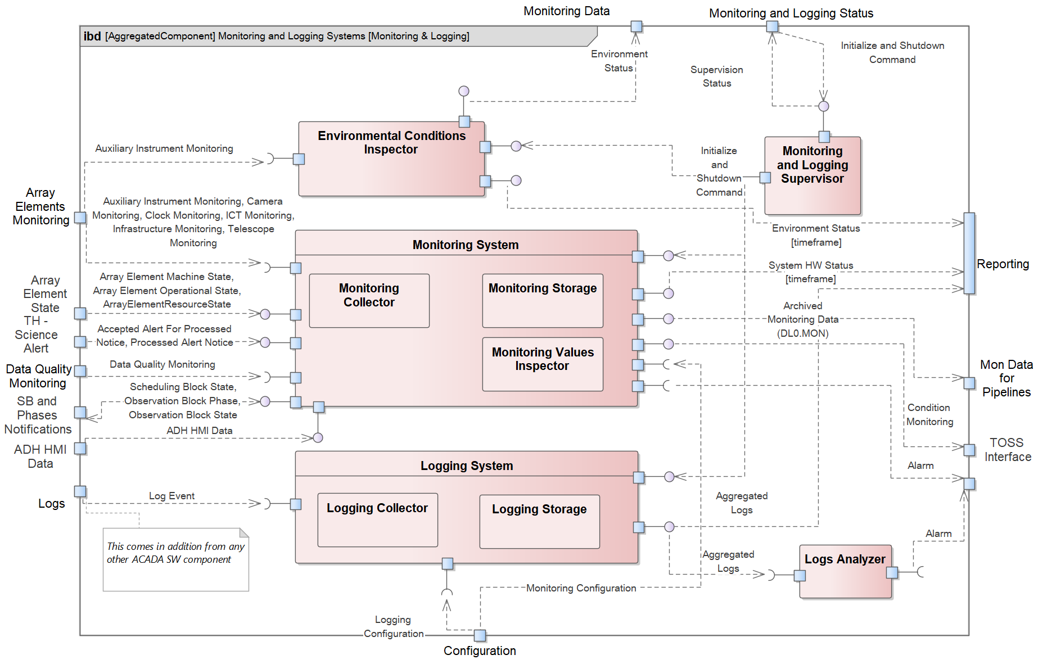
Monitoring System (MON)
Large throughput
Scalability
Partition tolerance
Availability
Notes:
The Monitoring System of CTA is the piece of software that is responsible for collecting all the data which are ancillary to the scientific data.
In particular, for example, the data coming from sensors: there are indeed a lot of sensors spread all over the instrumentation that makes the CTA an Internet of things environment;
the data coming from the auxiliary instruments such as the weather stations, LiDARs, FRAMs; and the log files that are produced by the low-lew firmware of the devices and by the user
MON must deal with a large data throughput and also must be able to scale up with the number of devices to monitor.
Besides, since we are dealing with scientific experiments, MON data should be accessible from everywhere and any time.
Main components of the Monitoring System are the Collectors which are in charge of retrieving the data from the different sources, and, thanks to a Queue mechanism, of forwanding them to the other software components for example to the Alarm System if some value is beyond the provided thresholds
Other important components are the Storage components that are in charge of persisting the data for later inspection.
And finally the Supervisors that are in charge of managing the life cycle of all the components

Slide 4

Monitoring Data as Big Data
Expected ~200.000 monitoring points sampled at a maximum rate of 5 Hz for a maximum throughput of ~1.26 Gbps, including logging
–> Volume and Velocity
Different data sources collected via different protocols
–> Variety
Provide a solid framework for identifying measurement systematics and maintenance issues
–> Value and Veracity
Notes:
In the previous slide, we saw that CTA is an Internet of Things environment. Here instead, we see that the Monitoring Data of CTA can be described as Big Data
We expect indeed to collect about 200.000 monitoring points sampled at a maximum rate of 5 Hz for a maximum throughput of ~1.26 Gbps, including logging –> Volume and Velocity
We have different data sources: the condition-based monitoring system, auxiliary instruments (weather stations, LiDAR, FRAM, etc.), low-level firmware, operational scripts, and user activities through the HMI. Also, data are collected via different protocols (ACS, OPC-UA Servers, Log files, etc.) –> Variety
Logging and monitoring systems aim at providing a solid framework for identifying measurement systematics and maintenance issues –> Value and Veracity
5 Petabyte/year

Slide 5
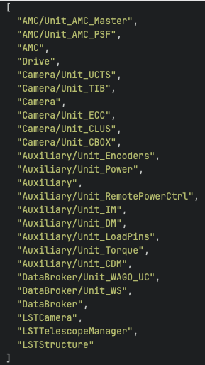
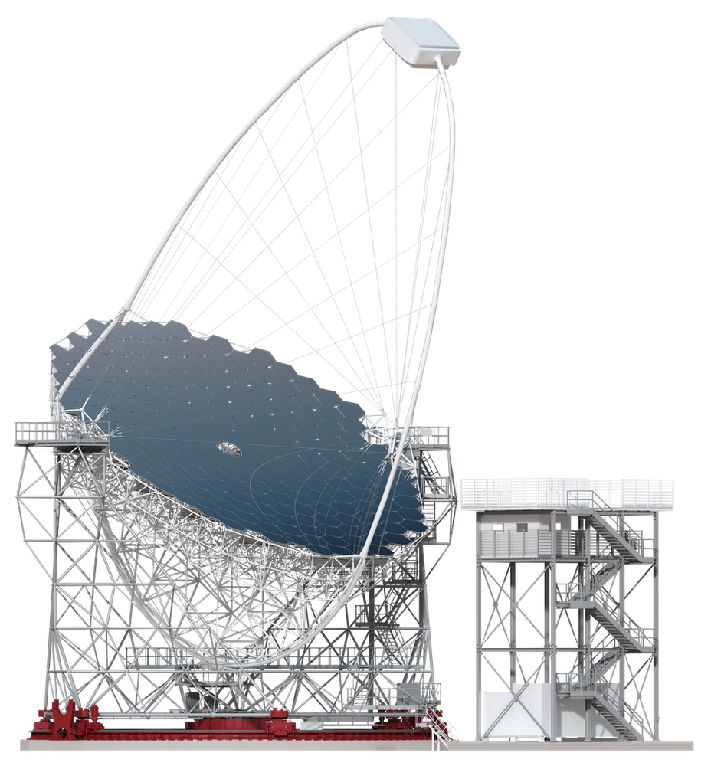
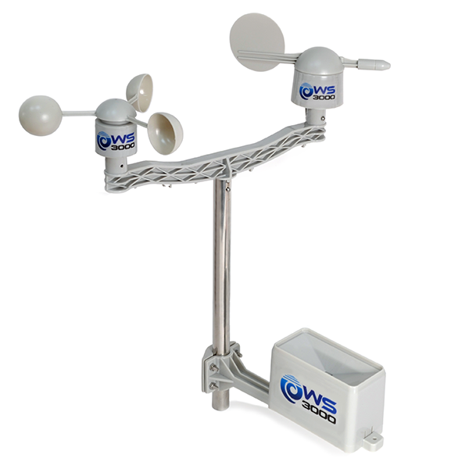
Goal Achieved: LST Integration
Successfully monitored
BACI Properties
and
Weather Station
Notes:
Recently, in the last couple of weeks, we successfully integrated and tested our software with real hardware. In particular, we were able to monitor some properties of an LST telescope located in La Palma, you see here the list of monitored properties, and the LST Weather Station
BACI property is a high-level representation of a monitoring or control point/entity;

Slide 6
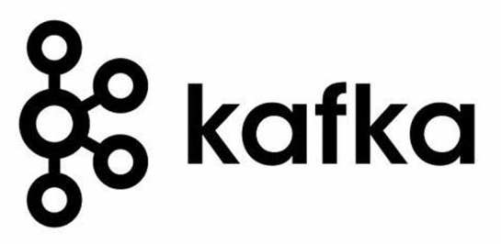
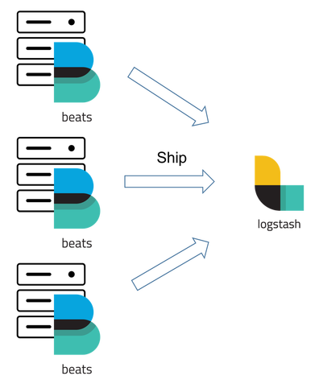


Technologies Adopted
Queue: Apache Kafka
Logging: Elastic Filebeats and Logstash
Data serialization: Apache Avro
Storage: Apache Cassandra
Notes:
But going back to software, I would like to spend a few words on the most important technologies the Monitoring System exploits, which are the most advanced ones in the field of Big Data and Internet of Things (IoT). We make use of Apache Kafka which is an event-streaming platform used by many companies in industries (for example Netflix and Spotify).
We use part of the Elastic stack for dealing with logging. We install in each device to be monitored a Filebeats instance, which acts as a log shipper by reading and forwarding the new messages to a log aggregator that we realize thanks to Logstash. These technologies allow the system to perform log filtering both at device and central level
We use Apache Avro for data serialization and for exchanging data from a component to another
Finally, we exploit Apache Cassandra that is a NoSQL database for persisting data. Cassandra is a database specifically developed for time-series, and today is used by a lot of companies like Instagram, apple, ebay, netflix and many others

Slide 7
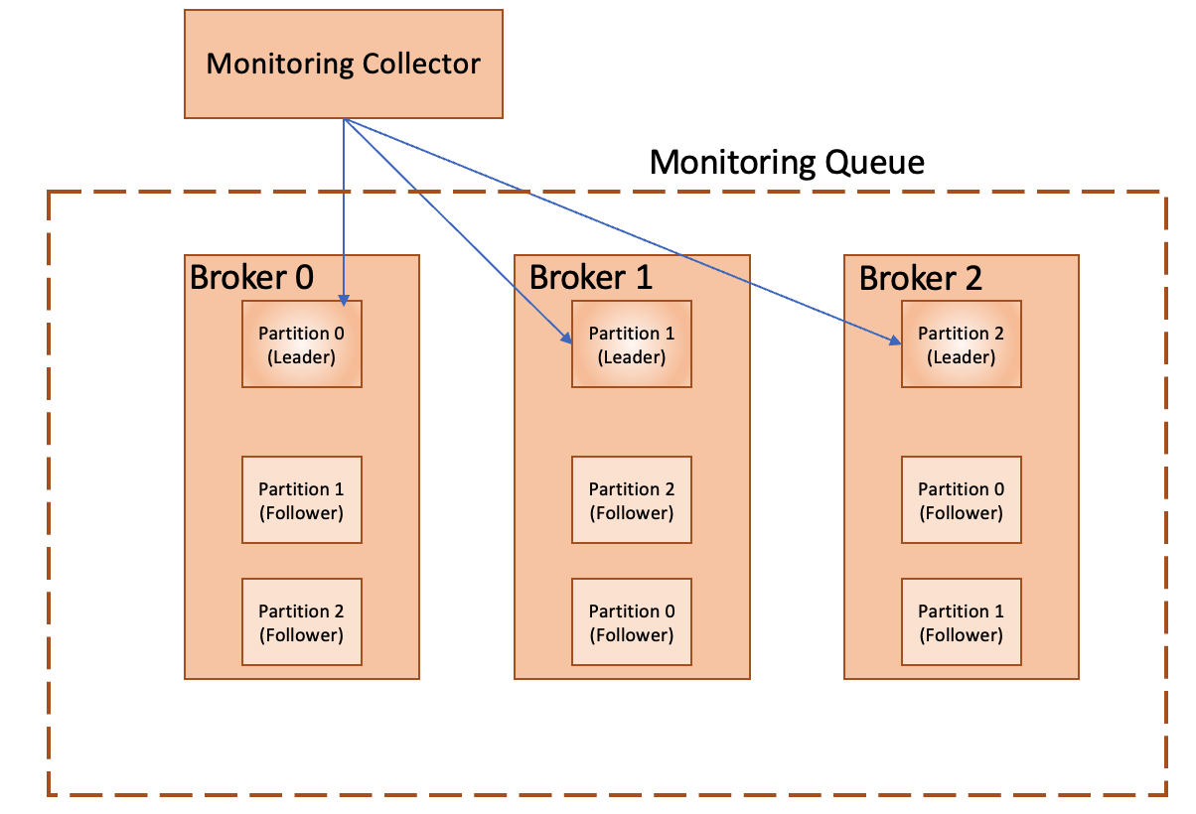
Queue Architecture
Collected values are written to a dedicated Kafka topic that is spread across partitions and replicated on different queue systems (Kafka brokers)
Text buffers
Notes:
Let’s take a look more closely at the Architecture of the Queue System that is responsible for data transfer inside the Monitoring Software.
The collected values are written to a dedicated Kafka topic. To satisfy requirements on fault tolerance, high throughput, and scalability, the topic is spread across three partitions. The partitions are simply some text buffers, so, to increase the writing speed, the partitions are spread across three different queue systems (kafka brokers), running on different nodes.
Each partition is automatically replicated with a Leader-Follower mechanism.

Slide 8
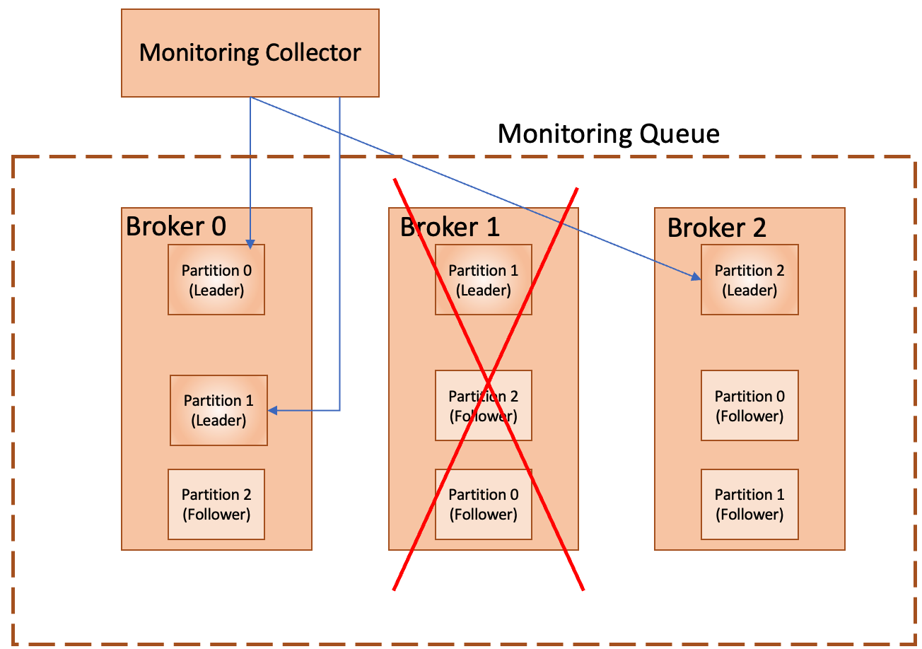
Queue Architecture
Collected values are written to a dedicated Kafka topic that is spread across partitions and replicated on different queue systems (Kafka brokers)
Notes:
So, if one or two brokers fail a new leader is elected among the available ones and the Monitoring System can continue collecting and archiving monitoring values

Slide 9
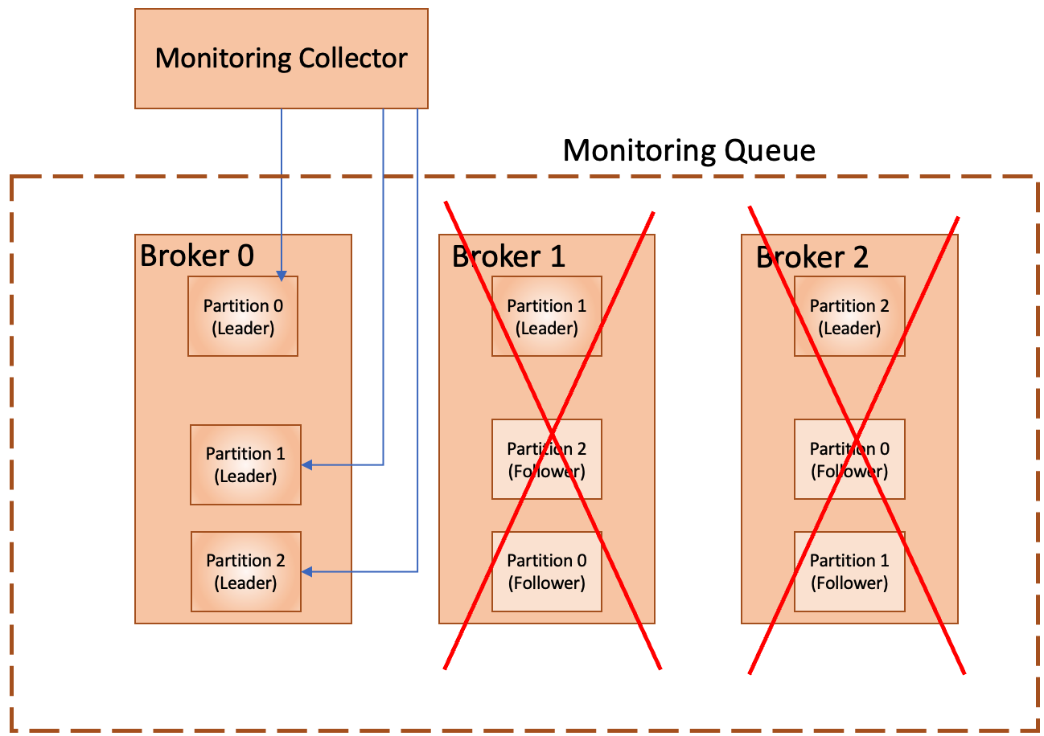
Queue Architecture
Collected values are written to a dedicated Kafka topic that is spread across partitions and replicated on different queue systems (Kafka brokers)
Notes:
By exploiting three brokers we are tolerant up to two node failures

Slide 10
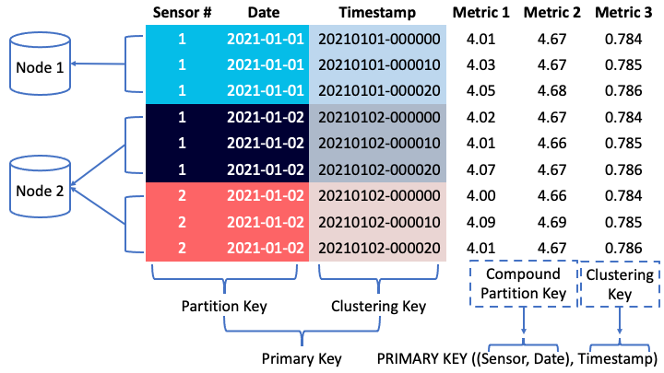
Storage Architecture
Read and write operations are performed using a primary key on a Cassandra table.
The partition key defines a unique set of rows that is managed within a node of the cluster.
Notes:
As for the Storage architecture, as I mentioned before we use Cassandra, which is a column-based database.
In our data model, a monitoring value is defined by eight fields that define the structure of the table inside the database. In Cassandra, reading and writing operations are performed using a primary key on a table, which in turn is composed by a partition key that defines a unique set of rows that is managed within a node of the cluster, and an optional clustering key, which handles the data arrangement part.
For example, in the picture you can see how all the data collected for a given sensor on a given date are stored together within a node
The expected rate of data collection, as I mentioned before, is about 200.000 monitoring point per second and this is also the requirement for the writing rate in Cassandra
assembly: name of the data source component, e.g. ‘PowerSupply1’;
name: name of the property, e.g. ‘Current’;se
serial_number: device serial number;
server_timestamp: time at which the property is received by the server;
source_timestamp: time at which the property is produced by the device;
units: units of the quantity represented by the property , in SI units, e.g. ‘A’;
env_id: string representing the environment, e.g. ‘CTA-N’, ‘CTA-S’;
data: time-series data (list of "double"), containing the monitoring information
payload, e.g. wind speed (m/s), voltage (V).

Slide 11
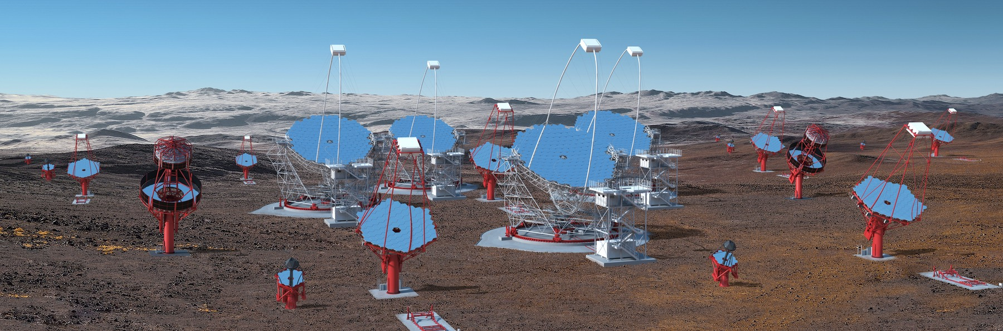
Hardware Requirements
MONITORING CTAO-S Baseline Configuration
  LST: 4
  MST: 25
  SST: 70
  616 monitoring points per single telescope
Both Queue and Storage require large I/O throughput
Assuming 16 CPU cores per node:
6 nodes for the Queue
6 nodes for the Storage
1 node for the Schema Registry
1 node for the Logging Aggregator
Rendering credit: Gabriel Pérez Diaz, IAC / Marc-André Besel, CTAO
99 telescopes
14 nodes and 224 cores
Notes:
And here we come to hardware requirements.
Currently, the baseline configuration for the CTAO-S facility foresees the deployment of 99 telescopes. For each of them, the Monitoring System will monitor 616 monitoring points
In order to address such a large data rate we will need 6 nodes for the Queue, 6 nodes for the Storage, 1 node for the Schema Registry, which is a component that persists the Avro Schema which is required for data transfer, and 1 node for the Logging Aggregator
The total amount is 14 nodes, and 224 cores assuming 16 cores per node
As hopefully, it was clear from previous slides, both queue and storage components require large I/O throughput. The ideal would be a solid-state drive.
Tùotal number of monitored points under a1) = 60984
Expected rate in CTAO-S Baseline under a1),a2) = 60984 value/s

Slide 12
Hardware Requirements
ALARM CTAO-S Baseline Configuration
  LST: 4
  MST: 25
  SST: 70
  220 monitoring points per single telescope
Both Queue and Storage require large I/O throughput
Assuming 16 CPU cores per node:
3 nodes for the Queue
1 node for the Storage
1 node for the Integrated Alarm System (IAS)
f
Rendering credit: Gabriel Pérez Diaz, IAC / Marc-André Besel, CTAO
99 telescopes
5 nodes and 80 cores
Notes:
A separate discussion is required for the Alarm System, which gets an architecture very similar to the Monitoring System, but of course, there are fewer monitoring points since not all of them generate an alarm. So, in this case, we expect only 220 monitoring points per telescope.
The hardware requirement in this case is 3 nodes for the Queue, 1 node for the Storage, and 1 node for the Integrated Alarm System (which is the alarm system developed in the context of ALMA experiment) for a total of 5 nodes and 80 cores
Total number of monitored points under a1) = 60984
Expected rate in CTAO-S Baseline under a1),a2) = 60984 value/s

Slide 13
The End
Thanks for your attention

Slide 14
Storage Architecture
Notes:
In our data model a monitoring value is defined by eight fields:
assembly: name of the data source component, e.g. ‘PowerSupply1’;
name: name of the property, e.g. ‘Current’;
serial_number: device serial number;
server_timestamp: time at which the property is received by the server;
source_timestamp: time at which the property is produced by the device;
units: units of the quantity represented by the property , in SI units, e.g. ‘A’;
env_id: string representing the environment, e.g. ‘CTA-N’, ‘CTA-S’;
data: time-series data (list of "double"), containing the monitoring information
payload, e.g. wind speed (m/s), voltage (V).
Cassandra read and write operations are performed using a primary key on a table composed by a partition key, which defines a unique set of rows that is managed within a node of the cluster, and an optional clustering column, which handles the data arrangement part (Fig. 1).

Slide 15
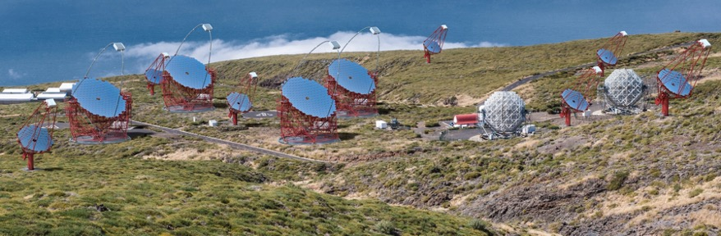
Hardware Requirements
MONITORING CTAO-N Baseline Configuration
  LST: 4
  MST: 15
  SST: 0
  181 monitoring points per single telescope
Both Queue and Storage require large I/O throughput
Assuming 16 CPU cores per node:
1 node for the Queue
1 node for the Storage
1 node for the Schema Registry
1 node for the Logging Aggregator
Rendering credit: Gabriel Pérez Diaz, IAC
19 telescopes
4 nodes and 64 cores
Notes:
Total number of monitored points under a1) = 60984
Expected rate in CTAO-S Baseline under a1),a2) = 60984 value/s

Slide 16
Hardware Requirements
ALARM CTAO-N Baseline Configuration
  LST: 4
  MST: 15
  SST: 0
  65 alarm points per single telescope
Both Queue and Storage require large I/O throughput
Assuming 16 CPU cores per node:
1 node for the Queue
1 node for the Storage
1 node for the Integrated Alarm System (IAS)
f
Rendering credit: Gabriel Pérez Diaz, IAC
19 telescopes
3 nodes and 48 cores
Notes:
Total number of monitored points under a1) = 60984
Expected rate in CTAO-S Baseline under a1),a2) = 60984 value/s

