Slide 1
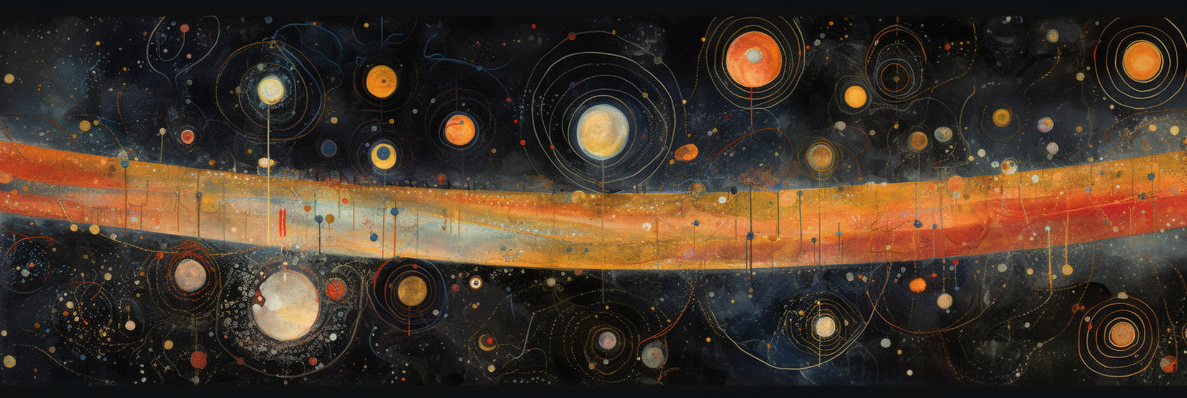
The cosmic dance
Unveiling the dynamics of supermassive black holes in cosmological simulations
Alice Damiano
PhD UniTS
Supervisors :
Stefano Borgani, Luca Tornatore, Milena Valentini
Spoke 3 General Meeting
Catania - 14/06/2023

Slide 2
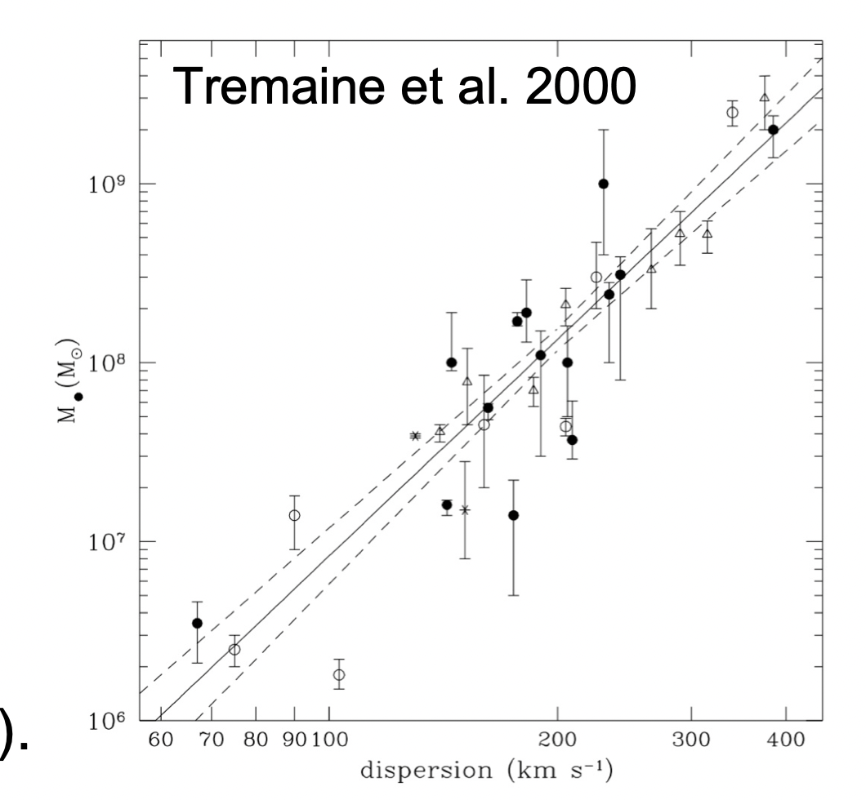
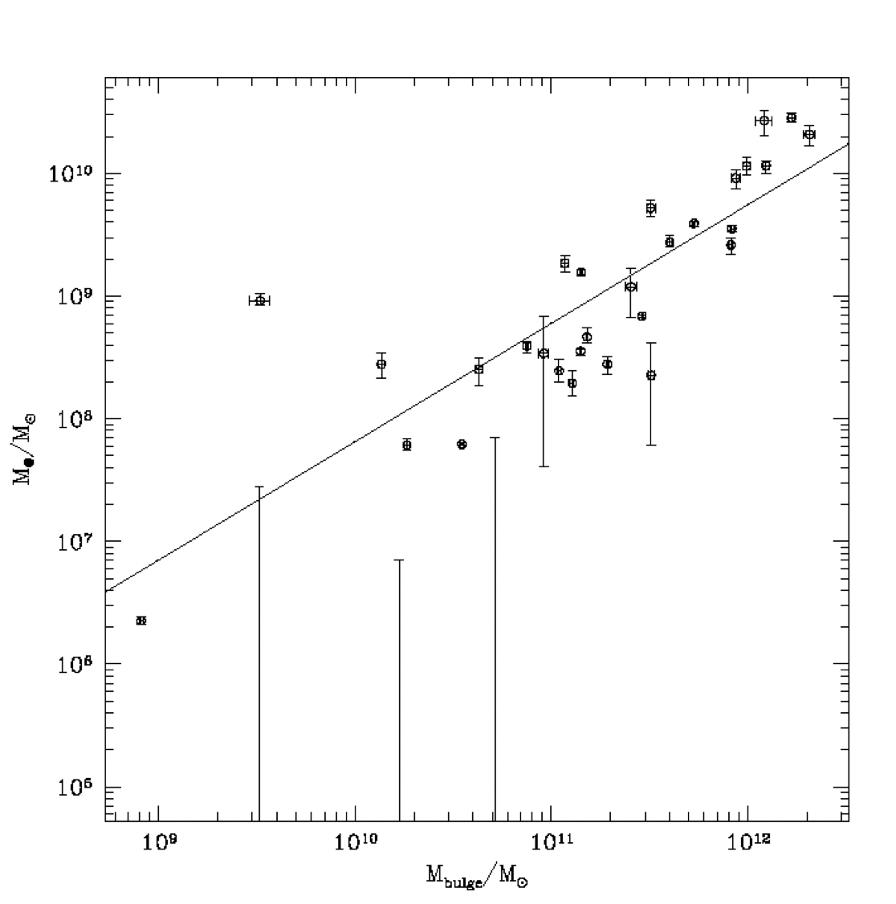
Part I
The importance of being a black hole
Active Galactic Nuclei, powered by Supermassive Black Holes, can solve the tension between the hierarchical structure growth and the $downsizingtrend^{1,2}$.
Tremaine et al.2000
The growth of Supermassive Black Holes and their host galaxy seem to be intertwined, witnessing that BHs play a key role in galaxy evolution${}^{3}$.
Fontanot, F., De Lucia, G., Monaco, P., Somerville, R.S. and Santini, P., 2009. The many manifestations of downsizing: hierarchical galaxy formation models confront observations. Monthly Notices of the Royal Astronomical Society, 397(4), pp.1776-1790
Bower, Richard G., et al. "Breaking the hierarchy of galaxy formation." Monthly Notices of the Royal Astronomical Society 370.2 (2006): 645-655.
Magorrian, John, et al. "The demography of massive dark objects in galaxy centers." The Astronomical Journal 115.6 (1998): 2285.
Magorrian 2000

Slide 3
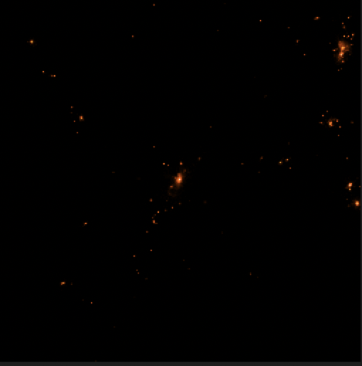
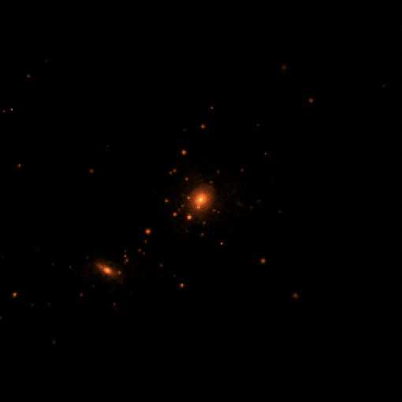
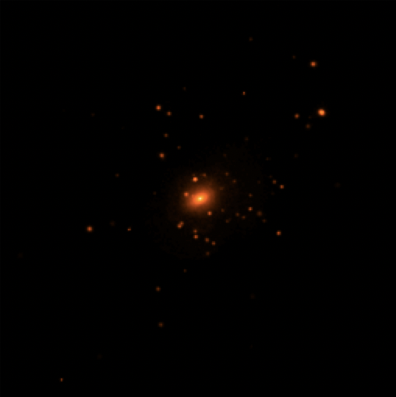
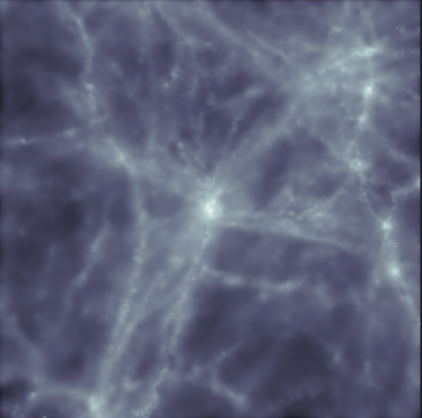
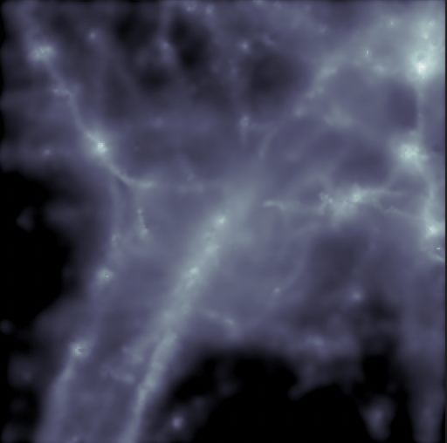
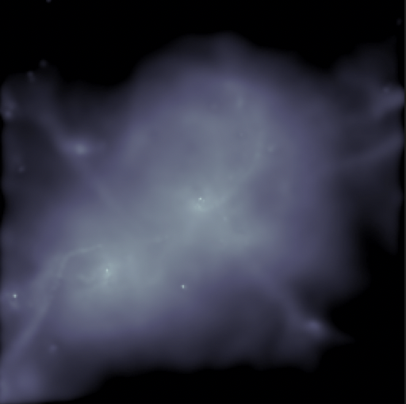
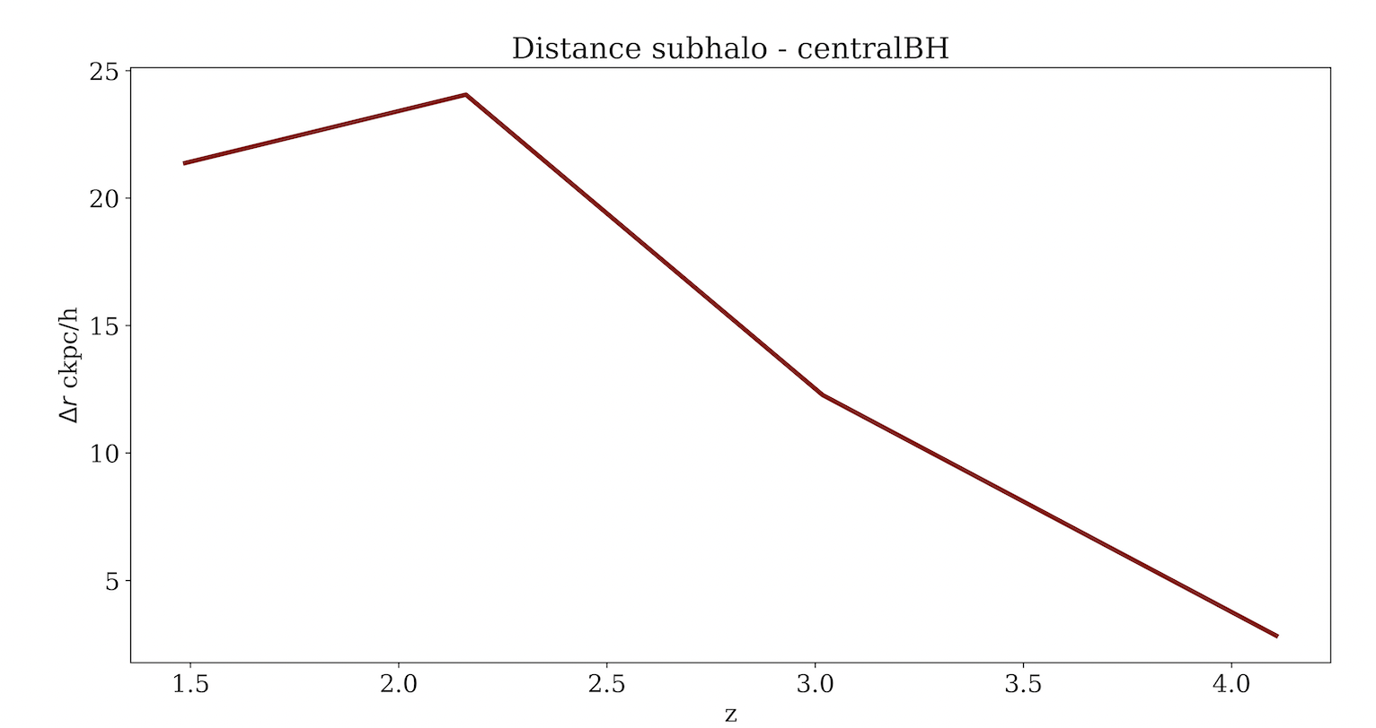
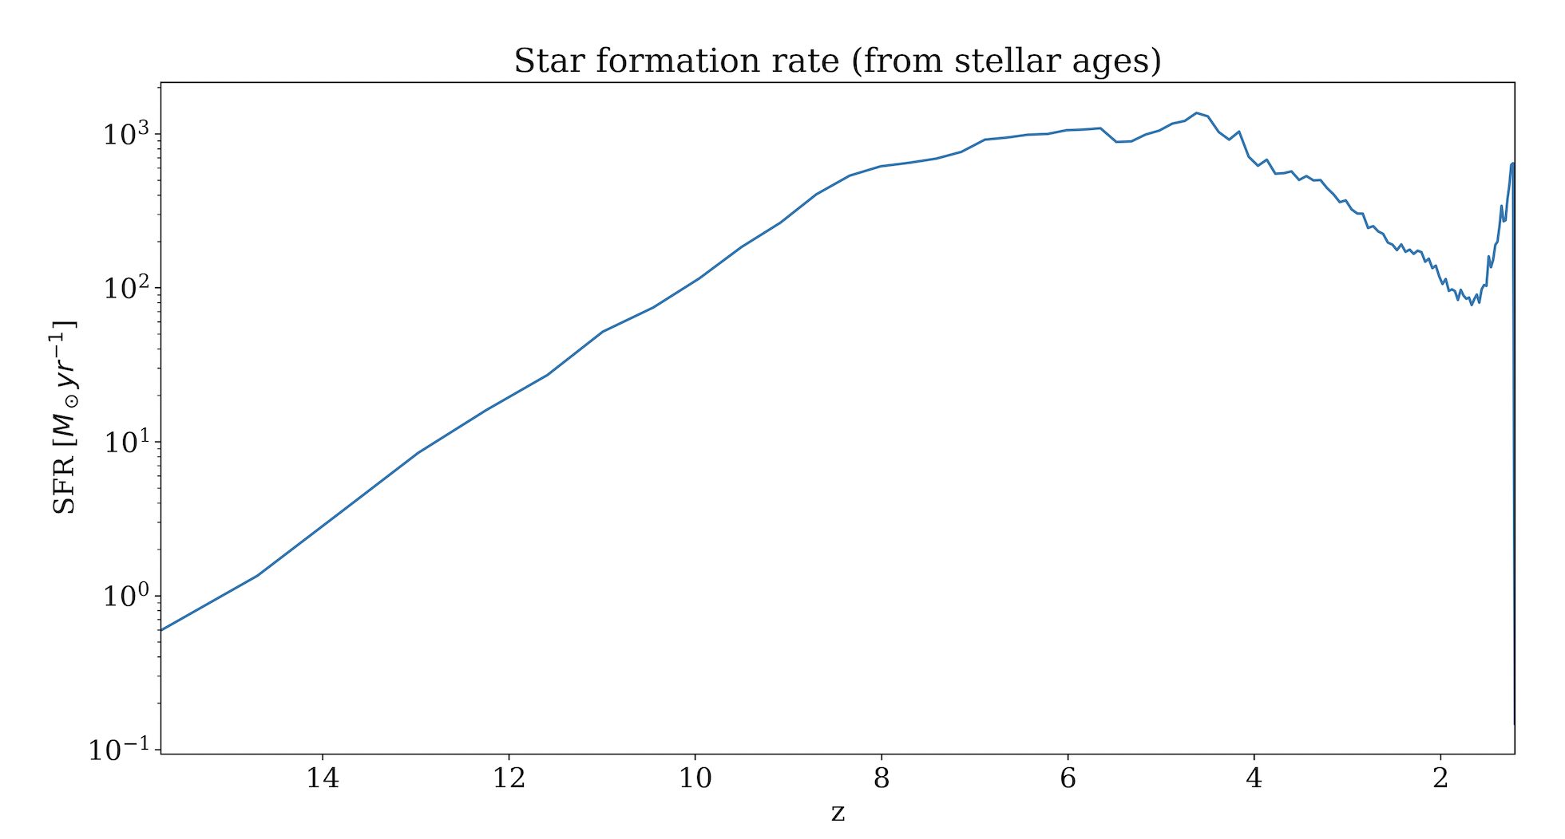
Part I
How it all started
Zoom-in simulations of galaxy clusters belonging to the DIANOGA set using the lagrangian OpenGadget3 code (TreePM-SPH).

Slide 4
Part II
Part II
Dealing with black holes in cosmological simulations
Solve the dynamics of a collision less self-gravitating fluid by sampling the fluid with discrete tracer particles. The evolution of the fluid is then obtained by integrating their equation of motion in the collective gravitational field.
Due to the sampling in mass, simulations cannot be able to reproduce the dynamics of single particles.
$$Φ({\overset{⃗}{r}}_{i})=\underset{j}{∑}\frac{Gm_{j}}{(|{\overset{⃗}{r}}_{i}-{\overset{⃗}{r}}_{j}|^{2}+ϵ^{2})^{1/2}}$$
The computation of the gravitational interactions is correct only above the softening length. In cosmological simulations it often relies on approximate methods.
One major obstacle is that becomes necessary to accurately follow the dynamics of one single object, the black hole, something that simulations with force resolution larger than a few pc are inherently not well equipped to do.
Tremmel, Michael, et al. "Off the beaten path: a new approach to realistically model the orbital decay of supermassive black holes in galaxy formation simulations." Monthly Notices of the Royal Astronomical Society 451.2 (2015): 1868-1874.

Slide 5
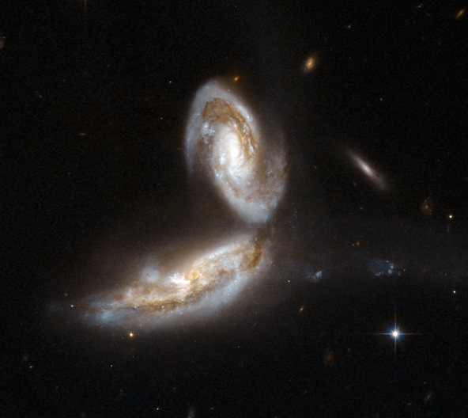
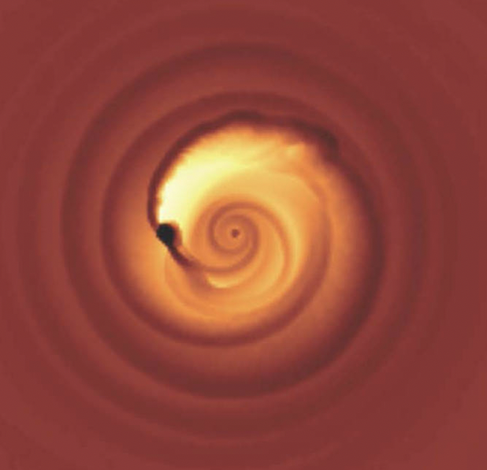
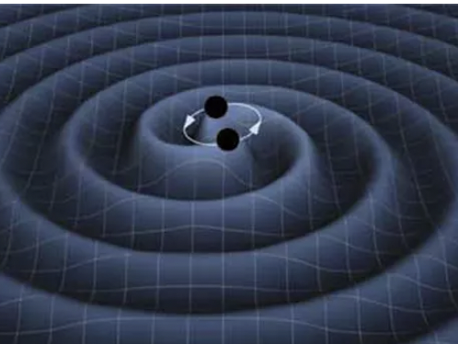
Part II
Black hole mergers
The two galaxies merge
The pairing phase is dominated by
dynamical friction
Stellar hardening and GW emission
drive the last stages
HST image of NGC5331
Image credit: Columbia University
Image credit: K. Thorne (Caltech) and T. Carnahan (NASA GSFC)
$$∼100kpc$$
$$∼10kpc$$
$$∼10pc$$
Cosmological simulations

Slide 6
Part II
Introducing dynamical friction: our new prescription
The recipe
Add a correction to the gravitational interactions under the softening length to account for the unresolved dynamical friction force.
How it works
Every particle at a distance < $h_{s}$ adds a contribution that depends on its mass and its relative velocity.
$${\overset{⃗}{F}}_{BH}={\overset{⃗}{F}}_{g}+\overset{N(<h_{s})}{\underset{i}{∑}}{\overset{⃗}{F}}_{{df}_{i}}({\overset{⃗}{v}}_{{rel}_{i}},m_{i})$$
$${\overset{⃗}{F}}_{{df}_{1}}$$
$${\overset{⃗}{F}}_{{df}_{2}}$$
$${\overset{⃗}{F}}_{{df}_{4}}$$
$${\overset{⃗}{F}}_{{df}_{3}}$$

Slide 7
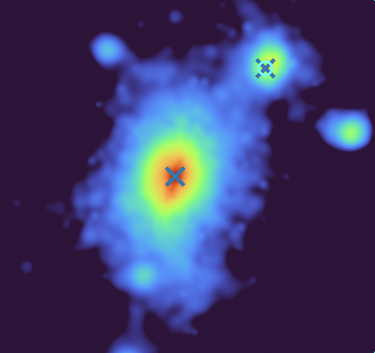
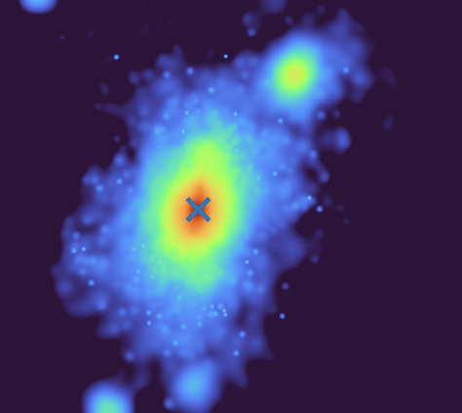
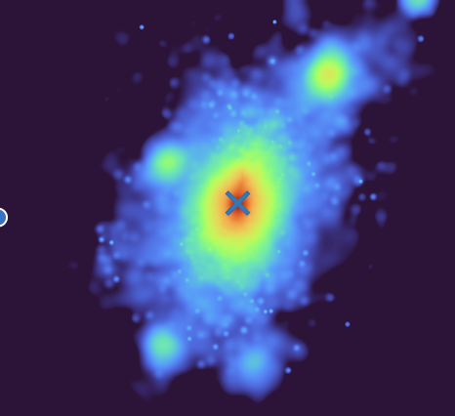
Part III
Comparing with other implementations: the pinning prescription
The recipe
Re-position the black hole in the position of the neighbour star particle having the minimum potential.
The black holes are well centered into the hosting galaxies
The merger events are extremely fast
The dynamics of merger is not reproduced

Slide 8
Part III
Comparing with other implementations: the dynamical mass
The recipe
The black hole particles have a second artificial boosted mass which account for gravitational interactions.
Improves the modelization of the merger event
Does not reproduce the loss of angular momentum shrinking the orbits of the merging black holes

Slide 9
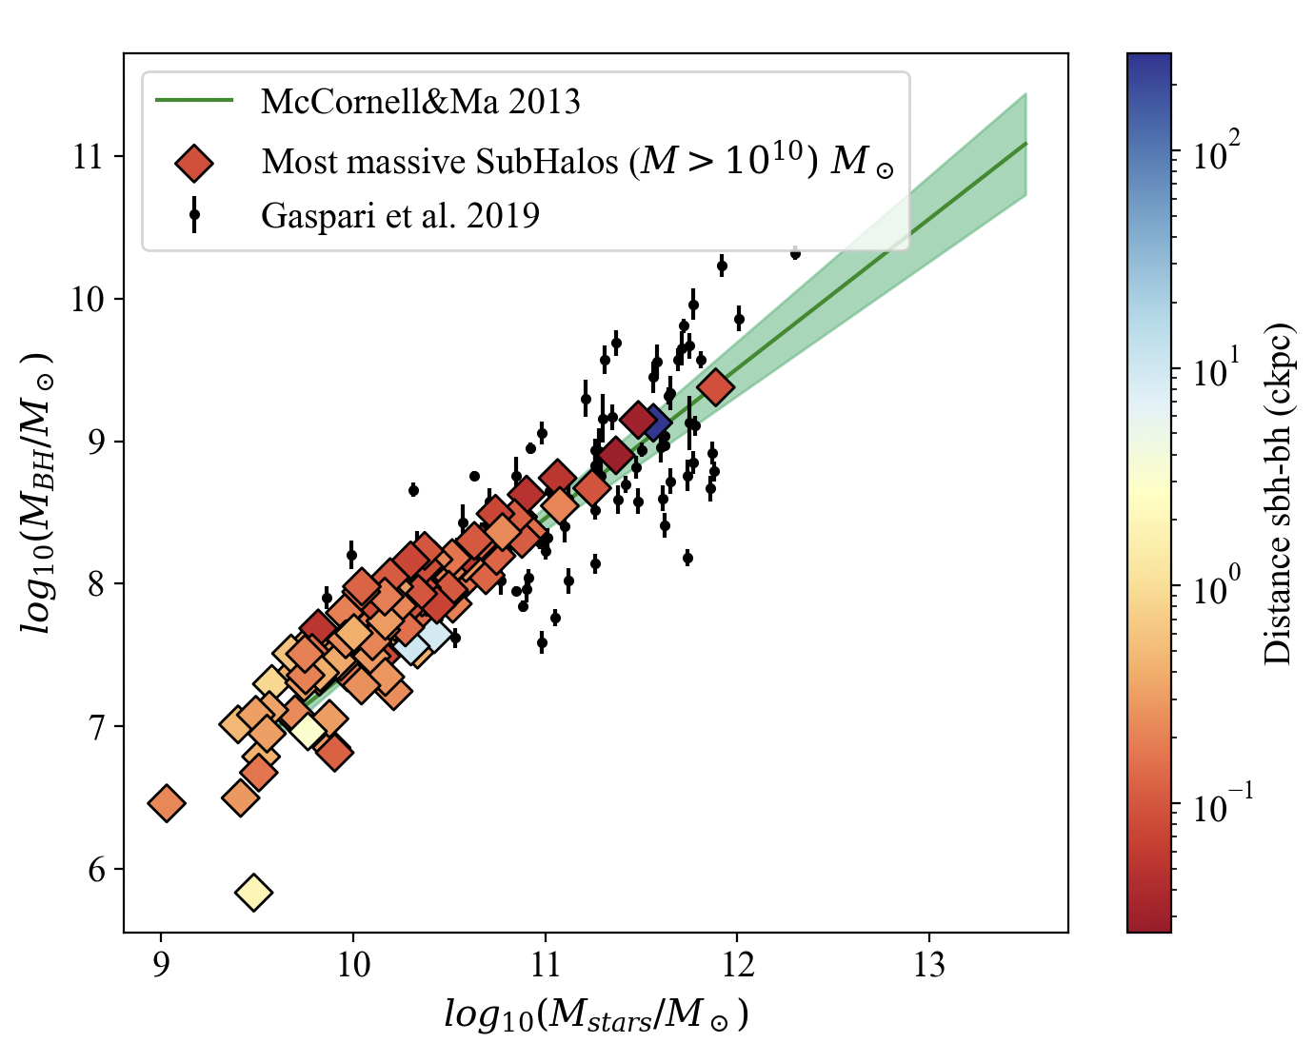
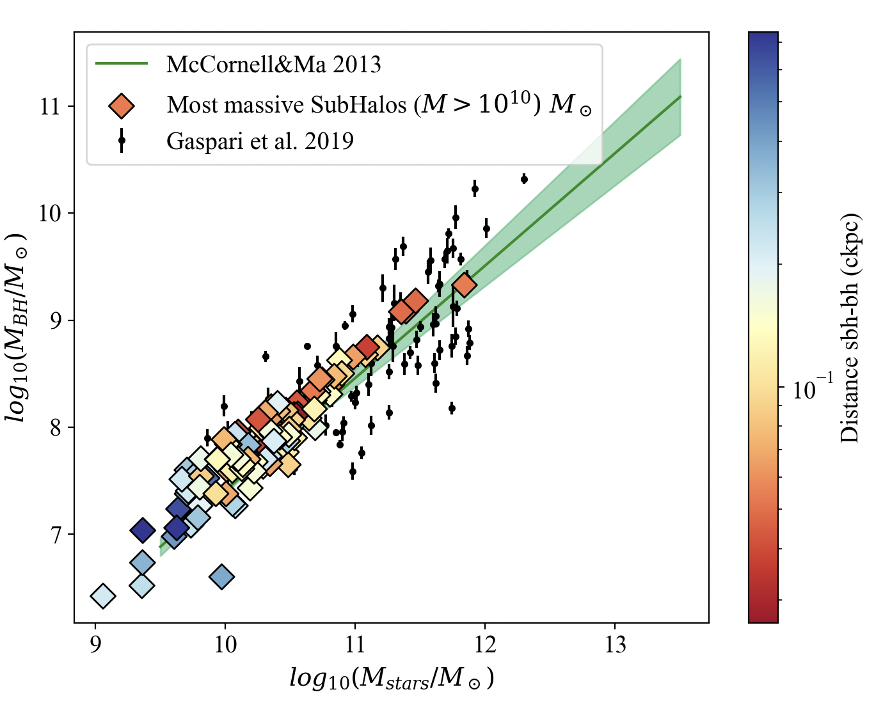
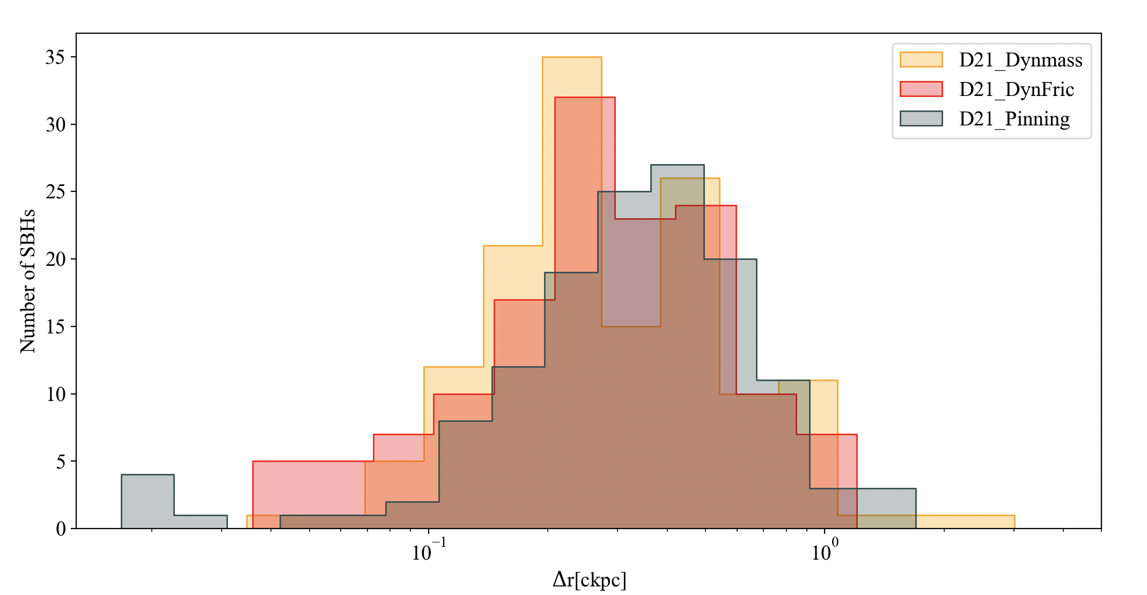
Part III
Part III
Some results
Dynamical mass
Dynamical friction
Magorrian relation reproduced
Decrease of SBH-BH distance
No massive SBH without a central BH
The wandering population decrease at lower redshift
The new implementation both centers the BHs and is capable to describe the dynamics of the merger event.

Slide 10
Current and future perspectives
Higher resolution galaxy cluster simulations to investigate the role of this new recipe on the AGN activity and galaxy population.
Study of the effect of the merging histories on higher-redshift protocluster regions.
Cosmological simulations to investigate the merger rate,
the black hole mass function and predictions for PTA, LISA.

