Slide 1
WP3 - Big Data Analysis, Machine Learning and Visualization
Fabio Vitello - Fabio Gargano
Spoke 3 General Meeting
12-14 Giugno 2023
Dipartimento di Fisica e Astronomia – Università di Catania
Centro Nazionale di Ricerca in High-Performance Computing, Big Data and Quantum Computing
Missione 4 • Istruzione e Ricerca

Slide 2
WP3 OBJECTIVES
This WP develops a prototype framework of data analysis, based on Machine Learning (ML) and Visualization tools exploiting diverse computing platforms and combining them with exascale applications. The framework will be tailored to the ACO-S community, identifying the use case best suited to tackle high-performance visualization tools and ML techniques. Furthermore, it copes with observational data coming from challenging large experiments.
Objective 2. Big data processing and visualization, via adopting innovative approaches (e.g. Artificial Intelligence, inference via Bayesian statistics) for the analysis of large and complex data volumes and for their exploration (e.g. in-situ visualization), capable of efficiently exploiting HPC solutions. (WP3, WP4, WP5)
Centro Nazionale di Ricerca in High-Performance Computing, Big Data and Quantum Computing
Missione 4 • Istruzione e Ricerca

Slide 3
WP3 OBJECTIVES
○ Action 2.2: To develop new methods and/or optimize existing prototype Machine Learning applications for the automated processing of large and complex data, produced on the Exascale systems by the ACO-S community.
○ Action 2.3: To develop and optimize existing solutions for high performance visualization, addressing on-site and remote visualization for Exascale and post-Exascale systems.
○ Action 2.4: To develop integrated solutions starting from the outcome of the previous actions, in order to provide a unique and optimized eco-system for Exascale platforms for big and complex data sets.
Centro Nazionale di Ricerca in High-Performance Computing, Big Data and Quantum Computing
Missione 4 • Istruzione e Ricerca

Slide 4
WP3 TASKS
T3.1: Requirements from AAA community
It will assess the requirements of the community and assess corresponding solutions in terms of Machine Learning and Visualization, exploiting the functionalities available in selected tools and/or the development of new functionalities.
Centro Nazionale di Ricerca in High-Performance Computing, Big Data and Quantum Computing
Missione 4 • Istruzione e Ricerca

Slide 5
WP3 TASKS
T3.2: Innovative Machine Learning
This task is in charge of designing, implementing and evaluating ML components in ACO-S pipelines. Targets include off-line processes for the transformations and enrichment of data, such as classification, segmentation, reduction, and emulation. For each component targeted, the task will provide an adequate ML model, together with an efficient and scalable implementation. Finally, its performance (both in terms of task outcome and efficient computation) will be assessed, to produce a final evaluation on the advantages and disadvantages of the produced ML solutions. Together with industrial partners the task will address a) search of patterns using network analysis in very large, noisy datasets, b)anomaly detection, c) techniques of privacy preserving, deployed in federated learning services (Cybersecurity)
Centro Nazionale di Ricerca in High-Performance Computing, Big Data and Quantum Computing
Missione 4 • Istruzione e Ricerca

Slide 6
WP3 TASKS
T3.3: HPC/Cloud Visualization Services
The main emphasis will be on fast and interactive visualization, using services at the HPC facilities near the data, but with high speed delivery of the results to the user’s desktop. Such tools will be tested and integrated on the existing open-source database as https://smart-turb.roma2.infn.it/ which will be further developed during this project such as to host a large quantity of geophysical and astrophysical datasets. The ultimate goal is to provide visualization capabilities that are fully interactive and can access and visualize large data sets at a remote repository.
Centro Nazionale di Ricerca in High-Performance Computing, Big Data and Quantum Computing
Missione 4 • Istruzione e Ricerca

Slide 7
#ID | Deliverable name | Short description | Type | Dissem. level | Delivery date (months)
D2 | Activity status report (M4.1) | Science cases/requirements definition activity status report | Report | Public | M4
D3 | Spoke Project Plan (M4.2) | This will be written by all WPs | Report | Public | M4
D4 | Activity status report (M6.1) | Science cases/requirements definition activity status report | Report | Public | M6
D8 | Activity status report (M12.2) | Spoke’s first year activity status report, written by all WPs | Report | Public | M12
D10 | Requirements definition document (M12.4) | Spoke requirement definition document: science cases, algorithms and technologies definitions | Report | Public | M12
D13 | Requirements definition document (M12.4) | Astrophysics Requirements Definition document | Report | Public | M16
D15 | Activity status report (M24.2) | Spoke’s second year activity status report, written by all WPs | Report | Public | M24
D18 | Identified ML and visualization solutions (M24.5) | Identified ML and visualization solutions implementation on existing/available HPC infrastructure results | Report | Public | M24
D23 | Best analysis strategies (M28.2) | Report on best analysis strategies and profiling on HPC infrastructures for astrophysical cases | Report | Public | M28
D27 | Final activity report (M36.4) | Spoke’s final activity status report, written by all WPs | Report | Public | M36
Centro Nazionale di Ricerca in High-Performance Computing, Big Data and Quantum Computing
Missione 4 • Istruzione e Ricerca

Slide 8
Partner | Task | Personale di riferimento | PM A1 | PM A2 | PM A3 | PM
INAF | T3.1, T3.2, T3.3 | Fabio Vitello, Claudio Gheller, Ugo Becciani, Andrea Possenti, Aldo Bonomo, Carmelita Carbone, Deborah Busonero, Simone Riggi | 41 | 92 | 92 | 225
UNITS | T3.2, T3.3 | Matteo Costanzi | 9 | 8 | 8 | 25
SISSA | T3.2, T3.3 | Matteo Viel, Roberto Trotta, Nicoletta Krachmalnicoff | 11 | 18 | 18 | 47
UNITO | T3.1, T3.2, T3.3 | Susanna Terracini | 10 | 12 | 12 | 34
UNICT | T3.1, T3.2 | Maria Letizia Pumo, Alessandro Lanzafame, Giuseppe Nunnari, Vincenza Carchiolo, Manicò, Mangioni, Malgeri | 16,9 | 22,8 | 22,5 | 62,2
INFN | T3.2 | Fabio Gargano, Nicola Mazziotta, Matteo Duranti, Valerio Formato, Stefano Della Torre, Sara Cutini, Massimiliano Lattanzi, Martina Gerbino, Melissa Pesce Rollins | 43 | 44 | 31 | 118
SNS | T3.1, T3.2 | Andrei Mesinger | 16 | 17 | 16 | 49
ROMTOV | T3.2 | Giuseppe Puglisi, Luca Biferale, Domenico Marinucci, Marina Migliaccio, Piermarco Cannarsa, Nicola Vittorio, Pasquale Mazzotta | 8,5 | 10,5 | 11,5 | 30,5
Centro Nazionale di Ricerca in High-Performance Computing, Big Data and Quantum Computing
Missione 4 • Istruzione e Ricerca

Slide 9
Partner | Task | Personale di riferimento | PM A1 | PM A2 | PM A3 | PM
INAF | T3.1, T3.2, T3.3 | Fabio Vitello, Claudio Gheller, Ugo Becciani, Andrea Possenti, Aldo Bonomo, Carmelita Carbone, Deborah Busonero, Simone Riggi | 41 | 92 | 92 | 225
UNITS | T3.2, T3.3 | Matteo Costanzi | 9 | 8 | 8 | 25
SISSA | T3.2, T3.3 | Matteo Viel, Roberto Trotta, Nicoletta Krachmalnicoff | 11 | 18 | 18 | 47
UNITO | T3.1, T3.2, T3.3 | Susanna Terracini | 10 | 12 | 12 | 34
UNICT | T3.1, T3.2 | Maria Letizia Pumo, Alessandro Lanzafame, Giuseppe Nunnari, Vincenza Carchiolo, Manicò, Mangioni, Malgeri | 16,9 | 22,8 | 22,5 | 62,2
INFN | T3.2 | Fabio Gargano, Nicola Mazziotta, Matteo Duranti, Valerio Formato, Stefano Della Torre, Sara Cutini, Massimiliano Lattanzi, Martina Gerbino, Melissa Pesce Rollins | 43 | 44 | 31 | 118
SNS | T3.1, T3.2 | Andrei Mesinger | 16 | 17 | 16 | 49
ROMTOV | T3.2 | Giuseppe Puglisi, Luca Biferale, Domenico Marinucci, Marina Migliaccio, Piermarco Cannarsa, Nicola Vittorio, Pasquale Mazzotta | 8,5 | 10,5 | 11,5 | 30,5
Total: 590,7 PM
Centro Nazionale di Ricerca in High-Performance Computing, Big Data and Quantum Computing
Missione 4 • Istruzione e Ricerca

Slide 10
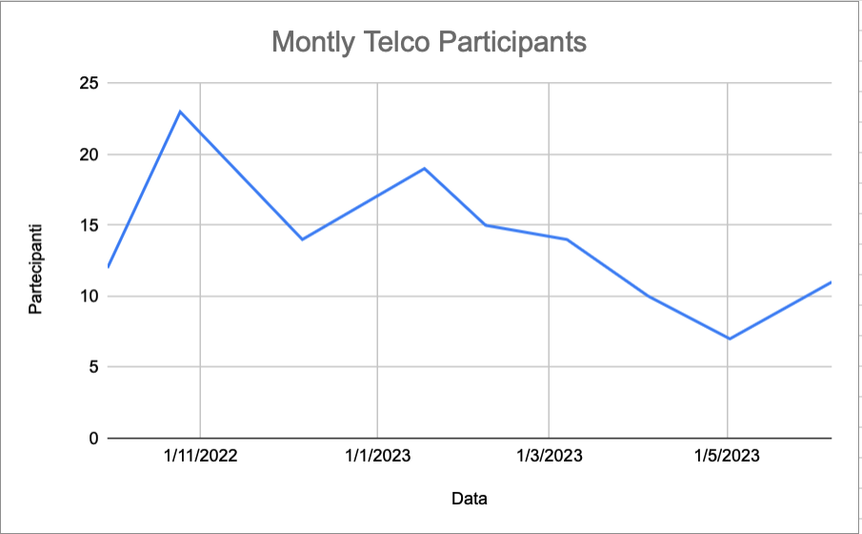
Regular meeting
First Tuesday of every month, with advance compilation of the monthly activity report;
The participation could be higher (less than 50% of the participants in the program are present);
Some institutions are particularly absent. It should go better now that the recruitment phase is nearing completion.
Centro Nazionale di Ricerca in High-Performance Computing, Big Data and Quantum Computing
Missione 4 • Istruzione e Ricerca

Slide 11
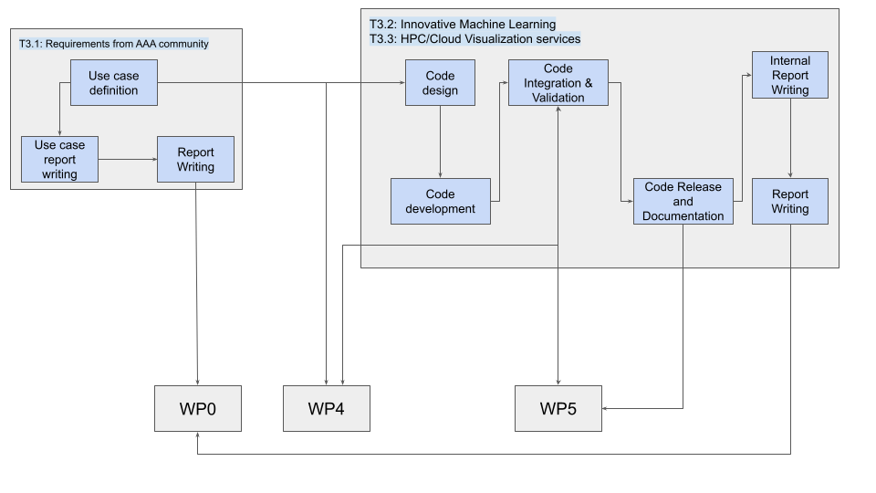
PERT DIAGRAM
Centro Nazionale di Ricerca in High-Performance Computing, Big Data and Quantum Computing
Missione 4 • Istruzione e Ricerca

Slide 12
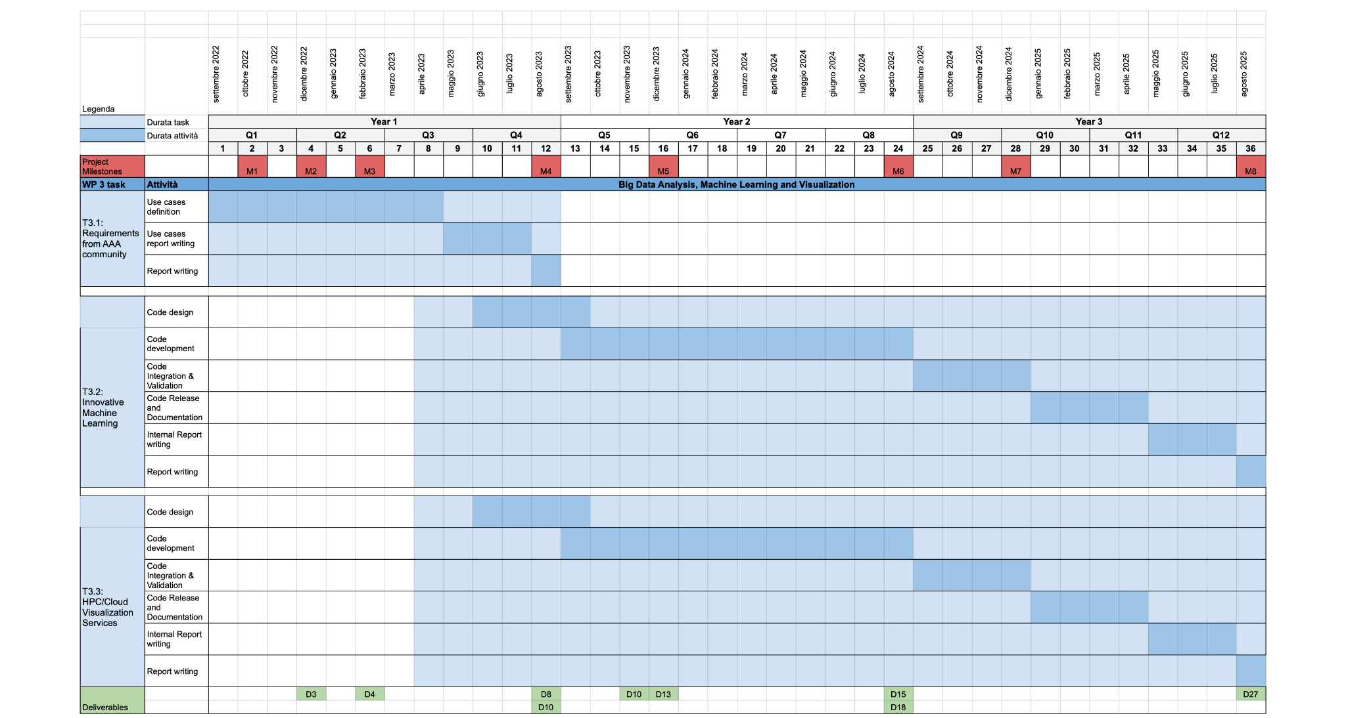
Centro Nazionale di Ricerca in High-Performance Computing, Big Data and Quantum Computing
Missione 4 • Istruzione e Ricerca

Slide 13
Centro Nazionale di Ricerca in High-Performance Computing, Big Data and Quantum Computing
Missione 4 • Istruzione e Ricerca

Slide 14
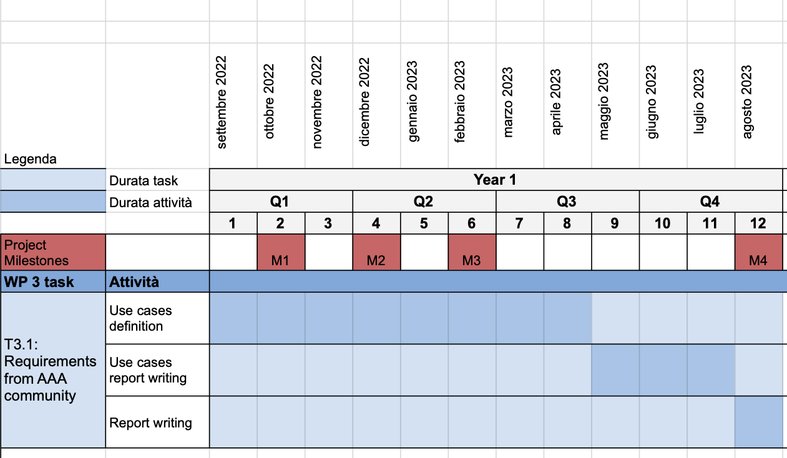
Centro Nazionale di Ricerca in High-Performance Computing, Big Data and Quantum Computing
Missione 4 • Istruzione e Ricerca

Slide 15
T3.1 Requirements from AAA community: use case definition
https://drive.google.com/file/d/19dmDP-zWJDm5lTjhvsXiio-i8yVOv4vR
Centro Nazionale di Ricerca in High-Performance Computing, Big Data and Quantum Computing
Missione 4 • Istruzione e Ricerca

Slide 16
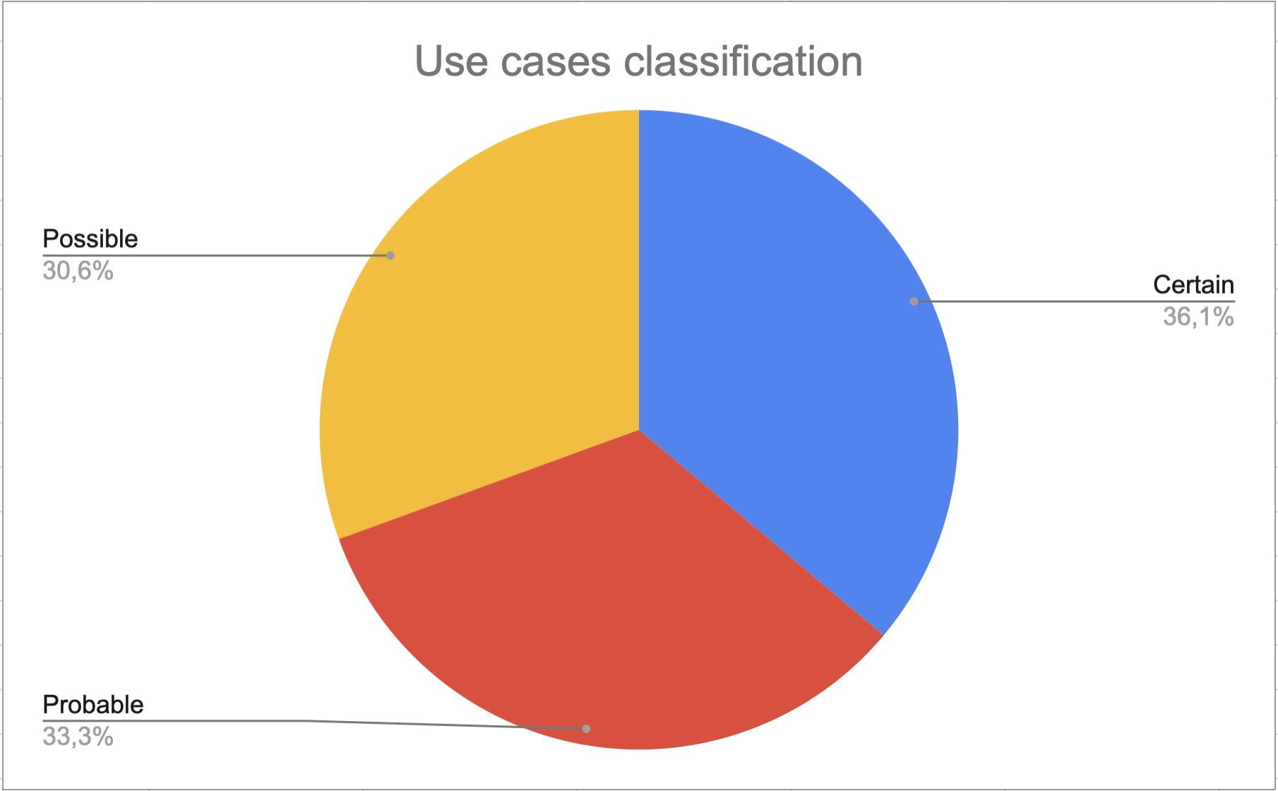
T3.1 Requirements from AAA community: use case definition
3 classes:
Certain: 13 use cases;
Probable: 12 use cases;
Possible: 11 use cases;
Centro Nazionale di Ricerca in High-Performance Computing, Big Data and Quantum Computing
Missione 4 • Istruzione e Ricerca

Slide 17
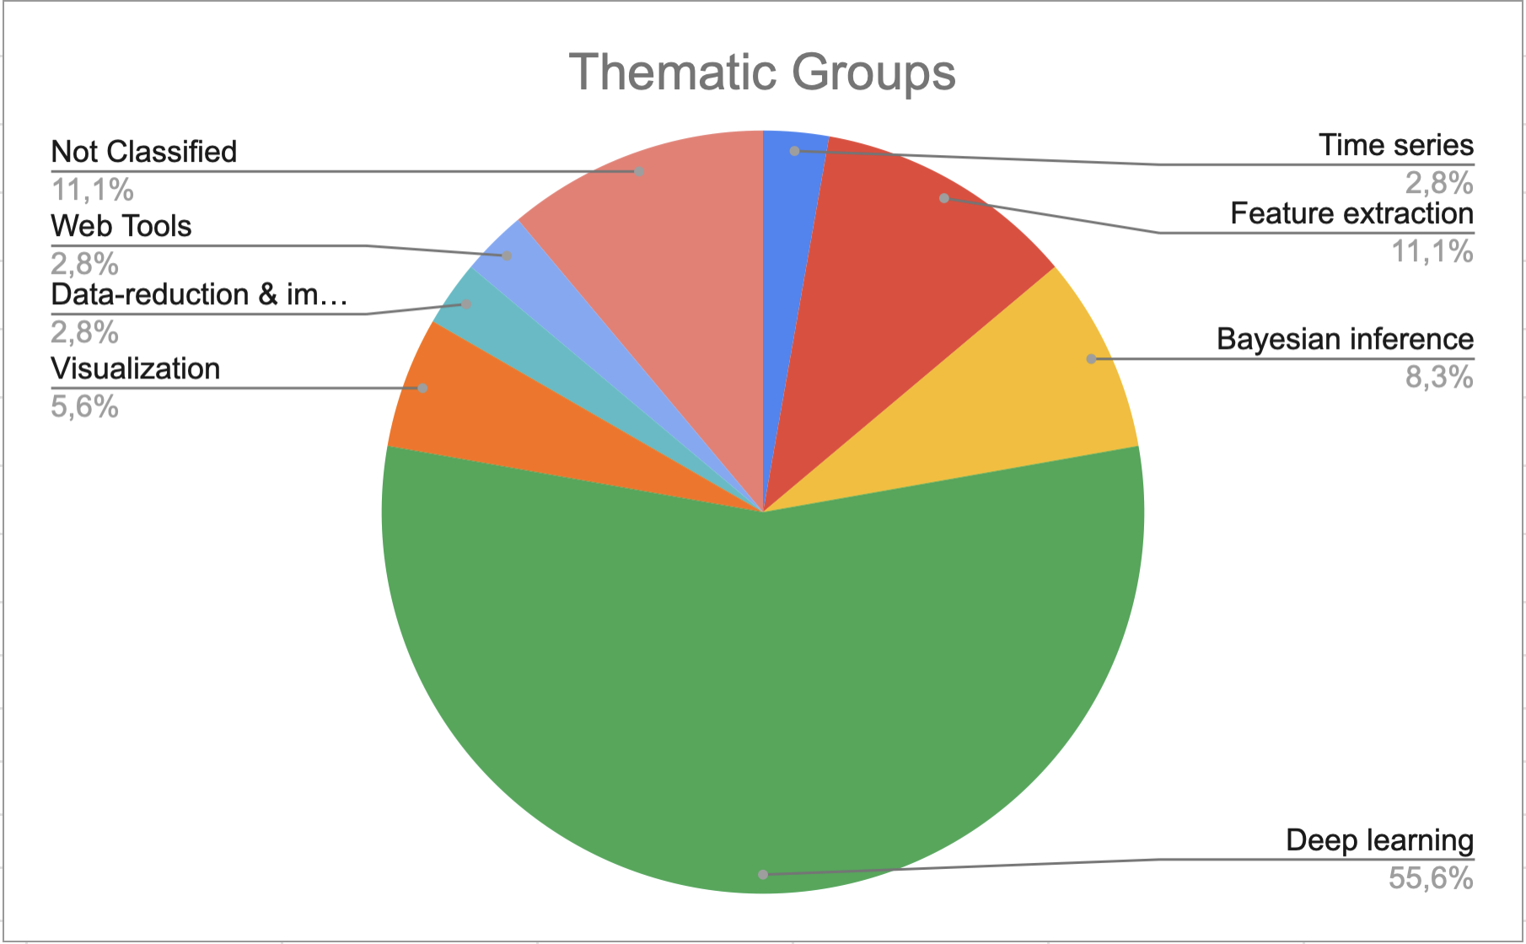
T3.1 Requirements from AAA community: use case definition
Thematic groups
Time series: 1 use case;
Feature extraction: 4 use cases;
Bayesian inference: 3 use cases;
Deep learning: 20 use cases;
Visualization: 2 use cases;
Data-reduction & imaging: 1 use case;
Web Tools: 1 use case;
Not Classified: 4 use cases.
Centro Nazionale di Ricerca in High-Performance Computing, Big Data and Quantum Computing
Missione 4 • Istruzione e Ricerca

Slide 18
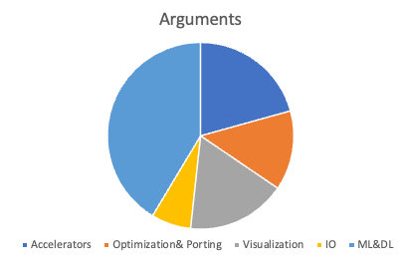
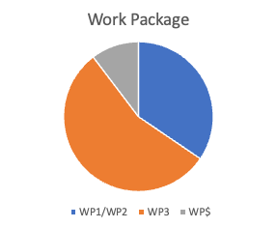
Bandi a cascata*
*Stolen from presentation G. Taffoni “Cascade Funding”
Centro Nazionale di Ricerca in High-Performance Computing, Big Data and Quantum Computing
Missione 4 • Istruzione e Ricerca

Slide 19
Criticalities
Lot of declared effort, what about real participation?
Hardware: we need to access HPC resources to develop our codes, ASAP*
Hardware: we need precise specs to emulate the system that we will use, ASAP*
*Stolen from presentation wp1 + wp2
Centro Nazionale di Ricerca in High-Performance Computing, Big Data and Quantum Computing
Missione 4 • Istruzione e Ricerca

