Slide 1
/!\ Disclaimer:
Activities shared between WP1 and WP2
Given similar goals, milestones, and deliverables: we agreed for this initial phase of the project to share the activities among the two WPs.
About ~20 participants (minutes)
We propose regular monthly calls .
Parallelization, optimization,
gpu porting
WP1
Astrophysical code
Extreme optimization for specific hardware
WP2, T2.2
Redesign for futuristic hardware
WP2, T2.3

Slide 2
ICSC_progetto_comunicazione**
WP1 - HPC code enabling and optimization
Giuseppe Puglisi & Stefano Della Torre
Spoke 3 General Meeting
12-14 Giugno 2023
Dipartimento di Fisica e Astronomia – Università di Catania

Slide 3
WP1 - HPC codes enabling and optimization
Scope: selects a number of codes that require intensive computational resources to face the next generation of scientific challenges and performs their redesign, reimplementation and optimisation in order to effectively exploit state-of-the-art HPC solutions.
T1.1: Selection, Analysis and testing of codes
T1.2: Software development, refactoring and optimization
T1.3: Integration, Verification and Validation

Slide 4
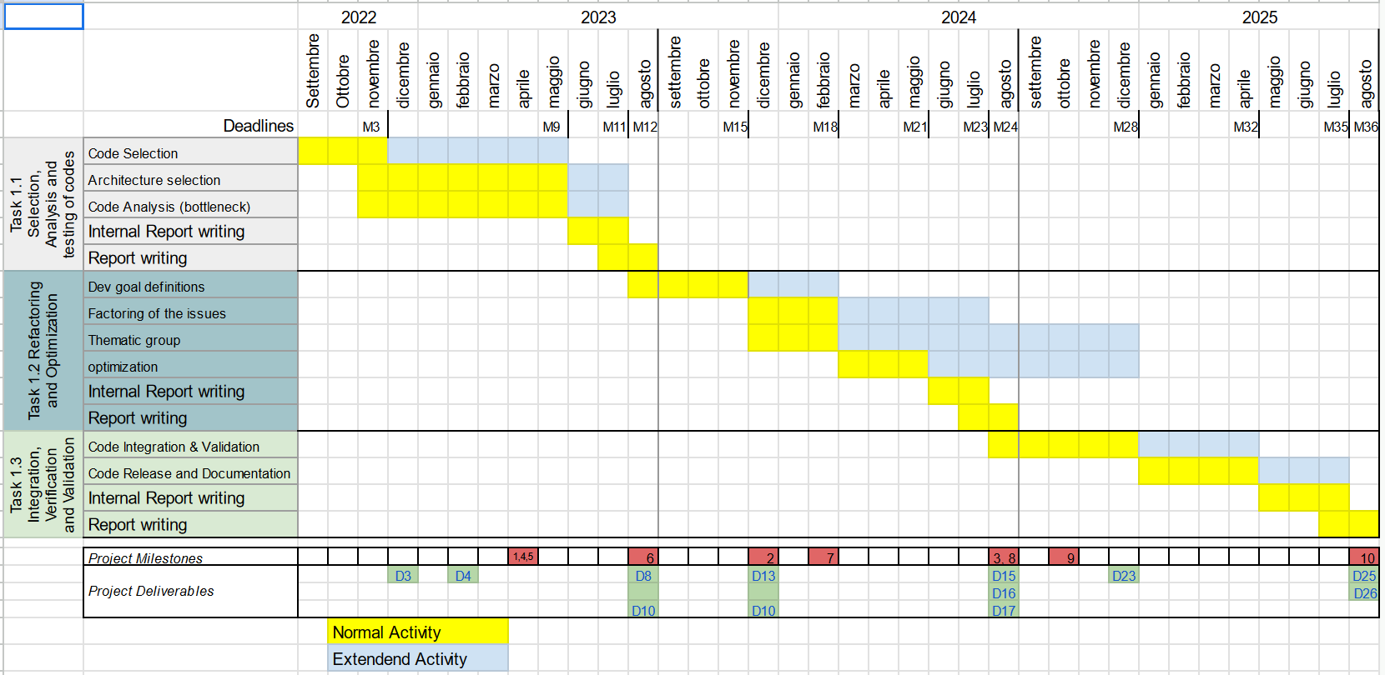
Gantt charts
WP1
credits: Stefano della Torre

Slide 5
ICSC_progetto_comunicazione**
WP2 - Design of innovative algorithms, methodologies and codes towards exascale and beyond
Pierluigi Monaco & Mario Spera
Spoke 3 General Meeting
12-14 Giugno 2023
Dipartimento di Fisica e Astronomia – Università di Catania

Slide 6
WP2 - Design of innovative algorithms, methodologies and codes towards exascale and beyond
Scope: This WP identifies innovative algorithms and methodologies upgrading their capability to exploit, and scale on, the exascale and post exascale architectures, reintegrating the resulting improved features in codes, workflows and pipelines. The energy impact will also be specifically considered.
T2.1: Science cases definition, algorithms identification, parallelism level assessment and profiling
T2.2: Algorithms co-design and methodologies to scale-up the capabilities of the algorithms and to find new innovative solutions
T2.3: Design of new architectural solutions aimed at the exploitation of post-exascale infrastructure
T2.4: Algorithms and methodologies integration into new big-data analysis applications

Slide 7
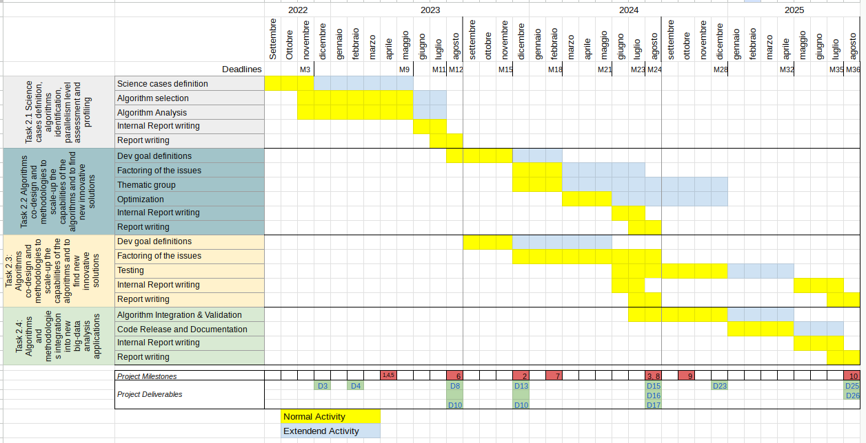
Gantt charts
WP2

Slide 8
WP1 and WP2 - Deliverables
Internal deliverables
Within M6: Internal Note (tabular form) listing the scientific cases studied with contributor and developer list
Within M11:Internal Note (tabular form) with codes profiling and development goals
Within M23: Internal Note (tabular form) with bottleneck identification for each studied codes, debug procedure and implemented strategies
Within M35: final Internal Note (tabular form) with codes profiling, development goals, bottleneck identification, debug procedure, implemented strategies and final results (publications, libraries, services deployed, performance gain, energy impact)
external deliverables
M12: yearly status report
M24: yearly status report
M36: final report

Slide 9
Activities shared between WP1 and WP2
Parallelization, optimization,
gpu porting
WP1
Astrophysical code
Extreme optimization for specific hardware
WP2, T2.2
Redesign for futuristic hardware
WP2, T2.3

Slide 10
From the slides of Rome kick-off
WP1 and WP2 should be considered as parts of the same work:
re-engineering a code for better performance is WP1,
extreme optimization on a part of a code is WP2.
By december 2022 we need a draft workplan, that details WG structure, deliverables, milestones.
Deliverables must be delivered to have access to the next chunk of funds, so we need to be very careful in specifying what we are going to do. We need to prioritise our plans, e.g.:
CERTI: algorithms that are critical to the success of the project,
PROBABILI: algorithms that will plausibly be delivered,
POSSIBILI: algorithms that we wish to improve, but success depends on extra resources.
Task 2.1: with WP1 we are surveying our participants to decide which codes/algorithms we select for the three priority classes, splitting the work into WP1 and WP2 (also a-posteriori). We can use open calls to
People joining the effort will be divided into two classes:
developers,
consultants.
Once algorithms are selected, we need to provide use cases to WP4 for the DMP, and receive recommendations for good practices of data management

Slide 11
Towards a (final) list of codes !
List of codes
21 codes !
All of the participants have filled the form
The progress on activities is updated directly in the form
/!\ July 15th: Deadline for all the Spoke3 participants to write the report activities
Instructions on how to fill the table are provided in the same file

Slide 12
The idea is to keep the software table updated, adding columns with all informations relevant for the year and final reports
codes profiling, development goals, bottleneck identification, debug procedure, implemented strategies and final results

Slide 13
=> Internal deliverable

Slide 14
Partner | Participating Personnel | Hired Personnel | #codes proposed | #CERTI
UniTS | Stefano Borgani, Pierluigi Monaco | RTDA: Milena Valentini; PhD: Alice Damiano, Luca Cappelli (Spoke 10), Marius Lepinzan (Spoke 1) | 2 | 2
INAF | Matteo Bachetti, Aldo Bonomo, Gianfranco Brunetti, Francesco Calura, Claudio Gheller, Giacomo Mulas, Diego Turrini | (11 TD da qui a fine anno) | 6 | 5
SISSA | Andrea Lapi, Mario Spera, Matteo Viel | AdR: Tommaso Ronconi, Chiara Moretti, Elena Sarpa (da agosto) | 3 | 2
UniTO | Andrea Mignone | AdR: Loic Chantry; PhD: Alessio Suriano | 1 | 1
UniCT | Giuseppe Puglisi, Loreto Di Donato, Alessandro Lanzafame | (1 PhD) | 1 | 1
INFN | Stefano Della Torre, Martina Gerbino, Massimiliano Lattanzi | TD: Paolo Campeti (+1 PhD) | 3 | 1
SNS | Andrea Pallottini, Andrei Mesinger, Julien Bloino | (6/8 PhD, da ottobre) | 3 | 3
RomaTOV | Herve’ Bourdin, Pasquale Mazzotta, Marina Migliaccio, Francesco Tombesi, NIcola Vittorio | TD: Marco Faltelli, Simone Ferretti; PhD: Avinash Anand | 2 | 2

Slide 15
Positions opened on ICSC
Hired
SISSA
Galapy - AdR
HI-emulator - AdR
UniTS
OpenGadget - RTDA + PhD
Pinocchio - PhD (Spoke 1)
About to Hire
Not yet hiring
INFN
COSMICA - PhD
CMB related codes - TD
UniTO
PLUTO - AdR + PhD
INAF
HPC Imaging - PhD
Stingray - TD
NP_TMCode - TD
Mercury-Arxes - TD
GUIBRUSH® - TD
RAMSES - TD
SNS
RAMSES - PhD
21cmFAST- PhD
Gaussian - PhD
UniToV
Litebird_sim - PhD
Sparse representations-2TD

Slide 16
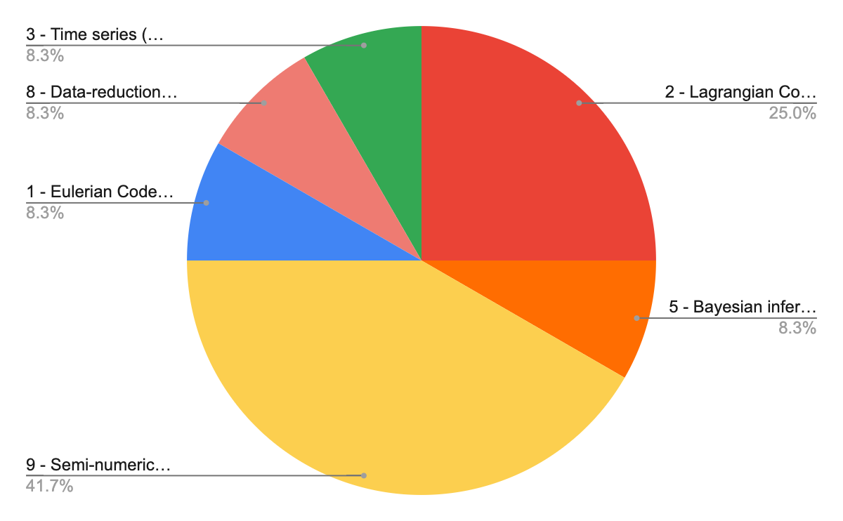
Thematic groups
proposed for Spoke3

Slide 17
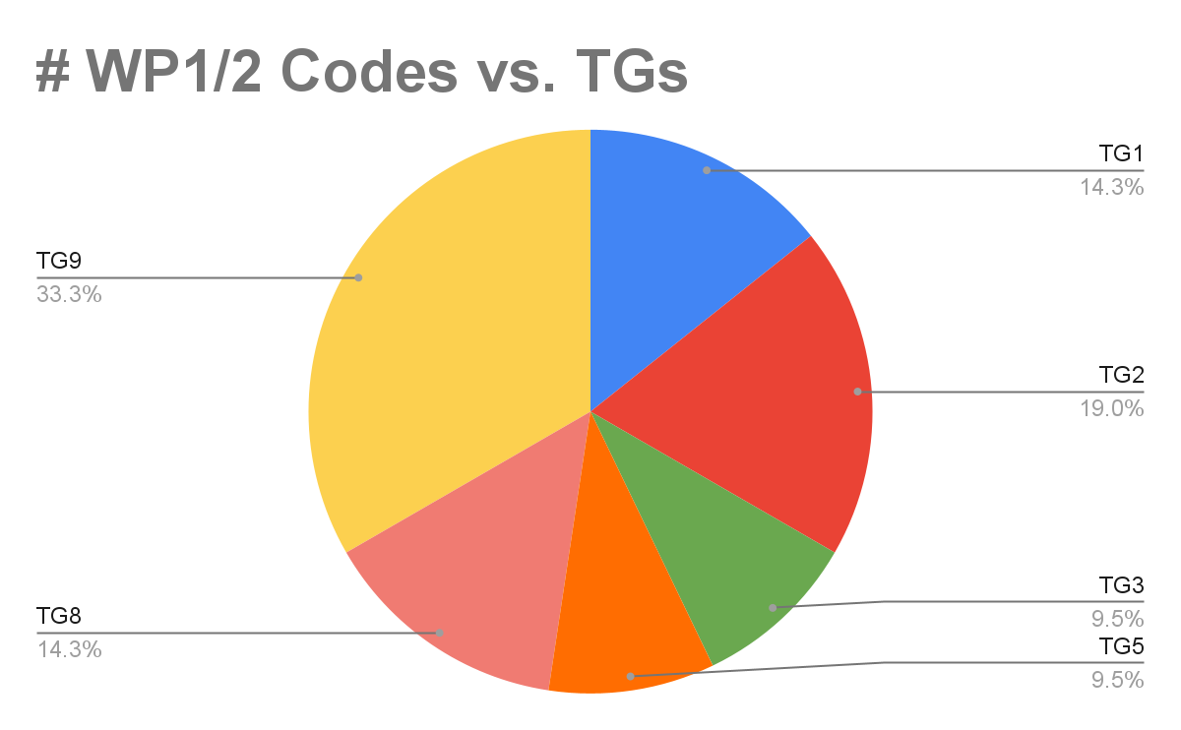
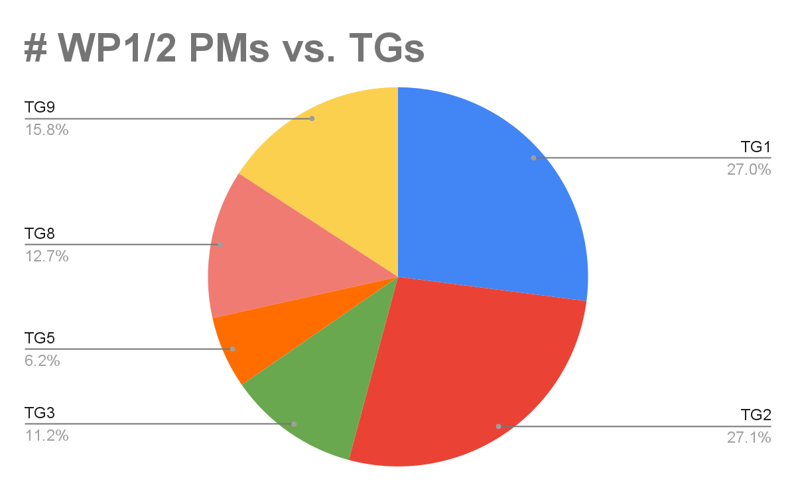
Thematic groups (TG)

Slide 18
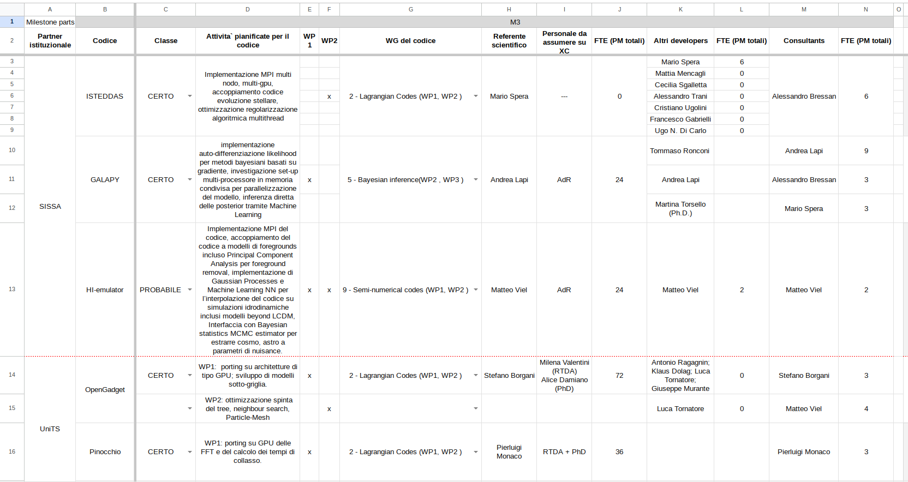
Code tracking

Slide 19
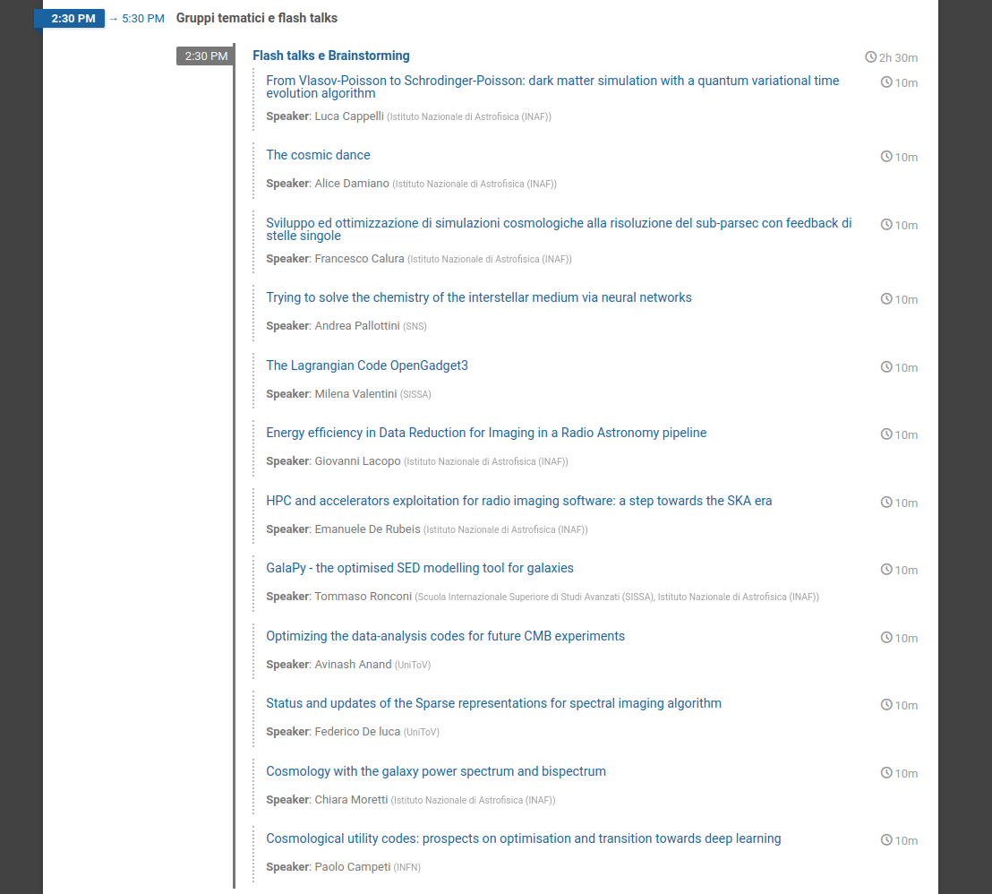
First science results: flash talks

Slide 20
Bandi a cascata
Enabling on innovative hardware and software (RISC-V processors and RISC-V-based computing accelerators) for the astrophysical characterization of gravitational-wave transients (WP2)
Parallelization and testing of simulation codes for cosmological instrumentation and optimization (WP1, 2)
Porting and optimization of codes for cosmological simulations on architectures with accelerators, primarily GPUs, but also FPGA. (WP1,2)
High Performance I/O: experimentation and optimization of I/O strategies adopting innovative High Performance storage devices, parallel filesystems or object storage solutions, I/O libraries (in particular HDF5 and ADIOS) (WP1,2)
The objective of this Open Call is to accelerate the performance of the XMAP, WINE and TEPID . The project will involve identifying the computationally intensive sections of the codes and optimizing them for execution on GPUs. (WP1,2)
Development of (multi)GPU-accelerated simulations of physical models based on SDE Monte Carlo algorithms (WP1,2)
Innovative Hybrid Accelerated Architectures (WP1,2)

Slide 21
What will the Hub see of our work (in the deliverables)?
For each code:
a very brief (10 lines?) project definition,
a progress metric (percentage?),
a link to a github (?) repository,
a link to a redmine (?) page ,
a (two-page?) report with figures demonstrating results,
published papers.

Slide 22
Critical points
Hardware: we need to access HPC resources to develop our codes, ASAP
Hardware: we need precise specs to emulate the system that we will use, ASAP
Hardware and community: it will be hard to keep momentum and build a community if computing resources must be acquired on best-effort basis
Science and community: a meeting more focused on science (including science from industrial partners) would be good, later in October, with sessions based on thematic groups
Key science projects

Slide 23
Spoke Leader INAF
Co-Leader INFN
Imprese Aderenti allo Spoke
Intesa SanPaolo
UnipolSai
Sogei
IFAB
Leonardo
Soggetti Pubblici Affiliati
Università Roma Tor Vergata
Università di Trieste
Università di Torino
Università di Catania
Scuola Normale Superiore - Pisa
Sissa - Trieste

