Slide 1
ICSC_progetto_comunicazione**
Spoke 3 – Management
A. Di Giorgio – C. Gheller – G. Taffoni
Spoke 3 General Meeting
12-14 Giugno 2023
Dipartimento di Fisica e Astronomia – Università di Catania
Centro Nazionale di Ricerca in High-Performance Computing, Big Data and Quantum Computing
Missione 4 • Istruzione e Ricerca

Slide 2
Agenda
Milestone e timeline
Data management plan
Deliverable e reporting su AtWork
Gruppi tematici
Key Science Projects
Coordinamento e monitoraggio attivita’ dei WP e monitoring progressi
Open Call overview
Requirement risorse di calcolo/storage
Dissemination & Training
Centro Nazionale di Ricerca in High-Performance Computing, Big Data and Quantum Computing
Missione 4 • Istruzione e Ricerca

Slide 3
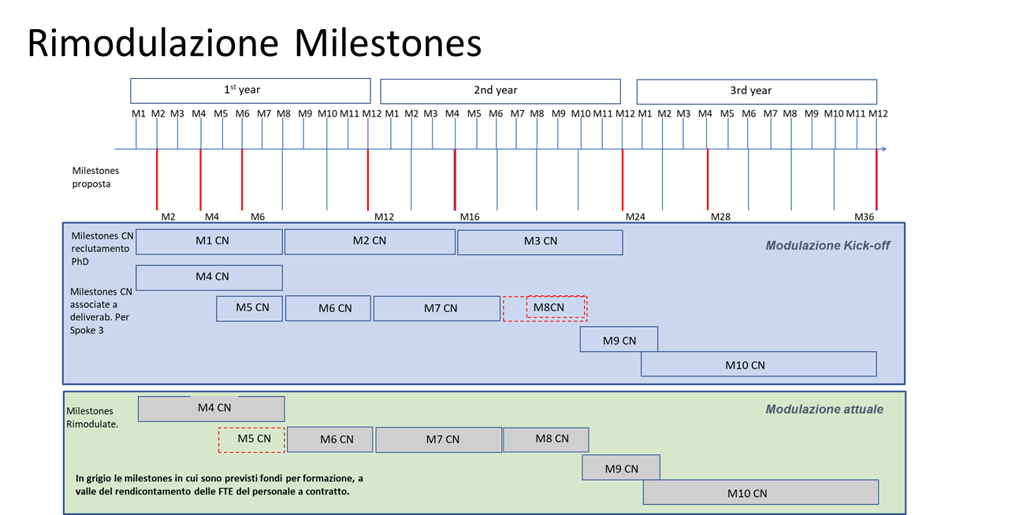
Centro Nazionale di Ricerca in High-Performance Computing, Big Data and Quantum Computing
Missione 4 • Istruzione e Ricerca

Slide 4
Centro Nazionale di Ricerca in High-Performance Computing, Big Data and Quantum Computing
Missione 4 • Istruzione e Ricerca

Slide 5
Centro Nazionale di Ricerca in High-Performance Computing, Big Data and Quantum Computing
Missione 4 • Istruzione e Ricerca

Slide 6
Deliverables
Progress Report Milestone 4
reporting period: September 2022 - April 2023
status: completed
Progress report Milestone 6
reporting period: May-August 2023
status: May reported
Activity Status Report Year 1
reporting period: September 2022 - August 2023
status: not yet requested, due date: fall 2023
All deliverables are managed by the HUB. In addition:
Bi-weekly reports in AtWork procedure
Centro Nazionale di Ricerca in High-Performance Computing, Big Data and Quantum Computing
Missione 4 • Istruzione e Ricerca

Slide 7
Key Science Projects
Identification of 10 Key Science Project (KSP) to be enabled by the R&D activities of the National Center by the implementation, optimization, parallelization of algorithms capable of exploiting state-of-the-art HPC architectures.
Due date: month 12
The KSP will be used as a measure of the success of the Spoke
We need to start the identification of the KSP immediately
Criteria to be discussed
Centro Nazionale di Ricerca in High-Performance Computing, Big Data and Quantum Computing
Missione 4 • Istruzione e Ricerca

Slide 8
Thematic Groups
The idea was born to support cross-domain expertise and experience exchange among the groups of developers and the WPs of Spoke3
Frozen in order to for all the groups to start their activities and the personnel to be in place
Now it’s the right time to start
How do we want to organize them? Focused discussion on WEDNESDAY morning
Issues:
Should not be an additional overhead
It’s hard to interoperate different groups, in different scientific areas, in different places
Ideas (just a couple of examples to ignite Wednesday discussion):
specific workshops or sessions within general events (like this one)
Periodic (every second week, every month?) Demos
Centro Nazionale di Ricerca in High-Performance Computing, Big Data and Quantum Computing
Missione 4 • Istruzione e Ricerca

Slide 9
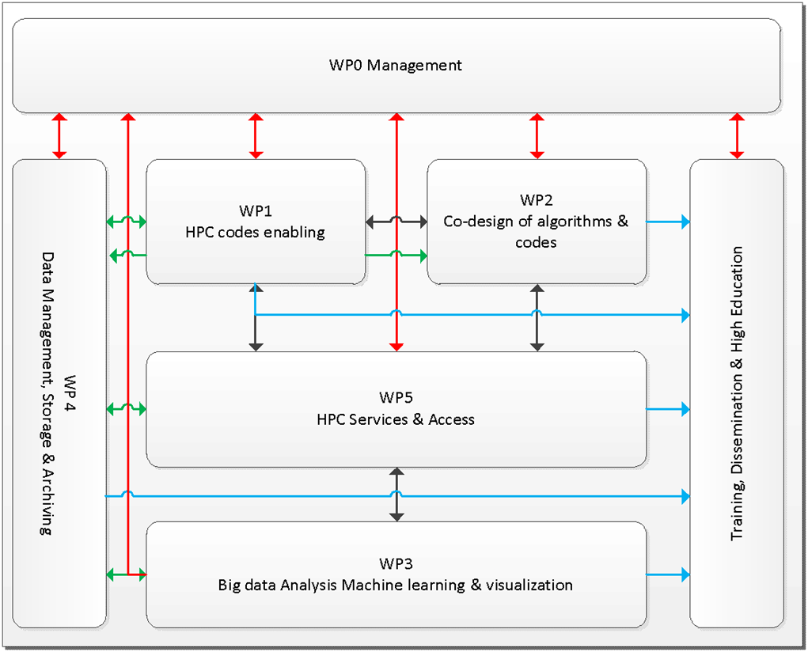
WP activities monitoring and Tracking
Four Research WP and one service WP
Identify synergies and collaboration areas (e.g. WP1 and WP2 tight collaboration)
WP detailed activity plan
Motivation:
Different activities distributed across different partners
Keep track of the progress and goals
Identify possible issues
Reduce, reuse, recycle
Centro Nazionale di Ricerca in High-Performance Computing, Big Data and Quantum Computing
Missione 4 • Istruzione e Ricerca

Slide 10
Monitoring and Tracking
Periodic meetings for each WP
Weekly (planning to reduce after summer) WP Leader meeting (our Friday Morning chat)
F2F meeting of WP Leaders, PM, TM and PIs (at least) every 6 months
In Sept we will conclude the hiring, F2F WP and Thematic Groups Scientific meeting (?);
Project Meeting every 6 months
SPOKE Board Meeting every month
…and a lot of minutes…
GDrive repository ( …going to change)
Centro Nazionale di Ricerca in High-Performance Computing, Big Data and Quantum Computing
Missione 4 • Istruzione e Ricerca

Slide 11
Open Calls
We are promoting Open Call that will involve both private and public sectors (including Universities not involved in the CN)
Topics will be complementary to the activities of the spoke's research and development program (to integrate and/or complete it)
Address aspects of the research and development work that require specialized skills or access to infrastructures or computing systems not available within the Spoke (or the National Center),
Open Calls lower than 200 Keuro (…but not only…)
Centro Nazionale di Ricerca in High-Performance Computing, Big Data and Quantum Computing
Missione 4 • Istruzione e Ricerca

Slide 12
Hardware Requirements
We identify more that 40 Use cases (tools, software, codes …) ;
We build a HW matrix (CPU+GPU+Interconnect+SystemSoftware requirements);
Development, Testing, Validation, Verification
We collect requirements in term of Core/hours by the SPOKE3: 30 milioni (node hours) su architettura ibrida CPU/GPU - to discuss in the Spoke assembly!
Scientific Run (KSPs) ISCRA like…
HPC codes
ML codes
HPC libraries
HPC data analysis
Centro Nazionale di Ricerca in High-Performance Computing, Big Data and Quantum Computing
Missione 4 • Istruzione e Ricerca

Slide 13
Open Calls
Areas of Interest:
16 for Private Sectors
Scientific
Visualization and Archives
Advanced optimization (Acc, Hybrid platforms, extreme IO…)
WPs and Partners collected 28 “Ideas”
On line document to diuscuss with the Assembly
Waiting for HUB guide-lines
Access to Innovative HW
Machine Learning and Deep learning
6 for Public Sectors
6 mixed
Centro Nazionale di Ricerca in High-Performance Computing, Big Data and Quantum Computing
Missione 4 • Istruzione e Ricerca

Slide 14
Training and Dissemination
Training and Dissemination are HUB related activities with SPOKE contributions;
We collect a few preliminary ideas to share with other SPOKE and HUB:
HPC Schools for Post Docs and young researchers
HPC code enabling Hekaton
HPC Code Development with applications in Space Science and Engineering
HPC for large audience and Citizen Scientists
Outreach activity based on a “spettacolo teatrale a tema calcolo”
Centro Nazionale di Ricerca in High-Performance Computing, Big Data and Quantum Computing
Missione 4 • Istruzione e Ricerca

Slide 15
Thanks for the attention
Questions?
Centro Nazionale di Ricerca in High-Performance Computing, Big Data and Quantum Computing
Missione 4 • Istruzione e Ricerca

