Slide 1
The infrastructure for continuous integration and deploying at SKA
Matteo Di Carlo (INAF-OAAB)
on behalf of the SKA system team
ROME, TETIS 2023

Slide 2
Square Kilometre Array (SKA) Observatory (SKAO)
One observatory, with 2 telescopes, on three continents; a 21th century observatory and an inter-governmental organisation with sustainability and respect to all our communities at its heart driven by a commitment to fundamental science and technology
Software development process is Agile
Mainly incremental and iterative
Many teams including a specialized team (known as system team) devoted to support the continuous Integration, test automation and continuous Deployment.

Slide 3
Merge hell
When many parts of the project are developed independently for a long period of time (weeks or longer),
Code base and build environments diverges
When changes are integrated
Weeks in verifying that everything works
Developers spend time in solving bugs introduced weeks earlier

Slide 4
Continuous integration
Single source repository
Minimize the use of branching
Automate the build
Automate testing
Every commit should build on an integration machine
Commit often
Small changes
Build fast
Multi-stage deployment
Ref: martinfowler.com/articles/continuousIntegration.html
Set of development practices that requires developers to integrate code into a shared repository several times a day.
Each check-in is verified by an automated build, allowing teams to detect problems as soon as possible.

Slide 5
Delivery vs Deployment
Continuous delivery
Automate the delivery of new releases of software
Deployment has to be predictable and sustainable
The code must be in a deployable state
Testing needs to cover enough of your codebase.
Continuous deployment
One step further: every single commit to the software that passes all the stages of the build and test pipeline is deployed into the production environment

Slide 6
Containerization
SKA == set of elements == a set software modules
For each module there is one repository
For each repository there is (at least) one container image
convenient way to package up applications and preconfigured server environments
i.e. a library can be packaged into a layer in a container solving its dependency once for all.

Slide 7
SKA-tango-images - Containerized environment for TANGO-controls application
This is only a partial set of container images present in the repository!
Ubuntu LTS
TANGO dependencies
TANGO Panic
TANGO test
TANGO C++
TANGO Java
TANGO itango
TANGO python builder
TANGO Dsconfig
TANGO Rest
extend
TANGO python runtime
TANGO VNC
TANGO DatabaseDS
Docker image
SKA Module 0
SKA Module 1
…
SKA Module n

Slide 8
SKA CICD practices
Kubernetes (k8s) for container orchestration (kubernetes.io)
Helm for packaging SKA k8s applications (helm.sh)
Tool for managing Kubernetes charts
Chart is a the set of information for running a Kubernetes application
For each SKA sub-system there must be an helm chart for running it in k8s!
Use of Makefile for lifecycle management (one command for build images, start application using helm, test application and clean)!
Standard set of makefile targets developed centrally and included in every repository as git sub-module; this means that all repos have the same folders/structure

Slide 9
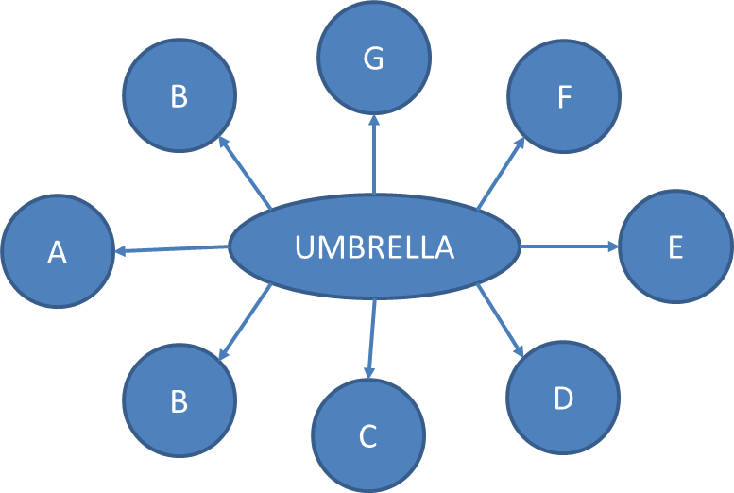
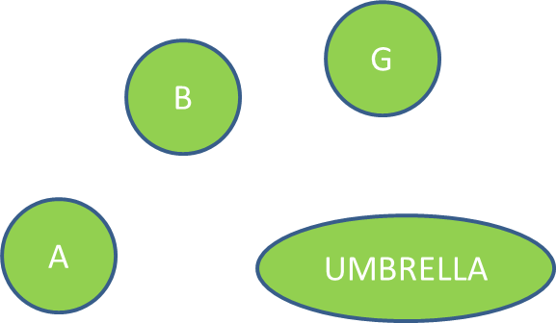
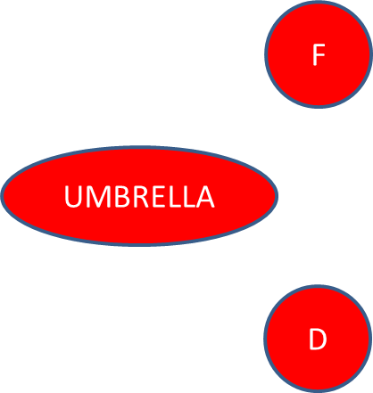
Integration (with Helm)
Helm has the concept of dependency
An helm chart can have one or more sub-charts
The integration of SKA elements can be done with this concept: umbrella charts!
For every SKA element, there is at least an umbrella chart for integration testing

Slide 10
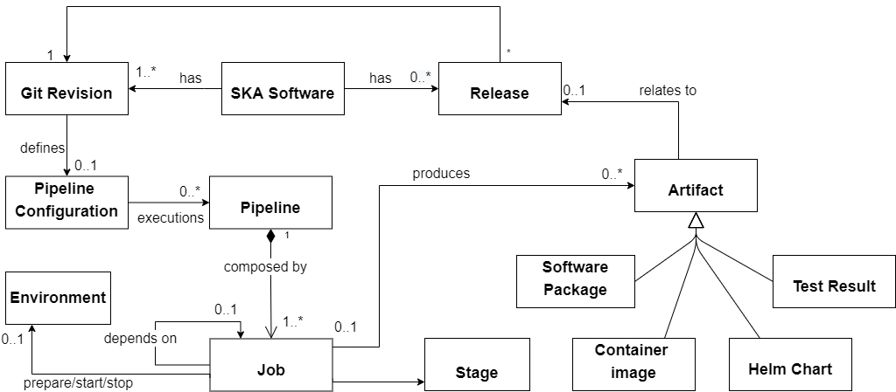
GitLab
Web-based DevOps lifecycle tool that provides a Git-repository manager providing wiki, issue-tracking and continuous integration and deployment pipeline features

Slide 11
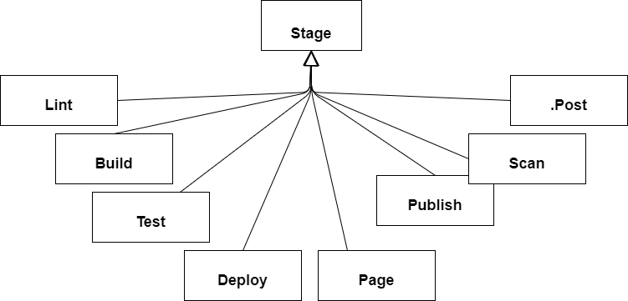
Pipeline machinery
The pipeline machinery is a set of gitlab templates (pipeline configurations) and make targets to track the development to delivery and retain all the released software forever
Create badges according to the generated coverage report
Helm chart, code and dockerfile
For vulnerability
Build the container image and push it in the gitlab registry
When tagging, it publish artefacts in an artefacts repository (nexus); it also build the changelog for the release page
For documentation

Slide 12
Test stage
Pre-deployment tests: very fast, without the system to be installed, usually with mocks
Post-deployment tests:
Install (deploy) the application (umbrella chart) on a new environment (k8s namespace)
Wait for all containers to be running
Run integration tests on the deployed application
Uninstall the application

Slide 13
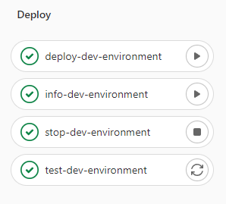
Deploy stage
Very often a single machine is not enough for the work of developers
Developers have the ability to deploy their applications on a namespace in the k8s cluster for development
Parlial deployment are allowed so that the development can happen both in a remote cluster and in the local machine of the developer

Slide 14
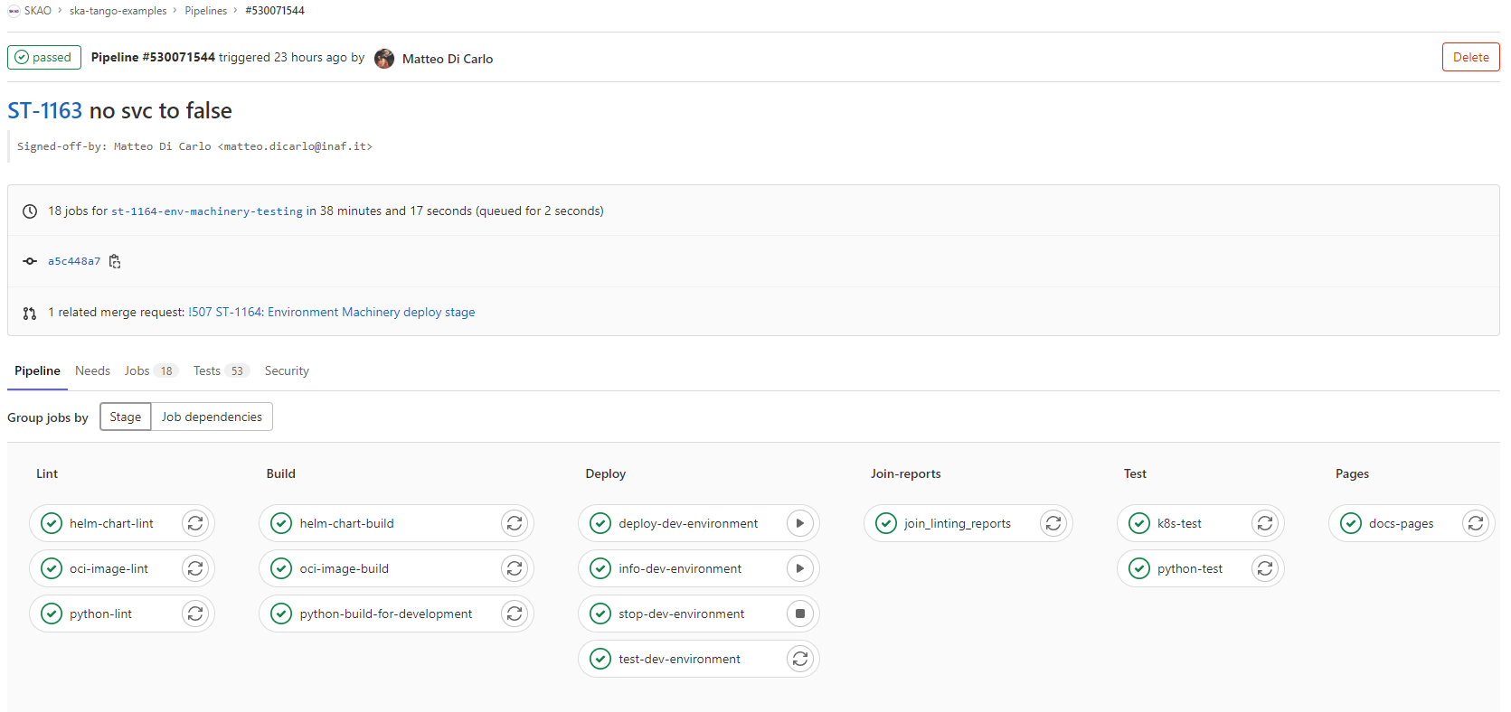
Pipeline machinery: motivations
Standards and Documentation
Shift-left testing
Ensuring the things that are committed are not broken
Quality checks

Slide 15
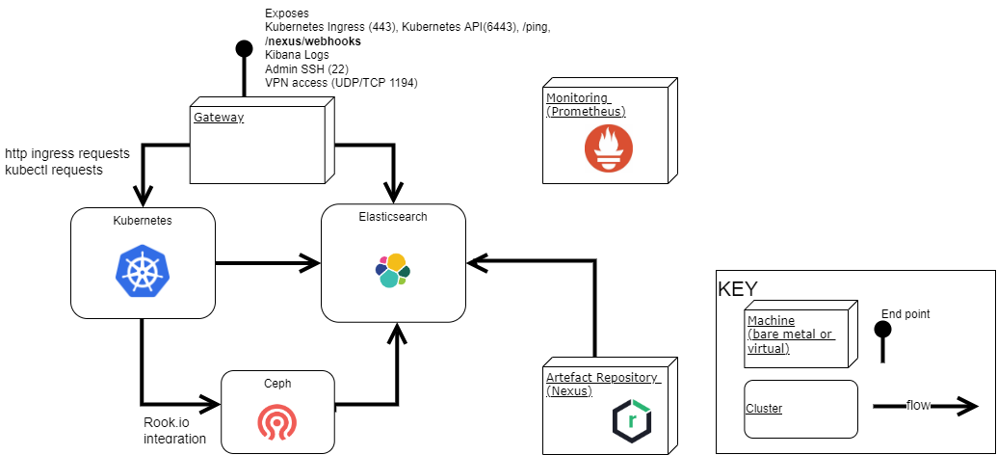
Infrastructure
At the moment there are 4 infrastructures made with this structure: UK (stfc), Portugal (engageska) Australia (CSIRO), Canada
3 masters
3 masters,
>5 workers
3 masters
Configured in Gitlab

Slide 16
Building the infrastructure (work in progress)
A set of ansible collections has been created in order to support the deployment and maintenance of SKA Services (monitoring collection, logging collection, etc.)
One repository collects all inventory files and variables to be applied per infrastructure
End-to-end testing made with the helm of an “terraform” repository for openstack integration

Slide 17
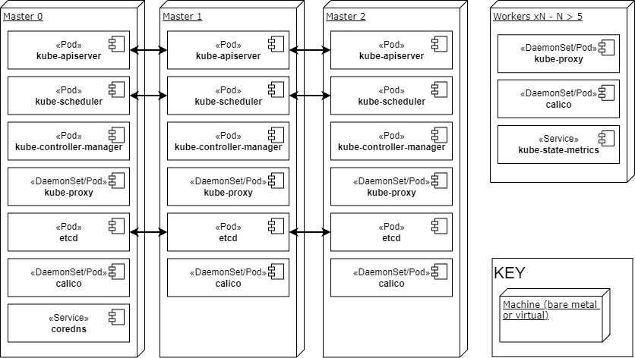
Kubernetes cluster
One Master is elected leader for the cluster giving one active scheduler - on failure, a new leader is elected, based on a quorum of remaining masters.
Round-robin load balancer for internal and external Kubernetes API access
Round-robin load balancer for internal communication of masters to global Kubernetes database;
etcd fault tolerant cluster based on raft consensus

Slide 18
Quality aspects
To ensure that all best practices are followed by SKA developers an AI, called Marvin, has been implemented in order to perform quality checks on Gitlab merge requests and validation on artefacts publication
Using webhooks from Gitlab and Nexus, Marvin performs its checks but also informs developers on what is happening like new releases
From a technical point of view it is a FastAPI application and a celery application both of them with a plugin architecture (where a plugin is a checks or a validation)

Slide 19
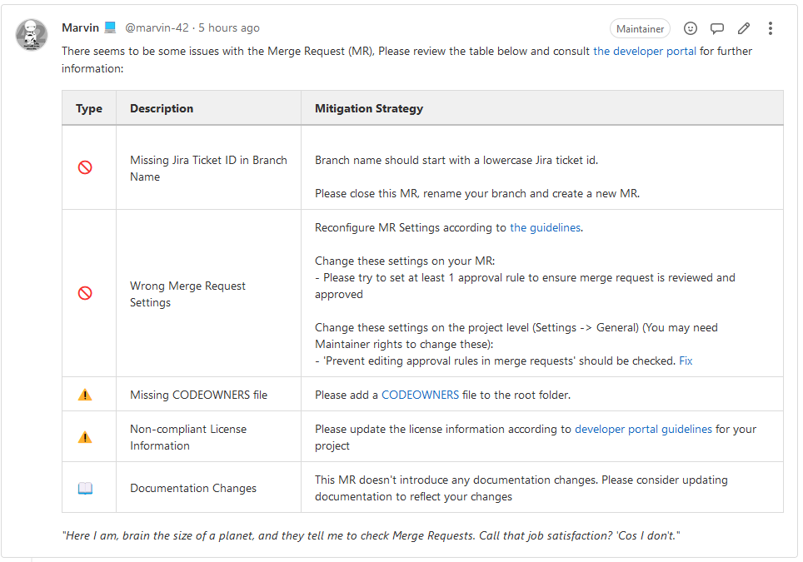
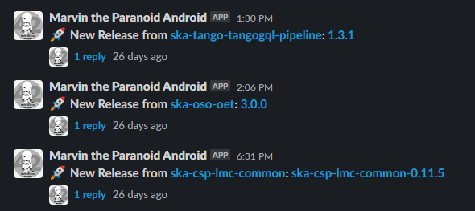
Marvin

Slide 20
SKA CICD Practices
Story based branching (2 weeks lifecycle)
Large use of Makefile
Every commit trigger a GitLab pipeline with a standard set of stages and jobs
Builing is fast with few exceptions: usually ~10 minutes
Integration testing in Gitlab is done within an isolated k8s namespace which are completely separate from each other
Every artefact is checked for quality

Slide 21
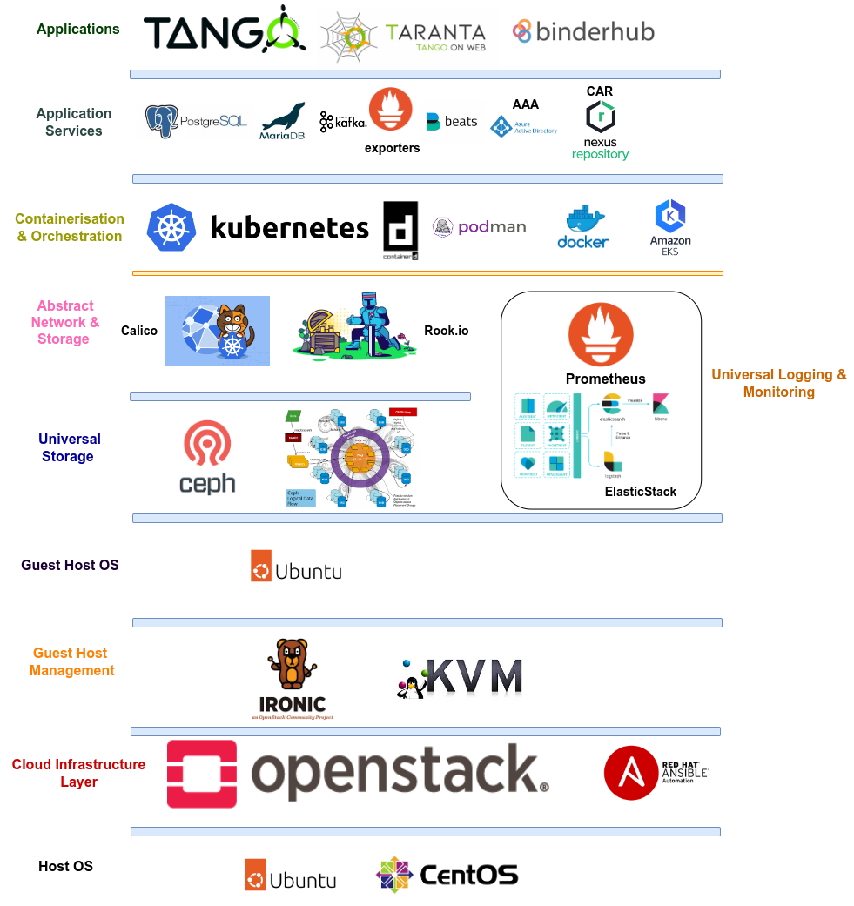
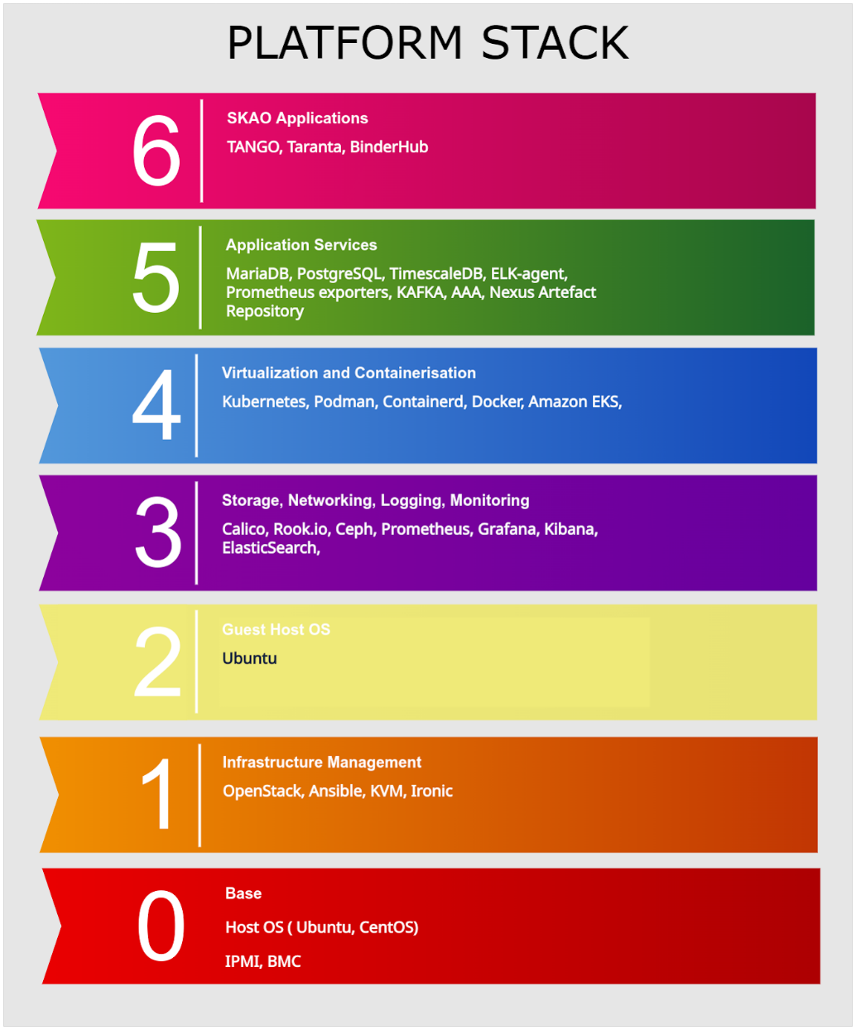
Thanks for you attention

