Slide 1
Monitoring and controlling the PRISMA network
Ing. Matteo Di Carlo
INAF – Osservatorio Astronomico d’Abruzzo
TETIS Workshop, Roma 2023

Slide 2
About
Software Engineer
Monitoring and control software (mainly for SKA project) 3D technologies software/exhibitions
Osservatorio Astronomico d’Abruzzo (INAF – OAAB)
Part of my time is devoted to PRISMA (Prima Rete Italiana per la Sorveglianza sistematica di Meteore e Atmosfera) as member of the Advisory committee.

Slide 3
PRISMA
Prima Rete Italiana per la Sorveglianza sistematica di Meteore e Atmosfera
www.prisma.inaf.it
https://www.facebook.com/inaf.prisma.it/
The goal is the observation of bright meteors (fireballs and bolides), in order to determine the orbits of the objects and calculate (with a good degree of approximation) the area of the possible fall of fragments in order to be able to recover the meteorites
Born as branch of the French equivalent network called FRIPON

Slide 4
Building block #1: Freeture
Main building block for FRIPON (the french equivalent network) and PRISMA
FreeTure is a free open source (GPL license) meteor detection software used to monitor the sky with GigE all-sky cameras to detect and record falling stars and fireball.
Developed by Chiara Marmo
Stable:
One folder per day for capture images
If a detection is recognized, it creates another folder
https://github.com/cmarmo/freeture

Slide 5
Building block #2: Ansible
Free software for software automation (deployment) on unix-like and windows systems
2 types of machines: simple and controller nodes
The controller sends execution commands to the nodes with SSH
The base concept is the «playbook» that is a sort of book where ansible collects the execution commands to send to the nodes.
A playbook can define roles and includes other playbooks.

Slide 6
Available services
Synchronization
Monitoring
Logging
Calibrations
Events analysis
Data access
(VPN, DNS)

Slide 7
Synchronization
2 services (containers) always running for synchronizing captures, detections and events data both from FRIPON and PRISMA nodes
2 modes of working: last n days synchronization and on request
Evolution of the rsync module

Slide 8
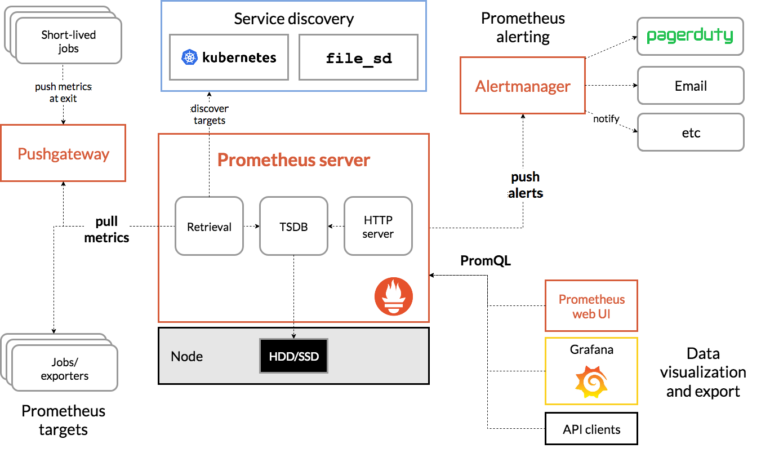
Monitoring with Prometheus

Slide 9
Node-exporter
Prometheus exporter for hardware and OS metrics exposed by *NIX kernels, written in Go with pluggable metric collectors.
Service available on every node that allow the access of hardware and os related data metrics
https://github.com/prometheus/node_exporter

Slide 10
Prisma-exporter
Personalization for PRISMA
Number of successful captures done of yesterday
Number of expected captures of yesterday
Number of daily captures
Number of monthly detections
Number of daily events
Daily calibration
Montly calibration
Processed event

Slide 11
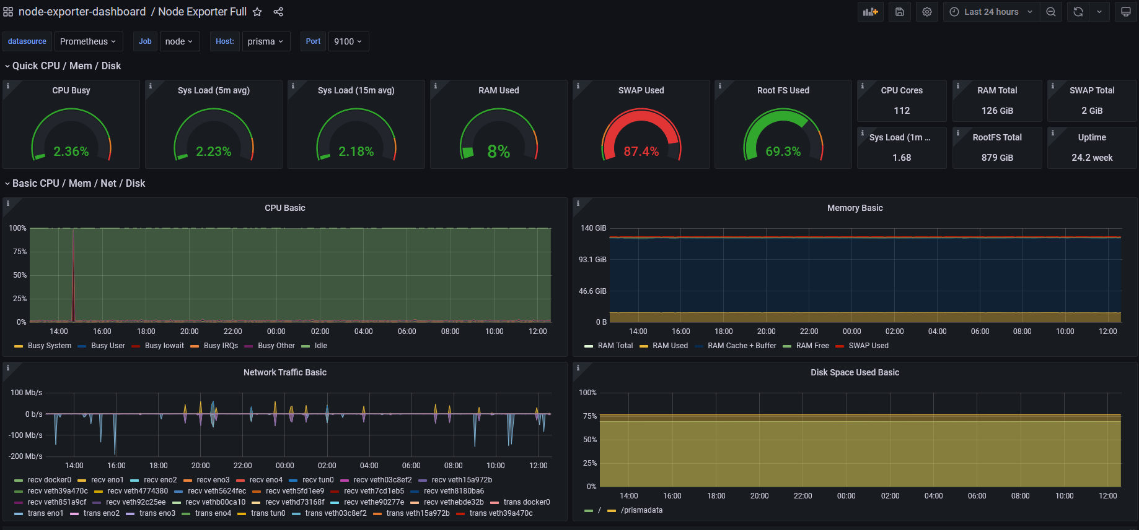

Slide 12
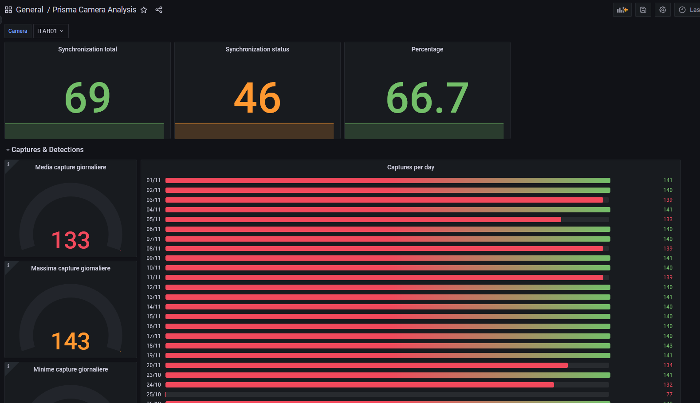

Slide 13
Logging con Elasticsearch
Real-time distributed search and analytics engine
“Real-time” refers to the ability to search (and sometimes create) data as soon as they are produced
Distributed because its indices are divided into shards with zero or more replicas
the analytics engine which allows the discovery, interpretation, and communication of meaningful patterns in data
Based on Apache Lucene: a free and open-source information retrieval software library
It is developed alongside a data-collection and log-parsing engine called Logstash, and an analytics and visualization platform called Kibana

Slide 14
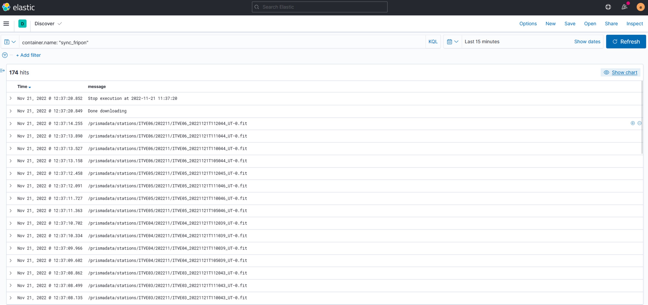

Slide 15
Calibrations and event analysis
Calibration software developed by D. Bargini in IDL
Incapsulated in 2 containers/services always running that ever X seconds:
Execute daily calibrations
Execute monthly calibrations
Execute events analisys

Slide 16
Data access
Rss: http://prismavpn.oato.inaf.it/prisma_rss/events
Detection: http://prismavpn.oato.inaf.it/prisma_rss/event/<yyyymm>/<yyyymmddThhmmss_UT>:
- http://prismavpn.oato.inaf.it/prisma_rss/event/202210/20221012T043037_UT
- http://prismavpn.oato.inaf.it/prisma_rss/event/202210/20221004T040456_UT
Captures: http://prismavpn.oato.inaf.it/prisma_rss/captures/<camera_code>
- http://prismavpn.oato.inaf.it/prisma_rss/captures/ITLO06
- http://prismavpn.oato.inaf.it/prisma_rss/captures/ITLO07

Slide 17
Other considerations - Disk space
Total nodes === 70
One month capture around 10 Gb per node
Total captures 700 GB (potential)
Monthly Events around 500 GB
Disk space
Total: 42T
Used: 30T
Free: 9,8T

Slide 18
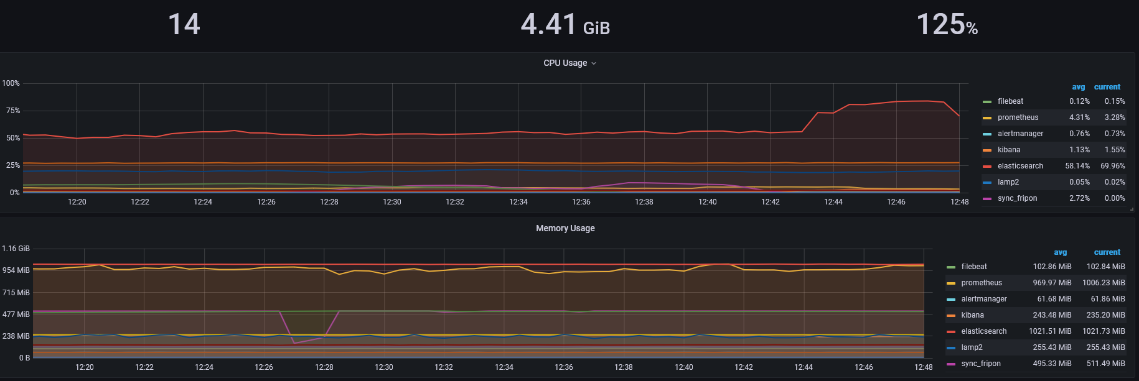
Other considerations – CPU e RAM

Slide 19
Conclusion
Working services
(VPN, DNS)
Synchronization
Monitoring
Logging
Calibrations
Event analisys
WIP
Storage on Trieste

