Slide 1
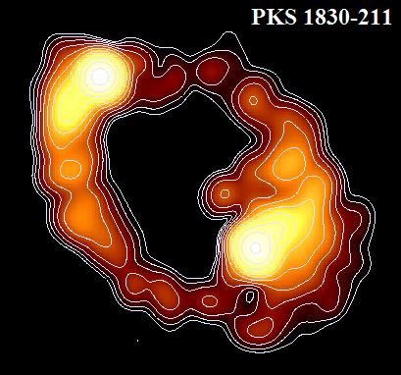
The radio VLBI view of the outstanding 𝛄-ray flare of the lensed blazar PKS 1830-211
Cristiana Spingola
Post-doc at INAF – Institute for Radioastronomy – VLBI/High energy group
M. Giroletti (INAF – IRA), M. Orienti (INAF – IRA), F. D’Ammando (INAF– IRA), S. Buson (University of Wurzburg) - Chris Fassnacht (UC Davis) - P. Edwards (CSIRO) - C.C. Cheung (Naval Research Laboratory) – J. Stevens (CSIRO) - S. Ciprini (Università di Perugia) –
and the OVRO collaboration

Slide 2
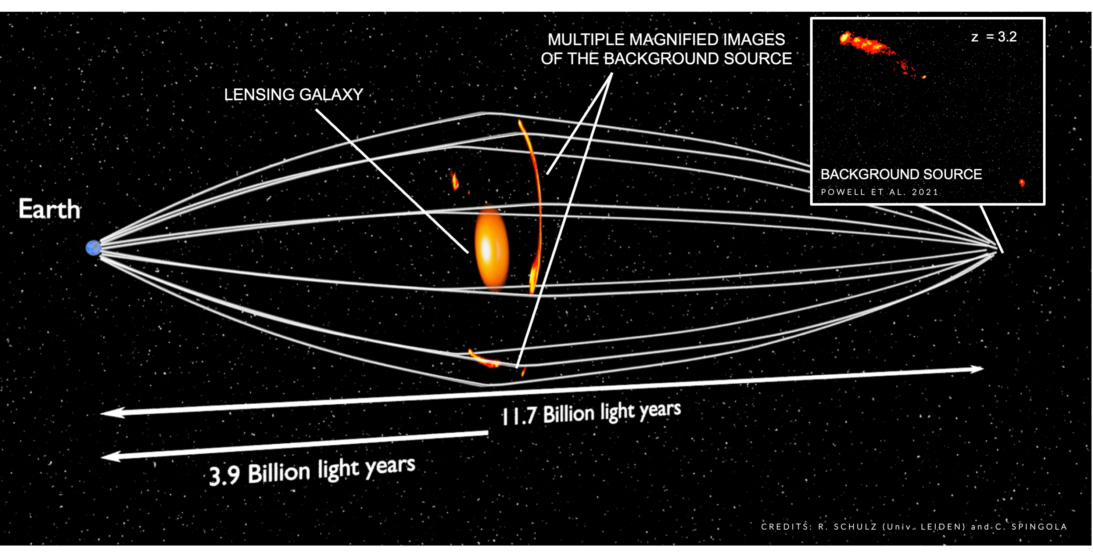
Why strong gravitational lensing?
The lensing magnification gives an improved spatial resolution and sensitivity
Price = strong lensing optical depth 𝞃∼0.001
AND TIME DELAYS
Global VLBI data and lens model from Spingola+2018

Slide 3
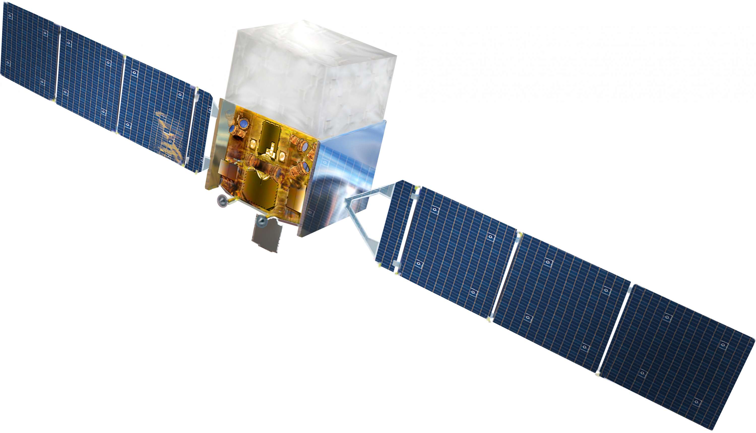
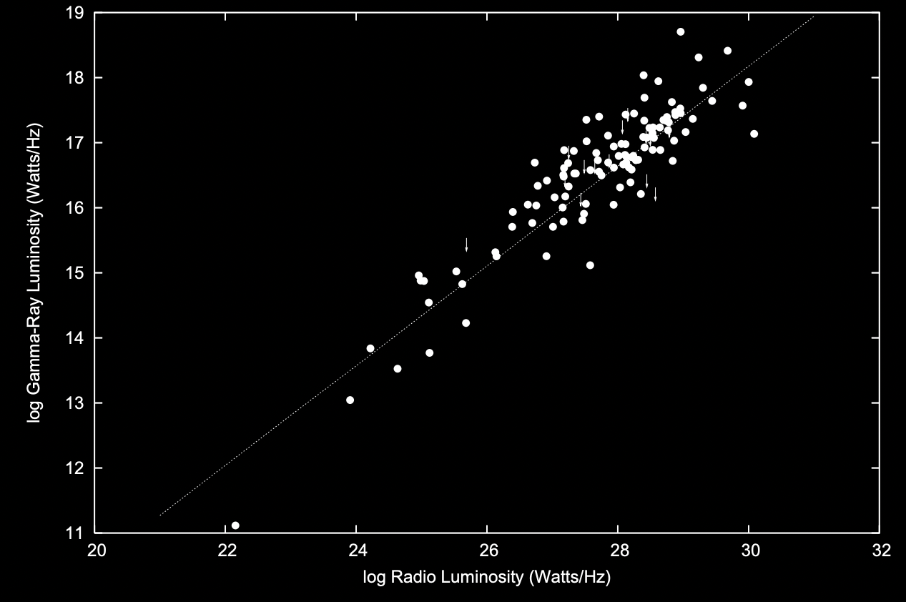
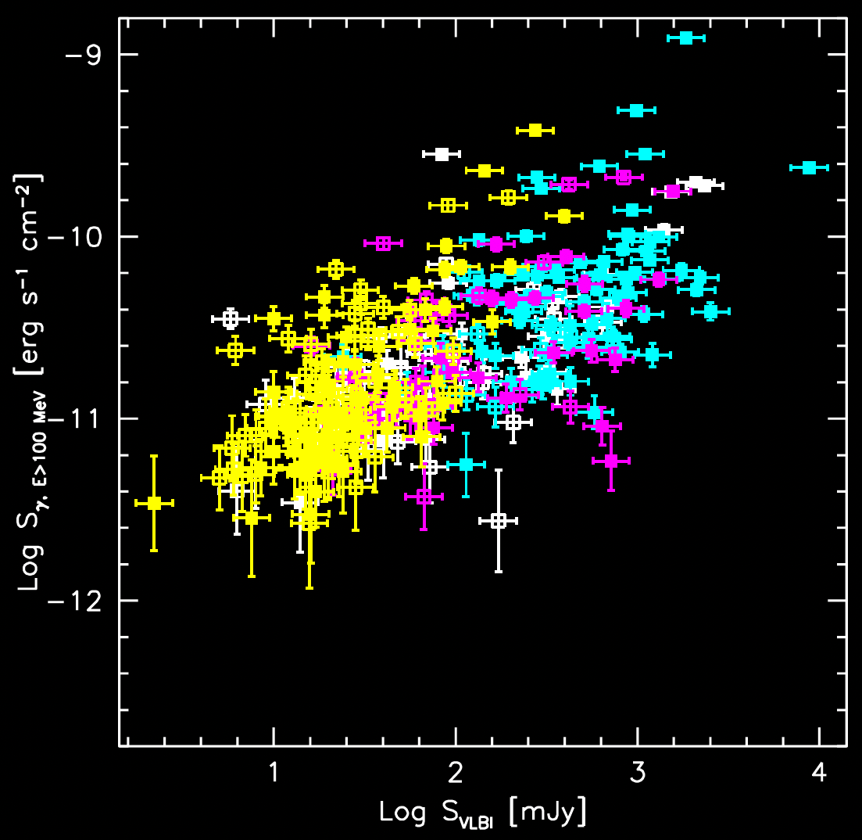
Gamma-ray blazars / the radio and gamma-ray connection
Time correlation
Flux correlation
Radio
𝛉
Gamma
Bloom 2008
EGRET + CLASS/GB6
Cross-corr
Blazars dominate the
extragalactic 𝛄-ray sky
(Ackermann+2011, Ajello+2012, Abdollahi+2020)
Giroletti+2016 and Lico+2017
Fermi-LAT + MWA (low freq)
Max-Moerbeck+ 2014
Ghirlanda+ 2010, Ackermann+2011, Leon-Tavares2012,
D’Ammando+ 2018, Fan+2018, see also review Massaro+ 2015
Vercellone et al. 2010, Hovatta+2015, Orienti+2015, Fuhrmann+2016, Bhatta 2017

Slide 4
Gamma-ray blazars / the radio and gamma-ray connection
Time correlation
Flux correlation
BUT
Orphan gamma-ray flares have been observed
(e.g., Spingola+ 2016, Liodakis+2018b)
Sometimes new knots, sometimes not
(e.g., Casadio+2015, Lico+ 2017)
Not all blazars have been detected at gamma rays
(e.g., Lister+ 2015)
Variability implies a region
sub-pc in size (e.g., Sbarrato+2011, Rani+2013)
but its location is unclear
Radio
𝛉
Gamma
Bloom 2008
EGRET + CLASS/GB6
Cross-corr
Blazars dominate the
extragalactic 𝛄-ray sky
(Ackermann+2011, Ajello+2012, Abdollahi+2020)
Giroletti+2016 and Lico+2017
Fermi-LAT + MWA (low freq)
Max-Moerbeck+ 2014
Ghirlanda+ 2010, Ackermann+2011, Leon-Tavares2012,
D’Ammando+ 2018, Fan+2018, see also review Massaro+ 2015
Vercellone et al. 2010, Hovatta+2015, Orienti+2015, Fuhrmann+2016, Bhatta 2017

Slide 5
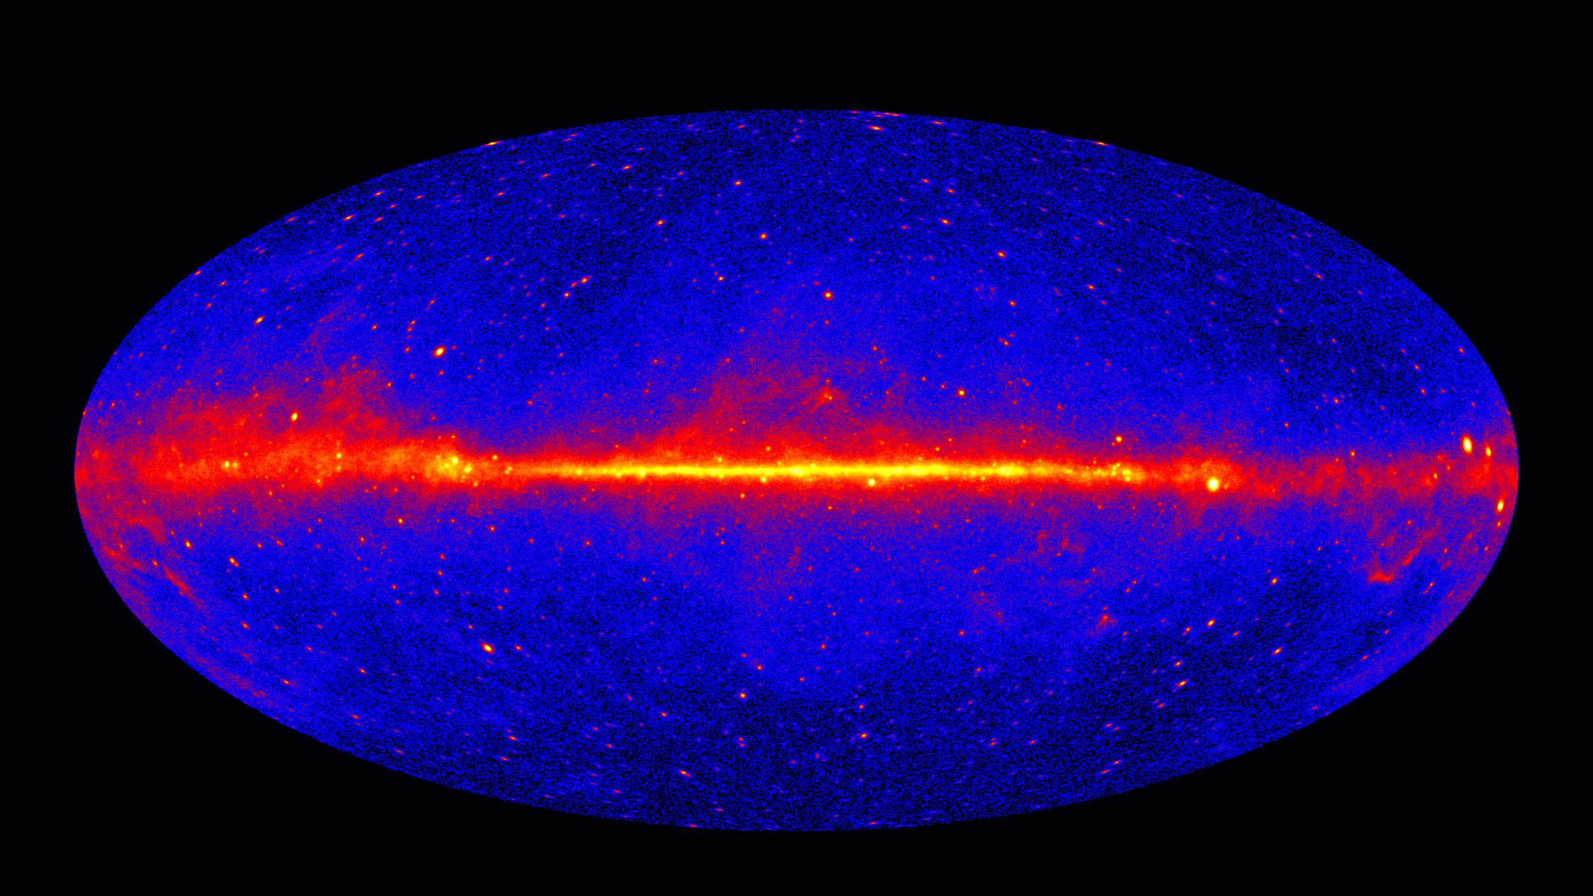
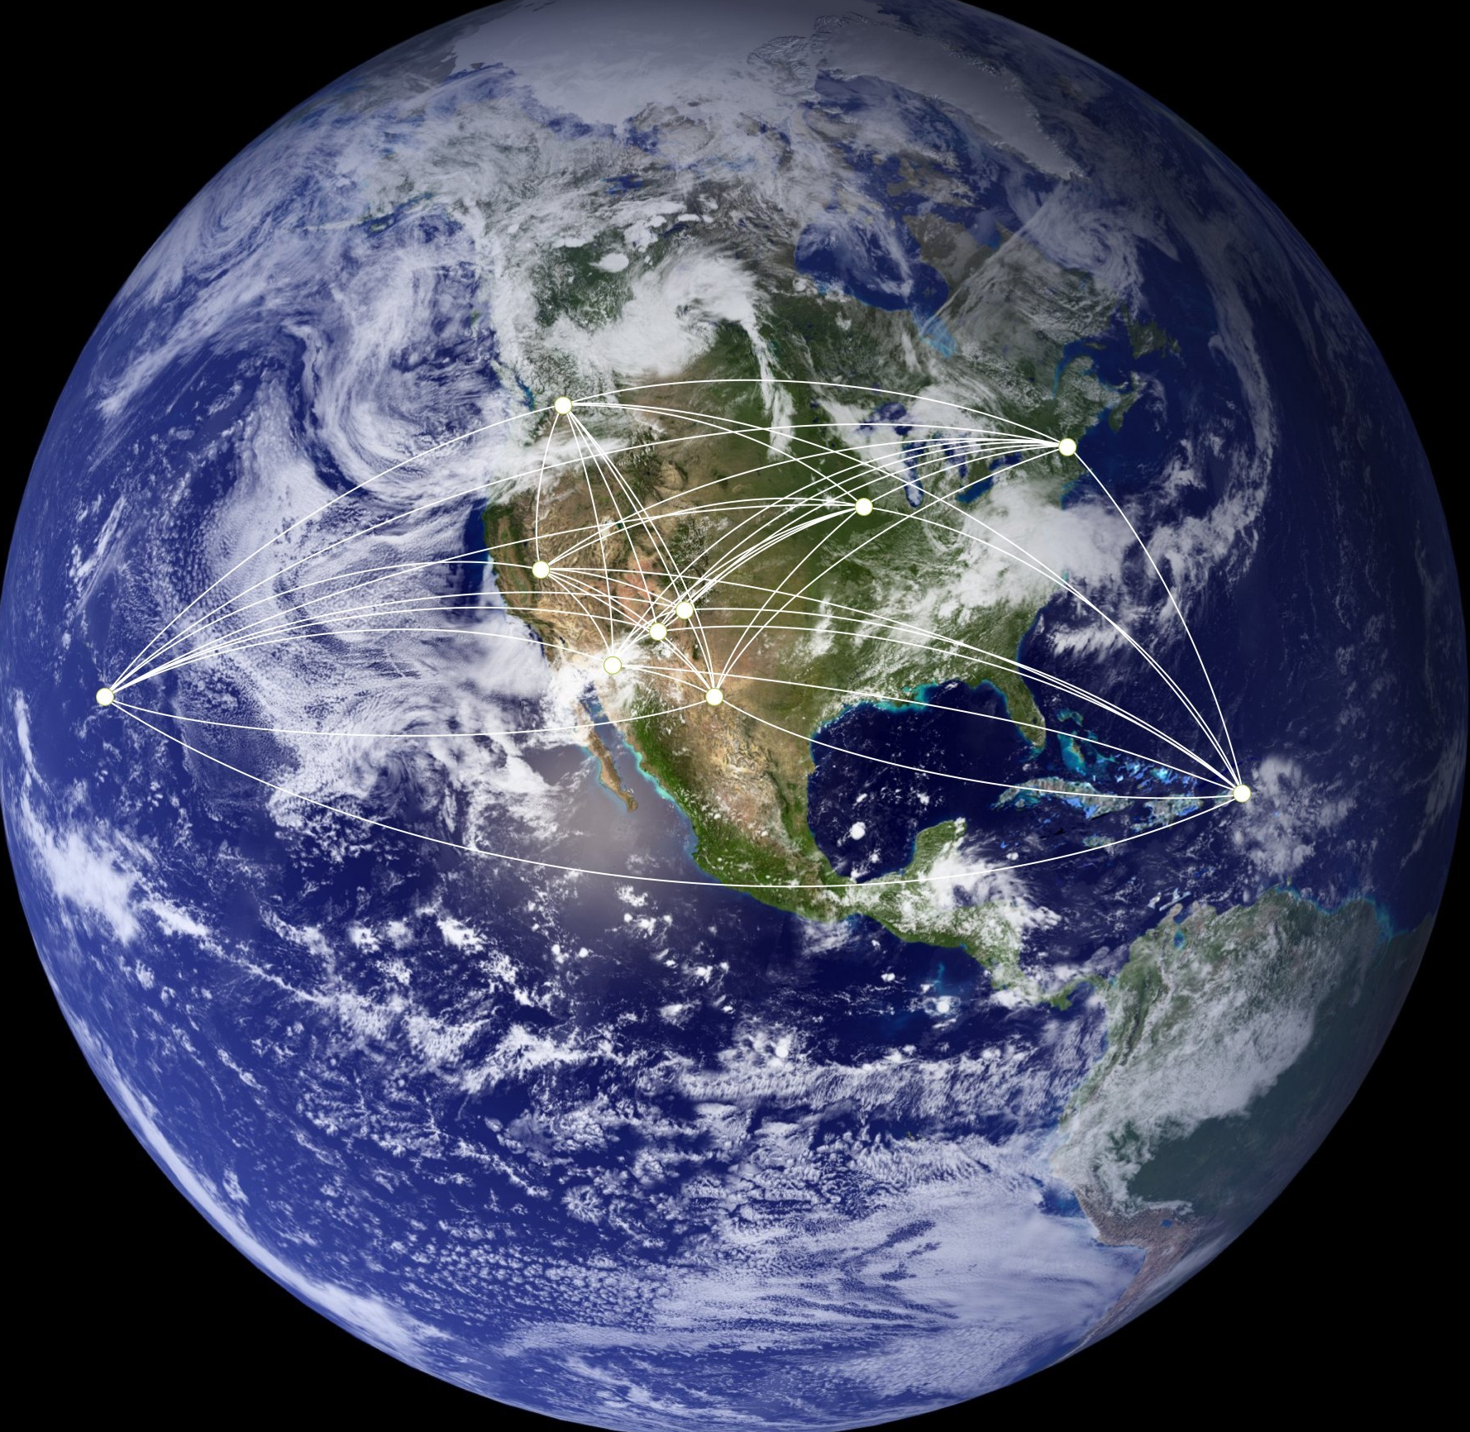
High angular resolution at radio wavelengths:
Very Long Baseline Interferometry (VLBI)
Very Long Baseline Array
Fermi Large Area Telescope
Credit: Jeff Hellerman, NRAO/AUI/NSF
Angular resolution 0.15-3.5 degrees
but very high time sampling (~a few hours)
Angular resolution mas / sub-mas
At gamma-rays we need strong lensing!

Slide 6
High angular resolution at gamma-rays:
Strong gravitational lensing (time delays)
Time delays can be used to constrain the relative location of the multi-band emission
A difference between the radio and the gamma-ray time delays directly implies that the two regions are separated (and vice-versa)
(Cheung+2014, Barnacka+2015,2016, Biggs & Browne 2018)
One step measurement of H₀ (Refsdal 1965)
The lensing system JVAS B0218+357 Credit: NASA's Goddard Space Flight Center
Cheung+2016 (Fermi-LAT gamma-rays) and Spingola+2016 (radio VLBI)

Slide 7
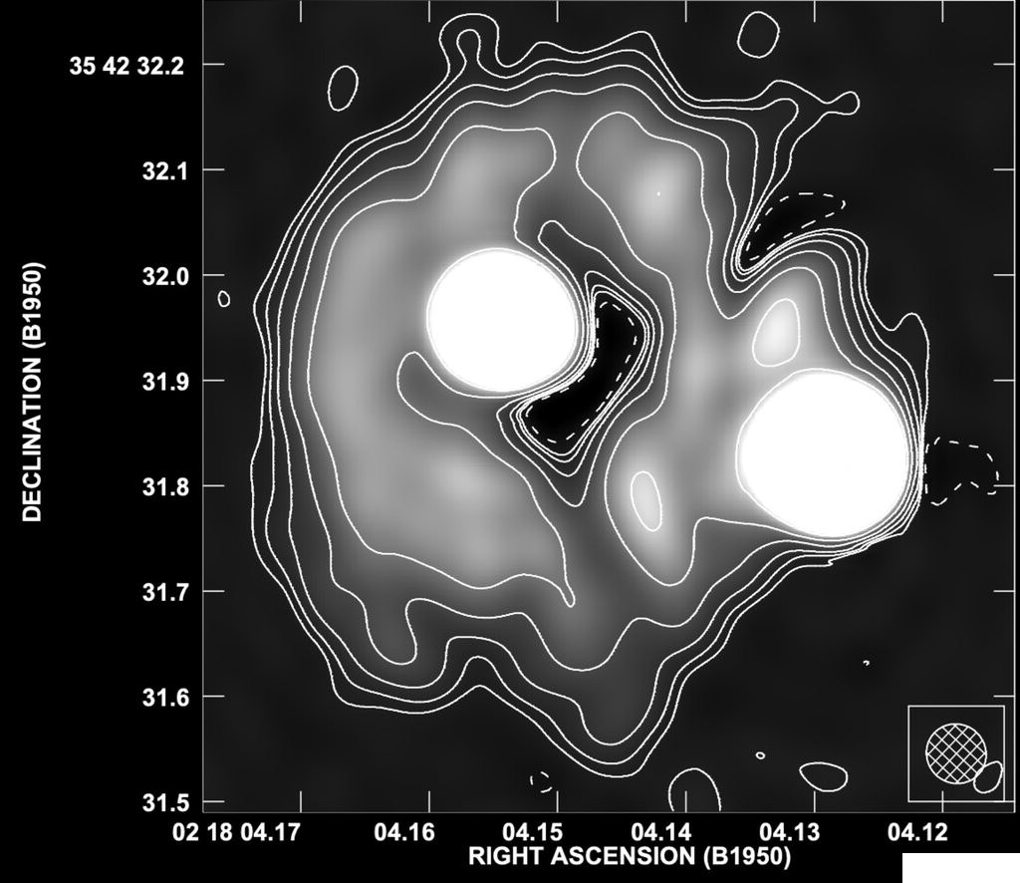
The (only) two lensed blazars known at gamma-rays
MERLIN 5 GHz maps ~50 mas resolution
JVAS B0218+357
PKS 1830-211
Biggs+2001, 2004, 2018; Spingola+ 2016; Hada +2020
z_{source}~1
z_{source}~2.5
Jauncey+1991, Lovell+1993, Patnaik+1993
~1 arcsec
~350 mas

Slide 8
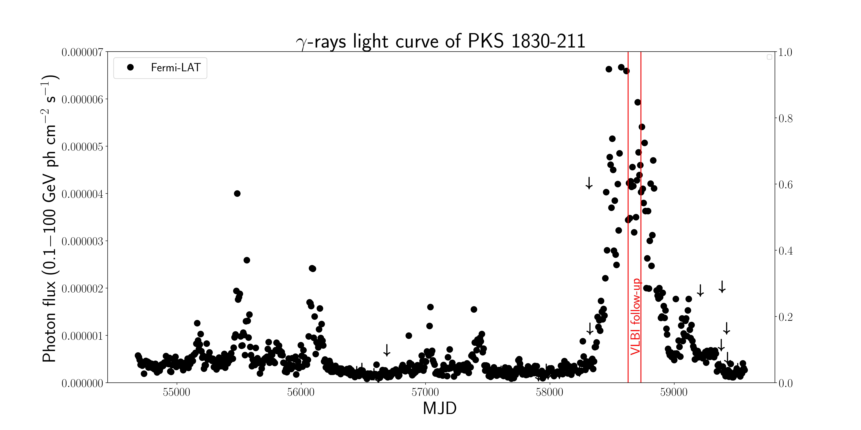
The outstanding 𝛄-ray flare from PKS 1830-211
Flare detection from radio to 𝛄-rays
(Buson+2019, Angioni+2019, Cardillo+2019, Carrasco+2019, Ciprini+2019)
PKS 1830-211
Spingola et al. in prep. (VLBI)
Buson et al. in prep. (Fermi-LAT)
+ rich follow-ups across the entire electromagnetic spectrum
z_{source}~2.5
Jauncey+1991, Lovell+1993, Patnaik+1993
~1 arcsec

Slide 9
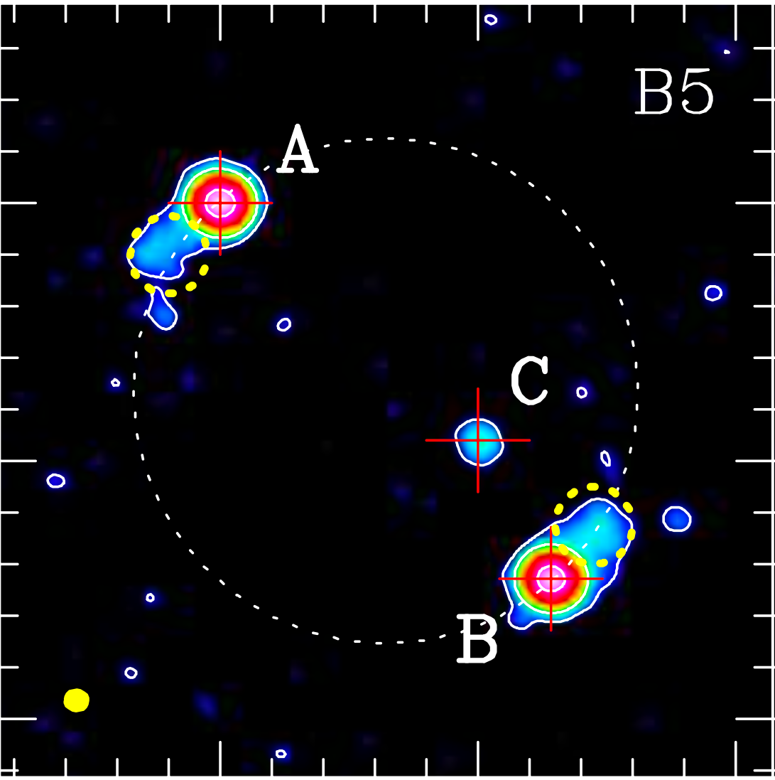
The outstanding 𝛄-ray flare from PKS 1830-211
ALMA Band 5 (180 GHz) during the FLARE
~60 mas resolution
MERLIN 5 GHz (1993!!)
Image A
𝜇_{c} = 0.022
Image B
Image C
Jauncey+1991, Lovell+1993, Patnaik+1993
Müller+ 2020
Significantly improved lens model precision
predictions for time delays Δt_{AB}= 26 – 29 days and Δt_{AC}= 31 – 34 days
ALMA Band 5 (180 GHz)
~60 mas resolution

Slide 10
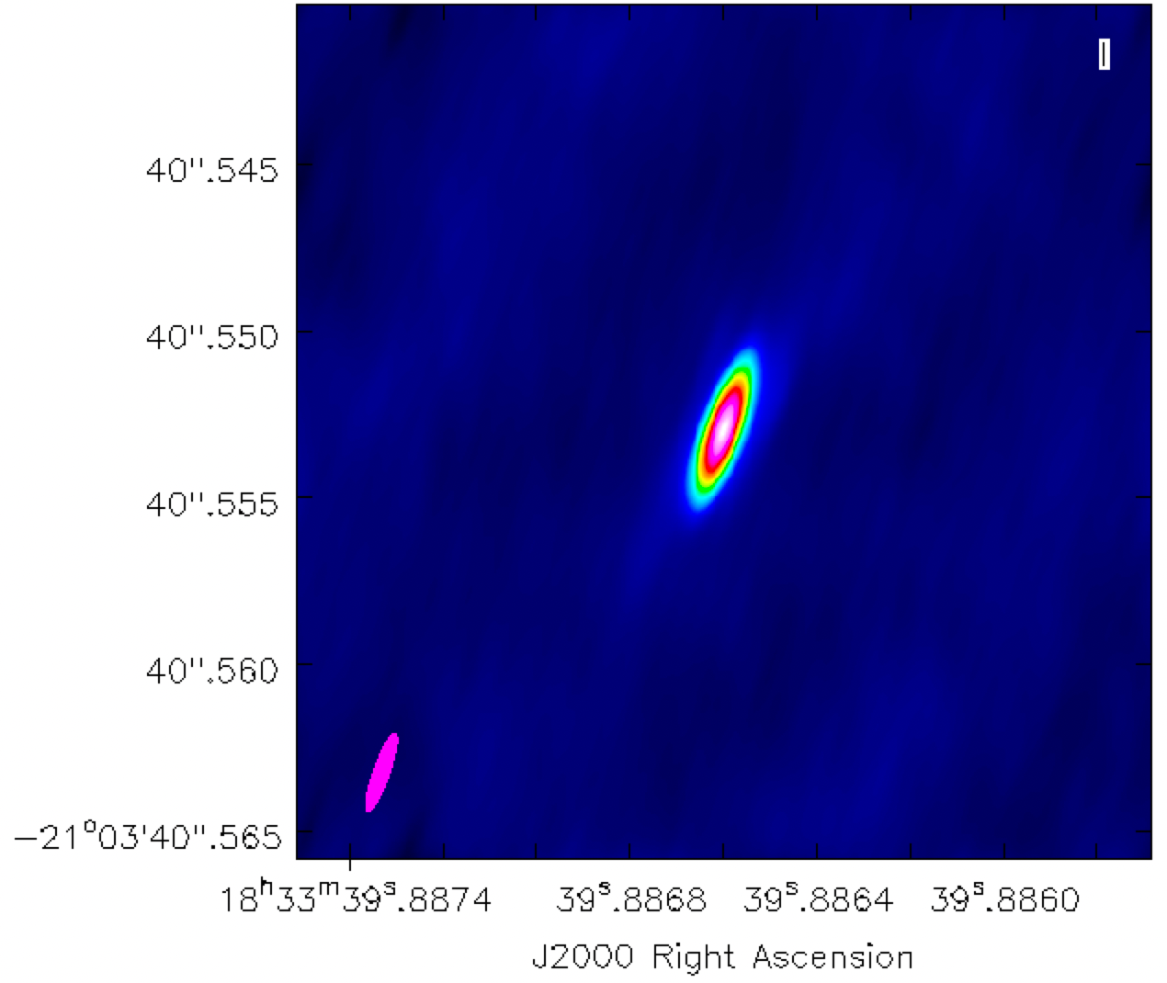
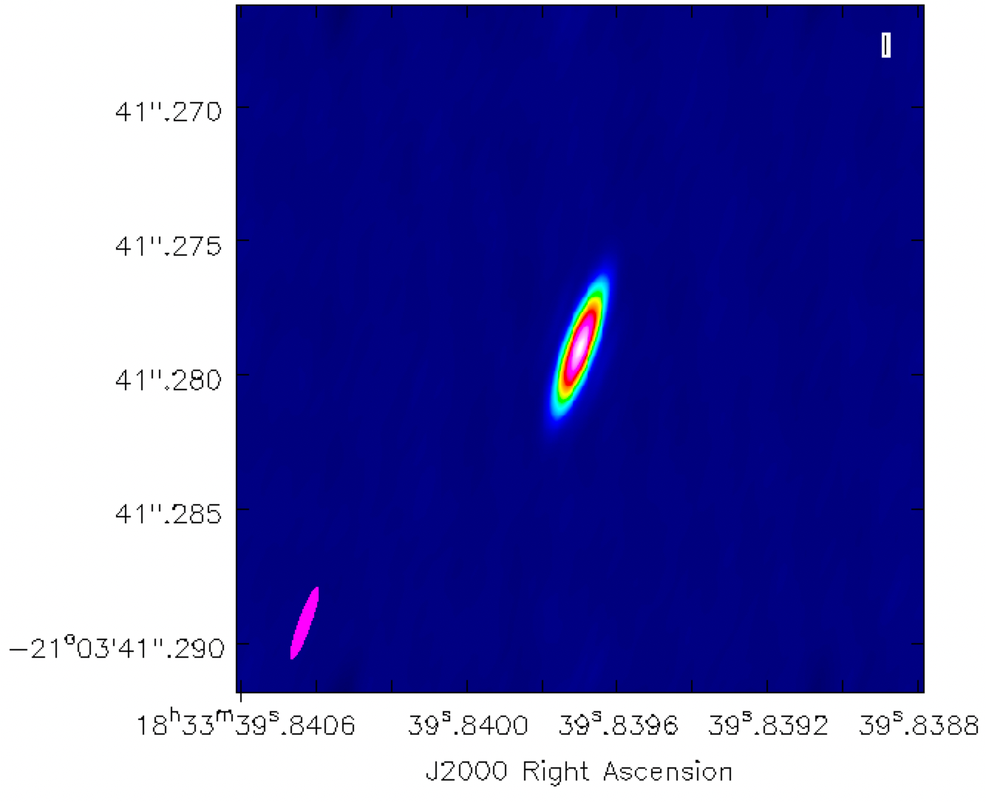
VLBI follow-up of the outstanding 𝛄-ray flare from PKS 1830-211 at 15, 24 and 43 GHz
No evidence for a knot ejection at mas and sub-mas resolution with the VLBA
Lensed image A
Lensed image B
15 GHz (2 cm)
Beam 3.0 mas x 0.5 mas, rms 0.1-0.3 mJy/beam

Slide 11
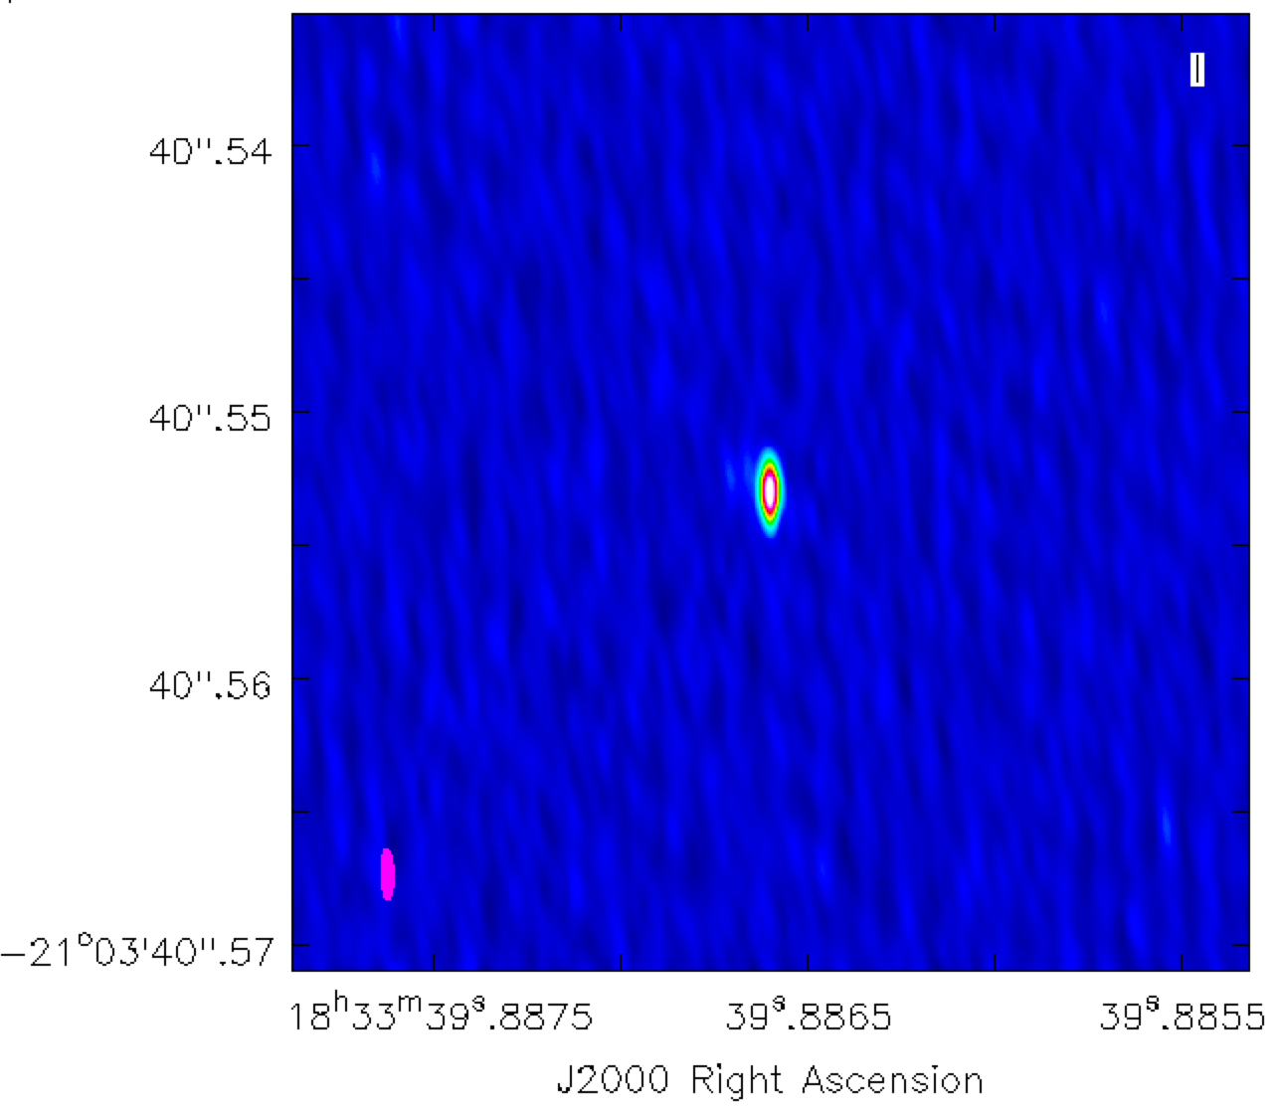
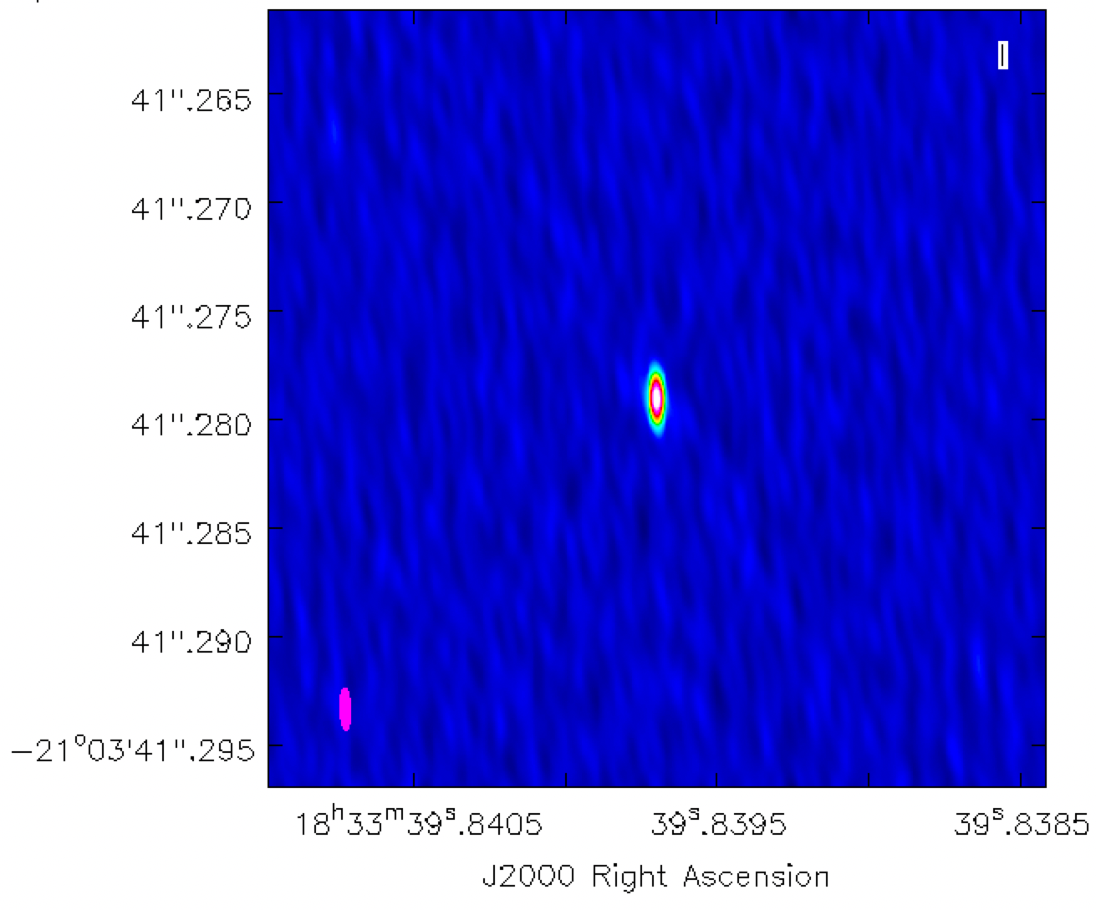
VLBI follow-up of the outstanding 𝛄-ray flare from PKS 1830-211 at 15, 24 and 43 GHz
No evidence for a knot ejection at mas and sub-mas resolution with the VLBA
Lensed image A
Lensed image B
24 GHz (1.2 cm)
Beam 2.0 mas x 0.4 mas, rms 0.2-0.5 mJy/beam

Slide 12
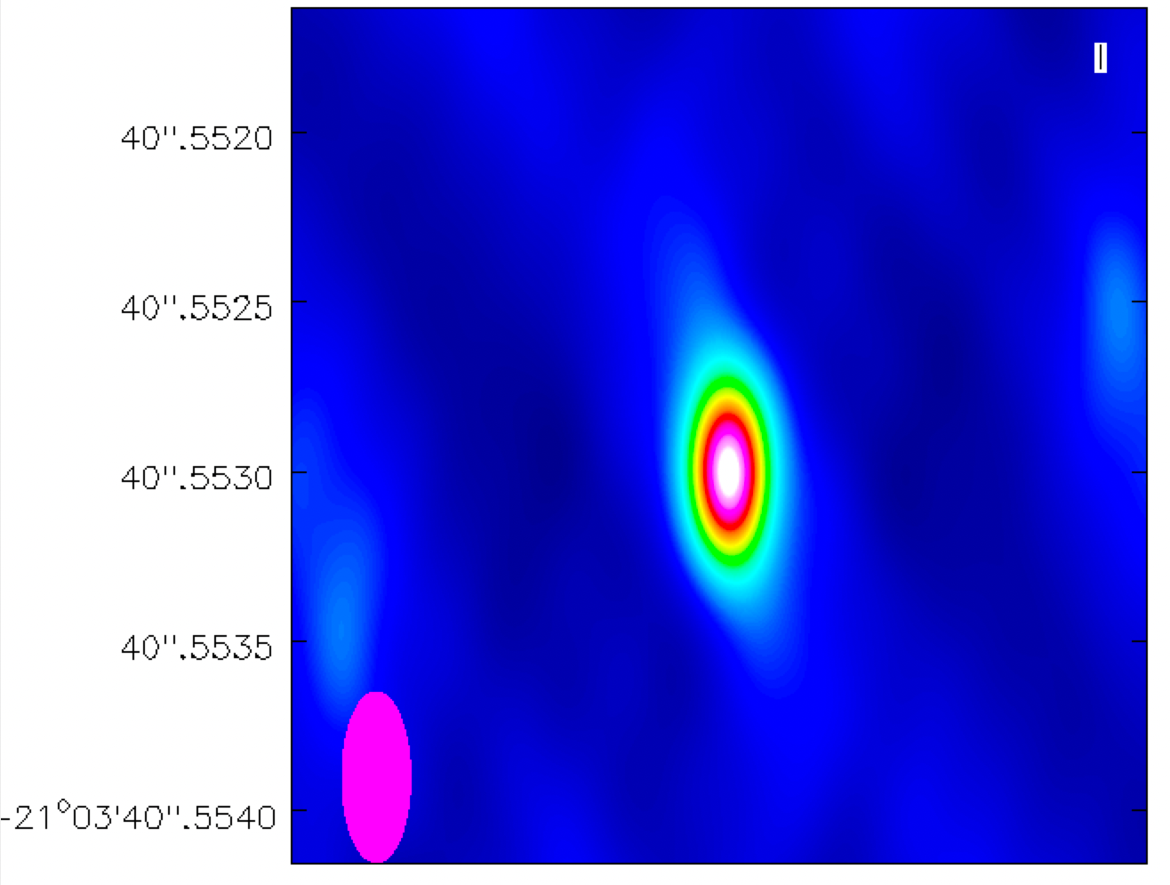
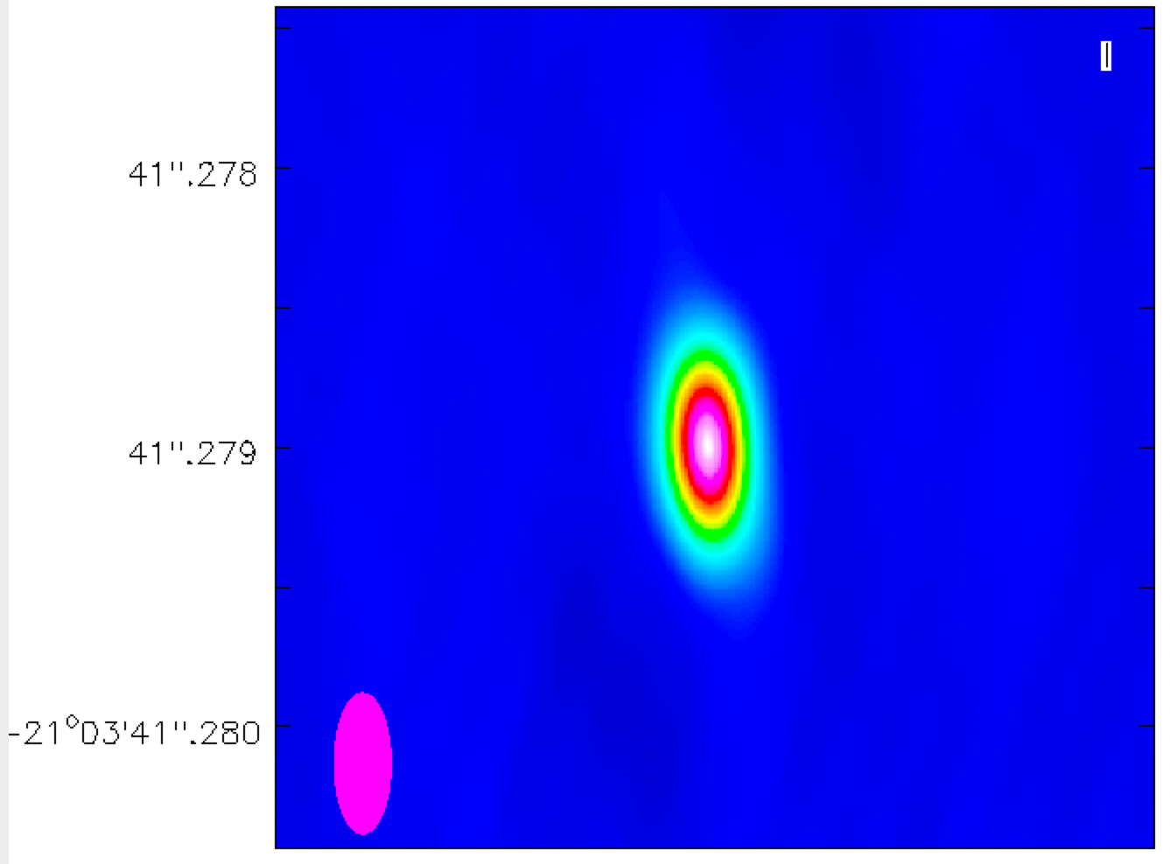
VLBI follow-up of the outstanding 𝛄-ray flare from PKS 1830-211 at 15, 24 and 43 GHz
No evidence for a knot ejection at mas and sub-mas resolution with the VLBA
Lensed image A
Lensed image B
43 GHz (7 mm)
Beam 0.5 mas x 0.2 mas, rms 0.5 - 2 mJy/beam

Slide 13
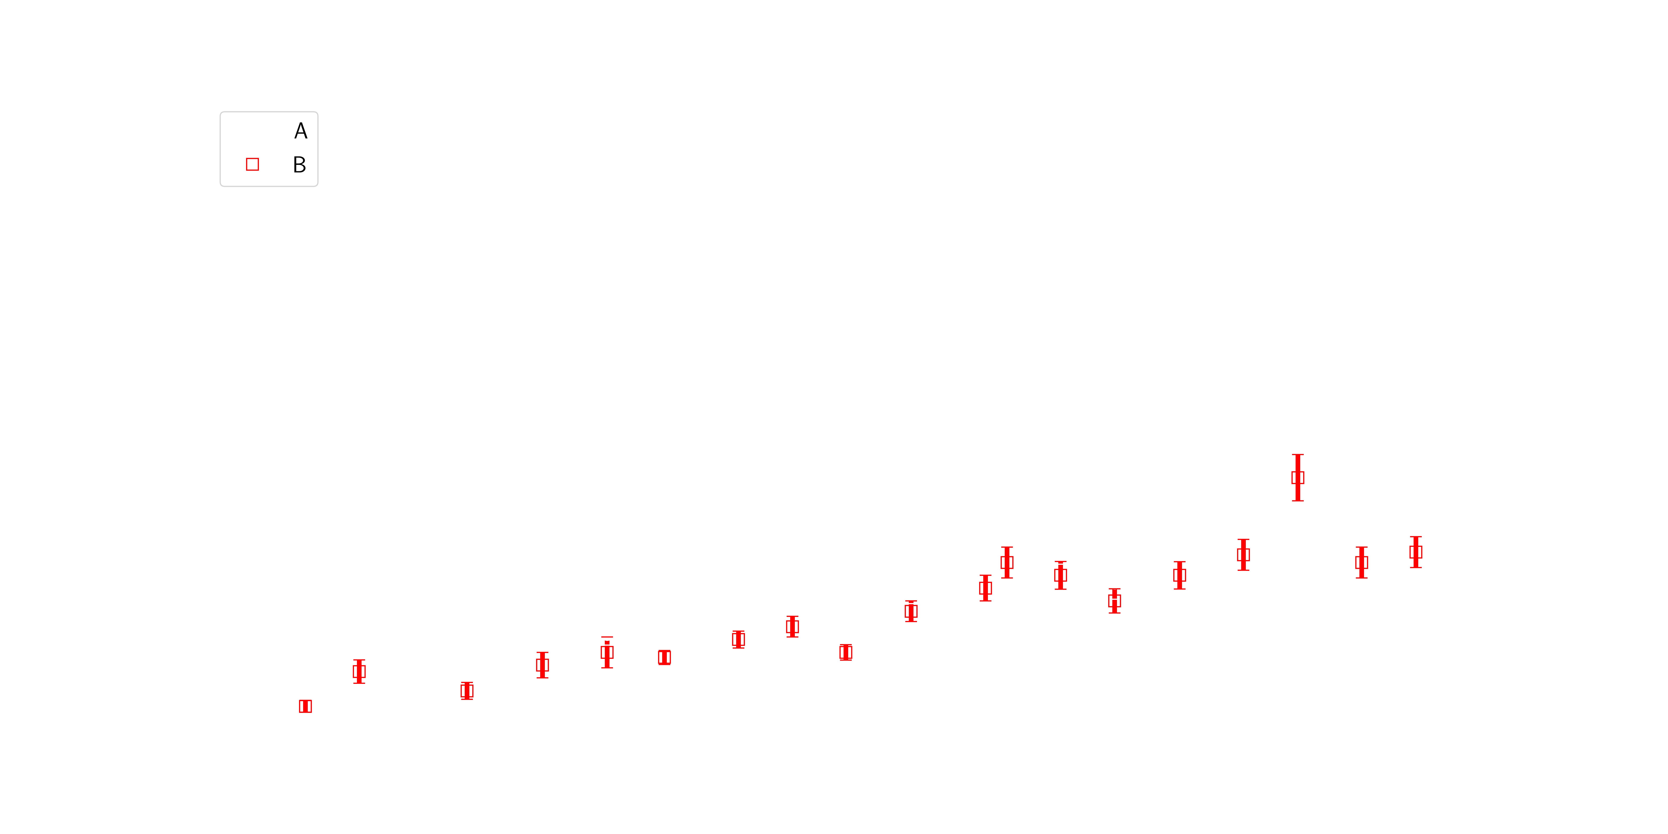
VLBI follow-up of the outstanding 𝛄-ray flare from PKS 1830-211
OBSERVED

Slide 14
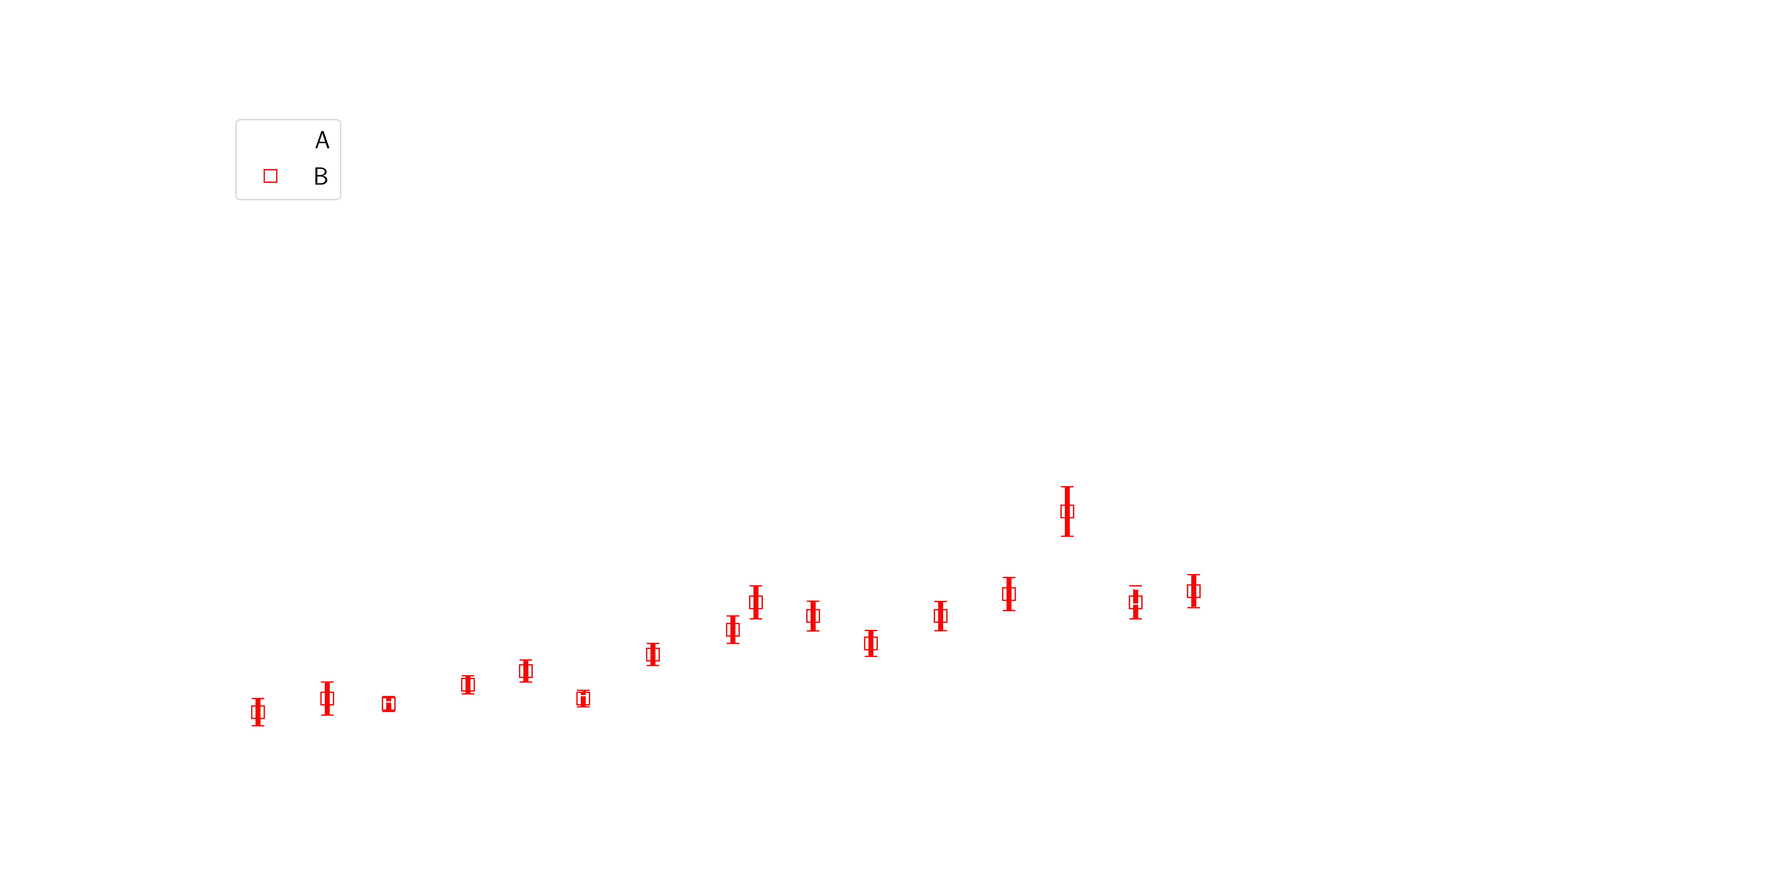
VLBI follow-up of the outstanding 𝛄-ray flare from PKS 1830-211
TIME SHIFTED
Δt_{AB} = 28.3 ± 3.1 days
𝝁_{A}/ 𝝁_{B} =1.1 ± 0.3
B - 28.3 days
Using 𝜒^{2,} cross-correlation and free-knot spline (PyCS3, Millon et al. 2020, 2022) methods / First time delay measured with VLBI
Realistic uncertainty is important because of H₀ estimate

Slide 15
Single-dish view the outstanding 𝛄-ray flare from PKS 1830-211
Autocorrelation function: correlation of a signal with a delayed version of itself
Owens Valley Radio Telescope (OVRO): 40m antenna in California
PKS 1830-211
Jy
VLBI Δt_{AB} = 28.3 ± 3.1 days
Monitoring program of more than 1500 Fermi-LAT sources
Sources observed ~twice per week
Angular resolution 2.6 arcmin FWHM

Slide 16
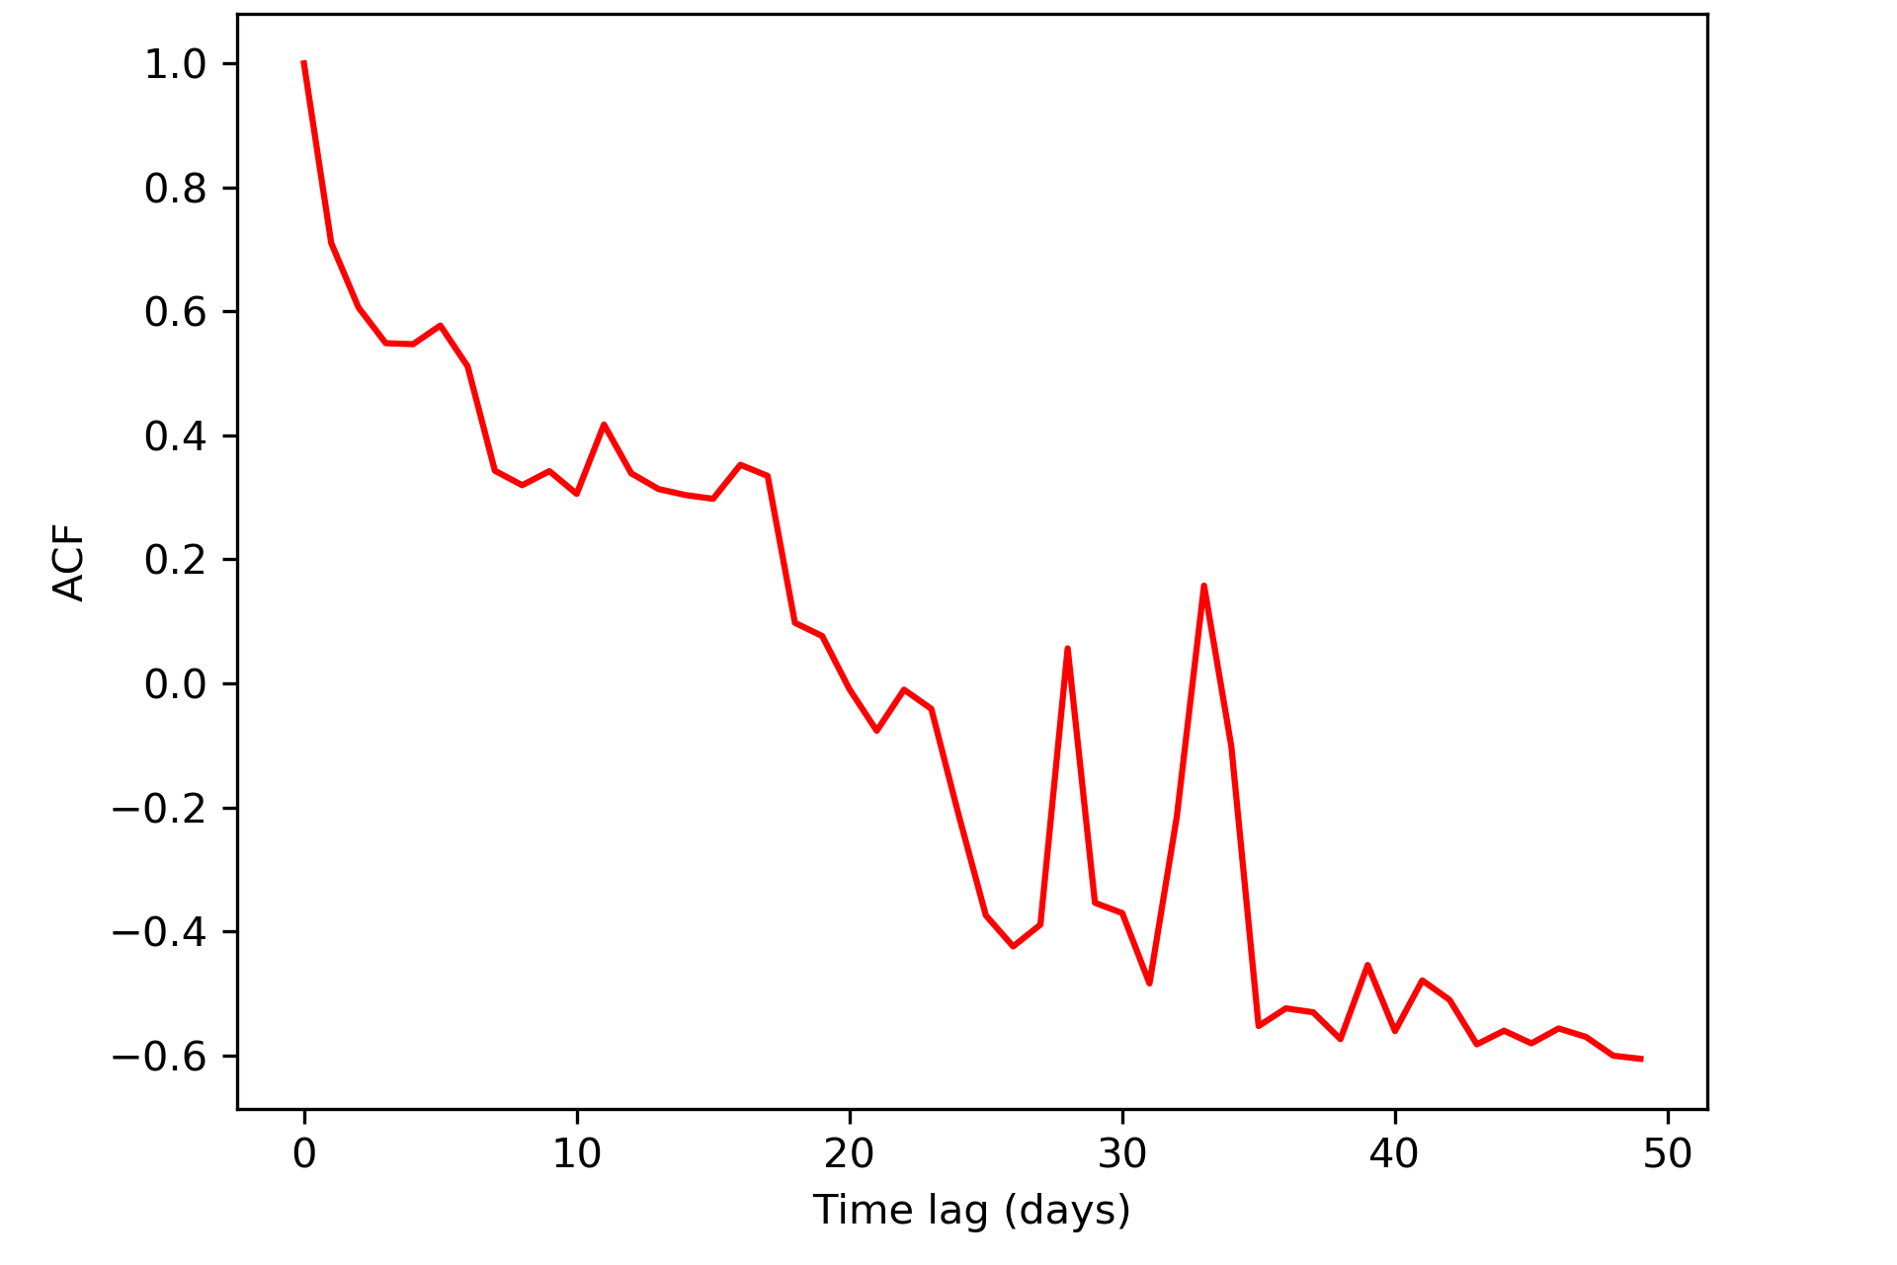
Single-dish view the outstanding 𝛄-ray flare from PKS 1830-211
Autocorrelation function: correlation of a signal with a delayed version of itself
Owens Valley Radio Telescope (OVRO): 40m antenna in California
Autocorrelation function
PKS 1830-211
Jy
Δt_{AC} ??
Δt_{AB}
VLBI Δt_{AB} = 28.3 ± 3.1 days
ACF on OVRO Predicted by Muller+2020
Δt_{AB} = 29 ± 3 days Δt_{AB}= 26 – 29 days
Δt_{AC??} = 34 ± 3 days Δt_{AC}= 31 – 34 days
Monitoring program of more than 1500 Fermi-LAT sources
Sources observed ~twice per week
Angular resolution 2.6 arcmin FWHM
This method could be used in a reverse way to find lenses in the time domain

Slide 17
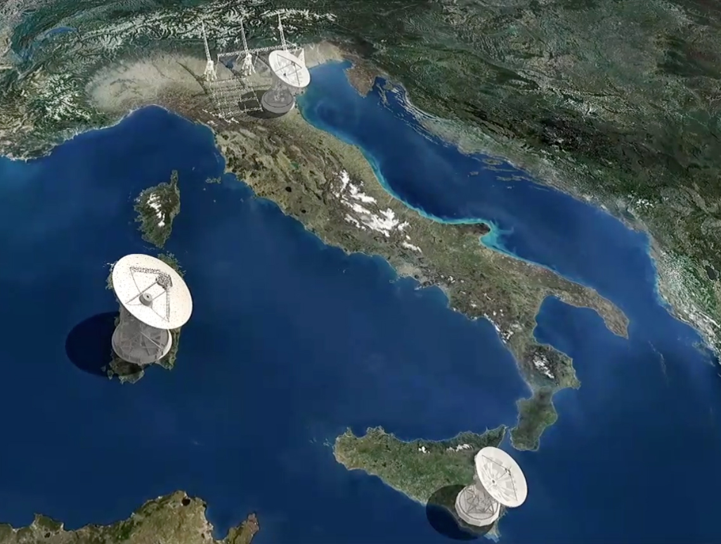
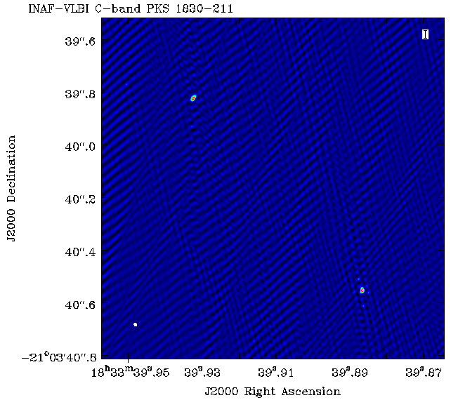
Ideally, we need high variability and long-term monitoring campaigns at high resolution
INAF-VLBI observations at 6 GHz
of PKS 1830-211
Medicina
Sardinia Radio Telescope
(Spingola et al. in prep.)
Noto
Beam FWHM ~10 mas -- rms 0.1 mJy/beam – peak s.b. 6.6 Jy/beam
Credits: MEDIA-INAF

Slide 18
Summary and future prospects
1. From VLBI monitoring during gamma-ray flare
𝝙t_{AB}= 28.3 ± 3.1 days in agreement with model-predicted one
to be compared with simultaneous 𝛄-ray time delay
2. Two time delays from «unresolved» radio light curve 29 ± 3 days and 34 ± 3 days (from central image??)
This method could be used in a reverse way to find lenses
in the time domain → Vera Rubin Observatory (will last 10 yrs)
and GAIA DR4 (end of 2025, 5.5yrs)
3. More precise time delays for better localization:
longer spatially-resolved monitoring programmes could be done with INAF-VLBI array
4. On-going work to search for image C in VLBI observations
5. There are only two lensed blazars known to date:
SKA will find thousands of lensed blazars (e.g. McKean+2015)
possible new highly variable 𝛄-ray-loud lensed blazars
THANK YOU!

Slide 19
Additional slides

Slide 20
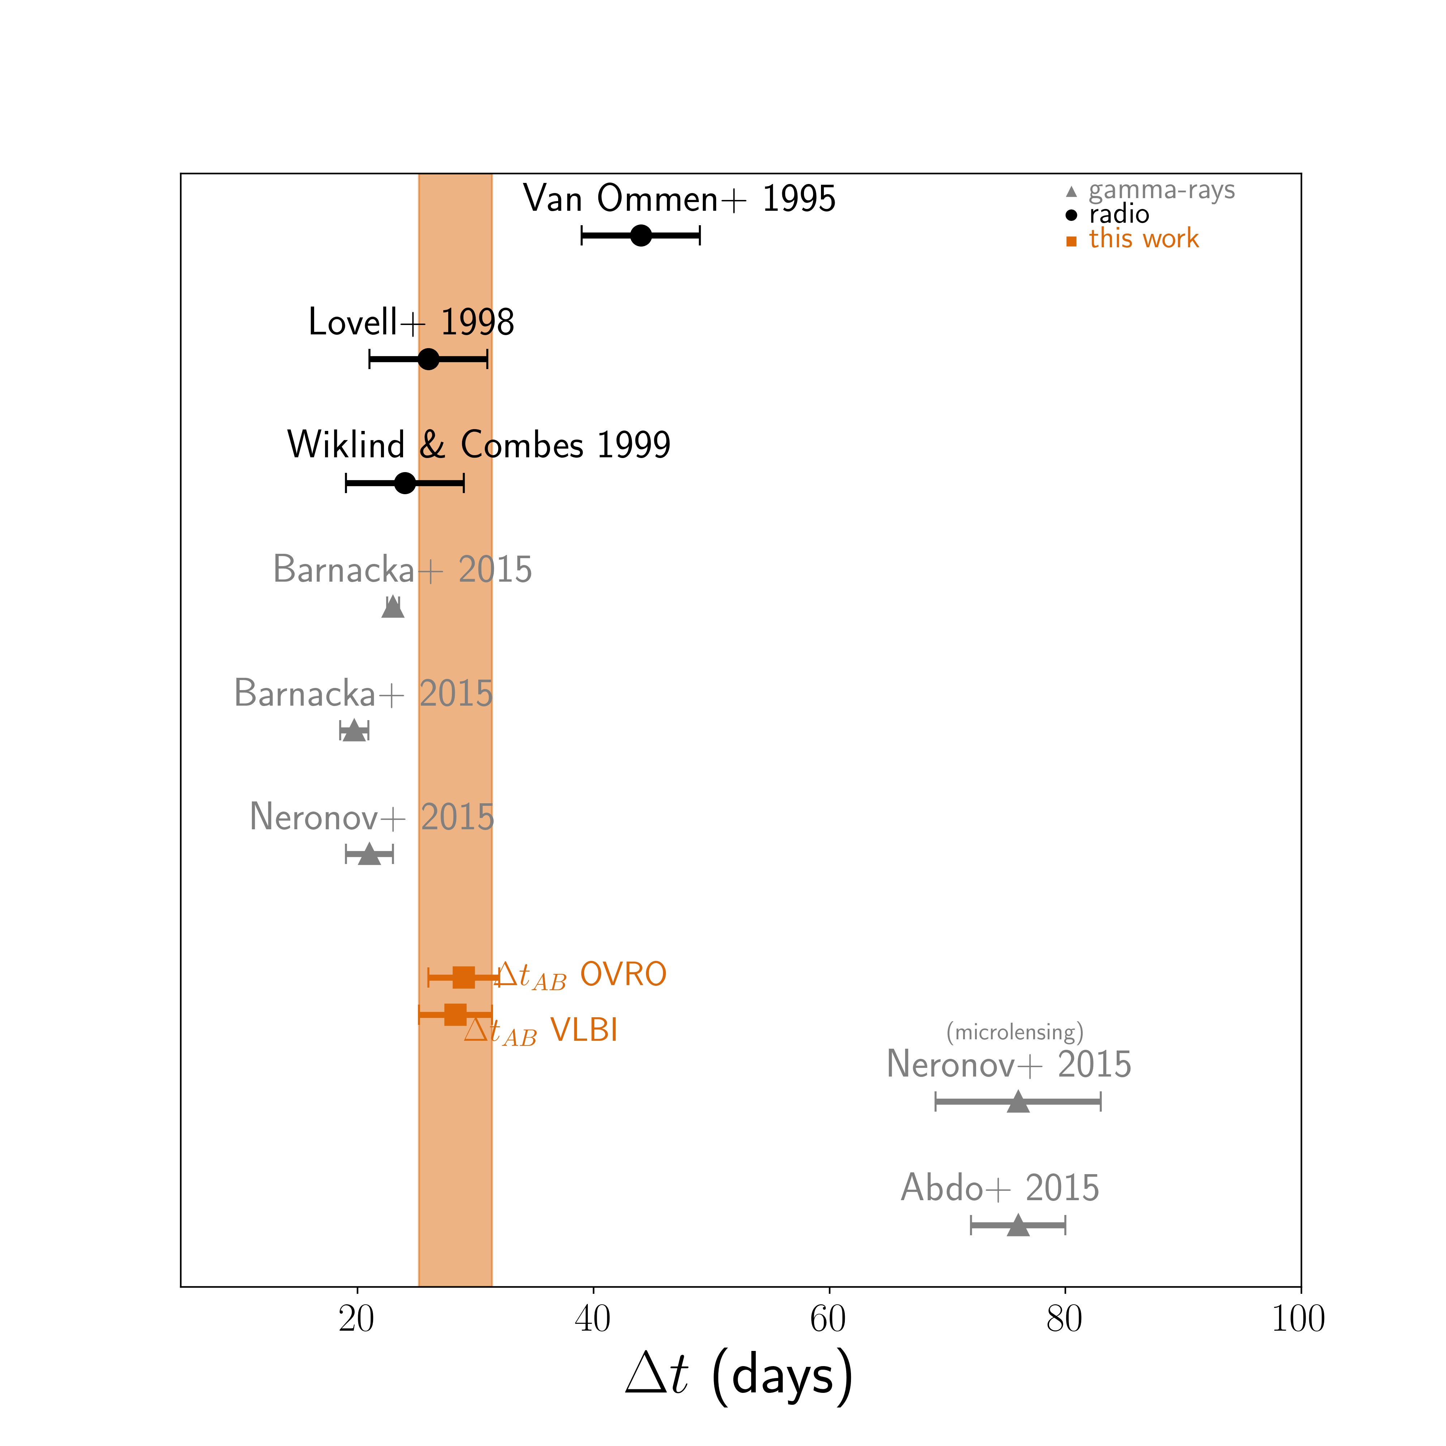
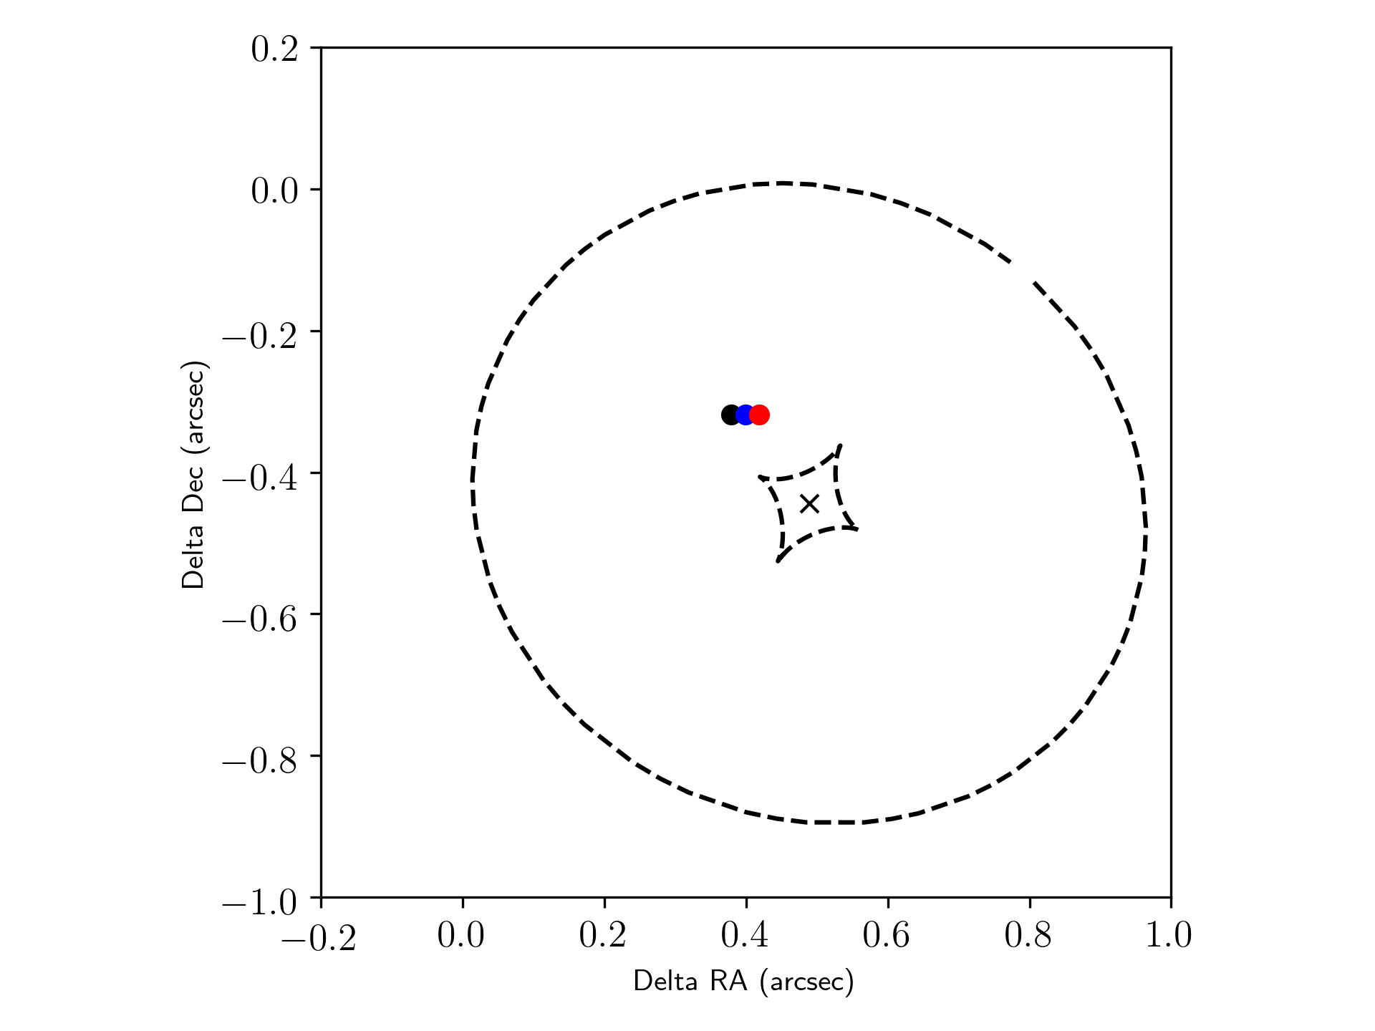
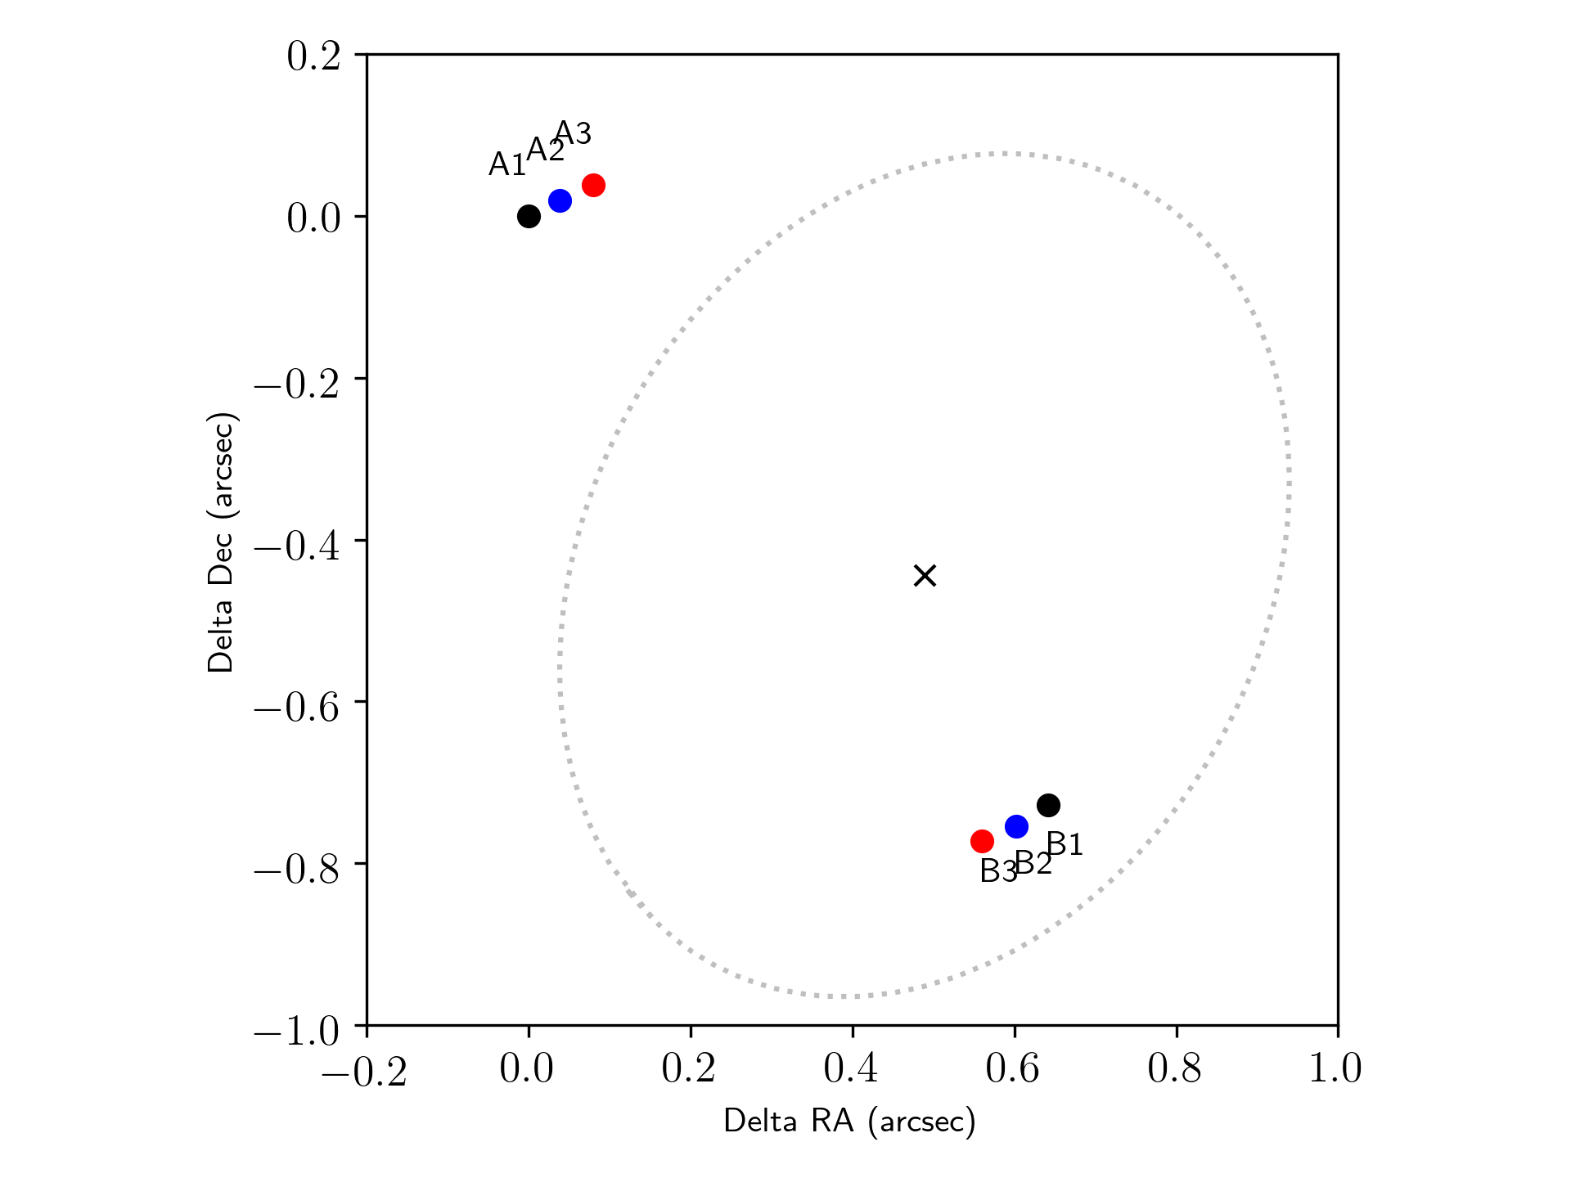
Comparison with the other estimates
Adopting Muller+2020 model
Revised with VLBI time delay
we need Fermi-LAT estimate of 𝝙t during the same flare
(Buson et al. in prep.)
20 mas ~ 160 pc
separation between the points at z=2.5
44 ± 5 days
SOURCE PLANE
26 ± 5 days
24 ± 5 days
23.0 ± 0.5 days
19.7 ± 1.2 days
See also Barnacka+2015,2016 for similar studies
21 ± 2 days
29 ± 3 days
A1-B1 – time delay = 29 days
A2-B2 – time delay = 27 days
A3-B3 – time delay = 25 days
28.3 ± 3.1 days
LENS PLANE
Time delays are important constraints to mass model –> different time delays = different mass models = different source models

Slide 21
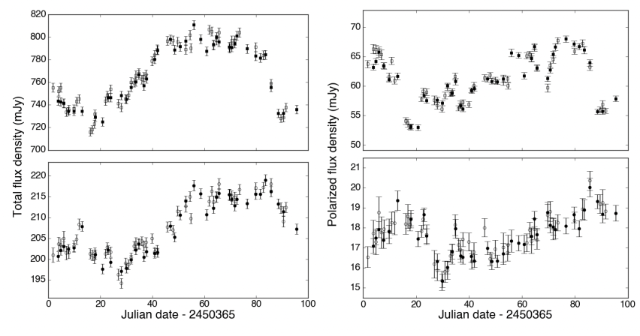
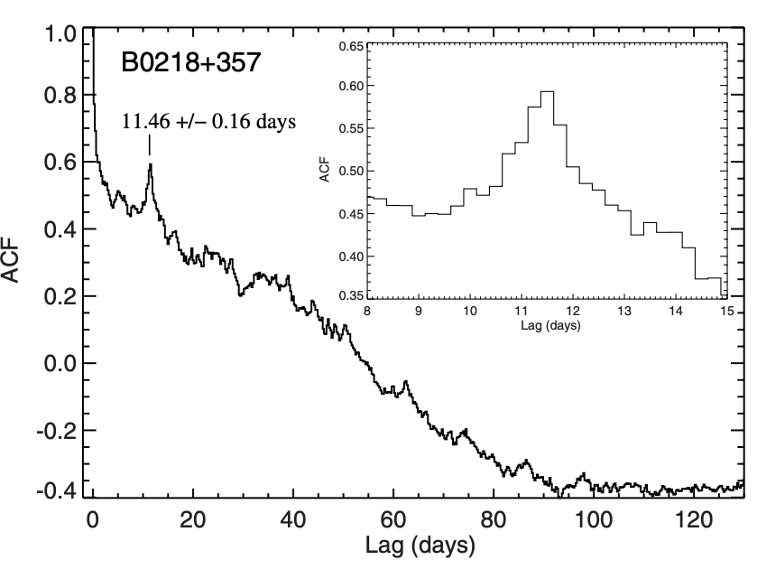
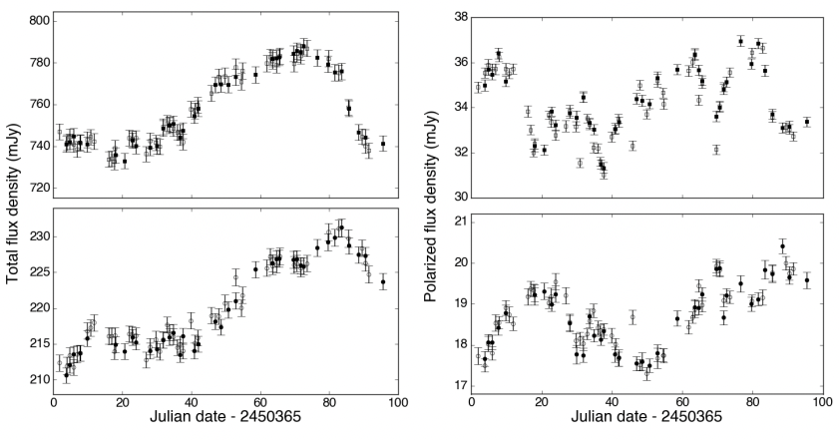
Comparison with JVAS B0218+357: higher precision
𝛄-rays Δt = 11.46 ± 0.16 days
Radio Δt = 11.2 ± 0.2 days
~4 hours precision
Cheung+2014
Long term monitoring with high time sampling
~4 hours precision
Biggs 2018
High variability, hence lot of structure in light curves

Slide 22
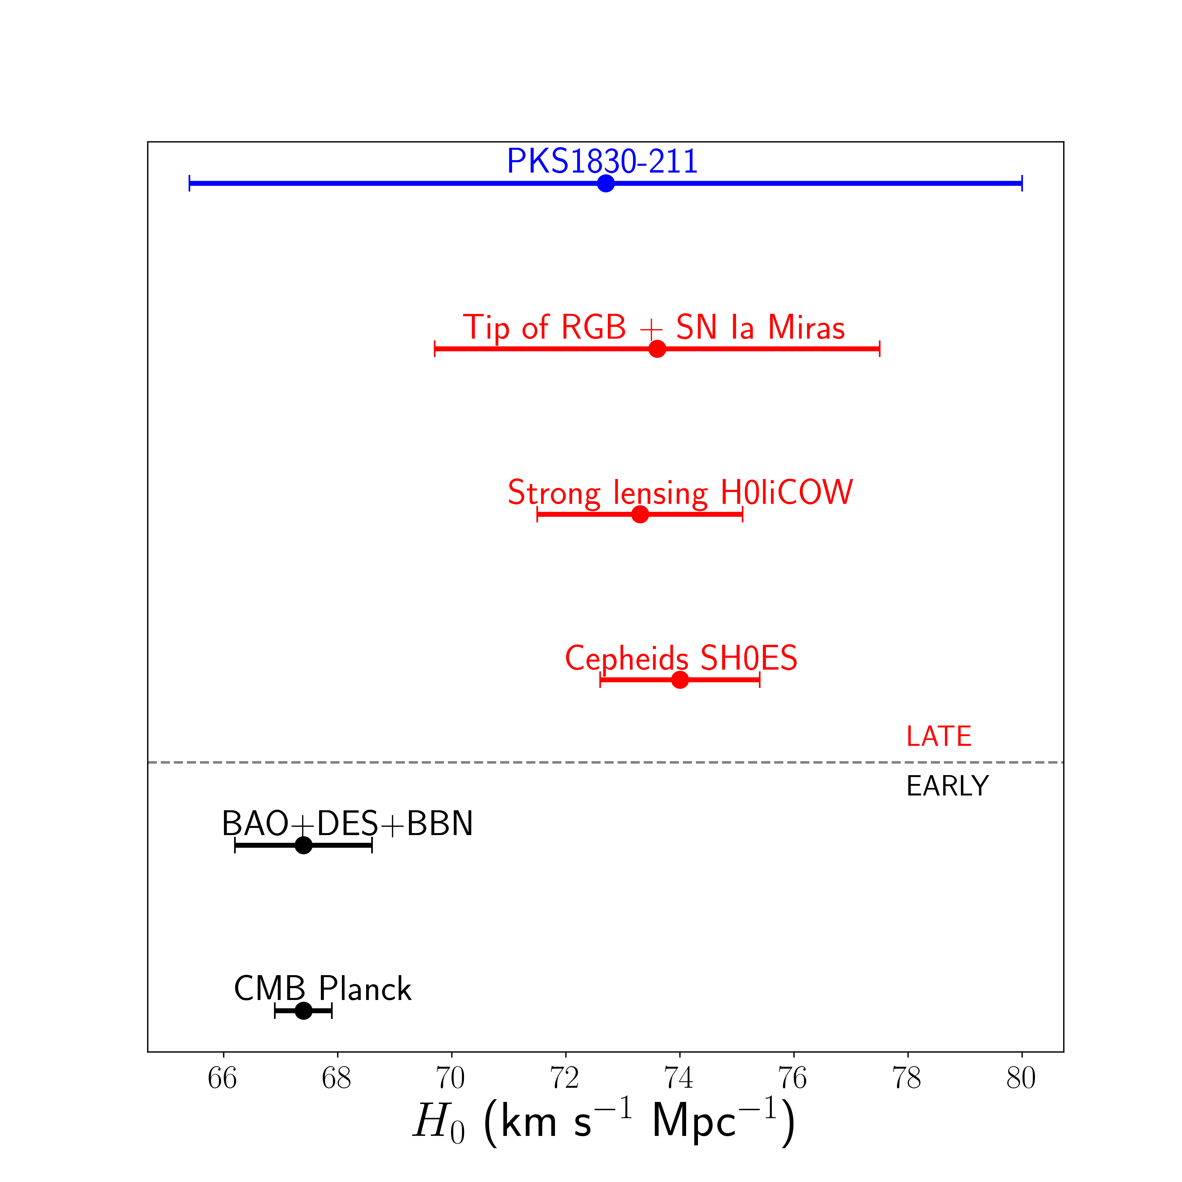
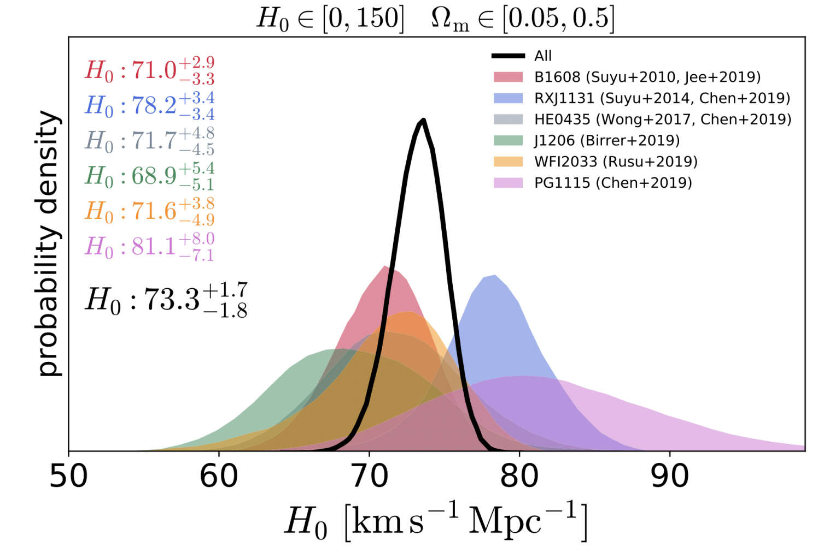
Hubble parameter H₀
H₀= 73 ± 8 km s⁻¹ Mpc⁻¹
Sigma takes into account the uncertainties of the mass model parameters from Muller+2020
Freedman+ 2019
Wong+ 2019
Riess+2018
Abbott+ 2018
Planck Collaboration 2018
6 strong lensing systems with time delays and lens model parameters measured at ~1 % precision
See also Treu et al. 2022 Review «Strong lensing time-delay cosmography in the 2020s»
See also Verde, Riess and Treu 2019, Nature Astronomy

Slide 23
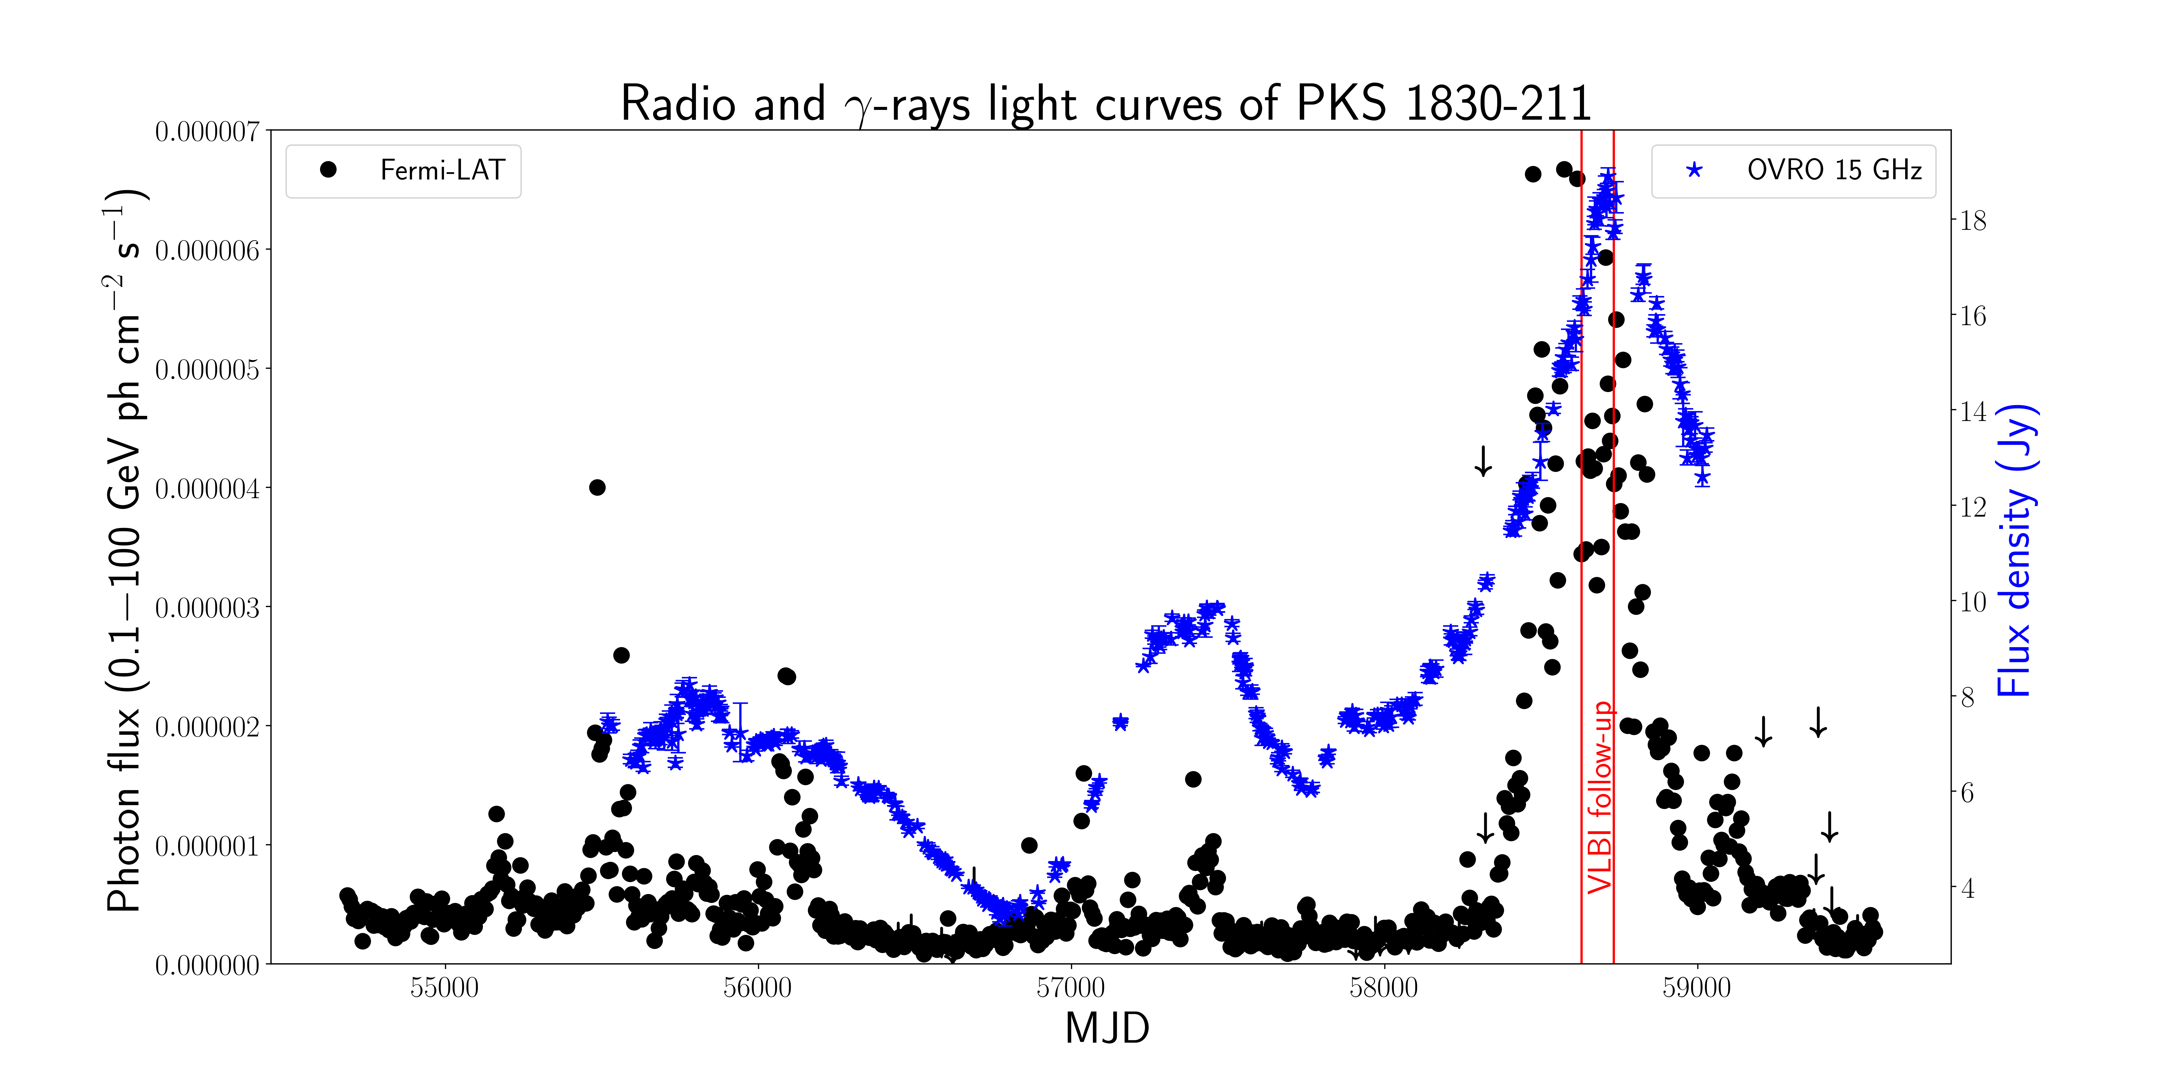

Slide 24
The radio-brightest lensed AGN: PKS 1830-211
Many estimates for Δt_{AB}
Radio 44 ± 5 days (Van Ommen+1995)
26 ± 5 days (Lovell+1998)
24 ± 5 days (Wiklind & Combes 1999)
𝛄-rays 23.0 ± 0.5 and 19.7 ± 1.2 days (Barnacka +2015)
21 ± 2 and 76 ±7 days (Neronov+ 2015, Nature Phys)
And magnification ratios between ~1.1 and ~7
(same references)
Time delays are important constraints to mass model –> different time delays = different mass models = different source models
Image A
Image B
Jauncey+1991, Lovell+1993, 1998

