Slide 1
AGN feedback from FR0, FRI and FRII in galaxy clusters
Francesco Ubertosi
Phd student @ University of bologna (Italy)
Supervisors: Prof. Gitti, M.; Prof. Brighenti, F.
francesco.ubertosi2@unibo.it

Slide 2
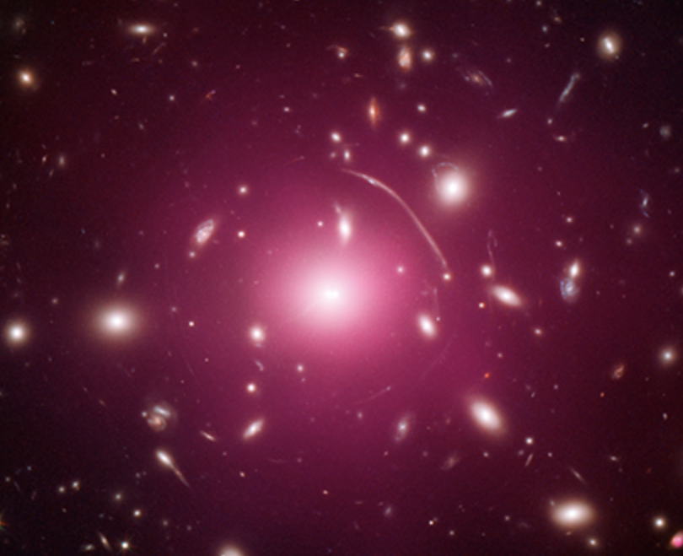
The intra-cluster medium (ICM)
X-ray
hot (10⁷ – 10⁸ K) and low-density (10⁻³ cm⁻³ ) gas, mostly hydrogen and helium
Optical
Detailed study of the ICM allowed by Chandra + XMM-Newton
Much more than gravity:
gas dynamics, radiative cooling, heating, transport processes, and energetic feedback
Abell 383, Bernal et al., 2016

Slide 3
The intra-cluster medium (ICM)
X-ray
“Cool core region”
Optical
Low entropy, dense gas
Short radiative cooling time (< 1 Gyr)
Centered on the brightest cluster galaxy (BCG)
The cold ICM should be depositing at the center at rates of ~100-1000 $M_{⊙}yr^{−1}$ and trigger intense star formation and AGN activity
Abell 383, Bernal et al., 2016

Slide 4
AGN feedback: X-ray cavities and shocks
Perseus
M87
Zhuravleva et al., 2019
The activity of the central AGN is the preferred explanation to the reduced star formation

Slide 5
The feedback loop paradigm: explaining the AGN/ICM interplay
After typically a few 10s of Myr, the AGN switches off
The ICM cools and flows to the center
ICM is heated, cooling and SF are largely reduced
FEEDBACK CYCLE
The AGN is fueled, radio jets are launched in the ICM
Inflation of X-ray cavities + shocks propagate outwards
AGN feedback through X-ray cavities and shocks: the example of RBS 797
Feedback from different classes of jetted radio galaxies: FR0s, FRIs and FRIIs

Slide 6
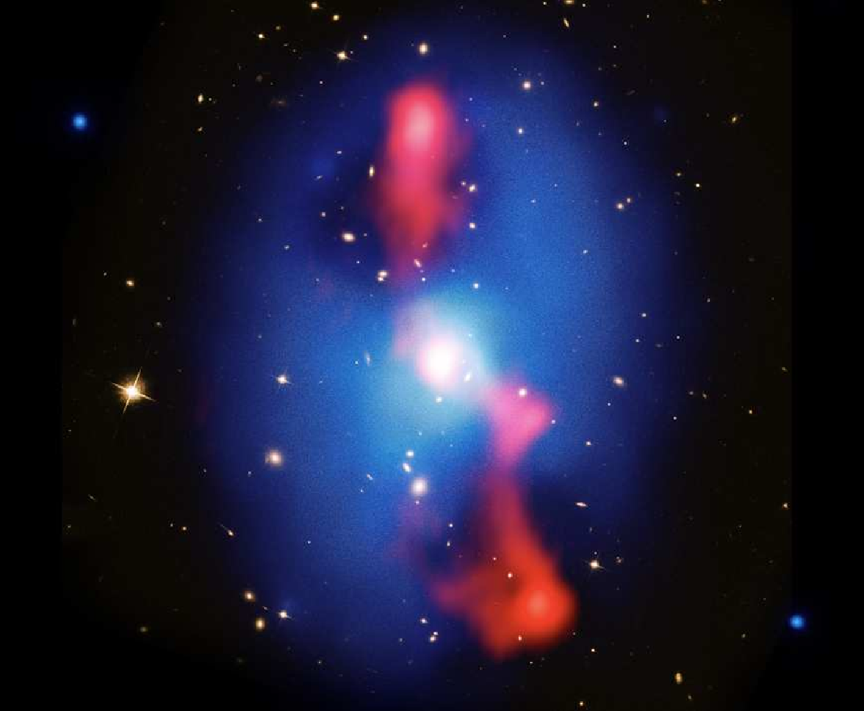
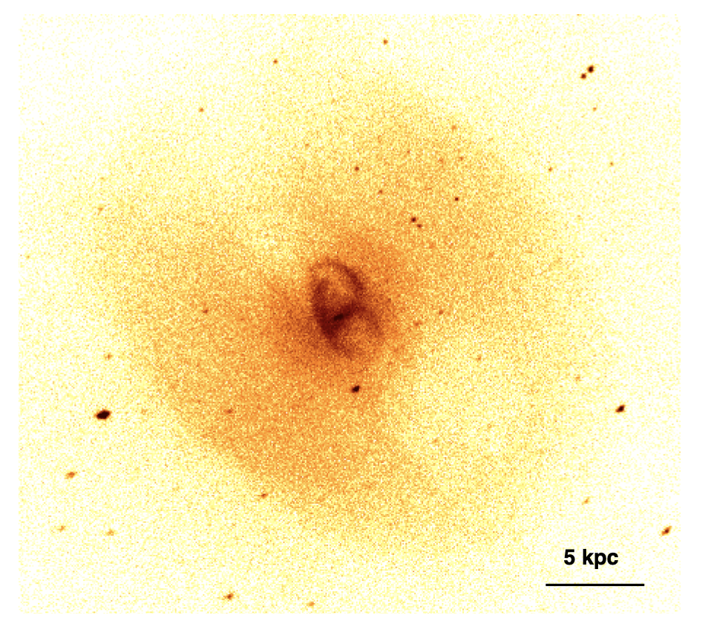
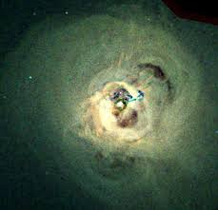
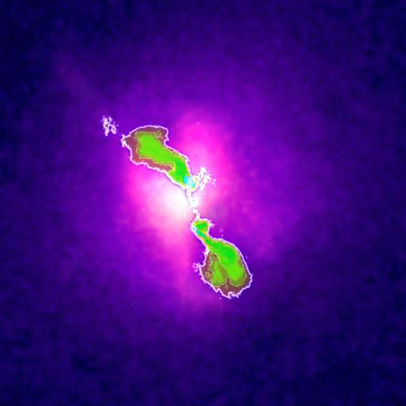
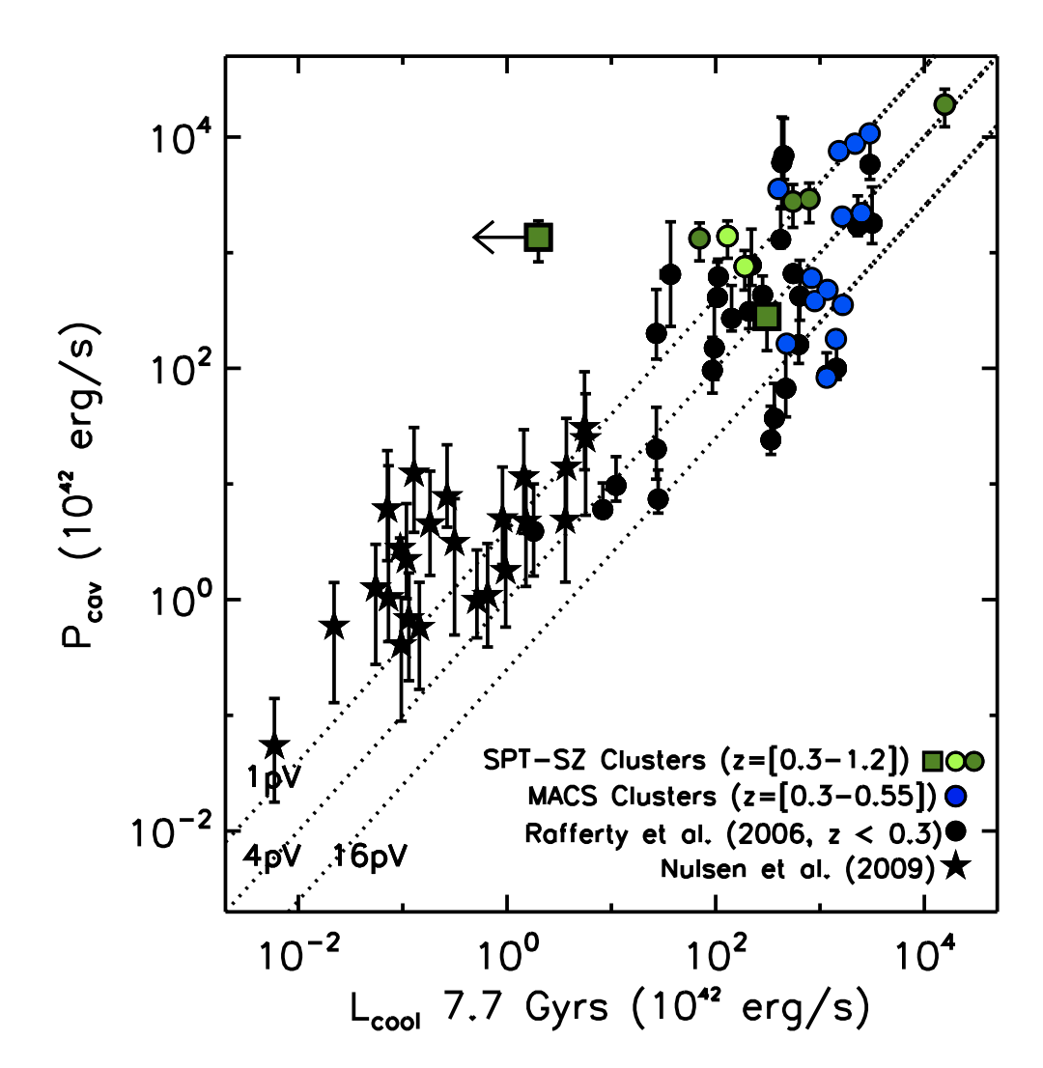
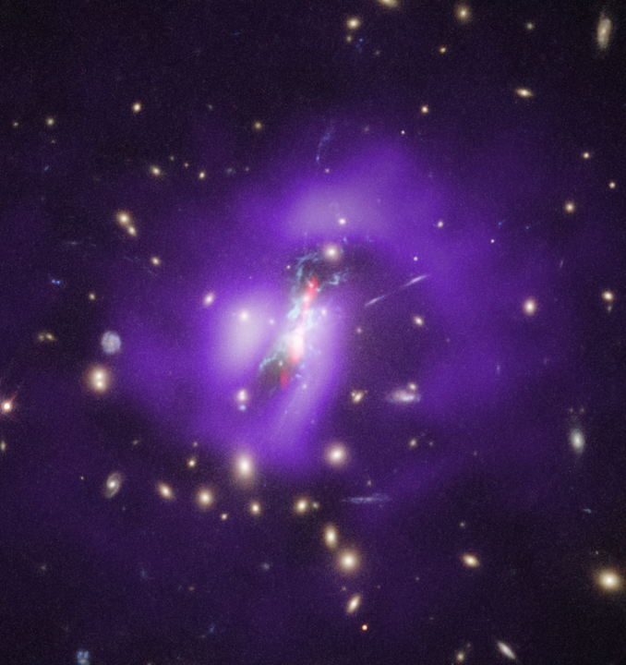
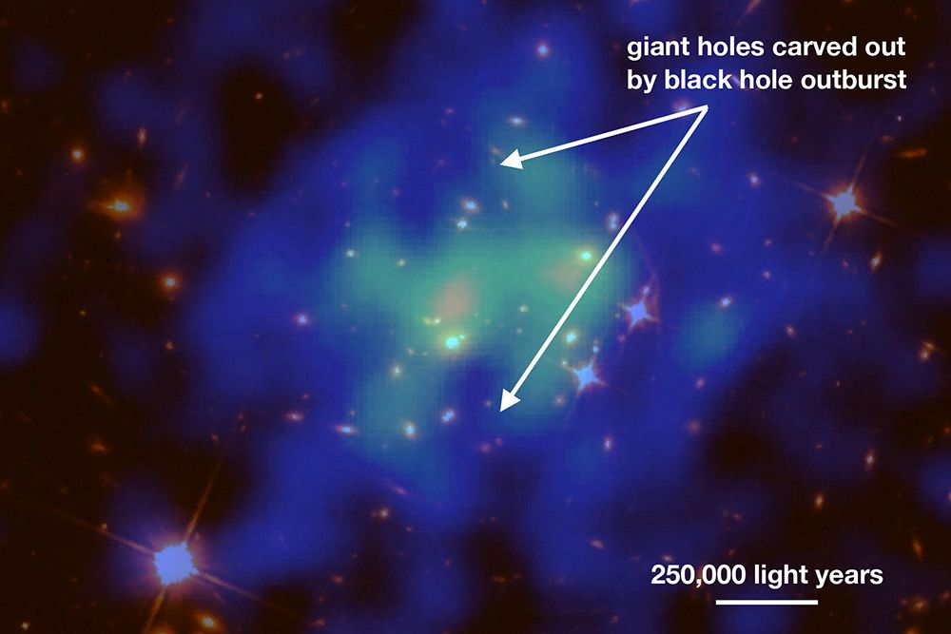
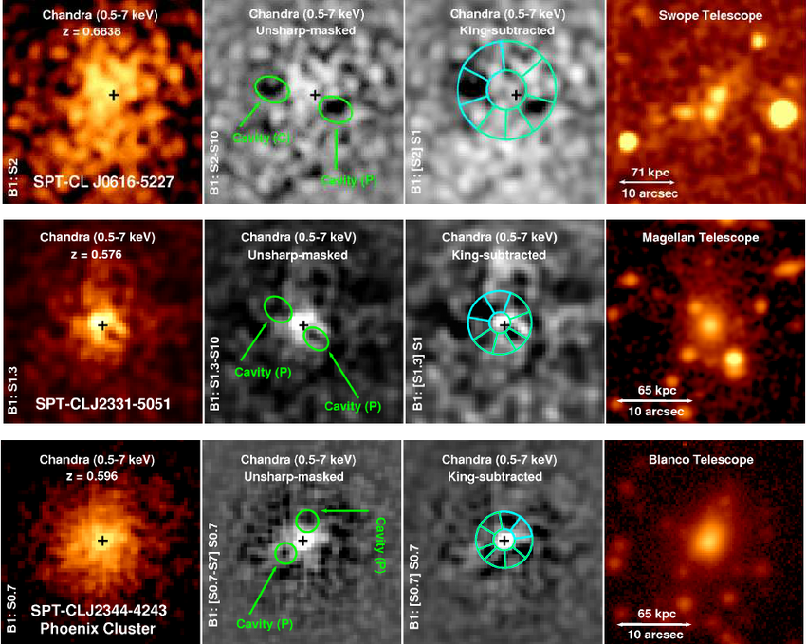
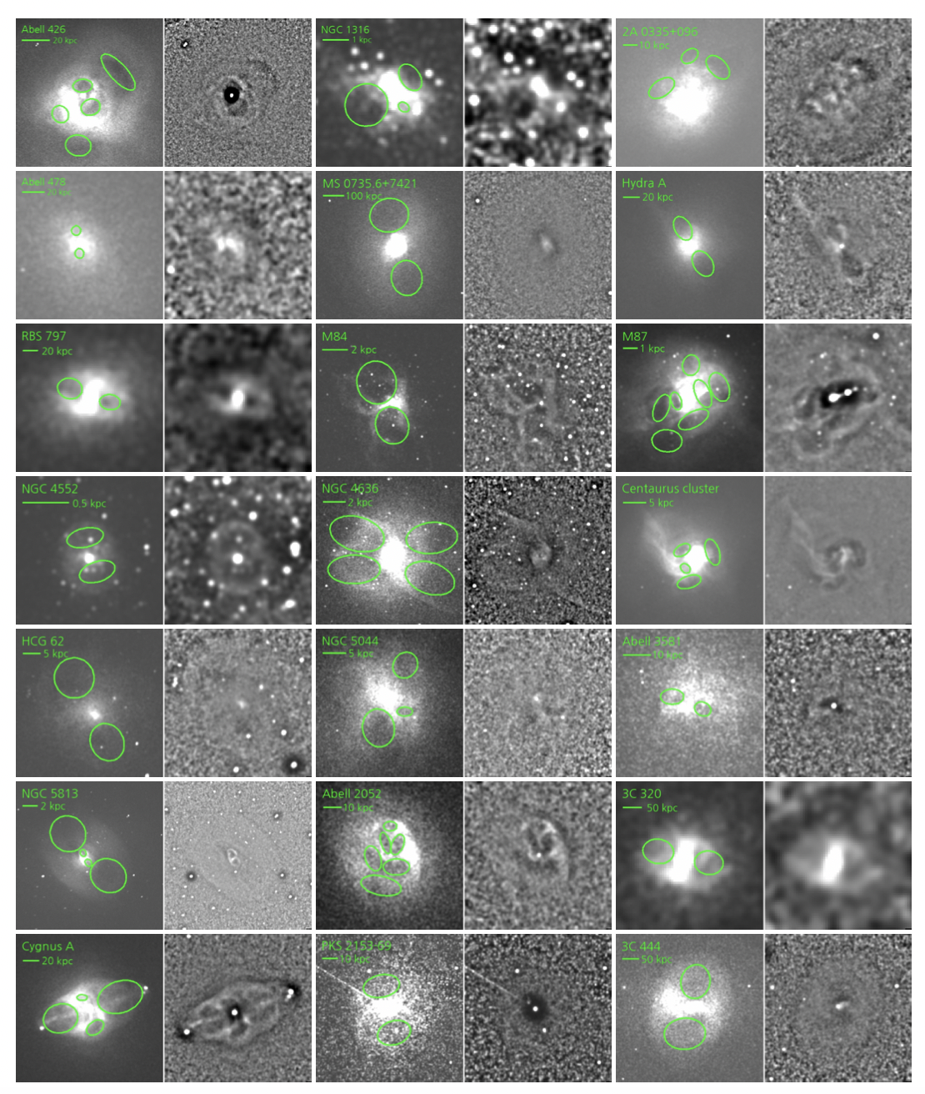
What is the role of X-ray cavities and shocks in the ICM?
More than 150 systems with X-ray cavities
($e.g.,$Shin et al. 2016)

Slide 7
What is the role of X-ray cavities and shocks in the ICM?
More than 150 systems with X-ray cavities
($e.g.,$Shin et al. 2016)

Slide 8
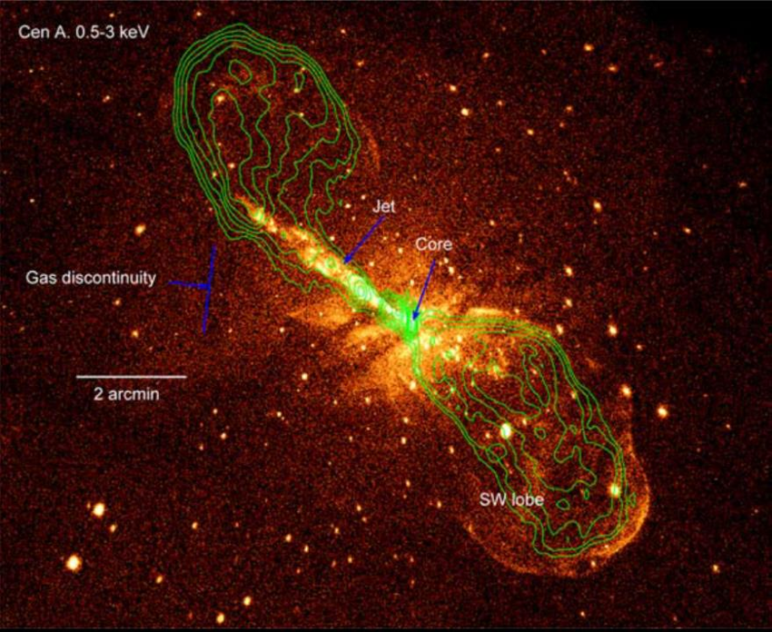
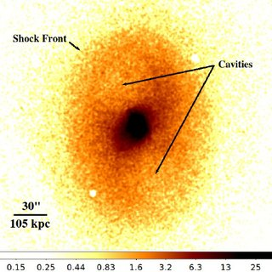
What is the role of X-ray cavities and shocks in the ICM?
Shock fronts driven by AGN jets with Mach numbers $ℳ∼1.1−1.5$ have been detected in a dozen systems
Shocks detection is difficult (requires long X-ray exposures)
BUT energy input from shocks is not negligible!
$$E_{shock}⪆E_{cavity}$$

Slide 9
What is the role of X-ray cavities and shocks in the ICM?
Shock fronts driven by AGN jets with Mach numbers $ℳ∼1.1−1.5$ have been detected in a dozen systems
Shocks detection is difficult (requires long X-ray exposures)
BUT energy input from shocks is not negligible!
$$E_{shock}⪆E_{cavity}$$

Slide 10
Multiple episodes of AGN activity and jet re-orientation
History of the AGN-ICM interaction traced by multiple pairs of X-ray cavities / radio lobes
(see e.g. McNamara & Nulsen 2007, 2012)
$→$ timescales of feedback cycle
+ timescales for jet reorientation
Cielo et al. 2018

Slide 11
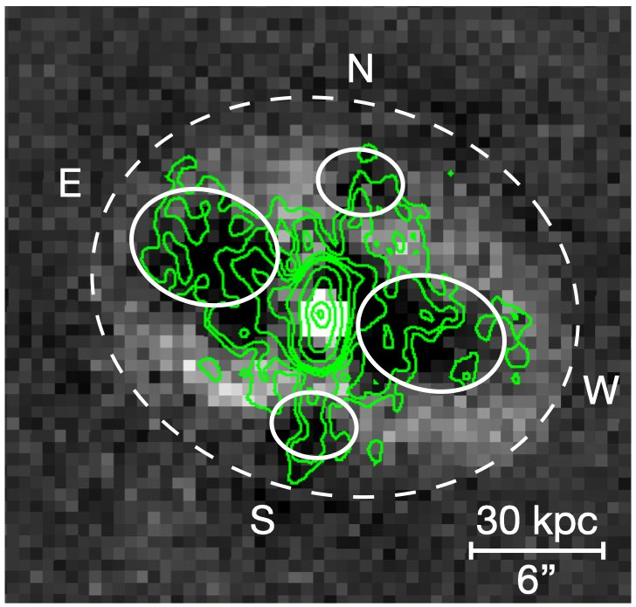
X-ray cavities and shocks in the galaxy cluster RBS 797
Chandra image (X-rays)
Green contours: JVLA@3 GHz (radio — PI: Ubertosi)
AGN-driven shock front
Radio-filled X-ray cavities
Ubertosi et al. (2021b) ApJ 923L 25
Ubertosi et al. (2023) ApJ 944 216

Slide 12
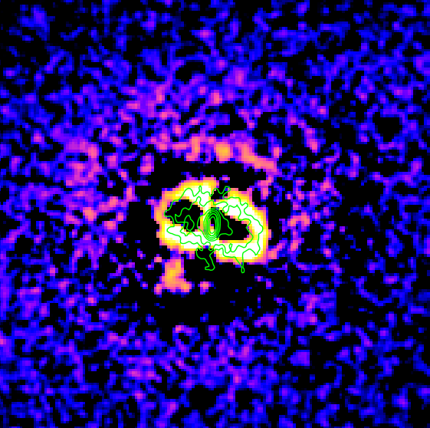
X-ray cavities and shocks in the galaxy cluster RBS 797
Time between the different shock fronts: $∼25 \text{Myr}$
Each$∼25 \text{Myr}$ the AGN started a new cycle of activity
$$E_{shocks}∼20×E_{cavities}$$
Ubertosi et al. (2021b) ApJ 923L 25
Ubertosi et al. (2023) ApJ 944 216

Slide 13
X-ray cavities and shocks in the galaxy cluster RBS 797
Time between the perpendicular X-ray cavities: $≤10 \text{Myr}$
If the jet axis has been reoriented, this happened relatively quickly
→ Observational constraint on the timescales for jet re-orientation
Ubertosi et al. (2021b) ApJ 923L 25
Ubertosi et al. (2023) ApJ 944 216

Slide 14
The feedback loop paradigm: explaining the AGN/ICM interplay
After typically a few 10s of Myr, the AGN switches off
The ICM cools and flows to the center
ICM is heated, cooling and SF are largely reduced
FEEDBACK CYCLE
The AGN is fueled, radio jets are launched in the ICM
Inflation of X-ray cavities + shocks propagate outwards
AGN feedback through X-ray cavities and shocks: the example of RBS 797
Feedback from different classes of jetted radio galaxies: FR0s, FRIs and FRIIs

Slide 15
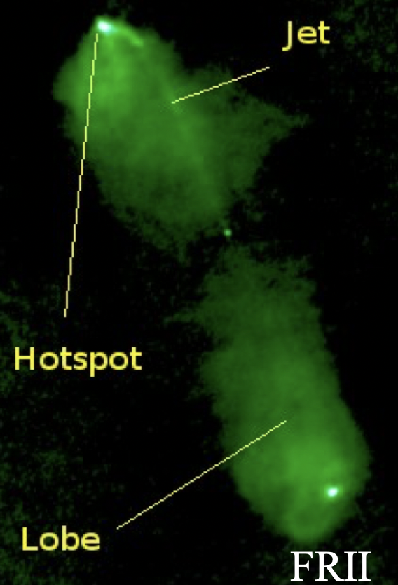
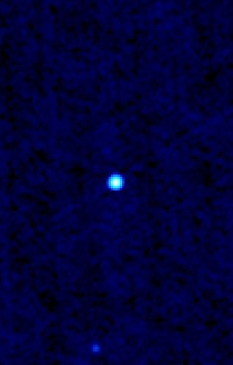
Jetted Radio Galaxies in Galaxy Clusters: FR0, FRI, FRII
FR I
Compact core
FR II
FR 0

Slide 16
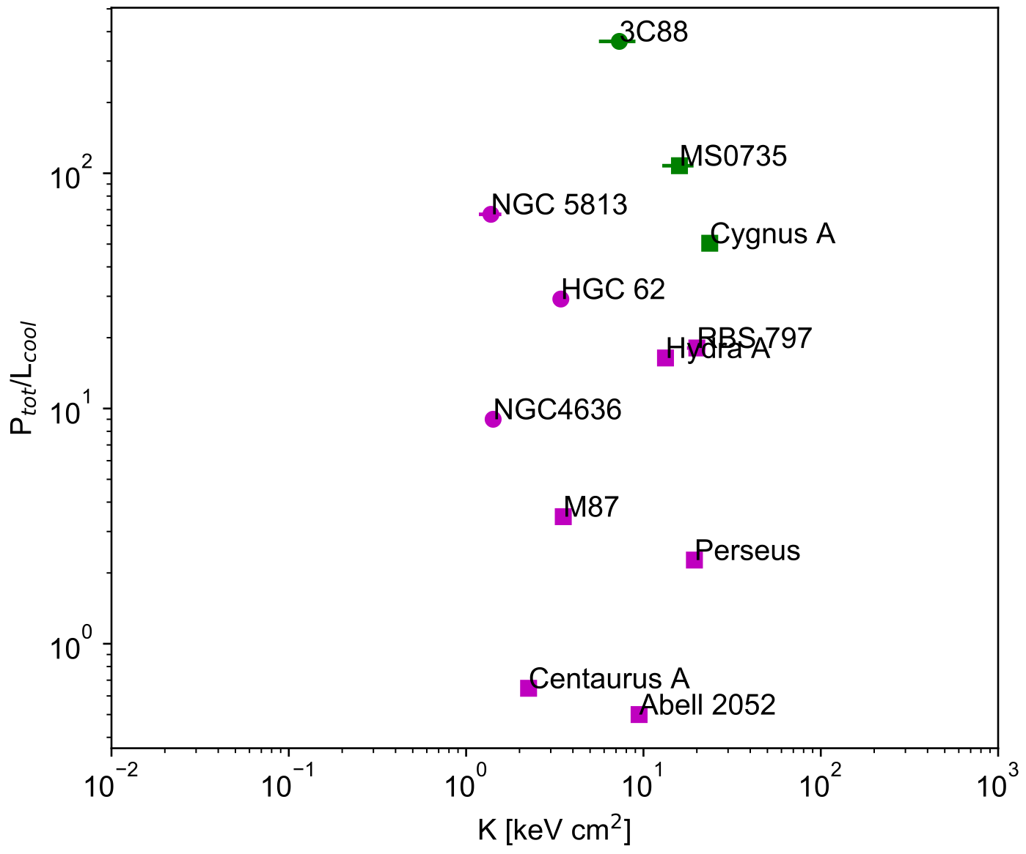
How FRI and FRII radio galaxies ‘feel’ their environment
Selection of 15 systems with detection of X-ray cavities and shocks reported in the literature
Entropy
Differences of orders of magnitude in feedback ratio do not cause any significant over heating of the central gas!
“Feedback ratio”$=\frac{P_{tot}\text{(}\text{cavities}\text{ + }\text{shock}\text{)}}{L_{cool}\text{(}\text{ICM}\text{)}}$
Ubertosi et al. (2023) ApJ 944 216

Slide 17
Jetted Radio Galaxies in Galaxy Clusters: FR0, FRI, FRII
FR I
Compact core
FR II
FR 0

Slide 18
The properties of FR0 radio galaxies
Compact radio galaxies, unresolved by FIRST (5’’) and NVSS at 1.4 GHz (Best & Heckman 2012), 5 times more numerous than FRIs (Baldi et al., 2018a).
FR0s could be powered by slowly spinning BHs which produce weak jets, with low bulk speed $Γ$ (Baldi et al., 2015, 2021; Giovannini et al. 2023).
15-20% of FR0s are surrounded by faint extended emission (Baldi et al. 2019, Capetti et al. 2020) $→$FR0s and FRIs may be the extremes of a continuous population of jetted radio sources of varying jet power
Compact core
Feedback from these weak radio galaxies?
FR 0

Slide 19
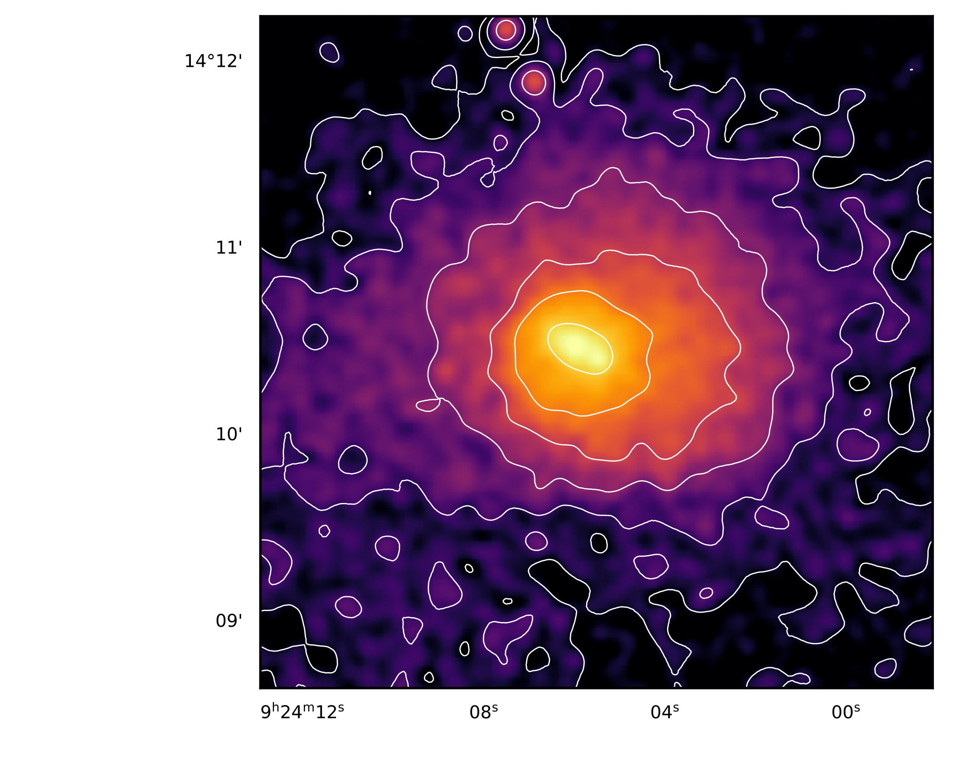
The central FR0 in the galaxy cluster Abell 795
FIRST survey
(1.4 GHz, 5’’ resolution)
VLASS survey
(3 GHz, 2.5’’ resolution)
A factor $∼2$ improvement in sensitivity & resolution
Central galaxy: FR0 radio galaxy
Ubertosi et al. (2021a) MNRAS, 503, 4627

Slide 20
The central FR0 in the galaxy cluster Abell 795
Mechanical power$⪅{10}^{43} \text{erg}\text{/}\text{s}$
The FR0 may have excavated X-ray cavities in the ICM: first evidence of feedback from these small radio galaxies?
Ubertosi et al. (2021a) MNRAS, 503, 4627

Slide 21
Summary & Conclusions
The X-ray study of the cluster environment of radio galaxies can constrain the jet power of the AGN. The complete feedback output of radio galaxies is both in X-ray cavities and shocks.
Multiple X-ray cavities & shocks allow us to obtain information on the time that passes in between each cycle of AGN activity. If the successive outbursts are misaligned, the timescales set upper limits on the time required for the jet to reorient.
The jet mechanical power (cavities + shocks) can typically balance the radiative losses of the environment, both for FRI and for FRIIs. From our sample of 15 objects it appears that the feedback response of FRIIs is overpowered, although this difference in feedback output does not seem to have consequences on the amount of cool gas at the cluster center —> how do jets heat the environment?
Early results on the emerging population of FR0 radio galaxies suggest that these galaxies can provide feedback through cavity inflation in the ICM of their host clusters. Confirmation of these results is key to understand the place of FR0s in the context of jetted radio galaxies.
THANK YOU FOR YOUR ATTENTION!
Ubertosi et al. (2021a) MNRAS, 503, 4627
Ubertosi et al. (2021b) ApJ 923L 25
Ubertosi et al. (2023) ApJ 944 216

Slide 22
BACKUP SLIDES

Slide 23
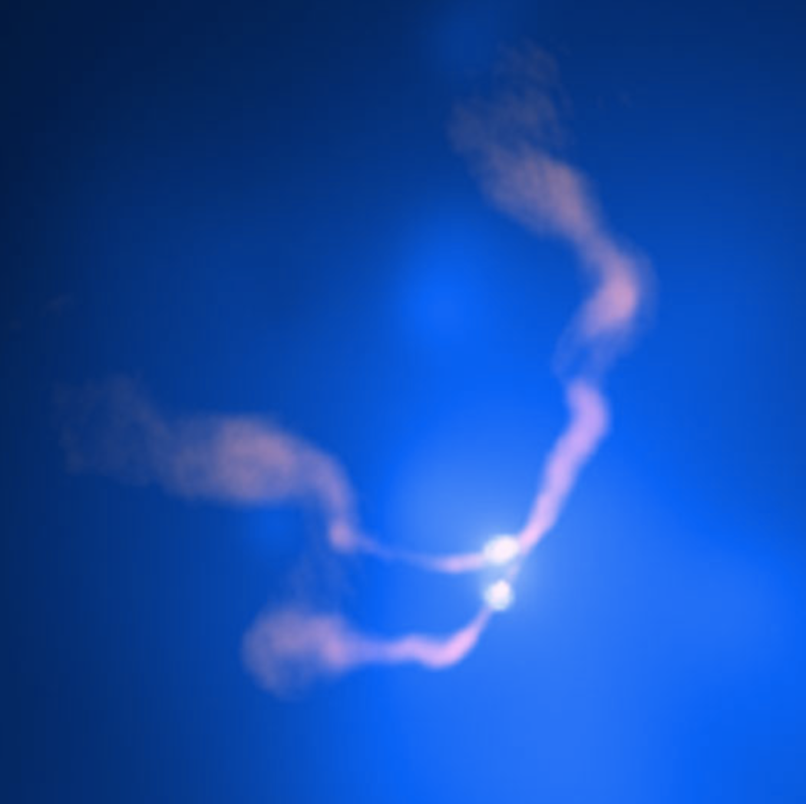
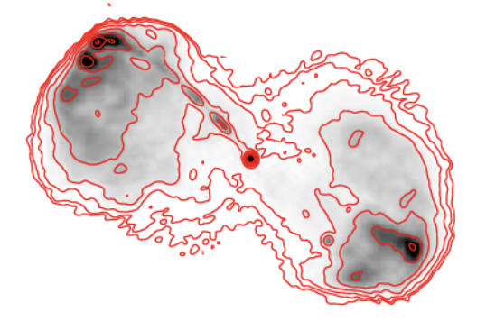
MISALIGNED X-RAY CAVITIES AND RADIO LOBES
How to explain these peculiar radio/X-ray morphologies?
(see e.g. Dennet-Thorpe et al. 2002; Merritt & Eckers 2002; Liu et al. 2004; Lal & Rao 2007; Cielo et al. 2018; Lu & Ricker 2020)
Backflow/Reorientation/Precession
… Binary AGNs?
NGC326 - Murgia et al. 2001
3C88 - Liu et al. 2019
3C75 - Hudson et al. 2006

Slide 24
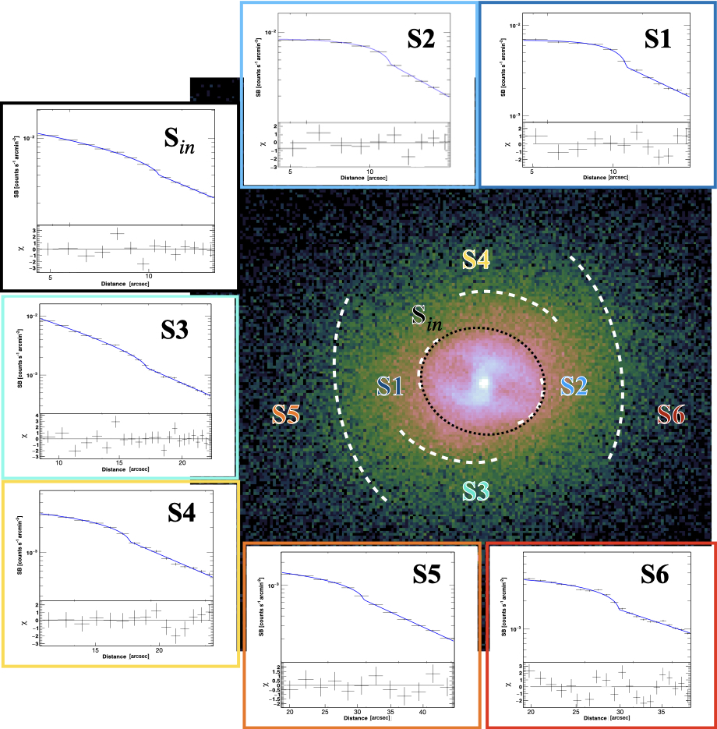
ANALYSIS OF THE SHOCK FRONTS IN RBS 797
X-ray surface brightness profiles
Temperature
Pressure
Ubertosi et al. (2023) ApJ 944 216

Slide 25
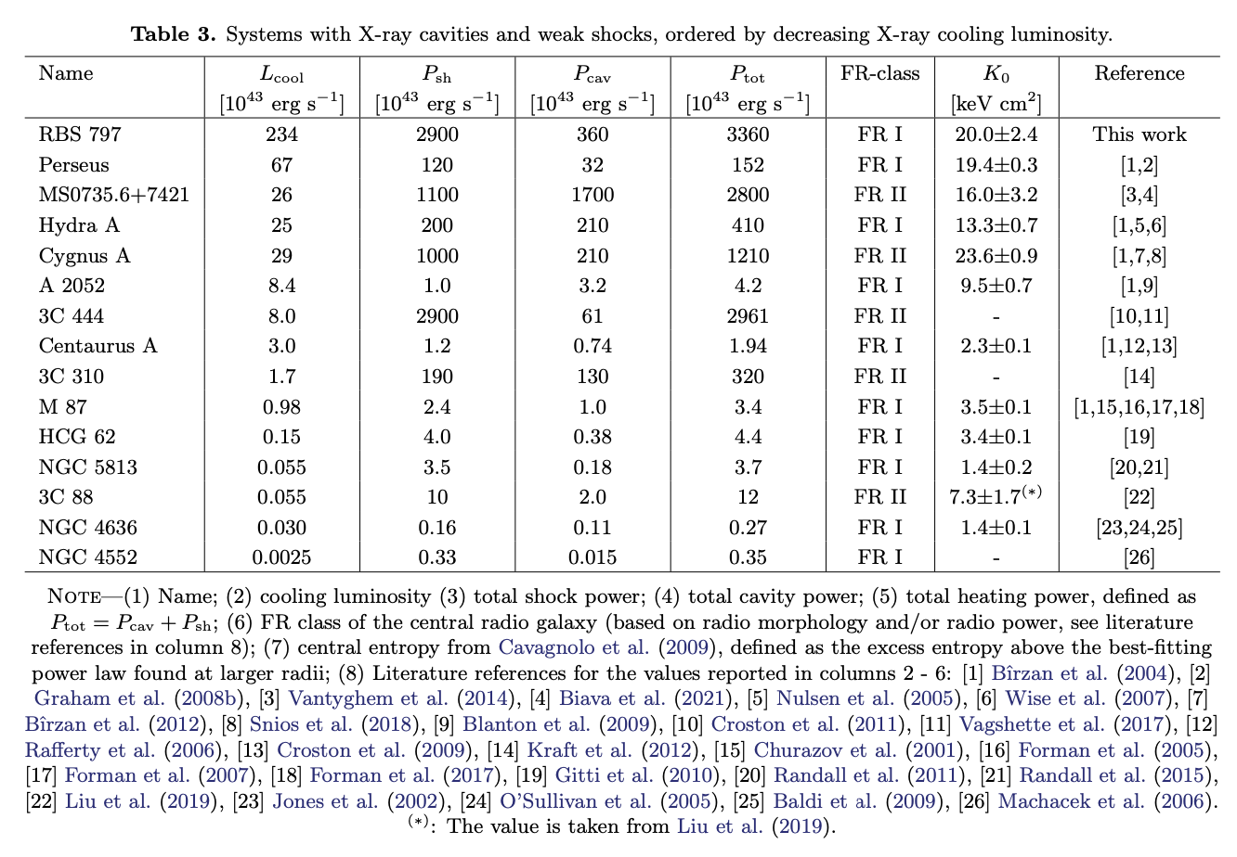
SHOCK AND CAVITY HEATING OF HOT ATMOSPHERES
Ubertosi et al. (2023)
ApJ 944 216

Slide 26
SHOCK AND CAVITY HEATING OF HOT ATMOSPHERES
Cavity power
Shock power
Radiative losses of the environment
Radiative losses of the environment

