Slide 1


Bubbles and Outflows:
the novel JWST/NIRSpec view of the z=1.59 quasar XID2028
Bologna & Friends
2/3/23
Mostly based on arXiv:2301.11060

Slide 2
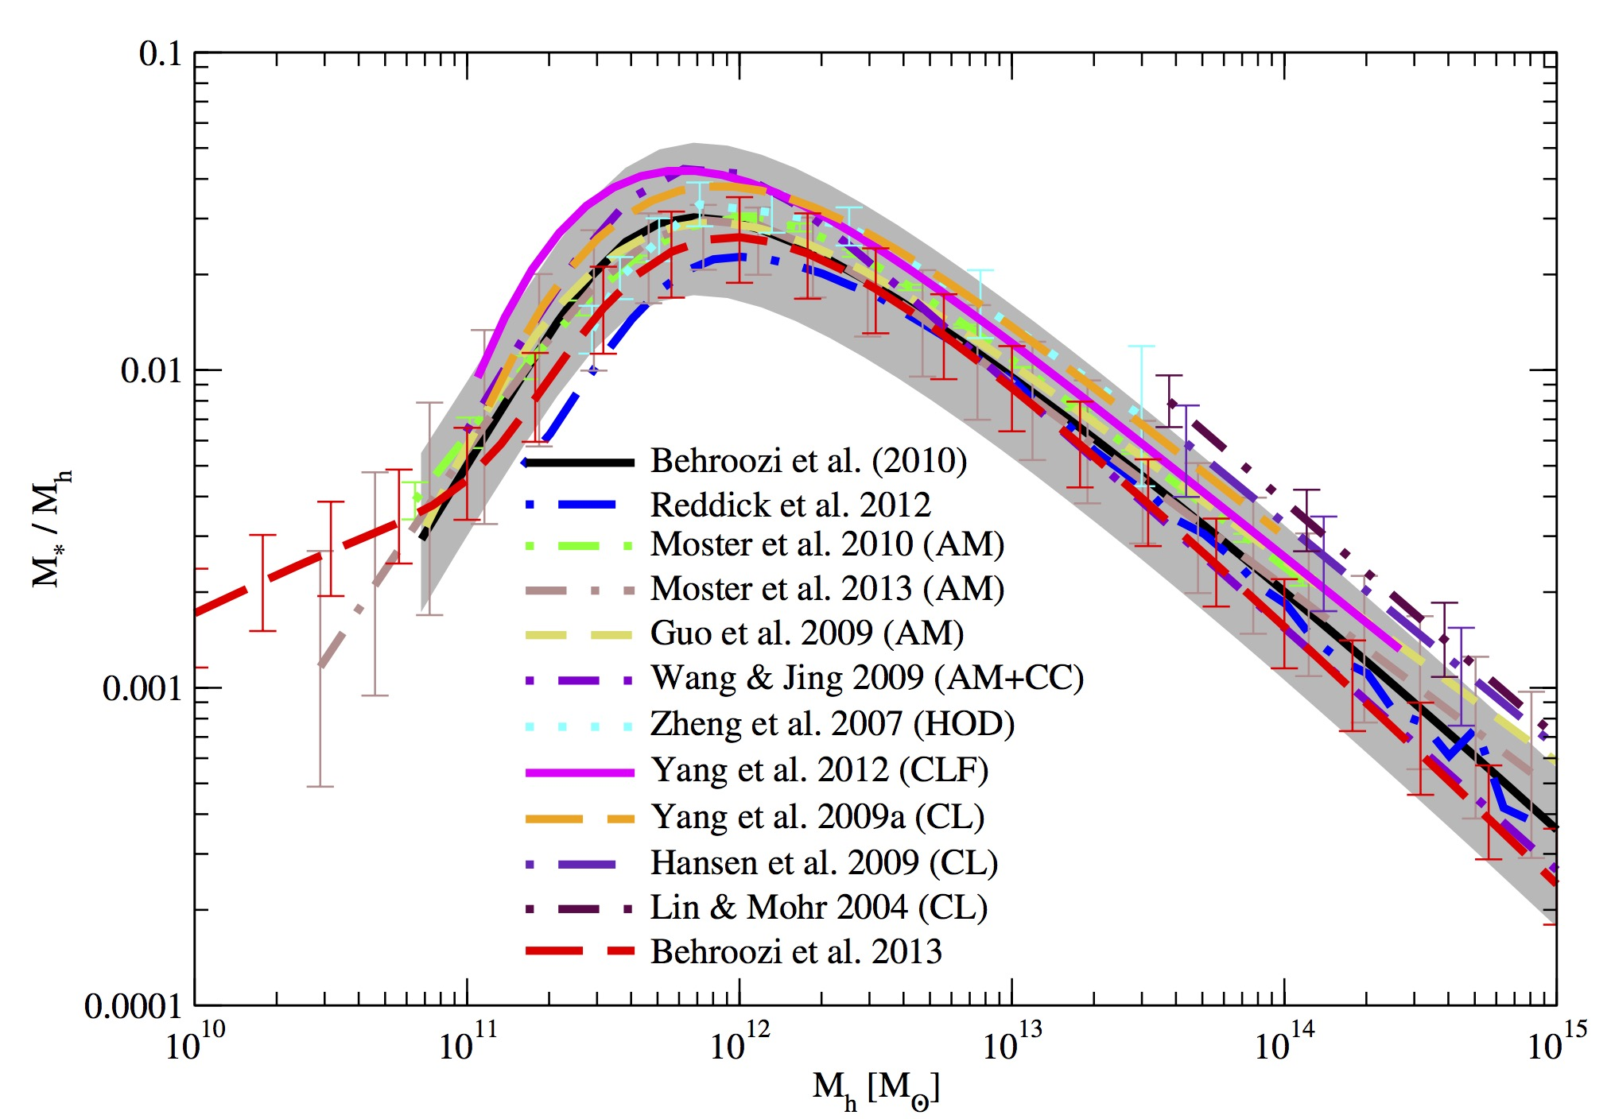
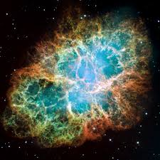
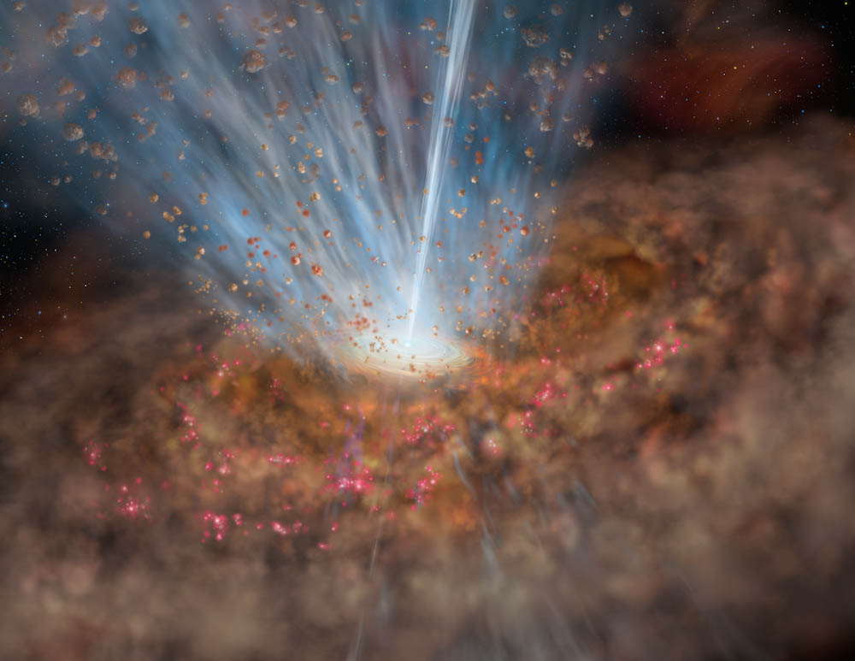
  Why most baryons are not condensed into stars?
Cosmic Baryon Fraction (𝛺b/𝛺0 = 0.15 from WMAP)
?
?
Galaxy formation efficiency
Behroozi+ 13
  Stellar feedback can’t explain reduced efficiency in massive galaxies (e.g. Hopkins+06, Croton+06, Murray+05, Pantalassa+07, Menci+08, …, and many others)

Slide 3
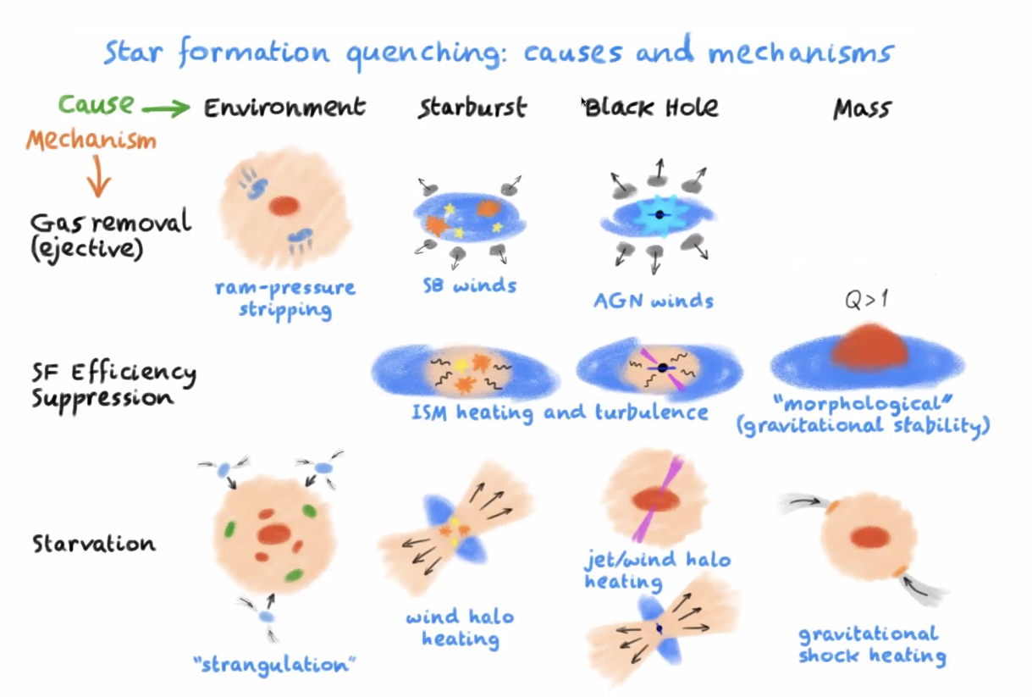
How to suppress/quench star formation in a galaxy?
Courtesy of R. Maiolino

Slide 4
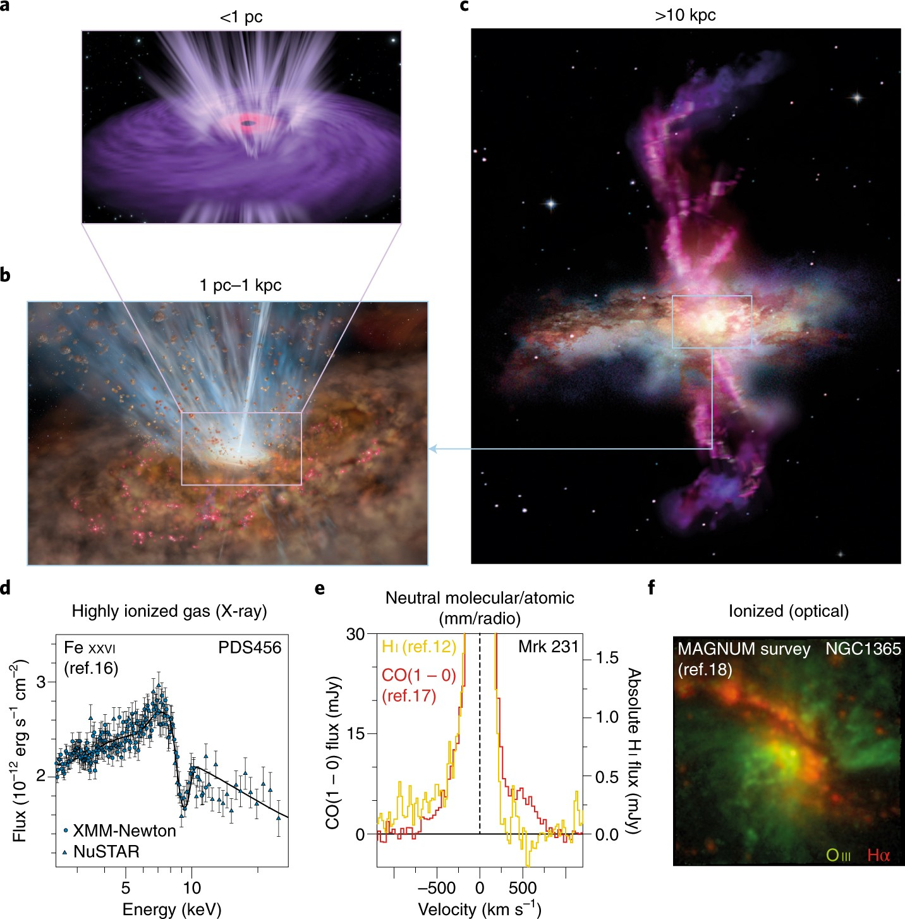
Outflows in different gas components and physical scales…
Highly ionized gas (from UV and X-ray lines):
v_{out} ~ 0.01-0.3 c
scale < pc
Molecular and atomic neutral gas (from mm/FIR/optical lines):
v_{out} ~ 100-1000 km/s
scale ~ 0.1-15 kpc
Ionized gas (from broad wings of forbidden optical lines):
v_{out} ~ 500-2000 km/s
scale ~ 1-15 kpc
Cicone et al. 2018

Slide 5
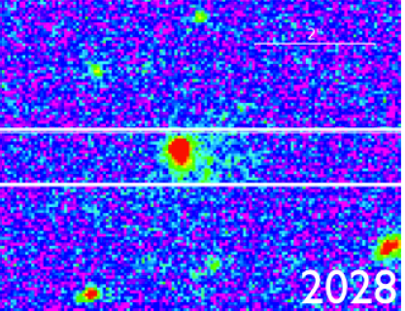
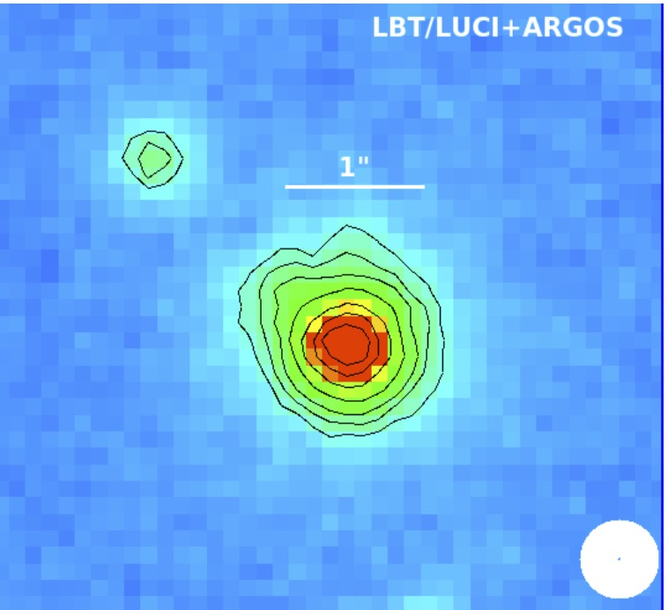
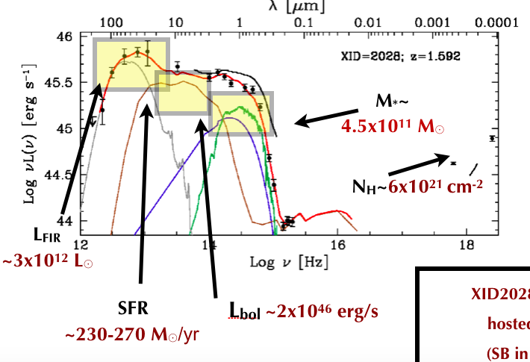
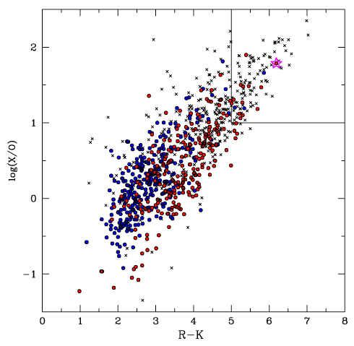
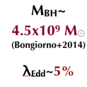
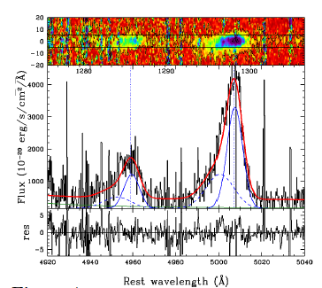
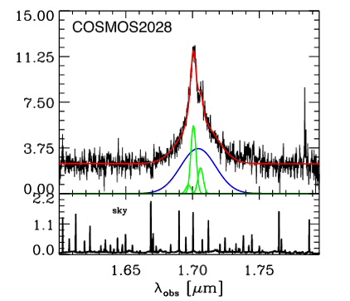
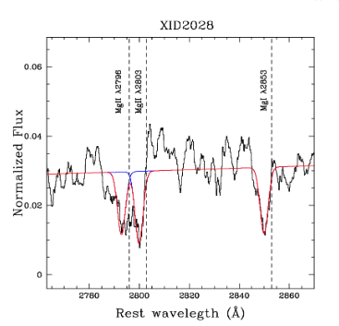
A PROTOTYPICAL QSO in the feedback phase
rest frame UV
rest frame optical
SED fitting (AGN and host parameters)
XID2028
Discovery
(1 out of 1800
XMM-COSMOS sources)
Brusa+2010
young stars & QSO
Radio “quiet”
L1.4GHz < 10²⁴ W/Hz
selection
figures from
Bongiorno+2014
Brusa+2015a
Perna+2015a
Cresci+2015a
Brusa+2018
Data from:
COSMOS photometry
HST/ACS
LBT/LUCI+ARGOS
Keck/DEIMOS
VLT/X-shooter
Luminosity
Ionised outflow ([OIII])
based on our previous experience
on early XMM surveys (Hellas2XMM)
Fiore, Brusa+2003, Mignoli+2004
Brusa+2005, Maiolino+2006
[MgII] neutral outflow
Obscuration
BLR
Halpha

Slide 6
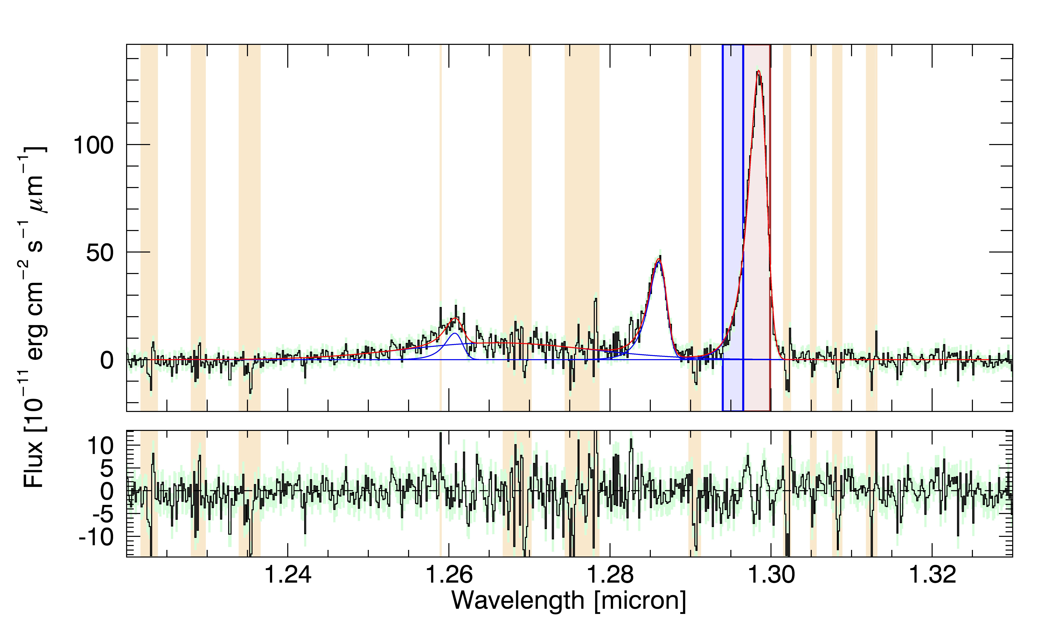
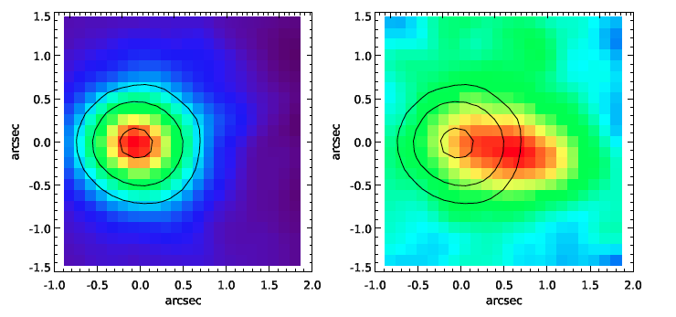
A feedback showcase: XID2028 at z=1.6
Integrated spectrum
on the central 1”x1”
Selected to be X-ray bright
and optically obscured
(Brusa+10,15)
SINFONI IFU observations
J band 6 hrs
Scale 0.125”x0.125”
PSF=0.6”
Integrated flux maps on the
line core (left)
and on the
line wing (right)
Outflow with
v_{out}~ 1500 km/s out to 13 kpc projected!

Slide 7
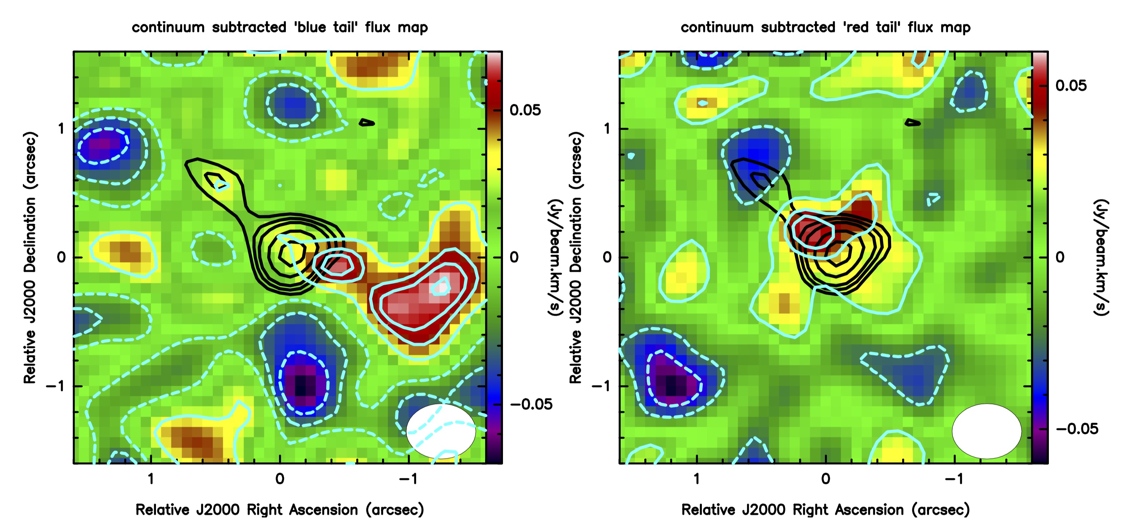
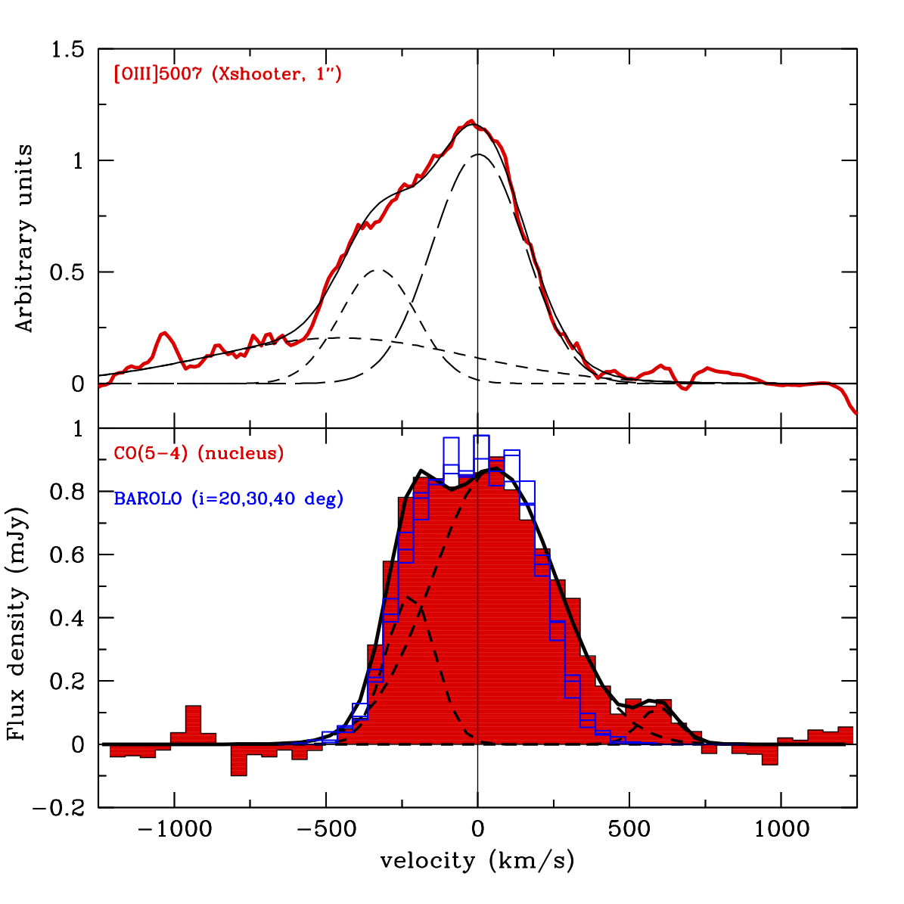
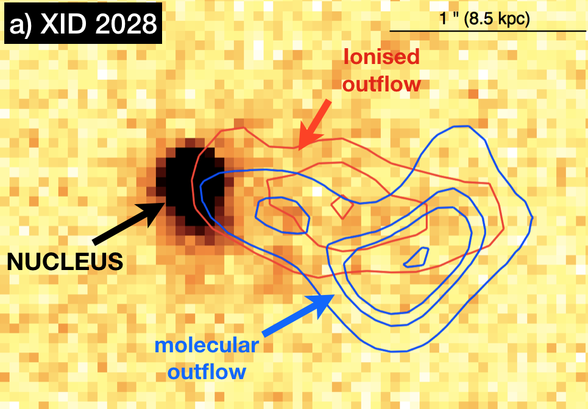
A spatially resolved CO(5-4) outflow
ALMA Observations in CO(5-4)
Brusa, GC et al. 2018
Imaging of the blue (< -350 km/s) and of the
red tail (>350 km/s) reveal a bi-directional outflow out to ~ 10 kpc and v ~ 700 km/s
CO mass outflow rate ~ 150-750 M/yr
First direct detection of a spatially resolved CO outflow at high-z
Spatially coincident with the ionized outflow component

Slide 8
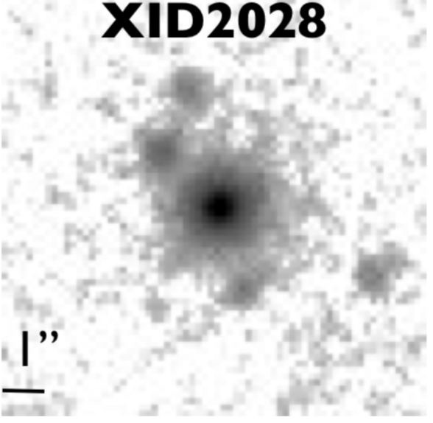
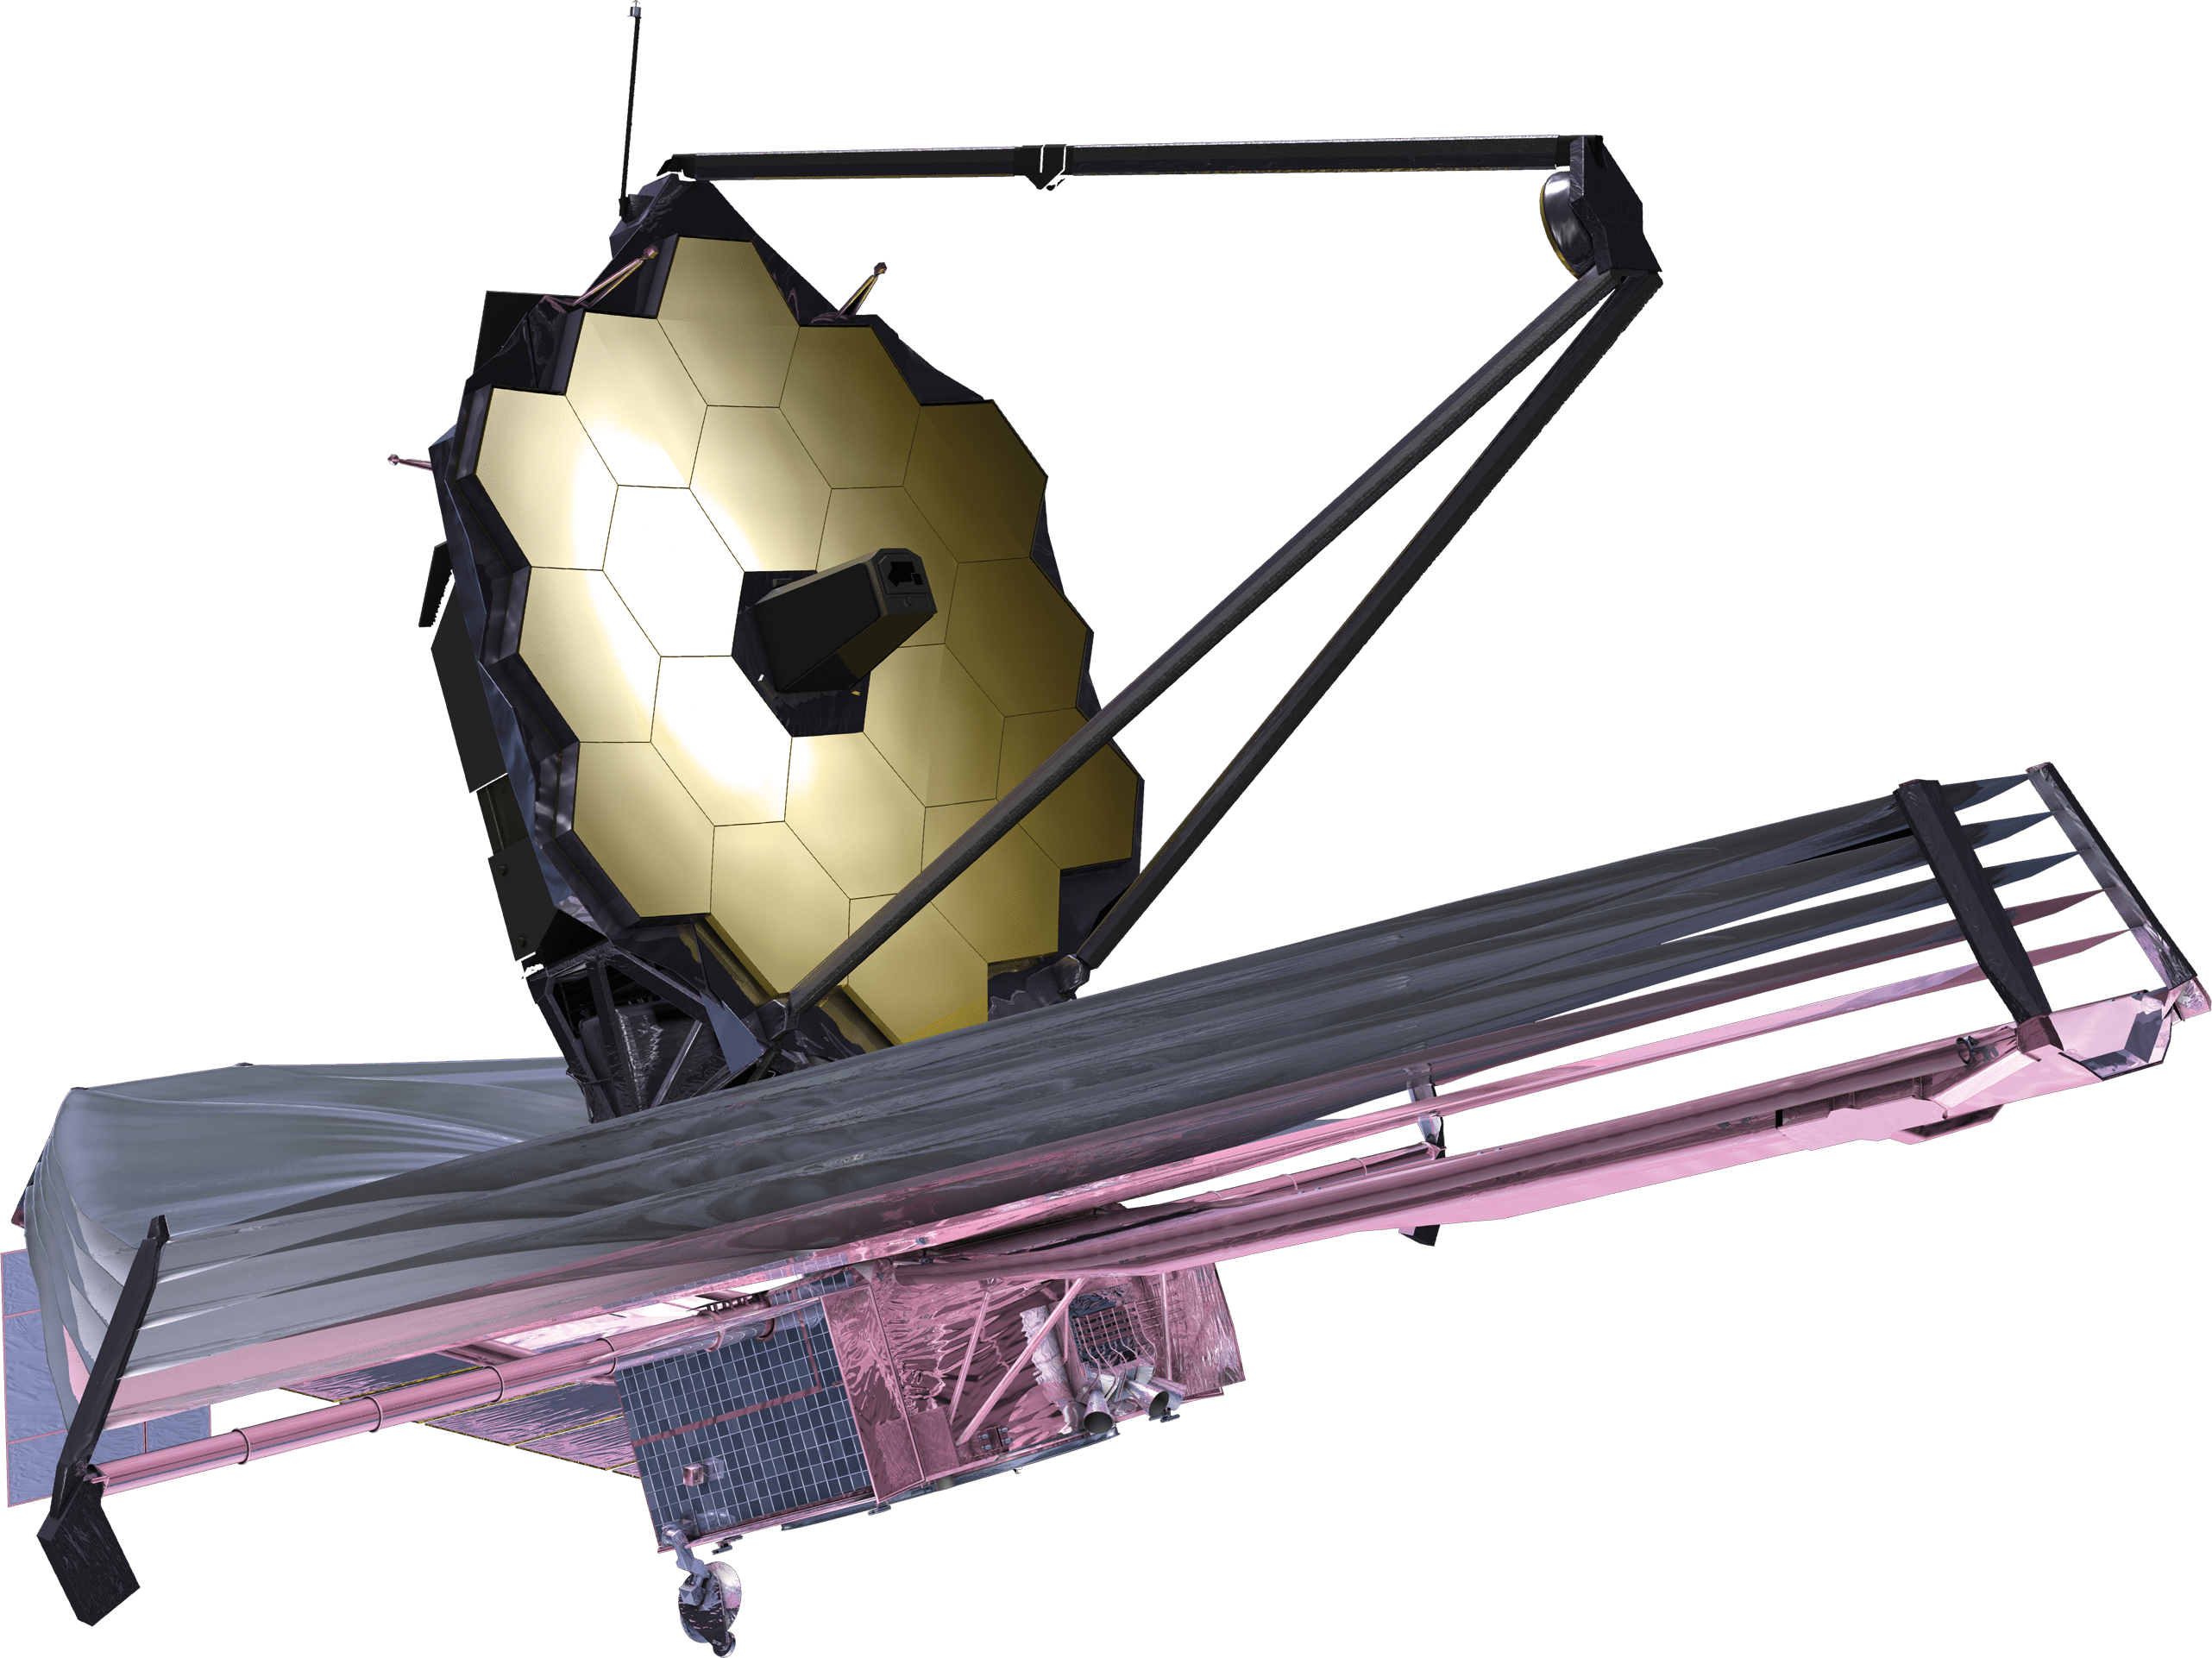
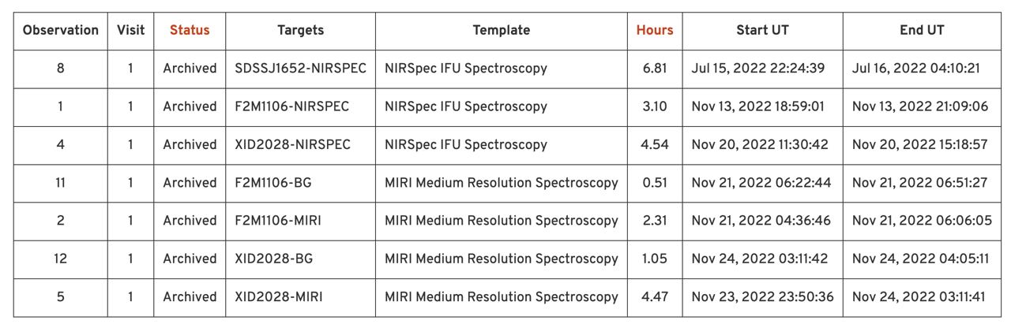
JWST likes it!
Part of Q3D ERS project
(PI D. Wylezalek)

Slide 9
JWST NIRSpec ERS data - Channel maps
SINFONI
NIRSpec

Slide 10
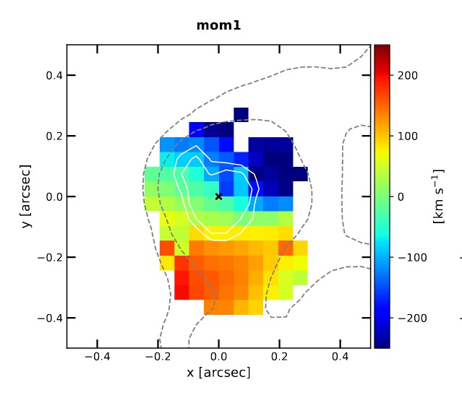
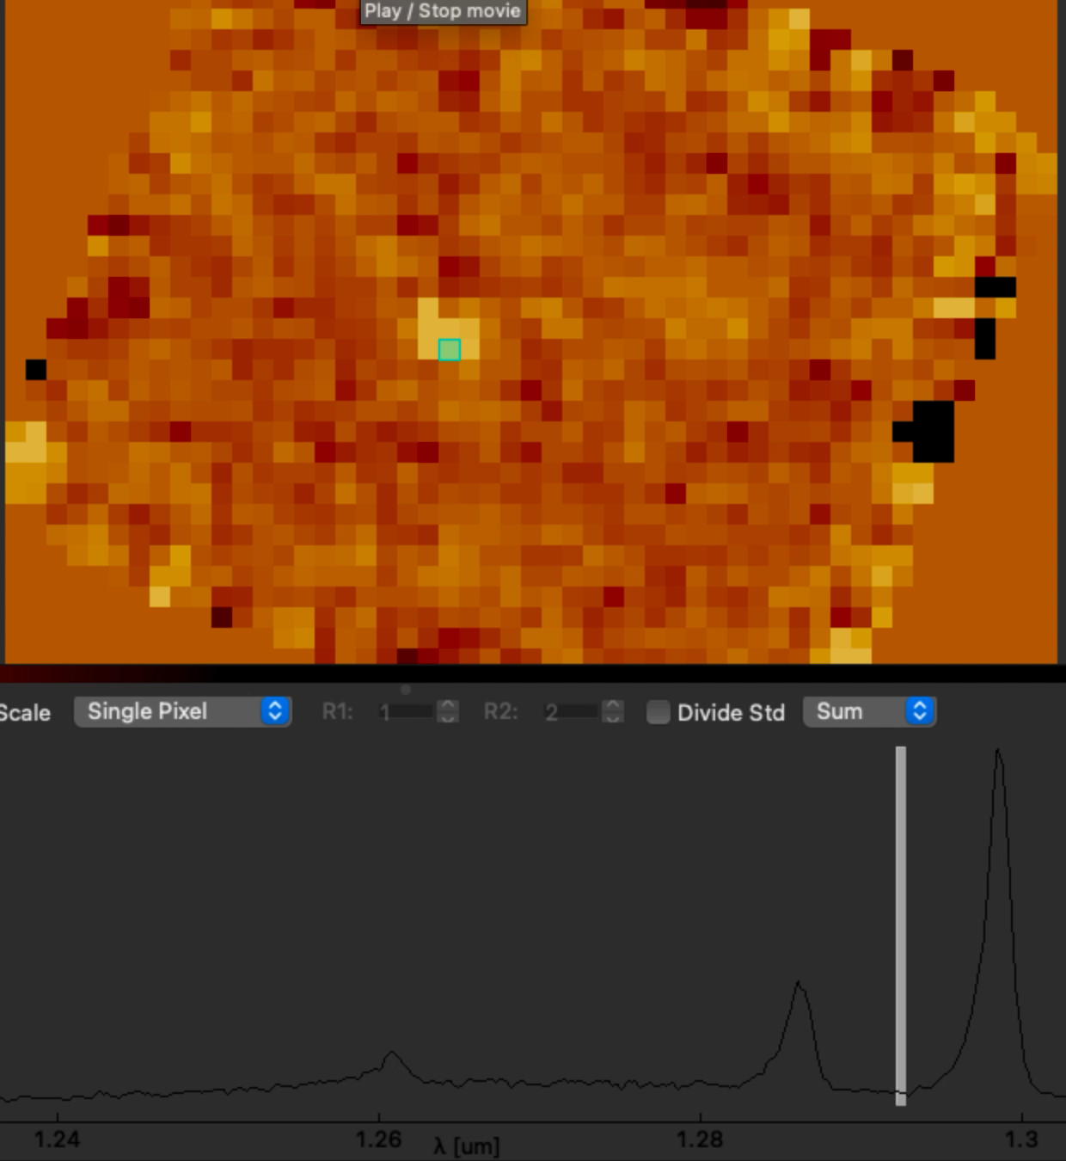
Kinematics
Cavity &
filaments
Outflow
Narrow component:
rotation
Total line profile

Slide 11
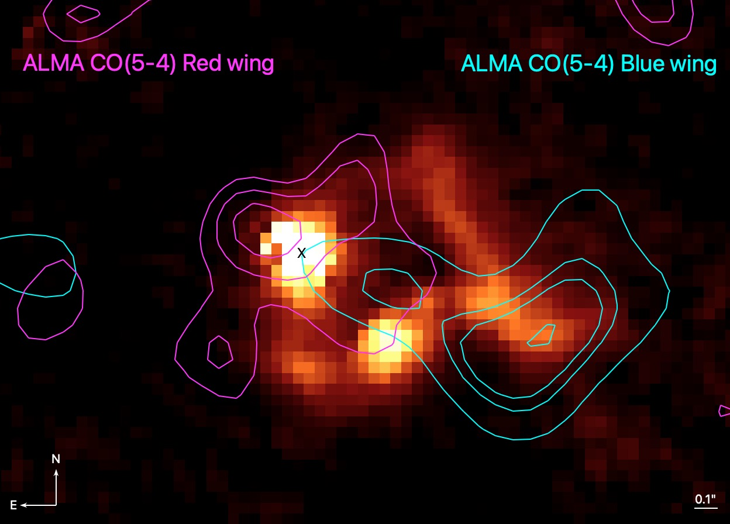
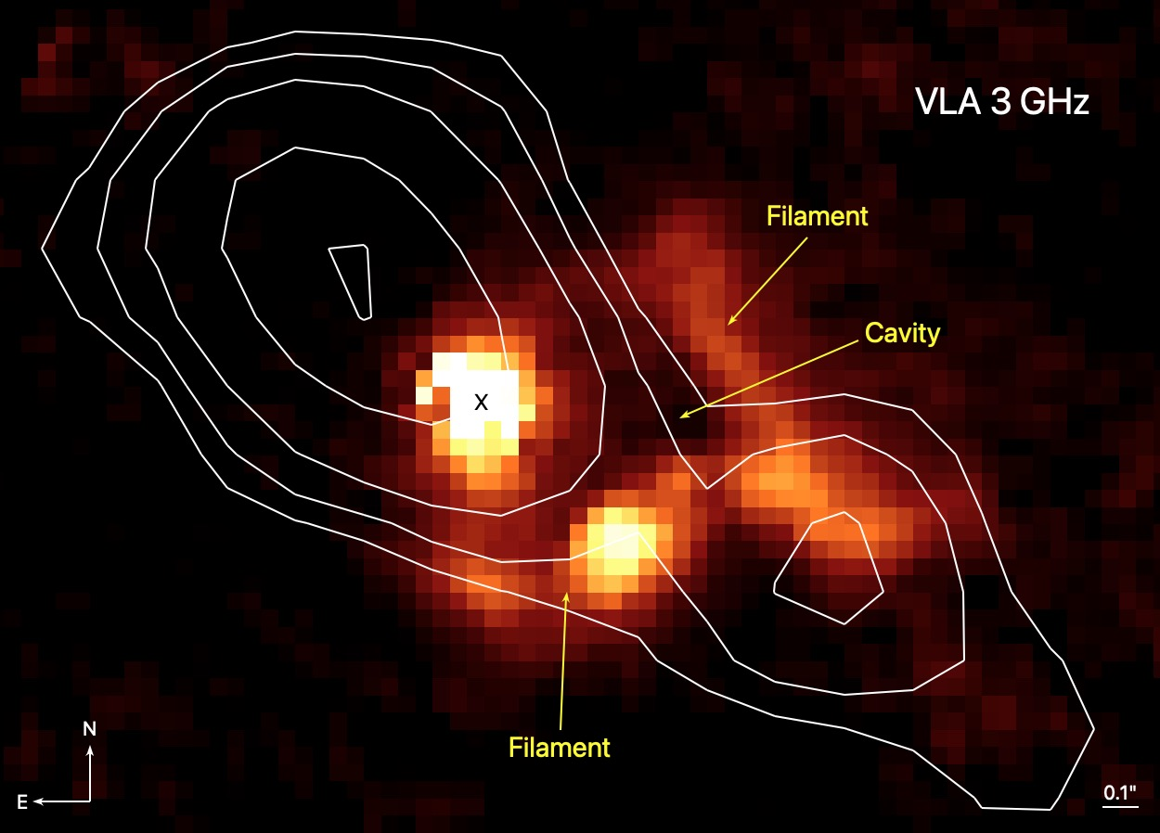
Multiwavelength outflow and radio jet?
Vardoulaki et al. (2019)
VLA-COSMOS Large Project (0.75" resolution,
integrated source flux density 92 μJy at 3 GHz)

Slide 12
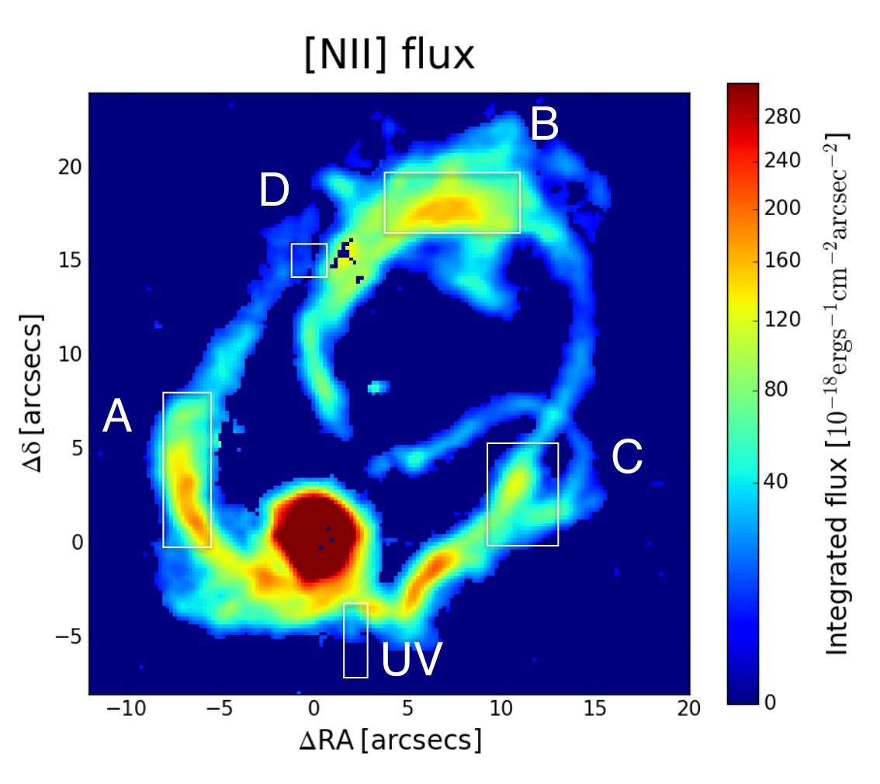
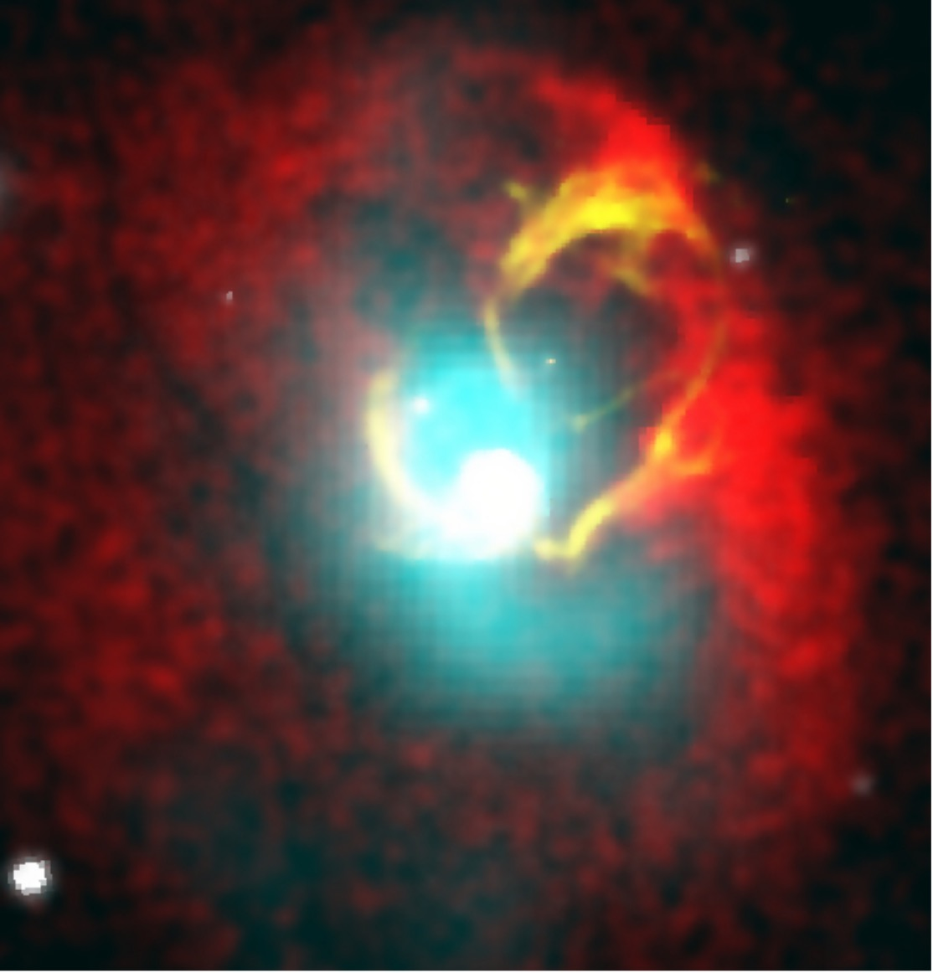
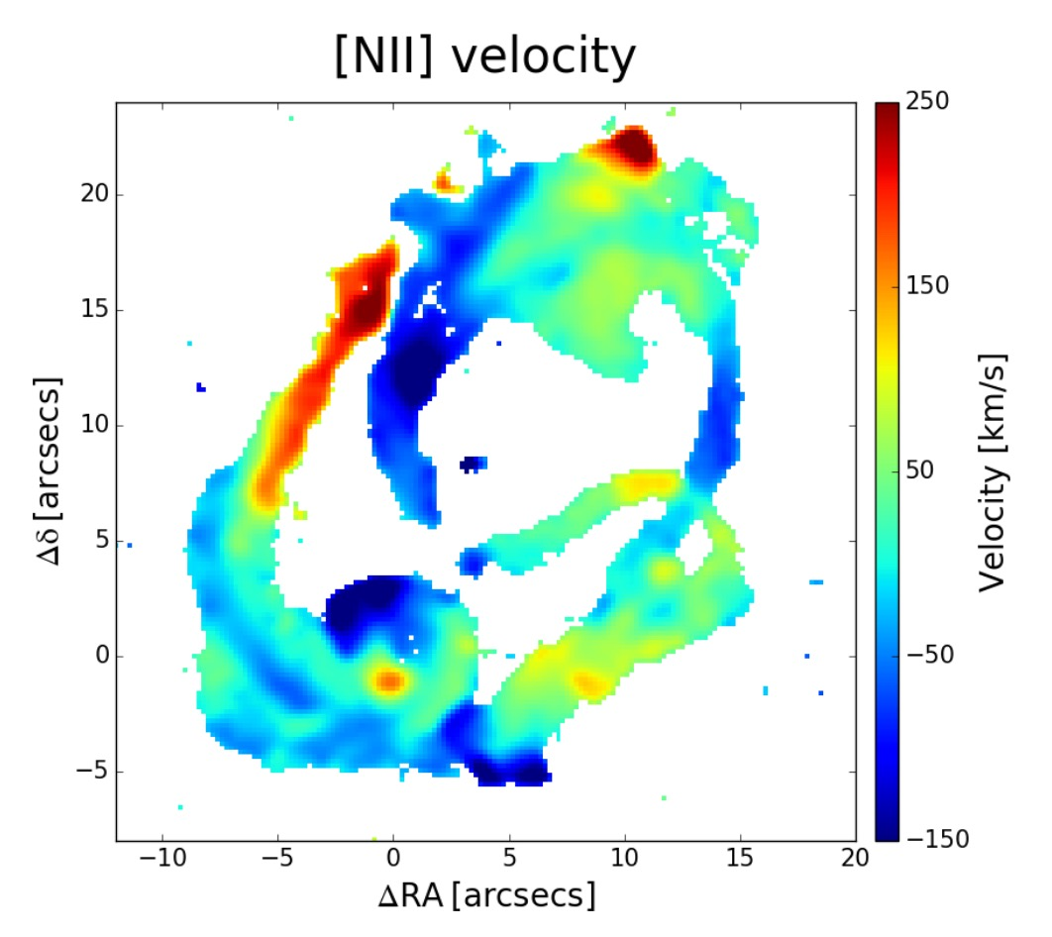
Filaments in bright radio galaxies
Balmaverde et al. 2018 (3C317 - Abell2052)

Slide 13
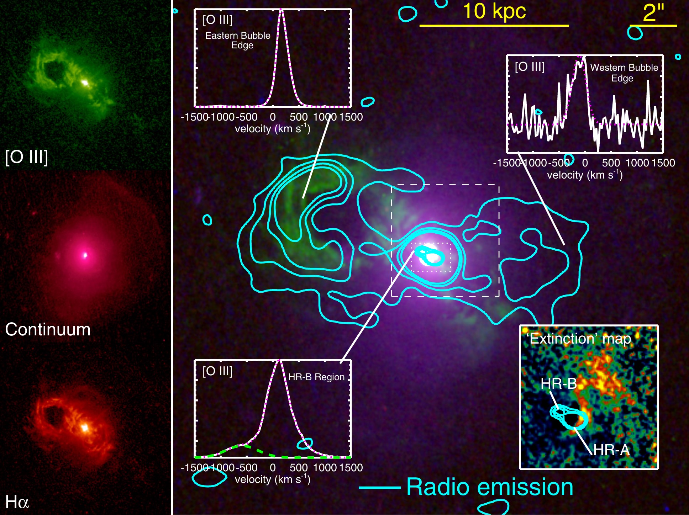
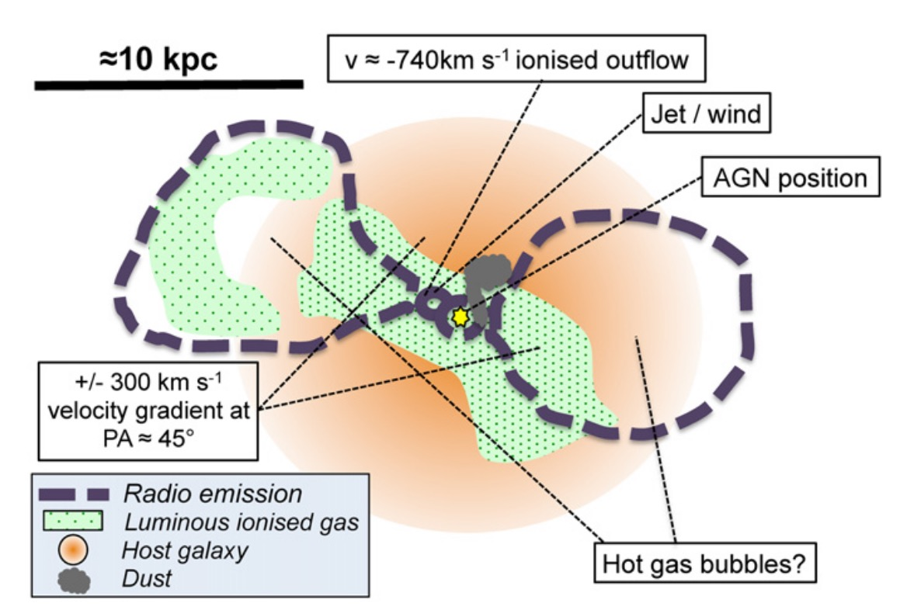
Bubbles and Filaments in low radio luminosity galaxies
The Teacup Galaxy
Harrison et al. 2015

Slide 14
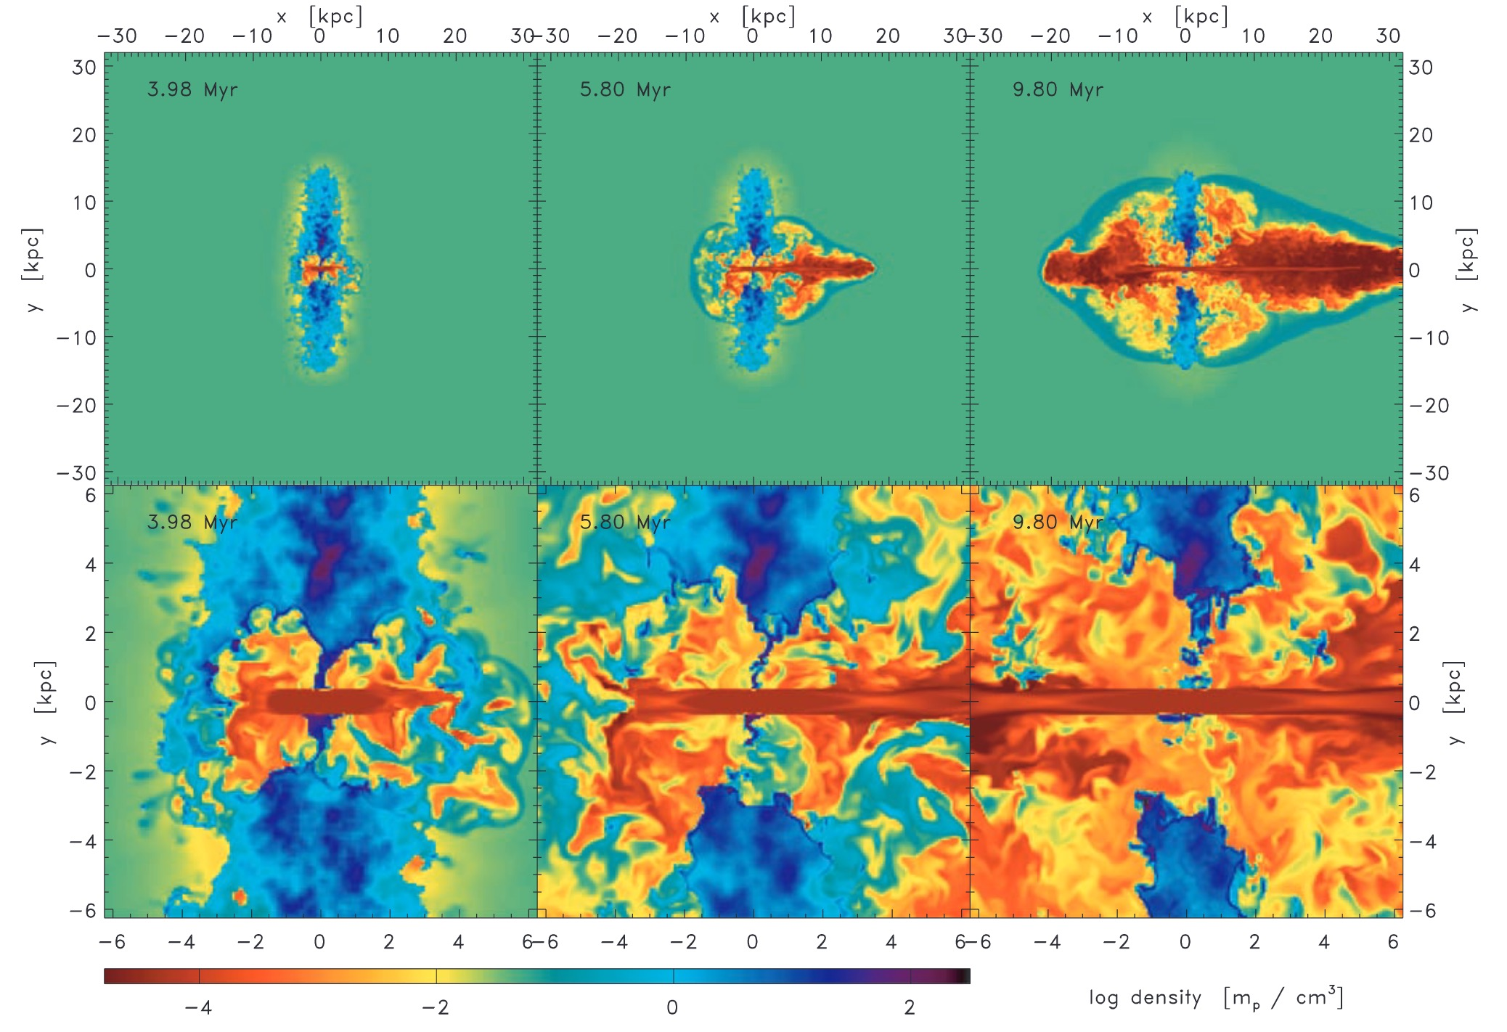
Bubbles and Jets in simulations
Expanding Bubble
Outflow
Gaibler et al. 2011

Slide 15

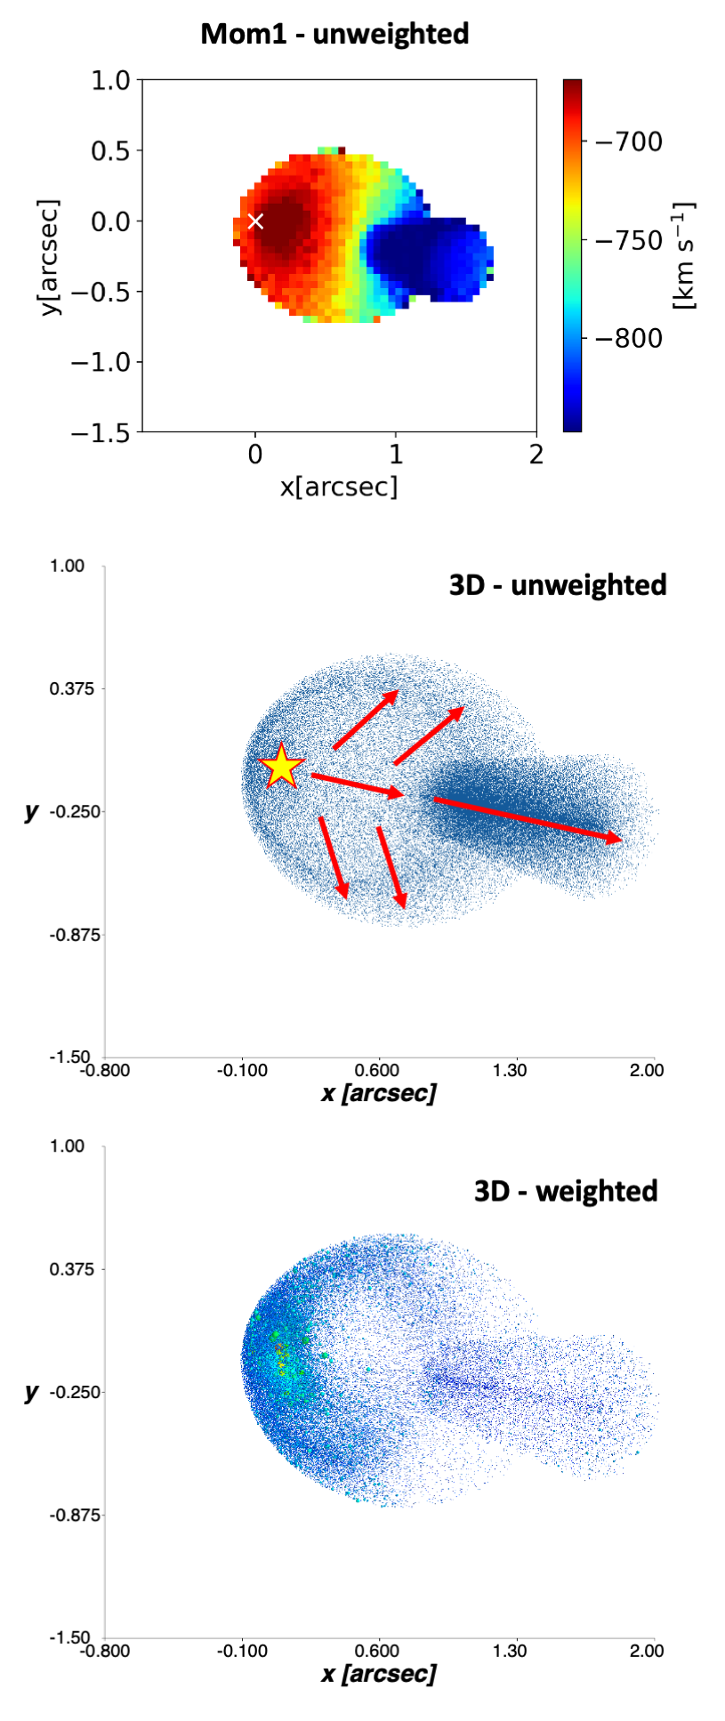
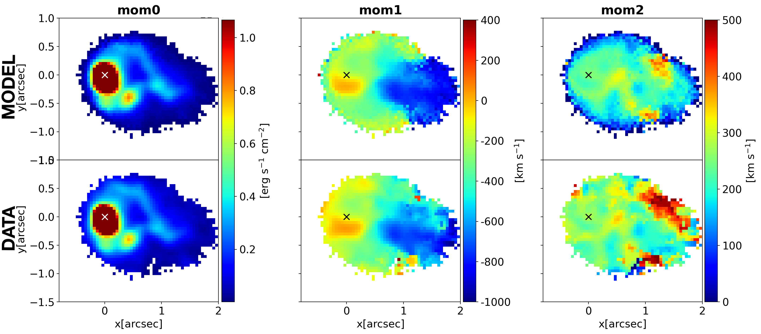
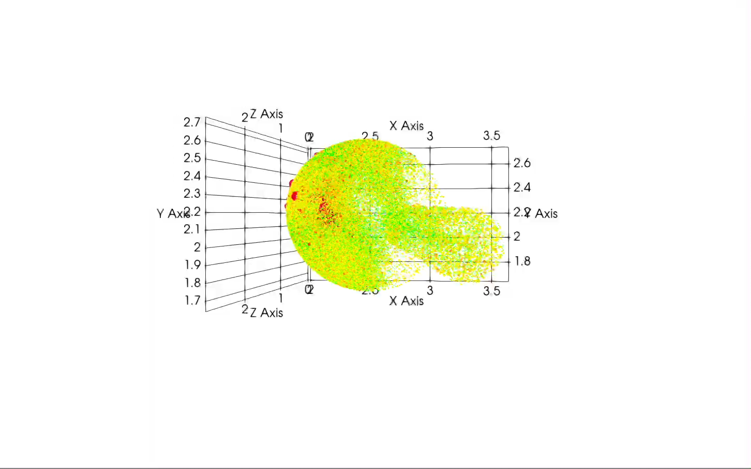
MOKA3D model of XID2028
Model
Data
Expanding bubble dragged by the jet + jet and outflow
piercing the ISM
Best fit params: v_{out} shell=775 km/s
v_{esp} shell=665 km/s; v_{out} outflow=960 km/s
Courtesy C. Marconcini

Slide 16
A glimpse at the ISM properties (full lines)

Slide 17
NaID590,5896
Outflow rate
Ionised Outflow:
direct measurement of density and extinction in the outflow
projection effects from MOKA3D
M_{out, ion}~ 6 M_{sun}/yr
.
Molecular Outflow (Brusa+18):
- rescaled for projection effects
M_{out,mol}~20-120 M_{sun}/yr
Neutral Outflow:
3 kinematical components
M_{out,neut}~30 M_{sun}/yr
.
.
Total Outflow Rate:
M_{out,tot}~ 60-160 M_{sun}/yr
.

Slide 18
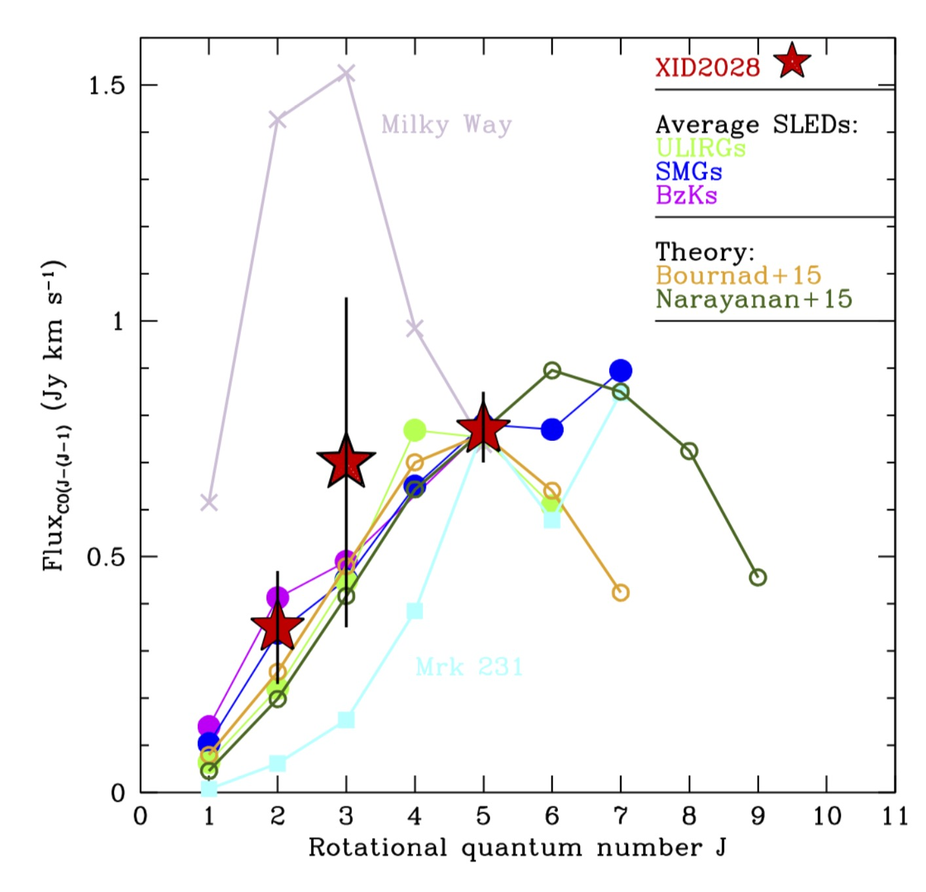
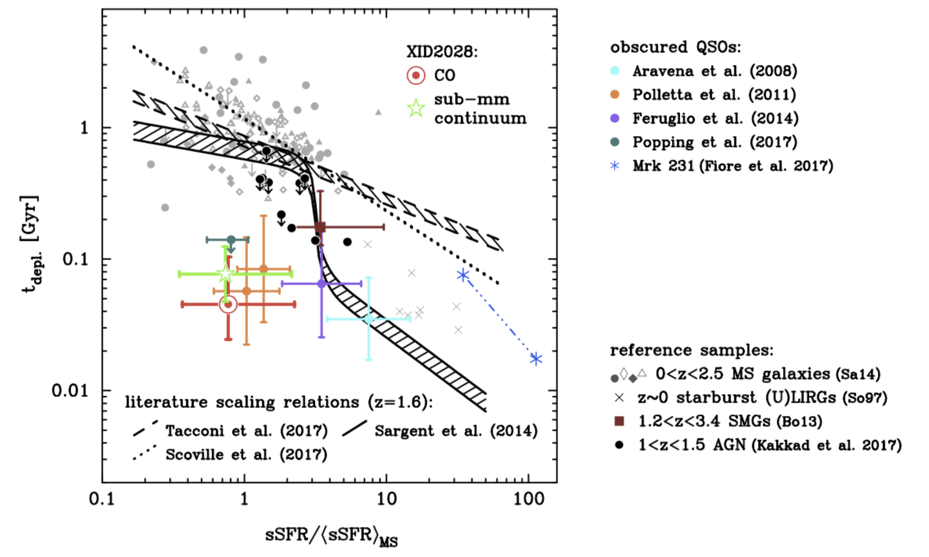
Molecular gas content of XID2028
We derive a total M_{gas} = 1±0.5 x 10¹⁰ M
consistent with estimate from RJ dust continuum
Gas fraction < 5% despite SFR~270 M/yr!
Depletion time scale vs.
“normalised” sSFR for
5x10¹⁰<M*<5x10¹¹
Derived CO excitation ladder
consistent with high-z ULIRGs, SMGs and BzKs:
-> SB like α_{co}=0.8 assumed
This converts in a t_{depl}=45-80 Myr (~30 Myr including outflow), ~2 orders of magnitude lower than the expected position on the plot for its sSFR
Evidence of QSO feedback from
gas removal and jet/ISM interaction?

Slide 19
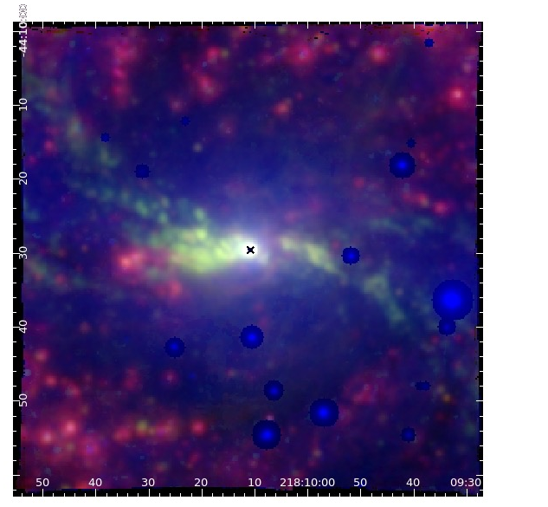
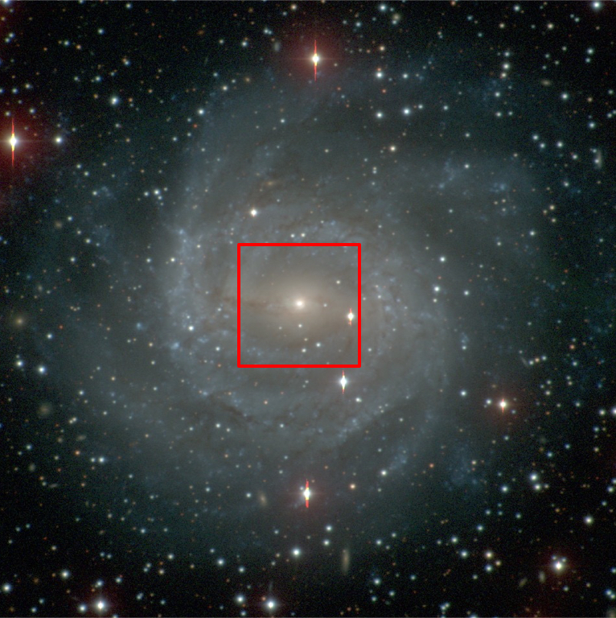
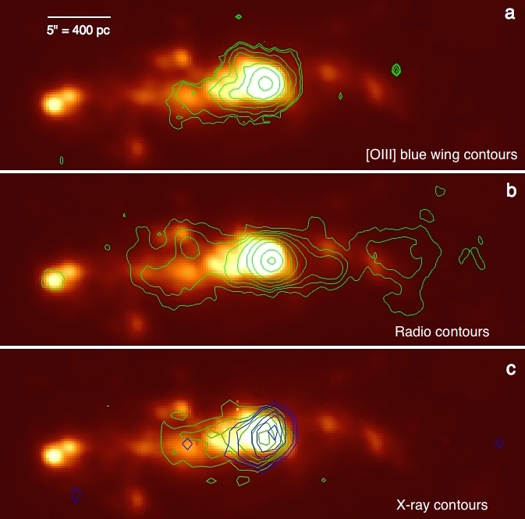
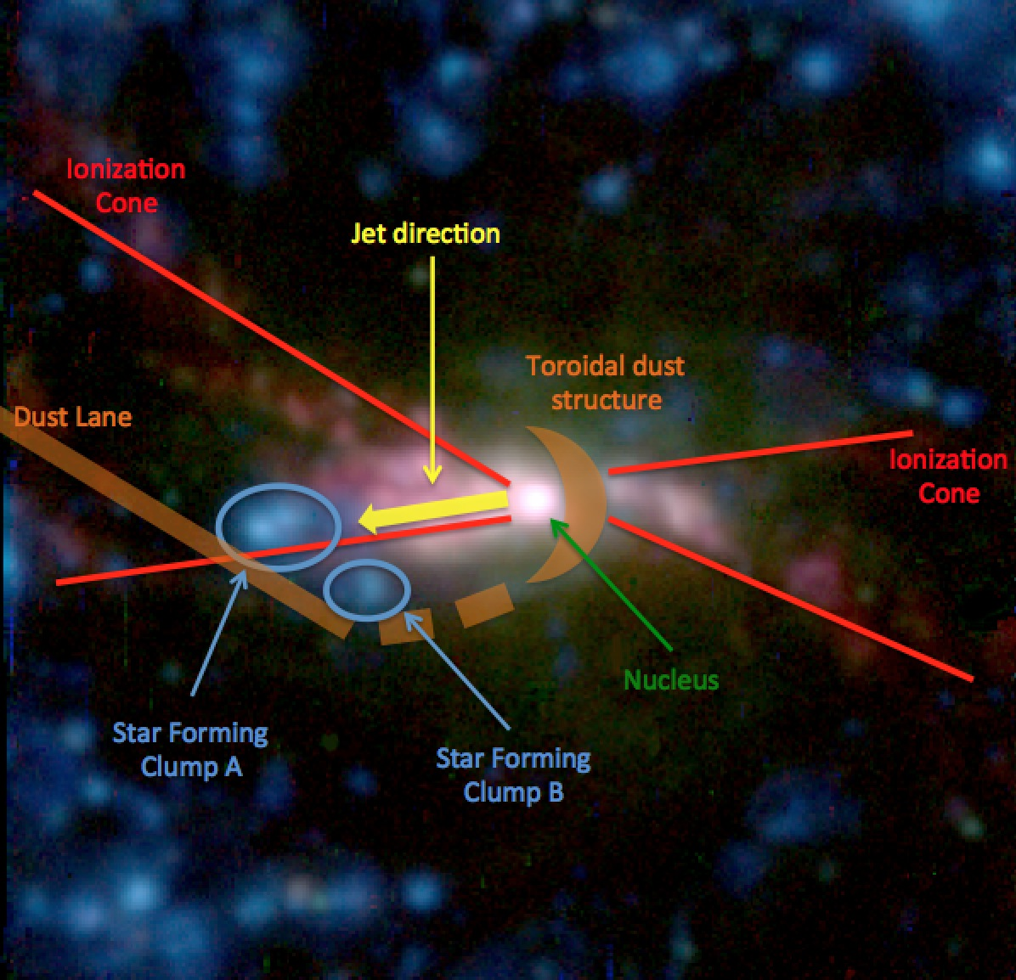
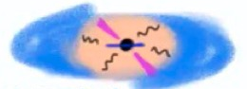
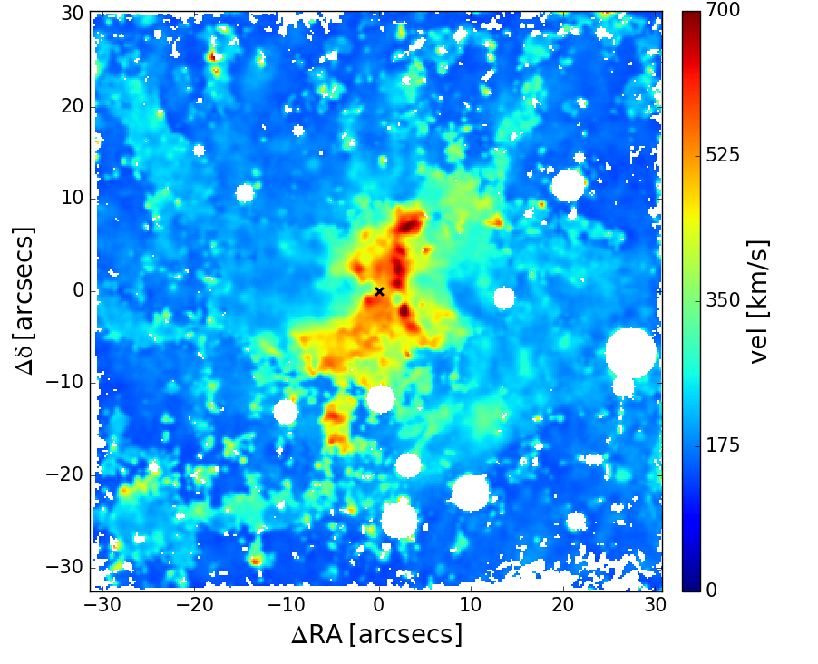
NGC 5643
Jet-Outflows and feedback: not just an isolated case
FOV ~ 5 kpc
Increasing evidence for a connection between outflows and radio-jets also at moderate radio luminosity (e.g. Morganti et al. 2015, Cresci et al. 2015b, Giroletti et al. 2017, Jarvis et al. 2018, Venturi et al. 2021, Ulivi et al. in prep)
MUSE
FOV
Radio contours
VLA 8.4 GHz
Hα
Cresci+2015
Both jet powered positive feedback and induced turbulence in NGC5253
Cresci et al. 2015
see Lorenzo’s talk after!
[OIII] W70
Venturi et al. 2021

Slide 20
Conclusions
The unprecedented sensitivity and resolution of NIRSpec allowed us to reveal new details about the morphology, kinematics, and wind/jet interaction with the ISM in this iconic source: required major leap to understand the role of feedback
Complex system of an highly collimated outflow plus an expanding bubble detected in the ionised gas
Multiphase gas outflows observed also in the molecular (ALMA) and neutral phase (NaID, NIRSpec)
Evidence of feedback in action on the gas reservoir of the galaxy
Supporting a connection between the radio emission and ionised gas outflows in AGN, as well as the relevant role of radio jets in AGN feedback on the host galaxy ISM even at modest luminosities

Slide 21
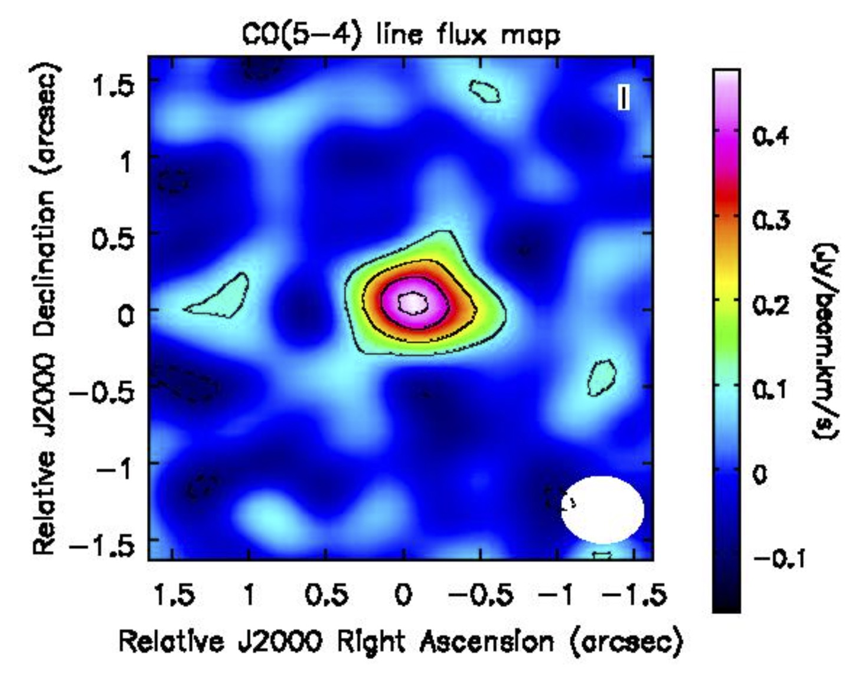
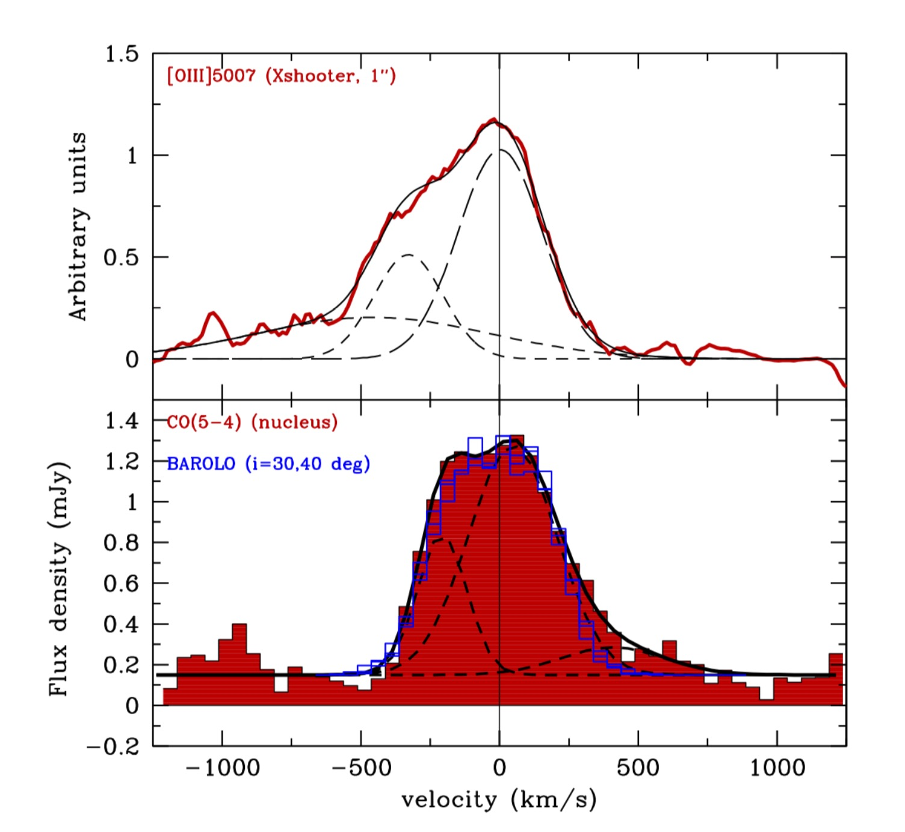
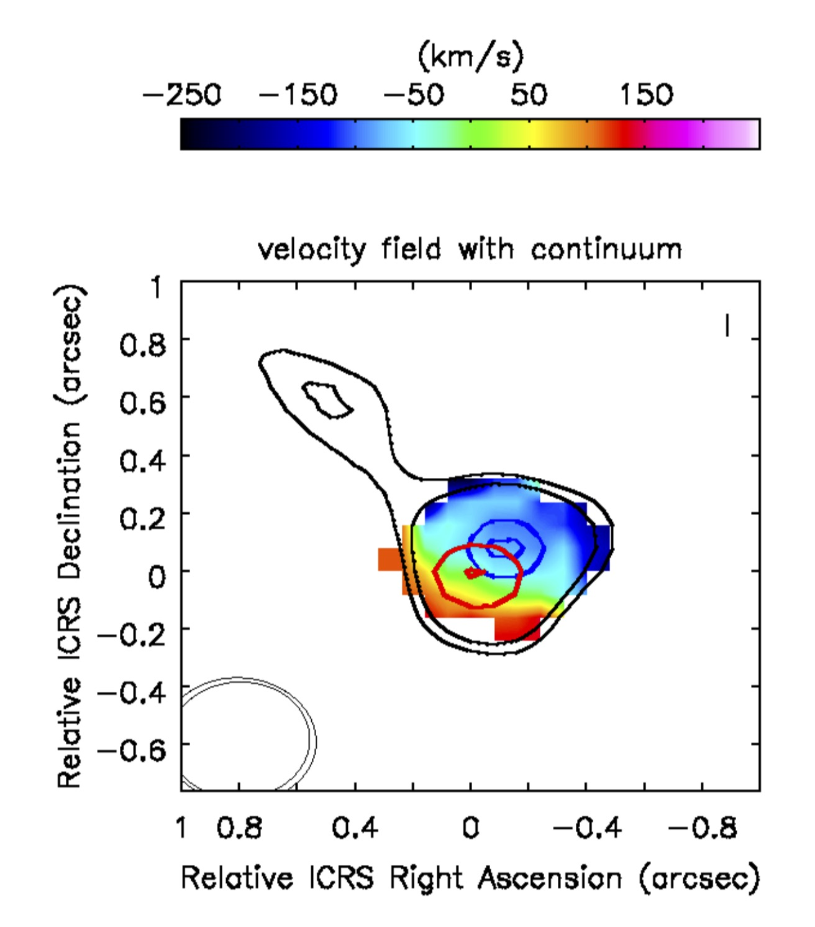
ALMA deep follow-up of XID2028: CO(5-4) line emission
ALMA Observations in CO(5-4) + continuum taken in Cycle 3
CO(5-4) is detected at >10 σ, FWHM=0.33”
log(L’_{CO(5-4)} /K km s⁻¹ pc⁻²) = 9.63
Broad (FWHM~500 km/s)
asymmetric line profile
The central component shows a velocity gradient along the source in the NW-SE direction
M_{dyn}≈ 6x10¹¹ M
Brusa, GC et al. 2018

Slide 22
Kinematics

Slide 23
Excitation

Slide 24
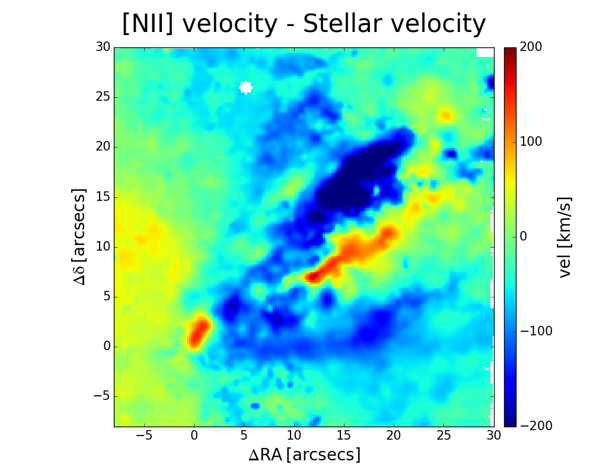
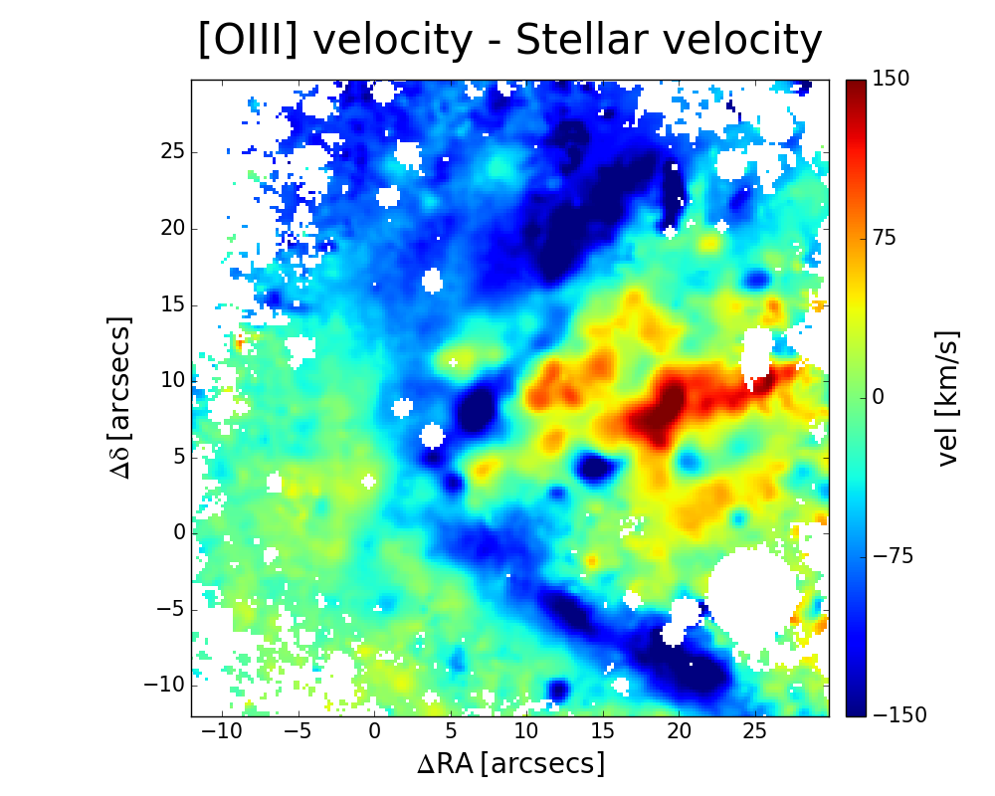
MOKA3D: Modeling Outflows Kinematics in AGN 3D
NGC 4945
Circinus
Outflows velocity fields are complex: real motions or effect of clumpy line emission?
Next generation kinematical model
X
Vobs
Y
Datacube
Montecarlo “cloud” model, assumed velocity field
Takes into account all geometrical projection effects and observational effects (e.g. beam smearing, binning, etc.)
Weigh clouds according to measured flux in spaxel where cloud is “observed”
Extremely versatile: allow tomographic reconstruction of 3D structure following assumption of velocity field
Marconcini+23

Slide 25
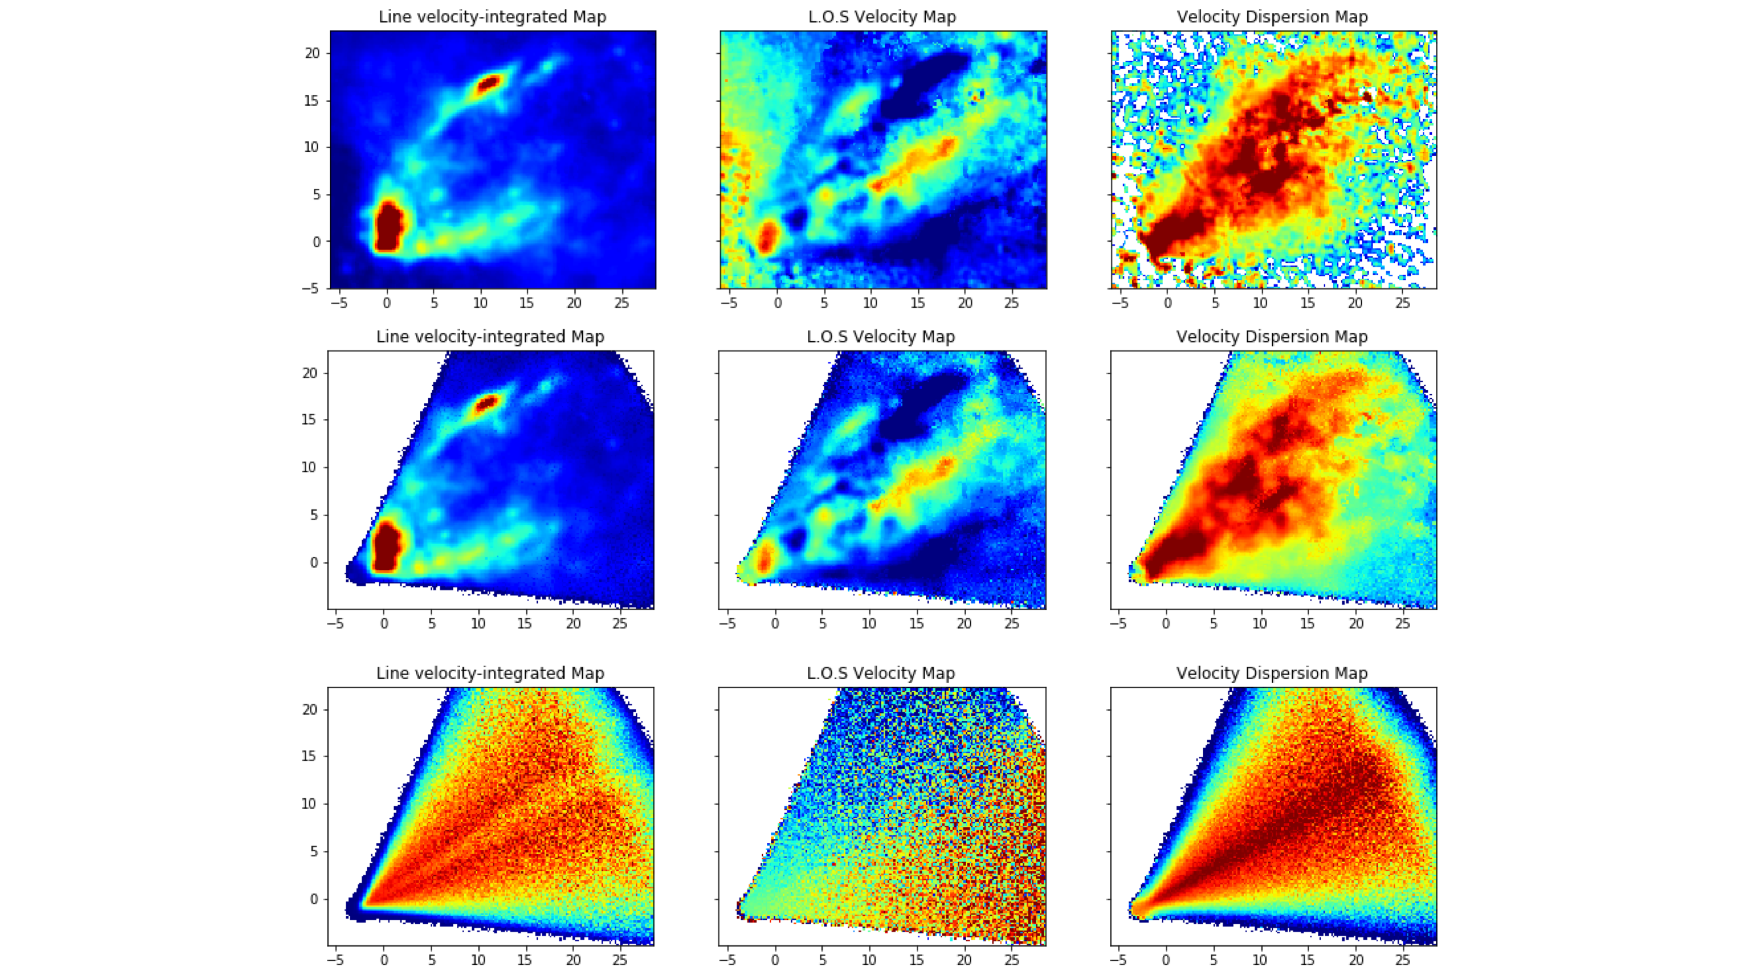
MOKA3D: Modeling Outflows Kinematics in AGN 3D
NGC4945 MUSE observations, MAGNUM survey
Flux
Velocity
Vel. Disp.
Observed
Observed
Model Unweighted
Model
Model Flux Weighted
Marconcini+23

