Slide 1
UFO in RQ and RL AGN
M. Dadina, INAF-OAS
(un RQ infiltrato… il giorno dopo la “consegna”)
..e ieri il Toro ha perso il derby…

Slide 2
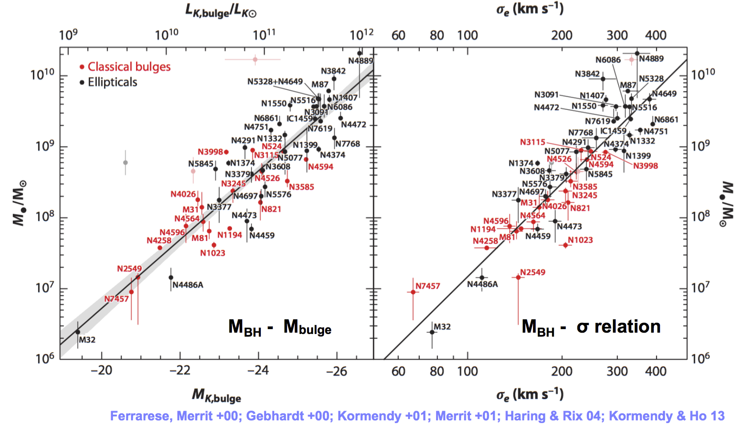
Since ~1995 we know that…
(almost..) all (massive enough?) galaxies in the Universe hosts a SMBH at their center...
(SMBH become a “compulsory” ingredient for galaxies formation/evolution)
2) the Mass of the SMBH “knows” the mass of the bulge of the hosting galaxy.
Notes:
Explained in the fugure

Slide 3
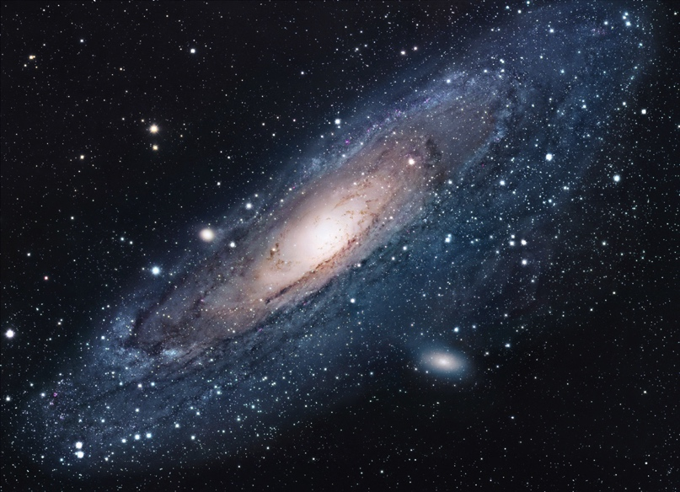
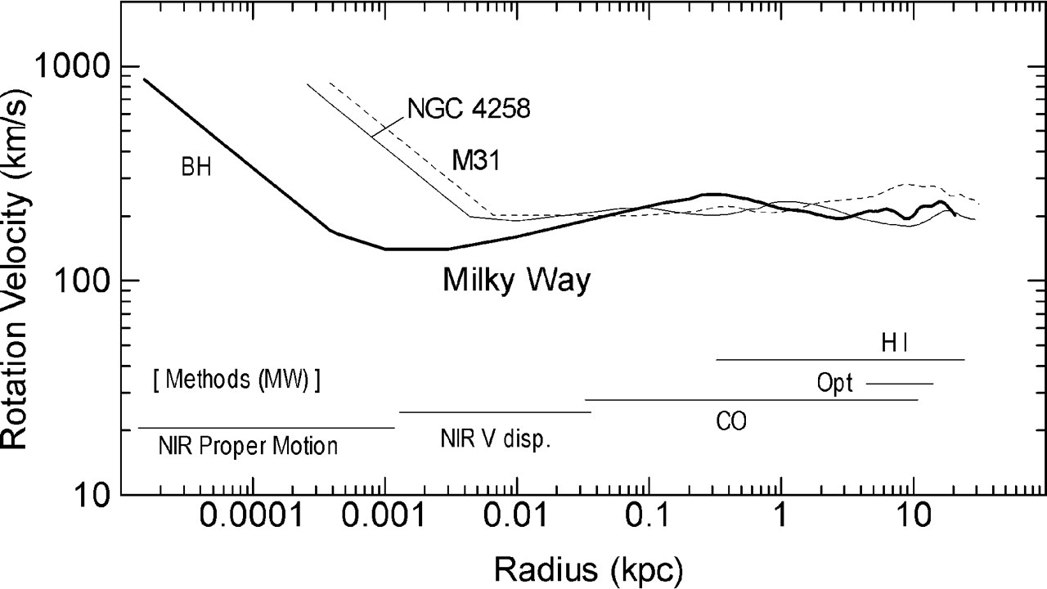
SMBH are “gravitational” objects…
Their gravitational influence is expected
to be limited within the inner few
0.001-0.01 kpc off the galaxies/bulges.
Bulges have typical dimensions of kpc...
Gravitation is not the (direct?) answer!
D_{bulge}~10 ⁸⁻⁹ R_{SMBH}
M_{bulge}~10 ³ M_{SMBH}
Feedback scenario:
DM Halos regulate the SMBH feeding (INFLOW)
(OUTFLOW)
SMBH activity regulates SF and gas content of the bulge
(thus self-regulating its own growth, stellar content,
stellar colors and so on…)
(Gaspari et al. 2013….)
Sofue & Rubin 2001
Notes:
SMBH IS SMALL
SMBH HAS SMALL SPHERE OF GRAVITATOIONAL INFLUENCE
NEED FEEDBACK – DM=INFALL SMBH ACTIVITY OUTFLOW

Slide 4
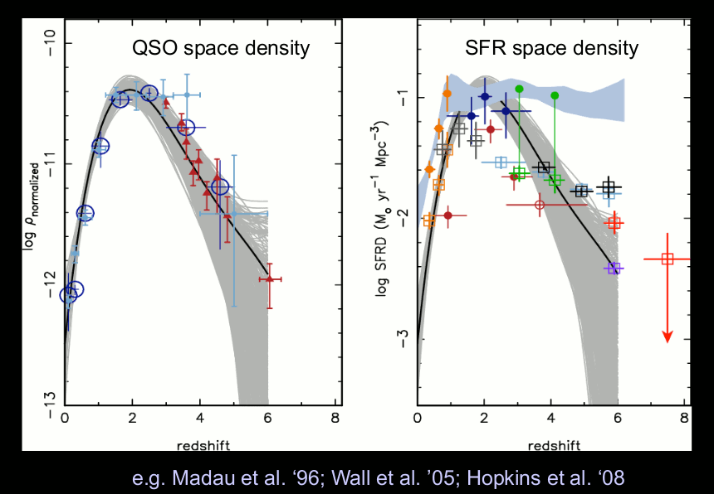
Why feedback?
“Soltan argument”
E_{binding, gas}≈M_{bulge} σ ²
SMBH density at z=0
in agreement with
what required
to power QSO
phases with
plausible value of
efficiency η
(E_{em}=ηE_{grav})
If: Accretion leads BH growth
and
1) efficency η≈0.1
2) σ≤400 km/s
E_{BH acc ≈} 0.1M_{BH}c² ≥ 80E_{binding, gas}
History of star formation and
BH growth are similar
^{If} even small fraction of the energy is
^{transferred (feedback) to gas}
➜ AGN may have profound effect on host galaxy!!!
^{(Fabian 12; King & Pounds 15)}
Indirect evidences!
“Feedback” implies the existence of a “medium” that links SMBH and bulge (DM halo?)
Notes:
SOLTAN: IF SMBH GROW VIA ACCRETION AND ACCRETION IS TRANSFORMED INTO ENERGY EMISSION WITH A CERTAIN EFFICENCY, THAN WE NEED EFFICENCY OF 10% TO EXPLAIN SMBH DENSITY IN THE LOCAL UNIVERSE (ACCRETION DOMINANT)
IF MASS OF SMBH IS DUE TO ACCRETION, AND ONLY 10% HAS BEEN TRANSFORMED IN ENERGY EMISSION, WE HAVE THAT THE EMITTED ENERGY DURING QSO PHASE IS 80 E BINDING GAS (QSO PHASE MAY “LARGELY” AFFECT THE GAS/ACCRETION PROPERTIES OF BULGES)
THE TWO EFFECTS ARE AT THE BASE OF THE SIMILARIRT OF SF AND ACCRETION HISTORY ALONG COSMIC TIME? DON’T KNOW, BUT SAME DIRECTION!

Slide 5
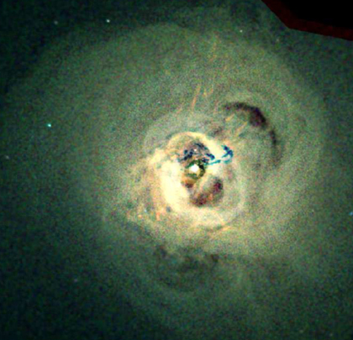
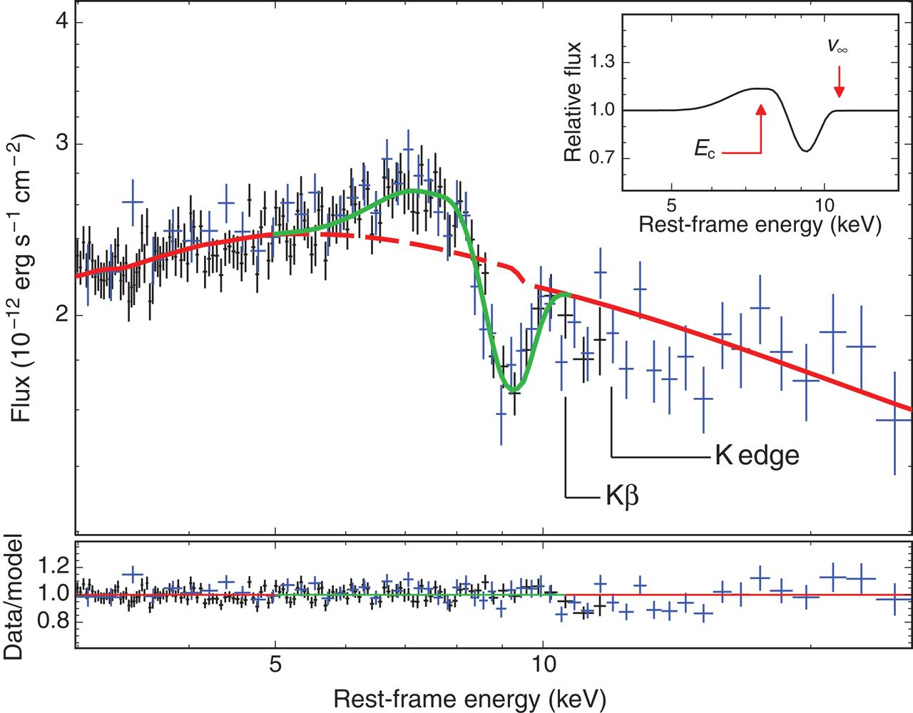
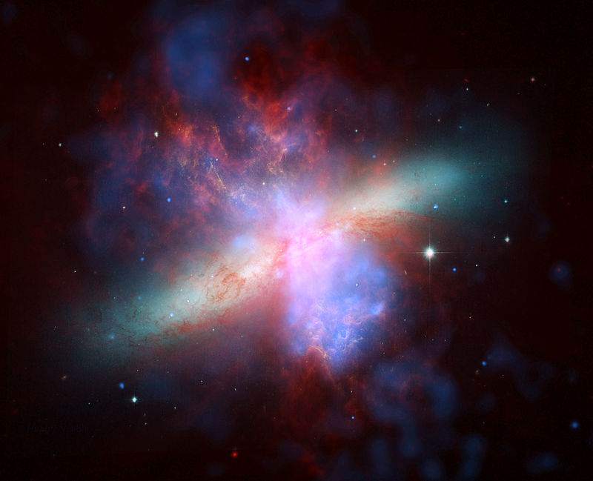
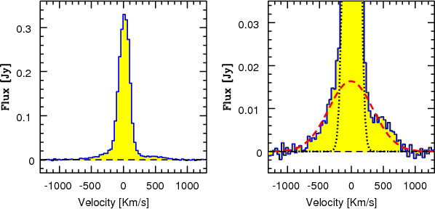
M82: starburst driven
outflow
Nardini et al. 2015
Fabian et al. 2006
Ultra-fast outflows (UFOs)
Galaxy clusters: Radio
mode to explain the
The heating of the
Cooling flows
QSO winds
massive molecular outflows
Direct evidences: we
see (possible) feedback
mechanisms in action!
(we already knew “AGN winds… think to WA, BAL… )
Feruglio et al. 2010
Notes:
WE SEE OUTFLOWS OF GAS ESCAPING GRAVITATIONAL POTENTIAL WELL AND STRONGLY INFLUENCING THEIR ENVIROMENT
NEW RESULTS ON QSO: UFOS AND MASSIVE MOLECULAR OUTFLOW

Slide 6
Fiore et al. 2017
We “assume” and/or “check” that
the different outflow(s) observed in different bands are
interconnected!
..knowing that we have a lot of “unknowns” and or
intrinsic “difficulties” to deal with (geometry of the
flows that translate into meaningful estimation of the
energetics, launching mechanisms, sizes and related
time-scales… to name few of them….)

Slide 7
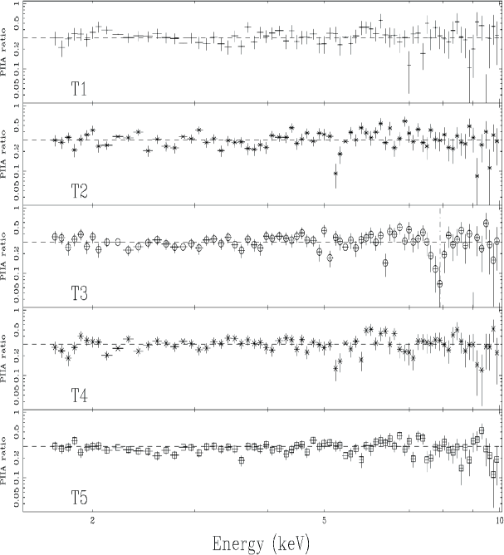
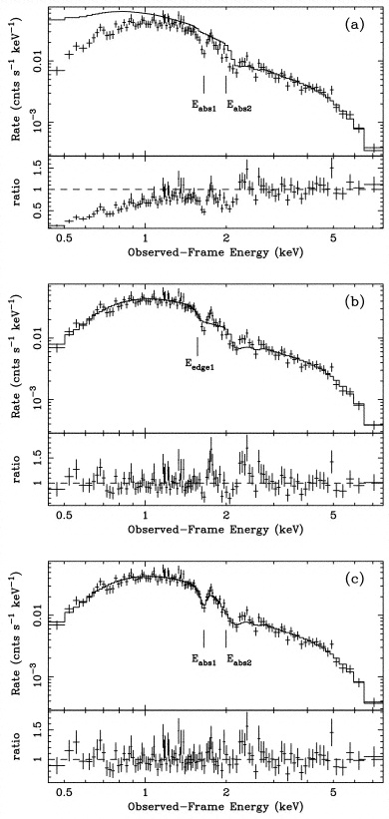
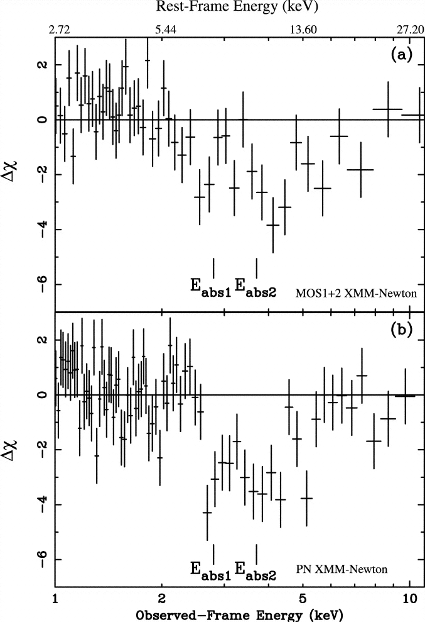
APM 08297+5255 (z=3.91)
PG 1211+143 (z=0.081)
Pounds et al. 2003
Mrk 509, Dadina et al. 2005
Chartas et al. 2002

Slide 8
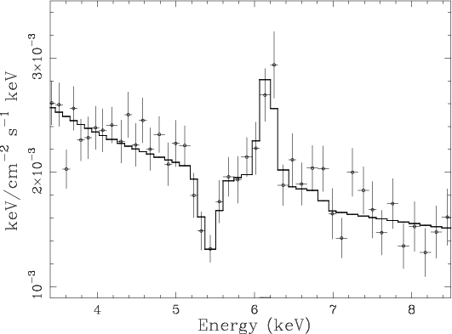
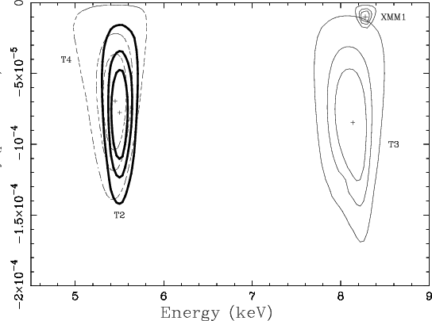
Mrk 509 – Dadina et al. 2005

Slide 9
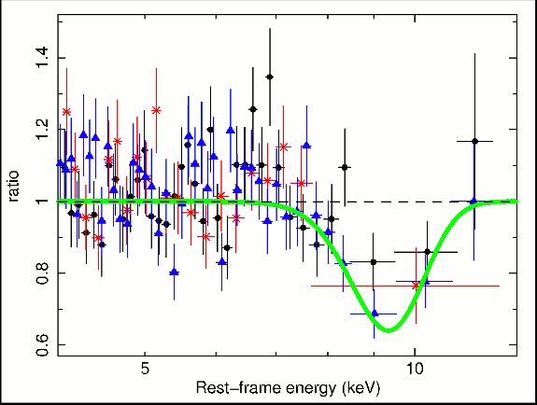
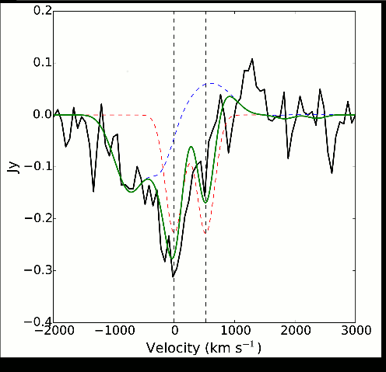
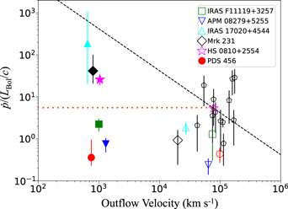
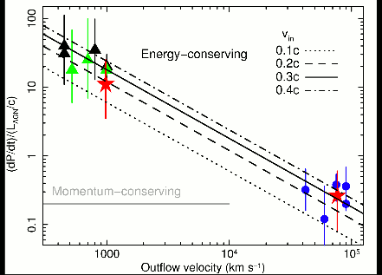
Tombesi et al. 2015: evidence of strong link between molecular outflow
and UFOs in the ultraluminous IR source IRAS1119+3257.
d~kpc
d<0.01pc
UFO drives molecular
Outflow (from SMBH region to Bulges)
2) Energy-driven flow
Notes:
WIND MODEL CONFIMED!
MOREOVER IT MAY AFFECT LARGE REGINS (CO REGIONS D KPC)
ENERGETIC ENOUGH AND ENERGY CONSERVATIVE FLOW

Slide 10
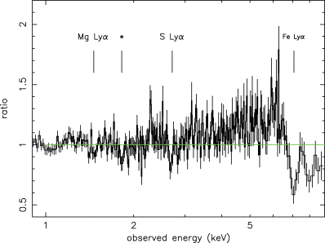
Pounds et al. 2006
PG 1211+143 v_{out}~0.13c
L_{kin}~2x10⁴⁵ erg/s (assuming radial flow with 10% covering fraction, Logξ=3 )
L_{bol}~5x10⁴⁵ erg/s
Notes:
Figure 1 EPIC pn camera data from the observation of PG1211+143 in 2001 compared with a simple power-law fit over the energy band 1–10 keV. Three narrow spectral features in the 2001 data and their proposed identification in P03 with absorption lines of highly ionized Mg, S and Fe are indicated. A further significant ‘absorption line’, marked by an asterix, lies close to the neutral Si absorption edge and was therefore ignored in P03.
Unless provided in the caption above, the following copyright applies to the content of this slide: © 2006 The Authors. Journal compilation © 2006 RAS

Slide 11
We need a complete census of…
Nh (cm-2)
Location(R,DeltaR)
Ionizationstate(ξ)
Velocity
Covering factor
Frequency in AGNs
Density
i) PHYSICS of accelerated and accreted flows (winds?, blobs?, acceleration mechanism? etc.)
ii) COSMOLOGY: i.e. estimate the mass outflow rate, thus the impact of AGN outflows on ISM, on DM and SMBH coevolution, galaxy formation but also IGM enrichment and heating!
Distance, Filling & Covering factors often unknown in particular in high-z QSOs !!!
Timing is fundamental:
Δt ~ Δr (dimension and location of the “clouds”)

Slide 12
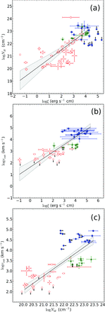
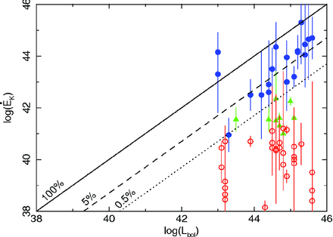
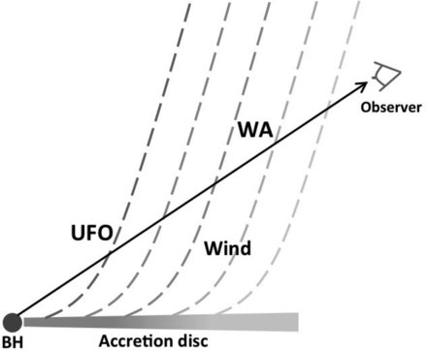
What do we know…?
(From samples of nearby RQ Seyferts/QSO)
30-50% of objects shows UFO (quasi spherical flows)
Nh~10²³ cm⁻²
V~0.1-0.3c …
ξ~10³⁻⁴ erg cm s⁻¹
Variable (clumpy?)
Log(v)
Log(ξ)
Log(Nh)
Tombesi et al. 2011, 12, 13
Gofford et al. 2013
Igo et al. 2020
Matzeu et al. 2023
(QSO @ 0.1<z<0.35)
Study of sample of “bright enough” source allowed
To infer that:
UFOs may affect the star formation of the hosts
UFOs and WAs may be part of the same phenomenon
Notes:
CONFIMRING THAT MAY BE ENERGETIC RELEVANT
INDICATING THAT MAY BE ARE SAME AS WA??? WIND MODEL!!!!!
DEFINATIVELY MAY BE ENERGETIC ENOUGH TO AFFECT

Slide 13
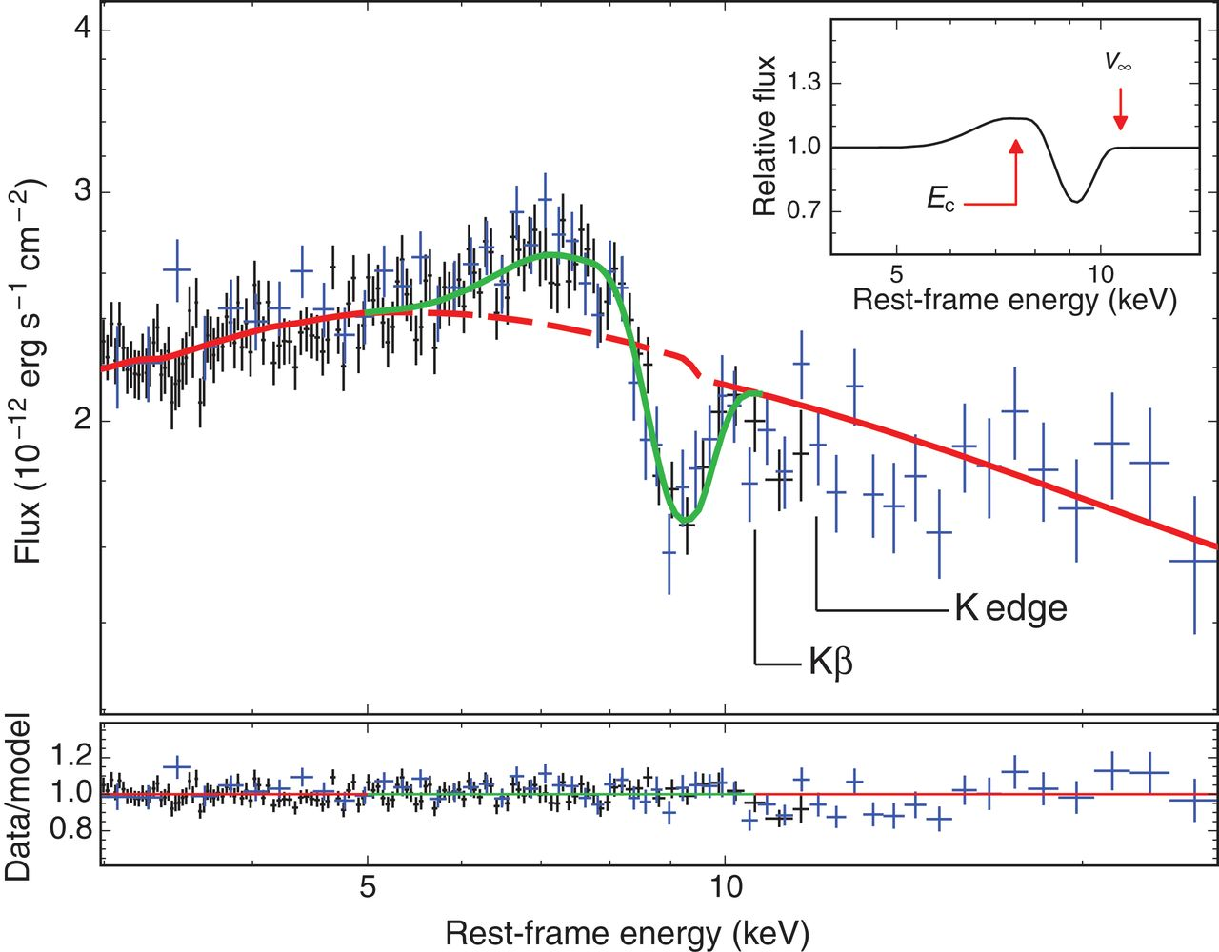
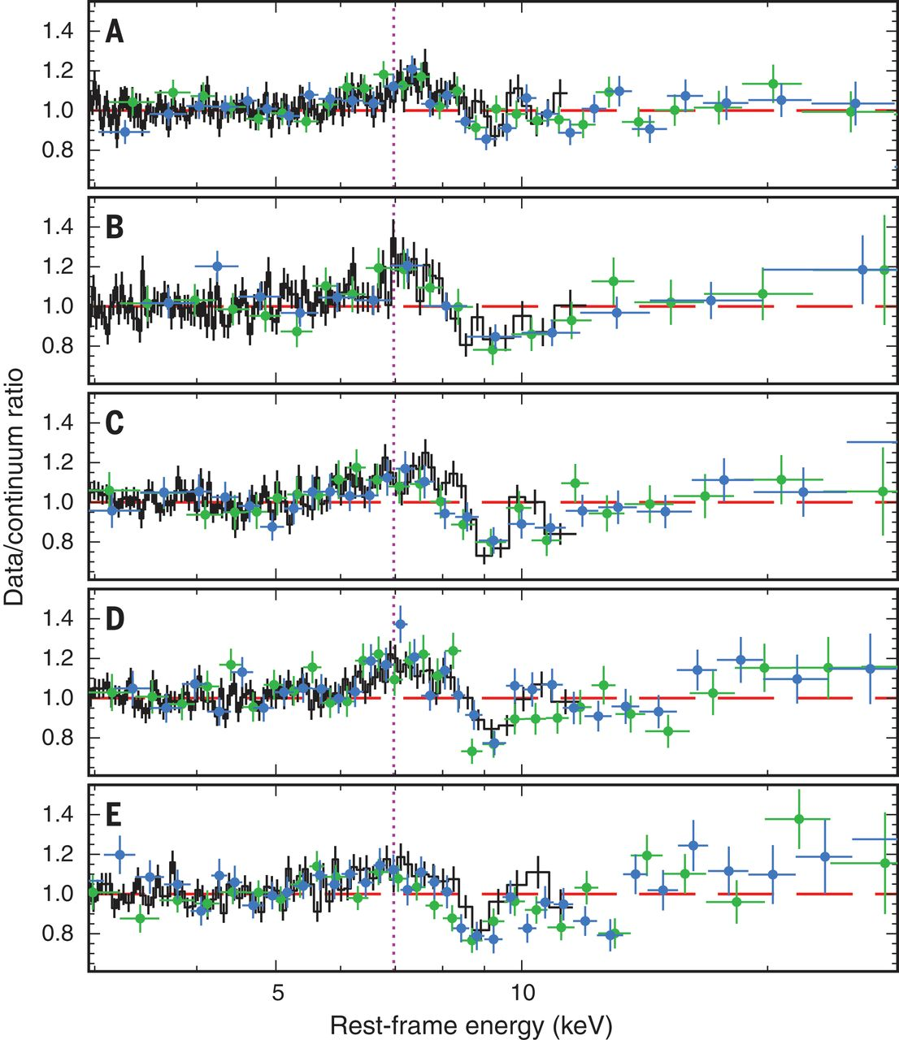
The “Rosetta Stone” PDS 456 (see Reeves, Braito and collaborators. since 2003)
Nardini et al. 2015
Ω~2Π

Slide 14
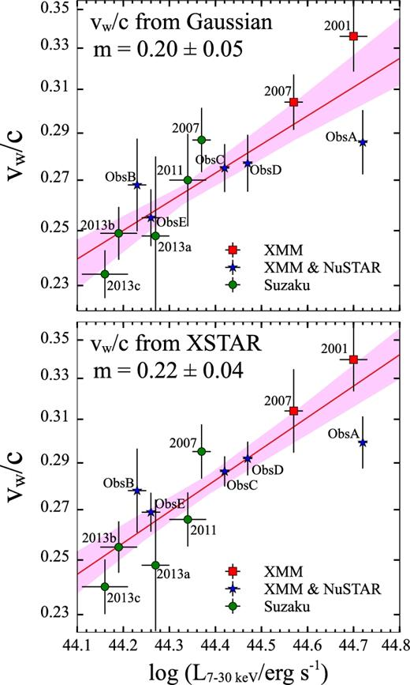
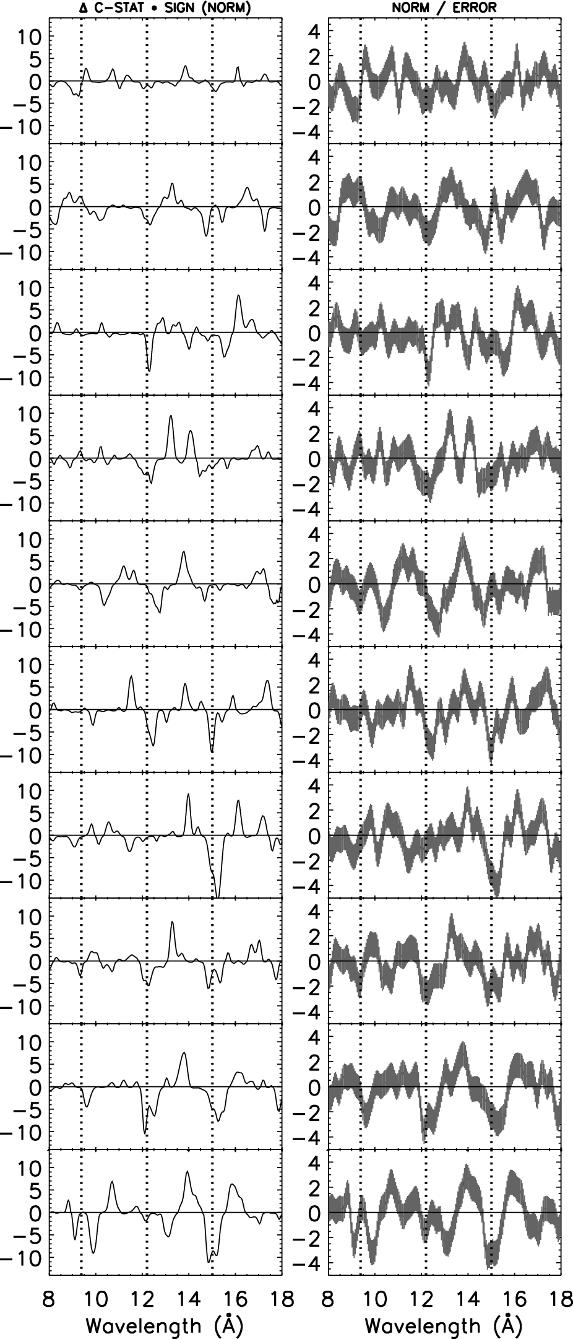
PDS 456, Matzeu et al./ 2017
Pinto et al. 2018 in IRAS 13224..
(… see also Parker et al 2017)
Same v vs L law… the intensity of the abs.
lines decreases with L

Slide 15
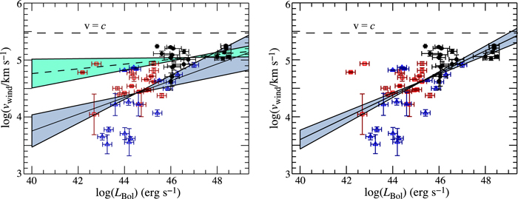
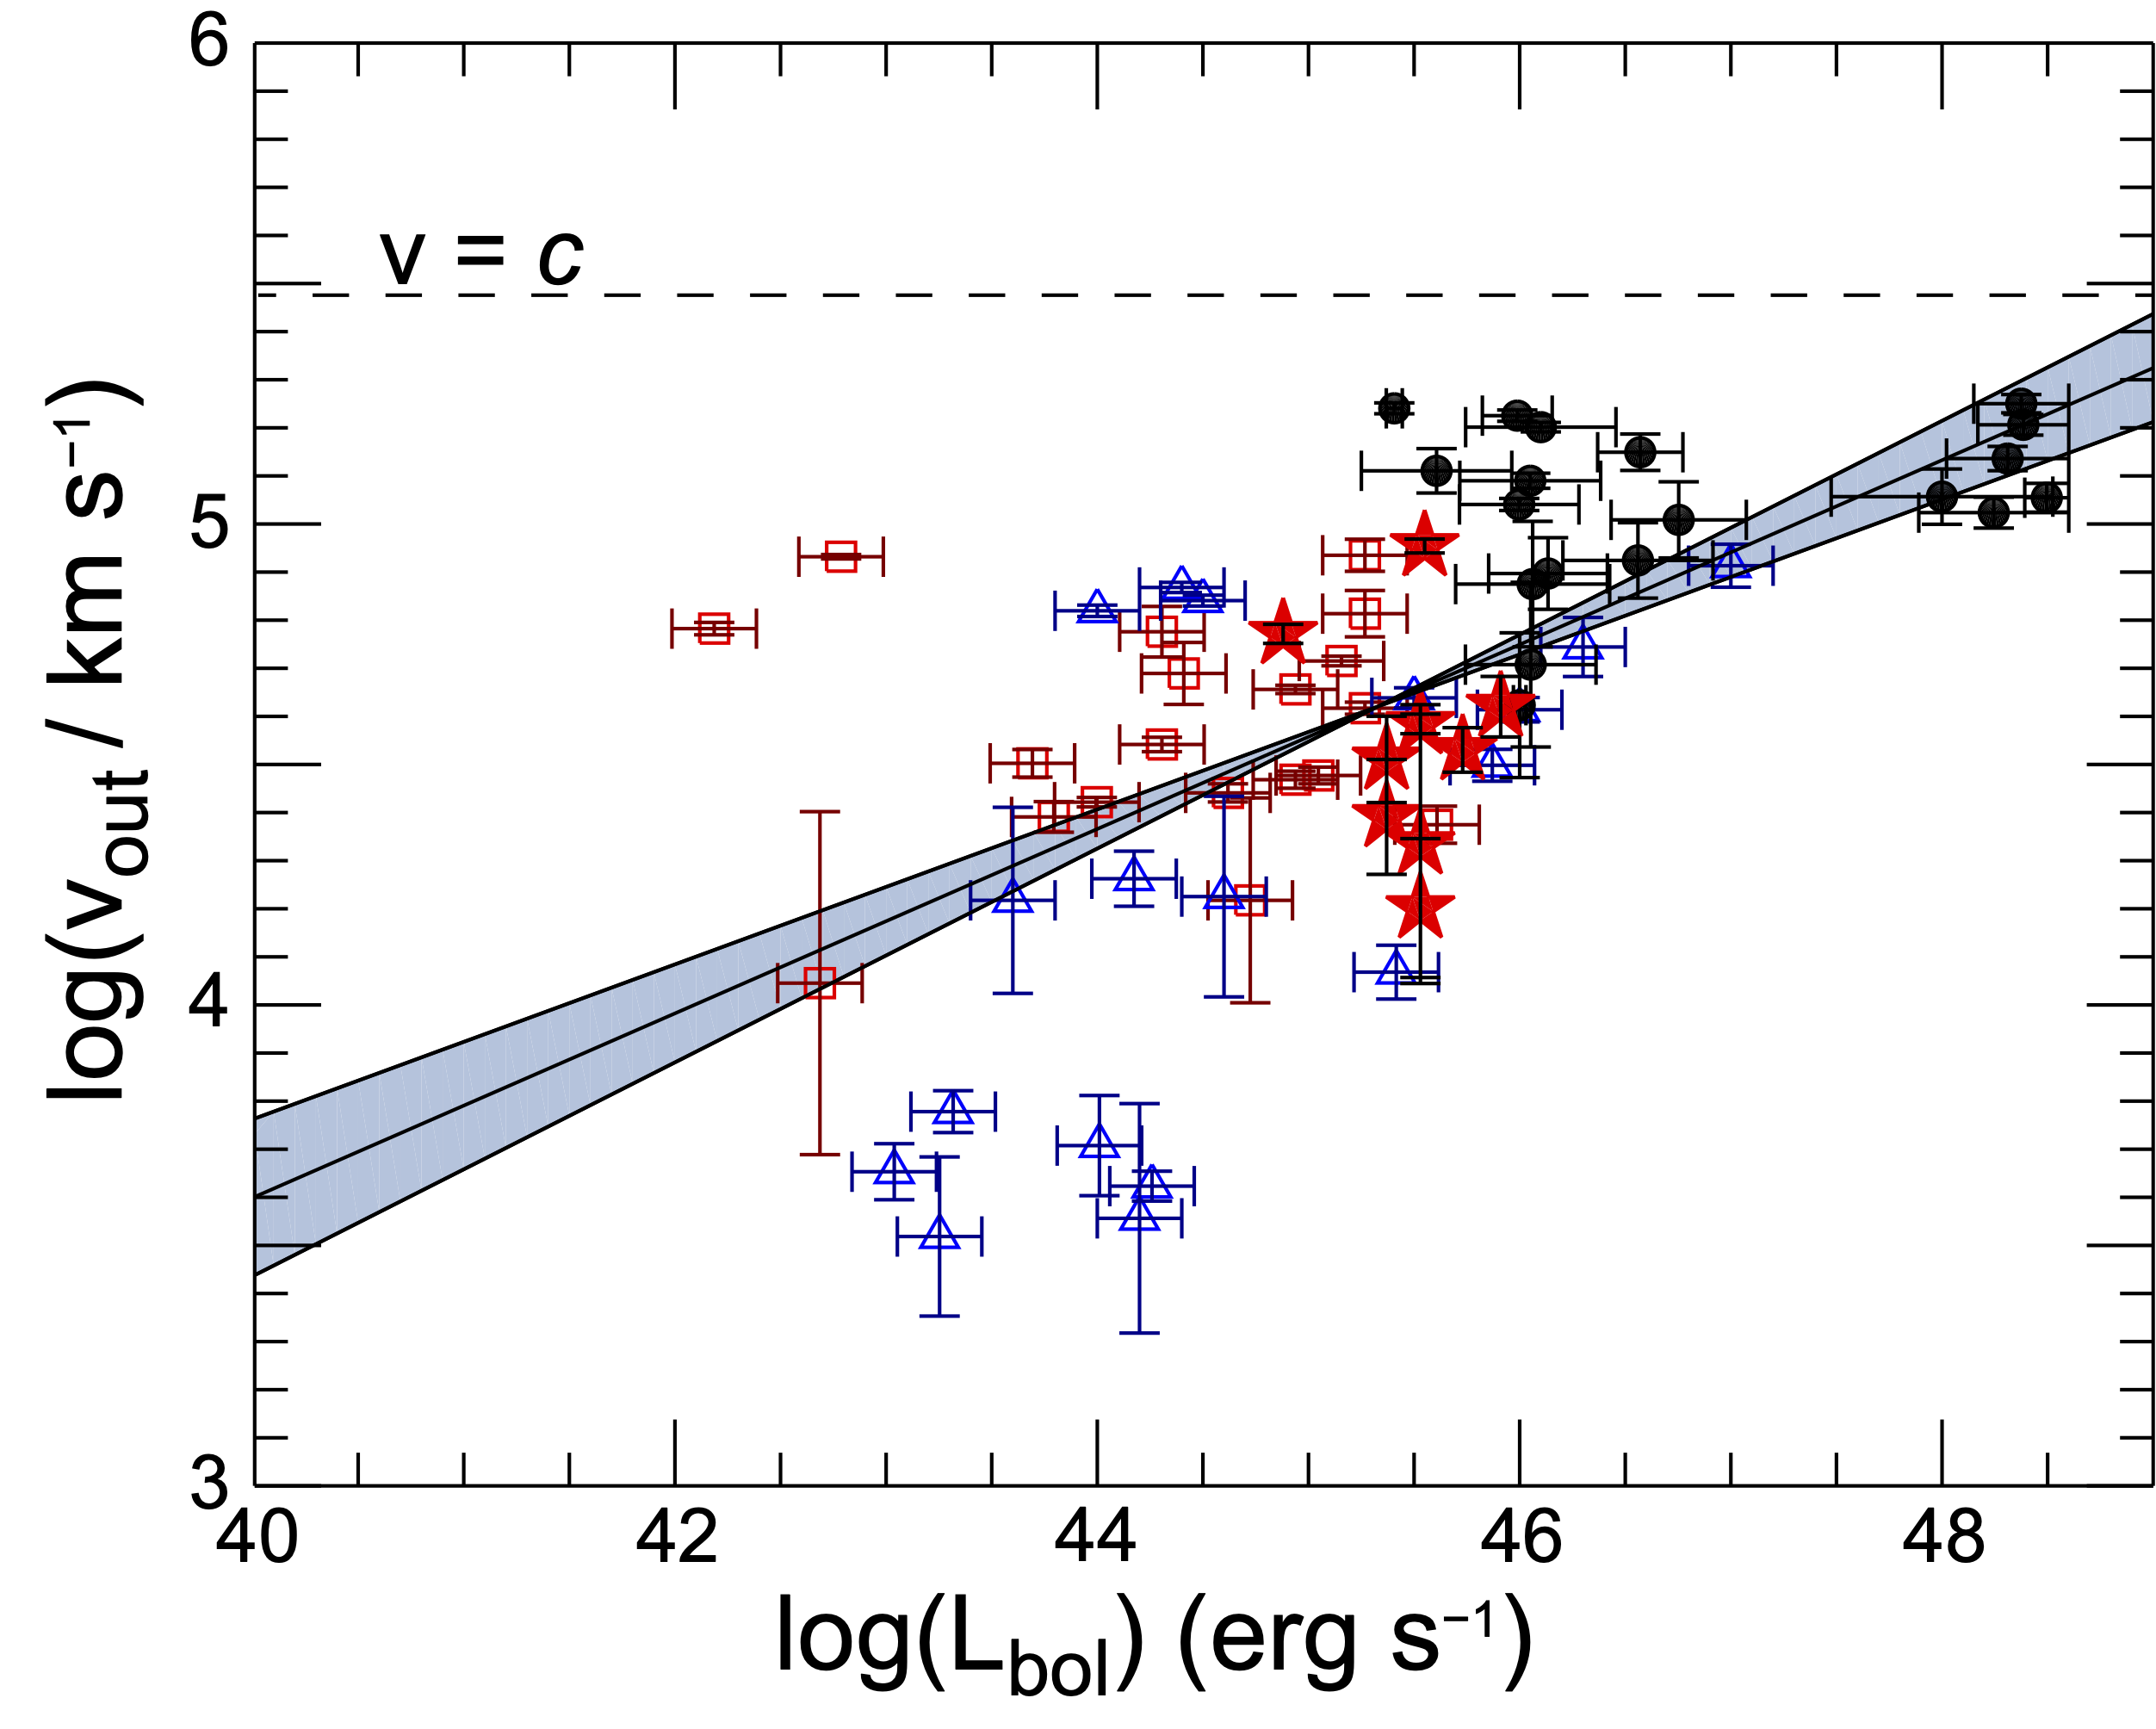
Low-z Tombesi (red squares), low-z Gofford (blue triangles) and high-z (black filled circles) AGN samples.
Matzeu et al. 2022

Slide 16
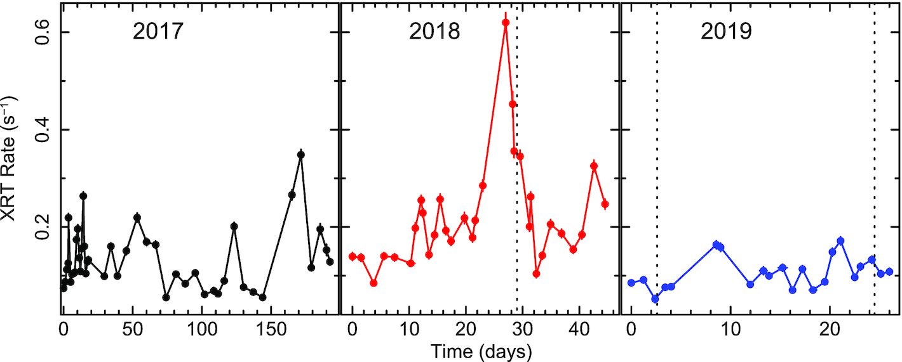
Is the corona dominating the state of the outflow (i.e. are “we” really radiatively
driven)?
Iron Abs. Feature EW in PDS 456: data from Matzeu et al. 2017 and Reeves et al 2021)…. done by me few days ago… in agreement with Pinto’s work…
But… p_{rad}~10³⁵ dyne
p_{kin}~4x10³⁶ dyne
(assuming dM/dt~μm_{p}ΩN_{H}r with r=32r_{g}=r_{esc}) ->MHD?
Reeves et al. 2021

Slide 17
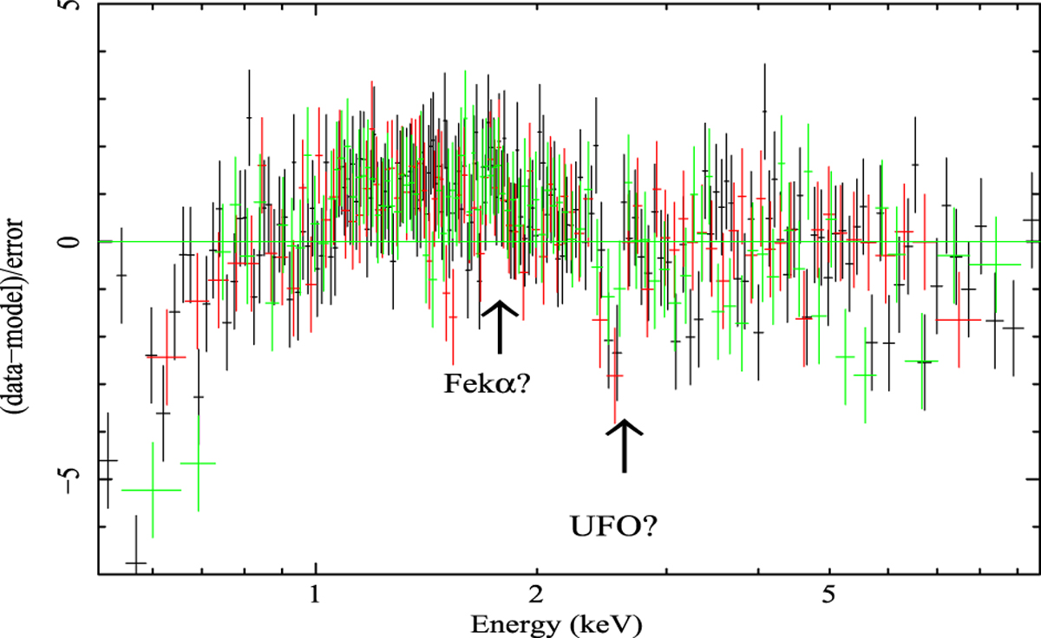
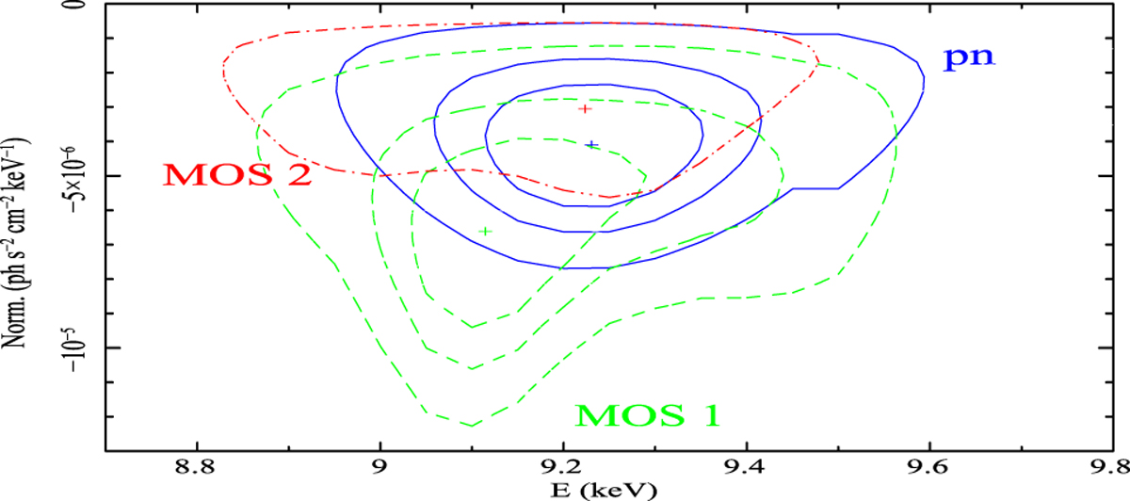
The case of (lensed) MG J0414+0534 @z=2.64 (Dadina et al. 2018)
v_{out} ≈ 0.3c.
L_{kin}~2L_{bol}
p_{kin}~17p_{rad}
R_{loud}~780
See also the case of the RQ QSO HS 0810+2554 (p_{kin}~9p_{rad}, Chartas et al. 2016)

Slide 18
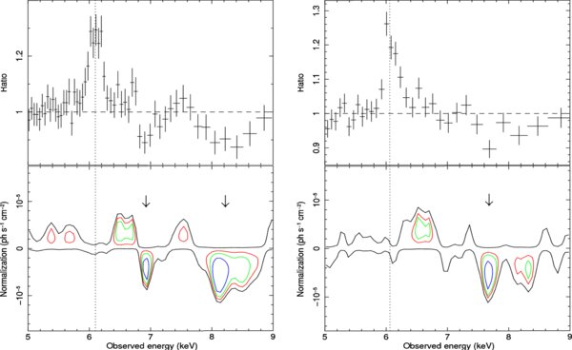
3C 111 3C390.3
Tombesi et al. 2010 3/5 RadioGalaxies (3C111, 3C120, 3c390.3) display (variable)
signatures of UFO -> v~0.04-0.15c…. Quite similar to RQ objects
- > see also Torresi et al. 2012a for a study of “classical WA outflows” in RL Galaxies
3C111-> similar to PDS 456? No UFO signature right after an outburst (Grandi et al. 2012,
Ballo et al 2011, Torresi et al 2012b). An UFO was present before…

Slide 19
Tombesi (red squares), low-z Gofford (blue triangles) and high-z (black filled circles) AGN samples.
Matzeu et al. 2022

Slide 20
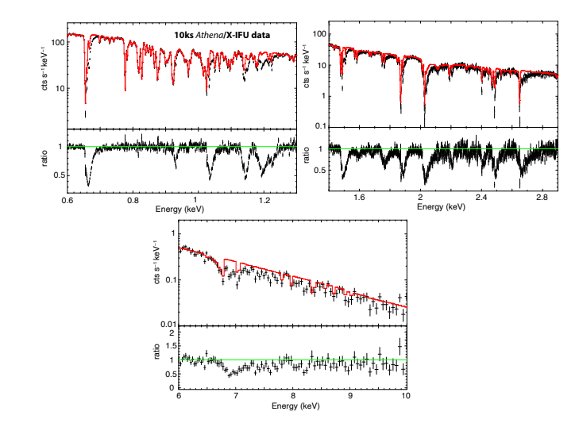
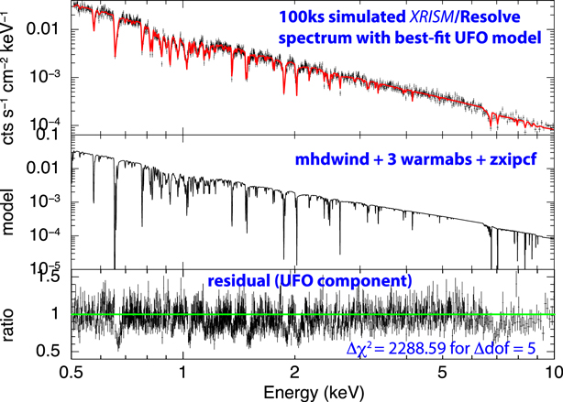
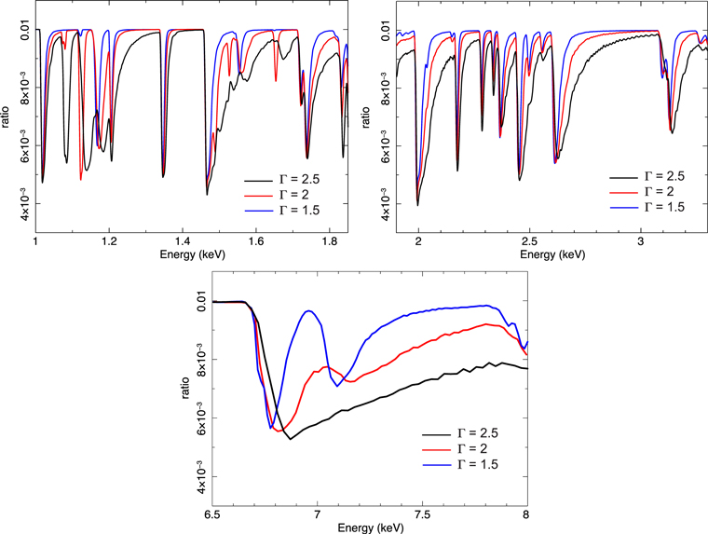
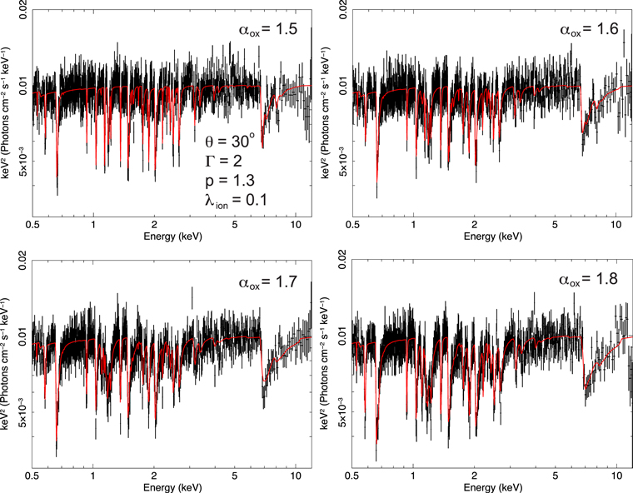
How to distinguish between DW and MHD?
High-resolution X-ray spectra?
From Sim et al. 2008, 2010
MHD (Fukumura et al. 2010, 2022)

Slide 21
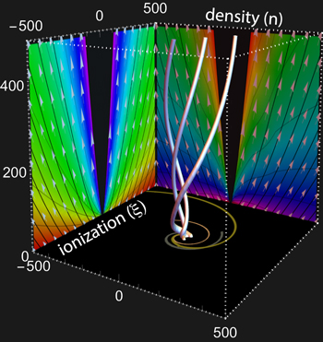
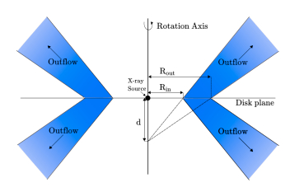
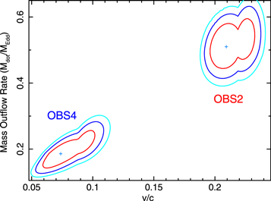
DW (Sim et al. 2008, 2010)
via XRADE, (Matzeu et al. 2022)
MHD models (Fukumura et al. 2010,
2015, 2018)
MCG-03-58-007
With new microcalorimeters on board Xrism and Athena
we should be able to measure:
Column density of the intercepted flow
The Intrinsic outflow velocity (maximum)
Mass outflow rate
The intrinsic ionizing Continuum
Inclination Angle… and so on…
Braito et al. 2022

