Slide 1
JET SIMULATIONS: RESULTS AND PERSPECTIVES
Paola Rossi, Gianluigi Bodo,
Silvano Massaglia e Dipanjan Mukherjee

Slide 2
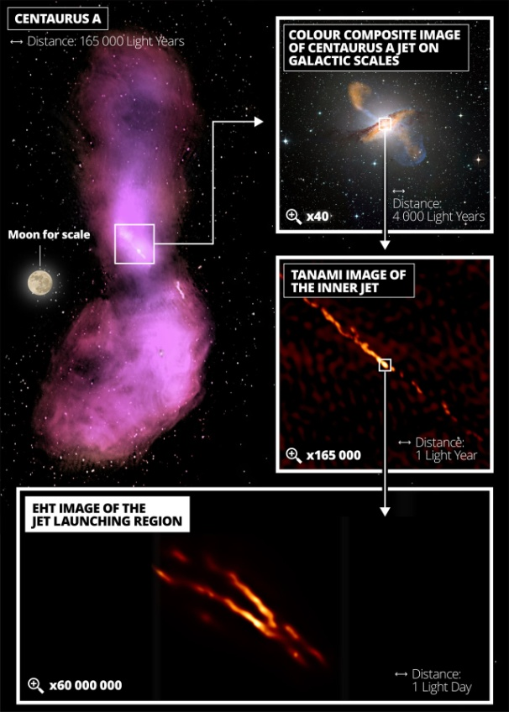
How can we approach the jet physics?
• Launching phase:acceleration
from disk and collimation
• Propagation phase:
confinement and stability
• Termination: Termination
interaction with external medium
• High-energy electron
acceleration
10¹⁵ cm
1-100 kpc
> 100 kpc (3 x 10²³ cm)
10⁴ cm

Slide 3
Multiscale approach
Turbulent propagation
up to 100 kpc
Launching region
10¹⁵ cm
Propagation region with
deceleration < 1 kpc
.
.
. .
. .
.
High-energy electron
acceleration 10⁴ cm
Termination shock,
hot spot
Propagation region with
No Deceleration 1-100 kpc

Slide 4
Deceleration
Our purposes are to study
How entrainment develops
pc
kpc
Constant external density
inside the galaxy core
10
-2
-4
10
,10
43
45
10
,10
erg s
-1
M=2,subrelativistic jet

Slide 5
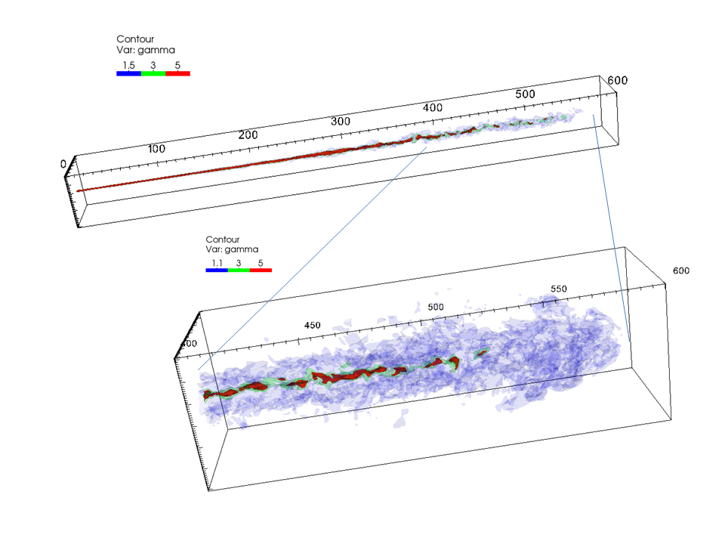
Jet instabilities: growth length-scale increases
with Lorentz factor and Mach number
Non linear growth
Mixing and mass entrainment
Jet deceleration
I ricollimation shocks
II growth of instabilities
III mixing and jet breaking

Slide 6
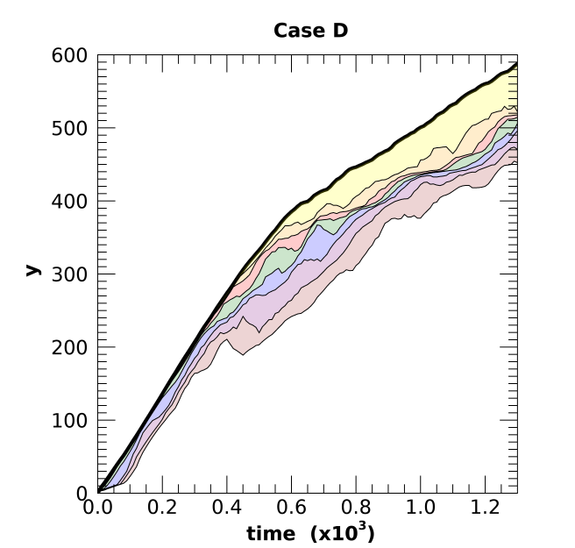
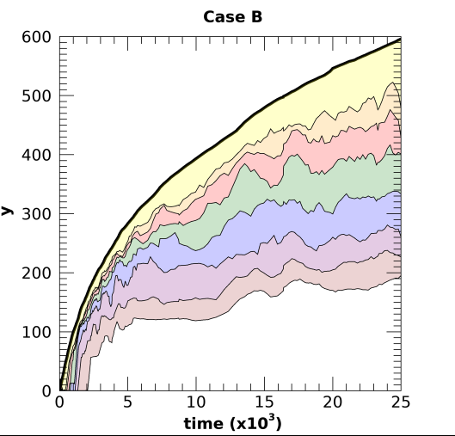
Each curve shows, as a
function of time, the distance
up to which relativistic material
(γ>5) carries more than certain
fraction of the initial momentum
flux: 70%,60%,50%......10%
Strong deceleration
Strong entrainment
Steady state
Time unit:
Weak deceleration
Weak entrainment
No Steady state
Rossi et al. 2008, 2020

Slide 7
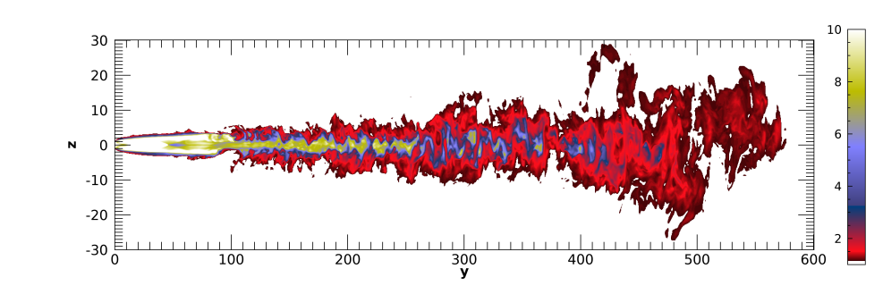
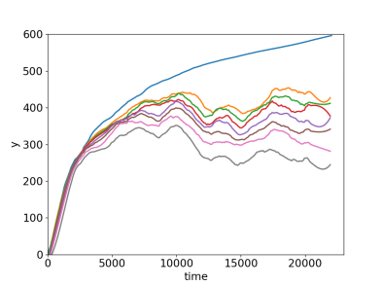
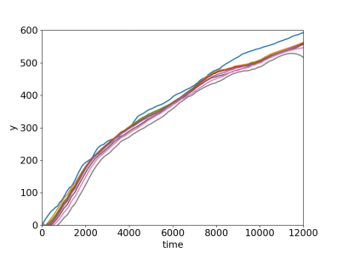
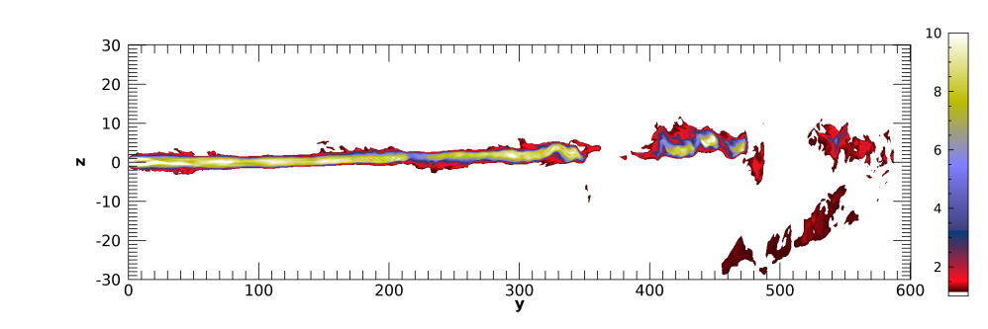
Magnetic effects
Magnetic field reduces
entrainment, stabilizing
KH inst. .
New inst. (current-driven)
starts deforming the jet
without deceleration.

Slide 8
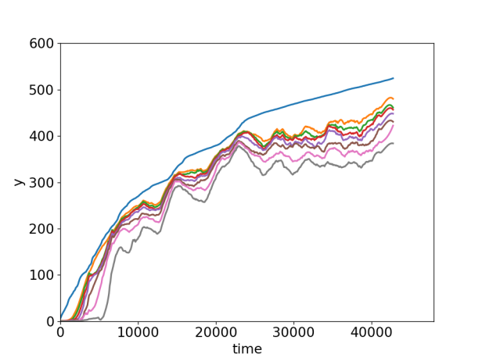
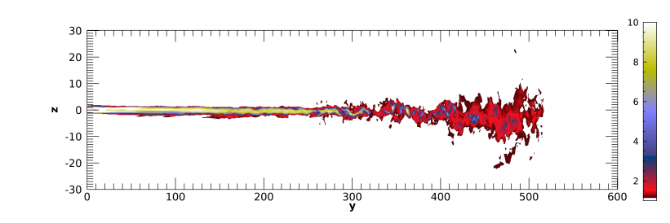
Why in lower power jets entrainment starts later?
It could be because there are weaker recollimation shocks
and recollimation shocks promote instability.
When does deceleration occur?
We can have deceleration in the first kpc
for low power jets,
with low magnetic field
Rossi et al. 2023

Slide 9
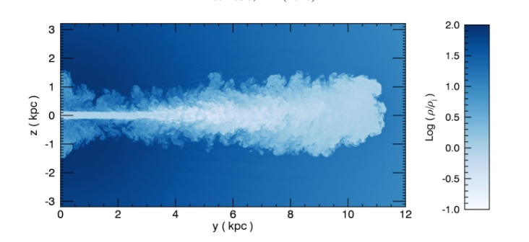
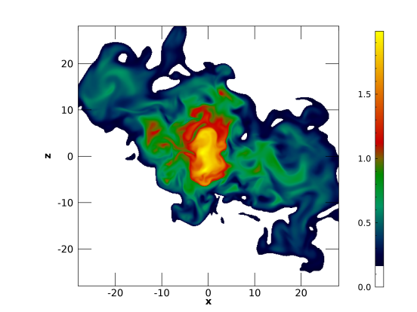
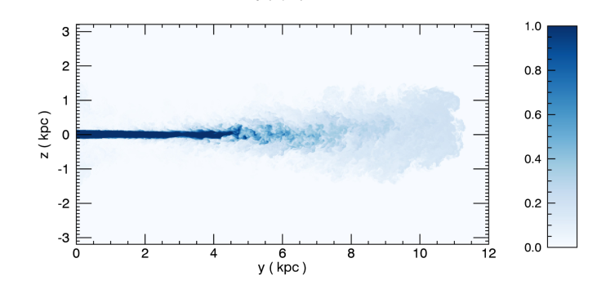
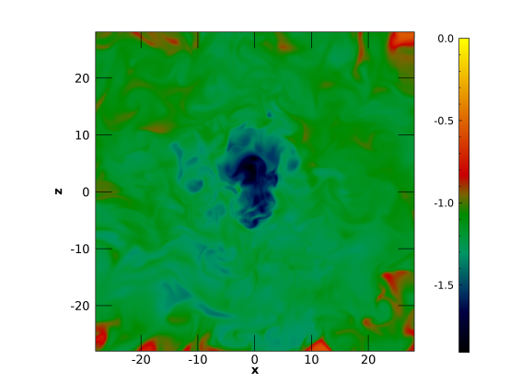
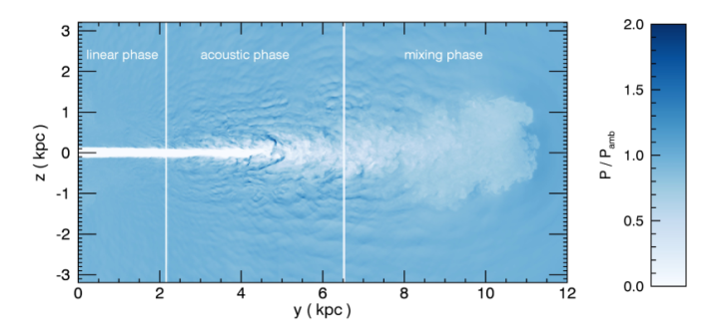
Turbulent propagation starting from 1 kpc
density
Mach number
Initial conditions:
tracer
We perform a set of simulations with similar conditions
Density
(0.06 c)
pressure
Non-relativistic with 3 different
external density stratification
(Massaglia et al. 2016)

Slide 10
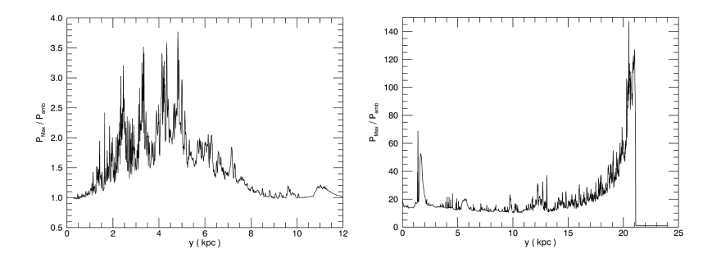
M=40 (0.6 c)
Results from HD simulations
3D is crucial for the jet evolution in 2D there is not turbulence
Ambient stratification and jet/ambient pressure ratio are not crucial
Transition jet kinetic power FRI to FRII:
Transition Mach number about 10
Jet energy dissipation via entrainment and acustic waves: feedback in radio galaxies
M=4
M=40
No hot spot
Hot spot
High pressure shocks enhanced emission

Slide 11
Magnetic effects

Slide 12
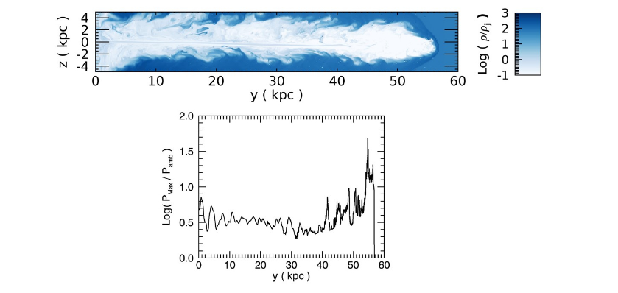
M=6 (0.1 c)
b=0.5 (about 100 mG)
Magnetic effects
b = pressione gas/pressione magnetica
M=19 (0.3 c)
b=0.5 (about 100 mG)
Assuming the emissivity proportional to P B² we
can get brightness maps

Slide 13
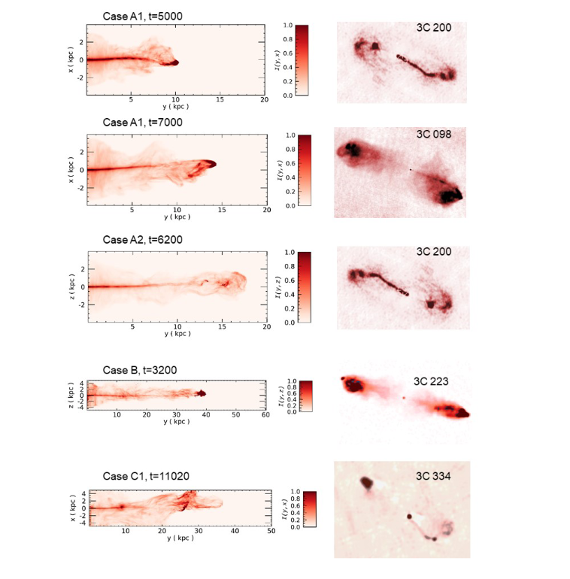
Results from MHD simulations
In the initial phases jets produce small FRIIs sizes < 5 kpc
Large values of b parameter (weak magnetic field) enhance the initial jet collimation , the final evolution is FRI (weak sources) or FRII(strong sources)
Small values of b parameter (strong magnetic field) produce strong non axially symmetric modes (bending, wiggling , ect), resulting in complex morphology.
Massaglia et al. 2019,2022

Slide 14
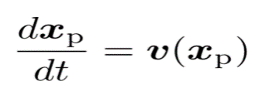
What about radiative processes?
Jets with new hybrid scheme: macro-particle* + fluid
*to each macro-particle we associate a
distribution function of non-thermal
relativistic particles
Macro-particles move at the fluid velocity
Evolution equation for the
distribution function
+
Energy losses, synchrotron, inverse compton
Sub-grid model for acceleration at shocks (we take into account shock strength, orientation of magnetic field etc.)
Synchrotron radiation

Slide 15
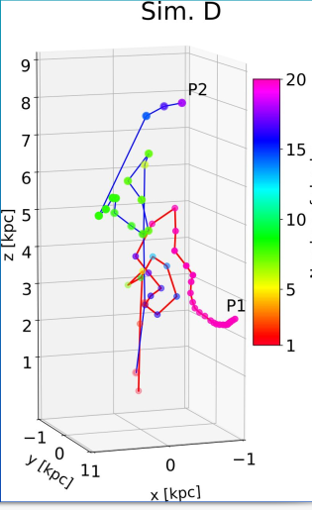
Number of shocks
Colors indicate
article ages (times
since injection)
Colors indicate
maximum energy
(connected with shocks)
Particles get energized at shocks
Shocks are inside the jet spine,at jet –head snd in the cocoon
Complex trajectories
Mukherjee et al.,2020,2021

Slide 16
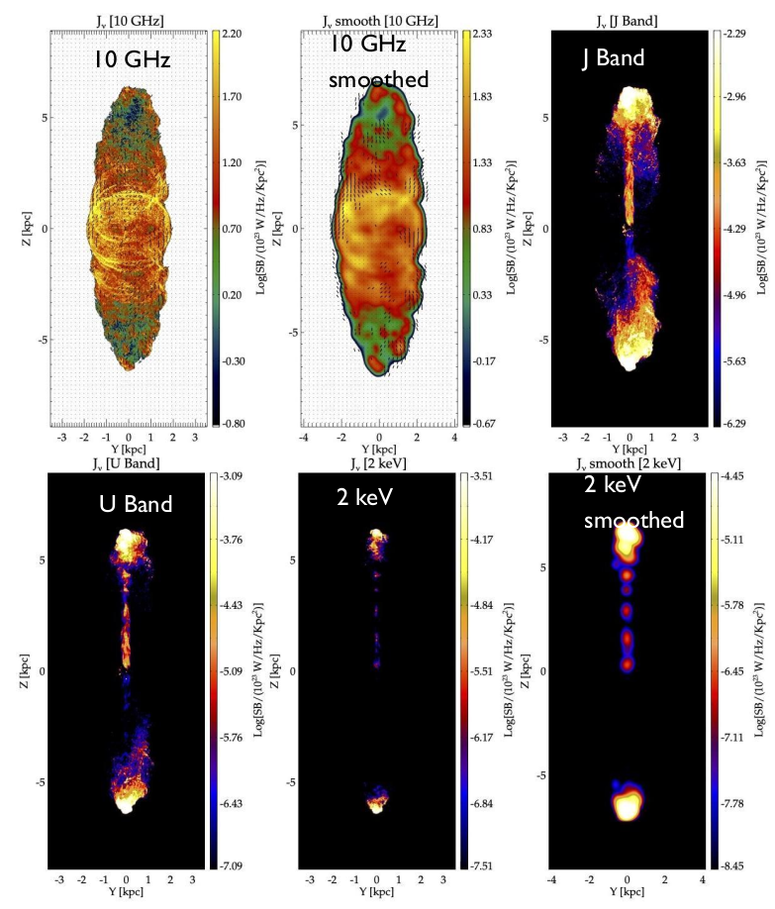
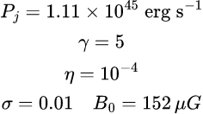
Simulation parameters
K-H unstable

Slide 17
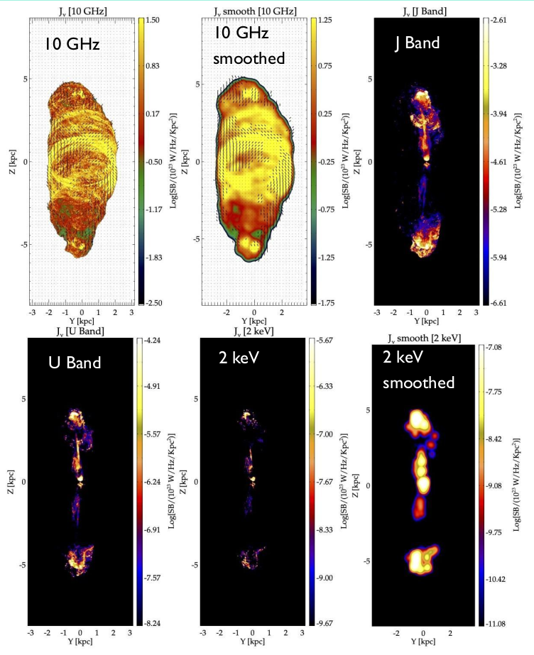
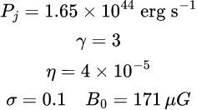
Simulation parameters
Current-Driven unstable

Slide 18
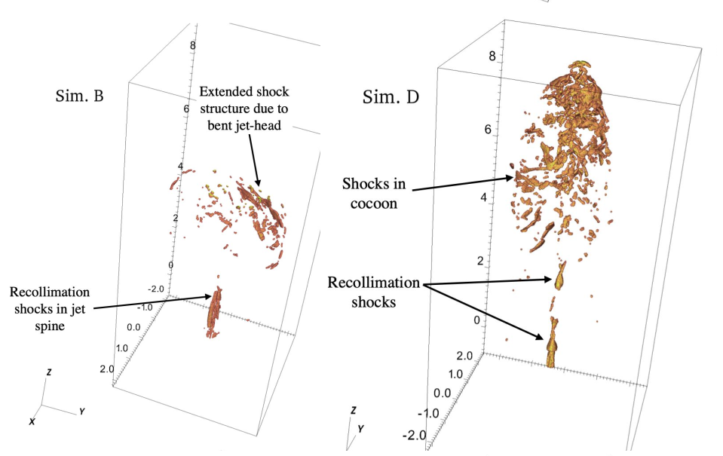
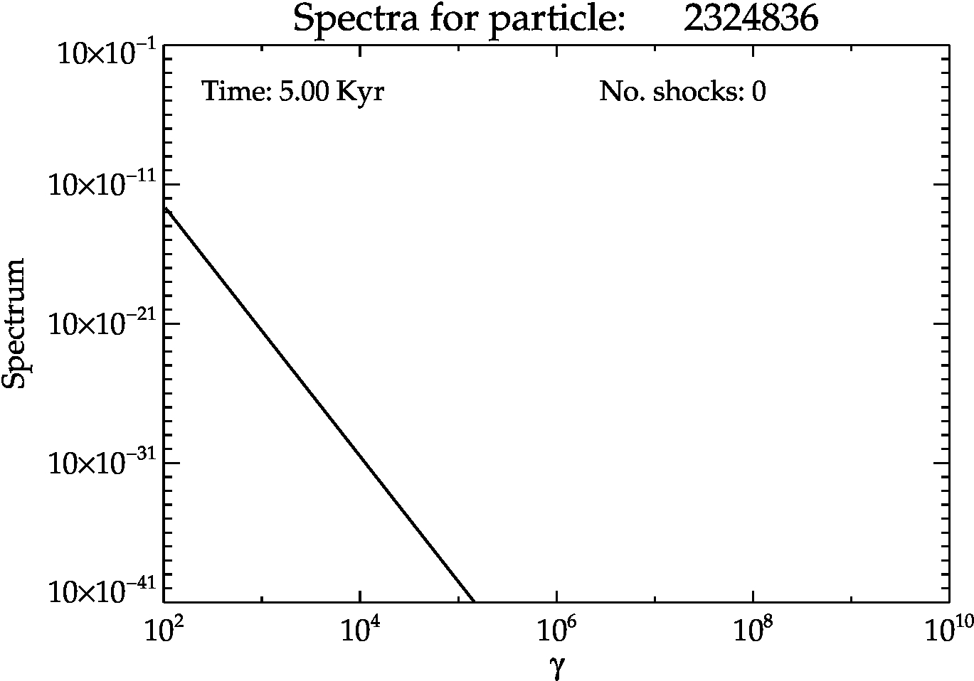
Kink unstable jet
KH unstable jet
Kink vs KH
The nature of the shock acceleration is fundamentally different between Kink unstable and KH unstable jet
Kink unstable jet have extended terminal shocks
KH unstable jet have weaker internal shocks all through the coccon

Slide 19
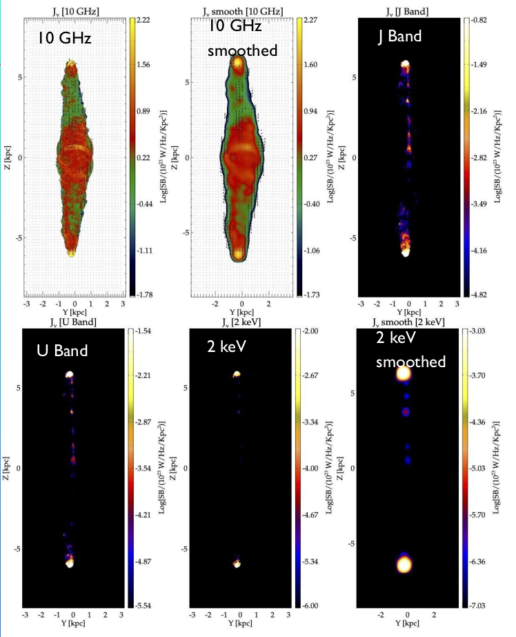
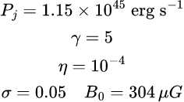
Simulation parameters
Stable jet

Slide 20
Some considerations
Low power jets be decelerated from relativistic to sub-relativistic velocities as a consequence of entrainment due to KH instabilities.
The radio source morphology does not depend on jet power only, but also magnetic field and density ratio play important roles
The magnetic field on one side stabilizes KH instabilities, on the other it leads to Current Driven (Kink) instabilities. Low and intermediate power jets with strong magnetic field can develop complex and variegated morphologies
The different instabilities play important role also in higher power jets and in the evolution of non-thermal particles.

Slide 21
…. perspectives
Adopting injection conditions more in agreement with acceleration models, more proper velocity structure (spine+wind)
New developments in the particle module (PLUTO code):
- particle acceleration from magnetic reconnection and turbulence
- feedback of relativistic particles on the fluid
- treatment of synchrotron self compton
- …..
Thank you!!!

