Slide 1
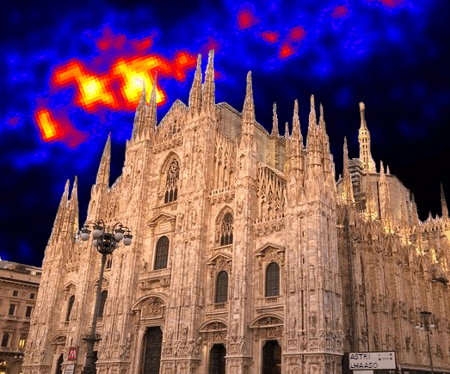


Multi-messenger astrophysics
Maurizio Spurio
Università di Bologna and INFN
maurizio.spurio@unibo.it

Slide 2


Multimessenger probes: two/three communities
2
Three large experimental branches
Gravitational waves (GWs), observed using laser interferometers
GWs
CR
Charged CRs
Antimatter
Neutrinos
γ−rays
p⁻ e⁺
γ
Individual quanta (CRs, antimatter, γ -rays, and ν, with experimental methods born in high-energy physics laboratories
The electromagnetic radiation, from radio to X-rays, with techniques developed by astronomers

Slide 3
Multimessenger: two communities
3
TeV cm⁻² s⁻¹
W m⁻²

Slide 4
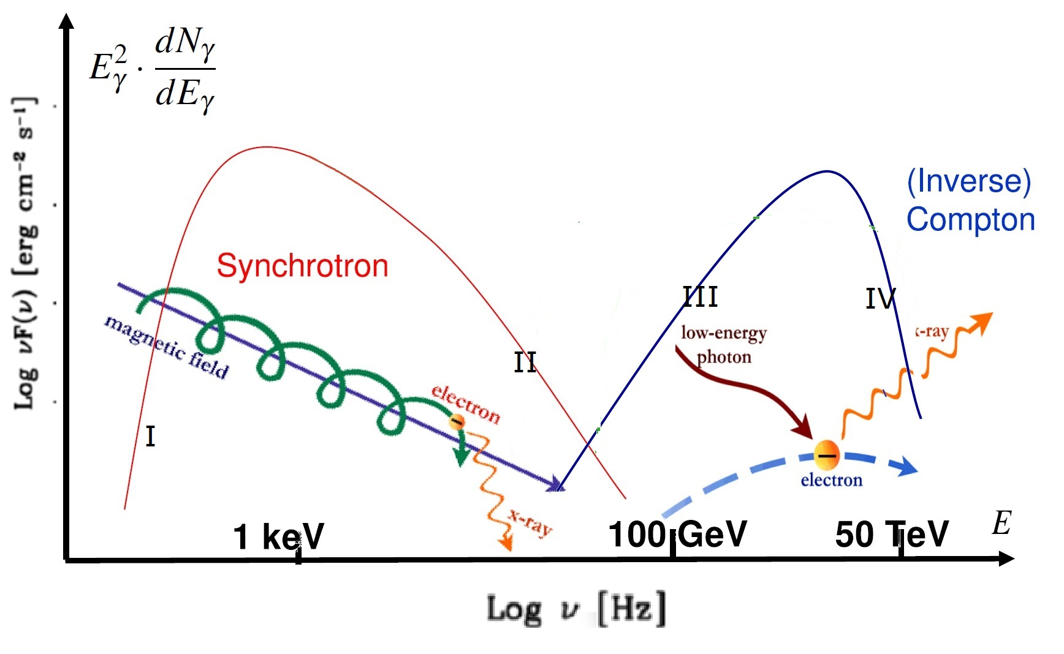
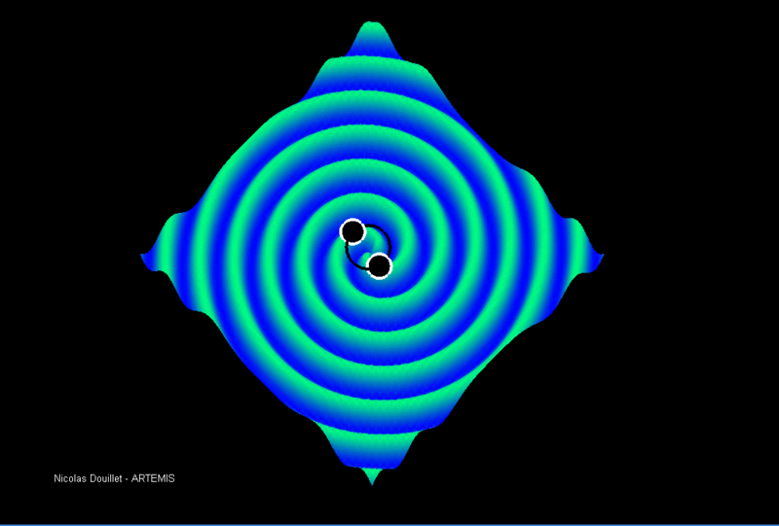
Multimessenger: two leading actors
4
electrons
hadrons
GWs
(F. Halzen)
CR
p⁻ e⁺
γ

Slide 5
Multi-messenger synergies
5
X-ray telescopes: Swift, INTEGRAL, SVOM, ATHENA…
- Provide transient triggers (GRB, AGN, Novae…)
- ToO program
γ-ray telescopes: Fermi-LAT
- All-sky complete monitoring
- Provide also transient triggers
Optical telescopes: TAROT, MASTER, LCOGT, ZTF, LSST…
Easy access follow-up
large error box
Characteristation of potential counterpart with spectroscopy (nature, redshift…)
VHE γ-ray telescopes:
HAWC, LHAASO…
- All-sky monitoring
- Provide triggers
HESS, MAGIC, CTA…
- Follow-up (not easy access)
Neutrino telescopes: ANTARES, IceCube, KM3NeT, GVD…
Mutual follow-up
Confirmation of sources, improve significance
Radio telescopes: Parkes,
MWA, Lofar, Nenufar, ASKAP, SKA, VLBI…
- Provide triggers (FRB…)
- Follow-up

Slide 6
Energy density
ν
At the UHE the radiance in neutrinos is larger than the energy in gamma rays

Slide 7
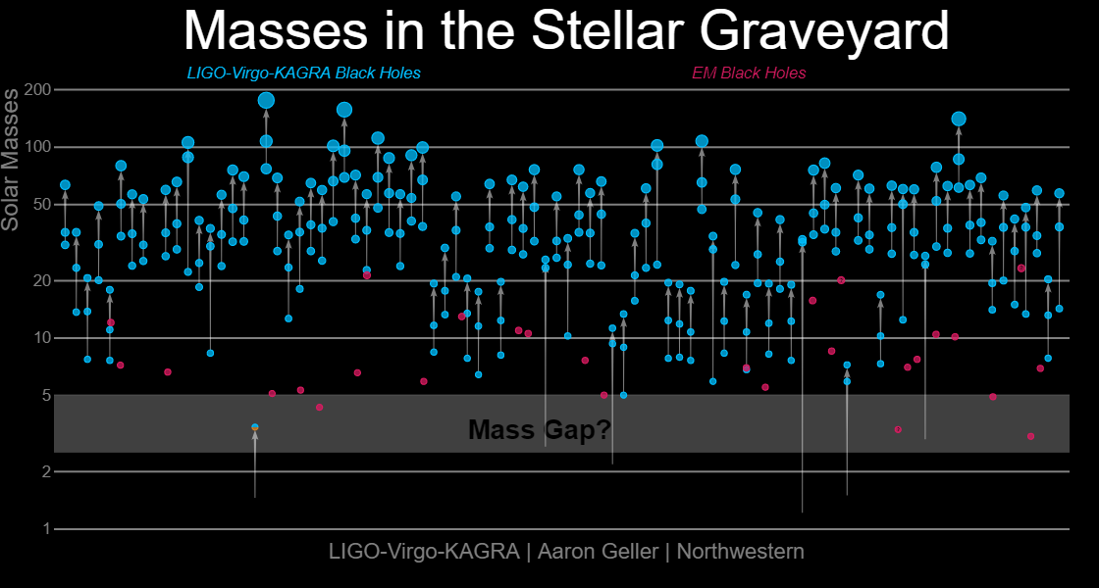
Multimessenger: prejudices
7
Experimental facts:
  EM and radiations (mainly originated by accelerated electrons) observed from different Galactic and extragalactic sources
  Charged CRs (mainly protons and nuclei) observed, as originated by Galactic and extragalactic sources
Then, the two phenomena should have a common origin.
So far, this is not confirmed by strong observational evidences either for Galactic and extragalactic objects
Remember: before 2015, very few (or no one) suspected the existences of >30 M_{sun} BHs
Consider: GRB170817A would have been totally irrelevant without GW170817

Slide 8
Multimessenger studies
{
}
EM
Experiments
Field-of-view
Effective area
Visibility conditions
Duty cycles
Time response
Sky visibility
Horizon
….
Different combinations for the study of the
Galaxy
Local region
Local Universe
Cosmology
CR
Charged CRs
Antimatter
Neutrinos
γ−rays
p⁻ e⁺
γ
GWs

Slide 9
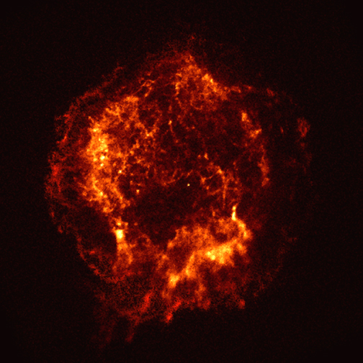
CRs, γ-rays and ν: intrinsically multimessenger
9
radiation fields and matter
p
CR
ν
π±
p⁻ e⁺
p
γ
π⁰
protons/nuclei
electrons/positrons
e±
γ
γ
Inverse Compton
(+Bremsstr.)

Slide 10
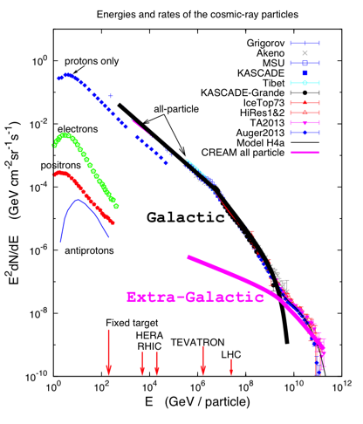
Energy radiance
How Galactic CRs are accelerated?
Where are they originated from?
How do they propagate in the ISM?
The comparable energy content of these three fluxes is intriguing for UHECRs origin
Common sources?
Common production mechanism?
ν sources could be mainly opaque to γ-rays
Ackermann et al, Snowmass 2022

Slide 11
The quest for galactic hadron sources
11
IACTs and ground arrays have reported >100 Galactic sources (Supernova Remnants, Pulsar Wind Nebulae, Binaries, Nova, ….)→ http://tevcat.uchicago.edu/
GeV-TeV 𝛄-ray observations as a potential guide
LHAASO report 𝛄-rays with up to PeV range
Emission measured from many 𝛄-ray sources seems leptonic-dominated but there are indications of hadronic components (IC443, W51, RXJ1713 (?)…)

Slide 12
The neutrino telescope world map 202*
12
ANTARES
0.01 km³
2008 –2022
GVD/
Baikal
1 km³
R&D – P-ONE
arXiv:2005.09493
KM3NeT
1+0.01
km³
R&D - TRIDENT
arXiv:2207.04519
IceCube
Deep ice 1 km³
2011 –
www.globalneutrinonetwork.org

Slide 13
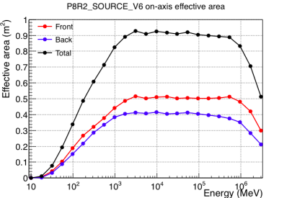
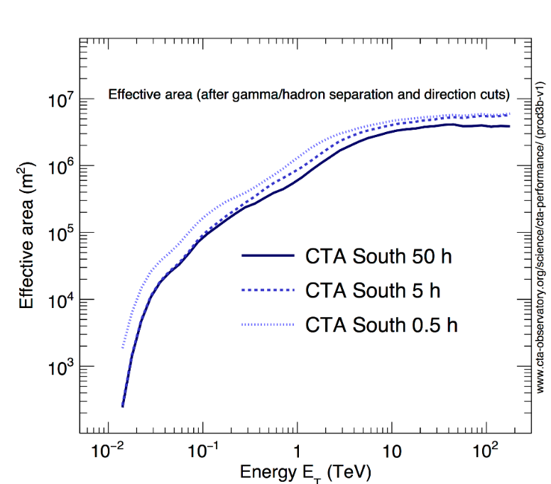
γ-ray effective area and horizon
γ
Fermi-LAT effective area vs. E
Extragalactic γ-rays
above the line, degrade in energy, and contribute to the diffuse (1-100) GeV background
100 TeV→100 EeV: Local cluster
4 Mpc
CTA Effective area
10 kpc
0.3→30 PeV: Galaxy

Slide 14

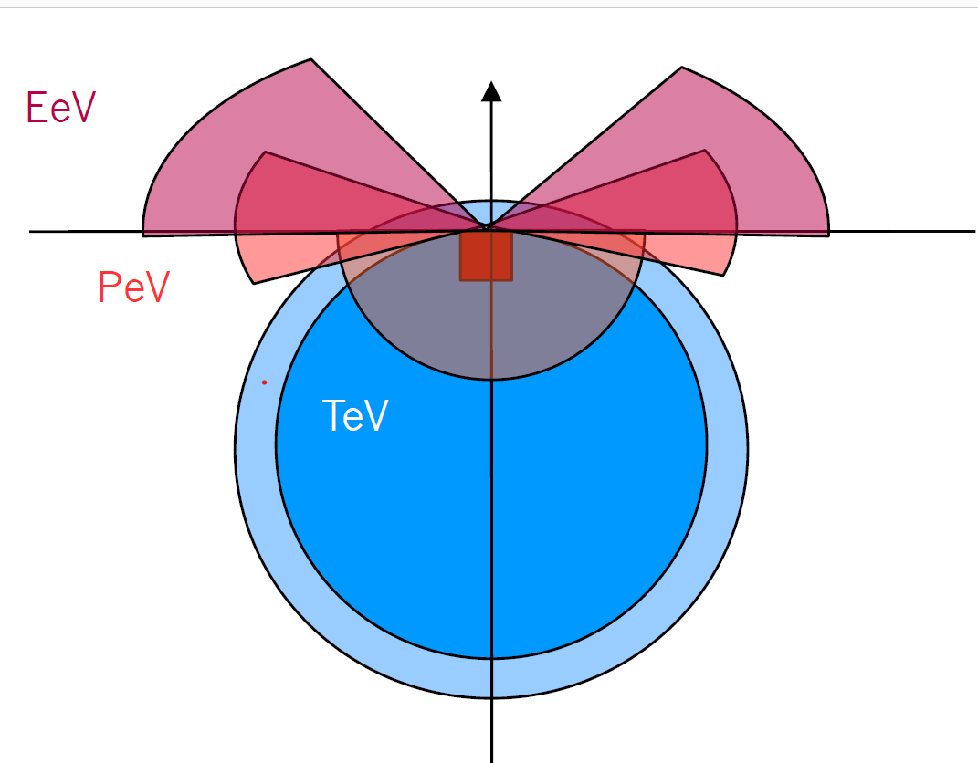

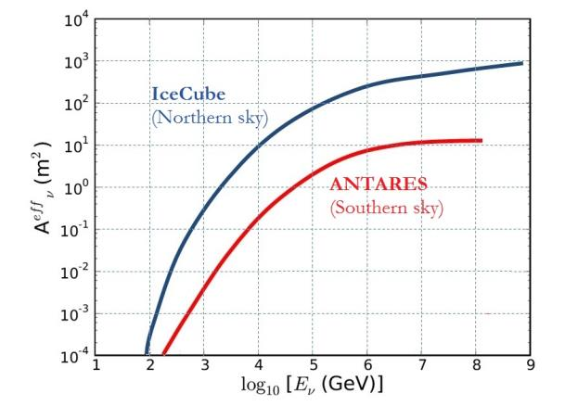
Detecting ν: effective area + angular resolution
Neutrino sky
2π of the sky: upgoing neutrinos, almost 100% duty cycle;
Effective area A^{eff}= function[(t,s); ν energy; analysis cuts;δ]
Angular resolution: O(0.1º) for upgoing tracks
CTA
KM3NeT
J. Phys. G. 43 (2016)
Effective area
Neutrino detectors
upgoing tracks

Slide 15
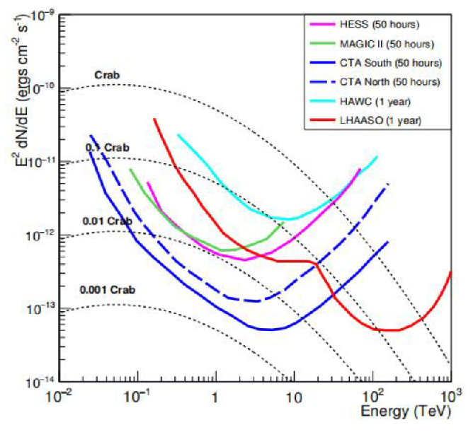
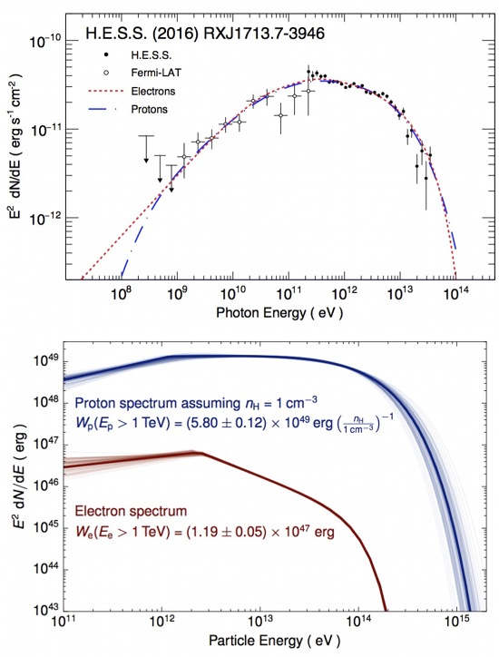
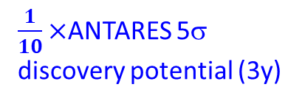
Sensitivity for a Galactic source
γ
Chin. Phys. C, 46, 035002 (2022)
RXJ 1713-3946
Fermi-LAT+ HESS
$\frac{1}{10}×$ANTARES 5σ discovery potential (3y)

Slide 16
Angular resolution of neutrino telescopes
16
KM3NeT cascade
= better energy resolution
KM3NeT Track
= better angular resolution
IceCube
track

Slide 17
Connecting network: EM, GW, ν, γ

Slide 18
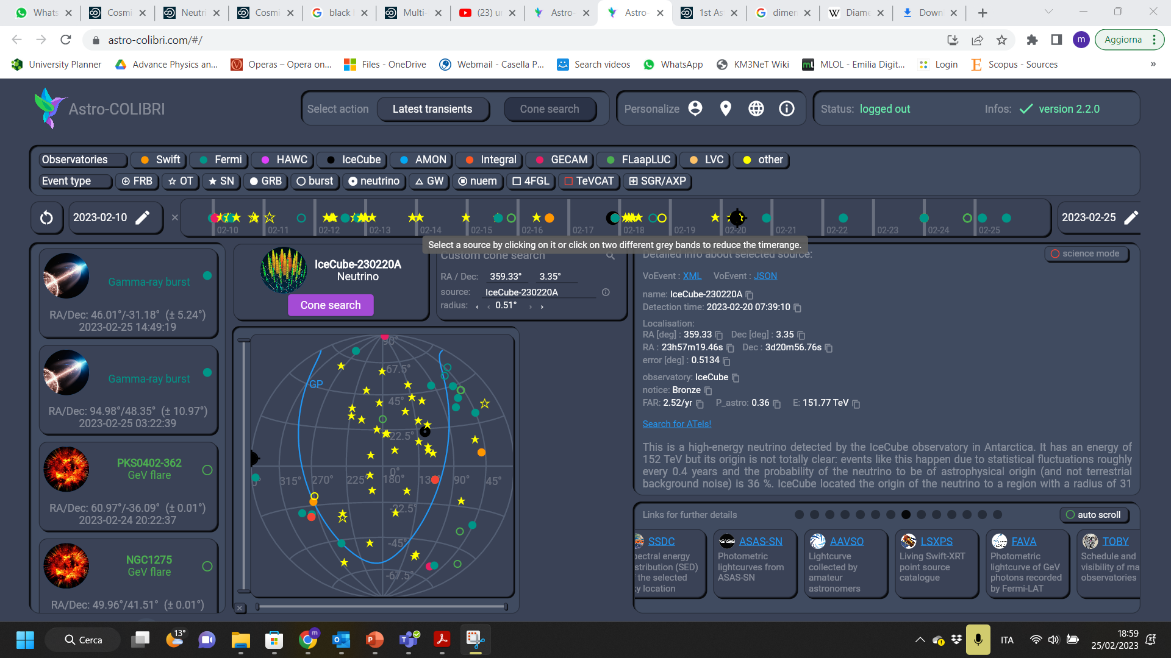

Slide 19
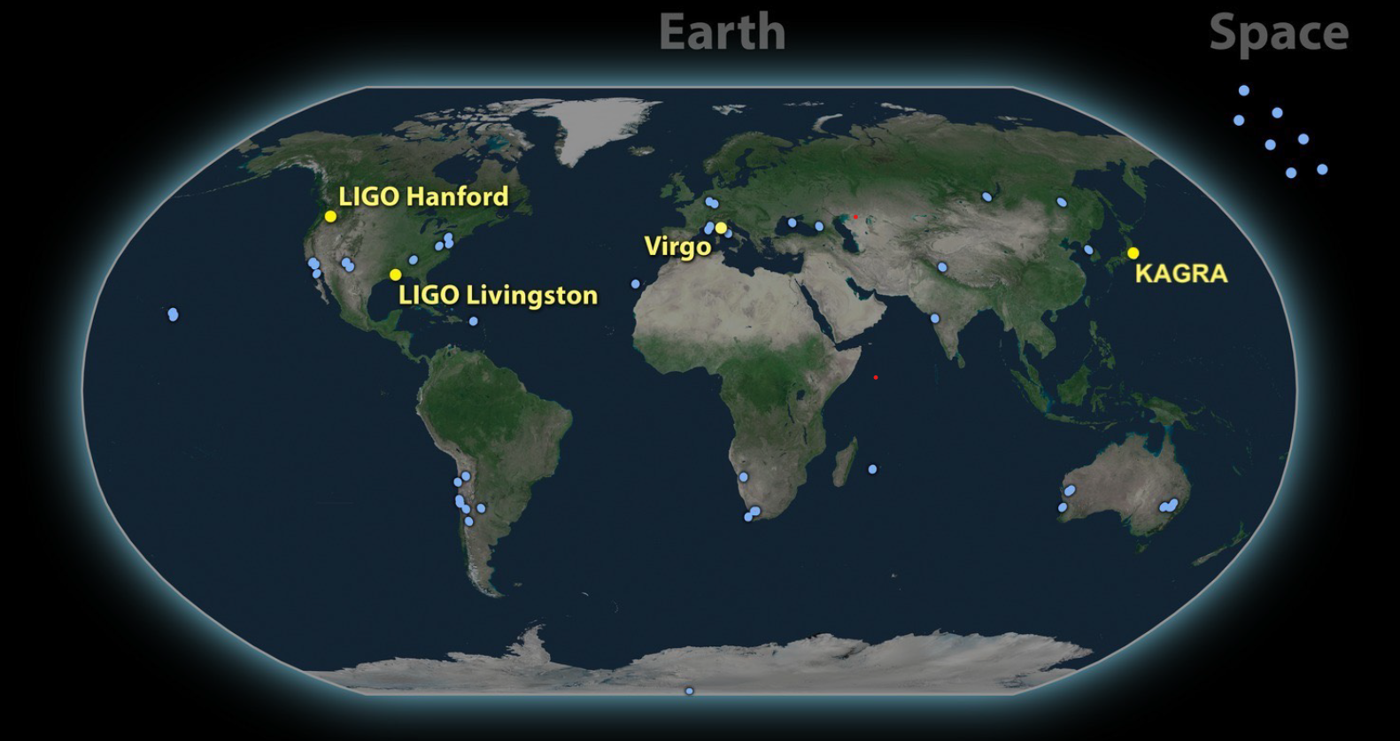
GW Observatories
19

Slide 20
Gravitational wave alert distribution in O4
20
https://emfollow.docs.ligo.org/userguide/analysis/searches.html
Embedded multi-messenger analysis: spatial- and temporal-coincident, assigning a FAR to the coincidence.
RAVEN: online pipeline search between GW events with alerts for GRBs and galactic supernova alerts (SNEWS)
LLAMA: online search pipeline combining IceCube HEN triggers

Slide 21
KM3NeT ν alert distribution
21

Slide 22
Conclusions
22
The study of the Universe with probes different from the EM radiation has only recently reached its maturity. Multimessenger astrophysics is the joint effort to understand HE phenomena using CRs, γ-rays, neutrinos, gravitational waves, in addition to EM radiation.
Multimessenger is a difficult task due to the differences in the experiments (visibility, duty cycles, sensitivity, time response,…). Information brokers are of fundamental importance.
Electrons and hadrons are at the origin of EM radiation and ν’s, respectively. IceCube do not see our own Galaxy, but the Universe: the Galaxy is so-far a neutrino desert
In the extreme universe more energy seems to be emitted in neutrinos than in γ-rays
Neutrinos seems to be produced in sources obscured to HE γ-rays: this is unexpected and represents a great opportunity for a “new” astronomy.
New actors (LHAASO, CTA,KM3NeT, IceCubeGen2,…) will play a fundamental role for this
Today, astroparticle physics with multimessenger probes is paving the way for the future of particle physics, after the next generation of collider.
Only knowing the beams (=accelerators and space medium), we will have the opportunity to study the underlying properties of particles and interactions

Slide 23
Spares
23

Slide 24
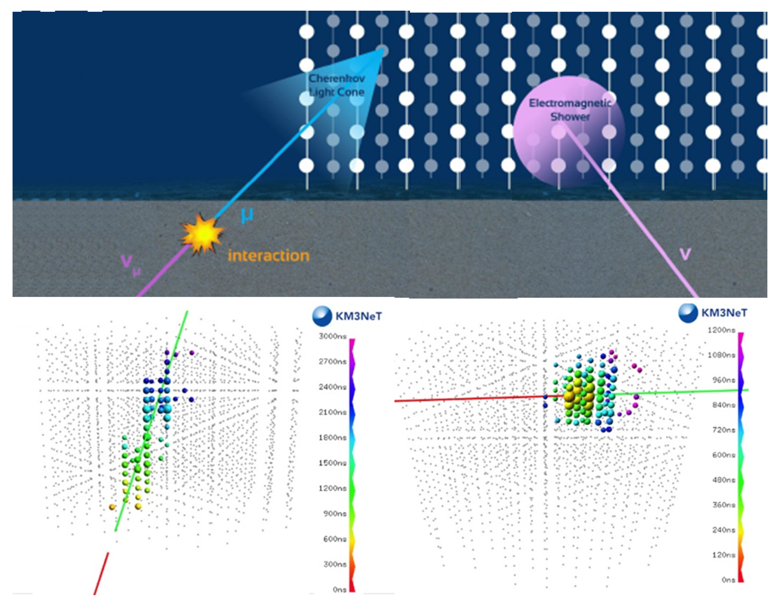
Event topologies in neutrino telescopes
KM3NeT expected angular resolution: Tracks
Track
=better angular resolution
Cascade
= better energy resolution

Slide 25
Time domain: ν vs. γ
From K. Murase

Slide 26
https://astro-colibri.science/

Slide 27
Instrument sensitivity (O3b)
27
In O4, expected ${10}_{−10}^{+52}$ BNSs and ${79}_{−44}^{+89}$BBHs
Almost twice the events in Gravitational-wave Transient Catalog after O4

Slide 28
The atmospheric neutrino background
28
EPJ 73: 2606 (2013)
PLB 816: 136228 (2021)
ν_{μ}
Atmospheric ν_{μ} and ν_{e} energy spectra can be measured
– energy estimation
– detector systematics
ν_{e}
Atm./Cosmic transition: 30-200 TeV
Notes:
Honda et al. 2007 (https://journals.aps.org/prd/abstract/10.1103/PhysRevD.75.043006)
Enberg et al. 2008 (https://doi.org/10.1103/PhysRevD.78.043005)

Slide 29
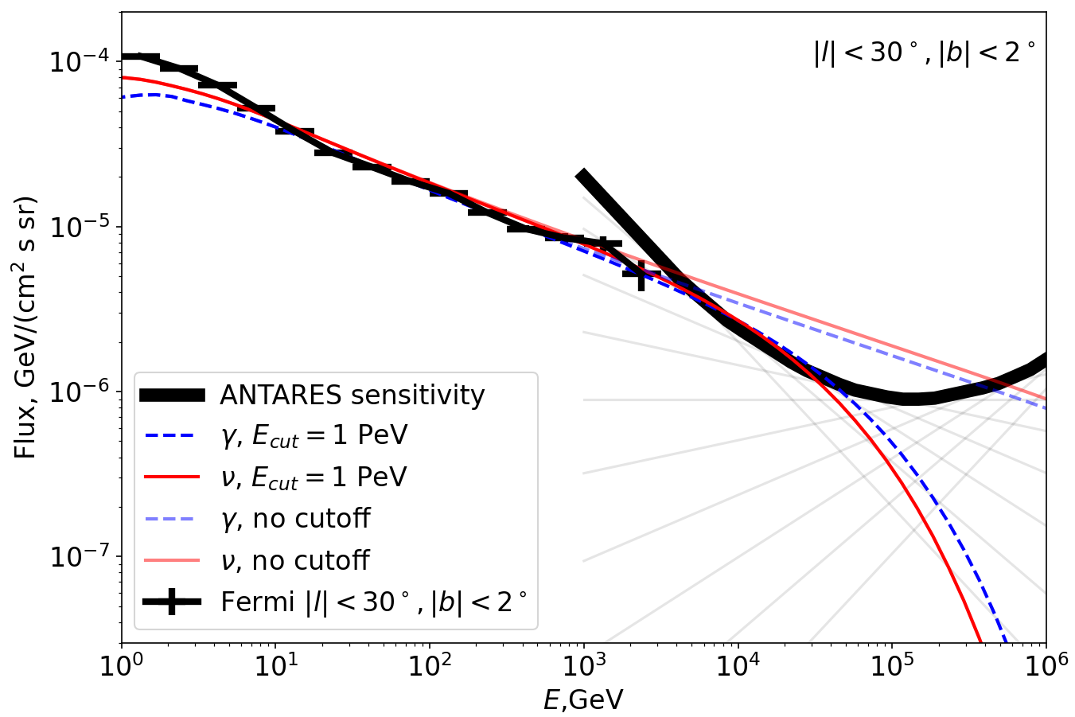
Search for diffuse flux from Galactic ridge
29
PLB 760 (2016) 143
ApJ 868 (2018) L20
new paper in preparation
A neutrino signal is expected from the Galactic Ridge, as suggested by gamma-ray data
ν flux relates to the spectrum of primary CRs, if CR flux does not have a cut-off below 1 PeV
Analysis in 2016 (7 y data 2007-2013) gives limits close to expectation without cutoff
Using the full ANTARES dataset, we expect a sensitivity below the extrapolated gamma-ray
OFF regions
Preliminary
Galactic ridge:
|l| < l_{ridge} ≈ 30-40° and |b| < b_{ridge} ≈ 2-3°
Notes:
Je crois que les deux figures sont difficiles à comparer :
dans 1/ (combinaison avec IceCube), on a un modèle précis avec une certaine fluence total (/GeV/cm²/s) qui est le seul paramètre. Après, c'est divisé par la taille du ciel (4pi sr) pour avoir une idée de la contribution du plan galactique au flux diffus d'IceCube (en /GeV/cm²/s/sr) alors que, pour de vrai, la contribution du plan galactique est bien sûr localisée.
dans 2/, on considère une densité constante dans une région rectangulaire donnée et on obtient des limites sur cette densité, pour différents indices spectraux (on pourrait dire qu'on a deux paramètres: la normalisation et l'indice spectral). Donc pour comparer avec l'autre, il faudrait multiplier la limite par (taille de la région considéré) / 4pi ~ 6e-3 pour la région 30deg/2deg. De plus, il faut regarder un spectre assez proche de celui de KRAgamma : E^-2.4 ou E^-2.5
A 10 TeV, (1) = 2e-8, (2) = 3e-6 (en regardant les deux lignes grises qui commencent le plus haut à gauche et finissent le plus bas à droite qui sont E^-2.4/-2.5). On corrige avec le facteur au-dessus ->1.8e-8, donc c'est comparable.

Slide 30
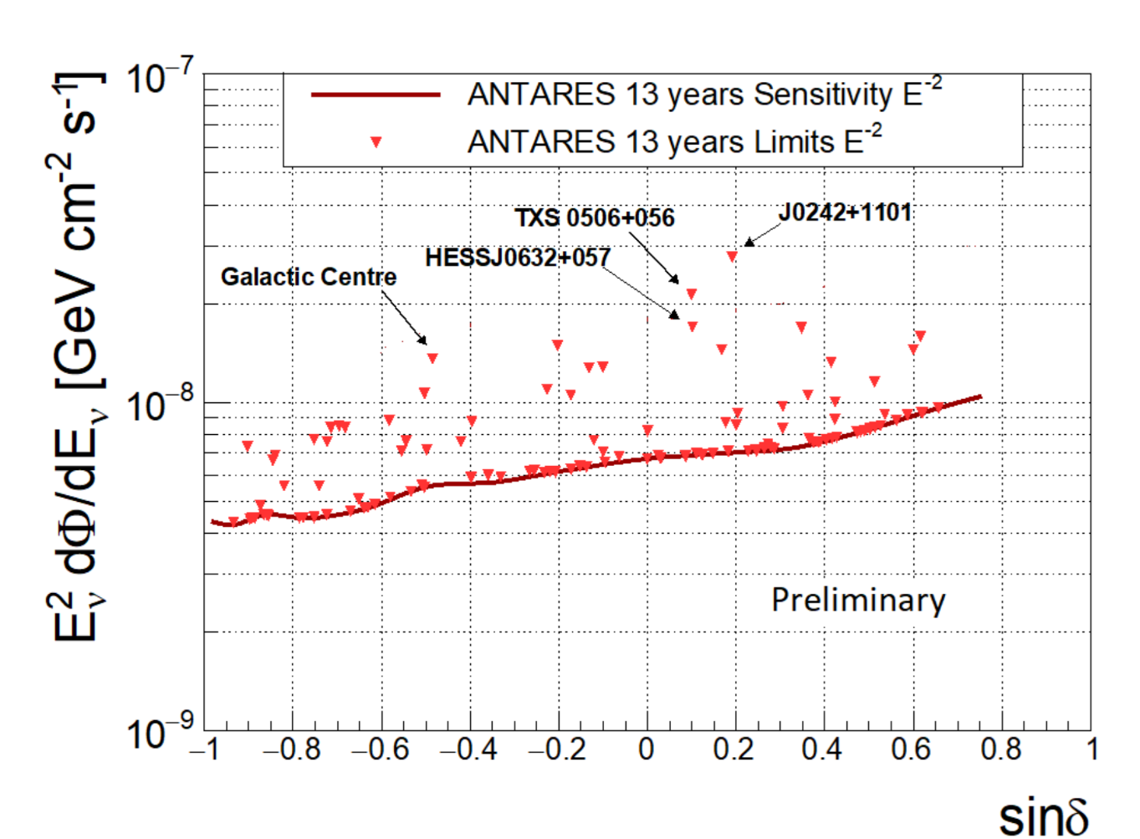
Search for cosmic sources: tracks+cascades
30
 PRD 96, 082001 (2017)
 PoS(ICRC2021)1161
Search in data for spatial clustering of events with respect to atmospheric (~isotropic) foregrounds
- Self-clustering of neutrinos
- Following templates for emission (point-source, extended, diffuse)
Data set 13 year (from Jan 2007 to Feb 2020); Livetime: 3845 days
Using a pre-definite candidate-list search: 121 investigated sources
Most significant source: J0242+1101
pre-trial significance: 3.8σ; post-trial : 2.4σ

Slide 31
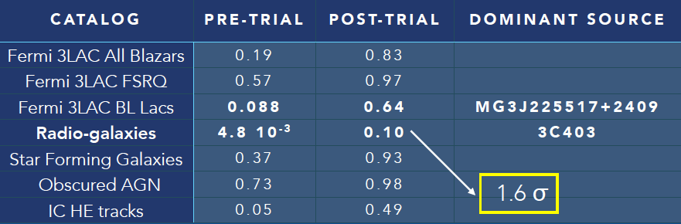
Catalog-based searches (stacking sources)
31
ApJ 911 (2021) 48
PoS(ICRC2021)1164
Based on Promising associations between IceCube neutrinos and radio galaxies [Plavin+,ApJ 894 (2020) 101; ApJ 908 (2021) 157]
Likelihood based stacking approach using data from 11 years (2008-2017)
Association with blazars of the 5th Roma-BZCat catalog as for IC events in [Buson+, ApJ 933 (2022) 2, L43]: work in progress

Slide 32
Multimessenger approaches: sending alerts
APP 35 (2012) 530–536
Alert system (TAToO: Telescopes and Antares Target of Opportunity) operating since 2009:
• High energy (HE): single neutrino with an energy ≥ 5 TeV. Rate: ~1/month
• Very high energy (VHE) : single neutrino with an energy ≥ 30 TeV. Rate: ~3-5/year
• Directional trigger: single neutrino from the direction (≤ 0.4°) of a local galaxy (≤ 20 Mpc). Mainly introduced to enhance the chance to detect a local CCSN. Rate: ~1/month
• Doublet trigger: at least two neutrinos coming from close directions (≤ 3°)
within a predefined time window (15 min).
No doublet trigger ever been issued

Slide 33
Multi-messenger approaches: receiving alerts
Follow-up of IceCube neutrinos:
115 IceCube events received, 37 analyzed (7 HESE, 3 EHE, 10 gold and 17 bronze)
No ANTARES candidates found compatible with any of the IceCube alerts
90% confidence level upper limits on the neutrino fluence
Dedicated offline follow-up of IC events:
TXS0506+056 (ApJL 863 (2018) 2, L30)
AT2019dsg and AT2019fdr (ApJ 920 (2021) 1, 50)
HESE and EHE events (ApJ. 879 (2019)2, 108)
Follow-up of LIGO/Virgo GWs
No candidates associated with GWs
Follow-up of Fermi-GMB and Swift GRBs
Follow-up of HAWC alerts

Slide 34
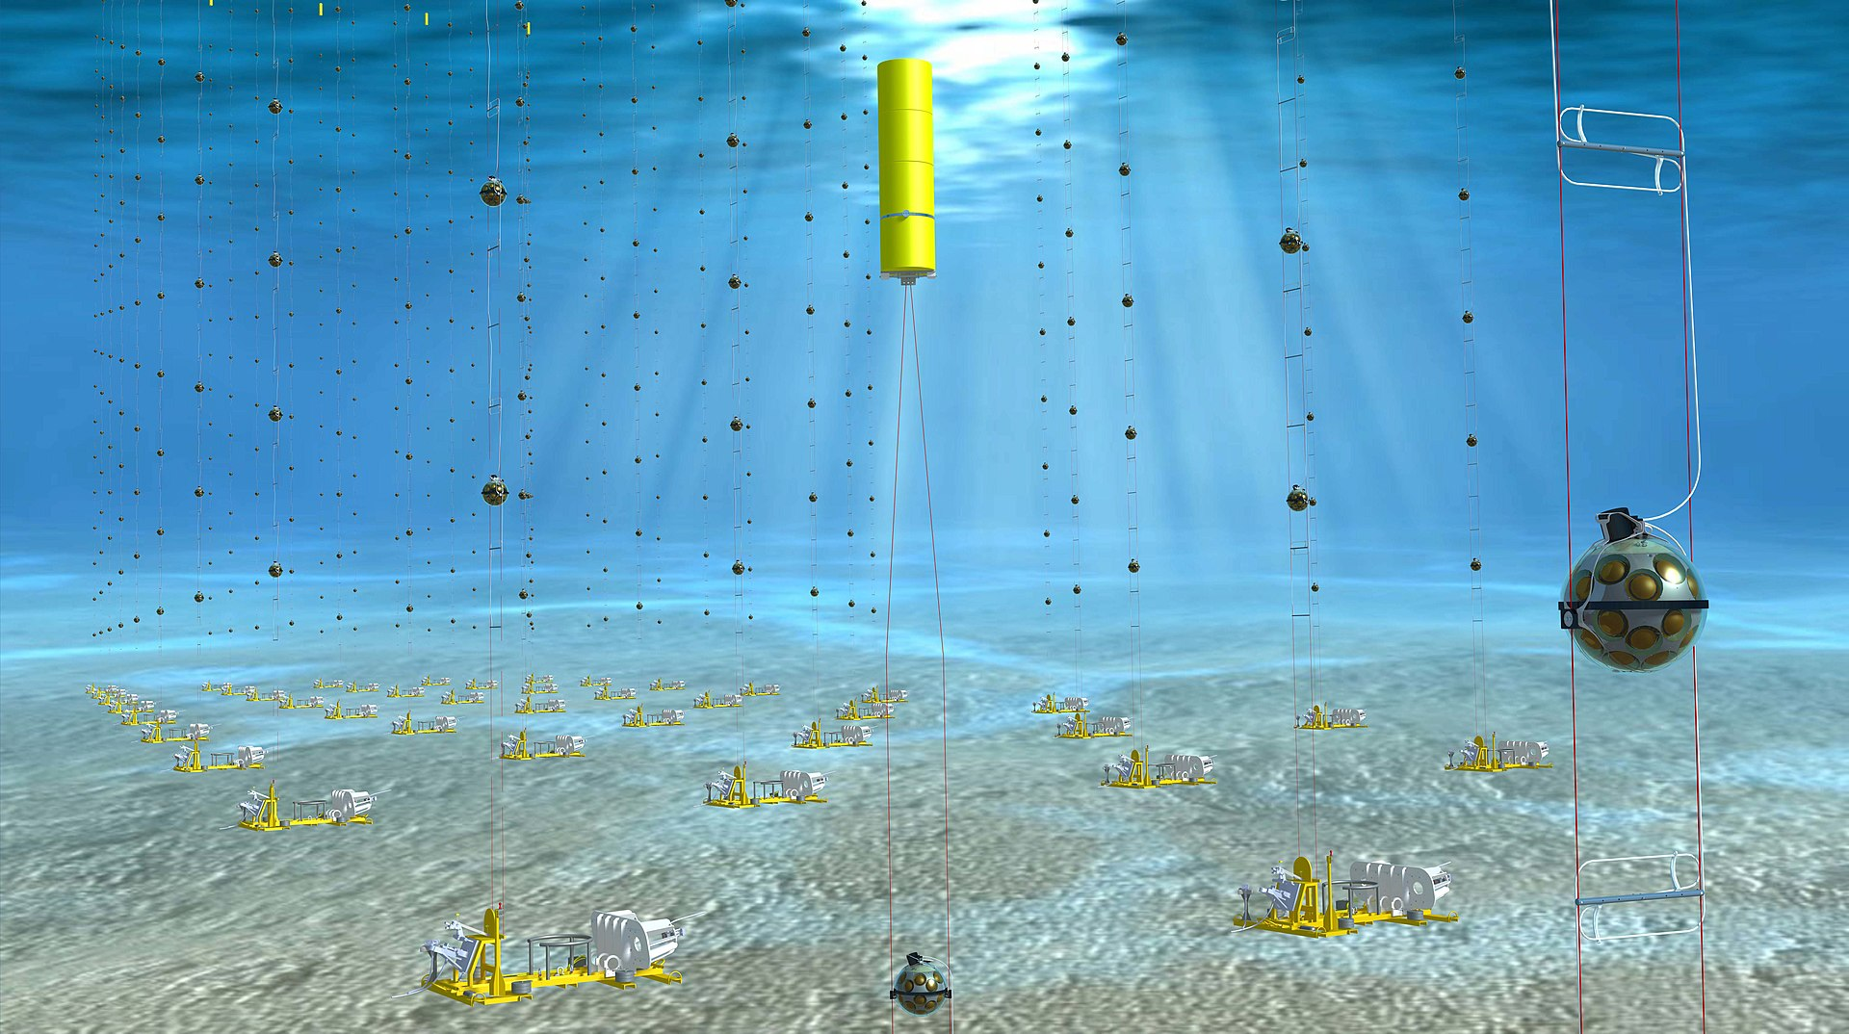
KM3NeT started!
Next generation neutrino telescope in the Mediterranean Sea
Under construction: currently running with 19 DUs (ARCA) and 10 DUs (ORCA)
ARCA reached a comparable sensitivity to cosmic neutrinos as ANTARES
Better median angular resolution (~0.1° @1 PeV) and x100 ANTARES instrumented volume (ARCA)
Will allow multi-flavour neutrino detection in real-time over an extended energy range (ARCA+ORCA)
Real-time framework in preparation, enter the multi-messenger game soon!
ARCA detector: burst in 2022 from the Italian PNRR (Insfrastrutture di ricerca)
Spares →

Slide 35
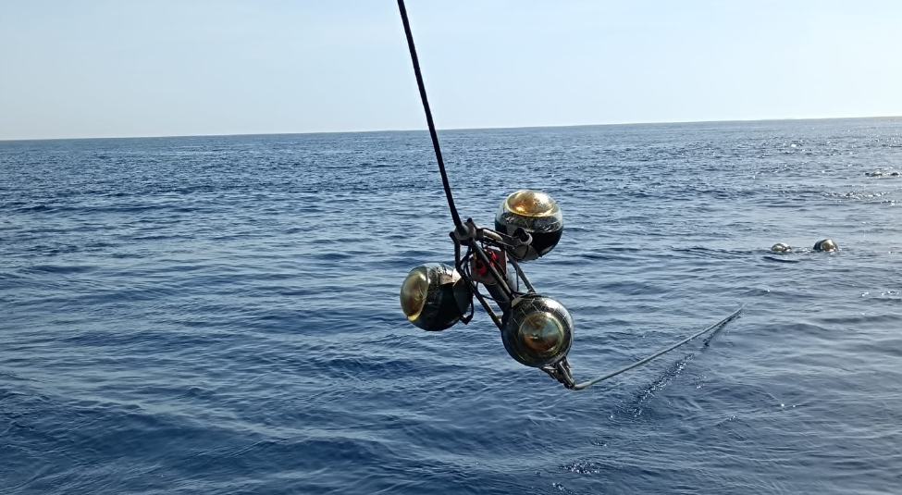

Slide 36

Sensitivity for a Galactic source
γ
$\frac{1}{10}×$ANTARES 5σ discovery potential (3y)
RXJ 1713-3946
Fermi-LAT+ HESS

