Slide 1

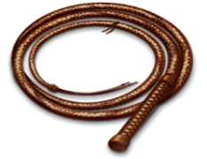
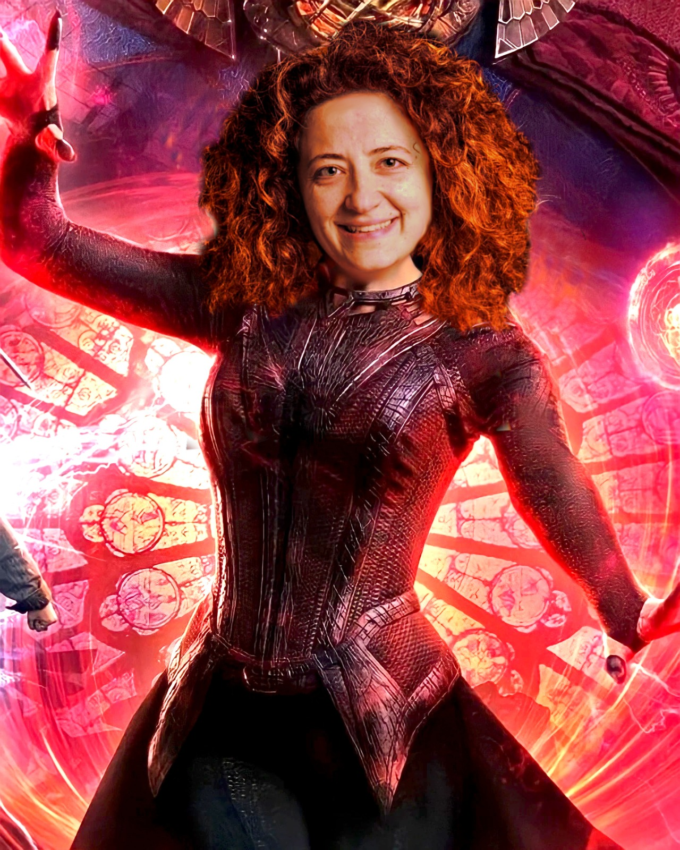
AVENGe
May 29-31, 2023
Gamma-ray astronomy and the search of the lost Pevatrons
Martina Cardillo
IAPS-INAF
martina.cardillo@inaf.it

Slide 2
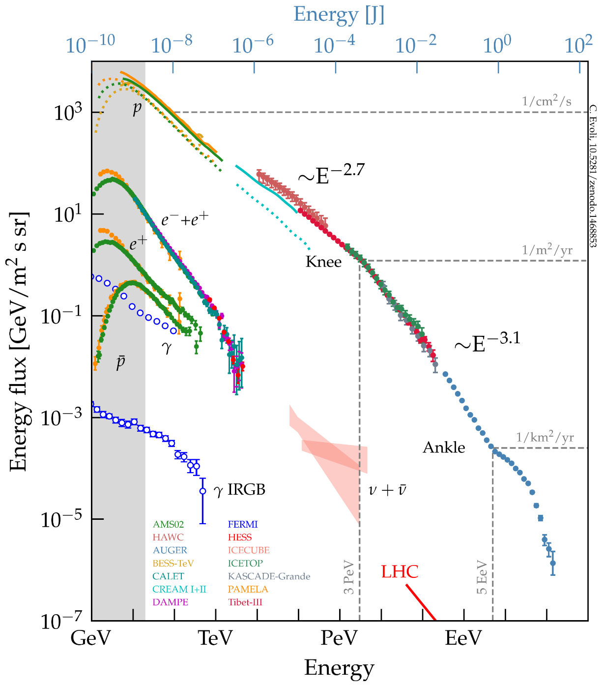
Cosmic Ray Overview: screenshot slide
Protons (85 %)
Nuclei (13%)
Electrons/Positrons (2%)
CR "Knee"
GALACTIC
Transition region
Solar modulation
extra-
GALACTIC
CR "Second Knee"
power law E^{-2,7}
power law E^{-3,1}
CR "Ankle"
W_{CR} ~ 1 eV/cm³
Galactic
component
Evoli 2021

Slide 3
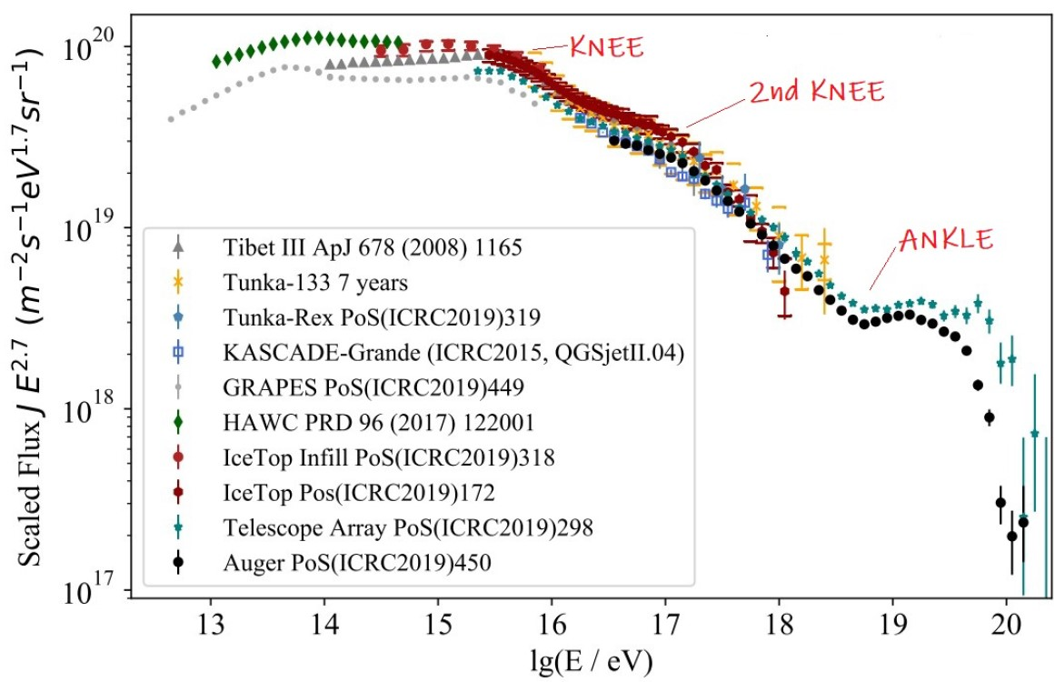
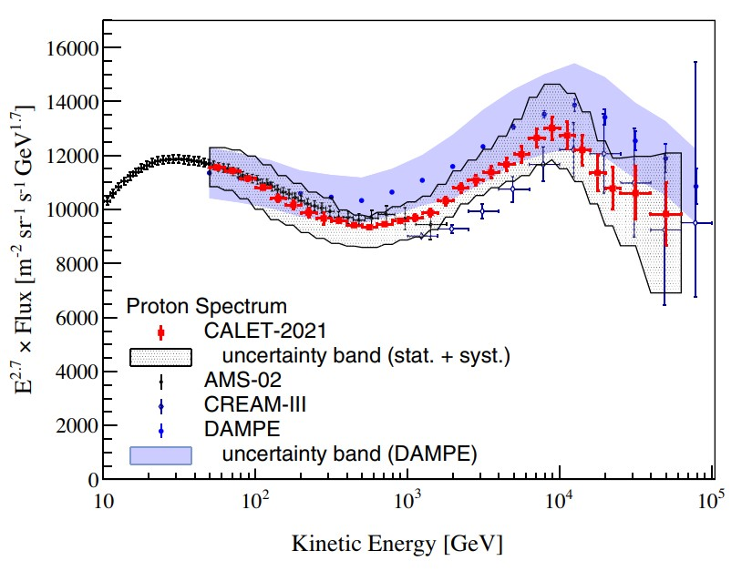
Cosmic Ray Overview
Schroder+19
Between the knee and the second knee (~10¹⁷ eV) should be the transition from Galactic to extragalactic component.
Extra-Galactic component
Limited information
Extra-Galactic magnetic field
Origin connected to transition region
But also the Galactic Component is not so bright and clear
Recent results by CALET/DAMPE show that the region below 1 PeV may not be as featureless as we
thought, showing hardening and steepening between 100 GeV and 100 TeV
Adriani+22

Slide 4
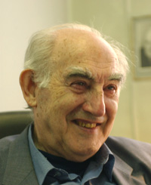
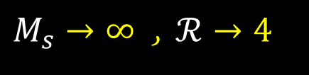
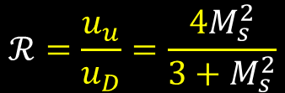


The main candidates: Supernova Remnants
1934 Zwicky & Baade
(SNR hypothesis)
1959. V.Ginzburg
(quantitative)
$$L_{SN}=R_{SN}E_{kin}≈3×{10}^{41}erg/s$$
Efficiency of order 10% per SN is sufficient to accomodate CR energetics.
$$L_{CR,gal}\sim 3×{10}^{40}erg/s$$
COLLISIONLESS SHOCKS:
energy dissipated via wave–particle interaction instead of particle–particle collisions.
STRONG SHOCKS AND DSA:
MAGNETIC FIELD AMPLIFICATION
$$ℛ=\frac{u_{u}}{u_{D}}=\frac{4M_{s}^{2}}{3+M_{s}^{2}}$$
$M_{s}→∞$ , $ℛ→4$

Slide 5
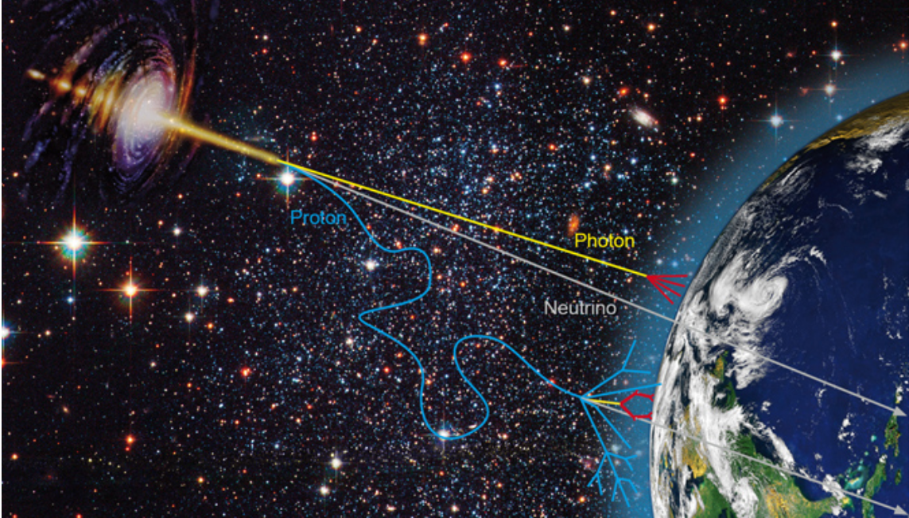
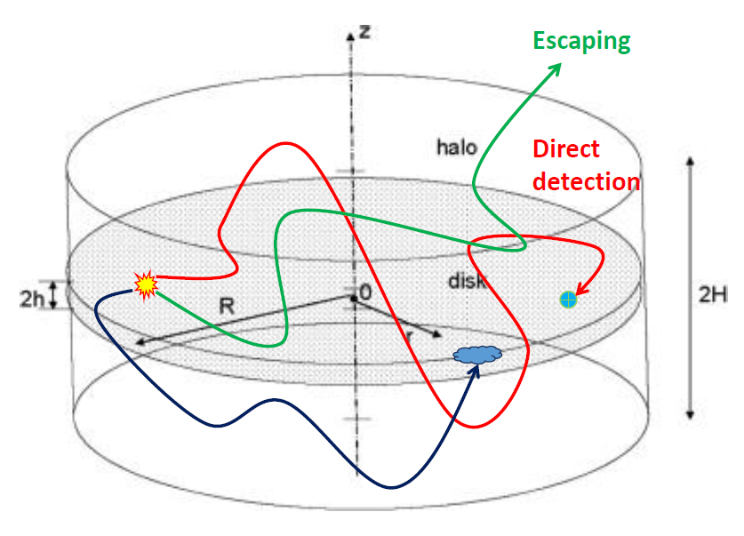
How can we study CRs?

Slide 6
Messengers and Instruments
Direct Detection
(E<100 GeV)
Space Based
Particles
Proportional tubes and scintillators (e.g. CREAM, TRACER)
Magnetic Spectrometers and silicon tracker (e.g. PAMELA, AMS-02)
Gamma-rays
Silicon Tracker and calorimeter (AGILE, Fermi-LAT)
NEUTRINOS
Indirect Detection
(E>100 GeV)
Ground Based
Particles&Gamma
Scintillators and Multiple Resistive plate chambers (e.g. KASCADE-Grande, Tibet_AS gamma, Argo )
Water Cherenkov (e.g. Milagro, HAWC)
Hybrid: water Cherenkov and fluorescence (e.g. Auger) or scintillators (e.g. LHAASO)
Gamma-rays
Imaging Atmospheric Cherenkov Telescope (e.g. HESS, VERITAS, MAGIC → ASTRI-MA, CTA)
Notes:
Per quanto riguarda la prima tecnica di rilevazione (scintillatori e water cherenkov), c’è il vantaggio di un cosiddetto duty-cicle maggiore perché l’osservazione e possibile in qualsiasi ora del giorno e con qualsiasi tempo atmosferico,
Oltre che del campo di vista molto ampio (>45°). La sensibilita, comunque, e limitata, a causa dell’impossibilita di puntare una sorgente e a causa della bassa capacita, per la rilevazione gamma, di eliminare le componenti di background dovute ai raggi cosmici stessi, che sono un fattore 1000 piu numerosi dei raggi gamma.

Slide 7
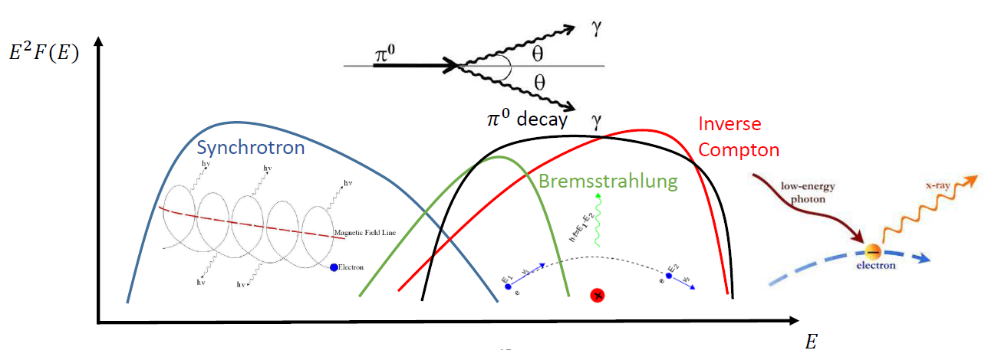
Radiative procesess: very quick look
Notes:
Li conosciuamo tutti ma servono per sottolineare due input fondamentali: lì'importanza del multiwavelength e la sovrapposizione tra elettroni e protoni (adorni)

Slide 8
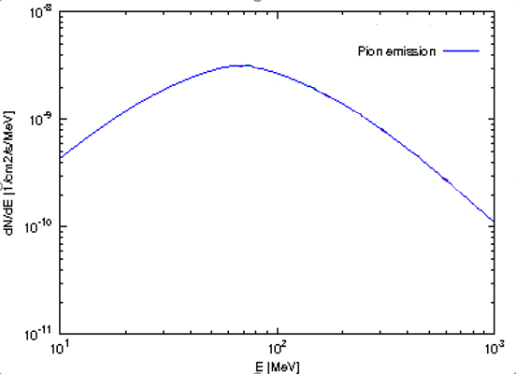
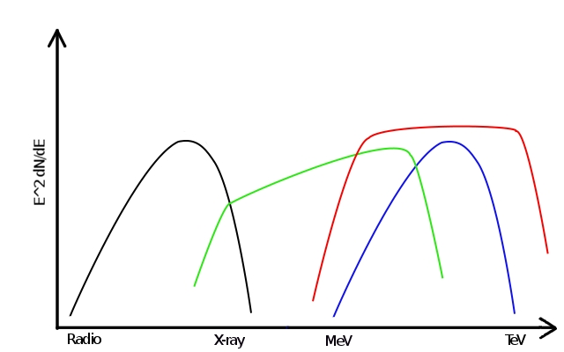
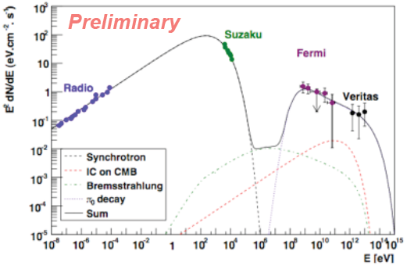
CR Acceleration: direct evidences
Low-Energies
200 MeV
→ Pion bump detection: distinction leptonic from hadronic component only at E<200 MeV
67,5 MeV
Tycho
Giordano et al. 2012
CAS A
High-Energies
Abdo et al. 2010
Pevatrons → gamma-ray at E>100 TeV can be only of hadronic origin (should be...)
Notes:
….e sottolineerei Theoretically….

Slide 9
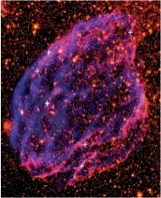
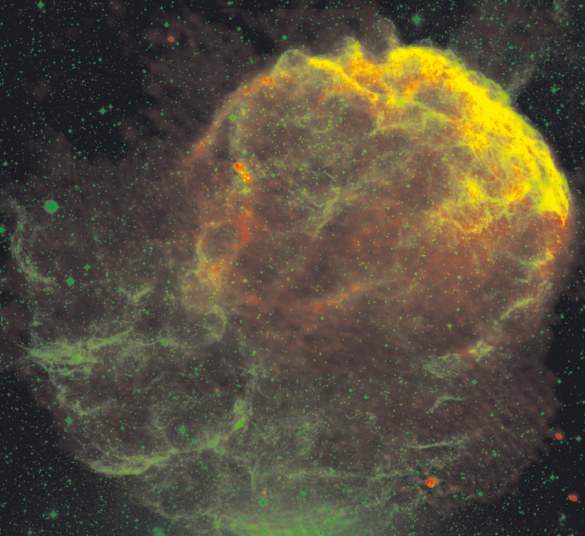
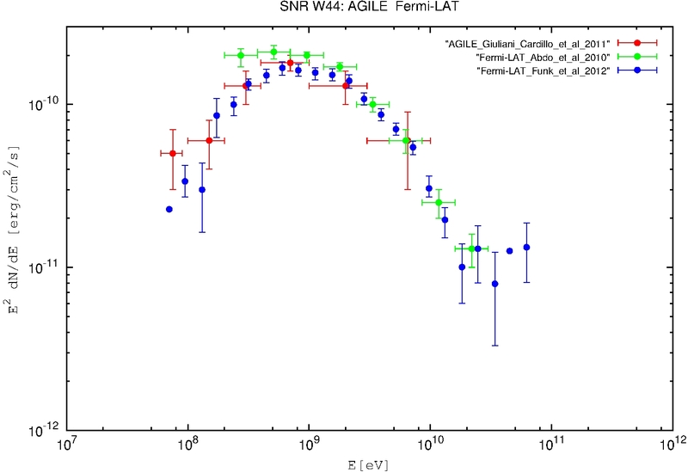
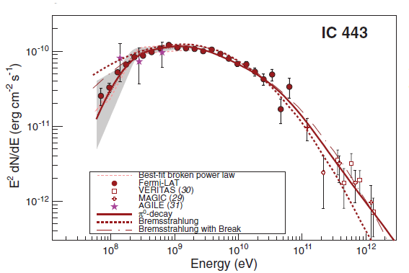
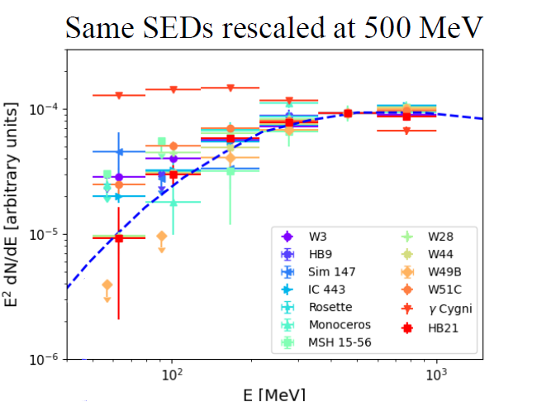
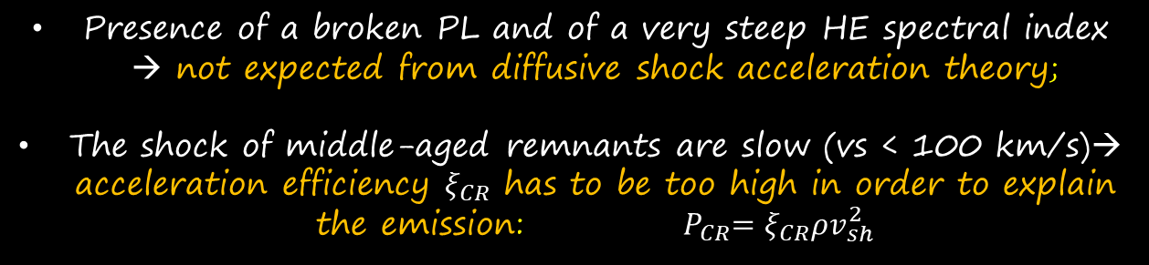
Supernova Remnants: Low-Energies
Ackermann et al. (2013)
Gamma-ray emission below 200 MeV detected by AGILE from the SNR W44, then confirmed by Fermi-LAT also in IC443
Giuliani, MC et al. 2011
Cardillo et al. 2014
Ackermann et al. 2013
Lemoine-Goumard talk Gamma2022
Presence of a broken PL and of a very steep HE spectral index → not expected from diffusive shock acceleration theory;
The shock of middle-aged remnants are slow (vs < 100 km/s)→ acceleration efficiency $ξ_{CR}$ has to be too high in order to explain the emission: ${ P}_{CR}=ξ_{CR}ρv_{sh}^{2}$
Presence of CRs confirmed but not confirmation of freshly accelerated CRs (likely RE-accelerated or D suppression)
[Cardillo et al. 2016, Celli et al. 2019]

Slide 10
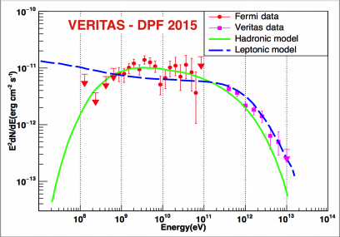
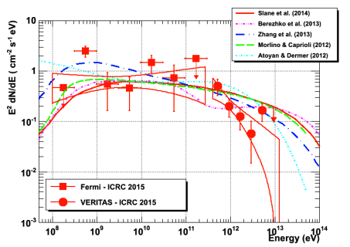
High-energy gamma-rays
10 TeV
Ghiotto 2015
10 TeV
Nahee 2015
Despite the great amount of SNRs detected in the gamma-ray band,
no young SNRs show gamma-ray emission up to $E≥100 TeV$
What is the probability to detect SNR
emitting Pevatron gamma-rays?

Slide 11
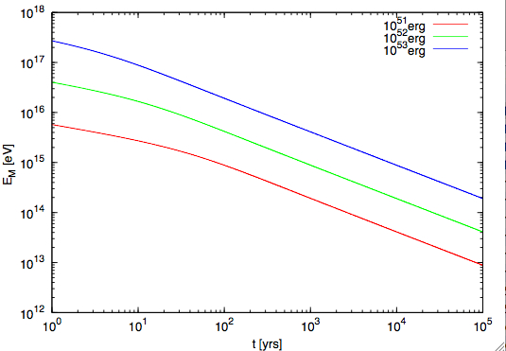
Maximum energy estimation
Cardillo, Amato, Blasi 2015
Current driven regime
(NR Bell instability)
Simulation results about growth rate
(Bell, Schure 2013)
Ejecta and Medium density profile
Sedov Time
Type I
(ISM)
$$E_{M}\left(R\right)=\frac{2Ze}{10}\sqrt{4πρR^{2}}\frac{ξ_{CR}}{cΛ}V_{sh}^{2}=130\left(\frac{ξ_{CR}}{0.1}\right){\left(\frac{M_{ej}}{M_{⊙}}\right)}^{−2/3}{\left(\frac{n_{ISM}}{{cm}^{−3}}\right)}^{1/6}\left(\frac{E_{SN}}{{10}^{51}erg}\right)TeV$$
Type II
(wind)
$$E_{M}\left(R\right)=\frac{2Ze}{5}\sqrt{4πρR^{2}}\frac{ξ_{CR}}{cΛ}V_{sh}^{2}=1\left(\frac{ξ_{CR}}{0.1}\right){\left(\frac{M_{ej}}{M_{⊙}}\right)}^{−1}{\left(\frac{\dot{M}}{{10}^{−5}M_{⊙}/yr}\right)}^{1/2}{\left(\frac{V_{w}}{10km/s}\right)}^{−1/2}\left(\frac{E_{SN}}{{10}^{51}erg}\right)PeV$$

Slide 12

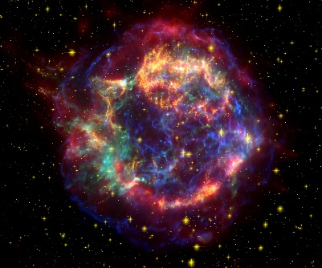



Main Conclusions
We have the proof of CR energization from some middle-aged SNRs but no proof of freshly accelerated CRs
Main hypothesis:
  middle-aged SNRs re-accelerate CRs (Cardillo et al. 2016)
  Middle aged SNRs could accelerate CRs but in regions with suppressed diffusion coefficient (Celli et al. 2019)
Type II SNRs can accelerate particles up to the knee through the NRH instability
but…
Type II SNRs can accelerate particles up to the knee at very early time → detection problem
Distant MCs could be "the only hope" of a Pevatron detection (Gabici 2009)
And what if SNR do not were galactic CR sources?

Slide 13
Theory
Where do most CRs come from?
Observations
Energetics
  P_{CR} ∼ 10⁴⁰ − 10⁴¹ erg/s
Power-law injected spectrum
  Required from acceleration theory
Maximum energy
  They must explain the PeV proton energies
Anisotropy
  Source distribution has to be correlated with CR anisotropy (at PeV, ~10⁻³)
Composition
  They must explain CR composition and its energy dependence
Detected VHE-UHE Emission
Spectral curvature
  Signature of Emax, KN, spectral breaks
Spatially-resolved emission
Correlation with target material
  Not perfect: i.e. emission is convolution of CR distribution with gas
Energy-dependent morphology
  Expected in general due to energy dependence of transport and/or cooling
A multi-wavelength counterpart!
Receipt to be a CR source
MC&Giuliani 2023
Notes:
From a theoretical point of view, the hadronic PeVatron requirements can be summa- 210
rized in the following way [66]: 211
• Energetics - Hadronic PeVatrons must explain the CR power of the Galaxy, estimated 212
to be about PCR ∼ 1040 − 1041 erg/s [10]; 213
• Power-law injected spectrum - According to DSA, the accelerated spectrum at the 214
source must follow a power-law that, after correction for transport effects and CR 215
anisotropy, has to be ∝ E−2.1÷2.3 [9,10]; 216
• Maximum energy - The acceleration efficiency at the source must be such as to explain 217
PeV particle energies; 218
• Anisotropy - The source distribution must be correlated with the CR anisotropy in 219
their arrival direction predicted by any diffusive model for CRs [10,75]; 220
• Composition - Galactic CR sources must explain their composition that is slightly 221
different with respect to the Solar CR one (e.g. large overabundance of light elements, 222
overabundance of metals with respect to H and He) [9,10]. Moreover, the composition 223
varies over energy (e.g. different elements have different spectral indices), and this 224
also this energy dependence needs to be reproduced. 225
From an observational point of view, a candidate hadronic PeVatron must have some 226
precise features [76]: 227
• Evidence of UHE γ-ray emission (E > 100 TeV) - If we have CR acceleration, we 228
expected protons accelerated at least up to 1 PeV and consequently, γ-ray emission 229
well above 100 TeV without a cut-off in the spectrum; 230
• Spectral curvature - The parent particle power-law is modified by the existence of a 231
maximum energy and/or to some break due to losses; 232
• Correlation with target material - The p-p interaction is most favoured in presence of 233
a dense target in the source surroundings [75,77] 234
• Extended emission with likely energy-dependent morphology - CRs diffuse through 235
the media surrounding the source and diffusion (as like as cooling) is energy depen- 236
dent; 237
• Multi-wavelength counterpart - Secondary non-thermal electrons produced in the p-p 238
interaction emit in radio/X-ray bands. 239
All these observational requirements can be

Slide 14
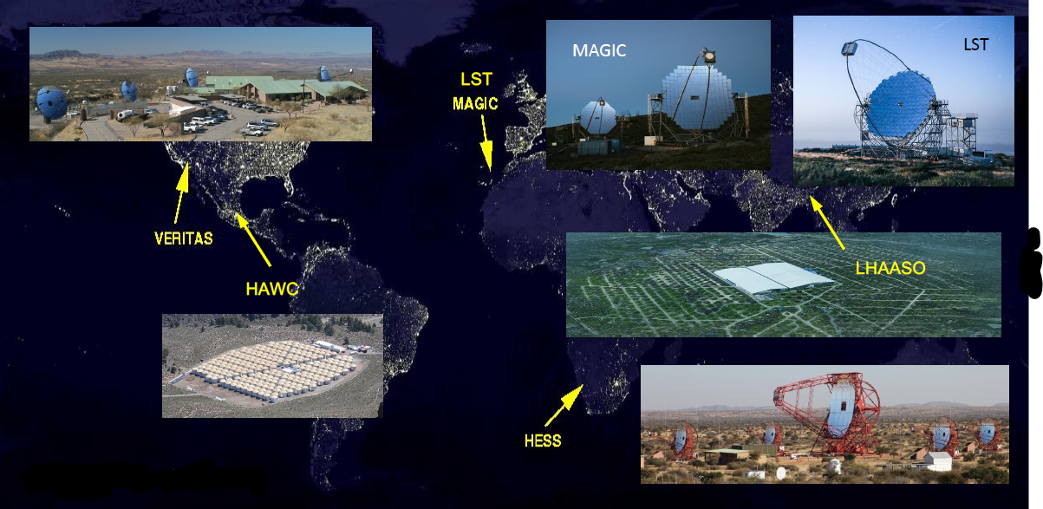
Current Cherenkov Facilities
From Ribot presentation at Gamma 2022
Notes:
HAWC: Sierra Negra volcano near Puebla, Mexico

Slide 15
Other sources
(Before LHAASO)
Notes:
I will explain later what is B.L…

Slide 16
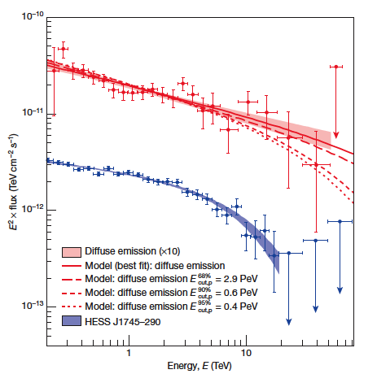
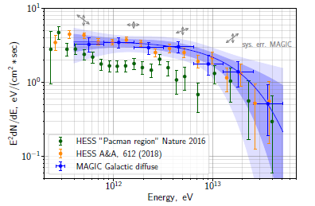
Other Sources? - Galactic Center Region
HESS collaboration 2016
HESS collaboration 2018
APEX+Planck: Dust
(ATLASGAL-Konsortium/Csengeri+ 2016)
HESS collaboration 2016
MAGIC collaboration 2020
Perfect correlation between molecular gas distribution and gamma-ray emission seen by HESS
CR energy density 10 times greater than CR sea
CR spectrum with and index γ_{E} =2.3-2.4 up to 100 TeV (but with large error bars)
Spatial distribution with 1/r (continuous injection)
Maybe from Sgr A* (Rodríguez-Ramírez et al., 2019)
First spectro-morphological analysis on-going (Devin talk Gamma 2022)
Notes:
Collegamento con i Superbubbles
Sito per Immagine APEX+Planck → https://www.mpifr-bonn.mpg.de/pressreleases/2016/3#
Three areas of the Galactic plane as seen by the APEX LABOCA camera merged with large-scale images from the Planck satellite. Above: 6 x 3 degree field centered on the Galactic centre (constellation: Sagittarius).
APEX, the Atacama Pathfinder EXperiment telescope, is located at 5100 metres altitude on the Chajnantor Plateau in Chile’s Atacama region.

Slide 17
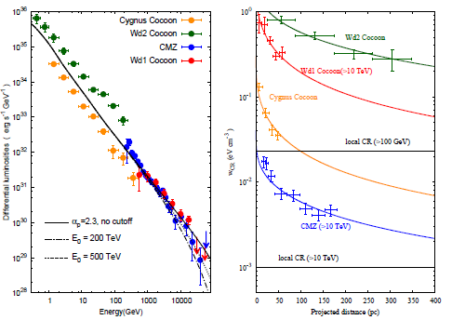
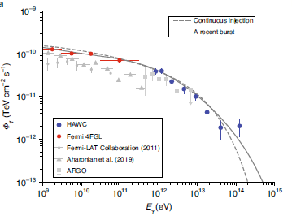
Other sources? – From GCR to Superbubbles
Hot and rarefied extended cavities formed by OB stars winds containing also a lot of SNRs [Bykov 1992]:
Multiple shocks and winds
  → enhanced turbulence and acceleration
No radiative phase
  → larger acceleration efficiency
Low-energy spectrum slope similar to the one measured by Voyager
Explanation of some CR composition anomalies
  → ²²Ne, Be abundances [ Higdon+ 2003, Tatischeff 2018]
Spatial and spectral behavior similar to the GC one [Aharonian 2018]
Vieu thesis 2023
DIRECT
PROOF ?
HAWC collaboration 2021
Aharonian et al. 2018

Slide 18
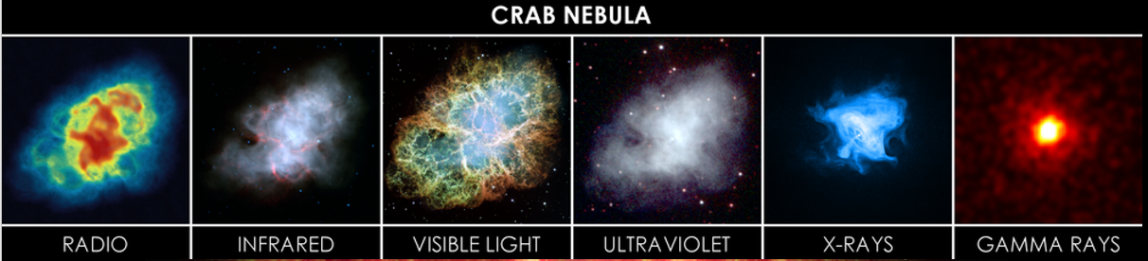
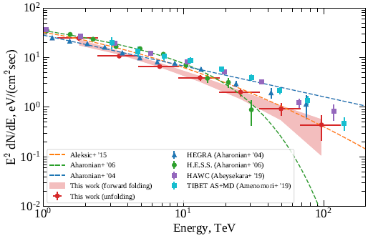


Other Sources? - CRAB NEBULA
Standard Candle for Gamma-ray astronomy (when it is not flaring)
MAGIC collaboration 2020
LHAASO collaboration 2021
Leptonic origin of gamma-rays possible!!
There is a hadronic component?
Detection
above 1 PeV!!!
Crab is a
PWN
(leptonic source)
but…
So…
Notes:
…ci ricolleghiamo alla questione sezione d'urto e Klein Nishina
Gamma-ray emission from Crab Nebula discovered by the Whipple telescope in 1989

Slide 19
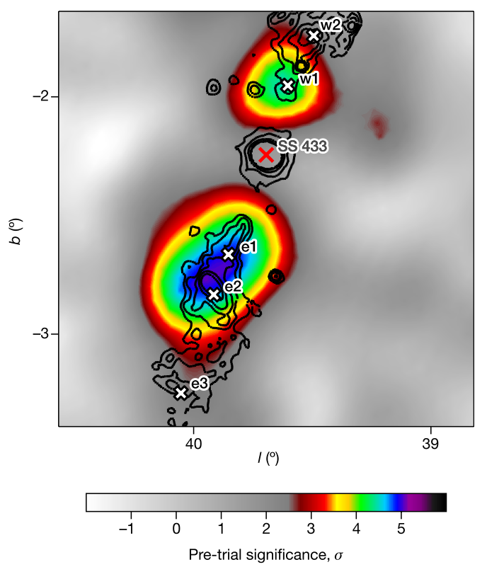
Other sources? - Gamma-ray binaries &: Microquasars
Binary stellar systems (BS/BH+Companion)
Cyg X-1, Cyg X-3 and SS 433 (emitting X-rays) show HE emission up to GeV.
The Manaetee Nebula
(Safi-Arb Gamma2022)
SS 433
HAWC (HAWC2018)
Fermi-LAT (Fang+2020)
HESS
Olivera-Nieto Gamma2022
Notes:
DA non molto, nel mondo del TeV si sono inseriti i Microquasars.
Microquasars are binary stellar systems where the remnant of a star that has collapsed to form a dark and compact object (such as a neutron star or a black hole) is gravitationally linked to a star that still produces light, and around which it makes a closed orbital movement. In this cosmic dance of a dead star with a living one, the first sucks matter from the second, producing radiation and very high energetic particles (Fig. 1). These binary star systems in our galaxy are known under the name of “microquasars” because they are miniature versions of the quasars (‘quasi-stellar-radiosource’), that are the nuclei of distant galaxies harboring a super massive black hole, and are able to produce in a region as compact as the solar system, the luminosity of
100 galaxies like the Milky Way. Nowadays the study of microquasars is one of the main scientific motivations of the space observatories that probe the X-ray and γ-ray Universe.
[Mirabel 2011]
SS 433 (broad MWL emission) is a key target to understand particle acceleration in XRB jets. The jet produces two bright TeV spots (e1 and w1). HESS conferma quanto visto da HAWC ed è il primo IACT ad avere questi risultati. Il TeV è in coincidenza dell'X mentre al GeV, come evidenzia Fermi, la situazione è più complessa.

Slide 20
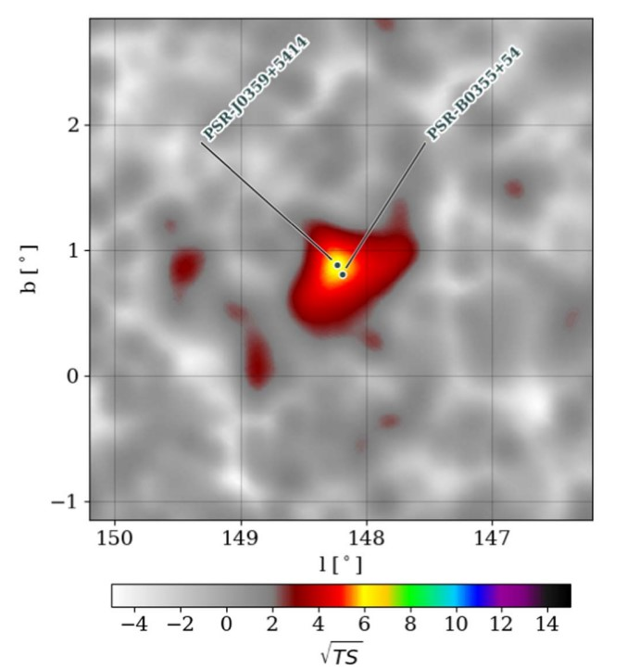

And for the propagation: TeV HALOS
VELA
HESS 2020
Both pulsar and extended emission evaded detection for a long time
Escaping electrons and positrons (due to RS that disrupts PWN) form an extended halo of GeV and TeV gamma-rays
Geminga
HAWC 2017
TeV Halos as new source class
TeV halo candidate near the Galactic plane in a non-crowded region.
This TeV halo candidate shares similar characteristics to others, suggesting that TeV halos could be a general feature of middle-age pulsars.
Propagation study
PSR J0359+5414
HAWC (Albert+23)
Notes:
Non sono sorgenti di accelerazione ma…

Slide 21
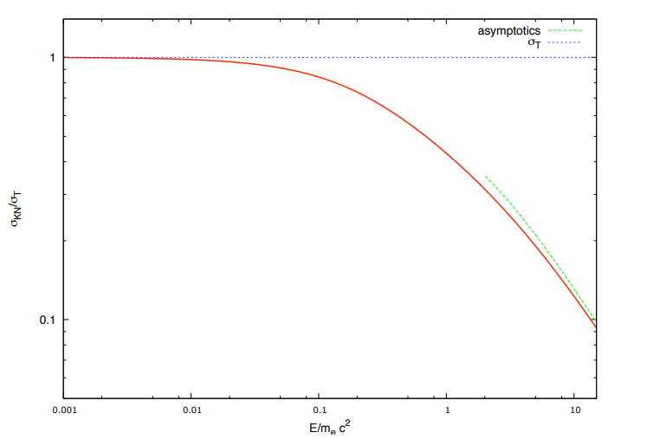

Pevatrons
HIGH-ENERGY ASTROPHYSICS
PEVATRON = an object capable of accelerating PARTICLES (hadrons or leptons) up to the PeV (=10¹⁵ eV) range
INVERSE COMPTON (leptonic)
Thomson scattering ($hν_{i}≪m_{e}c^{2}$)
transfer small,
scattering almost elastic,
Thomson cross-section applied
Klein-Nishina scattering ($hν_{i}≫m_{e}c^{2}$)
transfer large,
scattering deeply inelastic,
need to use cross-section derived from QED.
COSMIC RAY CONTEXT
PEVATRON= an object capable of accelerating HADRONS up to the PeV (=10¹⁵ eV) range

Slide 22

Ok…
We have some hints of emission around 100 TeV…
but just one PeVatron (the Crab)…
And it could be a leptonic one...
…when suddenly…

Slide 23
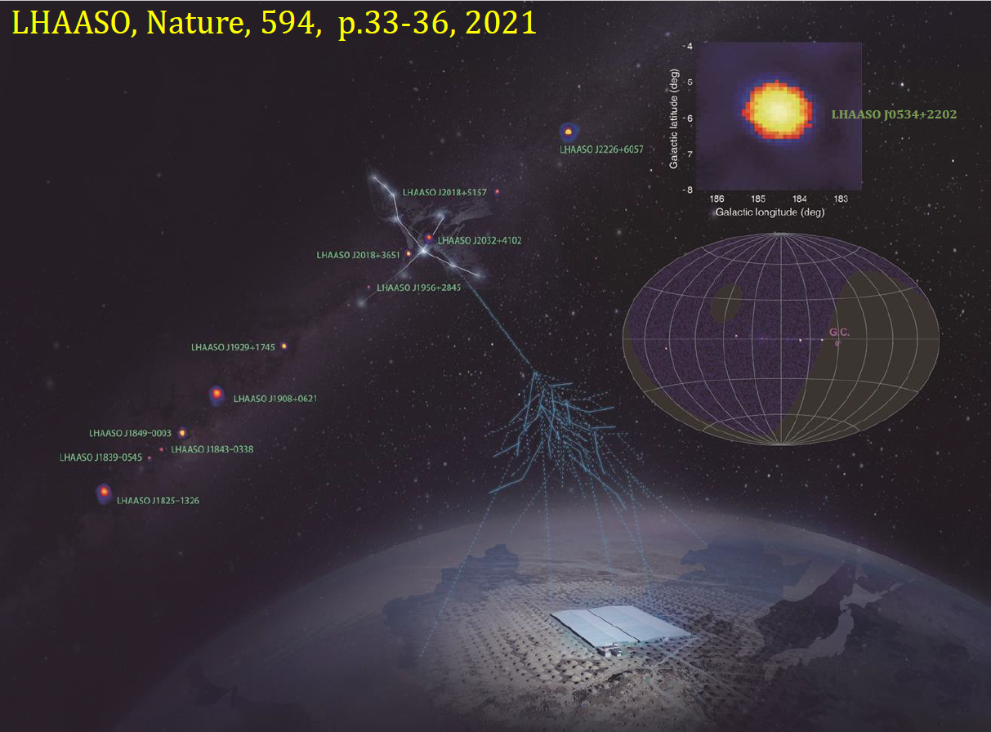

"PeVatrons" storm from LHAASO
OUR GALAXY IS FULL OF "PEVATRONS"!!!!!!
12 "PeVatrons" discovered with high significance (>7σ)!!
LEPTONIC
Or
HADRONIC?
Cao ICRC 2021
Notes:
…Da qui chiaramente è iniziato il putiferio tra gli altri strumenti, presenti e futuri, per capire meglio cosa LHAASO sta osservando e in generale per riuscire a selezionare i candidati pevatroni della nostra Galassia
We acknowledge the significant results obtained by HAWC and recognize that they hinted at what LHAASO saw successively
However, we think LHAASO results were a breakthrough for two main reasons, the extension by an order of magnitude of energy range and the relatively large number of sources.
Despite the fact the portion of the Galaxy observable by the LHAASO site is smaller than that by the HAWC site (and it doesn’t include the Galactic center) LHAASO tripled the number of known sources emitting above 100 TeV, demonstrating that this feature is quite common on galactic sources. The number of sources for which a hadronic scenario is almost excluded increased similarly.
Moreover, the detection of photons near (in some cases above) 1 PeV challenge an astrophysical explanation of what we are observing (both assuming hadronic or leptonic origin)
Let us also note that LHAASO obtained these results with only 10 months of observations, suggesting these 12 sources are only the top of the iceberg of what will be detected by future observations of both LHAASO and other instruments based on the same technology (i.e. SWGO at the south).
We tried to better explain our point of view also in the text.

Slide 24
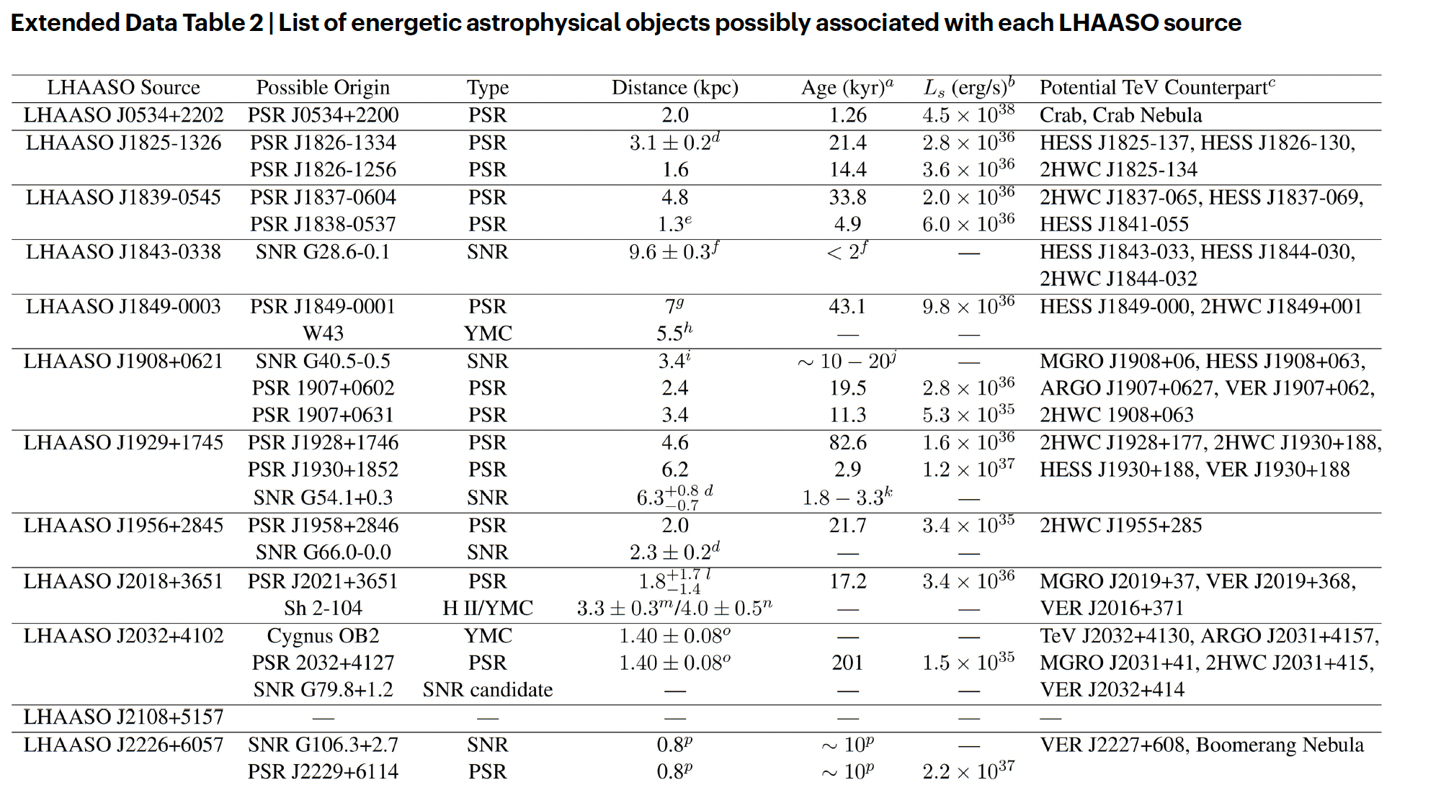
Notes:
- Have a look to the columns "Possible origin" and "Potential TeV Counterpart" → spiegare la problematica della risoluzione angolare

Slide 25
Other sources
(After Lhaaso)

Slide 26
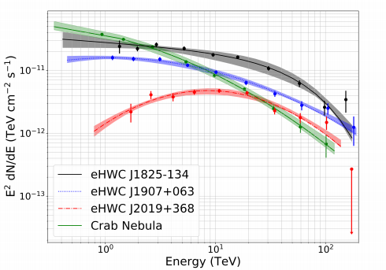
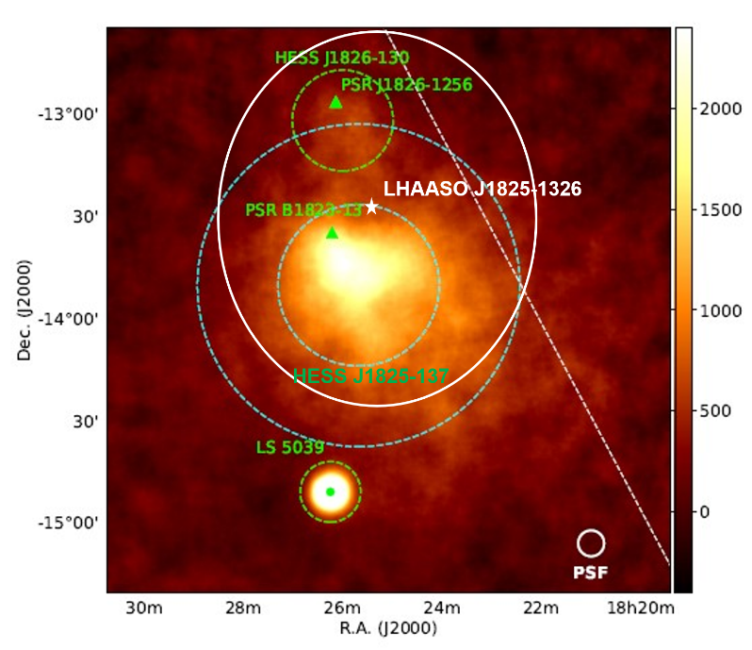
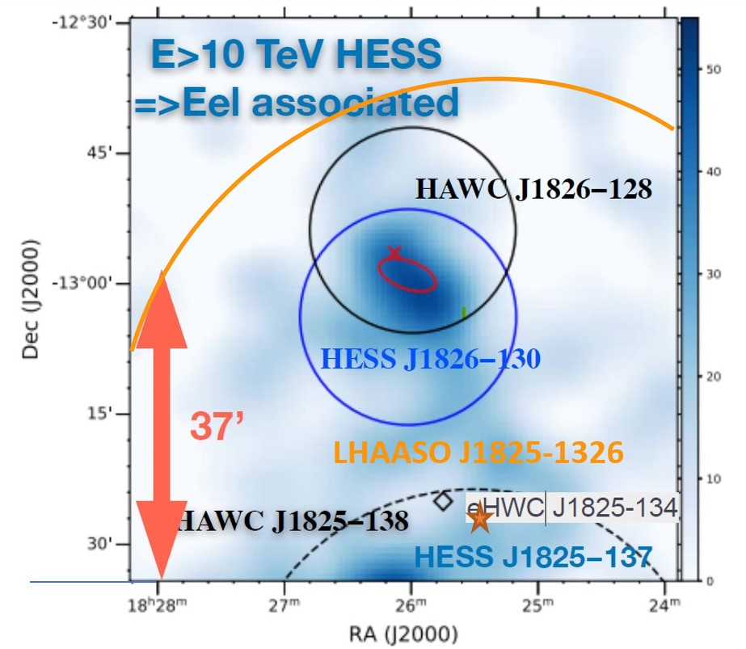
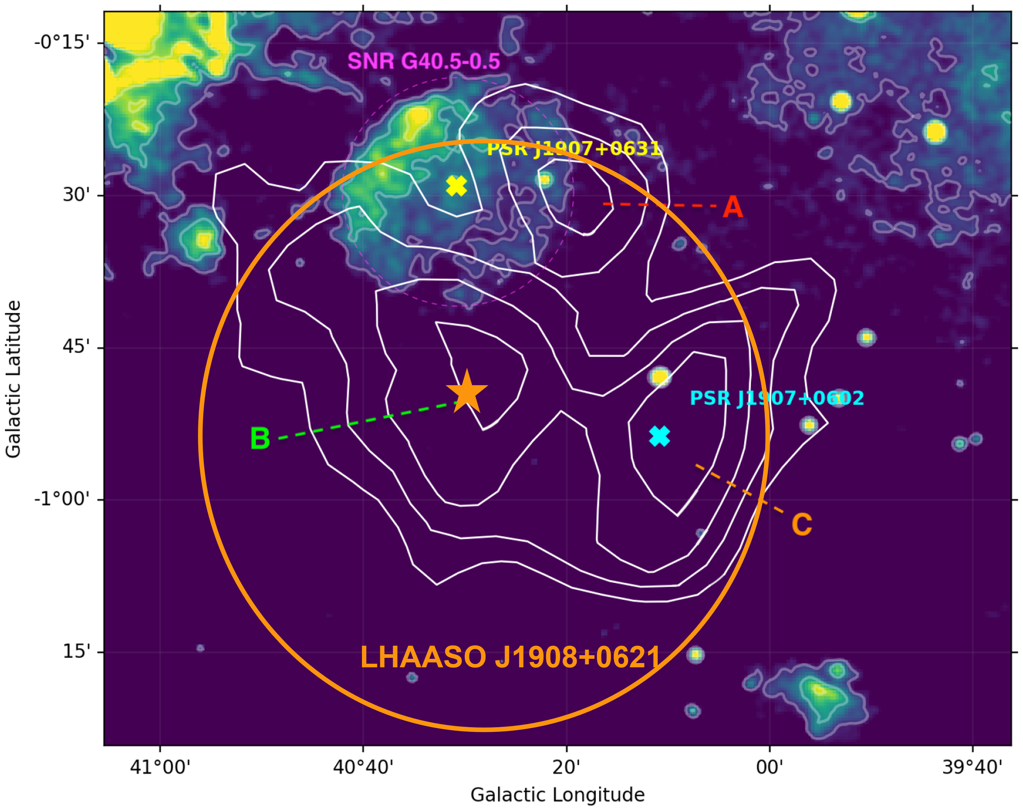
Pulsar Wind Nebulae
HAWC
The majority could be PWN!!!
(statistics: more numerous and long last)
Cao et al. 2021
Abeysekara et al. 2020
LHAASO J1825-1326
PWN? SNR?
[MC&Giuliani 2023]
LHAASO J1908+621
PWN?SNR?
[MC&Giuliani 2023]
Very Complex
Environment and low angular resolution
HESS coll. 2019
Burgess+ 2022
Crestan+ 2021
Notes:
Complex enviroinment traducibile come "un gran casino"
Two of the sources with the highest significance
J1825: HAWC risolve tre sorgenti, HESS 2 e ci sono sia PSR ma anche SNRs
J1908: 2 PSR e una SNR nei dintorni (interagente con le MCs)
PWNe should be the most numerous between the different kinds of Galactic sources 328
[48] and their γ-ray emission is estimated to last a very long time (∼ 100 kyrs)

Slide 27
Pulsar Wind Nebulae
Vercellone+ 2022
Leptonic origin of gamma-rays > 100 TeV is possible
  → IC on BKG photon field (no KN effect due to an increase of the cooling time in radiation dominated environments [low B]) [Breuhaus+ 2022]
Protons:
γ = 10⁵
χp = 15%
Acceleration is limited by the maximum potential drop (not in the Crab)
500h
Protons:
γ = 5 × 10⁶,
χp = 4%;
If there are protons (hadrons):
~few % of the total energy (Guepin+ (2020))
pp emission may show up in the high energy tale of IC emission
DeOnaWilhelmi+ 2022
Notes:
Complex enviroinment traducibile come "un gran casino"
Two of the sources with the highest significance
J1825: HAWC risolve tre sorgenti, HESS 2 e ci sono sia PSR ma anche SNRs
J1908: 2 PSR e una SNR nei dintorni (interagente con le MCs)
PWNe should be the most numerous between the different kinds of Galactic sources and their γ-ray emission is estimated to last a very long time (∼ 100 kyrs)

Slide 28
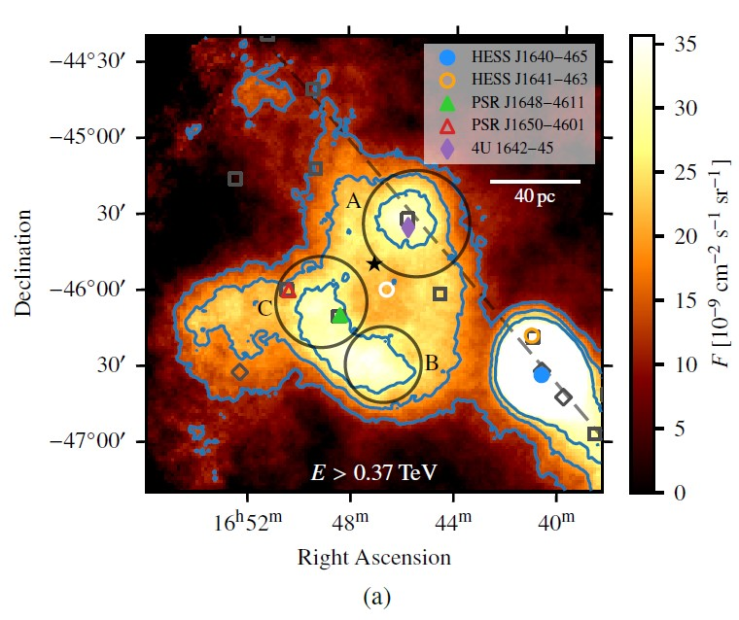
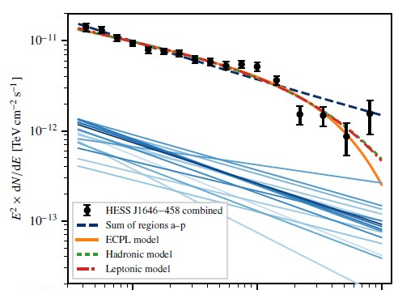
Young Massive Star Clusters (inside superbubbles)
Clusters with age < few Myrs that can reach M up to 6x10⁴ Solar masses
Acceleration at 1 PeV possible at Wind Termination Shocks [Morlino 2021, Vieu et al. 2022]
Collective effects in the most compact clusters (size of a few pc) can generate a collective ourflows (right amount of power [Vink 2022])
Several physical ingredients to a deep analysis (cluster population, stellar population inside, stellar wind, cluster wind, PA model, gas distribution) [Morlino CTAO general meeting]
Abeysekara+ 2021 (HAWC coll)
HAWC collaboration 2021
Cygnus Region
Aharonian+2022
Low-energy break
Banik 2022
Lemoine-Goumard
talk Gamma2022
Westerlund 1
E [TeV]
Notes:
Dopo LHAASO sono stati fatti degli studi più approfonditi che hanno capito meglio cosa sia necessario.
The power injected by a single stellar wind is between 10-50% of the power generated 305
by a SNR shock [67] with an average energy per massive star of about 1048 erg
Dalla presentazione di Vieu:
Massive star cluster = a bounded group of stars which contains SN progenitors (ZAMS >~ 8 Msol).
I superbubble sono i contenitori degli YMSCs
Can massive star clusters produce PeV photons?
Fast SN exploding within young compact massive star clusters can account for the
UHE GCR up to 100 PeV.
Very few of these events are required (~ 1/10 000 yr) and UHE particles escape within
1kyr => O(1), or possibly O(0) gamma-ray counterpart!
> Can massive star clusters produce ɣ-rays up to 100 TeV?
Young compact clusters can accelerate particles at the WTS up to 1 PeV and produce
detectable photons up to 100s TeV.nded group of stars which contains SN progenitors (ZAMS >~ 8 Msol).

Slide 29
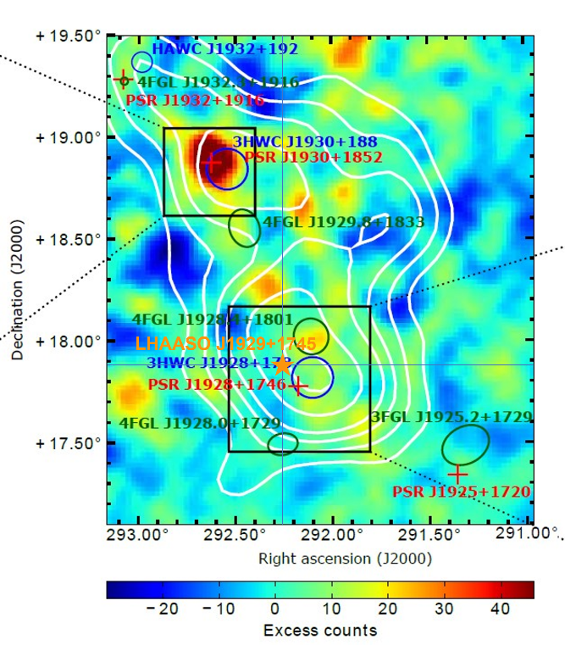
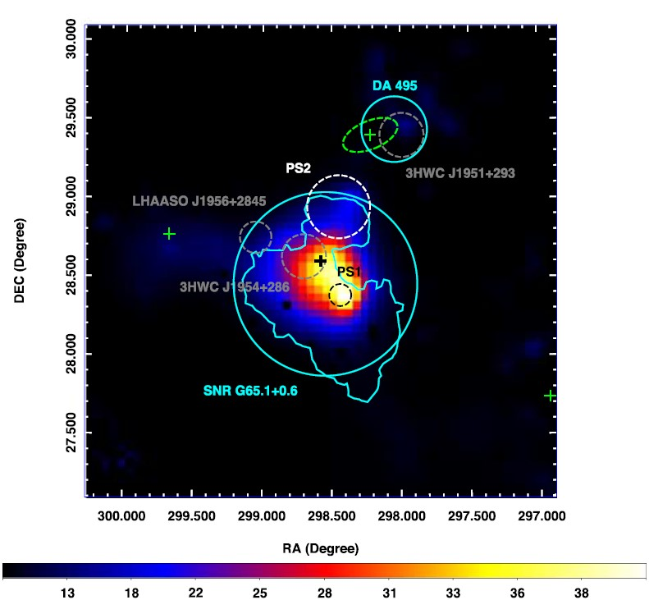
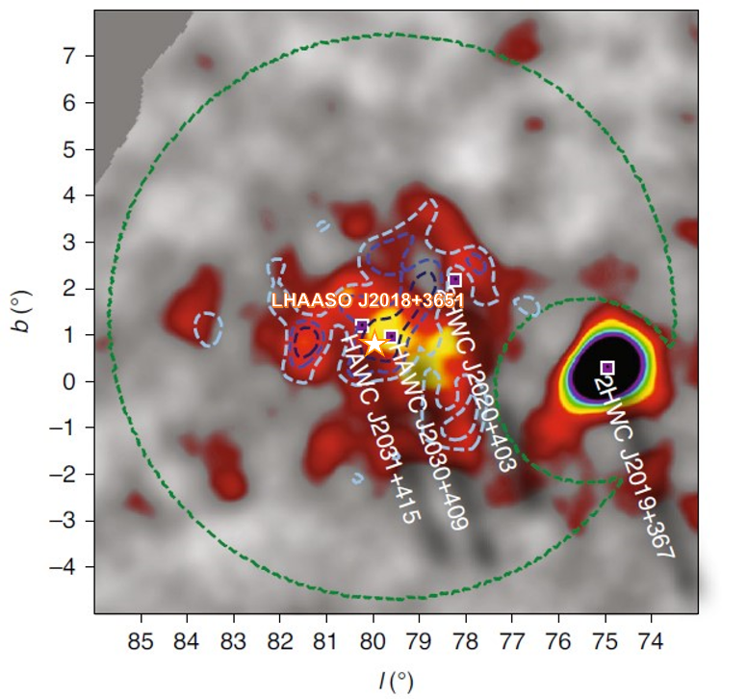
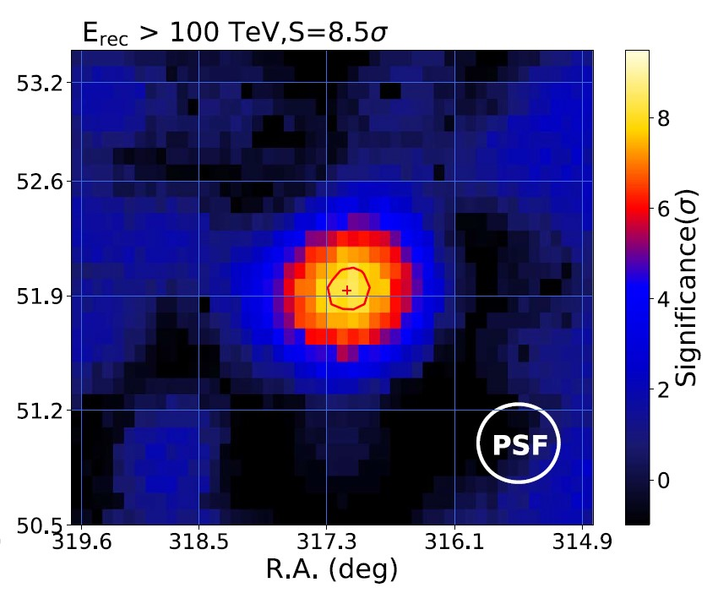
LHAASO J1825-1326
TeV HALOS
Albert+2023,HAWC coll.
LHAASO J1929+1745
Several LHAASO sources could be TeV halos!
[MC&Giuliani 2023]
HESS coll. 2019
LHAASO J1956+2845
LHAASO J2032+4102
LHAASO J2108+3651
Xing+ 2022
Cao, Aharonian+21
First source discovered at UHE
Abeysekara+ 2021 (HAWC coll)
Notes:
The main problem related to TeV halo detection is the possibility of confusing them with extended SNRs [118]. In order to verify the TeV halo origin of a
source, beyond the co-location of the bulk of its emission with a pulsar, this pulsar needs to have a spin-down luminosity sufficient to generate a halo and needs to be enough old to allow electrons to diffuse in the ISM (bow-shock nebula [70]). Furthermore, the extension of the halo has to be larger than the possible PWN X-ray emission, otherwise the emission
could be a γ-ray PWN, and its morphology must be explained by slow-diffusion, otherwise this could indicate a hadronic accelerator
*J1825 → HESS J1825: The extraordinary extension of this source makes it a possible candidate TeV halo [146], even because it is not possible to explain it within the standard dynamics of the PWN [147].
*J1929 → HAWC: Actually, the estimated age of the PSR (∼ 80000 yrs) and the lack of X-ray detection in its correspondence open the chance that 3HWC J1928+178 could be another TeV halo → però studi più approfonditi del proper motion non convincono
*J1956 → Dall'analisi dei dati Fermi-LAT he authors estimated a possible TeV halo generated from this source (based on Geminga one parameter), suggesting that this is the VHE/UHE emission source.
*J2032 → According to [118], it is a candidate TeV halo because it is associated with a pulsar >100 kyrs and has a TeV halo-expected-flux ma Nessun altra analisi lo conferma
*J2108 → prima sorgente rivelata alle UHE! but the absence of X-ray emission implies a weak magnetic field, favoring a TeV Halo scenario over that the
PWN one. Ma comunque non ci sono PSR vicine

Slide 30
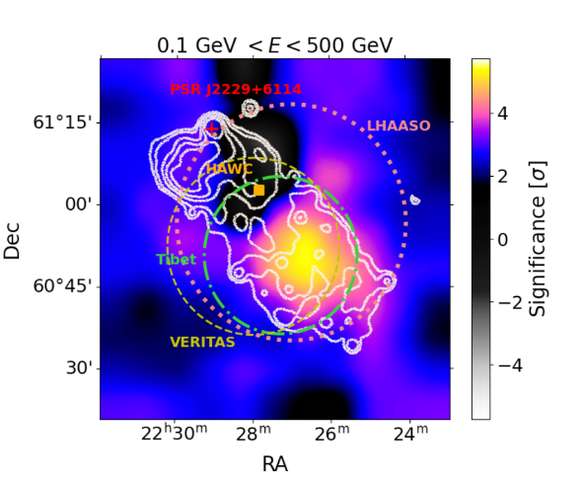
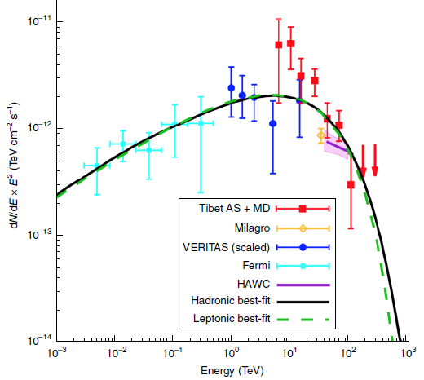
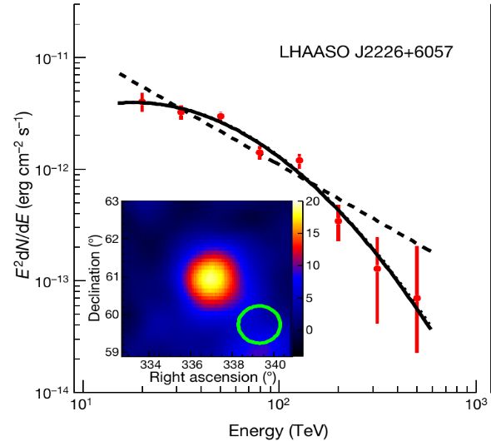




And finally… The Supernova Remnants
LHAASO J2226+6057
MAGIC coll. 2023
Fang+ 2022
Tibet AS collaboration 2021
Cao+ (LHAASO coll) 2021
Fermi-LAT and MAGIC detection favoured hadrons from SNR/MC interaction
Propagation study
Gamma Cygni (MAGIC collaboration 2019)
Celli Talk Gamma2022
W28 (Aharonian et al. 2008)
Notes:
Le SNR sono fondamentali anche per lo studio sulla propagazione dei raggi cosmici ma non ho tempo di parlarvene quindi credetemi sulla fiducia o andatevi a guardare qualche seminario/presentazione/articolo
MAGIC: evidenzia come la morfologia cambia con l'energia (ad alte energie solo la coda come anche al GeV) → modello adronico favorito

Slide 31
More kinds of source is "mel che one"
Vieu&Revill 2023

Slide 32

HIGHEST ENERGY SENSITIVITY
WIDE BAND SENSITIVITY
GOOD ANGUKAR RESOLUTION
NEUTRINOS
MC&Giuliani 2023

Slide 33

What we need in the next future?
Wide FoV with almost homogeneous off-axis acceptance
  Multi-target fields, surveys, and extended sources (GC, SNRs, TeV halos)
  Enhanced chance for serendipitous discoveries
Sensitivity: better than current IACTs (E > 10 TeV):
  Extended spectra for PeVatron confirmation and lepto/hadro origin discerning (SNRs, Micro-quasars, PWN)
  Diffusion coefficient constraints (Gamma-Cygni, SNRs, TeV halos)
Energy/Angular resolution: ≤ 10% / ≤ 0.1° (E ≤ 10 TeV)
  Characterize extended sources morphology
    Energy dependence
    Identification acceleration regions
  MW association
  Spectral Shape (hadrons vs leptons)
                And we would like also
                a neutrino detection, thanks!

Slide 34

The current VHE sky
Morlino's talk at CTA CM in 2022

Slide 35

The future VHE sky
Morlino's talk at CM in 2022

Slide 36












Hoffman&Zanin 2023
CTA North (La Palma)
Serra La Nave
(Sicily)
Teide Observatory
(Tenerife)
CTA South (Cile)
ASTRI Mini-Array
Sensitivity
Scuderi et al. 2022, JHEAP, 35, 52
Vercellone et al., 2022, JHEAP, 35, 1
D'Aì et al., 2022, JHEAP, 35, 139
ASTRI Mini-Array
Angular Resolution
CTA Sensitivity
CTA Angular Resolution
CTA website (https://www.cta-observatory.org/science/ctao-performance/#1472563157648 91558872-faf1)
1 telescope operative → in the next one-two months!
3 telescopes operative → early 2024
Complete Array→ by the end of 2024
LST1, La Palma
(Canarian Islands)

Slide 37


CTA&ASTRI Mini-Array
Angular
resolution
Sensitivity
Sensitivity: better than current IACTs (E > 10 TeV):
  Extended spectra and cut-offs contsraints
Energy/Angular resolution: ≤ 10% / ≤ 0.1° (E ≤ 10 TeV)
  Characterize extended sources morphology
Vercellone+ 2022,
Scuderi+ 2022,
CTA website,
MC&Giuliani 2023

Slide 38






PI: Giovanni Pareschi
PM: Salvo Scuderi
PS: Andrea Giuliani
The ASTRI Project
(Astrofisica con Specchi a Tecnologia Replicante Italiana)
ASTRI-Horn Prototype
ASTRI Mini-Array
9 ASTRI Telescopes at Teide
INAF "Flag Project" funded by MIUR → end-to-end prototype for CTAO at Serra la Nave (Mount Etna, Sicily)
First Crab detection above 5 sigma (Lombardi et al. 20)
Structure and mirrors selected for CTA SSTs
INAF commitment with the Italian government and international partners (University of Sao Paulo/FPESP - Brazil, North-West University - South Africa, IAC - Spain) [more than 150 researchers]
Dedicated Funding
Being deployed at the Teide Observatory (Tenerife, Canarian Islands) in collaboration with IAC

Slide 39
ASTRI Mini-Array Core Science
at the Observatorio del Teide
Vercellone et al. 2022
ASTRI Mini-Array expected Performances
ASTRI Mini-Array Core Science and Simulation Setup
Pillar-1: Origin of Cosmic Rays
Pillar-2: Cosmology and Fundamental Physics
Gamma-Ray Burst and Multi-Messangers Astrophysics
Non Gamma-ray Astrophysics
Multi-wavelength opportunities
Conclusions

Slide 40



ASTRI Mini Array & Pevatron hunting: SN 106.3+2.7
Morphology and spectrum from VERITAS [LHAASO points added in a second moment]
Detection @100TeV w ASTRI MA (200h exp) with high significance
200h
Vercellone+ 2022
Tibet AS collaboration 2021
Cao et al. 2021
With the ASTRI-MA angular resolution:
association of the SNR with the Molecular cloud, separating it from the pulsar
different morphologies at different energies

Slide 41







ASTRI Mini Array & Pevatron hunting – eHWC 1907+063
Aliu et al. 2014
Vercellone+ 2022
Morphology from VERITAS (Aliu et al. 2014)
PL spectrum from HAWC (Abeysekara et al. 2017) [LHAASO points added in a second moment]
Detection @100TeV w ASTRI MA (100h exp) with high significance
ASTRI MA, in the near future, will be the only instrument able to resolve TeV extended sources
ASTRI MA
100h
Cao et al. 2021
[Different scale]
ASTRI-MA overlapped w LHAASO
ASTRI-MA
HAWC
200h
Abeysekara+ 2017
Crestan+ 2021

Slide 42



CTA North (La Palma)
31 countries
About 1400 people
CTA South (Cile)
Notes:
In particolare ero qui per questo progetto

Slide 43
CTA and the PeVatrons

Slide 44

CTA key Science Projects
B.L.
50h deep observation of RX J1713.7-3946 (morphology studies)
50h follow up of the 5 best PeVatron candidates
PeVatron
Galactic Center
(see Pintore's talk )
Star Forming Regions
>500h on Galactic Centre Region
40h on Westerlund 1
130h on Cygnus
Other sources no linked to PeVatrons

Slide 45
Works in progress

Slide 46


Sensitivity of the Cherenkov Telescope Array to spectral signatures of
hadronic PeVatrons with application to Galactic Supernova Remnants
CTA Consortium paper, 2023
Spectral cutoff detection maps for 10h
Spectral CO detection vs source extension
PeVatron Test Statistic (PTS) method
PeVatron Detection maps (point-like sources)
Follow-up observations with high Night Sky Background conditions → PeVatrons studies are possible and do not subtract observation time to other KSP

Slide 47
Star Forming Regions: YMSCs et al.
Massive star clusters (PeVatrons):
  Model ready (Morlino et al 2021),
  analysis for Cygnus X region [S-w-CTA], Westerlund 1 [S-w-CTA] almost done, Westerlund 2 under progress
  Drafting not started yet
Isolated Massive Stars (Stellar wind contribution to GCRs):
  Analysis and models for HH80-81 (YMS) and BD 43 (massive runaway) underway, model ready.
  Model for YMSCs under progress.
  Drafting not started yet.
  Inclusion of Eta Carina and Gamma2 Velorum under discussion
Starburst galaxies (proving gamma-ray/dense gas correlation → increasing SF and SN activities):
  analysis + model for starburst galaxies (NGC 253, M82, Arp220 [S-w-CTA]),
  drafting of this section done partly, needs to be revised
• Gamma-ray - star formation rate correlation:
  Model ready (by P. Kornecki)
  Drafting started
From 2023 Consortium meeting

Slide 48

TeV halos
From 2022 Consortium meeting
Preliminary population studies show that CTA could detect a significant fraction
of such TeV halo sources, and resolve the shape of their profile for a number of
such objects depending on the realization of intrinsic properties.
However, in this work all PWNe are assumed to develop a pulsar halo, if not then results need to be rescaled according to the proper fraction!
LHAASO J2108+5157
Discover in the UHE domain w no PSR in 1 deg!
Inside the Cygnus Region
Association with a MC confirmed
49.3h with LST (June-September 2021) and 1D spectral analysis (point-like assummption) [3.7sigma at E>3 TeV]
→ ULs (2.2 sigma) 300GeV-100 GeV but important constraints through combination with LHAASO, Fermi-LAT and XMM-Newton (ULs)
TeV halo and MC interaction possible but with challenging requirements → complete modeling (combined haronid/leptonic component)
Notes:
Dalle slides CTA general meeting 2022:
Gamma-ray pulsar + PWN/TeV halo:
– Self-consistent leptonic scenario of emission explaining both prominent peaks in the SED
– Low magnetic field required by X-ray ULs - seems to be consistent with TeV halo hypothesis
Interaction of relativistic protons with molecular clouds:
– Acceleration site unknown
– Hard proton spectral index 0.5±0.3 needed to explain the emission - can be explained if gas clumps are present in a SNR shell,

Slide 49
IMPORTANT MESSAGES
A very brilliant future with ASTRI Mini-Array and CTA and synergy with current VHE instruments
PeVatrons could be studied also in HNSB conditions → no time taken to other KSPs
Deep observations are fundamental to obtain key results on some candidate PeVatrons (due to the fact that they are extended)
A lot of work to do → we need more specific and "focused" information (taking into account the Observatory role of CTA→ 40% of time for KSPs):
  choice of a few LHAASO "hadronic PeVatrons" candidates → possibly of different kinds (e.g. SNR, YMSC)
  estimation of exposure time necessary for these sources
  simulation of observation from the two sites and combination of the results → focus on the morphology reconstruction

Slide 50


Grazie
a tutti voi!

