Slide 1
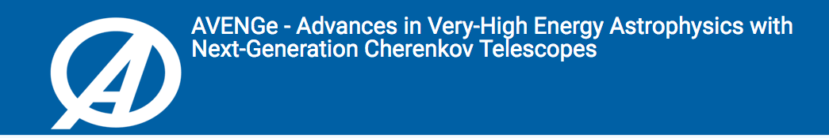

31 May 2023
The Cherenkov Telescope Array in multi-wavelength context
Elena Pian
INAF-OAS, Bologna
Collaborators: E. Cappellaro, F. Ambrosino,
M. Giroletti, P. Schipani, L. Zampieri

Slide 2
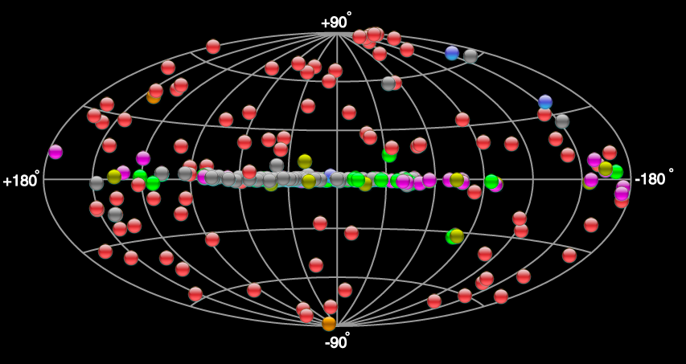
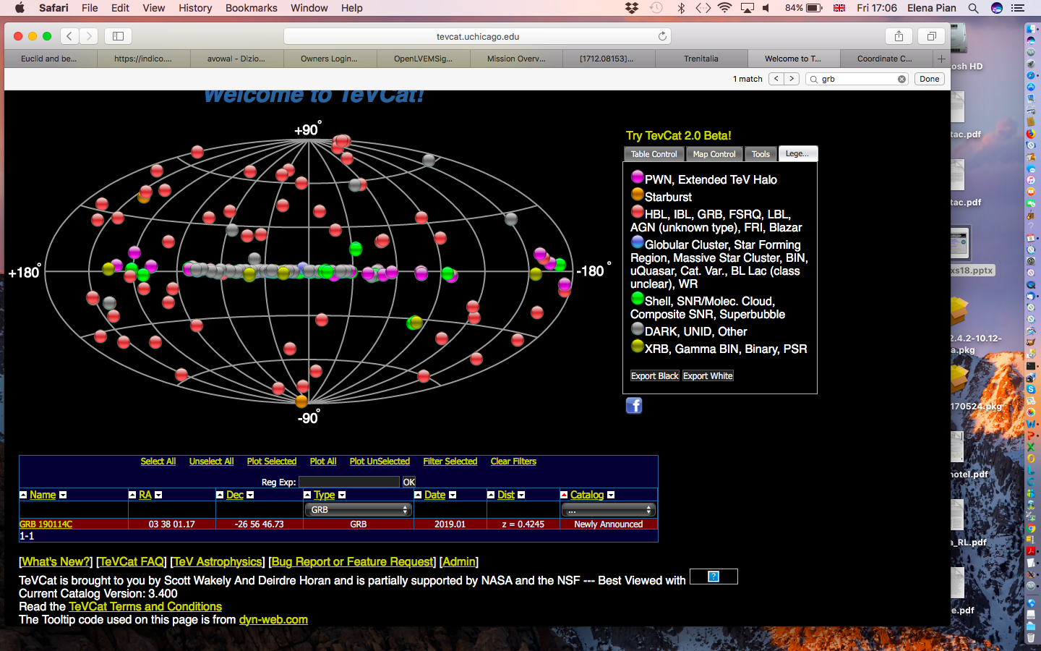
TeV Sky interactive map
http://tevcat.uchicago.edu
GRB221009A (z = 0.15)
(M82, NGC253)
~250 sources
(~25% unidentified)
SNe, TDE, FRB, dark matter decays…

Slide 3
The CTA+ radio/NIR/optical package
The Cherenkov Telescope Array Plus program (2023-2025), funded by the EU Recovery Plan (PNRR) and led by INAF, includes a package for the implementation or upgrade of 4 ground-based radio, NIR and optical facilities, of which 3 are oriented to the observation of TeV sources, and 1 – to be prototyped on the ASTRI MiniArray - represents an optimal secondary use of the SSTs:
VST Polarimeter (PI: P.Schipani, Naples)
E-SiFAP – optical/NIR photopolarimeter for TNG (PI: F.Ambrosino, Rome)
RadioFast VLBI (PI: M.Giroletti, Bologna)
Stellar Intensity Interferometry using the SSTs (PI: L.Zampieri, Padua)

Slide 4

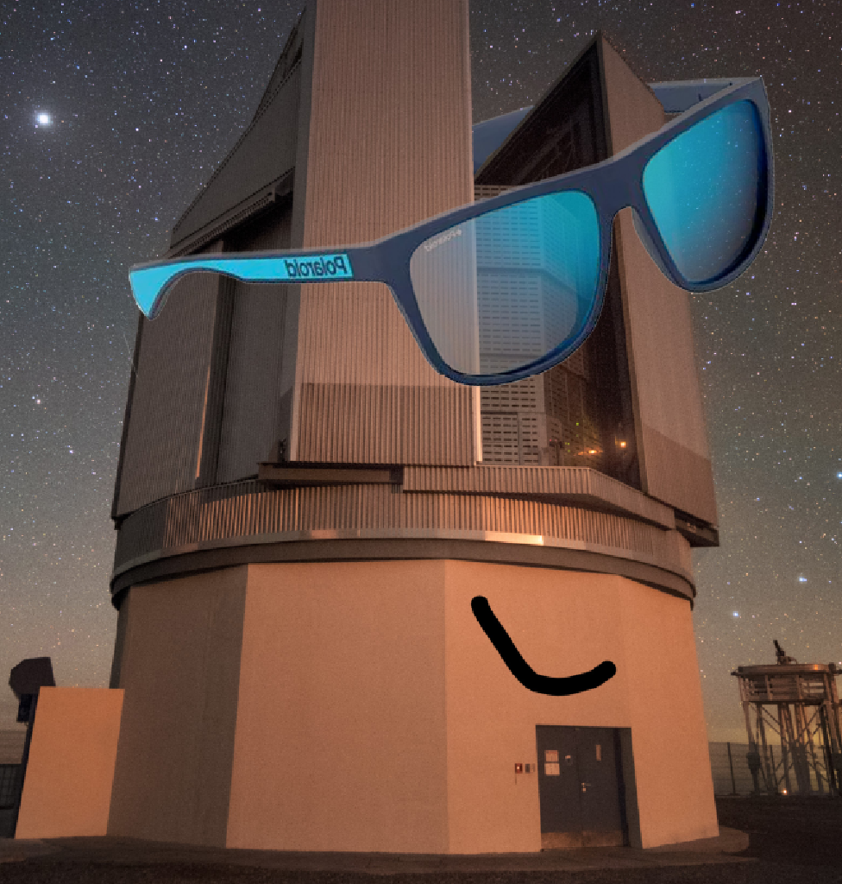
VSTPol: large field-of-view polarimetric camera for surveys

Slide 5
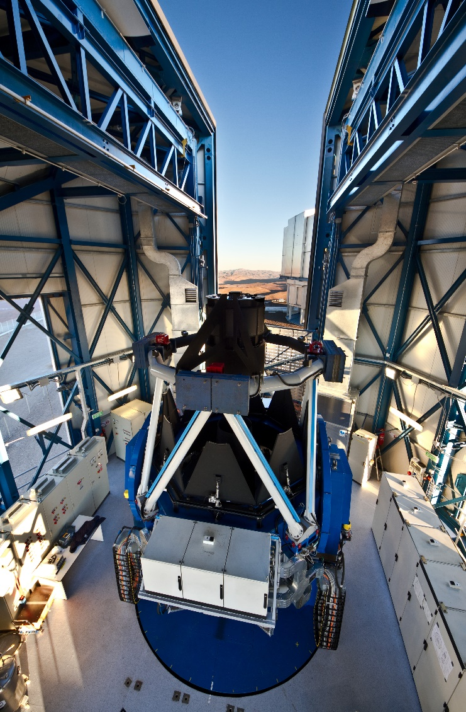
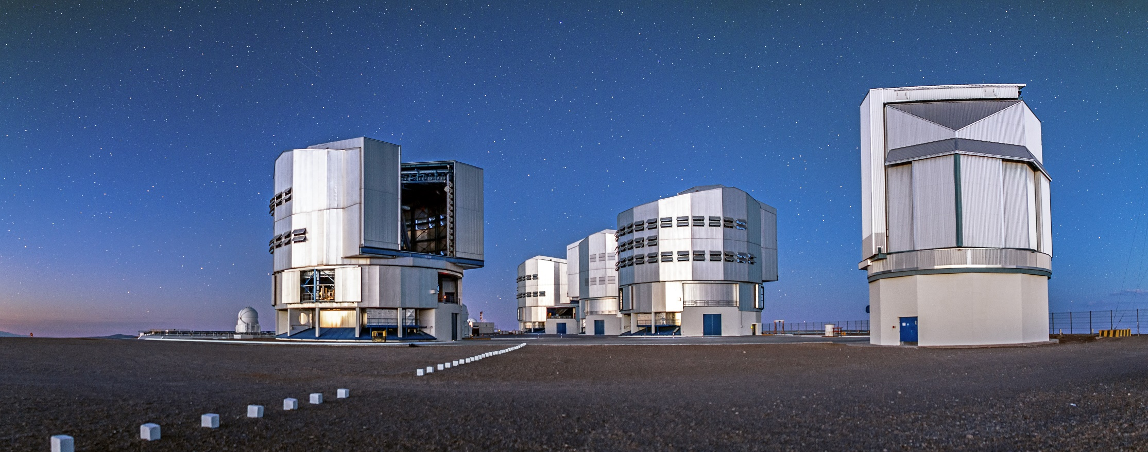

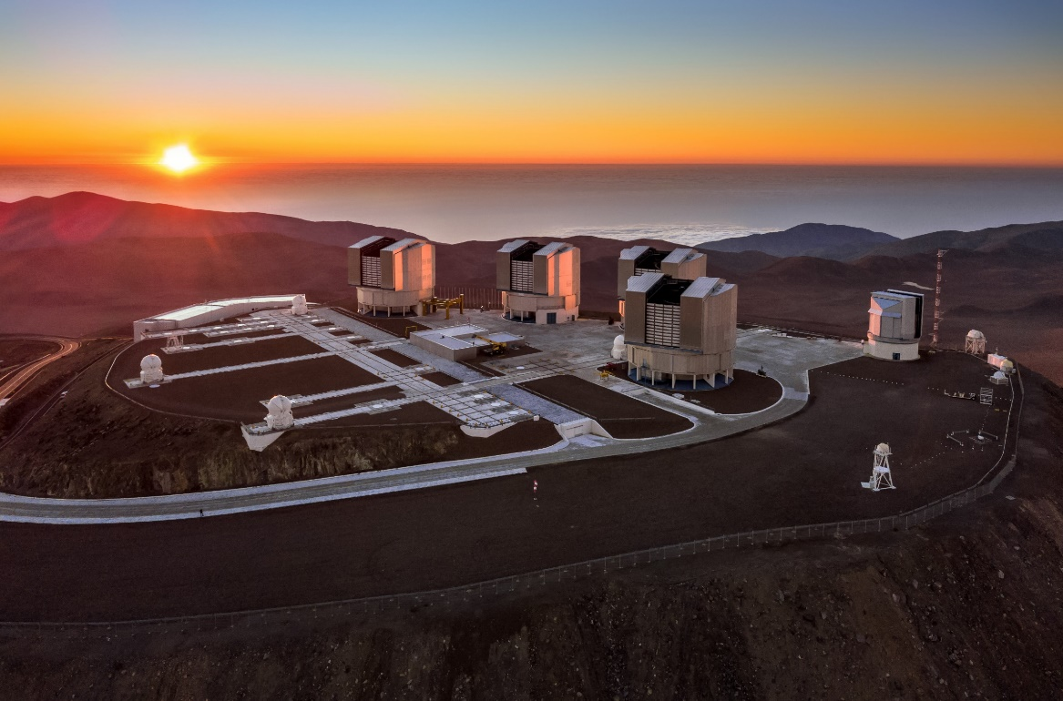
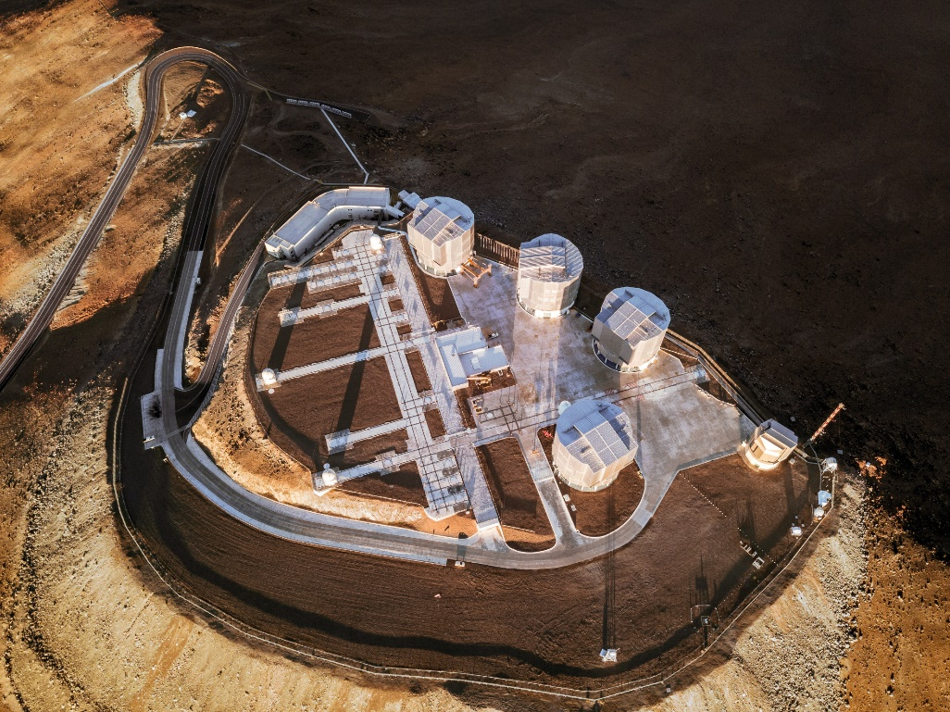
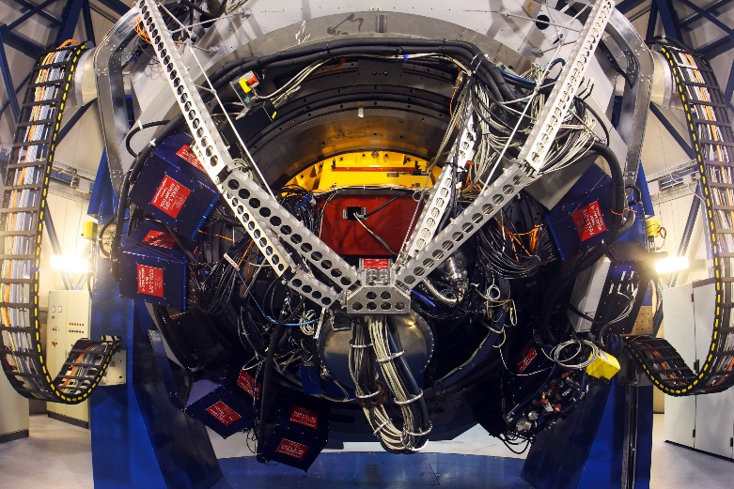

Paranal, same site of CTA South
VLT Survey Telescope (2.6m)
now managed by INAF (no longer by ESO)

Slide 6
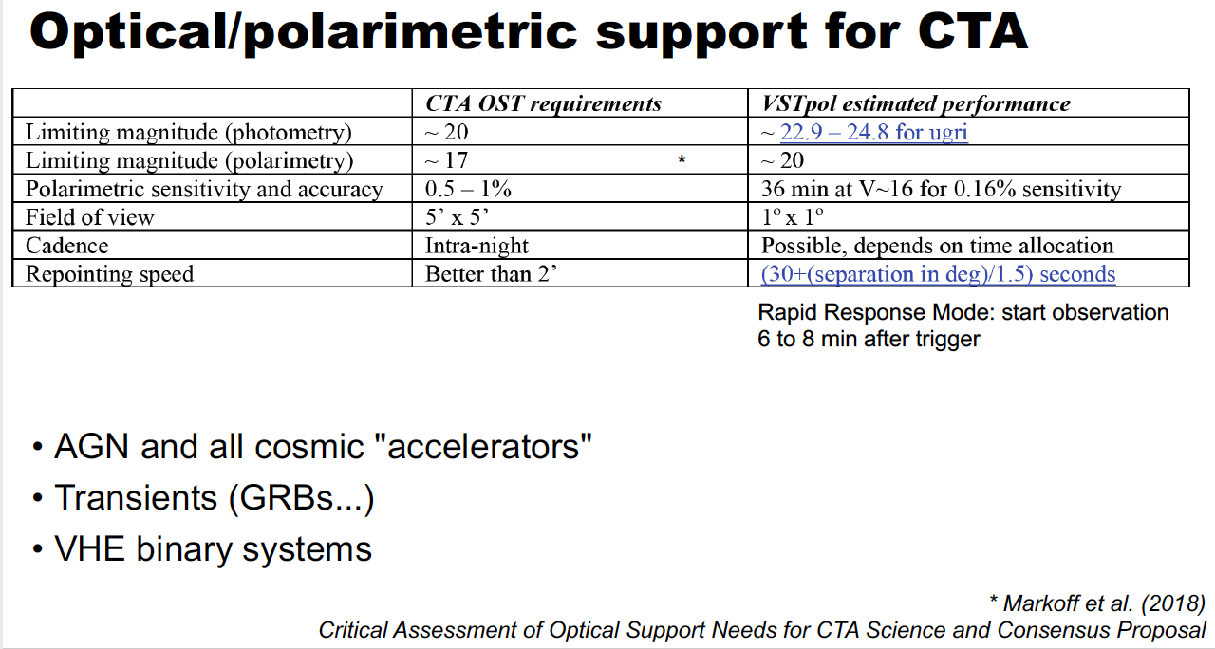
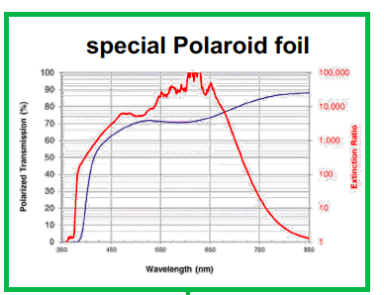
Design and Implementation will be coordinated by the INAF Astronomical
Observatories of Brera and Capodimonte

Slide 7
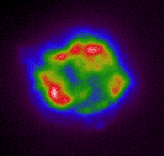
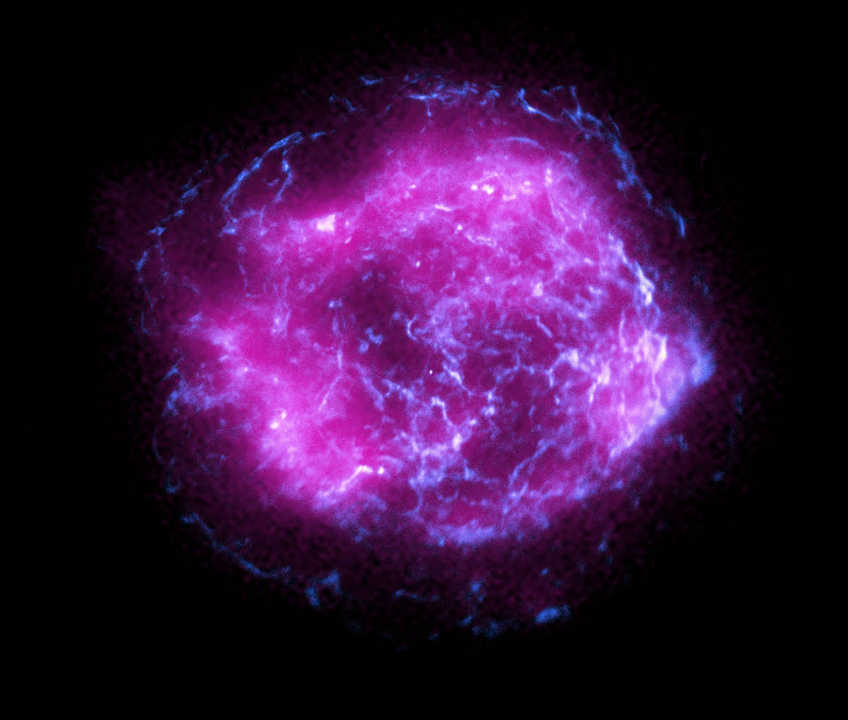
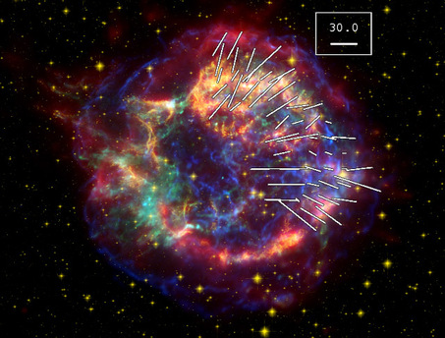
SNR Cas A (3 kpc) in polarized light
Chandra + IXPE 3-6 keV
IXPE
“
arcsec
Credit: NASA
X-ray polarization (2-5%) traces magnetic field geometry and orientation; sub-mm polarization (30%) traces dust formation and orientation
Dunne et al. 2009; Vink et al. 2022
L.Dunne, U.Nottingham; X-ray: NASA/CXC/SAO; Optical: NASA/STScI; Infrared: NASA/JPL-Caltech

Slide 8
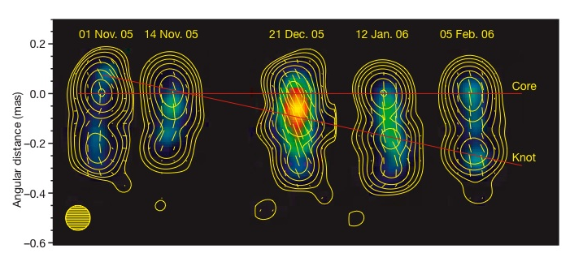
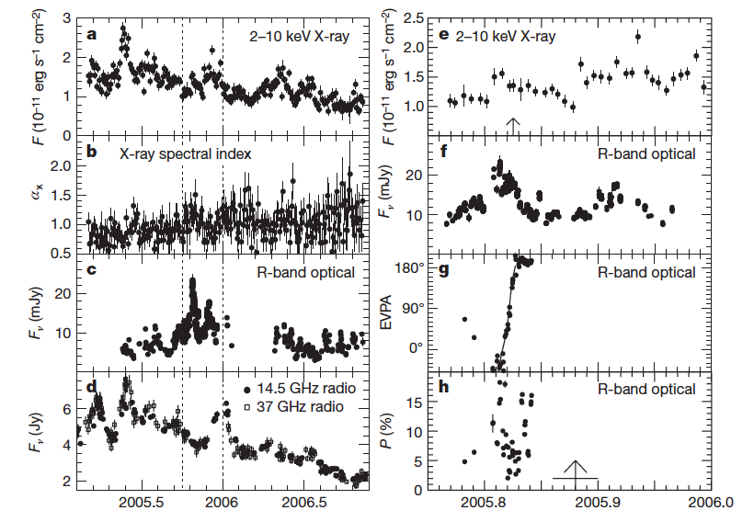
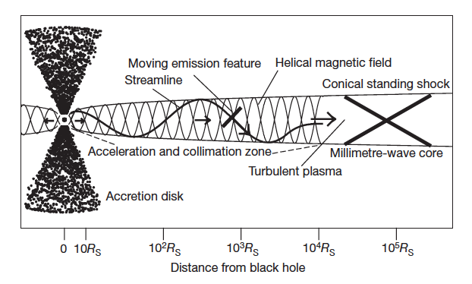
Multi-wavelength observations of BL Lac (z = 0.069)
Multi-wavelength outburst
Correlates with radio blob
development and polarization
Variation suggests helical
Magnetic field
5c
VLBA observations at 43 GHz
>0.2 TeV
knot crosses core
Marscher et al. 2008
Time (yr)

Slide 9
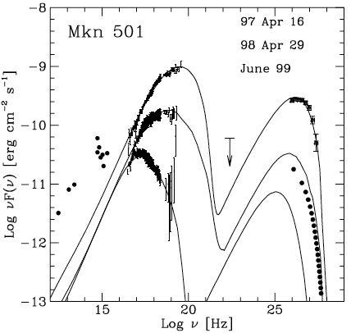
“Extreme” synchrotron blazars: Markarian 501
(z = 0.034)
16 Apr 97
29 Apr 98
Jun 99
Pian et al. 1998; Tavecchio et al. 2001

Slide 10
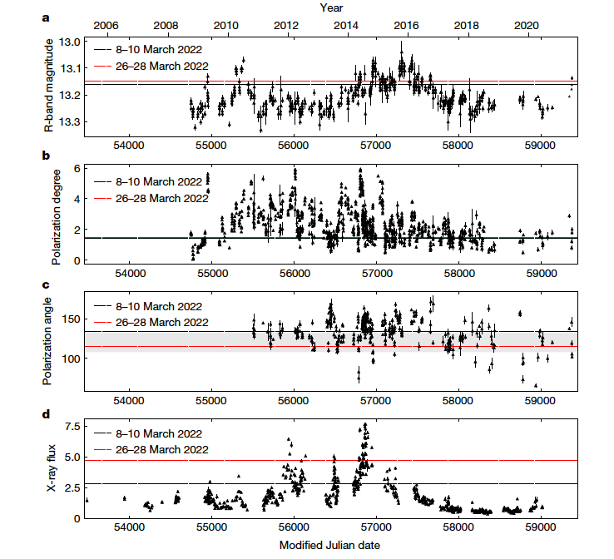
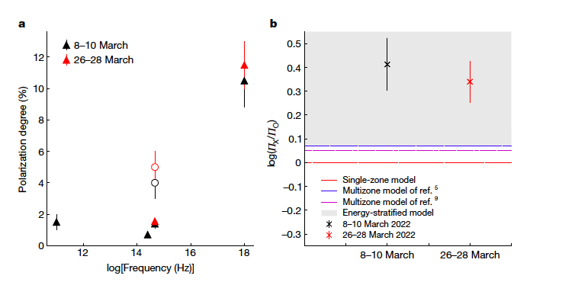
Markarian 501 (z = 0.034): multi-wavelength polarization
Direction of the jet
Polarization increases towards higher frequencies and does not vary between the 2 IXPE epochs; polarization angle is aligned with jet direction →
shock-accelerated, energy-stratified electron population model
Liodakis et al. 2022

Slide 11
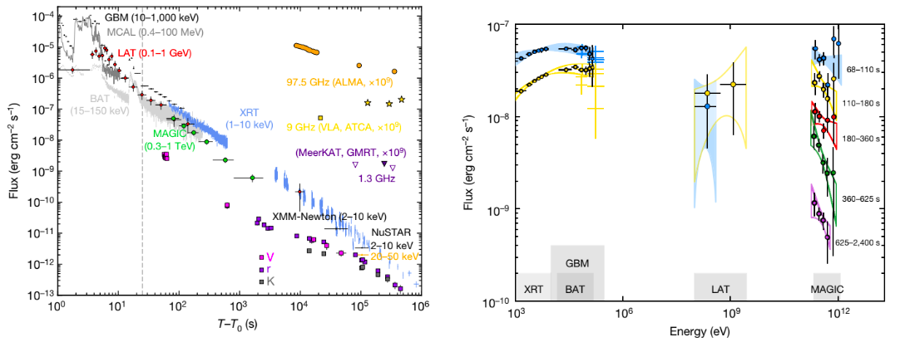
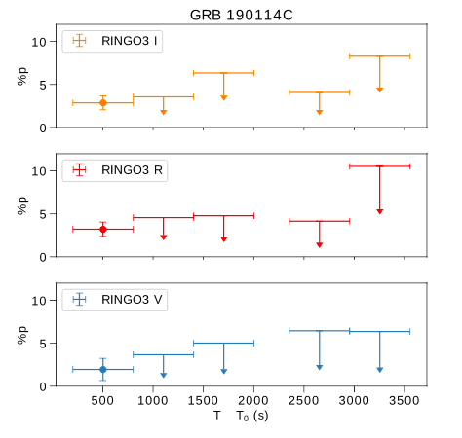
Optical polarization of the early counterpart of GRB190114C (z = 0.42)
MAGIC Collaboration 2019
Liverpool Telescope + RINGO3 polarimeter
Shrestha et al. 2022

Slide 12
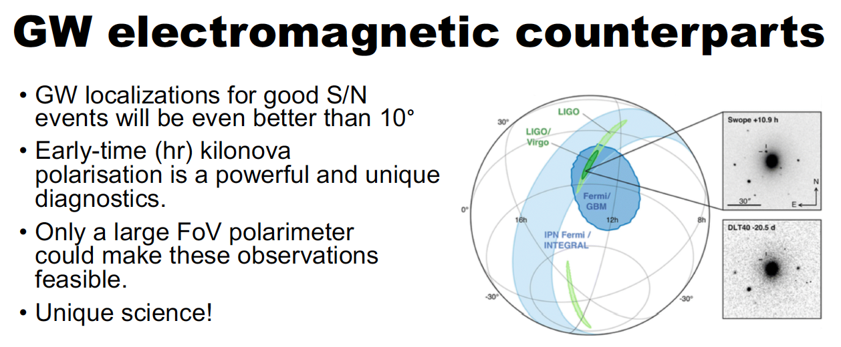
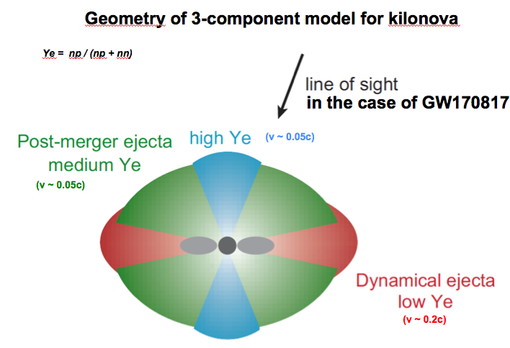
Kilonova AT2017gfo:
Upper limit on linear polarization ~0.5%
(Covino et al. 2017)
Tanaka et al. 2017; Pian et al. 2017

Slide 13
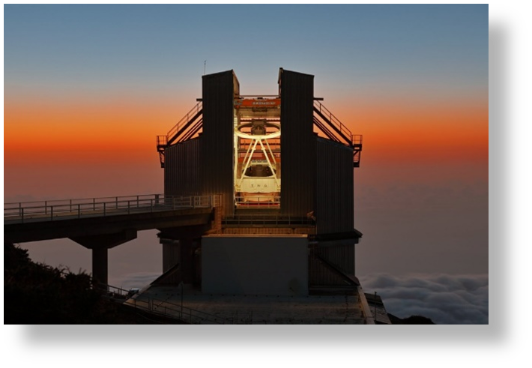
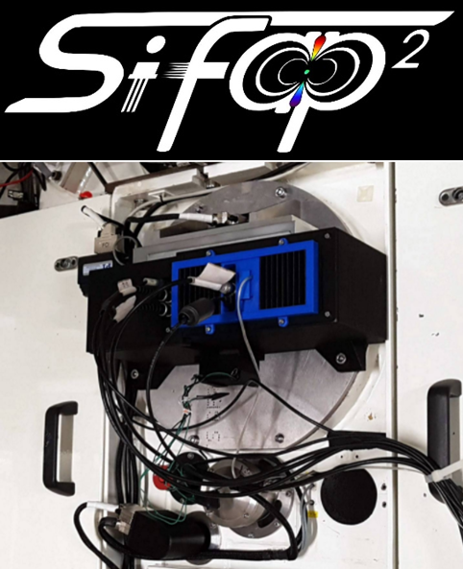
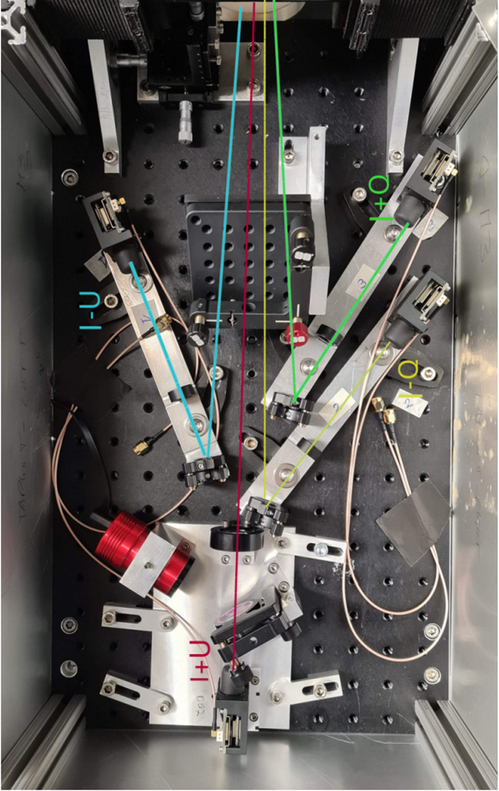
e-SiFAP: fast photopolarimetry in the optical/nIR bands
TNG (ORM) same site of CTA North
SiFAP4XP
SiFAP2/4XP heritage
Differential simultaneous fast (< 1 μs) photometry in the optical/nIR bands
Simultaneous optical/nIR measurement of linear polarisation
Versatile optomechanical configuration to be mounted at TNG (but in principle OK also for NTT, La Silla)
⇒ Optical/nIR follow-up of CTA targets, multiwavelength campaigns on transients

Slide 14
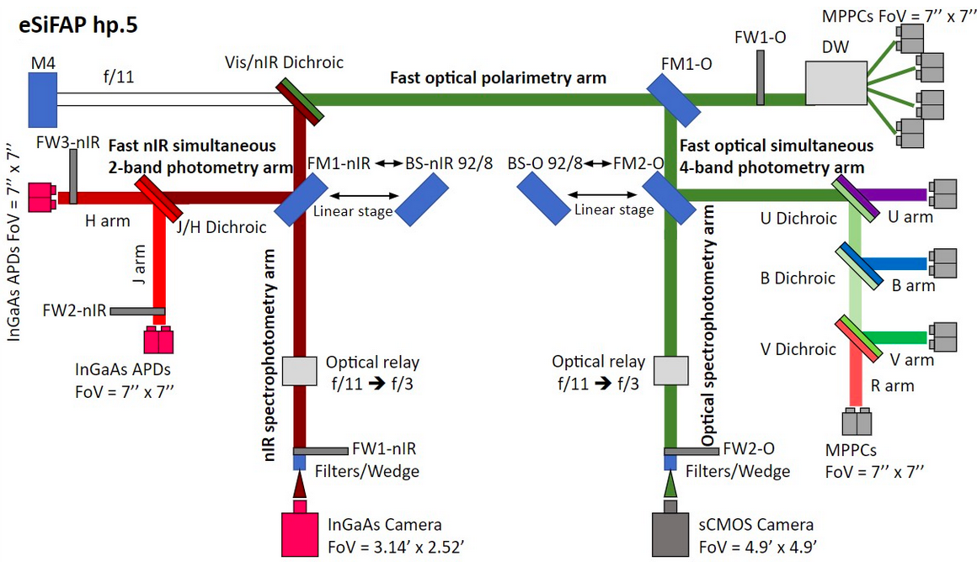

e-SiFAP instrument
Limit Vega magnitudes at TNG
( 1 s exposure time)
V ~ 21
J ~ 14.5-15
H ~ 13.5-14
K ~ 12-12.5
Optical photometry and polarimetry
NIR photometry

Slide 15
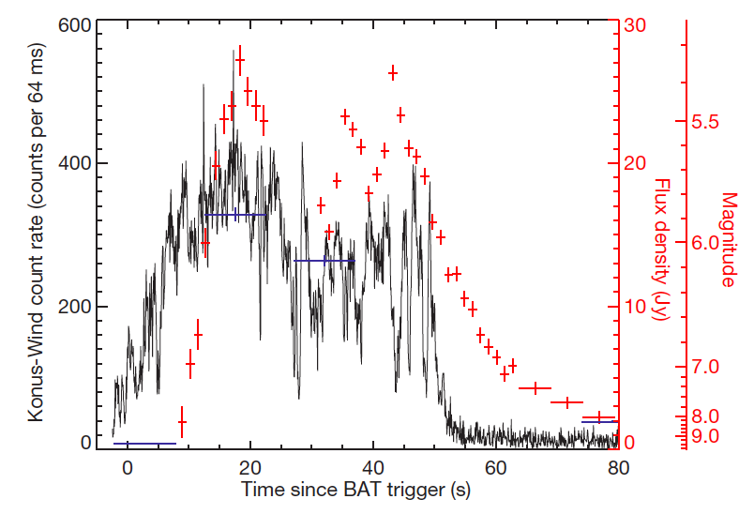
GRB080319B (z = 0.937)
REM+TORTORA
Racusin et al. 2008

Slide 16
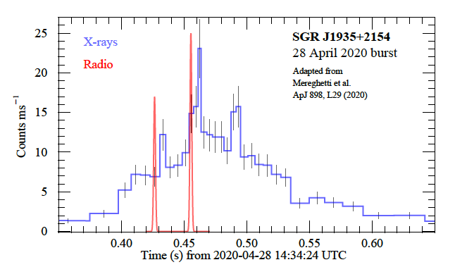
e-SiFAP Science
Over 1500 Fast radio bursts, millisecond flashes of GHz radiation (emitted energies of ~e40 erg), have been detected so far. They are extragalactic, but their optical/NIR counterparts are unknown. In April 2020 a Galactic FRB-analogue was detected also in hard X-rays from magnetar SGR J1935+2154
CHIME
INTEGRAL IBIS/ISGRI
Mereghetti et al. 2020; Tavani et al. 2020; Ridnaia et al. 2020; Nicastro et al. 2021

Slide 17
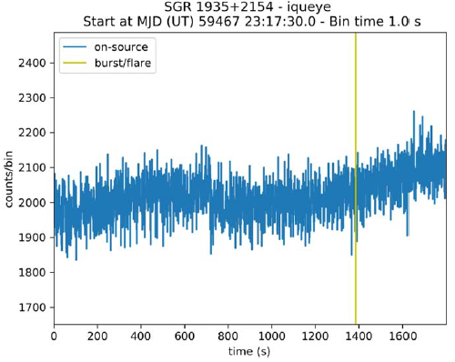
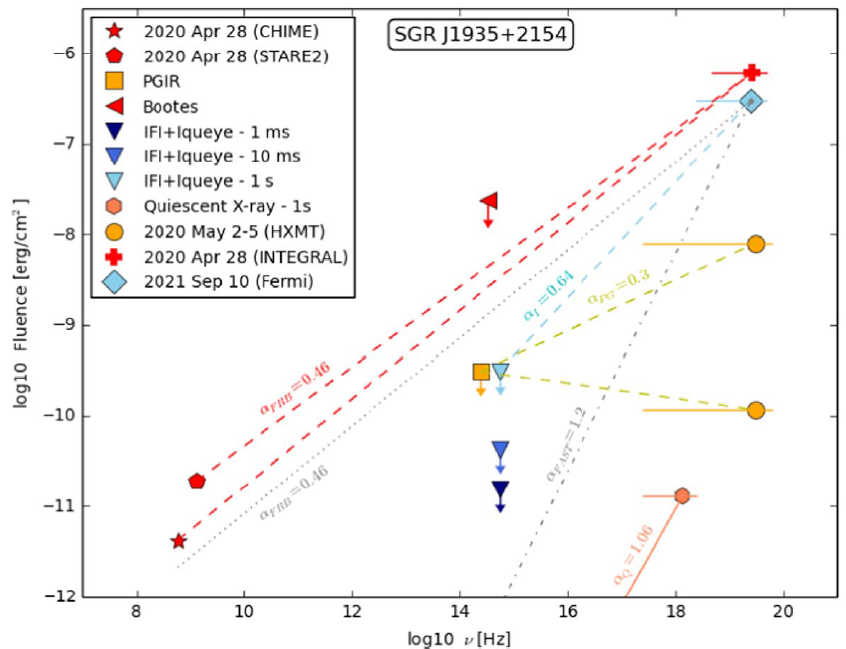
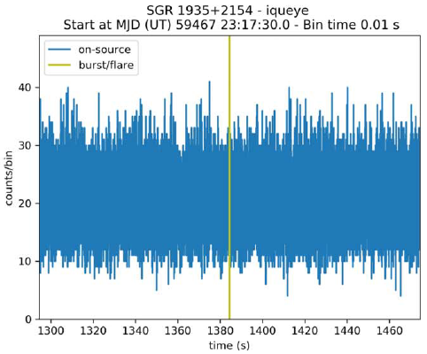
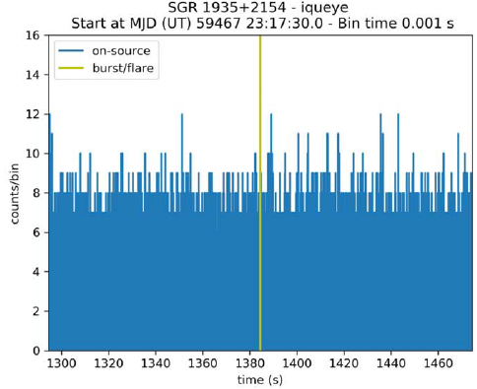
e-SiFAP Science
Search of variable optical counterpart of SGR J1935+2154 with 1.22 Asiago Telescope + Iqueye (time resolution down to ~1 ns) during the Fermi/GBM flare of September 2021
Av ~ 5.8
d ~ 4 kpc
Zampieri et al. 2022

Slide 18
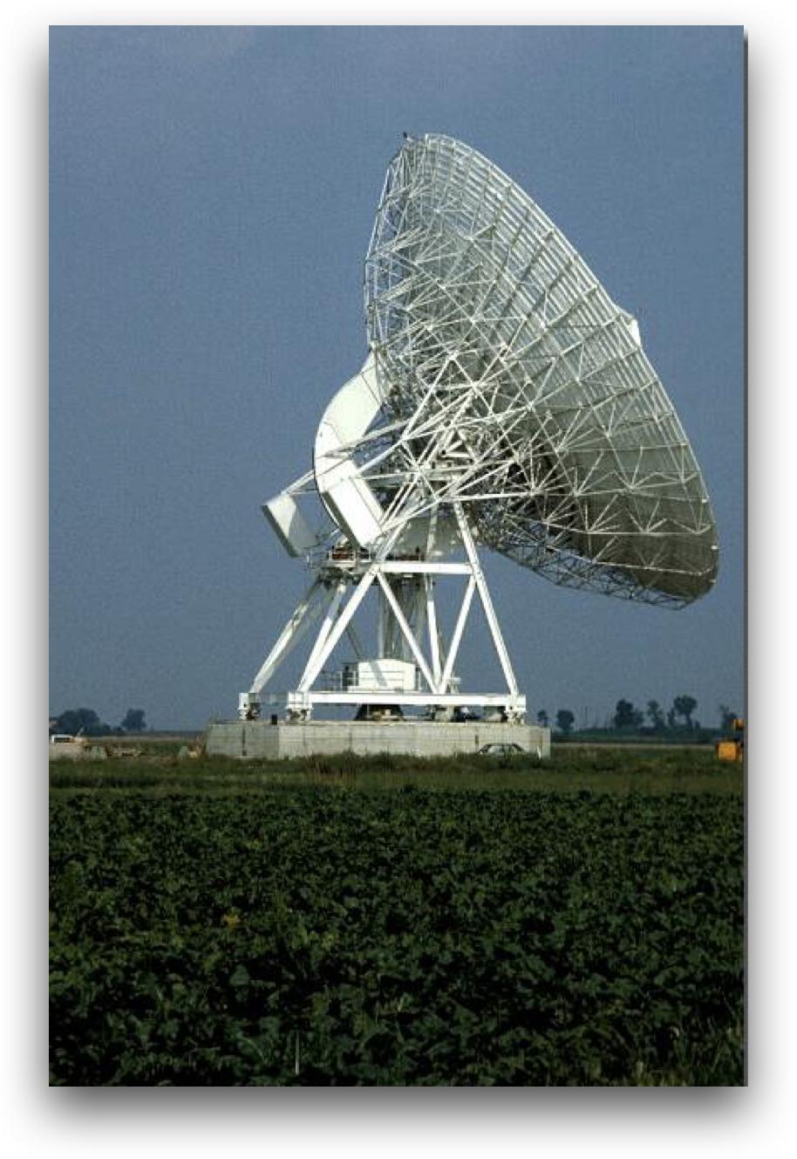
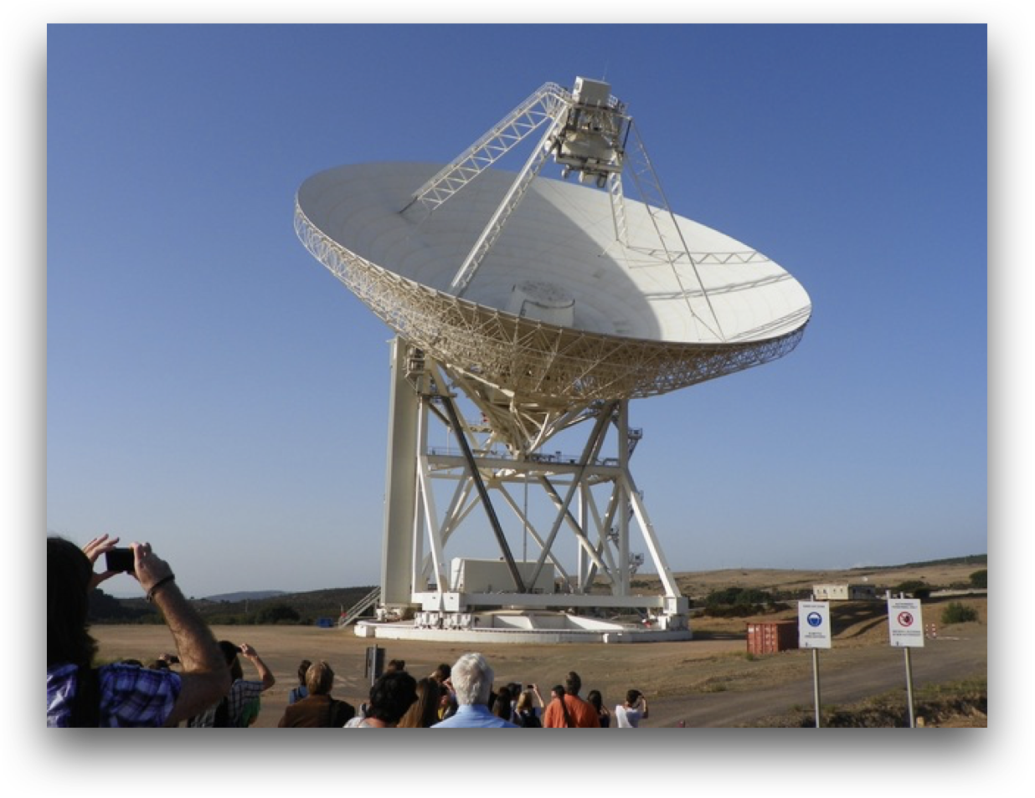
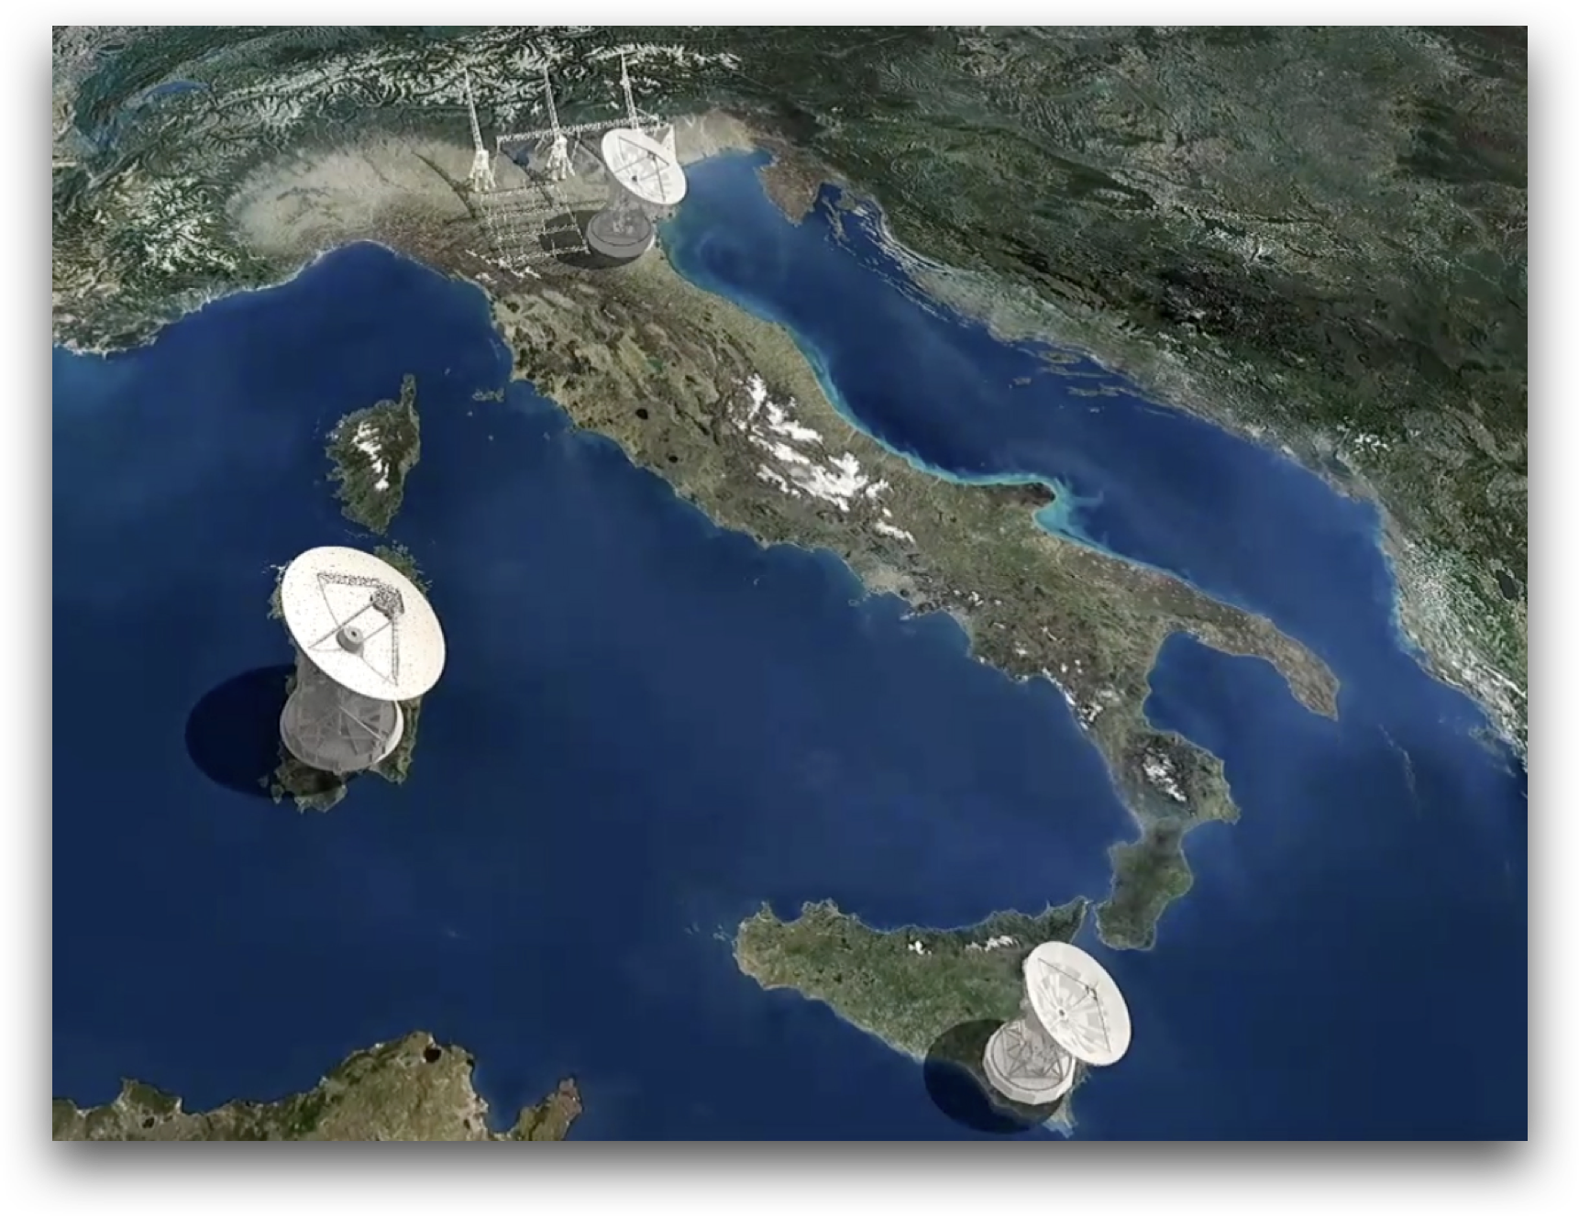
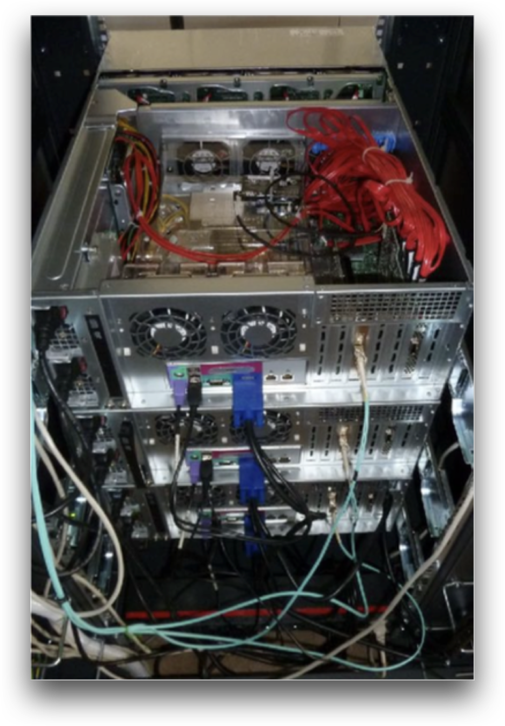
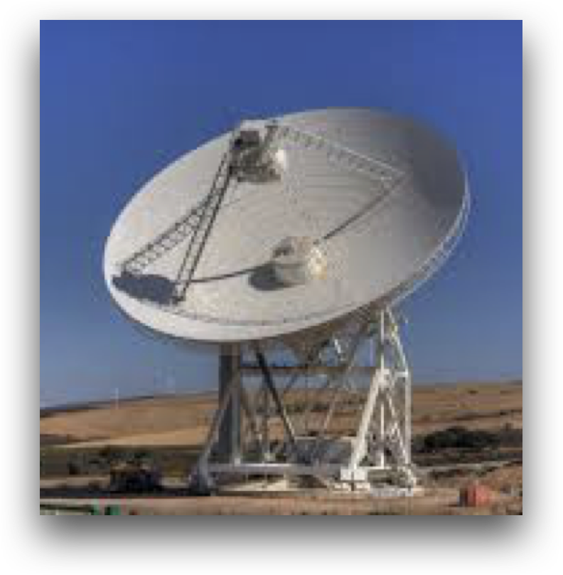
RadioFast VLBI
Sardinia, 64m, Medicina, 32m, Noto, 32m
Bologna, software correlator (DiFX)
Italian PNIR facility
INAF collecting area: 4825 m²
VLBA collecting area: 4909 m²
Notes:
Instruments scheme/upgrades, broad-band radio receivers brief Technical description, milestones… … [material from Marcello]

Slide 19
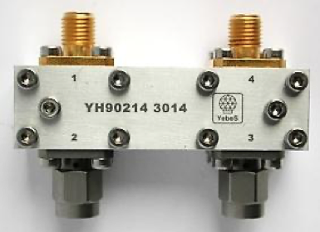
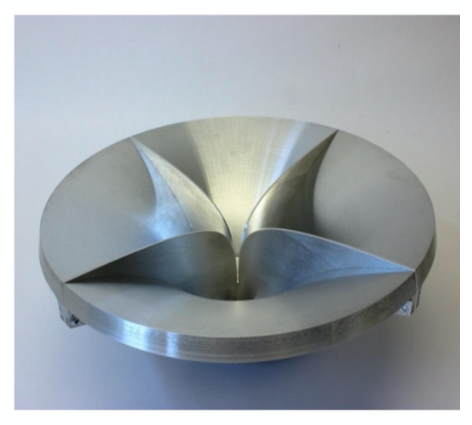
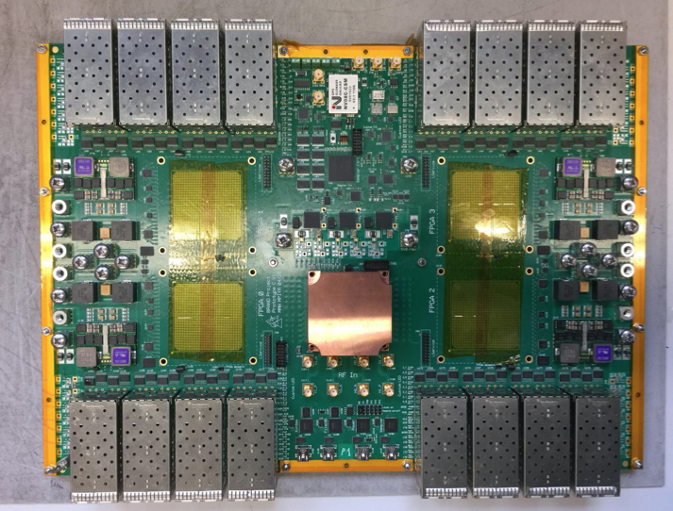

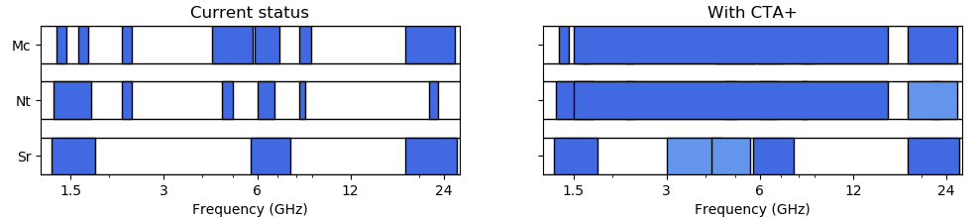
RadioFast VLBI
broadband receivers recommended as top priority technological development in EVN Science Vision Document for 2020-30
complemented with hardware (cpu/ram/storage) upgrades at national correlator & PON-SRT high-frequency investment
empowers Italian community with unique resource for privileged access to world-class facilities
Expertise acquired through RadioNet funded JRA indicates very limited risk
Notes:
see https://events.mpifr-bonn.mpg.de/indico/event/154/session/4/contribution/15/material/slides/0.pdf

Slide 20
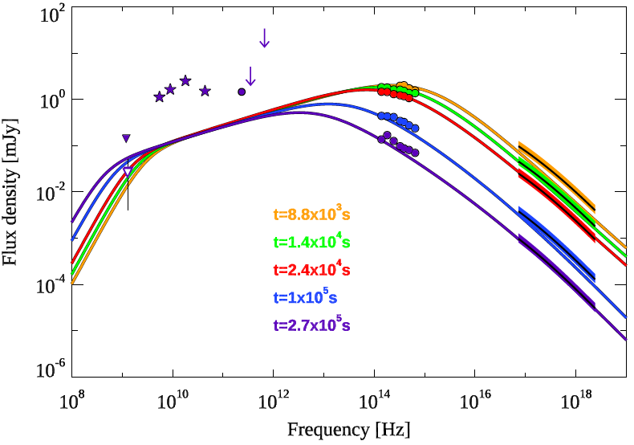
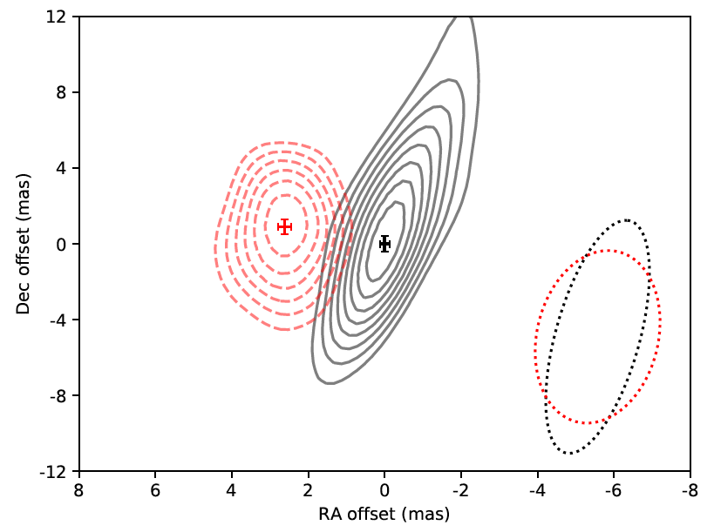
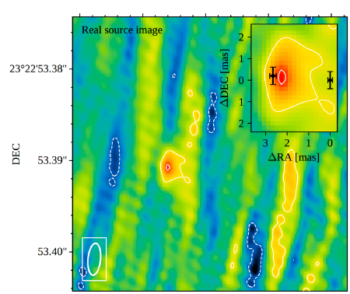
RadioFast VLBI Science
GRB190114C (z = 0.4245)
GRB170817A (40 Mpc), VLBI 4.5GHz
230 d
75 d
MAGIC Collaboration 2019
Mooley et al. 2018
βapp~ 3-5
Angular size of source is less than 2 mas, suggesting relativistic jet rather than cocoon (opening angle ~ 3 deg, Eiso,core = 3 e52 erg, viewing angle ~15 deg, Ghirlanda et al. 2019, Science)

Slide 21
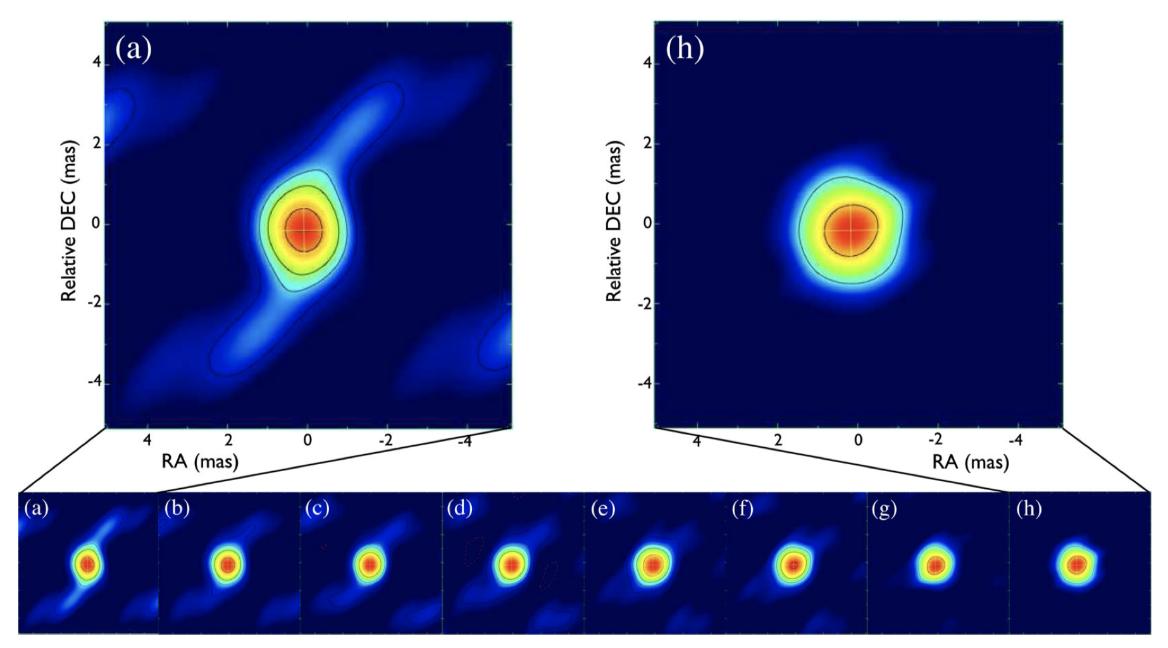
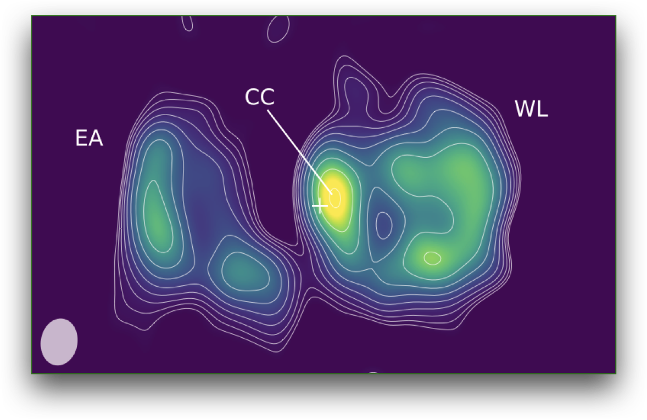
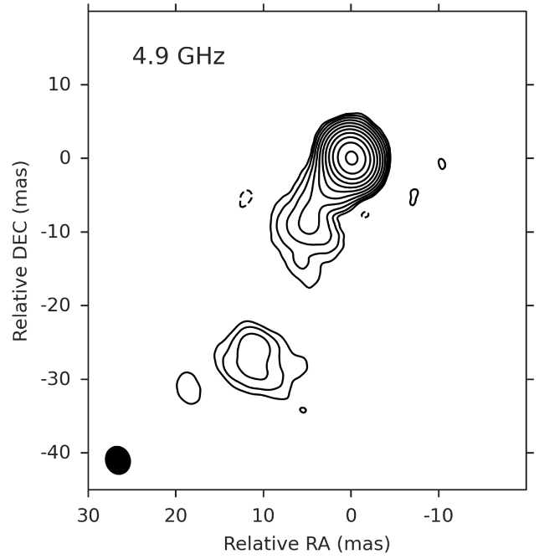
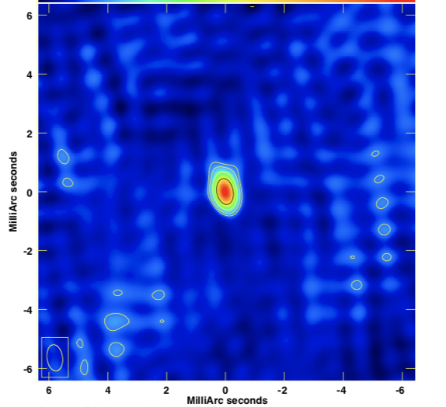

More RadioFAST VLBI Science
Galactic (VHE) transients: microquasars, novae
microquasar Cyg X-3, Egron et al. 2017
VHE nova RS Oph 2021, Munari, Giroletti et al. 2022
Extragalactic transients/variable: AGNs, TDEs, GRBs
neutrino blazar candidates
Nanci et al. 2020
221009A: the “BOAT”
Giarratana et al. in prep
TDE AT2019avd
Wang, Baldi, Giroletti+2022

Slide 22
SI³: Stellar Intensity Interferometry Instrument
Image reconstruction is feasible from the second-order coherence of light, measured as the temporal correlations of arrival times between photons recorded in different telescopes (this is obviously different from
Classical phase interferometry)
This technique connects telescopes only with electronic signals
and is practically insensitive to atmospheric turbulence and to imperfections in telescope optics.
Hanbury Brown & Twiss 1956; Glauber 1963; Dravins et al. 2013;
Abeysakara et al. 2020; Zampieri et al. 2022

Slide 23

SI³: Stellar Intensity Interferometry Instrument

Slide 24


Stellar Intensity Interferometry (SII) prototyped on the ASTRI MA
Degree of coherence of a source with angular size θ (in μarcsec) as a function of the telescope separation d
The ASTRI Mini-Array provides a suitable infrastructure for prototyping SII instruments
Main goal: Achieving optical imaging with resolution of ~100 microarcseconds using the long multiple baselines (36) of 9 SSTs

Slide 25


Stellar intensity interferometry Science
Dravins et al. 2013

Slide 26
Conclusions
The 4 facilities in WP1400 cover critical and unique aspects of CTA science:
Polarization (VSTPol), expected to accompany most of non-thermal radiation from the compact sources that will be primary targets of CTA. The VST polarimeter will also guarantee a large sky area coverage. Correlated operations with IXPE, LSST, radio arrays, multi-messenger.
(ultra)-rapid optical photometry (eSiFAP), optimally suited to sample the smallest variation timescales from stellar-size compact sources, like GRBs, PSRs and the elusive FRBs
broad-band radio spectroscopy and VLBI correlation performance, intended to sample simultaneously the radio emission of a range of relativistic Galactic and extragalactic CTA targets and improve the Italian competition and performance in the VLBI network
Intensity Interferometry, aimed at developing, using a subset of the CTA experiment, a pioneering technique with critical impact on the study of stellar structure and evolution

