Slide 1
HIGH-ENERGY VARIABILITY IN PWNe

Slide 2
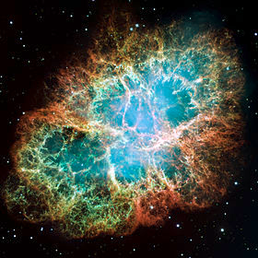
PWNe
PWNe are hot bubbles of relativistic particles and magnetic field emitting non-thermal radiation.
PWN
Originated by the interaction of the ultra-relativistic magnetized pulsar wind with the expanding SNR (or with the ISM)
Galactic accelerators. The only place where we can study the properties of relativistic shocks (as in GRBs and AGNs
Allow us to investigate the dynamics of relativistic outflows
SNR
PULSAR

Slide 3
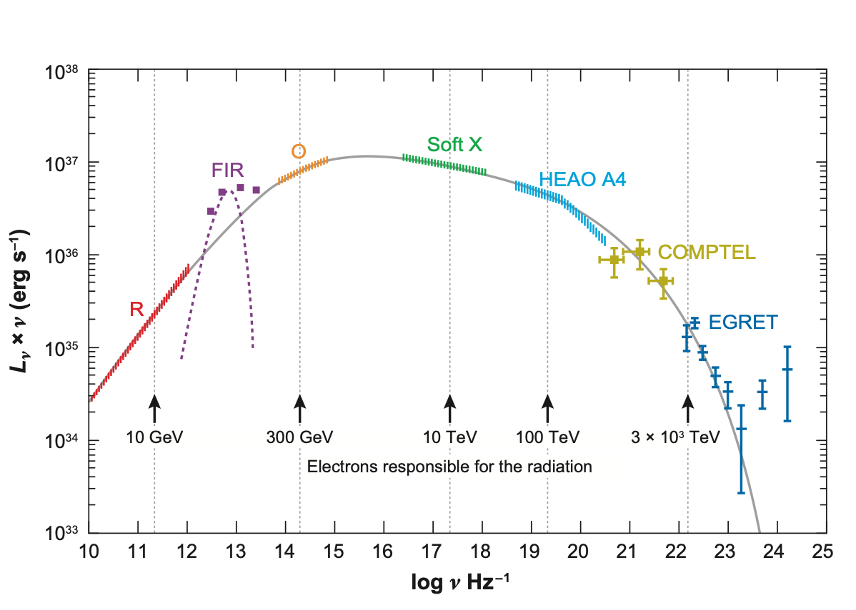
CRAB SYNCHROTRON SPECTRUM
High energy break
Low energy break
MeV cutoff
Hester 2008
Injection break
Synchr. cooling
Acceler. cutoff
The most efficient non-thermal accelerator.

Slide 4
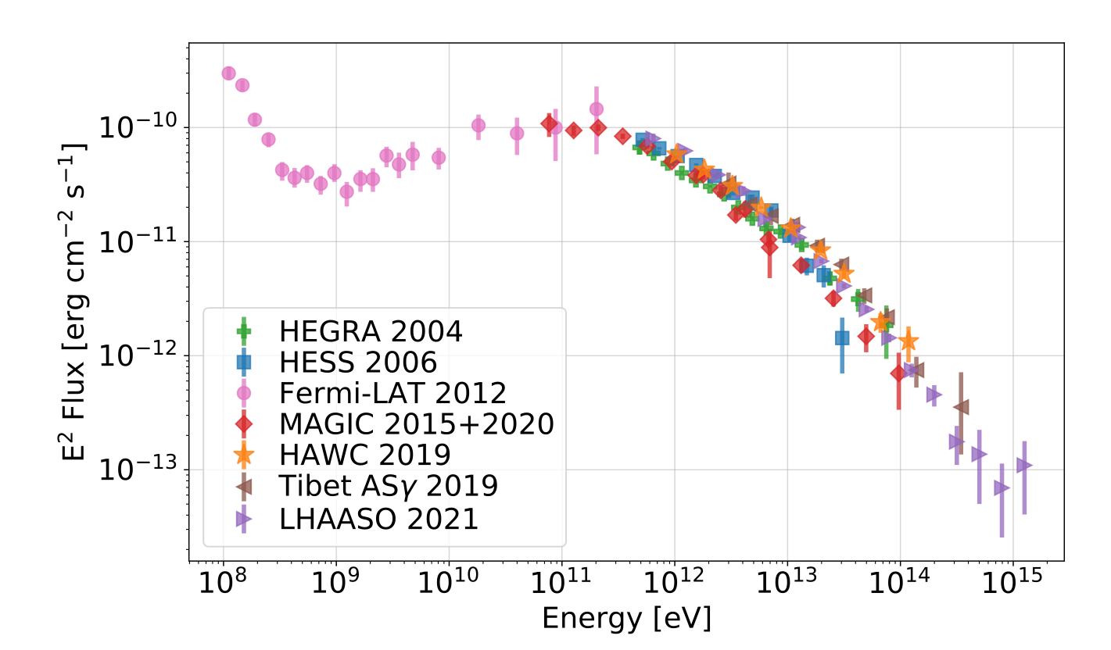
IC Gamma Spectrum
ONLY SYSTEM SSC DOMINATED
OTHER PWNE ARE NIR/FIR DOMINATED
TREND SET BY RADIO-OPT PARTICLES
X-RAY PARTICLES IN KN

Slide 5
ORIGIN OF THE SYNCHROTRON CUTOFF
Potential limited acceleration
$$\frac{L}{4πcR_{ts}^{2}}=\frac{1}{2}\frac{3Lt}{4πR_{n}^{3}}$$
$$\frac{L}{4πcR_{ts}^{2}}=P_{neb}=\frac{1}{σ}\frac{B_{ts}^{2}}{8π}$$
$$R_{ts}=\frac{1}{B_{ts}}\sqrt{\frac{σL}{c}}$$
$$\frac{eB_{ts}}{mc^{2}γ_{max}}=R_{L}=R_{ts}$$
$$mc^{2}γ_{max}=e\sqrt{\frac{L}{c}}=eΦ_{psr}$$
$$\frac{mc^{2}γ_{max}}{eB_{ts}}=R_{L}=R_{ts}$$
Acceleration limit at the TS
$$\frac{E_{max}}{eB_{ts}}=e\sqrt{\frac{σL}{c}}=eΦ_{psr}\sqrt{σ}$$
Magnetisation in the crab is just below equipartition
B ~ 150-120 uG

Slide 6
ORIGIN OF THE SYNCHROTRON CUTOFF
LOSS LIMITED acceleration
Comparing gyro-period wrt Synch Cooling time
$$τ_{gyr}=\frac{mcγ}{eB}$$
$$τ_{syn}=\frac{3m^{3}c^{5}}{2e^{4}B^{2}γ}$$
$$γ_{max}≃{10}^{8}\frac{1}{\sqrt{B}}$$
Maximum frequency is fixed
$$ν_{syn,max}≃150MeV$$
In crab the limits all coincide
Others all potential limited

Slide 7
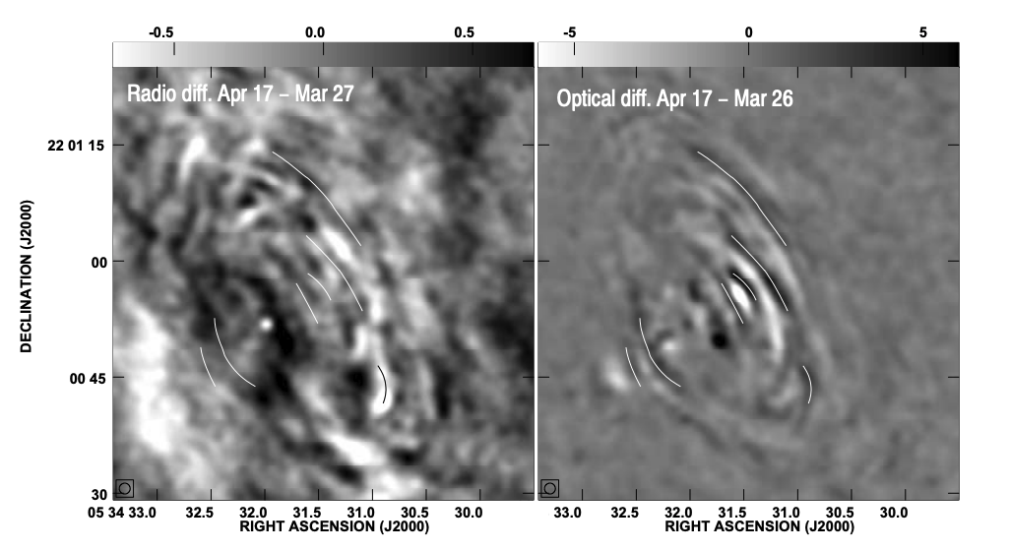
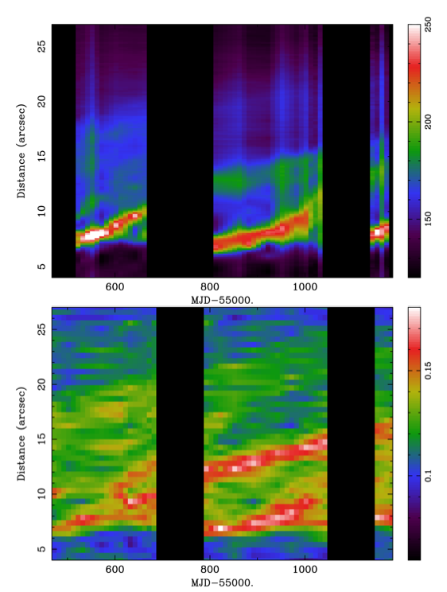
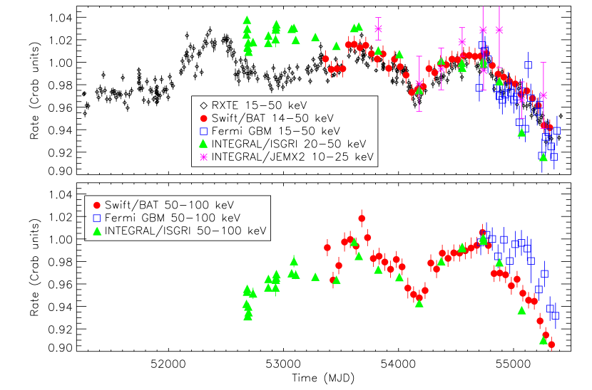
Variability at low energy

Slide 8
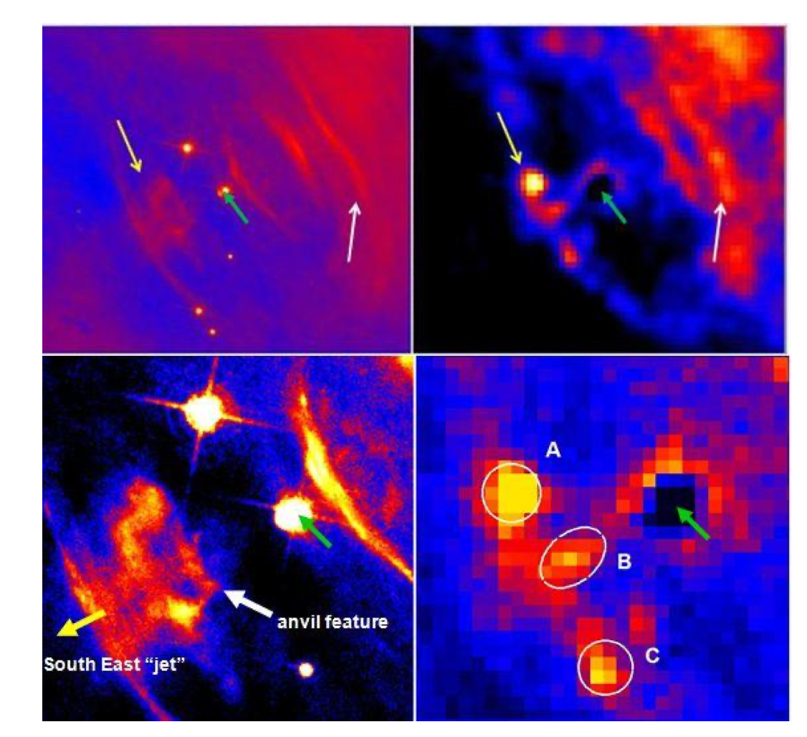
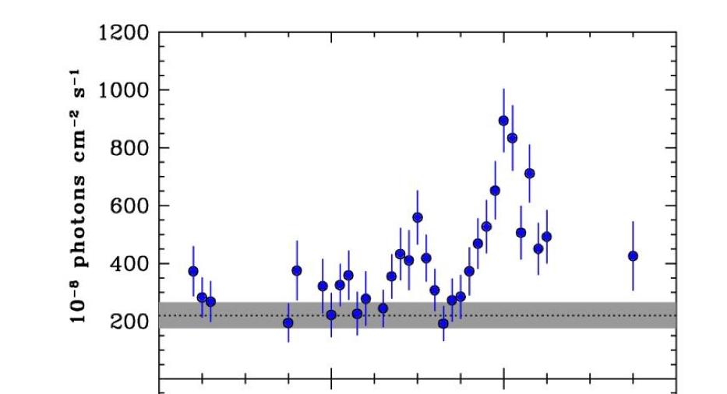
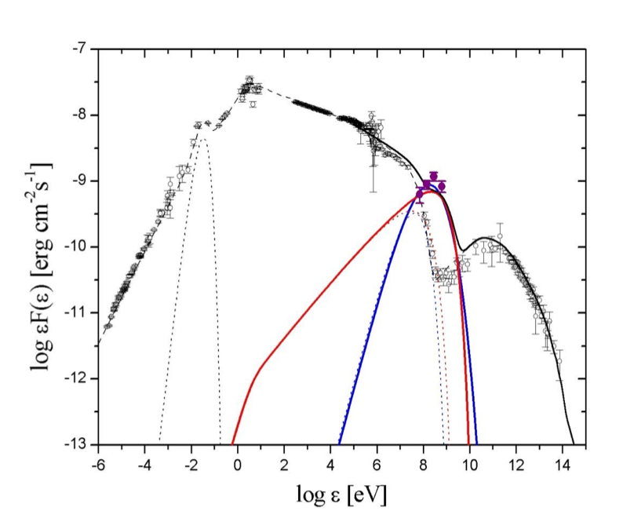
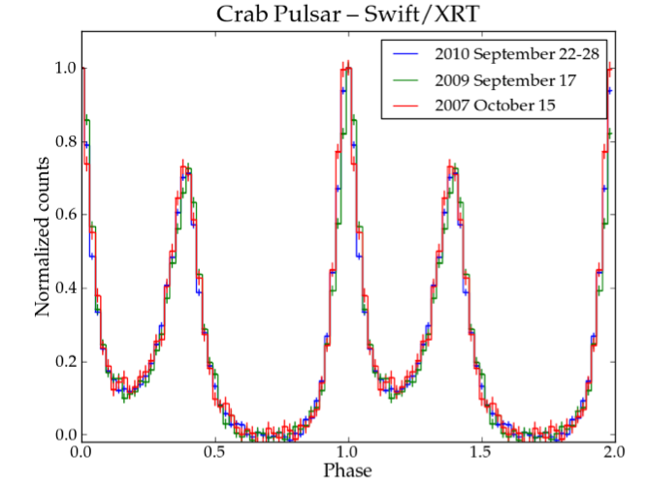
2010 Flare
~4 time over quiescent
Minor evidence in X
No change in pSR

Slide 9
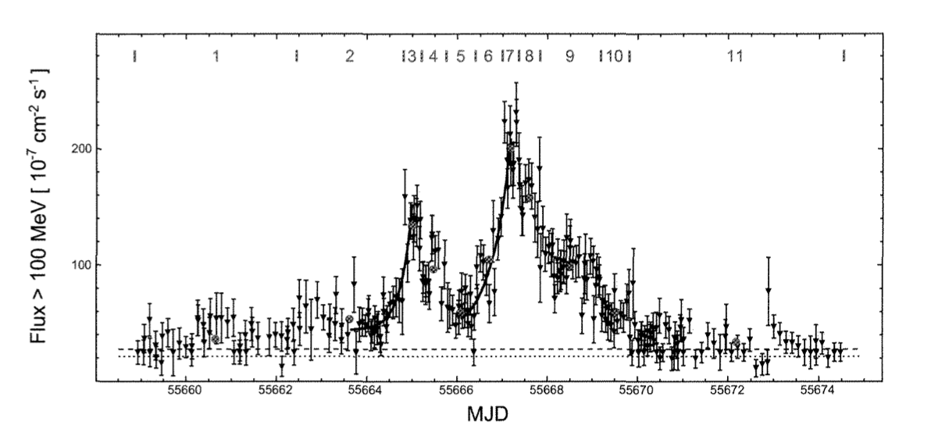
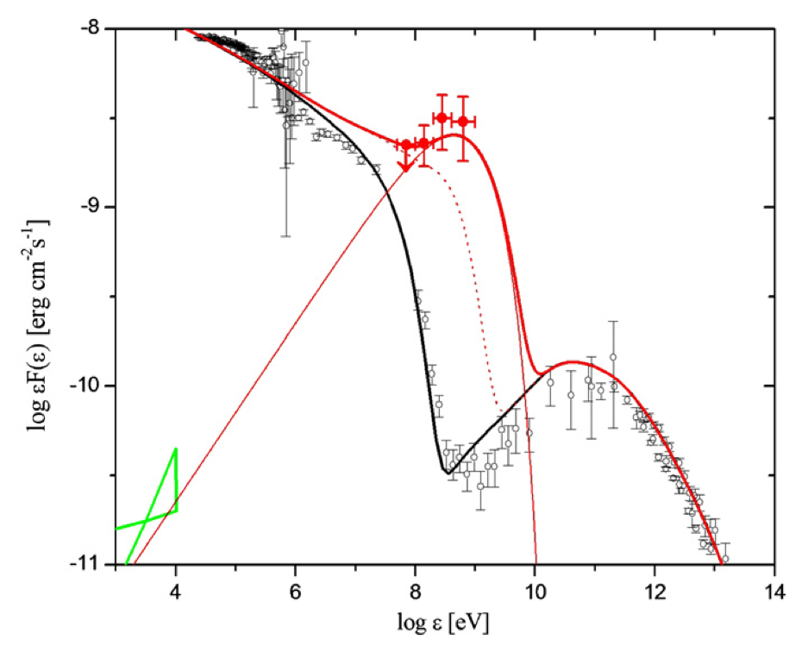
2011 Flare
25 times above quiescent
Flare is structured
Flare duration days-week
Compatible with almost monochromatic
Requires doppler boosting
Location - knot?

Slide 10
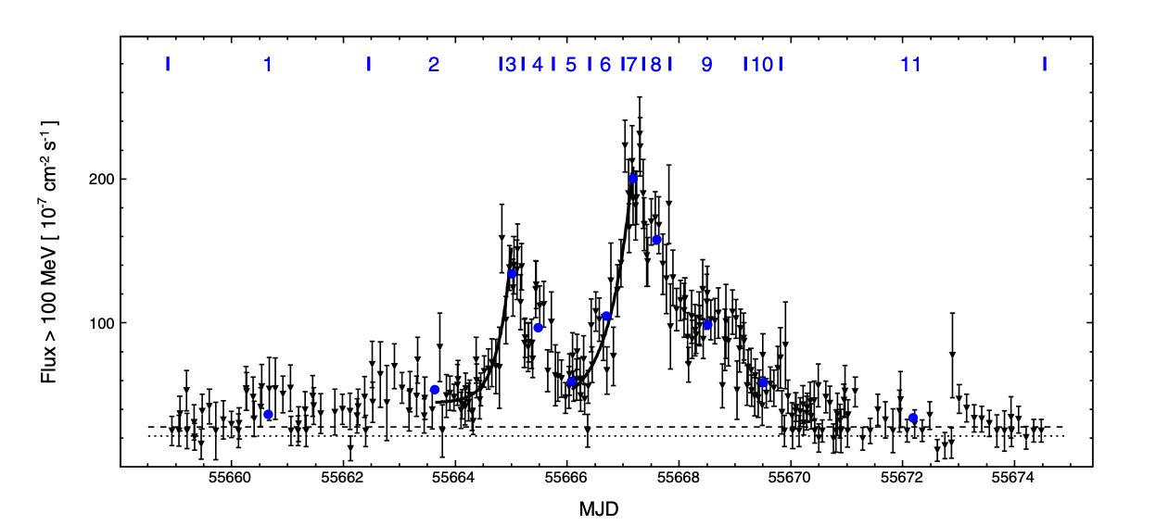
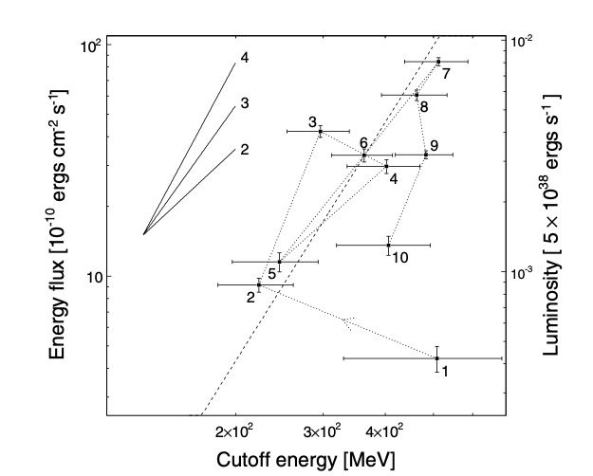
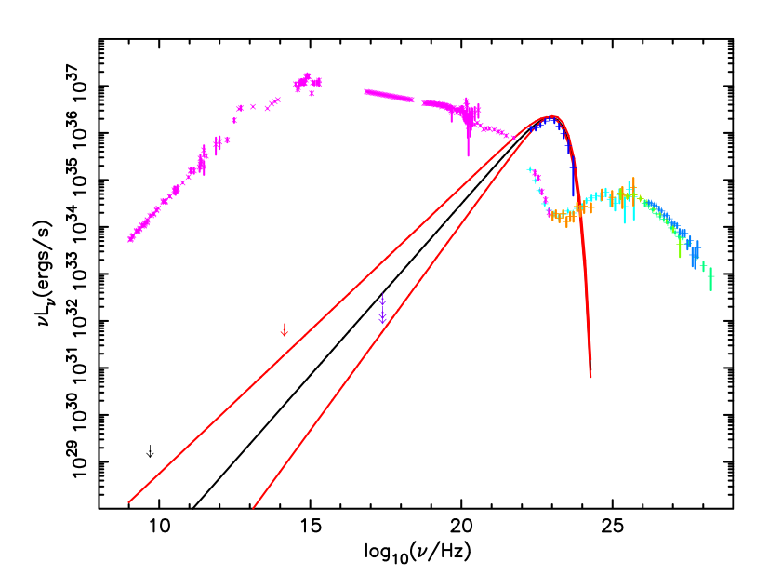
Spectral evolution
Cutoff energy is higher at peak
Chandra upper limit
Knot IR upper limit
1GhZ VLA Upper limit

Slide 11
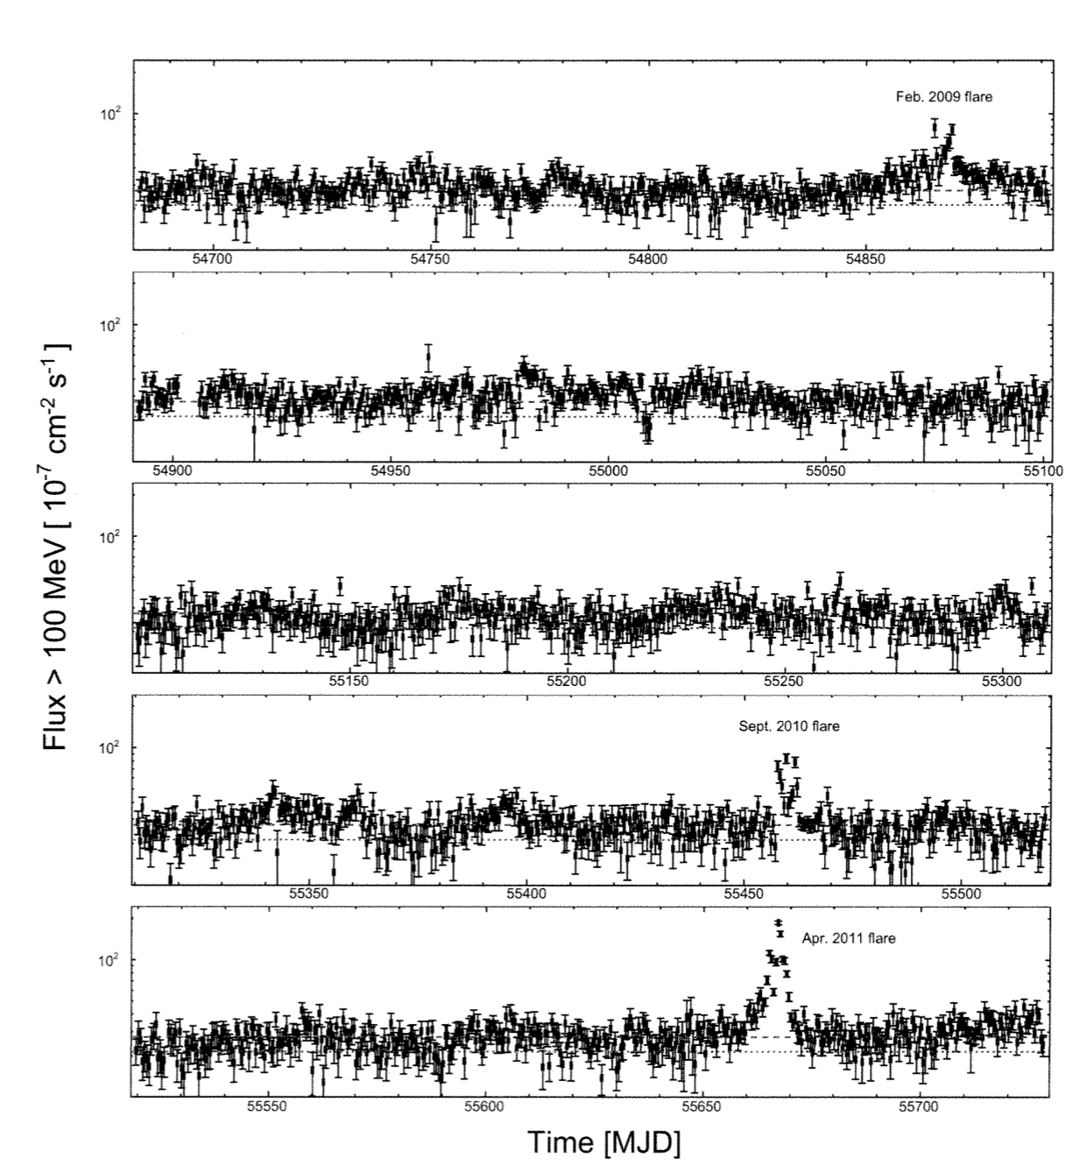
Gamma-ray varibility
Variability present also for quiescent emission in the form of month-long modulation
Likely originating in the variability of the wisps knot region

Slide 12
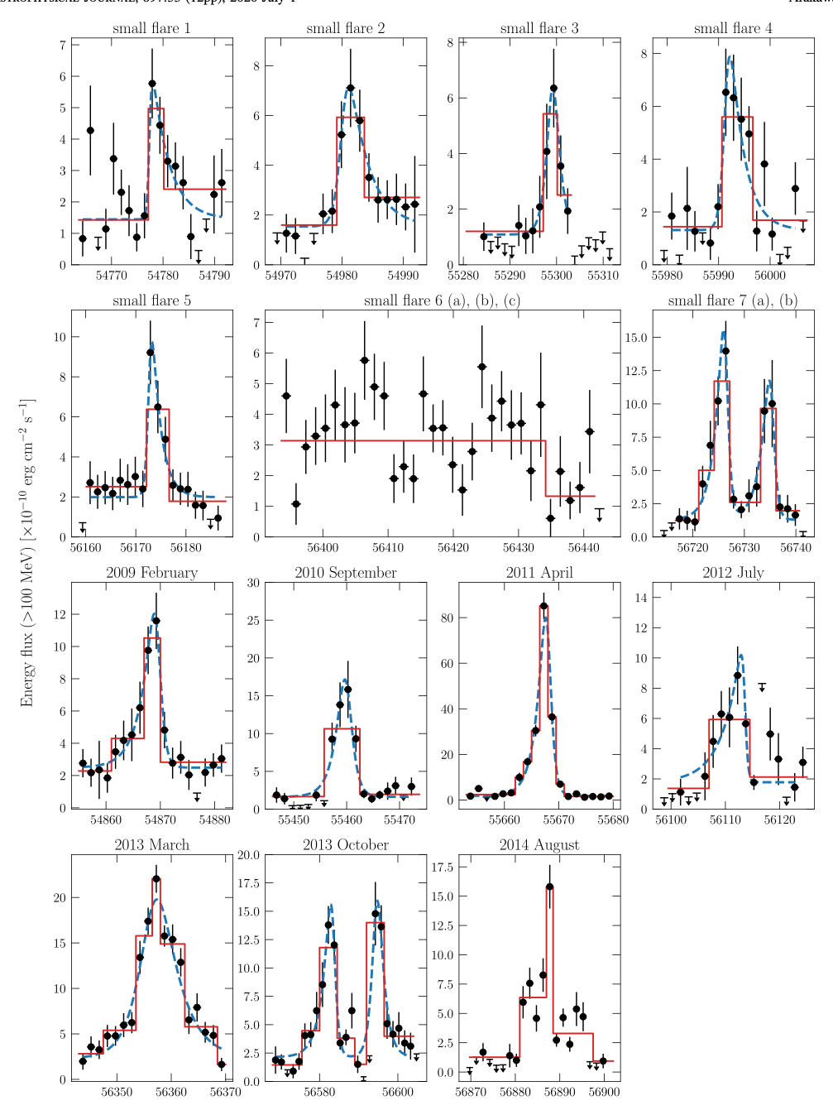
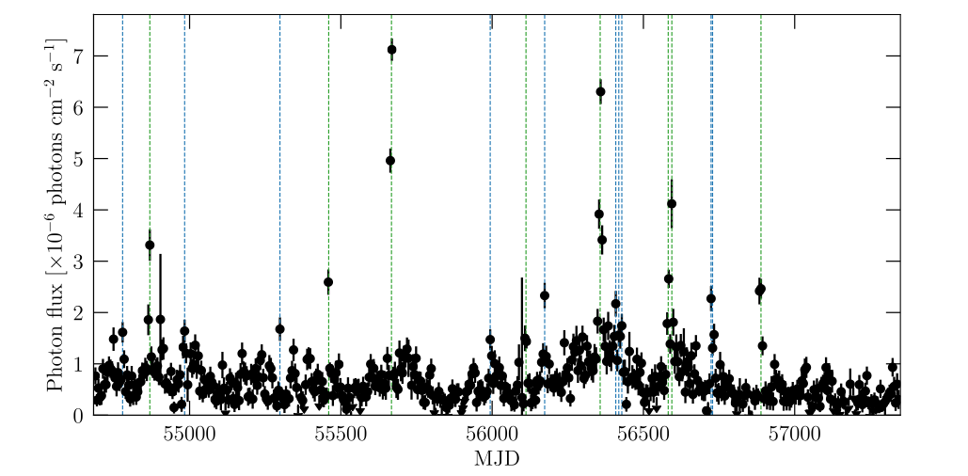
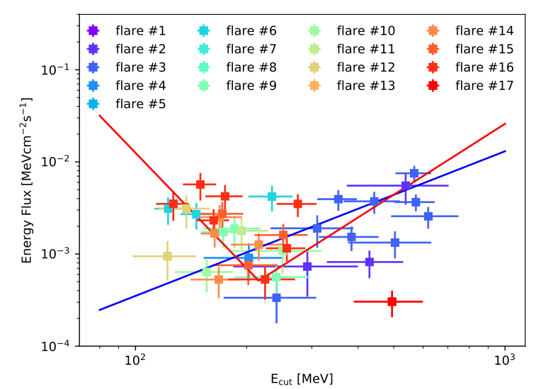
FLARES in time

Slide 13
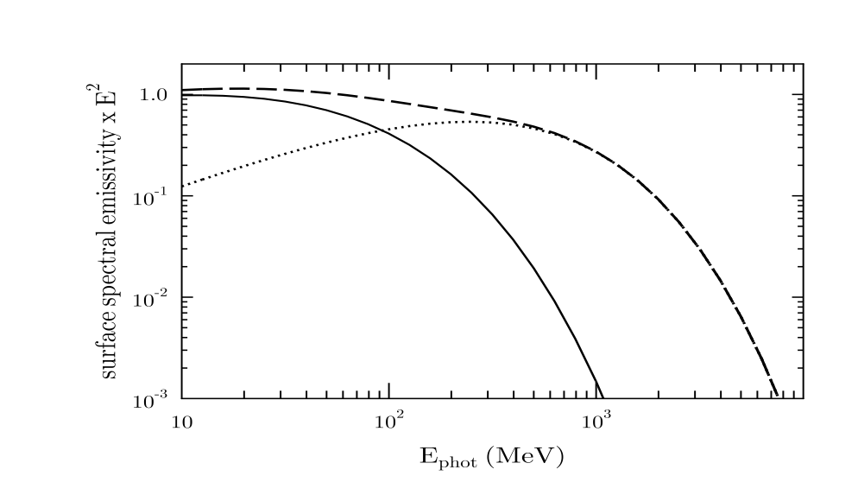
Twinking
IMPOSSIBLE to get acceleration and emission from the same region in a naive DSA approach
Decouple emission from acceleration
Introduce regions of very high magnetic field that are responsible for radiation
Require very localised regions (few day light) with magnetic field up to milli-G
Require emission to come to regions very close to the TS
Flare properties depends on the magnetic field in these regions

Slide 14
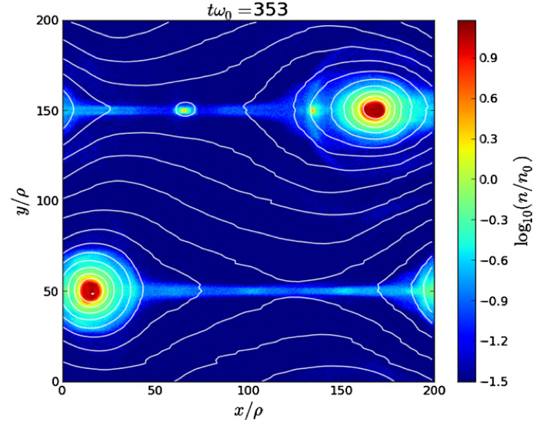
Reconnection
Psr winds are striped and this implies alternating field polarities in the PWN
Spicer orbit avcceleration
Tearing instab
Low guide field preferred
Milli-g magnetic field

Slide 15
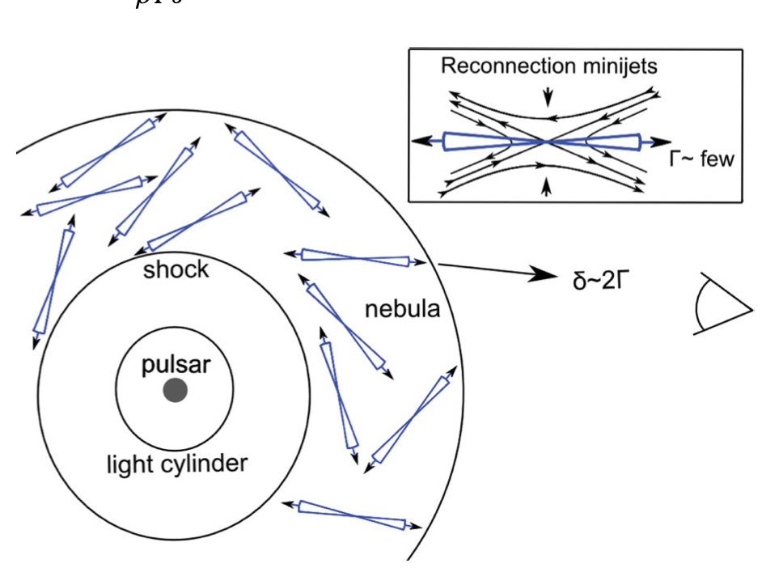
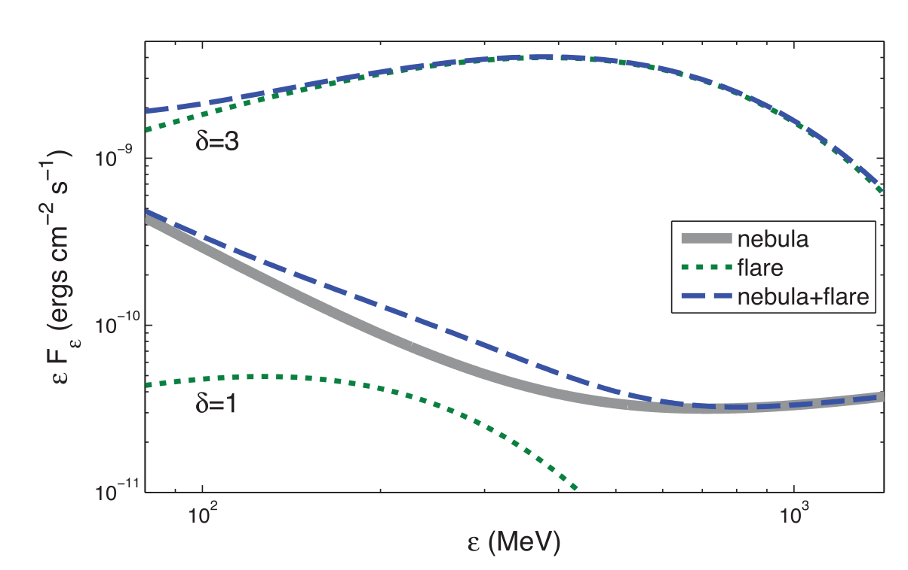
jetlets
Mini jets inside the nebula arising from reconnection led to beamed particles that gives flare due to doppler boosting
Boosting of order 3 are required

Slide 16
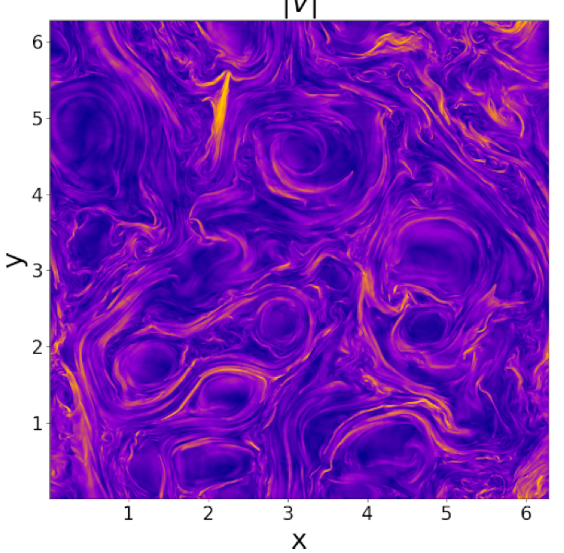
Intermittency
In turbulence intermittency manifests as higher tails at small scale on the PDE
Not clear if statistics of intermittency compatible with mill-G field

Slide 17
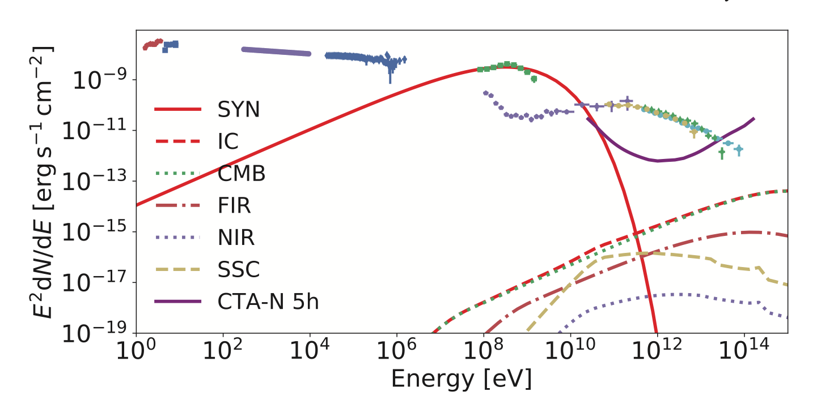
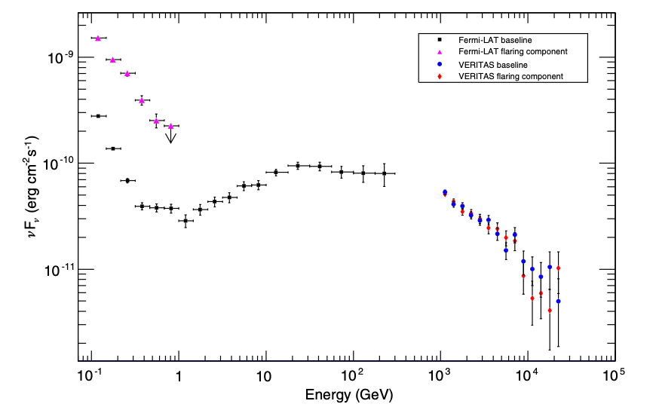
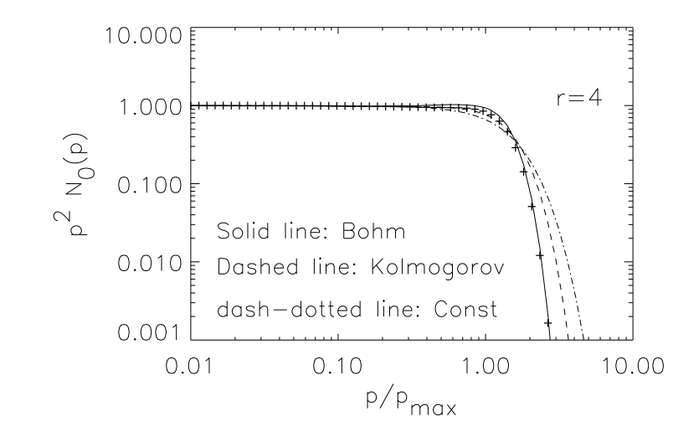
FLARES visibility with CTA
Only major flares potentially visible by CTA over 100h
Highly dependent on shape of the cutoff
2011
CTA 100H
At the synch limit the cutoff is super-exp
2013
CTA 100H

Slide 18
Conclusions
Flares in crab defies current DSA and LOSS limits
Flares likely very common in all PWNe
Flares do not show evident counterpart at any other wavelength
Lack of good constraints on the SED
None of existing model fully satisfactory
Minor doppler boosting and collimation always required
Reconnection likely to be operative but not clear if m-G field is there
Detectability of major flares at the very edge of CTA capability
Much of it depends on SED cutoff shape

