Slide 1
Extragalactic Survey
Some updates based on recent findings
Paolo Giommi
Associated INAF-AOB

Slide 2
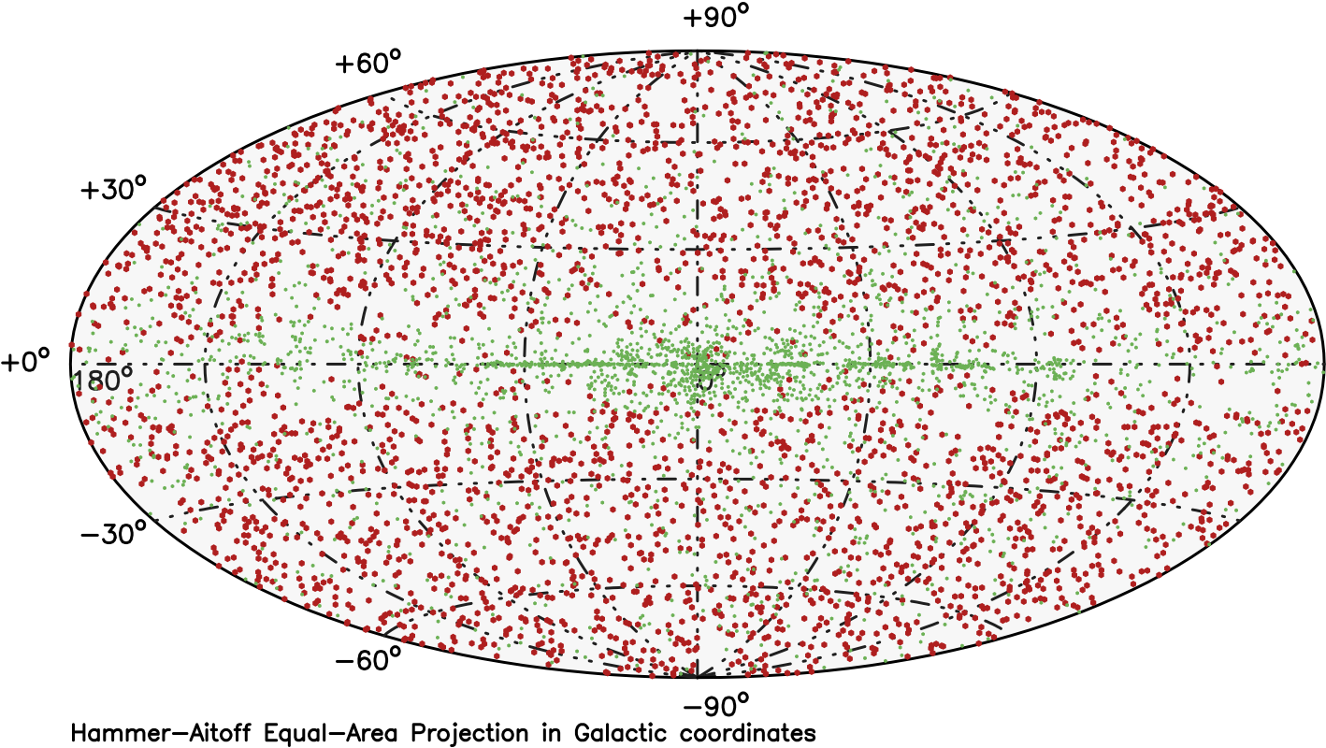
Fermi 4FGL-DR3 (0.1-300 GeV)

Slide 3
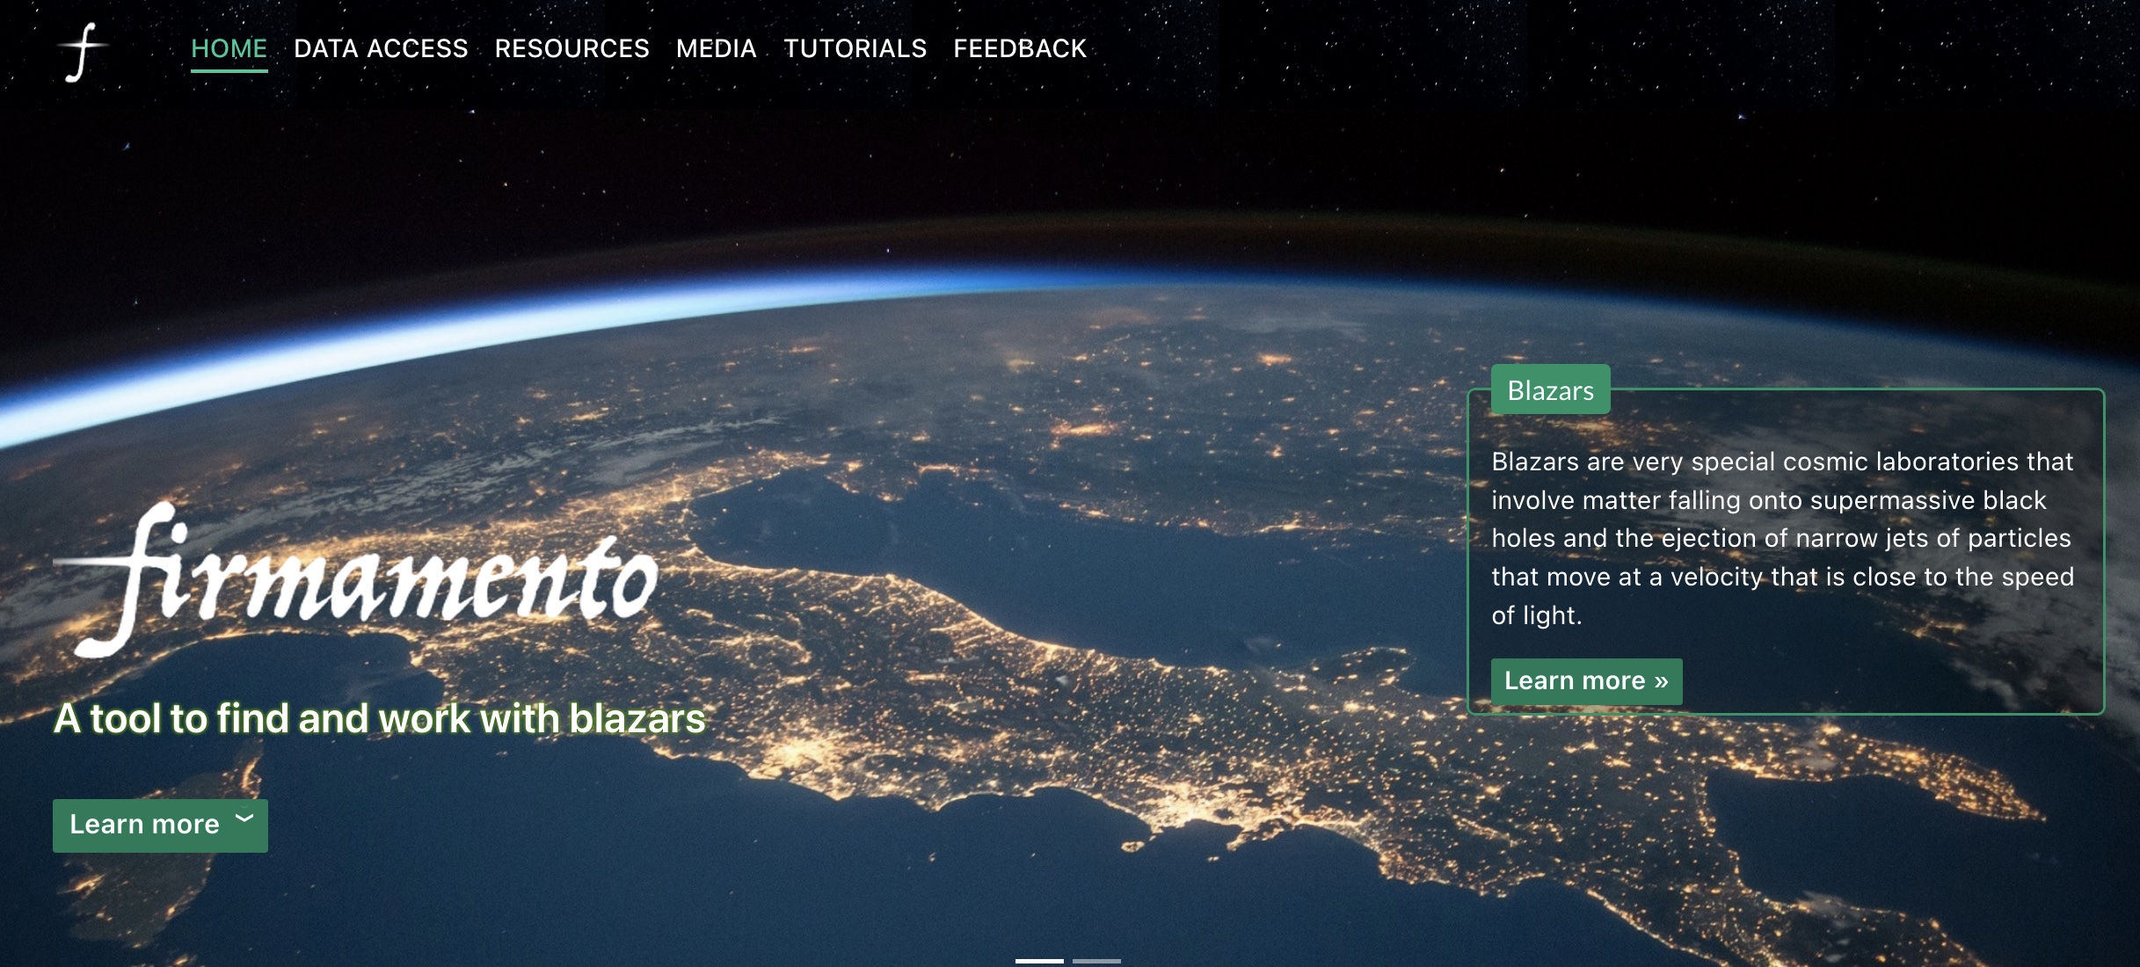
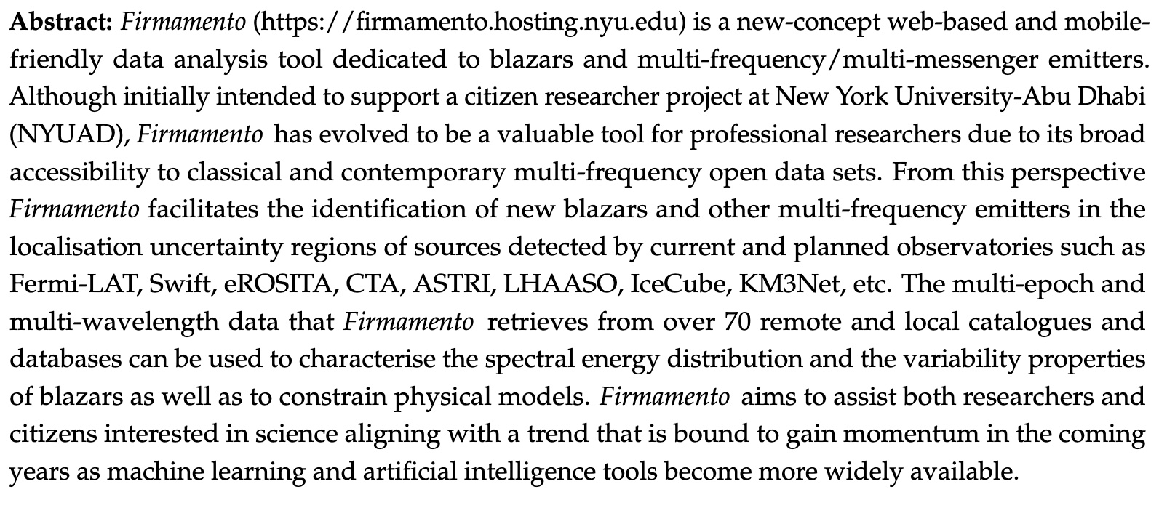
Submitted to Astronomical Journal
https://firmamento.hosting.nyu.edu

Slide 4
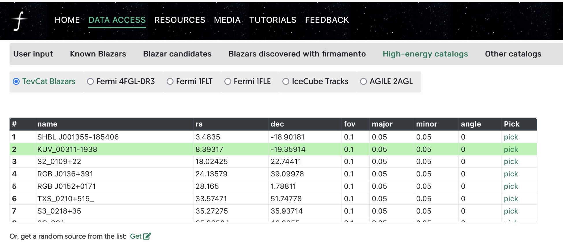

Slide 5
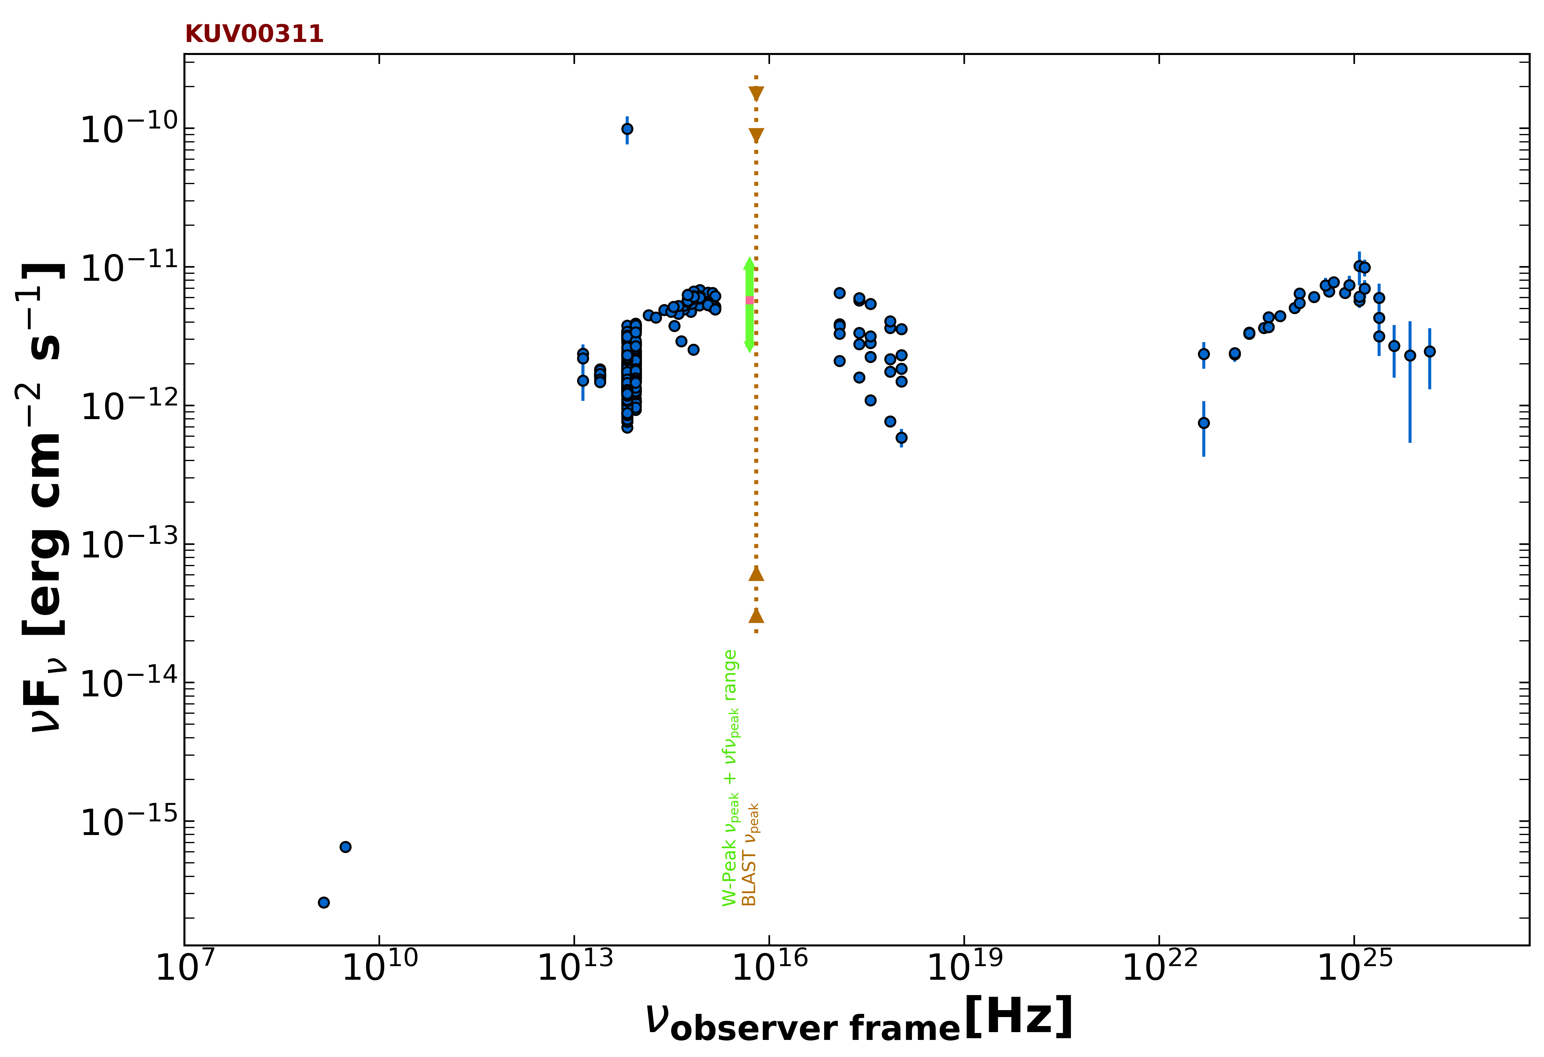

Slide 6
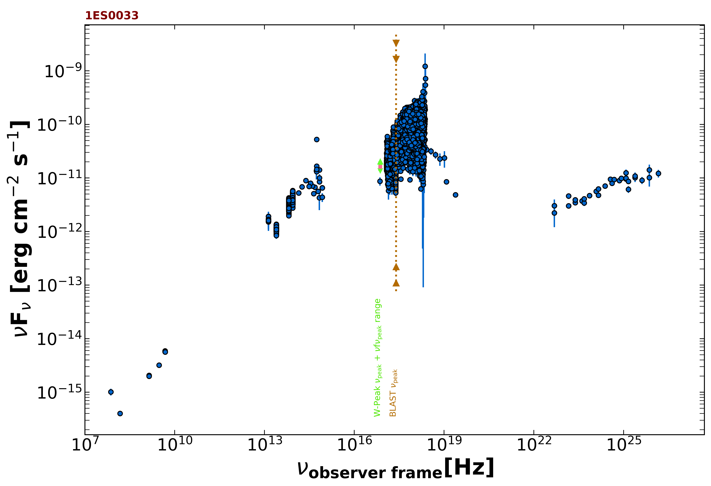
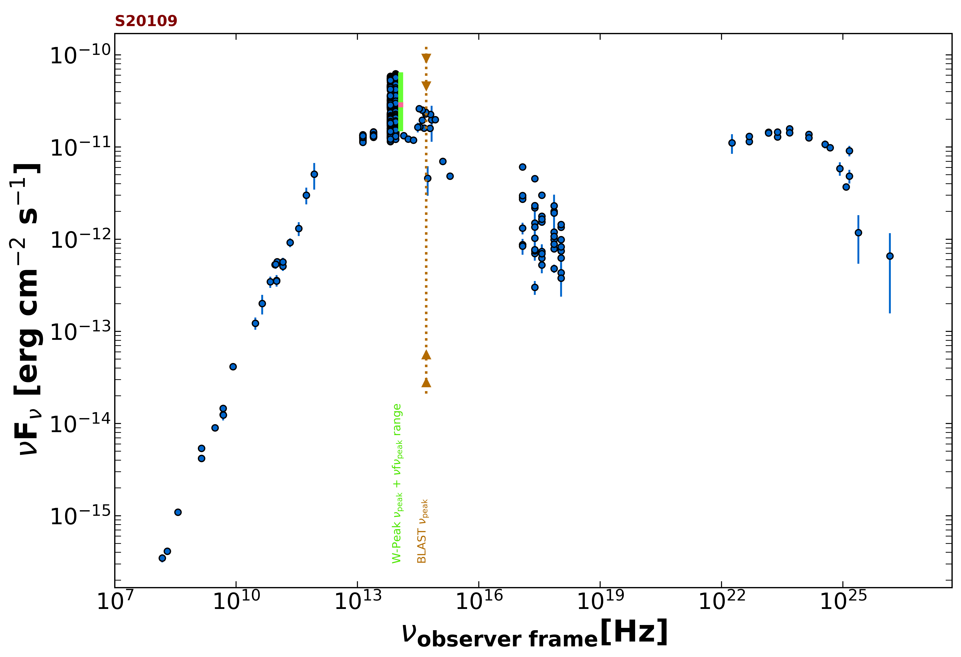
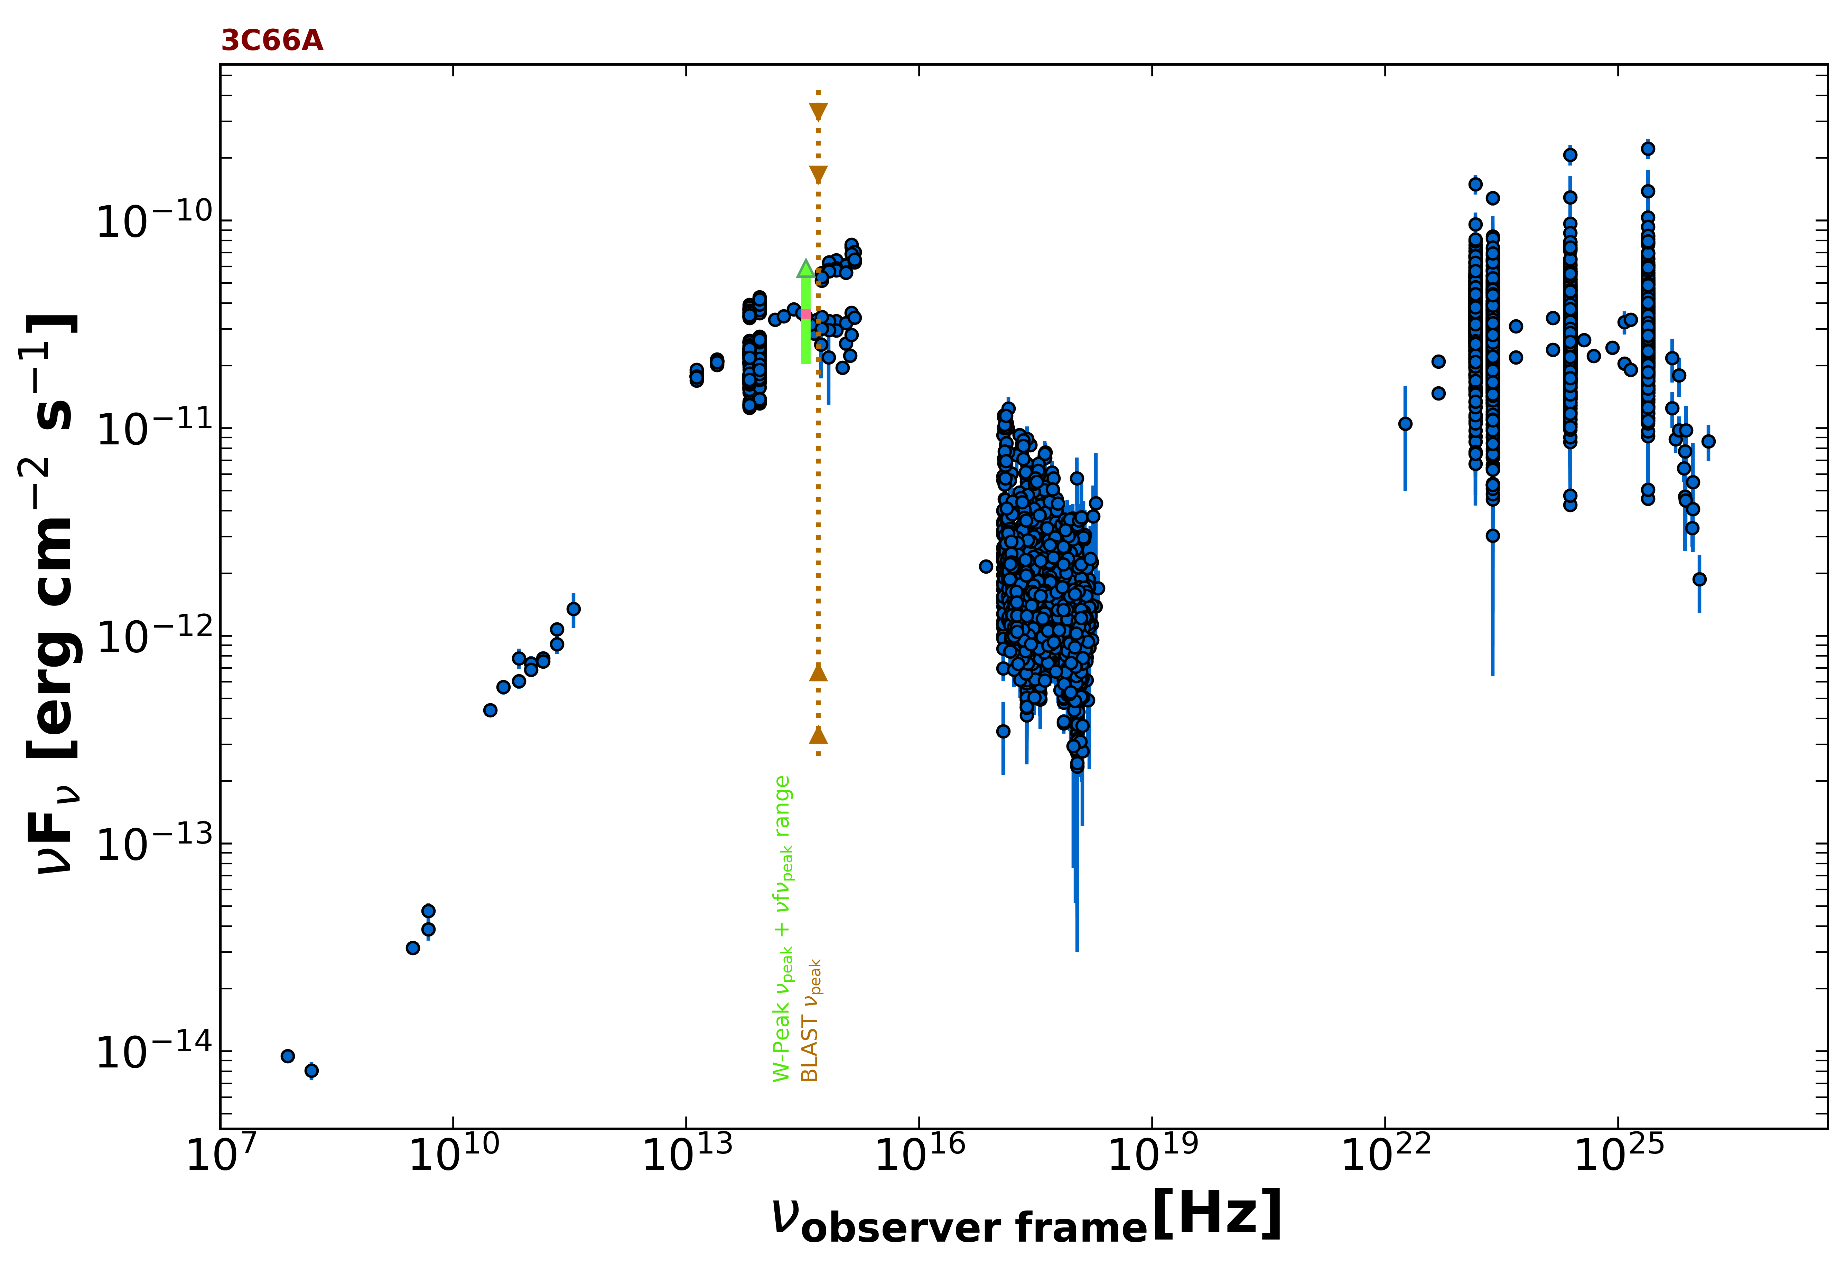
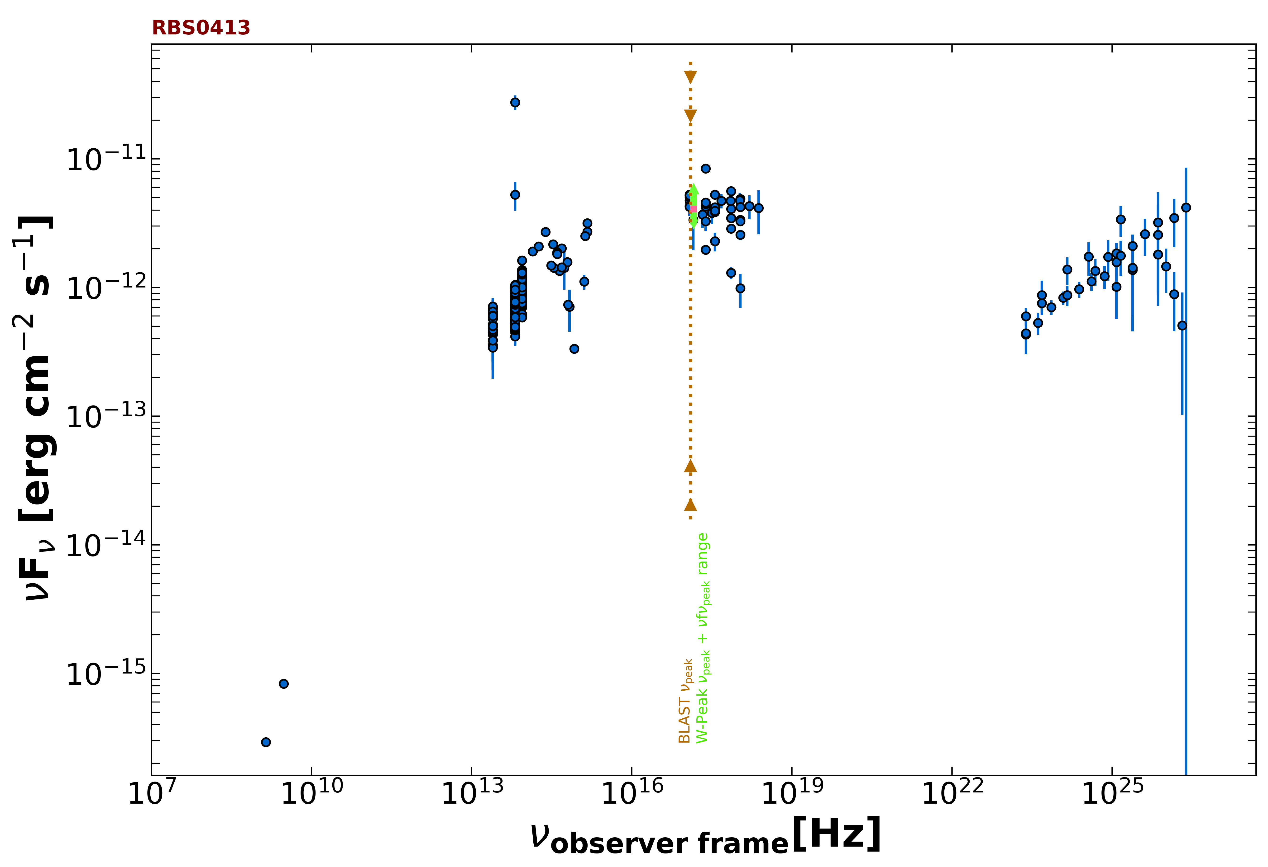

Slide 7
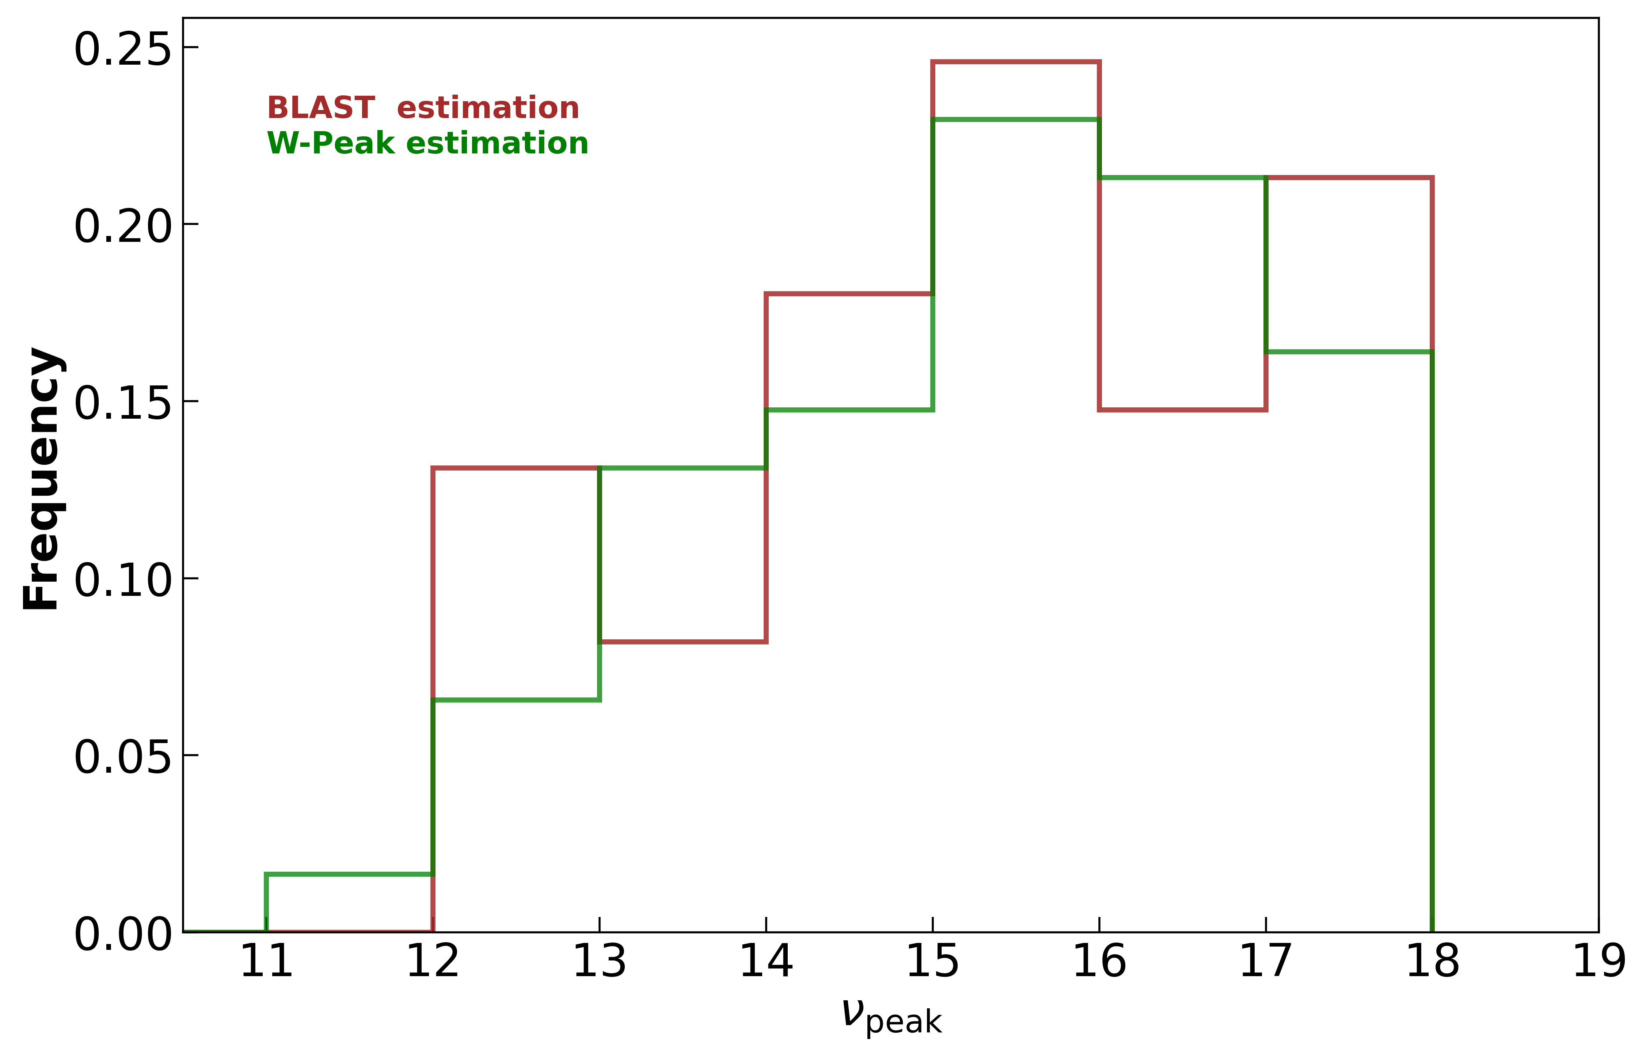

Slide 8
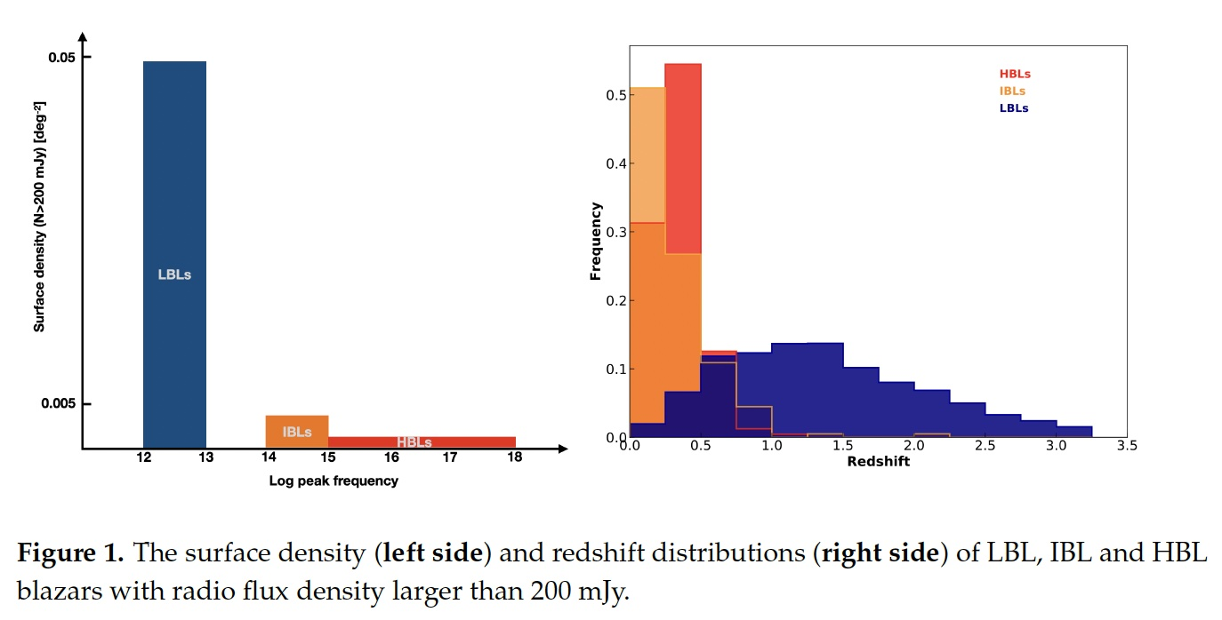
Giommi P., Padovani P., 2021, Univ, 7, 492.

Slide 9
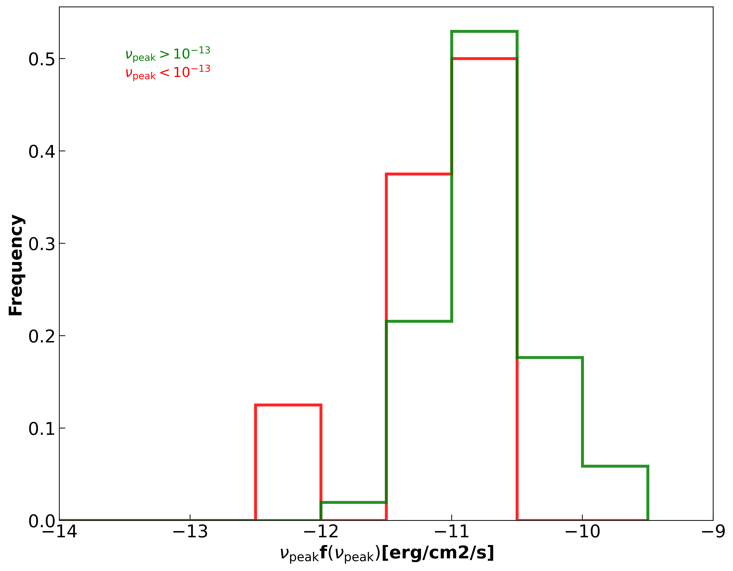

Slide 10
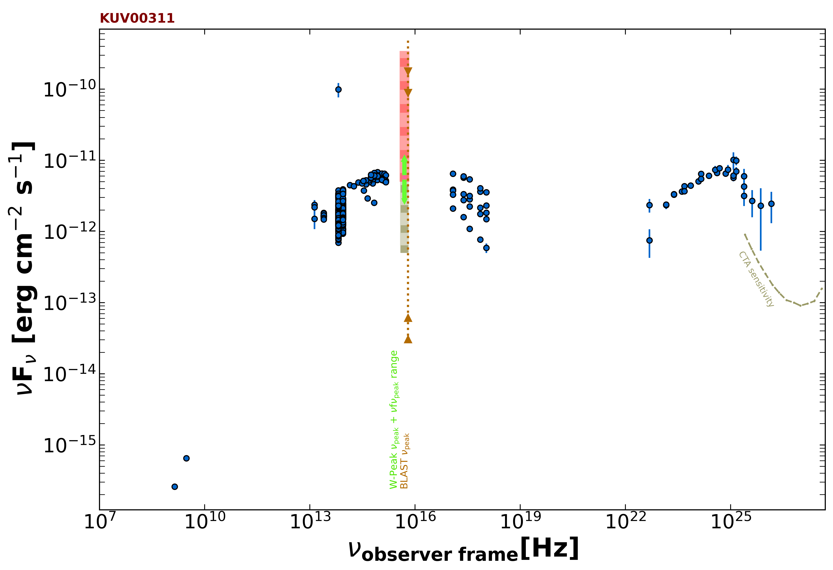
Log(νf(ν)) = -11.3

Slide 11
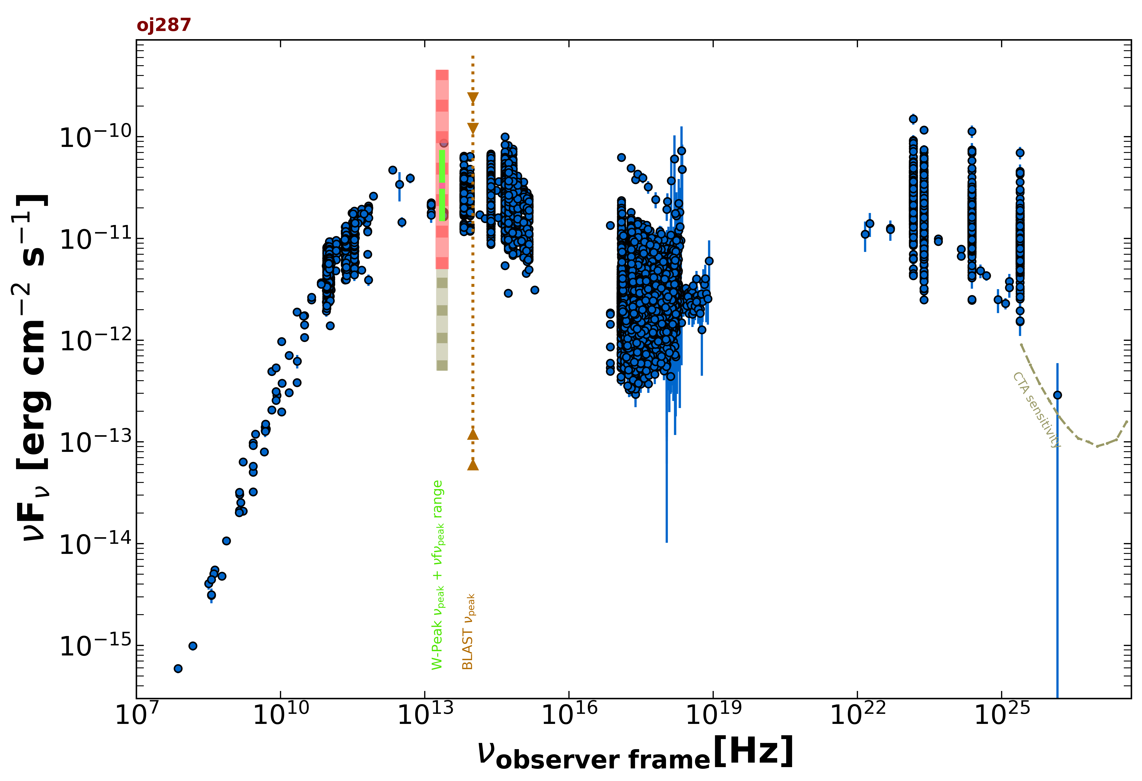

Slide 12
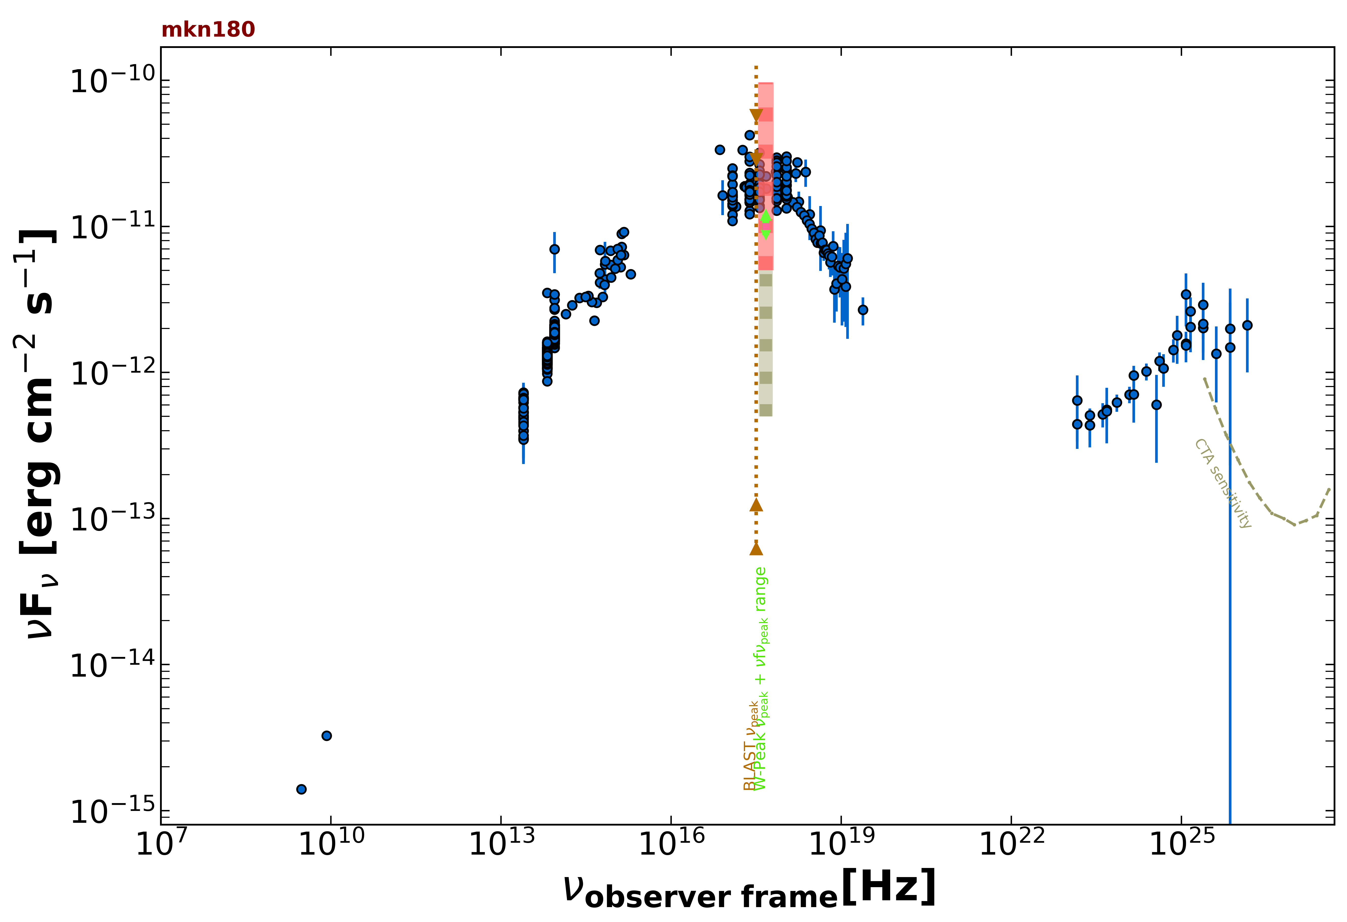

Slide 13
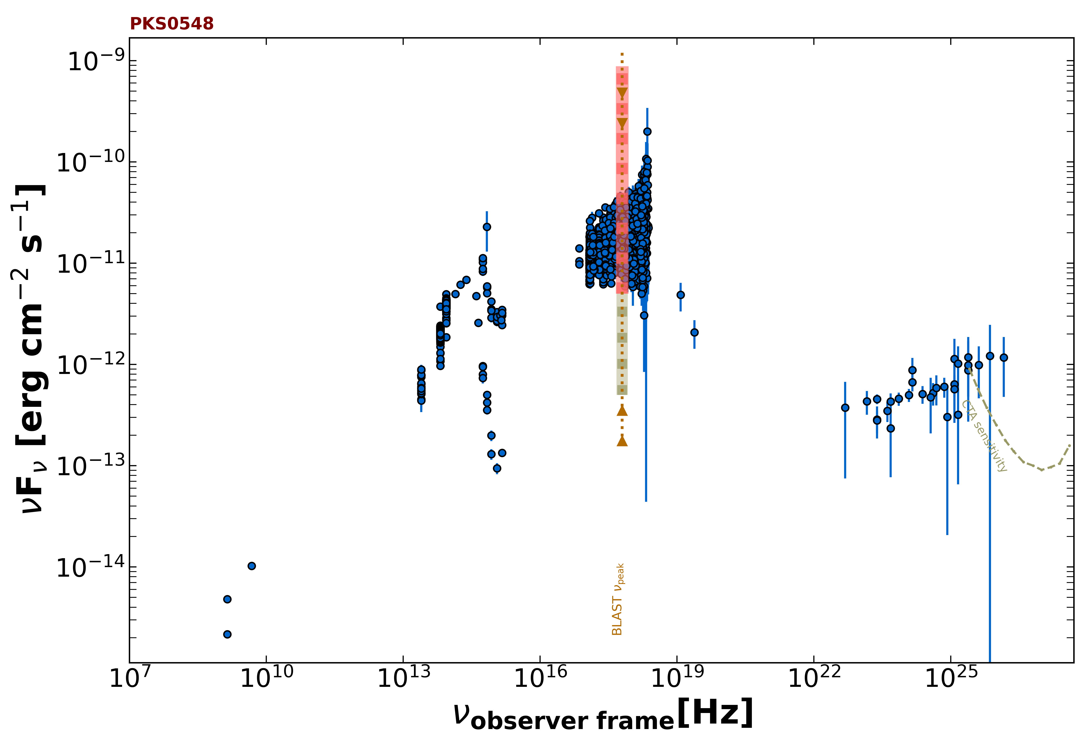

Slide 14
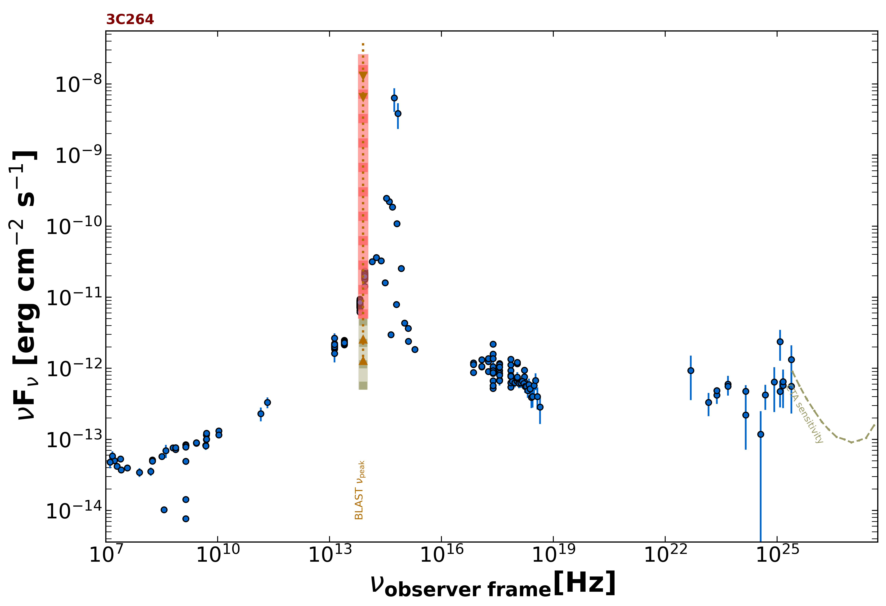
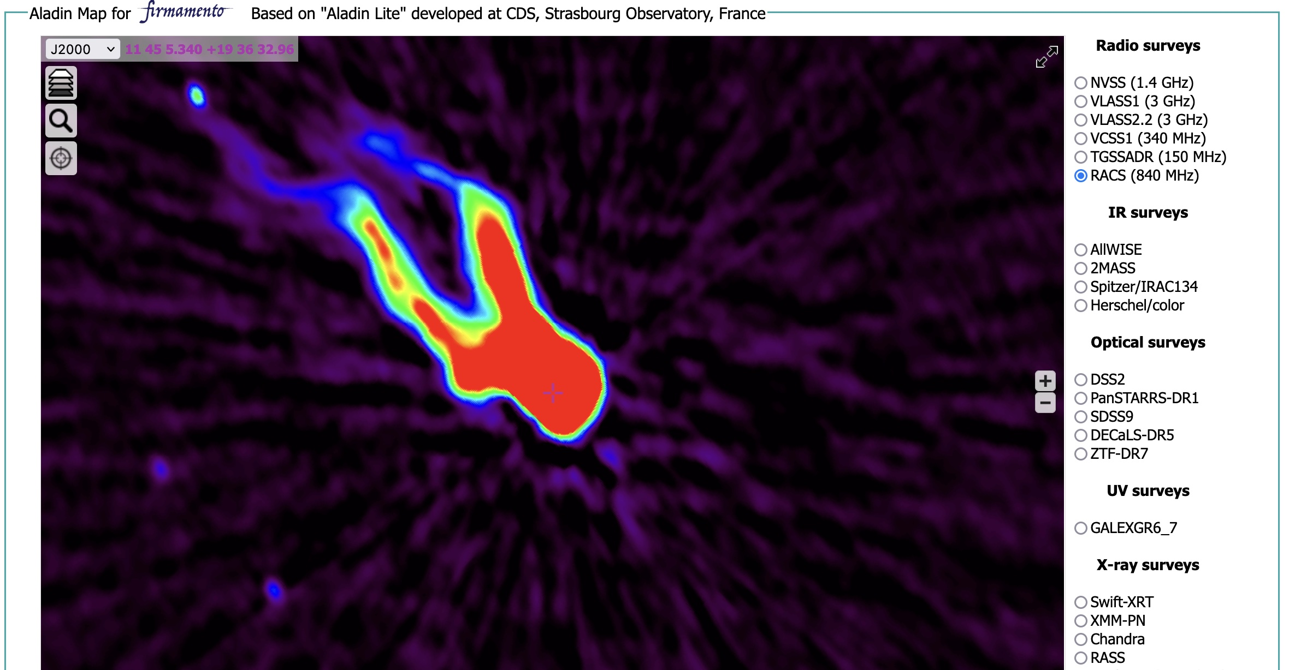

Slide 15
The Brera Blazar Search in eFEDS data with Firmamento
P. Giommi, A. Caccianiga, A. Moretti, A. Wolter, (OAB)
P. Padovani(ESO), A. Fruscione (CFA)
Ongoing Investigation of a sample of ~1000 candidates
(Radio matching eFEDS X-ray sources)
A few dozen previously unknown BL Lacs already identified
Several double-lobed sources found
First results like catalog of BL Lacs, LogN-LogS etc.
to be published in a few months

Slide 16
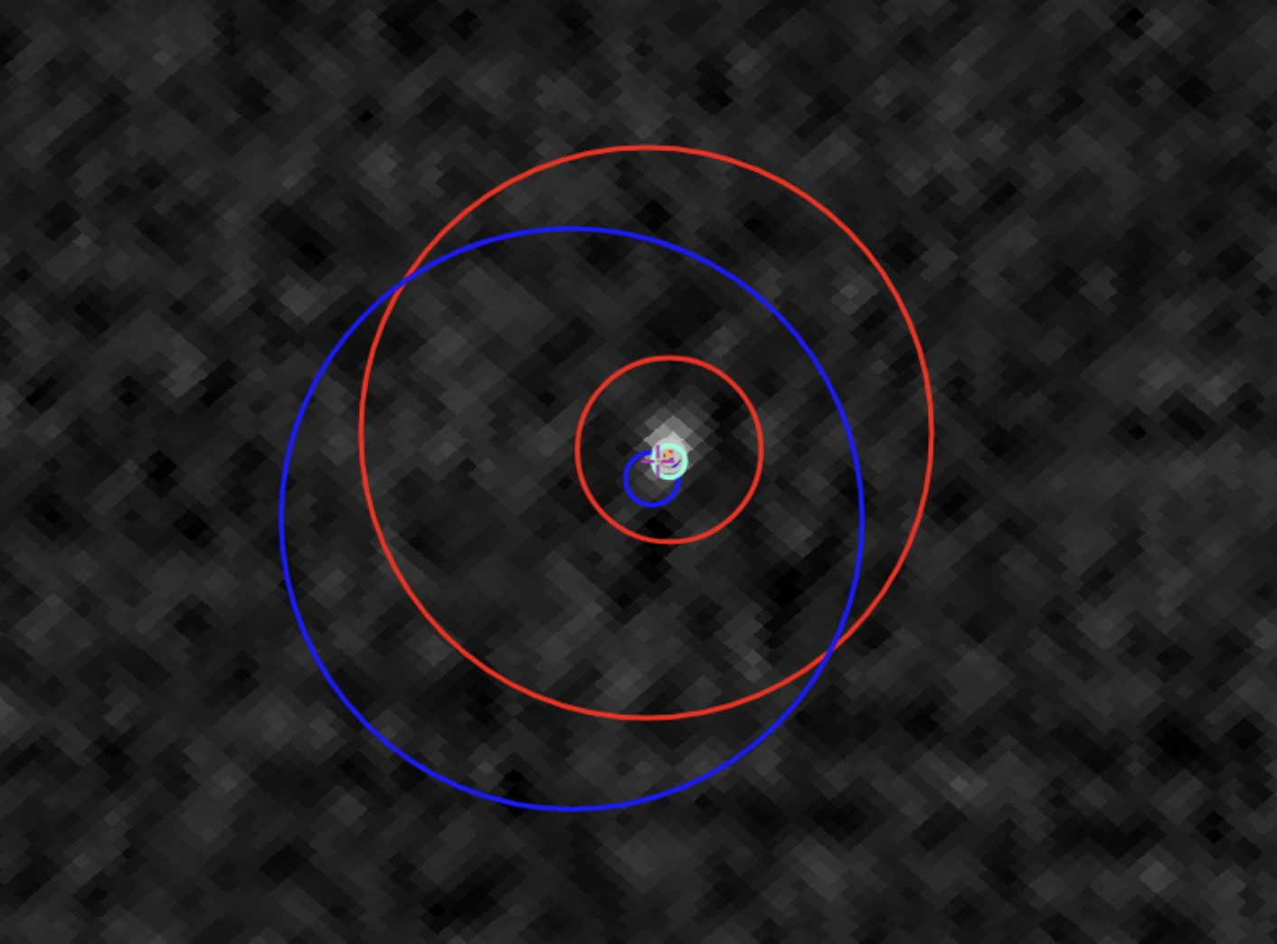
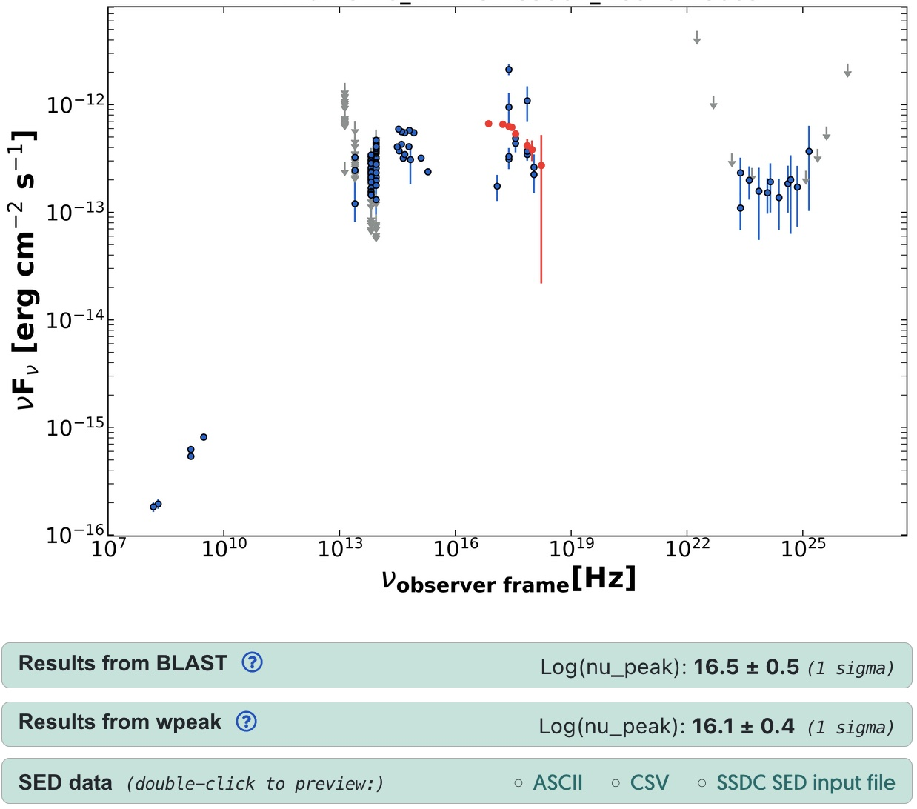
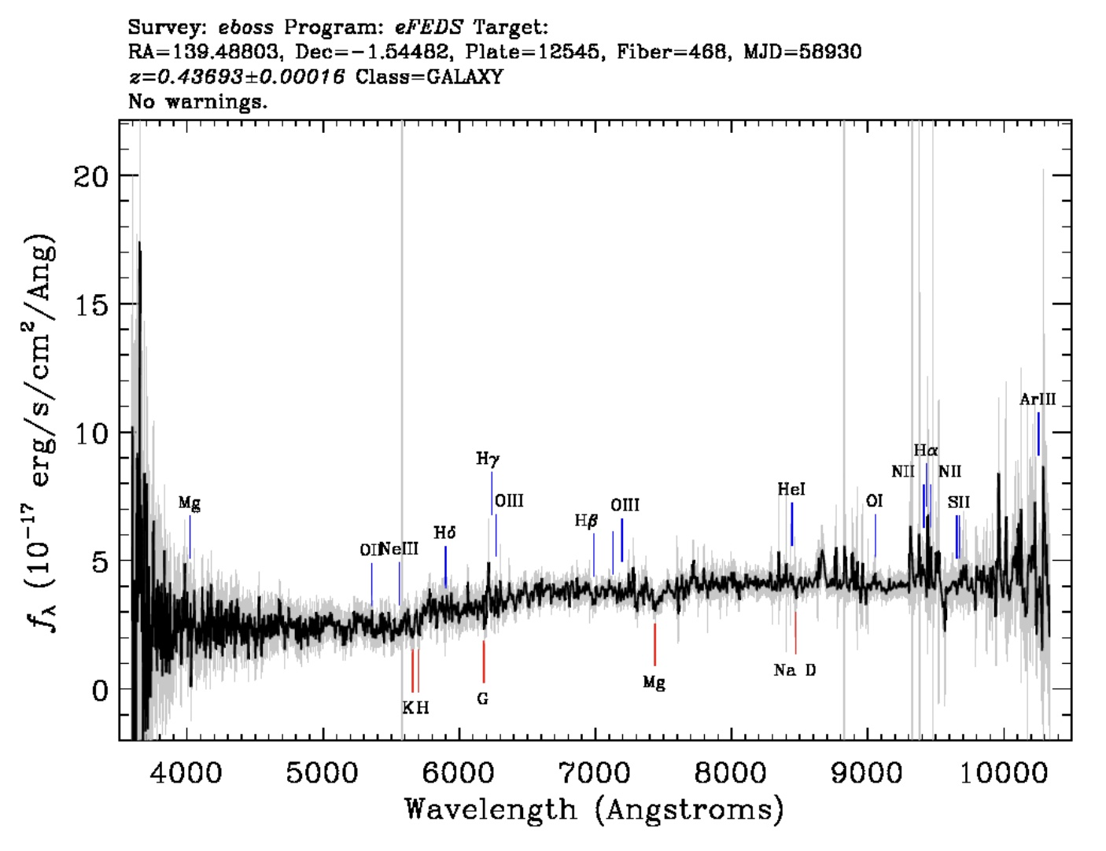

Slide 17
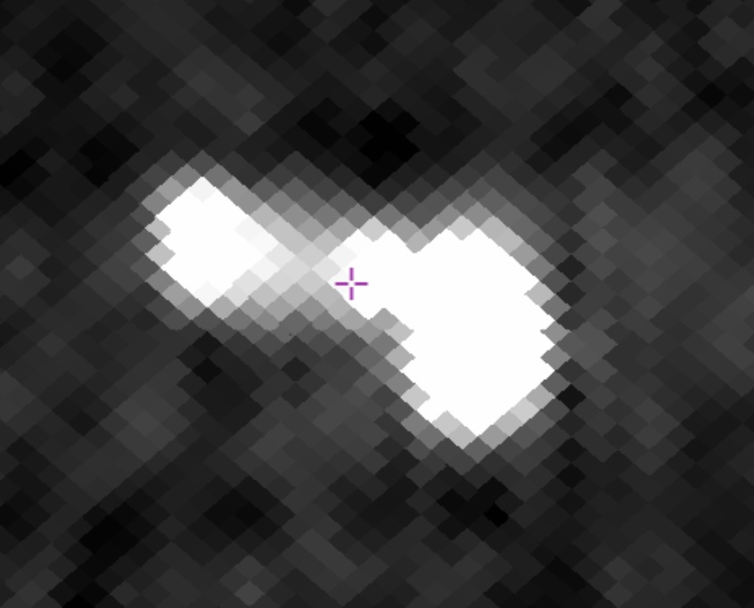
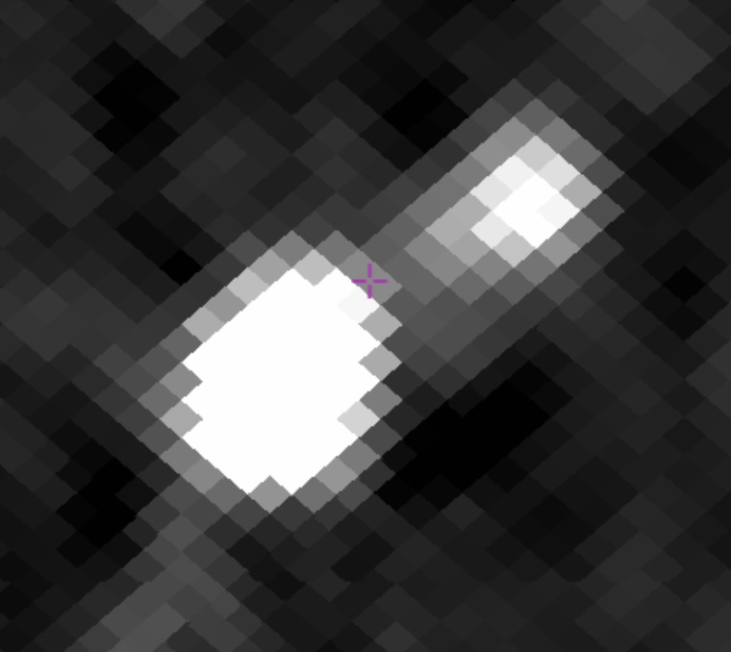
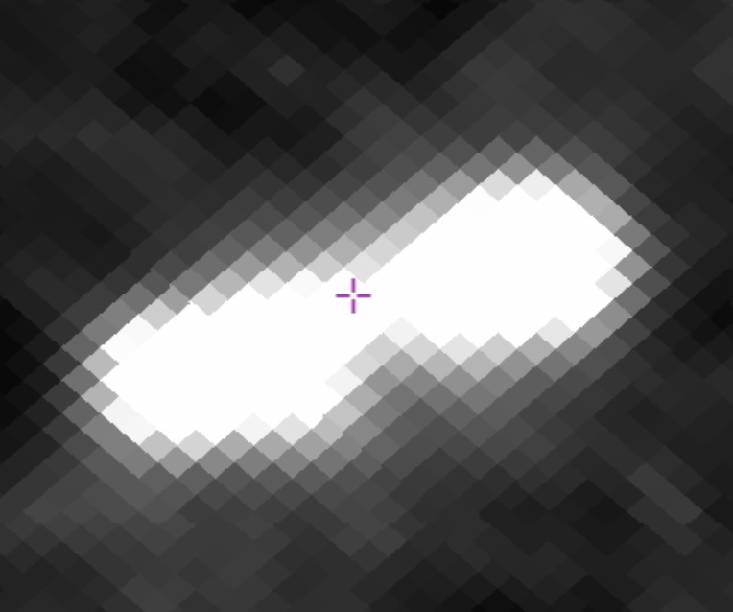
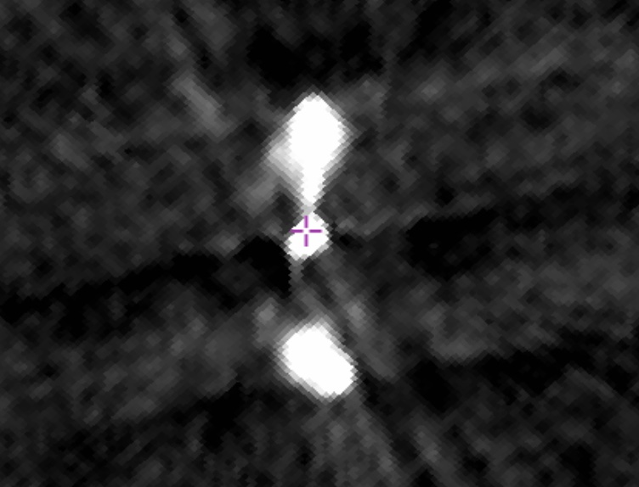

Slide 18
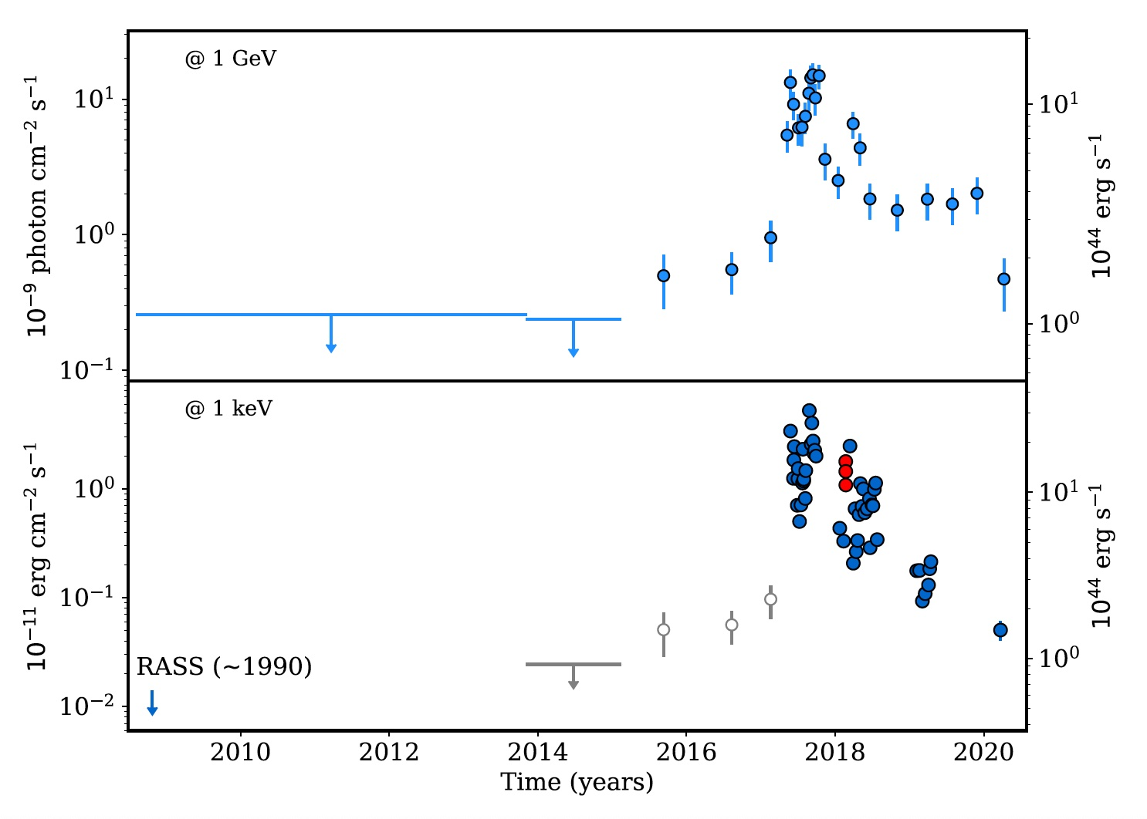
2021, MNRAS 502, 836

Slide 19
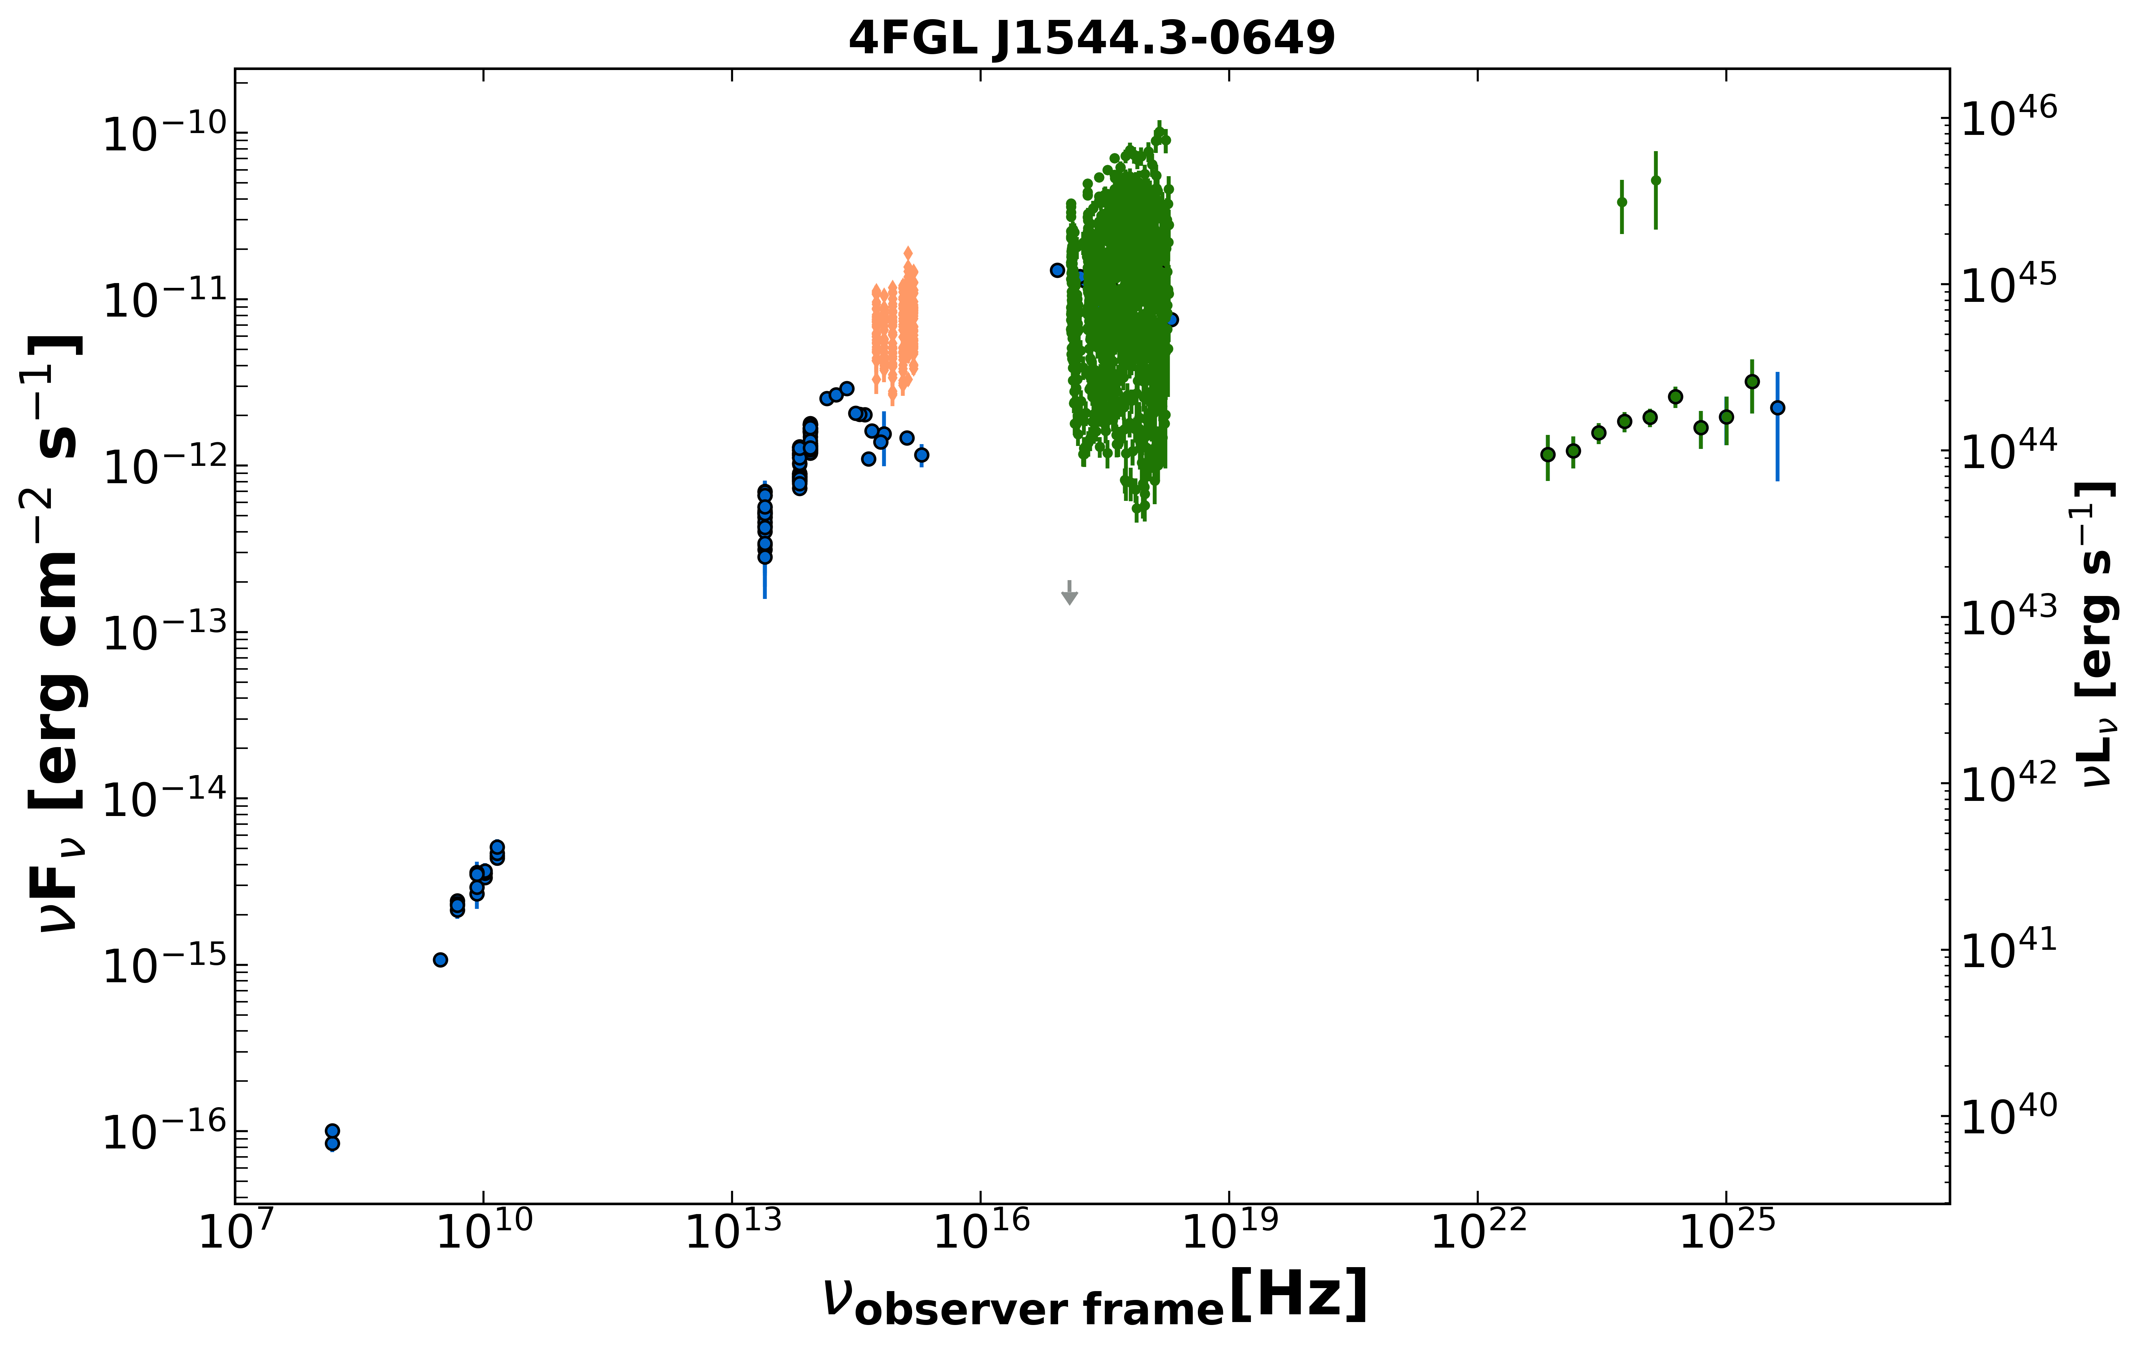
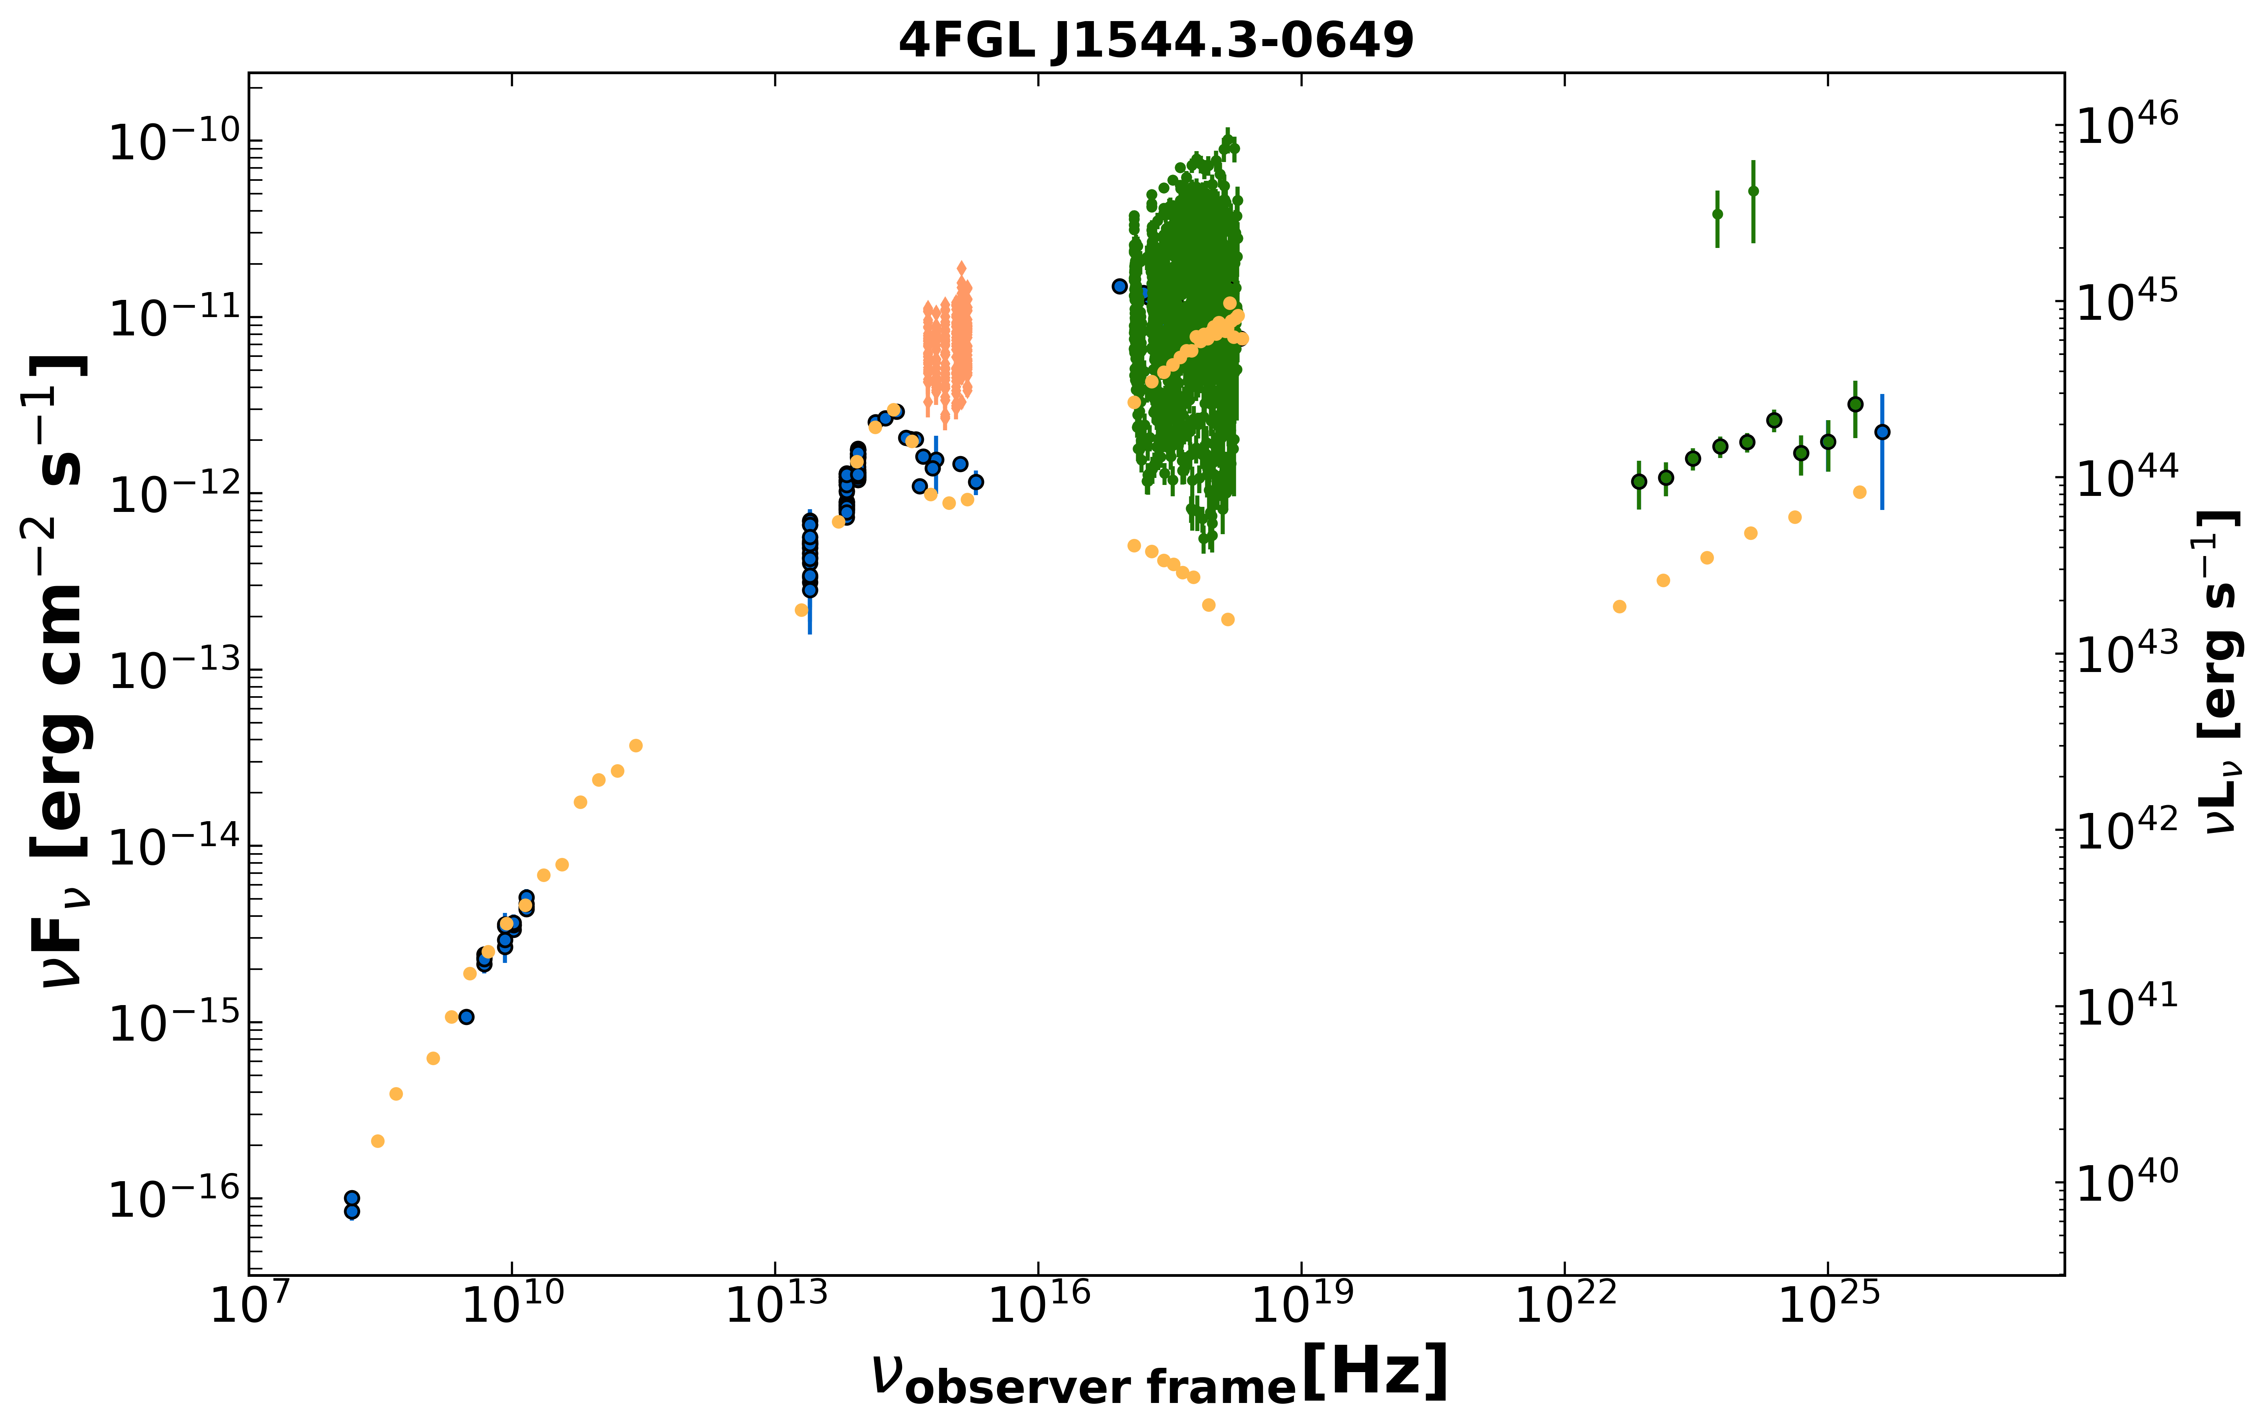

Slide 20
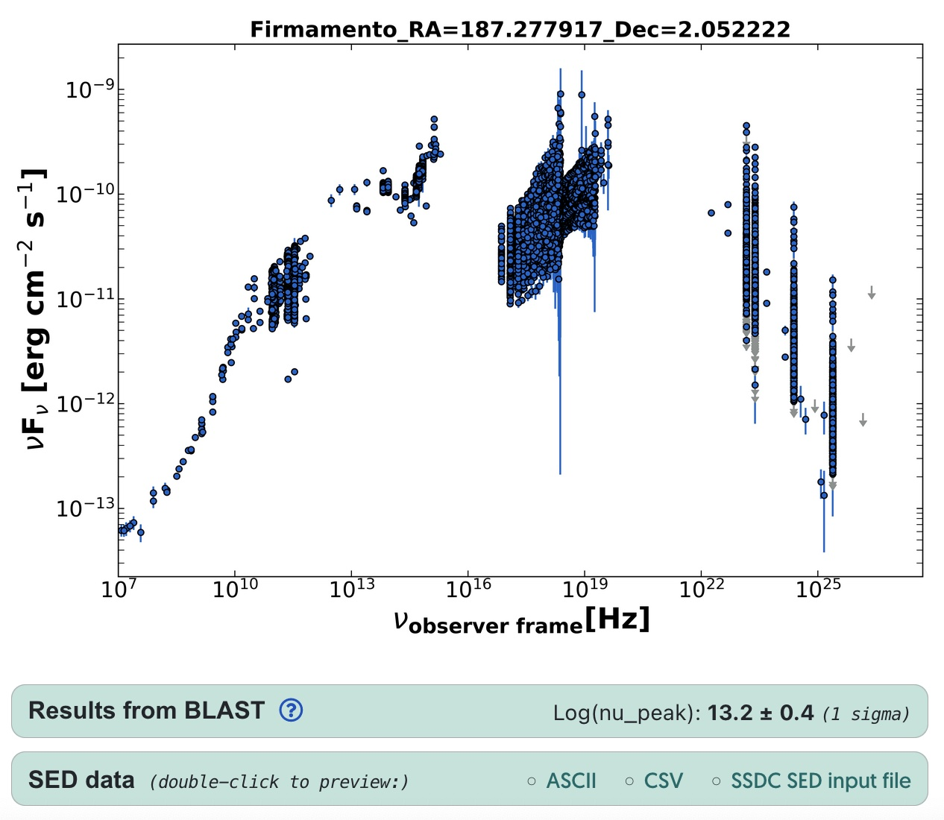
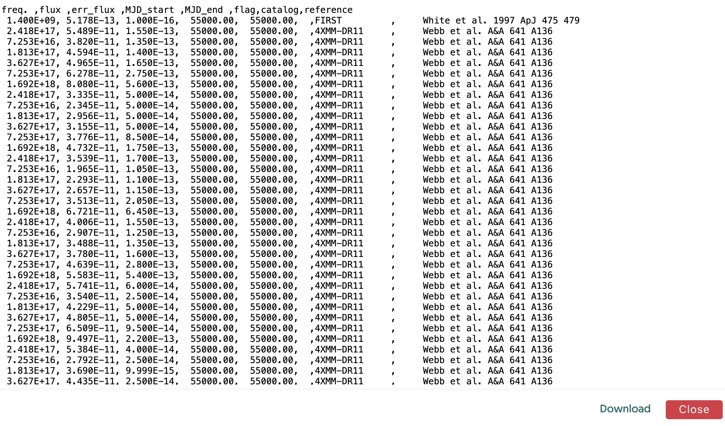
https://firmamento.hosting.nyu.edu
3C273

Slide 21
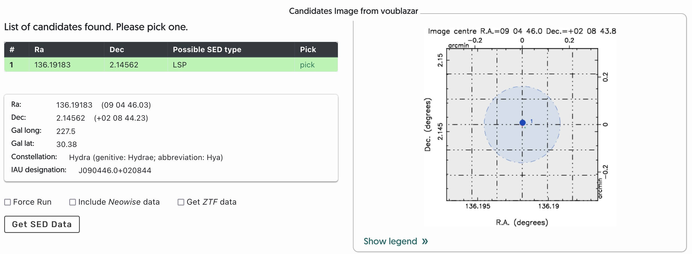

Slide 22
