Slide 1


Status and perspectives of intergalactic magnetic field studies
Davide Miceli
AVENGe, 31/05/2023

Slide 2
Magnetic Fields in the Universe
Magnetic field seeds origin
Current B-fields detected
Cosmological
Amplification process
Modern μG magnetic fields in galaxy and galaxy clusters
Dynamo amplification
Astrophysical

Slide 3
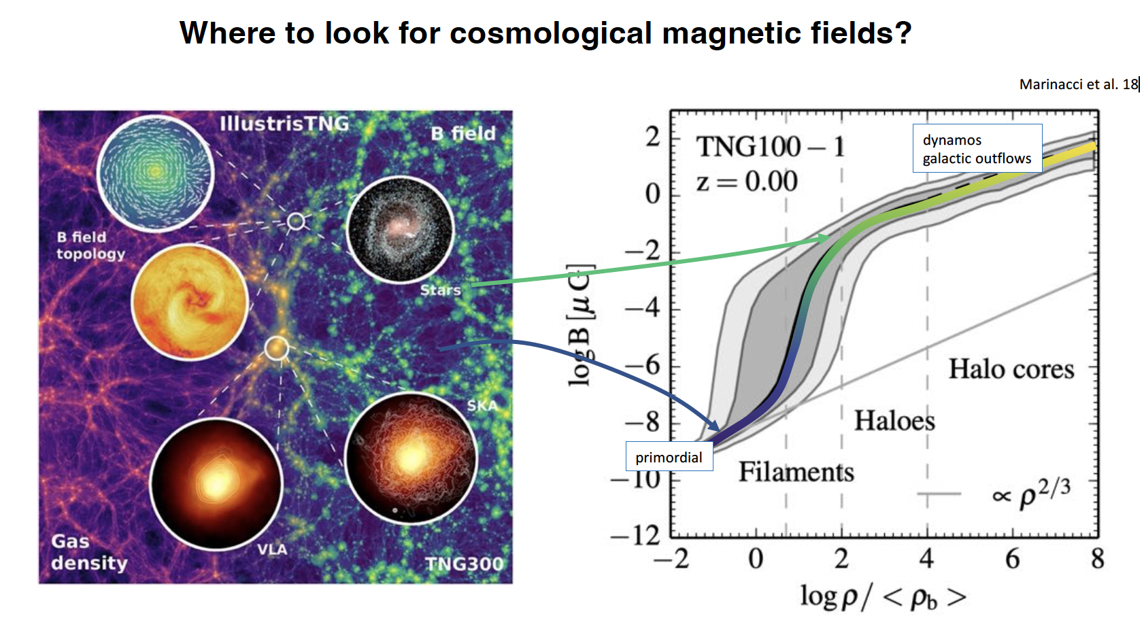
Magnetic Fields in the Universe
adapted from Andrii Neronov’s slides, Bologna,‘Cosmic magnetism in voids and filaments’, 2023

Slide 4
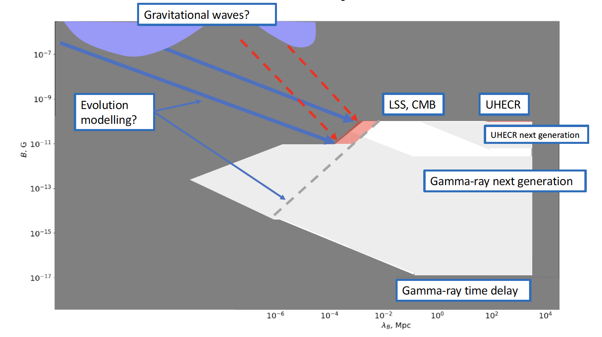
Intergalactic Magnetic Field (IGMF) limits
Upper Limits
IGMF Strength B
Lower Limits!!!
Correlation Length λ_{B}
adapted from Andrii Neronov’s slides, Bologna, ‘Cosmic magnetism in voids and filaments’, 2023

Slide 5
Lower Limits (LL): the kingdom of gamma rays
Results on IGMF are typically given considering two regimes:
  Long correlation length (λ_{B} >> λ_{IC} )
  (motion in homogeneous B, ballistic e±)
  Short correlation length (λ_{B} << λ_{IC} )
  (diffusion in angel, diffusive e±)
λ_{B} < λ_{IC}
λ_{B} > λ_{IC}

Slide 6
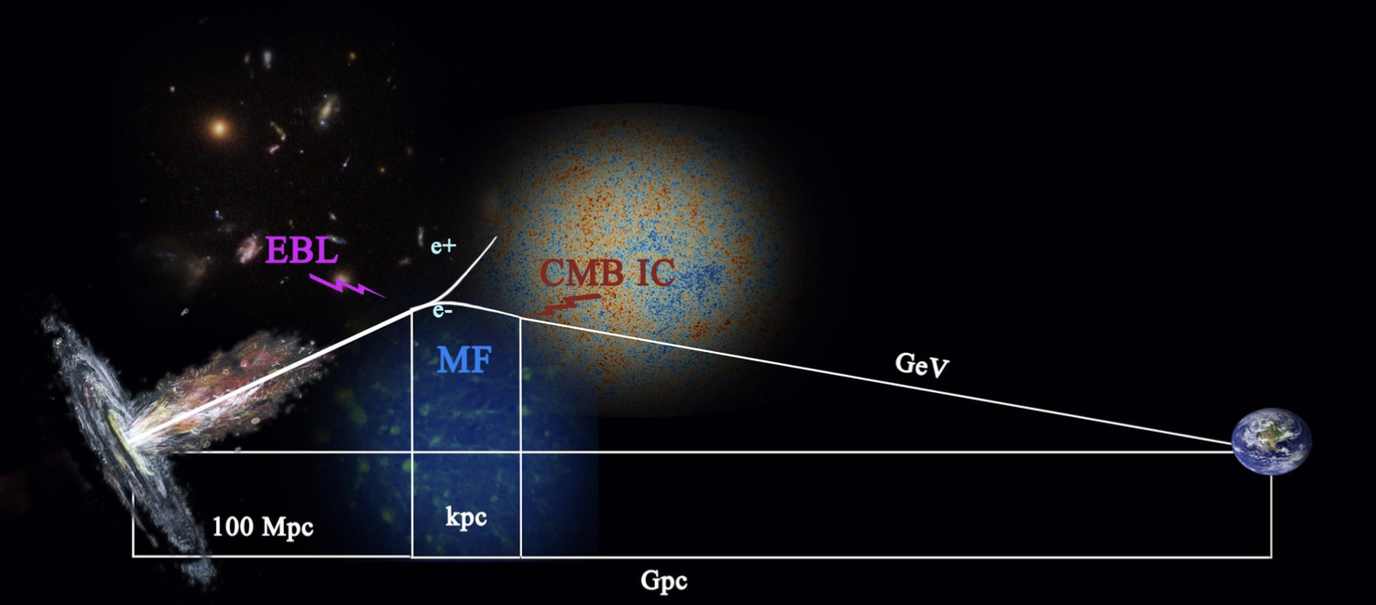
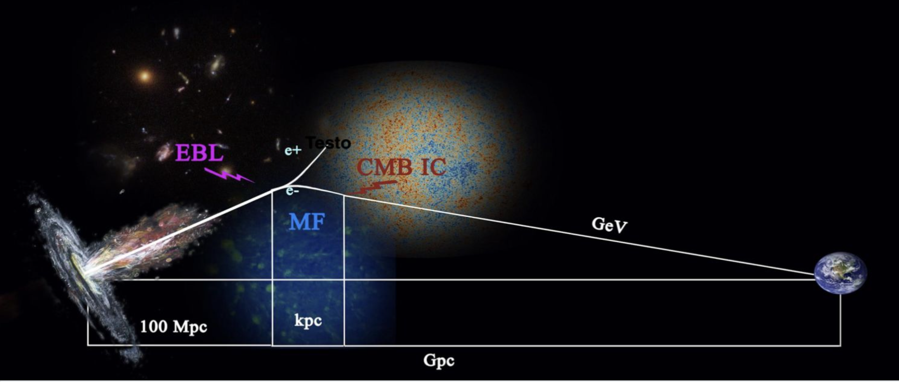
Probing IGMF in the GeV range
IGMF can generate an extended and time-delayed emission at GeV energies due to
magnetic field deflection + CMB reprocessing
tens GeV
Adapted from Vachaspati et al. 2020

Slide 7
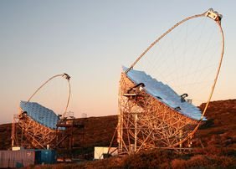
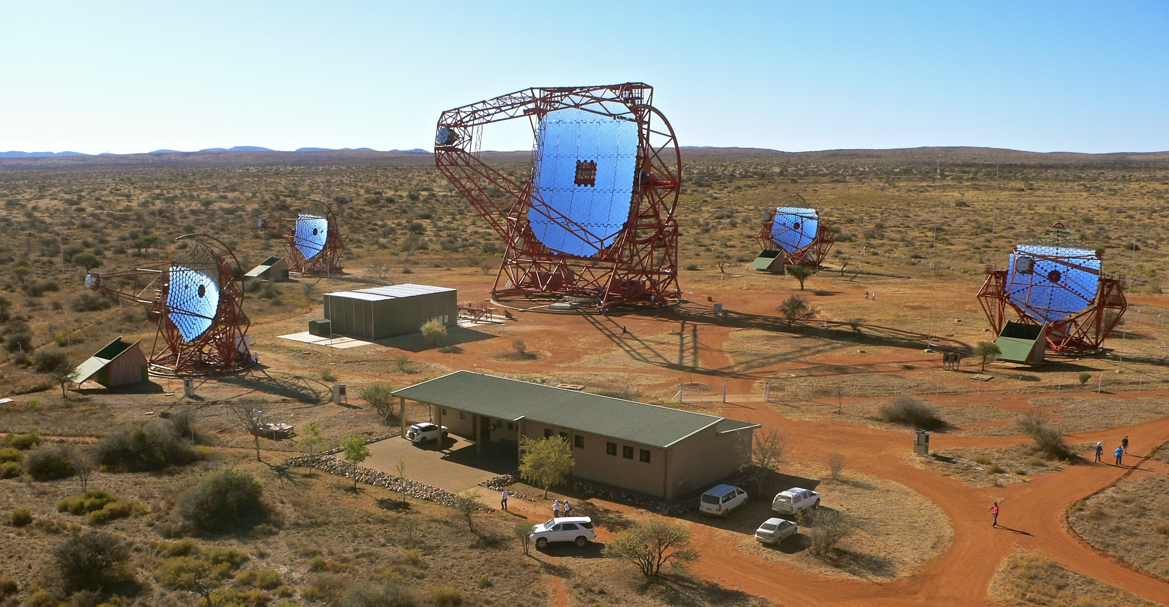
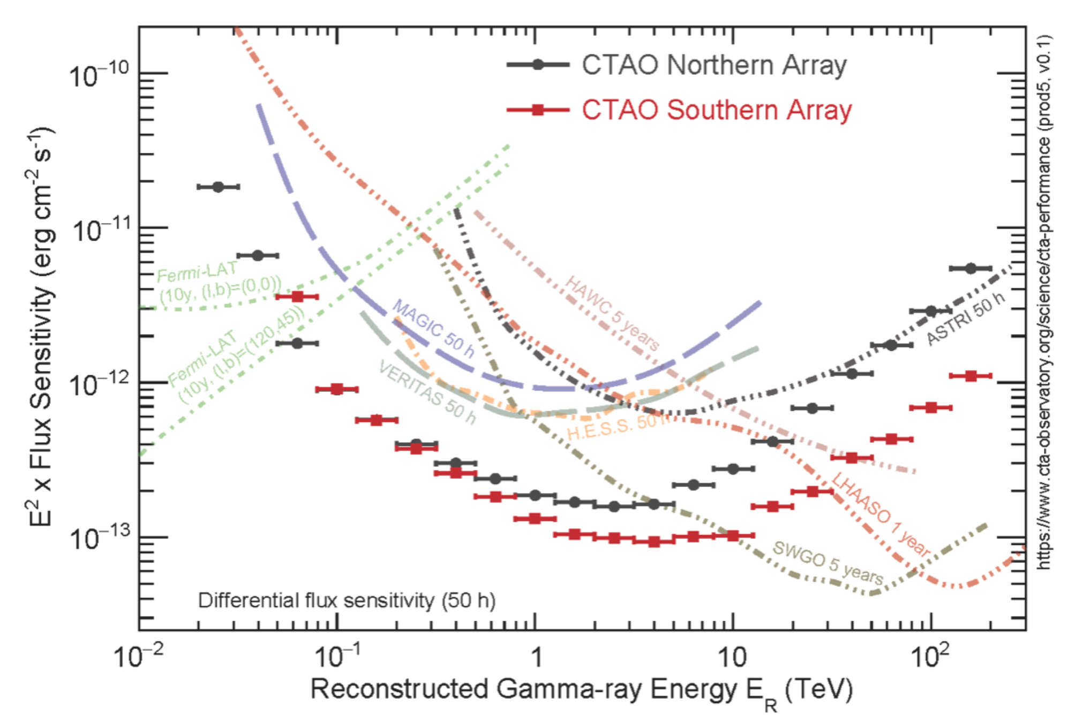
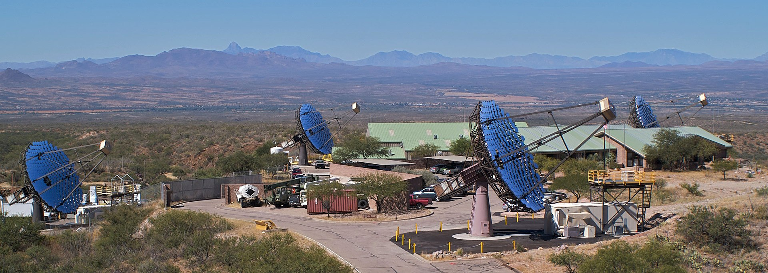
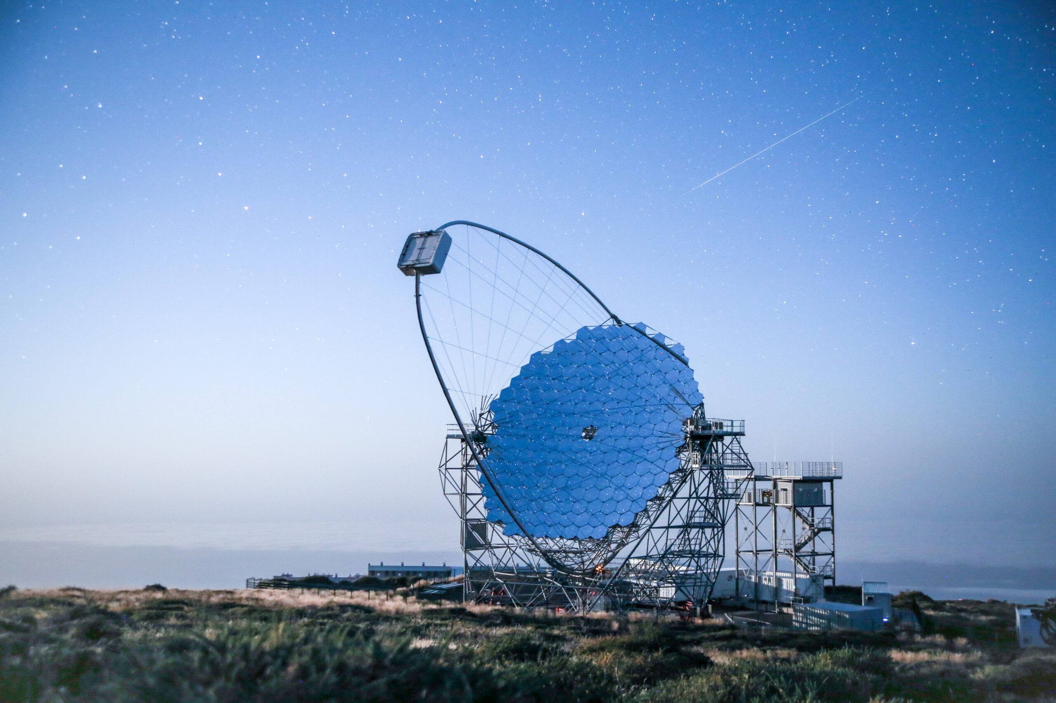
Gamma-ray window for IGMF
Reprocessed ɣs
Primary ɣs
50 GeV
1 TeV
100 TeV
https://www.cta-observatory.org/science/ctao-performance/

Slide 8
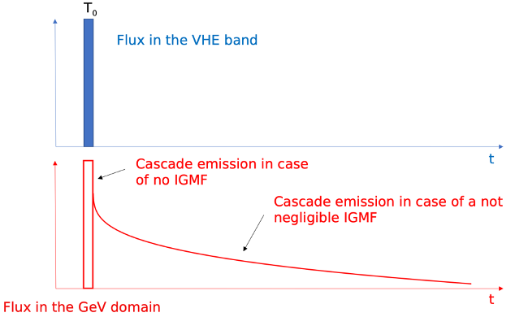
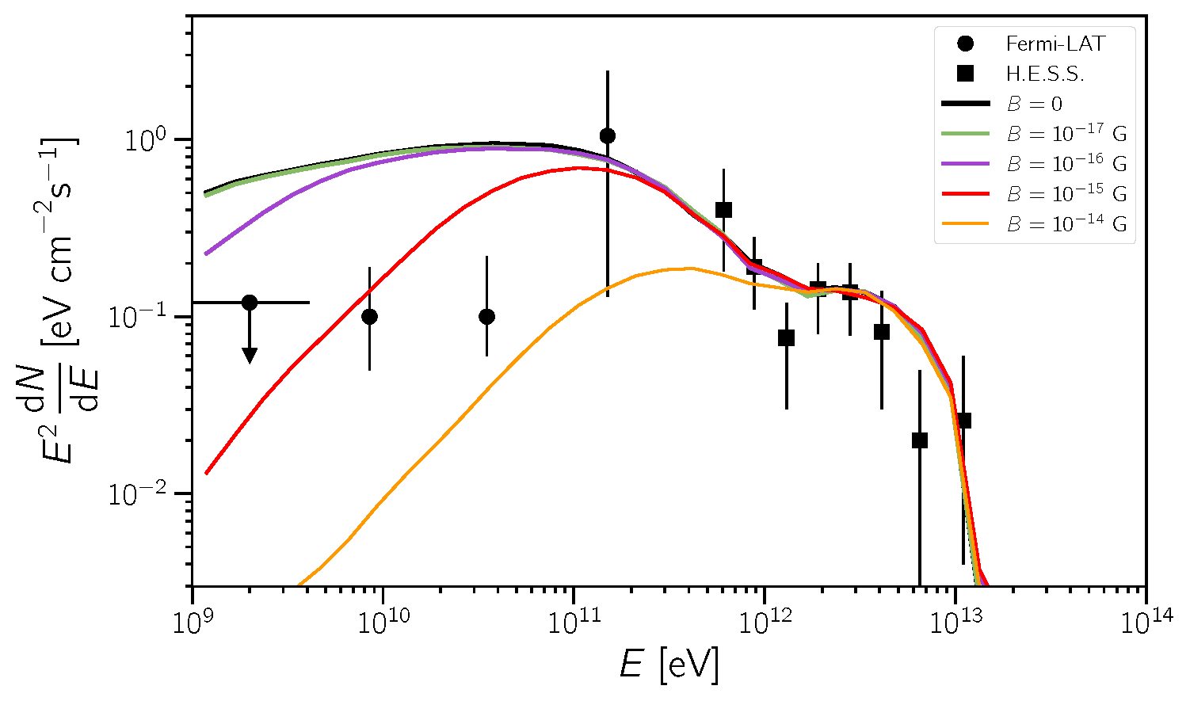
Gamma-rays for IGMF studies: Methods
How gamma-ray can probe IGMF properties (B strength and correlation length λ_{B})?
Extended emission
Time-delayed ’’pair-echo’’ emission
SED signatures
Alves Batista et al, 2022
Alves Batista & Saveliev, 2021

Slide 9
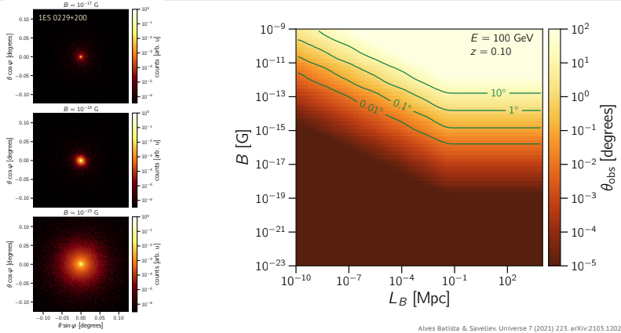
Gamma-rays for IGMF studies: Methods
How gamma-ray can probe IGMF properties (B strength and correlation length λ_{B})?
Method I : search for extended emission
                Alves Batista, 2021
A “smoking gun” for IGMF discovery
Size and shape depend on IGMF strength and source parameters (jet opening and orientation)
𝚹_{ext} ∝ B E_{ɣ}⁻¹ λ_{B} >> λ_{IC}
𝚹_{ext} ∝ B E_{ɣ}^{-3/4} λ_{B}^{1/2} λ_{B} << λ_{IC}

Slide 10

Gamma-rays for IGMF studies: Methods
How gamma-ray can probe IGMF properties (B strength and correlation length λ_{B})?
F_{delay} ~ F₀ $\frac{T}{Tdelay+T}$
T_{delay} ∝ B² E_{ɣ}^{-5/2} λ_{B} >> λ_{IC}
T_{delay} ∝ B² E_{ɣ}⁻² λ_{B} λ_{B} << λ_{IC}
Interesting for AGN flares or transient sources
Method II: search for time-delayed ‘pair-echo’ emission
From Da Vela’s talk at TeVPA 2022

Slide 11
Gamma-rays for IGMF studies: Methods
How gamma-ray can probe IGMF properties (B strength and correlation length λ_{B})?
Method III: search for SED signatures
Absorbed flux of a TeV source due to EBL
Aumont of cascade secondary emission (depends on the IGMF strength, correlation length, intrinsic source properties)
Non-detection: minimal cascade power and calculate LL on B
Alves Batista & Saveliev, 2021

Slide 12
IGMF studies: source features
What properties do we need?
Hard spectrum in the VHE domain
VHE Emission extending above few TeV
Redshift z > 0.1

Slide 13
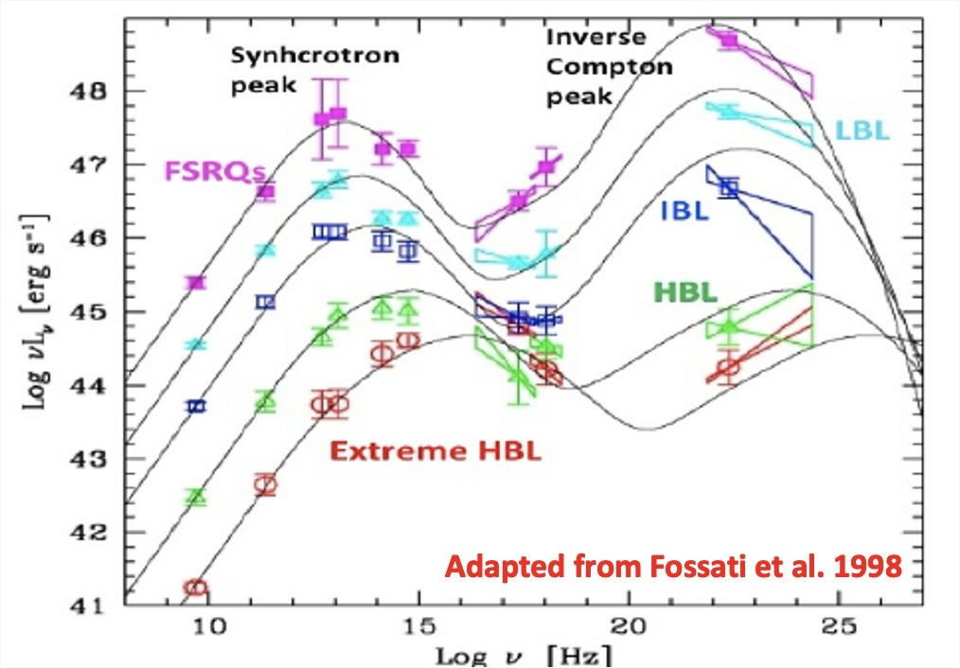
IGMF studies: sources
Blazars
Features:
Persistent sources of TeV radiation
Subclass with Hard-TeV spectrum
Population of ~ 80 sources as TeV
emitters
Drawbacks:
Source temporal (min-yrs) and spectral variability
Pollution by primary GeV emission
Unknown duty cycle

Slide 14
IGMF bounds from Blazars
Ackermann et al, 2018
Individual source analysis, T_{activity}=10 years, θ_{jet}=6°
B > 8 × 10⁻¹⁷ G
Stacking analysis, T_{activity}=10, 10⁴ and 10⁷ years, θ_{jet}=6°
B > 3 × 10⁻¹⁶ G

Slide 15
IGMF bounds from Blazars
E. Pueschel talk, Bologna, 2023

Slide 16
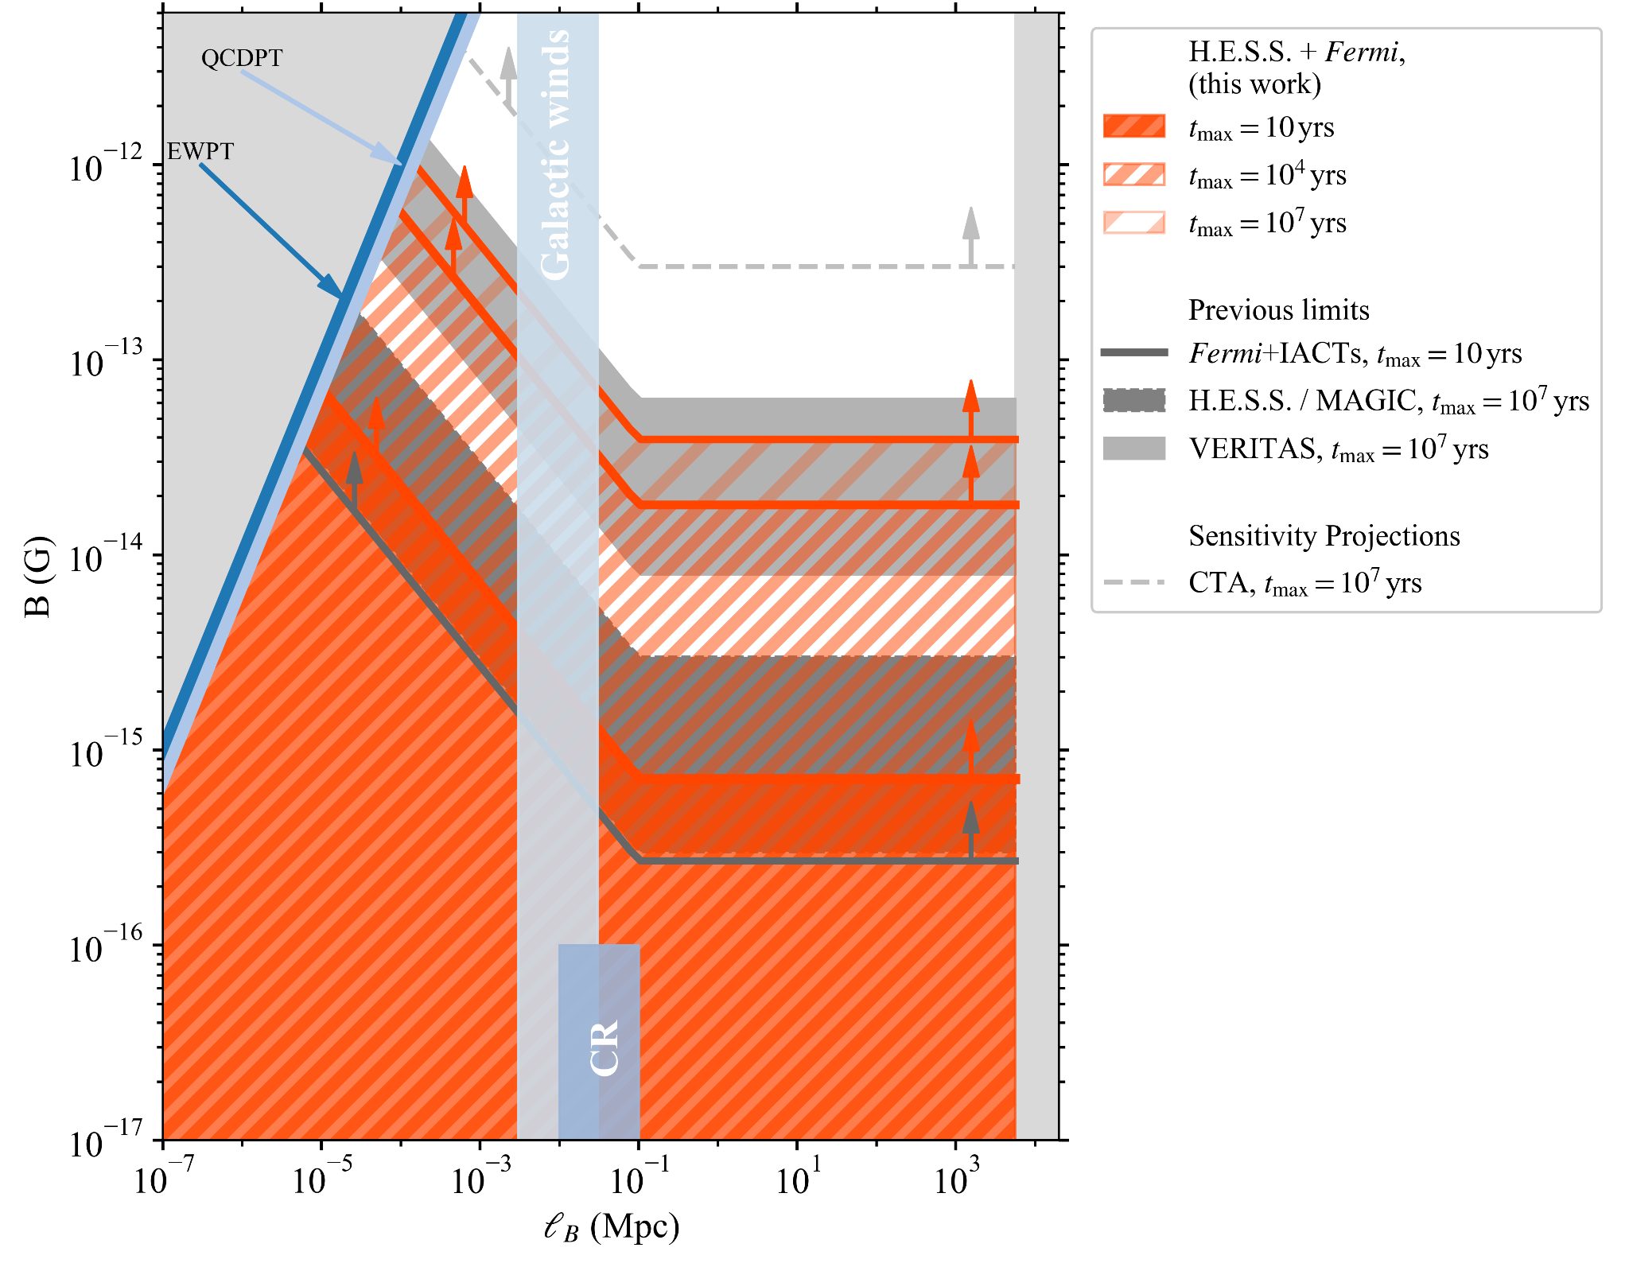
IGMF bounds from Blazars
Source stacking following selection criteria from 4LAC-DR2 catalog (pwl intrinsic spectrum, known redshift, HBL behaviour)
Building cascade halo template with CRPropa3 simulations
Combine Fermi-LAT+HESS data and compare with Intrinsic+halo flux sources
Provide LL for different duty cycle values (10, 10⁴, 10⁷ yrs)
M. Meyer talk, Bologna, 2023

Slide 17
IGMF bounds from Blazars
1ES0229+200 (z = 0.14), 140 hours of MAGIC observations
Published HESS, VERITAS data +. Fermi-LAT and new MAGIC data used for validation of results
VHE spectrum: power-law with exponential cutoff minimizing the cascade power: Γ≈1.72, E_{cut}≈6.9 TeV
The variability pattern is taken into account and inferred from the VHE lightcurves
Scan performed in the (B,λ_{B}) space in order to look for the IGMF configurations rejected by the data
B > 1.8 × 10⁻¹⁷ G λ_{B} > 0.2 Mpc
B > 1.8 × 10⁻¹⁷ (λ_{B}/0.2 Mpc)^{-1/2} G λ_{B} < 0.2 Mpc
MAGIC Collaboration, 2023

Slide 18
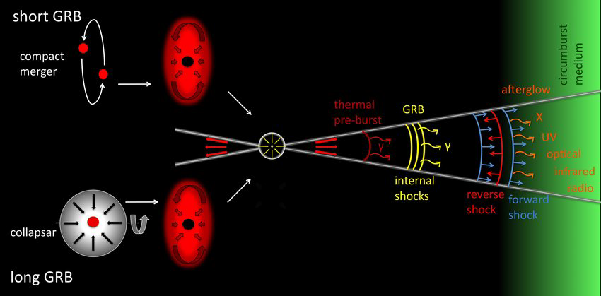
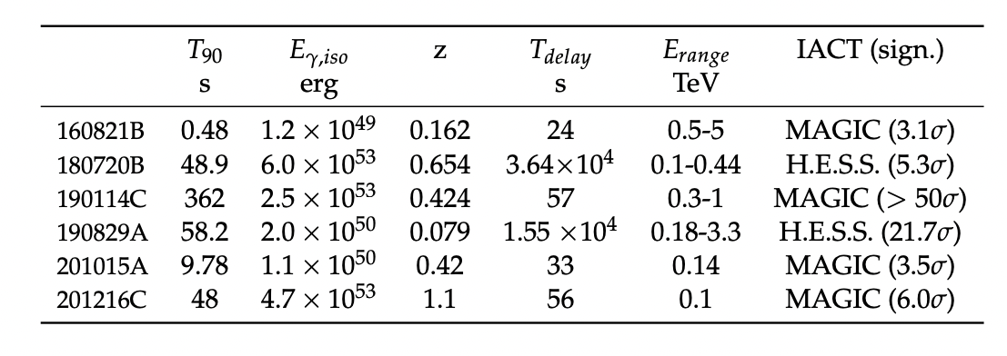
IGMF studies: sources
Drawbacks:
Limited number of events (5 events at TeV + 2 hints of TeV emission)
Source spectrum and spectral variability
GRBs
Features:
Cosmological sources
Bright transient events (L up to ~ 10⁵³ erg s⁻¹)
Advantages:
Pollution by primary GeV emission
Unknown duty cycle
GRBs at Very High Energy
221009A 289 1.0 x 10⁵⁵ 0.151 0-2400 0.5-18 LHAASO
Adapted from Miceli & Nava, 2022

Slide 19
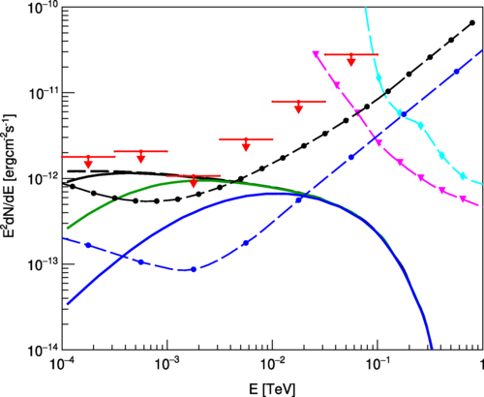
IGMF bounds from GRBs
The case of GRB190114C
10⁻²⁰ G
10⁻¹⁹ G
10⁻¹⁸ G
Fermi-LAT ULs
Fermi-LAT ULs
Dzhatdoev et al. 2020
Wang et al. 2020

Slide 20
IGMF bounds from GRBs
The case of GRB190114C
Vovk, 2023
Da Vela et al. 2023

Slide 21
GRB190114C (z = 0.42)
Comparison with MAGIC and CTA sensitivities
Spectral energy distribution
Primary GRB emission
Secondary emission
Observational time: 3 hours starting from 2400 s after trigger burst
MAGIC and CTA sensitivity derived from CTA website and rescaled in time
Preliminary

Slide 22
GRB190114C-like with lower redshift (z = 0.2)
Comparison with MAGIC and CTA sensitivities
Spectral energy distribution
Primary GRB emission
Secondary emission
Observational time: 3 hours starting from 2400 s after trigger burst
MAGIC and CTA sensitivity derived from CTA website and rescaled in time
Preliminary

Slide 23
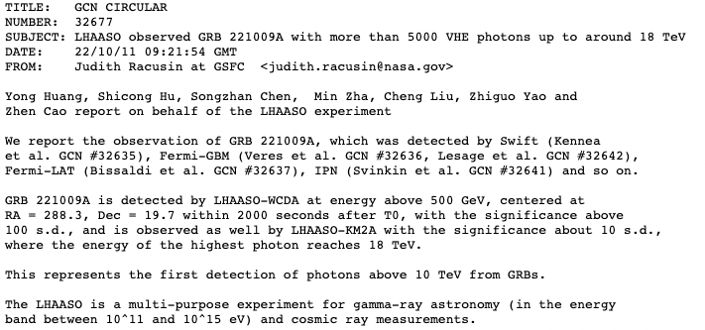
GRB221009A (z = 0.151)
GRB221009A is certainly the best transient source for IGMF studies so far but…
lack of IACT data in the 1-100 GeV band…

Slide 24
CTA prospects for IGMF studies
Single source test:
simulate 50-hour observation of 1ES 0229+200
Assume a disk-like halo brightness profile
Emission = “point-like component + halo cascade component”
Sensitivity = “minimal halo flux of fixed extension resulting in a 3σ detection of the extended component”
CTAC 2021

Slide 25
CTA prospects for IGMF studies
CTAC 2021
Several unknown parameters impact the results (IGMF coherence length, jet orientation, AGN activity evolution,…?)

Slide 26
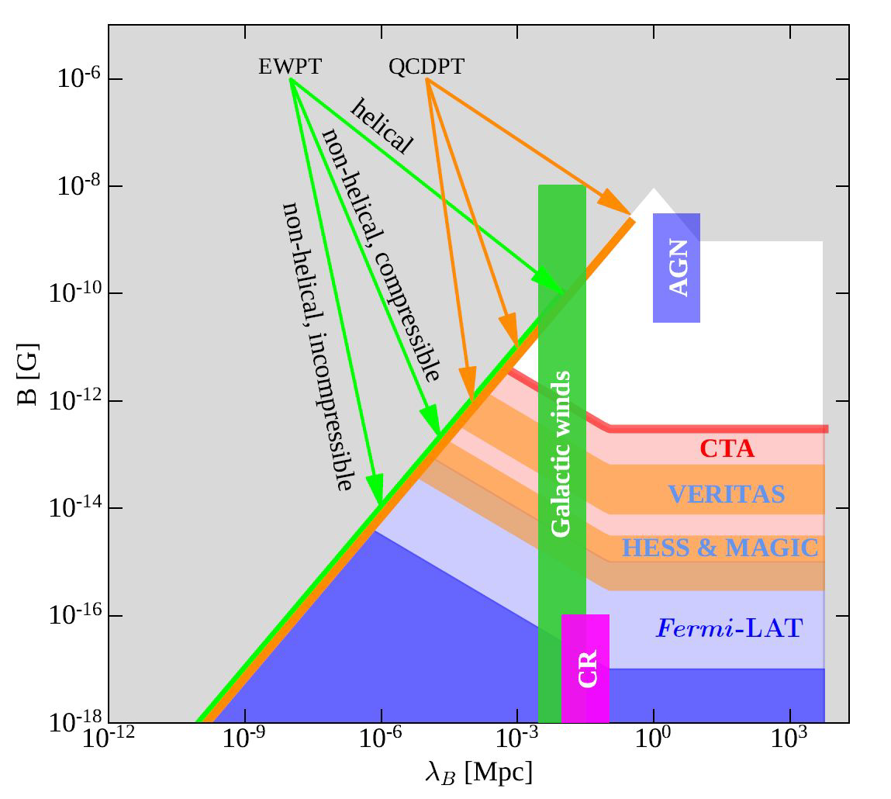
CTA prospects for IGMF studies
CTAC 2021

Slide 27
The contribution of CTA+ to IGMF
Reprocessed ɣs
Primary ɣs
50 GeV
LSTs
Better sensitivity,
angular resolution
for E< 100 GeV
Study reprocessed
cascade emission
1 TeV
100 TeV
SSTs
Intrinsic VHE spectrum
above TeV
Study intrinsic source
properties (photon index,
cut-offs?)
https://www.cta-observatory.org/science/ctao-performance/

Slide 28
Conclusions
IGMF current hot interdisciplinary topic (cosmology, astroparticle and astrophysics involved)
VHE can provide unique results to this field → detection? LL?
Recent studies and discoveries on AGNs and GRBs increase the “hype” on IGMF → for bright AGN flares or GRBs it may be worth to revise the observational strategies
CTA (+synergies with LHAASO,SWGO, ASTRI-MA, Fermi-LAT) will be able to play a relevant role → is the cascade emission there or are there relevant effects that we are missing?
CTA+ can provide a significant upgrade on IGMF studies both of secondary and primary gamma-ray emission

Slide 29
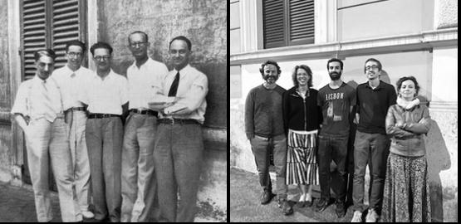
THANK YOU FOR YOUR ATTENTION

Slide 30
BACKUP SLIDES

Slide 31
Probing IGMF in the GeV range
IGMF can generate an extended and time-delayed emission at GeV energies due to
magnetic field deflection + CMB reprocessing
Time-delayed
Time-delayed
Extended
Neronov et al, 2009

Slide 32
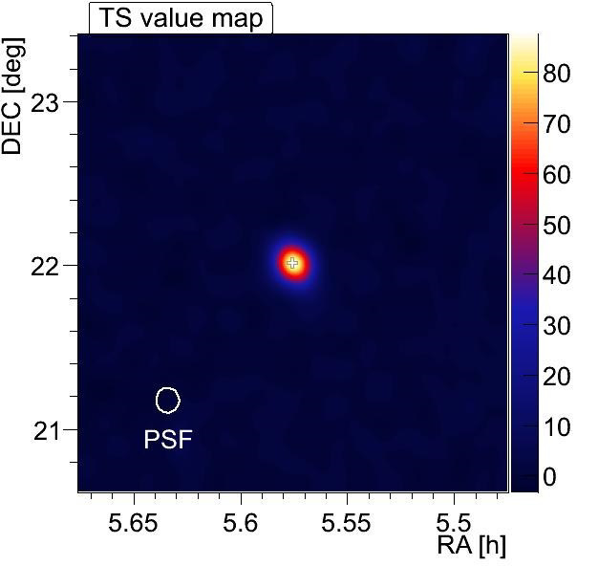
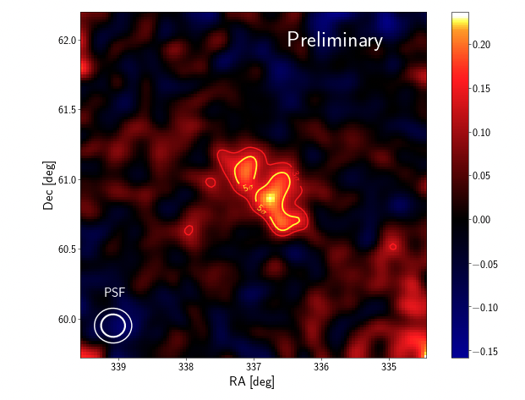
IGMF: Extended emission
Point-like source
Extended source

Slide 33
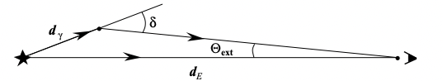
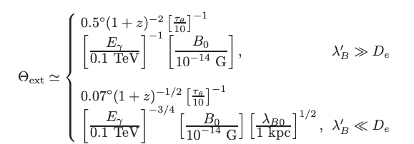
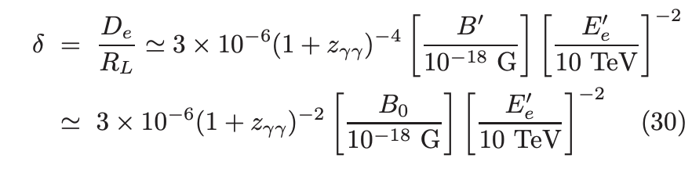
IGMF: Extended emission
Deflection angle (𝜹) and angular extention (𝚹_{ext}) are sensitive to magnetic field B, energy of reprocessed photons (E_{ɣ}) and source distance (z)
Neronov et al, 2009

Slide 34
Gamma-Ray Bursts (GRBs)
ɣ
Miceli & Nava, 2022

Slide 35
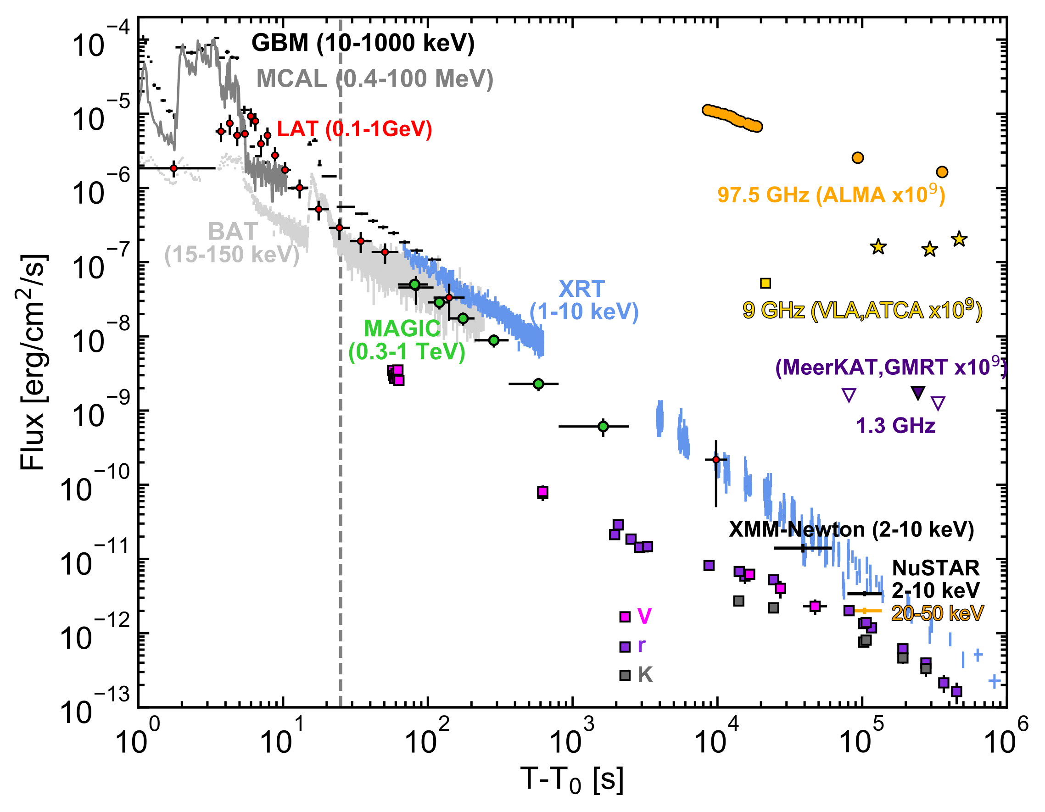
GRB190114C
Multi-wavelength light curve
Long GRB
E_{ɣ,iso} ~ 2.5 x 10⁵³ erg
z = 0.42
TeV detection info (MAGIC):
T_{delay} ~ 57 s
> 50σ in 20 minutes
detection up to 40 min
0.3 - 1 TeV energy range
MAGIC Coll. et al., 2019

Slide 36
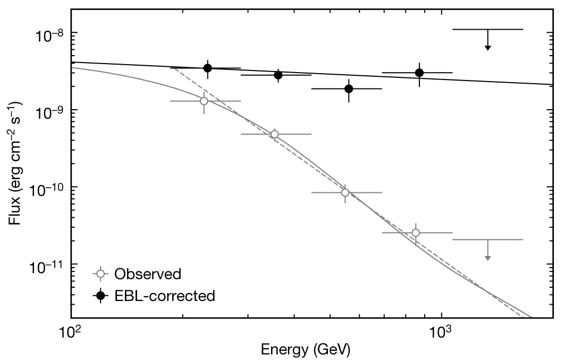
GRB190114C
Spectral energy distribution
Long GRB
E_{ɣ,iso} ~ 2.5 x 10⁵³ erg
z = 0.42
TeV detection info (MAGIC):
T_{delay} ~ 57 s
> 50σ in 20 minutes
detection up to 40 min
0.3 - 1 TeV energy range
~2
~5
TeV
MAGIC Coll. et al., 2019

