Slide 1

CTAO and CTA+
New Opportunities
for the italian community
M. Cappi
(INAF DS – Responsabile Divisione Alte Energie (UTGIII))
AVENGe meeting @ Roma – 29-31/05/’23

Slide 2
Outline
  CTAO Status
  CTA+ Status
  General considerations

Slide 3
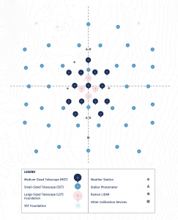
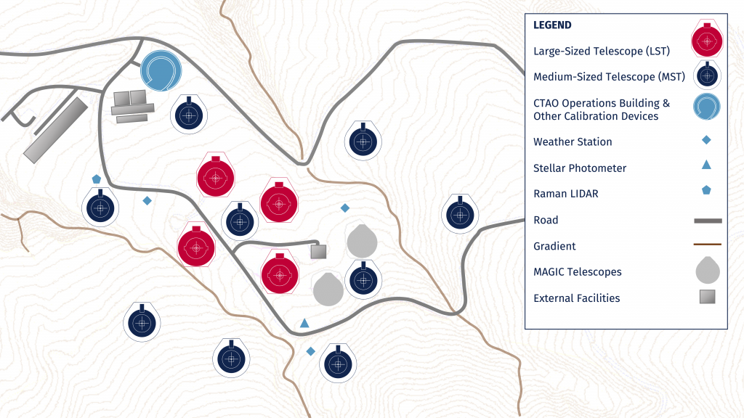
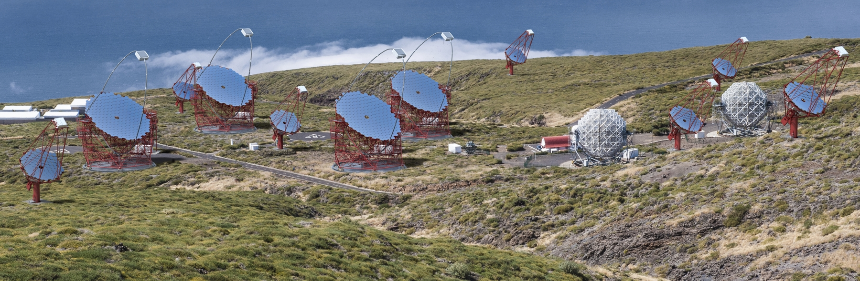
CTAO Status (i/iii)
Project:
  Money Matrix in May 2021 defined the project: CTA-N, CTA-S, HQs
  Italy contributes 60 M€ (out of ~310 M€), second only to DE (~80 M€)
  Layout baselined (Phase A):
      CTAO-N (La Palma): 4 LSTs + 9 MSTs
      (NB: ASTRI MA in Tenerife with 9 SSTs)
      CTAO-S (Chile, Paranal): 14 MSTs + 37 SSTs

Slide 4
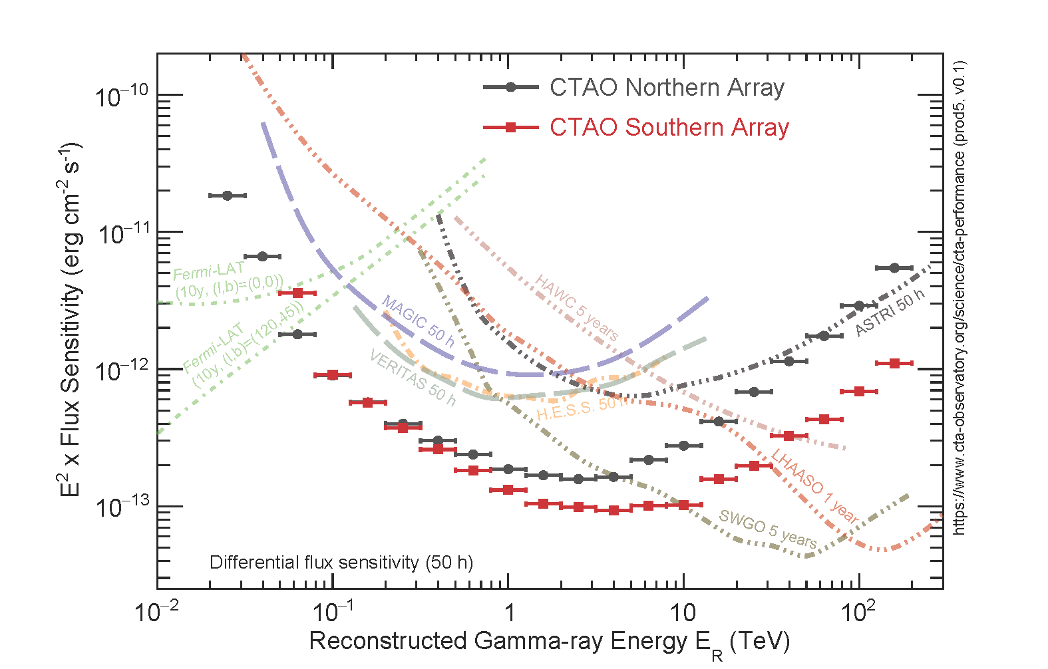
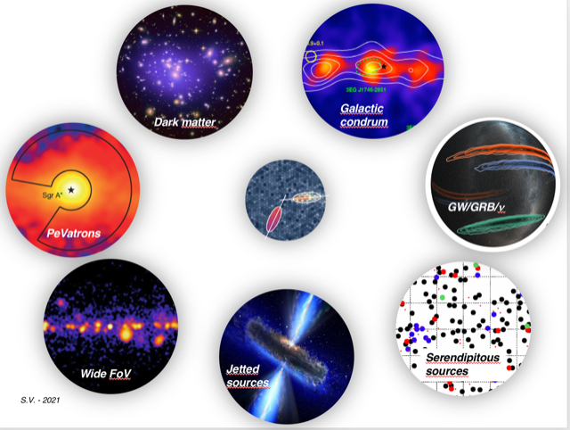
CTAO Status (ii/iii)
Project: The first (open) Observatory in the TeV energy range
50-60% of Open Time, all data public after 1 year proprietary time
Will revolutionise the TeV science and community
Expect the unexpected!

Slide 5
CTAO Status (iii/iii)
Programmatics:
  gGmbH to ERIC (from pre-construction to construction) with start, most likely, in September 2023
  New DG “BGR-elected” (Stuart Mc Muldroch) already active
  LST-1 already working (also with MAGIC), LST-2 to 4 within 2024, MST Pathfinder in CTAO-S, MST1-9 within ‘26-’27, SSTs within ’28, (NB: ASTRI1-9 within 2024)

Slide 6
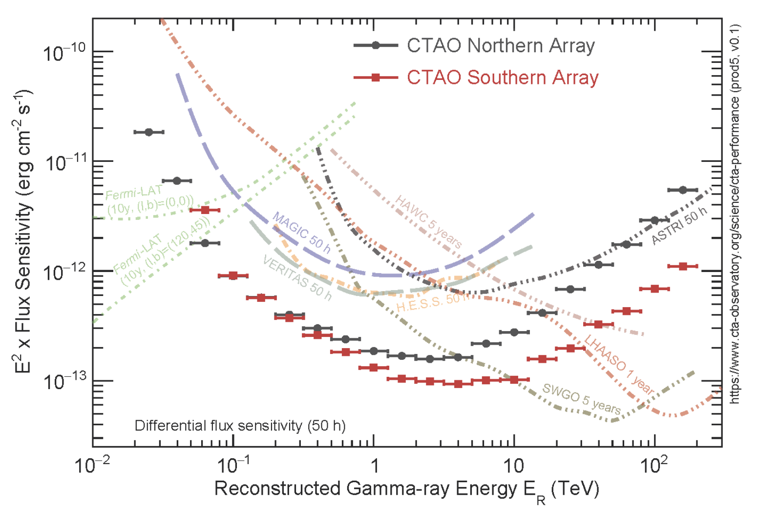
CTA+ Status
CTA+ is a (~71M€) INAF-lead Italian PNRR program to enhance the ESFRI/ERIC CTA infrastructure at both low (<1 TeV) and high (>100s TeV) energies, and provide it with state-of-the-art ground-based multi-frequency telescopes for the follow-up of multimessenger transient sources (such as GRBs, GWs, Neutrinos, etc.) which are Core Science for CTA, and for INAF.
A Program to enhance CTA with 2 Main ”boosts” (for now) and 3 ancillary enhancements (for future):
…and multi-ni/opt. follow-ups:
  …and R&D for future CTA
  …and Science & CTAO HQ
  enhancement
enhance (significantly)
sensitivity here (+ 2 LSTs)
…and here (+5 SSTs)

Slide 7
CTA+ PNRR Status (i/ii)
Project:
  PNRR Proposal approved in June 2022: 71.5M€ to be spent in 30 months (KO in 01/01/2023) 😱😱
  Main contribution is to enhance CTAO-S, opening/strengthening transient science in CTAO South i.e.:
      CTAO-S baseline + 2 LSTs (major effort) 💪 (PI: Antonelli)
      CTAO-S baseline + 5 SSTs (PI: Tagliaferri)
      + Multi-ni follow-up enhancements:
          VST polarimeter (PI: Schipani)
          TNG fast photometer (eSIFAP, PI: Ambrosino)
          Fast vlbi radio (PI: Giroletti)
          Stellar Intensity Interferometry (for ASTRI; PI: Zampieri)
      + R&D new detectors for Cherenkov telescopes or complementary
      + science & outreach in Italy and HQs (Resp.: Zanin)

Slide 8
CTA+ PNRR Status (ii/ii)
Programmatics:
  Kicked Off in 01/01/2023. -25 months to the end
  Project Team(s) are literally full-speed to prepare >6-7 tenders worth > 70M€ (within end of 2023!)
  Program will support 9 PhD courses + about 15 TDs (6 of which scientific).
  CTA+ and we (all) are formally part of the whole LST collaboration (major contributor for also LST collaboration), including all technical aspects but also for the Science Team (Now just To Be Defined). Known for INFN, but new for INAF.
  Italy (& INAF) has/will become the major contributor of CTAO
  (from ~60M€ to ~100M€, tbc)

Slide 9
CTAO and CTA+ - Conclusions
A/two Huge opportunity/ies for INAF/Italian technologists and scientists:
  NB: From BGR-approved Access Policy Document, KSP Time will be given in reward and proportionally to IKC+cash contributors (including governance and leadership). For the time being the idea is to pool all IKC and self-organize into a scientific collaboration.
  CTAO: Italy being major contributor, providing the 37 (+5) SSTs and host of the HQs → main player with important access to KSPs time (KSPs=GPS, EGS, Gal. Center, etc.)
  CTA+: LSTs mean 10s-100s GeV i.e. allow the “gamma-ray transients” window. Access already granted for the North, in 2-3 years also for CTAO-S. Also multi-ni facilities will open new windows for follow-ups.
  NB: ASTRI MA is synergic, and pathfinder, to CTAO and CTA+ contributions!

Slide 10
Conclusions
  CTAO will start hard-work construction next year (except LSTs which started already)
  PNRR CTA+ is admittedly a “crazy” project (for us), but a great scientific and programmatic opportunity, if added to the already important involvements in ASTRI-MA (end of ‘23/’24, 3 then 9 tel.) and CTAO
  My view: the main interest(s)/goals for this meeting are:
      Promote, to (soon) identify, the most interesting and promising KSP(s) to Italy, where we could obtain maximum return (wrt DE, S, F, J, etc.). Expect Italy will lead 1, max 1.5-2 KSPs at the end.
      Promote dialogue synergies within Italy (INAF, INFN, Univ.) to guarantee a fair and satisfactory return and recognition of all Italian IKCs, i.e. INAF, INFN, and Universities.

Slide 11
  Thank you very much for your time and attention

Slide 12
Breakthrough Science expected from both ASTRI Pathfinder and CTA (first worldwide gamma-ray Observatory) (I/III)
If first to demonstrate the
existence and Id. of Pevatrons…Nobel prize(?)
Galactic Center: a Pevatron factory? (still visible from Tenerife)
Blazars and Lorentz Invariance Violation
…..etc.
3 review papers (1 core science + 2 Observatory Science: Galactic and Extragalactic), to be published in weeks in international Journal of High Energy Astrophysics

Slide 13
Breakthrough Science expected from both ASTRI Pathfinder and CTA (first worldwide gamma-ray Observatory) (II/III)
→ ASTRI not only a precursor of CTA-S but an INAF observatory standalone!

Slide 14
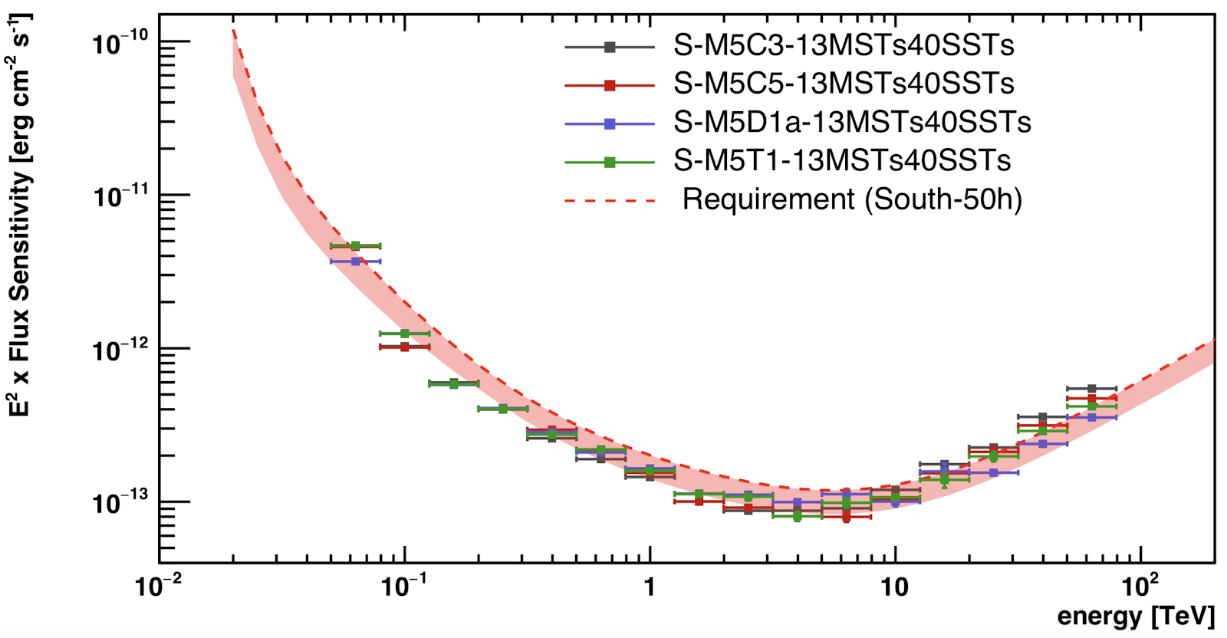
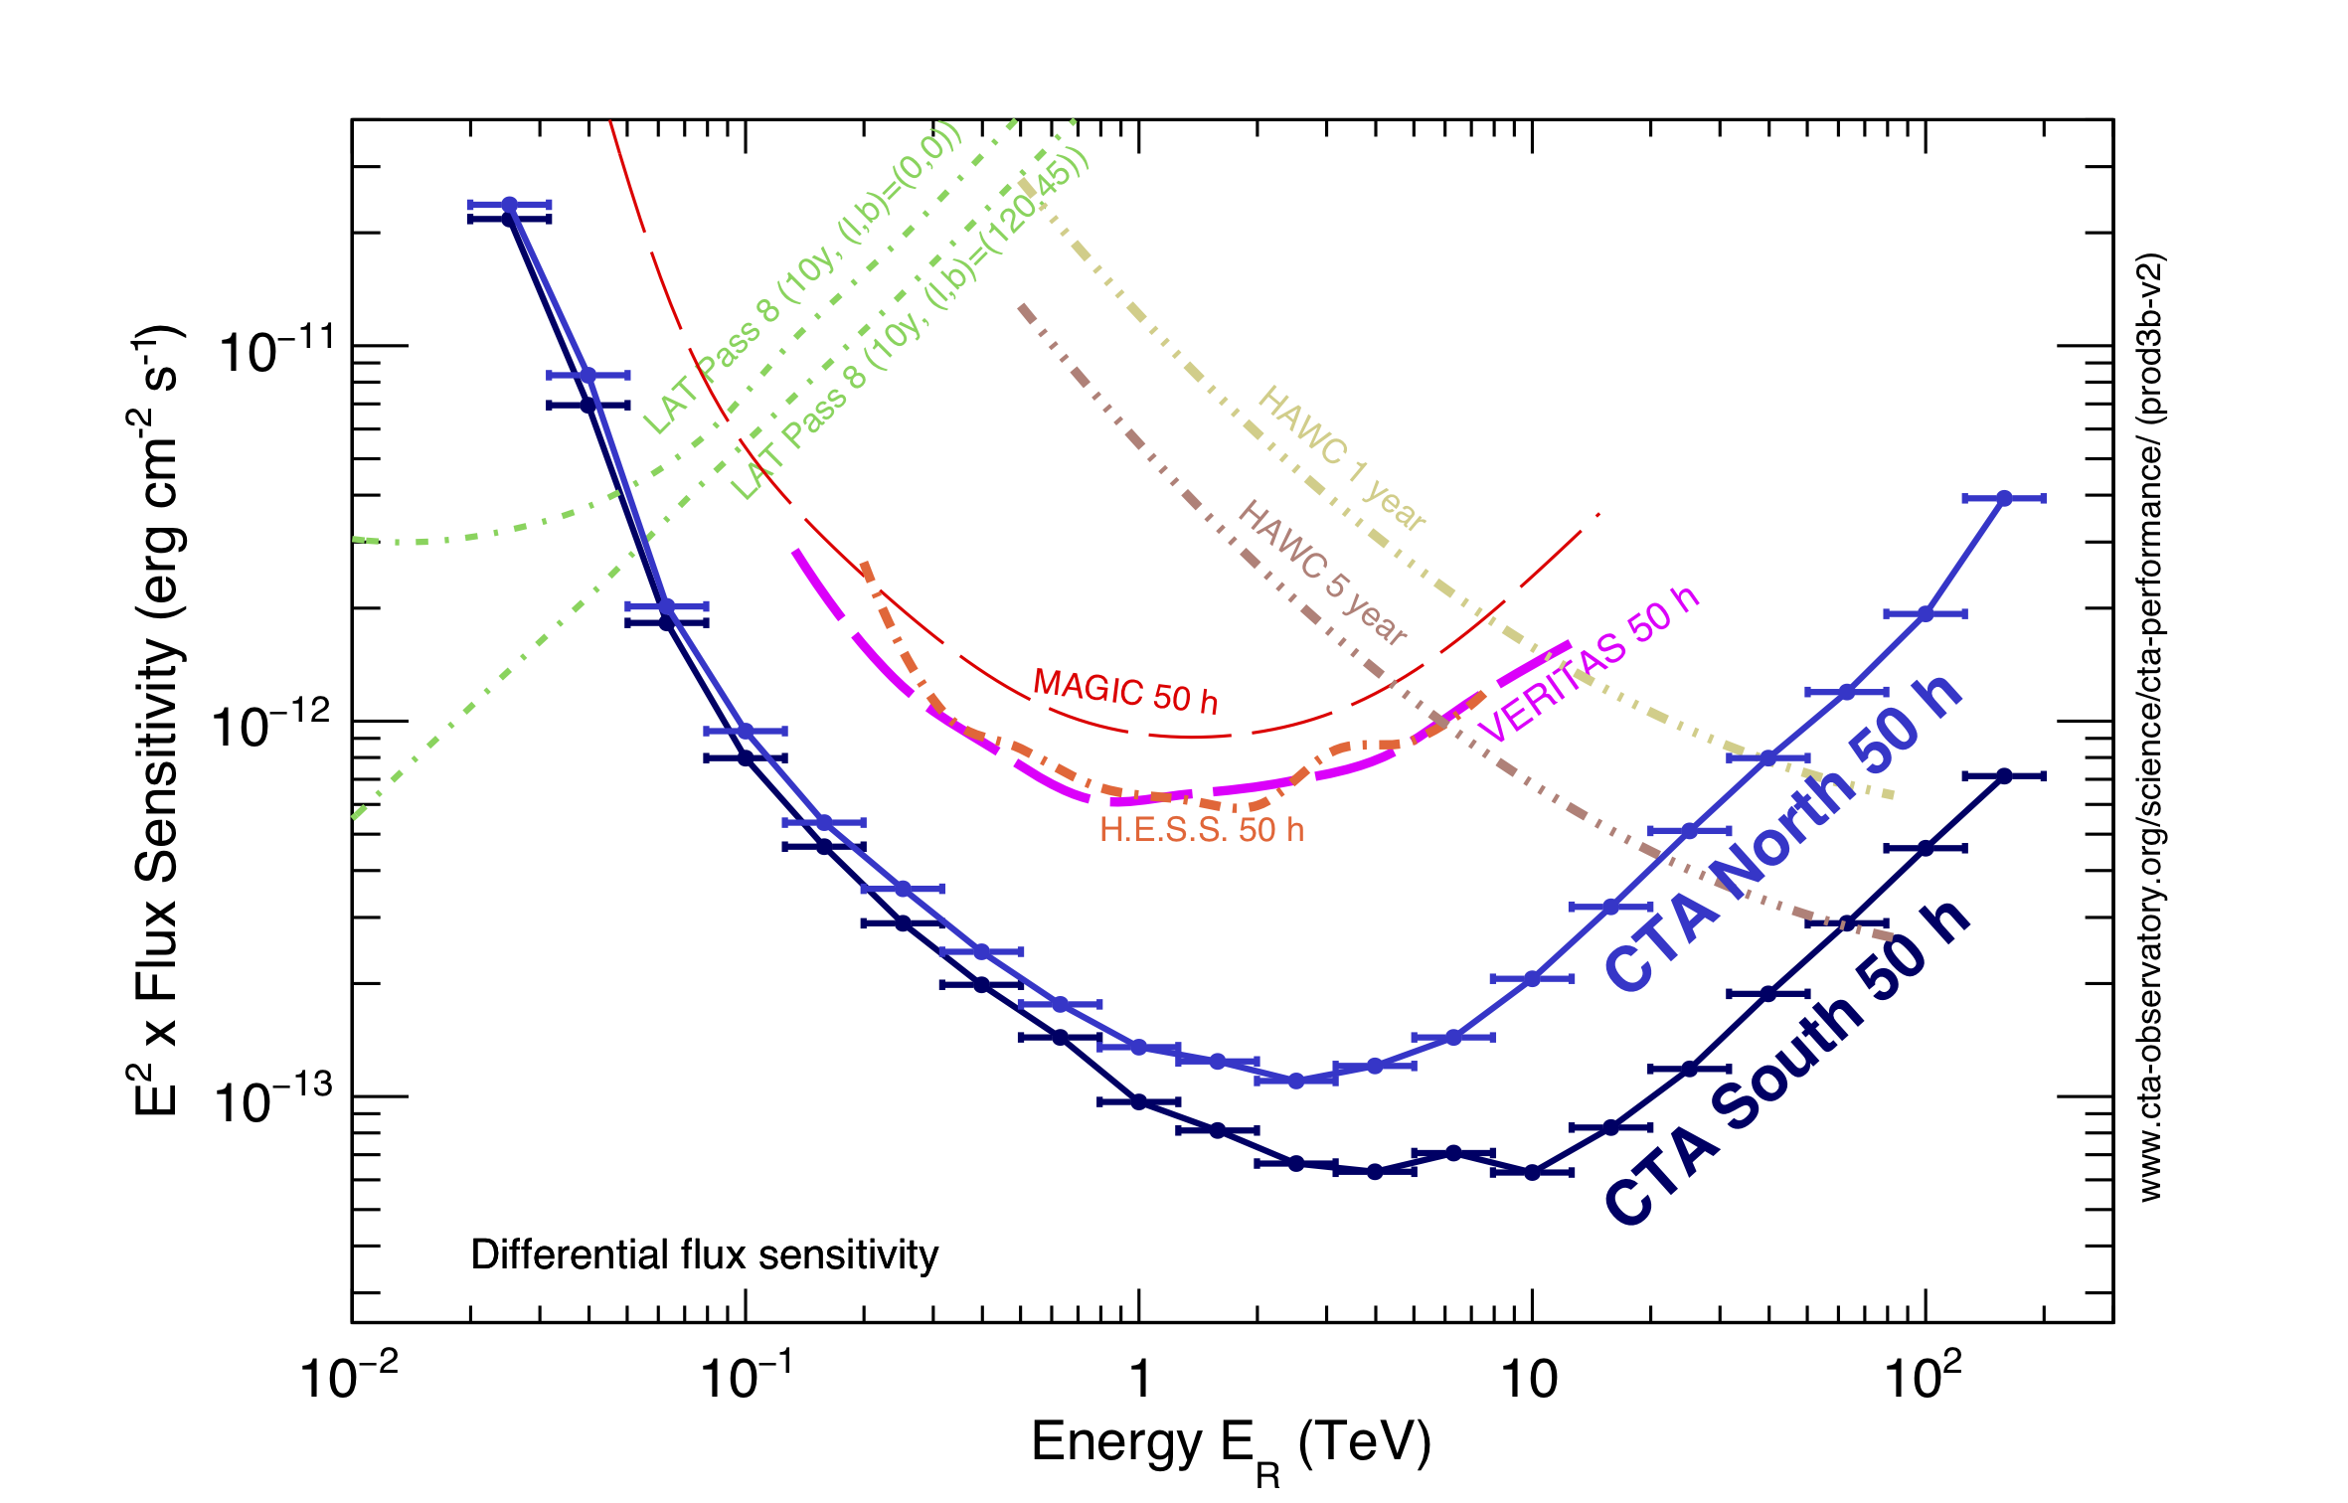
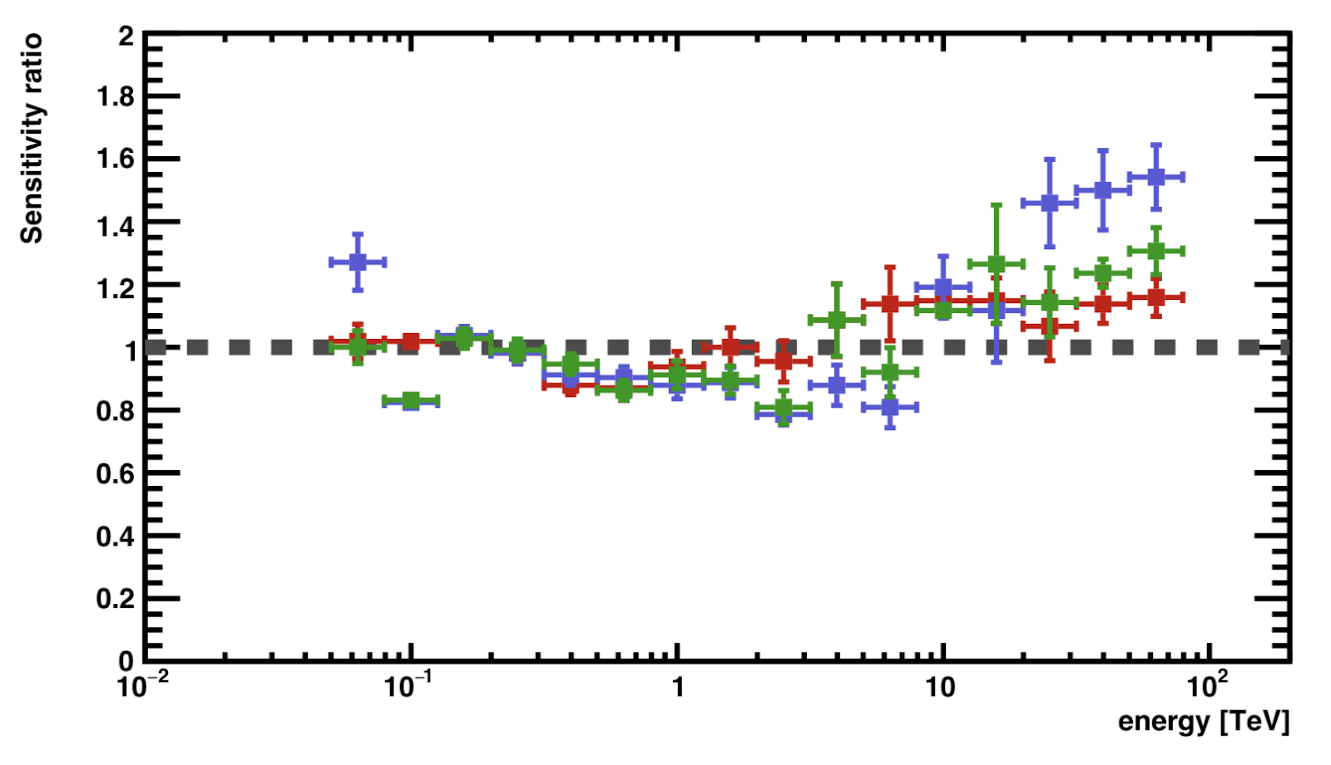
Breakthrough Science expected from both ASTRI Pathfinder and CTA (first worldwide gamma-ray Observatory) (III/III)
On-going layout optimisation of CTA-South
→ MM → convergence for ~ 13 MSTs + 40 SSTs
Key science in the south will be Galactic Plane Survey and Galactic Center
LIV
Extragalactic Survey
Etc. etc. (First IACT Open Observatory!)

