Slide 1







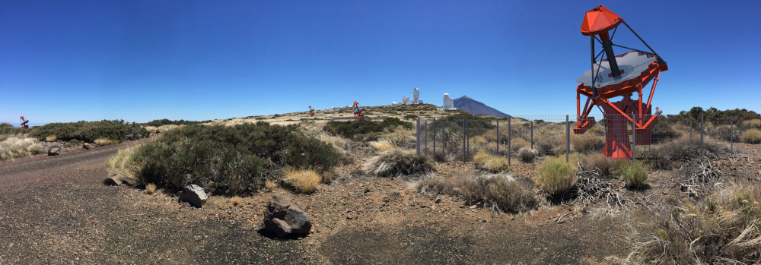
ASTRI Mini-Array Status & Implementation
Giovanni Pareschi– INAF / Brera
INAF RSN4 - Nopoli – 24 Nov 2022

Slide 2
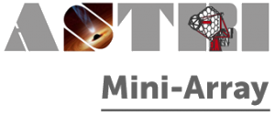
The ASTRI Mini-Array Project
The ASTRI Mini-Array is a project whose purpose is to construct, deploy and operate an array of 9 Cherenkov telescopes of the 4 meters class at the Observatorio del Teide in Tenerife (Spain) in collaboration with IAC.
More than 150 researchers belonging to
  INAF institutes (IASF-MI, IASF-PA, OAS, OACT, OAB, OAPD, OAR)
  Italian Universities (Uni-PG, Uni-PD, Uni-CT, Uni-GE, PoliMi) & INFN
  Fundacion Galileo Galilei
  International institutions (IAC - Spain, University of Sao Paulo – Brazil, North-West University – South Africa, IAC – Spain, Université / Observatoire de Geneve - CH).
Italian and foreign industrial companies are involved in the ASTRI Mini-Array project with important industrial return.

Slide 3
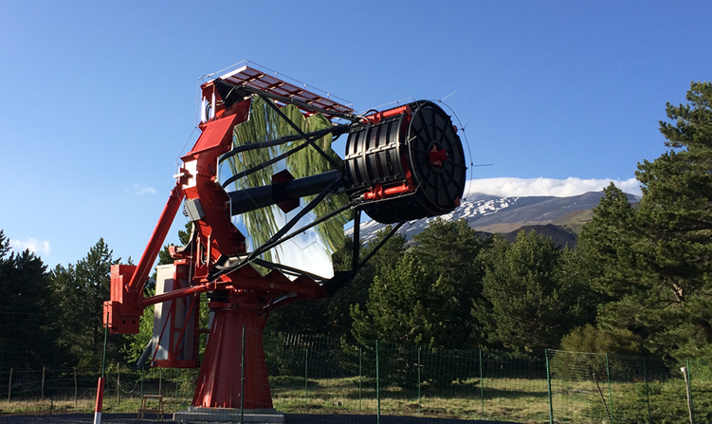
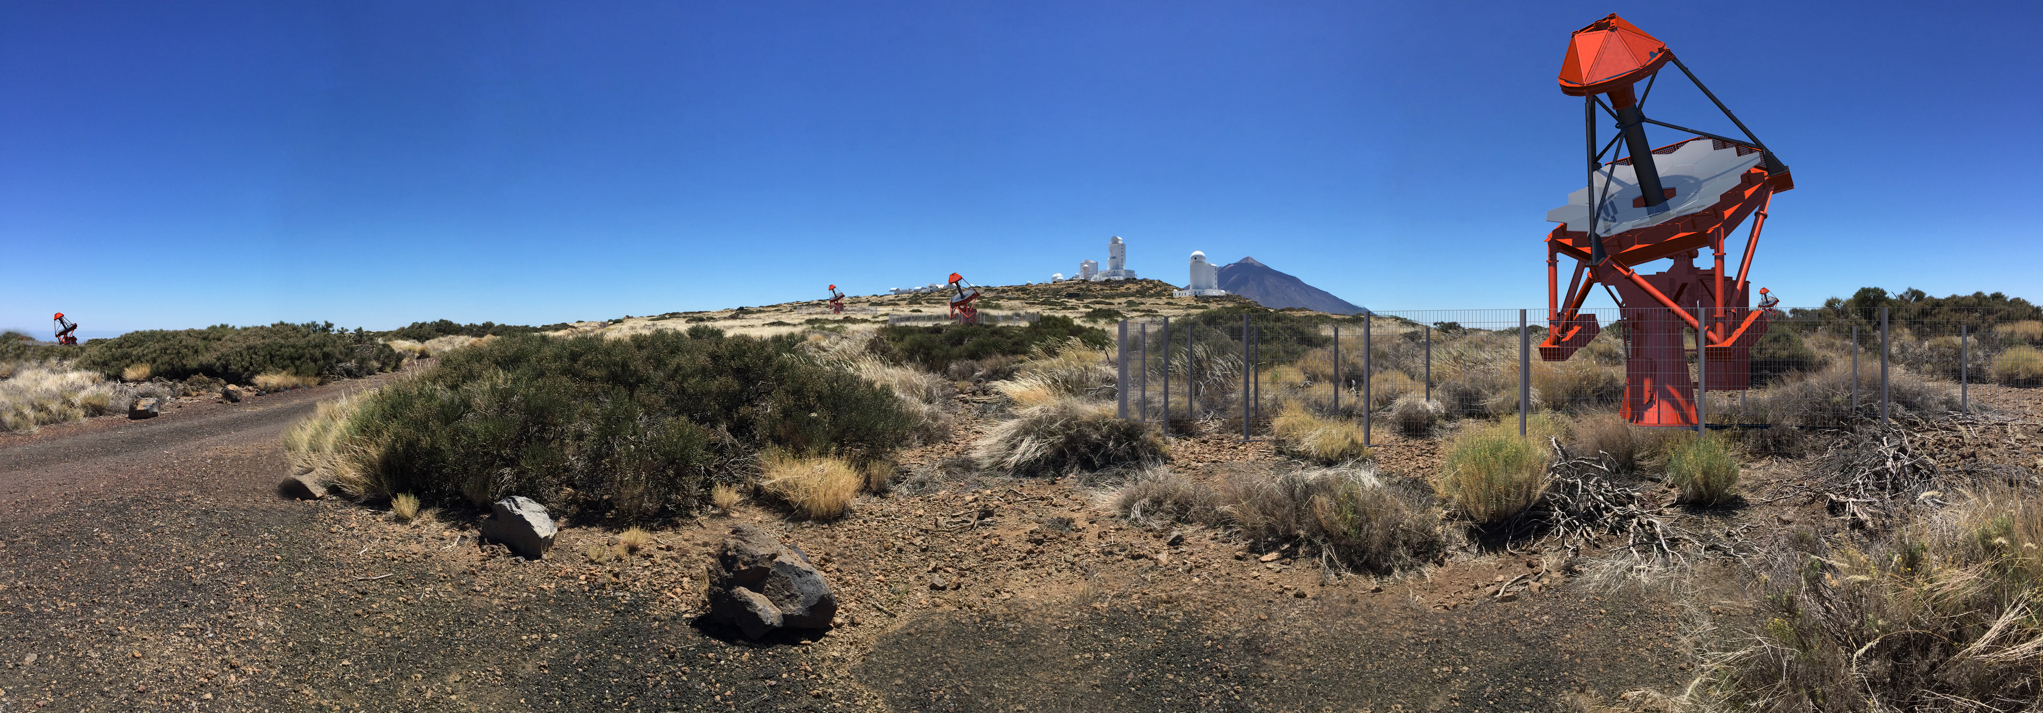
ASTRI: Astrophysics with Italian Replicating Technology Mirrors
ASTRI-Horn Prototype
INAF-led Project funded by Italian Ministry of Research
End-to-end prototype installed and operational on Mount Etna volcano (Sicily, Italy)
First detection of a gamma-ray source (Crab Nebula) above 5σ with a dual-mirror, Schwarzschild-Couder Chrenkov telescope (Lombardi et al., 2020)
Array of 9 ASTRI telescopes
INAF-led Project with international partners: Univ. of Sao Paulo/FPESP (Brazil), North-West Univ. (S. Africa), IAC (Spain), FGG, ASI/SSDC, Univ. of Padova, Perugia and INFN
Being deployed at the Observatorio del Teide (Spain) in collaboration with IAC and FGG-INAF.
First 4 years → Core Science, following 4 → Observatory Science. Science operation → 2024

Slide 4
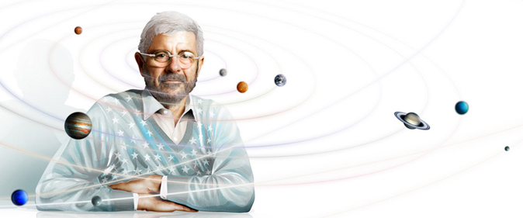
ASTRI - Astrofisica con Specchi a Tecnologia Replicante Italiana
Astrophysics with Mirrors via Italian Replication Technology
(No mirrors, no party!)
Name given by Nanni Bignami

Slide 5
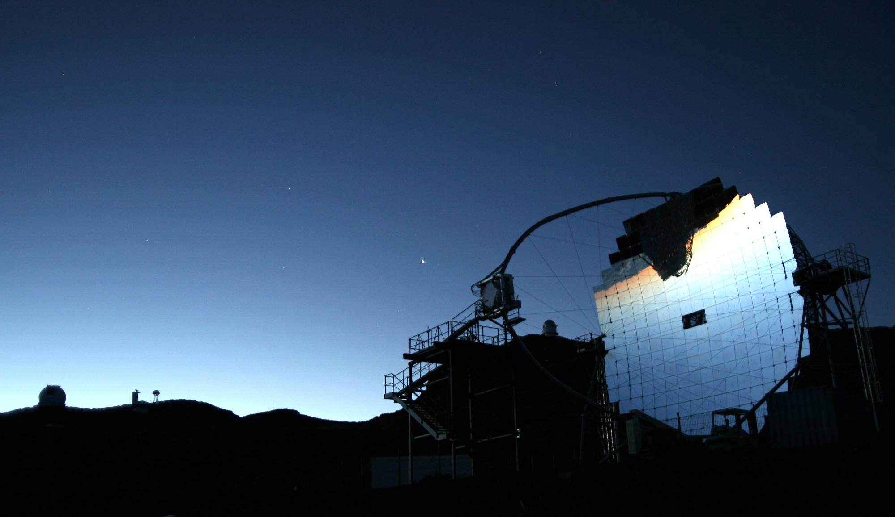
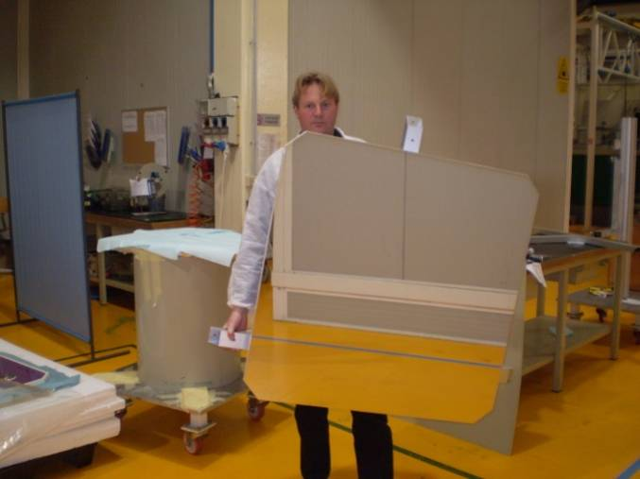
Adventure started with MAGIC II (2006)
Principal Inventor: Oberto Citterio
INAF + Media Lario

Slide 6
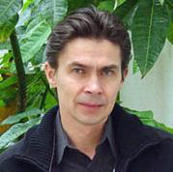
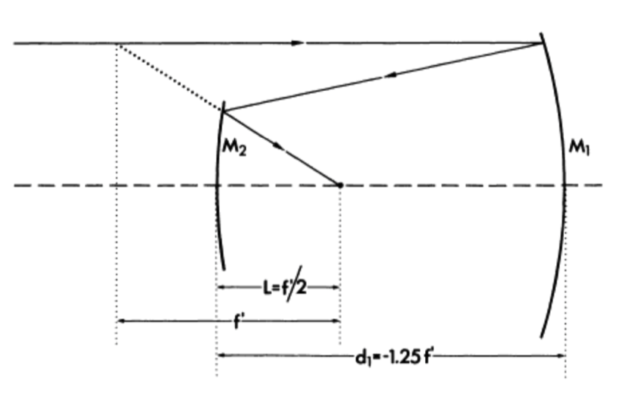
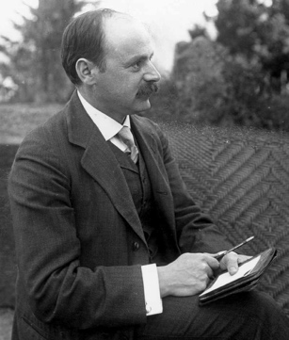
The Schwarzschild Aplanatic Telescope
1905: Karl Schwarzschild solved the Seidel ‘s equations for spherical aberration and coma finding a relation between parameters capable to make a telescope aplanatic. (Couder 1926 ➔ also correction of astigmatism with curved focal plane)
“For any geometry, 2 aspheric mirrors allow the correction of SI and SII to give an aplanatic telescope”
Vladimir Vassiliev, UCLA
Schwarzschild telescope
KS: f/3.0
b_{S1}= -13.5 (Hyperbola)
b_{S2}= 1.963 (Spheroid)
FoV:2.8 deg
RMS_{edge}~12’’
Technology challenge: Aspherical Optics manufacturing + large secondary mirror
6

Slide 7
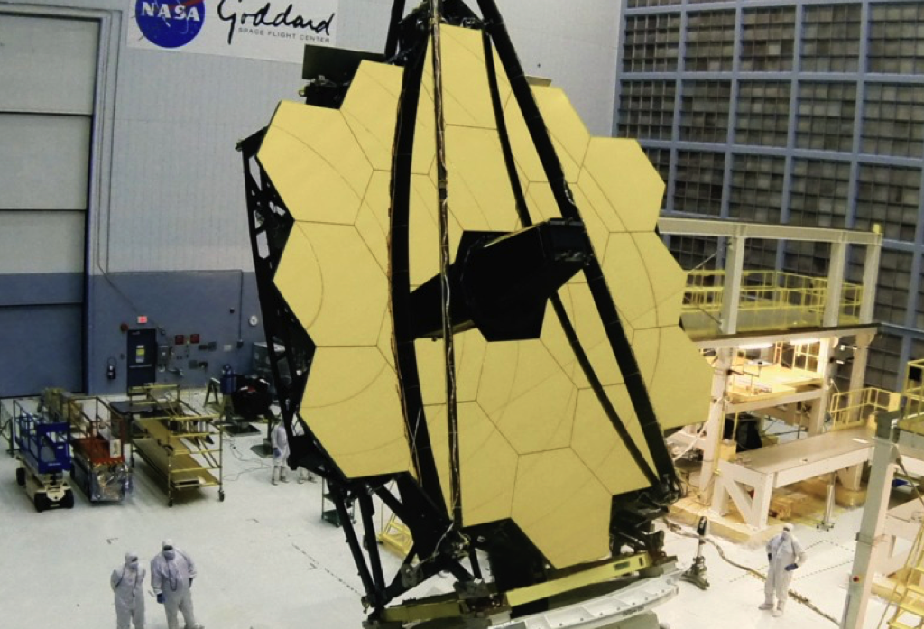
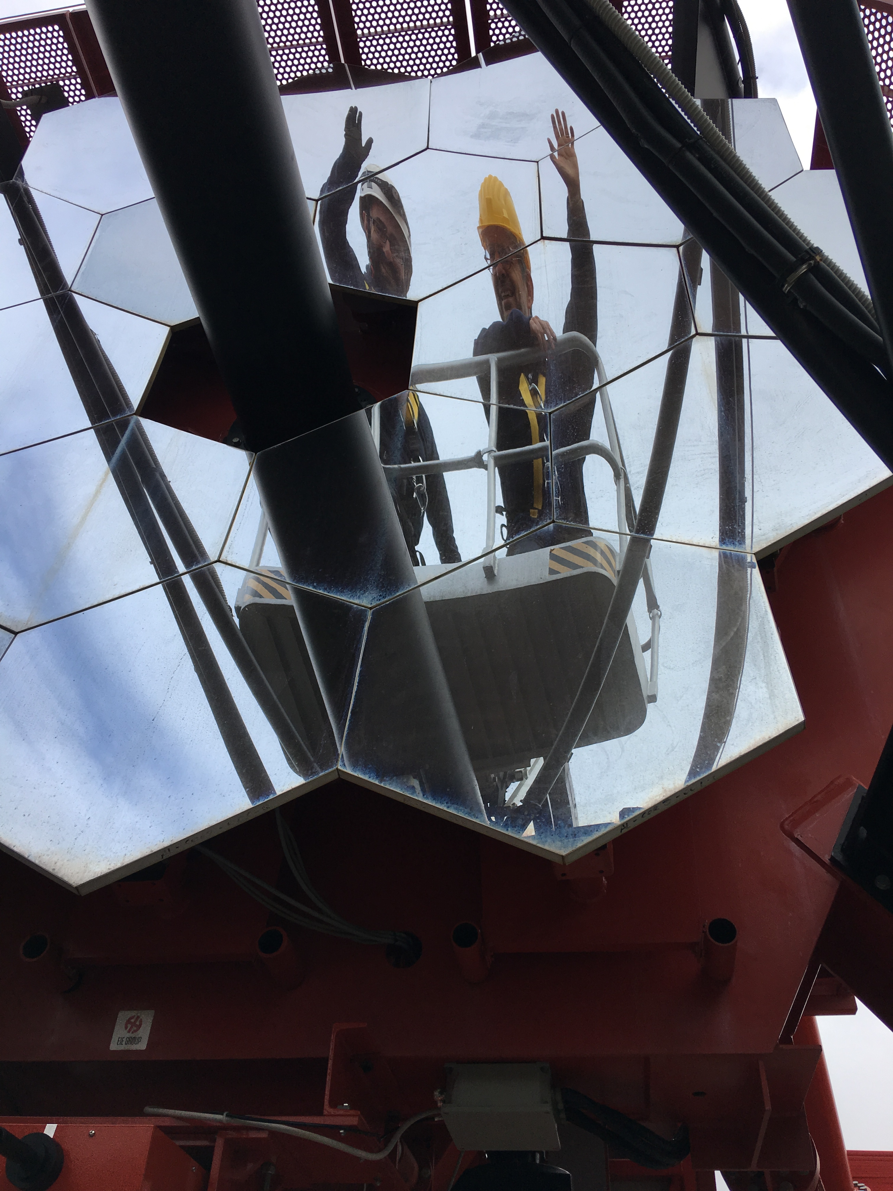
Segmented reflecting surface
Credits: NASA
JWST, reflecting surface cost: ➔ a few of M$/m²
ASTRI, reflecting surface cost:
➔ 2.5 K$/m²
(see Canestrari et al., SPIE, 2014)
7
7

Slide 8


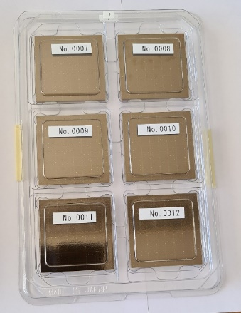
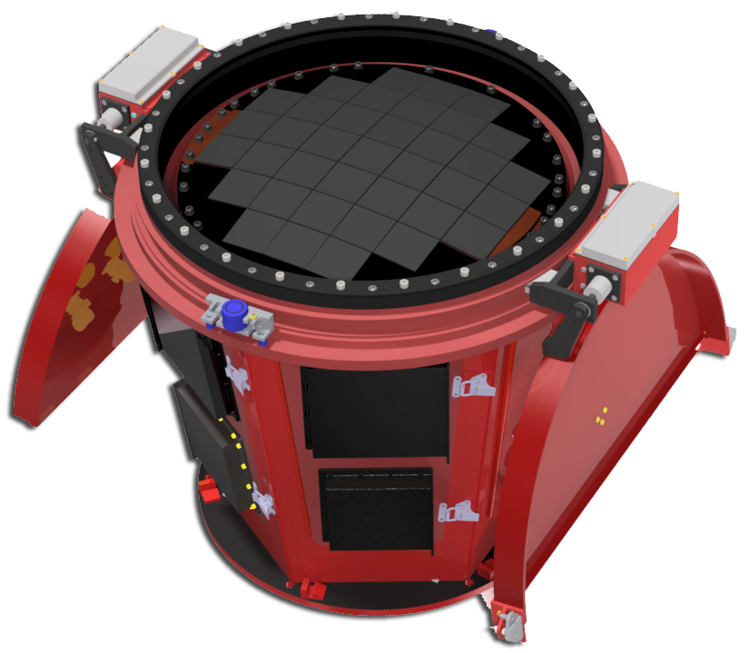
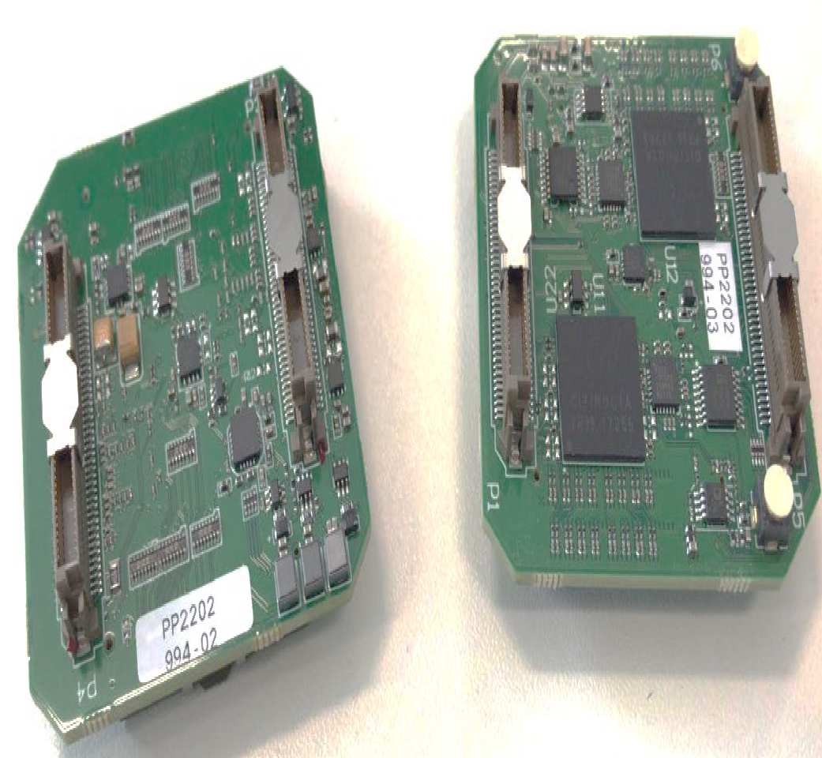

ASTRI Camera
The SiPM produced by Hamamatsu photonics (7x7 mm²) grouped in matrices of 8x8 pixels
37 matrices are arranged to adapt to the curved focal plane of the telescope.
innovative electronics for peak detection(CITIROC ASICS , WEEROC-INAF) ⇒ smalls mount of data
Interferential filter as front window (Romeo et al. (2018) and Catalano et al. (2018)) that allows to reduce the contribution from the night sky background at wavelengths greater than 550 nm where the sensitivity of SiPM detector is still high.
FIELD OF VIEW OF 10.5 Deg IN DIAMETER
SiPM matrices
ASIC board

Slide 9
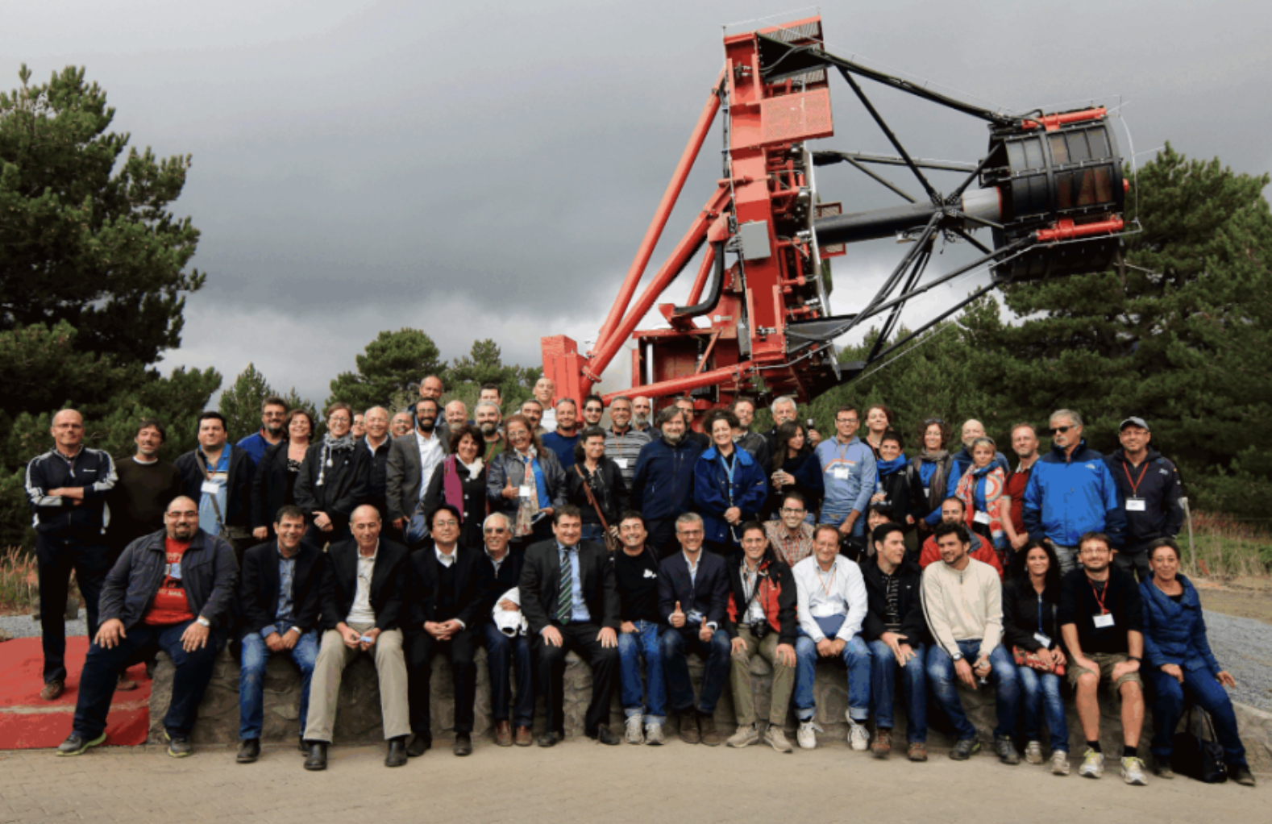
24 September 2014

Slide 10
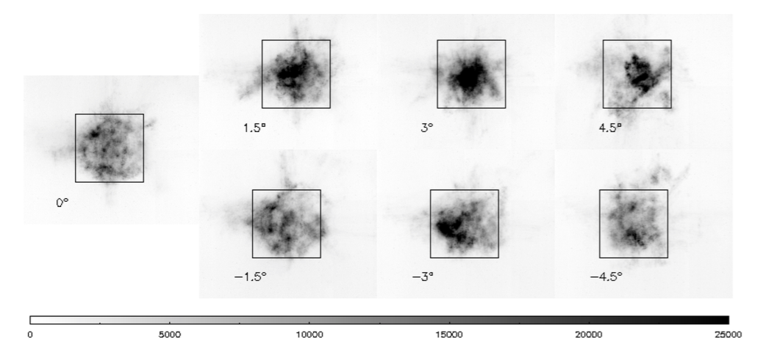

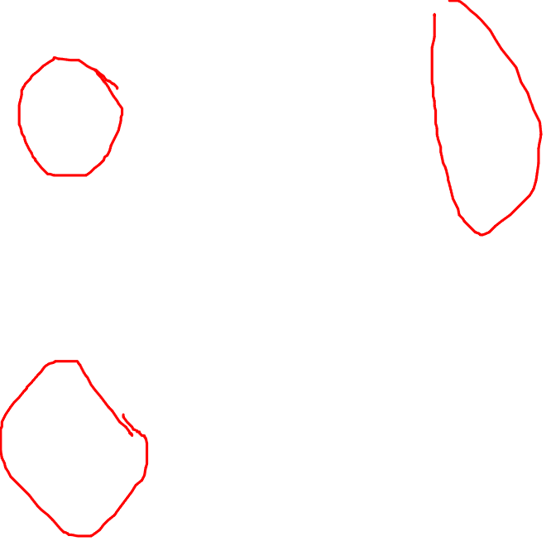
The ASTRI-Horn results
Giro et al. 2017
Lombardi et al. 2020

Slide 11
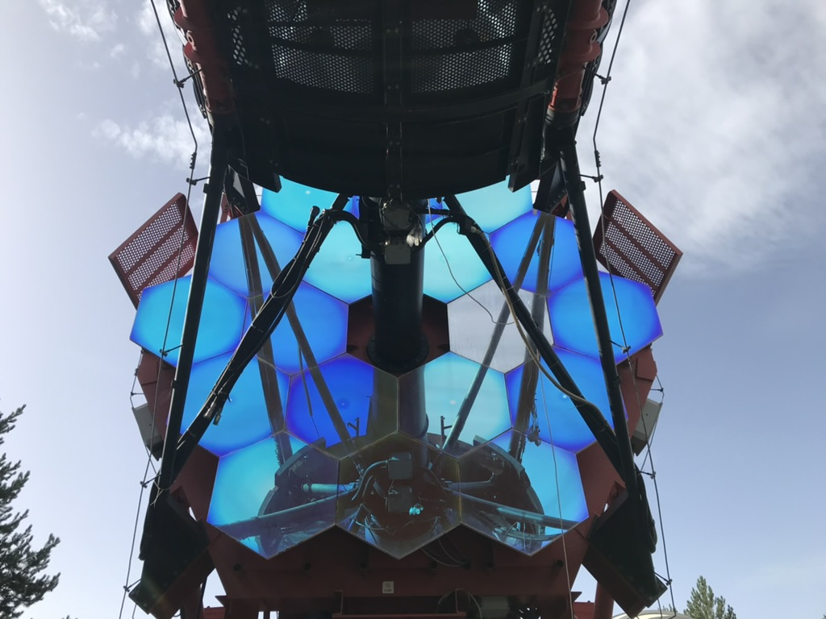
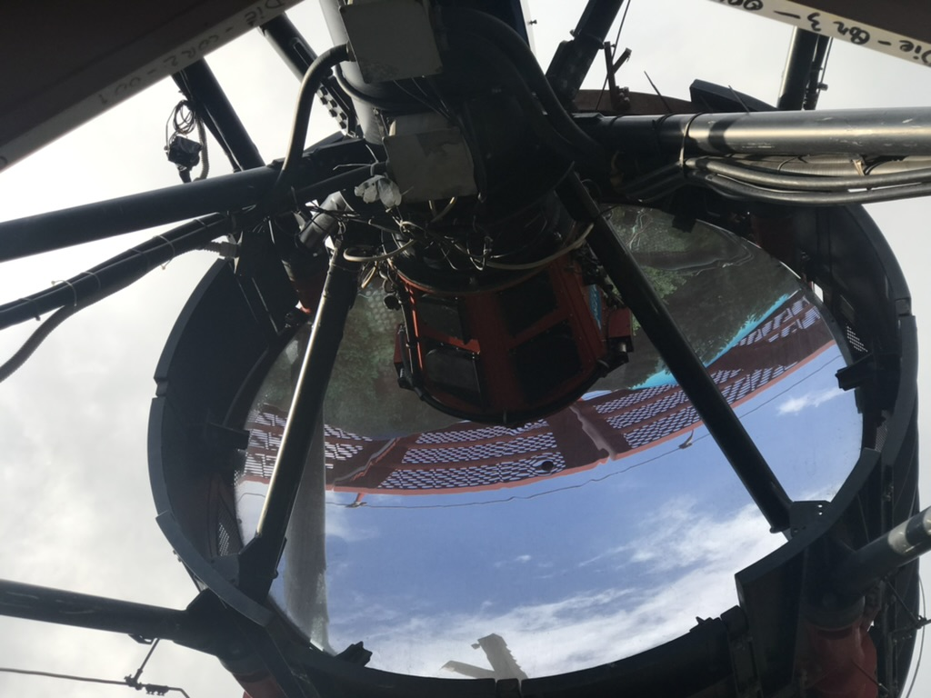
The NEW Mirrors
The new set of M1 DIE segments
The new M2 mirror

Slide 12
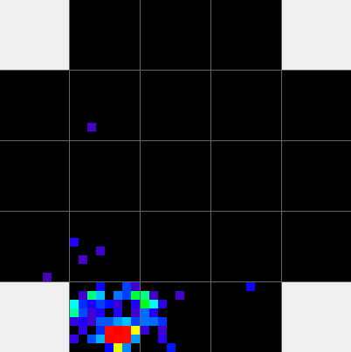
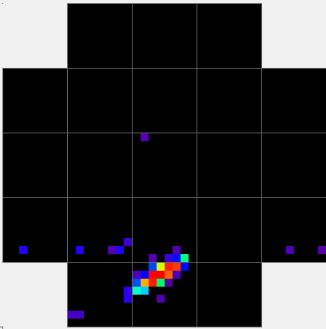
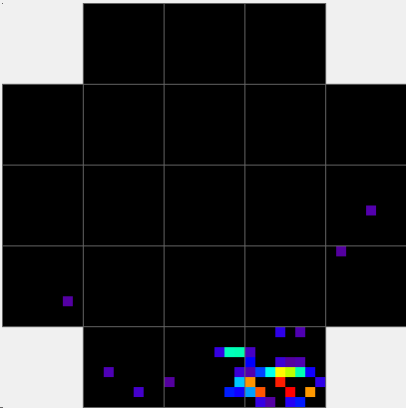
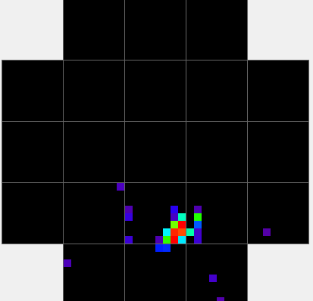
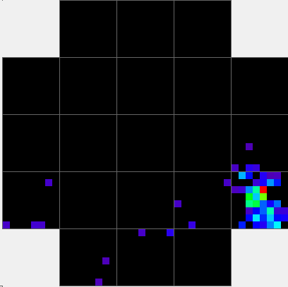
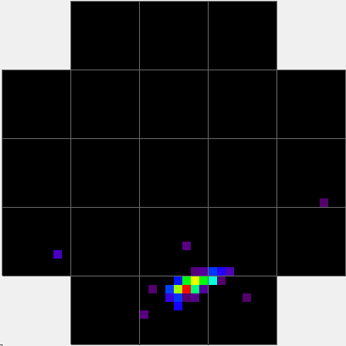
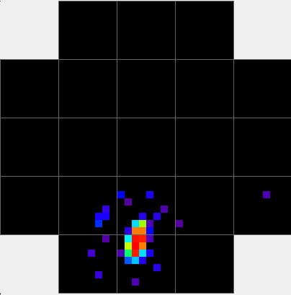
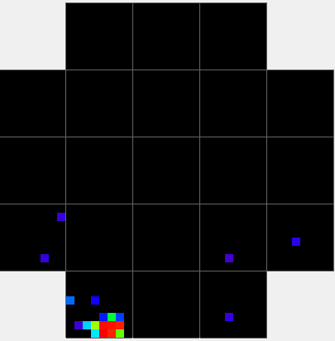
THE SHOWERS
P
γ
P
P
Ev# 13385
Size = 1110 pe
Ev# 13245
Size = 1193 pe
Ev# 17539
Size = 1081 pe
Ev# 12797
Size = 834 pe
P
γ
P
P
Ev# 6643
Size = 927 pe
Ev# 53900
Size = 1157 pe
Ev# 20556
Size = 1157 pe
Ev# 1250
Size = 721 pe

Slide 13
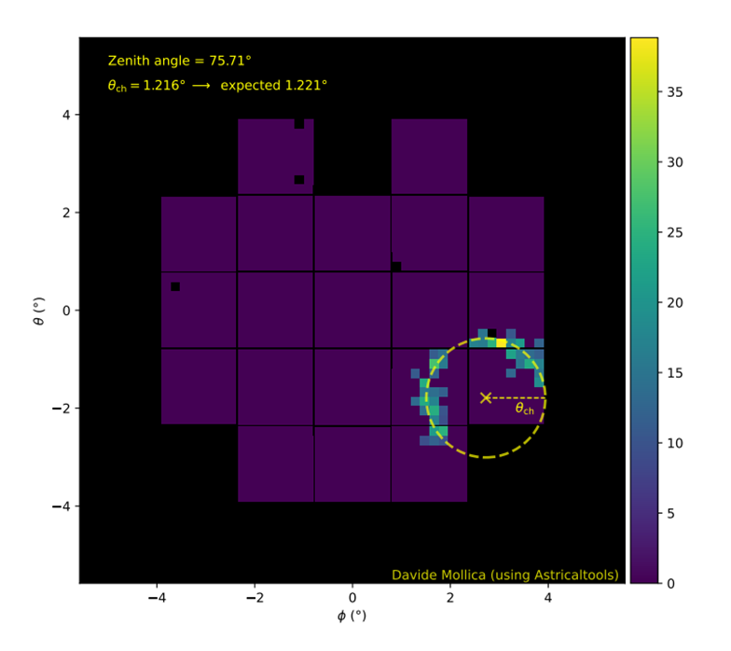
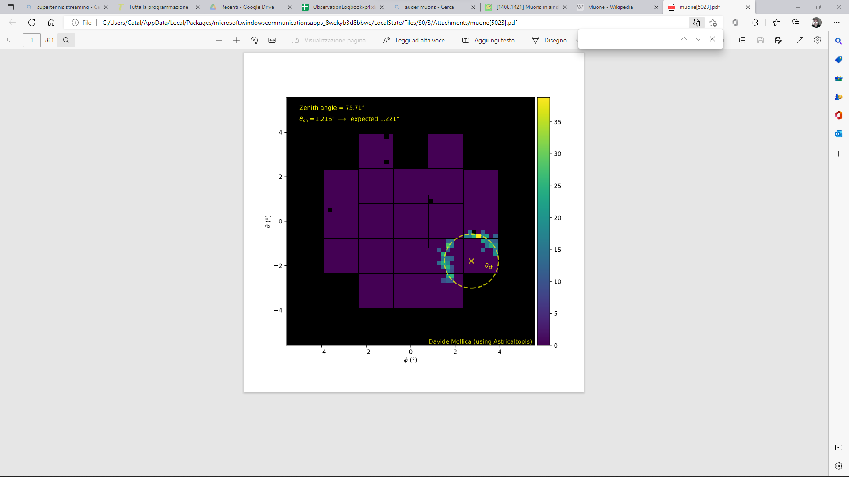
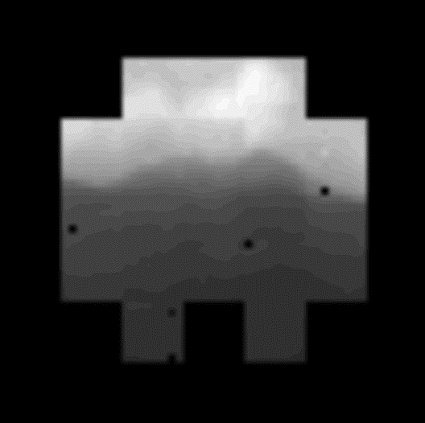
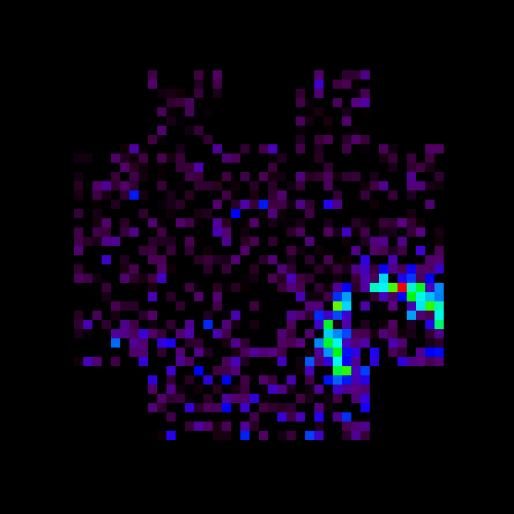
THE MUON

Slide 14
The mini-array @Teide: the adventure starting!
12 June 2019
14

Slide 15
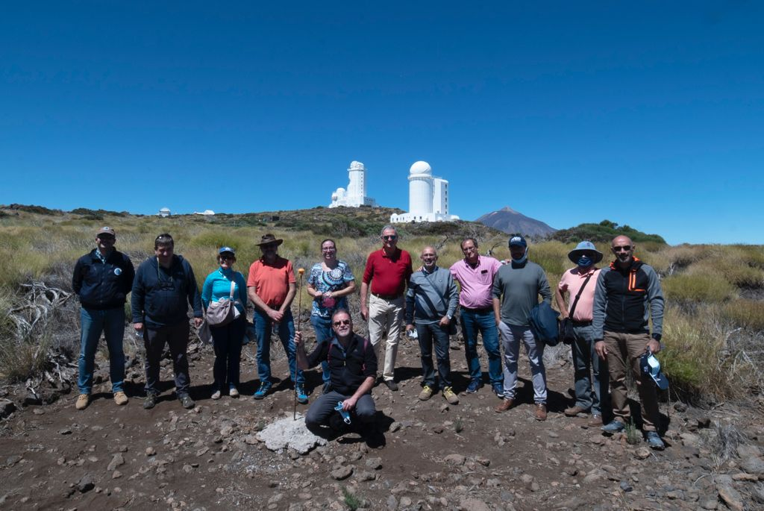
ASTRI Mini-Array @ Teide Observatory
29/06/2021
L.A. Antonelli – ASTRI Mini-Array – ICRC 2021

Slide 16
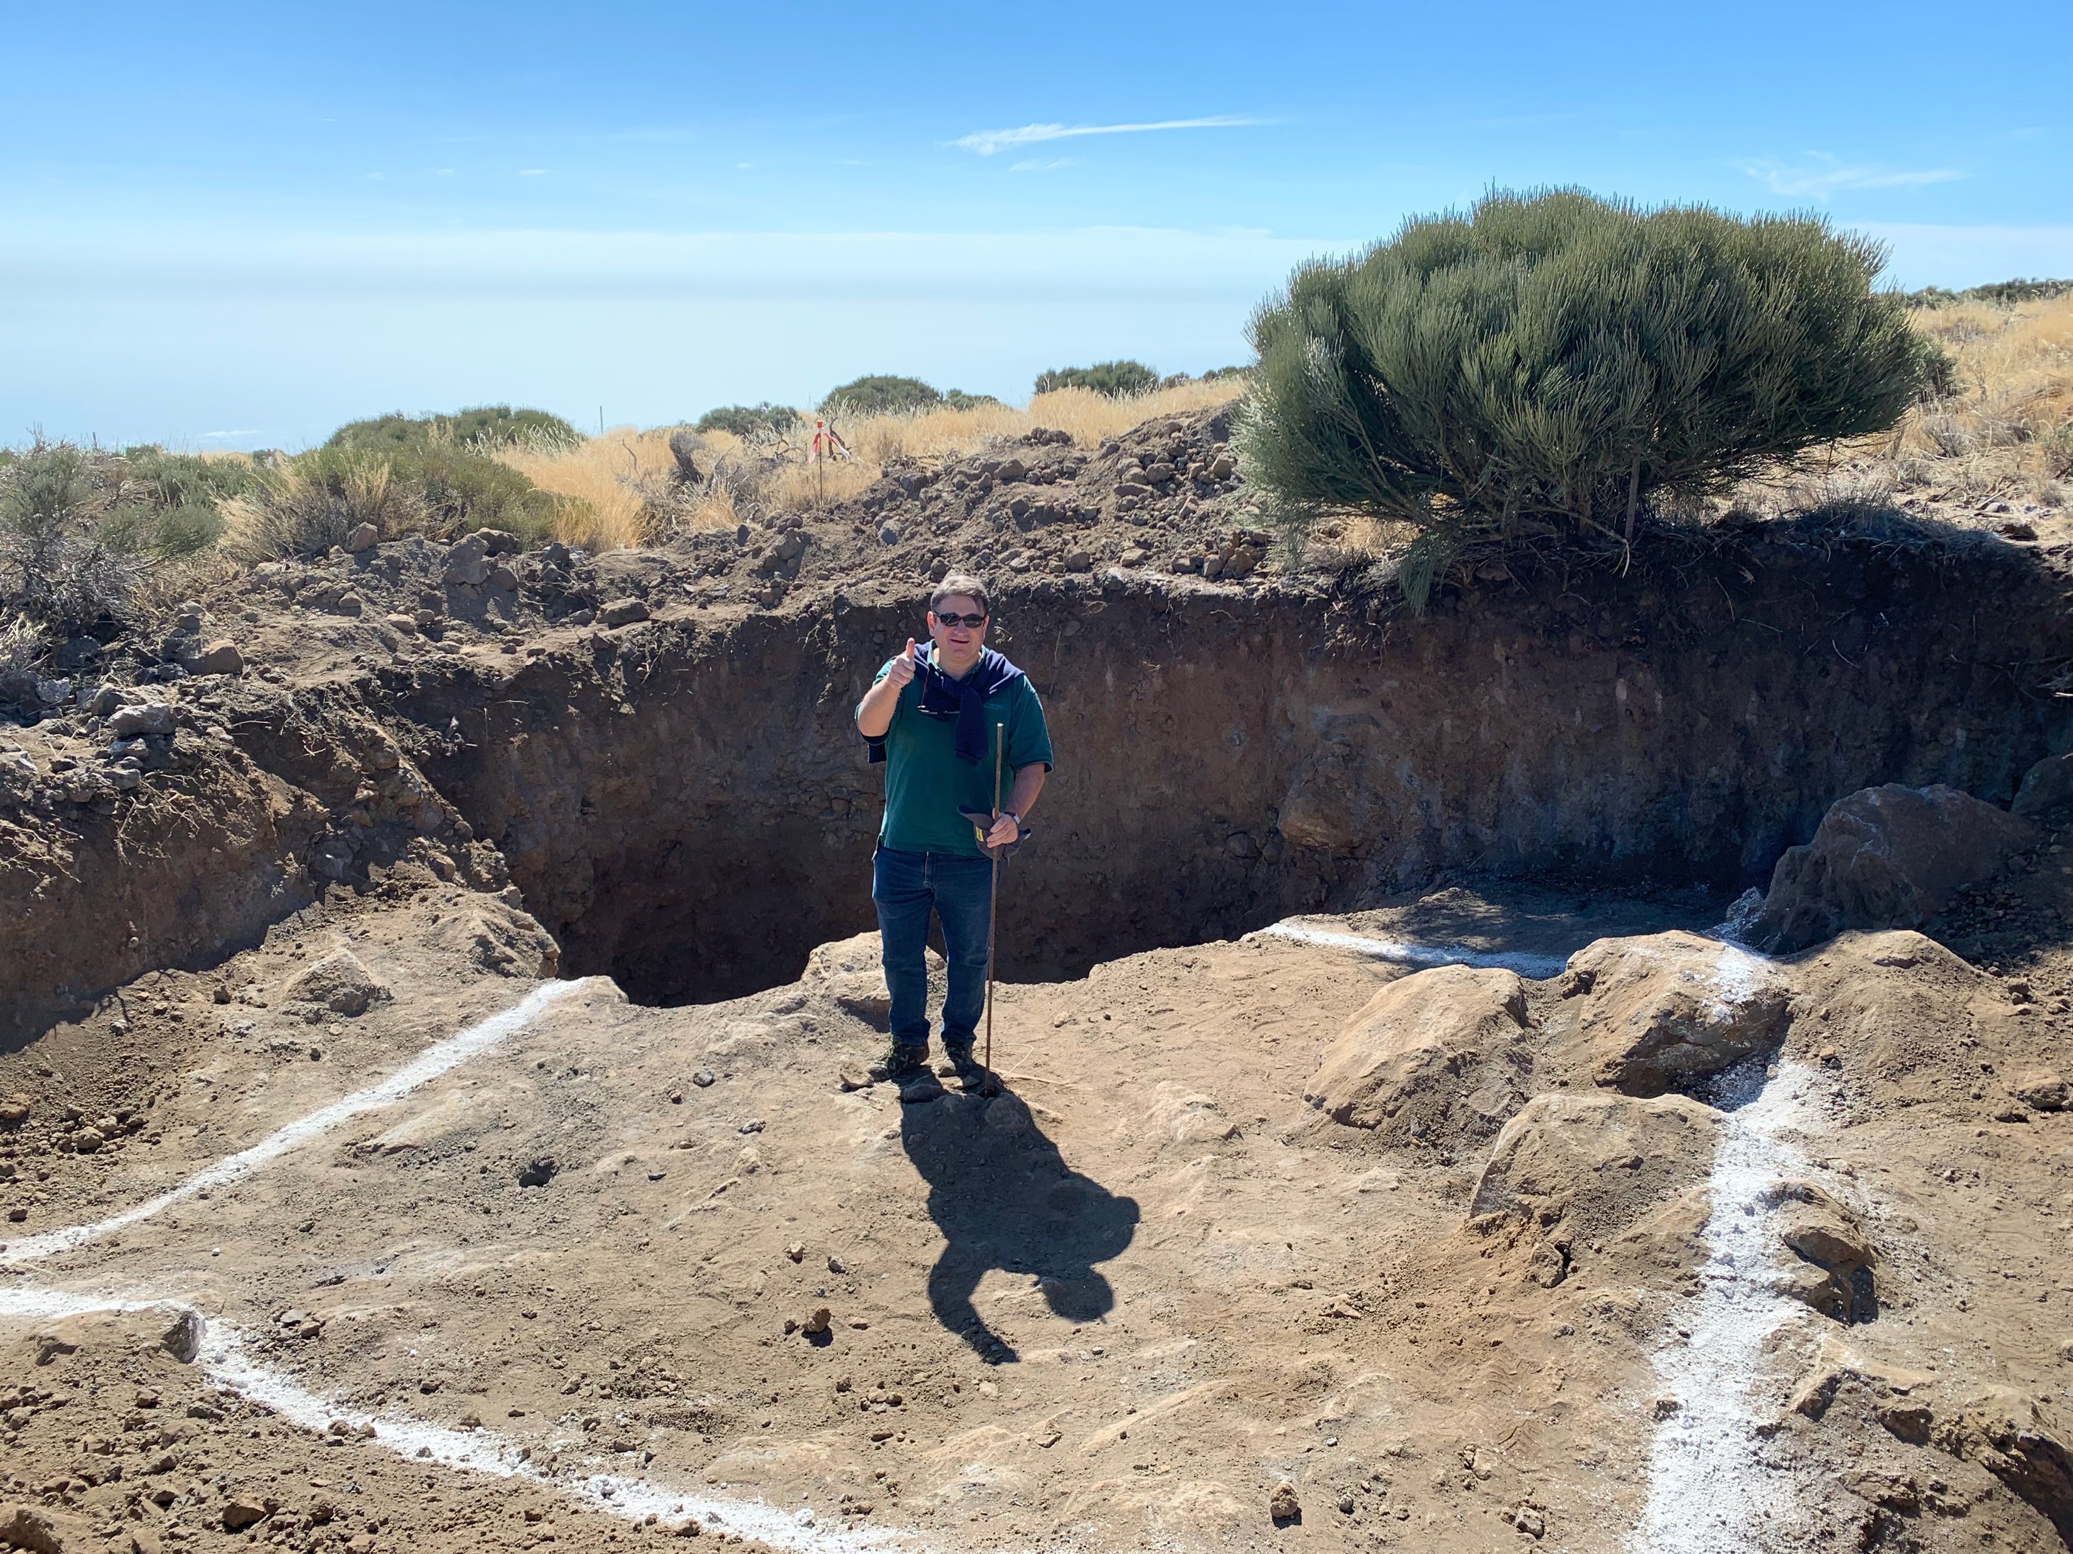
Infrstructure… 1 year ago

Slide 17
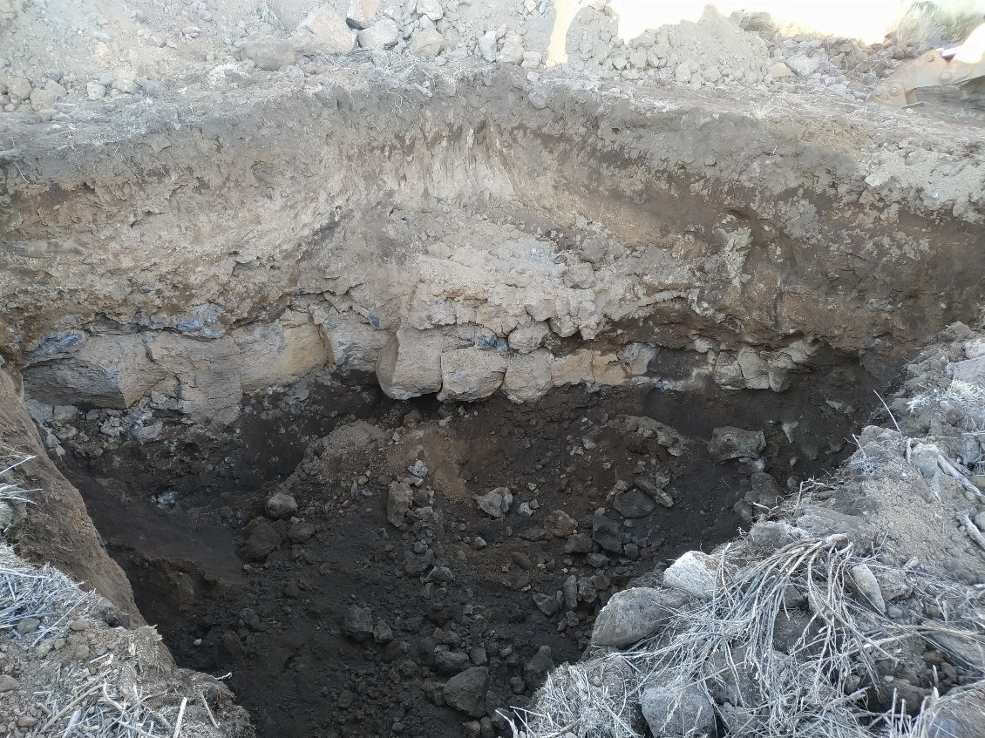
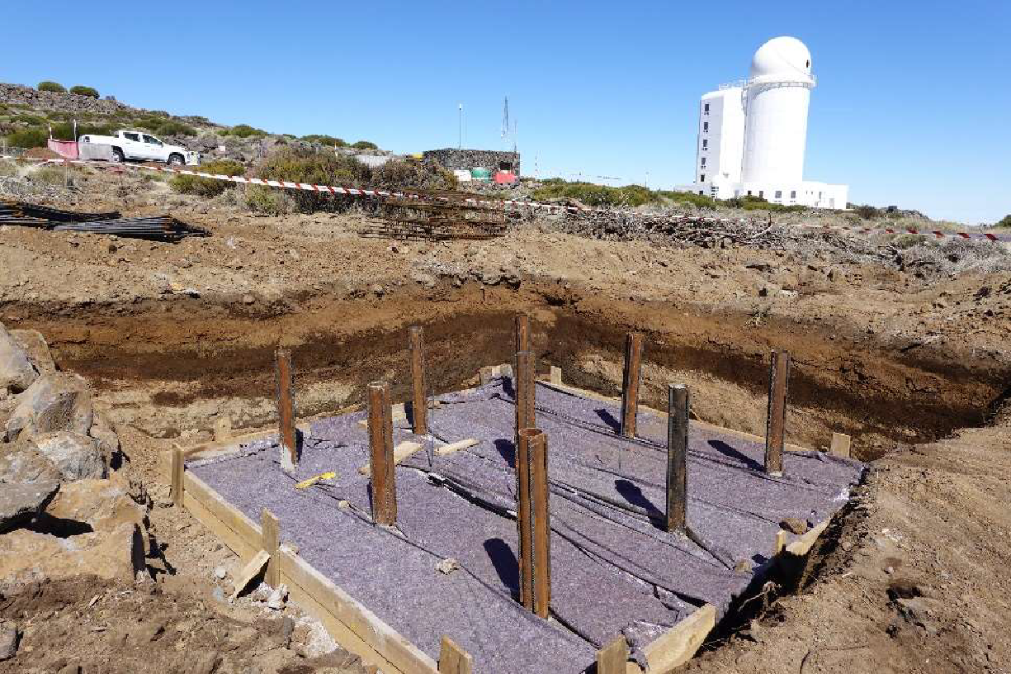
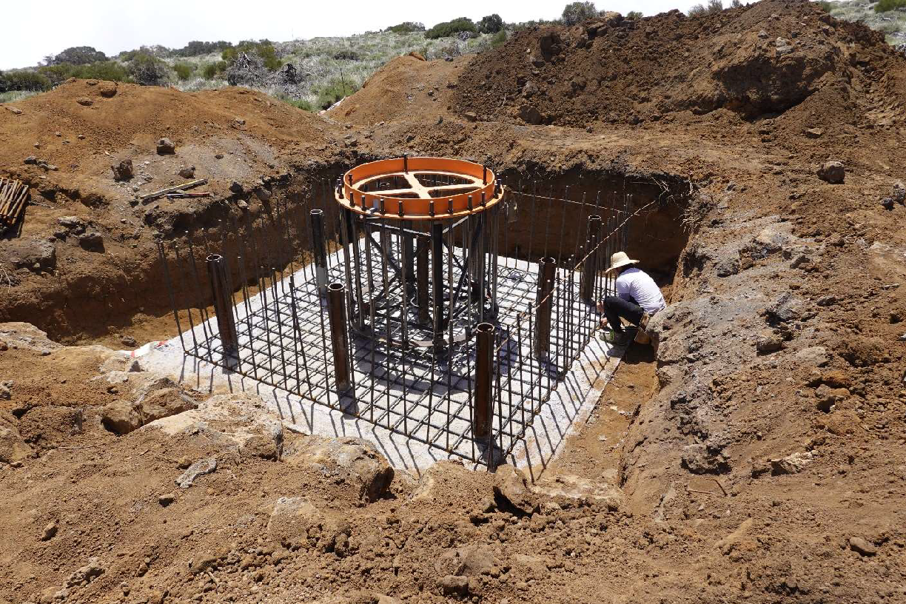
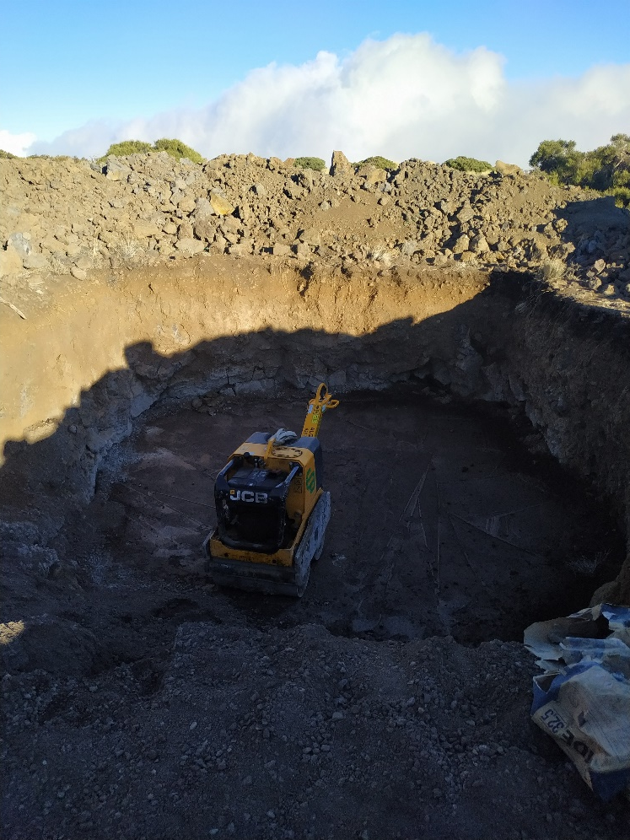
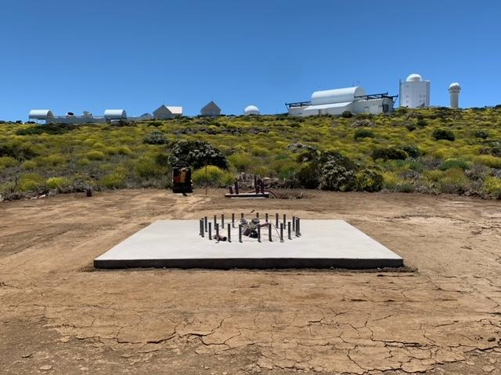
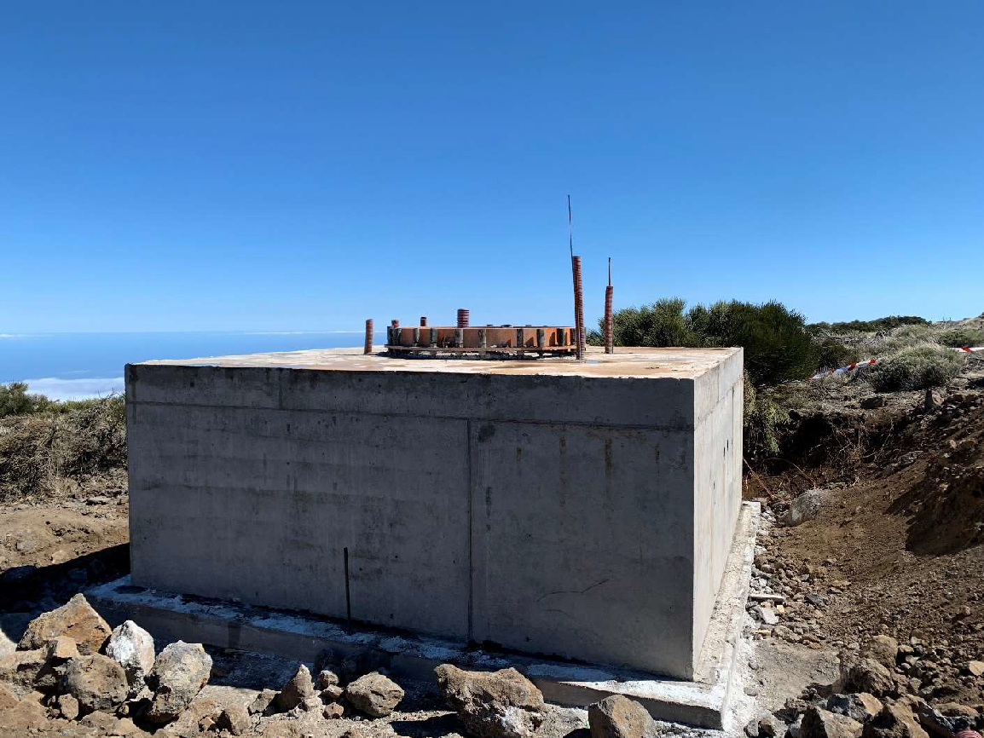
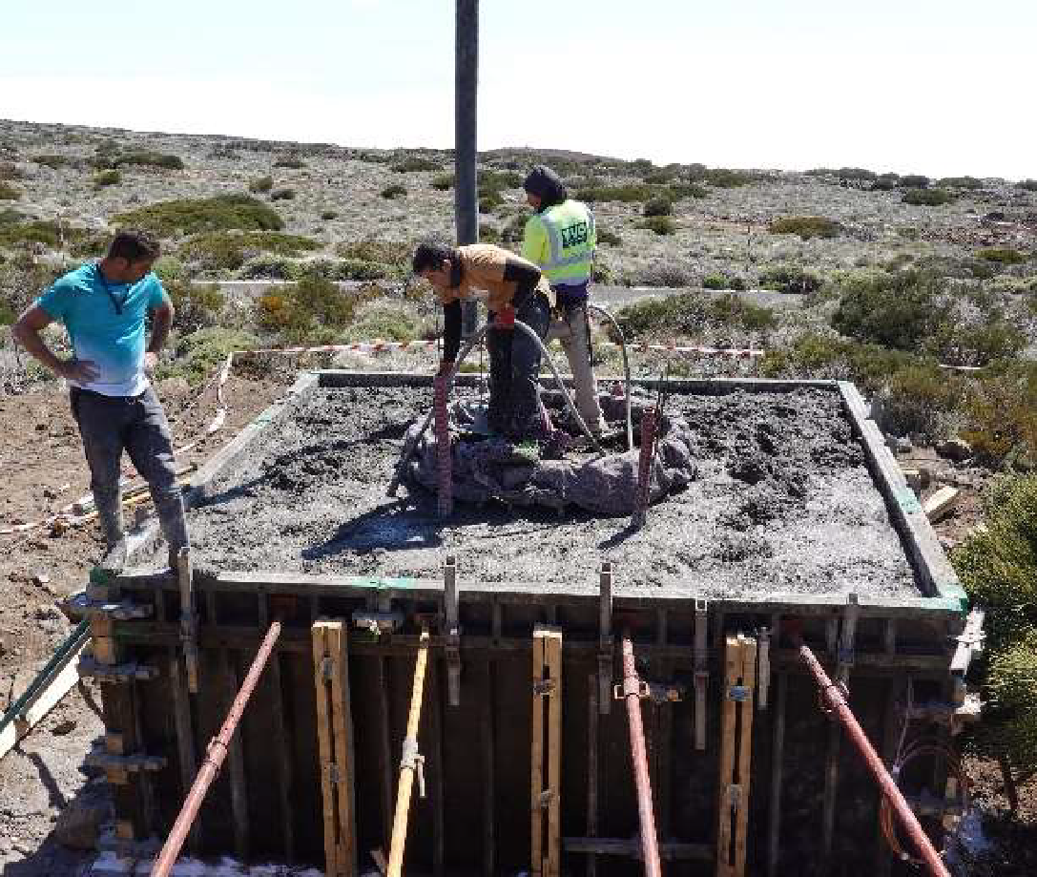
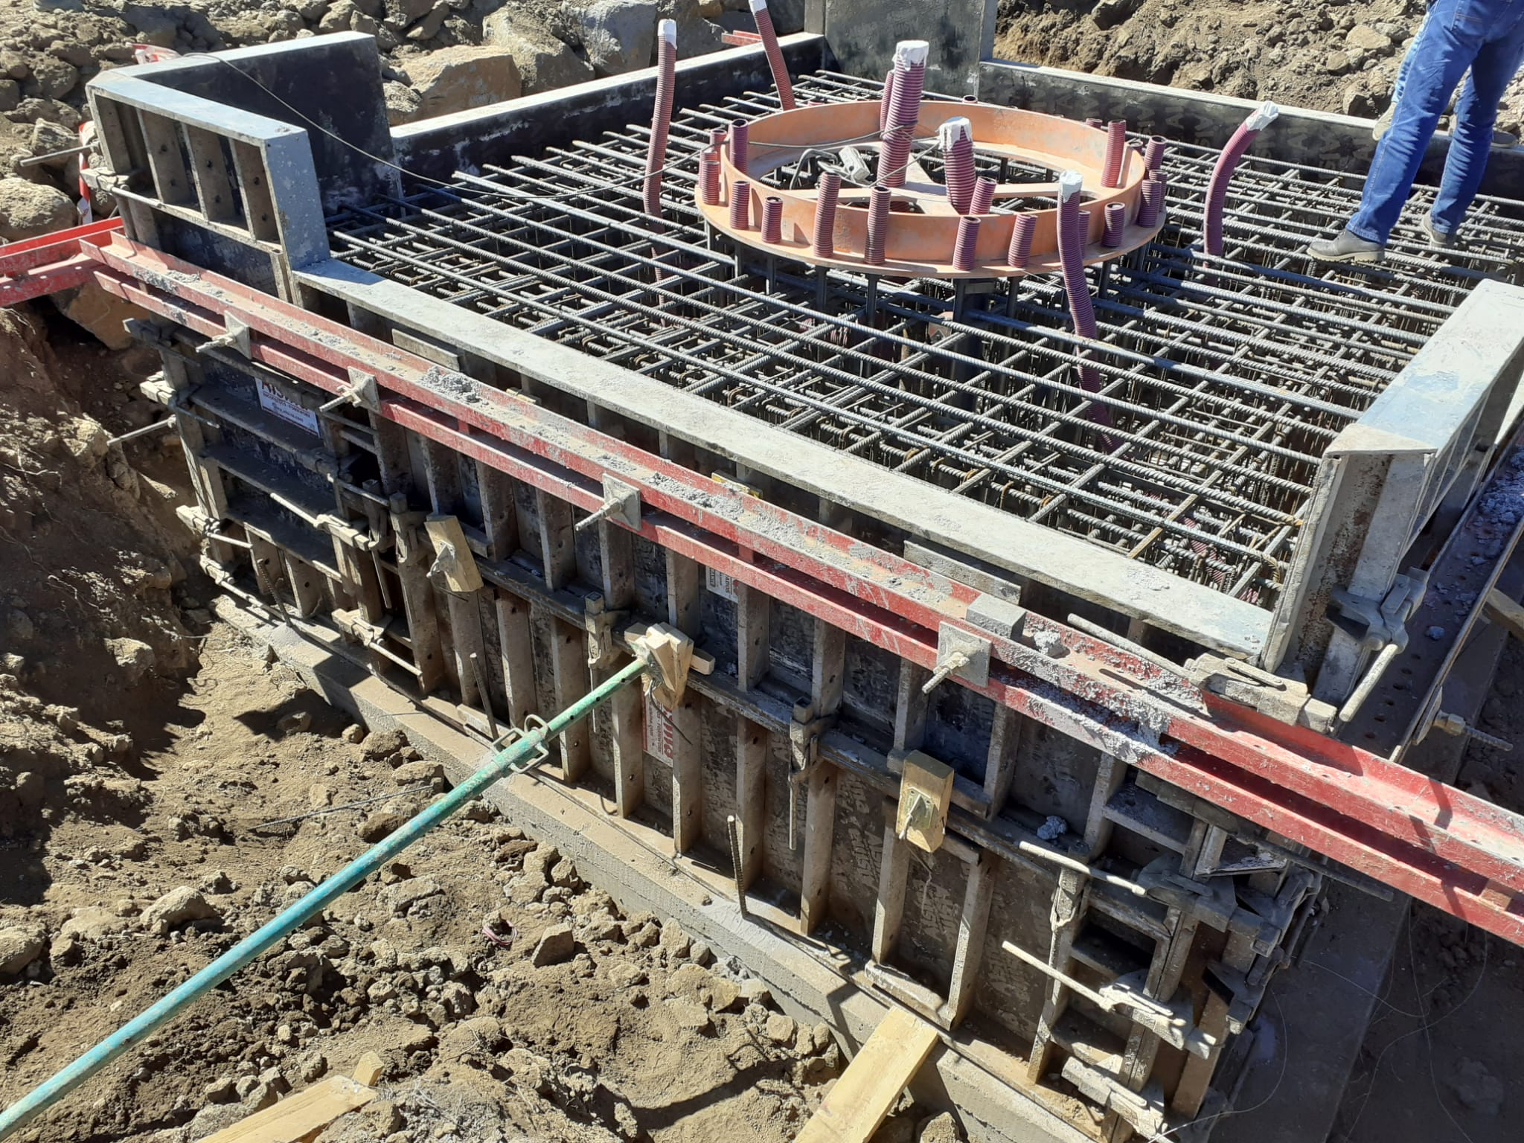
Infrastructure: foundations

Slide 18
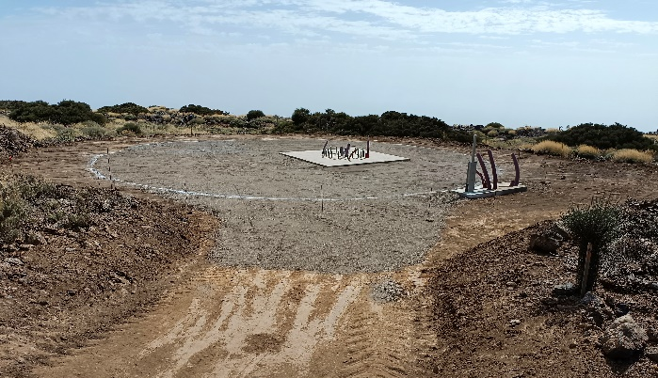
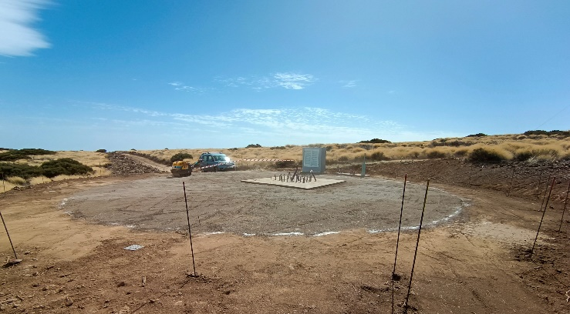
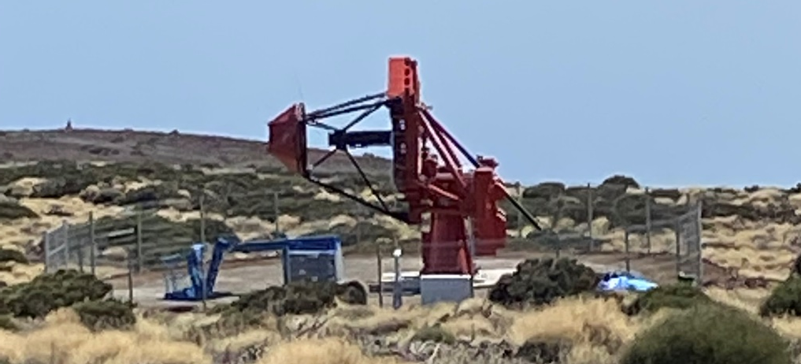
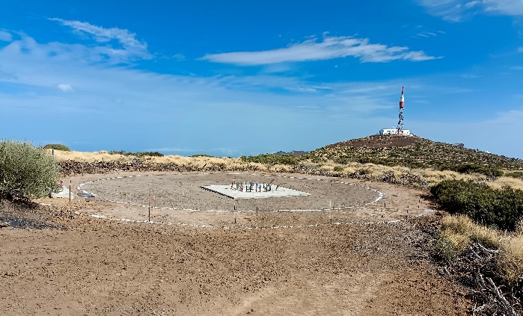
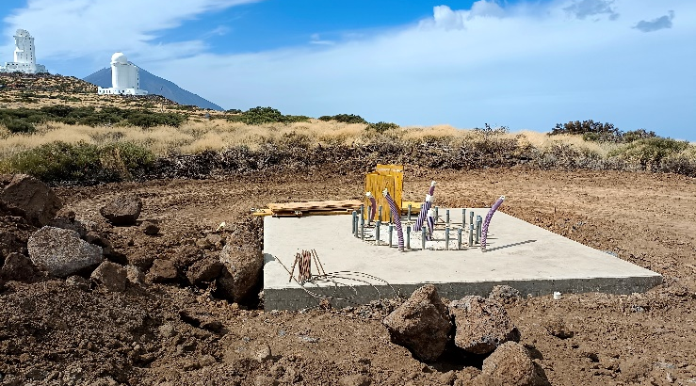
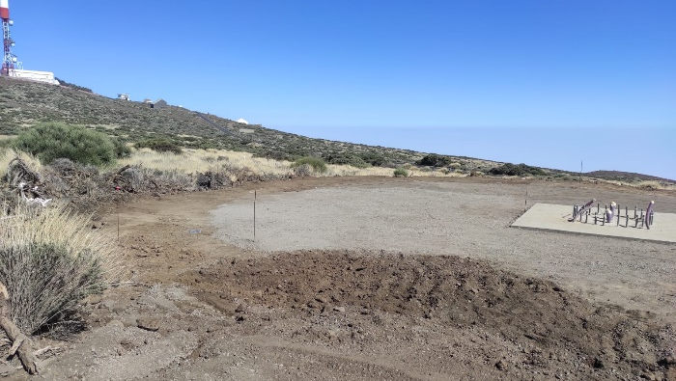
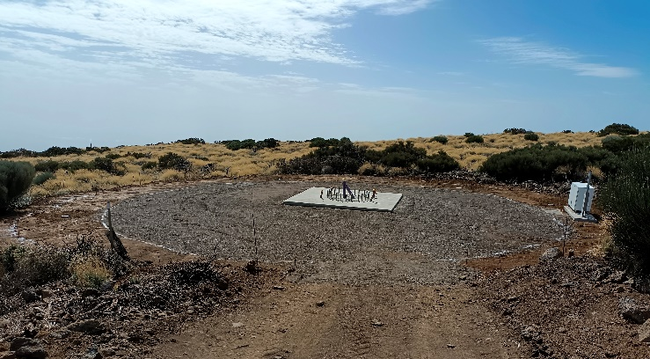
Infrastructure
ASTRI-6
ASTRI-2
ASTRI-1
ASTRI-3
ASTRI-7
ASTRI 5
Infrastructure delivery:
18th of November
ASTRI-9

Slide 19
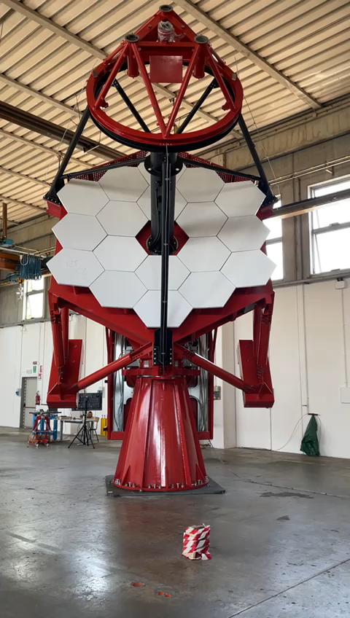


Telescope pre-assembly & testing at the EIE GROUP workshop (Mira, Venezia)
I/F Cabinet

Slide 20







ASTRI-1 on site integration
Telescope integration takes 3-4 weeks (working days) including:
Base grouting 2-3 days
M1 panels integration 2 days
M2 mirror integration 2 days
Acceptance at the end of January 2023

Slide 21


ASTRI-1
Optical support structure
1st truck leaving 6/6/2022
Photo CREDITS Tommaso Marchiori

Slide 22

The ASTRI Mini-Array locations
The ASTRI Mini-Array in Italy
Data Centre in Rome
Remote Array operation centers
The ASTRI Mini-Array in Tenerife
Telescope Array & auxiliaries (Observatorio del Teide - OT)
Local Control Room @ THEMIS building (OT)
On site Data Centre @ IAC Teide Residencia (OT)
Array operation center @IACTEC in La Laguna

Slide 23


Slide 24


The ASTRI Mini-Array – Performance
PRELIMINARY
Sensitivity: better than current IACTs (E ≳ 3 TeV)
  Extended spectrum and cut-off constraints
Energy/Angular resolution: ~10% / ~0.05° (E =10 TeV)
  Identify and characterize extended sources morphology
10° field of view with homogeneous off-axis performance
  Multi-target fields, surveys, and extended sources
  Enhanced chance for serendipitous discoveries
PRELIMINARY
Vercellone et al., to be submitted

Slide 25

The LHAASO PeVatrons
Cao et al., 2021, Nature
Discovery of 12 sources emitting at several hundreds of TeV, up to 1.4 PeV
Crab apart, the majority of remaining sources represent diffuse γ-ray structures with angular extensions up to 1°, and all of them are located along the Galactic plane
The actual sources responsible for the ultra high-energy γ-rays have not yet been firmly localized and identified (except for the Crab Nebula), leaving open the origin of these extreme accelerators
The ASTRI Mini-Array will investigate these and future PeVatron sources providing important information on their identification and morphology

Slide 26

Stellar Intensity Interferometry with the ASTRI Mini-Array
Imaging (aperture synthesis) with unprecedented angular resolution!!!
Kloppenborg et al. (2010)
Monnier et al. (2014)
CHARA/MIRC IR (H band) synthetized images of eps Aur (A9I)
Long partial eclipse of the star eps Aur produced by an absorber with a disc-like geometry
ASTRI SI³ can image many A/B-type stars in visible light, extending the sample collected with CHARA in the IR CREDITS: L. Zampieri

Slide 27




The ASTRI White Book
Le IRF di ASTRI sono appena state pubblicate su Zenodo
«ASTRI Project. (2022). ASTRI Mini-Array Instrument Response Functions (Prod2, v1.0)»
https://zenodo.org/record/6827882#.YtFCjZNBx60 - DoI: 10.5281/zenodo.6827882

Slide 28
ASTRI Mini-Array implementation timeline
Timeline based on current available information
Teide infrastructure almost complete -> Contract closed next week
ASTRI-1 telescope site acceptance review in January 2023
ASTRI-8 & ASTRI-9 telescopes procurement ongoing
  Shipping to Tenerife end of March 2023
  Acceptance at the site end of May 2023
First Cherenkov camera (engineering camera)
  → ready for lab test at the end of January 2023
  → first Cherenkov light at the end of April 2023
First three telescopes (ASTRI-1, 8, 9) complete with cameras → summer 2023
Second batch of telescopes will start to arrive @ end of 2023
ASTRI Mini-Array ready for commissioning at the end of 2024
Scientific observations start mid 2025
Photo credits: Tommaso Marchiori (EIE group)

Slide 29




High Energy (TeV to PeV) gamma-ray astronomy in the ’20 years of the new century
Ehi guys…HIC SUNT LEONES!
GHE MINGA ASTRI?
Hadronic accelleration seen up tp the PeV renergy in gamma.
Extended emission or some specific sources?
GRBs up to tens of TeVs

