Slide 1
IGMF
Cosmic Magnetism in Voids and Filaments - Bologna 2023
Matías Sotomayor Webar

Slide 2
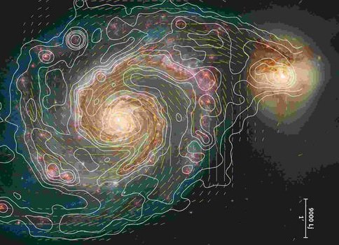
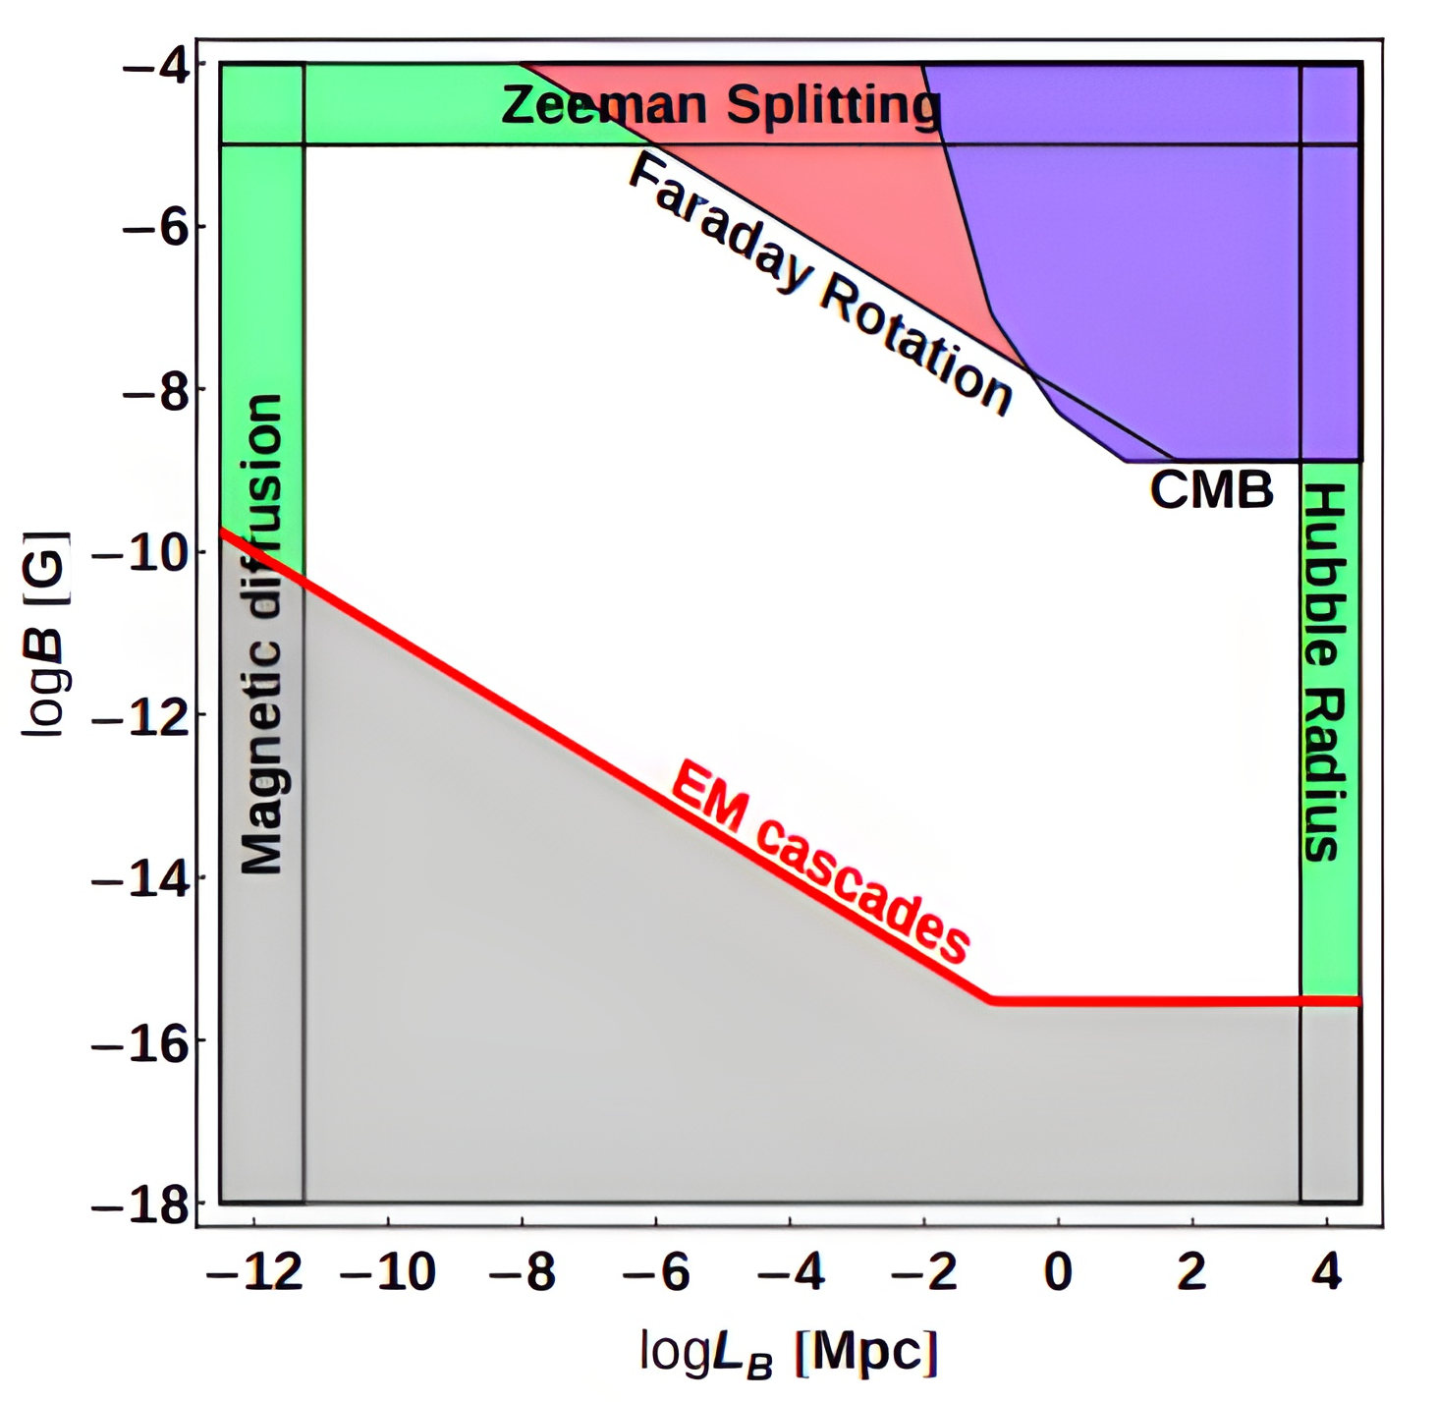
Cosmic Magnetism: Motivation & goal
Cosmic Magnetic Fields: How are they generated?
Dynamo amplification or Compression processes
Both imply the amplification of preexisting 'seed' field
Are the voids between filaments of the large scale structure of our universe magnetized? (Imprint of pre-amp primordial field)
If so, what is the origin for this field? Can we detect and characterize it?
Coherence length and intensity parameters model the IGMF
Our goal is to probe the parameter space by studying electromagnetic cascades
Notes:
Seed magnetic fields possibly produced in early times may have survived up to the present day close to their original form
Different methods and techniques, only upper/lower limits have been placed
Large allowed parameter space

Slide 3
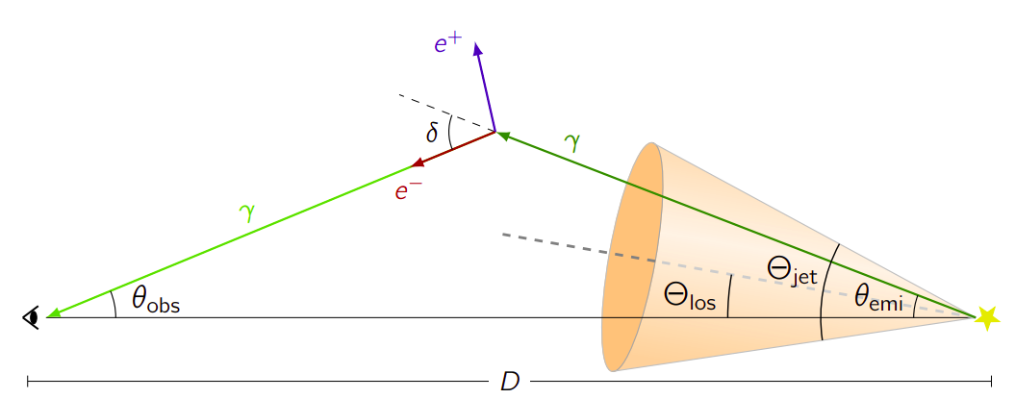
Electromagnetic Cascades in Intergalactic Medium
Best probe to test weak intensity IGMF
Initiated by TeV photon interactions with IR+optical+CMB photon fields
Pair production + inverse compton
If medium is magnetized, it could imprint its signature in the cascade as it develops (extension)
Cascade energy deposited as secondary photons in the GeV range (with time delay)
Plasma instabilities could play an important role (more later) we explore this scenario
Notes:
Get pair production and inverse compton processes figure....
Plasma instabilities could play an important role in hindering or preventing the cascade development, since this effect acts as a cooling mechanism for the electron positron pairs. We will touch on this a bit more later

Slide 4
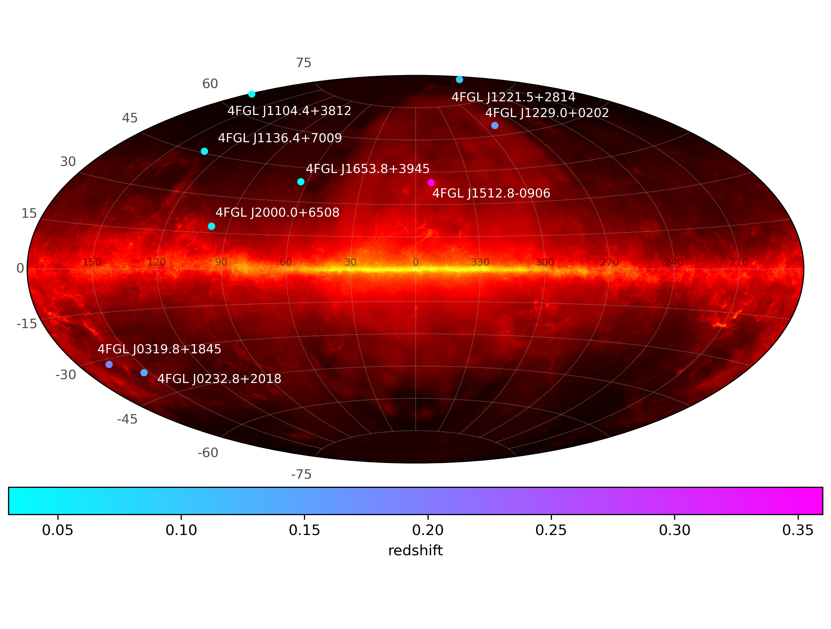
Fermi-LAT nearby BL-lac subsample
MKN421 represents a good candidate (redshift, flux, position)
Located at (l,b) = (179.83 ,+65.03)
Redshift = 0.031 (130 Mpc)
Eflux(GeV)=3.1x10⁻⁴ (MeV cm⁻² s⁻¹)

Slide 5
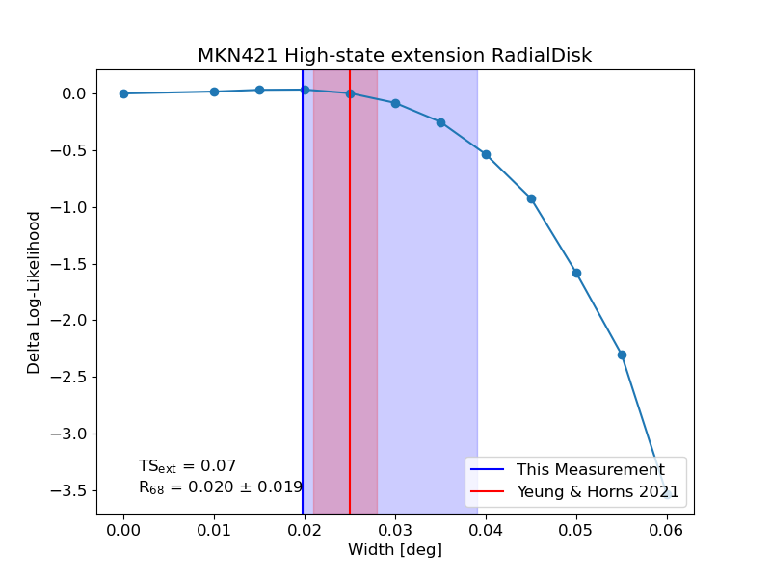
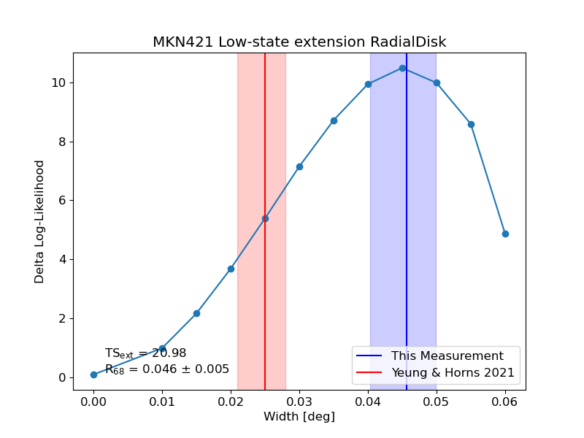
Test subject – MKN 421
Lightcurve from 2008Aug - 2022Sep
High and low flux-selected samples:
# of bins in low state: 742
# of bins in high state: 39
Angular extension for subsamples:
Low flux = 0.04 degrees
High flux = no extension
Full sample = 0.026 degrees
Notes:
(argument for larger cascade contribution at low-flux samples, while direct photons dominate at burst state due to time delay of secondaries...)
The analysis employed here for the extension is the one from fermipy and which uses either radial disks or gaussian shapes, but we want to do better than that by fitting
models/templates made from simulations that take into account the specific processes that gave rise to this secondary emission. That takes us to ELMAG...

Slide 6
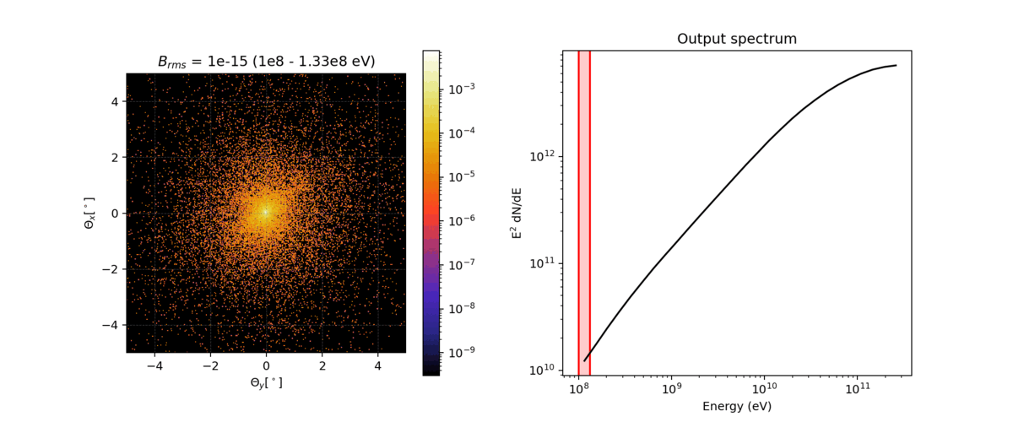
ELMAG 3.03 simulations
(Blytt et al. 2020)
Comprehensive analytical treatment of cascade development inside magnetized medium
Inputs:
Injected spectrum: PowerLaw index –2, between 10 - 100 TeV at z=0.031
EBL models
magnetic field strengths ∈ [10⁻¹⁴, 10⁻¹⁹] Gauss
coherence length fixed at 1 Mpc
We store energy binned spatial distribution of counts and time delay of secondaries
Lets us create a 3D template (energy,spatial) for the secondary cascade emission
Notes:
ELMAG considers energy losses,
First a slide with only a single image of the animation then change it to the gif...

Slide 7
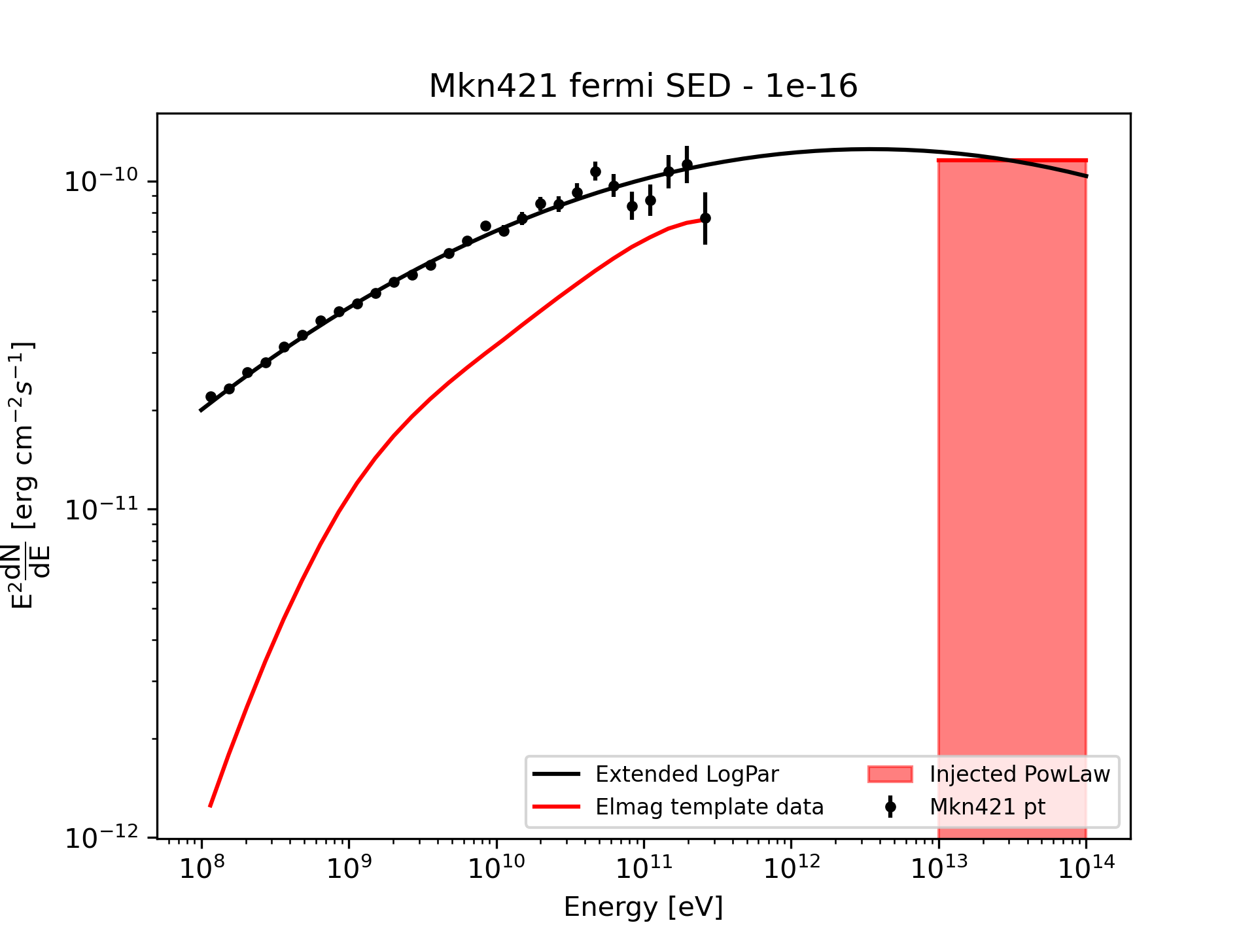
Strategy: Building and Fitting the model
Binned likelihood analysis: Fermipy version 1.2 - ScienceTools version 2.2.0
Model composed of 4FGL point sources (including mkn421), plus galactic isotropic and diffuse emission
Additional component for the extended secondary emission from our simulated templates
Free normalization for template and mkn421 pt source
Fit the ROI using fermipy script.
Fit Bfield and normalization (efficiency of cascade)
Expectation if 100% of energy produced in the cascade was deposited into the secondaries, but plasma instabilities could be preventing this, so by fitting the normalization, we are also fitting the efficiency of this energy loss process.
Notes:
Add component for extended emission to the ROI on top of the point source...

Slide 8
Poisson maximum likelihood test
Hypothesis test for simulated models
Likelihood estimator L defined from number of predicted and observed counts, for each component in the model and each bin
Optimize L by fitting the model parameters
Define test statistic TS: Ratio between Likelihood obtained for model with and without our simulated template

Slide 9
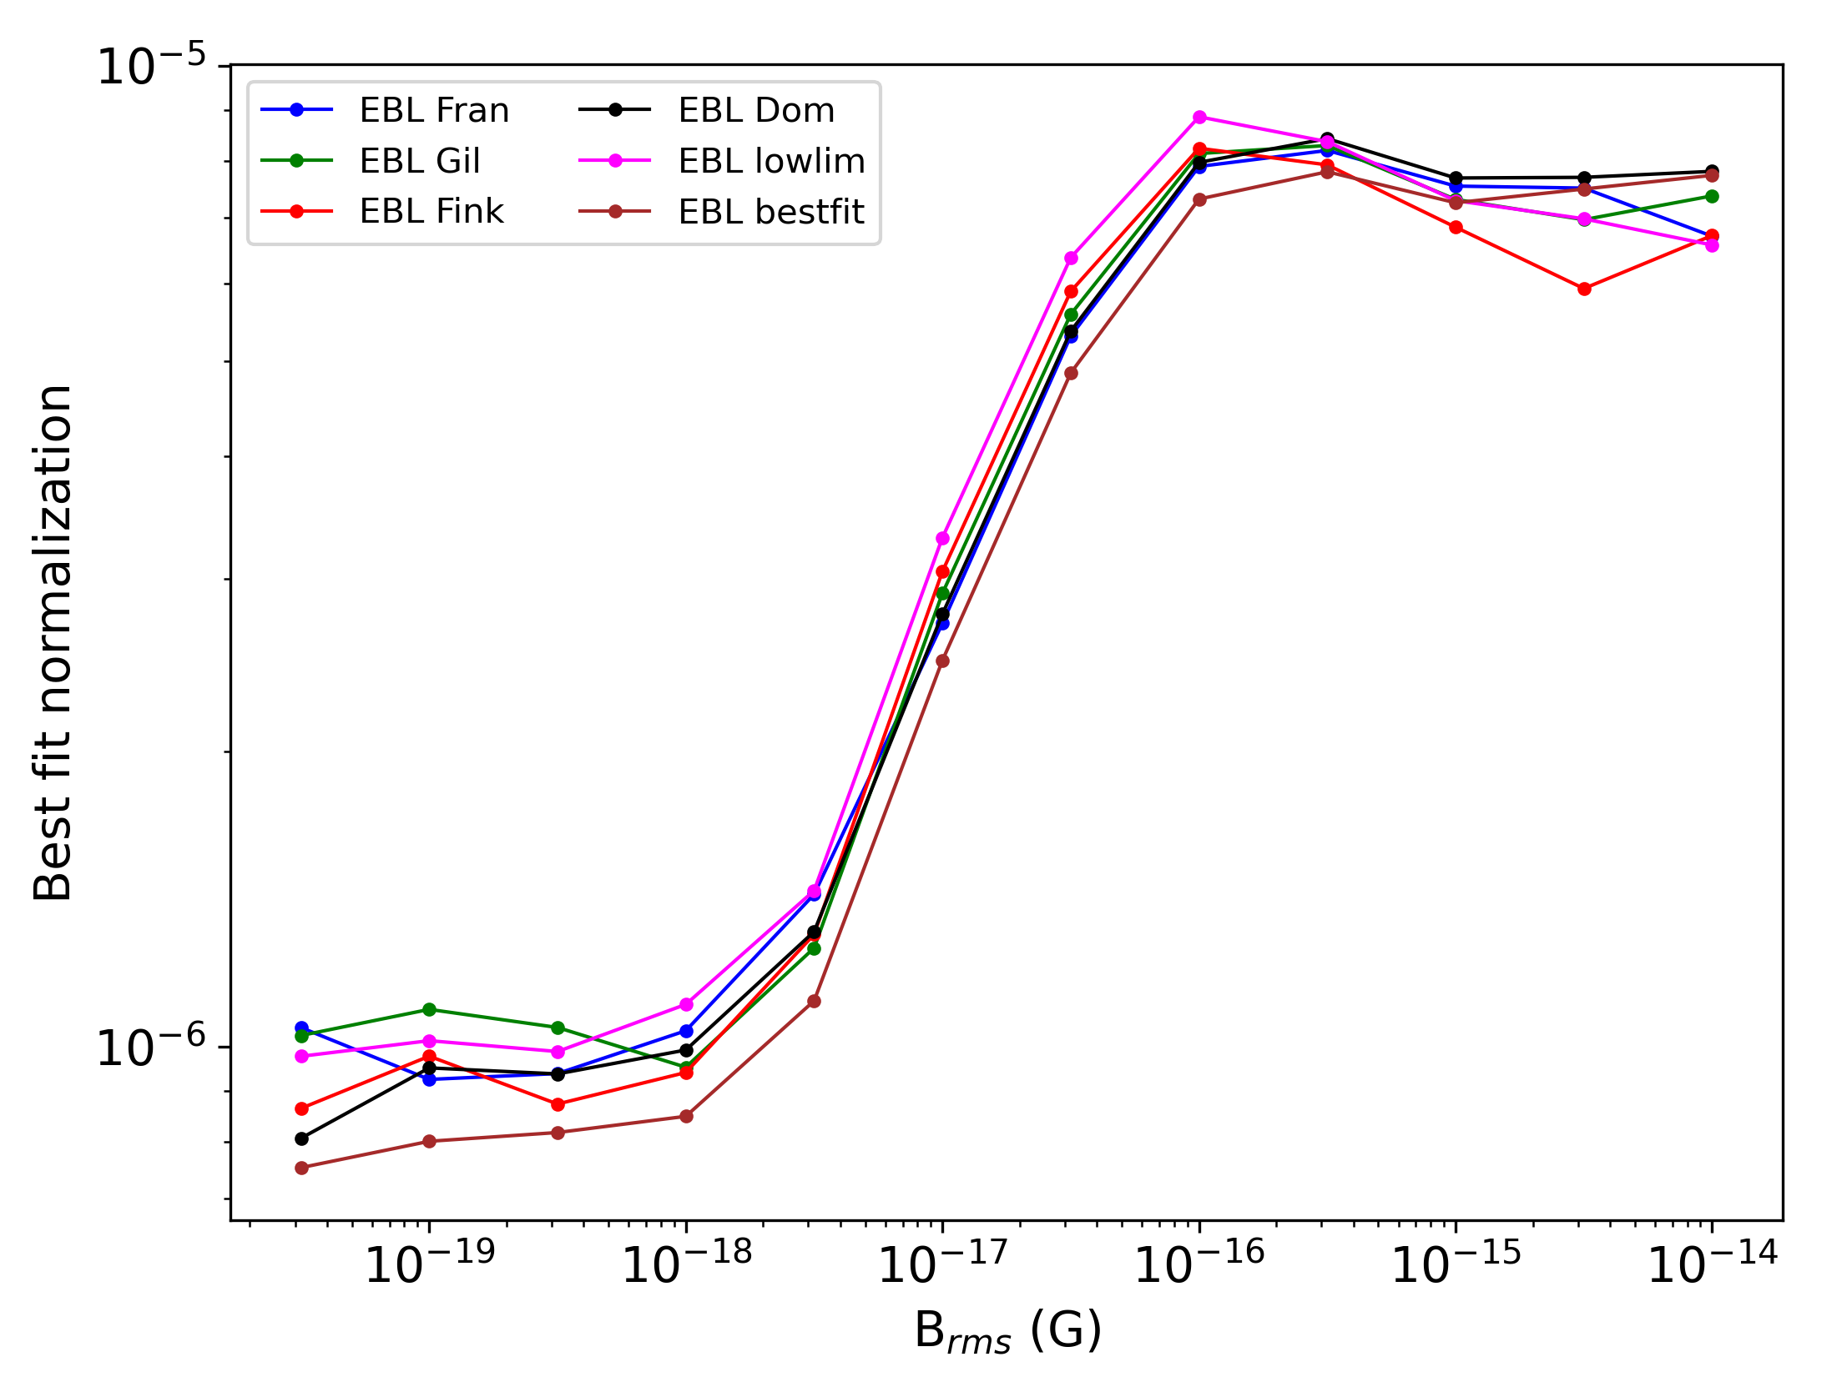
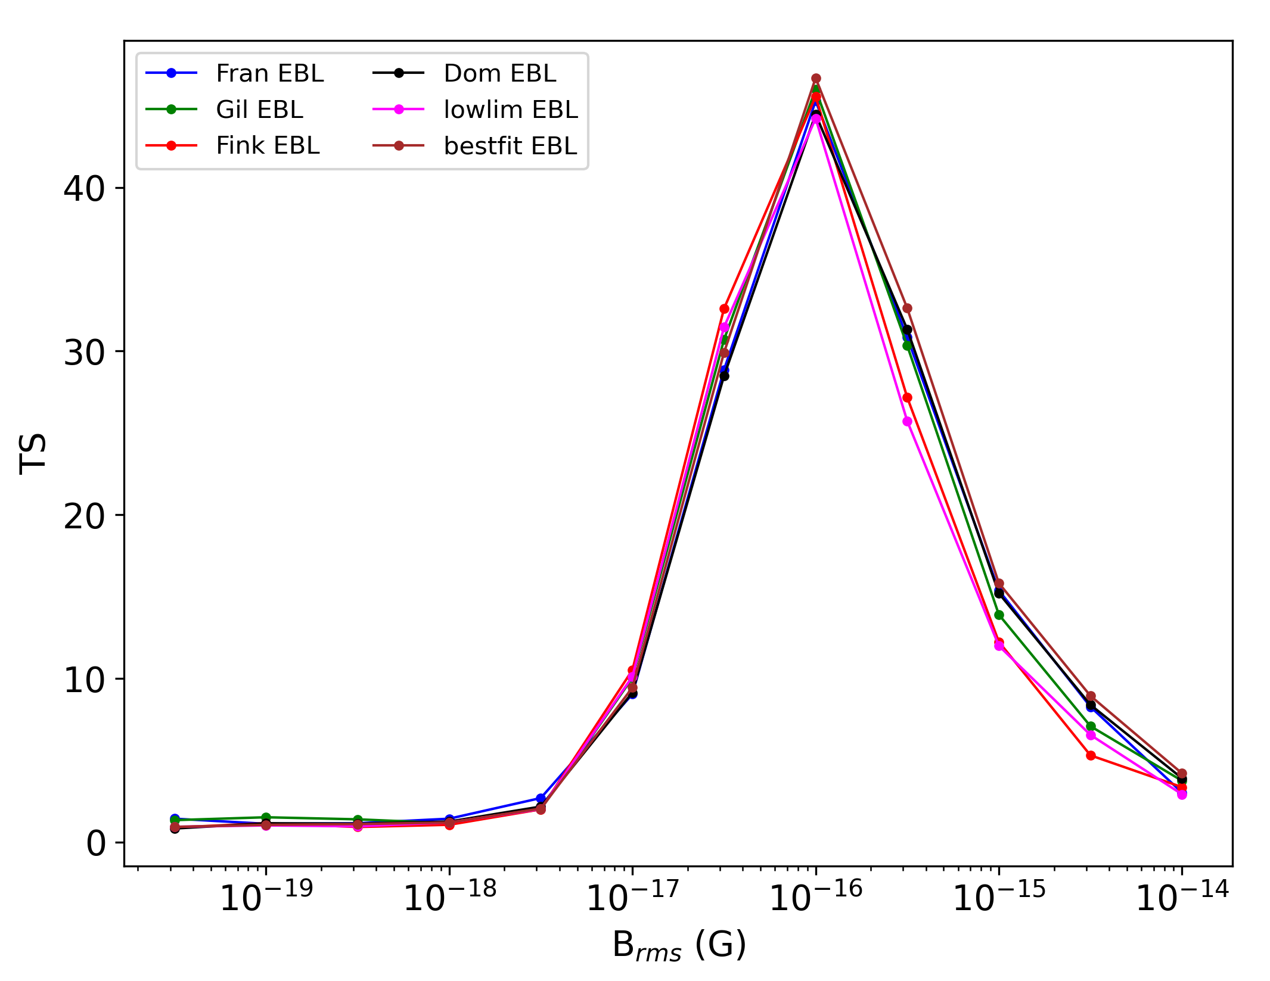
(Prelim.) Fit Results - Full sample
0.02 degree spatial binning
Max TS at B=10⁻¹⁶ Gauss
TS_{max} ~ 45 -> ~7 sigma
Small variability between different EBL models
Analysis performed for 0.01 deg bin as well

Slide 10
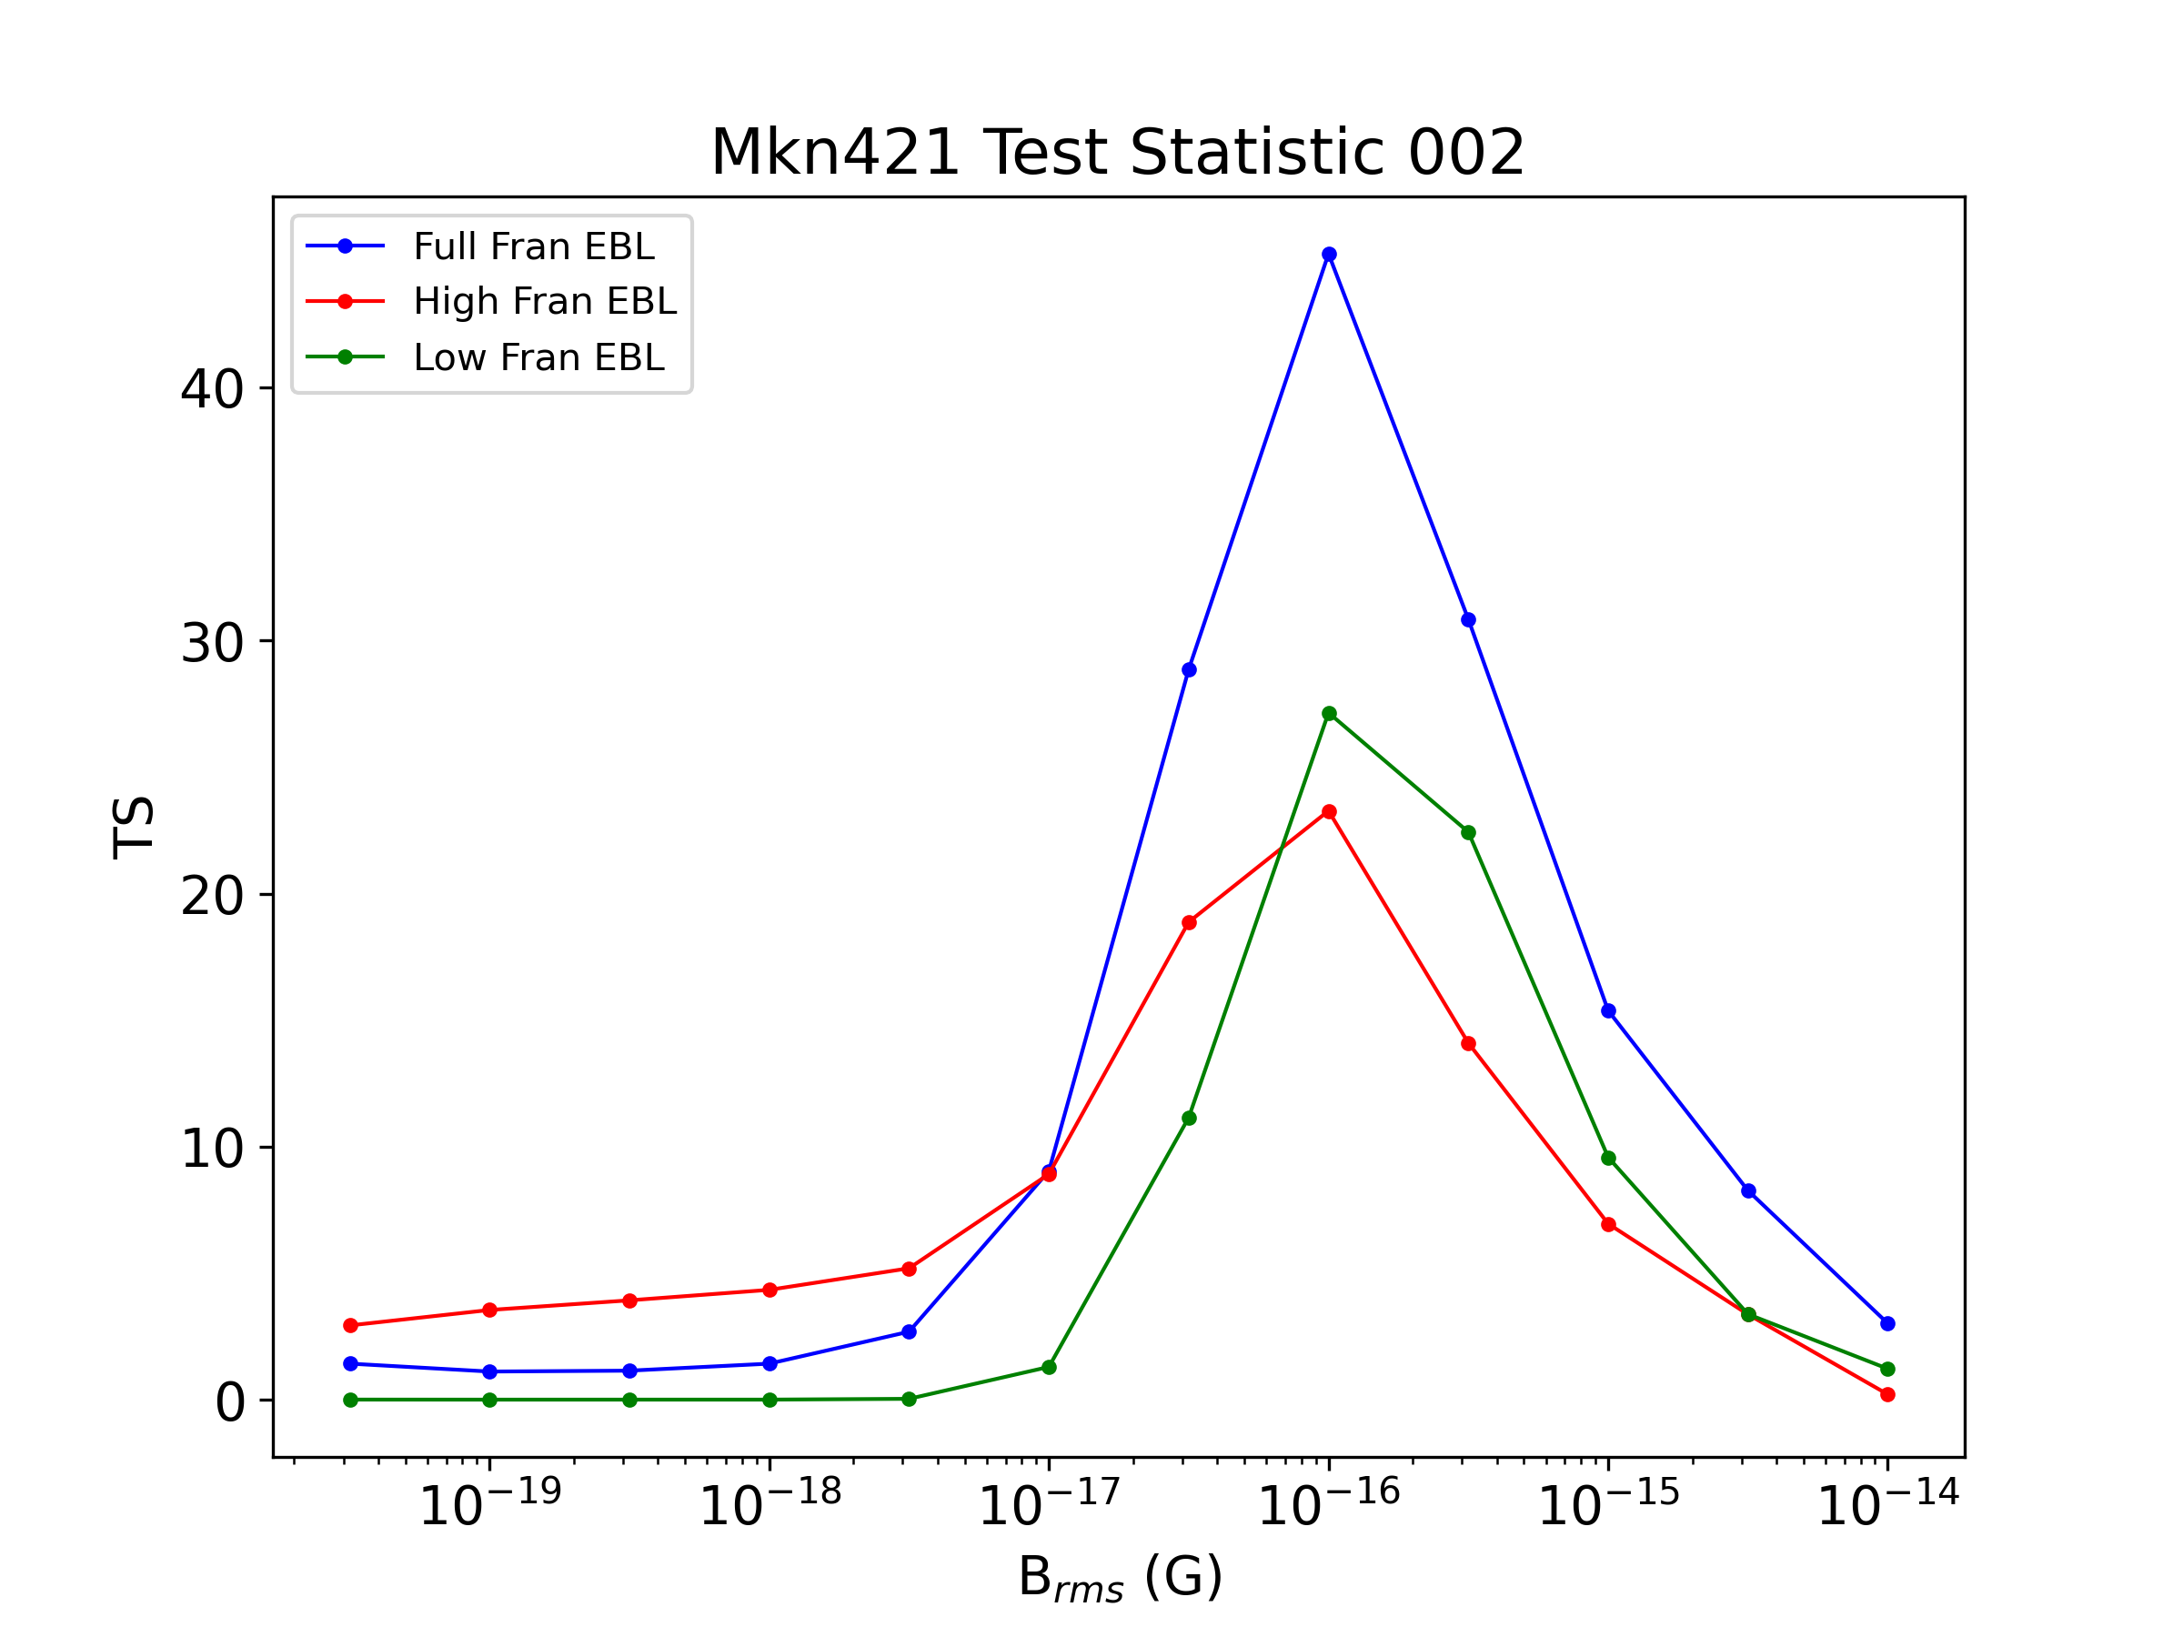
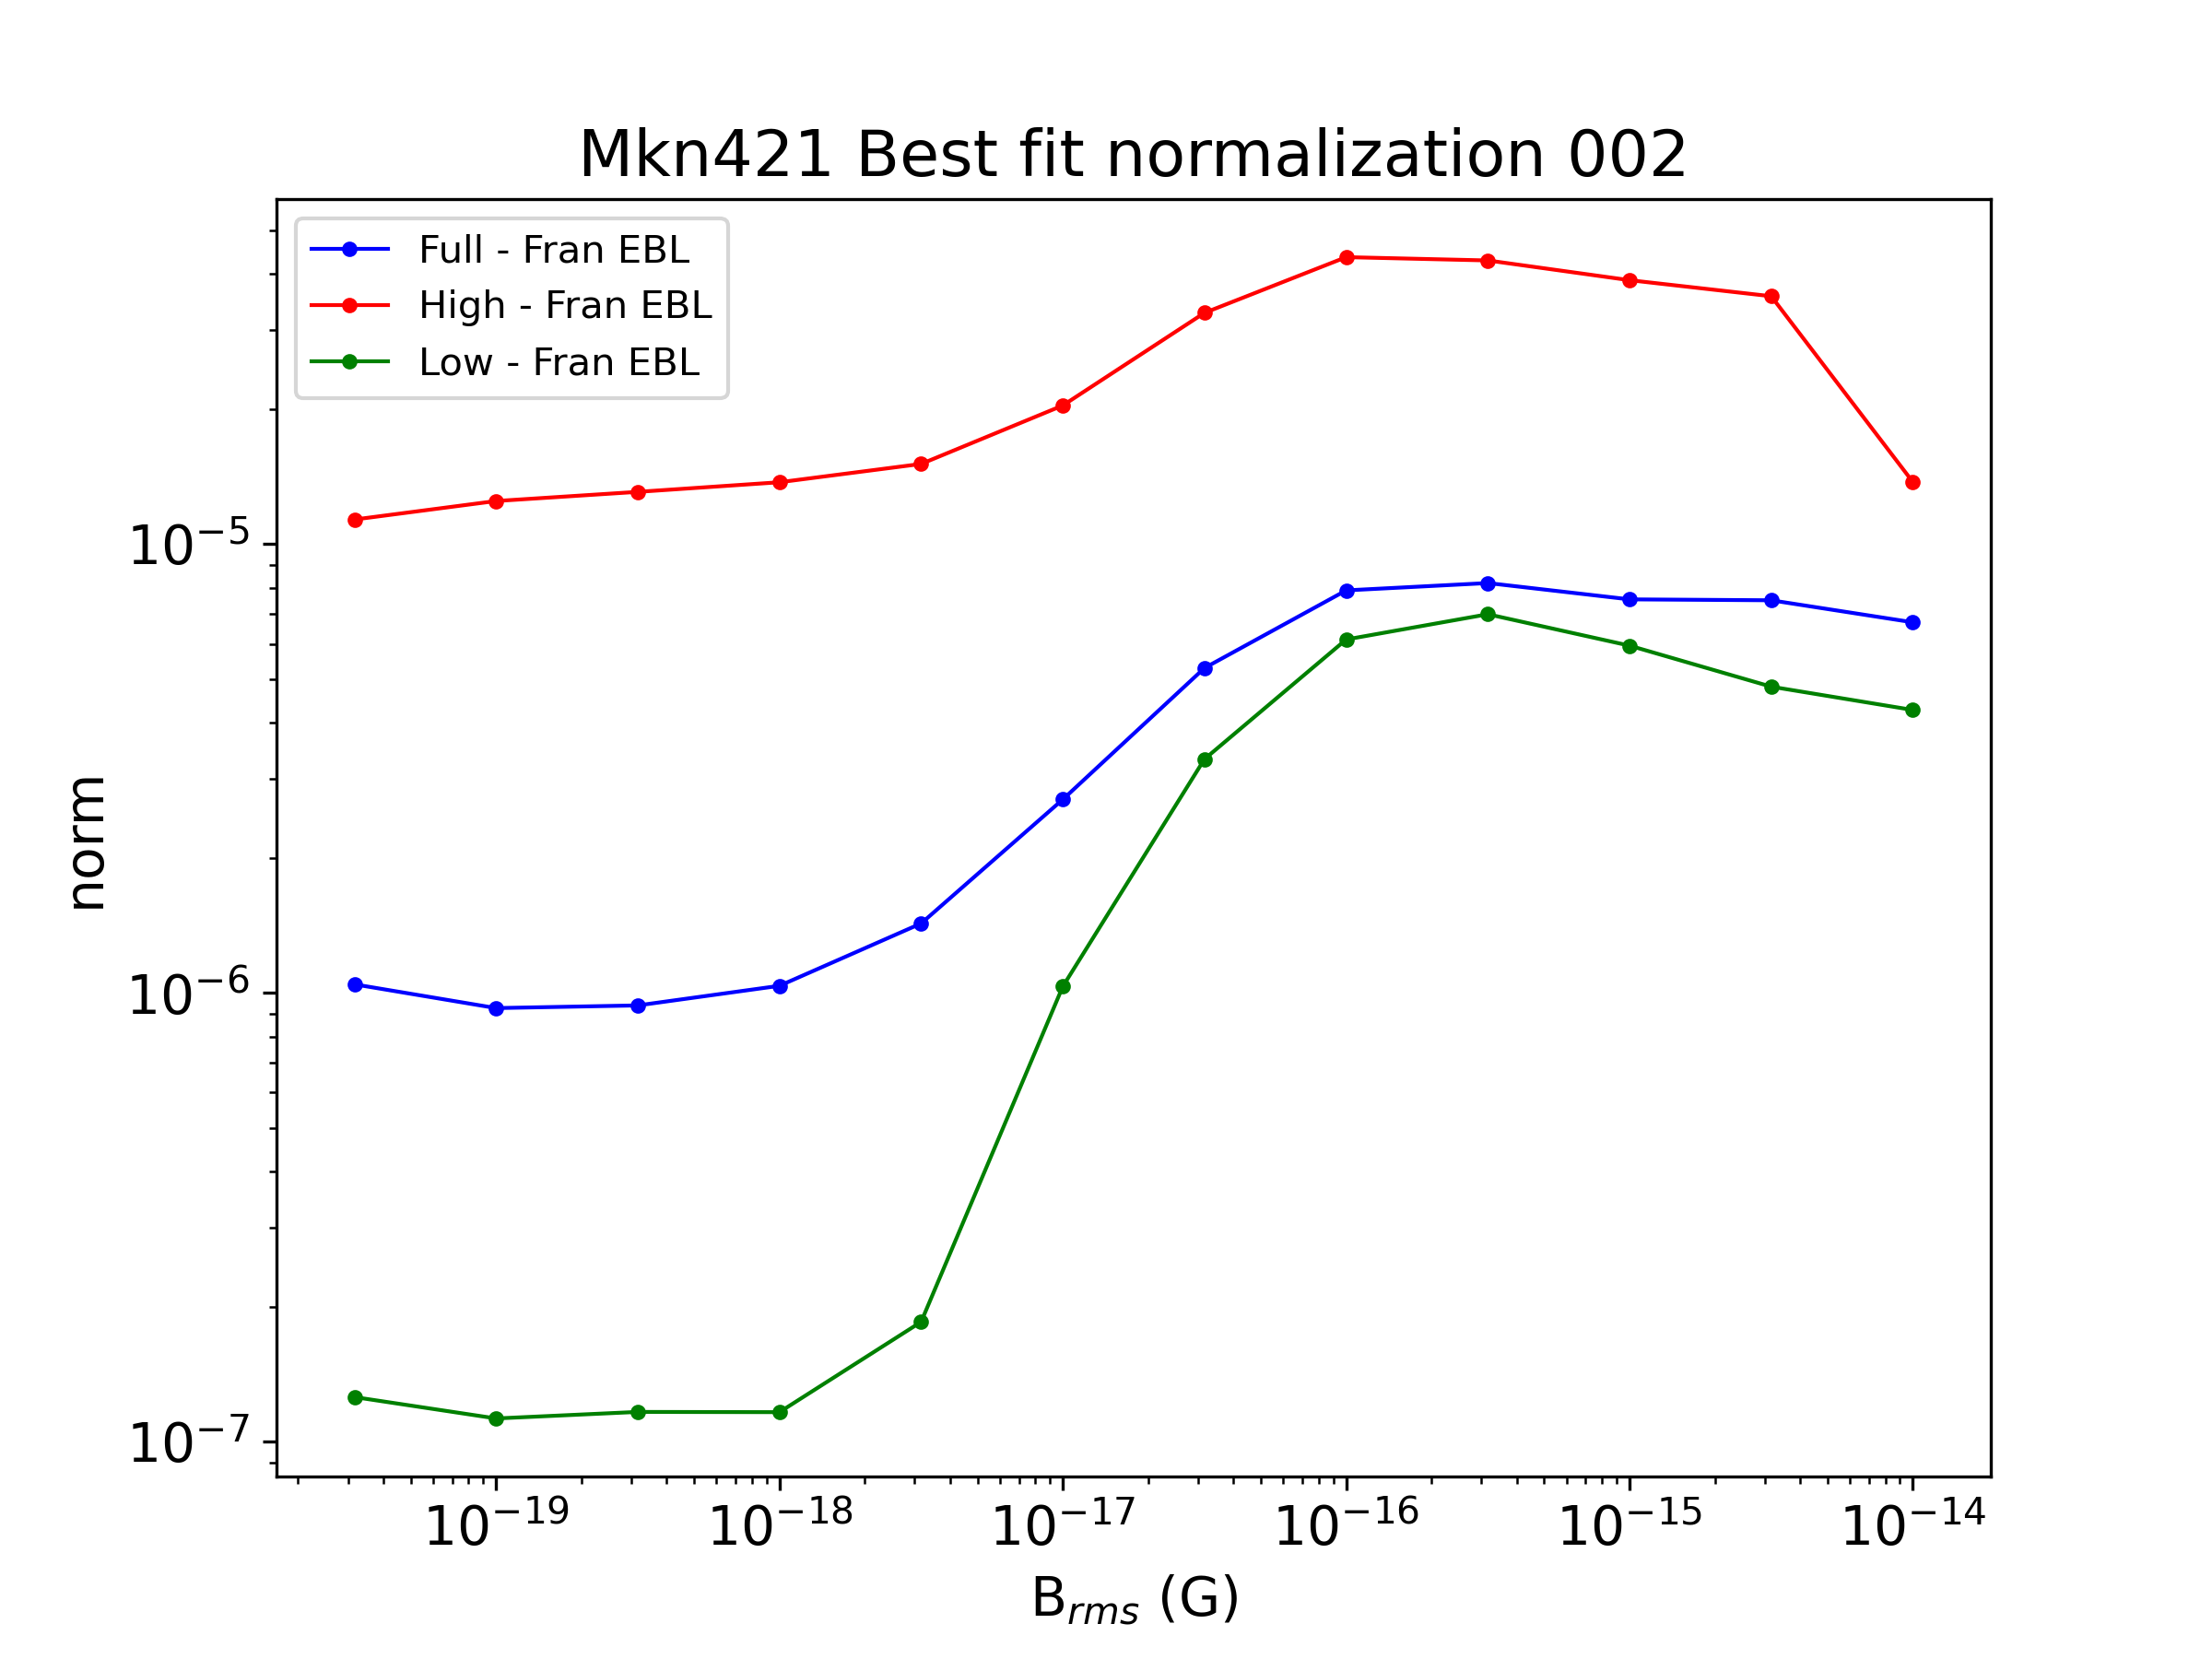
(Prelim.) Fit Results - Flux selected subsamples
Test Statistic, Best fit normalization for high and low flux states
Franceschini et al. EBL model
High and low flux subsamples produce similar TS results TS_{max} ~ 25

Slide 11
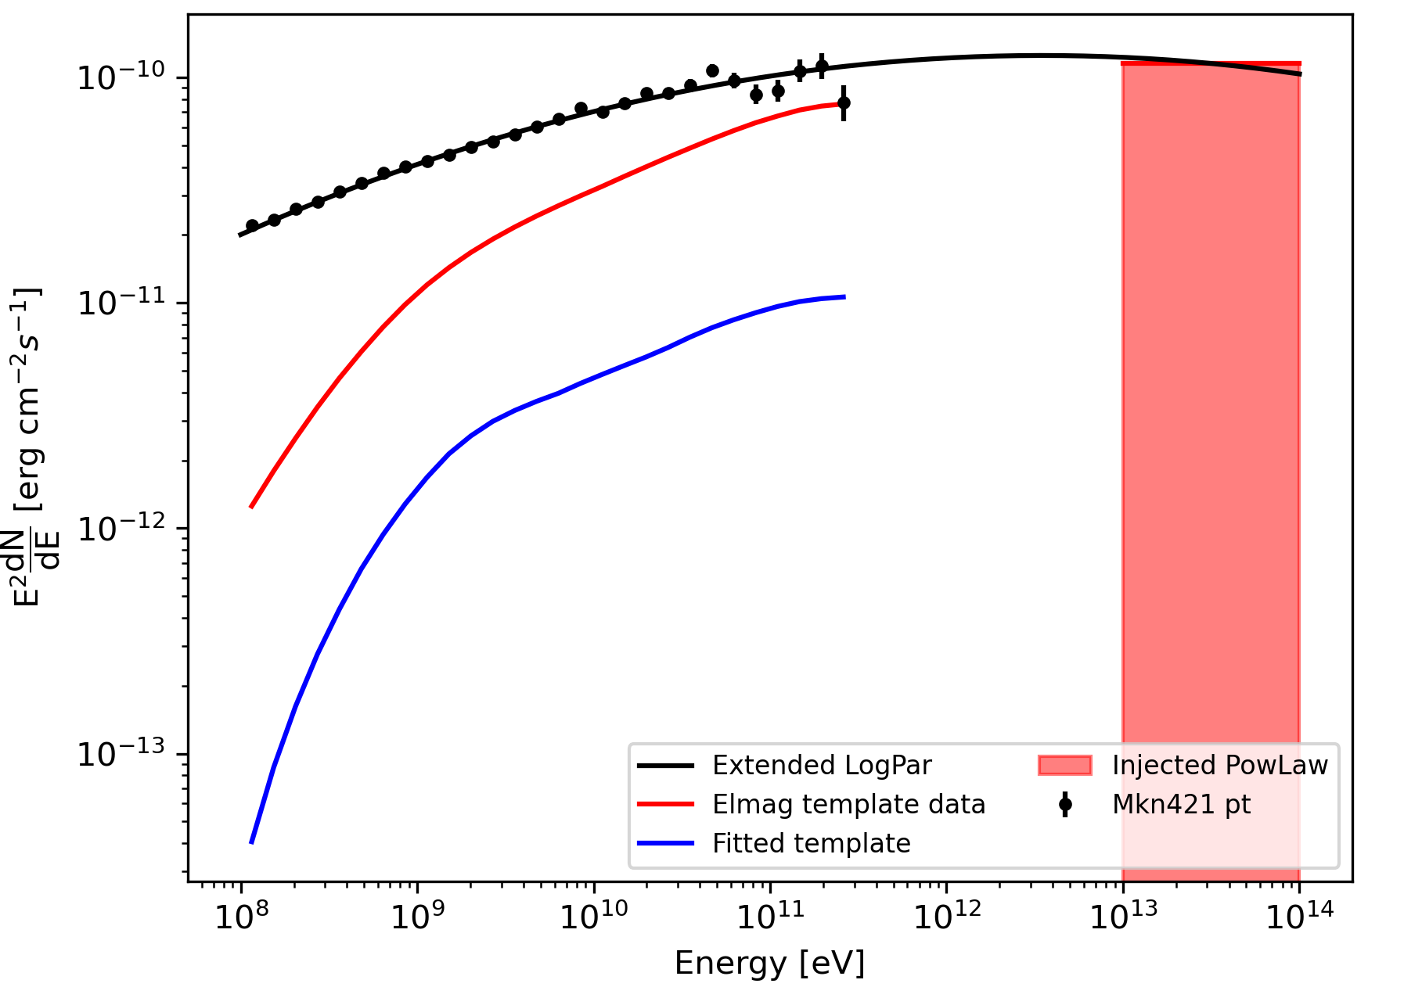
(Prelim.) Results – Implications & Interpretation
(Could represent) First significant detection of extended cascade emission around TeV blazar
Detected emission is consistent with a B field of magnitude Brms = 10⁻¹⁶ G
Results are allowed by the limits placed on the parameter space
Remark the importance that here we consider the plasma instability efficiency as a free parameter (normalization)
Potential source for considerable heating of intergalactic medium through plasma instabilities, which provides explanation for lyman alpha forest feature observed in quasar spectra
Best fit normalization for B=10⁻¹⁶ G implies a plasma instability efficiency of ~95%. In other words only 5% of the energy produced in the cascade goes into secondary gamma-ray photons.

Slide 12
Conclusion & summary
Mkn 421 (z=0.031, D~130 Mpc)
Fit point source + cascade template (extension and spectrum) with free parameter efficiency
Significant evidence for cascade emission and heating of medium -> supression of cascade ~95% for Brms=10⁻¹⁶G
No conflict with bounds obtained with E_{heating} = 0
Further validation tests and robust checks need to be performed
Additional TeV sources to be studied

Slide 13
Backup slides

Slide 14
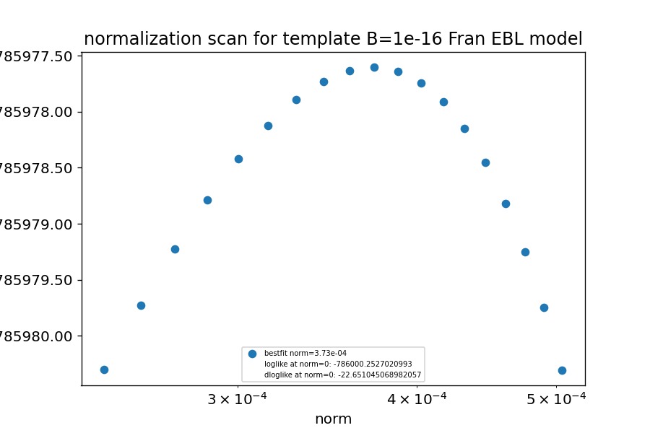
Loglikelihood Normalization Scan

Slide 15
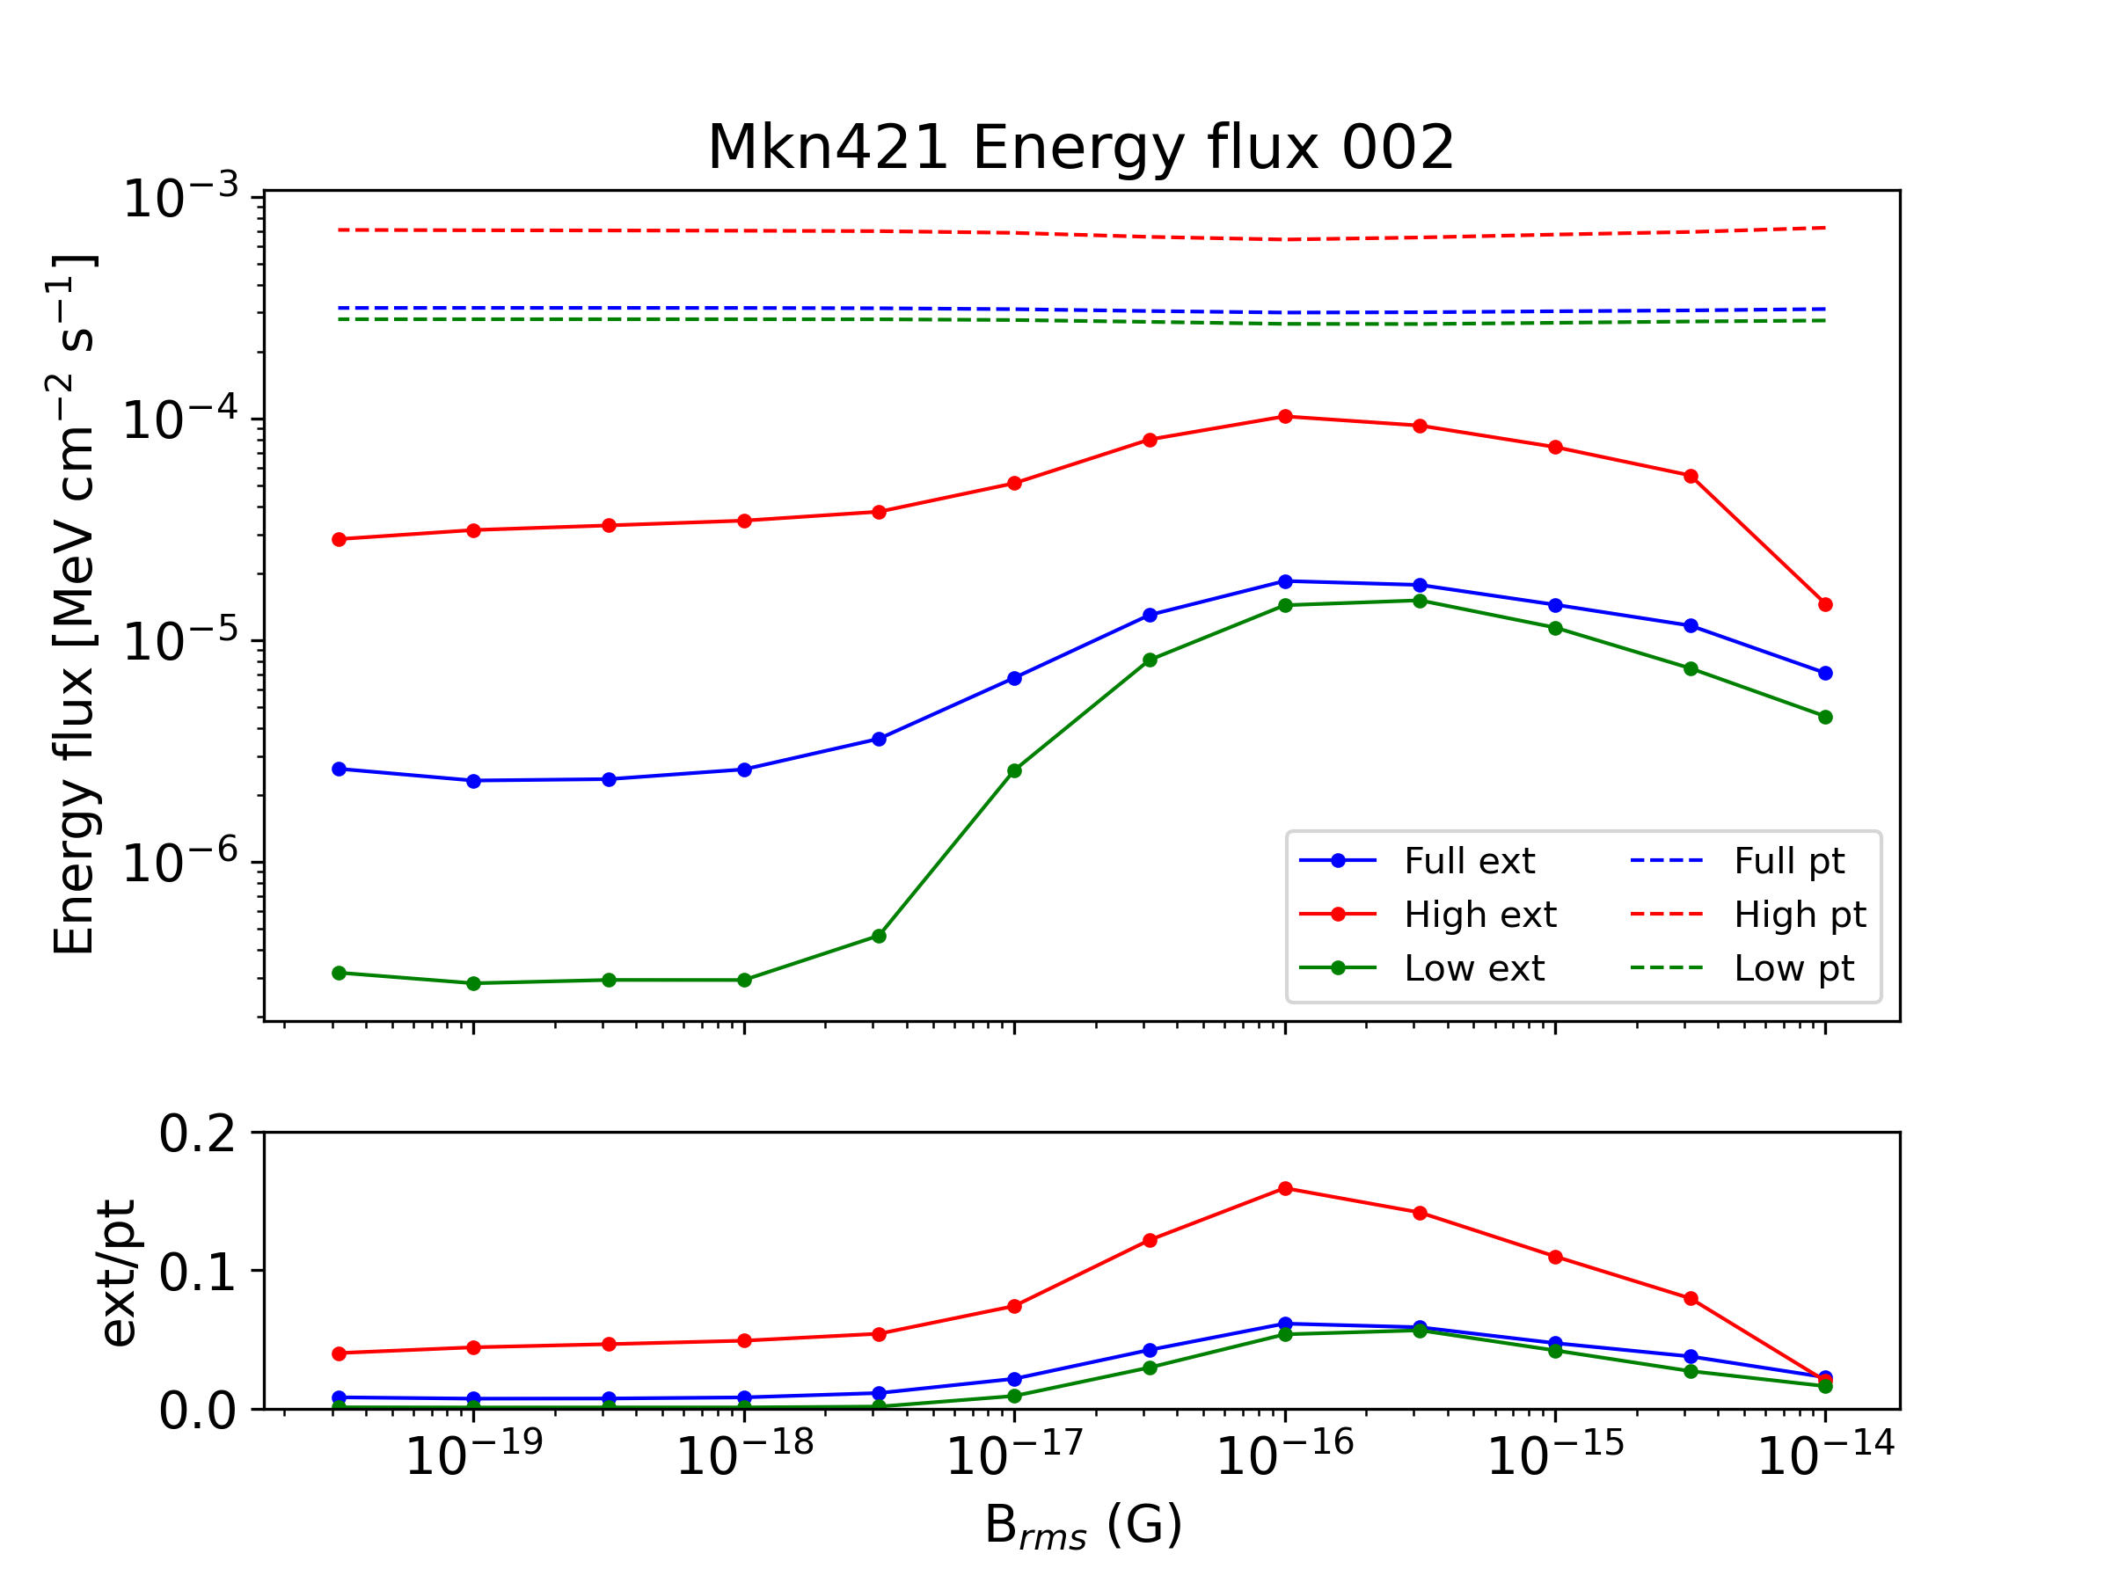
(Prelim.) Fit Results - Flux selected subsamples
TS, norms, eflux for high and low flux states
Franceschini et al. EBL model
During the flaring stages a harder spectrum is injected at TeV energies, therefore more photons for cascade production...

Slide 16
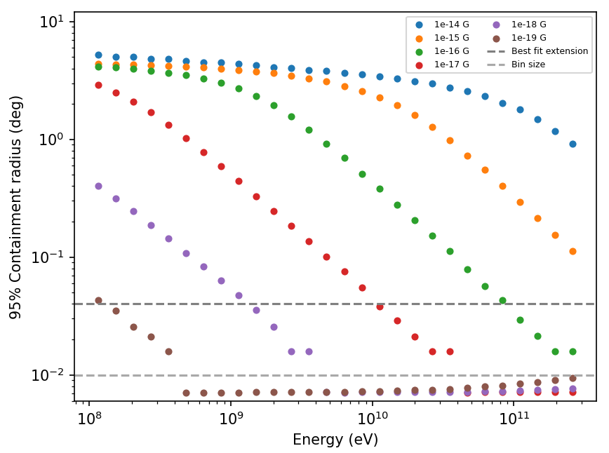
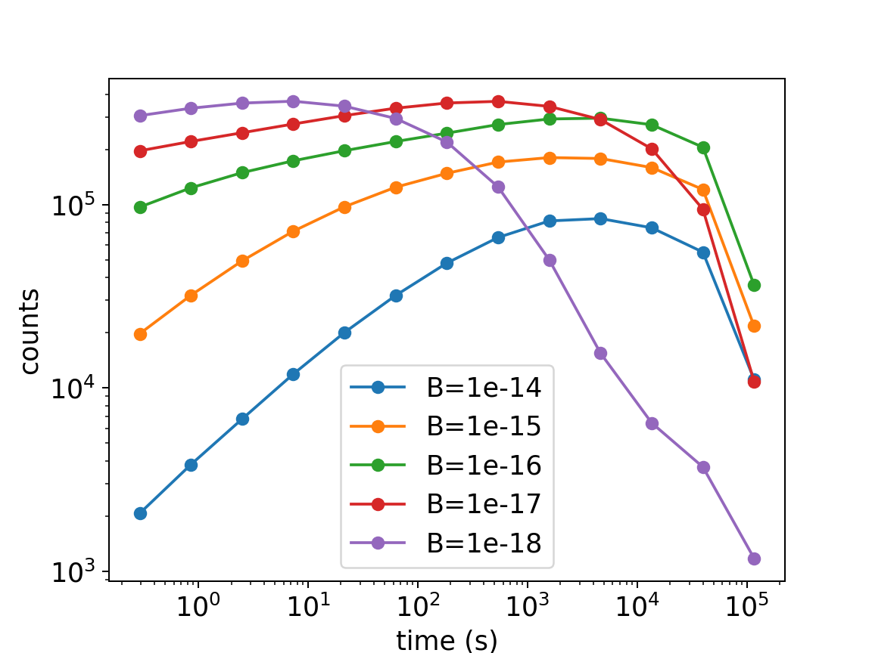
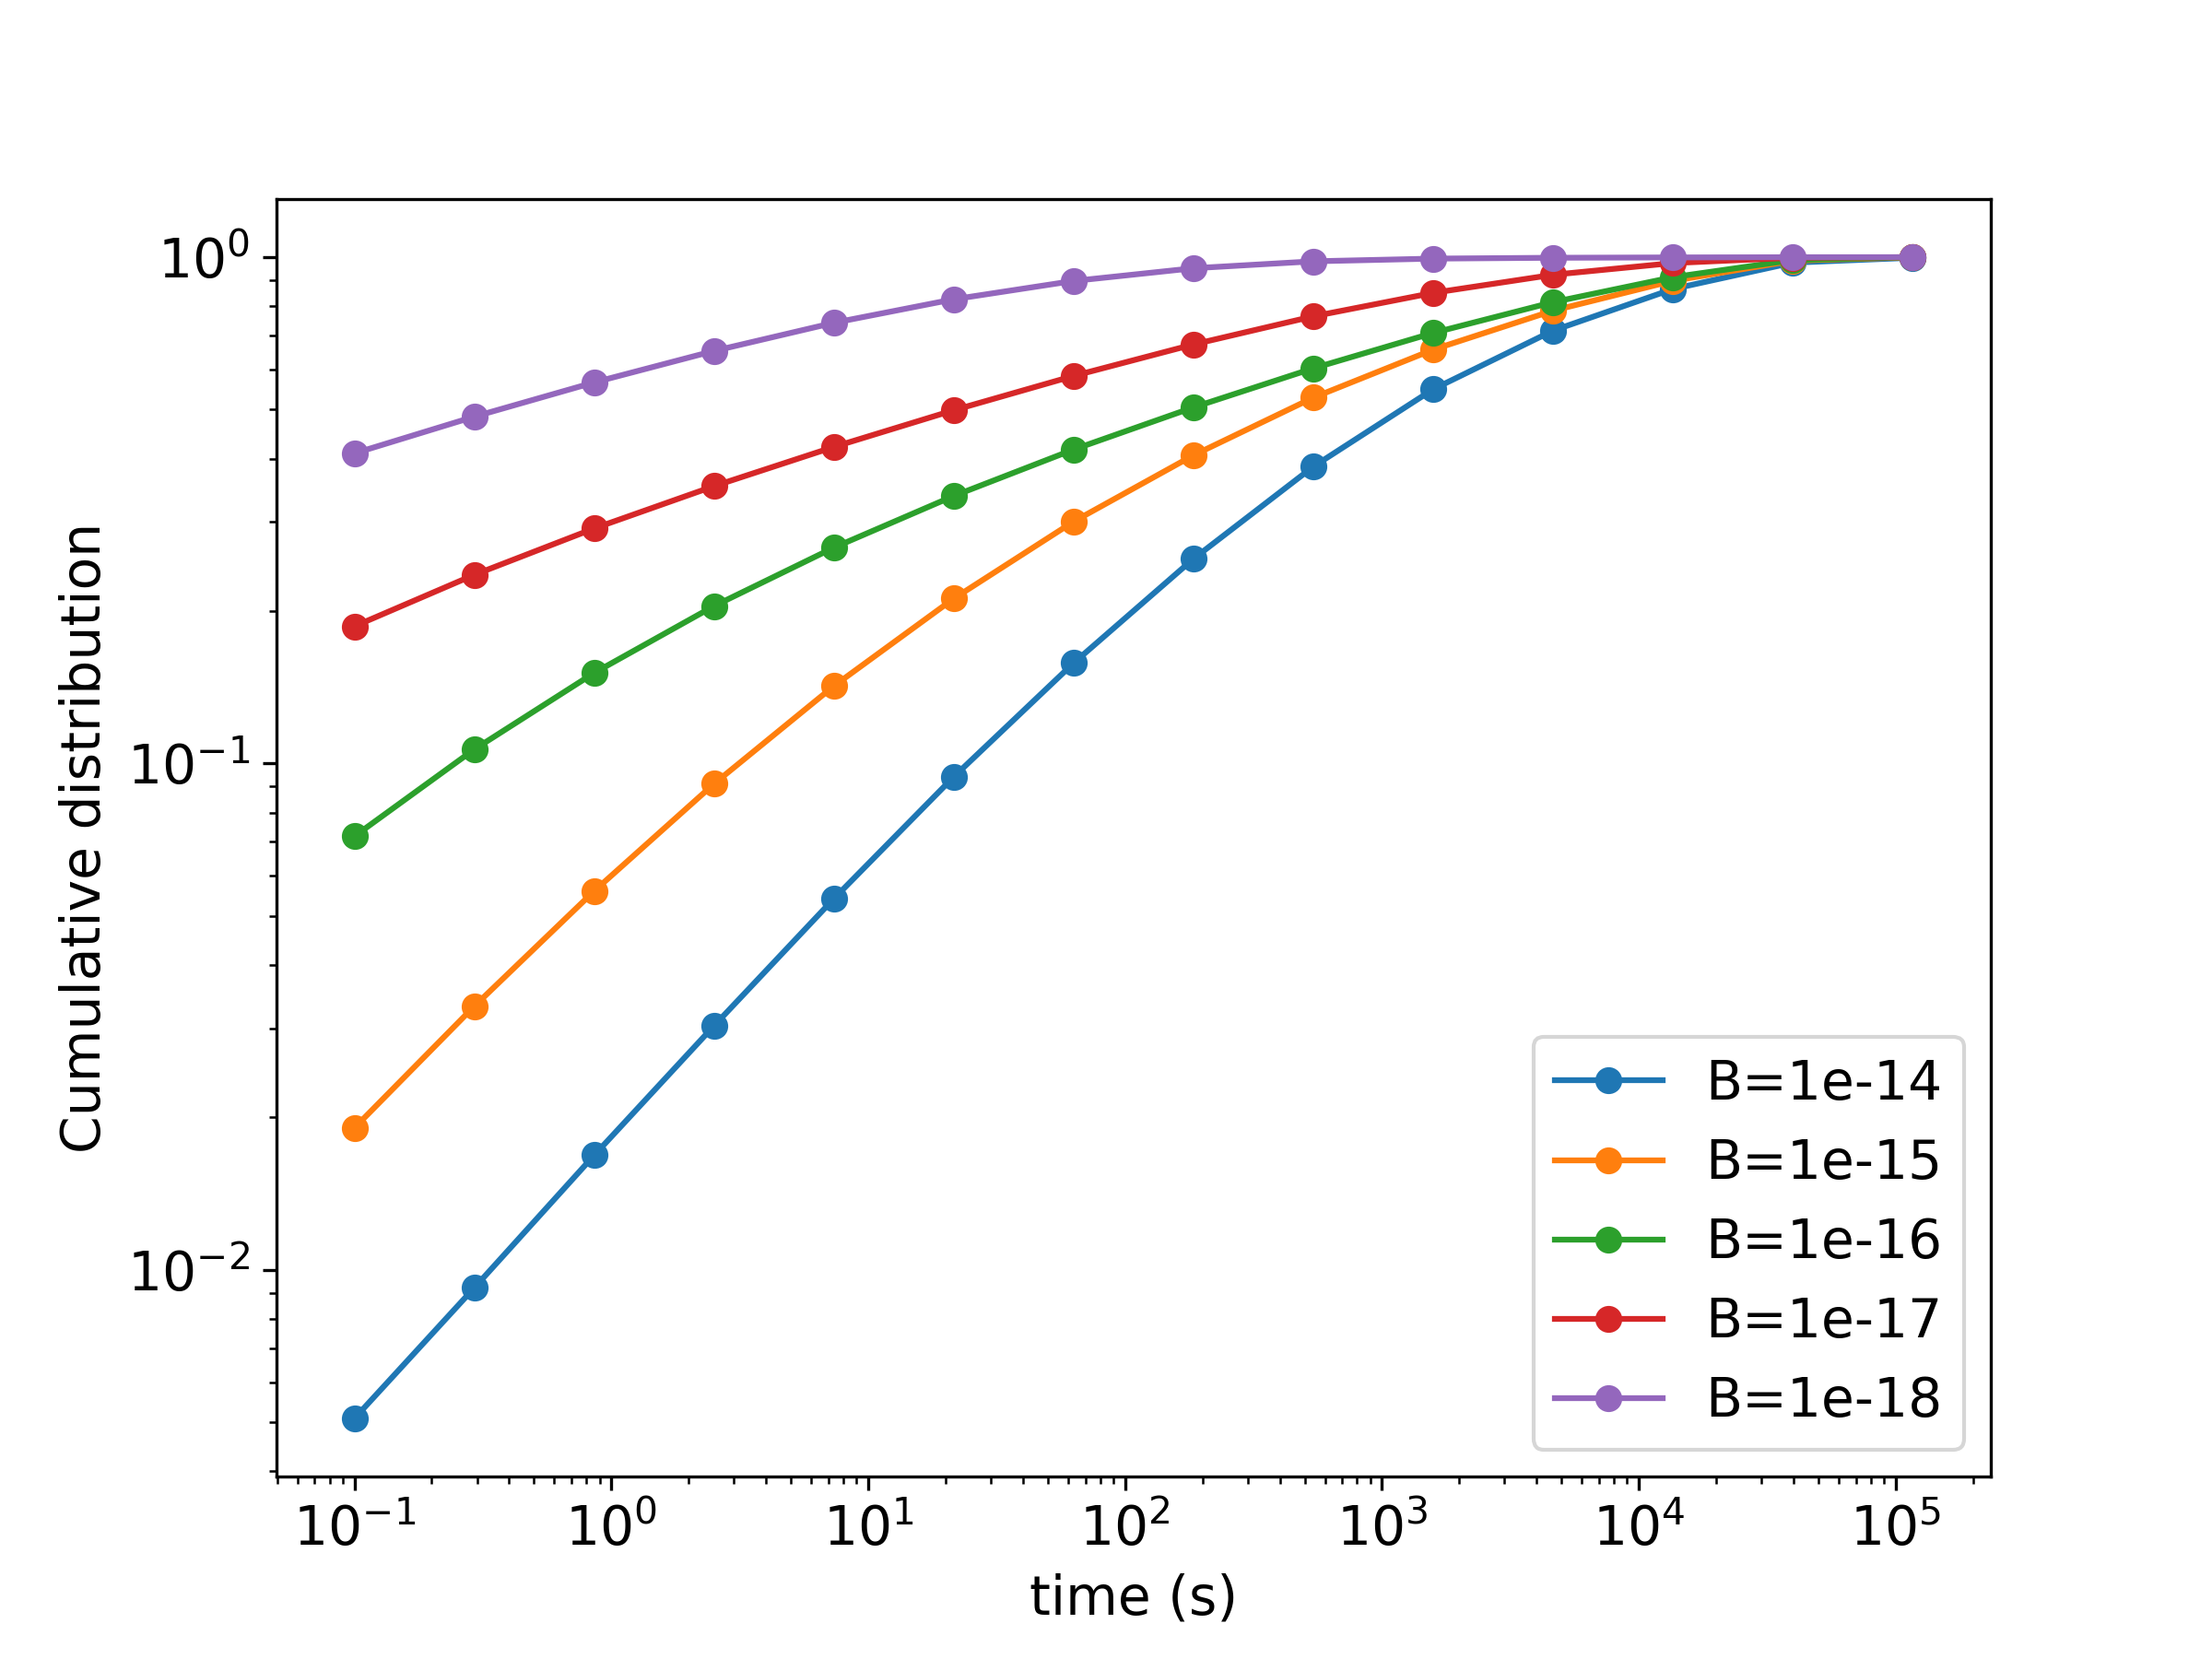
ELMAG simulations
0.1, 0.02, 0.01 binnings
Containment radius for our templates compared to the extension and binsize
Time delay distribution for secondary cascade photons (cumulative fraction of counts)
Notes:
Make cumulative plot of time delay

Slide 17
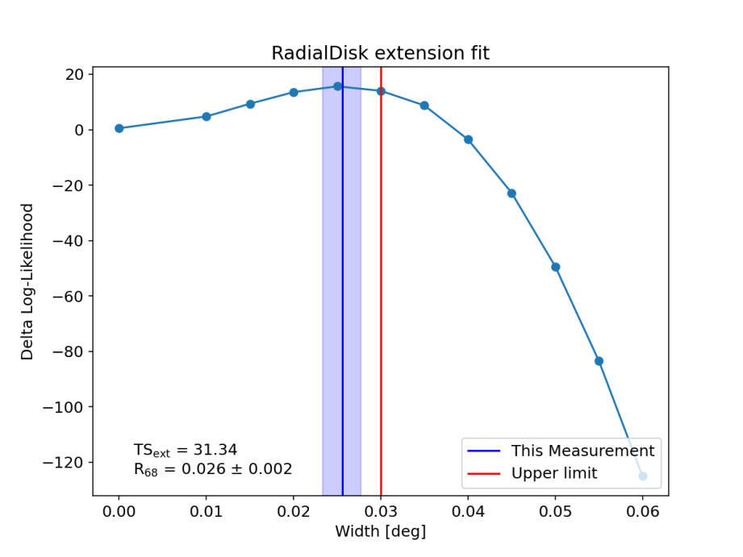
Test object - MKN421
Lightcurve from (2008Aug - 2022Sep)
High and low flux-selected samples:
# of bins in high state: 39
# of bins in low state: 742
Angular extension for full sample of 0.026 degrees
Notes:
(argument for larger cascade contribution at low-flux samples, while direct photons dominate at burst state due to time delay of secondaries...)
The analysis employed here for the extension is the one from fermipy and which uses either radial disks or gaussian shapes, but we want to do better than that by fitting
models/templates made from simulations that take into account the specific processes that gave rise to this secondary emission. That takes us to ELMAG...

Slide 18
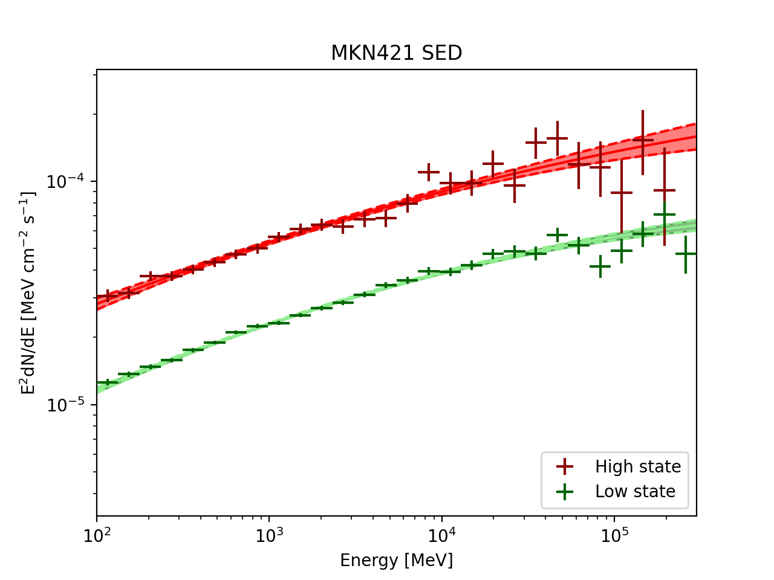
Test object - MKN421
Lightcurve from (2008Aug - 2022Sep)
High and low flux-selected samples:
# of bins in high state: 39
# of bins in low state: 742
High and low flux SEDs
Notes:
(argument for larger cascade contribution at low-flux samples, while direct photons dominate at burst state due to time delay of secondaries...)
The analysis employed here for the extension is the one from fermipy and which uses either radial disks or gaussian shapes, but we want to do better than that by fitting
models/templates made from simulations that take into account the specific processes that gave rise to this secondary emission. That takes us to ELMAG...

Slide 19
Outline
1 slide on the motivation + goals
1 slide on the cascade theory...
1 slide on the object (highlight position far away from MW) - mention red-shift maybe even jet angle.
Data with Fermi-LAT (light curve )
result on extension with Fermi-LAT - disk model - give details on analysis: version, settings
analysis: simulated cubes as templates for different magnetic fields, coherence length 1 Mpc
details on simulation (binning, show spectra cube)
strategy: fit templates to data adding free parameter efficiency (100% efficiency usually assumed for limits)
results on best-fit values
discussion on significance, on consistency

