Slide 1
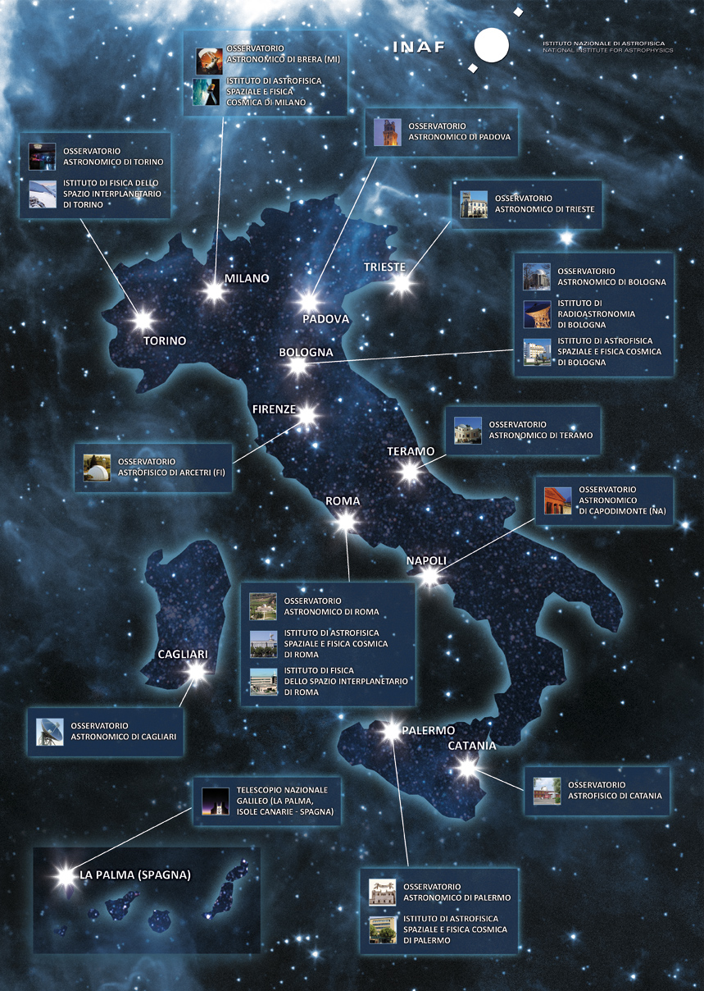


Final Design and Technologies for the IBIS 2.0
G. Viavattene¹, I. Ermolli¹, R. Cirami², G. Calderone², D. Del Moro³, P. Romano⁴, M. Aliverti⁵, V. Baldini², F. Giorgi¹, F. Pedichini¹, I. Coretti², P. Di Marcantonio², L. Giovannelli³, S. L. Guglielmino⁴, M. Murabito^{6,1}, L. Oggioni⁵, M. Oliviero⁶, R. Piazzesi¹, E. M. A. Redaelli⁵
¹INAF – OAR, ²INAF-OATs, ³Univ. Of Rome Tor Vergata, ⁴INAF – OACt, ⁵INAF – OAB, ⁶INAF - OAC
and with contributions by M. Munari, M. Stangalini, R. Briguglio and F. Landini

Slide 2
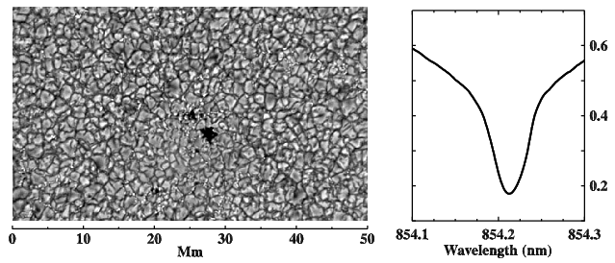
IBIS 2.0
[Cavallini (2006), Solar Physics, 236, 415-439]
[Ermolli et al. (2020), SPIE proceeding, 11447]
High resolution solar spectropolarimetric observations
Upgrade and update the previous version of IBIS (DST from 2003 to 2019) planned for VTT in Spring 2023
NEW
Full automation of calibration and observation procedures (ESO VLT standard)
Polarimetric Unit

Slide 3
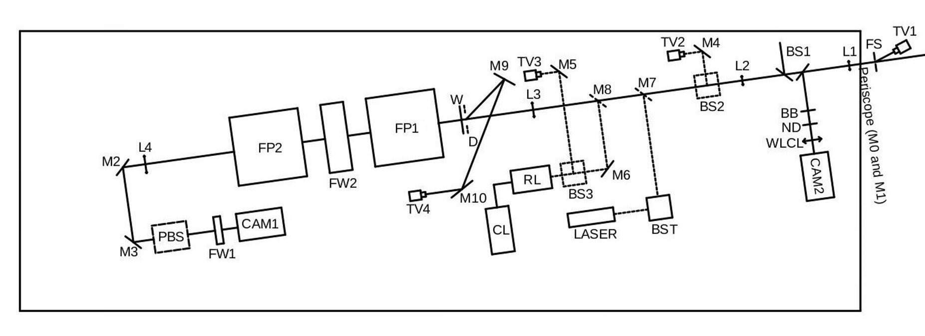
Synergies:
[Viavattene et al. (2020), IBIS-04: IBIS 2.0 System Design Description,
INAF Technical Report, Repository Open Access INAF]
INAF-OAR + INAF-OATs: PI +PM
INAF-OAR: reassembly in optical lab with a modified layout adapted for VTT
INAF-OAA: dynamical optical aberration tests of critical components
INAF-OATs + INAF-OAR: Instrument Control System hardware upgrade
INAF-OATs: Instrument Control Software
INAF-OAR + INAF-OAC: new polarimeter design
INAF-OACt + INAF-OAR: science cases
INAF-OAR + INAF-OAB: optomechanics
INAF-OAR: detector trade-off

Slide 4
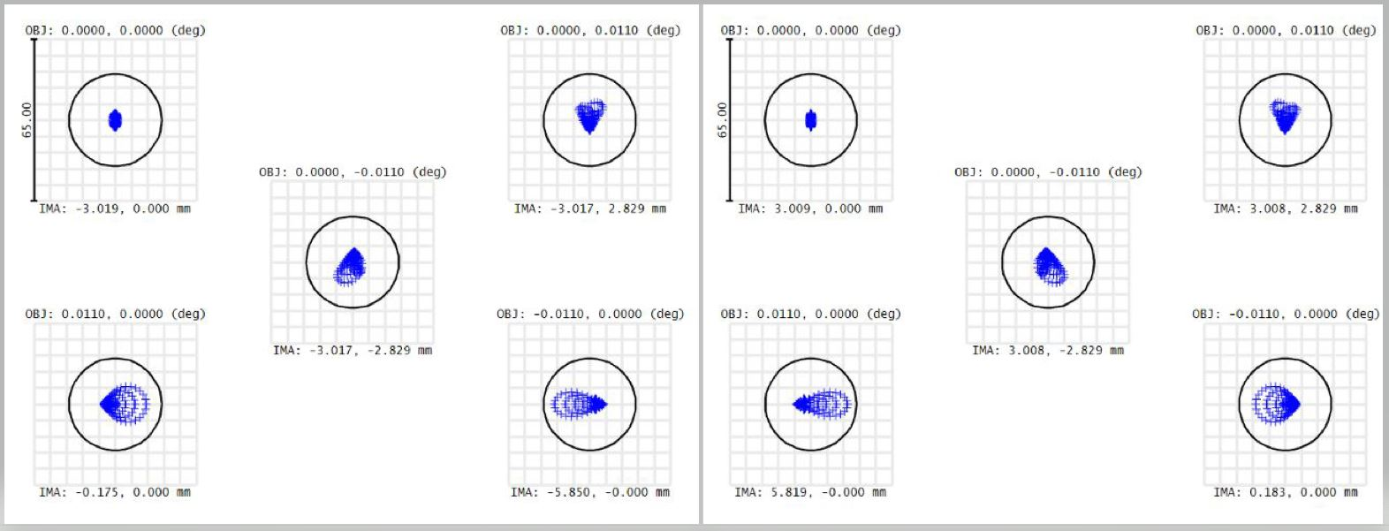
Polarimetric Unit:
6 modulation states
I+Q
I-Q
I+V
I-V
I-Q
I+Q
Optical design and optimization with Zemax OpticStudio
Fast 4Mpix sCMOS
WFE characterization of LCVR with interferometer at INAF-OAA
I-V
I+V
I-U
I+U
I+U
I-U
[Viavattene et al. (2022), Conceptual design of the IBIS 2.0 polarimetric unit,
INAF Technical Report, Repository Open Access INAF]
LCVR 1
LCVR 2
PBS
CAM1

Slide 5
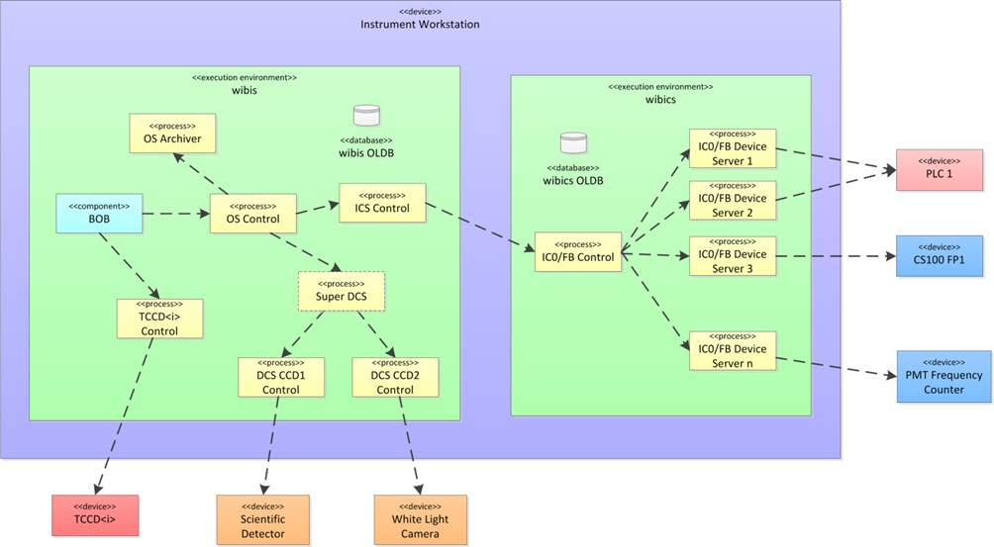
Instrument Control
New Instrument Control for a full automation of the calibration and observation procedures and remote access
Beckhoff PLC with dedicated motors, actuators and stages
First application of the ESO VLT Control Software to solar instrumentation
[Viavattene et al. (2020), IBIS-04: IBIS 2.0 System Design Description, INAF Technical Report, Repository Open Access INAF]

Slide 6
Thank you for your attention
www.ibis20.inaf.it

