Slide 1
End-to-end models for ground-based instrumentations
Marco Landoni
INAF - Istituto Nazionale di Astrofisica

Slide 2
The context
Projects are becoming more and more complex (e.g. ELT-ANDES, CUBES, etc)
Thus, the need to have models able to produce the simulated data in advance to guide the design and aid the data reduction is therefore increasing.
…especially for high RV spectrographs (10 cm/s or less in precision)

Slide 3
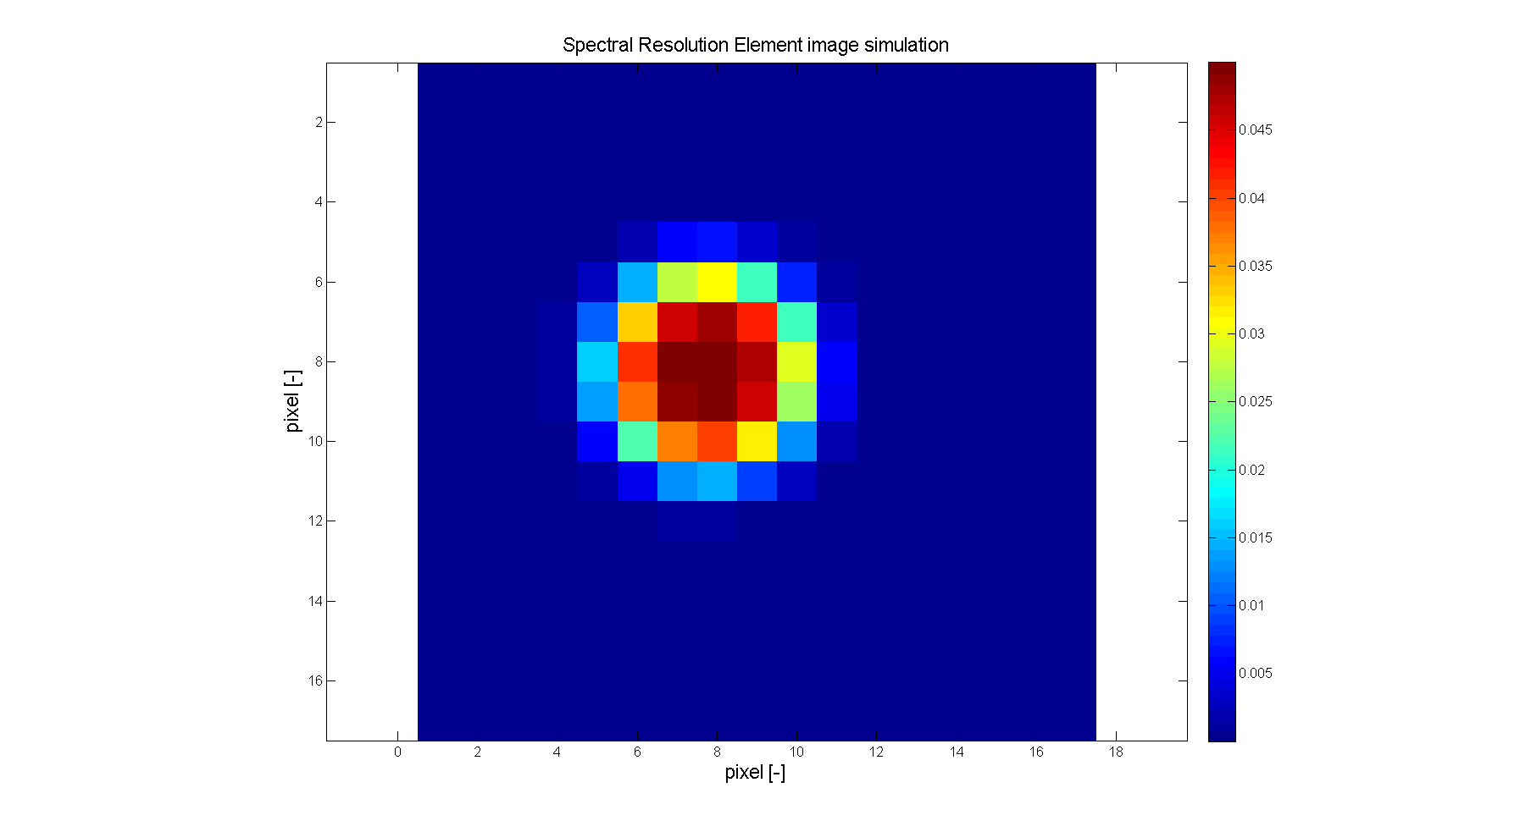
The case of ELT-ANDES

Slide 4
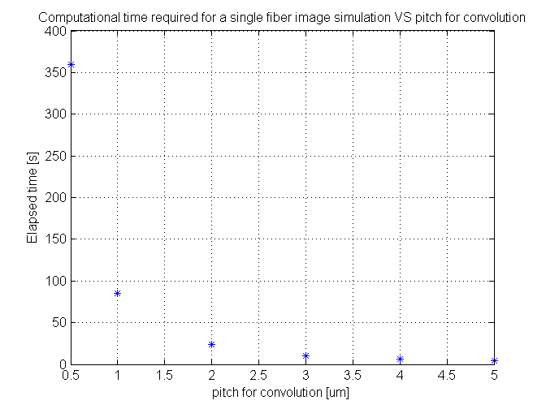
The required computation time for a single fiber SRE is ≅ 80 s
This means that for 70 fiber per SRE, about 1000 SRE per each order and 30 order in an echellogram the total time
Required to generate a syntetic echellogram would be = 1.68 10^8 s = 1945 days

Slide 5
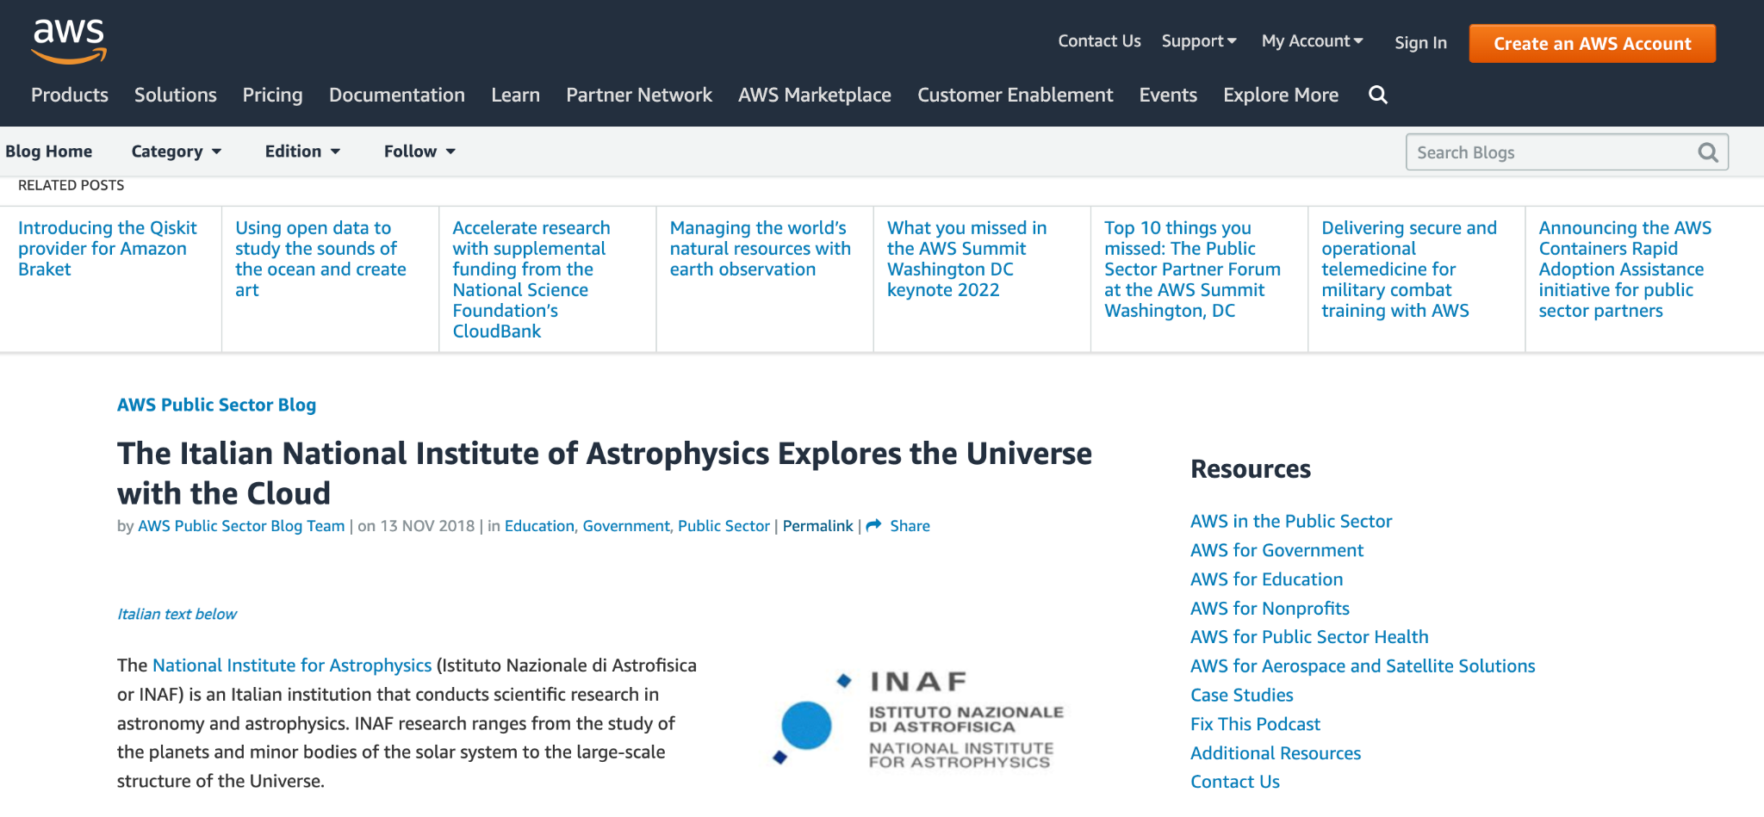
Presented in invited talk by AWS in Washington in 2019 Public Summit

Slide 6
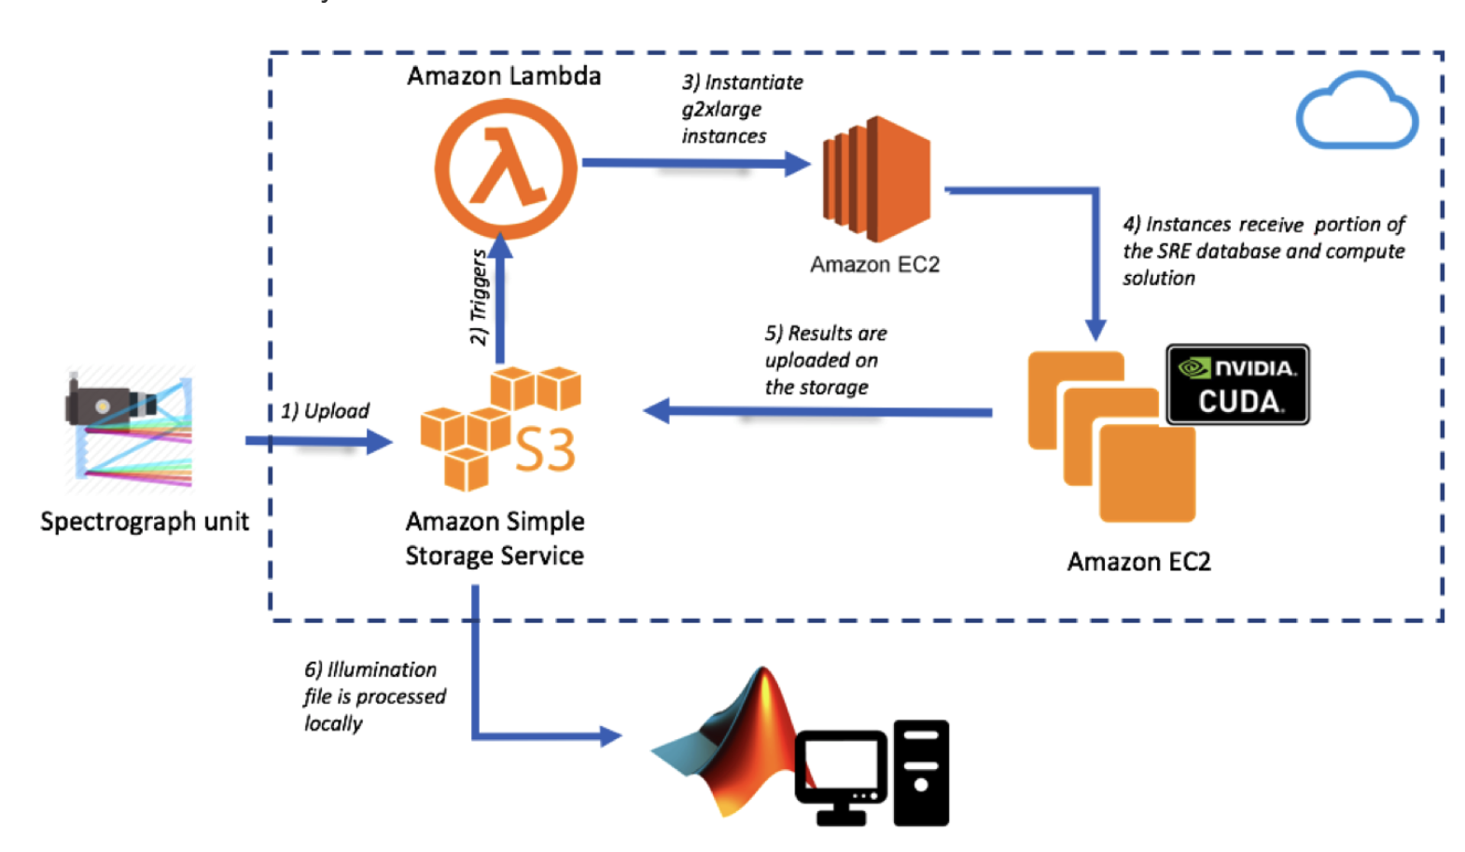
Architecture and conclusions
Suitable for ANDES
General purpose approach for embarrassingly parallel GPU-based computation
Scaled according to the need of the project.
Required a couple of kEUR for the whole PhaseA.
On demand

Slide 7
People involved and expertises
Marco Landoni (INAF): Cloud Computing model, GPU based computing and accellerated computing. Software engineering and science knowledge.
Matteo Genoni: Instrument modeling, designing and system engineering.
Andrea Scaudo, Gianluca Licausi: Detector modeling, Pyxel expertise.
Alberto Trombetta (Università Insubria, INAF associate): Software modeling and computing architecture.

